Slide 1
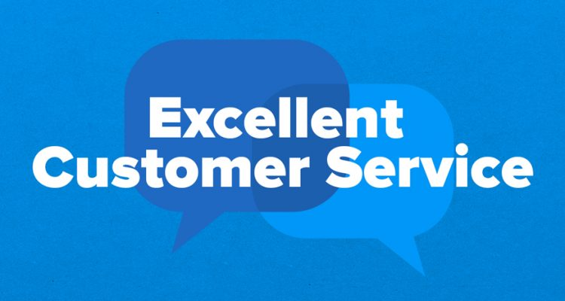
Customer Service Management
Session Two Class Presentation
Customer Service
  Skills for Success – 7th Edition
    Robert W. Lucas; McGraw-Hill Education; New York, NY 2019
      ISBN: 978-1-259-95407-8

Slide 2
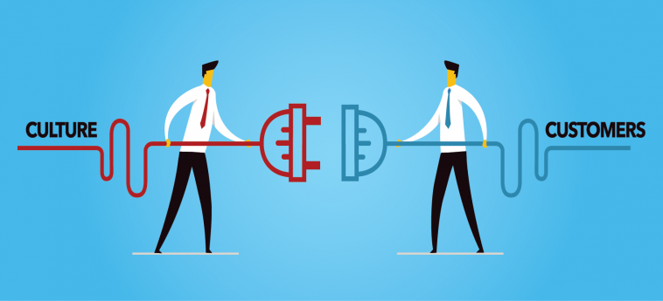
Part One: The Profession
Chapter Two: Contributing to the Service Culture
  “You’ll never have a product or price advantage again. They can be duplicated, but a strong customer service culture can’t be copied” - Jerry Fritz

Slide 3
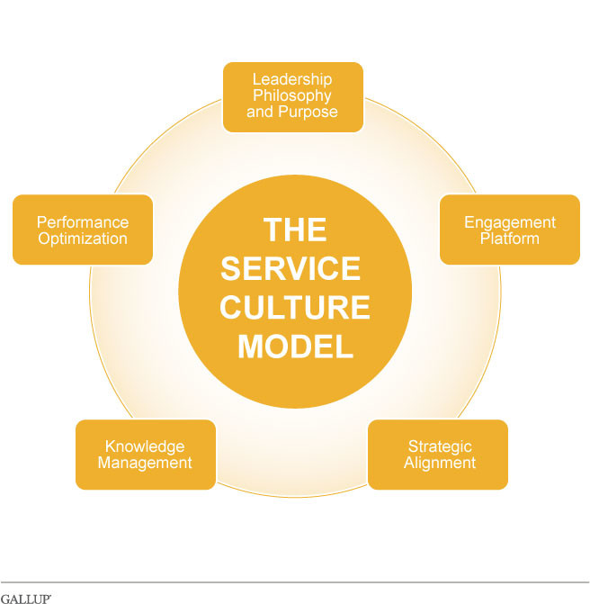
Defining a Service Culture
A Service Culture is a service environment made up of various factors, including the values, beliefs, norms, rituals, and practices of a group or organization.
  A service culture is different for each organization.
    No two organizations operate in same manner, have same focus, or provide management that accomplishes same results.

Slide 4
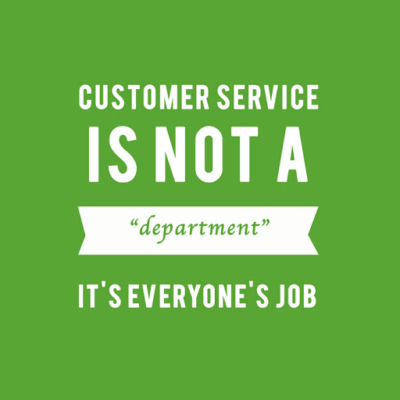
Defining a Service Culture
Any policy, procedure, action, or inaction on the part of your organization and its employees contributes to the service culture.
  A key point to remember about service culture is that you and every other employee play a key role in communicating the culture of your organization to your customers.
    You may communicate the culture through your appearance, your interaction with customers, and your knowledge, skill, and attitude.

Slide 5
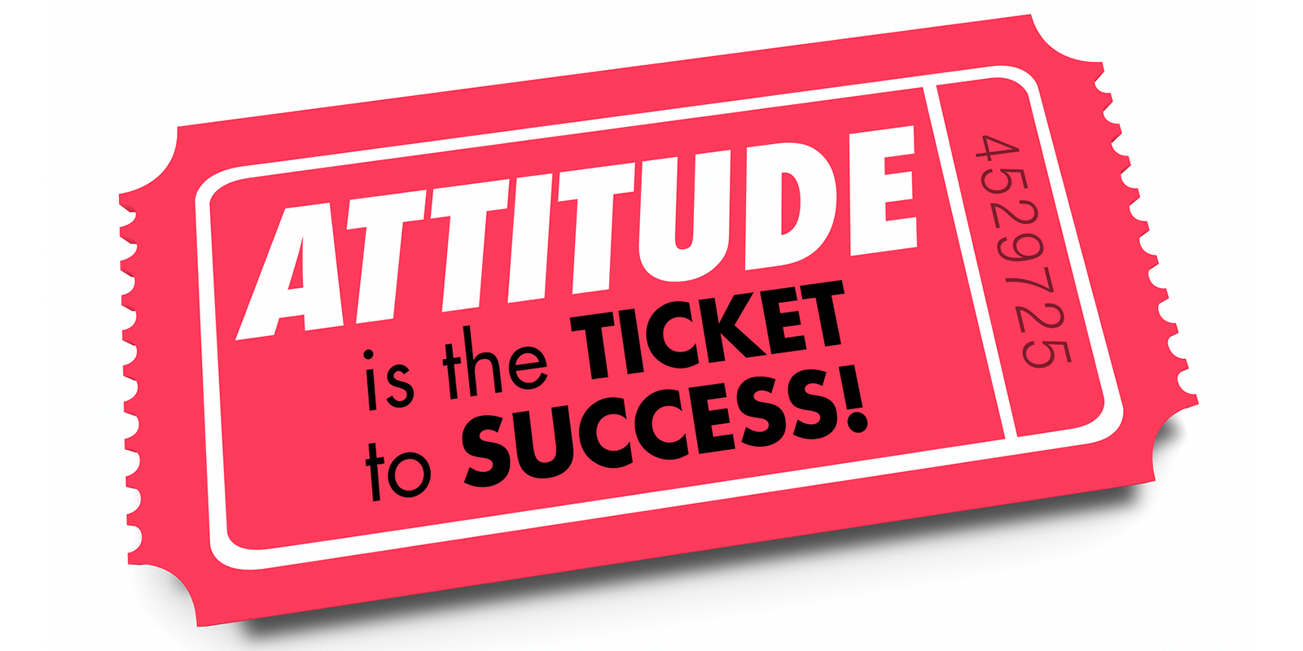
Attitude
Your Attitude is crucial to your success and that of your organization.
  Attitudes are emotional responses to people, ideas, and objects. They are based on values, differ between individuals and cultures, and affect the way people deal with various issues and situations.
    For you to be successful in the service industry (or any other), you must take ownership of your roles and responsibilities and show commitment to doing the best you can every day. You must project a positive attitude.

Slide 6
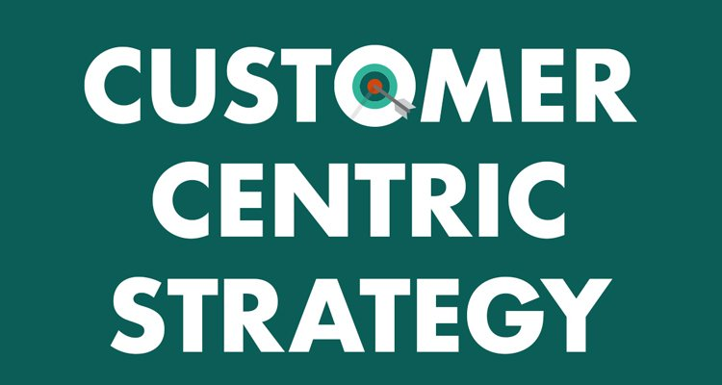
Customer-Centric
Successful organizations are Customer-Centered and focus on individual needs.
  Customer-Centric is a term used to describe service providers and organizations that put their customers first and spend time, effort, and money identifying and focusing on the needs of current and potential customers.
    Efforts are focused on building relationships and customer loyalty rather than simply selling a product or service and moving to the next customer.

Slide 7
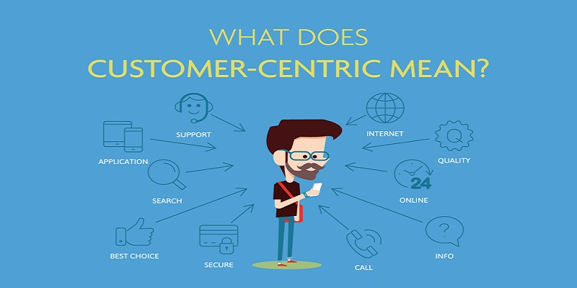
Customer Service
An organization’s service culture is made up of many facets, each of which affects the customer and helps determine the success or failure of customer service initiatives.
  Organizations that have a solid customer service culture that projects a customer-focused attitude typically generate positive feedback from their customers.

Slide 8
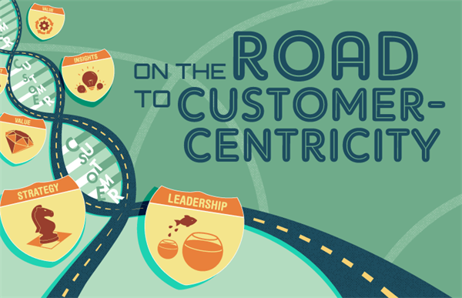
Customer Service
Many major organizations have become more customer-centric and stress relationships with customers.
  They realize that it is cheaper and smarter to focus efforts on better customer service to keep current customers.

Slide 9
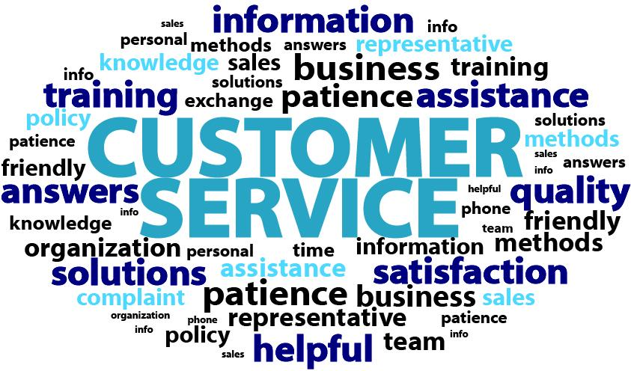
Elements of a Successful Service Culture
Many elements define a successful service organization.
  Service Philosophy or Mission
  Employee Roles and Expectations
  Policies and Procedures
  Products and Services
  Motivations and Rewards
  Management Support
  Employee Empowerment
  Training

Slide 10
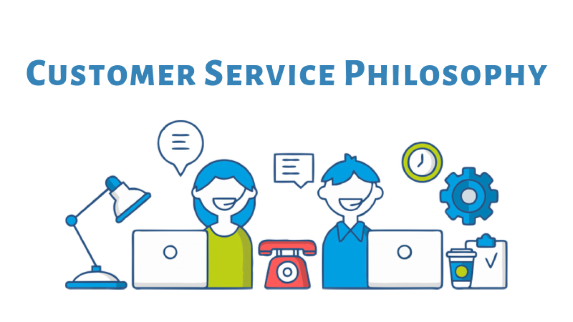
Elements of a Successful Service Culture
1. Service Philosophy or Mission
Many elements define a successful service organization.
  Service Philosophy or Mission
    The succinct direction or vision of an organization that supports day-to-day interactions with the customer.

Slide 11
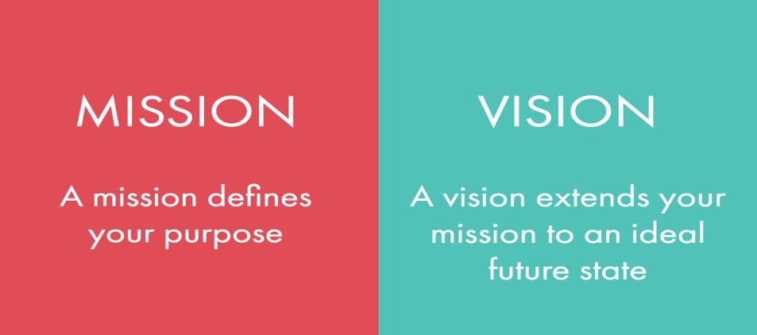
Service Philosophy or Mission
Most successful organizations have written mission and vision statements that answer the questions of “What does the organization do?” and “Why does it exist?”
  Mission Statement
    An organization’s mission statement defines its purpose or objectives and how it will attain them.
  Vision Statement
    A vision statement communicates an organization’s values and purpose and explains what the organization wants to be.

Slide 12
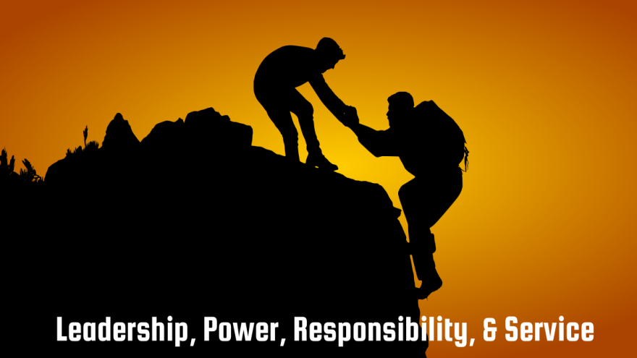
Service Philosophy or Mission
Leadership, real and perceived, is crucial to service success.
  In successful organizations, members of upper management make themselves clearly visible to frontline employees and are in tune with customer needs, wants, and expectations.
    They also “walk the talk” and continually drive and communicate the mission and vision of the organization through their words, actions, and decisions.

Slide 13
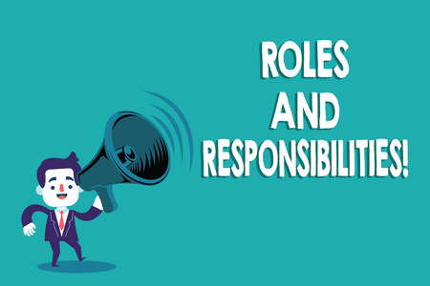
Elements of a Successful Service Culture
2. Employee Roles and Expectations
Many elements define a successful service organization.
  Employee Roles and Expectations
    The specific communications or measures that indicate what is expected of employees in customer interactions and that define how employee service performance will be evaluated.

Slide 14

Employee Roles and Expectations
Many tasks and responsibilities are assigned to frontline service providers.
  People who perform direct customer support functions are some of the most crucial in an organization.
    That is because customers and other people contact customer service representatives for information, to compliment and complain, and to purchase products and services.

Slide 15
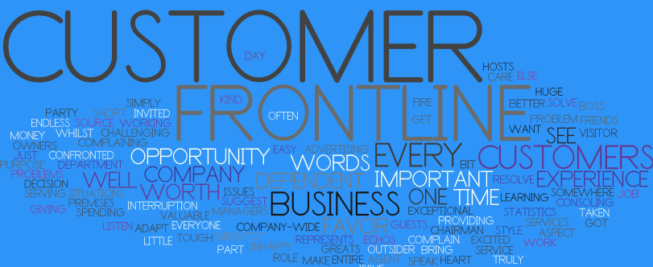
Employee Roles and Expectations
A service professional is the “face” of the organization in all interactions that start with customer contact.
  Your primary function is to listen actively and gather the information needed in order to make a decision on the best course of action to serve the customer in any given situation.
    This requires a polite, professional demeanor and effective and efficient answers to questions or resolutions to problems.

Slide 16

Employee Roles and Expectations
For you and your organization to be successful in providing superior service to your external and internal customers, your roles and expectations must be defined and communicated clearly in terms of the following characteristics, sometimes referred to as RUMBA:
  Realistic – Understandable – Measurable – Believable – Attainable

Slide 17
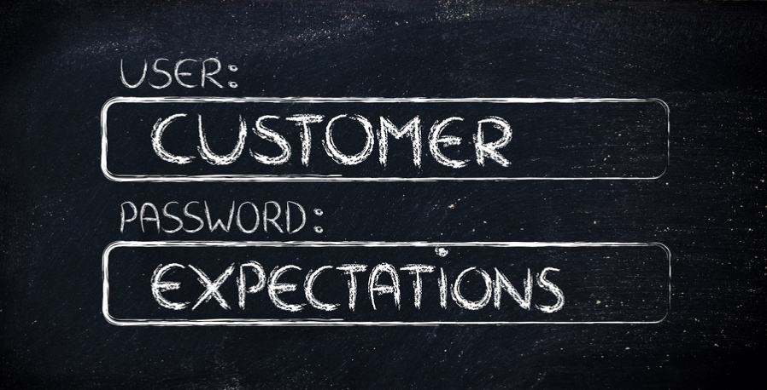
Employee Roles and Expectations
As customers have matured in their knowledge of service standards and what they expect of providers, they look for certain qualifications in those who serve.
  They gain knowledge from numerous sources that help them be more perceptive in their dealings with businesses.
    If customers do not get the service they expect they will take their business elsewhere and/or take legal action.
    In some cases, they may be “benevolent” and give the organization a second chance…by complaining.

Slide 18
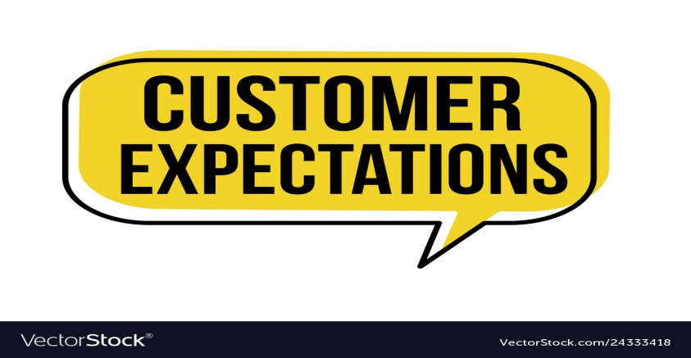
Employee Roles and Expectations
Customers expect service employees to have the following qualifications and competencies:
  Interpersonal Communication Skills
  Knowledge of Products and Services
  Technical Expertise Related to Products and Service
  Positive, Customer-Focused, “Can-Do” Attitude
  Initiative – Motivation – Integrity – Loyalty – Team Spirit Creativity – Ethics – Time Management Skills – Problem Solving Conflict Resolution Skills
    A lack of competency could result in a breakdown of the relationship between you and your customer, with ultimately negative repercussions.

Slide 19
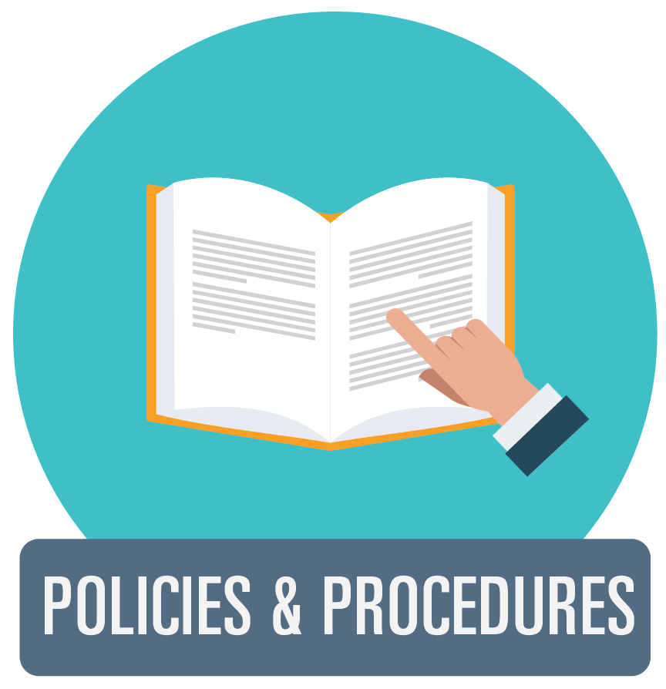
Elements of a Successful Service Culture
3. Policies and Procedures
Many elements define a successful service organization.
  Policies and Procedures
    The guidelines that establish how various situations or transactions will be handled.

Slide 20

Policies and Procedures
Although there are many local, state, and federal regulations with which you and your organization must comply, many policies are flexible.
  Customers negatively meet organizational culture directly when a service provider hides behind “company policy” to handle a problem.
    The goal should be to respond to customer requests and satisfy needs as quickly, efficiently, and cheerfully as possible. Anything less is an invitation for criticism, dissatisfaction, potential customer loss, and EE frustration.

Slide 21

Policies and Procedures
Organizations hang up fancy posters and banners claiming “The Customer is No. 1” or “We’re Here to Serve YOU!”
  But at the moment of truth, when customers come into contact with employees, they often hear, “Please take a number,” “I can’t do that,” or (on the phone) “ABC Company, please hold – CLICK.”
    When these things occur, the culture is not customer driven.
    Through conscientious and concerned assistance to customers, the organization can form a solid relationship with the consumer through its employees.

Slide 22

Elements of a Successful Service Culture
4. Products and Services
Many elements define a successful service organization.
  Products and Services
    The materials, products, and services that are state of the art, competitively priced, and meet the needs, wants, and expectations of a diverse customer base.

Slide 23

Products and Services
If customers perceive that you offer reputable products and services in a professional manner and at a competitive price, your organization will likely reap the rewards of loyalty and positive “press.”
  On the other hand, if products and services do not live up to expectations or promises, or if your ability to correct problems in products and services is deficient, you and your organization could suffer adversely.

Slide 24
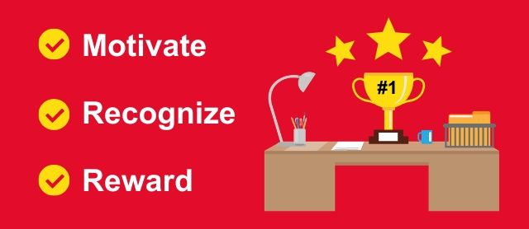
Elements of a Successful Service Culture
5. Motivators and Rewards
Many elements define a successful service organization.
  Motivators and Rewards
    Monetary rewards, material items, or feedback that prompts employees to continue to deliver service and perform at a high level of effectiveness and efficiency.

Slide 25
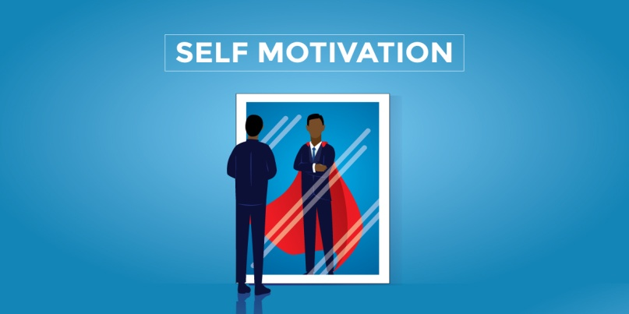
Motivators and Rewards
In any employee environment, people work more effectively and productively when their performance is recognized and adequately rewarded.
  Whether the rewards are in the form of monetary or material items, or a simple verbal pat on the back by the manager, most employees expect and thrive on some form of recognition.
    It is important to know and remember that there will be times when your only motivation and reward for accomplishing a goal or providing quality service will come from you.

Slide 26

Elements of a Successful Service Culture
6. Management Support
Many elements define a successful service organization.
  Management Support
    The availability of management to answer questions and assist frontline employees in customer interactions when necessary. Also, the level of management involvement and enthusiasm in coaching and mentoring the professional development of customer service representatives.

Slide 27
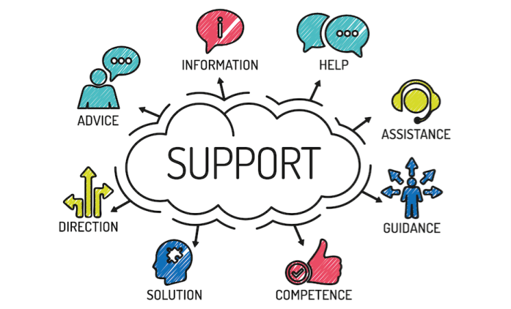
Management Support
A key role for a manager, supervisor, and/or team leader is to provide effective, ongoing coaching, counseling, and training to their employees.
  They can pass along valuable information, guidance, and aid others in enhancing knowledge and professional development.
    It is their job to monitor EE performance and ensure they receive appropriate rewards based on their ability to interact effectively with customers and fulfill the requirements of the job.

Slide 28

Management Support
Look for a strong mentor in your organization, and ask them to provide support and help you grow personally and professionally.
  A mentor is an individual who dedicates time and effort to support and assist others.
    In an organization, they are typically people with a lot of knowledge, experience, skills, and initiative, and have a large personal and professional network established.

Slide 29
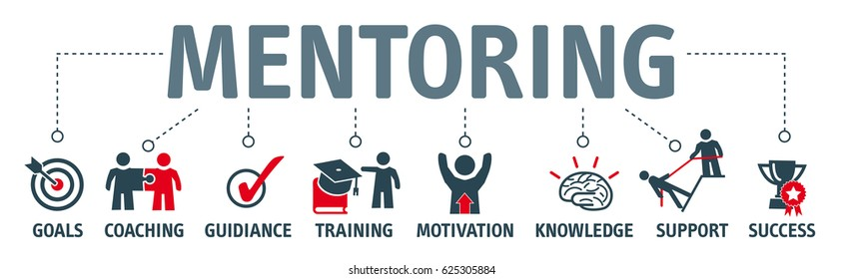
Management Support
When searching for someone to mentor you, look for these characteristics:
  Willingness to be a Mentor
  Experience in the Organization or Industry
  Knowledge about the Organization and Industry
  Good Communicator – Verbal, Non-Verbal, Listening
  Awareness of the Organizational Culture
  Well-Connected Inside and Outside the Organization
  Good Coaching Skills and Good Motivator
  Enthusiastic – Charismatic – Trustworthy – Patient – Creative Thinker – Self-Confident – Good Problem Solver

Slide 30

Elements of a Successful Service Culture
7. Employee Empowerment
Many elements define a successful service organization.
  Employee Empowerment
    Providing EEs with the authority to make on-the-spot decisions that will facilitate efficient and timely customer service based on training they receive and criteria established by supervisors.

Slide 31

Employee Empowerment
Employee Empowerment is one way for a supervisor to help ensure that service providers can respond quickly to customer needs or requests.
  Empowerment is the term used to describe the giving of decision-making and problem-resolution authority to subordinate employees in an organization.
    This precludes having to get permission from higher levels in order to take action or serve a customer.

Slide 32

Employee Empowerment
Such authority allows on-the-spot responsiveness to the customer while making service representatives feel trusted, respected, and an important part of the organization.
  Empowerment is also an intangible way that successful service organizations reward employees.
    Often someone who has decision-making authority feels better about themselves and the organization.

Slide 33

Elements of a Successful Service Culture
8. Training
Many elements define a successful service organization.
  Training
    Instruction or information provided through a variety of techniques and vehicles that teach knowledge or skills, or attempt to influence employee attitudes toward excellent service delivery and achieving customer satisfaction and loyalty.

Slide 34
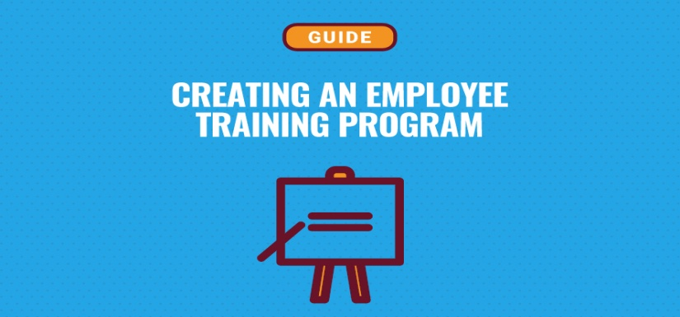
Training
The importance of effective training cannot be overstated. It is an essential component of any organizational culture that supports customer service.
  To perform the job successfully and create a positive impression in the minds of customers, employees must be given needed tools.
    This training should address interpersonal skills, technical skills, organizational awareness, or job skills. Training should help the EE know what is expected and how to meet those expectations.

Slide 35

Establishing a Service Strategy
The first step a company should take in creating or defining its service environment is to make sure it knows who its customers are and how it plans to attract and maintain those customers.
  Next, the organization should periodically conduct an inspection of all its systems and practices. This will help determine where the company is now and where it needs to be in order to better serve customers and to be competitive in a global service economy.

Slide 36
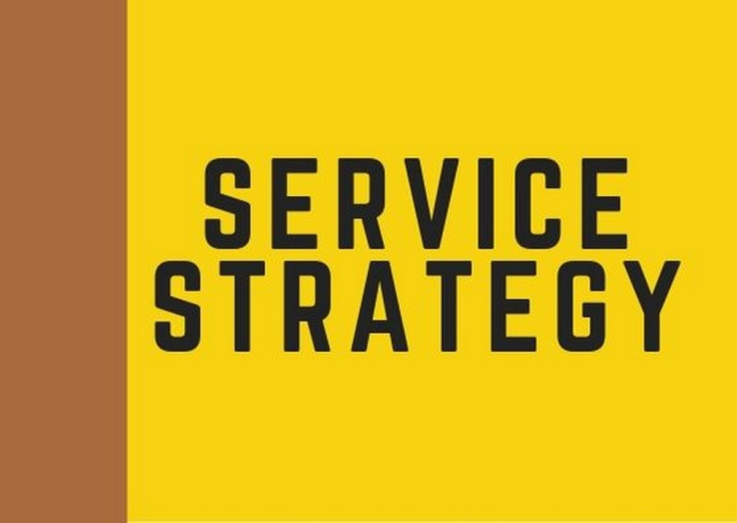
Establishing a Service Strategy
It is not just your organization’s responsibility to ensure the success of customer service.
  As a service professional, you have to be familiar with organizational goals and work toward helping make them successful.

Slide 37
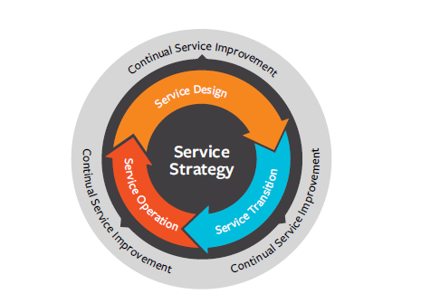
Establishing a Service Strategy
From the perspective of a customer service professional, ask yourself the following questions to help clarify your role:
  Who is my customer?
  What am I doing, or can I do, to help achieve organizational excellence?
  Do I focus all my efforts on total customer satisfaction?
  Am I empowered to make the decisions necessary to serve my customer. If not, what level of authority should I obtain?
  Are there policies and procedures that inhibit my ability to serve the customer? If so, what changes should I recommend?
  When was the last time I told customers I appreciated their business?
  In what areas of organizational skill and product and service knowledge do I need additional information?

Slide 38

Customer-Friendly Systems
The best way to create a service culture is to get everyone in the organization involved in planning and brainstorming.
  Everyone should be encouraged to share ideas about how and where internal changes need to be made and to be more “friendly” and responsive to customer needs.
    All EEs must take the initiative to solve problems and better serve the customer.

Slide 39

Customer-Friendly Systems
Advertising and Complaint or Problem Resolution
Policies and practices that say, “We care” or “You’re important” can help ensure effective customer service.
  Customer-friendly systems that can send positive messages are advertising and complaint or problem resolution.
    Advertising campaigns should send a message that products and services are competitive in price and that the quality and quantity are at least comparable to those of competitors.
    The manner in which complaints or problems are resolved can signal the organization’s concern for customer satisfaction.
      Empower employees to resolve situations on their own.

Slide 40
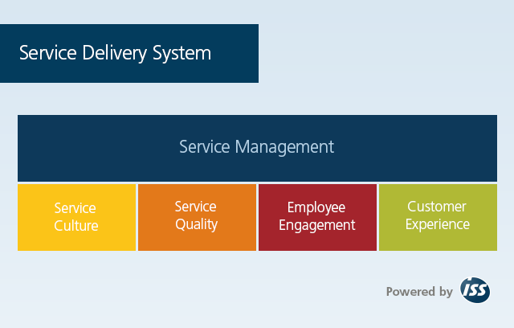
Customer-Friendly Systems
Service Delivery Systems
Service Delivery Systems are a combination of people, technology, and other internal and external elements that make up your organizations’ method of getting its products and services to customers.
  Your organization must determine the best way to deliver quality products and services and to provide follow-up support to its customers.
    There should be ongoing and continuous reevaluation of system success to ensure it keeps up with changing needs of customers.

Slide 41

Tools for Service Management
In a customer-oriented environment, it is important that organizations gauge their service effectiveness continually, as perceived through the eyes of their customers.
  Organizations are continually looking for new ways to gather customer feedback and analyze organizational effectiveness.
  Typical tools include:
    Employee Focus Groups – Employee Opinion Surveys – Customer Focus Groups – Mystery Shoppers – Customer Satisfaction Surveys – Customer Comment Cards – Profit and Loss Statements – EE Exit Interviews Audits – Management Visits and Inspections

Slide 42

11 Strategies for Promoting a Positive Service Culture
To perform effectively as a customer service professional, you will need a plan.
  Partner with Customers
  Explore Your Organization’s Vision
  Help Communicate the Culture and Vision to Customers
  Demonstrate Ethical Behavior
  Identify and Improve Your Skills
  Become an Expert on Your Organization
  Demonstrate Commitment
  Treat Vendors and Suppliers as Customers
  Share Resources
  Work With, Not Against, Your Customers
  Provide Service Follow-Up

Slide 43
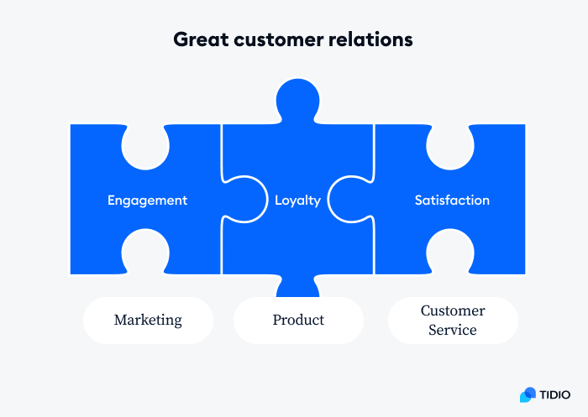
1. Partner with Customers
The most important strategy for an organization to adopt in order to create a positive customer-centric service culture is to form a solid relationship with its customers.
  Customers are the reason you have a job and your organization continues to exist.
    You should do whatever it takes to promote a positive, healthy, customer-provider relationship.

Slide 44
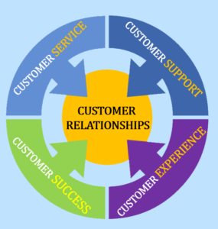
Partner with Customers
Promote a positive and healthy customer relationship:
  Communicate openly and effectively.
  Address customers by their preferred name.
  Smile – project a positive image.
  Listen intently, and then appropriately.
  Say “Please,” “Thank you,” and “You’re welcome.”
  Facilitate situations in which you meet customer needs and both of you succeed in win/win situations while meeting company goals.
  Focus on developing an ongoing relationship with customers instead of a one-time service or sales approach.

Slide 45
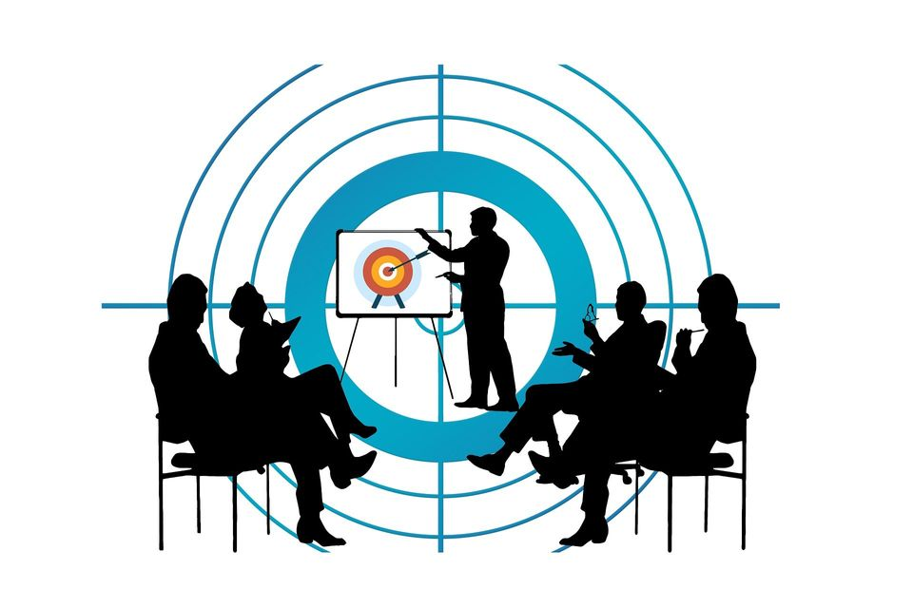
2. Explore Your Organization’s Vision
Successful employees understand their organizational vision, the logic behind it, and work toward making it a reality.
  Effective managers strive to get their customer service representatives excited about the organizational vision.
    A lack of EE engagement and support for the vision can lead to poor customer service, lowered morale and motivation, and long-term loss of customers and revenue.

Slide 46

3. Communicate Culture and Vision to Customers
When you encounter a customer, you have a unique opportunity to project a positive, customer-centric image.
  In that initial contact, you can show that you are there to serve the customer and exceed their expectations.
    Through your attitude, language, appearance, knowledge of products and services, body language and communication with your customers, they will feel your commitment to serve them.

Slide 47

4. Demonstrate Ethical Behavior
The code of ethics of your organization is intertwined with its culture and is the moral standard that guides actions and defines right from wrong.
  Positive ethics drive decision making within the organization and in interactions with customers.
  Ethics also provide the criteria by which customers judge a service provider and the organization.
    By acting in an ethical manner and “doing the right thing,” you and your organization can thrive and beat the competition.

Slide 48

Demonstrate Ethical Behavior
Ethical Behavior is an essential element of your career in customer service. It is based on values – those of the society, organization, and employees.
  These values are a combination of beliefs, ideologies, perceptions, experiences, and a sense of what is right (appropriate) and wrong (inappropriate) and are demonstrated through your words and actions and those of your peers and supervisors.
    It is how you and others around you handle problems or other situations that arise on a daily basis that paint a picture of the organization’s overall ethical values, and, in some cases, your own.

Slide 49
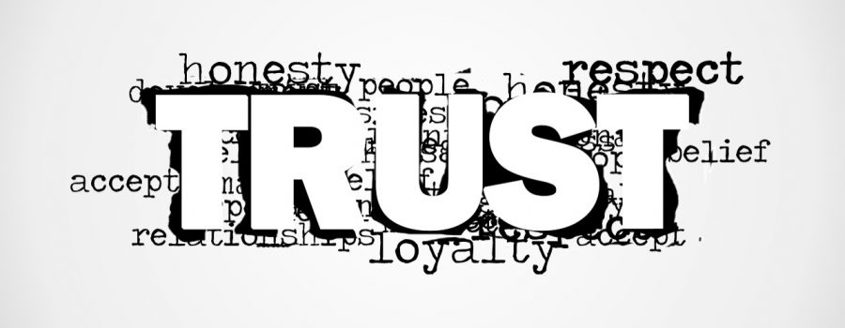
Trust
The key to ongoing customer relationships is Trust.
  Without trust you have no relationship and cannot win customer loyalty or succeed as a professional.

Slide 50
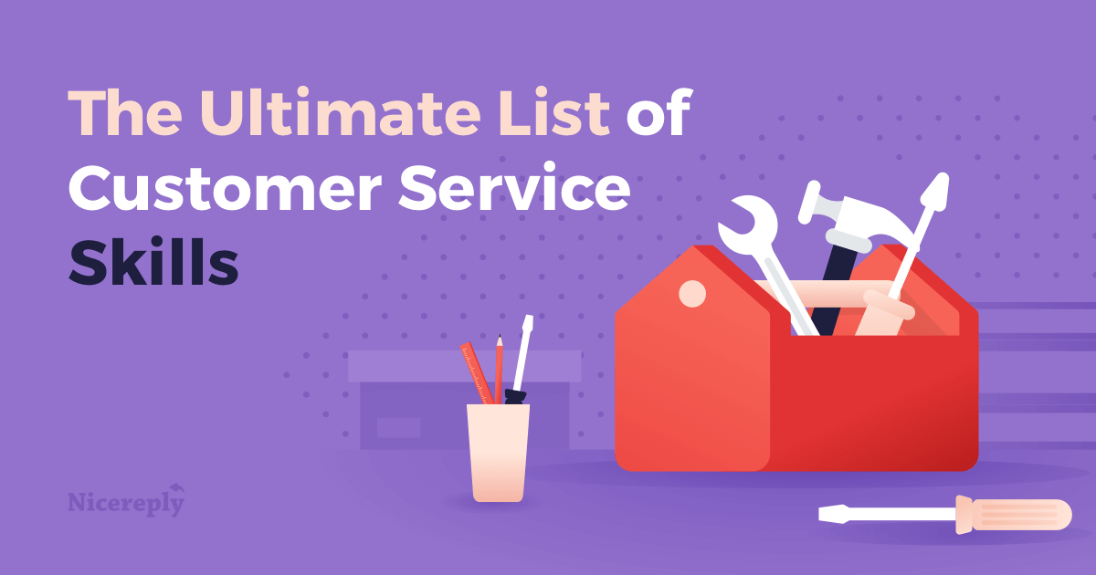
5. Identify and Improve Service Skills
Take an inventory of interpersonal and customer service skills; use the strengths and improve the weaker areas.
  By upgrading your knowledge and skills related to people, customer service, and products and services offered, you position yourself as a resource to the customer and an asset to the organization.

Slide 51
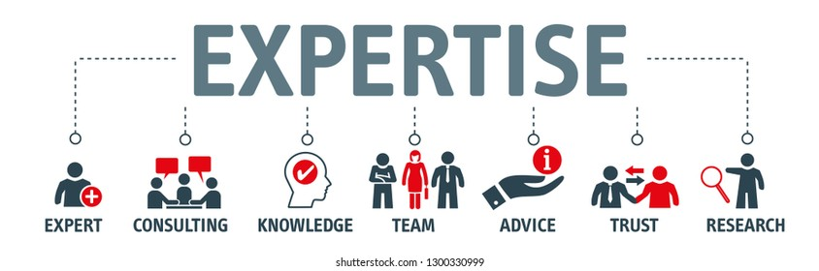
6. Become an Expert on Your Organization
As the frontline contact person with customers, you are likely to receive a variety of questions related to the organization.
  Typical questions involve organizational history, structure, policies and procedures, systems, products, or services.
    By being well versed in the many facets of the organization and its operation, related industry topics, and your competition, you can project a more knowledgeable, helpful, and confident image that contributes to total customer satisfaction.

Slide 52

7. Demonstrate Commitment
As an employee with customer contact opportunities and responsibilities, you are the organization’s representative.
  One mistake that many frontline employees and supervisors make in communications with customers is to intentionally or unintentionally demonstrate a lack of commitment or support for their company and a sense of powerlessness.
    A common way in which this occurs is with the use of “they” language when dealing with customers. The alternative is to take ownership or responsibility for a situation. Be positive.

Slide 53

8. Treat Vendors and Suppliers as Customers
Each contact with a vendor or a supplier offers an excellent opportunity to tap into a pre-established network and potentially expand your own customer service base while providing better service to existing customers.
  By building and nurturing relationships with people outside your organization, you can often learn what is happening with competitors and within the service industry and create opportunities to capitalize on this knowledge to strengthen your organization.

Slide 54

9. Share Resources
By building strong interpersonal relationships with coworkers and peers throughout the industry, you can develop a support system of resources.
  Sometimes customers will request information, products, or services that are not available through your organization.
    By being able to refer customers to alternative sources, you will have provided a service, and they are likely to remember that you helped them indirectly. They may return or recommend to others.

Slide 55
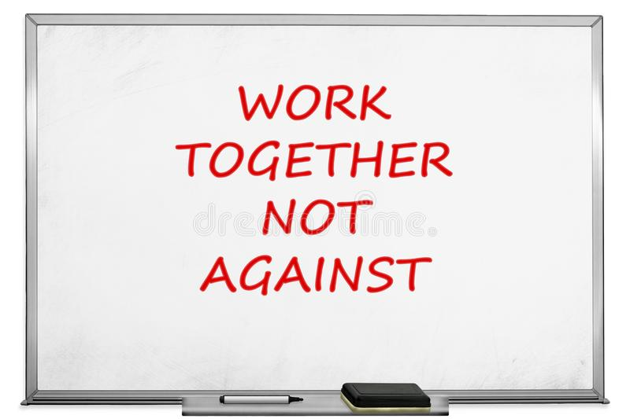
10. Work With, Not Against, Your Customers
Customers are in control. It’s a buyer’s market, and many customers are aware of this.
  Many organizations have become very creative and proactive in their efforts to attract and retain customers.
    Your efforts should convey the idea that you are working with customers to better serve them.

Slide 56

11. Provide Service Follow-Up
Providing follow-up is probably one of the most important service components.
  Service does not end when service encounter or sale concludes.
  There are numerous follow-up opportunities to ensure customer satisfaction was attained.
    Think of creative ways to follow up: feedback surveys, call-backs, thank you cards, birthday cards, special sale mailings, etc.

Slide 57

Separating Average Companies from Excellent Companies
The following demonstrates a company’s service commitment:
  Executives spend time with customers.
  Executives spend time talking to frontline service providers.
  Customer feedback is regularly solicited and acted upon.
  Innovation and creativity are encouraged and rewarded.
  Benchmarking is done with similar organizations.
  Technology is widespread, frequently updated, and used effectively.
  Employees receive training to keep current on industry trends, organizational issues, skills, and technology.
  Open communication exists between all levels of EEs and management.
  Employees are provided with guidelines and empowered to do whatever is necessary to satisfy the customer.
  Partnerships with customers and suppliers are common.
  The status quo is not acceptable.

Slide 58

What Customers Want
Seven Things Customers Want:
  Personal Recognition
  Courtesy
  Timely Service
  Professionalism
  Enthusiastic Service
  Empathy
  Patience

Slide 59

What Customers Want
1. Personal Recognition
Personal Recognition
  Customers want to be recognized as being important to you and your organization. They want to feel appreciated.
    This can be demonstrated in a number of ways, but the simplest and most cost effective to recognize a customer who enters your work area, even if you cannot immediately stop what you are doing to serve them, is to smile and acknowledge their presence.

Slide 60
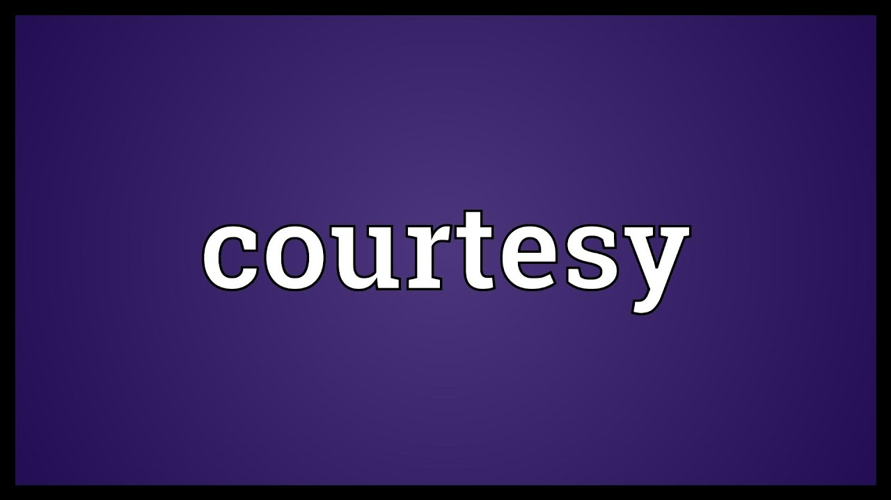
What Customers Want
2. Courtesy
Courtesy
  Basic courtesy involves pleasantries such as “Please” and “Thank You,” as there is no place or excuse for rude behavior in a customer service environment.
    Even though customers may not always be right, you must treat them with respect.

Slide 61

What Customers Want
3. Timely Service
Timely Service
  Most people do not mind waiting briefly for service if there is a legitimate reason, but they do not like to spend what they believe is undue amounts of time waiting to be served.

Slide 62

What Customers Want
4. Professionalism
Professionalism
  Customers expect and should receive knowledgeable answers to their questions, service that satisfies their needs and lessens effort on their part, and service personnel who take pride in their work.
    You can demonstrate these characteristics by exemplifying sound ethics and effective interpersonal-communication skills.

Slide 63

What Customers Want
5. Enthusiastic Service
Enthusiastic Service
  Customers come to an organization for a purpose – to satisfy a need, which may be nothing more than to “look around.” They should find a dedicated team of service professionals standing by to assist them in whatever way possible.
    By delivering service with a smile, offering additional services and info, and taking the time to give extra effort in every service encounter, you can help guarantee a positive service experience for your customer.

Slide 64
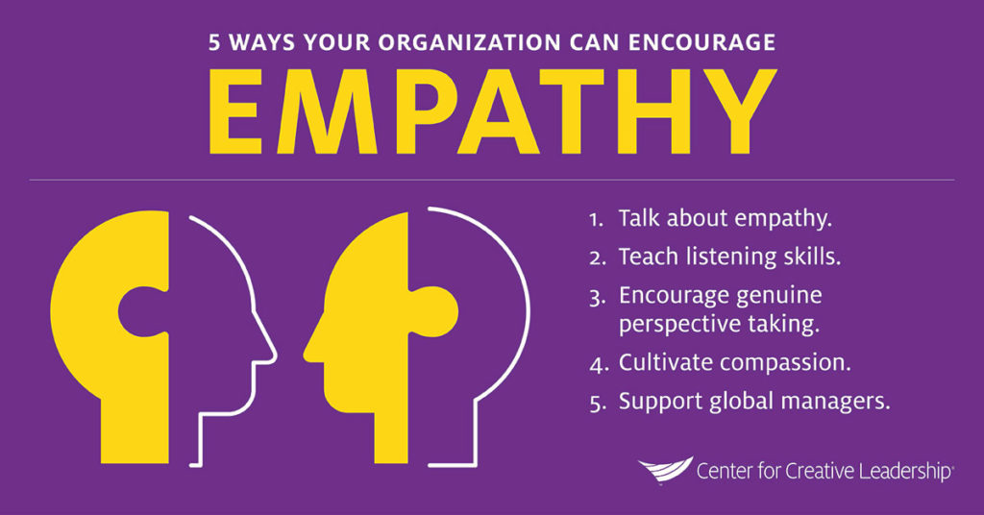
What Customers Want
6. Empathy
Empathy
  Customers also want to be understood. You’re job as a service provider is to make every effort to be empathetic and understanding, and to provide appropriate service.
    A common strategy for showing empathy is the: FEEL, FELT, FOUND Technique (i.e.) “I know how you feel, I’ve felt the same way before, but I’ve found that an alternative product XYZ…”

Slide 65

What Customers Want
7. Patience
Patience
  Customers should not have to deal with your frustrations or pressures. Efficiency and effectiveness should seem effortless.
    If you are angry because of a policy, procedure, management, or the customer, you must strive to mask that feeling. By suppressing your desire to speak out or react emotionally, you can remain in control, serve the customer professionally, and end the contact.

Slide 66
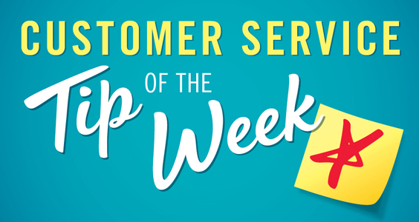
Customer Service Tip
Before you can identify what a customer wants, you have to ask appropriate questions and actively listen to responses.
  In some cases, they may just want to browse; however, in others they may have specific products or services in mind and likely would appreciate your assistance in locating them and helping them complete the transaction in a timely manner.
    When the customer talks, you listen.
    You cannot talk and listen at the same time.

Slide 67


