Slide 1
Business Communications Session Four
Business Communication
Process and Product – 9th Edition
Mary Ellen Guffey and Dana Loewy; Cengage Learning 2018, 2015
ISBN: 978-1-305-95796-1

Slide 2
Unit Three: Workplace Communication
Chapter Eight: Positive Messages
Learning Outcomes:
Understand the channels through which typical positive messages travel in the digital era – emails, memos, and business letters – and apply the 3x3 writing process.
Compose direct messages that make requests, respond to inquiries online and offline, and deliver step-by-step instructions.
Prepare contemporary messages that make direct claims and voice complaints, including those posted online.
Create adjustment messages that salvage customers’ trust and promote further business.
Write special messages that convey kindness and goodwill.

Slide 3
Neutral and Positive Messages: The Writing Process
In the workplace most messages are positive or neutral and, therefore, direct.
Positive messages are routine and straightforward; they help workers conduct everyday business.
Such routine messages include simple requests for information or action, replies to customers, and explanations to coworkers. Other types of positive messages are instructions, direct claims, and complaints.

Slide 4
Phase 1: Analyzing, Anticipating, and Adapting
In Phase 1, prewriting, you will need to spend some time analyzing your task.
As you begin writing process, ask yourself these important questions:
Do I really need to write this email, memo, or letter?
Why am I writing?
How will the reader react?
What channel should I use?
How can I save my reader’s time?

Slide 5
Phase 2: Researching, Organizing, and Drafting
In Phase 2, drafting, you will first want to check the files, gather documentation, and prepare your message.
Make an outline of the points you wish to cover.
As you compose your message, avoid amassing huge blocks of text.
No one wants to read endless lines of type. Instead, group related information into paragraphs, preferably short ones.

Slide 6
Phase 3: Editing, Proofreading, and Evaluating
Phase 3, revising, involves putting the final touches on your message.
Careful and caring writers ask themselves the following:
Is the message clear?
Is the message correct?
Did you plan for feedback?
Will this message achieve its purpose?

Slide 7
Writing Requests
When you write messages that request information or action and you think your request will be received positively, start with the main idea.
The most emphatic positions in a message are: opening and closing. Readers tend to look at them first.
The first sentence of an information request is usually a question or polite command. It should not be an explanation or justification, unless resistance to the request is expected.
When the information or action requested is likely to be forthcoming, immediately tell the reader what you want.

Slide 8
Writing Requests
If several questions must be asked, you have two choices: You can ask the most important question first, or you can begin with a summary statement.
Avoid beginning with “Will you please…”
Although such a statement sounds like a question, it is actually a disguised command with a period instead of a question mark.
To avoid having to choose between a period and a question mark, just omit “Will you” and start with “Please.”

Slide 9
Writing Requests Providing Details
The body of a message that requests information or action provides necessary details.
Remember that the quality of the information obtained from a request depends on the clarity of the inquiry.
If you analyze your needs, organize your ideas, and frame your request logically, you are likely to receive a meaningful answer that doesn’t require a follow-up message.

Slide 10
Writing Requests Providing Details
Whenever possible, focus on benefits to the reader.
To improve readability, itemize appropriate information in bulleted or numbered lists.

Slide 11
Writing Requests Closing with Appreciation and an Action Request
In the closing of your message, tell the reader courteously what is to be done.
If a date is important, set an end date to take action and explain why.
You can save the reader time by spelling out the action to be taken.
Avoid other overused endings such as “Thank you for your cooperation” (trite), “Thank you in advance for…” (trite and presumptuous), and “If you have any questions, do not hesitate to call me (suggests that you didn’t make yourself clear).

Slide 12
Writing Requests Closing with Appreciation and an Action Request
Showing appreciation is always appropriate, but try to do so in a fresh and efficient manner.
For example, you could hook your thanks to the end date (“Thanks for returning the questionnaire before May 5th.”)
You might connect your appreciation to a statement developing reader benefits (“We are grateful for the information you will provide, because it will help us serve you better”).
You could briefly describe how the information will help you (“I appreciate this information, which will enable me to…”).
When possible, make it easy for the reader to comply with your request (“Note your answers on this sheet and return it in postage-paid envelop”).

Slide 13
Responding to Requests
Often, your message will respond directly and favorably to requests for information or action.
A customer wants information about a product, a supplier asks to arrange a meeting, an employee inquires about a procedure, or a manager requests your input on a marketing campaign.
In complying with such requests, you will want to apply the same direct strategy you used in making requests.

Slide 14
Responding to Requests
In the first sentence of a direct reply email, deliver the information the reader wants immediately.
When agreeing to a request for action, announce the good news promptly.
Avoid wordy, drawn-out openings. More forceful and more efficient is an opener that answers the inquiry.

Slide 15
Responding to Requests
When customers or prospective customers inquire about products or services, your response should do more than merely supply answers.
Try to promote your organization and products.
Be sure to present the promotional material with attention to the “you” view and to reader benefits.

Slide 16
Reacting to Customer Comments Online
We live in an age when vocal individuals can start a firestorm of criticism online or become powerful brand ambassadors who champion certain products. Therefore, businesses must listen to social media comments about themselves and, if necessary, respond.
You may ask, how do companies know when to respond, how?
This is invaluable knowledge in an evolving field and, some would say, a minefield littered with disastrous missteps and missed opportunities.

Slide 17
Reacting to Customer Comments Online
Social media marketing experts are developing guidelines to provide organizations with tools for strategic decision making in various situations.
Businesses can’t control the conversation without disabling fans’ comments on their Facebook walls or blogs, but they can respond in a way that benefits customers, prevents the problem from snowballing, and shines a positive light on the organization.

Slide 18
Embracing Customer Comments
Customer reviews online are opportunities for savvy businesses to improve their products or services and may serve as a free and efficient crowdsourced quality-control system.
Retailers such as Walmart, Amazon, and L.L. Bean use powerful software to sift through billions of social media posts and product reviews.
The data offer real-time feedback that may help clear up supply chain bottlenecks, expose product flaws, and improve operating instructions.

Slide 19
Adopting Best Practices for Replying to Online Posts
Social media experts say that not every comment on the Web merits a response. They recommend responding to posts only when you can add value. For example, by correcting false information or providing customer service.

Slide 20
Responding to Customers Online
As businesses increasingly interact with their customers and the public online, they develop rules of engagement - best practices.
Be Positive
Respond in a friendly, upbeat, yet professional tone.
Correct mistakes politely.
Do not argue, insult, or blame others.
Be Honest
Own up to problems and mistakes.
Inform customers when and how you will improve the situation.
Be Transparent
State your name and position with the business.
Personalize and humanize your business.
Be Helpful
Point users to valuable information on your website or other sites.
Follow up with users when new information is available.

Slide 21
Direct Claims and Complaints
In business, things can and do go wrong. When you as a customer must write to identify or correct a wrong, the message is called a claim.
Straightforward claims are those to which you expect the receiver to agree readily.

Slide 22
Direct Claims and Complaints
In an age of digital communication, claims written as letters still play an important role even as they are being replaced by telephone calls, emails, and social media posts.
Depending on the circumstances, letters more convincingly establish a record of what happened. Some business communicators opt for letters they can either attach to email messages or fax.
Regardless of the channel, straightforward claims use a direct approach.

Slide 23
Stating a Clear Claim in the Opening
When you, as a customer, have a legitimate claim, you can expect a positive response from a company.
Smart businesses want to hear from their customers.
They know that retaining a customer is far less costly than recruiting a new customer.

Slide 24
Stating a Clear Claim in the Opening
Open your claim with a compliment, a point of agreement, a statement of the problem, a brief review of action you have taken to resolve problem, or a clear statement of the action you want.
You might expect a replacement, a refund, a new product, credit to your account, correction of a billing error, free repairs, a free inspection, or cancellation of an order.
When the remedy is obvious, state it immediately.
When it is less obvious, you might ask for a change in policy or procedure or simply for an explanation.

Slide 25
Explaining and Supporting a Claim
In the body of a claim message, explain the problem and justify your request. Provide the necessary details so that the difficulty can be corrected without further correspondence.
Avoid becoming angry or trying to fix blame. Bear in mind that the person reading your message is seldom responsible for the problem.
Instead, state the facts logically, objectively, and unemotionally; let the reader decide on the causes.

Slide 26
Concluding with an Action Request
End a claim message with a courteous statement that promotes goodwill and summarizes your action request.
If appropriate, include an end date.

Slide 27
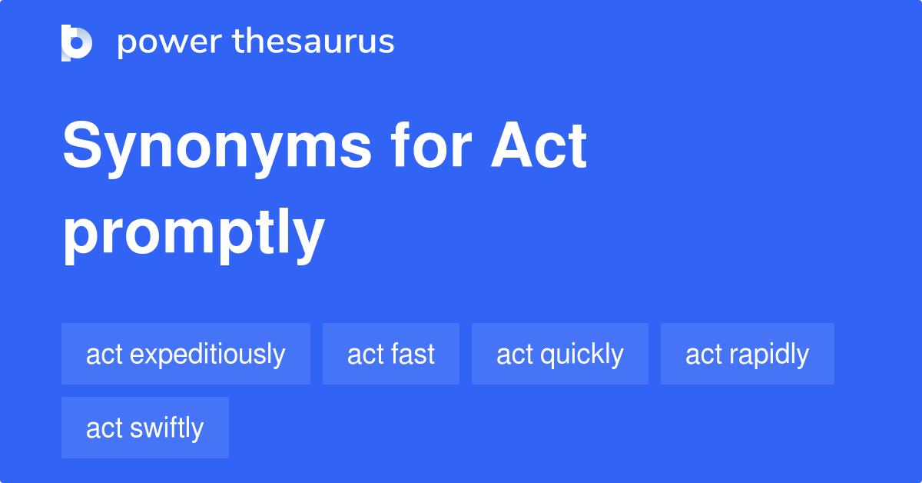
Concluding with an Action Request
Finally, in making claims, act promptly.
Delaying claims make them appear less important.
Delayed claims are also more difficult to verify.
By taking time to put your claim in writing, you indicate your seriousness.
A written claim starts record of problem, should later action be necessary.
Be sure to save a copy of your message whether paper or electronic.

Slide 28
Completing the Message and Revising
Revising a draft message will help to temper its original tone, describe the problem objectively, and provide all the facts and figures.
Most importantly, it will help to specify exactly what you want to be done.

Slide 29
Adjustment Messages
Even the best-run and best-loved businesses occasionally receive claims or complaints from consumers.
When a company receives a claim and decides to respond favorably, the message is called an adjustment.
Most businesses make adjustments promptly: they replace merchandise, refund money, extend discounts, send coupons, and repair goods.

Slide 30
Adjustment Messages
Businesses make favorable adjustments to legitimate claims for two reasons:
Consumers are protected by law for recovery of damages.
Most organizations genuinely want to satisfy customers and retain their business.

Slide 31
Adjustment Messages
In responding to customer claims, you must first decide whether to grant the claim.
Unless the claim is obviously fraudulent or excessive, you will probably grant it. When you say “Yes,” your adjustment message will be good news to the reader. Deliver that good news by using the direct strategy.
When your response is “No,” the indirect strategy might be more appropriate.

Slide 32
Adjustment Messages
You have three goals in adjustment messages:
Rectify the wrong, if one exists.
Regain the confidence of the customer.
Promote further business.

Slide 33
Revealing Good News Up Front
Instead of beginning with a review of what went wrong, present the good news in an adjustment message immediately.
In announcing that you will make an adjustment, do so without a grudging tone – even if you have reservations about whether the claim is legitimate.

Slide 34
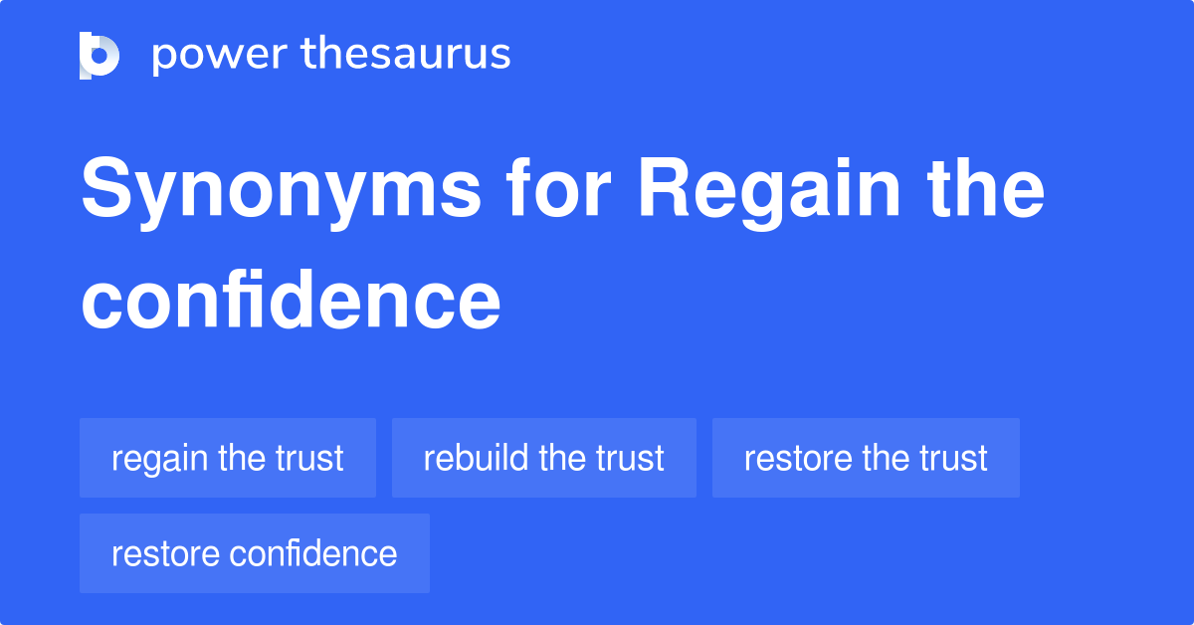
Explaining Compliance in the Body of an Adjustment Message
How to rebuild lost confidence depends on the situation and the claim.
If procedures need to be revised, explain what changes will be made.
If a product has defective parts, tell how product is being improved.
If service is faulty, describe genuine efforts to improve it.
In your explanation avoid emphasizing negative words such as “trouble,” “regret,” “misunderstanding,” “fault,” “defective,” “effort,” “inconvenience,” and “unfortunately.”
Keep your message positive and upbeat.

Slide 35
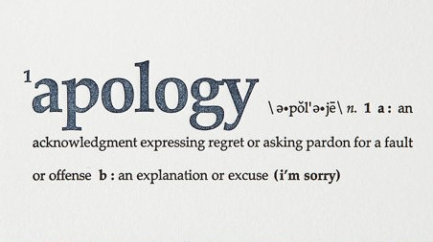
Deciding Whether the Apologize
People like to hear apologies. A well-timed apology can increase the culprits’ influence and likeability. They will be perceived as more trustworthy.
Don’t, however, fall back on the familiar phrase, “I’m sorry for any inconvenience we may have caused.” It sounds mechanical and insincere. Instead, try something like this: “We understand the frustration our delay has caused you,” “We’re sorry you didn’t receive better service,” or “You’re right to be disappointed.”
If you feel that an apology is appropriate, do it early and briefly.

Slide 36
Deciding Whether the Apologize
The primary focus of an adjustment message is on how you are complying with the request, how the problem occurred, and how you are working to prevent recurrence.
End positively by expressing confidence that the problem has been resolved and that continued business relations will result.

Slide 37
Goodwill Messages
Many communicators are intimidated when they must write goodwill messages expressing thanks, recognition, and sympathy.
Sending a ready-made card or picking up the telephone is easier than writing a message but personal sentiments are more expressive and meaningful than printed cards or oral messages.
However, if you frequently communicate with the receiver by email and if you are sure your note will not get lost, then sending an email will suffice.

Slide 38
Goodwill Messages
The best goodwill messages – whether thanks, congratulations, praise, or sympathy – concentrate on the FIVE Ss:
Selfless
Focus message solely on receiver, not the sender.
Specific
Personalize message by referencing specific incident.
Sincere
Let your words show genuine feelings.
Spontaneous
Keep the message fresh and enthusiastic.
Short
Try to accomplish message purpose in a few sentences.

Slide 39
Saying Thank You
Expressing Thanks for Gift
When expressing thanks, tell what the gift means to you.
Use sincere, simple statements.
Sending Thanks for a Favor
In showing appreciation for a favor, explain the importance of the gesture to you.
Extending Thanks for Hospitality
When you have been a guest, send a note that compliments the fine food, charming surroundings, warm hospitality, excellent host, and good company.
Recognizing Employees for their Contributions
A letter that recognizes specific EE contributions makes the person feel appreciated even if it is not accompanied by a bonus check.

Slide 40
Replying to Goodwill Messages
Answering a Congratulatory Note
In responding to congratulations, keep it short and simple.
Responding to Praise
When acknowledging a pat-on-the-back note, use simple words in conveying your appreciation.

Slide 41
Expressing Sympathy and Sending Condolences
Most of us bear misfortune and grief more easily when we know that others care.
Notes expressing sympathy, though, are probably more difficult to write than any other kind of message.
Commercial sympathy cards make the task easier, but they are far less meaningful than personal notes.
Grieving friends want to know what you think – not what Hallmark’s card writers think.

Slide 42
Expressing Sympathy and Sending Condolences
In writing a sympathy note, (1) refer to the death or misfortune sensitively, using words that show you understand the pain; (2) in the case of a death, praise the deceased in a personal way; (3) offer assistance without going into excessive detail; and (4) end on a reassuring, forward-looking note.
Sympathy messages may be typed, although handwriting seems more personal. In either case, use notepaper or personal stationary.

Slide 43
Unit Three: Workplace Communication
Chapter Nine: Negative Messages
Learning Outcomes:
Understand the strategies of business communicators in conveying negative news, apply the 3x3 writing process, and avoid legal liability.
Distinguish between the direct and indirect strategies in conveying unfavorable news.
Explain the components of effective negative messages, including opening with a buffer, apologizing, showing empathy, presenting the reasons, cushioning the bad news, and closing pleasantly.
Apply effective techniques for refusing typical requests or claims as well as for presenting bad news to customers in print or online.
Describe and apply effective techniques for delivering bad news within organizations

Slide 44
Communicating Negative News
The truth is that everyone occasionally must deliver bad news in business.
Because bad news disappoints, irritates, and sometimes angers the receiver, such messages must be written carefully.
The bad feelings associated with disappointing news can generally be reduced if the receiver (1) knows the reasons for the rejection, (2) feels that the news was revealed sensitively, and (3) believes the matter was treated seriously and fairly.

Slide 45
Goals in Conveying Unfavorable News
Goals in Conveying Unfavorable News, include:
Explaining Clearly and Completely
Conveying Empathy and Sensitivity
Projecting a Professional Image
Maintaining Friendly Relations
Being Fair

Slide 46
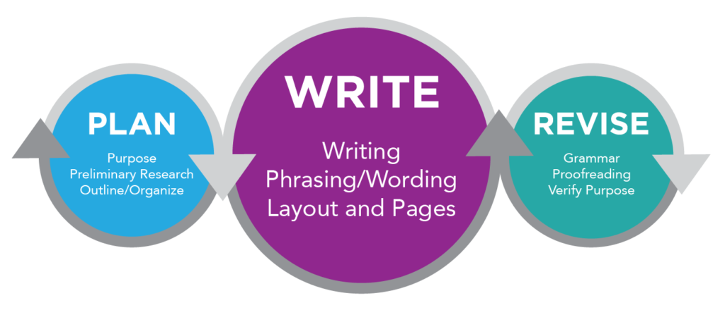
Applying the 3x3 Writing Process
Thinking through the entire writing process is especially important when writing bad-news messages, because the way bad news is revealed often determines how it is accepted.
You have probably heard people say, “I didn’t mind the news so much, but resented the way I was told!”
Certain techniques can help you deliver bad news sensitively, beginning with the 3x3 writing process.

Slide 47
Analyzing, Anticipating, and Adapting
In Phase 1 (prewriting), you need to analyze the bad news and anticipate its effect on the receiver.
When you have bad news to convey, one of your first considerations is how that message will affect its receiver.
If the disappointment will be mild, announce it directly.
If the bad news is serious or personal, consider techniques to reduce the pain.

Slide 48
Analyzing, Anticipating, and Adapting
Choose words that show that you respect the reader as a responsible, valuable person.
Select the best channel to deliver the bad news.
In many negative situations, you will be dealing with a customer. If your goal is retaining the goodwill of a customer, a letter on company stationary will be more impressive than an email.

Slide 49
Researching, Organizing, and Drafting
In Phase 2 (drafting), you will gather information and brainstorm for ideas.
Jot down all the reasons you have that explain the bad news.
If four or five reasons prompted your negative decision, concentrate on the strongest and safest ones.
Avoid presenting any weak reasons: readers may seize on them to reject the entire message. Include an ample explanation of the negative situation, and avoid fixing blame.

Slide 50
Editing, Proofreading, and Evaluating
In Phase 3 (revising), you will read over your message carefully to ensure that it says what you intend.
Check your wording to be sure you are concise without being gruff.
If you overused certain words, use a thesaurus to find synonyms.
Read your sentences to see if they sound like conversation and flow smoothly. This is the time to edit and improve coherence and tone.
Readers are more likely to accept negative messages if the tone is friendly and respectful. Even when the bad news cant be changed, its effect can be reduced somewhat by the way it is presented.

Slide 51
Analyzing Negative-News Strategies
One of the first steps you will take before delivering negative news is analyzing how your receiver will react to this news.
In earlier chapters we discussed applying the direct strategy to positive messages. We suggested using the indirect strategy when the audience might be unwilling, uninterested, displeased, disappointed, or hostile.
In this chapter, we expand on that advice and suggest additional considerations that can help you decide which strategy to use.

Slide 52
When to Use the Direct Strategy
The direct strategy may be more effective in situations such as the following:
When the bad news is not damaging or is insignificant.
When receiver may overlook the bad news, but changes need attention.
When organization or receiver prefers directness & straightforwardness.
When messages must demonstrate strength; firmness is necessary.

Slide 53
When to Use the Indirect Strategy
The indirect strategy does not reveal the bad news immediately. It enables you to keep the reader’s attention until you’re ready to explain the reasons for the bad news.
Some writing experts suggest that the indirect strategy ill suits today’s skeptical, impatient, even cynical audience. Others argue the relative merits of both approaches and their effects on the receiver.
In social media, bluntness seems to dominate the public debate. Directness is equated with honesty; hedging, with deceit.

Slide 54
When to Use the Indirect Strategy
Many communicators prefer to use the indirect strategy to soften negative news.
Whereas good news can be revealed quickly, bad news may be easier to accept when broken gradually.

Slide 55
When to Use the Indirect Strategy
Typical instances in which the indirect strategy works well:
When the bad news is personally upsetting (i.e.) layoff
When the bad news will provoke a hostile reaction; provides buffer.
When the bad news threatens customer relationship; offers explanation.
When the bad news is unexpected; revealed cautiously.

Slide 56
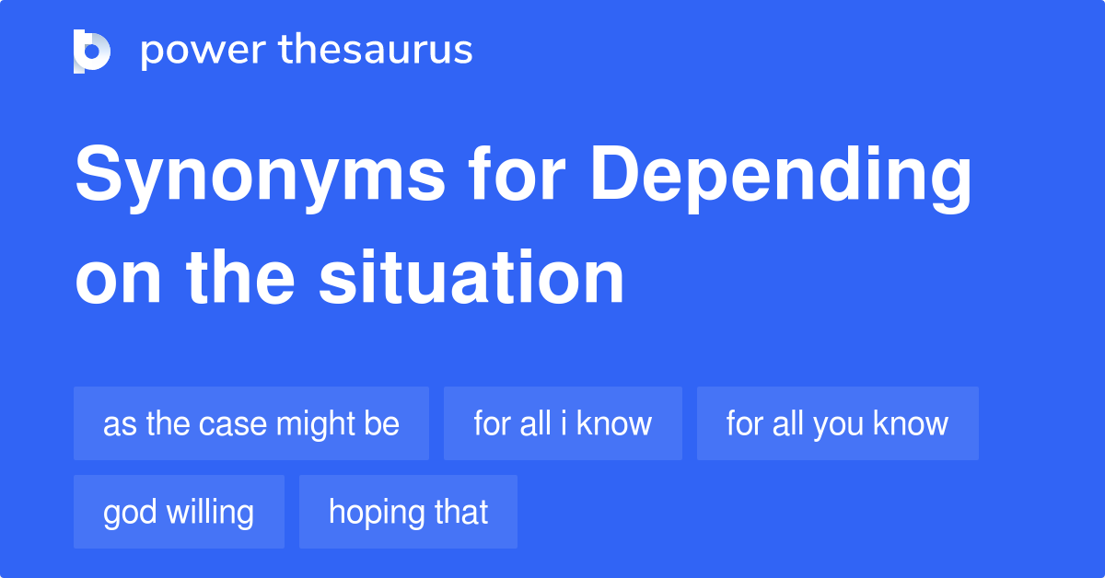
When to Use the Indirect Strategy
Whether to use the direct or indirect strategy depends largely on the situation, the reaction you expect from the audience, and your goals.
The direct method saves time and is preferred by some who consider it more professional and even more ethical than the indirect method.
Others think that revealing bad news slowly and indirectly shows insensitivity to the receiver.
By preparing the receiver, you tend to soften the impact.

Slide 57
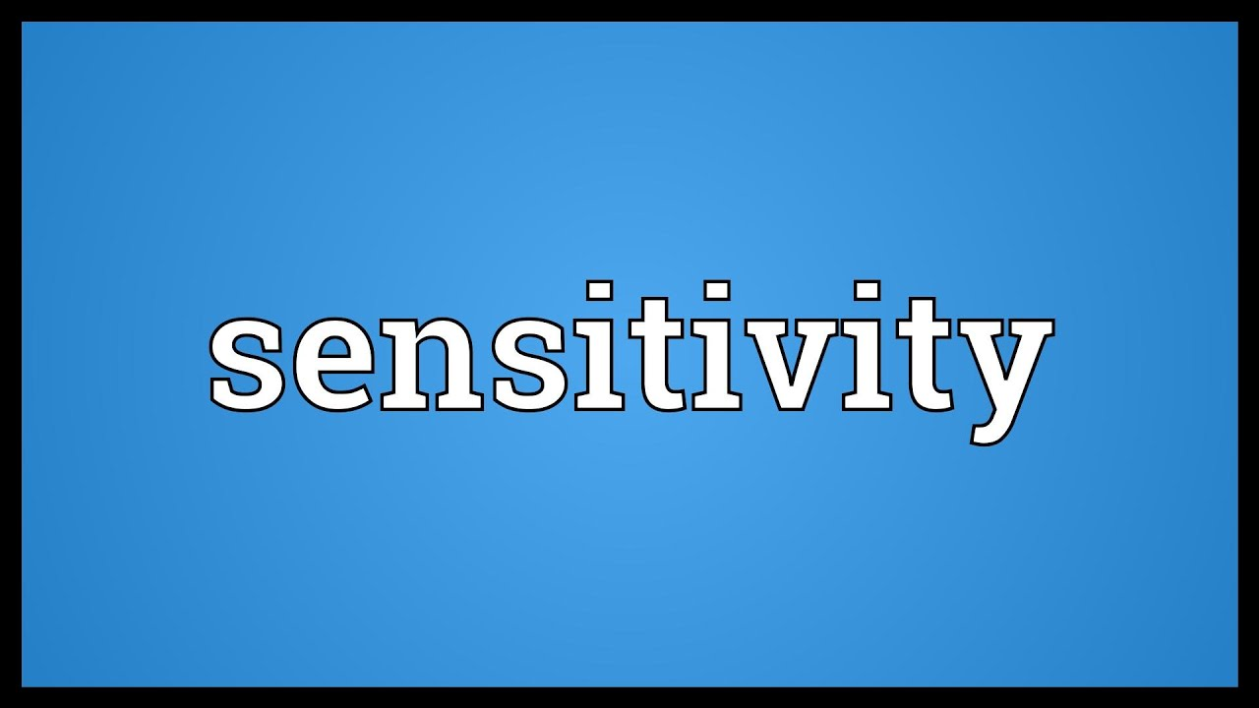
Composing Effective Negative Messages
Even though it may be impossible to make the receiver happy when delivering negative news, you can reduce bad feelings and resentment by structuring your message sensitively.
Most negative messages contain some or all of these parts: buffer, reasons, bad news, and closing.
This section also discusses apologies and how to convey empathy in delivering bad news.

Slide 58
Opening Indirect Messages with a Buffer
A buffer is a device to reduce shock or pain.
To buffer the pain of bad news, begin with a neutral but meaningful statement that makes the reader continue reading.
The buffer should be relevant and concise and provide a natural transition to the explanation that follows.
The individual situation, of course, will help determine what you should put in the buffer.
Avoid trite buffers such as “Thank you for your letter.”

Slide 59
Opening Indirect Messages with a Buffer
Not all business communication authors agree that buffers increase the effectiveness of negative messages. However, in many cultures softening bad news is appreciated.
The following are buffer possibilities:
Best News
Compliment
Appreciation
Agreement
Facts
Understanding

Slide 60
Opening Indirect Messages with a Buffer
Best News
Start with the part of the message that represents the best news.
Compliment
Praise the receiver’s accomplishments, organization, or efforts, but do so with honesty and sincerity.
Appreciation
Convey thanks for doing business, for sending something, for showing confidence in your organization, for expressing feelings, or simply for providing feedback.
Agreement
Make a relevant statement with which both reader and receiver can agree.
Facts
Provide objective information that introduces the bad news.
Understanding
Show that you care about the reader.

Slide 61
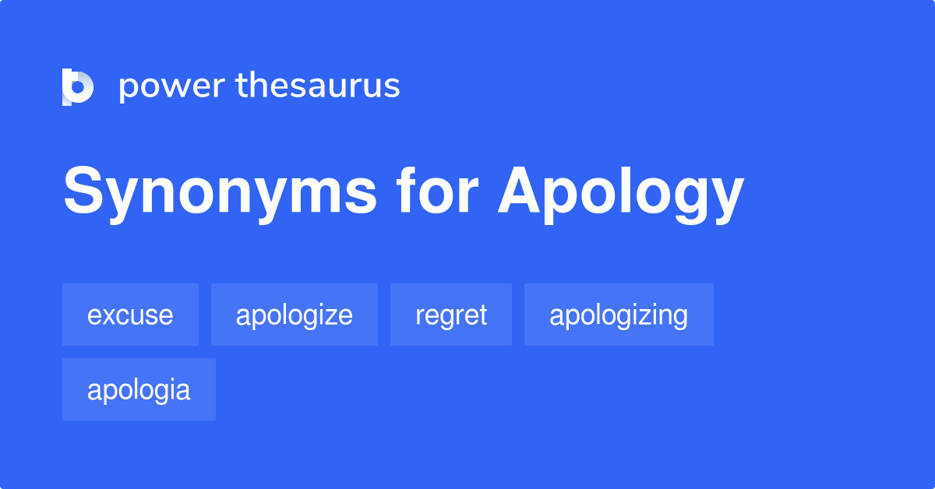
Apologizing
Apologies are often part of negative-news messages.
An apology is defined as an “admission of blameworthiness and regret for an undesirable event.”
Apologies to customers are especially important if you or your company erred. They cost nothing, and they go a long way in soothing hard feelings.

Slide 62
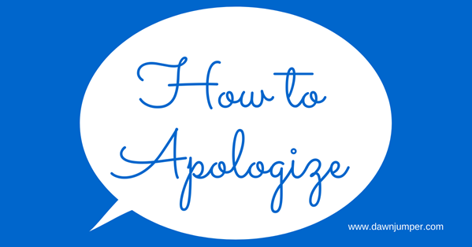
Apologizing – The Five Rs
Professional writer John Kador recommends what he calls the Five Rs model for effective apologies in business messages.
Recognition
Responsibility
Restitution
Remorse
Repeating

Slide 63
Showing Empathy
One of the hardest things to do in negative messages is to convey sympathy and empathy. Empathy is the ability to understand and enter into the feelings of another.
Researchers insist that businesses “must demonstrate empathy across three channels: (1) internally to their own employees, (2) externally to their customers, and (3) to the public via social media.”
Some companies may fear appearing weak and vulnerable, but authentic dialogue is expected in today’s transparent social media environment.

Slide 64
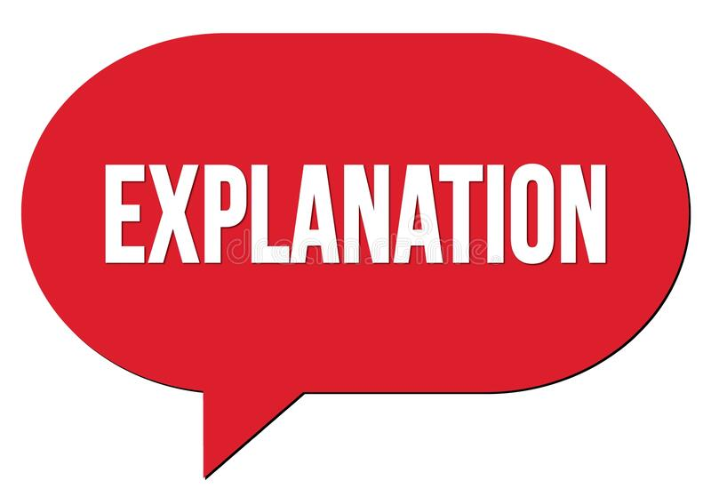
Presenting the Reasons
Providing an explanation reduces feelings of ill will and improves the chances that readers will accept the bad news.
Without sound reasons for denying a request, refusing a claim, or revealing other bad news, a message will fail, no matter how cleverly it is organized or written.
In the indirect strategy, the reasons appear before the bad news.
In the direct strategy, the reasons appear immediately after bad news.

Slide 65
Cushioning the Bad News
Although you can’t prevent the disappointment that bad news brings, you can reduce the pain somewhat by breaking the news sensitively.
Be especially considerate when the reader will suffer personally from the bad news.
A number of thoughtful techniques can cushion the blow.

Slide 66
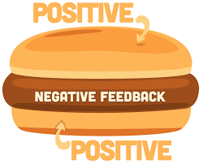
Cushioning the Bad News
1. Positioning the Bad News Strategically
Instead of spotlighting it, sandwich bad news between sentences, perhaps among your reasons. Don’t let the refusal begin or end a paragraph; the reader’s eye will linger on these high-visibility spots.
Another technique that reduces shock is putting a painful idea in an subordinate clause. Subordinate clauses often begin with words such as “although,” “as,” “because,” “if,” and “since” (i.e. Although another candidate was hired, we appreciate your interest.)

Slide 67
Cushioning the Bad News
2. Using the Passive Voice
Passive-voice verbs enable you to depersonalize an action.
Whereas the active voice focuses attention on a person (We don’t give refunds), the passive voice highlights the action (Cash refunds are not given because…).
Use the passive voice for the bad news.

Slide 68
Cushioning the Bad News
3. Highlighting the Positive
Messages are far more effective when you describe what you can do instead of what you can’t do.
Rather than “We will no longer allow credit card purchases,” try a more positive appeal: “We are now selling gasoline at discount cash prices.”

Slide 69
Cushioning the Bad News
4. Implying the Refusal
It is sometimes possible to avoid a direct statement of refusal. Often, your reasons and explanations leave no doubt that a request has been denied. Explicit refusals may be unnecessary and at times cruel.
In this refusal to contribute to a charity, for example, the writer never actually says “no;” “Because we will soon be moving into new offices, all our funds are earmarked for relocation costs. We hope that next year we will be able to support your worthwhile charity.”
The danger of an implied refusal, of course, is that it is so subtle that the reader misses it. Be certain that you make the bad news clear, thus preventing the need for further correspondence.

Slide 70
Cushioning the Bad News
5. Suggesting a Compromise or an Alternative
A refusal is not so depressing – for the sender or the receiver – if a suitable compromise, substitute, or alternative is available.
In denying permission to a group of students to visit a historical residence, for instance, this writer softens the bad news by proposing an alternative: “Although private tours are not given, we do open the house and its gardens for one charitable event in the fall.”
You can further reduce impact of the bad news by refusing to dwell on it. Present it briefly (or imply it), and move on to your closing.

Slide 71
Closing Pleasantly
After explaining the bad news sensitively, close the message with a pleasant statement that promotes goodwill.
The closing should be personalized and may include a forward look, an alternative, good wishes, freebies, resale information, or a sales promotion.

Slide 72
Refusing Typical Requests and Claims
When you must refuse typical requests, you will first think about how the receiver will react to your refusal and decide whether to use the direct or the indirect strategy.
If you have any doubt, use the indirect strategy.

Slide 73
Managing Negative News Online
Today’s impatient, hyperconnected consumers eagerly embrace the idea of delivering their complaints to social networking sites rather than calling customer service departments.
Why rely on word of mouth or send a letter to a company about poor service or a defective product when you can shout your grievance to the entire world?
Internet sites encourage consumers to quickly share complaints about stores, products, and services that fall short of their standards.

Slide 74
Managing Negative News Online
Businesses can employ some of the following effective strategies to manage negative news on social networking sites and blogs:
Recognize social networks as important communication channels.
Become proactive.
Join the fun.
Monitor comments.

Slide 75
Delivering Bad News in Person
Whether you are an employee or a supervisor, you may have the unhappy responsibility of delivering bad news.
First, decide whether the negative information is newsworthy.
If you know that the news will upset the receiver, the reason-first strategy is most effective.
When the bad news involves one person or a small group nearby, you should generally deliver that news in person.

Slide 76
Delivering Bad News in Person
A guideline on how to do so tactfully, professionally, and safely:
Gather all the information.
Cool down and have all the facts before marching in on the boss or confronting someone. Remember that every story has two sides.
Prepare and rehearse.
Outline what you plan to say so that you are confident, coherent, and dispassionate.
Explain: past, present, future.
If you are telling the boss about a problem such as the computer crash, explain what caused the crash, the current situation, and how to fix it.
Consider taking a partner.
If you fear a shoot-the-messenger reaction, bring someone with you.
Think about timing.
Don’t deliver bad news when someone is stressed or grumpy, or on Friday PM.
Be patient with the reaction.
Give the receiver time to vent, think, recover, and act wisely.

Slide 77
Announcing Bad News to Employees and the Public
In an age of social media, damaging information can rarely be contained for long. Executives can almost count on it to be leaked.
Corporate officers who fail to communicate effectively and proactively may end up on the defensive and face an uphill battle trying to limit damage.
Many of the same techniques used to deliver bad news personally are useful when organizations face a crisis or must deliver bad news to various stakeholders.

Slide 78
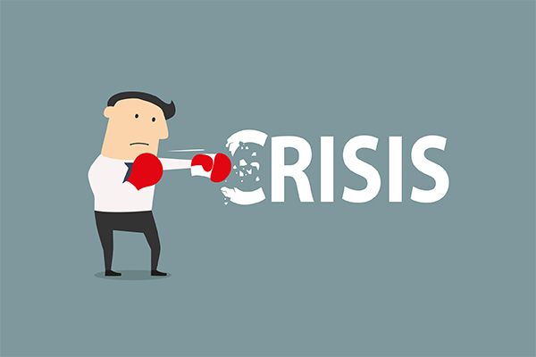
Announcing Bad News to Employees and the Public
Smart organizations involved in a crisis prefer to communicate the news openly to employees and stakeholders.
A crisis might involve serious performance problems, a major relocation, massive layoffs, a management shakeup, or public controversy.
Instead of letting rumors distort the truth, managers ought to explain the organization’s side of the story honestly and promptly.

Slide 79
Announcing Bad News to Employees and the Public
Morale can be destroyed when employees learn of major events affecting their jobs through the grapevine or from news accounts – rather than from management.
When bad news must be delivered to individual EEs, management may want to deliver the news personally. With large groups, however, this is generally more complicated.
Organizations deliver bad news through multiple channels.

