Slide 1

Fundamentals of Management
Session Six

Slide 2
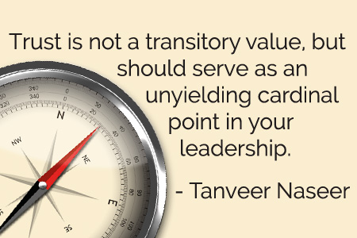
Part Four: Leading
Chapter Twelve: Leadership and Trust
  Define leader and leadership.
  Compare and contrast early leadership theories.
  Describe the four major contingency leadership theories.
  Describe modern views of leadership and issues facing leaders today.
  Discuss trust as the essence of leadership.

Slide 3
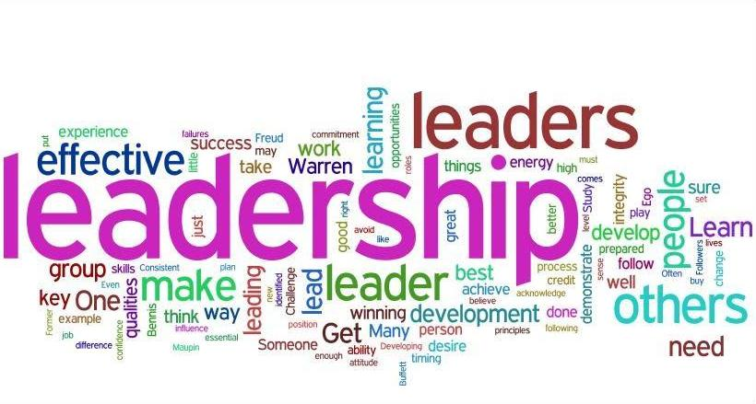
Leaders and Leadership
A Leader is Someone who can influence others and has managerial authority.
  Because leading is one of the four management functions, ideally all managers should be leaders.
Leadership is the process of leading a group & influencing that group to achieve its goals.

Slide 4
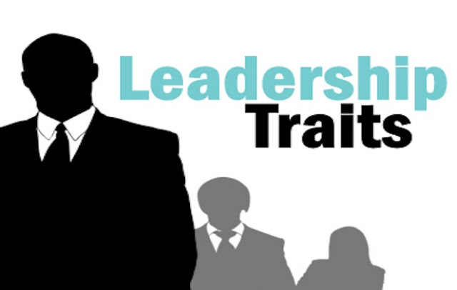
Trait Theories of Leadership
Trait Theories of Leadership search for characteristics or traits that differentiate leaders from non-leaders.
  Most people can cite a list of qualities they admire in leaders – intelligence, charisma, decisiveness, enthusiasm, strength, bravery, integrity, self-confidence, etc., but there is no definitive list of traits consistently associated with leadership.
    Traits alone are not sufficient for identifying effective leaders.

Slide 5

Common Leadership Traits
Drive
  Leaders exhibit a high effort level. They have a relatively high desire for achievement, they are ambitious, they have a lot of energy, they are tirelessly persistent in their activities, and they show initiative.
Desire to Lead
  Leaders have a strong desire to influence and lead others.
  They demonstrate the willingness to take responsibility.
Honesty and Integrity
  Leaders build trusting relationships with followers by being truthful, or non-deceitful, and by showing high consistency between word and deed.
Self-Confidence
  Followers look to leaders who don’t self doubt. Leaders, therefore, need to show self-confidence in order to convince followers of the rightness of their goals and decisions.

Slide 6
Common Leadership Traits
Intelligence
  Leaders need to be intelligent enough to gather, synthesize, and interpret large amounts of information, and they need to be able to create visions, solve problems, and make correct decisions.
Job-Relevant Knowledge
  Effective leaders have a high degree of knowledge about the company, industry, and technical matters. In depth knowledge allows leaders to make well-informed decisions and to understand the implications of those decisions.
Extraversion
  Leaders are energetic, lively people. They are sociable, assertive, and rarely silent or withdrawn.
Proneness to Guilt
  Guilt proneness is positively related to leadership effectiveness, because it produces a strong sense of responsibility for others.

Slide 7
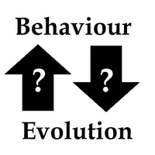
Behavioral Theories of Leadership
Iowa – Ohio – Michigan – Managerial Grid
Behavioral Theories of Leadership search for behaviors that differentiate effective leaders from ineffective leaders.
  If behavioral theories could identify critical behavioral determinants of leadership, people could be trained to be leaders – the premise behind management development programs.

Slide 8

Behavioral Theories of Leadership
There is a dual nature of leader behaviors.
  Focusing on the work to be done and focusing on the employees – is an important characteristic of successful leadership.
    Task and relationship oriented.

Slide 9
Fiedler Contingency Theory
The Fiedler Contingency Theory proposes that effective group performance depends on the proper match between a leader’s style and the degree to which the situation allowed the leader to control and influence.
  Fiedler’s research uncovered three contingency dimensions that defined the key situational factors in leader effectiveness.
    Leader-Member Relations: the degree of confidence, trust, and respect EE’s had for their leader.
    Task Structure: the degree to which job assignments were formalized and structured.
    Position Power: the degree of influence a leader had over activities such as hiring, firing, discipline, promotions, and salary increases.

Slide 10

Situational Leadership Theory (SLT)
The Situational Leadership Theory proposed by Paul Hersey and Ken Blanchard focuses on followers’ readiness.
  Readiness refers to the extent to which people have the ability and willingness to accomplish a specific task
  The emphasis on the followers in leadership effectiveness reflects the reality that it is the followers who accept or reject the leader.
    SLT acknowledges the importance of followers and builds on the logic that leaders can compensate for ability and motivational limitations in their followers, with intuitive appeal.

Slide 11
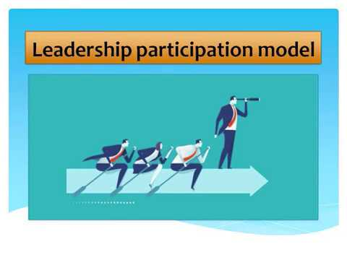
Leader-Participation Model
The Leader-Participation Model developed by Victor Vroom and Phillip Yetton is a leadership contingency theory that suggests the participation-level of a leader in decision-making is relative to the different types of situations they encounter.
  The model confirms that leadership research should be directed at the situation rather than at the person.
    That is, it probably makes more sense to talk about autocratic and participative situations than autocratic and participative leaders.

Slide 12

Path-Goal Theory
The Path-Goal Theory developed by Robert House says that the leader’s job is to assist followers in attaining their goals and to provide direction or support needed to ensure that their goals are compatible with the organization’s or group’s goals.
  The term path-goal is derived from the belief that effective leaders clarify the path to help their followers get from where they are to the achievement of their work goals and make the journey along the path easier by reducing roadblocks and pitfalls.

Slide 13

Path-Goal Theory
In contrast to Fiedler’s view that a leader couldn’t change his or her behavior, House assumed that leaders are flexible and can display any or all of these leadership styles depending on the situation.

Slide 14

Path-Goal Theory
An EE’s performance and satisfaction are likely to be positively influenced when the leader chooses a leadership style that compensates for short comings in either the EE or the work setting.
  However, if the leader spends time explaining tasks that are already clear or when the EE has the ability and experience to handle them without interference, the EE is likely to see such directive behavior as redundant or even insulting.

Slide 15
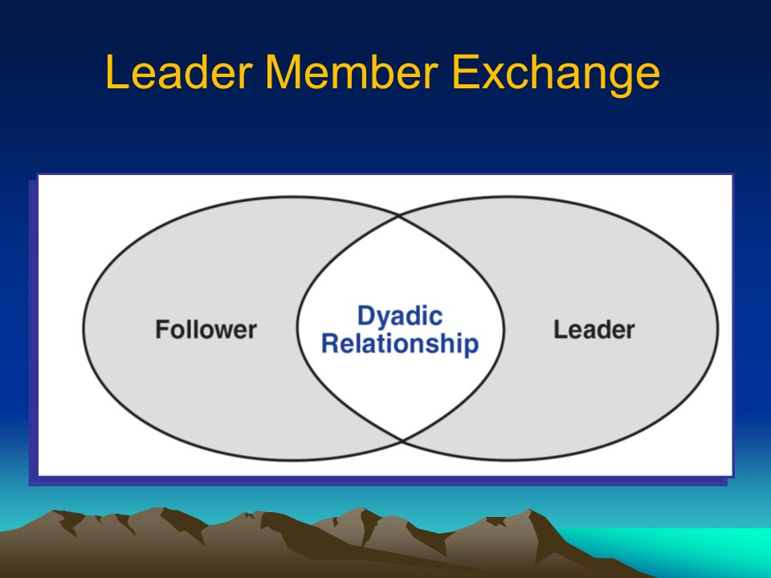
Leader-Member Exchange (LMX) Theory
The Leader-Member Exchange Theory says leaders create in-groups and out-groups and the in-group will have higher performance ratings, less turnover, and greater job satisfaction.
  Early on in the relationship a leader will implicitly categorize a follower as an “in” or as an “out.”
    Leaders also encourage LMX by rewarding those EE’s with whom they want a closer linkage and punishing those with whom they do not.

Slide 16

Leader-Member Exchange (LMX) Theory
Followers with in-group status will have higher performance ratings, engage in more helping or “citizenship” behaviors at work, and report greater satisfaction with their boss.
  These findings are not surprising, as leaders are more likely to invest their time and other resources in those whom they expect to perform the best.

Slide 17
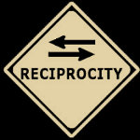

Transactional Leaders
Transactional Leaders are those who lead primarily by using social exchange or transactions.
  Transactional leaders guide or motivate followers to work toward established goals by exchanging rewards for their productivity.

Slide 18
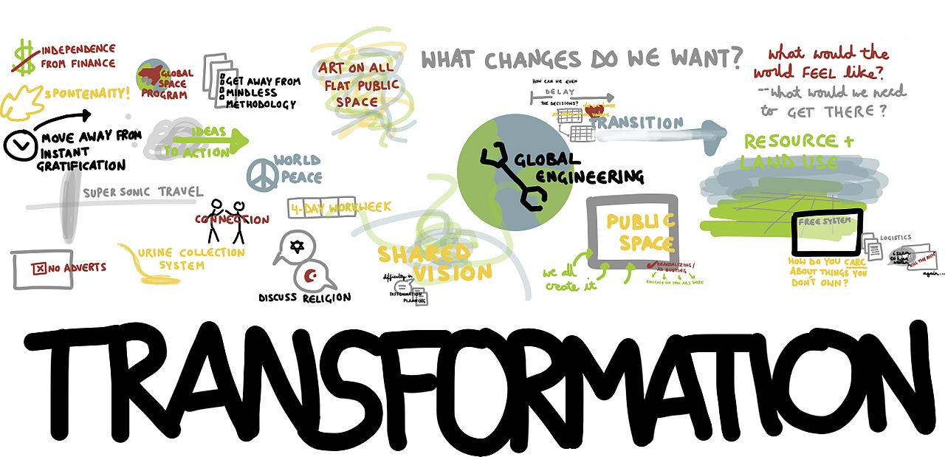
Transformational Leaders
Transformational Leaders stimulate and inspire (transform) followers to achieve extraordinary outcomes.
  Transformational leaders pay attention to the concerns and developmental needs of individual followers; changing followers’ awareness of issues by helping those followers look at old problems in new ways; and being able to excite, arouse, and inspire followers to exert extra effort to achieve group goals.

Slide 19

Transactional vs. Transformational Leaders
The evidence supporting the superiority of transformational leadership over transactional leadership is impressive.
  Transformational leaders were evaluated as more effective, higher performers, more promotable than their transactional counterparts, and more interpersonally sensitive.
    Transformational leadership is strongly correlated with lower turnover rates and higher levels of productivity, work engagement, EE satisfaction, creativity, goal attainment, and follower well-being.

Slide 20

Charismatic Leaders
Charismatic Leaders are enthusiastic, self-confident leaders whose personalities and actions influence people to behave in certain ways.
  Charismatic Leaders have vision, willingness to take risks to achieve that vision, sensitivity to both environmental constraints and follower needs, and other behaviors that are out of the ordinary.
    There is an impressive correlation between charismatic leadership and high performance and satisfaction among followers.

Slide 21

Visionary Leadership
Visionary Leadership is the ability to create and articulate a realistic, credible, and attractive vision of the future that improves on the present situation.
  The vision, if properly selected and implemented, is so energizing that it “in effect jump-starts the future by calling forth the skills, talents, and resources to make it happen.
    An organization’s vision should offer clear and compelling imagery that taps into people’s emotions and inspires enthusiasm to pursue the organization’s goals.

Slide 22

Leaders and Teams
Because leadership is increasingly taking place within a team context and more organizations are using work teams, the role of the leader in guiding team members has become increasingly important.
  Effective team leaders have mastered the difficult balancing act of knowing when to leave their teams alone and when to get involved.
    Important responsibilities of team leaders include coaching, facilitating, handling disciplinary action problems, reviewing team and individual performance, training, and communication.

Slide 23

Empowerment
Managers are increasingly leading by not leading; that is, by empowering their employees.
  Empowerment involves increasing the decision-making discretion of workers.
    Today, many EE’s are making the key operating decisions that directly affect their work.

Slide 24

Empowerment
More companies are empowering EE’s because of a need for quick decisions by those people who are most knowledgeable about the issues.
  If organizations want to successfully compete in a dynamic global economy, EE’s have to be able to make decisions and implement changes quickly.

Slide 25

National Culture
National Culture is an important situational variable in determining which leadership style will be most effective.
  However, most leadership theories were developed in the U.S., and have an American bias:
    Emphasize follower responsibilities rather than rights.
    Assume centrality of work and democratic value orientation.
    Stress rationality rather than spirituality, religion, or superstition.
    Assume self-gratification rather than commitment to duty or altruistic motivation.

Slide 26
National Culture
A number of elements of transformational leadership appear to be associated with effective leadership regardless of what country the leader is in.
  Effective business leaders in any country are expected by their subordinates to provide a powerful and proactive vision to guide the company into the future, strong motivational skills to stimulate all EE’s to fulfill the vision, and excellent planning skills to assist in implementing the vision.

Slide 27

Virtual Leadership
Today’s managers and their EE’s are increasingly being linked by technology rather than by geographic proximity.
  To be an effective virtual leader, managers must recognize that they have choices in the words and structure of their digital communications. They also need to develop the skill of “reading between the lines” in the messages they receive.
    It’s important to try and decipher the emotional content of a message as well as the written content.

Slide 28

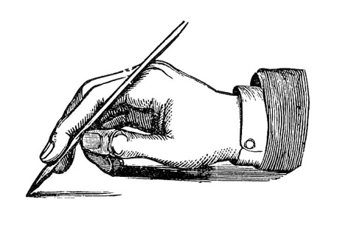
Virtual Leadership
For an increasing number of managers, good interpersonal skills may include the abilities to communicate support and leadership through digital communication and to read emotions in others’ messages.
  In this “new world” of communication, writing skills are likely to become an extension of interpersonal skills.

Slide 29

Emotional Intelligence
Emotional Intelligence – more so than IQ – is the best predictor of who will emerge as leader.
  Leaders need basic intelligence and job-relevant knowledge, but IQ and technical skills are “threshold capabilities.”
    They are necessary, but not sufficient requirements for leadership.

Slide 30
Emotional Intelligence
Emotional Intelligence – more so than IQ – is the best predictor of who will emerge as leader.
  Emotional Intelligence is what allows an individual to become a star performer. It emphasizes:
    Self-Awareness
    Self-Management
    Self-Motivation
    Empathy
    Social Skills

Slide 31
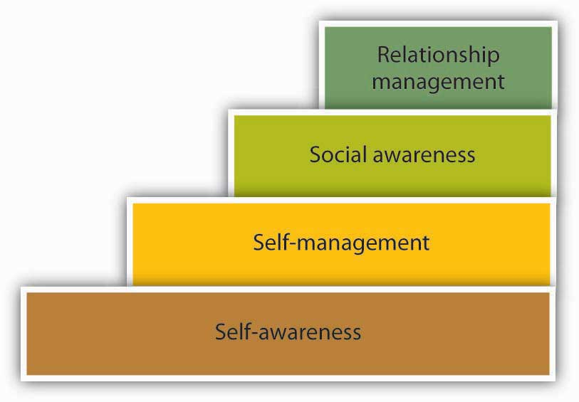
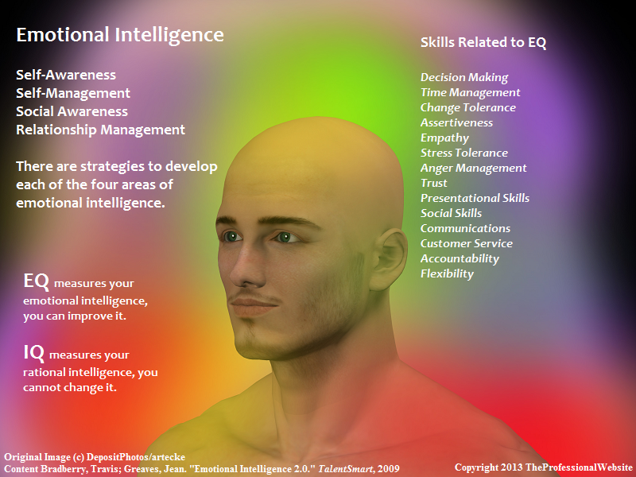
Emotional Intelligence
Emotional Intelligence has been shown to be positively related to job performance at all levels.
  But it appears to be especially relevant in jobs that demand a high degree of social interaction.
    And, of course, that’s what leadership is all about.

Slide 32
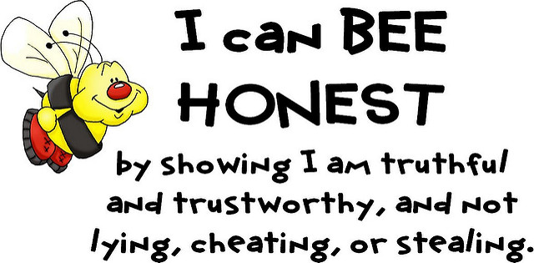
Trust
Trust is the essence of leadership.
  In today’s uncertain environment, leaders need to build, or even rebuild, trust and credibility.
    The main component of credibility is honesty.
    Surveys show that honesty is consistently singled out as the number one characteristic of admired leaders.
        Honesty is absolutely essential to leadership.

Slide 33

Trust
In addition to being honest, credible leaders are competent and inspiring.
  Followers judge a leader’s credibility in terms of his or her honesty, competence, and ability to inspire.
    Trust is closely entwined with the concept of credibility, and in fact, the terms are often used interchangeably.
    Trust is the belief in integrity, character, and ability of a leader.

Slide 34
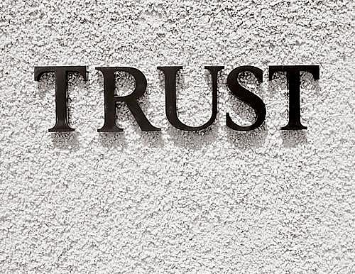
Trust
Five dimensions that make up Trust:
  Integrity
    Honesty and truthfulness
  Competence
    Technical and interpersonal knowledge and skills
  Consistency
    Reliability, predictability, and good judgment in handling situations
  Loyalty
    Willingness to protect a person, physically and emotionally
  Openness
    Willingness to share ideas and information freely

Slide 35
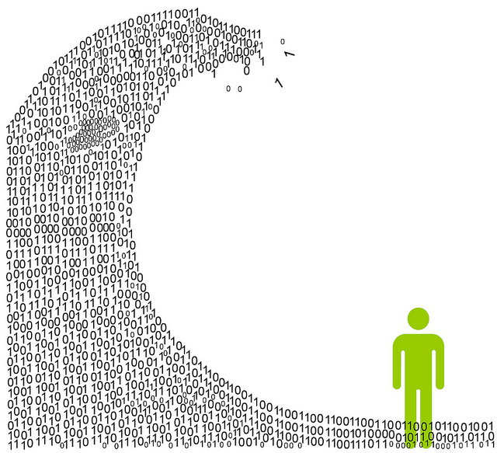
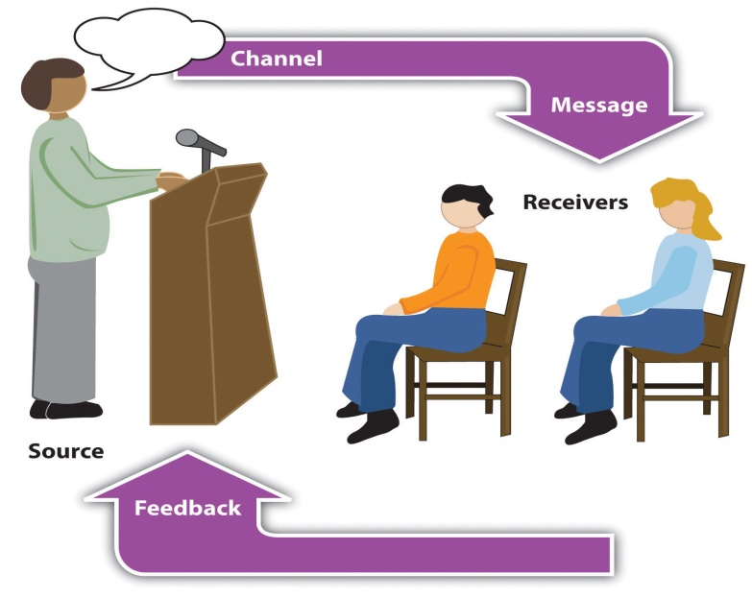
Part Four: Leading
Chapter Thirteen: Managing Communication and Information
  Describe what managers need to know re: communicating effectively.
  Explain how technology affects managerial communication.
  Discuss contemporary issues in communication.

Slide 36
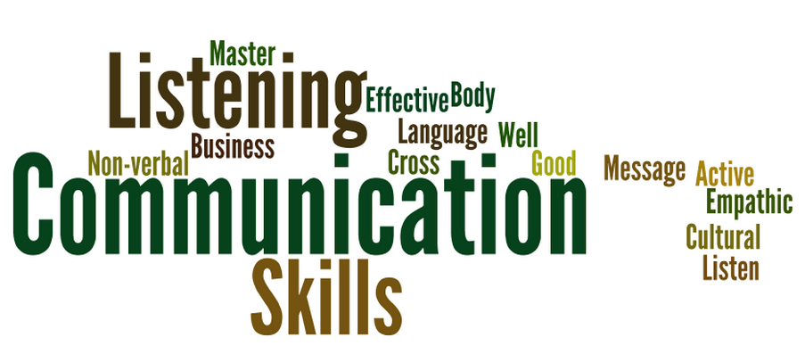
Communication
Everything a manager does involves communication.
  The best idea, the most creative suggestion, or the finest plan cannot take form without communication.
    Managers, therefore, need effective communication skills.

Slide 37

Communication
Communication can be thought of as a process or flow. And, communication problems occur when deviations or blockages disrupt that flow.
  Communication is a transfer of understanding and meaning from one person to another.

Slide 38
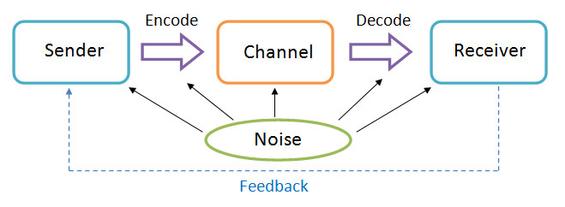
Communication Process

Slide 39

Communication Process (7 Parts)
Part One and Two
The sender initiates a message by encoding a thought.
  It is the process of converting a message into symbolic form.
  Four conditions affect the encoded message:
    Skill – ability to encode the message (write, speak, etc.)
    Attitudes – we hold predisposed ideas on topics and have biases.
    Knowledge – communication is restricted by knowledge of topic.
    Social Cultural System – our beliefs and values, which are part of our culture, influence us as a communication source.

Slide 40

Communication Process (7 Parts)
Part Three
The message is the actual physical product from the source that conveys some purpose.
  Our message is affected by the code or group of symbols we use to transfer meaning (verbal, written, gesture), the content of the message itself, and the decisions that we make in selecting and arranging both codes and content.

Slide 41

Communication Process (7 Parts)
Part Four
The channel is the medium through which the message travels. It’s selected by the source, who must determine whether to use a formal or informal channel.
    Formal channels are established by the organization and transmit messages that pertain to the job-related activities of members.
    Other forms of messages, such as personal or social, follow the informal channels in the organization.

Slide 42

Communication Process (7 Parts)
Part Five and Six
The receiver is the person to whom the message is directed.
  However, before the message can be received, the symbols in it must be translated into a form that can be understood by the receiver – the decoding of the message.
    Just as the encoder was limited by her skills, attitudes, knowledge, and social cultural system, the receiver is equally restricted.
    Accordingly, the source must be skillful in writing or speaking; the receiver must be skillful in reading or listening.

Slide 43

Communication Process (7 Parts)
Part Seven
The final link in the communication process is the feedback loop.
  Feedback is the check on how successful we’ve been in transferring our message as originally intended.
    It determines whether understanding has been achieved.

Slide 44

Grapevine
The grapevine is the unofficial way that communication takes place in an organization. It’s neither authorized or supported by the organization.
  Ironically, good information passes among us rapidly, but bad information travels even faster.
    In an organization characterized by openness, the grapevine may be extremely accurate.
    In an authoritative culture, the rumor mill may not be accurate. However, the information may contain an element of truth.

Slide 45
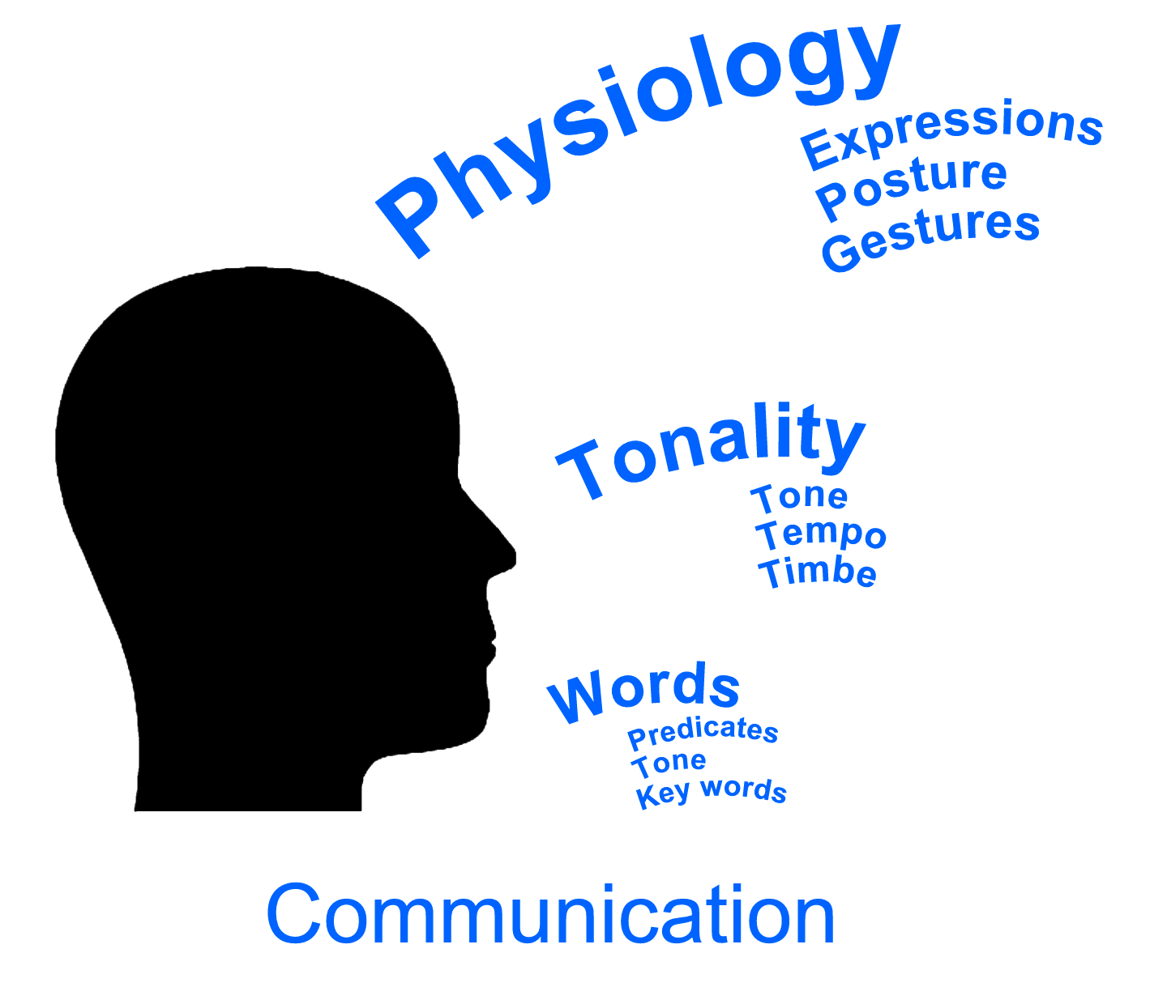
Nonverbal Communication
Some of the most meaningful communications are neither spoken nor written - they are nonverbal communications.
  The best known areas of nonverbal communication are body language and verbal intonation.
    Body language refers to gestures, facial configurations, and other movements of the body.
    Verbal intonation refers to the emphasis someone gives to words or phrases.
      “It’s not what you say, but how you say it.”

Slide 46
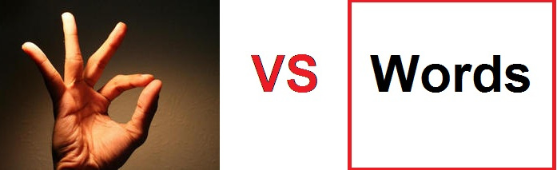
Nonverbal Communication
The fact that every oral communication also has a nonverbal message cannot be overemphasized, as the nonverbal component is likely to carry the greatest impact.
  Research indicates that 65 to 90 percent of the message of every face-to-face conversation is interpreted through body language.
    Without complete agreement between the spoken words and the body language that accompanies it, receivers are more likely to react to body language as the “true meaning.”

Slide 47
Communication Barriers
A number of interpersonal and intrapersonal barriers affect why the message decoded by a receiver is different from what the sender intended.

Slide 48
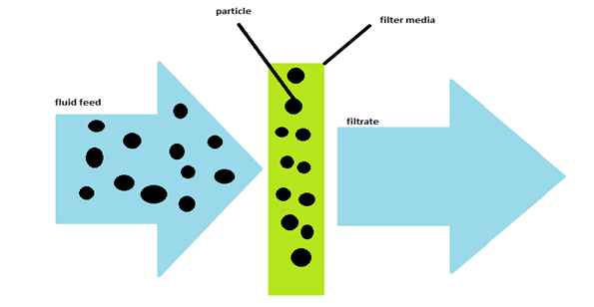
7 Communication Barriers
1. Filtering
  The deliberate manipulation of information to make it appear more favorable to the receiver.
    For example, when an EE tells his boss what he feels the boss wants to hear, he is filtering information.

Slide 49
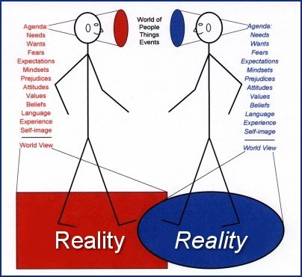
7 Communication Barriers
2. Selective Perception
  Receiving communications on the basis of what one selectively sees and hears depending on his or her needs, motivation, experience, background, and other personal characteristics.
    Receivers also project their interests and expectations into communications as they decode them.

Slide 50

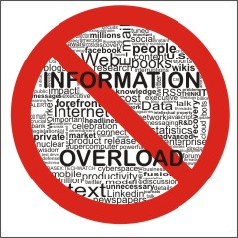
7 Communication Barriers
3. Information Overload
  When the amount of information one has to work with exceeds one’s processing capacity.
    For example, the demands of keeping up with emails, phone calls, faxes, meetings, and professional reading create an onslaught of data that is nearly impossible to process and assimilate.

Slide 51

7 Communication Barriers
4. Emotions
  How the receiver feels when a message is received influences how he or she interprets it.
    You’ll often interpret the same message differently, depending on whether you’re happy or distressed.
      We often disregard our rational and objective thinking process and substitute emotional judgments.

Slide 52
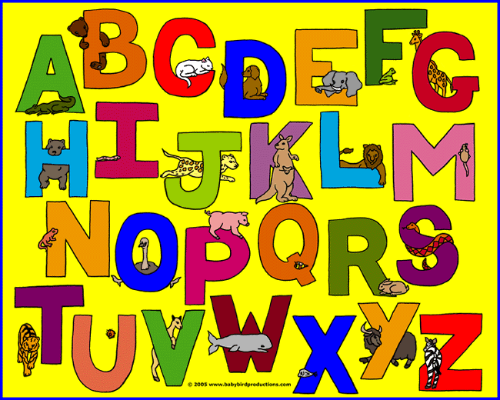
7 Communication Barriers
5. Language
  Words have different meanings to different people.
    Receivers will use their definitions of words being communicated.
    “The meanings of words are not in the words; they are in us.”
      A person’s age, education, and cultural background are three of the more obvious variables that influence the language a person uses and the definitions he or she applies to words.

Slide 53

7 Communication Barriers
6. Gender
  How males and females react to communication may be different, and they each have a different communication style.
    To keep gender differences from becoming persistent barriers to effective communication, individuals must strive for acceptance, understanding, and a commitment to communicate adaptively with each other.

Slide 54

7 Communication Barriers
7. National Culture
  Communication differences can also arise from different languages that individuals use to communicate and the national culture of which they are a part.
    In the U.S., managers rely heavily of memoranda, announcements, position papers, and other formal forms of communication to state their positions on issues.
    In collectivist countries, managers engage in extensive verbal consultation with EE’s over an issue first and draw up a formal document later to outline the agreement made.

Slide 55
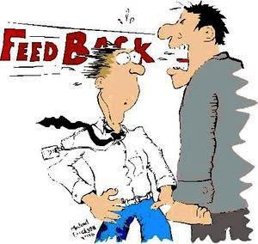
5 Components in Overcoming Communication Barriers
1. Use Feedback
  Check the accuracy of what has been communicated or what you think you heard.
    Many communication problems are directly attributed to misunderstanding and inaccuracies.
      These problems are less likely to occur if the manager gets feedback, both verbal and nonverbal.

Slide 56

5 Components in Overcoming Communication Barriers
2. Simplify Language
  Use words that the intended audience understands.
    Effective communication is achieved when a message is both received and understood.

Slide 57

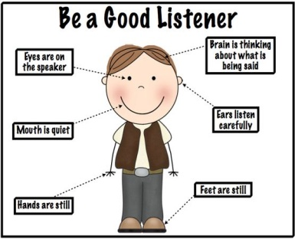
5 Components in Overcoming Communication Barriers
3. Listen Actively
  Listen for the full meaning of the message without making premature judgment or interpretation or thinking about what you are going to say in response.
    Active listening is enhanced by developing empathy with the sender – that is, by putting yourself in the sender’s position.
      An empathetic listener reserves judgment on the message’s content and carefully listens to what is being said.

Slide 58
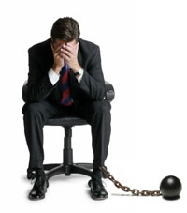
5 Components in Overcoming Communication Barriers
4. Constrain Emotions
  Emotions can cloud and distort communication.
    Recognize when your emotions are running high. When they are, don’t communicate until you have calmed down.

Slide 59
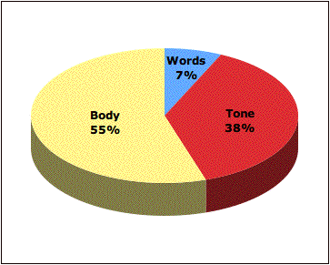
5 Components in Overcoming Communication Barriers
5. Watch Nonverbal Cues
  Be aware that your actions speak louder than your words. Keep the two consistent.
    Be sure your actions align with and reinforce the words that go along with them.

Slide 60

Technology and Managerial Communication
Information Technology (IT) has radically changed the way organizational members work and communicate.
  A recent survey found that 20 percent of EE’s at large companies say they contribute regularly to blogs, social networks, wikis, and other web services.

Slide 61

Communication Issues
Managers are learning, the hard way sometimes, that all this new technology has created special communication challenges, particularly in the areas of:
    Legal and Security Issues
    Lack of Personal Interaction

Slide 62

Legal and Security Issues
Organizations are often affected by the exposure of sensitive or embarrassing information.
  Managers need to ensure that confidential information is safeguarded, and information systems are protected against hackers and/or spam.

Slide 63
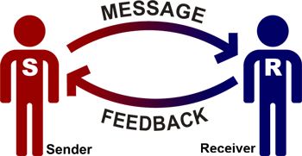
Lack of Personal Interaction
It can be especially challenging to achieve understanding and collaborate on getting work done when communication takes place in a virtual environment.
  In response, some companies have banned email on certain days, and others have simply encouraged EE’s to collaborate more in person as much as humanly possible.
  Instead of fighting it, some companies are encouraging EE’s to utilize the power of social networks to collaborate on work and to build strong connections.

Slide 64


Knowledge Management
Part of a manager’s responsibility in fostering an environment conducive to learning and effective communications is to create learning capabilities throughout the organization.
  Knowledge management involves cultivating a learning culture in which organizational members systematically gather knowledge and share it with others in the organization, so as to achieve better performance.

Slide 65

Knowledge Management
Managers need to find ways to make it easier for EE’s to communicate and share their knowledge, so they can learn from each other ways to do their jobs more effectively and efficiently.
  One way to do this is to build online information databases that EE’s can access. Another way is to develop communities of practice – groups of people who share a concern, a set of problems, or a passion about a topic and who can deepen their knowledge and expertise in that area by interacting on an ongoing basis.

Slide 66

Customer Service
What communication takes place and how it takes place can have a significant impact on a customer’s satisfaction with the service and likelihood of being a repeat customer.
  Managers in service organizations need to make sure that EE’s who interact with customers are communicating appropriately and effectively with those customers. How? By first recognizing the three components in any service delivery process:
    The customer
    The service organization
    The individual service provider

Slide 67

Employee Input
In today’s challenging environment, companies need to get input from their employees.
  Hold Town-Hall Meetings where information is shared and input solicited.
  Provide Information about what’s going on, good and bad.
  Invest in Training so that EE’s see how they impact the customer experience.
  Analyze Problems Together – managers and EE’s.
  Make It Easy for EE’s to give input by setting up different ways for them to do so (online, suggestion box, preprinted cards, etc.)

Slide 68

Ethical Communication
Ethical communication includes all relevant information, is true in every sense, and it is not deceptive in any way.
  On the other hand, unethical communication often distorts the truth or manipulates audiences.
    Managers can encourage ethical communications by asking questions:
      Has the situation been defined fairly and accurately?
      Why is the message being communicated?
      How will the people affected by or who receive the message be impacted?
      Does the message help achieve the greatest possible good while min. harm?
      Will this decision that appears to be ethical now seem so in the future?
      How comfortable are you with your communication effort? What would a person you admire think of it?

Slide 69
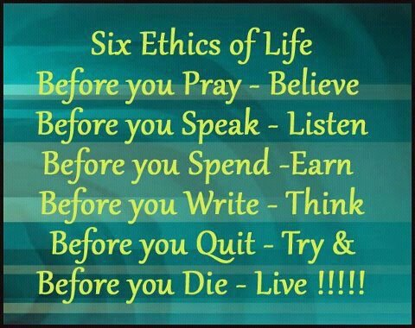
Ethical Communication
Remember that as a manager, you have a responsibility to think through your communication choices and the consequences of those choices.
  If you always remember that, you’re likely to have ethical communication practices.

Slide 70


