Slide 1

Entrepreneurship
CLASS Presentation SUMM Consolidate. Session 1
Entrepreneurship
  Theory, Process, Practice -12th Edition
    Donald F. Kuratko, Cengage Learning, Boston, MA 2024
      ISBN: 978-0-357-89950-2

Slide 2

Executive Summary
Chapter One
Entrepreneurship is not just starting a business – it is a discipline, mindset, and process centered on:
  Recognizing Opportunities
  Creating Value Through Innovation
  Taking Calculated Risks
  Mobilizing Resources to Build Something New
    It is a driving force of economic growth, innovation, and societal change.

Slide 3

Entrepreneurship is a Mindset
Not Just a Business
Entrepreneurship involves thinking, acting, and feeling differently.
  It is built on:
    Opportunity Recognition
    Risk Tolerance
    Resilience
    Innovation

Slide 4

Entrepreneurship is a Mindset
Not Just a Business
Entrepreneurship includes three dimensions:
  Cognitive
    How You Think
  Behavioral
    How You Act
  Emotional
    How You Respond to Uncertainty

Slide 5
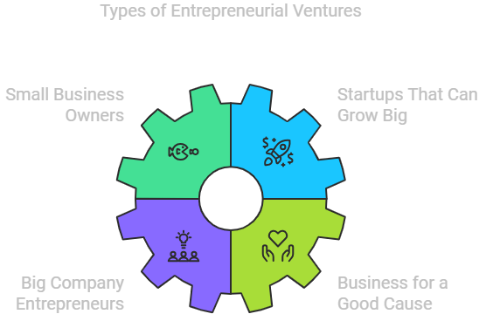
Types of Entrepreneurial Ventures
Entrepreneurship exists on a spectrum.
  Survival Ventures
    Income Stability
  Lifestyle Ventures
    Independence and Balance
  Managed Growth Ventures
    Steady Expansion
  Aggressive Growth Ventures
    Scale and Innovation Impact

Slide 6
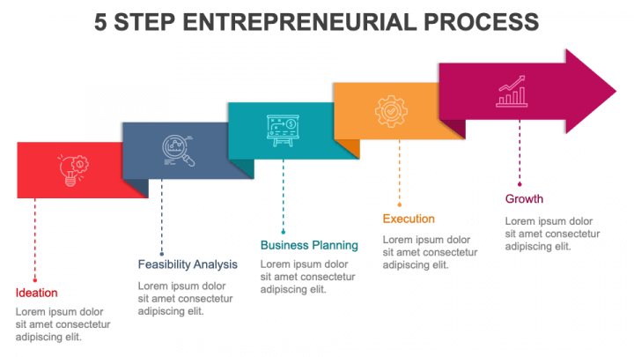
The Entrepreneurial Process
A structured, learnable process:
  Identify Opportunity
  Develop a Business Concept
  Gather Resources
  Implement
  Create Value (or Learn From Failure)
    Entrepreneurship is not chaotic – it is systematic and strategic.

Slide 7

Evolution of Entrepreneurship
From 18th century (risk-taking and organizing resources) to Innovation + Opportunity + Value Creation.
  Entrepreneurs are:
    Agents of Change
    Drivers of Economic and Social Progress

Slide 8

Myths of Entrepreneurship
Debunked
Entrepreneurs are Born
  They are Developed
It’s All About Money
  It’s About Value Creation
It’s Chaotic
  It’s Structured
It’s Only Tech
  It Exists in All Industries
Most Fail
  Failure is Part of Learning
    Entrepreneurship can be taught and learned.

Slide 9

Schools of Thought
Macro (External Factors)
  Environmental (Culture, Society)
  Financial (Access to Capital)
  Displacement (Push Factors Like Job Loss)
Micro (Internal Factors)
  Traits (Skills, Mindset)
  Opportunity Recognition
  Strategy and Planning
    Success = External Environment + Internal Capability

Slide 10
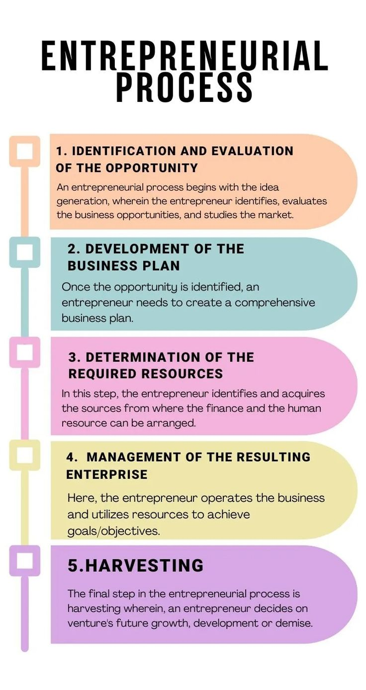
Process Models
Integrative Model
  Inputs
    Opportunity
    Individual
    Resources
    Organization
  Outputs
    Venture
    Innovation
    Jobs
    Economic Growth

Slide 11

Process Models
Dynamic Model
  Businesses Constantly Adapt to Their Environment
    Flexibility = Competitive Advantage

Slide 12


Entrepreneurial Revolution
Massive Global Growth in Startups.
  Job Creation – Innovation – Economic Expansion
    Entrepreneurship is now a dominant global force.

Slide 13

Modern Trends
The Latest Trends in Entrepreneurship:
  Venture Capital and Crowdfunding
  Corporate Entrepreneurship (Innovation Inside Companies)
  Social Entrepreneurship
  Global Entrepreneurship Growth
  Rise of Women and Minority Entrepreneurs
  Expansion of Entrepreneurship Education

Slide 14

Future of Entrepreneurship
The Future of Entrepreneurship focuses on:
  Developing the Entrepreneurial Mindset
  Learning Through Experience (Not Just Theory)
  Cross-Disciplinary Education
  Innovation Across All Sectors

Slide 15
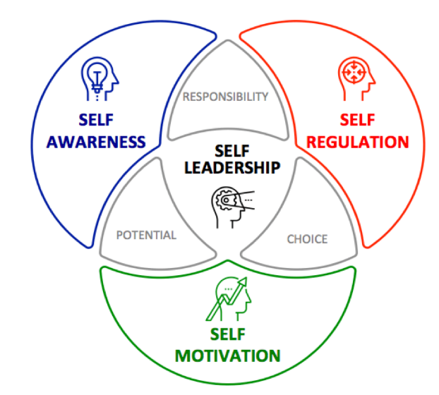
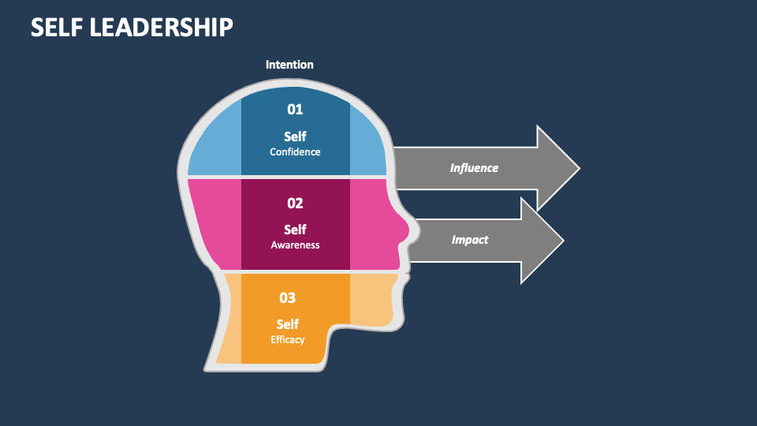
Understanding
What This Really Means
Entrepreneurship = Leadership of Self
  This curriculum teaches that entrepreneurship is a personal transformation and a shift from security to opportunity, fear to action, and comfort to growth.
    It’s about becoming the CEO of your own life.

Slide 16

Understanding
What This Really Means
Mindset -> Resources
  Success is less about Money and Ideas and more about Execution, Adaptability, and Persistence.
    How you Think determines what you Build.

Slide 17
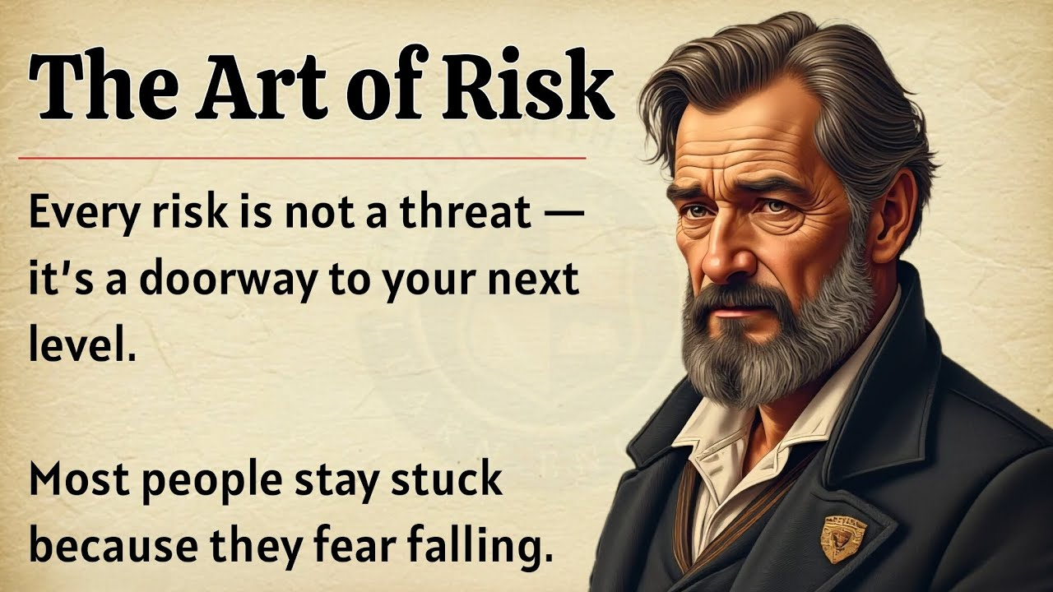
Understanding
What This Really Means
Risk is Reframed
  Employees avoid Risk and Entrepreneurs Manage and Leverage Risk.
    Risk becomes a Tool and Not a Threat.

Slide 18
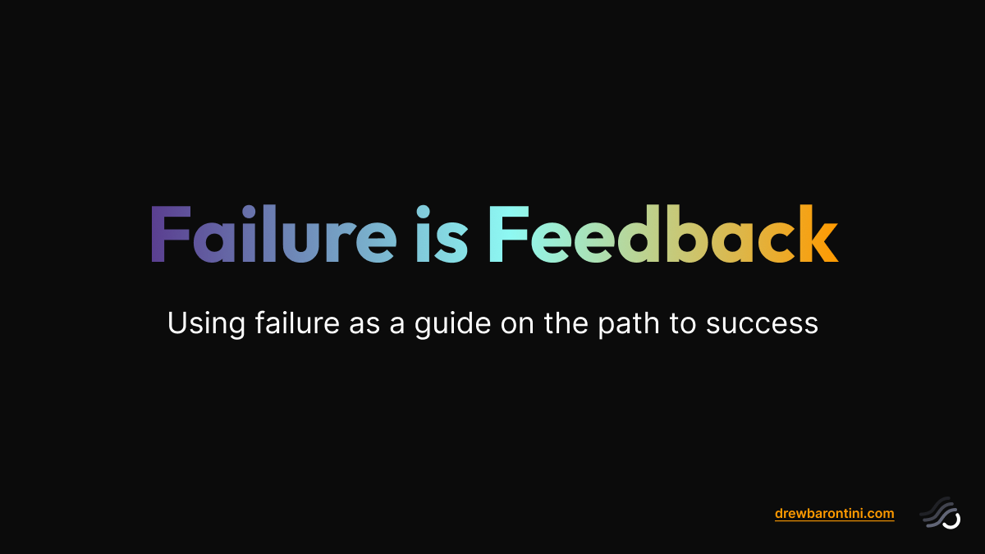
Understanding
What This Really Means
Failure is Part of the Process
  Failure is Feedback. Each attempt opens New Opportunities (Corridor Principle)
    Growth Mindset is Essential.

Slide 19

Understanding
What This Really Means
Opportunity is Everywhere
  Entrepreneurs see Order in Chaos and turn Problems into Solutions.
    The world is full of Hidden Opportunities.

Slide 20

Application
(How to Use This in Real Life)
Personal Life (CEO of You)
  Apply the Mindset by:
    Taking Ownership of Your Future
    Setting Personal “Venture Goals”
    Embracing Discomfort and Growth
      Start a Side Hustle – Write a Book – Build a Personal Brand

Slide 21
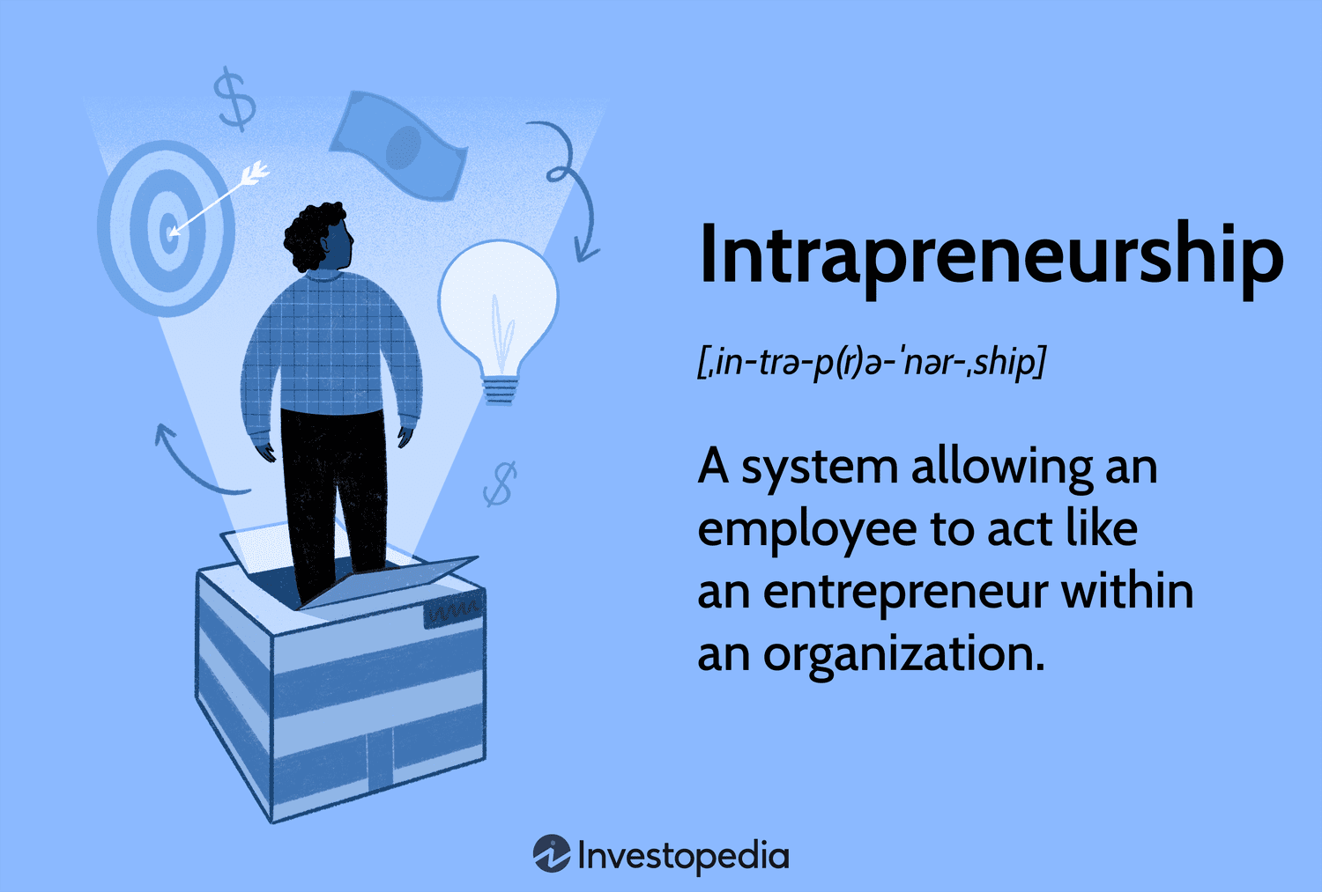
Application
(How to Use This in Real Life)
Career and Workplace (Intrapreneurship)
  You Don’t Need to Own a Business
    Innovate Within Your Organization
    Solve problems Proactively
    Think Like an Owner
      Become Indispensable by creating value, not just doing tasks.

Slide 22

Application
(How to Use This in Real Life)
Business Creation
  Use the Process
    Identify a Real Problem
    Validate the Idea
    Build a Simple Solution
    Scale Gradually
      Focus on Customers, Value, and Sustainability.

Slide 23

Application
(How to Use This in Real Life)
Leadership Development
  Entrepreneurial Leadership Means:
    Vision Casting
    Risk-Taking
    Empowering Others
    Driving Change
      Lead like a Builder, not just a Manager.

Slide 24


Application
(How to Use This in Real Life)
Education and Mentorship
  For Those You Lead:
    Teach Thinking, Not Just Content
    Encourage Creativity, Problem-Solving, and Initiative
      Build Mindset and Skills

Slide 25

Core Insight
Entrepreneurship is the disciplined pursuit of opportunity through innovation, risk management, and value creation – driven by a transformational mindset.

Slide 26

Final Takeaway
Entrepreneurship is not reserved for a few – it is:
  A Learnable Discipline
  A Way of Thinking
  A Path to Impact and Leadership
    The real goal of entrepreneurship is not just to build a business, rather to build a person capable of creating value anywhere.

Slide 27
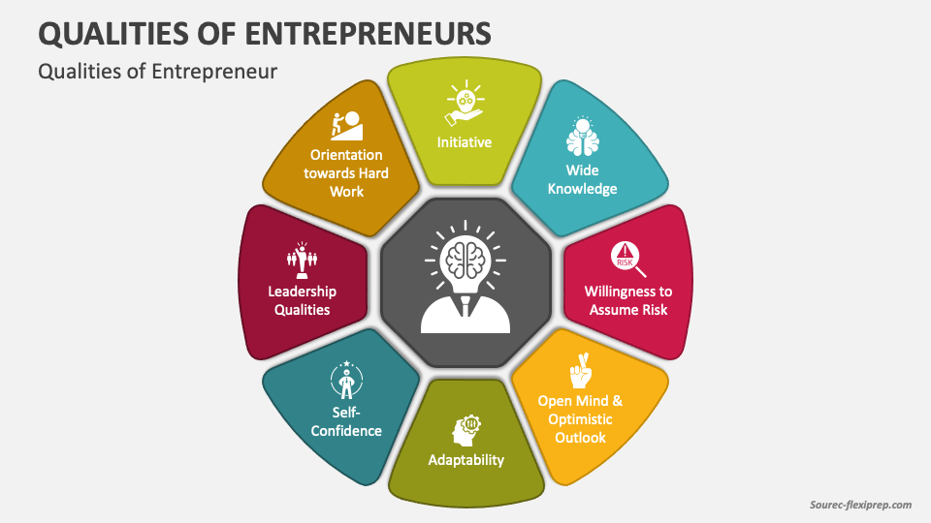
The Entrepreneurial Mindset
Chapter Two
An entrepreneurial mindset is the ability to identify opportunities, adapt to uncertainty, take calculated risks, and persist through challenges.
  It combines:
    Passion
    Resilience
    Adaptability
    Vision
    Learning Orientation
    Ethical Awareness

Slide 28

The Entrepreneurial Mindset
Entrepreneurship is not defined by one personality trait.
  It results from thinking patterns, behaviors, experiences, and motivation working together.
    Entrepreneurship is learned and shaped through experience, not just inherited traits.

Slide 29
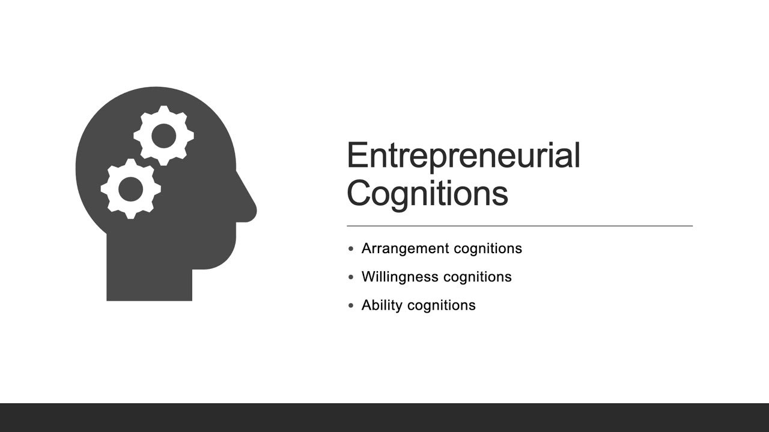
Entrepreneurial Cognition
Entrepreneurial cognition refers to how entrepreneurs think when:
  Identifying Opportunities
  Evaluating Ideas
  Making Decisions
  Solving Problems
  Building Ventures
    Entrepreneurs use mental models to connect unrelated information and create innovative solutions.

Slide 30
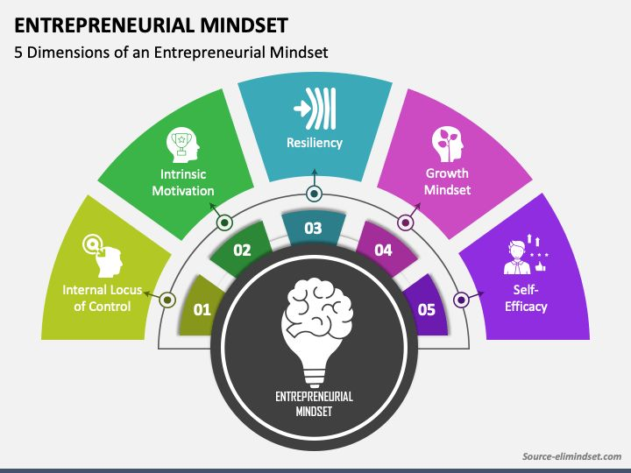
Entrepreneurial Cognition
An entrepreneur must train themselves to:
  Spot Inefficiencies
  Connect Trends
  Question Assumptions
  Test Ideas Quickly
    Example: A student noticing long campus coffee lines creates a mobile app to preorder.

Slide 31
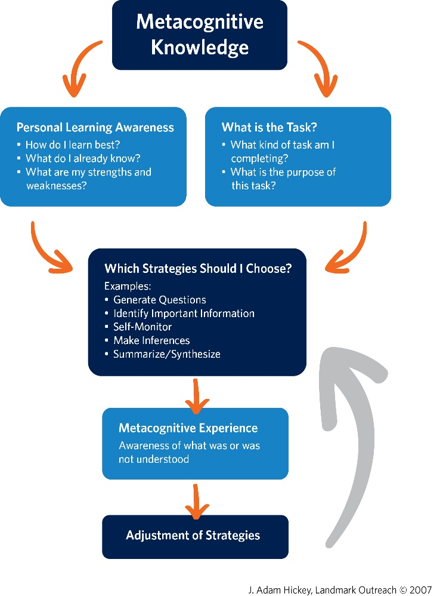
Metacognition
(Thinking About Thinking)
Metacognition is the ability to adjust how you think depending on the situation.
  Entrepreneurs constantly ask:
    What information do I need?
    What strategy should I use?
    What assumptions am I making?
    Should I pivot?

Slide 32
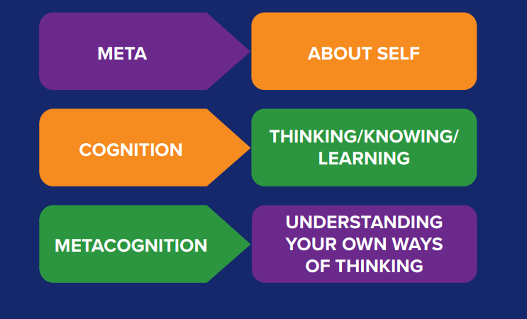
Metacognition
(Thinking About Thinking)
Entrepreneurs must practice reflection, scenario planning, strategy adjustment, and learning from mistakes.
  Before pitching investors, an entrepreneur reframes the business idea to emphasize scalability instead of product features.

Slide 33
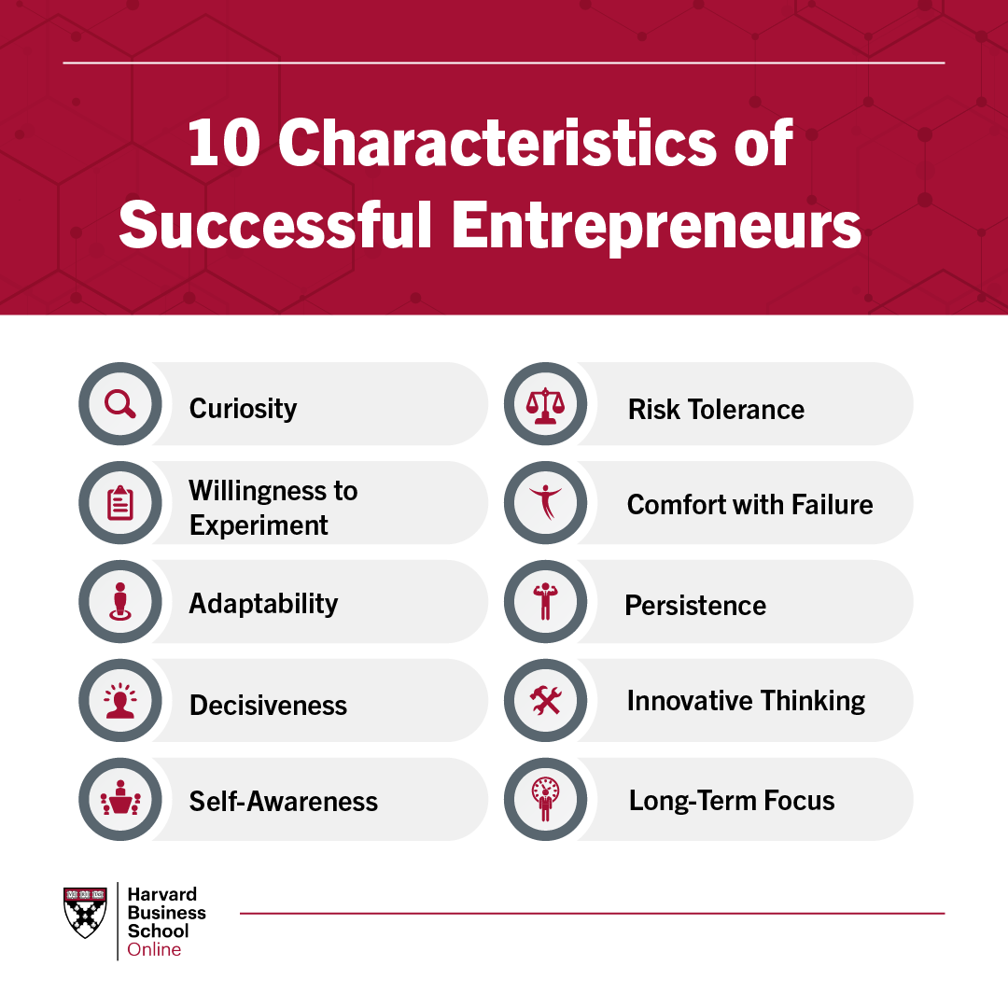
Characteristics of Successful Entrepreneurs
Research identifies common traits among successful entrepreneurs.
  Core Traits Include:
    Determination
    Persistence
    Initiative
    Independence
    Creativity
    Leadership
    Optimism
    Confidence
    Integrity

Slide 34

Characteristics of Successful Entrepreneurs
Research identifies common traits among successful entrepreneurs (cont.).
  High-Impact Mindset Traits
  Opportunity Orientation
    Focus on Possibilities, Not Limitations
  Internal Locus of Control
    Belief the Outcomes Depend on Your Actions
  Tolerance for Ambiguity
    Comfort with Uncertainty
  Calculated Risk-Taking
    Smart – Not Reckless - Decisions
  Vision
    Seeing What Others Don’t Yet See

Slide 35
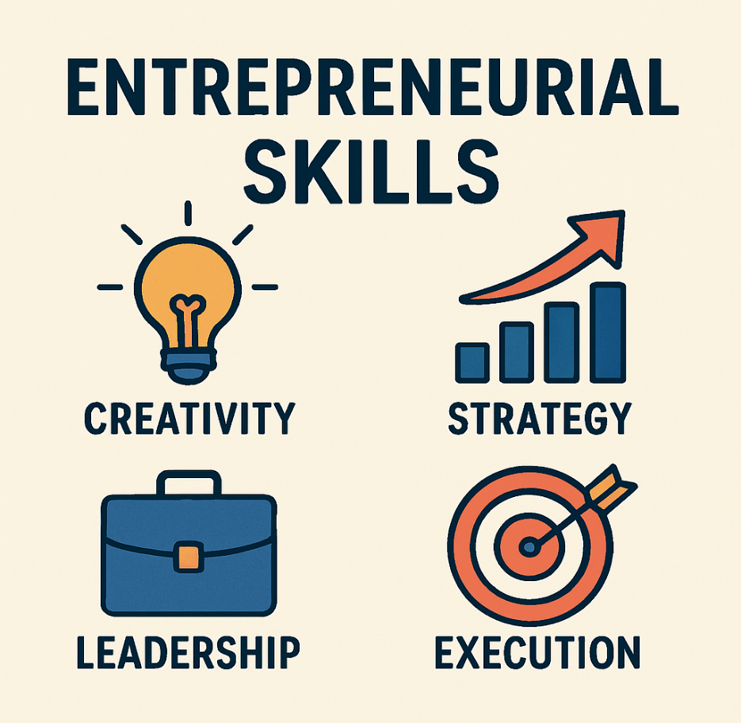
Characteristics of Successful Entrepreneurs
Entrepreneurs must develop these characteristics.
  Side Projects
  Leadership Roles
  Experimentation
  Feedback Loops

Slide 36
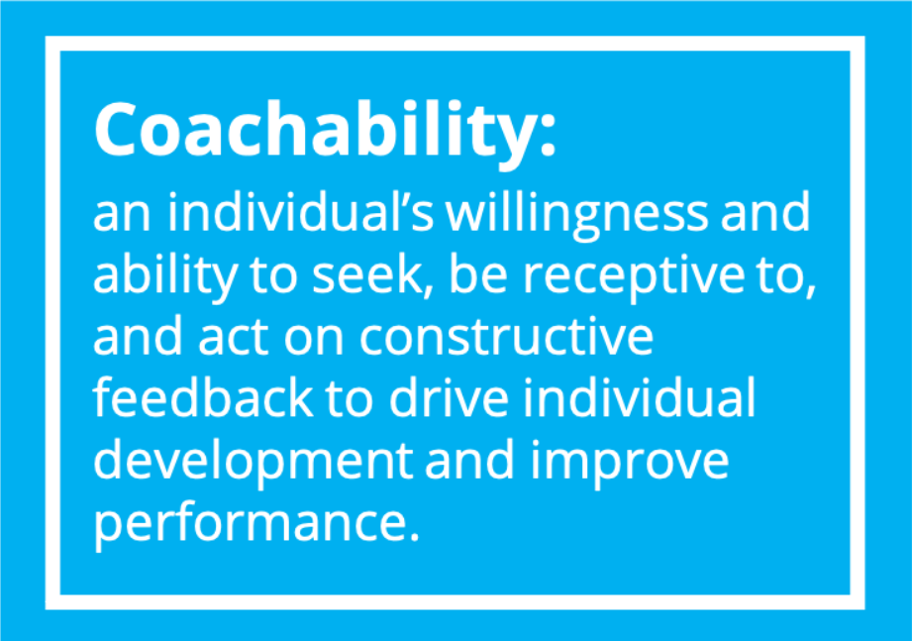

Hustle and Coachability
Entrepreneurial Hustle
  Hustle means acting quickly and creatively under uncertainty.
    Examples include finding customers without marketing budgets, pitching before product completion, and testing ideas rapidly.

Slide 37


Hustle and Coachability
Research shows Entrepreneurial Hustle improves:
  Leadership Perception
  Legitimacy
  Stakeholder Trust
    Instead of waiting for perfect conditions, take small strategic actions immediately.

Slide 38

Hustle and Coachability
Coachability
  Coachability is the ability to:
    Seek Feedback
    Accept Criticism
    Adapt Behavior
    Apply Mentorship Advice

Slide 39

Hustle and Coachability
Highly Coachable Founders:
  Innovate Faster
  Improve Faster
  Succeed More Often
    Ask mentors: “What am I missing?”

Slide 40
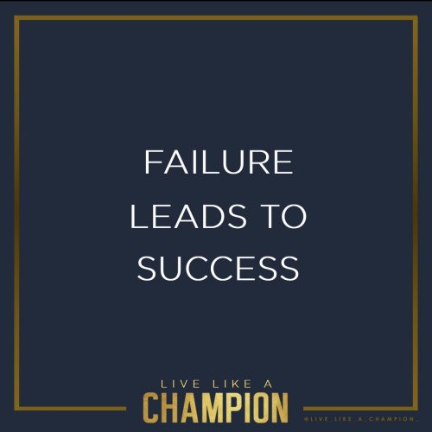
How Entrepreneurs Deal with Failure
Failure is normal in entrepreneurship.
  Successful entrepreneurs:
    Treat Failure as Information
    Process Emotional Grief
    Reflect on Causes
    Adjust Strategy

Slide 41
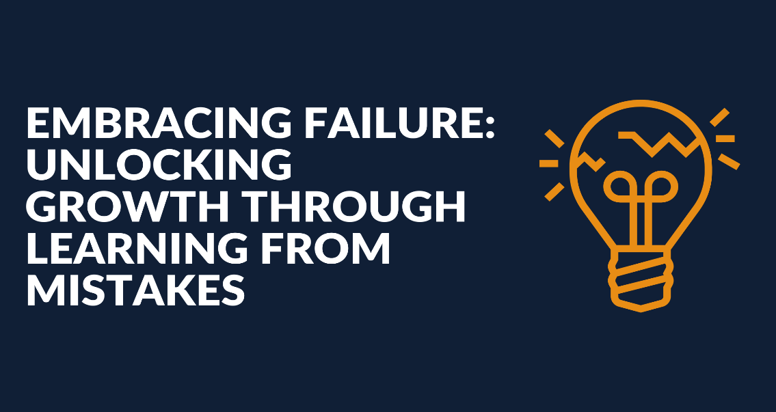
How Entrepreneurs Deal with Failure
Recovery from failure happens through two steps:
  Loss Orientation
    Understand What Failed
  Restoration Orientation
    Move Forward with New Goals

Slide 42


How Entrepreneurs Deal with Failure
After failure, entrepreneurs should ask:
  What worked?
  What didn’t?
  What assumptions were wrong?
  What should I change next time?

Slide 43

The Entrepreneurial Experience
Entrepreneurs are not born finished, they emerge through action.
  Three things develop together:
    Opportunity
    Venture
    Entrepreneur

Slide 44

The Entrepreneurial Experience
Entrepreneurs should start before they feel ready.
  Growth happens during execution.
    A student starting a clothing brand becomes marketer, leader, negotiator, and strategist during the process.

Slide 45

The Dark Side of Entrepreneurship
Entrepreneurial strengths can become weaknesses if unchecked.
  Risks can be mitigated through:
    Developing Partnerships
    Testing Ideas Early
    Keeping a Savings Buffer
    Maintaining Support Systems

Slide 46
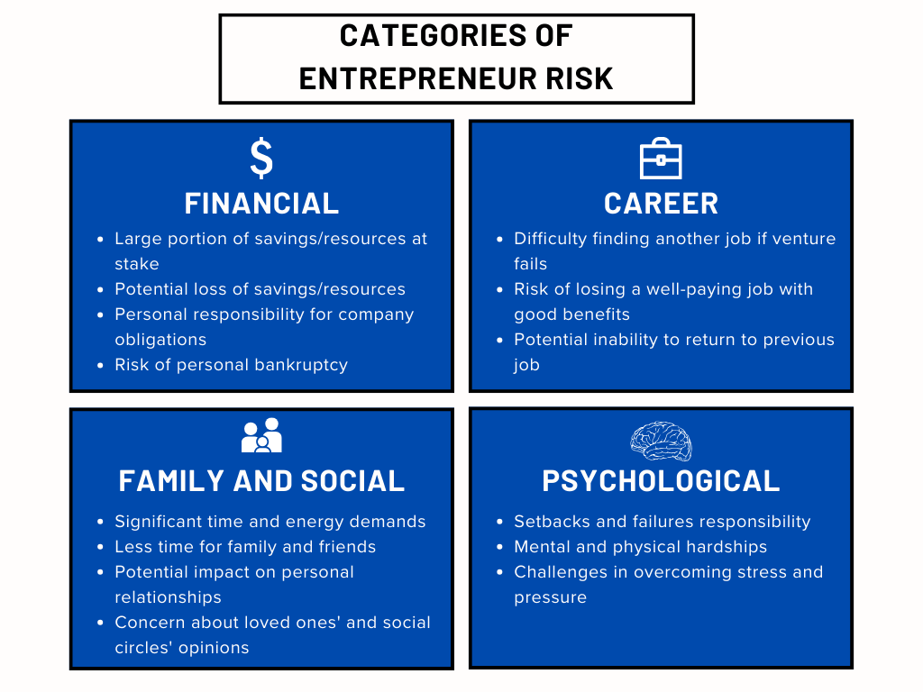
The Dark Side of Entrepreneurship
Types of Risk Entrepreneurs Face:
  Financial Risk
    Loss of Savings or Assets
  Career Risk
    Leaving Stable Employment
  Family and Social Risk
    Reduced Personal Time
  Psychological (Psychic) Risk
    Stress, Anxiety, Identity Loss After Failure

Slide 47

Entrepreneurial Stress
Common causes of entrepreneurial stress:
  Isolation
  Workload Overload
  Responsibility Pressure
  People Management Challenges
  High Achievement Expectations
    Symptoms include insomnia, headaches, burnout, and anxiety.

Slide 48

Entrepreneurial Stress
Ways to manage stress:
  Networking with Other Founders
  Taking Breaks
  Delegating Tasks
  Exercising
  Maintaining Hobbies
  Communicating with Employees
  Seeking Professional Support
    Sleep improves innovation and decision-making.
    Protect sleep like an investment asset.

Slide 49

Ego Risks
(The Hidden Dangers)
Entrepreneurs sometimes develop:
  Excessive Control Needs
    Micromanagement Destroys Teams
  Distrust
    Leads to Poor Collaboration
  Obsession with Success
    Creates Burnout and Poor Decisions
  Unrealistic Optimism
    Ignoring Warning Signs
    Balance Confidence with Evidence

Slide 50

Entrepreneurial Ethics
Ethical Challenges Entrepreneurs Face
  Entrepreneurs Make Decisions Affecting:
    Employees
    Customers
    Investors
    Communities
    Society

Slide 51

Entrepreneurial Ethics
Ethical Dilemmas Occur Because:
  Survival Pressure is High
  Rules are Unclear
  Outcomes are Uncertain
  Stakeholders Have Conflicting Interests
    Example: Using cheaper unsafe materials to stay profitable.

Slide 52

Entrepreneurial Ethics
Entrepreneurs should confirm ethical standards by asking:
  “Is this legal?”
  “Is this fair?”
  “Would I defend this Publicly?”

Slide 53
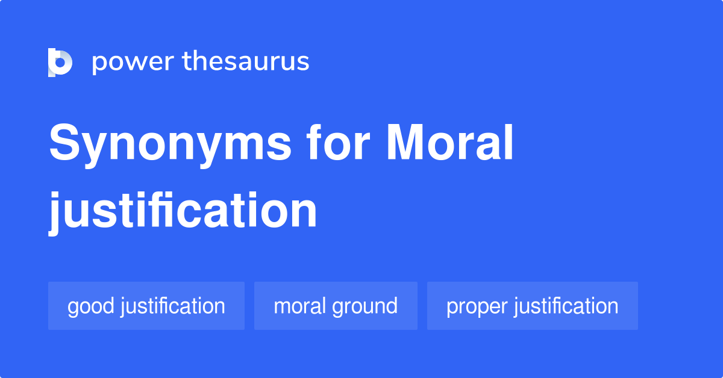
Common Ethical Rationalizations
People justify ethical behavior by saying:
  “It’s not illegal”
  “It helps the company”
  “No one will find out”
  “Everyone does it”
    Recognize these warning signs early.

Slide 54

Ethical Risks in E-Commerce
Online businesses face issues like:
  Fake Reviews
  Misleading Advertising
  Reputation Manipulation
  Data Misuse
    Trust is critical in digital entrepreneurship.
    Transparency builds long-term brand value.

Slide 55

Building an Ethical Venture Strategy
Strong Ethical Organizations include:
  Ethical Consciousness
    Leaders Model Integrity
  Ethical Processes
    Clear Policies and Expectations
  Institutionalization
    Ethics Integrated into Daily Decisions
      Reward Employees for Ethical Behavior – Not Just Performance

Slide 56

Ethical Leadership by Entrepreneurs
Businesses leader behavior shapes culture directly.
  Employees copy what leaders do – not what they say.
  Leaders should demonstrate:
    Honesty
    Fairness
    Accountability
    Responsibility

Slide 57
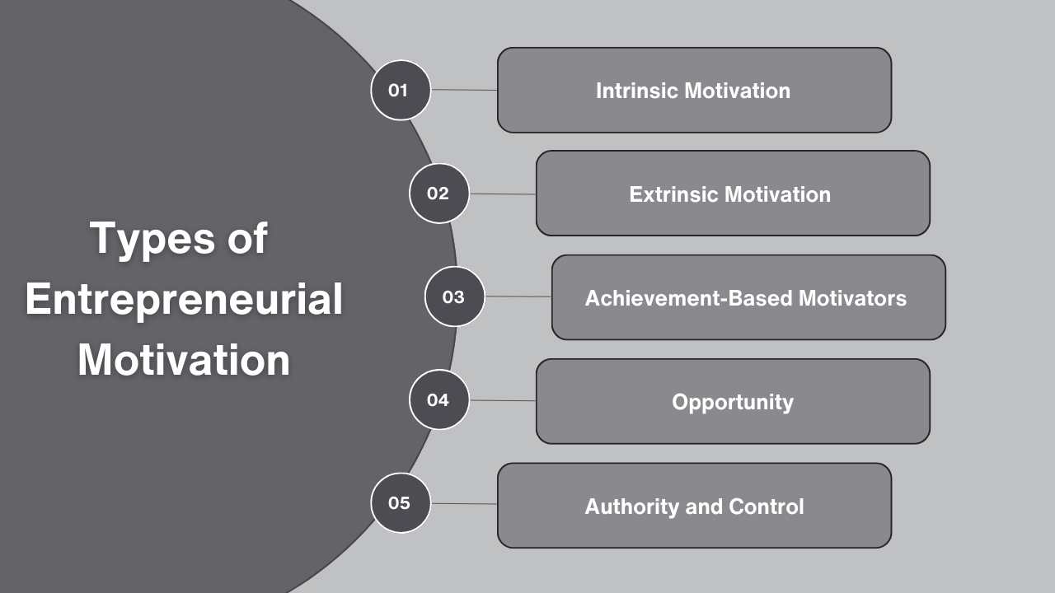
Entrepreneurial Motivation
Entrepreneurs Persist Because of:
  Personal Goals
  Independence
  Achievement Needs
  Opportunity Recognition
  Belief in Outcomes

Slide 58

Entrepreneurial Motivation
Motivation strengthens when results meet expectations. It weakens when:
  Progress Stalls
  Goals Feel Unreachable
  Environment Discourages Effort
    Set realistic milestones to maintain motivation momentum.

Slide 59
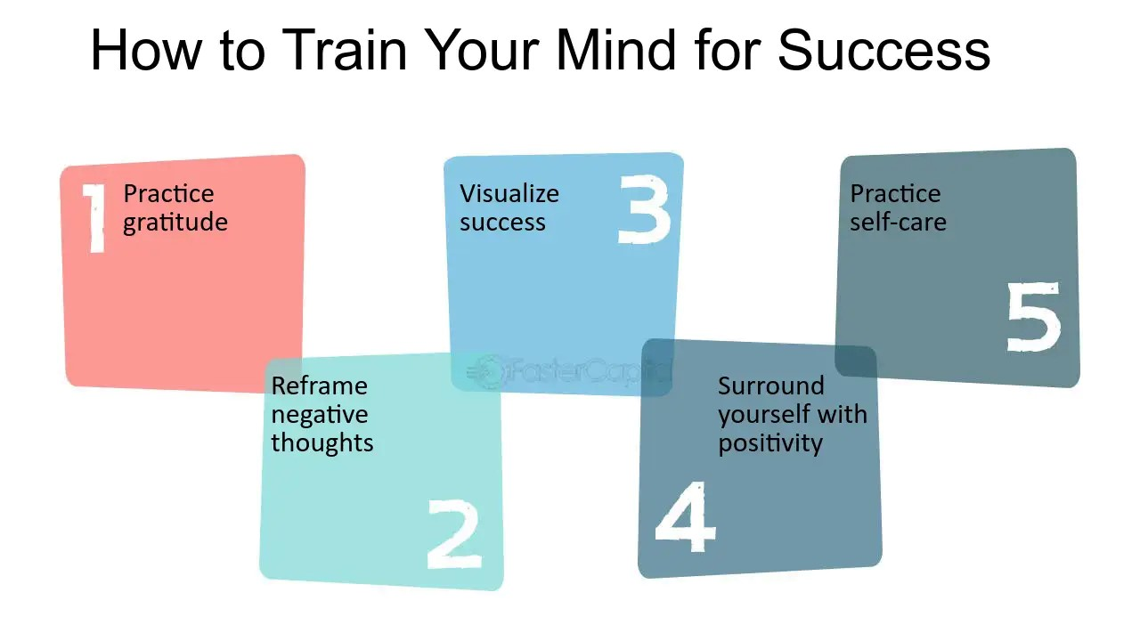
Practical Application
Train Your Mindset
  Practice Opportunity Recognition Daily
    Ask: “What Problem Can I Solve Here?”

Slide 60
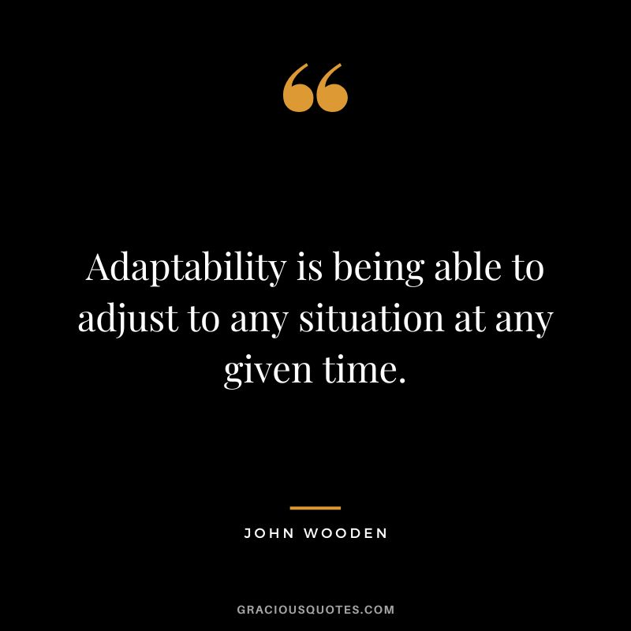
Practical Application
Build Cognitive Adaptability
  Change Strategy When Conditions Change.
    Example: Pivot Business Model After Customer Feedback.

Slide 61

Practical Application
Develop Hustle Habits
  Act Quickly with Limited Resources.
    Example: Launch a Test Version Before Perfecting Product.

Slide 62

Practical Application
Seek Mentorship
  Improve Faster Through Feedback
    Example: Join Startup Incubators or Networking Groups.

Slide 63
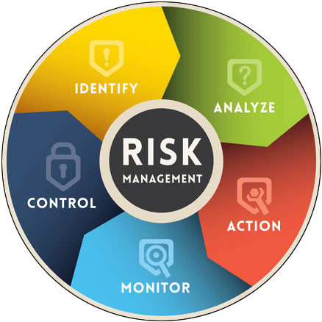
Practical Application
Manage Risk Strategic ally
  Test Before Committing Large Investments
    Example: Validate Demand Before Manufacturing Inventory.

Slide 64
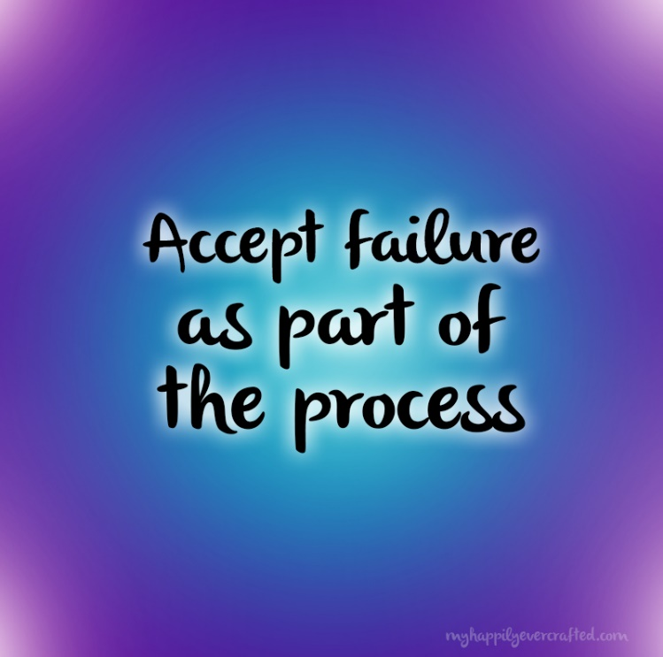
Practical Application
Normalize Failure
  Treat Mistakes as Experiments
    Example: Track Lessons after Each Project Attempt.

Slide 65

Practical Application
Protect Mental Health
  Entrepreneurship is a Marathon, Not a Sprint
    Example: Schedule Recovery Time Intentionally.

Slide 66
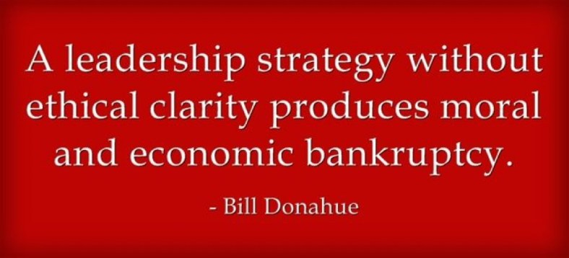
Practical Application
Lead Ethically From Day One
  Ethics Build Long-Term Trust and Sustainability.
    Example: Never Manipulate Customer Reviews, Even If Competitors Do.

Slide 67

Core Insight
Entrepreneurship is not just about starting businesses – it’s about how you think, adapt, persist, manage risk, and lead ethically in uncertain environments.

Slide 68

Corporate Entrepreneurship
Chapter Three
Entrepreneurial Mindset in Organizations
  An entrepreneurial mindset inside organizations means employees and managers think creatively, take initiative, accept calculated risk, and pursue innovation – even within structured corporate systems.

Slide 69

Entrepreneurial Mindset in Organizations
Modern companies must adopt this mindset because:
  Markets Change Rapidly
  Competition is Global
  Technology Evolves Quickly
  Customer Expectations Shift Constantly

Slide 70
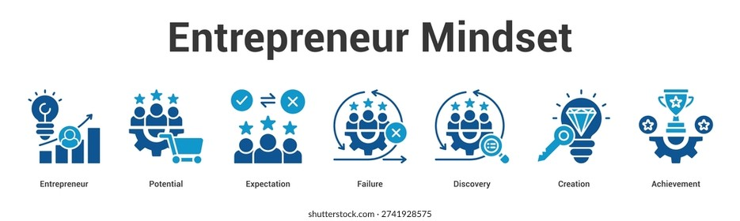
Entrepreneurial Mindset in Organizations
Innovation is no longer optional, it is essential for survival.
  Organizations like Google, 3M, Amazon, and Tesla succeed partly because they embed entrepreneurship internally.
    Example: A retail company encouraging employees to suggest automation improvements in inventory systems is practicing entrepreneurial thinking internally.

Slide 71
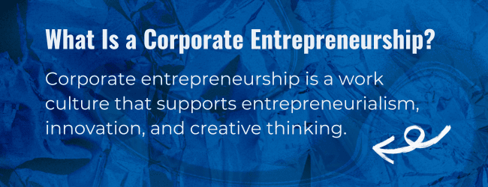
Need for Entrepreneurial Thinking in Organizations
Corporate Entrepreneurship Helps Companies:
  Stay Competitive
  Retain Talented Employees
  Respond to Disruption
  Create New Products and Services
  Improve Efficiency and Productivity
    Without innovation, companies risk stagnation.
    Example: EEs leaving corporations to start a business often do so because their ideas are ignored internally. Companies that support innovations keep this talent.

Slide 72

Definition of Corporate Entrepreneurship
Corporate entrepreneurship refers to innovation activities inside existing organizations that:
  Create New Businesses
  Improve Products and Services
  Redesign Strategy
  Transform Structures or Processes

Slide 73

Definition of Corporate Entrepreneurship
Corporate entrepreneurship includes three major components:
  Corporate Venturing
    Creating new businesses within a company.
  Strategic Renewal
    Reinventing how a company competes.
  Innovation
    Introducing new products, systems, or processes.

Slide 74

Obstacles to Innovation in Corporations
Traditional management practices often unintentionally block innovation. Common barriers include:
  Rigid Procedures
    Blocks Creativity
  Focus Only on Efficiency
    Limits Experimentation
  Fear of Risk
    Prevents Bold Ideas
  Uniform Compensation
    Discourages Extra Effort
  Protecting Existing Business
    Stops Exploration

Slide 75

Reengineering Corporate Thinking
Organizations must shift from bureaucratic control to innovation-friendly cultures.
  Methods Include:
    Identifying Creative Employees Early
    Supporting Ideas from Leadership
    Setting Innovation Goals
    Encouraging Experimentation
    Promoting Collaboration

Slide 76
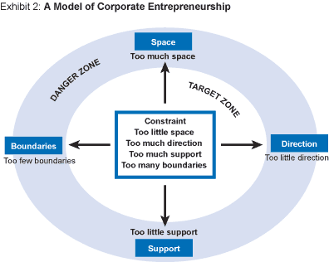
Elements of Corporate Entrepreneurship Strategy
A strong corporate entrepreneurship strategy includes three major elements:
  Entrepreneurial Strategic Vision
    Leadership clearly communicates innovation goals.
  Supportive Organizational Architecture
    Structures that support innovation: flexible policies, funding access, teamwork across departments, and autonomy.
  Entrepreneurial Processes and Behavior
    Employees across all levels actively participate in innovation.

Slide 77
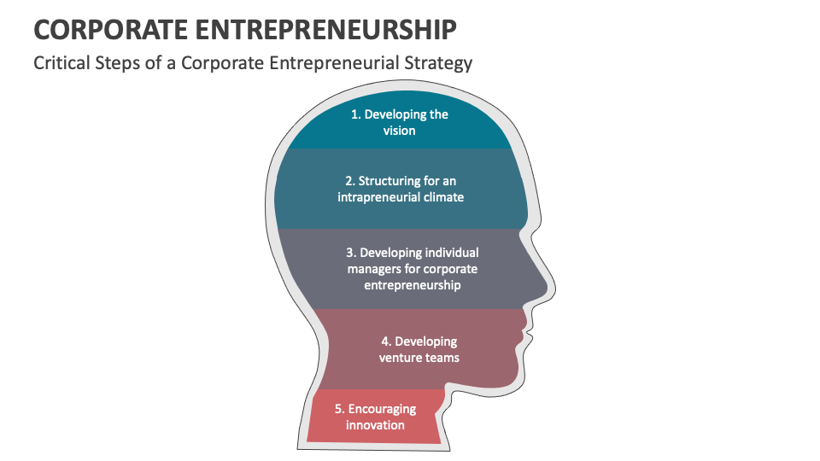
Developing Managers for Corporate Entrepreneurship
Managers must learn how to:
  Think Creatively
  Support Experimentation
  Manage Innovation Teams
  Remove Barriers
  Evaluate Opportunities

Slide 78
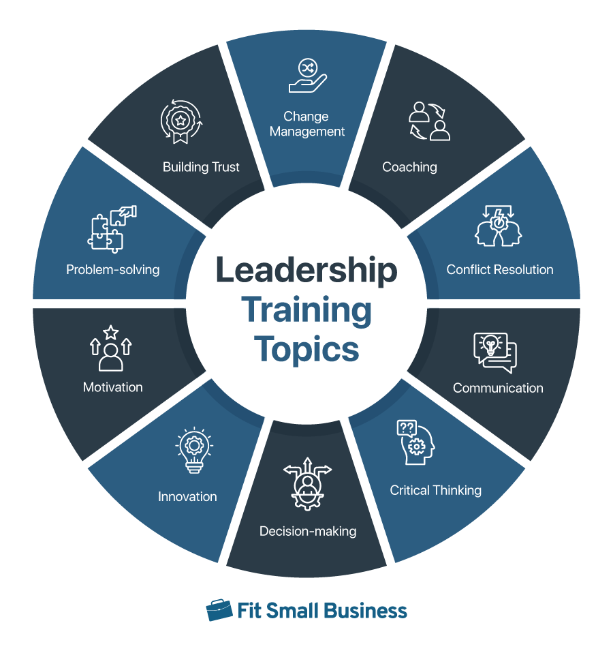
Developing Managers for Corporate Entrepreneurship
Training Programs Often Include:
  Understanding Entrepreneurship
  Innovation Thinking Exercises
  Idea Development Processes
  Barrier Removal Strategies
  Team Collaboration
  Action Planning
    Leadership workshops teaching managers how to support EE ideas increase innovation output.

Slide 79
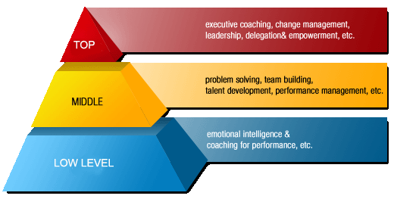
The Interactive Process of Corporate Entrepreneurship
Corporate entrepreneurship is not top-down only, it involves all organizational levels.
  Senior Managers
    Set Vision and Direction
  Middle Managers
    Support and Develop Opportunities
  First-Line Managers
    Experiment and Implement Ideas
      Innovation succeeds when all levels collaborate.

Slide 80
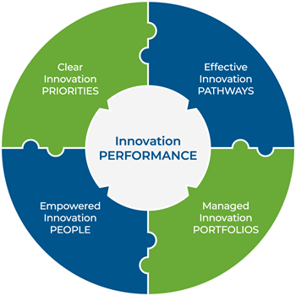
Creating an Innovation-Friendly Environment
Five Key Practices Support Innovation:
  Set Clear Innovation Goals
  Provide Feedback and Encouragement
  Reward Creative Ideas
  Allow Autonomy
  Tolerate Failure
    Companies that punish failed experiments discourage innovation entirely.

Slide 81
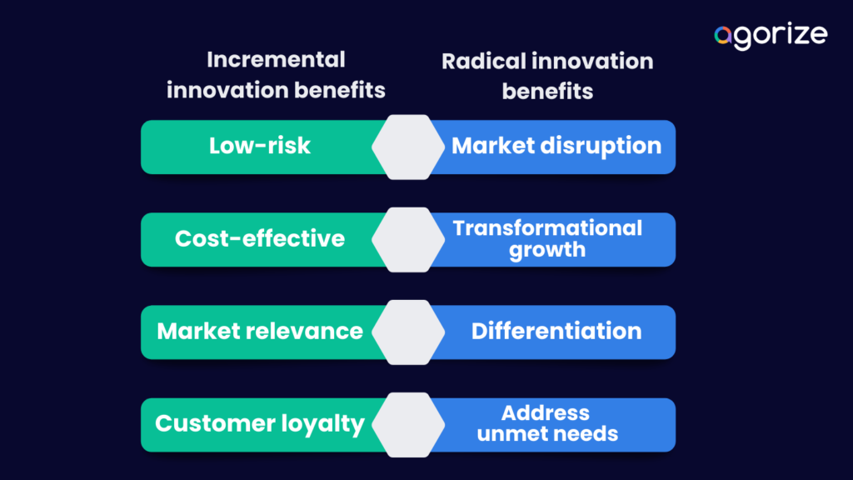
Radical vs. Incremental Innovation
Organizations need both Radical & Incremental Innovation.
  Radical Innovation
    Major Breakthroughs
      Requires Vision and Experimentation
  Incremental Innovation
    Small Improvements Over Time
      Often Easier to Implement But Equally Valuable

Slide 82

Corporate Entrepreneurship Assessment Factors
(CEAI Model)
Five Internal Conditions Influence Innovation Success:
  Management Support
    Leadership Encourages Experimentation
  Autonomy
    Employees Can Make Decisions
  Rewards
    Innovation is Recognized
  Time Availability
    Employees Have Time to Explore Ideas
  Flexible Boundaries
    Departments Collaborate Easily

Slide 83

Innovation Teams
I-Teams
I-Teams are small groups inside organizations that develop new ideas like startups within organizations.
  Characteristics:
    Semi-Independent
    Cross-Functional
    Innovation-Focused
    Flexible Decision-Making

Slide 84

Balancing Control and Autonomy
Successful Organizations Maintain Balance
  Too Little Control = Chaos
  Too Much Control = No Innovation
    Provide Freedom to Experiment but Require Milestone Reporting.

Slide 85
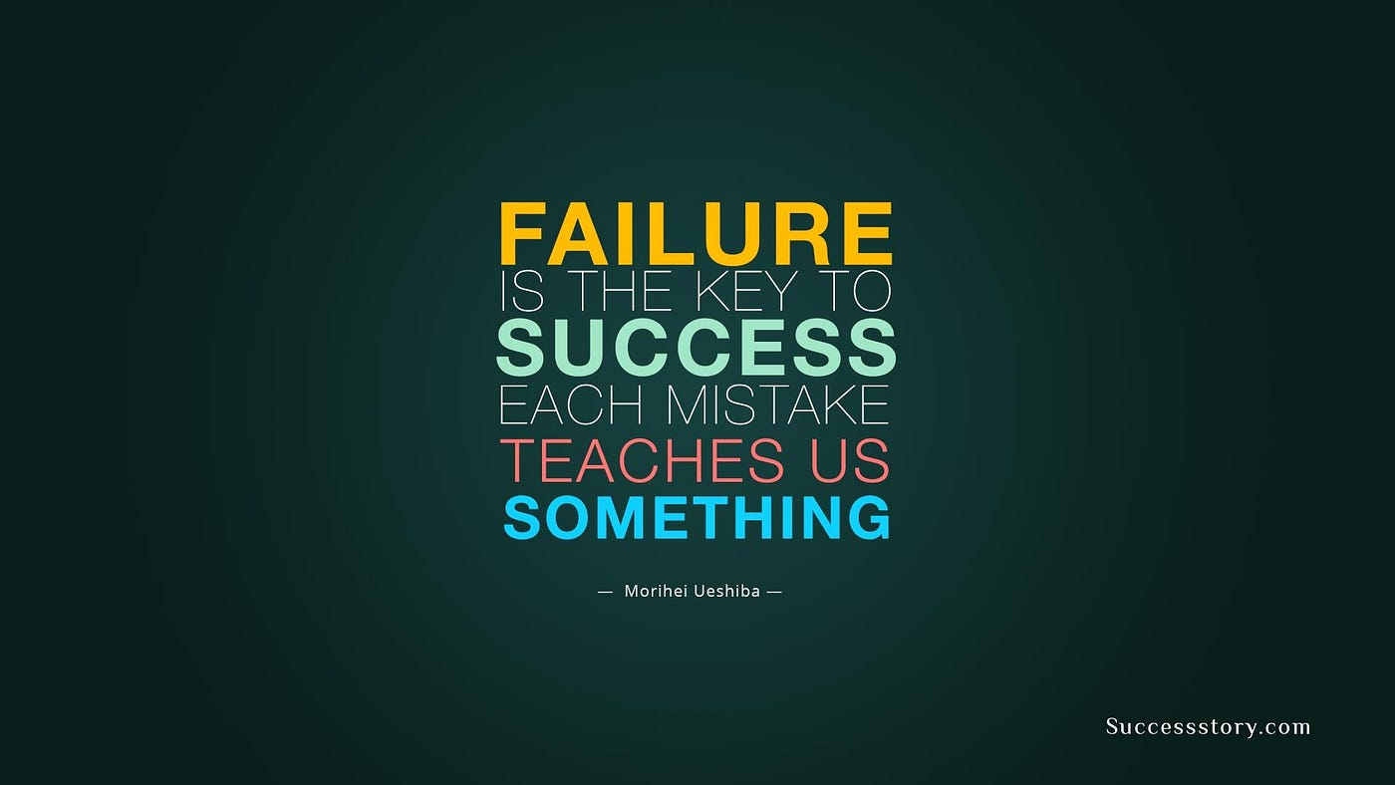
Learning From Failure
Failure is Essential to Innovation.
  Organizations Should:
    Analyze Mistakes
    Support Employees Emotionally
    Extract Lessons
    Encourage Reattempts
      Companies that punish failure discourage creativity.

Slide 86

Sustaining Corporate Entrepreneurship
Long-Term Innovation Requires:
  Leadership Commitment
  Employee Engagement
  Reward Systems
  Flexible Structures
  Continuous Opportunity Evaluation
    Innovation must become part of the organizational culture, not a temporary initiative.

Slide 87

Understanding the Chapter
The chapter argues that corporate entrepreneurship transforms traditional organizations into adaptive, competitive, opportunity-seeking systems.
  Instead of relying only on founders for innovation, modern firms distribute innovation across employees at every level.
    Innovation is not an event, it is a continuous organizational strategy.

Slide 88

Real-World Application
Healthcare Organization
  Encouraging nurses to suggest workflow improvements increases efficiency and patient safety.
Technology Company
  Allowing engineers 10% innovation time leads to new product features.
Retail Business
  Creating a small digital strategy team helps transition to e-commerce faster.
Manufacturing Company
  Cross-department innovation teams reduce production costs through automation ideas.

Slide 89

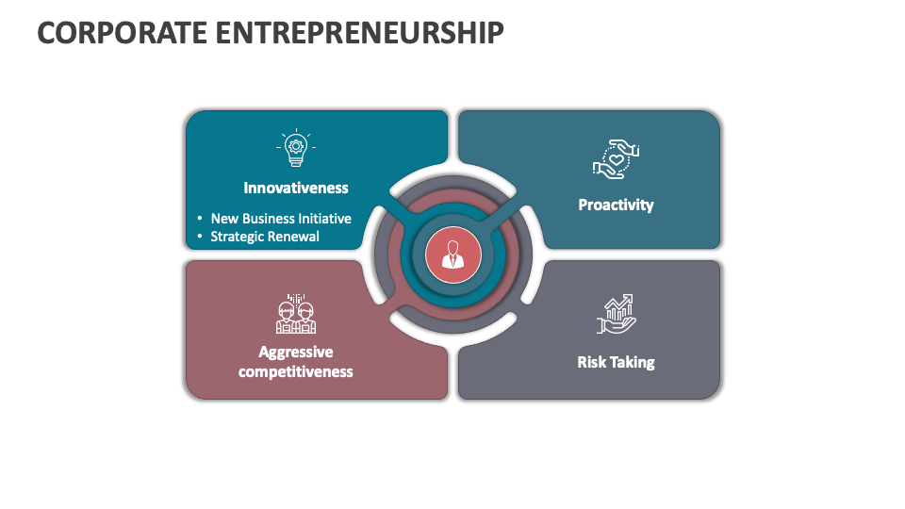
Summary
Corporate Entrepreneurship:
  Promotes Innovation Inside Organizations
  Creates New Ventures Internally
  Improves Strategy and Processes
  Requires Leadership Support
  Depends on Employee Participation
  Balances Autonomy with Control
  Treats Failure as Learning
  Uses Teams to Develop Ideas
  Sustains Competitive Advantage

Slide 90


