Slide 1
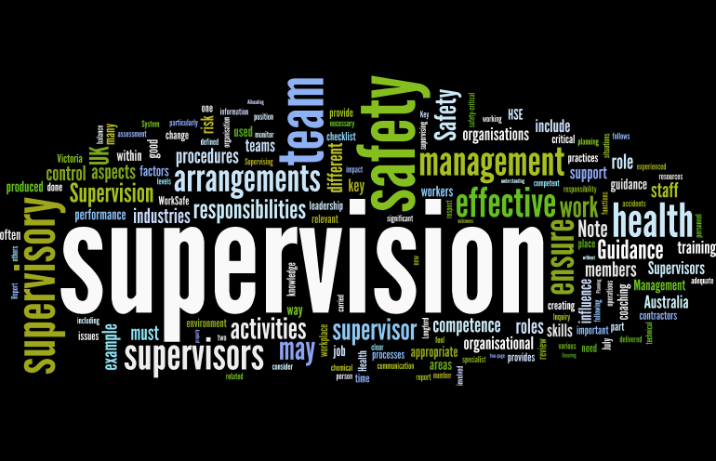
Supervision
Supervision
  Concepts and Practices of Management, 13th Edition
    Edwin C. Leonard, Jr., Ph.D. and Kelly A. Trusty, Ph.D. Cengage Learning, Boston, MA 2013
      ISBN: 978-1-285-86637-6

Slide 2

Part Three: Organizing, Staffing, Managing and Measuring for Success
Chapter Nine: The Principles of Organizing
  After studying this chapter, you will be able to:
    Describe the organizing function of management.
    Discuss the impact of the informal organization and informal group leaders and how supervisors should deal with them.
    Explain unity-of-command and span-of-management principles and applications.
    Justify why a supervisor should strive for the “ideal” organizational structure.
    Compare and contrast departmentalization and alternative approaches for grouping activities and assigning work.
    Assess the implications of downsizing for restructuring and suggest alternatives.
    List major factors contributing to organizing effective meetings, (x) supervisor’s role.

Slide 3

Organizing as an Essential Managerial Function
Organizations have been looking for ways to increase their efficiency by making adjustments to the way they do business.
  For many, this has meant the elimination of jobs and the restructuring of those that remain.
    The challenge for many managers has become that of how to organize so that they can do more with less.

Slide 4

Organizing as an Essential Managerial Function
As one of the five major functions of management, organizing requires every manager to be concerned with building, developing, and maintaining working relationships that will help the organization achieve its objectives.
  Although organizations may have varied objectives and may operate in many kinds of environments, the fundamental principles of organizing are universal.

Slide 5

Organizing as an Essential Managerial Function
A manager’s organizing function consists of designing a structure for grouping activities and assigning them to specific work units (i.e. departments and teams).
  Organizing includes establishing formal authority and responsibility relationships among activities and departments.
    The term organization refers to any group structured by management to carry out designated functions and accomplish certain objectives.

Slide 6

Organizing as an Essential Managerial Function
Management should design the structure and establish authority relationships based on sound principles and organizational concepts, such as unity of command, span of supervision, division of work, and departmentalization.
  Although organizing the overall activities of the enterprise is initially the responsibility of the CEO, it eventually becomes the responsibility of supervisors.
    Therefore, supervisors must understand what it means to organize.

Slide 7

Organizations Are People
People are the substance and essence of any organization, regardless of how the enterprise is structured.
  Managers and supervisors may become preoccupied with developing and monitoring the formal structure and they may neglect the far more important aspect of relationships with and among EEs, which affect the workers and the workplace.

Slide 8
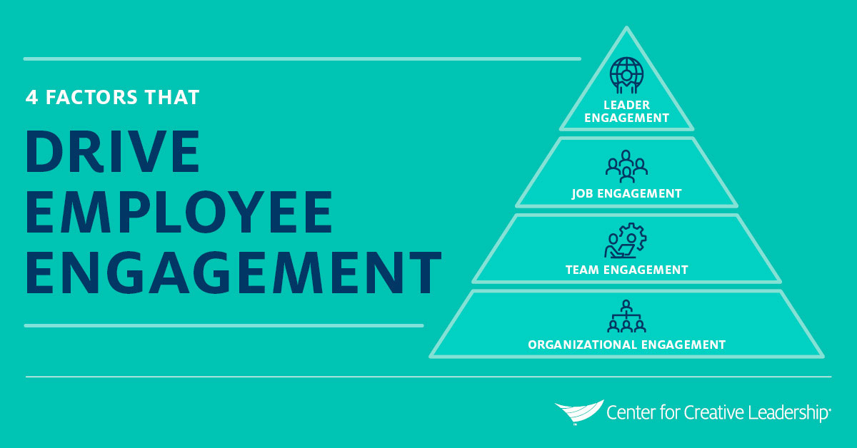
Organizations Are People
Workplace relationships can significantly impact employee engagement.
  Employee Engagement is influenced by their level of belief in the company’s goals, their perceived emotional connection with their employer, the number of obstacles to success they find in their day-to-day work, the availability of resources, ability to maintain energy, whether the workplace has a supportive social environment, and whether they have feelings of accomplishment.

Slide 9


Organizations Are People
Ultimately, most EEs would much rather be part of a team they’re committed to, not just a member of an organization.
  Developing and maintaining a consistent management approach that engenders “esprit de corps” is a key link in the productivity process.
    Such management – balancing appropriate levels of results-orientation with an understanding of EE needs – is neither easy nor unattainable.

Slide 10

Informal Organization
Every enterprise is affected by a social subsystem known as the informal organization, also called the “invisible organization.”
  Whenever people work together, social relationships and informal work groups inevitably arise.

Slide 11
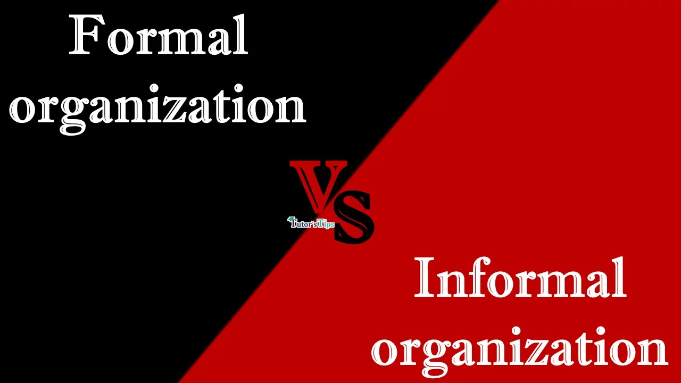
Informal Organization
At the heart of the informal organization are people and their relationships, whereas the formal organization primarily represents organizational structure and flow of authority.
  Supervisors can create and rescind formal organizations they have designed; they cannot eliminate an informal organization because they did not establish it.

Slide 12

Informal Organization
Informal groups arise to satisfy the needs and desires of members that the formal organization does not satisfy.
  Informal organization satisfies members’ social needs by providing recognition, close personal contacts, status, companionship, and other aspects of emotional satisfaction.
    Groups also offer their members other benefits, including protection, security, and support. Furthermore, they provide convenient access to the informal communications network, or grapevine.

Slide 13

Informal Organization
The grapevine provides a communication channel and satisfies members’ desire to know what is going on.
  The informal organization also influences the behavior of individuals in the group.
    For example, an informal group may pressure individuals to conform to the performance standards to which most group members subscribe.

Slide 14

Informal Organization
The Informal Organization and the Supervisor
At different times, the informal organization makes the supervisor’s job easier or more difficult.
  Because of their interdependence, the attitudes, behaviors, and customs of informal work groups affect the formal organization.
    Every organization operates in part through informal work groups, which can positively or negatively impact departmental operations and accomplishments.

Slide 15

Informal Organization
The Informal Organization and the Supervisor
The informal group has potential to influence EEs to strive for work performance targets or restrict production, and cooperate with or reject supervisors, to the point of influencing their removal.
  Supervisors must be aware that informal groups can be very strong and can shape EE behavior to an extent that interferes with supervision.
  Organizational negativity pollutes overall organizational culture, increases stress and EE turnover, and reduces quality of work.
    The negative attitudes that lead to negative behavior patterns are often traced to groups that influence members to conform to group norms.
    The pressures of informal groups can frustrate the supervisor trying to get the results that their managers expect.

Slide 16

Informal Organization
The Informal Organization and the Supervisor
To influence the informal organization to play a positive role, the supervisor first must accept and understand it.
  The supervisor should group EEs so that those most likely to compose harmonious teams work on the same assignments.
  Moreover, the supervisor should avoid activities that would unnecessarily disrupt those informal groups whose interests and behavior patterns support the department’s overall objectives.
    If an informal group is influencing EEs negatively, and to the extent that the department is threatened, a supervisor may have to redistribute work assignments or adjust work schedules, etc.

Slide 17
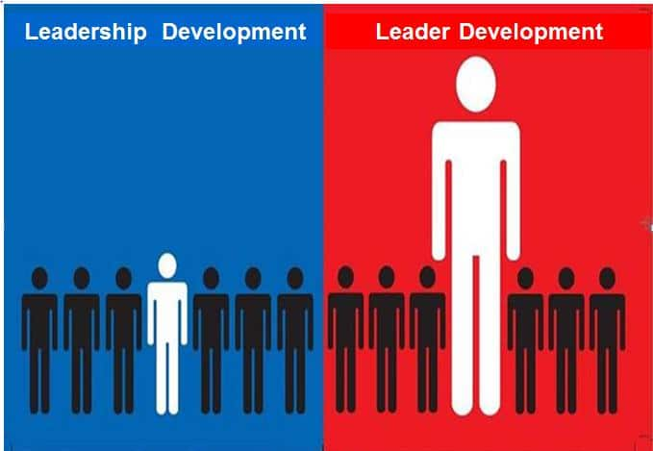
Informal Organization
Supervising and Informal Work-Group Leaders
Most informal work groups develop their own leadership.
  An informal leader may be chosen by the group because they are well-liked or very knowledgeable, or the leader may assume leadership by being an effective spokesperson for the group.
    Work group leaders play significant roles in both formal and informal organizations; without their cooperation, the supervisor may have difficulty controlling the performance of the department.

Slide 18


Informal Organization
Supervising and Informal Work-Group Leaders
A sensitive supervisor will make every effort to gain cooperation and goodwill of informal leaders of different groups and will solicit cooperation in furthering departmental objectives.
  When approached properly, informal leaders can help supervisors, especially as channels of communication.
    Informal leaders may be viable candidates for supervisor understudies. However, it is questionable whether these people can function as informal leaders once designated as understudies.

Slide 19

Informal Organization
Supervising and Informal Work-Group Leaders
Instead of viewing informal leaders as “ringleaders,” supervisors should consider them EEs who have influence and who are “in the know,” and then try to work with them.
  For example, to try to build good relationships with informal leaders, a supervisor may periodically give them information before anyone else or ask their advice on certain problems. However, the supervisor must be careful to avoid having informal leaders lose status in their groups because the leaders’ close association with the supervisor is being observed and could be interpreted negatively by EEs.
  Similarly, the supervisor should not extend unwarranted favors to informal leaders as this could undermine their leadership.
    The supervisor should look for subtle approaches to have informal groups and their leaders dovetail their special interests with the firm’s activities.

Slide 20

Unity of Command
Employees need to know what is expected of them and to whom they report.
  Generally, people cannot serve two masters, and the masters can effectively manage only a limited number of people.

Slide 21

Unity of Command
The CEO groups the activities of the organization into divisions, departments, services, teams, or units and assigns duties accordingly.
  Upper-level management places managers and supervisors in charge of divisions - departments and defines their authority relationships.
  Supervisors must know who their managers and subordinates are.
    To arrange authority relationships this way, management follows the unity-of-command principle, which holds that each EE should report directly to only one immediate supervisor. That is, there is only one person to whom the EE is directly accountable.

Slide 22

Unity of Command
While formal communication and the delegation of authority normally flow upward and downward through the chain of command, there are exceptions, such as in functional authority and the matrix organizational structure.
  Similarly, task forces, project groups, and special committees may blur the unity-of-command concept.

Slide 23

Unity of Command
Having more than one boss usually leads to unsatisfactory performance by the EE due to confusion over who is in charge.
  A supervisor should make certain that, unless there is a valid reason for an exception, only one supervisor should direct an EE.

Slide 24
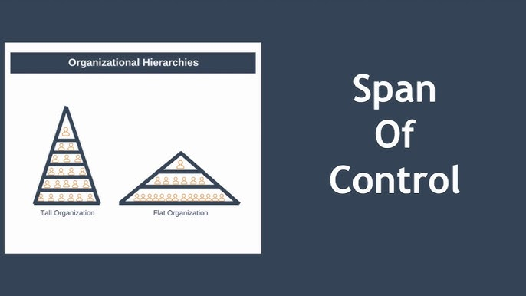
Unity of Command
The Span-of-Management Principle
    There is an upper limit to the number of EEs a supervisor can manage effectively. This principle is called the span of control.
  Because no one can manage an unlimited number of people, the CEO must organize divisions and departments as separate operating units and place managers and supervisors in charge.
    The CEO delegates authority to managers, who then delegate authority to supervisors, who, in turn supervise the EEs.

Slide 25

Unity of Command
The Span-of-Management Principle
Most top-level executives have from three to eight subordinate managers, and the span of management usually increases the lower a person descends in the managerial hierarchy.
    A span of management between 15 and 25 is not uncommon at the first level of supervision.

Slide 26

Unity of Command
The Span-of-Management Principle
There has long been a question concerning the link between organizational size and organizational performance.
  The economic law of diminishing returns has been applied to suggest that size can impact organizational efficiency.
    However, the “optimal size” for a firm has never been defined; the answer remains elusive.

Slide 27

Unity of Command
Factors Influencing the Span of Management
The number of EEs one person can supervise effectively depends on a number of factors, such as:
  Supervisory Competence
  Specialized Staff Assistance
  Employee Abilities
  Employee Location
  Nature and Complexity of Activities
  Objective Performance Standards
    There must be a weighing, or balancing, of the factors listed above, to arrive at an appropriate span of management for each supervisor.

Slide 28

Unity of Command
How Managerial Levels, Unity of Command, and Span of Management Relate
It is generally accepted that “one-person-one-boss” should be the standard.
  But some organizations have created another level, the lead person, often called the “working supervisor.” A lead person is not usually considered a part of management.
    Although the authority of these individuals is somewhat limited, particularly in EE evaluation and discipline, they perform most managerial functions.

Slide 29

Unity of Command
How Managerial Levels, Unity of Command, and Span of Management Relate
While it may be desirable to use “leads,” it is not without disadvantages.
  One can easily see how an EE might view the lead person as a great communicator, with greater skills, knowledge, abilities, (SKAs) and competency than supervisor.
    Suddenly, the lead person becomes the unofficial supervisor and lines of leadership and authority are blurred.

Slide 30

Unity of Command
How Managerial Levels, Unity of Command, and Span of Management Relate
In summary, other things being equal, the narrower the spans of management, the more managerial levels are needed.
  Organizational structures are taller when spans of management are narrower, and structures are flatter when spans are wider, especially at the supervisory level.
    Adding levels can be costly and can complicate communication and decision making. On the other hand, reducing levels may widen the spans of management to the extent supervisors become overburdened and can’t maintain adequate control of EEs and departmental activities.

Slide 31
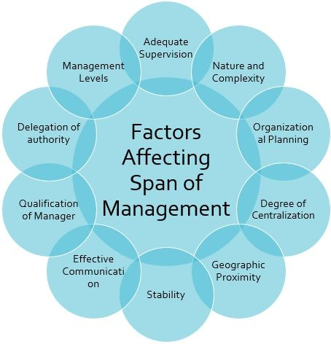
Unity of Command
How Managerial Levels, Unity of Command, and Span of Management Relate
The managerial problem is to decide which is better: a broad span with few levels or a narrow span with more levels.
  This important question often confronts upper management.
    A first-line supervisor does not normally face this question, but supervisors should understand how it influences the design and structure of their organization.

Slide 32

Planning the “Ideal” Departmental Structure
Supervisors should think of an ideal departmental structure – a structure the supervisor believes can best achieve the department’s objectives.
  The supervisor should plan the departmental structure based on sound organizational principles, not personalities.
    If the organization is planned primarily to accommodate current EEs, shortcomings will likely persist.

Slide 33

Planning the “Ideal” Departmental Structure
When a department is structured around one EE or a few, serious problems can occur when key EEs are promoted or leave.
  When departments are organized according to activities and functions, the company can seek qualified EEs.

Slide 34

Planning the “Ideal” Departmental Structure
While CEOs continually search for ideal organizational structure, they often neglect a key component, that is, the concept of a learning organization.
  In “The Fifth Discipline,” Peter Senge describes learning organizations as places “where people continually expand their capacity (SKAs) to create results they truly desire, where new and expansive patterns of thinking are nurtured, where collective aspiration is set free, and where people are continually learning to see the whole together.”

Slide 35
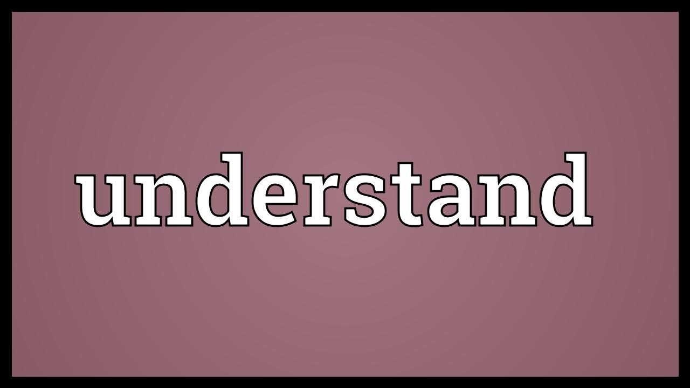
Approaches to Structuring Work
It is important for managers, supervisors, and EEs to understand how their positions and responsibilities relate to the positions and responsibility of other EEs.
  Organizational charts, job descriptions, job specifications and manuals can help EEs understand their positions and the relationships among various departments and jobs.

Slide 36
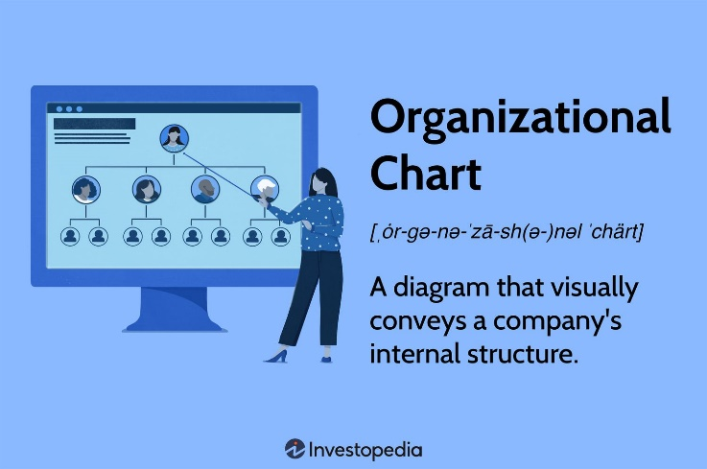
Approaches to Structuring Work
In planning their organizational structures, many companies develop organizational charts for all parts of their operations.
  An organizational chart is a graphic portrayal of organizational authority and responsibility relationships using boxes, etc.
    The graphic elements of organizational charts are usually interconnected to show the grouping of activities that make up a department, division, or section. Each box normally represents one position category, although several EEs may be included in a position category.

Slide 37
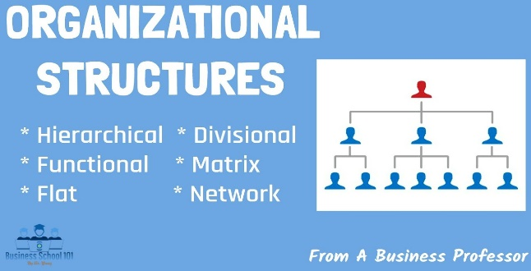
Approaches to Structuring Work
By studying the relationships of categories, anyone can readily determine who reports to whom.
  Historically, organizational charts have been constructed vertically, arranged in a pyramid shape, reflective of a hierarchal organizational structure. In the past decade, however, an increasing number of firms’ organization charts, primarily those with focus on innovation, reflect a “flattened” structure, one with fewer hierarchal levels and decision-making authority distributed across levels of organization.
    The arrangement of an organization chart can provide a great deal of insight about how power is distributed, how decisions are made, and how work and information flows throughout an organization.

Slide 38

Approaches to Structuring Work
A Job Description identifies the job’s principle elements, duties, and scope of authority and responsibility.
  Job Specifications refer to the skills, knowledge, and abilities (SKAs), personal qualifications, that are needed to perform the job.
    Job specifications are typically included as part of the job description.

Slide 39
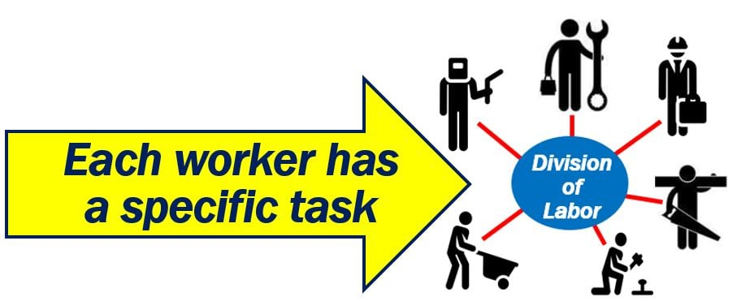
Approaches to Structuring Work
The question of how to develop an organizational chart begins w/ analysis of what work needs to be done by when and by whom.
  The organizational structure is influenced largely by the principle of division of work (specialization). This principle holds that jobs can be divided into smaller tasks, which allows EEs to specialize in narrower areas of their fields.
    EEs can then master these smaller tasks and produce more efficiently.

Slide 40

Approaches to Structuring Work
Departmentalization is the process of grouping activities and people into organizational units, usually known as departments.
  A department is a set of activities and people over which a manager or supervisor has responsibility and authority.
    Most organizations have departments because the division of work and specialization enhance efficiency and results.

Slide 41

Approaches to Structuring Work
The formal organizational structure is based on a company’s number and types of departments, positions and functions, and authority and reporting relationships.
  Supervisors may confront the need to departmentalize their areas, so they should be familiar with the alternatives for grouping activities.
    Departmentalization is usually done according to function, products or services, geographic location, customer, process and equipment, or time.

Slide 42
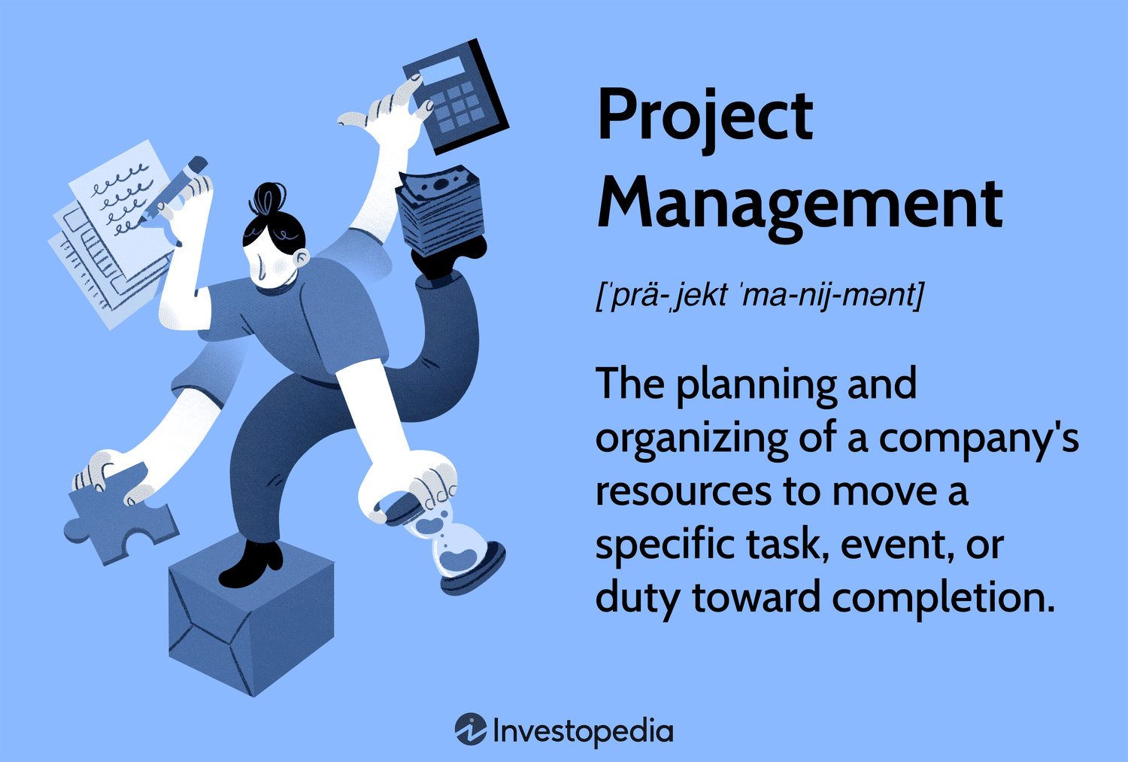
Approaches to Structuring Work
The Project Management Structure
The need to coordinate activities across departments has contributed to the development of the project management-type organizational structure, also called a matrix structure.
  The project management-type structure, adds horizontal dimensions to the vertical (top-down) orientation of the organizational structure.
    It is a hybrid in which both regular (functional) line and staff departments coexist with project teams or group assignments across department lines.

Slide 43

Approaches to Structuring Work
The Project Management Structure
Project structures enable managers to undertake several projects simultaneously, some of which may be of a relatively short duration.
  Each project is assigned to a project manager who manages the project from inception to completion.
    EEs from different functional departments are assigned to work on each project as needed, either part time or full time.

Slide 44

Approaches to Structuring Work
The Project Management Structure
Project managers are responsible for coordinating activities on their designated projects.
  However, project managers must work closely with departmental supervisors.
    The EEs who work in these departments report directly (functionally) to the departmental supervisors, but their services are used under the authority and responsibility of the project managers to whom they are assigned for varying periods.

Slide 45
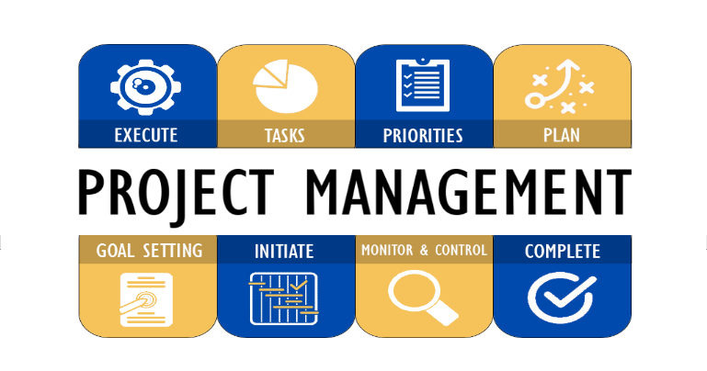
Approaches to Structuring Work
The Project Management Structure
Several problems are associated with the project management-type organizational structure.
  The most frequent is direct accountability. The matrix structure violates the principle of unity of command because departmental EEs are accountable to a departmental supervisor and project managers. Other problems involve scheduling EEs who are assigned to several projects.
    These problems can be avoided, or at least minimized, by planning properly and clarifying authority relationships before the project starts.

Slide 46

Approaches to Structuring Work
Work Assignments and Organizational Stability
Supervisors are challenged more frequently by the problem of how and to whom to assign work than by the problem of how to organize departments.
  How and to whom to assign work involves differences of opinion.
    The assignment of work should be justifiable and explainable on the basis of good management rather than personal likes and dislikes or intuition.

Slide 47

Approaches to Structuring Work
Work Assignments and Organizational Stability
The supervisor is subject to pressures from different directions.
  Some EEs are willing and want to assume more work, while others believe they should not be burdened by additional duties.
    One of the supervisor’s most important responsibilities is to assign work so everybody has a fair share and do their part equitably and satisfactorily.

Slide 48

Approaches to Structuring Work
Work Assignments and Organizational Stability
A supervisor’s task of assigning departmental work is easier when the supervisor consistently uses the strengths and experiences of all EEs.
  However, supervisors are often inclined to assign heavier and more difficult tasks to capable EEs who are the most experienced.
    Over the long term, it is advantageous to train & develop less experienced EEs so that they, too, can perform difficult jobs.

Slide 49

Approaches to Structuring Work
Work Assignments and Organizational Stability
The principle of organizational stability advocates that no organization should become dependent on one or several key “indispensable” individuals whose absences or departures would disrupt the organization.
  Organizations need enough EEs who have been trained well and have flexible skills.
    One way to develop such flexibility is to assign EEs to different jobs in the department temporarily.

Slide 50

Approaches to Structuring Work
Work Assignments and Organizational Stability
At times, a supervisor may have to hire temporary EEs to meet workload demands for a project or other needs.
  Temporary EEs can be helpful when given work assignments they can complete and when they do not cause disruptions or disagreements with permanent EEs.
    Some temporary EEs prove themselves so competent that supervisors seek to hire them for permanent positions.

Slide 51

Approaches to Structuring Work
Authority and Organizational Structures
Once management establishes departments, it must set and clarify relationships among and within the departments.

Slide 52
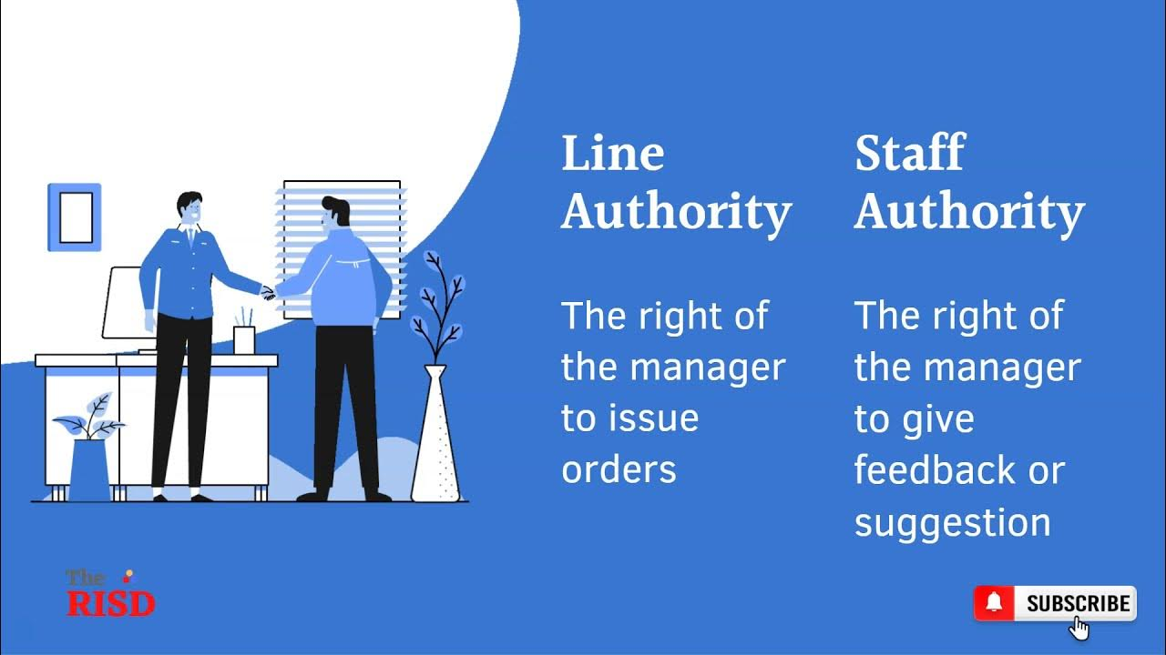
Approaches to Structuring Work
Authority and Organizational Structures
Every organization has a vertical, direct line of authority that can be traced from the CEO to departmental EEs.
  Line authority provides the right to direct others and requires them to conform to company decisions, policies, rules, and objectives.
    Line authority establishes who can direct whom in the organization.

Slide 53
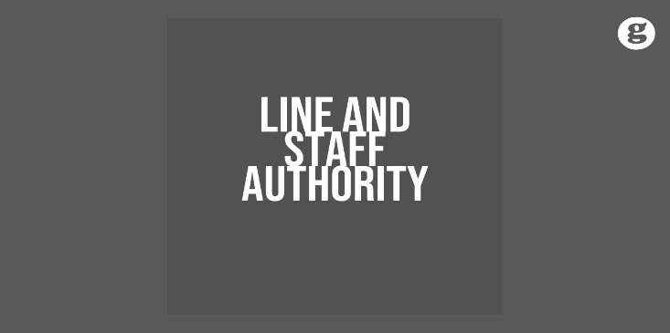
Approaches to Structuring Work
Authority and Organizational Structures
Line supervisors cannot be expected to direct subordinates adequately and expertly in all phases of operations without some assistance.
  In order to perform their managerial functions, line supervisors need the assistance of specialists who have been granted staff authority.
    Staff authority refers to the right and duty to provide counsel, advice, support, and service regarding policies, procedures, technical issues, and problems in a person’s area of expertise.

Slide 54
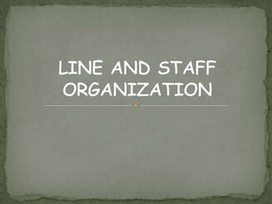
Approaches to Structuring Work
Authority and Organizational Structures
Most organizations use a line-and-staff type organizational structure.
  Human resources and accounting departments, usually are classified as staff since they mainly support other departments.
    For the most part, staff supervisors lack direct authority to order line EEs to conform to policies and procedures - they primarily counsel and advise.
    Line supervisors can accept the staff person’s advice, alter it, or reject it, but because the staff person is usually the expert in the field, supervisors typically accept, and even welcome, the staff person’s advice.

Slide 55

Approaches to Structuring Work
Authority and Organizational Structures
There is no one best way to organize. Organizational theorists contend that structure should follow strategy.
  Intense competition for the consumer dollar, rising resource costs, globalization, and a search for ways to increase profitability is leading many organizations to alter their strategies.
    The authors contend, “Organizations tend to be more effective when they are structured to fit strategic change and demands of the situation.”

Slide 56

Organizational Principles in an Era of Organizational Downsizings
Management often resorts to restructuring and/or downsizing in order to reduce costs, streamline operations, and become more efficient and competitive.
  The major organizational impact of downsizing is a reduction of staff, middle-level managers, and the removal of organizational levels.
    For supervisors and other managers who survive downsizing, the span of management usually widens.

Slide 57

Organizational Principles in an Era of Organizational Downsizings
Alternatives to Downsizing
Proponents of downsizing and restructuring have typically advocated EE empowerment and engagement.
  Empowerment essentially means delegating sufficient authority to EEs to allow them to make decisions and become more involved in achieving organizational objectives.
    Engagement means that the EE is fully involved in, and enthusiastic about their work.

Slide 58

Organizational Principles in an Era of Organizational Downsizings
Alternatives to Downsizing
Nothing is more important than getting EEs committed to expanding opportunities that reorganization might bring.
  Studies show that job satisfaction increases if EEs have more opportunities to use their SKAs and if career development and skills training accompany reorganization.

Slide 59
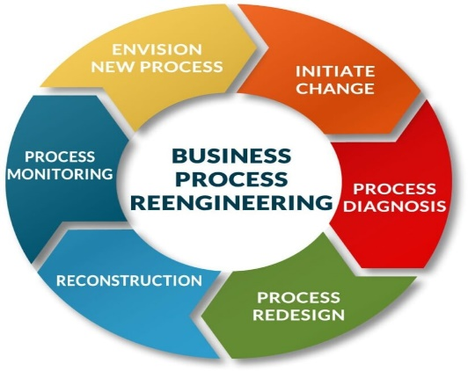
Organizational Principles in an Era of Organizational Downsizings
Alternatives to Downsizing
Some firms have tried reengineering, whereby they restructure based more on process than on department or function.
  Reengineering requires supervisors and EEs to focus on customer needs and services rather than on functions and specialties.
    (x) Little Caesars worked with a consulting company to reengineer pizza preparation processes, such as distance a worker has to walk each week while making and serving pizzas, in order to increase efficiency and customer satisfaction.

Slide 60

Organizational Principles in an Era of Organizational Downsizings
Alternatives to Downsizing
Some authorities have suggested that reengineering will require “process managers,” who will manage key processes and whose broadened responsibilities will cut across line and staff functions and organizational levels.
  When carried out, reengineering could create what has been called the horizontal corporation, in which organizational structures flatten and managerial authority relationships are minimal.

Slide 61

Organizational Principles in an Era of Organizational Downsizings
Alternatives to Downsizing
Making the decision to downsize an organization is not easy, and sometimes strategies are put in place that can produce increased efficiency & effectiveness without the need to eliminate workers.
  Decision makers should resist making drastic personnel changes without first exploring other options that will keep workers engaged.
    Research shows that presumed economic advantages of downsizing are not always realized, and often organizations are left with a demoralized workforce, which can breed a whole new collection of problems.

Slide 62

Organizational Principles in an Era of Organizational Downsizings
Alternatives to Downsizing
Regardless of whether we want them, radical company restructurings will become more commonplace.
  Organizational principles will always be part of supervision and any organizational change will require supervisors to understand how to apply and adapt certain organizational principles.

Slide 63

Organizing for Effective Meeting Management
Electronic messaging or instant messaging (IM) systems are not the complete answer to effective supervision. But they have become a form of real time direct communication.
  Corporate intranets, chat rooms, and IM are forms of synchronous communications. The sessions are live, and each user can respond to others in real time.
    While these, along with email and the wide collection of collaboration software available, are ways to supply information people need to perform their jobs and to share ideas and opinions, face-to-face meetings can sometimes be the most effective way to achieve organizational objectives.

Slide 64

Organizing for Effective Meeting Management
Many work teams have experimented with meeting facilitators.
  The group leader or the supervisor does not conduct the meeting. This role falls to the facilitator, a function that is often rotated among team members.
    This approach allows the supervisor to observe, listen, and ask probing questions of team members. In addition, team members gain leadership experience.

Slide 65

Organizing for Effective Meeting Management
The meeting chairperson or facilitator must be skilled at keeping the meeting focused.
  The meeting chairperson is ultimately responsible for the meeting’s effectiveness.
    Their general approach is crucial. They set the tone for the meeting and should model expected meeting etiquette and behaviors.

Slide 66

Organizing for Effective Meeting Management
Along with ensuring that attendees are tuned in to the meeting - no distractions (i.e. cell phones), the chairperson should also encourage everyone to be involved.
  Initially, everyone’s contribution should be accepted w/out judgment, and everyone should feel free to participate.
    The chairperson may have to ask controversial questions to start the discussion and participation. This is often done by asking provocative, open-ended questions that use words like who, what, when, where, why. Questions that can be answered with a “yes” or “no” should be avoided.

Slide 67

Organizing for Effective Meeting Management
The supervisor is responsible for giving and getting information.
  To get information or to open discussion on a particular topic, the supervisor might want to ask: who, what, when, where, why questions before getting to the how.

Slide 68

Organizing for Effective Meeting Management
Another technique is to start at one side of the conference table and ask members to express their thoughts on problem in turn.
  While this approaches forces everyone to participate, it discourages spontaneous participation and allows the rest of the group to sit back and wait until called upon.
    This approach also may cause some individuals to take a stand on an issue before they are mentally prepared to do so.

Slide 69

Organizing for Effective Meeting Management
The chairperson should appoint someone, for example, a scribe or note-taker, to record what happened during the meeting.
  Before adjourning the meeting, the chairperson may have the scribe orally summarize the key points of the meeting, describe the chosen action, and confirm that participants are in agreement on the essence of the meeting.
    This process gives all a chance to review and agree on what took place.

Slide 70

Organizing for Effective Meeting Management
The chairperson should see to it that every participant gets the written summary, or minutes.
  The summary should also be distributed to all other personnel who have a need to know what took place or who and what is essential in accomplishing the necessary actions.
    The meeting action summary should list actions to be taken by the group, assign accountability (who is to do what by when), and become a record for follow up and feedback.

Slide 71

Organizing for Effective Meeting Management
The written summary also serves as a permanent record or guideline for future situations involving similar circumstances.
  If some matters are left undecided, the summary can provide a review of the alternatives that were discussed to help crystallize the thinking of participants.
    For permanent standing committees, such as the organization’s safety committee, it is advisable to use the summary to announce when the group shall meet next.

Slide 72

Organizing for Effective Meeting Management
Remember: None of us is as smart as all of us.
  A group of individuals exchanging information, opinions, and experiences will usually develop a better solution to a problem than could any one person who thinks through a problem alone.
    The meeting management tips and suggestions offered here should become a part of every supervisor’s toolbox.

Slide 73

Supervisory Tips
Guidelines for Planning and Leading a Meeting
  Select participants who will bring knowledge and expertise to the meeting.
  Notify participants well in advance of the meeting.
  Have a plan and an agenda.
  Begin the meeting on time.
  Present problems and issues to be discussed and the meeting’s objectives.
  Encourage all group members to participate fully in the discussion.
  Allow time for participants to offer information and discuss alternatives.
  Strive to find consensus and areas of agreement before voting on proposal.
  Try to stay on subject and adjourn on time - make adjustments as necessary.
  Distribute a summary of the meeting (minutes) and actions to be taken.

Slide 74
Supervisory Tips
Suggested Meeting Ground Rules
  Everyone will be candid and specific.
  Everyone will have a say.
  Everyone will stop what they are doing and listen carefully to other team members’ comments.
  Everyone will avoid electronic distractions.
  All team members must support their opinions with facts.
  No one will be allowed to interrupt another; we hear each other out.
  We are a TEAM – Together Everyone Achieves More.

Slide 75
Supervisory Tips
Questions to consider when planning a meeting
  What is the purpose (goal) of the meeting?
  What are the opportunities, threats, conflicts, problems, concerns, issues, or topics that should be considered?
  What information must be disseminated before the meeting?
  What information must be gathered before the meeting?
  What preparation is needed on the part of the participants?
  What work must be completed before the meeting?
  What additional resources will be needed to accomplish the purpose?
  What are the ground rules for conducting the meeting?
  Who is involved with the concerns, issues, or topics?
  Who must do advance work or make decisions regarding the agenda?
  Who should be invited because they can provide information needed for problem solving or discussing the issue?
  Who will develop and distribute the agenda?

Slide 76
Supervisory Tips
Questions to consider when planning a meeting
  Who must attend?
  Who will facilitate the meeting?
  Who will be assigned as the note-taker?
  How much time do we need to allot to each topic?
  How should the meeting room be arranged?
  How do we strive to find consensus and areas of agreement?
  How do we stay focused on the subject(s)?
  When and where should the meeting be scheduled?
  When should the meeting end?
  When and how should the meeting be evaluated?
  When and what follow-up is needed to the meeting (i.e. distribute summary of the meeting and actions to be taken).

Slide 77

How to Use Time More Effectively
In Stephen Covey’s, “The 7 Habits of Highly Effective People,” the first 3 help guide decisions about how to best use our time.
  Be Proactive - Begin with the End in Mind - Put First Things First
  He suggests that in order to effectively use the time we are allotted, we need to take charge of our time, know where we are going, and prioritize the things we need to do.
    We need to be deliberate and focused in planning, organizing, and managing our activities in order to use our time effectively.

Slide 78

How to Use Time More Effectively
By developing a vision about what the end result should be, developing plans, organizing, and prioritizing activities supervisors will be able to use their time effectively.

Slide 79


