Slide 1
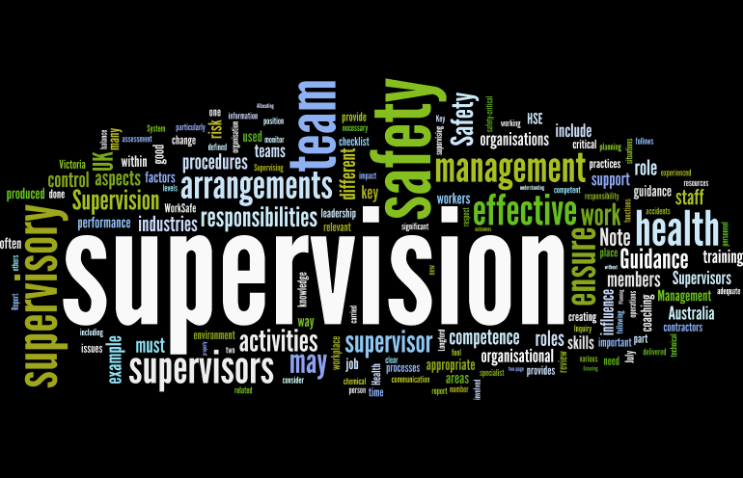
Supervision
Supervision
  Concepts and Practices of Management, 13th Edition
    Edwin C. Leonard, Jr., Ph.D. and Kelly A. Trusty, Ph.D. Cengage Learning, Boston, MA 2013
      ISBN: 978-1-285-86637-6

Slide 2

Part Two: Essentials of Effective Supervision
Chapter Six: Communicating in a Noisy World
  After studying this chapter, you will be able to:
    Define communication and explain its importance in today’s culture.
    Discuss the implications of the new communication age.
    Analyze the channels of communication available to the supervisor.
    Identify and discuss the barriers to effective communication.
    Describe ways to overcome communication barriers.

Slide 3

Communication
Communication is the process of transmitting information and understanding from one person to another.
  Effective communication means a successful transfer of information, meaning, and understanding from sender to a receiver.
    In other words, communication is the process of imparting ideas and making oneself understood to others.

Slide 4

Communication
Most supervisory activities involve interacting with others, and each interaction requires skillful handling of the information process.
  Communication links all the managerial functions.
    Supervisors must explain the nature of work, instruct EEs, describe what is expected of them, and counsel them.
    Supervisors also must report to their managers, both orally and in writing, and discuss their plans with other supervisors.

Slide 5
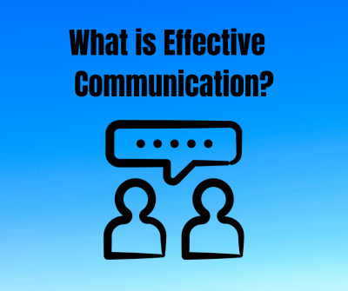
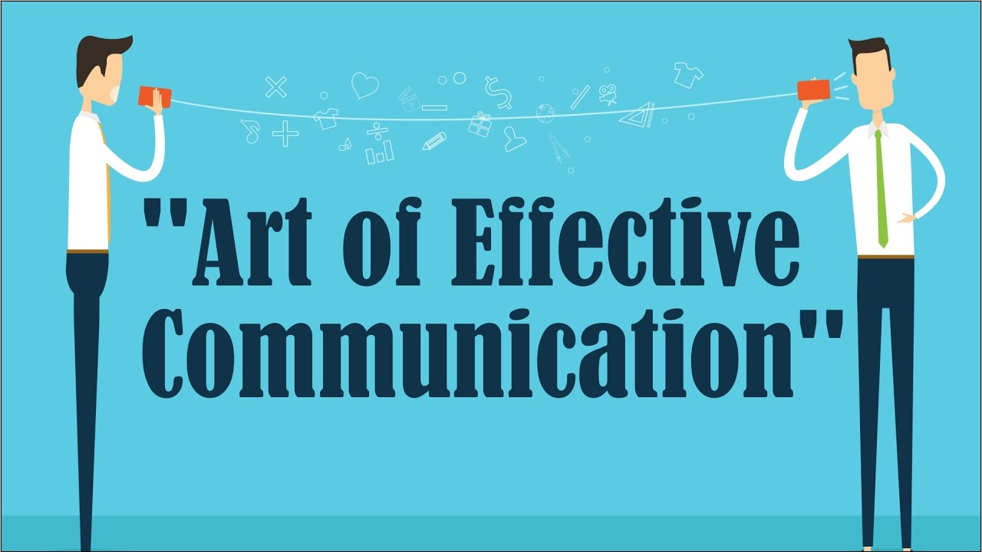
Effective Communication
Effective communication includes both sending and receiving.
  Understanding is a personal matter between two people.
    If an idea has the same meaning as the one intended, then we can say that effective communication has taken place. If, however, the idea received by a listener or reader is not the one intended, then communication has not been effective. The sender has merely transmitted words.

Slide 6

Effective Communication
This does not mean that the sender and receiver must agree on a message or an issue; it is possible to communicate and not agree.
  Author Chip Heath developed principles for making an idea “stick.” Heath says, “A sticky idea is one that people understand when they hear it, that they remember later on, and that change something about the way they think or act.”

Slide 7

Effective Communication
One should always pause, think, and ponder the impact of a message on the intended receiver.
  Say what you mean, and mean what you say.

Slide 8


Effective Communication
Research shows that more than half the supervisor’s day involves giving and getting information.
  The supervisor’s effectiveness depends on the ability to create an environment that fosters communication.
    Fortunately, the skills of communication can be developed.

Slide 9

Channels of the Communication Network
In every organization, the communication network has four primary and equally important channels:
  The formal, or official, channel of communication
  The informal channel, usually called the grapevine
  The Web or social networks
  Body language
    The formal and informal channels carry messages from one person or group to another in organizations – downward, upward, and horizontally.

Slide 10
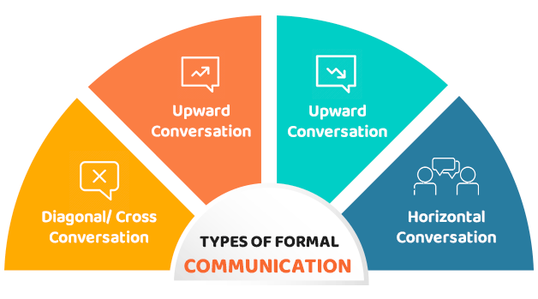
Formal Channels
Formal communication channels are established primarily by an organization’s structure.
  Vertical formal channels can be visualized by following the lines of authority from the top-level executive down through the organization to supervisors and employees.

Slide 11

Downward Communication
The concept of a downward formal channel of communication suggests that management issues instructions or disseminates information that supervisors at the next level receive and pass on to their subordinates, and so on down the line.
  The downward channel is most often used by higher-level managers to communicate.
    Downward communication helps to tie levels together, and is important for coordination. Managers use it to communicate instructions, objectives, policies and procedures, and other information.

Slide 12

Downward Communication
The very best supervisors use open, honest, sincere, and genuine communication, which guides EEs down a path of excellence.
  EEs want to be told what they need to know, how they can learn it, what constitutes a job well done, and how they will be evaluated.

Slide 13

Upward Communication
Upward communication is equally important to the official network.
  Supervisors who have managerial authority accept an obligation to keep the team informed and to contribute ideas to management. Similarly, EEs should feel free to convey their ideas to supervisors and to report on activities related to their work.
    Managers and supervisors should encourage a free flow of upward communication.

Slide 14

Upward Communication
Upward communication usually involves informing and reporting, including asking questions, making suggestions, and lodging complaints.
  This is a vital means by which managers can determine whether proper actions are taking place and can obtain valuable EE insight into the problems facing a unit.
    For example, EEs may report production results and also present ideas for increasing production.

Slide 15

Upward Communication
Supervisors should encourage upward communication from EEs and give ample attention to the information being transmitted.
  Supervisors must show they want EE suggestions as well as the facts, and then they must evaluate information promptly.
    No one knows problems and possible solutions, better than EEs doing the work. In order to tap into this source of information, supervisors must convey a genuine desire to obtain and use the ideas suggested by EEs.

Slide 16

Upward Communication
Some ideas for improving getting-and-giving skills include using Management by Walking Around (MBWA), which involves going where the action is and asking others what you can do to help them be the best they can be.
  Effective supervisors develop rapport with EEs and stakeholders, really listening to ideas and suggestions and acting on suggestions.
    A supervisor with effective information-getting skills usually wins the respect and admiration of colleagues and associates.

Slide 17

Upward Communication
It is the supervisor’s duty to advise upper management whenever there are significant developments and to do so as soon as possible, before or after such events occur.
  It is inappropriate for a manager to learn important news elsewhere; this can be interpreted as supervisors not being on top of their responsibilities.

Slide 18

Horizontal Communication
A third direction of formal communication that is essential for efficient organizational functioning is lateral or horizontal communication between departments or people at the same levels but in charge of different functions.
  Horizontal communication must be open and freely flowing to coordinate functions among departments.

Slide 19

Horizontal Communication
Horizontal communication typically involves discussions and meetings to accomplish tasks that cross departmental lines.
  For example, a production manager may have to contact managers of the marketing and shipping departments to ascertain progress on a delivery schedule for a product.
    Without an open communication environment it would be impossible to coordinate specialized departmental efforts toward a common purpose.

Slide 20

Informal Channels
The Grapevine
Informal communication channels, AKA - the Grapevine, are a normal outgrowth of informal groupings of people on the job, of their social interactions, and other understandable desire to communicate with one another.
  Every organization has its grapevine. This is a perfectly natural element, because it fulfills the EE’s desire to know the latest information and to socialize.
    The grapevine offers members of an organization an outlet for imagining, as well as an opportunity to express apprehensions in the form of rumors.

Slide 21

Understanding the Grapevine
The grapevine can offer considerable insight into EE’s thoughts and feelings.
  An alert supervisor acknowledges the grapevine and tries to take advantage of it whenever possible. The grapevine often carries factual information, but sometimes it carries half-truths, rumors, private interpretations, suspicious, and other bits of distorted or inaccurate information.
    Research indicates that many EEs have more faith and confidence in the grapevine than in what their supervisors tell them.

Slide 22

Understanding the Grapevine
The grapevine cannot be predicted because its path today is not necessarily the same as its path yesterday.
  Most EEs hear information through the grapevine, but some do not pass it along.
    Any person in an organization may become active in the grapevine on occasion; some individuals are more active than others.
    Some people feel their prestige is enhanced if they can pass along latest news, and they do not hesitate to spread and embellish upon that news.

Slide 23

Understanding the Grapevine
The grapevine sometimes helps clarify and supplement formal communication, and it often spreads information that could not be disseminated as well or as rapidly through official channels.

Slide 24

The Supervisor and the Grapevine
The supervisor should realize that it is impossible to eliminate the grapevine.
  It is unrealistic to expect that all rumors can be stamped out, and the grapevine is certain to flourish in every organization.
    To cope with the grapevine, supervisors should tune in to it and learn what it is saying. Supervisors should also determine who leads the grapevine and who is likely to spread its information.

Slide 25

The Supervisor and the Grapevine
Many rumors begin in the wishful-thinking stage of EE anticipation. Other frequent causes of rumors are uncertainty and fear.
  The best cure for rumors is to expose the facts to all EEs and to give straight answers to all questions.
    Morale suffers when hopes are built up in anticipation of something that doesn’t happen.

Slide 26

The Supervisor and the Grapevine
Rumors are often far worse than reality.
  If a supervisor does not disclose facts to EEs, those EEs will make up their own “facts,” which may be worse than the reality.
    Much of the fear caused by uncertainty can be eliminated or reduced if the truth of what will happen is disclosed. Continued rumors and uncertainty may be more demoralizing than even the saddest facts presented openly.

Slide 27

The Supervisor and the Grapevine
If you mention a rumor without refuting it, some people may speculate that the rumor is at least partly true.
  The best prescription is to state the facts openly and honestly.
  When supervisors lack all the information, they should admit it, try to assess the real situation, and report the situation to EEs.
    One of the best ways to stop a rumor is to expose its untruthfulness.

Slide 28

The Supervisor and the Grapevine
Supervisors should remember that the receptiveness of a group of EEs to rumors is directly related to the quality of the supervisor’s communication and leadership.
  When EEs believe their supervisors are concerned about them and make every effort to keep EEs informed, they tend to disregard rumors and to look to their supervisors for answers.

Slide 29

The Supervisor and the Grapevine
The supervisor should listen to the grapevine and develop skills to address it.
  An alert supervisor knows that certain events cause undue anxiety. In this case, the supervisor should explain immediately why such events have occurred.

Slide 30
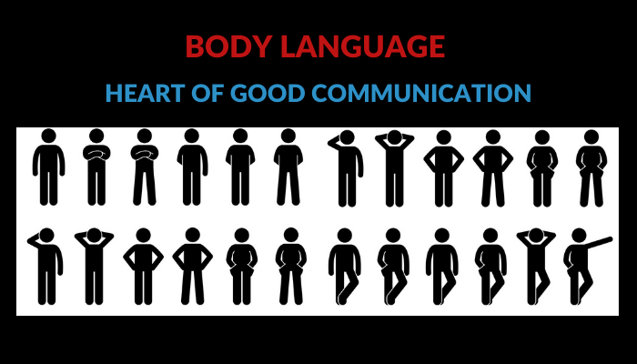
Your Body Language is Communication
The supervisor’s body language communicates something to EEs, whether it is intended or not.
  Gestures, a handshake, a shrug of the shoulder, a smile, or silence – all have meaning and may be interpreted differently by others.

Slide 31

Your Body Language is Communication
One of the problems with text messages and other modern communications media is that we are not able to read the true meaning because there is no body language or tone of voice to reinforce the important points of the message.
  We believe that one of the greatest advantages of face-to-face oral communication is that it can provide the sender an immediate opportunity to determine if the communication was understood.

Slide 32
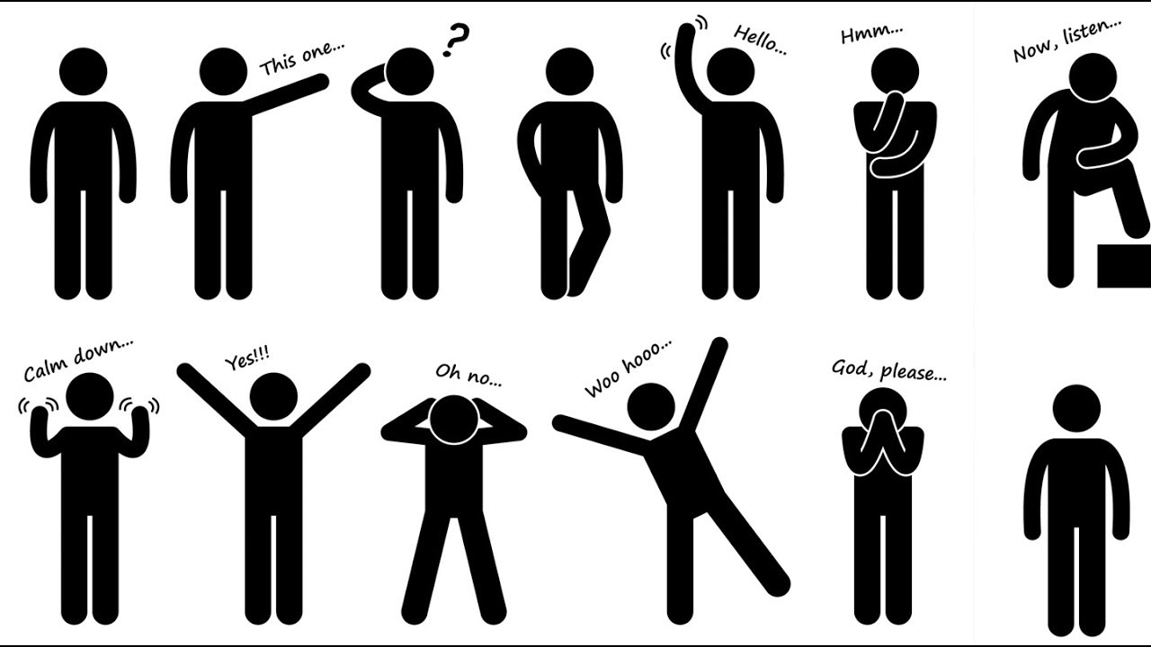
Your Body Language is Communication
Body language is not universal.
  The messages sent by different expressions or postures vary from situation to situation and particularly from culture to culture.

Slide 33
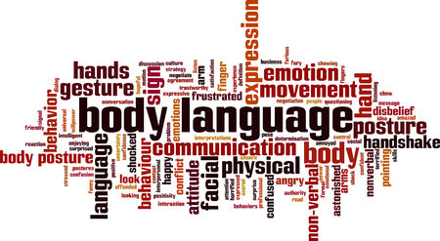
Your Body Language is Communication
Regardless of the channel the supervisor uses, their goal is to convey the message in a timely manner that is easily understood.
  To reiterate, the supervisor must always remember that effective communication takes place only when the meaning received by the intended audience is the same as that the sender meant to send.
    You must become familiar with barriers to effective communication.

Slide 34

Barriers to Effective Communication
Human differences and organizational conditions can create obstacles that distort messages between people - these obstacles and resulting distortion can be called noise.
  Misunderstandings, confusion, and conflicts develop when communication breaks down. These breakdowns are not only costly in terms of money but also create dilemmas that hurt teamwork and morale.
    Many human-relations problems are traceable to faulty communication.
    The ways supervisors communicate with their subordinates constitute the essence of their relationships.

Slide 35

Too Much Information (TMI)
In today’s business world, EEs and supervisors are inundated with hundreds of bits of information every day.
  Many messages are long and wordy, which can cause misunderstanding and lost productivity.
    The typical written message is loaded with words that have little or no bearing on the message’s purpose.

Slide 36

Too Much Information (TMI)
Giving EEs to much information results in information overload and causes EEs to complain of being overwhelmed with irrelevant and redundant messages.
  How long does it take before EEs consider all the messages to be junk mail and discard them?
    Regardless of the medium used, you should use the KISS Technique – Keeping it short and simple means using as few words as possible.

Slide 37

Too Much Information (TMI)
With the advent of electronic forms of communication, it seems that EEs should have all the information needed to do their jobs.
  On the one hand, companies want EEs to have access to the best and latest information and resources to do a better job.
    On the other hand, Web use can become time-consuming for some EEs and, if left unchecked, can impede productivity.

Slide 38

Language and Vocabulary Differences
People differ greatly in their abilities to convey meanings.
  Words can be confusing, even though language is the principal method used to communicate.
    In organizations that speak common languages, differences in culture, accents, dialects, and word meaning can be profound.

Slide 39
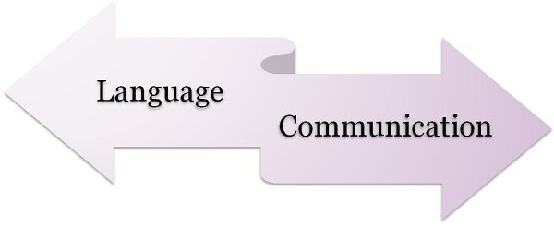
Language and Vocabulary Differences
Words can mean different things to people, particularly in English, which is one of the most difficult languages in the world.
  The ways some words are used in sentences can cause people to interpret messages in ways other than intended.
    When a word has multiple meanings, the desired meaning must be clarified because receivers tend to interpret words based on their perceptions, experiences, and cultural backgrounds.

Slide 40
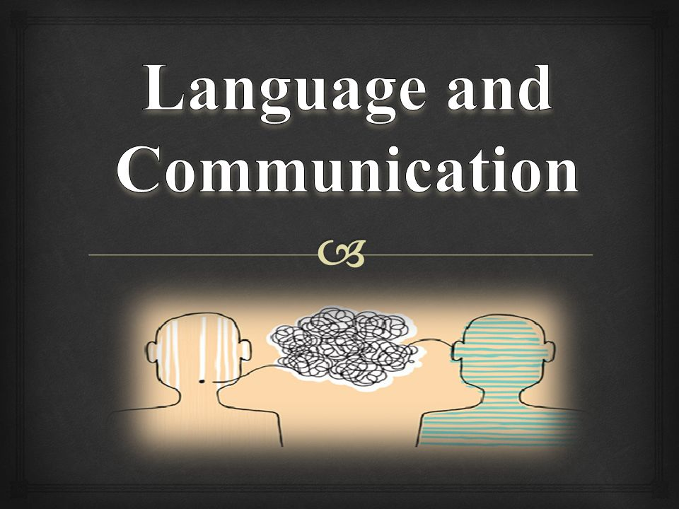
Language and Vocabulary Differences
Supervisors should use plain, direct words in brief and simple statements.
  When needed, supervisors should restate messages to clarify the intended meaning or context.

Slide 41

Status and Position
An organization’s structure, with its multilevel managerial hierarchy, creates a number of status levels among members of the organization.
  Status refers to the degree of responsibility and power afforded by a person’s professional or social position.
    Status can affect attitudes the members of an organization hold toward a position and its occupant.

Slide 42
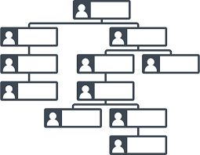
Status and Position
Differences in status and positions become apparent as one level tries to communicate with another.
  For example, a supervisor who tries to convey enthusiasm to an EE about higher production and profits for the company may find the EE indifferent. The EE may instead be concerned with achieving a higher personal wage and security.
    By virtue of position in the company, the supervisor and the EE represent different points of view, which may be an obstacle to understanding.

Slide 43
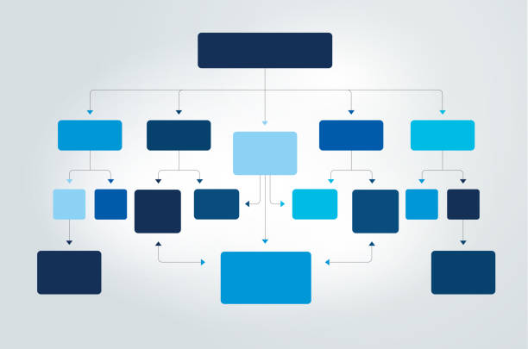
Status and Position
When EEs listen to a supervisor’s message, several factors come into play.
  First, EEs evaluate the supervisor’s words in light of their own backgrounds and experiences. Second, they also consider the supervisor’s personality, position, and status.
    It is difficult for EEs to separate a supervisor’s message from the feelings that they have about the supervisor. As a result, EEs may infer nonexistent motives in a message.

Slide 44
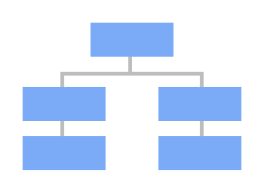
Status and Position
Obstacles due to position and status also can distort the upward flow of communication when subordinates are eager to impress management.
  Some EEs may screen information passed up the line; they may tell their supervisor only what they think the supervisor likes to hear and omit or soften unpleasant details. This is known as filtering.
    By the same token, supervisors are eager to impress their managers. Thus, they may fail to pass on important information because they believe the information portrays their supervisory abilities unfavorably.

Slide 45
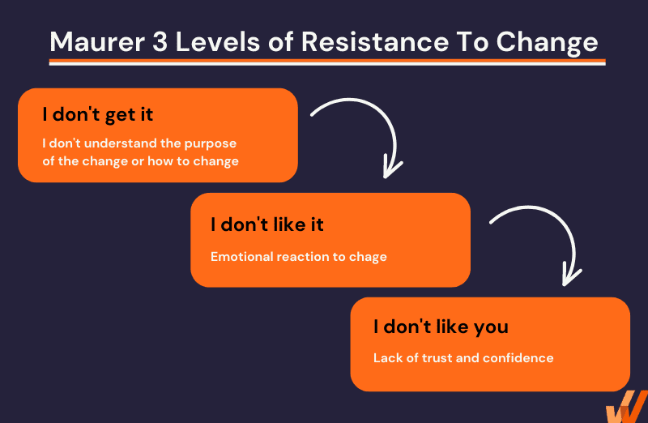
Resistance to Change
Some people prefer things as they are; they do not welcome change in their work situations.
  It is normal for EEs to prefer environments to remain unchanged.
    If a message is intended to convey a change or a new idea – something that will upset work assignments, positions, or the daily routine – EEs may be inclined to resist the message. Why? People don’t resist change, they resist being changed. If they have no input into the change process, EEs will generally greet the change with suspicion.

Slide 46
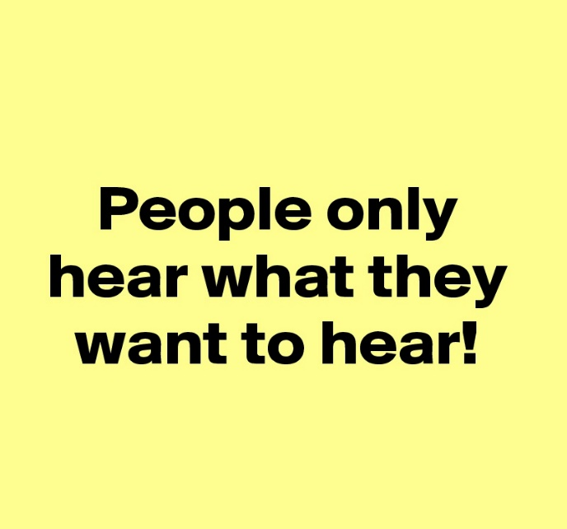
Resistance to Change
Receivers usually hear what they want to hear.
  If a message is not consistent with their personal beliefs and values, the listeners may ignore it, reject it as false, or find a convenient way of twisting it to fit their own vantage point.

Slide 47

Resistance to Change
In today’s economy, many receivers are insecure or fearful; these barriers become even more difficult to overcome.
  EEs become so preoccupied with their own thoughts that they attend only to those ideas they want to hear, selecting only those parts of the message they can accept. EEs brush aside, fail to hear, or explain away bits of information they do not like or that are irreconcilable with biases.
    Supervisors must be aware of these possibilities, particularly when a message is intended to convey some change that may interfere with the normal routine or customary work environment.

Slide 48

Perceptual Barriers
Barriers arise from deep-rooted personal feelings, prejudices, and physical conditions.
  The perception that all people in a group share attitudes, values, and beliefs is called stereotyping. Stereotyping influences how people respond to others. It becomes a barrier to effective communication as people are categorized into groups because of their gender, age, or race instead of being treated as unique individuals.
    Managers must be aware of stereotyping as it can impede communication.

Slide 49


Perceptual Barriers
Messages can be misunderstood because people perceive the situation or circumstances (i.e. the world) differently.
  According to Georgetown Professor, Deborah Tannen, we need to “Say what you mean, and mean what you say.”

Slide 50

Insensitive Words and Poor Timing
Sometimes, one party in a conversation uses “killer” phrases.
  Comments like, “That’s the stupidest idea I’ve ever heard!” “You do understand, don’t you?” or “Do you really know what you’re talking about?” can kill conversation. Often, the receiver of the killer phrase becomes silent and indifferent to the sender. Sometimes, the receiver takes offense and directs anger back to the sender.
    Insensitive, offensive language or impetuous responses can make understanding difficult. These exchanges happen in many workplaces. Often, the conflict that results impedes organizational goals.

Slide 51
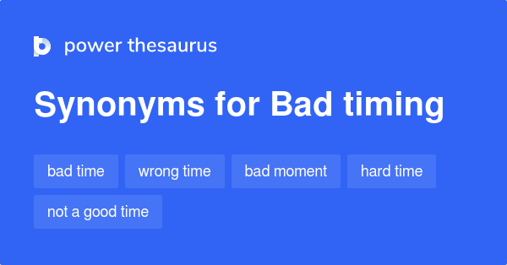
Insensitive Words and Poor Timing
Another barrier to effective communication is timing.
  EEs come to the workplace with “baggage” – events that happened off the job. It can be difficult to pay attention to a sender while anticipating a test, for example, or if an argument that started at home before work is still simmering.
  An EE can pretend to listen politely but receive little to nothing.
    When other issues demand attention, responsiveness to work information will fail to meet the other party’s expectations.

Slide 52

Inability to Create Meaning
Communication begins when the sender encodes an idea or a thought.
  When managers draft responses to issues, they should address several key questions, including:
    What conclusion have I formed about this issue?
    What claim do I want to make?
    What evidence or reasons can I offer in support of my claim?
    What data can I provide to back up my claim?

Slide 53

Inability to Create Meaning
Decoding is the receiver’s version of encoding. During decoding, receivers put messages into forms they can interpret.
  To analyze a manager’s position on an issue, an EE must find and weigh management’s claim, evidence, and data, but may ask more: “Does the choice of words influence how I feel about this issue?” “Do I agree with premise or assumptions underlying their position?”
    The receiver’s interpretation of a message often differs from what the sender intended.

Slide 54

Overcoming Barriers to Effective Communication
Most techniques for overcoming communication barriers are relatively easy and straightforward.
  A supervisor once remarked, “Most of these techniques are just common sense.” The reply to this comment is simply “Yes, but haven’t you observed how uncommon common sense often is?” The lesson is, “If you do not know, find out then follow up.”
    Supervisors must ensure their communication is effective.

Slide 55

Preparation and Planning
A major step toward becoming a better communicator is to avoid speaking or writing until the message to be communicated has been thought through and is clear in the sender’s mind.
  Only when supervisor’s can express their ideas in an organized way can they hope for others to understand. So, before communicating, supervisors should know what they want and should plan the steps needed to attain their objectives.
    Regardless of the method of communication used, supervisors must consider many elements before sending messages.

Slide 56

Preparation and Planning
For example, when supervisors want to assign jobs, they should first analyze those jobs thoroughly so they can describe properly.
  An EE’s ability to do a job depends on determining what information is important. Therefore, the supervisor needs to plan the method of communication – visual (body language), vocal (tone of voice), verbal (words), and emotional (feelings).
    When supervisors must give their bosses bad news, they should study the problems until they can explain them easily.

Slide 57
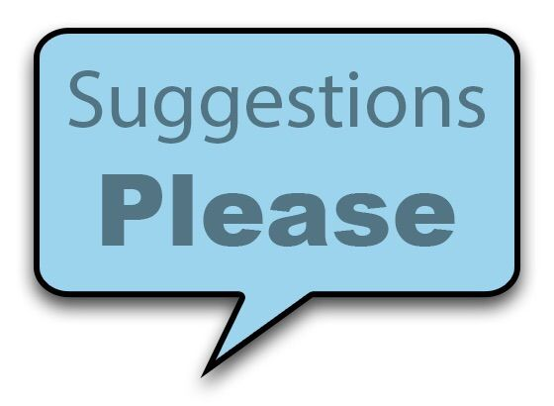
Preparation and Planning
Supervisors should only raise problems with their bosses after having formulated suggestions on how to solve or prevent them.
  When communication is to involve disciplinary action, supervisors should investigate the cases sufficiently and compile all relevant information before issuing penalties.
    Communication should not begin until supervisors know what they should say to achieve their goals.

Slide 58

Using Feedback
Feedback is the most important method for improving communication.
  Feedback is the receiver’s verbal or nonverbal response to a message.
  Feedback can be used to determine whether the receiver understood the message and to get the receiver’s reaction to that message.
  The sender can initiate feedback by using questions, discussion, signals, and clues. Merely asking the receiver, “Do you understand?” and receiving “Yes” as an answer may not suffice.
    More information is usually required to ensure that a message was received as intended.

Slide 59

Using Feedback
A simple way to obtain feedback is to observe the receiver and to judge that person’s responses based on such nonverbal clues as expressions of bewilderment or understanding, raised eyebrows, frowns, and eye movement.
  This kind of feedback is possible only in face-to-face communication, which is one of the major advantages of this form of communication.

Slide 60

Using Feedback
Perhaps the best feedback technique for ensuring a sender’s message is understood is for the sender to ask the receiver to paraphrase or play back the information received.
  This approach is much more satisfactory than merely asking whether the instructions are clear.
    The process of restating all or part of the person’s basic idea in the receiver’s own words, rather than “parroting back verbatim,” shows that communication has taken place.

Slide 61

Using Feedback
When the receiver states the content of the message, the sender knows the receiver has heard and understood the message.
  The receiver may then ask additional questions and request comments that the speaker can provide immediately.
    Do not ask questions that can be answered with simply a “yes” or “no.”
    Phrase questions that force the person to clarify and elaborate position(s)

Slide 62

Using Feedback
When a supervisor receives a written message, and doubts any part of its meaning, the supervisor should contact the sender to discuss and clarify the message.

Slide 63

A Calm Atmosphere
When supervisors try to communicate with EEs who are upset, the chance for mutual understanding is minimal.
  It is much better to communicate when both parties are calm and unburdened by unusual tension or stress.
    One of the best ways for supervisors to create the proper atmosphere for communicating with EEs is to set times to meet in a quiet space. This enables both parties to discuss problems calmly and thoughtfully.

Slide 64

A Calm Atmosphere
Similarly, if supervisors want to discuss something with their managers, they should make appointments for times and places that allow calm, uninterrupted discussion.
  How (the tone), when (the time), and where (the place) are as important to the message.

Slide 65

Taking Time to Listen
Listening is a very important part of the supervisor’s job, whether in one-on-one conversations or in meetings.
  The ability to listen is critical to success as a supervisor.
    Therefore, supervisors should work to develop their listening skills every chance they get.

Slide 66

Taking Time to Listen
A supervisor should always listen patiently to what the EE has to say.
  Intensive listening helps reduce misunderstanding, and, by listening, the supervisor can respond in ways that are appropriate to the EE’s concerns.
    Supervisors should provide feedback by restating EE’s messages from time to time and by asking, “Is this what you mean?”

Slide 67

Taking Time to Listen
One of the worst things supervisors can do is to appear to be listening while their minds are elsewhere.
  Supervisors can avoid this situation by politely stating, “Right now is not a convenient time for us to have this discussion. It needs my full attention, and if we can reschedule this meeting (set specific time), you will have my undivided attention.”
    Attentiveness to the speaker goes a long way toward building trust.

Slide 68

The Do’s and Don’ts of Effective Listening
Do’s of Listening
  Adopt the attitude that you will always have something to learn.
  Take time to listen, give speaker your full attention, and hear speaker out.
  Withhold judgment until the speaker is finished.
  Strive to locate the main ideas of the message.
  Try to determine the work meanings in the context of the speaker’s background. Listen for what is being implied as well as what is being said.
  Establish eye contact with the speaker. Read body language. Smile, nod, and give an encouraging sign when the speaker hesitates.
  Ask questions at appropriate times to be sure to understand the message.
  Restate the speaker’s idea at appropriate moments to make sure you have received it correctly.

Slide 69
The Do’s and Don’ts of Effective Listening
Don’ts of Listening
  Don’t listen with only half an ear by “tuning out” the speaker.
  Don’t pretend that you are listening to the speaker.
  Don’t unnecessarily interrupt the speaker or finish the speaker’s statement because of impatience or wanting to respond immediately.
  Don’t let distractions (fidgeting-doodling) get in the way of you and speaker.
  Don’t confuse facts with opinions.
  Don’t show disapproval or insensitivity to the speaker’s feelings.
  Don’t respond until the speaker has said what they want to say.
  Don’t become defensive.

Slide 70

Repetition of Messages
It often helps to repeat a message several times, preferably using different words and different methods.
  The degree of repetition should depend largely on the content of the message and the impact on the intended receivers.
    However, the message should not be repeated so much that it gets ignored because it sounds too familiar or boring.

Slide 71

Reinforcing Words with Action
To succeed as communicators, supervisors must complement their words with appropriate and consistent actions.
  Supervisors communicate a great deal through their actions; actions do speak louder than words. Therefore, one of the best ways to give meaning to messages is to act accordingly.
    When verbal announcements are backed by action, the supervisor is more credible. However, when a supervisor says one thing but does another, EEs will eventually behave similarly.

Slide 72

Managing Meetings with the Boss
Every manager has someone higher in the organization to whom they report.
  It is critical that supervisors understand the importance of communicating “up the organization.”
    Supervisors should communicate not only the issue and items impacting their departments but also the positive contributions of their team members and other members of the organization.

Slide 73

Managing Meetings with the Boss
All managers should develop a climate that encourages a free flow of upward communication. However, the responsibility for upward communication typically falls on the supervisor.
  Supervisors must take the responsibility for keeping management informed and for managing the relationships with their own bosses.
    Supervisors also must be prepared to contribute suggestions, ideas, and opinions on a timely basis.

Slide 74

Managing Meetings with the Boss
Most upward communication occurs in meetings between supervisors and their managers.
  Supervisors should try to build bonds with their bosses.

Slide 75

Managing Meetings with the Boss
Supervisors must understand what the boss expects of them, and the boss must know what their subordinates need from them to achieve their organizational goals objectives.
  Each interaction that the supervisor has impacts the boss’s perception of the supervisor, and vice versa.
    How supervisors manage upward is vital to their careers.

Slide 76

Managing Meetings with the Boss
How supervisors can effectively manage meetings with the boss:
  Respect the Boss’s Time
  Check Your Motives
  Analyze the Boss’s Listening Style
  Plan Your Agenda
  Do Not Go to the Boss “Naked”
  Commit to the Truth
  Advertise Success
  Learn to Say No
  Do Not Keep Information from Your Boss
  Anticipate Problems
  Meet Periodically to Clarify Expectations
  Do Not be a Complainer
  Do Not Put the Boss on the Defensive
  Leave on a Positive Note
  Make a Resolution

Slide 77

Effective Communication
Six pillars for successful supervisory communications:
  Provide EEs with timely and complete information.
  Strive to be understood and to understand: - feedback is vital to success.
  Understand how your actions and body language influence others.
  Keep messages short and simple: - “manageable pieces for maximum impact.”
  Encourage everyone to ask questions.
  Follow-up to make sure that the message is doing what is intended.

Slide 78

Effective Communication
Steps to achieving communication objectives:
  What are my objectives in sending the message?
  Why am I sending the message?
  Does the message contain useful and timely information?
  Do I have a handle on my emotions?
  Is this the best way to address this issue?
  Who is supposed to get the message?
  Have I considered the receiver’s position on the issue?
  Have I selected the right words and tone?
  Have I framed the message to get the receiver’s attention?
  What will the receiver do with the message upon receiving it?
  How will I know the receiver has acted?
  How will the receiver’s action impact performance?

Slide 79


