Slide 1

Business Survey
Session Five Class Presentation
Business Foundations
  A Changing World 11th Edition
    O.C. Ferrell, Geoffrey Hirt, and Linda Ferrell; McGraw Hill Education; New York, NY 2018
      ISBN: 978-1-259-68523-1

Slide 2
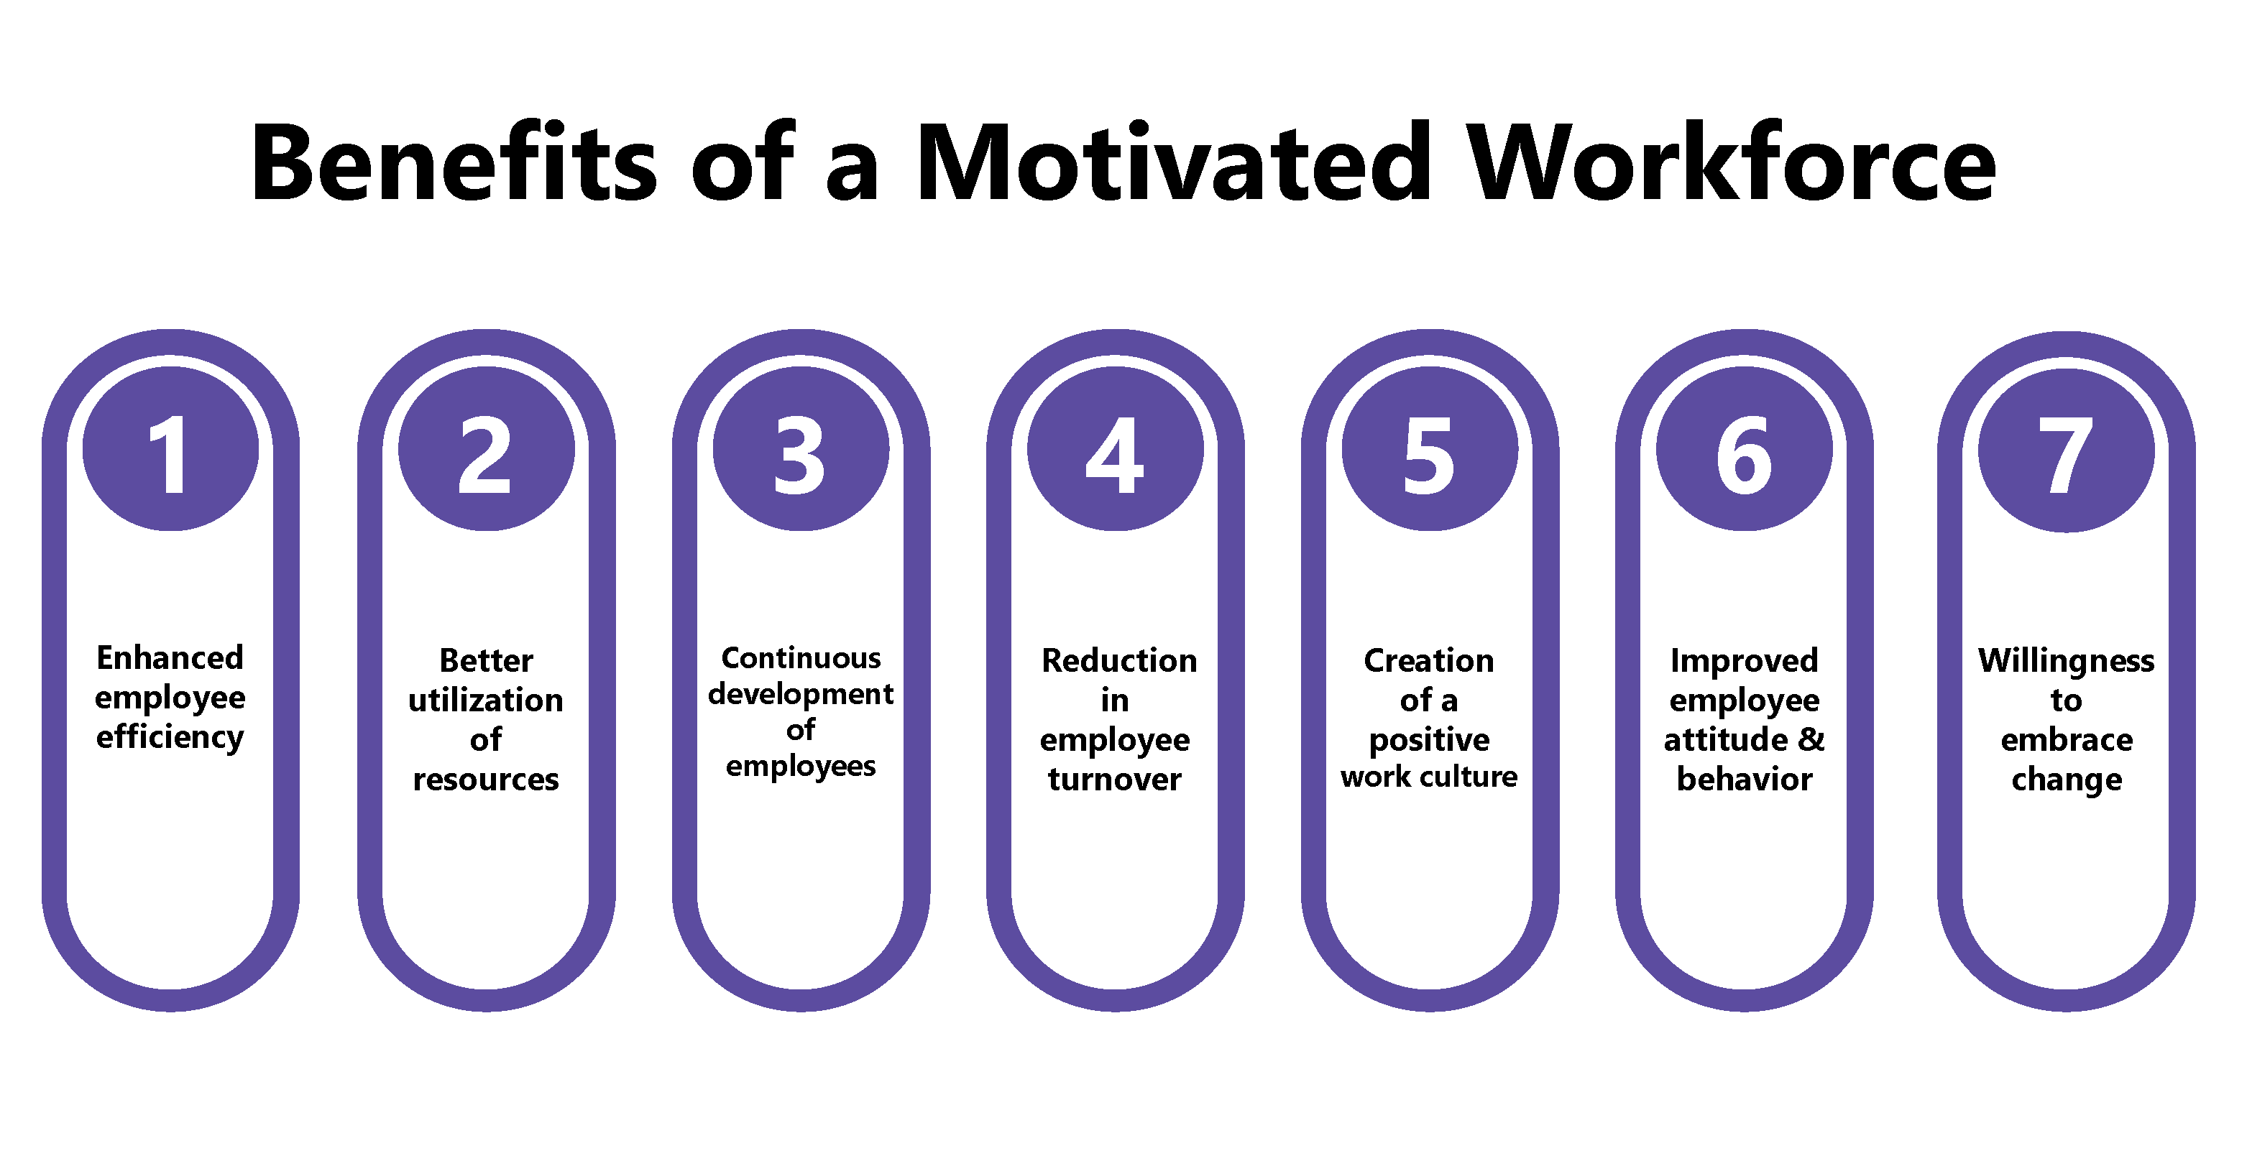
Part Four: Creating the Human Resource Advantage
Chapter Nine: Motivating the Workforce

Slide 3

Introduction
Because EEs do the work of the business and influence whether the firm achieves its objectives, top managers agree EEs are an organization’s most valuable resource.
  To achieve organizational objectives, employees must have the motivation, ability (appropriate knowledge and skills), and tools (proper training and equipment) to perform their jobs.
    Managers who understand the needs of EEs can help them reach higher levels of productivity and thus contribute to the achievement of organizational goals.

Slide 4

Nature of Human Relations
What motivates EEs to perform on the job is the focus of human relations, the study of the behavior of individuals and groups in organizational settings.
  Human relations involves motivating employees to achieve organizational objectives efficiently and effectively.
    The field of human relations is important as businesses strive to understand how to boost workplace morale, maximize employees’ productivity and creativity, and motivate their ever more diverse employees to be more effective.

Slide 5

Nature of Human Relations
Motivation
Motivation is an inner drive that directs a person’s behavior toward achieving goals.
  A goal is the satisfaction of some need, and a need is the difference between a desired state and an actual state.
  Both needs and goals can be motivating.
    Motivation explains why people behave as they do; similarly, a lack of motivation explains, at times, why people avoid doing what they should do. A person who recognizes or feels a need is motivated to take action to satisfy the need to achieve a goal.

Slide 6

Nature of Human Relations
Motivation
Human relations is concerned with the needs of employees, their goals and how they try to achieve them, and the impact of those needs and goals on job performance.
  Effectively motivating employees helps keep them engaged in their work. Engagement involves emotional involvement and commitment.
    Motivating employees to stay engaged is a key responsibility of management.

Slide 7

Nature of Human Relations
Morale
One prominent aspect of human relations is Morale – an employee’s attitude toward their job, employer, and colleagues.
  High morale contributes to high levels of productivity, high returns to stakeholders, and employee loyalty.
    Conversely, low morale may cause high rates of absenteeism and turnover (when employees quit or are fired and must be replaced).

Slide 8
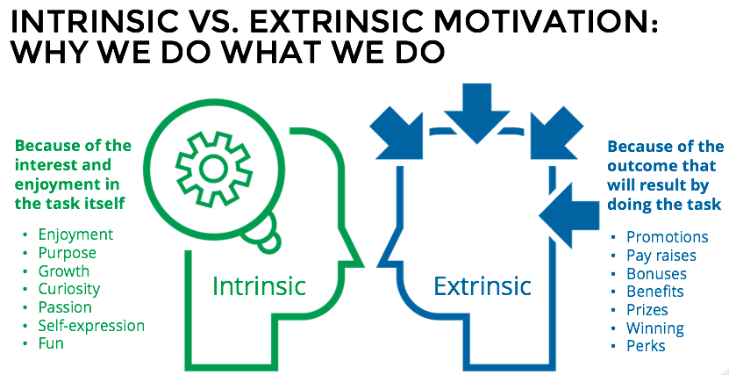
Nature of Human Relations
Intrinsic and Extrinsic Rewards
EEs are motivated by perceptions of intrinsic and extrinsic rewards. Both types contribute to motivation that stimulates employees to do their best in contributing to business goals.
  An Intrinsic Reward is the personal satisfaction and enjoyment that you feel from attaining a goal.
  Extrinsic Rewards are benefits and/or recognition that you receive from someone else.

Slide 9

Nature of Human Relations
Morale Boosters
Many companies offer a diverse array of benefits designed to improve the quality of employees’ lives and increase their morale and satisfaction.
  Respect, involvement, appreciation, adequate compensation, promotions, a pleasing work environment, and a positive organizational culture are all morale boosters.

Slide 10

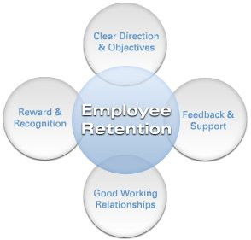
How to Retain Good Employees
The following is a list of ways in which a manager can effectively retain good employees:
  Challenge Employees
  Provide Adequate Incentives
  Don’t Micromanage
  Create a Work-Friendly Environment
  Provide Opportunities for Employee Growth

Slide 11

How to Motivate Employees
The following are proven methods to motivate EEs.
  Interact with EEs in a friendly and open manner.
  Equitably dispense rewards and other incentives.
  Create a culture of collaboration.
  Provide positive and negative feedback and constructive criticism.
  Make EEs feel as if they are partners rather than workers.
  Handle conflicts in an open and professional manner.
  Provide continuous opportunities for improvement and EE growth.
  Encourage creativity in problem solving.
  Recognize EEs for jobs well done.
  Allow EEs to make mistakes, as these are learning opportunities.

Slide 12
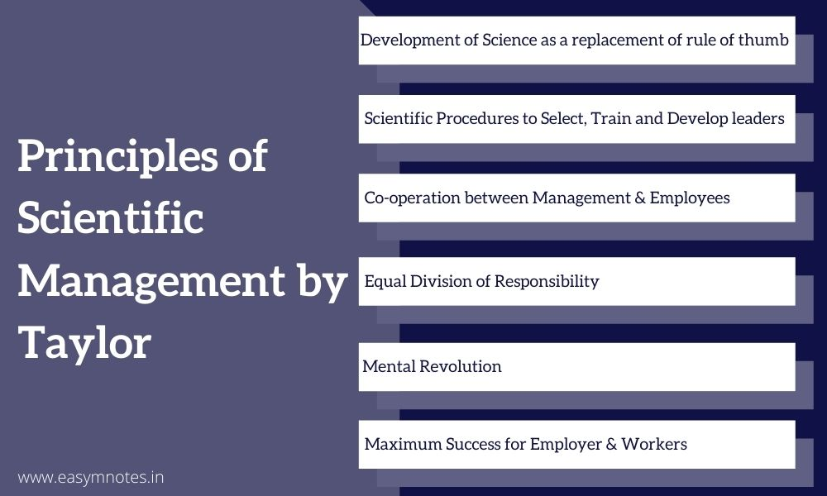
Historical Perspectives on Motivation
Scientific Principles of Management
The birth of the study of human relations can be traced to time and motivation studies conducted at turn of the century by Frederick W. Taylor and Frank and Lillian Gilbreth.
  Their studies analyzed how workers perform specific work tasks in an effort to improve the employee’s productivity.
    These efforts led to the application of scientific principles of management.

Slide 13

Historical Perspectives on Motivation
Classical Theory of Motivation
According to the Classical Theory of Motivation, money is the sole motivator for workers.
  Taylor suggested that workers who were paid more would produce more, an idea that would benefit both companies and workers.
  To improve productivity, he thought that managers should break down each job into its component tasks (specialization), determine the best way to perform each task, and specify the output to be achieved by the worker performing the task.
    He suggested that managers link workers’ pay directly to their output and offer incentives for exceeding their set quota.

Slide 14

Historical Perspectives on Motivation
The Hawthorne Studies
Elton Mayo wanted to determine what physical conditions in the workplace – such as, light and noise levels – would stimulate EEs to be most productive.
  He discovered that productivity increased regardless of the physical conditions, a phenomenon called Hawthorne effect.
    EE’s expressed satisfaction because their supervisors had asked for their help and cooperation in the study.
    Researchers concluded that social and psychological factors could significantly affect productivity and morale.

Slide 15
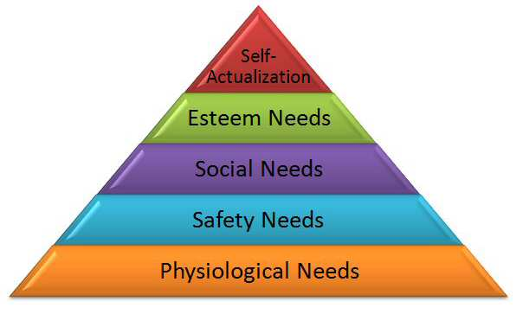
Theories of Motivation
Maslow’s Hierarchy of Needs
Abraham Maslow theorized that people have 5 basic needs and arranged them in order of importance.
  Physiological Needs
    The most basic and first needs to be satisfied, are the essentials for living – water, food, shelter, and clothing.
  Security Needs
    Related to protecting yourself from physical and economic harm.
  Social Needs
    The need for love, companionship, and friendship – desire for acceptance.
  Esteem Needs
    Relate to respect – both self-respect and respect from others.
  Self-Actualization Needs
    Maximizing your potential. Being the best you can be.

Slide 16
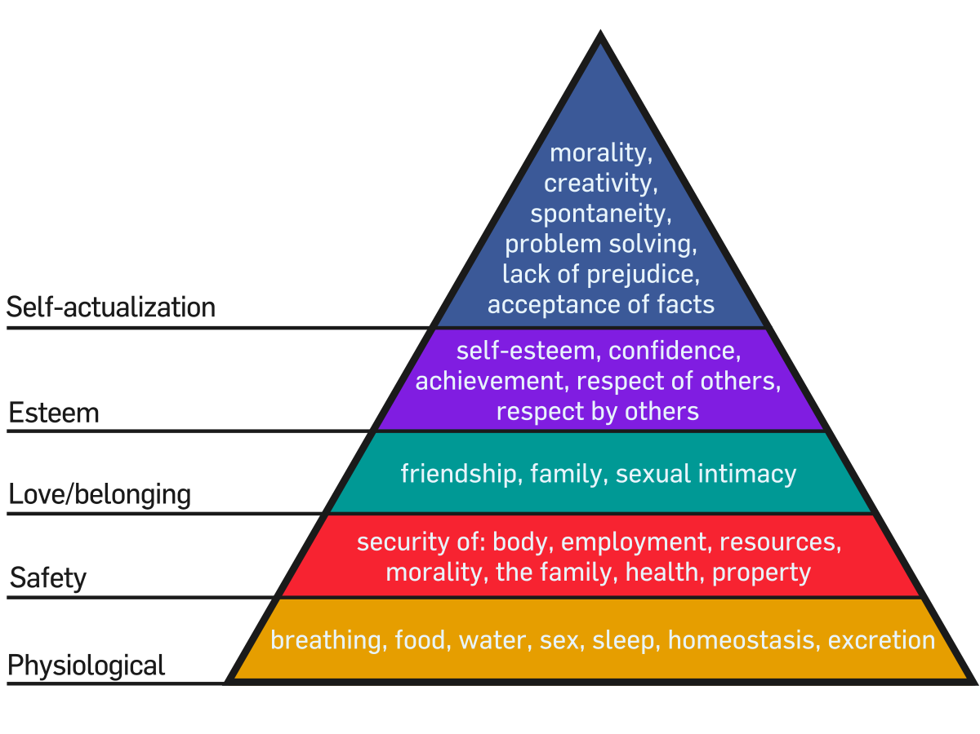
Theories of Motivation
Maslow’s Hierarchy of Needs
Maslow’s theory maintains that the more basic needs at the bottom of the hierarchy must be satisfied before higher-level goals can be pursued.
  Managers should learn from Maslow’s hierarchy that employees will be motivated to contribute to organizational goals only if they are able to first satisfy their physiological, security, and social needs through their work.

Slide 17
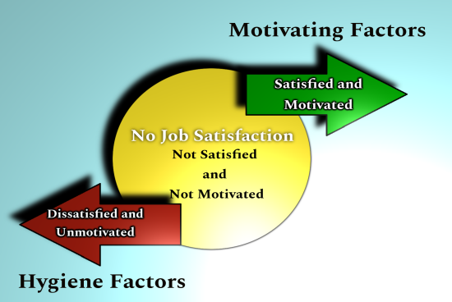
Theories of Motivation
Frederick Herzberg’s Two-Factor Theory
Herzberg proposed a theory of motivation that focuses on the job and on the environment where the work is done.
  He studied various factors relating to the job and their relation to employee motivation and concluded that they can be divided into (1) Hygiene Factors and (2) Motivational Factors.
    Hygiene Factors: company policies; supervision; working conditions; relationships with peers, supervisors, and subordinates; salary; and security.
    Motivational Factors: achievement; recognition; work itself; responsibility; advancement; and personal growth.

Slide 18
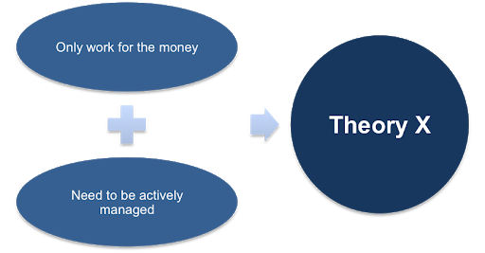
Theories of Motivation
McGregor’s Theory X
Theory X assumes workers generally dislike work and must be forced to do their jobs.
  Theory X managers believe:
    The average person dislikes work and will avoid it when possible.
    Most workers must be coerced, controlled, directed, or threatened with punishment to get them to work toward the achievement of organizational objectives.
    The average worker prefers to be directed and to avoid responsibility, has relatively little ambition, and wants security.

Slide 19

Theories of Motivation
McGregor’s Theory X
Managers who subscribe to the Theory X view maintain tight control over workers, provide almost constant supervision, try to motivate through fear, and make decisions in an autocratic fashion, eliciting little or no input from their subordinates.
  The Theory X style of management focuses on physiological and security needs and virtually ignores the higher needs discussed by Maslow. It does not take into account people’s needs for companionship, esteem, and personal growth.

Slide 20

Theories of Motivation
McGregor’s Theory Y
Manager’s subscribing to Theory Y view assume workers like to work and that under proper conditions EEs will seek out responsibility in an attempt to satisfy their social, esteem, and self-actualization needs.
  Theory Y managers believe:
    The expenditure of effort in work is as natural as play or rest.
    People will exercise self-direction and self-control to achieve objectives to which they are committed.
    People will commit to objectives when they realize that the achievement of those goals will bring them personal reward.
    The average person will accept and seek responsibility.
    Imagination, ingenuity, and creativity can help solve organizational problems, but most organizations do not solicit this from EEs.
    Organizations today do not make full use of workers’ potential.

Slide 21
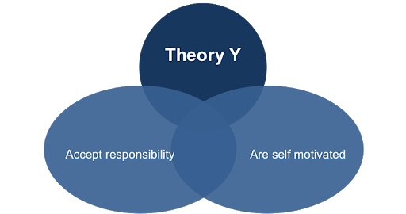
Theories of Motivation
McGregor’s Theory Y
Theory Y managers maintain less control and supervision, do not use fear as the primary motivator, and are more democratic in decision making, allowing subordinates to participate in the process.
  Theory Y managers address the high-level needs in Maslow’s Hierarchy as well as the physiological and security needs.

Slide 22

Theories of Motivation
William Ouchi’s Theory Z
Theory Z is a management philosophy that stresses EE participation in all aspects of company decision making.
  Theory Z incorporates elements associated with the Japanese approach to management, such as trust and intimacy.
    In a Theory Z organization, all members share in responsibilities; the management style is participative; and employment is long term and, often lifelong. Theory Z results in employees feeling organizational ownership.

Slide 23

Theories of Motivation
Equity Theory
Equity Theory suggests people are willing to contribute to an organization depending on their assessment of the fairness, or equity, of the rewards they will receive in exchange.
  In a fair situation, a person receives rewards proportional to the contribution they make to the organization. However, in practice, equity is a subjective notion.
    An EE compares their input-output ratio (effort/compensation) with that of their peers within the organization, and if they feel the ratio is comparable with others they will feel they are being treated equitably.

Slide 24
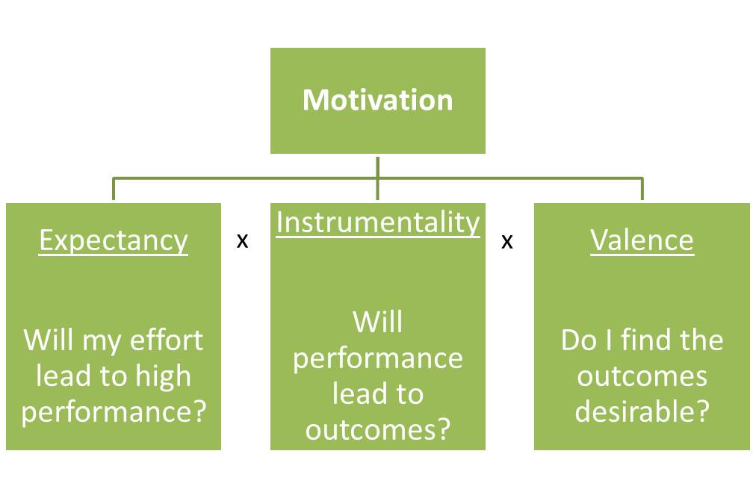
Theories of Motivation
Victor Vroom’s Expectancy Theory
Expectancy Theory states that motivation depends not only on how much a person wants something but also on the person’s perception of how likely they are to get it.
  A person who wants something and has a reason to be optimistic about it will be strongly motivated. In contrast, if you do not believe you will get what you want, you may not be motivated to try and get it, even though you really want it.

Slide 25

Theories of Motivation
Goal-Setting Theory
Goal-Setting Theory states that goals act as motivators to focus EE efforts on achieving performance outcomes.
  Setting goals can positively affect performance because goals help EEs direct their efforts and attention toward the outcome, mobilize their efforts, develop consistent behavior patterns, and create strategies to obtain desired outcomes.

Slide 26
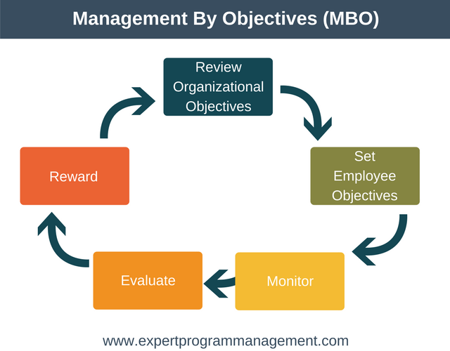
Theories of Motivation
Management by Objectives
Management by Objectives (MBO) refers to the need to develop goals that both managers and employees can understand and agree upon.
  This requires managers to work with employees to set personal objectives that will be used to further organizational objectives.
    By linking managerial objectives with personal objectives, EEs feel a sense of commitment toward achieving organizational goals.

Slide 27

Strategies for Motivating Employees
Based on the various theories that attempt to explain what motivates employees, businesses have developed several strategies for motivating their employees and boosting morale and productivity.
  Some of these techniques include behavior modification and job design, as well as, the already described employee involvement programs and work teams.

Slide 28
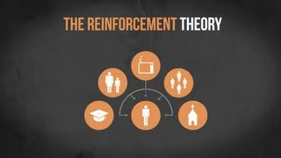
Strategies for Motivation
Behavior Modification
Behavior Modification involves changing behavior and encouraging appropriate actions by relating consequences of behavior to the behavior itself.
  Behavior modification is an application of Reinforcement Theory, the theory that behavior can be strengthened or weakened through the use of rewards and punishments.
    B.F. Skinner found that behavior which was rewarded will tend to be repeated, while behavior that is punished will be eliminated.
    Punishment often leads to EE dissatisfaction and turnover.

Slide 29

Strategies for Motivation
Job Design
Managers have several strategies they can use to design jobs to help improve employee motivation.
  Job Rotation
    Allows EE’s to move from one job to another in an effort to relieve the boredom that is often associated with job specialization.
  Job Enlargement
    Adds more tasks to a job instead of treating each task as separate.
    Jobs are more satisfying as the number of tasks increases.
  Job Enrichment
    Incorporates motivational factors such as opportunity for achievement, recognition, responsibility, and advancement into a job.
  Flexible Scheduling Strategies
    Allows EE’s to choose flexible work schedules, as long as they are at work during a specific core period, a compressed work week, work from home, and job sharing opportunities.

Slide 30

Importance of Motivational Strategies
Motivation is more than a tool that managers can use to foster employee loyalty and boost productivity.
  It is a process that affects all the relationships within an organization and influences many areas like pay, promotion, job design, training opportunities, and reporting relationships.
    Employees are motivated by the nature of the relationships they have with their supervisors, by the nature of their jobs, and by characteristics of the organization.

Slide 31

Motivational Strategies
There are various ways employers can motivate employees; however, managers must be careful when considering what kinds of incentives to use.
  Different cultures and individuals value different kinds of incentives more highly than others.
    Motivation is not an easy thing to understand, especially as organizations become more diverse.

Slide 32
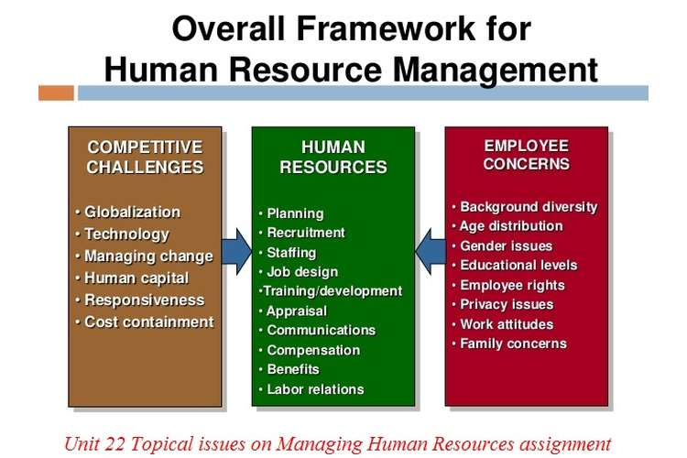
Part Four: Creating the Human Resource Advantage
Chapter Ten: Managing Human Resources

Slide 33

Introduction
If a business is to achieve success, it must have sufficient numbers of employees who are qualified and motivated to perform the required duties.
  Thus, managing the quantity (from hiring and firing) to the quality (through training, compensating, and so on) of employees is an important business function.
    Meeting the challenge of managing diverse human resources effectively can give a company the competitive edge.

Slide 34

The Nature of Human Resource Management
Human resources is defined as labor, physical and mental abilities that people use to produce goods and services.
  Human Resources Management (HRM) refers to all the activities involved in determining an organization’s human resource needs, as well as acquiring, training, and compensating people to fill those needs.
    Human resource managers are concerned with maximizing the satisfaction of employees and motivating them to meet organizational objectives productively.

Slide 35

The Nature of Human Resources Management
How an organization treats its employees is of much importance to consumers.
  Approximately 85% of consumers say that a company’s corporate social responsibility (CSR) practices, including treatment of EE’s, plays a significant role in deciding where to take their business.
    EEs are concerned not only about how much a job pays; they are concerned with job satisfaction, personal performance, recreation, benefits, work environment, and opportunities for advancement.

Slide 36

Planning for Human Resources Needs
When planning and developing strategies for reaching the organization’s objectives, a company must consider whether it will have the human resources necessary to carry out its plans.
  After determining how many EEs and what skills are needed to satisfy the overall plans, the HR manager ascertains how many EE’s the company has and how many will be retiring or otherwise leaving the organization during the planning period.
    The manager can then forecast how many EEs the company will need to hire and what qualifications they must have or determine if layoffs are required to meet the demand more efficiently.

Slide 37

Planning for Human Resources Needs
HRM planning also requires forecasting the availability of people in the workforce who will have the necessary qualifications to meet the organization’s future needs.
  The human resources manager then develops a strategy for satisfying the organization’s human resources needs.
    As organizations strive to increase efficiency through outsourcing, automation, or learning to effectively use temporary workers, hiring needs can change dramatically.

Slide 38

Planning for Human Resources Needs
Job Analysis
Managers analyze jobs within the organization in order to match the human resources to the available assignments.
  Job Analysis determines, through observation and study, pertinent information about a job – the specific tasks that comprise it; the knowledge, skills, and abilities necessary to perform it; and the environment in which it will be performed.
    Managers use the information obtained through a job analysis to develop job descriptions and job specifications.

Slide 39

Recruiting and Selecting New Employees
After forecasting the firm’s human resources needs and comparing them to existing resources, the HR manager should have an idea of how many new EEs are needed.
  With the aid of job analysis, management can then recruit and select employees who are qualified to fill specific job openings.

Slide 40

Recruiting
Recruiting means forming a pool of qualified applicants from which management can select employees.
  There are two sources from which to develop this pool of applicants – (1) internal and (2) external.
    Internal applicants include the organization’s current EEs.
      The cost of hiring from within is cheaper and improves morale.
    External sources of applicants consist of advertisements in newspapers and professional journals, employment agencies, colleges, vocational schools, recommendations from other EEs, competing firms, unsolicited applications, online websites, and social networking sites such as LinkedIn.

Slide 41

Selection
Selection is the process of collecting information about applicants and using that information to decide which to hire. It includes the application itself, as well as interviewing, testing, and reference checking.
  The first round of evaluation involves assessment, and if this goes well, the candidate will receive an interview.
    Rigorous scrutiny is necessary to find those applicants who can do the work expected and fit into the firm’s structure and culture.
    Finding the “right” candidate can save a lot of time and money.

Slide 42

The Application
In the first stage of the selection process, the individual fills out an application form and perhaps has a brief interview.
  The goal of this stage of the process is to get acquainted with the applicants and to weed out those who are obviously not qualified for the job.
    In addition to identifying obvious qualifications, the application can provide subtle clues about whether a person is appropriate for a particular job.

Slide 43

The Interview
The next phase of the selection process involves interviewing applicants.
  Interviews allow management to obtain detailed information about applicant’s experience and skills, reasons for changing jobs, attitudes toward the job, and an idea of whether the person would be a good fit with the company.
    A potential EE’s questions may be as revealing as their answers.

Slide 44

Reference Checking
Before making the offer, the company should always check the applicant’s references.
  Reference checking usually involves verifying educational background and previous work experience.
  An internet search is often done to determine social media activities or other public activities.
    Background checking is important because applicants may misrepresent themselves on their applications or resumes.

Slide 45

Legal Issues in Recruiting and Selecting
Legal constraints and regulations are present in almost every phase of the recruitment and selection process, and a violation of these regulations can result in lawsuits or fines.
  Therefore, managers should be aware of these restrictions to avoid legal problems.

Slide 46

Developing the Workforce
Once the most qualified applicants have been selected, have been offered positions, and have accepted their offers, they must be formally introduced to the organization and trained so they can begin to be productive members of the workforce.
  Orientation familiarizes the newly hired EEs with co-workers, company procedures, and physical properties of the company. It also involves socializing the new employee into the ethics and culture of the company.

Slide 47

Training
Although recruiting and selection are designed to find employees who have the knowledge, skills, and abilities the company needs, new employees still must undergo training to learn how to do the specific tasks of the job.
  On-the-job training allows workers to learn by actually performing the tasks of the job, while classroom training teaches EEs with lectures, conferences, videos, case studies, and web-based training.

Slide 48
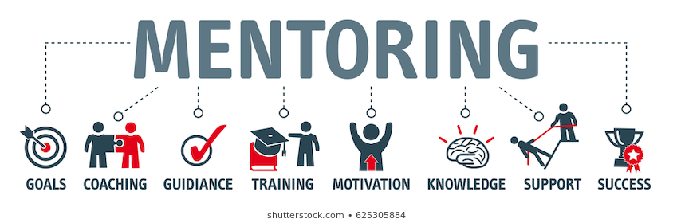
Mentoring
Mentoring involves supporting, training, and guiding an employee in their professional development.
  Mentoring provides EE’s with a one-on-one interaction with somebody in the organization that not only teaches them but also acts as their supporter as they progress in their jobs.
    Mentoring is important to helping EE’s succeed.

Slide 49

Development
Development is training that augments the skills and knowledge of managers and professionals.
  Training and development are also used to improve the skills of employees in their present positions and to prepare them for increased responsibility and job promotions.
    Training is a vital function of human resources management.

Slide 50

Assessing Performance
Assessing an EE’s performance, strengths and weaknesses, is one of the most difficult tasks for managers.
  However, performance appraisal is crucial because it gives employees feedback on how they are doing and what they need to do to improve. It also provides a basis for determining how to compensate and reward EEs, and it generates information about the quality of the firm’s selection, training and development activities.
    Performance appraisals may be objective or subjective.
    An objective assessment is quantifiable.

Slide 51

Assessing Performance
It is important for managers to provide constructive criticism on employee weaknesses in addition to their strengths so workers know what to expect and how they are viewed.
  Whether assessment is objective or subjective, it is vital that the manager discuss the results with the employee, so that the employee knows how well they are doing the job.
    The results of a performance appraisal become useful only when they are communicated, tactfully, to the employee and presented as a tool to allow the employee to grow and improve.

Slide 52

Performance Characteristics
Productivity
  Rate at which work is regularly produced.
Quality
  Accuracy, professionalism, and deliverability of produced work.
Job Knowledge
  Understanding of the objectives, practices, and standards at work.
Problem Solving
  Ability to identify and correct problems effectively.
Communication
  Effectiveness in written and verbal exchanges.
Initiative
  Willingness to identify and address opportunities for improvement.
Adaptability
  Ability to become comfortable with change.
Planning and Organization Skills
  Ability to schedule projects, set goals, and maintain organizational systems.

Slide 53
Performance Characteristics
Teamwork and Cooperation
  Effectiveness of collaborations with co-workers.
Judgment
  Ability to determine appropriate actions in a timely manner.
Dependability
  Responsiveness, reliability, and conscientiousness demonstrated on the job.
Creativity
  Extent to which resourceful ideas, solutions, and methods for task completion are proposed.
Sales
  Demonstrated through success in selling products, services, self, and company.
Customer Service
  Ability to communicate effectively with customers, address problems, and offer solutions that meet or exceed their expectations.
Leadership
  Tendency and ability to serve as a doer, guide, decision maker, and role model.
Financial Management
  Appropriateness of cost controls and financial planning.

Slide 54

Turnover
Turnover, which occurs when employees quit or are fired and must be replaced by new employees, results in lost productivity from the vacancy, costs to recruit replacement employees, management time devoted to interviewing, training, and socialization expenses for new employees.
  Turnover is not always an unhappy occasion when it takes the form of a promotion or transfer. It also can create new opportunities for the organization and others.

Slide 55

Promotion
A Promotion is an advancement to a higher-level job with increased authority, responsibility, and pay.
  In some companies and most labor unions, seniority – the length of time a person has been with the company or at a particular job classification – is the key issue in determining who should be promoted.
    Most managers base promotions on seniority only when they have candidates with equal qualifications. Managers prefer to base promotions on merit.

Slide 56

Transfer
A Transfer is a move to another job within the company at essentially the same wage level.
  Transfers allow workers to obtain new skills or to find a new position within an organization when their old position has been eliminated because of automation or downsizing.

Slide 57
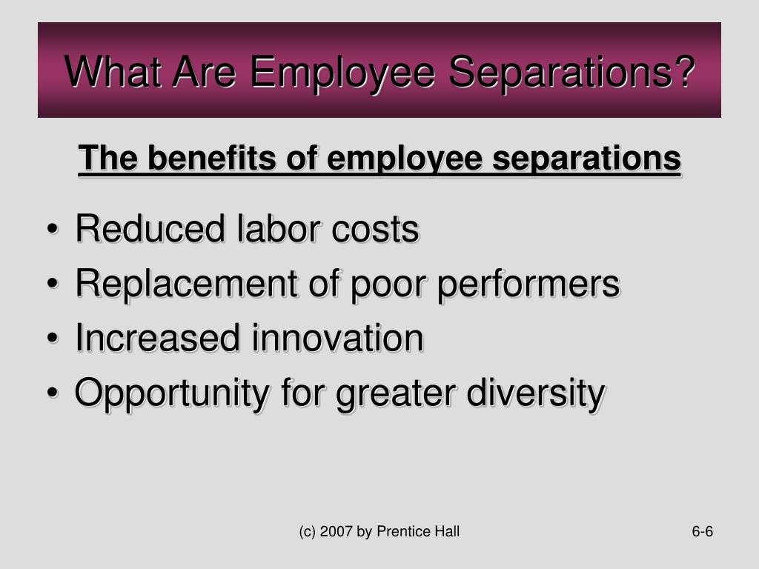
Separations
Separations occur when employees resign, retire, are terminated, or are laid off.
  Employees may be terminated, or fired, for poor performance, violation of work rules, absenteeism, and so on.
    Businesses are generally able to fire employees “at will,” that is, for any reason other than for race, religion, sex, or age, or because an employee is a union organizer.

Slide 58

Termination
Managers should warn employees when their performance is unacceptable and may lead to dismissal, elevating the importance of performance appraisals.
  They should also document all problems and warnings in employees’ work records. To avoid the possibility of lawsuits from individuals who may feel they have been fired unfairly, employers should provide clear, business-related reasons for any firing, supported by written documentation if possible.
    Employee disciplinary procedures should be carefully explained to all employees and should be set forth in employee handbooks.

Slide 59

Exit Interview
When employees choose to leave the organization, the company will often ask them to conduct an Exit Interview.
  An exit interview is a survey used to determine why the employee is leaving the organization.
    The company hopes that this feedback will alert them to processes they can improve upon to dissuade valuable employees from leaving in the future.

Slide 60

Compensating the Workforce
People generally don’t work for free, and how much they are paid for their work is a complicated issue.
  Designing a fair compensation plan is an important task because pay and benefits represent a substantial portion of an organization’s expenses.
    Wages that are too high may result in the company’s products being priced too high, making them uncompetitive in market.
    Wages that are too low may damage employee morale and result in costly turnover.

Slide 61

Compensating the Workforce
Designing a fair compensation plan is a difficult task because it involves evaluating the relative worth of all jobs within the business while allowing for individual efforts.
  Compensation for a specific job is typically determined through wage/salary survey, which tells the company how much compensation comparable firms are paying for specific jobs that the firms have in common.
    Compensation for individuals within a job category depends on both compensation for that job and the individual’s productivity.
    EEs with identical jobs may not receive exactly the same pay.

Slide 62

Financial Compensation
Wages
Financial compensation falls into two general categories – (1) wages and (2) salaries.
  Wages are financial rewards based on the number of hours the employee works or the level of output achieved.
    Wages based on the number of hours are called time wages.
      The advantage of time wages is the ease of computation,
      The disadvantage is that they provide no incentive to increase productivity. In fact, may encourage EE’s to be less productive.

Slide 63

Financial Compensation
Commissions
To overcome the disadvantages of time wages, companies pay on an incentive system, using piece wages or commissions.
  Piece wages are based on the level of output achieved.
    A major advantage of piece wages is that they motivate employees to supervise their own activities and increase output.
  Commissions are an incentive system that pays a fixed amount or a percentage of the employee’s sales.

Slide 64

Financial Compensation
Salary
A Salary is a financial reward calculated on a weekly, monthly, or annual basis.
  Salaries are associated with white-collar workers such as office personnel, executives, and professional employees.
    Although a salary provides a stable stream of income, salaried workers may be required to work beyond usual hours without additional financial compensation.

Slide 65

Financial Compensation
Bonuses
In addition to the basic wages or salaries paid to employees, a company may offer bonuses, monetary rewards offered by companies for exceptional performance as incentives to increase productivity.
  Many workers receive a bonus as a “thank you” for good work and an incentive to continue working hard.
    Bonuses and perks foster happier employees and reduce turnover.

Slide 66

Benefits
Benefits are nonfinancial forms of compensation provided to EEs, such as pension plans for retirement; health, disability, and life insurance; holidays and paid days off for vacation or illness; credit union membership; health programs; child care; employee assistance programs and more.
  Such benefits increase employee security and, to a certain extent, their morale and motivation.

Slide 67

Importance of Workplace Diversity
Customers, employees, suppliers – all the participants in the world of business – come in different ages, genders, races, ethnicities, nationalities, and abilities; a truth that business has come to label diversity.
  Understanding this diversity means recognizing and accepting differences as well as valuing the unique perspectives such differences can bring to the workplace.

Slide 68

The Benefits of Workforce Diversity
There are a number of benefits to fostering and valuing workforce diversity, including:
  More productive use of a company’s human resources.
  Reduced conflict among EE’s of different ethnicities, races, religions, and sexual orientations as they learn to respect each other’s differences.
  More productive working relationships among diverse employees as they learn more about and accept each other.
  Increased commitment to and sharing of organizational goals among diverse employees at all organizational levels.
  Increased innovation and creativity as diverse EE’s bring new, unique perspectives to decision-making and problem-solving tasks.
  Increased ability to serve the needs of a diverse customer base.

Slide 69

Affirmative Action
Many companies strive to improve their working environment through Affirmative Action Programs, legally mandated plans that try to increase job opportunities for minority groups by analyzing the current pool of workers; identifying areas where women and minorities are underrepresented; and establishing specific hiring and promotion goals, along with target dates for meeting those goals to resolve the discrepancy.
  Reverse discrimination occurs when a company’s policies force it to consider only minorities or women instead of concentrating on hiring the person who is best qualified.

Slide 70


