Slide 1
Business Survey
Business Foundations
A Changing World 11th Edition
O.C. Ferrell, Geoffrey Hirt, and Linda Ferrell; McGraw Hill Education; New York, NY 2018
ISBN: 978-1-259-68523-1

Slide 2
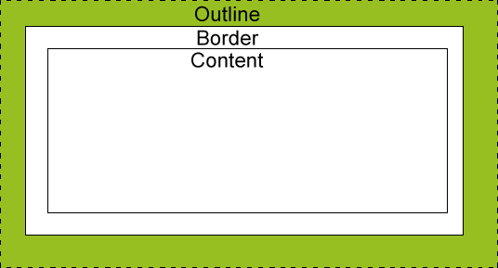
Part Three: Managing for Quality and Competitiveness
Chapter Six: The Nature of Management
Chapter Outline:
The Importance of Management
Management Functions: Plan-Organize-Staff-Direct-Control
Types of Management: Levels and Areas
Skills Needed by Managers
Technical-Conceptual-Analytical-Human Relations
Leadership
Decision Making
Management in Practice

Slide 3
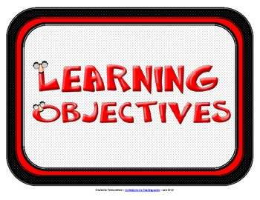
The Nature of Management
Learning Objectives
Define Management and explain its role in the achievement of organizational objectives.
Describe the major functions of management.
Distinguish among three levels of management and the concerns of managers at each level.
Specify the skills managers need in order to be successful.
Summarize the systematic approach to decision making used by many business managers.
Recommend a new strategy to revive a struggling business.

Slide 4
Introduction
For any organization – small or large, for profit or nonprofit – to achieve its objectives, it must have resources to support operations, employees to make and sell the products, and financial resources to purchase additional goods and services, pay employees, and generally operate the business.
To accomplish this, it must also have one or more managers to plan, organize, staff, direct, and control the work that goes on.

Slide 5
The Importance of Management
Management is a process designed to achieve an organization’s objectives by using its resources effectively and efficiently in a changing environment.
Effectively - having the intended result.
Efficiently - accomplishing the objectives with minimum resources.
Managers make decisions about the use of an organization’s resources and are concerned with planning, organizing, directing, and controlling the organizational activities so as to reach its objectives.

Slide 6
The Importance of Management Universal
Management is universal. It takes place not only in business, but also in government, the military, labor unions, hospitals, schools, and religious groups – any organization requiring the coordination of resources.
Every organization must acquire resources (people, services, raw materials and equipment, financial, and information) to effectively pursue its objectives and coordinate their use to turn out a final good or service.

Slide 7
The Importance of Management Staffing
Employees are one of the most important resources in helping a business attain its objectives.
Hiring people to carry out the work of an organization is known as staffing.
Beyond recruiting people for positions within the firm, managers must determine what skills are needed for specific jobs, how to motivate and train employees, how much to pay, what benefits to provide, and how to prepare employees for higher-level jobs in the firm at a later date.

Slide 8
The Importance of Management Downsizing
Sometimes, managers must make the difficult decision to reduce the workforce.
This is known as downsizing, the elimination of significant numbers of employees from an organization.
After downsizing, an effective manager will promote optimism, positive thinking, and minimize criticism and fault-finding.

Slide 9
The Importance of Management Suppliers
Acquiring suppliers is another important part of managing resources and ensuring that products are made available to customers.
A good supplier maximizes efficiencies and provides creative solutions to help the company reduce expenses and reach its objectives.

Slide 10
The Importance of Management Financial Resources
The manager needs adequate financial resources to pay for essential activities.
Primary funding comes from owners and shareholders, as well as banks and other financial institutions.
All these resources and activities must be coordinated and controlled if the company is to earn a profit.

Slide 11
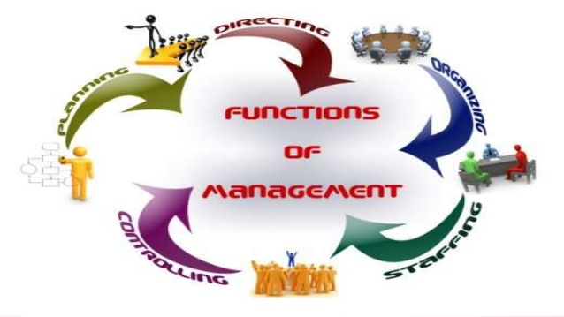
Management Functions
To harmonize the use of resources so that the business can develop, produce, and sell products, managers engage in a series of activities:
Planning
Organizing
Directing
Controlling

Slide 12
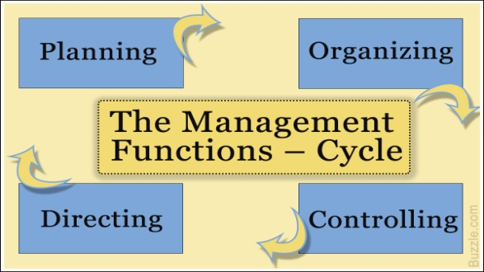
Management Functions
The Functions of Management:
Planning
Activities to achieve the organization’s objectives.
Organizing
Resources and activities to achieve the organization’s objectives.
Directing
Employees’ activities toward achievement of objectives.
Controlling
The organization’s activities to keep it on course.

Slide 13
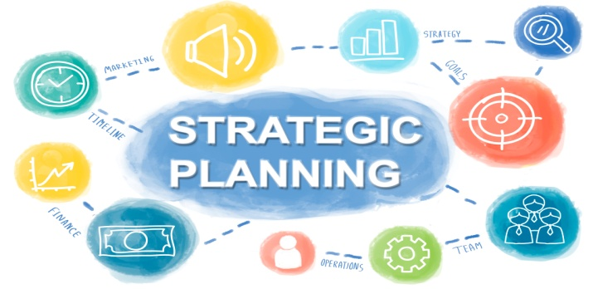
1. Planning
Planning, the process of determining the organization’s objectives and deciding how to accomplish them, is the first function of management.
Planning is a crucial activity because it designs the map that lays the groundwork for other functions.
It involves forecasting events and determining the best course of action from a set of options or choices.
The plan itself specifies what should be done, by whom, where, when, and how.

Slide 14
Planning Mission
A mission, or mission statement, is a declaration of any organization’s fundamental purpose and basic philosophy.
It seeks to answer the question: “What business are we in?”
Good mission statements are clear and concise statements that explain the organization’s reason for existence.

Slide 15
Planning Mission Statement
A well-developed Mission Statement, no matter what the industry or size of the business, will answer five basic questions:
Who are we?
Who are our customers?
What is our operating philosophy (basic beliefs, values, ethics,…)?
What are our core competencies and competitive advantages?
What are our responsibilities with respect to being a good steward of environmental, financial, and human resources?

Slide 16
Planning Goals
A goal is the result that a firm wishes to achieve.
A company almost always has multiple goals, which illustrates the complex nature of the business.
A goal has three key components:
An attribute sought, such as profits, customer satisfaction, or product quality; A target to be achieved, such as the volume of sales or the extent of management training to be achieved; and a time frame in which the goal is to be achieved.

Slide 17
Planning Objectives
Objectives, the ends or results desired by an organization, derive from the organization’s mission.
A business’s objectives may be elaborate or simple.
Common objectives relate to profit, competitive advantage, efficiency, and growth.

Slide 18
Planning Goals vs. Objectives
The principal difference between goals and objectives is that objectives are stated in such a way that they are measureable.
Organizations with profit as an objective want to have money and assets left over after paying off business expenses.
Objectives regarding competitive advantages are generally stated in terms of percentage of sales increase and market share.
Efficiency objectives involve making the best use of the org’s resources.
Growth objectives related to an organization’s ability to adapt and to get new products to the marketplace in a timely fashion.
One of the most important objectives for business is sales.

Slide 19
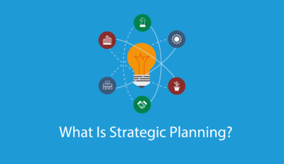
Planning Strategic Plans
There are three general types of plans for meeting objectives – strategic, tactical, and operational.
A firm’s highest managers develop its Strategic Plans, which establish the long-range objectives and overall strategy or course of action by which the firm fulfills its mission.
Strategic Plans must take into account the organization’s capabilities and resources, the changing business environment, and organizational objectives. Plans should be market-driven, matching customers’ desire for value with operational capabilities, processes, and human resources.

Slide 20
Planning Tactical Plans
Tactical Plans are short range and designed to implement the activities and objectives specified in the strategic plan.
These plans, which usually cover a period of one year or less, help keep the organization on the established course.
A fast-paced and ever-changing market requires companies to develop short-run or tactical plans to deal with the changing environment.

Slide 21
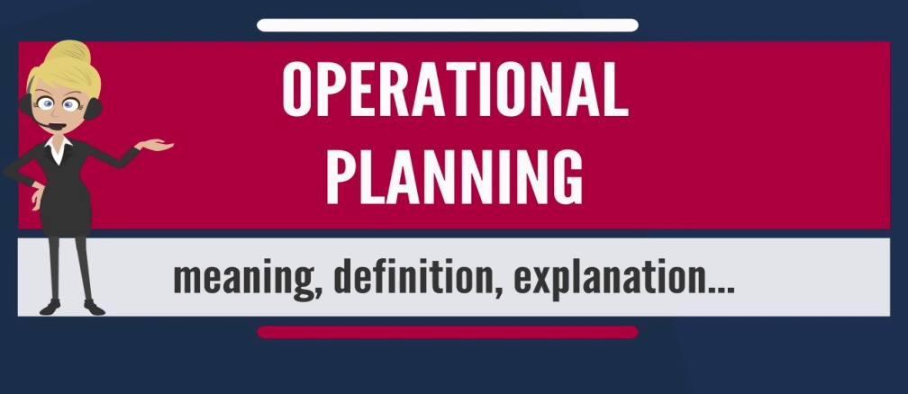
Planning Operational Plans
Operational Plans are very short term and specify what actions specific individuals, work groups, or departments need to accomplish in order to achieve the tactical plan and ultimately the strategic plan.
(i.e.) A work group may be assigned a weekly production quota to ensure there are sufficient products available to elevate market share (tactical goal) and ultimately help the firm be number one in its product category (strategic goal).

Slide 23
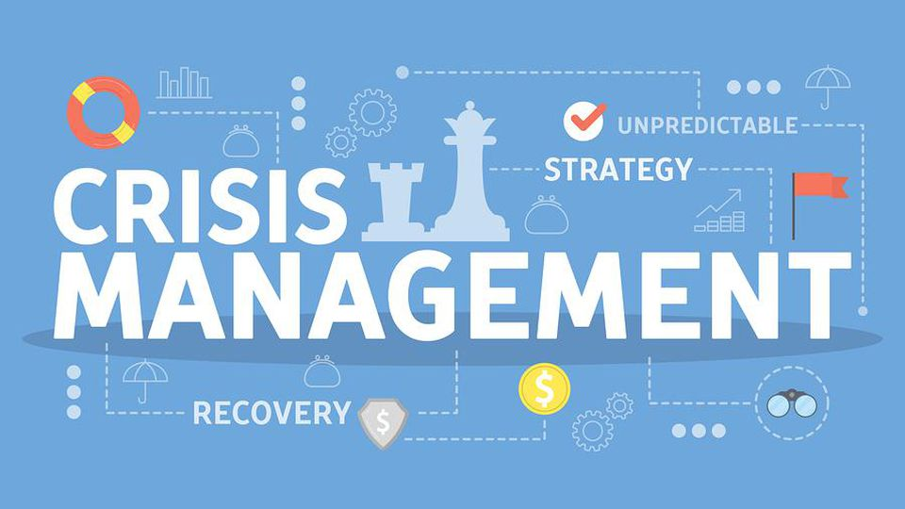
Planning Crisis Management
Another element of planning is Crisis Management or Contingency Planning, which deals with potential disasters such as product tampering, oil spills, fire, earthquake, computer viruses, or even a reputation crisis due to unethical or illegal conduct by one or more employees.
Businesses that have correct and well-thought-out contingency plans tend to respond more effectively when problems occur than do businesses who lack such planning.

Slide 24
Planning Crisis Management
Crisis management plans generally cover maintaining business operations throughout a crisis and communicating with the public, employees, and officials about the nature of and the company’s response to the problem.
Communication is especially important to minimize panic and damaging rumors; it also demonstrates that the company is aware of the problem and plans to respond.

Slide 25
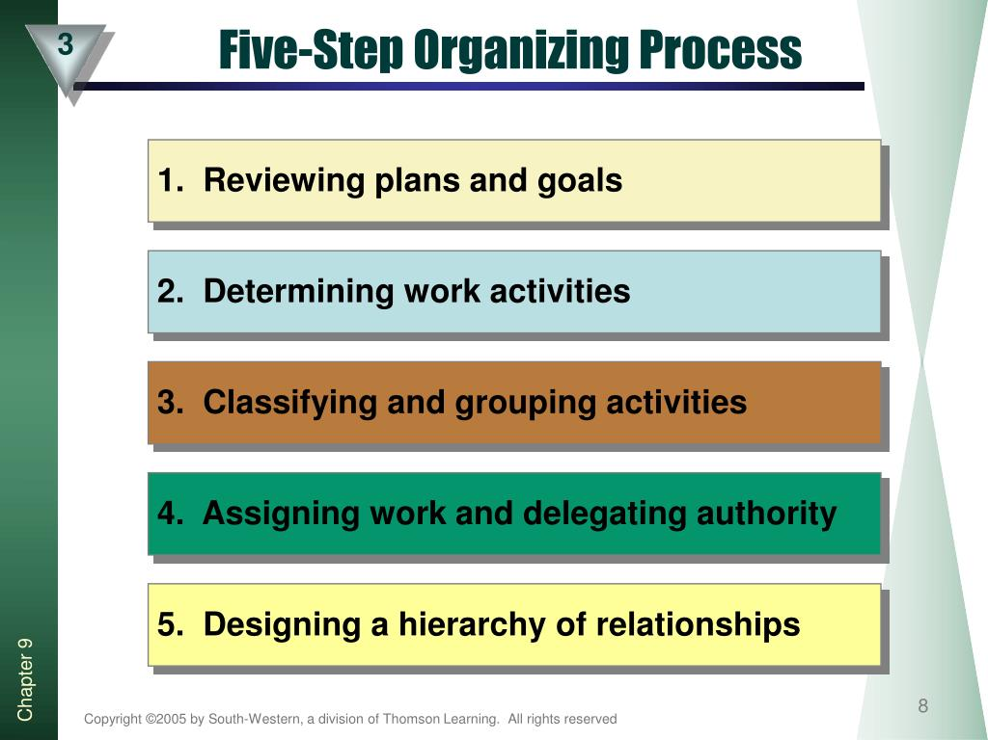
2. Organizing
Organizing is the structuring of resources and activities to accomplish objectives in an efficient and effective manner.
Managers organize by reviewing plans and determining what activities are necessary to implement them; then, they divide the work into small units and assign it to specific individuals, groups, or departments.
Organizing occurs continuously because change is inevitable.

Slide 26
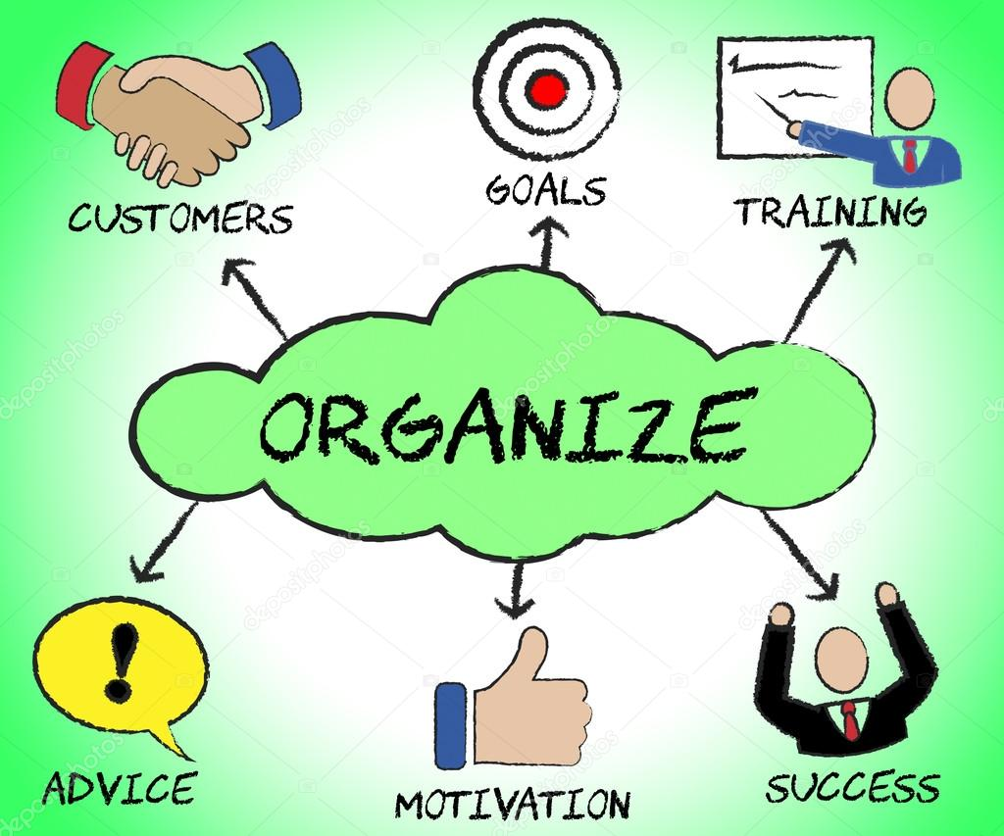
Organizing
Organizing is important for several reasons:
It helps create synergy, whereby the effect of a whole system equals more than that of its parts. It also establishes lines of authority, improves communication, helps avoid duplication of resources, and can improve competitiveness by speeding up decision making.

Slide 27
3. Directing
During planning and organizing, staffing occurs and management must direct the employees.
Directing is motivating and leading employees to achieve organizational objectives.
Good directing involves telling employees what to do and when to do it through the implementation of deadlines and then encouraging them to do their work.
Directing also involves determining and administering appropriate rewards and recognition.

Slide 28
Directing Motivating Employees
Most workers want more than money or reward as an incentive to do their job: they need to know that their employers values their ideas and input.
Managers should give employees some decision making authority as soon as possible. Smart managers ask workers to contribute ideas for reducing costs, making equipment more efficient, improving customer service, or even developing new products.
This participation also serves to increase employee morale.

Slide 29
Directing Motivating Employees
Recognition and appreciation are often the best motivators.
Employees who understand more about their effect on the financial success of the company may be induced to work harder for that success.
Managers who understand the needs and desires of workers can encourage their employees to work harder and more productively.

Slide 30
4. Controlling
Planning, organizing, staffing, and directing are all important to the success of an organization, whether its objective is earning a profit or something else.
Controlling is the process of evaluating and correcting activities to keep the organization on course.

Slide 31
Controlling
Controlling involves (5) activities:
Measuring performance
Comparing present performance with standards or objectives
Identifying deviations from the standards
Investigating the causes of deviations
Taking corrective action when necessary

Slide 32
Controlling
Controlling and planning are closely linked.
Planning establishes goals and standards.
By monitoring performance and comparing it with standards, managers can determine whether performance is on target.
When performance is substandard, management must determine why and take appropriate actions to get the firm back on course.
In short, the control function helps managers assess the success of their plans. When the outcomes of plans do not meet expectations, the control process facilitates revision of the plans.

Slide 33
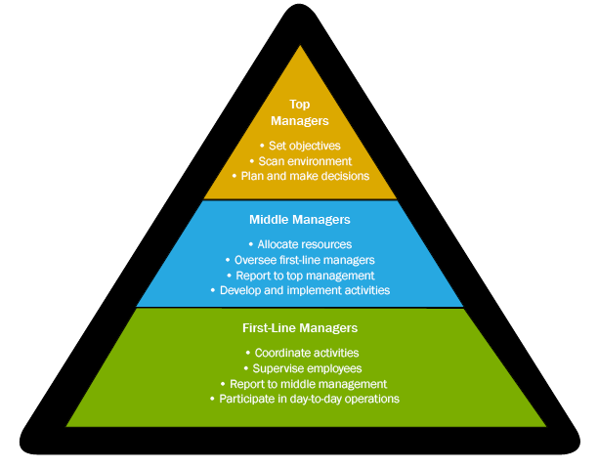
Types of Management
All managers, regardless of type of organization, perform the four functions previously discussed.
But, in a large company with more than one manager, responsibilities must be divided and delegated.
The division of responsibility is generally achieved by establishing levels of management and areas of specialization – finance, marketing, and so on.

Slide 34
Levels of Management
Many organizations have multiple levels of management – top management, middle management, and first-line, or supervisory management.
These levels form a pyramid. And, as the pyramid shape implies, there are generally more middle managers than top managers and still more first-line managers.
Many small organizations may have only one manager, typically the owner, who assumes the responsibilities of all three levels.

Slide 35
Top Management
Top Mangers include the president and other executives, such as the chief executive officer (CEO), chief financial officer (CFO), and the chief operations officer (COO), who have overall responsibility for the organization.
The COO reports to the CEO and is often considered the number two in command.
In public corporations, even the CEO has a boss – the firm’s Board of Directors.

Slide 36
Top Management
Top-level managers spend most of their time planning. They make the organization’s strategic decisions, decisions that focus on overall scheme or key idea for using resources to take advantage of opportunities.
For example, they decide whether to add products, acquire companies, sell unprofitable business segments, and move into foreign markets. They also represent their company to the public and to government regulators.

Slide 37
Diversity
Workforce diversity is an important issue in today’s corporations.
Effective managers at enlightened corporations have found that diversity is good for workers and for the bottom line.
Putting together different kinds of people to solve problems often results in better solutions.

Slide 38
Diversity
Managers from companies devoted to workforce diversity devised five rules that make diversity recruiting work.
Involve Employees
Educate all employees on the tangible benefits of diversity recruiting to garner support and enthusiasm for those initiatives.
Communicate Diversity
Prospective employees are not likely to become excited about joining your company just because you say that your company is diversity-friendly – they need to see it.
Support Diversity Initiatives and Activities
By supporting community-based diversity organizations, your company will generate the priceless word of mouth publicity that will lead qualified diversity candidates to your company.
Delegate Resources
If you are serious about diversity recruiting, you will need to spend some money getting your message out to the right places.
Promote Your Diversity Initiatives
Employers need to sell their company to prospective diversity employees and present them with a convincing case as to why their company is a good fit for the diversity candidate.

Slide 39
Middle Management
Rather than making strategic decisions about the whole organization, Middle Mangers are responsible for tactical and operational planning that will implement the general guidelines established by top management.
Their responsibility is more narrowly focused than that of top managers. They are involved in the specific operations of the firm and spend more time organizing than other mangers.

Slide 40
First-Line Management
Most people get their first management experience as First-Line Mangers, those who supervise workers and the daily operations of the organization.
They are responsible for implementing the plans established by middle management and directing workers’ daily performance on the job.
They spend much of their time directing and controlling.

Slide 41
Areas of Management
At each level there are managers who specialize in the basic functional areas of business: finance, production and operations, human resources (personnel), marketing, IT, and administration.
Each of these management area is important to a business’ success. And, every company must have someone responsible for obtaining financial resources, transforming resources into finished products for the marketplace, hiring and/or dealing with staff, marketing goods and services, handling the firm’s IT resources, and managing a business segment or the overall business.

Slide 42
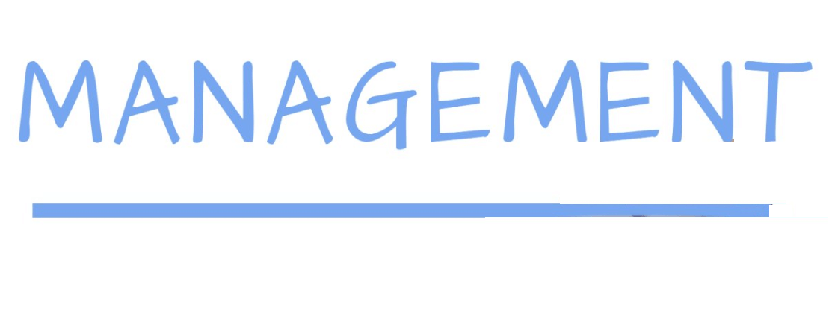
Areas of Management
Financial Manager
Focus on obtaining the money needed for the successful operation of the organization and using that money in accordance with organizational goals.
Production and Operations Manager
Develop and administer the activities involved in transforming resources into goods, services, and ideas ready for the marketplace.
Human Resource Manager
Handle the staffing function and deals with EE’s in a formalized way.
Marketing Manager
Responsible for planning, pricing, and promoting products and making them available to customers through distribution.
Information Technology (IT) Manager
Responsible for implementing, maintaining, and controlling technology applications in business, such as computer networks.
Administrative Manager
Manage an entire business or a major segment of a business; do not specialize in a particular function.

Slide 43
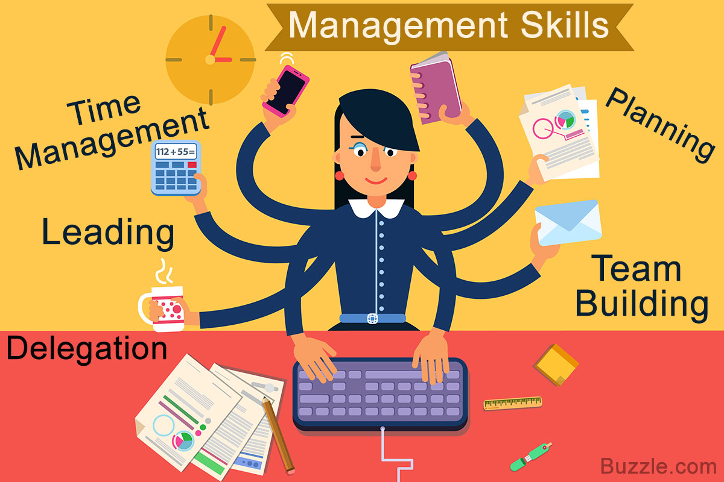
Skills Needed by Managers
Managers are typically evaluated using the metrics of how effective and efficient they are.
Managing effectively and efficiently requires certain skills:
Technical Expertise
Conceptual Skills
Analytical Skills
Human Relations Skills
Leadership

Slide 44
Technical Expertise
Managers need Technical Expertise, the specialized knowledge and training required to perform jobs related to their area of management.
Technical skills are most needed by first-line managers and are least critical to top-level managers.

Slide 45
Conceptual Skills
Conceptual skills, the ability to think in abstract terms, and to see how parts fit together to form the whole, are needed by all managers, but particularly top-level managers.
Top management must be able to evaluate continually where the company will be in the future.
Conceptual skills also involve the ability to think creatively.

Slide 46
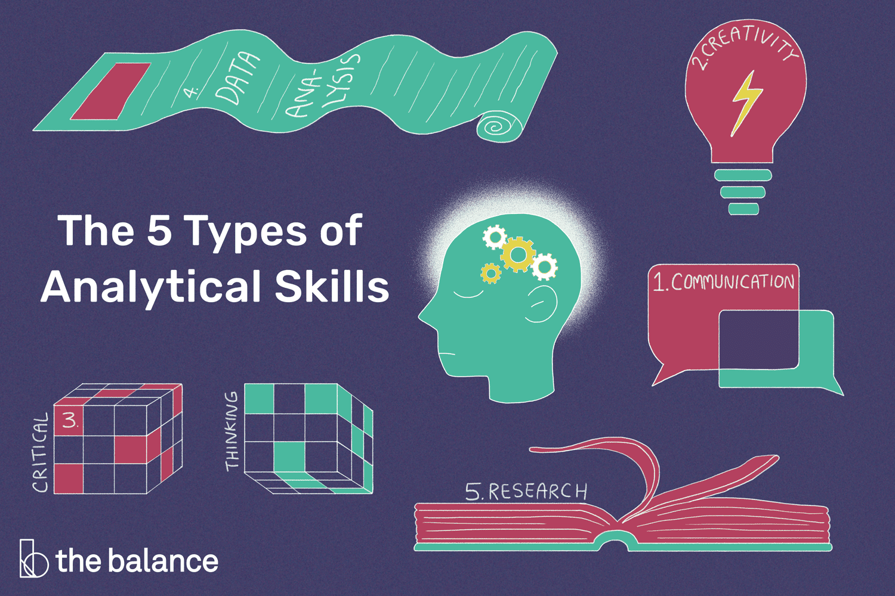
Analytical Skills
Analytical skills refer to the ability to identify relevant issues and recognize their importance, understand the relationships between them, and perceive the underlying causes of a situation.
When managers have identified critical factors and causes, they can take appropriate action.
To be analytical, it is necessary to think about a broad range of issues and to weigh different options before taking action.

Slide 47
Human Relations Skills
People skills, or Human Relations skills, are the ability to deal with people, both inside and outside the organization.
Those who can relate to others, communicate well with others, understand the needs of others, and show a true appreciation for others are generally more successful than managers who lack suck skills.

Slide 48
Leadership
Leadership is the ability to influence employees to work toward organizational goals.
Strong leaders manage and pay attention to the culture of their organizations and the needs of their customers.
Managers are classified into three types based on leadership style:
Autocratic Leaders
Democratic Leaders
Free-Rein Leaders

Slide 49
Autocratic Leaders
Autocratic leaders make all the decisions and then tell employees what must be done and how to do it.
They generally use their authority and economic rewards to get employees to comply with their directions.

Slide 50
Democratic Leaders
Democratic leaders involve their employees in decisions.
The manager presents a situation and encourages his or her subordinates to express opinions and contribute ideas. The manager considers the EE’s point of view and makes decision.

Slide 51
Free-Rein Leaders
Free-Rein leaders let their EE’s work without much interference.
The manager sets performance standards and allows employees to find their own way to meet them.
For this style to be effective, employees must know what the standards are, and they must be motivated to attain them.
The Free-Rein leadership style can be a powerful motivator because it demonstrates a great deal of trust and confidence in EE.

Slide 52
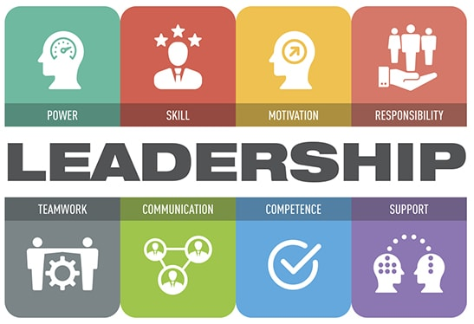
Leadership Styles
The effectiveness of the autocratic, democratic, and free-rein styles depends on several factors:
One consideration is the type of employees.
Other considerations are the manager’s abilities and the situation itself.

Slide 53
Contingency Leadership
Many managers are unable to use more than one style of leadership. Some are even incapable of allowing their subordinates to participate in decision making.
Thus, what leadership style is “best” depends on specific circumstances, and effective managers will strive to adapt their leadership style as circumstances warrant.

Slide 54
Authentic Leadership
Authentic leadership is a bit different from the other three leadership styles because it is not exclusive.
Authentic leaders are passionate about the goals and mission of the company, display corporate values in the workplace, and form long-term relationships with stakeholders.
While leaders might incorporate different leadership styles depending on the business and the situation, all leaders must be able to align employees behind a common vision to be effective.
Strong leaders also realize the value that employees can provide by participating in the firm’s organizational culture.

Slide 55
Successful Leadership
Requirements for Successful Leadership:
Communicate objectives and expectations.
Gain the respect and trust of the stakeholders.
Develop shared values.
Acquire and share knowledge.
Empower employees to make decisions.
Be a role model for appropriate behavior.
Provide rewards and take action to achieve goals.

Slide 56
Employee Empowerment
Businesses are increasingly realizing the benefits of participative corporate cultures characterized by employee empowerment.
Employee Empowerment occurs when employees are provided with the ability to take on responsibilities and make decisions about their jobs.
Employee empowerment does not mean that managers are not needed. In fact, managers are important for guiding employees, setting goals, making major decisions, and other responsibilities.

Slide 57
Participative Decision Making
Leaders who wish to empower EE’s adopt systems that support an EE’s ability to provide input and feedback on company decisions.
Participative Decision Making, a type of decision making that involves both manager and employee input, supports employee empowerment within the organization.
Empowered employees feel like they have an active role in the organization’s success.

Slide 58
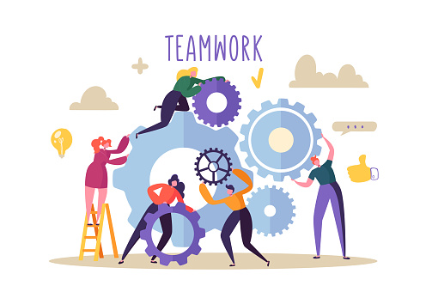
Teamwork
Teamwork has often been an effective way for encouraging employee empowerment.
Although decision making in teams is collective, the most effective teams are those in which all employees are encouraged to contribute their ideas and recommendations.
Because each EE can bring in his or her own unique insights, teams often result in innovative ideas or decisions that would not have been reached by only one or two people.

Slide 59
Teamwork Groupthink
However, truly empowering EE’s in team decision making can be difficult.
It is quite common for more outspoken EE’s to dominate the team and engage in “groupthink,” in which team members go with the majority rather than what they think is the right decision.
Training EE’s how to listen to one another and provide relevant feedback can help to prevent these common challenges.
Another way is to rotate the team leader so that no one person can assume dominance.

Slide 60
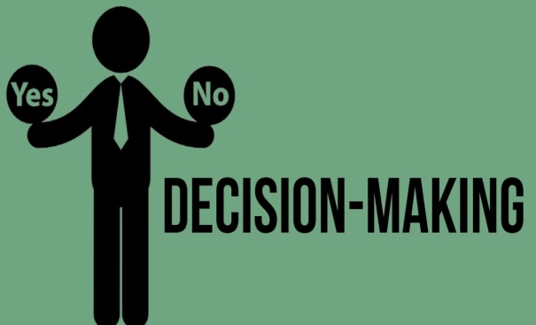
Decision Making
Decision Making is important in all management functions and at all levels, whether the decisions are on a strategic, tactical, or operational level.
A systematic approach using the following six steps usually leads to more effective decision making:
Recognize and define the decision situation.
Develop options to resolve the situation (brainstorm).
Analyze the options (assess appropriateness).
Select the best option. Reject the others.
Implement the decision. Put into action.
Monitor the consequences of the decision.

Slide 61
Management in Practice
Management functions can be simplified into two basic activities:
Figuring out what to do despite uncertainty, great diversity, and an enormous amount of potentially relevant information.
Getting things done through a large and diverse set of people despite having little direct control over most of them.

