Slide 1


Human Relations in Organizations
Session Four

Slide 2

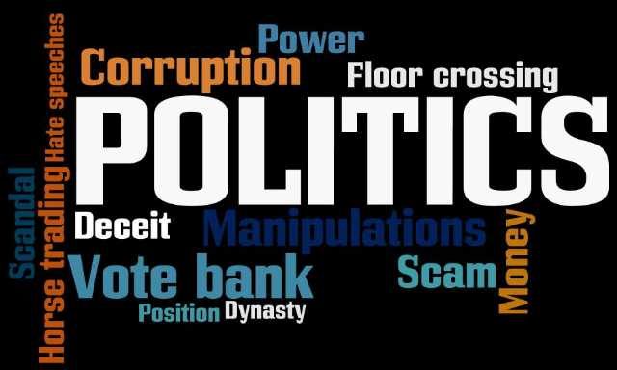
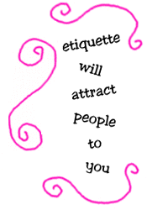
Power and Influence
Ethical Power, Politics, and Etiquette…and Service

Slide 3
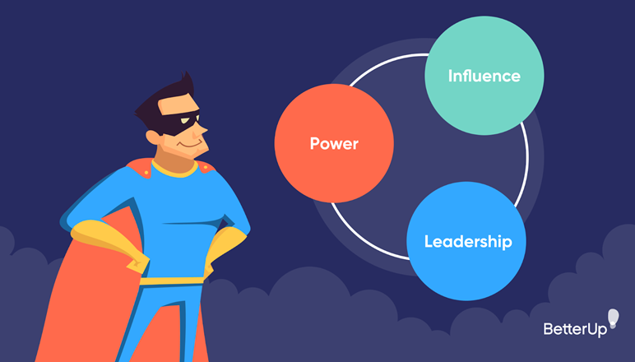
Power-Politics-Etiquette
Power is needed to reach objectives in all organizations, and power affects performance.
  Managers who abuse power using unethical behavior can impair an organization’s morale and performance.

Slide 4
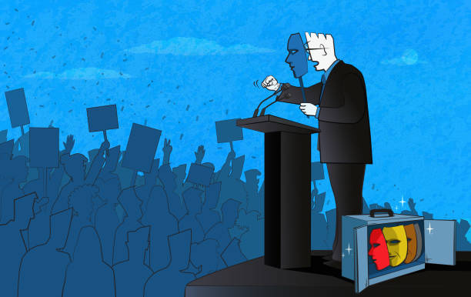
Power-Politics-Etiquette
Like power, politics is important to organizational performance.
  People using unethical politics tend to lie, cheat, and break rules – in time people identify and distrust them.

Slide 5

Power-Politics-Etiquette
People using proper etiquette behave differently than those who don’t.
  Unethical etiquette behavior hurts human relations, & performance.

Slide 6

Power and Politics
Power and politics can be helpful or harmful to an organization, depending on the behavior.
  Most large organizations have codes of conduct to help employees know the difference between ethical and unethical behavior

Slide 7

Ethical Power
Ethical power and politics includes behavior that benefits both the individual and the organization.
  It creates a win-win situation, meeting the goal of human relations.

Slide 8


Power
Power is a person’s ability to influence others to do something they would not otherwise do.
  “Martin Luther King, Jr. said, “Power properly understood is nothing but ability to achieve purpose – it is strength to bring about change.”
    Without power, managers could not achieve organizational objectives.

Slide 9


2 Sources of Power
Position Power
  Derived from top-level management and is delegated down the chain of command.
    Coercive, connection, and reward power
Personal Power
  Derived from the person.
    Referent, information, and expert power

Slide 10
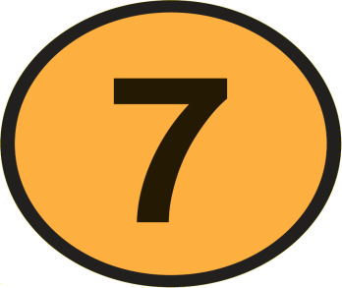
7 Bases of Power
Coercive
  Using threats and/or punishment to influence compliance.
Connection
  Based on the user’s relationship with influential people.
Reward
  Based on the user’s ability to influence others with something of value to them – what’s in it for them?
Legitimate
  Based on the user’s position power, which is given by the organization.
Referent
  Based on the user’s personal power.
Information
  Based on the user’s information being desired by others.
Expert
  Based on the user’s skill and knowledge.

Slide 11

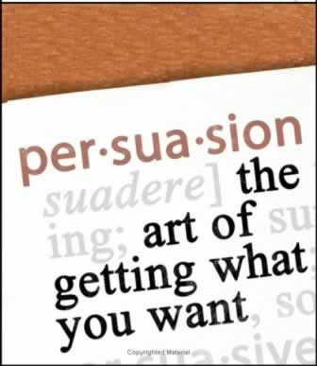
Influencing Tactics
Your power is your ability to influence others to do something they would not otherwise do to help you meet your objectives.
  Along w/ power sources & bases, you need to have persuasion skills.

Slide 12
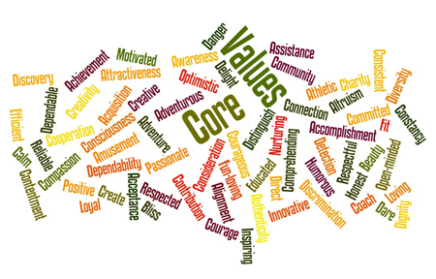

Reading People
If you are going to influence someone, you have to understand the person’s values, attitudes, beliefs, and use incentives that will motivate the individual.

Slide 13

Reading People
Reading people is a key interpersonal skill.
  Put yourself in the place of the person you want to persuade – anticipate how the person sees world
  Get the other person’s expectations right
  Incorporate information about other person’s expectations into your persuasive presentation – use tactic most suitable to person
  Keep focus on other person’s expectations when trying to persuade – create a win-win situation

Slide 14

5 Influencing Tactics
The following five influencing tactics can be used together to help you influence others.
  Ingratiation (Praise)
  Rational Persuasion
  Inspirational Appeal
  Personal Appeal
  Legitimization

Slide 15

1. Ingratiation (Praise)
Be friendly and give praise to get the person in a good mood before making a request.
  When using ingratiation (praise) follow these guidelines:
    Be sensitive to the individual’s moods.
    Compliment the person’s past related achievements.
    State why the person was selected for the task.
      When people believe the task is important and they are well-qualified, they will find it tough to refuse doing you a favor.
    Acknowledge inconvenience posed by your request.

Slide 16

2. Rational Persuasion
Rational Persuasion includes logical arguments with factual evidence to persuade the person that the behavior will result in meeting the objective.
  When you develop rational persuasion, follow these guidelines:
    Explain the reason your objective needs to be met.
    Explain how other person will benefit by meeting your objective.
      Create a win-win situation
    Provide evidence that your objective can be met.
      Offer a detailed step-by-step plan
    Explain how potential problems and concerns will be handled.
      Get the other person’s input on resolution
    Explain why your proposal is better than competing ones.

Slide 17

3. Inspirational Appeal
The inspirational appeal tactic attempts to arouse people’s enthusiasm through internalization to meet the objective.
  You appeal to the other person’s values, ideals, and aspirations or increase their self-confidence by displaying feelings that appeal to the person’s emotions and enthusiasms
  When you develop an inspirational appeal follow these guidelines:
    You need to develop emotions and enthusiasm.
    Link the appeal to the person’s self-concept.
    Link the request to a clear, appealing vision.
    Be positive and optimistic.
    Use nonverbal communication to bring emotions to verbal message.

Slide 18
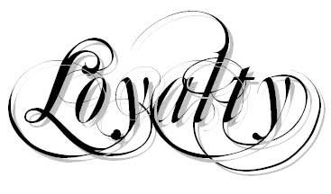
4. Personal Appeal
When using Personal Appeals request the person to meet your objective based on loyalty and friendship.
  Present your request as a favor to you.
    “Please do it for me,” not “This is an order”
  When using personal appeals, follow these guidelines:
  Begin by stating that you need a favor and why it is important.
    Then ask for the favor – it is tough to say no
  Tell the person that you are counting on them.
    Failure to help could hurt your relationship
  Appeal to your friendship.

Slide 19
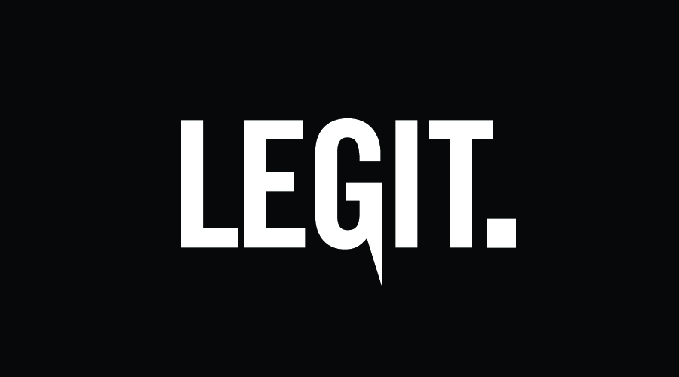
5. Legitimization
With the legitimization tactic, you rely on organizational authority that a reasonable request is being made and that the person should meet your objective.
  When using legitimization, follow these guidelines:
    Refer to organizational policies, procedures, rules, and other written documentation
    Refer to precedent

Slide 20
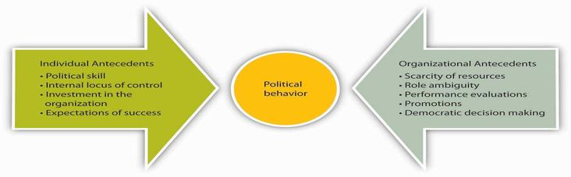
Organizational Politics
Politics is critical to your career success. It is the process of gaining and using power.
  Power and politics go hand in hand.
    Political behavior is used to develop relationships necessary to get the job done.

Slide 21

Political Behavior
Three political behaviors commonly used in organizations:
  1. Networking
    The process of developing relationship alliances with key people for the purpose of politicking – your network of people helps you get your job done.
  2. Reciprocity
    Politics is about reciprocal exchanges – reciprocity involves creating obligations & debts, developing alliances, and using to accomplish objectives.
      When others do something for you, you incur an obligation that they may expect to be repaid.
  3. Coalition Building
    A coalition is a network of alliances that helps you achieve a specific objective.

Slide 22

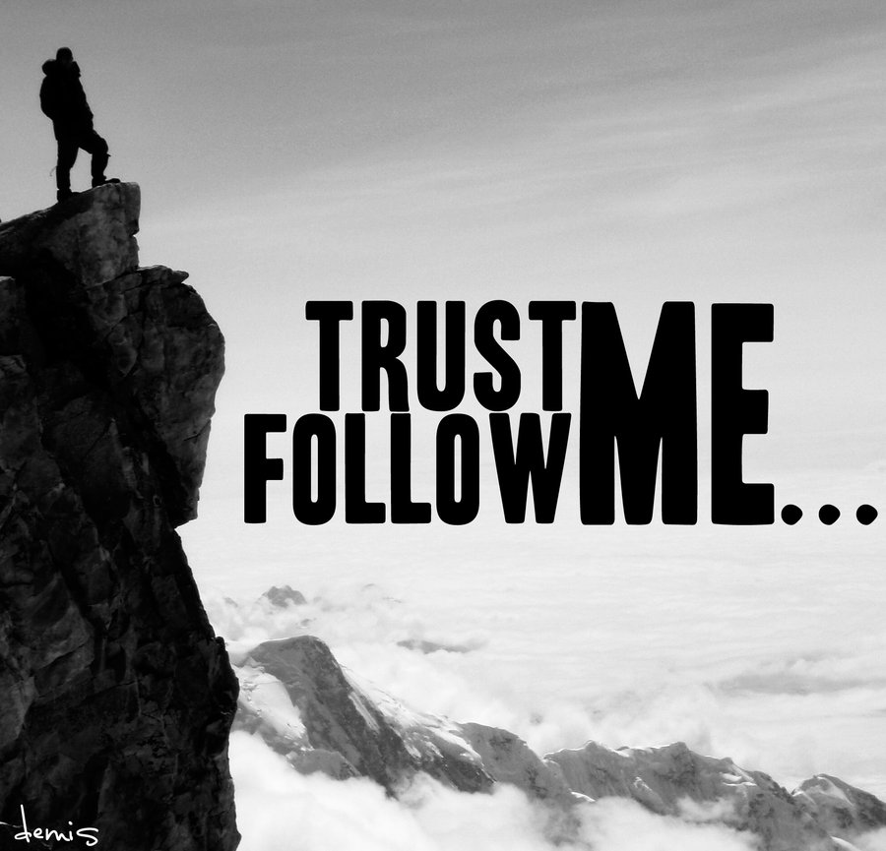
Political Skill
Political success is about developing networks of alliances and coalitions in reciprocal exchanges.
  When exchanges create a win-win situation for all members of the alliance and organization – the goal of human relations is met.
  Developing trust is very important.
    Being honest builds trust.

Slide 23
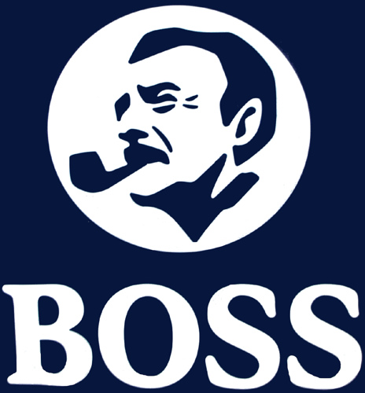

Vertical Politics
Vertical politics are relations with superiors and subordinates.
  Your boss and those you supervise (and who report to you) are the most important persons with whom to develop effective relations.

Slide 24

Relationship with the Boss
Your relationship with your boss will affect job satisfaction and can be the difference between success or failure in job.
  Don’t Try to Change your Boss
    Analyze your boss’ style and preferences, and if necessary – change your style
  Common Expectations of Bosses:
    Loyalty
    Chain of Command
    Cooperation
    Initiative
    Information
    Openness to Criticism
    Regaining Your Boss’s Trust

Slide 25

Developing Manager-Employee Relations
You should strive for harmonious relations with others where differences of opinion are encouraged and settled in a peaceful manner.
  Morale should be kept at high levels, but the manager should not try to please all the people all of the time.
    A manager can have good human relations without being well-liked personally, or popular.

Slide 26
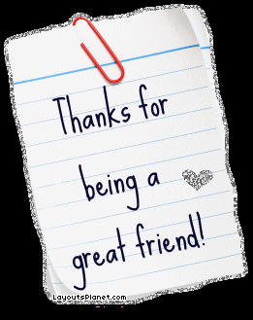

Friendship
The relationship between the manager and employee cannot be one of real friendship.
  Manager must evaluate the employee’s performance.
    True friends don’t evaluate or judge.
  Manager must give employees directions.
    True friends don’t give orders.

Slide 27


The Open-Door Policy
The Open-door policy is the practice of being available to others.
  Your management ability is directly proportional to the amount of time your door is open, both literally and figuratively.
  For effective human relations, you must be available to employees to give them the help they need, when they need it.
    Your success depends on your employees!

Slide 28
Horizontal Politics
Horizontal politics are your relations with your peers and members of other departments and organizations.
  Your peers are the people who are on the same level in the organizational hierarchy as you.
    Your direct peers also report to your boss.

Slide 29


Relations with Peers
To be successful, you must cooperate, compete with, and sometimes even criticize your peers.
  Your success is linked to others in the organization.
  Even though you are cooperative with your peers, you are still in competition with them.
  Do not go looking for faults in your peers, but if your peers fail, help them to try to correct situation or prevent it from recurring.

Slide 30

Business Etiquette
When using power and politics, our behavior should be ethical using proper business etiquette:
  Conversation Etiquette
  Dining Etiquette
  Hoteling, Telecommuting, and Cubicle Etiquette
  Cell Phone Etiquette
  E-Mail and Texting – Instant Messaging Etiquette
  Job Interview Etiquette
  Meeting and Presentation Etiquette
  Networking Etiquette

Slide 31

Motivation
Motivating Performance

Slide 32
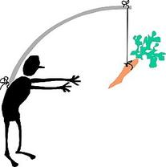

Motivating Performance
The primary reason people do what they do is to meet their needs/wants - Motivation is the internal process leading to behavior to satisfy those needs/wants.
  Motivation is about answering people’s often unasked question, “What’s in it for me?” by helping them meet their needs/wants.

Slide 33

Motivation
The process people go through to meet their need is:
  Need – Motive – Behavior – Satisfaction or Dissatisfaction
    For Example:
    You are thirsty (Need) and have a drive (Motive) to get a drink.
    You drink (Behavior) that quenches your thirst (Satisfaction)

Slide 34

Motivation
Managers often view motivation as an employee’s willingness to put forth effort and commitment to achieve organizational objectives.
  Your ability to motivate yourself and others is critical to career success.
    Motivated, engaged employees give companies a competitive advantage through increased performance.

Slide 35
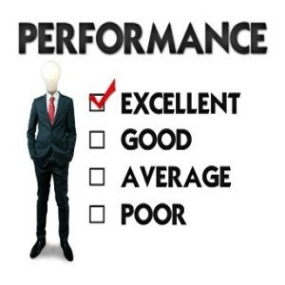
The Performance Formula
The level of performance attained is determined by three independent factors:
    Ability
    Motivation
    Resources
  For performance levels to be high, it is the manager’s responsibility to ensure all three factors are addressed.
    Performance = Ability x Motivation x Resources

Slide 36

Content Motivational Theories
To increase performance, managers must know their own needs and their employees’ needs, and must satisfy them – this is the goal of human relations.
  The Content Motivational Theories focus on identifying people’s needs in order to understand what motivates them.

Slide 37
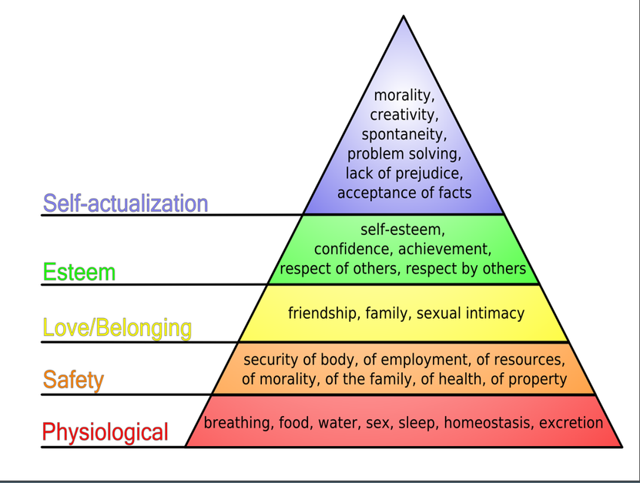
Needs Hierarchy
Maslow
The Needs Hierarchy is Maslow’s theory of motivation, which is based on five needs:
    Physiological
    Safety
    Social
    Esteem
    Self-Actualization

Slide 38
ERG Theory
Clayton Alderfer
ERG Theory organizes Maslow’s hierarchy into three levels of needs:
    Existence (Physiological and Safety Needs)
    Relatedness (Social Needs)
    Growth (Esteem and Self-Actualization)
  To use ERG Theory, answer six questions:
      What need does the individual have?
      What needs have been satisfied?
      Which unsatisfied need is the lowest in the hierarchy?
      Have some higher-order needs been frustrated? If so, how?
      Has the person refocused on the lower-level need?
      How can the unsatisfied needs be satisfied?

Slide 39

Two-Factor Theory
Herzberg
Two-Factor Theory is Herzberg’s classification of needs as:
  Hygienes
    Hygienes are called “extrinsic factors” because attempts to motivate come from outside the job itself.
  Motivators
    Motivators are called “intrinsic factors” because motivation comes from the job itself.

Slide 40


Using Two-Factor Theory to Motivate Employees
Herzberg contends: providing hygiene factors keeps people from being dissatisfied, but it does not motivate people.
  To motivate, you must ensure hygiene factors are adequate – once employees are satisfied with their environment, they can be motivated through their jobs.
    The best way to motivate employees is to build challenge and opportunity for achievement into the job itself.

Slide 41
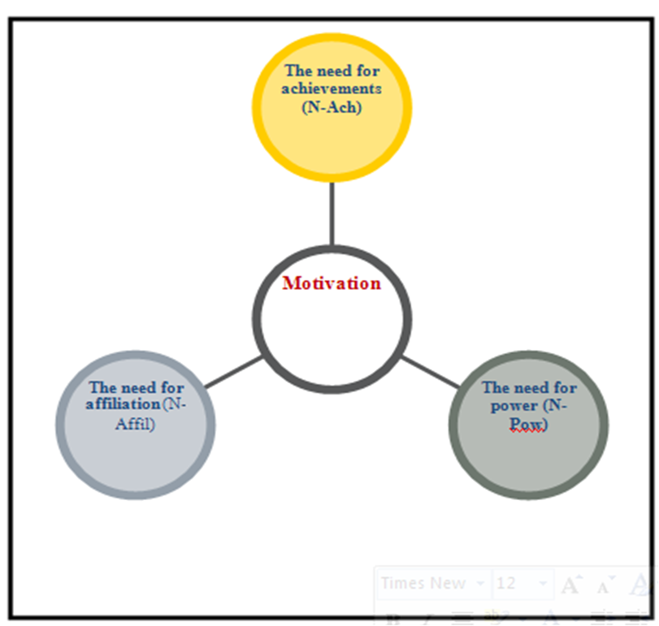
Manifest Needs Theory
McClelland
The Manifest Needs Theory of motivation is primarily McClelland’s classification of needs as:
  Achievement (Esteem and Self-Actualization)
  Power (Esteem and Self-Actualization)
  Affiliation (Social and Relatedness Needs)
  It is a personality-based approach to motivation.
    All people possess the need for achievement, power, and affiliation – but, to varying degrees.

Slide 42

Manifest Needs Theory
1. The Need for Achievement
  Wanting to take personal responsibility for solving problems; goal-oriented; seeking challenge, excellence and individuality; taking calculated, moderate risks; desiring concrete feedback on their performance; willing to work hard.

Slide 43


Manifest Needs Theory
2. The Need for Power
  Wanting to control the situation; wanting influence or control over others; enjoying competition in which they can win; willing to confront others.

Slide 44

Manifest Needs Theory
3. The Need for Affiliation
  Seeking close relationships with others; wanting to be liked by others; enjoying list of social activities; seeking to belong.

Slide 45

Process Motivation Theories
Content Motivation Theories attempt to understand what motivates people, whereas Process Motivation Theories attempt to understand how and why people are motivated.
  Their focus is more on behavior than needs.

Slide 46

Expectancy Theory
Victor Vroom
The Expectancy Theory states motivation depends on how much people want something and how likely they’re get it.
  Motivation = Expectancy x Valence
  Expectancy
    Person’s perception of their ability (probability) to accomplish objective.
    The higher one’s expectancy, the better the chance for motivation.
  Valence
    The value a person places on the outcome or reward.
    The higher the value (importance) of the outcome or reward, the better the chance of motivation.

Slide 47
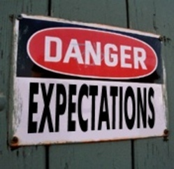
Motivating with Expectancy Theory
The following conditions should be implemented to motivate others:
  Define objectives and necessary performance needed to achieve.
  Tie performance to rewards.
  Be sure rewards are of value to the person(s).
  Make sure they believe you will do what you say you will do – you need their trust to motivate.

Slide 48

Equity Theory
According to Equity Theory, people compare inputs - effort, experience, seniority, status, intelligence, and so forth – and outputs – praise, recognition, promotions, increased status, supervisor’s approval, etc. – with those of relevant others.
  If employees believe there is inequity, they will change their behavior to create equity, such as doing less work, changing the situation – like getting a raise, or getting another job.
    Most employees tend to inflate their own efforts or performance when comparing themselves with others.

Slide 49

Motivating with Equity Theory
Using Equity Theory in practice can be difficult because you don’t know:
  Who the employee’s reference group is, and
  What their view of inputs and outcomes is
  Some useful general recommendations:
    Equity is based on perception.
    Rewards should be equitable.
    High performance should be rewarded, but employees must understand the inputs needed to attain certain outcomes.
    Realize that what people know or don’t know isn’t important – all that really counts is what they feel.

Slide 50
Reinforcement Theory
B.F. Skinner
Reinforcement Theory focuses on getting people to do what you want them to do through incentives, because incentives do motivate behavior and performance.
  The Theory contends that people’s behavior is learned through experiences of positive and negative consequences.
  It suggests that rewarded behavior tends to be repeated while unrewarded behavior tends not to be repeated.
    An individual learns what is, and is not, desired behavior as a result of the consequences for specific behavior.

Slide 51

Four Types of Reinforcement
Positive Reinforcement
  A method of encouraging continued behavior is to offer attractive consequences (rewards) for desirable performance.
Avoidance Reinforcement
  Avoidance is also called “negative reinforcement.”
  The person avoids the negative consequence.
Extinction
  Extinction attempts to reduce or eliminate undesirable behavior by withholding reinforcement when the behavior occurs.
Punishment
  Punishment is used to provide an undesirable consequence for undesirable behavior.

Slide 52
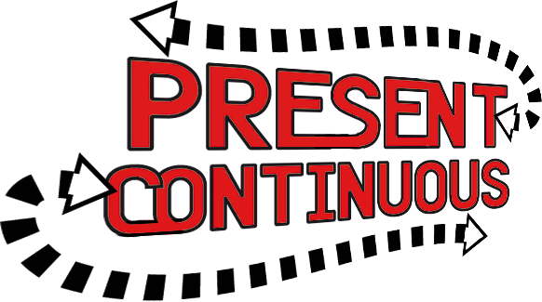
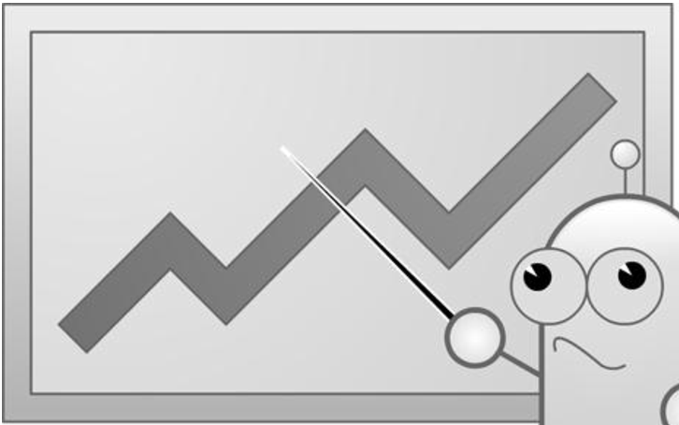
Schedules of Reinforcement
The frequency and magnitude of the reinforcement may be as important as the reinforcement itself
  The two major classifications are:
  Continuous Reinforcement
    Each desired and undesired behavior is reinforced.
  Intermittent Reinforcement
    The reward is given based on the passage of time or output.

Slide 53

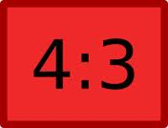
Intermittent Reinforcement
When electing to use Intermittent Reinforcement, there are four alternatives:
  Fixed Interval Schedule
  Variable Interval Schedule
  Fixed Ratio Schedule
  Variable Ratio Schedule
  Ratios are generally better motivators than intervals.
  The variable ratio is the most powerful schedule for sustaining behavior.

Slide 54
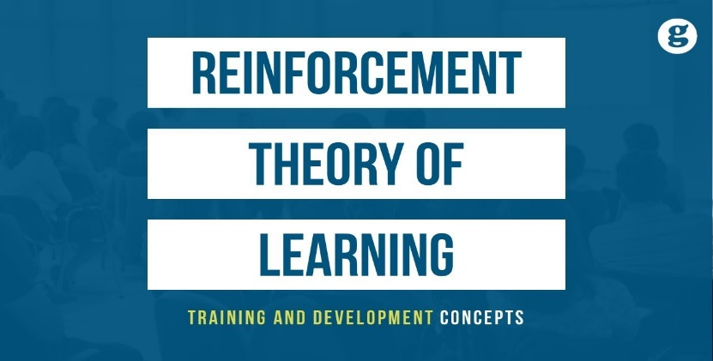
Motivating with Reinforcement
Generally, positive reinforcement is the best motivator.
  Following are some general guidelines:
    Make sure employees know exactly what is expected of them.
    Select appropriate awards.
    Select the appropriate reinforcement schedule.
    Do not reward mediocre or poor performance.
    Look for positive and give praise, don’t focus on negative and criticizing.
    Never go a day without giving praise.
    Do things for people, instead of to them, and you will see improvement.

Slide 55


Incentives and Recognition
People do respond to incentives and we can nearly always get them to do what we want them to do as long as we find the right levers – combination of types and schedules of reinforcement – to motivate the desired behavior.
  One great method of recognition that we can all use, and that is not part of a formal program is giving praise.

Slide 56


Giving Praise
Giving praise develops a positive self-concept and leads to better performance through the Pygmalion Effect.
  Praise is a motivator – not a hygiene – because it meets the employees’ needs for self-esteem and self-actualization, growth, and achievement: It is probably the most powerful, least expensive, simplest, and yet most underused motivational technique.

Slide 57

Giving Praise
The steps in the Giving Praise are as follows:
  Tell the person exactly what was done correctly.
  Tell the person why the behavior is important.
  Stop for a moment of silence.
  Encourage repeat performance.
  Praise is a reinforcement that is very effective when used with a variable interval schedule.
  Send “thank you” notes:
    A handwritten note is personal and powerful.

Slide 58
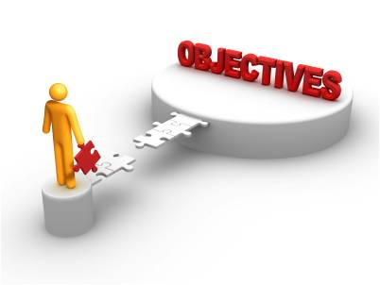
Objectives and MBO
Setting difficult objectives leads to higher levels of motivation and performance.
  Motivate people to high levels of performance; objectives should be:
    Difficult but Achievable
    Observable and Measurable
    Specific – with a Target Date
    Participatively Set when Possible
    Accepted

Slide 59
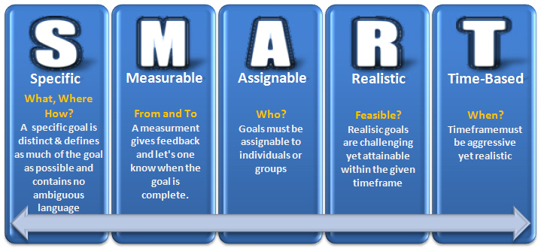
Writing Objectives
Objectives should be written, and:

Slide 60

Management By Objectives (MBO)
Management by Objectives is the process in which managers and their employees jointly set objectives, periodically evaluate the performance, and reward according to the results.
  Three steps of an MBO program are as follows:
    Set Individual Objectives and Plans
    Give Feedback and Evaluate Performance
    Reward According to Performance

Slide 61
Management By Objectives (MBO)
An MBO program is a motivator – not a hygiene – because it meets employee’s needs for esteem and self-actualization, growth, power and achievement.
  An MBO program empowers employees to increase responsibility with an opportunity for creating meaningful challenging work to help them grow and accomplish what they and the manager want/need to accomplish.
    An MBO program creates a win-win situation.

Slide 62

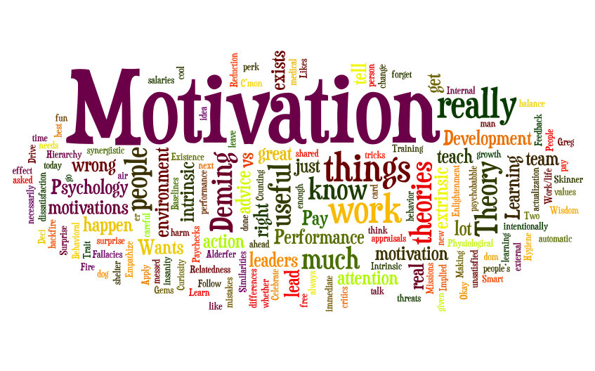
Motivation
Motivating and Rewarding Employees
  Define and explain motivation.
  Compare and contrast early theories of motivation.
  Compare and contrast contemporary theories of motivation.
  Discuss current issues in motivating employees.

Slide 63

Motivation
To get employees to put forth maximum work effort, managers need to know how and why they are motivated.
  The secret to being an effective motivator is understanding each individual’s unique needs.

Slide 64

Motivation
Motivation refers to the process by which a person’s efforts are energized, directed, and sustained toward attaining a goal.
  The definition has three key elements:
    Energy
      A measure of channeled intensity or drive.
    Direction
      Effort directed toward and consistent with organizational goals.
    Persistence
      Putting forth continuous effort to achieve those goals.

Slide 65

Motivation
Motivating high levels of employee performance is an important organizational concern and managers need to keep looking for answers.
  A recent Gallup poll found that a large majority of U.S. employees – some 64 percent are not excited about their work.
    “Employees are essentially ‘checked out.’ They’re sleepwalking through their workday, putting time, but not energy or passion, into their work.”

Slide 66


Maslow’s Hierarchy of Needs Theory
Abraham Maslow – a psychologist – proposed that within every person is a hierarchy of five needs: from the physiological to self-actualization
  Each level must be substantially satisfied before the next becomes dominant; an individual moves up the hierarchy 0ne level to next.
  Lower level needs are satisfied externally, while higher-level needs are satisfied internally.
    Managers use this knowledge to satisfy EE’s needs.
    Once a need is satisfied, it no longer motivates.

Slide 67
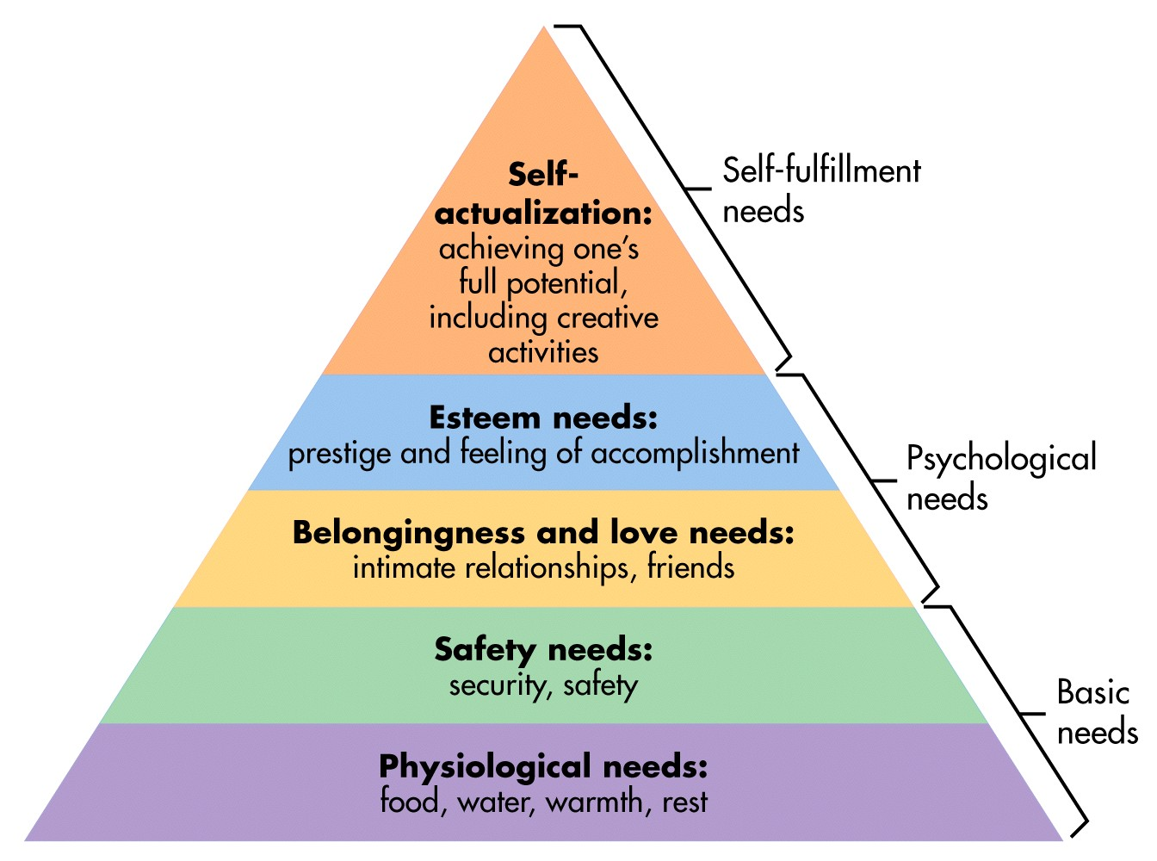
Maslow’s Hierarchy of Needs Theory

Slide 68

McGregor’s Theory X and Theory Y
Based on two assumptions about human nature:
  Theory X
    A negative view of people that assumes workers have little ambition, dislike work, want to avoid responsibility, and need to be closely controlled to work effectively.
  Theory Y
    A positive view that assumes employees enjoy work, seek out and accept responsibility, and exercise self-direction.
      To maximize EE motivation, use Theory Y practices – Allow EE’s to participate in decisions, create responsible and challenging jobs, and encourage good group relations.

Slide 69
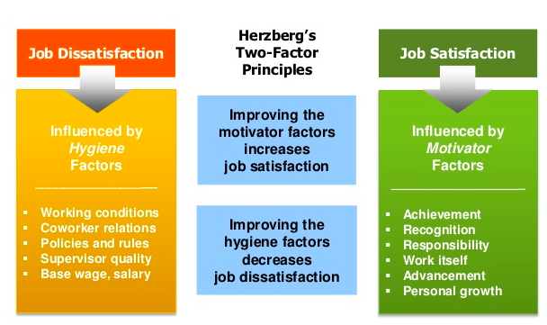
Herzberg’s Two-Factor Theory
Motivation-Hygiene Theory
According to Herzberg’s Two-Factor Theory: Intrinsic Factors (Motivators)are related to job satisfaction, while Extrinsic Factors (Hygienes) are associated with job dissatisfaction.

Slide 70

McClelland’s Three-Needs Theory
According to McClelland’s Three-Needs Theory, The following three acquired (not innate) needs are major motives in work:
  Need for Achievement
    The drive to succeed and excel in relation to a set of standards.
  Need for Power
    The need to make others behave in a way that they would not have behaved otherwise.
  Need for Affiliation
    The desire for friendly and close interpersonal relationships.
      The best managers tend to be high in need for power, and low in need for affiliation.

Slide 71

Goal-Setting Theory
According to Goal-Setting Theory, specific goals increase performance and difficult goals, when accepted, result in higher performance than do easy goals.
  Performance is often higher when EE’s participate in setting goals.
  Performance is also higher when EE’s receive feedback on progress.

Slide 72
Goal-Setting Theory
Three other contingencies besides feedback influence the goal-performance relationship:
  Goal Commitment
    An internal locus of control and participation in goal-setting.
  Adequate Self-Efficacy
    An individual’s belief that they are capable of performing a task.
  National Culture
    Americans assume subordinates will be reasonably independent, people will seek challenging goals, and performance is considered important by both managers and subordinates.

Slide 73

Job Design
Managers should design jobs deliberately and thoughtfully to reflect the demands of the changing environment, the organization’s technology, and EE’s skills, abilities, and preferences.
    When jobs are designed like that EE’s are motivated to work hard.

Slide 74

Job Design
According to Hackman and Oldman, any job can be described in terms of the following five core job dimensions:
  1. Skill Variety
    Degree to which the job requires a variety of activities so the worker can use a number of different skills and talents.
  2. Task Identity
    Degree to which the job requires completion of a whole and identifiable piece of work.
  3. Task Significance
    Degree to which the job affects the lives or work of other people.

Slide 75
Job Design
According to Hackman and Oldman, any job can be described in terms of the following five core job dimensions:
  4. Autonomy
    Degree to which the job provides freedom, independence, and discretion to the individual in scheduling the work and in determining the procedures to be used in carrying it out.
  5. Feedback
    Degree to which carrying out the work activities required by the job results in the individual obtaining direct and clear information about the effectiveness of one’s performance.

Slide 76

Equity Theory
Equity Theory, developed by J. Stacey Adams, proposes that EE’s compare what they get from a job (outcomes) in relation to what they put into it (inputs) and then compare their input-outcome ratio with those of relevant others.
  If the ratio is inequitable, whether under-rewarded or over-rewarded, the EE will attempt to do something about it.
    The result might be lower or higher productivity, improved or reduced quality of output, increased absenteeism, or voluntary resignation.

Slide 77

Equity Theory
The referent – the other persons, systems, or selves individuals compare themselves against in order to see equity – is an important variable.
  The “persons” category includes other individuals with similar jobs in the same organization but also includes friends, neighbors, or professional associates.
  The “system” category includes organizational pay policies, procedures, and allocation.
  The “self” category refers to input-outcome ratios that are unique to the individual.

Slide 78

Equity Theory
Originally Equity Theory focused on Distributive Justice, which is the perceived fairness of the amount and allocation of rewards among individuals.
  Most recent research has focused on looking at issues of Procedural Justice, which is the perceived fairness of the process used to determine the distribution of rewards.
    By increasing the perception of procedural justice, EE’s are likely to view their bosses and the organization as positive even if they’re dissatisfied with pay, promotions, and other personal outcomes.

Slide 79
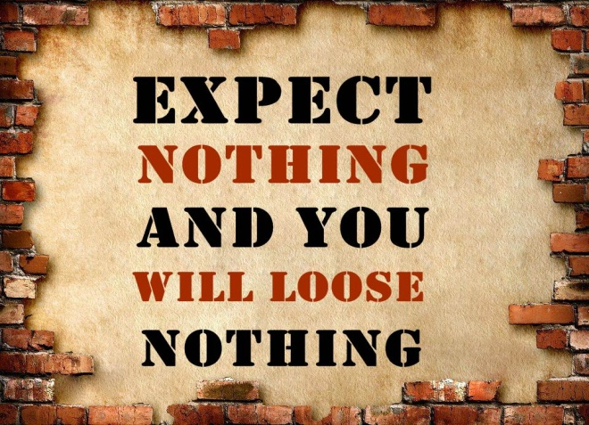
Expectancy Theory
Victor Vroom’s Expectancy Theory states than an individual tends to act in a certain way based on the expectation that the act will be followed by a given outcome and on the attractiveness of that outcome to the individual.
  It includes three variables or relationships:
    Expectancy – Instrumentality – Valence

Slide 80
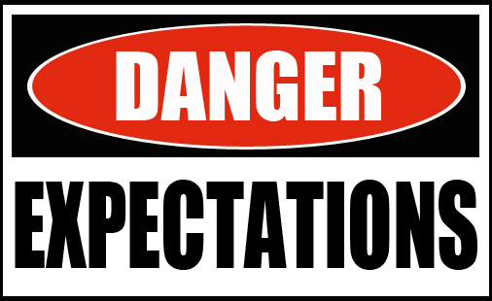
Expectancy Theory
Expectancy or Effort-Performance Linkage
  The probability perceived by the individual that exerting a given amount of effort will lead to a certain level of performance.
Instrumentality or Performance-Reward Linkage
  The degree to which the individual believes that performing at a particular level is instrumental in attaining the desired outcome.
Valence or Attractiveness of Reward
  The importance that the individual places on the potential outcome or reward that can be achieved on the job. It considers both the goals and needs of the individual.

Slide 81
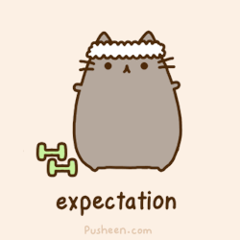
Expectancy Theory
The key to Expectancy Theory is understanding an individual’s goal and the linkage between effort and performance, between performance and rewards, and finally, between rewards and individual goal satisfaction.
  Managers should align EE awards with their individual needs.
    Managers must recognize that no universal principle explains what motivates individuals, and they must understand why EE’s view certain outcomes as attractive or unattractive.

Slide 82

Rewards Programs
Employee rewards programs play a powerful role in motivating appropriate EE behavior.
  1. Open-Book Management
    A motivational approach in which an organization’s financial statements are shared with all EE’s as they participate in workplace decisions.
      Used to motivate EE’s to make better decisions about their work, be better able to understand the implications of what they do and how they do it, and see the ultimate impact on the bottom line.
      By sharing this information, EE’s begin to see the link between their efforts, level of performance, and operational results.

Slide 83
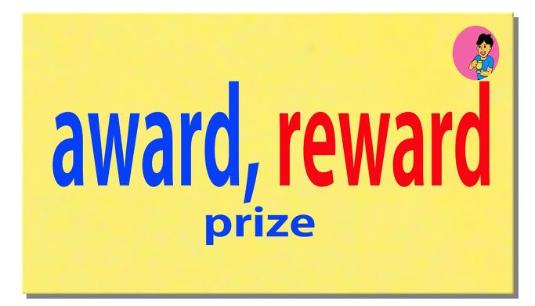
Rewards Programs
Employee rewards programs play a powerful role in motivating appropriate EE behavior.
  2. Employee Recognition
    Programs that consist of personal attention and expressions of interest, approval, and appreciation for a job well done.
      Recognition is the most powerful workplace motivator.
      But, recognition doesn’t have to come from managers alone.

Slide 84

Rewards Programs
Employee rewards programs play a powerful role in motivating appropriate EE behavior.
  3. Pay-for-Performance
    PFP programs are variable compensation plans that pay EE’s on the basis of some performance measure.
      Performance measures might include such things as individual productivity, team or work group productivity, departmental productivity, or the overall organization’s profit performance.
      Making some or all of an EE’s pay conditional on some performance measure focuses their attention and effort toward that measure, then reinforces the continuation of the effort with a reward.

Slide 85

Rewards Programs
It’s hard to keep EE’s productive during challenging times, even though it’s especially critical.
  The key with any rewards program is continuing to show EE’s that the company cares about them.
    The value in companies comes from EE’s who are motivated to be there, and managers have to give EE’s a reason to want to be there.

Slide 86

…

