Slide 1
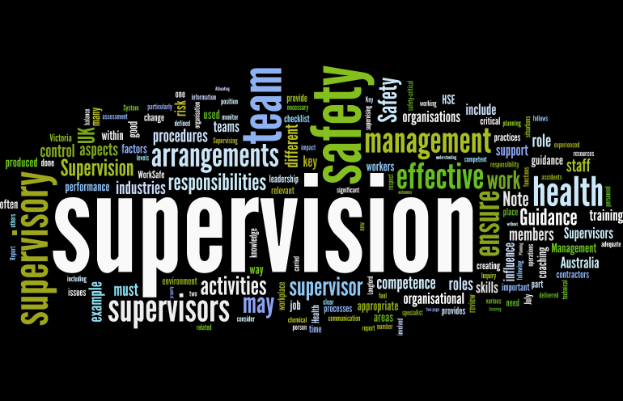
Supervision
Supervision
  Concepts and Practices of Management, 13th Edition
    Edwin C. Leonard, Jr., Ph.D. and Kelly A. Trusty, Ph.D. Cengage Learning, Boston, MA 2013
      ISBN: 978-1-285-86637-6

Slide 2

Part Three: Organizing, Staffing, Managing and Measuring for Success
Chapter Eleven: Building and Managing Effective Teams
  After studying this chapter, you will be able to:
    Describe the form and function of the different types of work groups and the unique relevance of each to the supervisory role.
    Explain the relevance of research findings about work groups.
    Distinguish the relationships between EE morale, engagement, teamwork and productivity, and identity factors that influence EE engagement.
    Discuss techniques for assessing EE morale, including observation and EE attitude surveys.
    Understand why counseling is an important part of the supervisor’s job.
    Identify programs that organizations use to help EEs with personal and work-related problems.

Slide 3

Understanding Work Groups and Their Importance
A supervisor must be concerned not only with EEs as individuals but also with how those EEs relate to groups both inside and outside the supervisor’s department.

Slide 4
Understanding Work Groups and Their Importance
On the job, an EE’s attitude and morale can be shaped to a large degree by co-workers, at times even more than by the supervisor or other factors in the work environment.
  Therefore, a supervisor should be aware of work groups and how those groups function.
    Moreover, a supervisor must understand how morale influences EE performance and what can be done to maintain a high level of morale at the departmental level.

Slide 5

Why Work Groups Form and Function
Work groups form & function in work settings for many reasons. Among the most common are the following:
  Companionship and Identification
    The work group provides a peer relationship and a sense of belonging, which can help satisfy the EE’s social needs.
  Behavior Guidelines
    People tend to look to others, especially their peers, for guides to acceptable workplace behavior.
  Problem Solving
    The work group may be instrumental in providing a means by which an EE may solve a personal or minor work-related problem.
  Protection
    EEs often look to the work group for protection from outside pressures, such as those pressures placed on supervisors and higher-level managers.

Slide 6

Why Work Groups Form and Function
Much behavioral research has focused on factors that make work groups tightly knit, cohesive, and effective.
  A work group is usually cohesive when it:
    Is small.
    Has members who communicate relatively easily.
    Has members who perceive themselves as having higher status than other EEs, as in job classification, or pay.
    Shares similar personal characteristics, such as age, gender, ethnic background, and off-the-job interests.
    Is relatively distant from other EEs, as in geographically dispersed work groups and groups away from the home office.
    Has formed due to outside pressures for self-protection, such as a layoff or disciplinary action taken by management.
    Has succeeded in some group effort, which encourages members to seek new objectives.

Slide 7

Why Work Groups Form and Function
The most effective teams are those that have shared cognition, or a common level and depth of knowledge that allows all team members to anticipate and execute actions toward meeting the group’s goals.
  In other words, in order to reach their goal, every team member must be on the same page of the playbook.
    However, sometimes having all team members stuck on the same page can be detrimental to team performance and organizational outcomes if the team engages in groupthink, the tendency of members of a group to make faulty decisions because of group pressures, even in the face of red flags or better, more logical alternatives.

Slide 8

Why Work Groups Form and Function
Groupthink can have dire consequences.
  It is important for supervisors to consider ways to encourage diverse opinions and opposing points of view, as well as check in with team regularly to ensure they are steering toward appropriate outcomes.
    The supervisor will never be completely aware of the kinds of forces that are most prevalent in department group dynamics. However, regular interaction with teams, as well as sensitivity to EE needs and individual concerns, can help the supervisor guide work groups more effectively.

Slide 9

Classifications of Work Groups
Four major types of employee work groups can be identified in most organizations:
  (1) Command, (2) Task, (3) Friendship, and (4) Special Interest.
    Because these classifications overlap, a supervisor should recognize that EEs may be members of several such groups.

Slide 10

Command Groups
The command group consists of EEs classified according to the authority relationships on the formal organizational chart.
  Members of this group work together daily to accomplish regularly assigned work. For example, at the departmental level, a command group consists of a supervisor and EEs who report to the supervisor.
    Throughout the organization are interrelated departments or command-group divisions that reflect the formal authority structure.

Slide 11
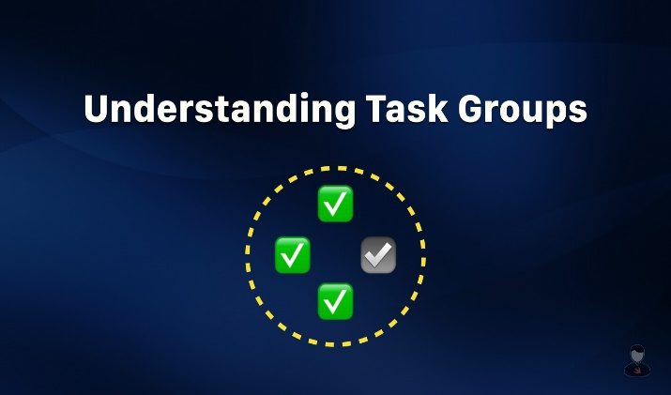

Task Groups
A task group or cross-functional team consists of EEs from different departments brought together to accomplish a particular task or project.
  For example, for a telephone to operate in a customer’s home or business, the telephone company’s EEs and supervisors from a number of department’s, such as customer service, construction, plant installation, central office equipment, and accounting, may work together to accomplish the job.

Slide 12

Friendship Groups
The friendship group is an informal group of people who have similar personal characteristics and social interests.
  Many friendship groups are related primarily to common factors like age, gender, ethnic background, outside interests, and marital status.
    Command and task groups may be instrumental in bringing friendship groups together. Also, preexisting friendships often serve as a catalyst for increased productivity and performance of newly formed teams, primarily because the team does not need to spend much time becoming oriented and building the relationships necessary to work effectively together.

Slide 13

Special Interests Groups
The special-interest group accomplishes in a group things that individuals feel unable or unwilling to pursue individually.
  A temporary special-interest group might be a committee of EEs who wish to protest an action taken by a supervisor or management, promote a charitable undertaking, or organize an EE picnic.

Slide 14
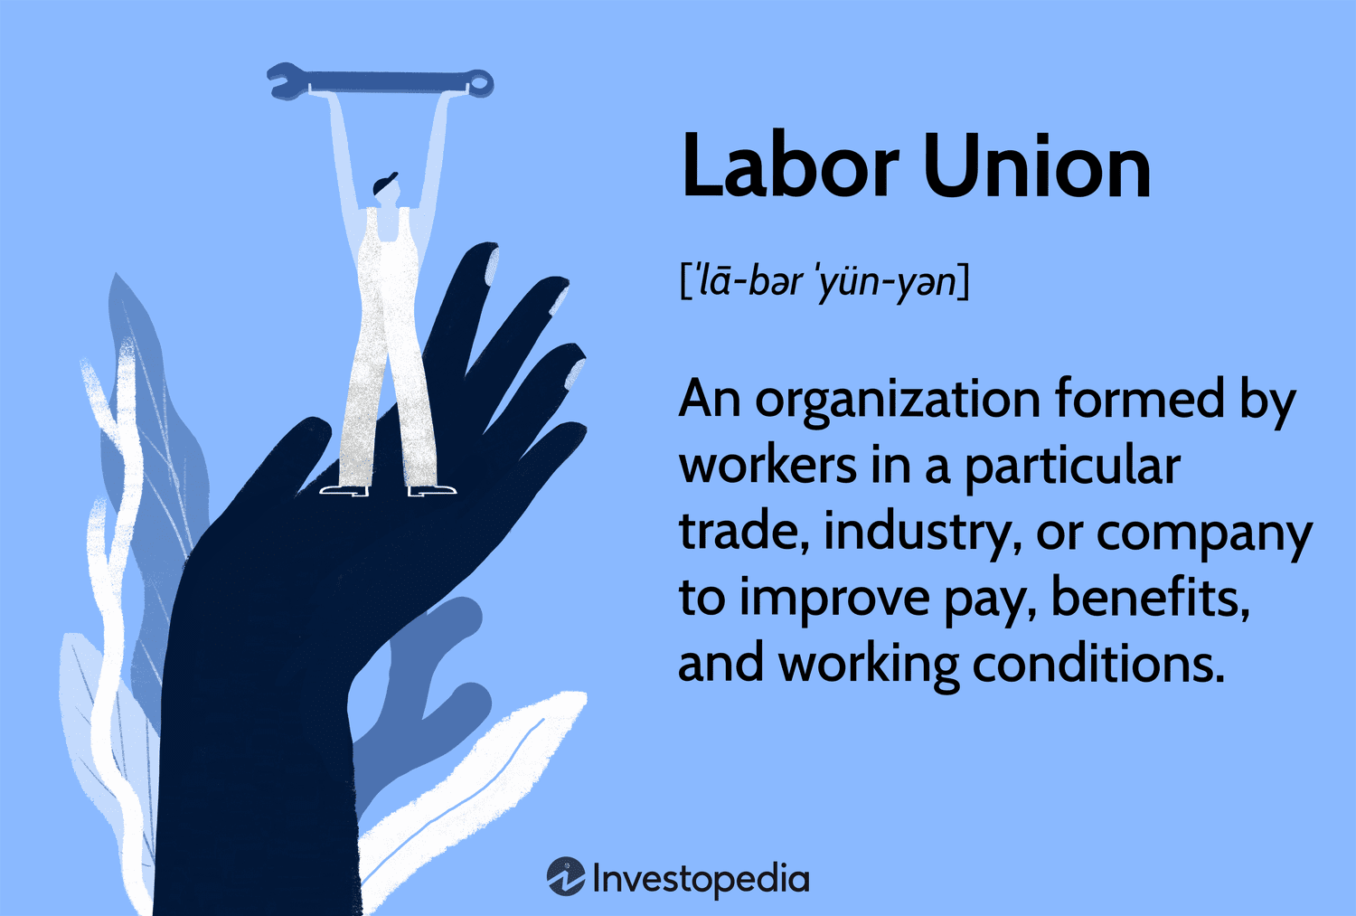
Special Interest Groups
A labor union is an example of a more permanent special-interest group because it is legally and formally organized.
  A labor union brings together EEs from different departments and divisions as they strive to achieve economic and other objectives.
    Some EEs believe that membership in a group provides them with greater security and better control over their jobs. Others believe that the presence of a labor union in matters of grievances and complaints promotes a fairer settlement of disputes.

Slide 15

Understanding Work Groups
An EE may belong to a number of groups in the workplace, and the supervisor who understands these different groups is more likely to influence these groups.
  Some research studies have suggested that a supervisor has a better chance of influencing an EE’s behavior as a member of a work group than individually without the work group’s influence.

Slide 16

Research Insights for Managing Work Groups
Numerous behavioral studies have been conducted on work groups and on how they function.
  These studies have suggested a number of approaches for managing work groups effectively.
    While these approaches will not guarantee the desired results, they are consistent with behavioral research findings concerning work-group dynamics and group behavior.

Slide 17
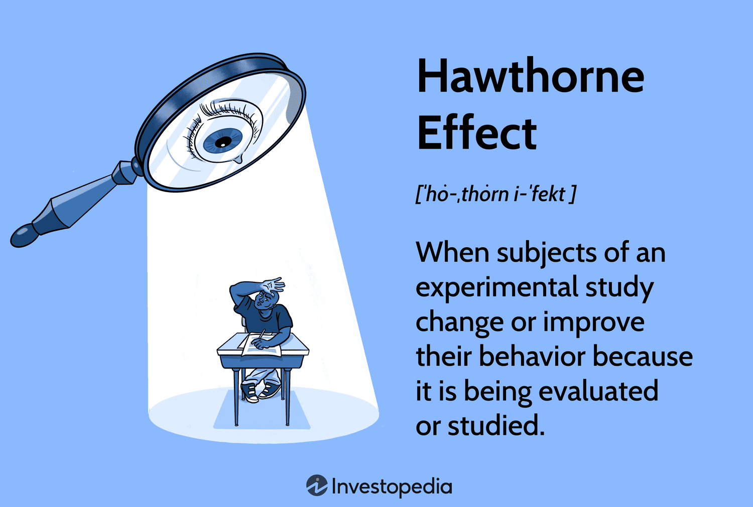
Findings From Group (Team) Research
The work-group studies that have probably had the most lasting influence during the 20th Century and beyond were conducted in the late 1920’s and early 1930’s at Western Electric Company’s Hawthorne plant near Chicago.
  Known as the Hawthorne Studies, they remain a comprehensive and definitive source on the subject of work-group dynamics as they relate to EE attitudes and productivity.

Slide 18

Findings From Group (Team) Research
Throughout the text, we have mentioned various organized participative management programs.
  Regardless of what these programs are called, they share certain characteristics.
    These programs try to build effective work teams that foster the continual improvement of work processes, project tasks, and customer service.

Slide 19
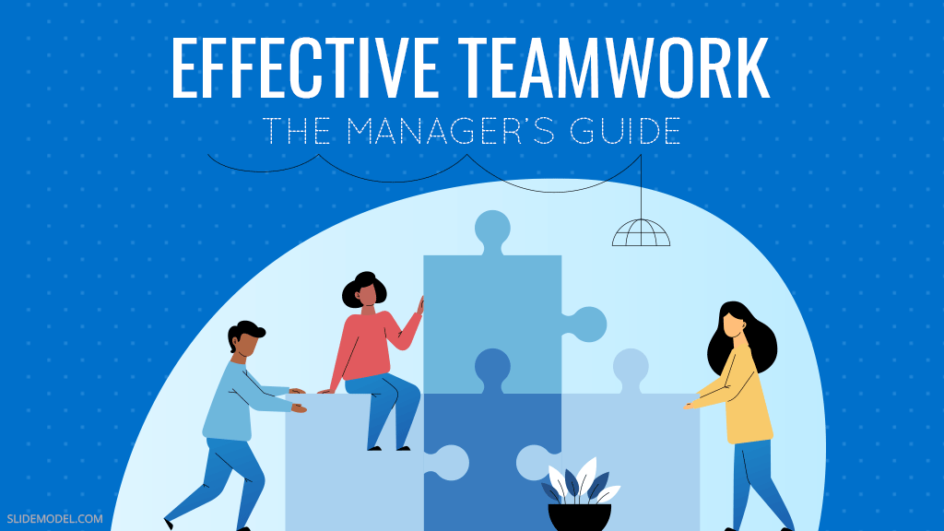
Finding From Group (Team) Research
A comprehensive survey conducted by Jon Katzenbach and Douglas Smith identified principles that are closely associated with effective work teams, including the following:
  Team members must be committed to the group and its performance.
  Teams function better when they are small, usually ten or less members.
  Teams should be composed of individuals with skills that are complementary and sufficient to deal with the problem.
  Teams should be committed to objectives that are specific and realistic.

Slide 20

Finding From Group (Team) Research
Much can be learned from Steven Jones and Michael Beyerlain’s “Developing High Performance Work Teams.”
  Because supervisors must take on more responsibility and receive less recognition, they feel threatened by transitions to teams. Therefore, supervisors must be coached, supported, and encouraged in new roles.
  Team members must be held accountable for their actions to increase feelings of personal responsibility for the team’s success.
  New team leadership roles for supervisors include coaching and facilitating.
  Communication becomes more important. Team leaders must be process oriented and have meetings to clarify team roles.

Slide 21

Insights Into The Group Development Process
The first step in convening a work group is identifying the task that the group needs to accomplish or the problem that needs to be solved.
  Then, the supervisor needs to identify work-group members who will fulfill the skill-knowledge-ability needs of task or problem, or delegate this role to an EE who is familiar with SKAs of others in the department or company.

Slide 22
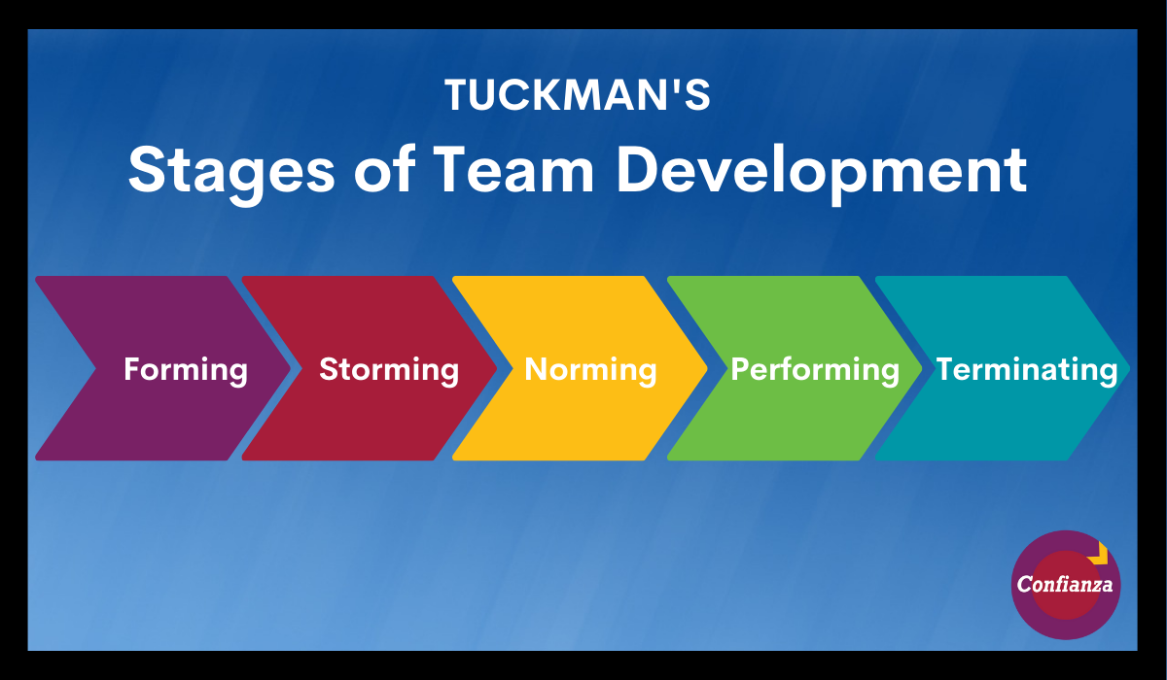
Insights Into The Group Development Process
Once the group is built, it may seem logical for the supervisor to step out of the way and let the team do its work.
  However, Tuckman and Jensen’s classical research on the process of group development asserts that when new work groups are formed, the supervisor remains a key player.
    They describe five specific stages small groups go through: (1) forming, (2) storming, (3) norming, (4) performing, and (5) adjourning.

Slide 23
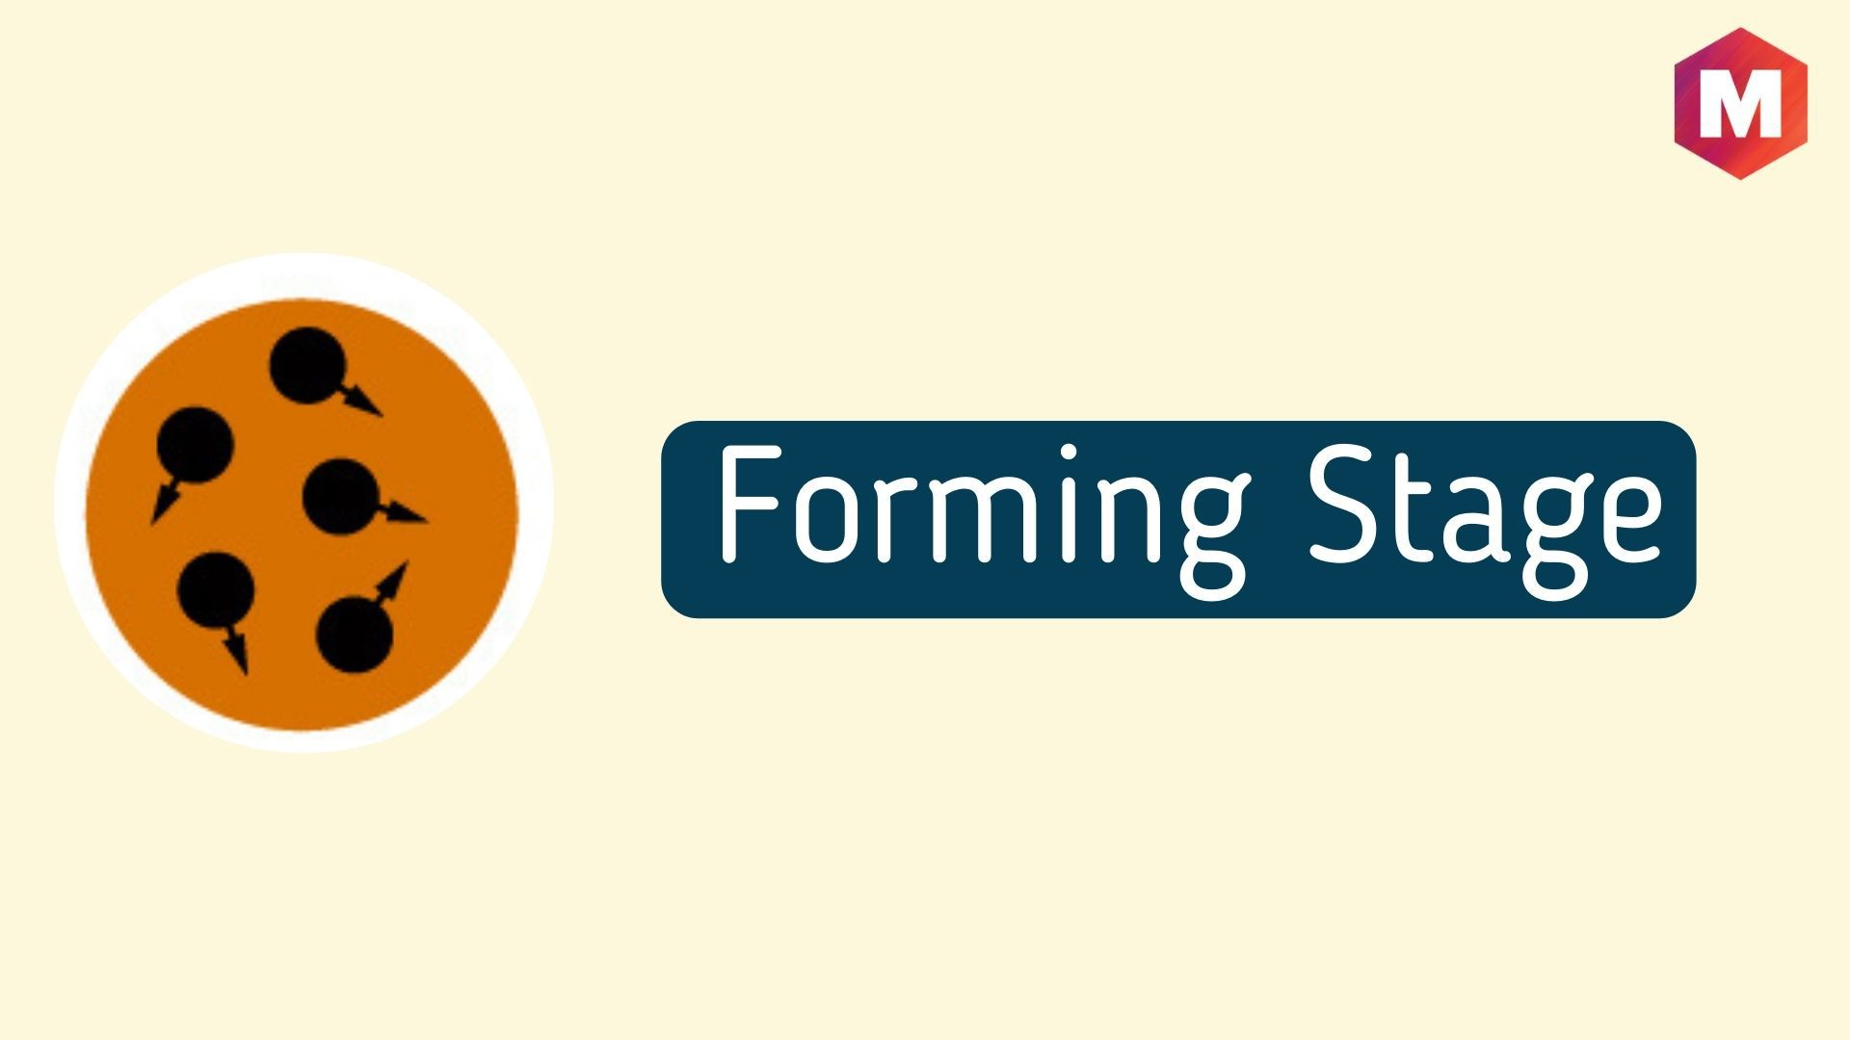
Insights Into The Group Development Process
The following are 5 specific stages small groups go through:
  1. Forming
    When a group first convenes, individuals meet, agree on goals, and begin the task at hand. At the same time, members are often on their best behavior as they gather information and impressions about the rest of the group’s personalities, motivations, and orientation to the task. During this stage, the supervisor’s role is directive in outlining roles, responsibilities, the task, and its deliverables.

Slide 24
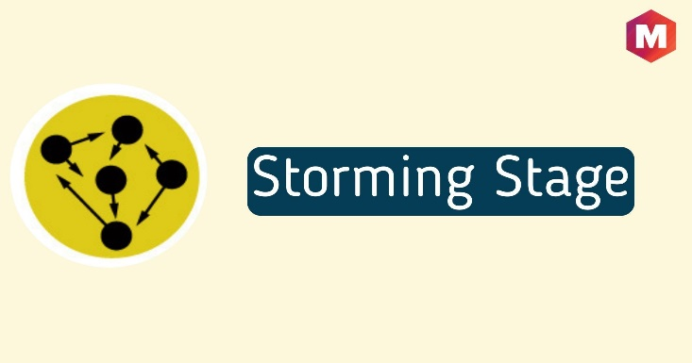
Insights Into The Group Development Process
The following are 5 specific stages small groups go through:
  2. Storming
    As the work progresses, group members begin to share ideas and perspectives about the task and the group itself, some of which may be in competition or conflict. The supervisor should remain accessible to the team during this stage to provide feedback, suggest decision-making strategies, give explicit direction regarding next steps, and coach EEs in the use of professional behavior when competing ideas and personalities begin to hamper productivity.

Slide 25
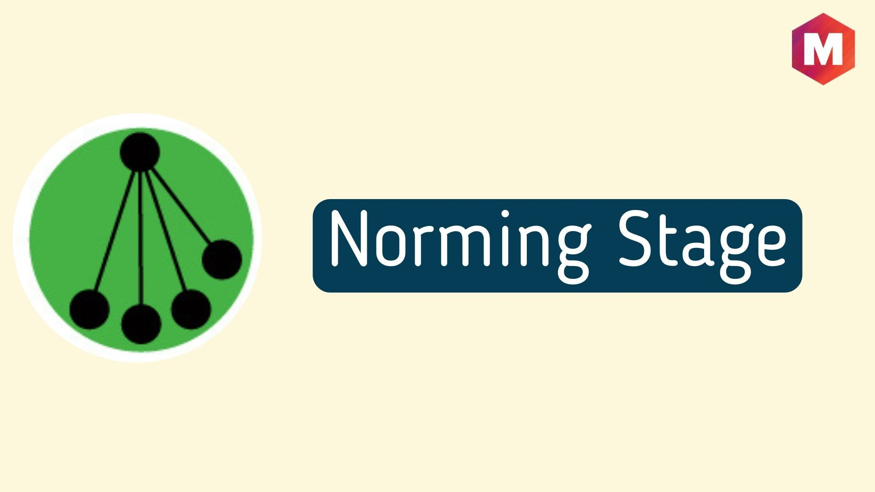
Insights Into The Group Development Process
The following are 5 specific stages small groups go through:
  3. Norming
    Once group members establish their roles and responsibilities and a shared understanding of the goal, they tend to move forward productively w/ the work. At this point in the group development process, the supervisor should expect, receive, and review regular reports of progress from the group and provide feedback and support when appropriate.

Slide 26
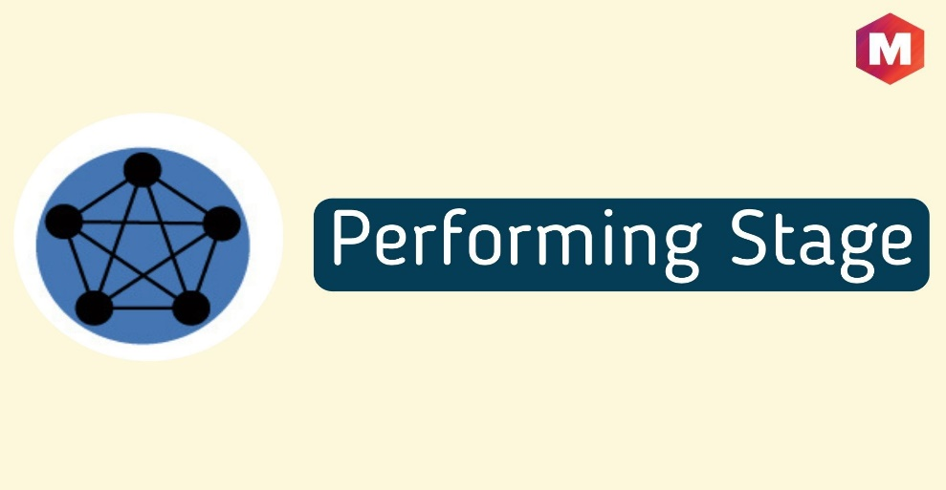
Insights Into The Group Development Process
The following are 5 specific stages small groups go through:
  4. Performing
    Groups at this stage run like clockwork. They can work independently, make decisions, and establish new goals with little or no supervision. Group members have established processes for resolving conflict and changing direction when necessary. The group’ s supervisor should remain active in holding the group accountable for deliverable’s, providing feedback, and approving changes as proposed.

Slide 27
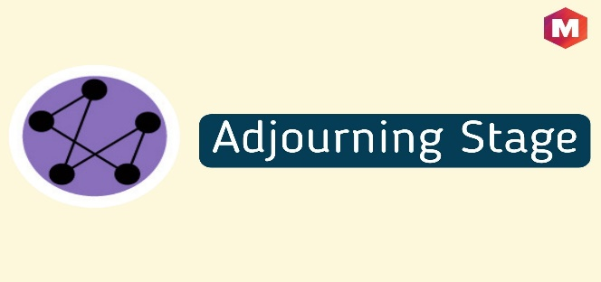
Insights Into The Group Development Process
The following are 5 specific stages small groups go through:
  5. Adjourning
    At some point, an existing group may no longer be necessary, particularly in the case of task or special-interest groups that have achieved the goals for which they were originally established. In order to help group members transition to new roles, either in new groups or back to their original positions, the supervisor should be directive in providing explicit guidance to each employee about their new responsibilities.

Slide 28

Examples of Highly Effective Teams
The highly effective team is the one whose members are always supporting and encouraging on another.
  Chris Widener, president of Made for Success, said it well:
    The coach always does a pre-game talk, laying out the vision. During the game, the coach is always updating the team as to where they are and what changes need to be made. He or she coaches and communicates throughout the game. When you watch a great team, they are talking to each other all of the time, helping one another out, encouraging one another, praising one another, and telling each other how they can make changes so the same mistakes aren’t made again.

Slide 29
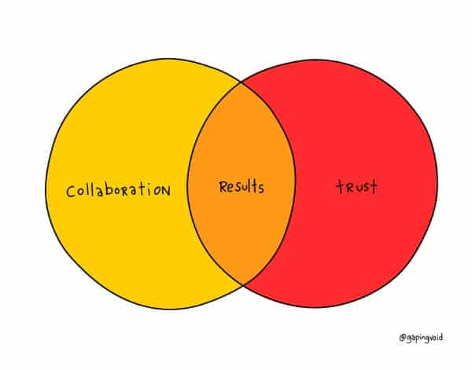
Examples of Highly Effective Teams
  Good communication skills are needed to create trust and collaboration among the various players.
  An American Management Association’s Critical Skills Survey found that 72% of managers and executives surveyed want EEs who are compatible in a team setting, supporting the notion that very little is accomplished without strong collaboration.
    Remember, there is no “I” in the word team.

Slide 30
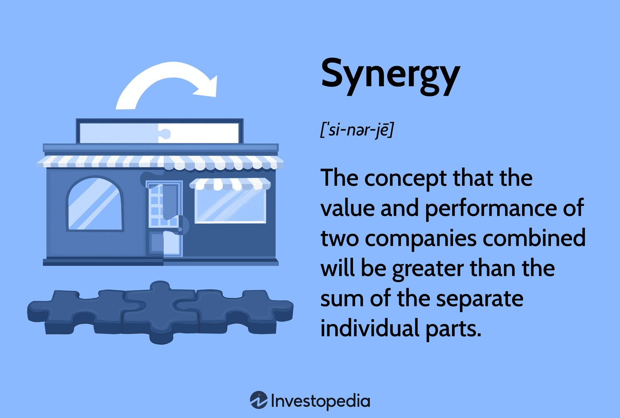
The Importance of Team Members
Another factor that may help explain the difference between winning and losing teams is synergy.
  A synergistic effect takes place when the whole is greater than the sum of its parts.
    Successful teams need individuals who are willing to put aside individual differences and focus on the goals of the team.

Slide 31

The Importance of Team Members
Astute sports fans can recall their favorite stars from some of the most winningest teams. But for every star, there are dozens of unheralded support players, sometimes called role players.
  These role players show up for work every day, clearly understand their roles, are trained so they know how to perform, continuously improve on their jobs, and want to feel that they are contributing meaningfully to the effectiveness of their teams. They are an essential component to the success of a team.

Slide 32
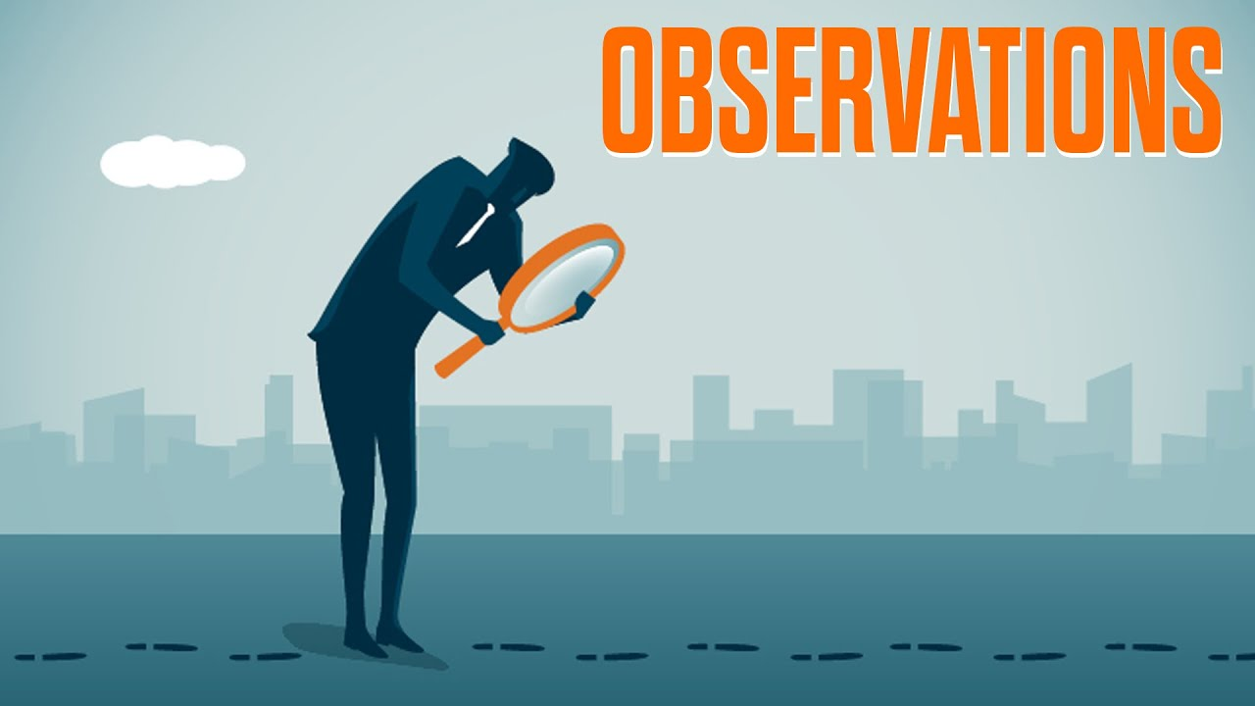
The Importance of Team Members
Finally, a team is made up of a group of individuals who must work together to meet individual and team objectives.
  It is important to remember people are more motivated to achieve goals they help set.
    Strong leadership and effective communication are key ingredients for successful teams.

Slide 33
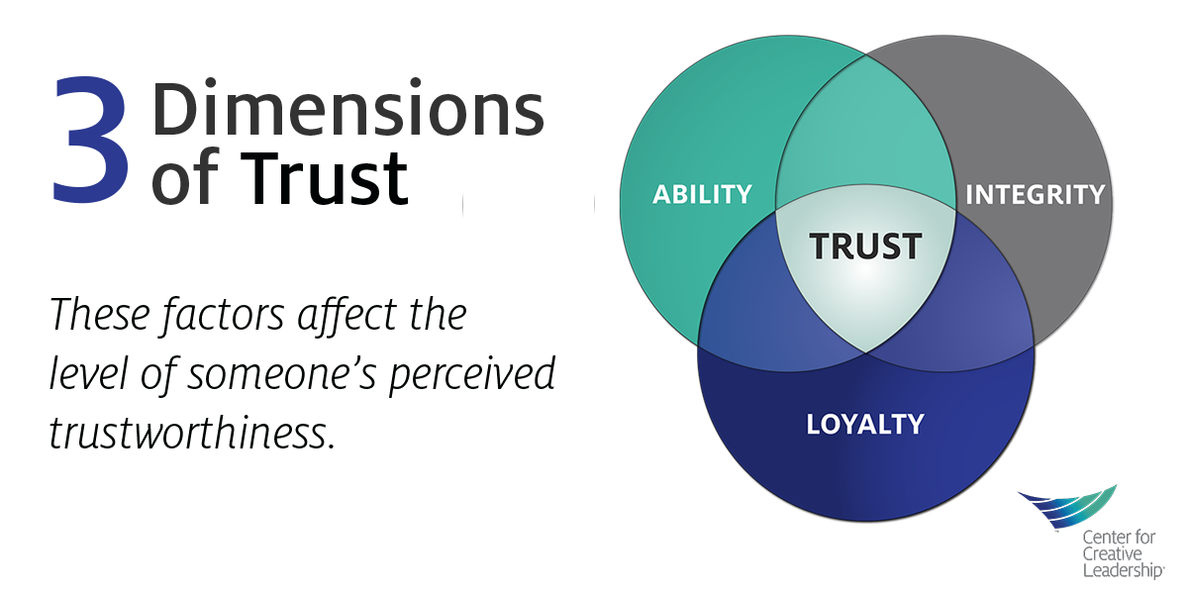
The Importance of Team Members
The ability to trust a leader is more important today than ever.
  Perhaps nothing is more important to the success of a team than the leader’s ability to build an environment of mutual trust and respect.
    Finally, not everyone is suited for team play. The key is to identify people who can work in teams and those who cannot.

Slide 34

Supervisory Tips
Characteristics of Effective Work Teams
  Top management removes the barriers, that is, clears the roadblocks.
  Team members receive training on how to work together.
  Group members agree on team goals and objectives and commit to those goals.
  All members participate actively in team meetings and discussions.
  All team members follow team rules, guidelines, and procedures.
  All member are valued and treated with respect and dignity.
  Team members share vital information and ensure everyone is informed on a need-to-know basis.
  Members express ideas without fear of retribution. Team members also feel free to disagree, and the group grows with differences of opinion.
  The team uses systematic problem-solving approach, but is encouraged to think “outside the box.”
  All members are included in solving problems, developing alternatives, and making decisions.
  Decisions are made by consensus. All members support decision, even if they don’t totally agree.
  The team is cohesive – openness, trust, support, and encouragement are always present.
  Conflict is viewed as healthy and is brought into the open in a timely manner.
  Group members give each other honest feedback on performance.
  Team training and peer helping are essential elements of the team process.
  The team continually evaluates its performance and uses that information for improvement.
  Team members take pride in accomplishments.
  Members enjoy their team affiliation.

Slide 35

Virtual Teams
As many companies have expanded their operations domestically and internationally, they have found that virtual teams can help them focus on meeting customer requirements.
  A virtual team is one that has members who rarely, if ever, meet face-to-face, even though they work on a project or in an area of operations with a common goal. They share a common purpose, but are physically separated and interact electronically.
    These work teams present unique supervisory challenges at every stage of development and performance.

Slide 36

Virtual Teams
Virtual teams function primarily through technological tools that enable them to communicate and share documents.
  While technology serves as the primary facilitator for the growth of virtual teamwork, it also has been indicated as a significant challenge to productivity and the achievement of team goals.
    In a study of virtual team meeting breakdowns, investigators found that most problems stemmed from technology policy restrictions, mandated technology changes, and inadequate or malfunctioning technology tools.

Slide 37

Virtual Teams
However, technology is not the only challenge in geographically dispersed teams.
  Trust and power are seen as barriers to success.
    In virtual teams rating themselves as having a high level of trust among members, EEs indicated that sharing and shifting power based on needs of the group and specific tasks helped them succeed in reaching the goals.
    In virtual teams with low levels of trust, power battles, coercion, misunderstandings, and conflicts of interest kept teams from performing.

Slide 38

Virtual Teams
These challenges illustrate that virtual teams share some of the same challenges as face-to-face teams, but at the same time they encounter barriers that are not typically found in the traditional office setting.
  Some challenges unique to virtual teams include, poor nonverbal communication, lack of informal conversations and forging of friendships, increased miscommunication and misunderstanding, difficulty in achieving consensus and establishing shared understandings about tasks and goals.

Slide 39

Virtual Teams
Virtual teams require strong management support.
  The need for supervisory feedback and evaluation is paramount.
    The challenge for a manager or supervisor of a virtual team is to hold team members together and keep them motivated, even though they are separated geographically.

Slide 40

Virtual Teams
The focus must be on overall results rather than on the specific activities of team members.
  Managers of virtual teams have tried various techniques to help team members stay focused on their projects and to strengthen their functioning and team spirit.
    Among these techniques are giving the project team a name or logo, rotating the hosting conference calls, and recognizing accomplishments.

Slide 41
Supervisory Tips
Twelve Principles for Making Virtual Teams Work
  Get the team together physically, or in a videoconference, early on.
  Clarify processes and tasks, not just roles and goals.
  Commit to a communication charter (expectations and norms).
  Leverage the best communication technologies.
  Build a team with rhythm (systems and schedules).
  Agree on a shared language.
  Create a virtual staff lounge or water cooler.
  Clarify and track commitments.
  Foster shared leadership.
  Don’t forget one-on-one meetings (coaching and mentoring).
  Visit the past to define the future (learn culture & accomplishment).
  Realign reward structures for virtual teams.

Slide 42

Understanding and Maintaining EE Morale and Engagement
Most definitions of morale recognize that it is essentially a state of mind.
  For example, Merriam-Webster’s online dictionary defines morale as “the mental and emotional condition of an individual or group with regard to the function or tasks at hand.”
    We consider morale to be the attitudes and feelings of individuals and groups toward their work, their environment, their supervisors, their top-level management, and the organization.

Slide 43

Understanding and Maintaining EE Morale and Engagement
Morale is not one single feeling or attitude but a composite.
  It can affect EE performance and willingness to work, which in turn can affect individual and organizational objectives.
    When EE morale is high, EEs usually do what the company wants them to do; when it is low, the opposite tends to occur.

Slide 44
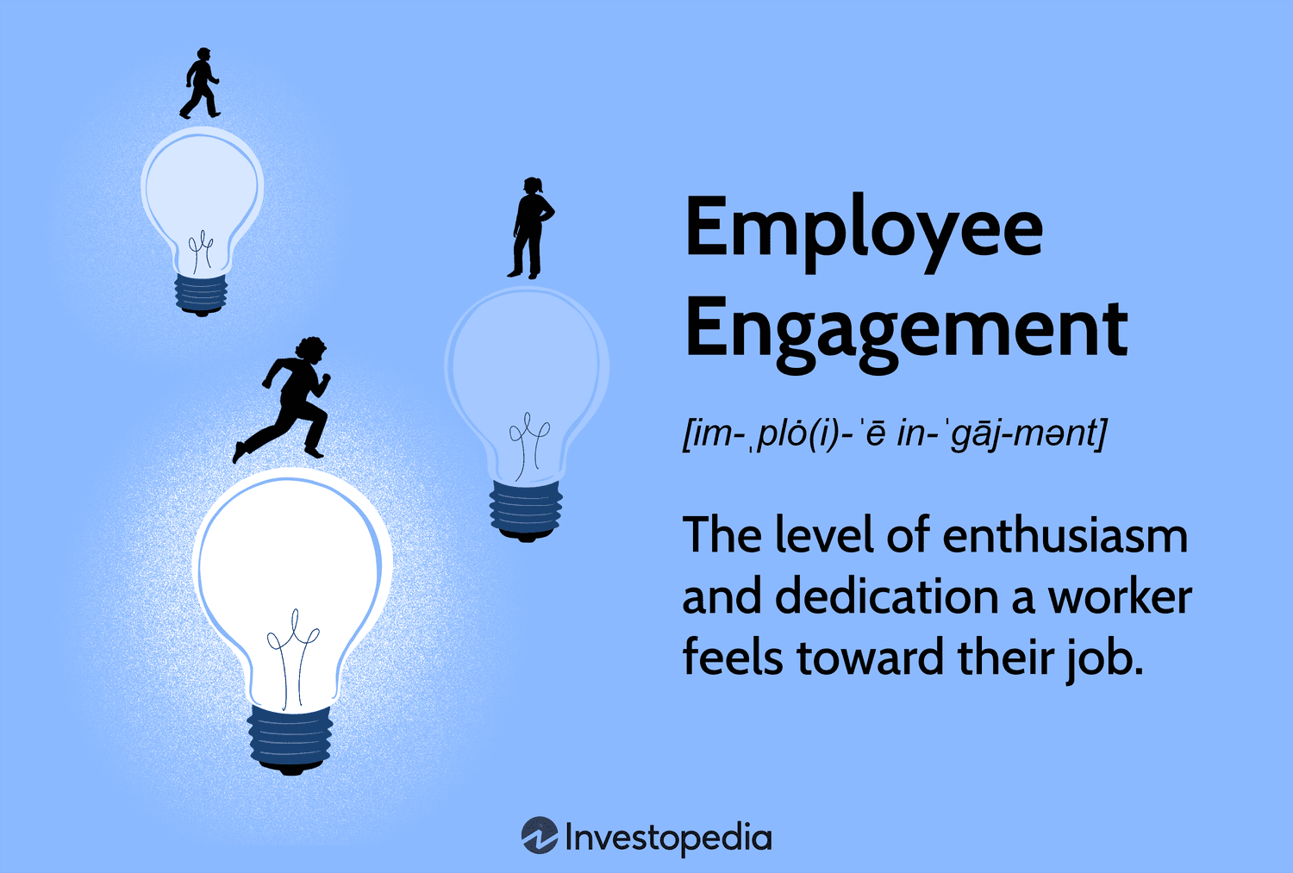
Understanding and Maintaining EE Morale and Engagement
Engagement is the level of emotional commitment the EE has to the organization and its goals.
  If we consider the two terms side by side, we might conjecture that the two mean essentially the same thing, but they do not.
    Morale is the general feeling toward the workplace, and engagement focuses on its goals.

Slide 45

Understanding and Maintaining EE Morale and Engagement
Cari Turley provides an illustration that shows the difference:
  Treating everyone on your staff to ice cream would improve morale for the afternoon. But that’s about it. Consider, however, promising an ice cream social for the afternoon to your sales team as a reward for closing the big account they’ve been after. You get the same morale boost on ice cream day, but you also get the incentive to close the deal, the anticipation of the event, and the message that good work is noticed and rewarded. That’s much likelier to translate to business results than impromptu dessert, and for no additional cost.

Slide 46

Understanding and Maintaining EE Morale and Engagement
Today’s EEs are less happy with many aspects of their jobs, which is a significant problem because it has been recognized and documented that reasons EEs stay with or leave employers are more frequently attributed to factors other than pay.
  However, an organization’s EEs can have high morale, love their boss and their job, but never get anything done, which can put them at risk of being let go or becoming “dead wood.”
    When EEs are highly engaged, by contrast, they invest more time, effort, and sometimes creativity and passion into the work they do in order to do their best and help the company achieve its objectives.

Slide 47

Understanding and Maintaining EE Morale and Engagement
Workplaces are finding that considering the roots of morale in engagement increases trust, loyalty, and performance more so than just creating a feel-good environment.
  Highly engaged EEs have less absenteeism and are less likely to leave their jobs than those who are disengaged.

Slide 48
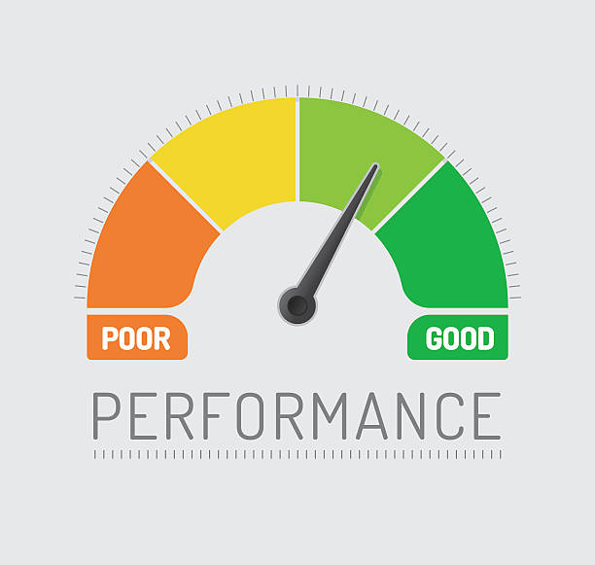
Understanding and Maintaining EE Morale and Engagement
Gallup’s research on EE engagement has linked its levels to several performance outcomes:
  Customer ratings, profitability, productivity, turnover, theft, safety incidents, absenteeism, and product quality.
    Additionally, they found that workers who rate themselves as highly engaged at work view their lives as better, report having better moods and better relationships with colleagues, and are more likely to say they like what they do at work every day.

Slide 49
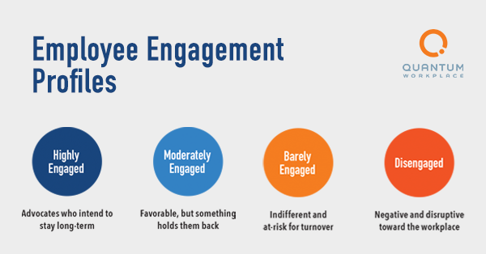
Understanding and Maintaining EE Morale and Engagement
Highly engaged workers, cooperate, are enthusiastic about work, understand their jobs, and look for ways to improve.
  Workers who are not engaged and aren’t concerned about customers, productivity, safety, or the organizations’ purpose, waste managers’ time, are often absent, have more accidents, and quit more often than engaged workers.

Slide 50
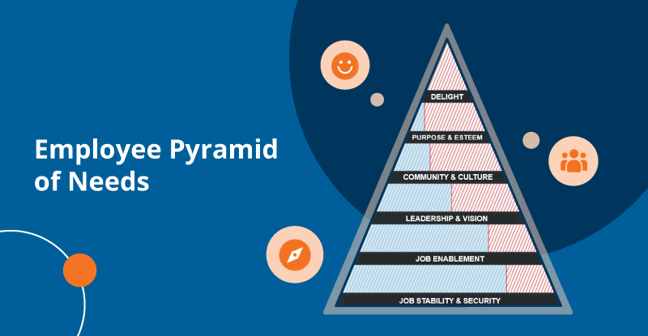
Factors Influencing Engagement and Morale
The research on engagement has identified a number of things workers need in order to feel engaged with their work and committed to their organization’s mission.
  They need to know what is expected of them; have the appropriate materials and equipment to do their jobs, opportunities to do things they are good at; and be recognized for their achievements.

Slide 51

Factors Influencing Engagement and Morale
EEs engage and thrive when their supervisors show that they care about them, encourage them to develop their strengths, value their opinions, and promote an organizational mission that makes workers feel important.
  Further, workers who have colleagues who are committed to doing good work and are genuinely friendly enjoy and invest in their work, and they are inspired to contribute new ideas when they are given feedback about their performance and provided with opportunities to grow in new ways.
    When an organization provides this type of work environment, workers become more trusting of management, more willing to put in extra effort, and more likely to recommend their company to others.

Slide 52

Factors Influencing Engagement and Morale
When developmental interactions focus on the positives or strengths, a person’s morale is much higher and engagement and performance increase.
  When managers focus on EE’s strengths, give them opportunities to use their strengths, and help them build those strengths to an even greater extent, the EEs will feel good about their contribution to the organization and grow in their commitment to their work.
  As workers become more engaged, they become more productive.
    If managers just focus on what EEs do wrong, they tend to get more of the same or even worse performance.

Slide 53

Factors Influencing Engagement and Morale
These findings encourage supervisors to focus on strengths and find ways to help EEs build on those strengths.
  The Gallup research also found that investing in workers’ well-being also contributes to higher levels of engagement.
    Placing a high priority on helping workers maintain a healthy balance between work and family, providing a sense of job security, and ensuring sufficient health and retirement benefits also encourages worker loyalty, commitment, and investment in the company’s mission.

Slide 54

Factors Influencing Engagement and Morale
Any factor can influence EE morale, positively or negatively.
  Some factors are within supervisor’s control, while others are not.
    Influences outside the organization are beyond the supervisor’s control. Nevertheless, they may significantly affect EE morale. Examples of such external factors are family relationships, care of children or elderly parents, financial difficulties, problems with friends, vehicle breakdowns, and sickness or death in the family.
    What happens at home can change an EE’s feelings very quickly. An argument before work may set the tone for the rest of the day.
    Even headlines in the morning newspaper may depress or uplift.

Slide 55

Factors Influencing Engagement and Morale
Company conditions can also influence morale.
  Examples of external factors are compensation, relations with co-workers, and working conditions. These factors are partially or fully within the supervisor’s control. For example, when compensation is adequate, other factors may be more significant, but even if wages are good, morale can sink quickly when working conditions are neglected. The critical factor is whether the supervisor tries to improve working conditions.
    EEs will often perform well under undesirable conditions and still maintain high morale and engagement when they believe their supervisors are seriously trying to improve working conditions.

Slide 56

Morale, Engagement, Teamwork, and Productivity Relationships
Workplace morale tends to be contagious, as does engagement, and this contagion works in both positive and negative ways.
  When managers select and hire EEs who are enthusiastic and interact with those workers using the strategies described earlier, the workers become committed and driven as they gain tenure in the company.
    If supervisors provide those workers with opportunities to influence others in their work groups, their positive morale and work ethic rubs off.

Slide 57

Morale, Engagement, Teamwork, and Productivity Relationships
In most organizations, informal groups form organically, and certain people in those groups naturally emerge as leaders.
  When supervisors position informal leaders where they can share their strengths, energy and commitment, and inspire others – overall team engagement levels are often elevated.

Slide 58

Morale, Engagement, Teamwork, and Productivity Relationships
In a similar way, when actively disengaged workers emerge as leaders in teams and informal groups, they model behaviors and attitudes such as complaining, absenteeism, and negativity toward management that can frustrate and demotivate others in the group, thus decreasing everyone’s productivity.
  Clearly, choosing engaged team leaders is the right choice.

Slide 59

Morale, Engagement, Teamwork, and Productivity Relationships
Teamwork is often associated with morale, but the two are not the same.
  Morale refers to the attitudes and feelings of EEs, whereas teamwork relates primarily to the degree of cooperation among people who are solving problems and accomplishing objectives.
    Good morale and high engagement help achieve teamwork, but teamwork can be high when morale and engagement are low. Such a situation might exist when jobs are scarce and EEs tolerate bad conditions and poor supervision for fear of losing their jobs.

Slide 60

Morale, Engagement, Teamwork, and Productivity Relationships
On the other hand, teamwork may be absent when morale is high and is accompanied by high engagement.
  For example, salespeople being paid on straight commissions are typically rewarded for individual efforts toward achieving the company’s objectives rather than for group performance.

Slide 61

Morale, Engagement, Teamwork, and Productivity Relationships
There is substantial evidence to suggest that, in the long run, EEs with high engagement tend to be highly productive.
  Highly engaged self-disciplined, mission-driven groups of EEs tend to do more satisfactory work than those from whom the supervisor tries to force performance with little regard for the EEs themselves.
    When supervisors are considerate of their EEs, recognize their efforts, build on their strengths, and encourage positive attitudes among them, there tends to be greater mutual trust, lower absenteeism and turnover, and fewer grievances.

Slide 62

Morale, Engagement, Teamwork, and Productivity Relationships
One study reported: A worker’s ability to form “best” friendships at work is among the most powerful of 12 indicators of a highly productive workplace.
  Workplaces with low turnover and high customer satisfaction, productivity, and profitability also tend to be places where employees report having a best friend present.

Slide 63

Engagement Should be Everyone’s Concern
Jim Clifton, Chairman-CEO of Gallup, contends that how EEs feel about their job starts and ends with their direct supervisor.
  If EEs feel, among other things, that their supervisor takes a real interest in their development or offers frequent (authentic) recognition, they are very likely to be engaged.
    Every manager, from the CEO to the supervisor, should be concerned with the engagement level of the workforce. It should be a priority to develop and maintain EE engagement at the highest level.

Slide 64
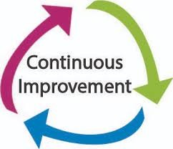
Engagement Should be Everyone’s Concern
It should be clear that the actions of the first-line supervisor, probably more than anyone else, influences engagement and morale in day-to-day contact with EEs.
  Bringing engagement to a high level and maintaining it is a continuous process; engagement cannot be achieved simply through short-run devices, such as pep talks or contests.
    High engagement is slow to develop and difficult to maintain.

Slide 65

Engagement Should be Everyone’s Concern
The level of morale can vary considerably from day to day.
  Morale is contagious in both directions because both favorable and unfavorable attitudes spread rapidly among EEs.
    Unfortunately, it seems to be human nature for EEs to quickly forget the good and long remember the bad when it comes to factors influencing morale.

Slide 66

Engagement Should be Everyone’s Concern
The supervisor is not alone in desiring high engagement and positive morale.
  EEs are just as concerned with engagement because it is paramount to their work satisfaction and achievement. Feeling engaged helps to make the EE’s day at work a pleasure, not a misery.
    Positive morale and high engagement are important to an organization’s customers as well. Customers can sense whether EEs care about their satisfaction and are serving them enthusiastically or are just going through the motions.

Slide 67
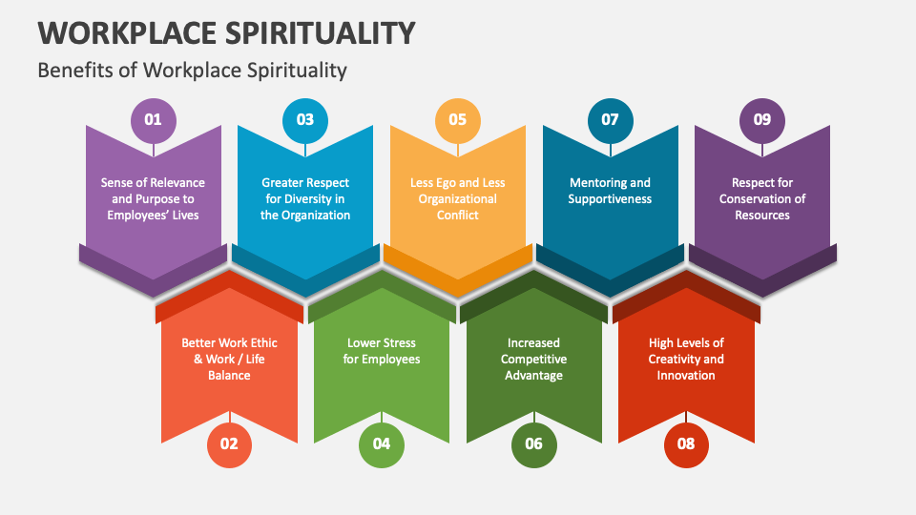
Engagement Should be Everyone’s Concern
Because of widespread concern about deteriorating EE morale and disengagement of workers, organizations have launched programs and efforts that collectively have been called workplace spirituality.
  This term essentially covers organizational efforts that are designed to make the work environment more meaningful and creative by recognizing and tapping into people’s deeply held values and spiritual beliefs.
    Some believe that spirituality can improve EE’s personal lives and mental outlook and that this might translate to a better work environment.

Slide 68
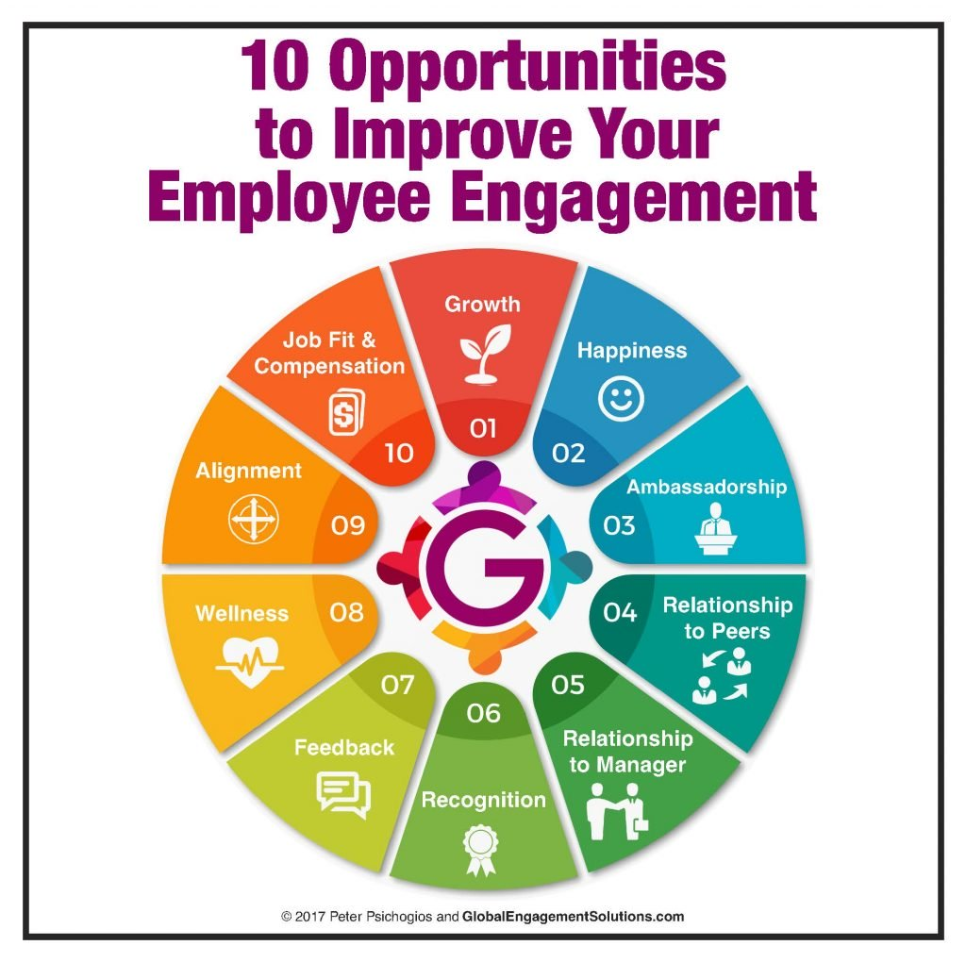
Assessing Employee Engagement
Most firms believe that, if they are to succeed, employee engagement is important in the long run.
  Measuring engagement is complicated and somewhat elusive.
    However, there are behaviors that demonstrate engagement or lack of it.

Slide 69
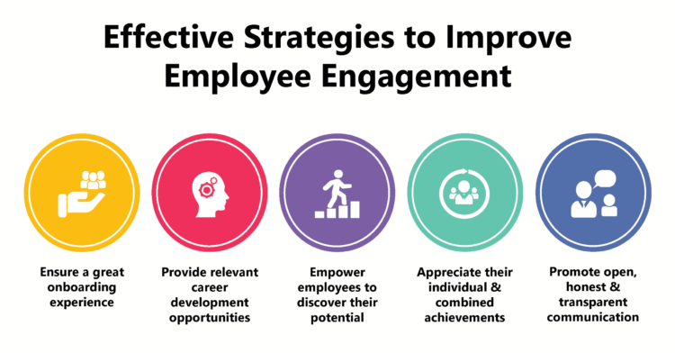
Assessing Employee Engagement
An employer can observe when a worker puts in extra effort, is proactive and creative in solving problems, and encourages co-workers.
  A number of surveys comprised of proxy measures for engagement have been developed and are widely used to assess levels of engagement.

Slide 70
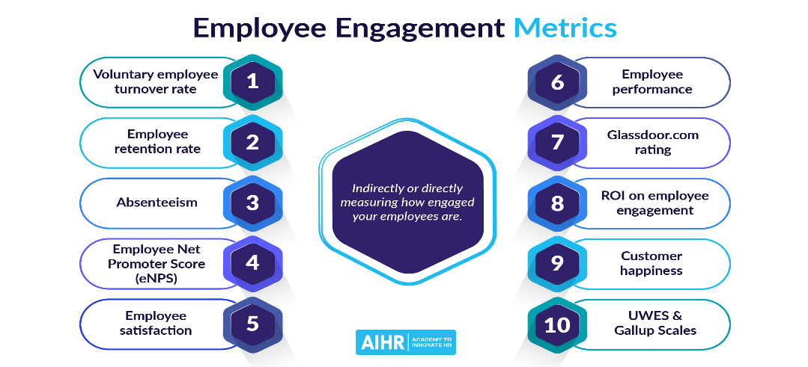
Assessing Employee Engagement
Employers can analyze these measures relative to employee and organization performance in areas such as attendance, turnover, sick leave use, productivity, and profit margins to create action plans for improvement.
  Supervisors are advised to approach engagement measurement systematically to assess prevailing levels and trends.

Slide 71
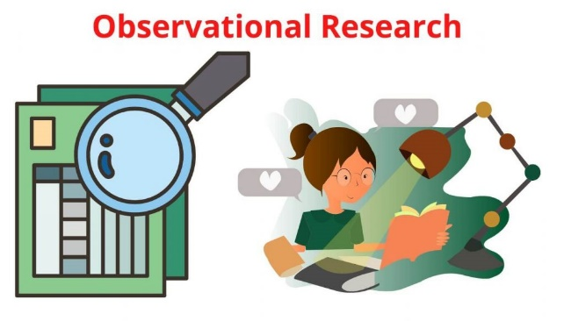
Observation and Study
By observing, monitoring, and studying patterns of EE behavior, a supervisor can often discover evidence of EE engagement.
  A supervisor should monitor such key indicators as job performance, tardiness and absenteeism, the amount of waste or scrap, employee complaints, and accident and safety records.
    If the reasons for changes in these indicators are related to EE feelings of engagement, the supervisor should determine, through conversation with the EE, whether the causes are within the supervisor’s span of control and follow-up accordingly.

Slide 72

Observation and Study
Specific behaviors in the workplace also provide insight into EE engagement levels.
  Supervisors should consider the extent and character of EE communication.
  Are EEs pleasant and fair, do they engage in conversation, and share ideas?
  Also, supervisors should study EE choices on a day-to-day basis to observe the decisions they make on a consistent basis to see the extent to which decisions are appropriate and focused on achievement and performance.
    Real time assessment of EE engagement is critical to organizational performance.

Slide 73
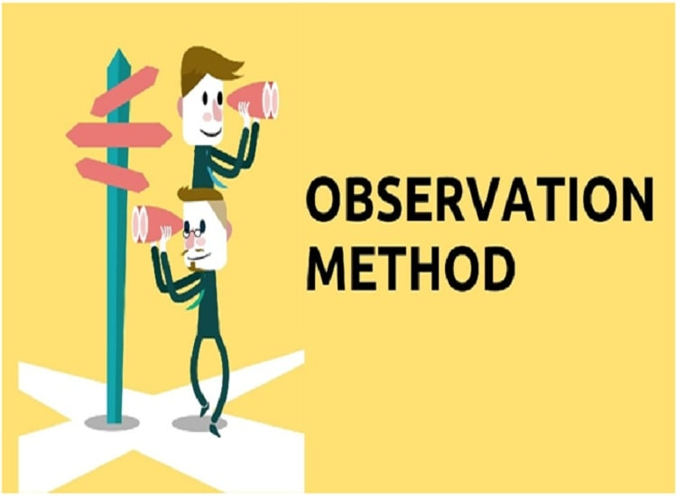
Observation and Study
Daily working relationships offer numerous opportunities for a supervisor to observe and analyze changes in EE engagement and morale.
  However, many supervisors often do not take the time to observe; others do not analyze what they observe.
    It is only when EE engagement and/or performance drop significantly that some supervisors first take note. By then, the problems that caused the changes will have magnified to the point where major corrective actions are necessary.

Slide 74

Observation and Study
Many companies conduct exit interviews with individuals leaving their employ.
  Exit interviews are usually conducted by HR, although sometimes the supervisor may fill this role. The interviewer asks why the person is leaving and about the person’s perceptions of the firms conditions.
    Results of exit interviews are used to assess morale in the firm as a whole or in certain departments, as well as to identify reasons for EE turnover.

Slide 75
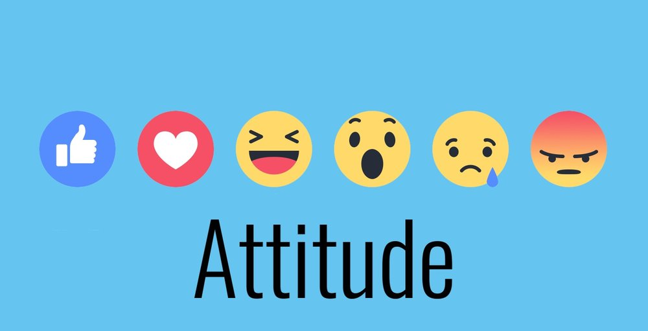
Attitude Surveys
Another technique to assess EE engagement is an attitude survey, also called an engagement survey or morale survey.
  All EEs, or a sample of the EEs, are asked to express their opinions about major aspects of organizational life, usually in the form of answers to questions or rating scales printed on a survey form.
    The survey questionnaire elicits EE opinions about such factors as management and supervision, job conditions, job satisfaction, rewards and incentives, recognition, co-workers, pay and benefits, job security, and advancement opportunities. Often engagement surveys also include items asking whether EEs feel a sense of belonging, whether they would promote the organization to others, and if they feel committed to the company and its mission.

Slide 76

Attitude Surveys
Attitude surveys are limited by their ability to report workforce engagement and summarize EE sentiments at a specific moment in time.
  An isolated incident or organizational change may have temporary effects on morale or long-term impacts on engagement, neither of which can be measured with a single survey.
    Supervisors might consider using attitude surveys regularly as part of continuous improvement processes to monitor shifts in organizational or departmental culture and climate that might erode engagement over time.
    This long-term data can be used to identify specific problems and make proactive changes accordingly.

Slide 77

Follow-Up of Survey Results
What happens to the survey results can have dramatic impact on EE engagement.
  If the survey results are put on a shelf, the survey has done nothing to help the organization.
    Survey results should be used as a tool, a baseline for problem solving and action planning efforts that will increase engagement and morale across the organization.

Slide 78

Follow-Up of Survey Results
Attitude surveys may reveal deficiencies the supervisor can easily address and/or eliminate.
  Frequently, however, responses are difficult to evaluate, such as a complaint that communication channels are not open to EEs.
    Such complaints raise more questions than answers and may necessitate a careful study of existing policies and procedures to see whether corrective actions are warranted.

Slide 79

Follow-Up of Survey Results
When management does not make needed changes as a result of a survey, the survey wastes time and money.
  If no changes materialize, or changes are not communicated to EEs, morale may decline. EEs may feel their problems and suggestions were ignored.
    Concerns or dissatisfaction expressed in an attitude survey should be addressed promptly by managers and supervisors. At a minimum, EEs should be informed that management is aware of the dissatisfaction and will work to change things by some future date.

Slide 80

Organizational Development
Many companies follow up their attitude surveys with feedback meetings and conference sessions with groups of EEs and supervisors.
  In these meetings, the results of attitude surveys are discussed and debated openly.
    The groups are expected to recommend improvements, which are forwarded anonymously to higher-level management for consideration and possible implementation.

Slide 81

Organizational Development
This participative management approach is often part of a broader concept known as Organizational Development (OD) or Process Consultation.
  This concept usually involves group meetings under the guidance of a neutral conference leader. For the most part, these meetings focus on solving problems that may be hindering work performance or causing disruption, poor coordination, inadequate communication, or strained personal relations.
    When there is frank discussion in an open and informal atmosphere, EEs tend to open up about what is really on their minds and what might be done to solve problems and reduce conflict.

Slide 82
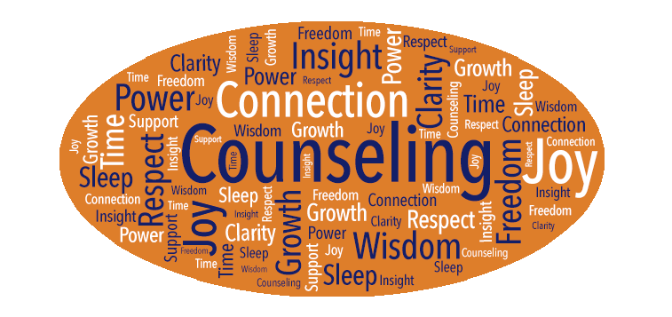
The Supervisor’s Counseling Role
Counseling is not the same as coaching.
  In counseling, the supervisor tries to address on-the-job performance problems that result from an EE’s personal problems.
    An EE’s performance problems may stem from a job-related personal problem, such as failure to get a promotion, or from an off-the-job issue, such as a financial or health crisis. When not addressed, these problems can impede EE morale, engagement, and quality of work. Therefore, the supervisor must help the EE return to productivity.

Slide 83

The Supervisor’s Counseling Role
The most effective way to get an EE back on track is to counsel – to ask, listen, reflect, and encourage.
  A counseling interview is essentially non-directive; the supervisor serves primarily as an empathetic listener, and the EE is encouraged to discuss the problem frankly and to develop solutions.
    By being a good listener, the supervisor can find out what happened and may help the EE develop alternatives.

Slide 84

The Supervisor’s Counseling Role
The supervisor should listen carefully and without interruption to understand.
  The supervisor should use paraphrasing and reflecting to improve understanding.
    The supervisor should not offer specific advice because it might bring unwanted repercussions. If the EE is dissatisfied with the results of following a supervisor’s advice, they might blame the supervisor, which would complicate an already difficult situation.

Slide 85

The Supervisor’s Counseling Role
Aside from conducting a private counseling interview or referring the EE to some source of assistance, there may be little else the supervisor can do to cope with the factors affecting an EE’s morale.
  The supervisor’s main role is to help get the EE’s performance back to an acceptable level.

Slide 86

The Supervisor’s Counseling Role
Steps in the Counseling Process
  Performance Problem Identified
    Determine Cause – If Skill Deficiency = Coaching or Training
    Determine Cause – If Personal Problem = Counseling
  Counseling Interview Techniques
    Ask Open-Ended Questions
    Listen Intently and Empathically
    Paraphrase Reflection
      Get Agreement from EE that there is a Problem
  Know Company Policy-Procedures-Programs
  Help EE Explore Alternatives
    Do not give advice, but help EE choose course of action they think will work best.
    Provide encouragement and support, reinforce progress-improvement with praise.
    Consider other alternatives if there is no improvement or if targets are not met.

Slide 87

Supporting and Helping Employees
Personal and Work-Related Problems
Many organizations have made Employee Assistance Programs (EAPs) available to employees.
  These programs typically involve a special department or outside resources retained by the firm to whom supervisors may refer EEs with certain types of problems, or EEs may access on their own.
    Most EAPs provide help for alcoholism and substance abuse; marriage, childcare, and family problems; financial questions; and other personal, emotional, or psychological problems that interfere with performance.

Slide 88
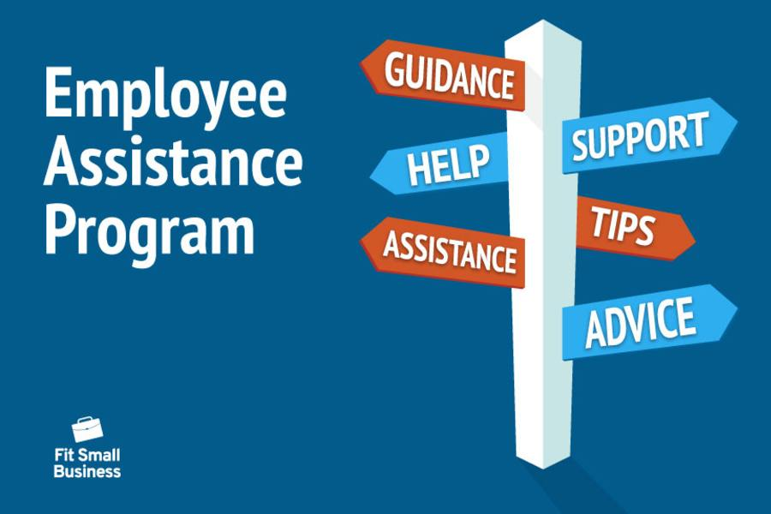
Supporting and Helping Employees
Personal and Work-Related Problems
Most EAPs emphasize the confidential nature of the services.
  Supervisors should discuss the confidentiality with EEs and assure them that no stigma will be associated with their seeking EAP help.
    However, the supervisor should inform an EE who refuses EAP assistance and whose work performance continues to deteriorate that such refusal might be a consideration in a termination decision.

Slide 89

Wellness Programs
Another approach often used by some organizations where EAPs are in place, is the wellness program.
  A Towers Watson Global Benefits Attitude Survey found that workers’ wellness is directly related to performance, both EE performance and organizational performance.
    The survey identified 7 lifestyle risk factors that decrease productivity even in the best-equipped workforces; stress, obesity, lack of physical activity, poor nutrition, tobacco use, presentism, and substance abuse.

Slide 90
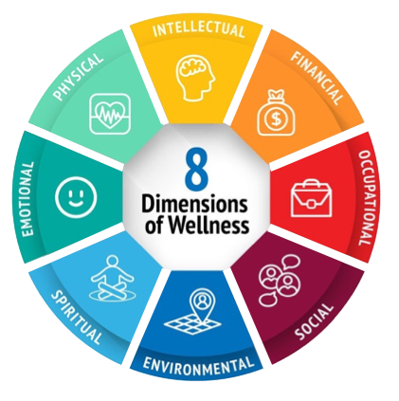
Wellness Programs
In order to comprehensively empower workers for success, employers are forced to consider how they can address these risk factors by promoting and supporting EE wellness.
  Companies are recognizing this growing challenge and are committed to helping by providing wellness programs for EEs.
    A wellness program is essentially a firm’s organized effort to help EEs stay healthy physically and mentally so they can stay productive and engaged, and to reduce employer health costs.

Slide 91

Paid Time Off (PTO)
It is well known that all work and no play will negatively impact the best of us.
  We all need time to pause, relax, and recharge our batteries.
    Increasingly, companies are developing paid time off (PTO) programs where EEs can use their accrued time off for personal reasons rather than solely for illness or vacations.

Slide 92

Good Supervision
The Foundation for High Engagement
All aspects of good supervision impact EE engagement as it relates to job conditions. However, perhaps the most significant day-to-day influence on EE engagement is the supervisor’s general attitude and behavior in departmental relationships.
  When a supervisor’s behavior indicates they are suspicious of EE’s motives and actions, low morale will likely result. When supervisors act worried or depressed, EEs tend to follow suit. When supervisors lose their temper, some EEs may also lose their temper.
    Conversely, supervisors who show confidence in their EE’s work and commend EEs for good performance reinforce their positive outlook.

Slide 93
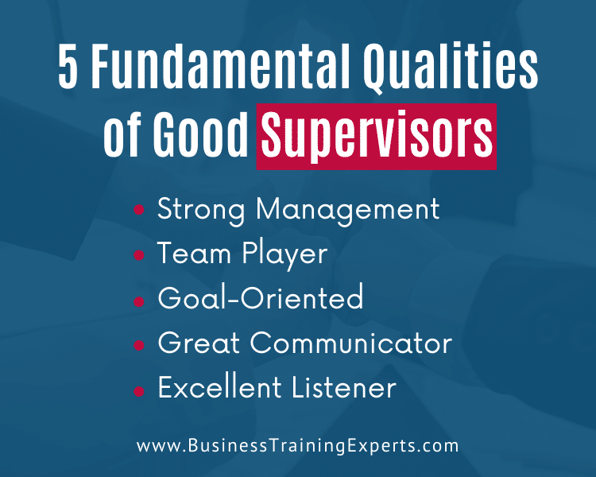
Good Supervision
The Foundation for High Engagement
This does not mean that a supervisor should overlook difficulties that are present from time to time.
  Rather, it means that if something goes wrong, the supervisor should act as a leader who has the situation in hand.
    For example, supervisors often will be called on to mediate conflict among their EEs. The supervisor should demonstrate the attitude that the EEs will be relied on to correct the situation and do what is necessary to prevent similar situations.

Slide 94


