Slide 1


Human Relations in Organizations
Session Five

Slide 2


Teamwork and Group Development
Team Dynamics, Creativity and Problem Solving, and Decision Making.

Slide 3

Teamwork
Teamwork involves working together to achieve something beyond the capabilities of individuals working alone.
  The common organizational structure is based on teams.

Slide 4


Teamwork
Job recruiters ranked ability to work well within a team as the second most sought after skill in new employees, just below communication and interpersonal skills, which are the foundation for team skills.

Slide 5

Types of Teams
Formal
There are formal groups, which are sanctioned by the organization (departments).
  Functional Teams are formal, ongoing teams that consist of managers and their employees.
    Task teams (committees) work together on a specific activity – this is in addition to your job in a functional group, so it’s possible you could have two bosses.

Slide 6
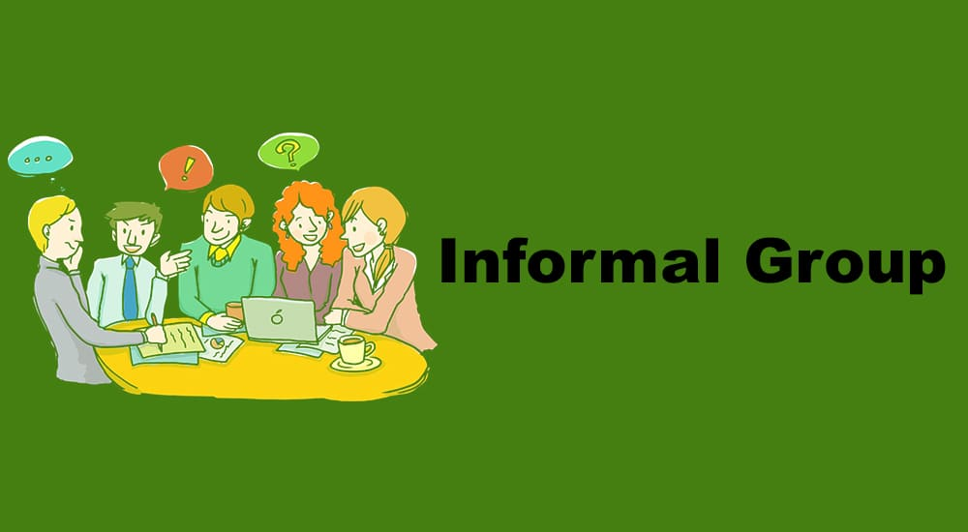
Types of Teams
Informal
There are informal groups, which are developed spontaneously when members get together voluntarily because of similar interests.

Slide 7
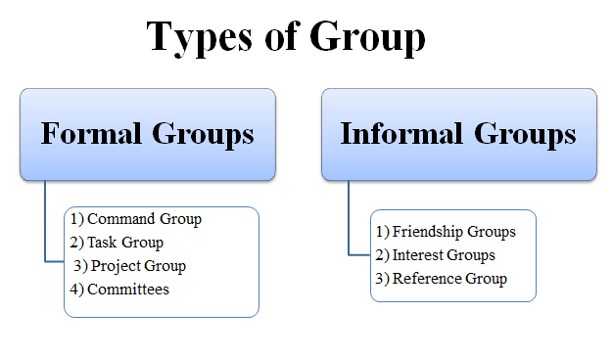
Types of Teams
Informal
Employees are commonly members of multiple teams.

Slide 8

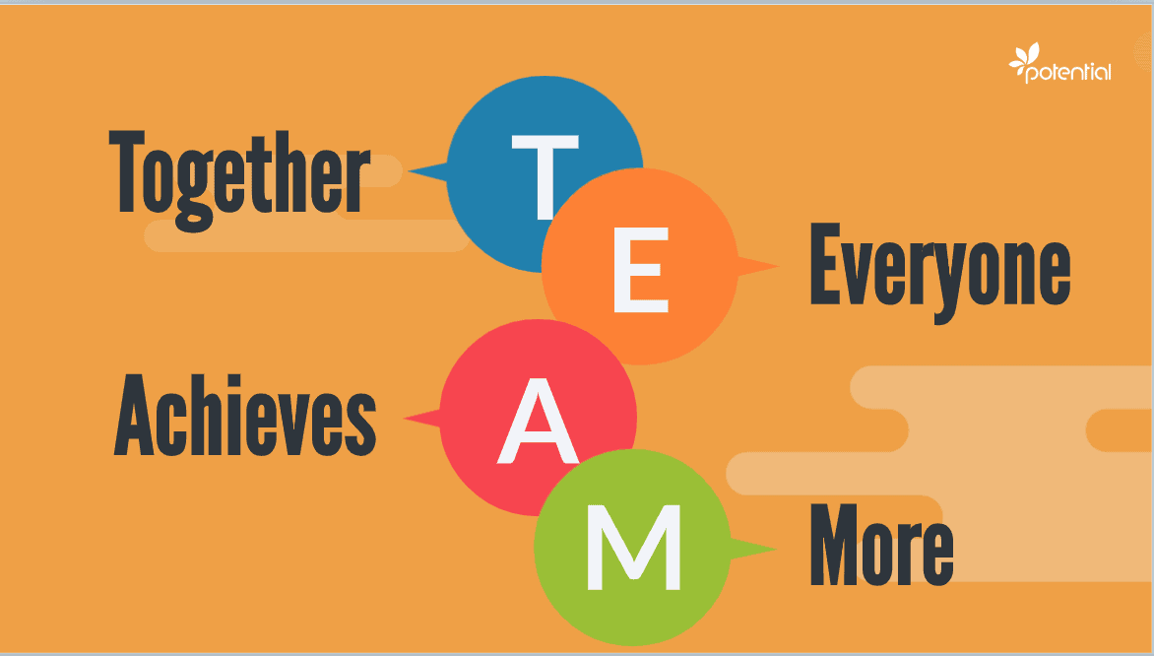
The Team Performance Model
The Team Performance Model is a function of:
  Team Structure + Team Dynamics+ Team Development Stage

Slide 9
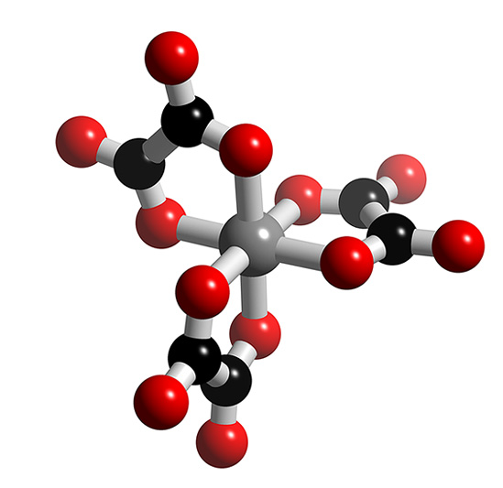
Team Structure
There are four team structure components that, along with team dynamics and development, affect team performance.
  Conflict
  Leadership
  Composition
  Creative Problem-Solving and Decision-Making

Slide 10

Team Dynamics
Team dynamics refers to the patterns of interactions that emerge as groups develop.
  Six components of team dynamics:
  Objectives
  Team Size
  Team Norms
  Group Cohesiveness
  Status within the Team
  Group Roles

Slide 11
Team Dynamics
Defined
Objectives
  Teams must agree on objectives and be committed to achieving them.
Team Size
  The ideal size depends on the team’s purpose.
Team Norms
  Functional groups policies and rules to help provide guidelines for behavior.
Group Cohesiveness
  The extent to which a group will abide by and enforce its norms depends on its attractiveness and closeness.
Status within the Team
  The more respect, prestige, influence, and power a member has the higher his or her status within the team.
Group Roles
  Roles are shared expectations of how members will fulfill the requirements of position: there are (1) task, (2) maintenance, and (3) self-interest roles.

Slide 12
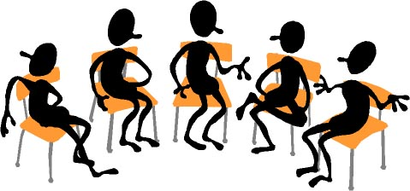
Group Roles Found in Teams
Task Roles
  Focus on getting the job done, and influencing others to help.
Maintenance Roles
  Things group members do and say to develop and sustain group dynamics.
  Focus on people working effectively together, and influencing others to work as team members.
Self-Interest Roles
  Things group member do and say to meet their own needs or objectives at the expense of the team.

Slide 13

Group Roles
Implications for Leaders
To be effective, a team must have members who play task roles and maintenance roles, while minimizing self-interest.

Slide 14
Team Development Stages
Orientation – Forming Stage
  Low development level, high commitment, and low competence
Dissatisfaction – Storming Stage
  Moderate development level, lower commitment, and some competence
  After members work together for some time, they tend to become dissatisfied with the group
Resolution – Norming Stage
  High development level, variable commitment, and high competence
  As members develop competence, they often become more satisfied with the group and committed to it
Production – Performing Stage
  Outstanding development level, high commitment, and high competence
  High commitment and competence enhances productivity & performance
Termination
  During this stage, members experience feelings about leaving the group

Slide 15

Key Variables
The two key variables identified through each stage of group development are:
  Work on the task (competence)
  The socioemotional tone or morale (commitment)

Slide 16

Team Development and Situational Supervision
With each stage of group development, a different supervisory style is needed to help the group perform effectively at that stage and to develop to the next level.
  Role(s) the manager should play during the different stages of group development:
    Orientation = Autocratic Style
    Dissatisfaction = Consultative Style
    Resolution = Participative Style
    Production = Laissez-Faire Style

Slide 17


Leadership Skills
With the trend toward teams, today there are typically more meetings in the workplace.

Slide 18
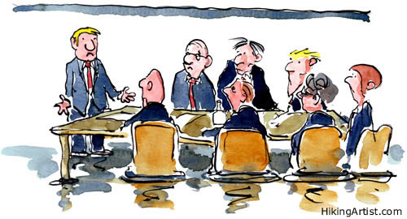
Planning Meetings
  You need meeting leadership skills for career success.
  There are at least five areas in which planning a meeting is needed:
    Objectives
    Participants and Assignments
    Agenda
    Date, Time, and Place
    Leadership
    The Written Plan

Slide 19
Conducting Meetings
The First Meeting
  At the first meeting, the group is in the orientation stage.
  This leader should use the high task role; however, the members should be given the opportunity to spend time getting to know one another.
The Three Parts of Each Meeting
  Begin the meetings on time; waiting for late members personalize the members who are on time and develops a norm for coming late.
  Each meeting should cover the following:
    Objectives
    Agenda
    Summarize and Review Assignments

Slide 20





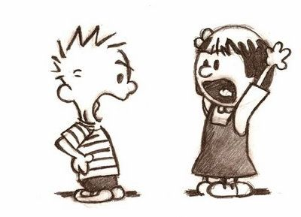
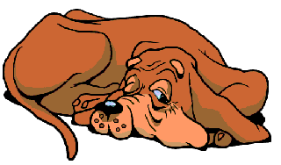
Handling Problem Team Members
1. The Silent Member
  Encourage the silent member to participate.
2. The Talker
  Slow down the talkers, don’t shut them up, and don’t let them dominate the group.
3. The Wanderer
  Keep the group on track – cut-off unwanted conversation.
4. The Bored Member
  Keep members motivated – assign tasks.
5. The Arguer
  Resolve the conflict, but not in an argumentative way.
6. The Social Loafer
  Use peer pressure to get them to do their work.
  Confront social loafers assertively.

Slide 21
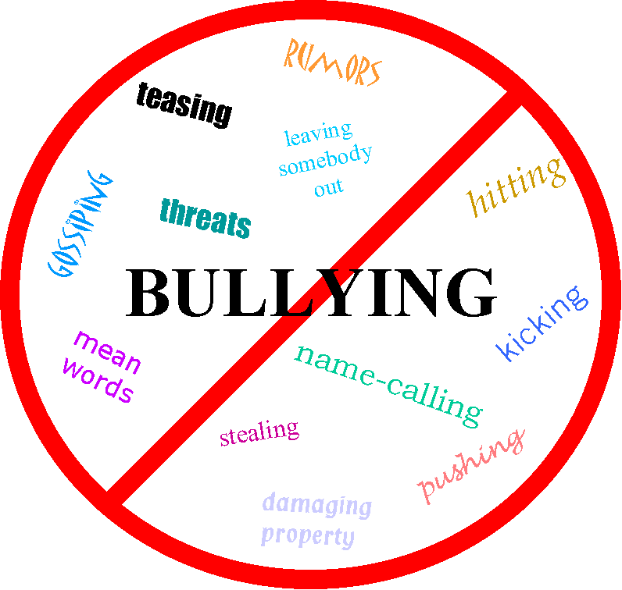
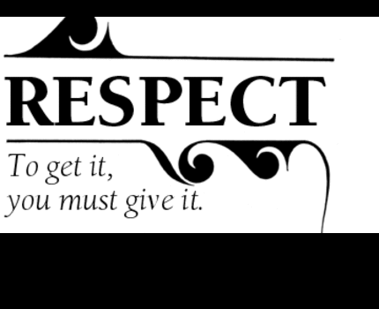
Conclusion
When you work in a team, do not embarrass, intimidate, or argue with any members, no matter how much they provoke you.
  If you do, the result will make martyrs of them and a bully of you.

Slide 22
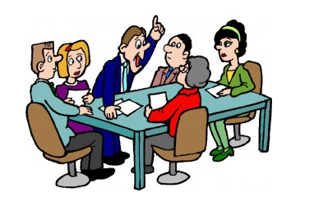

Problem-Solving and Decision-Making
Problem-solving and decision-making are an important part of group structure, affecting behavior, human relations, and performance.
  Decision-making separates the successful from the failed teams.

Slide 23


Work Teams - Groups
Work Teams are one of the realities and challenges of managing in today’s global environment.
  Before we can understand teams, however, we first need to understand some basics about groups and group behavior.

Slide 24

Groups
A group is defined as two or more interacting and interdependent individuals who come together to achieve specific goals.
  Formal Groups are work groups that are defined by the organization’s structure and have designated work assignments and specific tasks directed at accomplishing goals.
  Informal Groups are social groups.
    These groups occur naturally in the workplace and tend to form around friendships and common interests.

Slide 25
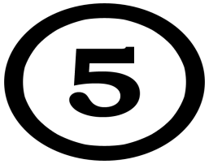
Five Stages of Group Development
1. Forming Stage
  The first stage of group development in which people join the group and then define the group’s purpose, structure, and leadership.
    Involves a great deal of uncertainty as members “test the waters” to determine what kind of behaviors are acceptable.
2. Storming Stage
  The second stage of group development, which is characterized by intergroup conflict.
    There’s conflict over who will control the group and what the group needs to be doing.
    A hierarchy of leadership and sense of direction will emerge.
3. Norming Stage
  The third stage of group development, characterized by close relationships and cohesiveness.
    Group demonstrates a strong sense of group identity and set of norms.
4. Performing Stage
  The fourth stage of group development, when the group is functional and works on the group task.
    Energies have moved beyond developing group structure and getting to know and understand each another to working on the group’s task.
5. Adjourning Stage
  The final stage of group development for temporary groups, during which they prepare to disband.
    Focused on wrapping up group activities instead of task performance.
    Group members react in different ways. Some are upbeat, thrilled about the group’s accomplishments. Others may be sad over the loss of camaraderie and friendships.

Slide 26

Five Stages of Group Development
Managers can be more effective if they understand the dynamics of each stage the group is operating in.
  Managers need to understand the problems and issues that are most likely to surface within that stage of group development.
    Groups do not always proceed sequentially from one stage to next.
    Sometimes, groups are storming and performing at the same time.
    Groups even occasionally regress to previous stages.

Slide 27

Concepts of Group Behavior
Roles
Roles are behavior patterns expected of someone who occupies a given position in a social unit.
  We adjust our roles to the group we belong to at the time.
  Employees attempt to determine what behaviors are expected of them by reading their job descriptions, getting suggestions from their bosses, and watching what their coworkers do.
    Role conflict happens when an EE has conflicting role expectations.

Slide 28
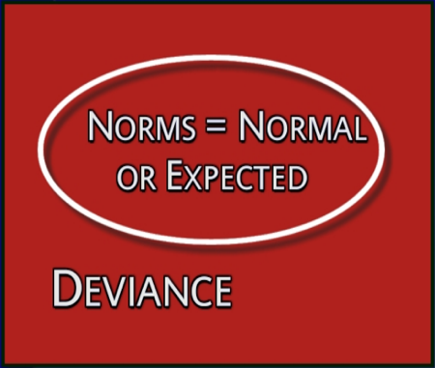
Concepts of Group Behavior
Norms
Norms are acceptable standards or expectations that are accepted and shared by group members.
  Most organizations have common norms, which typically focus on:
    Effort and Performance
    Dress Codes

Slide 29
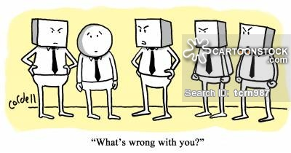
Concepts of Group Behavior
Conformity
Conformity is adjusting one’s behavior to align with a group’s norms.
  We all want to be accepted by groups to which we belong, which makes us susceptible to conformity pressures.

Slide 30

Concepts of Group Behavior
Status Systems
Status System is a prestige grading, position, or rank within a group and an important factor in understanding behavior.
  A disparity between what individuals perceive their status to be and what others perceive it to be is a significant motivator with behavioral consequences.
  It’s important for people to believe there’s congruency and equity between perceived ranking of an individual and their status symbol.
    Anything can have status value if others in the group admire it.

Slide 31
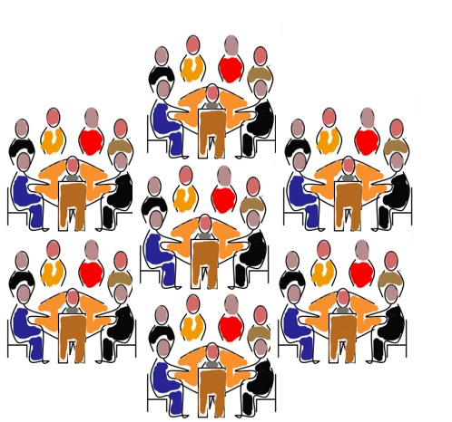
Concepts of Group Behavior
Group Size
Group Size affects a group’s behavior, but the effect depends on what criteria you’re using.
  Small Groups (5-7 Members) Better At:
    Completing tasks faster
    Figuring out what to do
    Getting the job done.
  Large Groups (12 or more Members) Better At:
    Problem solving
    Finding facts
    Gaining diverse input

Slide 32

Concepts of Group Behavior
Group Cohesiveness
Group Cohesiveness is the degree to which members are attracted to one another and share the group’s goals.
  The more that members are attracted to one another and the more that a group’s goals align with individual goals, the greater the group’s cohesiveness.
    Highly cohesive groups are more effective.

Slide 33
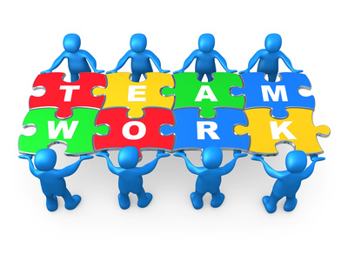
Teams
Research suggests that teams typically outperform individuals when the tasks being done require multiple skills, judgment, and experience.
  Organizations are using team-based structures because they’ve found that teams are more flexible and responsive to changing events than are traditional departments or other permanent work groups.
    Teams have the ability to quickly assemble, deploy, refocus, and disband.

Slide 34
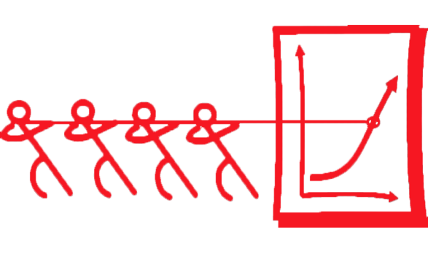
Teams
Teams differ from Groups.
  Work Groups interact primarily to share information and to make decisions to help members do their job more efficiently/effectively.
  Work Teams are groups whose members work intensely on a specific, common goal using their positive synergy, individual and mutual accountability, and complementary skills.
    Managers are looking for that positive synergy that will help the organization improve its performance.

Slide 35
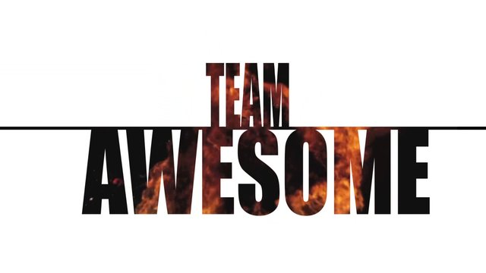
Team Effectiveness
Four Key Components
1. Context
  Adequate Resources
    If a team does not have what it needs its ability to perform is limited.
  Leadership and Structure
    A team needs to agree on role responsibility and accountability.
  Climate of Trust
    Facilitates cooperation, reduces need to monitor each others’ behavior, and bonds members around the belief that others will not take advantage.
  Performance Evaluation and Reward Systems
    Members have to be accountable both individually and jointly.
    Members and groups want to be rewarded.

Slide 36
Team Effectiveness
Four Key Components
2. Composition
  Knowledge, Skills, and Abilities of Members
    To perform effectively, a team needs (1) technical expertise, (2) problem-solving and decision-making skills, and (3) interpersonal skills.
  Personality
    Three of the Big Five dimensions of personality are related to team effectiveness – conscientiousness, openness to experience, agreeableness.
  Allocating Roles
    Match member strengths with role responsibilities.
  Diversity
    Research shows that diversity can have a negative effect on team functioning.
  Size of Teams
    A team should be small enough that it can be fed with two pizzas!
  Member Flexibility and Preferences
    Some people prefer not to work on teams.

Slide 37
Team Effectiveness
Four Key Components
3. Work Design
  Important work design elements include: (1) autonomy, (2) using a variety of skills, (3) being able to complete an identifiable task, and (4) working on a task that has a significant impact on others.
    Research indicates that these characteristics enhance team member motivation and increase team effectiveness.

Slide 38
Team Effectiveness
Four Key Components
4. Process
  Common Purpose
    Provides direction, momentum, and commitment for team members.
  Specific Goals
    Facilitate clear communication and help maintain focus on getting results.
  Team Efficacy
    Emerges when teams believe in themselves and believe they can succeed.
    Effective teams have confidence in themselves and in their members.
  Conflict Levels
    Effective teams need some task conflict.
    However, relational conflict is dysfunctional.
  Social Loafing
    Teams are successful when all members contribute.

Slide 39

Shaping Team Behavior
A manager can do several things to shape a team’s behavior including proper selection, employee training, and rewarding the appropriate team behaviors.

Slide 40
Shaping Team Behavior
Few trends have influenced how work gets done in organizations as much as the use of work teams.
  The shift from working alone to working on teams requires EE’s to cooperate with others, share information, confront differences, and sublimate personal interests for the greater good of the team
    Managers can build effective teams by understanding what influences performance and satisfaction.

Slide 41

Current Issues
In global organizations, understanding the relationship between team effectiveness and team composition is more challenging because of the unique cultural characteristics represented by members of a global team.
  In addition to recognizing team members’ abilities, skills, knowledge, and personality, managers need to be familiar with and clearly understand the cultural characteristics of the group and its members.

Slide 42
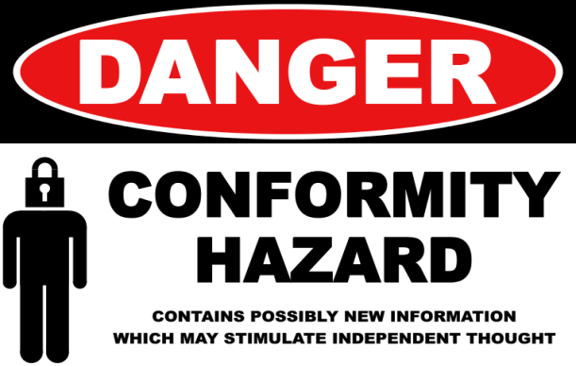
Current Issues
Some of the structural areas where we see differences in managing global teams include conformity, status, social loafing, and cohesiveness.
  1. Conformity
    Conformity to social norms tends to be higher in collectivist cultures than in individualistic cultures. However groupthink tends to be less of a problem in global teams because members are less likely to feel pressured to conform to ideas, conclusions, and decisions of group.

Slide 43

Current Issues
Some of the structural areas where we see differences in managing global teams include conformity, status, social loafing, and cohesiveness.
  2. Status
    The importance to status varies among cultures.
    Managers must understand who and what holds status when interacting with people from a culture different than their own.

Slide 44
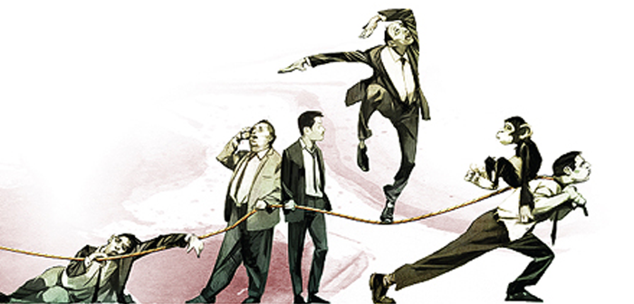
Current Issues
Some of the structural areas where we see differences in managing global teams include conformity, status, social loafing, and cohesiveness.
  3. Social Loafing
    Social loafing is consistent with individualistic cultures, which are dominated by self interest. It’s not consistent with collectivist societies, in which individuals are motivated by group goals.

Slide 45

Current Issues
Some of the structural areas where we see differences in managing global teams include conformity, status, social loafing, and cohesiveness.
  4. Cohesiveness
    In a cohesive group, members are unified and “act as one.”
    There’s a great deal of camaraderie and group identity is high.
    In global teams, however, cohesiveness is often more difficult to achieve because of higher levels of “mistrust, miscommunication, and stress.”

Slide 46

Global Teams
Communication issues often arise because not all team members may be fluent in the team’s working language, which can lead to inaccuracies, misunderstanding, and inefficiencies.

Slide 47
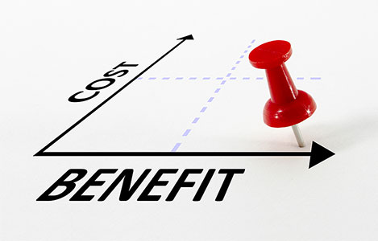
Teamwork
Teamwork takes more time and often more resources than does individual work.
  So, the benefits of using teams need to exceed the costs.

Slide 48

Team Managers
Effective work team managers are being described as coaches rather than bosses. They’re expected to provide instruction, guidance, advice, and encouragement to help team members improve their job performance.
  They need to:
  Analyze ways to improve team performance.
  Create a supportive climate.
  Influence changed behavior

Slide 49


