Slide 1

Human Relations in Organizations
Session One

Slide 2

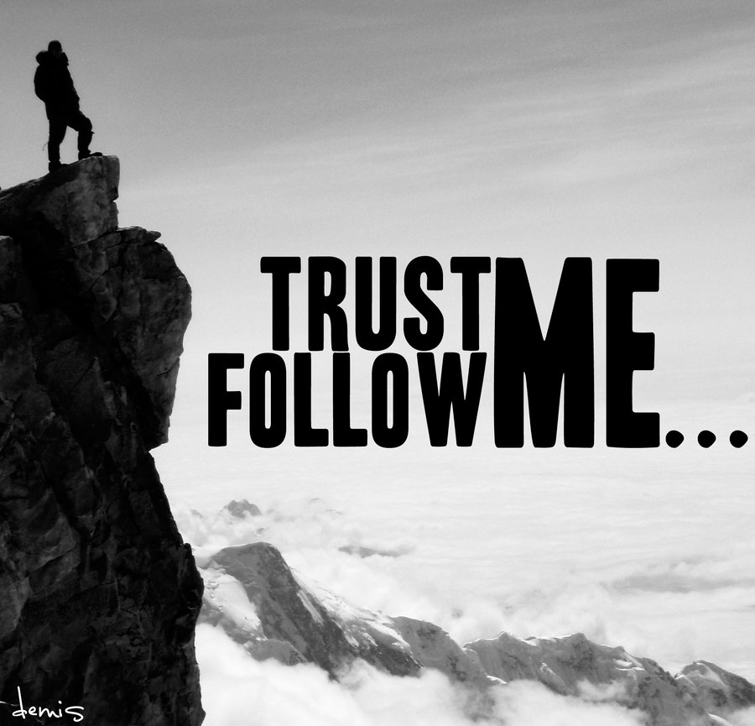

Chapter Seven
Leading and Trust

Slide 3

Leadership
Leadership is the process of influencing others to work toward the achievement of common objectives.
  The success of individual careers and the fate of organizations are determined by how effectively leaders behave.

Slide 4
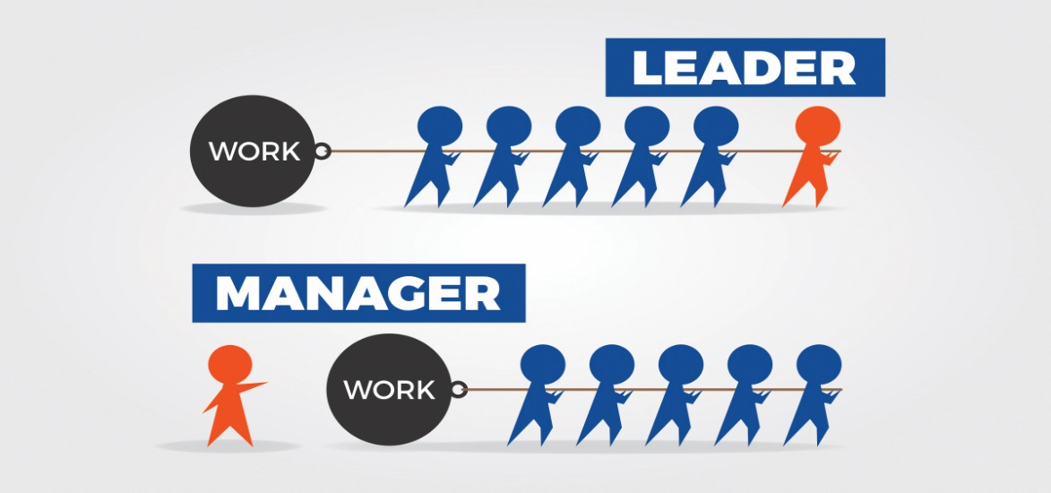
Leadership vs. Management
Management and Leadership are related but different concepts.
  Someone can be a manager without being a true leader, because they do not have the ability to influence others.
  There are also good leaders who are not managers - the informal leader, an employee group member, is a case in point.

Slide 5
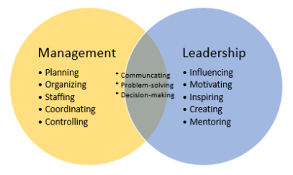
Leadership vs. Management
Leadership is one of the five management functions:
    Planning
    Organizing
    Staffing
    Leading
    Controlling

Slide 6
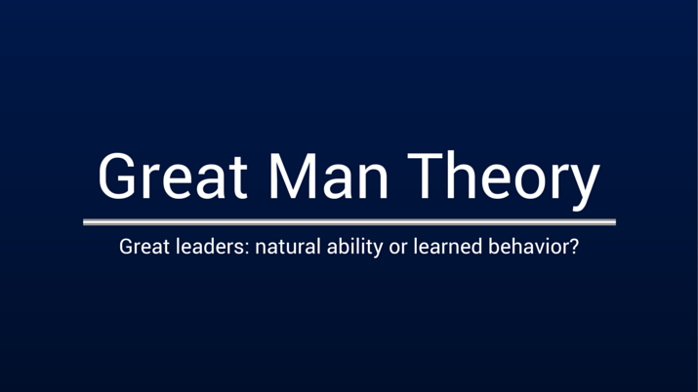
The “Great Man” Theory
Early studies were based on the assumption that leaders were born, not made – the concept was called the “Great Man” theory.

Slide 7
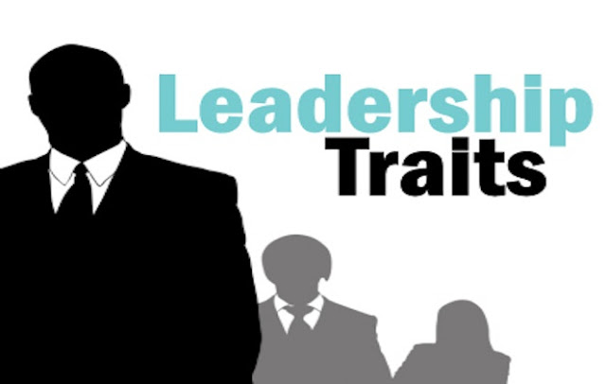

Leadership Trait Theory
Leadership Trait Theory assumes that there are distinctive physical and psychological characteristics accounting for leadership effectiveness.
  Personality traits do affect leadership style and creative outcomes. However, no one has come up with a universal list of traits that all successful leaders possess.

Slide 8

The Ghiselli Study
Ghiselli identified the following six traits, in order of importance, as being significant traits for effective leadership:
  Supervisory Ability
  Need for Occupational Achievement
  Intelligence
  Decisiveness
  Self-Assurance
  Initiative

Slide 9
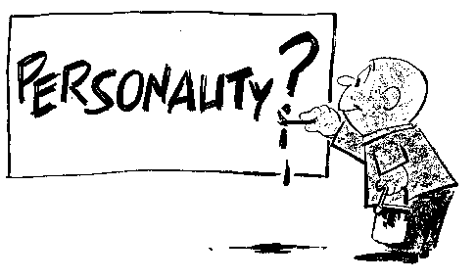
Current Leadership Studies
Current research supports the hypothesis that traits do play a role in predicting leadership qualities.
  One study found that the Big Five personality does have a preferred leadership profile, with:
    High Surgency and Conscientiousness being positively related to successful leadership.
    High Agreeableness and low Adjustment being negatively related to leadership success.

Slide 10

Current Leadership Studies
Answers to The Wall Street Journal-Gallup survey revealed the following as the three most important traits for success:
  Integrity
  Industriousness
  Ability to get along with others

Slide 11
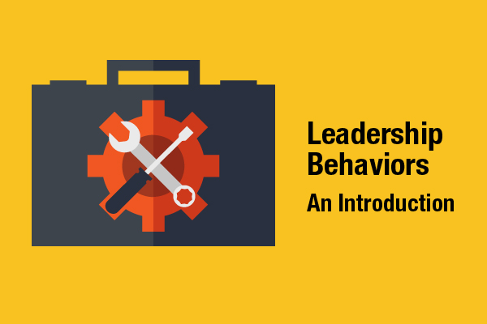
Behavioral Leadership Theories
By the mid-1900’s leadership research had switched from trait theory to a focus on the leader’s behavior.
  Behavioral Leadership Theories assume that there are distinctive styles that effective leaders use consistently, that is, that good leadership is rooted in behavior.

Slide 12
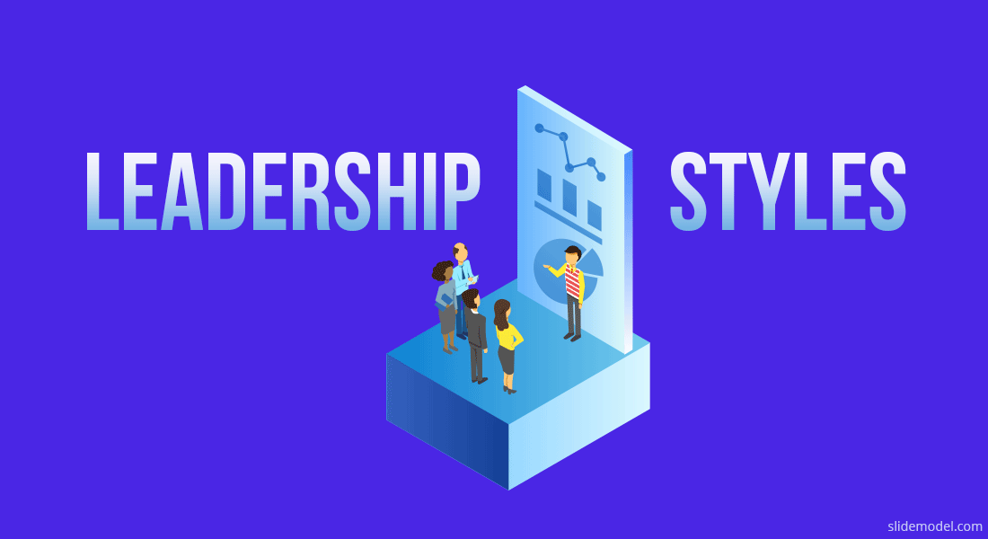
Two-Dimensional Leadership Styles
Structuring and Consideration
Respondents to a 1945 Ohio State University study to determine leadership styles questionnaire perceived their leader’s behavior toward them on two distinct dimensions.
  Initiating Structure
    The extent to which the leader takes charge to plan, organize, direct, and control as the employee performs the task
  Consideration
    The extent to which the leader communicates to develop trust, friendship, support, and respect

Slide 13
Two-Dimensional Leadership Styles
Job-Centered and Employee-Centered
Researchers at University of Michigan defined the same two dimensions, or styles, of leadership behavior; however, they called the two styles by different names.
  Job-Centered
    This is the same as Initiating Structure
  Employee-Centered
    This is the same as Consideration

Slide 14
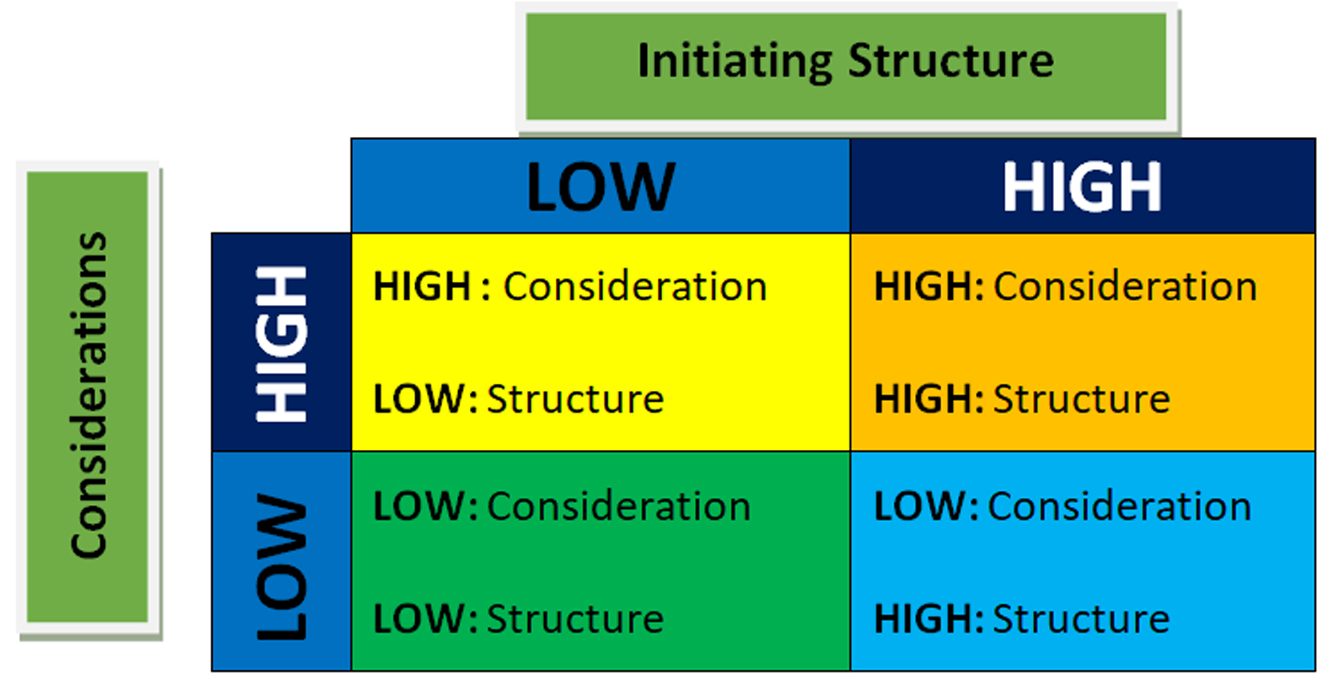
Leadership Styles
Different combinations of the two dimensions of leadership result in four Leadership Styles.

Slide 15
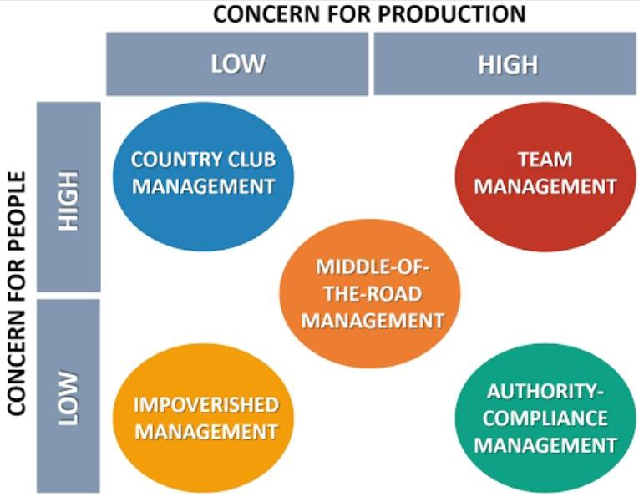
Leadership Styles
The Leadership Grid is Blake and Mouton’s model identifying the ideal leadership style as having a high concern for both production and people.

Slide 16

Leadership Styles
The Leadership Grid Identifies Five Major Styles:
  The Impoverished Manager
    This leader has low concern for both production & people
  The Sweatshop Manager
    This leader has a high concern for production - a low concern for people
  The Country-Club Manager
    This leader has a high concern for people - a low concern for production
  The Organized-Person Manager
    This leader has balance - medium concern for both production & people
  The Team Manager
    This leader has a high concern for both production & people
    This is the ideal leadership style

Slide 17
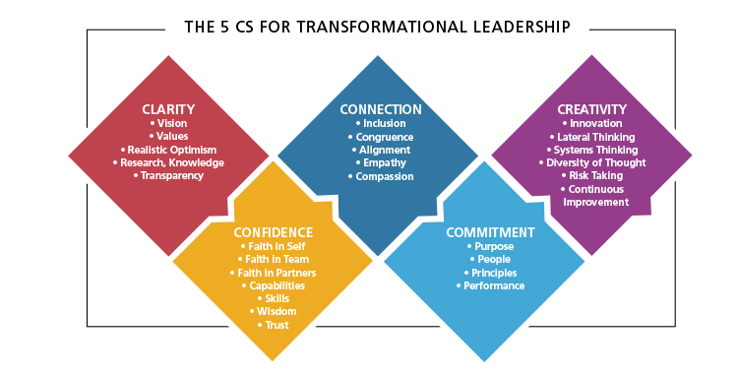
Transformational Leadership
Transformational Leadership is about (1) Change, (2) Innovation, and (3) Entrepreneurship.

Slide 18
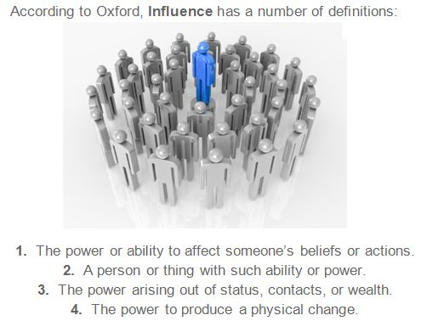
Charismatic Leadership
Charismatic Leadership characterizes extraordinary forms of influence, and is frequently associated with leaders who are perceived as exceptional, gifted, and even heroic

Slide 19
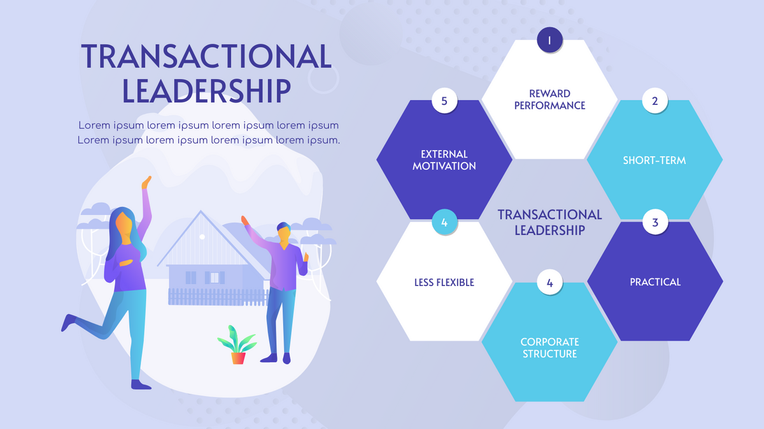
Transactional Leadership
Transactional leadership is based on the principle of: “Do this for me, and I’ll reward you.”

Slide 20

Servants and Stewardship
Stewardship Theory states that leaders should be servants of the organization.
  Leaders’ primary motivations are to serve organization’s interests and mission, as opposed to more self-serving, opportunistic ends.

Slide 21
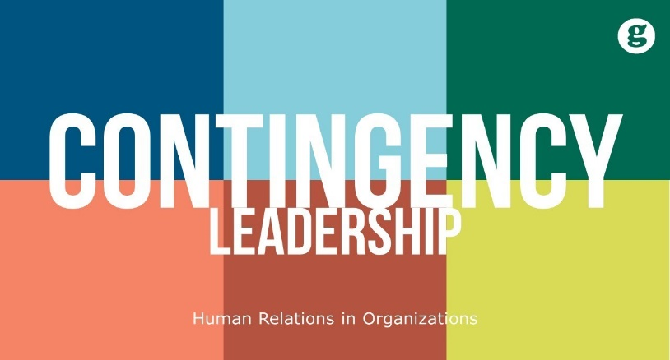
Contingency Leadership Theories
Contingency Leadership Theory assumes that appropriate leadership styles vary from situation to situation.
  The Contingency Leadership Theory developed by Fiedler is used to determine if a person’s leadership style is task or relationship oriented and if the situation matches the leader’s style.
    If there is no match, Fiedler recommends that the leader change the situation, rather than the leadership style.

Slide 22

Contingency Leadership Theories
Situational Favorableness
Situational Favorableness is the degree to which a situation enables the leader to exert influence over the followers – more favorable the situation, more power for the leader.
  Leader-Member Relations
    The better the relations, the more favorable the situation.
  Task Structure
    The more structured the jobs, the more favorable the situation.
  Position Power
    The more power, the more favorable the situation.

Slide 23
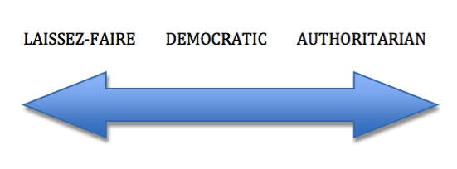
The Leadership Continuum
From Autocratic to Participative
The Leadership Continuum moves from the autocratic style to a more participative style.
  Autocratic Style
  State the decision that is not open to discussion
  Make the decision and convince employees that it is a good idea
  Present the decision and ask if there are any questions
  Present a decision that is subject to change based on input
  State the situation, ask for a recommendation, make the decision
  Let employees make a decision within set limits
  Let employees make ongoing decisions
  Participative Style

Slide 24

Leadership Continuum
Before selecting one of the styles on the continuum, the user must consider the following three factors:
  The Manager
    What is the leader’s preferred style, based on experience and confidence in the subordinates?
  The Subordinates
    What is the subordinates’ preferred style for the leader?
  The Situation
    What are the environmental considerations, such as the organization’s size, structure, goals, and technology?

Slide 25
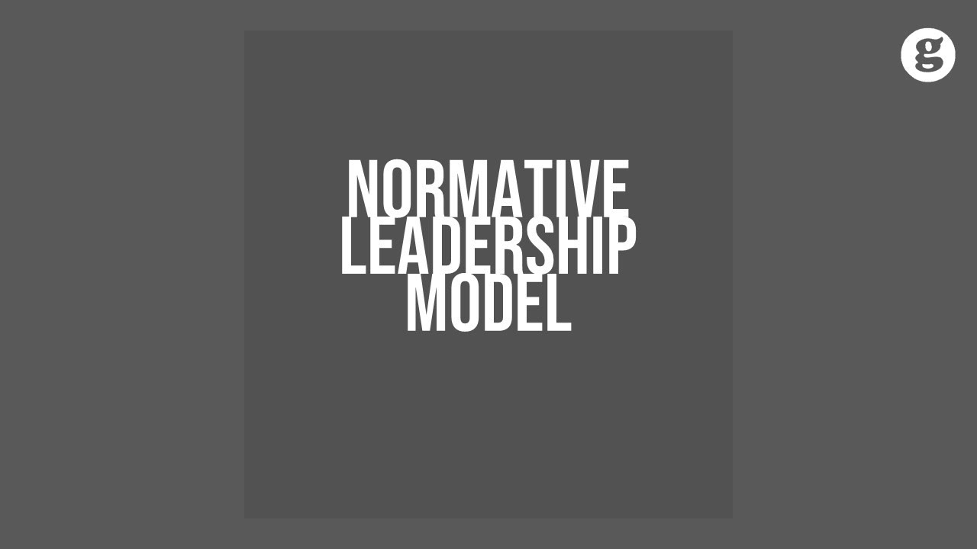
Normative Leadership Theory
Normative Leadership Theory is a decision-free model that enables the user to select from five leadership styles the one that is appropriate for the situation.
  Although the Normative Leadership Theory is primarily a leadership model, it is also used to determine the level of participation in decision-making.

Slide 26

Normative Leadership Theory
Five Leadership Styles
Decide
  Leader makes the decision alone.
Consult Individually
  Talk to individuals to get info and suggestions; then leader decides.
Consult Group
  Talk to group for info and suggestions; then leader makes decision.
Facilitate
  Have group meeting for participation with leader making decision.
Delegate
  Group makes the decision.

Slide 27

Situational Leadership
Situational Leadership is a model for selecting from four leadership styles the one that best matches the employee’s maturity level in a given situation.
  Telling
    High Task/Low Relationship (HT/LR)
  Selling
    High Task/High Relationship (HT/HR)
  Participating
    High Relationship/Low Task (HR/LT)
  Delegating
    Low Relationship/Low Task (LR/LT)

Slide 28
Situational Leadership
The effective supervisor adapts their style to meet the capabilities of the individual or group.
  Directive Behavior
    The supervisor focuses on directing and controlling behavior to ensure that the task gets done.
  Supportive Behavior
    The supervisor focuses on encouraging and motivating behavior.
    They explain things and listen to employee views, helping employees make their own decisions.
    When a supervisor interacts with employees, the focus can be on directing (getting the task done), supporting (developing relationships), or both

Slide 29
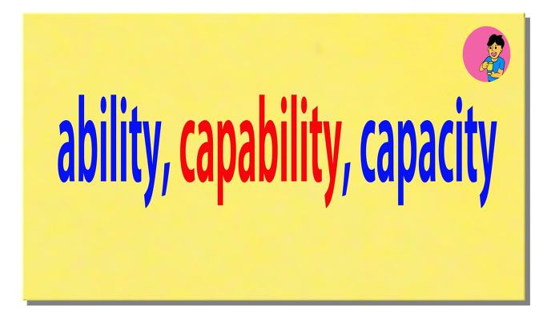
Situational Leadership
There are two distinct aspects of capability which include ability and motivation and can be located on a continuum from low to high.
  Ability
    Do the employees have the experience, education, skills and so on to do the task without direction from the supervisor?
  Motivation
    Do the employees want to do the task? Will they perform the task without a supervisor’s encouragement and support?

Slide 30

Supervisory Style
  The better a supervisor is at matching their supervisory style to employee’s capabilities, the greater their chances of being a successful supervisor.
  The four supervisory styles:
    Autocratic Style
    Consultative Style
    Participative Style
    Laissez-Faire

Slide 31
Four Supervisory Styles
Autocratic
  Employees are like “Babies”
    Involves high directive and low supportive behavior and is appropriate when interacting with low capability employees.
Consultative
  Employees are like “Teenagers”
    Involves high directive and high supportive behavior and is appropriate when interacting with moderate capability employees.
Participative
  Employees are like “New Graduates”
    This style is characterized by low directive and high supportive behavior and is appropriate when interacting with employees with high capability.
Laissez-Faire
  Employees are “Star Performers”
    Entails low directive and low supportive behavior and is appropriate when interacting with outstanding employees.

Slide 32
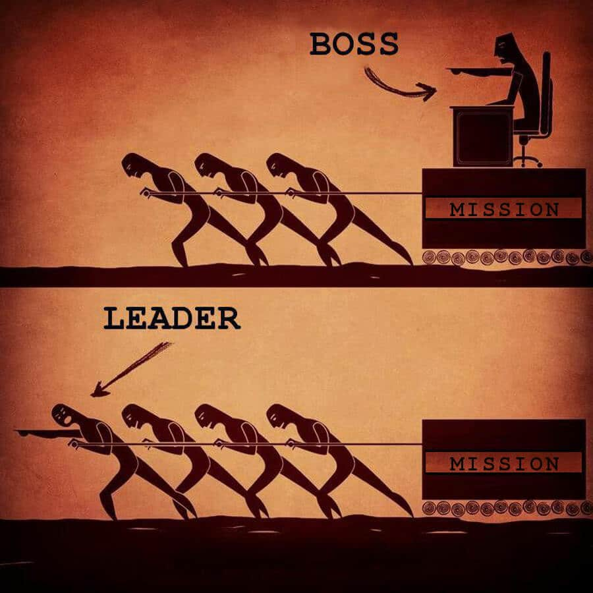
Leadership Theories
The leadership theories presented assume that some leadership style will be effective in each situation.
  Leadership is a shared process between the group members, and there is not substitute for leadership.
    However, there are substitutes for managers.

Slide 33
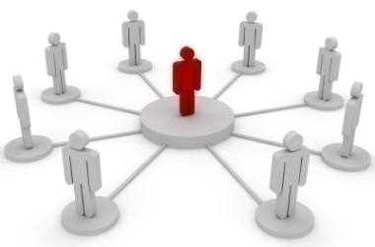
Management
The following characteristics may substitute for management:
  Characteristics of Subordinates
    Ability, knowledge, experience, training; need for independence; professional orientation; indifference toward organizational goals.
  Characteristics of Task
    Clarity and routine; invariant methodology; provision of own feedback concerning accomplishment; intrinsic satisfaction.
  Characteristics of the Organization
    Formalization (explicit plans, goals, and areas of responsibility); inflexibility (rigid, unbending rules and procedures), highly specified and active advisory and staff functions; closely knit, cohesive work groups; organizational rewards not within the leader’s control; spatial distance between superior and subordinates.

Slide 34
Diversity and Global Leadership
Thinking globally and having global leadership skills are essential to effective organizations.
  Most leadership theories were developed in the U.S., so they do have an American bias. Theories assume:
    Employee responsibility, rather than employee rights
    Self-gratification, rather than commitment to duty or altruistic motivation
    Democratic values, rather than autocratic values
    Rationality, rather than spirituality, religion, or superstition

Slide 35

Types of Trust
Trust is the positive expectation that another will not take advantage of you. You can’t be a truly effective leader without trust.
  Three kinds of trust, include:
  Deterrence Based Trust
    Because we lack experience in dealing with the other person we fear reprisal if the trust is violated – so we avoid being untrustworthy.
  Knowledge Based Trust
    Trust is based on experience dealing with the other person.
    Based on our knowledge, we can predict the other’s behavior.
    The most common organizational trust.
  Identification Based Trust
    Trust is based on an emotional connection.
    The highest level of trust.

Slide 36

Developing Trust
There are five dimensions of trust
  Integrity is in the center, holding the other four dimensions together, because without integrity, trust breaks us apart.
    Integrity
    Competence
    Consistency
    Loyalty
    Openness
      Self Disclosure
      Johari Window

Slide 37

Identification-Based Trust
Self-disclosure enhances human relations and is what takes the level of trust to the identification level.
  The Johari Window has four regions representing the intersection of two axes:
  Degree to which information about you is known to or understood by you.
  Degree to which information about you is known by others.
  Based on our understanding of self, we select those aspects of self that are appropriate to share with others.
  To develop trust and improve human relations, we gradually share self-disclosure to open the hidden and blind areas of the Johari Window.

Slide 38
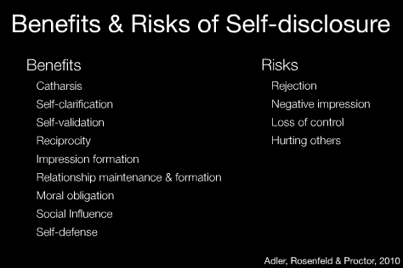
Self-Disclosure
Developing trust through self-disclosure does include the risk of being hurt, disappointed, and taken advantage of.
    Although people often fear risk of self-disclosure, the rewards of improved human relations and personal friendship are worth risk.

Slide 39
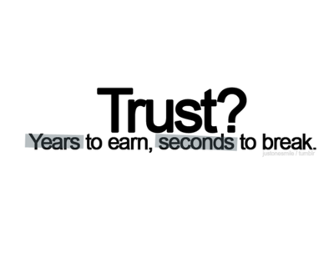
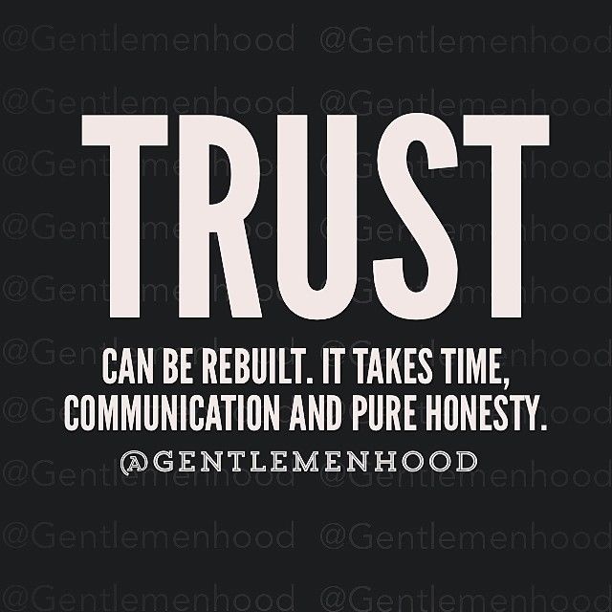
Repairing Trust
Trust is earned and builds over time.
  It is much easier to destroy trust than to build it.
  Years of trust can be hurt or destroyed with one act of distrust.
    Because trust is easily broken, knowing how to repair trust has become a critical competency.

Slide 40


Fundamentals of Management
Session Two

Slide 41
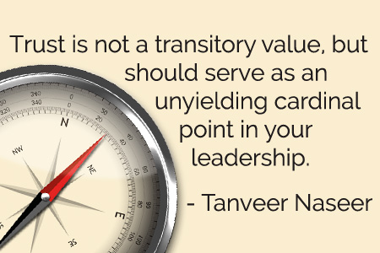
Part Four: Leading
Chapter Twelve: Leadership and Trust
  Define leader and leadership.
  Compare and contrast early leadership theories.
  Describe the four major contingency leadership theories.
  Describe modern views of leadership and issues facing leaders today.
  Discuss trust as the essence of leadership.

Slide 42
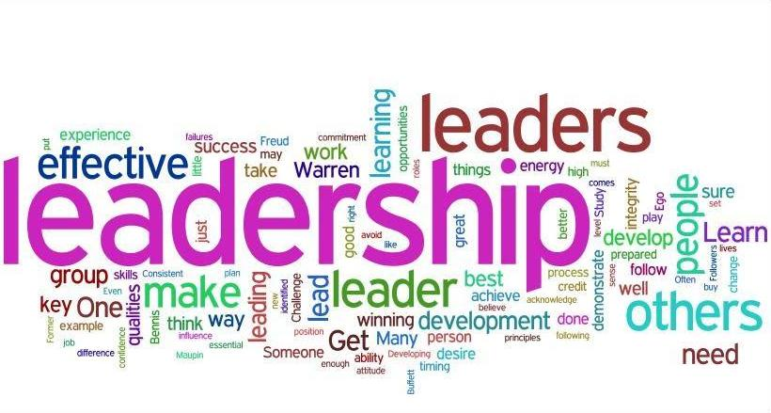
Leaders and Leadership
A Leader is Someone who can influence others and has managerial authority.
  Because leading is one of the four management functions, ideally all managers should be leaders.
Leadership is the process of leading a group & influencing that group to achieve its goals.

Slide 43

Trait Theories of Leadership
Trait Theories of Leadership search for characteristics or traits that differentiate leaders from non-leaders.
  Most people can cite a list of qualities they admire in leaders – intelligence, charisma, decisiveness, enthusiasm, strength, bravery, integrity, self-confidence, etc., but there is no definitive list of traits consistently associated with leadership.
    Traits alone are not sufficient for identifying effective leaders.

Slide 44

Common Leadership Traits
Drive
  Leaders exhibit a high effort level. They have a relatively high desire for achievement, they are ambitious, they have a lot of energy, they are tirelessly persistent in their activities, and they show initiative.
Desire to Lead
  Leaders have a strong desire to influence and lead others.
  They demonstrate the willingness to take responsibility.
Honesty and Integrity
  Leaders build trusting relationships with followers by being truthful, or non-deceitful, and by showing high consistency between word and deed.
Self-Confidence
  Followers look to leaders who don’t self doubt. Leaders, therefore, need to show self-confidence in order to convince followers of the rightness of their goals and decisions.

Slide 45
Common Leadership Traits
Intelligence
  Leaders need to be intelligent enough to gather, synthesize, and interpret large amounts of information, and they need to be able to create visions, solve problems, and make correct decisions.
Job-Relevant Knowledge
  Effective leaders have a high degree of knowledge about the company, industry, and technical matters. In depth knowledge allows leaders to make well-informed decisions and to understand the implications of those decisions.
Extraversion
  Leaders are energetic, lively people. They are sociable, assertive, and rarely silent or withdrawn.
Proneness to Guilt
  Guilt proneness is positively related to leadership effectiveness, because it produces a strong sense of responsibility for others.

Slide 46
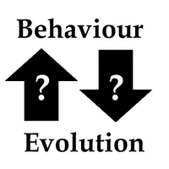
Behavioral Theories of Leadership
Iowa – Ohio – Michigan – Managerial Grid
Behavioral Theories of Leadership search for behaviors that differentiate effective leaders from ineffective leaders.
  If behavioral theories could identify critical behavioral determinants of leadership, people could be trained to be leaders – the premise behind management development programs.

Slide 47

Behavioral Theories of Leadership
There is a dual nature of leader behaviors.
  Focusing on the work to be done and focusing on the employees – is an important characteristic of successful leadership.
    Task and Relationship oriented.

Slide 48
Fiedler Contingency Theory
The Fiedler Contingency Theory proposes that effective group performance depends on the proper match between a leader’s style and the degree to which the situation allowed the leader to control and influence.
  Fiedler’s research uncovered three contingency dimensions that defined the key situational factors in leader effectiveness.
    Leader-Member Relations: the degree of confidence, trust, and respect EE’s had for their leader.
    Task Structure: the degree to which job assignments were formalized and structured.
    Position Power: the degree of influence a leader had over activities such as hiring, firing, discipline, promotions, and salary increases.

Slide 49

Situational Leadership Theory (SLT)
The Situational Leadership Theory proposed by Paul Hersey and Ken Blanchard focuses on followers’ readiness.
  Readiness refers to the extent to which people have the ability and willingness to accomplish a specific task
  The emphasis on the followers in leadership effectiveness reflects the reality that it is the followers who accept or reject the leader.
    SLT acknowledges the importance of followers and builds on the logic that leaders can compensate for ability and motivational limitations in their followers, with intuitive appeal.

Slide 50
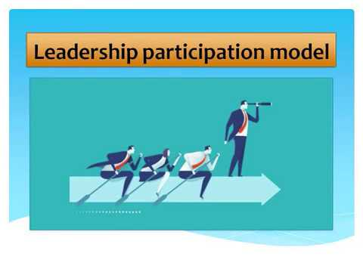
Leader-Participation Model
The Leader-Participation Model developed by Victor Vroom and Phillip Yetton is a leadership contingency theory that suggests the participation-level of a leader in decision-making is relative to the different types of situations they encounter.
  The model confirms that leadership research should be directed at the situation rather than at the person.
    That is, it probably makes more sense to talk about autocratic and participative situations than autocratic and participative leaders.

Slide 51

Path-Goal Theory
The Path-Goal Theory developed by Robert House says that the leader’s job is to assist followers in attaining their goals and to provide direction or support needed to ensure that their goals are compatible with the organization’s or group’s goals.
  The term path-goal is derived from the belief that effective leaders clarify the path to help their followers get from where they are to the achievement of their work goals and make the journey along the path easier by reducing roadblocks and pitfalls.

Slide 52
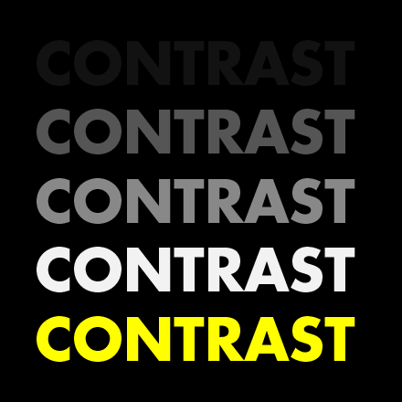
Path-Goal Theory
In contrast to Fiedler’s view that a leader couldn’t change his or her behavior, House assumed that leaders are flexible and can display any or all of these leadership styles depending on the situation.

Slide 53

Path-Goal Theory
An EE’s performance and satisfaction are likely to be positively influenced when the leader chooses a leadership style that compensates for short comings in either the EE or the work setting.
  However, if the leader spends time explaining tasks that are already clear or when the EE has the ability and experience to handle them without interference, the EE is likely to see such directive behavior as redundant or even insulting.

Slide 54
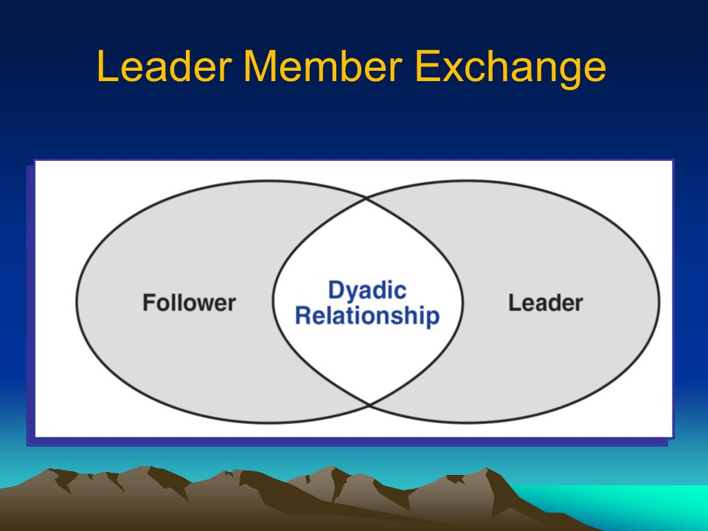
Leader-Member Exchange (LMX) Theory
The Leader-Member Exchange Theory says leaders create in-groups and out-groups and the in-group will have higher performance ratings, less turnover, and greater job satisfaction.
  Early on in the relationship a leader will implicitly categorize a follower as an “in” or as an “out.”
    Leaders also encourage LMX by rewarding those EE’s with whom they want a closer linkage and punishing those with whom they do not.

Slide 55

Leader-Member Exchange (LMX) Theory
Followers with in-group status will have higher performance ratings, engage in more helping or “citizenship” behaviors at work, and report greater satisfaction with their boss.
  These findings are not surprising, as leaders are more likely to invest their time and other resources in those whom they expect to perform the best.

Slide 56
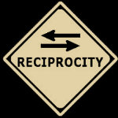

Transactional Leaders
Transactional Leaders are those who lead primarily by using social exchange or transactions.
  Transactional leaders guide or motivate followers to work toward established goals by exchanging rewards for their productivity.

Slide 57
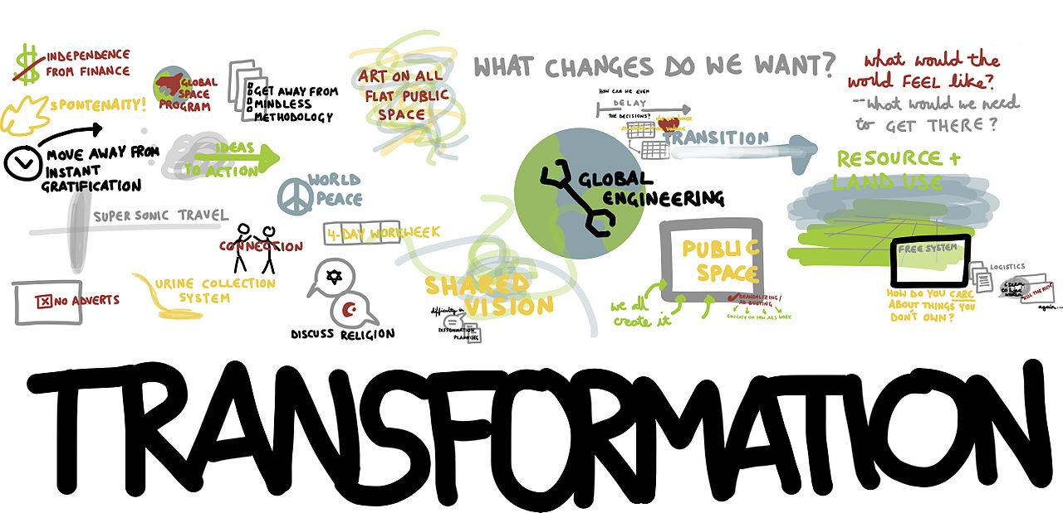
Transformational Leaders
Transformational Leaders stimulate and inspire (transform) followers to achieve extraordinary outcomes.
  Transformational leaders pay attention to the concerns and developmental needs of individual followers; changing followers’ awareness of issues by helping those followers look at old problems in new ways; and being able to excite, arouse, and inspire followers to exert extra effort to achieve group goals.

Slide 58

Transactional vs. Transformational Leaders
The evidence supporting the superiority of transformational leadership over transactional leadership is impressive.
  Transformational leaders were evaluated as more effective, higher performers, more promotable than their transactional counterparts, and more interpersonally sensitive.
    Transformational leadership is strongly correlated with lower turnover rates and higher levels of productivity, work engagement, EE satisfaction, creativity, goal attainment, and follower well-being.

Slide 59

Charismatic Leaders
Charismatic Leaders are enthusiastic, self-confident leaders whose personalities and actions influence people to behave in certain ways.
  Charismatic Leaders have vision, willingness to take risks to achieve that vision, sensitivity to both environmental constraints and follower needs, and other behaviors that are out of the ordinary.
    There is an impressive correlation between charismatic leadership and high performance and satisfaction among followers.

Slide 60

Visionary Leadership
Visionary Leadership is the ability to create and articulate a realistic, credible, and attractive vision of the future that improves on the present situation.
  The vision, if properly selected and implemented, is so energizing that it “in effect jump-starts the future by calling forth the skills, talents, and resources to make it happen.
    An organization’s vision should offer clear and compelling imagery that taps into people’s emotions and inspires enthusiasm to pursue the organization’s goals.

Slide 61

Leaders and Teams
Because leadership is increasingly taking place within a team context and more organizations are using work teams, the role of the leader in guiding team members has become increasingly important.
  Effective team leaders have mastered the difficult balancing act of knowing when to leave their teams alone and when to get involved.
    Important responsibilities of team leaders include coaching, facilitating, handling disciplinary action problems, reviewing team and individual performance, training, and communication.

Slide 62

Empowerment
Managers are increasingly leading by not leading; that is, by empowering their employees.
  Empowerment involves increasing the decision-making discretion of workers.
    Today, many EE’s are making the key operating decisions that directly affect their work.

Slide 63

Empowerment
More companies are empowering EE’s because of a need for quick decisions by those people who are most knowledgeable about the issues.
  If organizations want to successfully compete in a dynamic global economy, EE’s have to be able to make decisions and implement changes quickly.

Slide 64

National Culture
National Culture is an important situational variable in determining which leadership style will be most effective.
  However, most leadership theories were developed in the U.S., and have an American bias:
    Emphasize follower responsibilities rather than rights.
    Assume centrality of work and democratic value orientation.
    Stress rationality rather than spirituality, religion, or superstition.
    Assume self-gratification rather than commitment to duty or altruistic motivation.

Slide 65
National Culture
A number of elements of transformational leadership appear to be associated with effective leadership regardless of what country the leader is in.
  Effective business leaders in any country are expected by their subordinates to provide a powerful and proactive vision to guide the company into the future, strong motivational skills to stimulate all EE’s to fulfill the vision, and excellent planning skills to assist in implementing the vision.

Slide 66

Virtual Leadership
Today’s managers and their EE’s are increasingly being linked by technology rather than by geographic proximity.
  To be an effective virtual leader, managers must recognize that they have choices in the words and structure of their digital communications. They also need to develop the skill of “reading between the lines” in the messages they receive.
    It’s important to try and decipher the emotional content of a message as well as the written content.

Slide 67

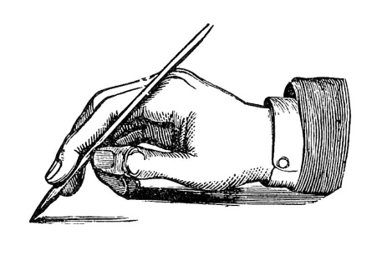
Virtual Leadership
For an increasing number of managers, good interpersonal skills may include the abilities to communicate support and leadership through digital communication and to read emotions in others’ messages.
  In this “new world” of communication, writing skills are likely to become an extension of interpersonal skills.

Slide 68

Emotional Intelligence
Emotional Intelligence – more so than IQ – is the best predictor of who will emerge as leader.
  Leaders need basic intelligence and job-relevant knowledge, but IQ and technical skills are “threshold capabilities.”
    They are necessary, but not sufficient requirements for leadership.

Slide 69
Emotional Intelligence
Emotional Intelligence – more so than IQ – is the best predictor of who will emerge as leader.
  Emotional Intelligence is what allows an individual to become a star performer. It emphasizes:
    Self-Awareness
    Self-Management
    Self-Motivation
    Empathy
    Social Skills

Slide 70
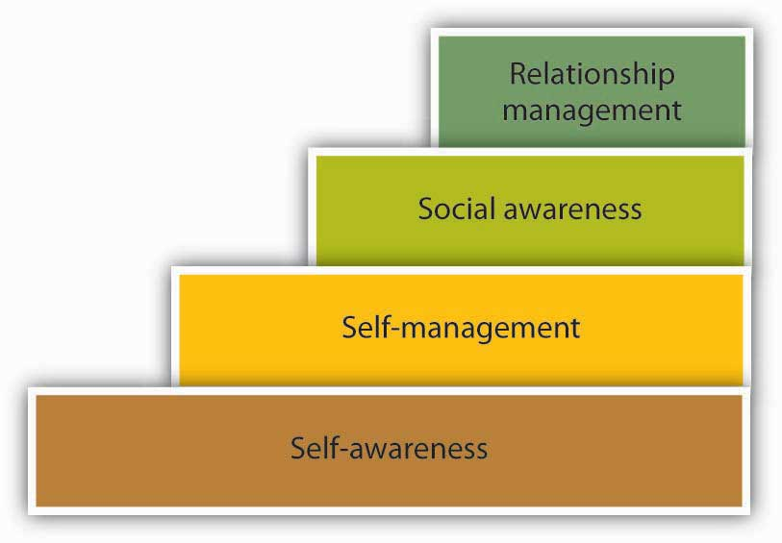
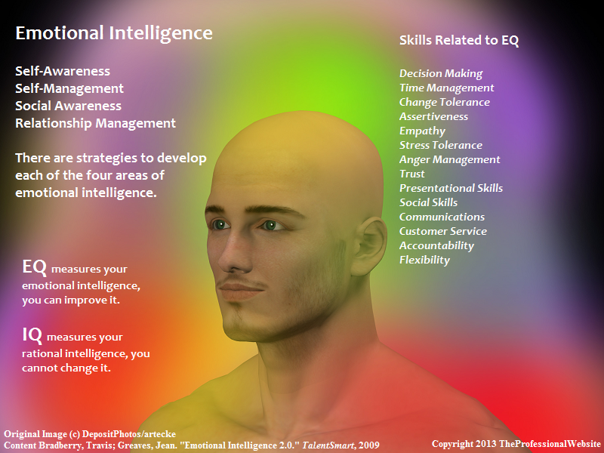
Emotional Intelligence
Emotional Intelligence has been shown to be positively related to job performance at all levels.
  But it appears to be especially relevant in jobs that demand a high degree of social interaction.
    And, of course, that’s what leadership is all about.

Slide 71
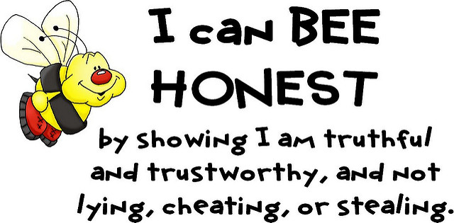
Trust
Trust is the essence of leadership.
  In today’s uncertain environment, leaders need to build, or even rebuild, trust and credibility.
    The main component of credibility is honesty.
    Surveys show that honesty is consistently singled out as the number one characteristic of admired leaders.
        Honesty is absolutely essential to leadership.

Slide 72

Trust
In addition to being honest, credible leaders are competent and inspiring.
  Followers judge a leader’s credibility in terms of his or her honesty, competence, and ability to inspire.
    Trust is closely entwined with the concept of credibility, and in fact, the terms are often used interchangeably.
    Trust is the belief in integrity, character, and ability of a leader.

Slide 73
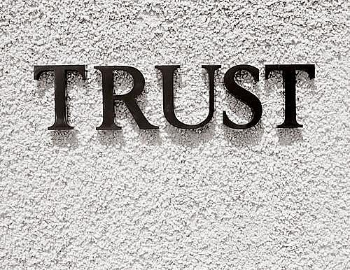
Trust
Five dimensions that make up Trust:
  Integrity
    Honesty and truthfulness
  Competence
    Technical and interpersonal knowledge and skills
  Consistency
    Reliability, predictability, and good judgment in handling situations
  Loyalty
    Willingness to protect a person, physically and emotionally
  Openness
    Willingness to share ideas and information freely

Slide 74

…

