Slide 1
Human Relations in Organizations Session 7

Slide 2
Chapter Four
Time and Career Management
Time and career management skills lead to better behavior, more effective human relations, higher levels of performance, and career success.

Slide 3
Time Management and Career Management
If you manage your time better, you will have more time to spend developing effective human relations skills.
Developing time management skills is also an effective way to better balance work-family life, reduce stress, increase personal productivity, and experience inner peace.

Slide 4
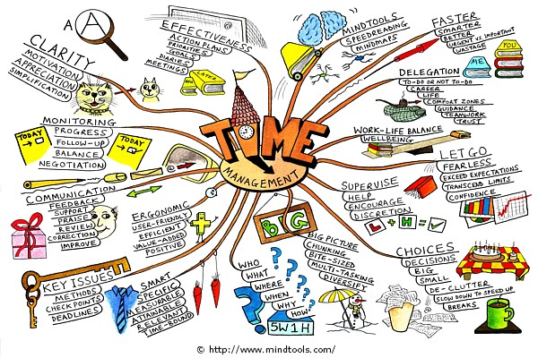
Time Management
The term Time Management refers to techniques designed to enable people to get more done in less time with better results.

Slide 5
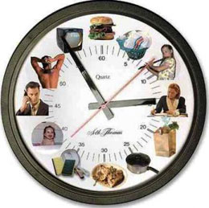
Analyzing Time Use
The first step to successful time management is to determine current use of time.
People often do not realize how much time they waste until they analyze time use.

Slide 6
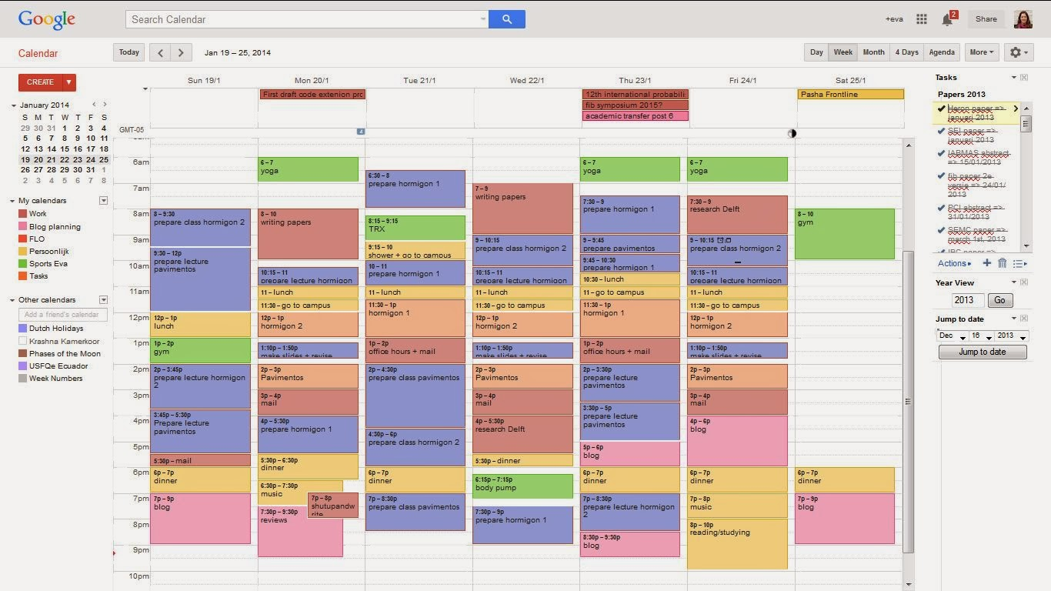
Time Log
The Time Log is a daily diary that tracks activities and enables a person to determine how time is used.
After keeping time logs for 5 to 10 working days, you can analyze them by answering the following questions…

Slide 7
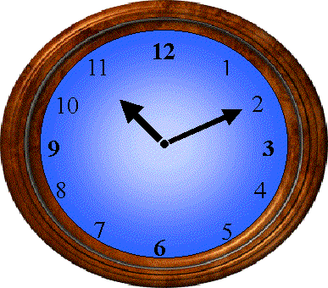
Analyzing Time Log
How much time are you spending on your primary responsibilities?
What areas are you spending too much time?
What areas are you not spending enough time?
Identify major interruptions that limit your time
Identify tasks that you can/should delegate to others
How much time of yours is controlled by another?
How can you gain more control of your time?
How can you plan to eliminate recurring crisis that limit your time?
Look for habits, patterns, and tendencies
List three of five of your biggest time wasters
How can you manage your time more efficiently?

Slide 8
Multitasking
Research has found that people who multitask are actually less efficient than those who focus on one “complex” project at a time
The brain is actually not capable of doing two things at once.
Managing two tasks at once reduces the brain power available for either task, and it increases stress.

Slide 9
Priority Determination
At any given time, you have to face having to do many different tasks, and one of the things that separate successful from unsuccessful people is ability to do the important things later.
A priority is the preference given to one activity over another.
Tasks that you must get done should be placed on a to-do-list and then prioritized, ranking the order of importance.

Slide 10
The To-Do-List
The To-Do-List is the written list of activities the individual has to complete.
In summary, decide what is really important, put it on your list, and find the time to do it.

Slide 11
Priority Determination
Three Priority Determination Questions
Do I need to be personally involved?
Is the task my responsibility or will it affect the performance or finances of another person or group?
Deadline - is quick action needed?

Slide 12
Assigning Priorities
Based on the answers to the three priority determination questions, a manager can:
Delegate a task.
Assign it a (1) high, (2) medium, or (3) low priority.

Slide 13
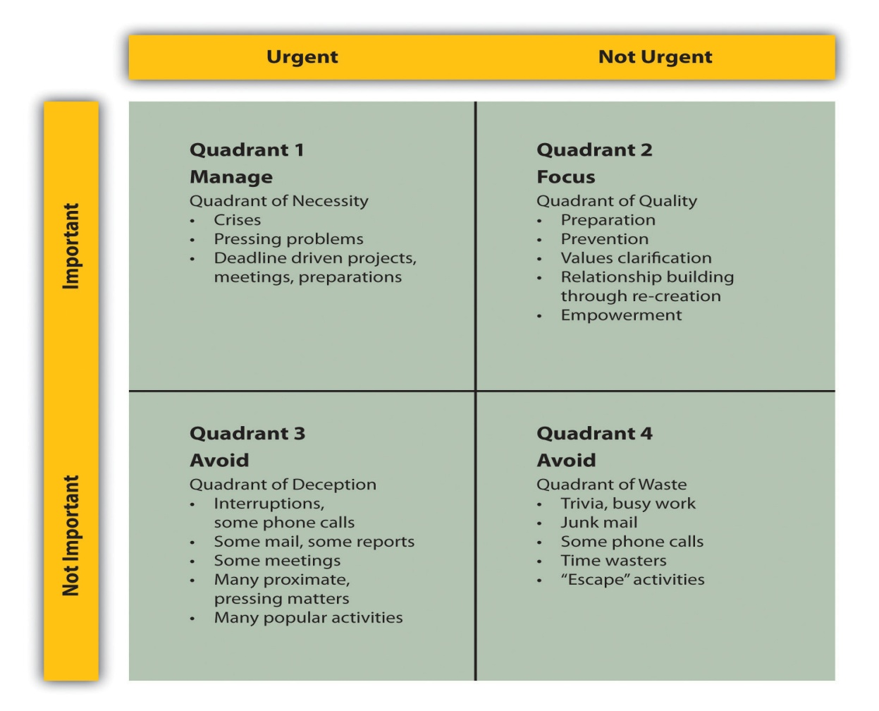
Time Management System
Experts say that many people waste 2 hours a day.
Learn to prioritize:

Slide 14
Time Management System
Four major parts to the Time Management System are:
Priorities
Setting priorities on a to-do-list helps increase performance.
Objectives
Objectives state what we want to accomplish w/in a given period of time.
Plans
Plans state how you will achieve your objectives by listing necessary activities to perform.
Schedules
Schedules state when the activities planned will be carried out – schedule each day.

Slide 15
Time Management Steps
Plan Each Week
On the last day of each week, plan the coming week
Schedule Each Week
Scheduling your week helps to achieve your important objectives.
Steven Covey says, “The key to success is not to prioritize your schedule, but to schedule your priorities weekly and daily.
Schedule Each Day
At the end of each day, you should schedule the next day, or you can begin each day by scheduling it.

Slide 16
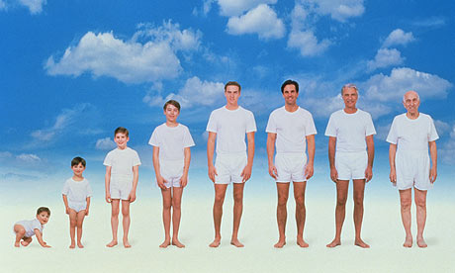
Career Management
Take responsibility for managing your career.
Before planning your career, you must consider your career stage – as people get older they have different career stage needs.
20’s – This is the time when you are just getting started.
30’s – This decade is the time when you develop expertise.
40’s and 50’s – By age 45 most people have weathered a failure or two and know whether or not they have a shot at advancement.
60’s and 70’s – At this state people begin to prepare for retirement, or may transition to part-time work.

Slide 17
Career Planning and Development
There is a difference between career planning and career development:
Career Planning
The process of setting career objectives and determining how to accomplish them.
Career Development
The process of gaining skill, experience, and education to achieve career objectives.

Slide 18
Career Planning Model
Take responsibility for your career & develop a career plan.
The Career Planning Model steps are as follows:
Self-Assessment
Career Preferences and Exploration
Career Objectives
Develop a Plan
Control

Slide 19
Career Planning Model
Step One: Self-Assessment
Who are you; what are your interests, values, needs, skills, and expertise; what are your goals and objectives?
Step Two: Career Preferences and Exploration
Based on your self-assessment, you must decide what you want from your job and career, and prioritize.
Step Three: Set Career Objectives
Set short and long-term objectives.
Step Four: Develop a Plan
Develop a plan that will enable you to attain your objectives.
Step Five: Control
It is your responsibility to achieve your objectives.

Slide 20
Getting a Job
To obtain a good job, you need to develop a career plan, a resume and cover letter, conduct research, and prepare for the interview.
Career Plan
Interviewers are often turned off by candidates who have no idea of what they want in a job and career – they are often impressed by candidates with realistic career plans.
Resume and Cover Letter
The resume is about 40% of getting a job. The cover letter and resume are your introduction to the organization you wish to work for. If the resume is not neat, has errors or contains mistakes, you may not get the interview.
The cover letter should be short – some will not even read it.
Research
Research is required to determine where to send your resume
Once you land an interview, but before you go to it, research the organization.
Prepare Questions
You should also prepare to answer possible questions that you could be asked during a job interview.

Slide 21
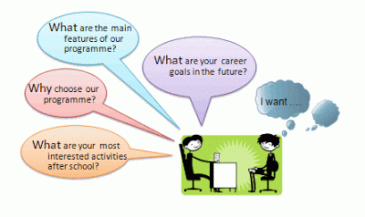
Common Interview Questions
Answering “common interview questions” prior to going to an interview is good preparation for the job.
In most cases, the interview is given the most weight in job decisions.
It is vital to make a very positive impression.

Slide 22
Common Interview Questions
How would you describe yourself?
What is most important to you in your job and career?
What are your greatest strengths and weakness?
What have you learned from your mistakes?
What would your last boss say about your work performance?
What motivates you to go the extra mile on a project or job?
What have you accomplished that shows your initiative & willingness to work?
Why should I hire you?
What skills do you have?
What makes you different from the other qualified candidates?
What can you tell us about our company?
What are your short-term and long-term goals?
If you were a fruit…what kind of fruit would you be? ☺
If you had a super power…what power would you posses? ☺
What questions do you have for me…?

Slide 23
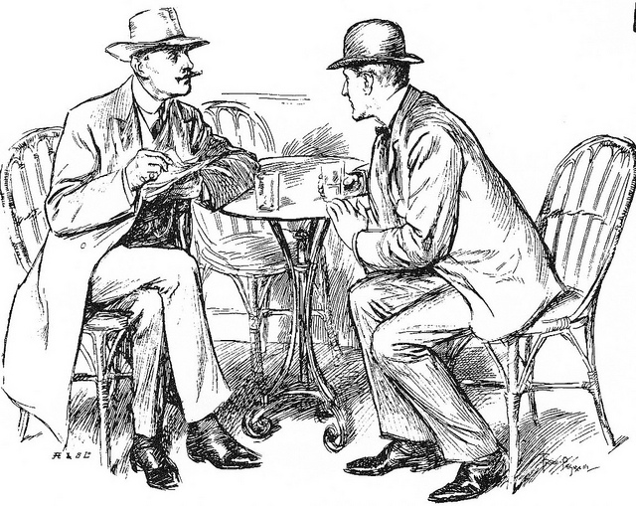
Interview
The interview is given the most weight in job decisions.
Be sure to follow job interview etiquette.
Conveying a relaxed presence.
Highlight accomplishments.
Generate interest.
Dress for success.

Slide 24
Resume
Your most important selling points should be visible in your resume:
Contact Information
Objective
Qualification Summary
Education
Experience
Awards and Achievements

Slide 25
Getting Raises and Promotions
10 Tips to Help You Get Ahead:
Be a top performer at your present job.
Finish assignments early.
Volunteer for extra assignments and responsibility.
Keep up with the latest technology.
Develop good human relations with important people in organization.
Know when to approach your boss.
Be polite.
Never say anything negative about anyone.
Be approachable.
Smile, and go out of your way to say “hi” to people.

Slide 26
Career Paths
A career path is a sequence of job assignments that lead to more responsibility, with raises and promotions.

Slide 27
Raises and Promotions
If you want a raise or promotion, it’s your responsibility to prove that you deserve one! Prepare your case: self-documentation.
Preparation for Getting a Raise or Promotion:
It is very important to understand your job responsibilities and how you are evaluated by your boss, both formally and informally.
Know you boss’s expectations and exceed them, or at least meet them.
Do what needs to be done to get a high performance appraisal.
Asking for a Raise or Promotion:
When asking for a raise or promotion, don’t catch your boss by surprise.
The best time to ask is usually during the performance appraisal.
Present your critical incidents – positive things you’ve done.

Slide 28
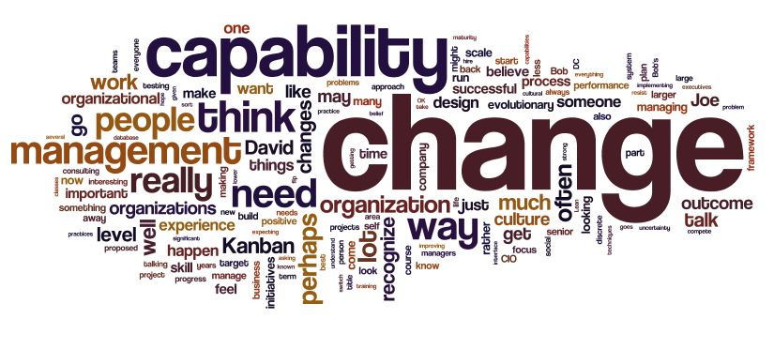
Changing Organizations
If you are satisfied that you are meeting your career plan with one organization, stay with it.
If not, search out new opportunities elsewhere.

Slide 29
Job Shock
Job Shock occurs when expectations are not met.
People often change jobs only to find the same frustrations they hoped to leave behind.
Few jobs, if any, meet all expectations.

Slide 30
Global Career
Globalization will affect your career in one way or another.
Regardless of your career goals, possessing good human relations skills with a diversity of people is critical to your career success.

Slide 31
Apparel and Grooming
Apparel and grooming play a major role in making a good first impression, because they help you get and keep the job.
They are also important in maintaining your image to help you get raises and promotions.
Fair or not – in most organizations – your appearance will affect your career success.
Remember that you are judged on your appearance, and how you look affects the business’s image and success.

Slide 32
Personality and Time and Career Management
Better time management leads to more effective behavior and performance, which in turn leaves more time to improve human relations.

Slide 33
…

