Slide 1
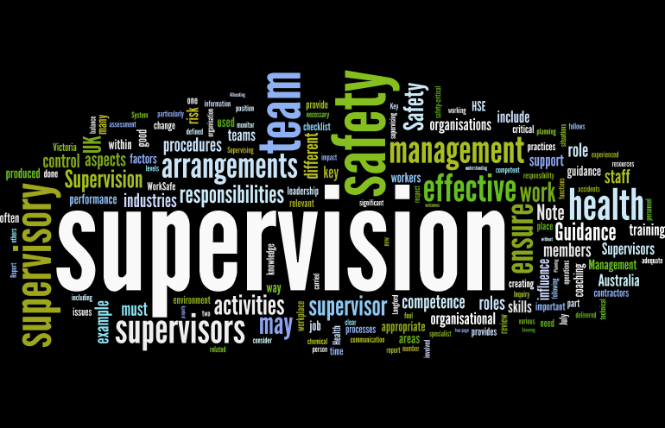
Supervision
Supervision
  Concepts and Practices of Management, 13th Edition
    Edwin C. Leonard, Jr., Ph.D. and Kelly A. Trusty, Ph.D. Cengage Learning, Boston, MA 2013
      ISBN: 978-1-285-86637-6

Slide 2

Part One: Supervisory Management Overview and Challenges
Chapter Two: The Managerial Functions
  After studying this chapter, you will be able to:
    Identify the difficulties supervisors face in fulfilling managerial roles.
    Explain why effective supervisors should have a variety of skills.
    Define management and discuss how mgmt. functions are interrelated.
    Discuss the important characteristics of the supervisor as a team leader.
    Explain the difference between management and leadership.
    Discuss concepts of authority & power relating to being a good supervisor.
    Explain need for coordination & cooperation and its role in performance.

Slide 3

The Person in the Middle
The supervisory position is a difficult and demanding role.
  Supervisors are “people in the middle” – the principal links between higher-level managers and employees.
    A supervisor is a first-level manager, that is, a manager in charge of entry-level and other departmental EEs.

Slide 4

The Person in the Middle
Employees may view their supervisors as the management of the organization, since the supervisor is their primary contact with management.
  Employees expect a supervisor to be technically competent and to be a good leader who can show them how to get the job done.

Slide 5
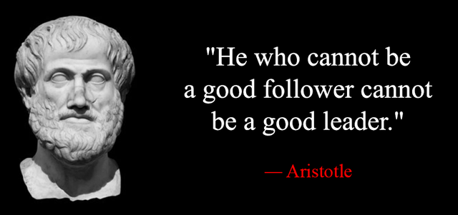
The Person in the Middle
The supervisor must also be a competent subordinate to higher-level managers.
  In this role, the supervisor must be a good follower.

Slide 6
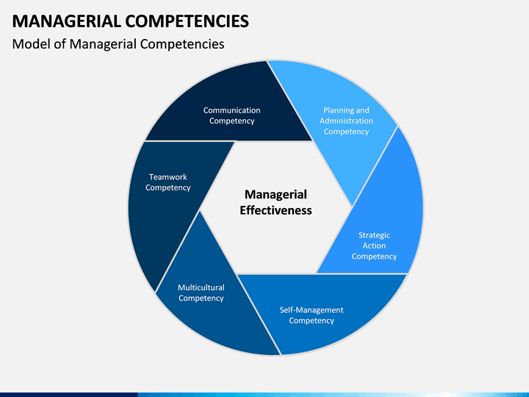
The Person in the Middle
The position of any supervisor has two main requirements.
  Must have a good working knowledge of the jobs to be performed.
  Must be able to manage the department.
    It is the supervisor’s managerial competence that usually determines the effectiveness of their performance.

Slide 7

Managerial Skills Make the Difference
Effective supervisors manage their departments in a manner that gets the job done through their people instead of doing the work themselves.
  The difference is in their managerial skills and how they apply them.

Slide 8

Managerial Skills Supervisors Need
Technical Skills
  The ability to perform the jobs in the supervisor’s area of responsibility.
Human Relations Skills
  The ability to work with and through people; these skills include open-mindedness and the ability to motivate team members.
Communication Skills
  The ability to give – and get – information.
Administrative Skills
  The ability to plan, organize, and coordinate the activities of a work group.
Conceptual Skills
  The ability to obtain, interpret, and apply the information needed to make sound decisions.
Leadership Skills
  The development of a leadership style that emphasizes collaboration, trust, and empathy; engages followers in all aspects of the organization; and helps followers to better themselves.
Political Skills
  The savvy to ascertain the hidden rules of the organizational game and to recognize the roles various people play in getting things done outside of formal organizational channels.
Emotional Intelligence Skills
  The intelligent use of your emotions to help guide your behavior and thinking in ways that enhance your results. You can maximize your emotional intelligence by developing good communication skills, interpersonal relationships, and mentoring relationships.

Slide 9
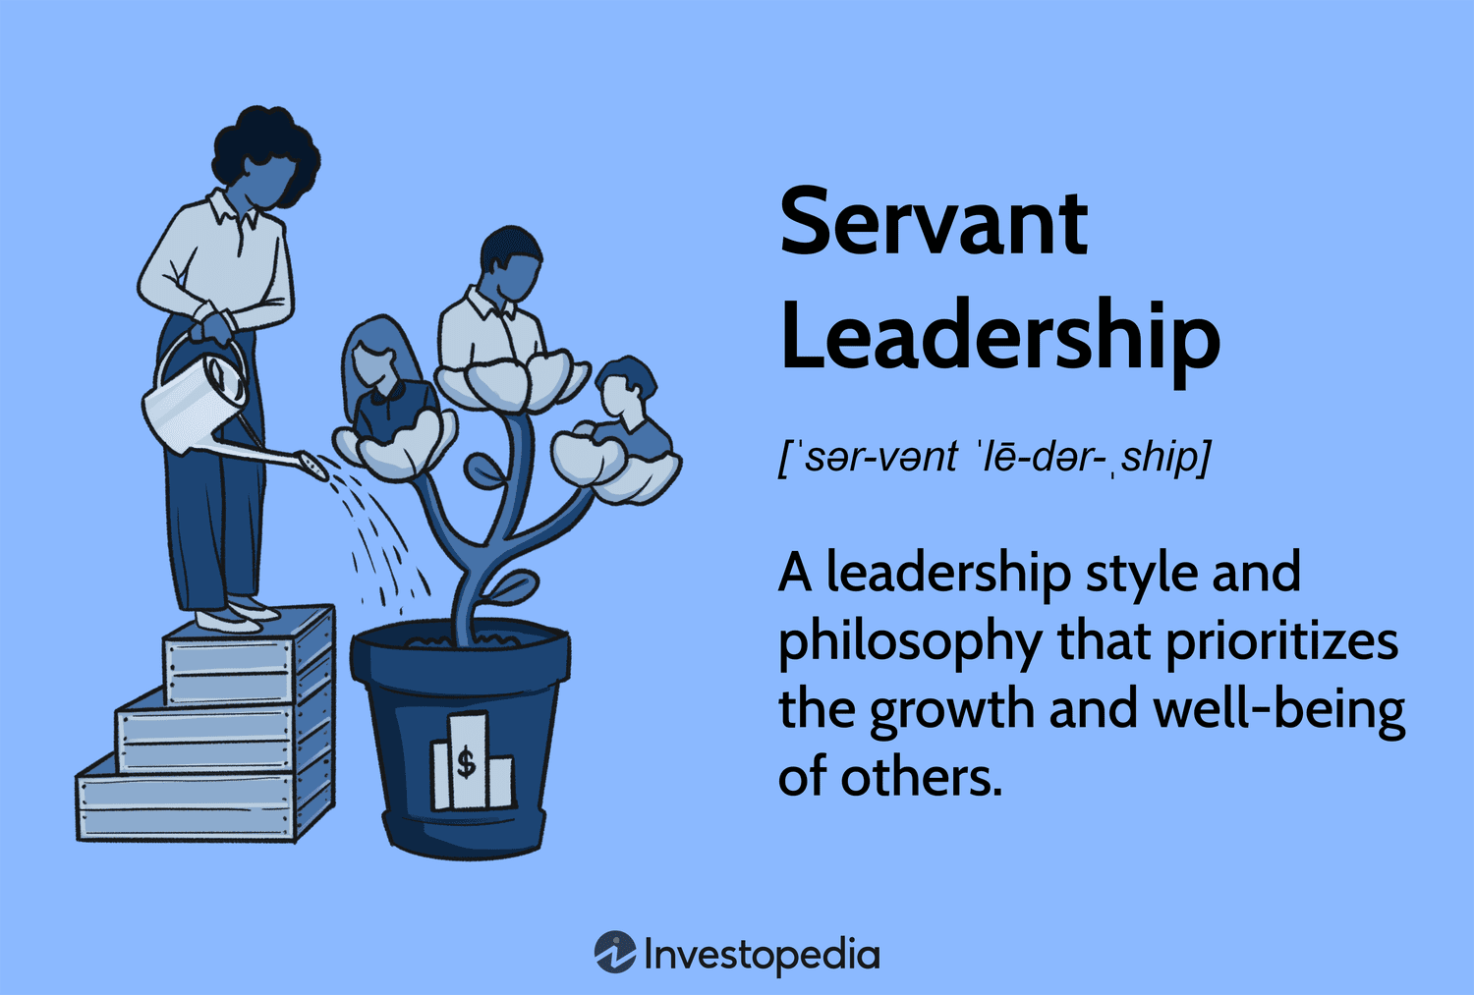
Be a Servant Leader
Servant Leadership means looking after the needs of followers so they can be the best they can be.

Slide 10


Managerial Skills can be Learned and Developed
Leaders are made not born.
  Supervisors are able to learn the skills involved in managing people.
  It takes time, effort, and determination to develop managerial skills.
    Supervisors will make mistakes, but people learn from mistakes as well as from successes.

Slide 11
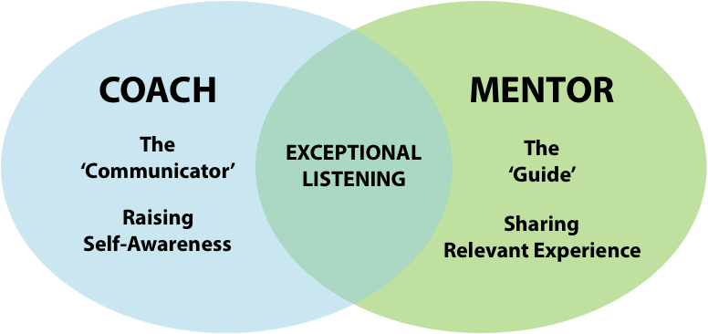

Managerial Skills can be Learned and Developed
To be great…take lessons from coaches who provide the best with solid fundamentals of leadership. Use multiple coaches as you develop through the years.
  Find someone who has the knowledge of the fundamentals and the ability and willingness to instruct.
    Select a coach or mentor who will help you uncover your desires and help you chart a course of action to achieve them.
    Mentoring and EE development is a key part of the job.

Slide 12
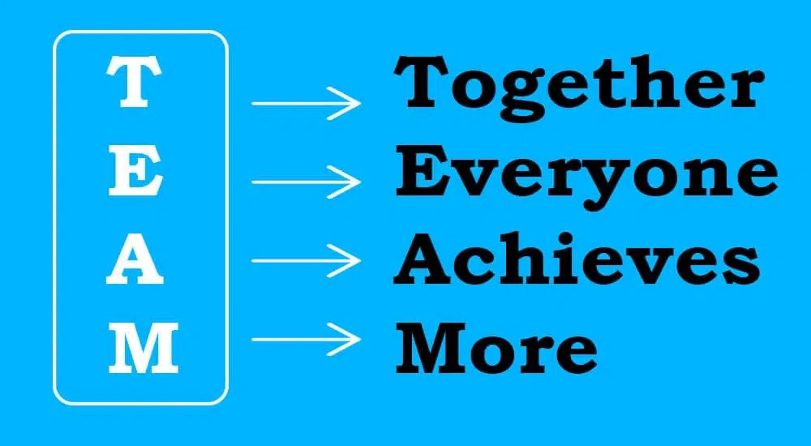
Functions of Management
Management is the process of getting things accomplished with and through people by guiding and motivating their efforts toward common objectives.
  Successful managers will assure you that their employees are their most important asset.
    Successful managers recognize they are only as good as the people they supervise. In most endeavors, one person can accomplish relatively little. Therefore, individuals join forces with others to attain mutual goals.

Slide 13

Functions of Management
Those who hold supervisory positions significantly influence the effectiveness with which people work together and use resources to attain goals.
  The managerial role of a supervisor is to make sure assigned tasks are accomplished with and through the help of EEs.

Slide 14

Functions of Management
The foundation for success is built when the manager clarifies what is expected in the way of performance and specifies the behaviors that are acceptable in the work group.
  The role of the supervisor is to do all those things that enable EEs to be the best they can be - in other words, effectively and efficiently achieve organizational objectives.
    The better the supervisor manages, the better the departmental results.

Slide 15
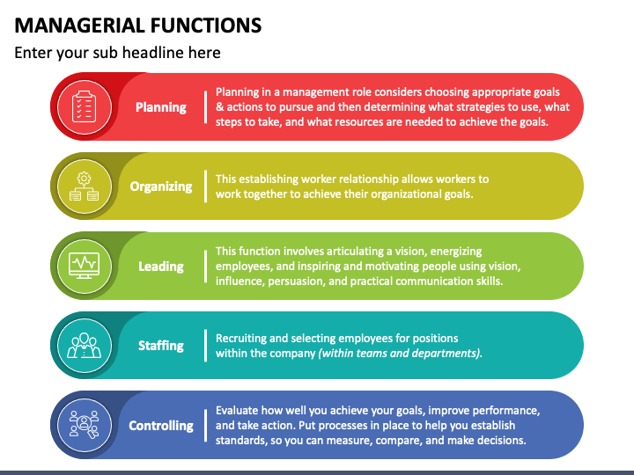
The Managerial Functions
Supervisors, as well as other managers, perform the same basic managerial functions in all organizations:
  Planning
  Organizing
  Staffing
  Leading
  Controlling

Slide 16

Planning
Planning consists of setting goals, objectives, policies, procedures, and other plans needed to achieve the purposes of the organization.
  In planning the manager chooses a course of action from various alternatives.
    Planning is primarily conceptual. It means thinking before acting, looking ahead and preparing for the future, laying out in advance the road to be followed, and thinking about how the job should be done.

Slide 17
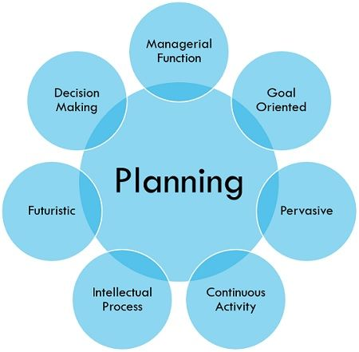
Planning
Planning includes collecting and sorting information from numerous sources and using that information to make decisions.
  Planning includes not only deciding what, how, when, and by whom work is to be done, but also developing “what-if” scenarios.

Slide 18

Planning
Planning is the managerial function that comes first.
  As you proceed with other managerial functions, planning continues, plans are revised and alternatives are chosen as needed.
    This is particularly true as a supervisor evaluates the results of previous plans and adjusts future plans accordingly.

Slide 19
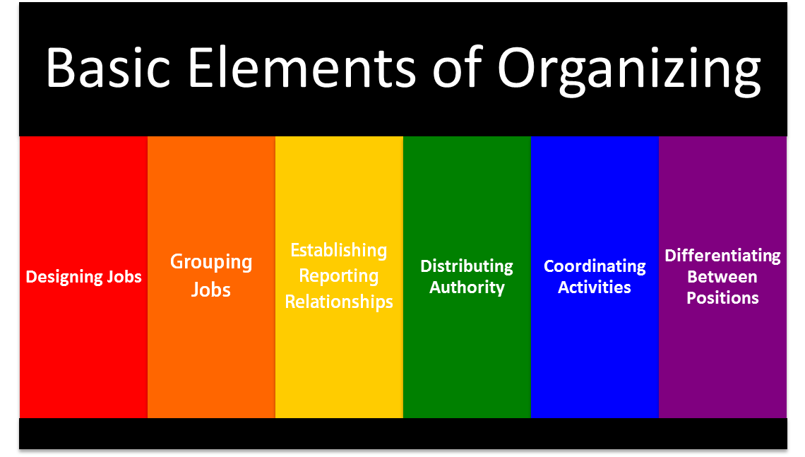
Organizing
Organizing means arranging and distributing work to accomplish the organization’s goals.
  Once plans are made, the organizing function answers the question, “How will the work be divided and accomplished?”
    The supervisor defines various job duties and groups these duties into distinct areas, sections, units, or teams. The supervisor must specify the duties, assign them, and, at the same time, give subordinates the authority they need to carry out their tasks.

Slide 20

Staffing
Staffing involves the managerial tasks of recruiting, selecting, orienting, and training employees.
  This function includes appraising the performances of employees, promoting as appropriate, and giving them opportunities to develop.
  Staffing includes devising an equitable compensation system.
    In many companies, most activities involved in staffing are handled by the human resources (HR) department; however, day-to-day responsibility for the essential aspects of staffing remains with the supervisor.

Slide 21

Leading
Leading means guiding the activities of employees toward accomplishing objectives.
  The leading function of management involves guiding, teaching, and supervising subordinates.
    This includes developing employees to their potential by directing, coaching, and motivating those employees effectively.

Slide 22

Leading
Leading is also known as directing, motivating, or influencing because it plays a major role in EE morale, job satisfaction, productivity, and communication.
  It is through this function the supervisor seeks to create a climate that is conducive to EE satisfaction and, at the same time, achieves the objectives of the department.
    Finding the ways to satisfy the needs of a diverse EE workforce is a significant challenge.

Slide 23
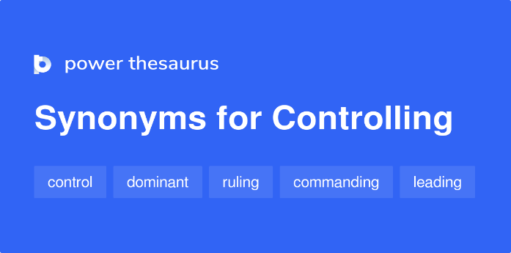
Controlling
The managerial function of controlling involves ensuring that actual performance is in line with intended performance and taking corrective action as needed.
  The supervisor must have the wisdom and foresight to take corrective action when necessary to achieve the planned objectives.
    It also means revising plans as circumstances require.

Slide 24
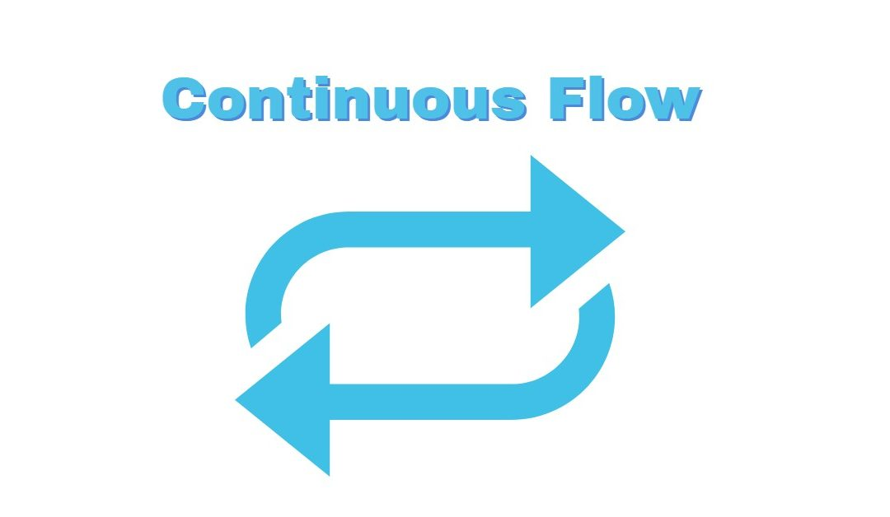
The Continuous Flow of Managerial Functions
The five managerial functions can be viewed as a circular, continuous movement. The functions flow into each other, and each affects the others. At times, there is no clear line to mark where one function ends and the other begins.
  It is impossible for a supervisor to set aside a certain amount of time for one or another function because the effort spent in each function varies as conditions and circumstances change.
    Undoubtedly, planning must come first. Without plans, the supervisor cannot organize, staff, lead, or control.

Slide 25
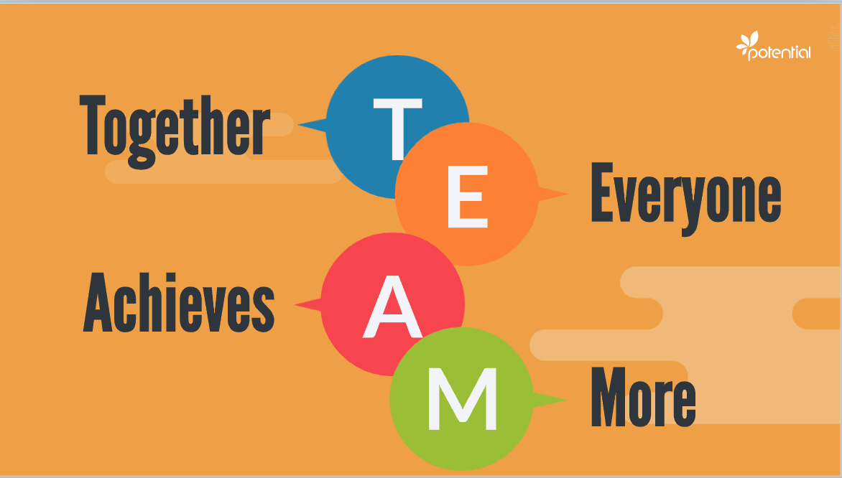
The Supervisor as Team Leader
Many organizations have implemented a team-based organizational structure focused on customer satisfaction, productivity, profitability, and continuous improvement.
  Teams are a means to an end, and that end is superior performance to what team members would achieve working as individuals.

Slide 26
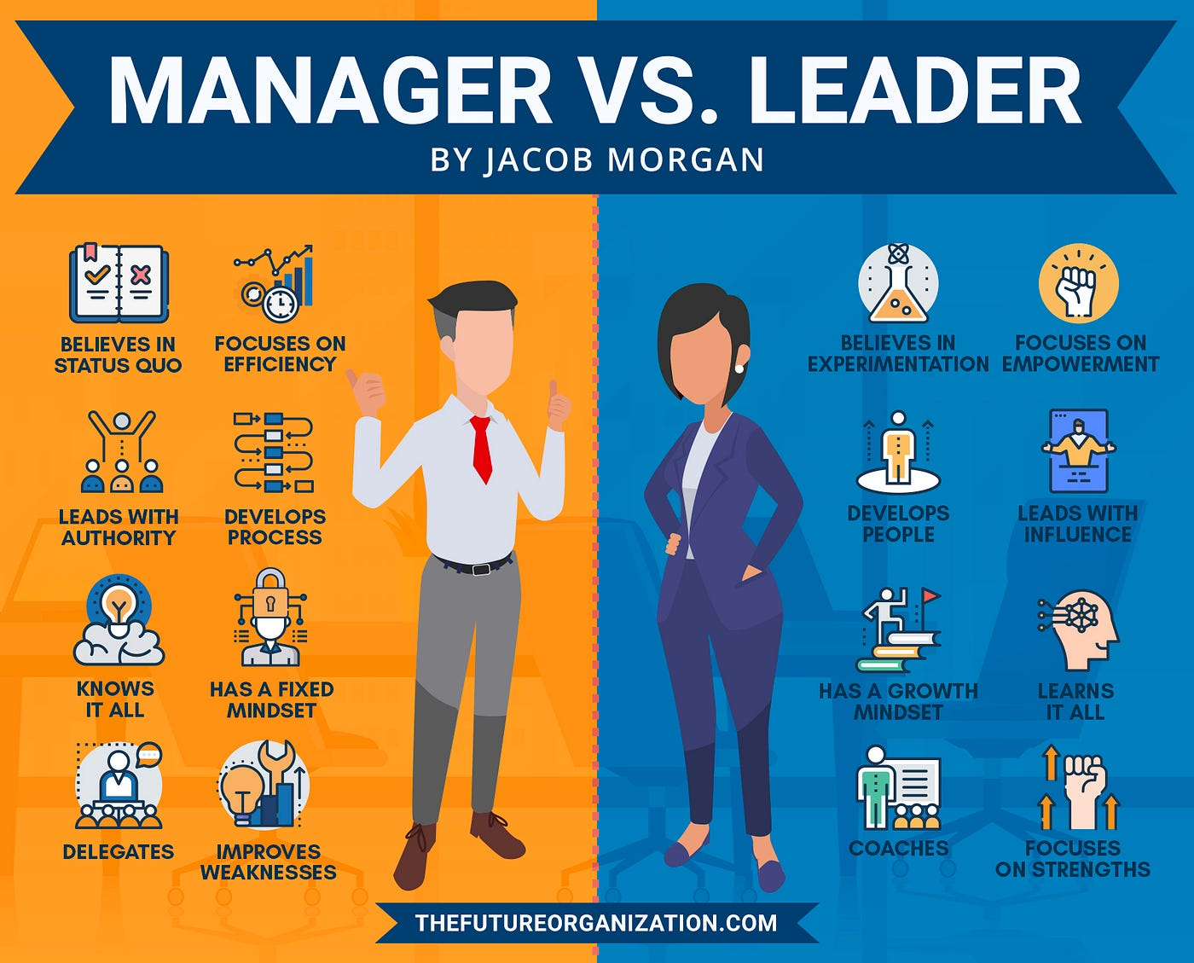
Managers and Leaders
Are They Different?
Author Stephen Covey wrote, “Leadership is not management.”
  Management is efficiency in climbing the ladder of success; leadership determines whether the ladder is leaning against the right wall.

Slide 27
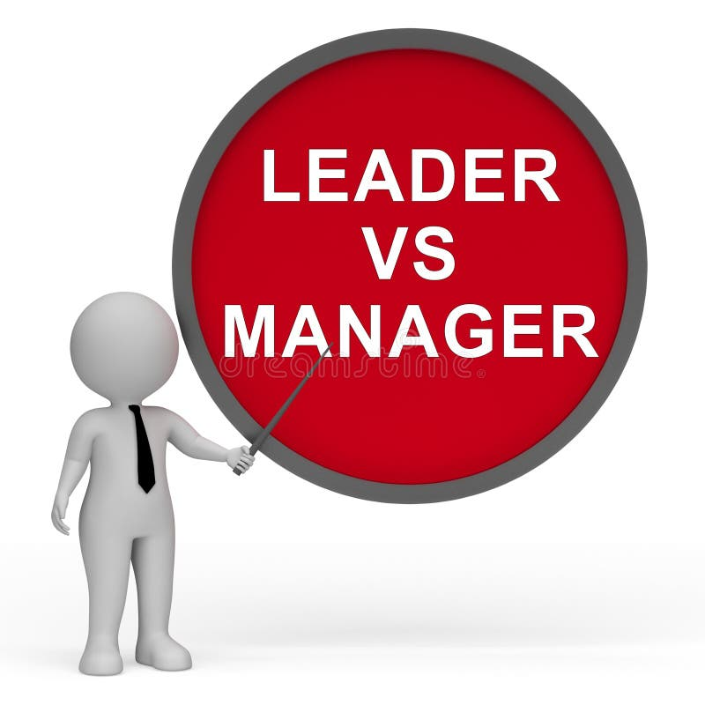
Managers and Leaders
Are They Different?
Warren Bennis, points out differences between managers and leaders:
  The manager does things right; the leader does the right thing.
  The manager relies on control; the leader inspires trust.
  The manager focuses on systems & structures; the leader focuses on people.
  The manager administers; the leader innovates.
  The manager asks how and when; the leader asks what and why.
  The manager accepts the status quo; the leader challenges it.

Slide 28

Managerial Authority
Authority is the legitimate or rightful power to lead others, the right to order and act.
  It is the formal, positional right by which a manager can require subordinates to do or not to do a thing the manager deems necessary to achieve organizational objectives.
    Managerial authority is not granted to an individual, but rather to the position the individual holds at the time. When individuals leave their jobs or are replaced, they cease to have that authority. When a successor assumes the position, that person then has the authority.

Slide 29

Managerial Authority
Included in positional managerial authority is the right and duty to delegate authority.
  The delegation of authority is the process by which the supervisor receives authority from a higher-level manager and, in turn, makes job assignments and entrusts related authority to subordinates.
    Having managerial authority means the supervisor has the power and the right to issue directives in order to accomplish the tasks assigned to the department. This authority includes the power and right to reward and discipline, if necessary. Of course, this power, like all authority, is limited.

Slide 30
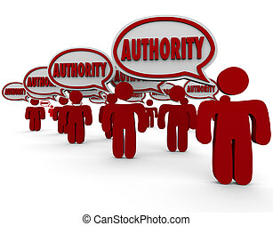
Managerial Authority
The Acceptance Theory of Authority states that a manager does not possess real authority until and unless the subordinate accepts it.
  A supervisor may instruct an EE to carry out a work assignment. The EE has several alternatives from which to choose.
    Although such a response is not likely, the employee can refuse to obey, thereby rejecting the supervisor’s authority. Alternatively, the EE may grudgingly accept the supervisor’s direction and carry out the assignment in a mediocre fashion.

Slide 31

Managerial Authority
The supervisor should expect to experience resistance from some of their employees.
  When some employees reject the supervisor’s authority, they will have no choice but to impose disciplinary action on those employees.

Slide 32

Avoiding Reliance on Managerial Authority
Most successful supervisors know that to motivate workers to perform their duties, it is usually best not to rely on formal managerial authority but to employ other approaches.
  Supervisors prefer to avoid even speaking about their authority. Instead they want to speak of their responsibilities, tasks or duties.
    EEs are likely to perform better if they understand why the task needs to be done and have a voice in how to do it.

Slide 33

Delegating Authority
The delegation of authority is the process by which the supervisor received authority from a higher-level manager and, in turn, makes the job assignments and entrusts related authority to subordinates.
  Just as the possession of authority is a required component of any managerial position, the process of delegating authority to lower levels in the hierarchy is required for an organization to have effective managers, supervisors, and employees.

Slide 34

Power
The Ability to Influence Others
Some theorists suggest that a manager’s power comes from two main sources:
  Position Power
    Derives from a person’s organizational position.
  Personal Power
    Emanates from the relationship a supervisor has with other people.
    A supervisor’s personal power depends to a greater extent on the follower’s perceptions of that supervisor’s knowledge, skill, and expertise.

Slide 35

Power
The Ability to Influence Others
Others assert that power arises from the following five sources:
  Reward Power
    Supervisors have reward power if they can grant rewards.
  Coercive Power
    Supervisors who threaten punishment and discipline use this power.
  Legitimate Power
    Some supervisors gain compliance by relying on their position or rank (“I’m the boss, do as I say.”).
  Expert Power
    Knowledge or valuable information gives a person expert power over those who need that information.
  Referent Power or Charismatic Power
    People are often influenced by another person because of some tangible or intangible aspect of another’s personality.

Slide 36

Power
The Ability to Influence Others
Effective supervisors understand the impact their power has on others.
  Research indicates that reward power, coercive power, and legitimate power often force EEs to comply with directives but do not get those EE’s commitment to organizational objectives.
    Accordingly, supervisors who use expert power and referent power effectively have the greatest potential for achieving organizational goals.

Slide 37

Power
The Ability to Influence Others
The Acceptance Theory of Authority is also relevant to the application of power.
  Supervisors can hold title, occupy same level in hierarchy, and have equal authority, yet different degrees of power, depending on their abilities and how others perceive them.

Slide 38

Coordination
Management has generally been defined as a process of getting things done through and with the help of people by directing their efforts toward common objectives.
  In a sense, all levels of management could be broadly visualized as involving the coordination of efforts of all the members and resources of an organization toward overall objectives.
    Some writers have therefore included the concept of coordination as a separate managerial function.

Slide 39

Coordination
Coordination is the orderly synchronization (or putting together) of efforts of the members and resources of an organization to accomplish the organization’s objectives.
  Coordination is not a separate managerial function; it is an implicit, interrelated aspect of the managerial functions previously cited.
  Coordination is fostered whenever a manager performs any of the functions of planning, organizing, staffing, leading, and controlling.
    The ability to communicate clearly/concisely is essential for coordination.

Slide 40

Cooperation as Related to Coordination
Cooperation is the willingness of individuals to work with and help each other. It primarily involves the attitudes of a group of people.
  Coordination is more than the mere desire and willingness of participants.
    Consider a group of workers who are attempting to move a heavy object. They are sufficient in number, willing and eager to cooperate with each other, and trying hard to move the object. They are also fully aware of their purpose. However, in all likelihood their efforts will be of little avail until one of them – the supervisor – gives the order to apply the right amount of effort at the right place at the right time. Then the group members can move the object.

Slide 41
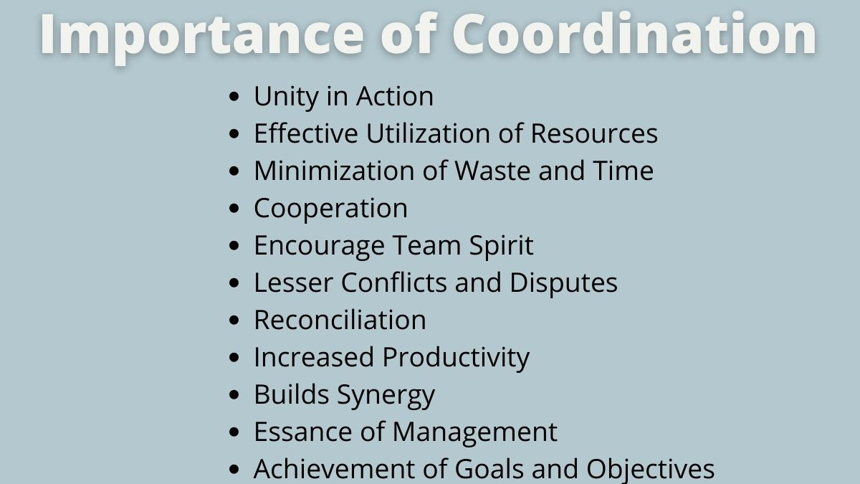
Cooperation As Related to Coordination
While cooperation is helpful and the lack of it could impede progress, its presence alone will not surely get the job done.
  Efforts must be coordinated toward the common goal.

Slide 42
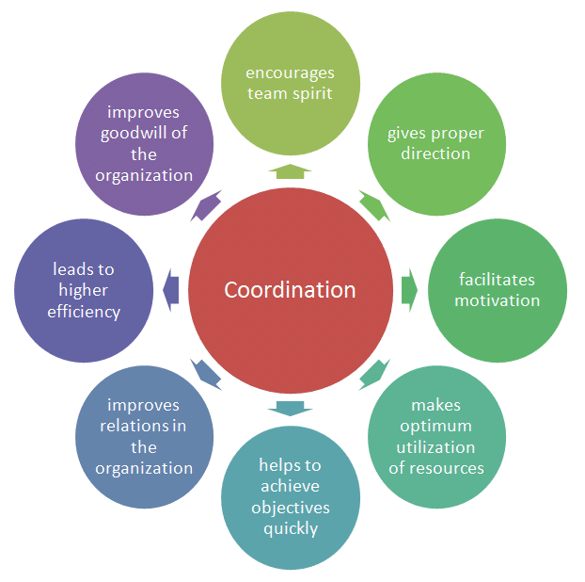
Attaining Coordination
Coordination is not easily attained, and the task of achieving coordination is becoming more complex.
  Every supervisor’s primary focus should be on getting the desired results from their people.

Slide 43

Attaining Coordination
The complexities of human nature present coordination problems.
  In short, EEs come to the workplace with a baggage cart loaded with all of their personal issues. Although we remind EEs to leave their personal problems at the door when they come to work, they don’t. Many are preoccupied with their own work and personal baggage.
    Since they are evaluated primarily on how well they do their jobs, they tend not to get involved in other areas and are often indifferent to the fact that their activities may affect others.

Slide 44
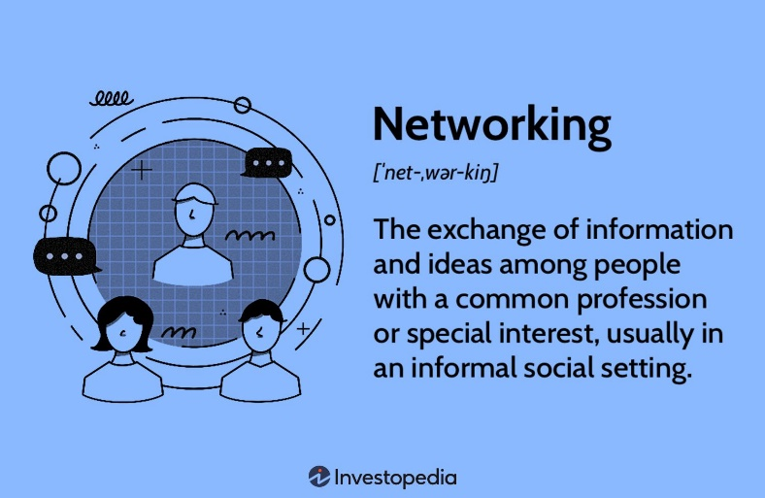
Attaining Coordination
Supervisors can achieve coordination by building networks focused on attaining common objectives.
  According to Merriam Webster’s Collegiate Dictionary, a network is “a fabric or structure of cords or wires that cross at regular intervals and are knotted or secured at the crossings.” Think of it this way – A person’s relationships are the knots, and the strengths of the relationships equals the strength of the network.
    Networking facilitates the flow of ideas across organizational barriers and thereby eases the coordination effort.

Slide 45

Coordination as Part of the Managerial Functions
While performing the managerial functions, the supervisor should recognize that coordination is a desired result of effective management.
  Proper attention to coordination within each of the five managerial functions contributes to overall coordination.

Slide 46

Coordination as Part of the Managerial Functions
The supervisor must ensure that the various plans are aligned with the right people.
  For example, a supervisor may wish to discuss job assignments with the EEs who are to carry them out. In this way, the EEs can express their opinions or objections, which need to be reconciled in advance. Furthermore, EEs may be encouraged to make suggestions and to discuss the merits of proposed plans and alternatives.
    When EEs are involved in initial departmental planning, the supervisor’s chances of achieving coordination usually improve.

Slide 47

Coordination as Part of the Managerial Functions
When leading, the supervisor is significantly involved in coordination.
  The essence of giving instruction is to coordinate the activities of EEs in such a manner that the overall objectives are reached in the most efficient way possible.
    In addition, a supervisor must assess and reward the performance of EEs to maintain a harmonious work group.

Slide 48
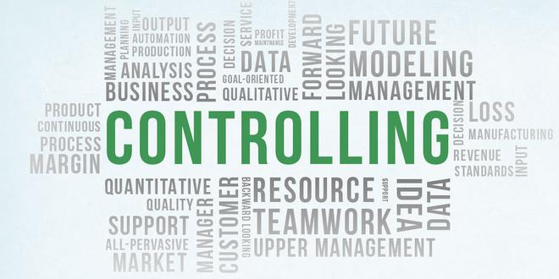
Coordination as Part of the Managerial Functions
The supervisor is also concerned with coordination when performing the controlling function.
  By checking, monitoring, and observing, the supervisor makes certain that activities conform to established plans. If there are any discrepancies, the supervisor should take immediate action to reprioritize or reassign tasks. In so doing, the supervisor may achieve coordination at least from then on.
    The very nature of the controlling process contributes to coordination and keeps the organization moving toward its objectives.

Slide 49

Coordination with Other Departments
Not only must supervisors coordinate activities within their own departments, but they also must coordinate the efforts of their departments with those of others to achieve organizational goals.
  Achieving coordination is an essential component of the supervisory management position.

Slide 50


