Slide 1
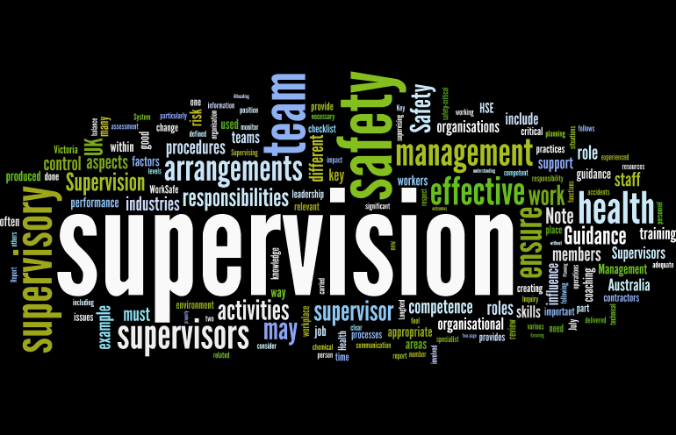
Supervision
Supervision
  Concepts and Practices of Management, 13th Edition
    Edwin C. Leonard, Jr., Ph.D. and Kelly A. Trusty, Ph.D. Cengage Learning, Boston, MA 2013
      ISBN: 978-1-285-86637-6

Slide 2

Part Two: Essentials of Effective Supervision
Chapter Five: Leadership and Follower
  After studying this chapter, you will be able to:
    Define leadership, explain its importance at the supervisory level, and describe elements of contemporary leadership thought.
    Outline the importance of trust in the leadership process and the effects of lack of trust on EE engagement and productivity.
    Discuss the critical nature of ethics in informing leaders’ behaviors and influencing followers and organizational culture.
    Explain the delegation process and describe its three major components.
    Discuss why some supervisors do not delegate, and describe its benefits.
    Compare the autocratic (authoritarian) approach to supervision with the participative approach.
    Explain the role of followers in the leadership process and differentiate between different types of followers.

Slide 3

The Test of Supervisory Leadership
Leadership is the process of influencing the opinions, attitudes, and behaviors of others toward the achievement of a goal.
  Anyone who can direct or influence others toward objectives can function as a leader, no matter what position that person holds.

Slide 4
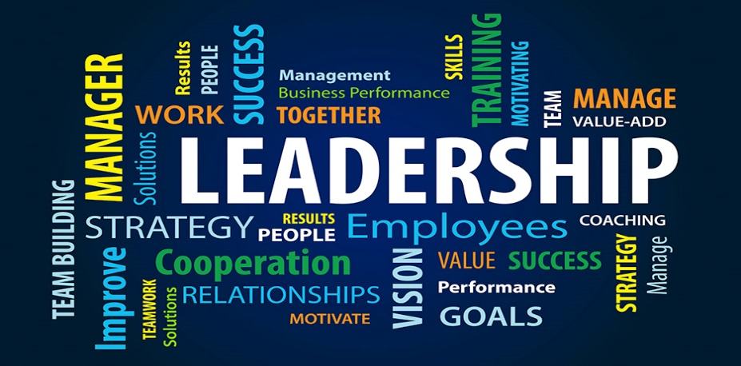
The Test of Supervisory Leadership
Therefore, leadership in the general sense is a process rather than just a positional relationship.
  Leadership includes what the followers think and do, not just what the supervisor does.
    Leadership resides in a supervisor’s ability to obtain the work group’s willingness to follow – willingness based on commonly shared goals and a mutual effort to achieve them.

Slide 5

The Test of Supervisory Leadership
The willingness of others to follow is not enough by itself.
  The following questions might identify several other tests for leadership:
    Does the leader possess a clear vision of what needs to be done (continuous pursuit of excellence and worthwhile objectives)?
    Does the leader communicate that vision and get others “onboard”?
    Does the leader build a climate of mutual trust and respect?
    Does the leader create the proper infrastructure to support the vision?
    Does the leader enable the followers to be the best they can be?
    Does the leader leave the organization better than they found it?

Slide 6
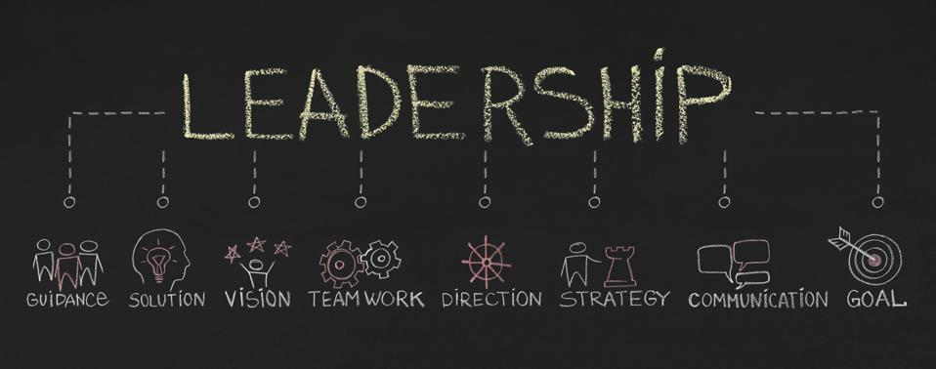
The Test of Supervisory Leadership
Obviously, leadership effectiveness, like beauty is in the eyes of the beholder, but the better leaders are known as great communicators and people of impeccable credibility.

Slide 7
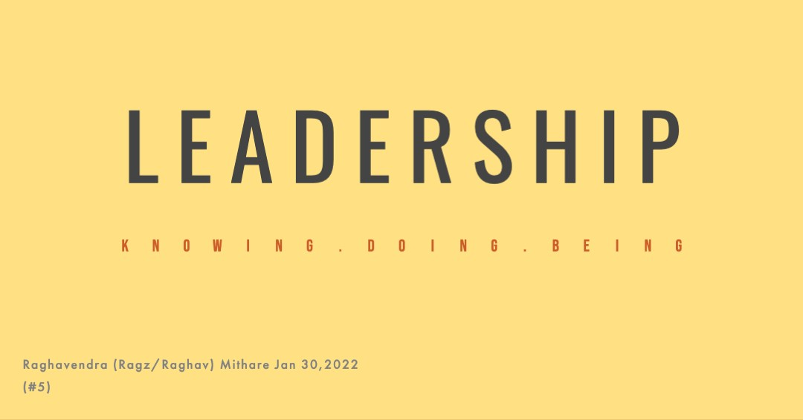
Leadership Can Be Developed
Supervisors often believe that any definition of leadership should include basic traits.
  That is, they believe that effective leaders have some special qualities, and they point to certain successful supervisors as representing outstanding leadership.

Slide 8

Leadership Can Be Developed
However, studies show that there is no significant relationship between one’s ability to lead and any such trait characteristics as age, height, weight, sex, race, and other physical attributes.
    Leadership behaviors can be learned.

Slide 9
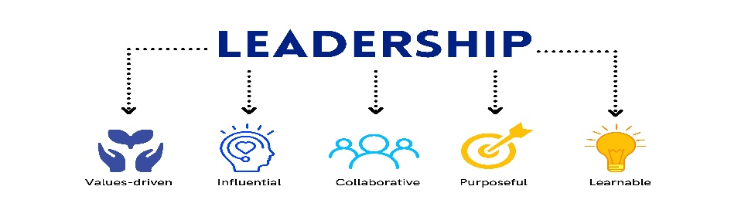
Leadership Can Be Developed
Successful supervisors tend to be well-rounded in their interests and aptitudes.
  They are good communicators, are mentally and emotionally mature, and have strong inner drives.
    Most important, they tend to rely more on their conceptual and interpersonal skills than on their technical skills. These are essentially learned characteristics, not innate qualities.

Slide 10

Effective Supervisory Leadership as a Dynamic Process
Good communication is the foundation of effective leadership, such as getting others to do things they’ve never done before.
  The ability to communicate, to keep lines of communication open at all times, and to communicate in ways that meet EE expectations and EE needs is essential for any supervisor to be a leader.

Slide 11

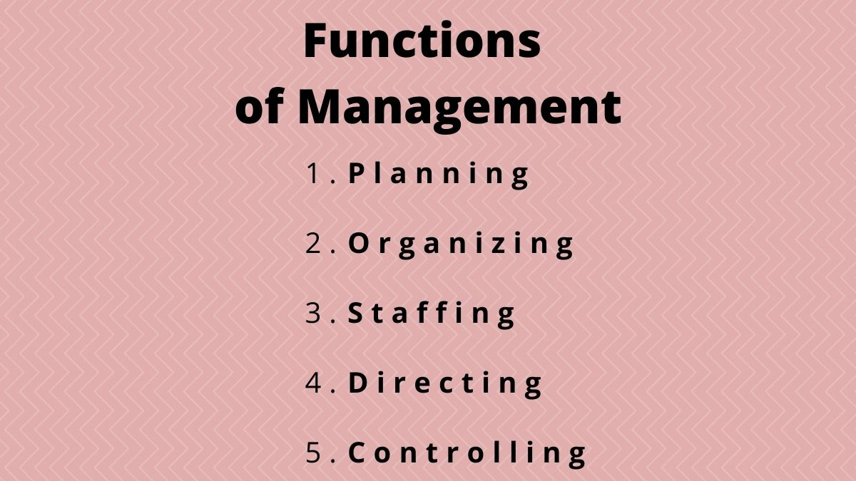
Effective Supervisory Leadership as a Dynamic Process
The larger the work group, the more important it is for the supervisor to be an effective planner, organizer, and coordinator.
  Also, the supervisor will have to delegate more authority.
    The smaller the work group and the closer the supervisor’s location to the EEs, the more the supervisor must address the individual needs of those in the group.

Slide 12

Effective Supervisory Leadership as a Dynamic Process
Understanding EE expectations is vital to effective supervision.
  The ability to assess EE expectations and the demands of the job situation and then act appropriately is a skill that can be developed with experience and practice.

Slide 13
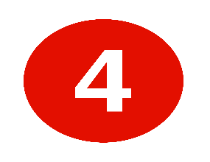
Contemporary Thoughts on Leadership
Warren Bennis identified four things people want from leaders:
  Direction
    People want leaders to have purpose. The leader has a clear idea of what is to be done. Leaders love what they do and love doing it. Followers want passion and conviction from a strong point of view.
  Trust
    Followers want to have faith in their leader. Integrity, competence, constancy, caring, candor, and congruity are essential elements of building a relationship of mutual trust.
  Hope
    Leaders believe, and they kindle the fire of optimism in followers.
  Results
    Leaders accomplish difficult tasks. Success breeds success.

Slide 14

Contemporary Thoughts on Leadership
In order to provide these things for followers, leaders must be intentional in their behaviors and interaction with EEs.
  If their behaviors and decisions are reliable and consistent, authentic relationships will grow because EEs know what to expect.
    When leaders take action with energy, commitment, confidence, and creativity, EEs are excited to go where they are being led, and typically they go the extra mile under leader’s guidance in order to achieve results.

Slide 15

Contemporary Thoughts on Leadership
Noted leadership researchers James Kouzes and Barry Posner maintain that “leadership is an observable, learnable set of practices.
  Given the opportunity for feedback and practice, those with desire and persistence to lead can improve their abilities to do so.

Slide 16

Contemporary Thoughts on Leadership
After examining the experiences of managers who were leading others to outstanding accomplishments, Kouzes and Posner identified five practices and 1o specific behaviors that managers can learn and use at all levels.
  These practices and behaviors include:
    Challenging the process
      (searching for opportunities, experimenting, and taking risks).
    Inspiring a shared vision
      (envisioning the future, enlisting the support of others).
    Enabling others to act
      (fostering collaboration, strengthening others)
    Modeling the way
      (setting an example, planning small wins)
    Encouraging the heart
      (recognizing contributions, celebrating accomplishments)

Slide 17

Contemporary Thoughts on Leadership
Leaders need a clear vision, goals, and objectives; and followers who understand what is expected of them.
  Then leaders must engage followers in pursuit of those goals.
    If you don’t know where you’re supposed to go, how will you know when you get there? Further, how will your followers know where to go?

Slide 18
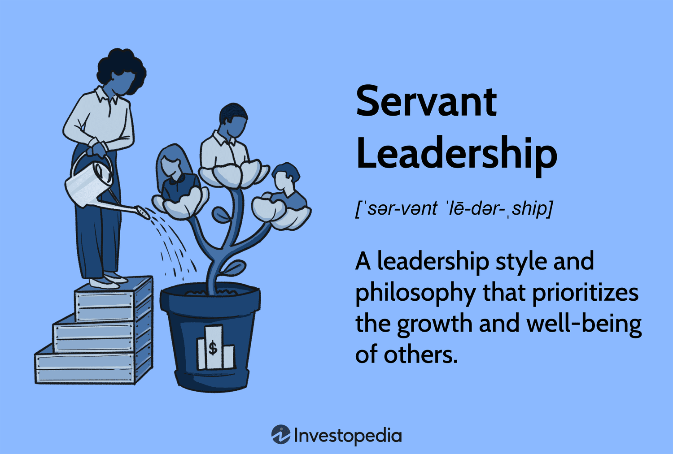
Servant-Leadership

Slide 19


Servant-Leadership
In his book “Good to Great,” author Jim Collins described “Level 5” leaders as those who facilitate, coach, and empower others to find their own direction.
  We believe that there are times when the leader must provide direction and that there are situations in which subordinates should be enabled to pursue their own direction – as long as it is consistent with the overall vision for the organization.

Slide 20
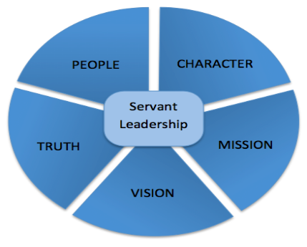
Servant-Leadership
Authentic leaders are chosen by those they serve = followers.
  Regardless of their level of competence, every EE needs guidance, and servant-leaders set up their subordinates for success.
  Professor Douglas contends servant-leaders treat EEs as equals, affirm their worth, and match their performance to their values.
    Larry Spears of the Greenleaf Center for Servant-Leadership, said: “Servant-leadership provides a strong set of values and ethics for people and organizations.”

Slide 21

Servant-Leadership
Of all the keys to effective servant-leadership, whether service is focused on employees, customers, or other stakeholders, listening is the most essential.
  Kent Keith, CEO of the Greenleaf Center, explains, “Servant leaders are really good at listening, they stay close to their colleagues, have good understanding of what their colleagues need to perform at a high level, and work hard to get that to them.”

Slide 22
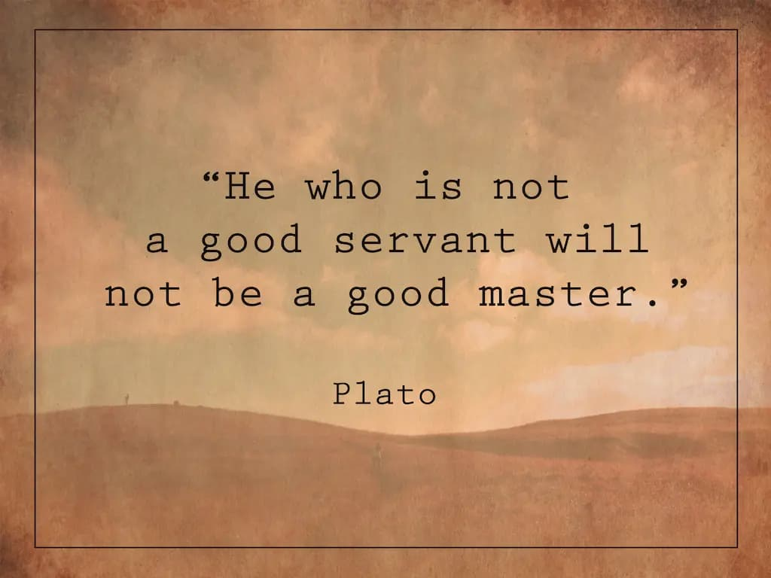
Servant-Leadership
The essence of servant-leadership.
  Use these keys to unlock your EE’s potential:
    Foresight
    Conceptualization
    Commitment to Growth of People
    Awareness
    Persuasion
    Listening
    Empathy
    Healing
    Stewardship
    Building Community

Slide 23

Leadership Style Depends on Many Factors
Most supervisors and managers recognize that no one leadership style is effective in all situations.
  There is no simple set of do’s and don’ts one can implement to achieve high motivation and excellent performance.
    Although leadership skills can be learned and developed, no one formula will apply in all situations and with all people.

Slide 24
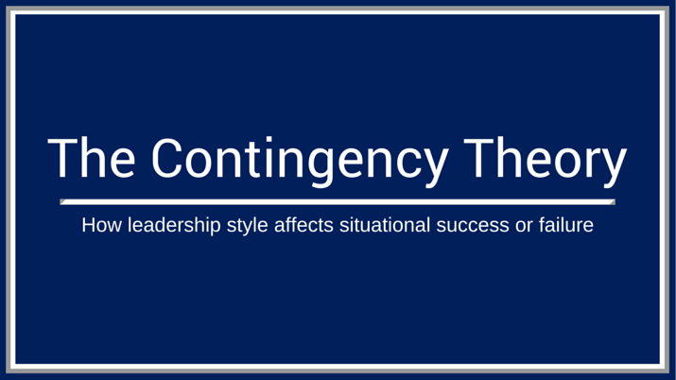
Leadership Style Depends on Many Factors
Evidence suggests that an effective approach to leadership is contingent on numerous factors in any given situation.
  Contingency-Style Leadership proponents advocate that considerations include such things as the supervisor, the organization, the type of work, the skill level and motivation of EEs, and time pressures.

Slide 25
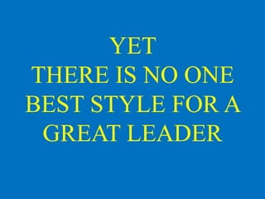
Leadership Style Depends on Many Factors
The consensus from dozens of leadership theorists is that no one best style of leadership exists.
  Effective leaders must be able to establish standards, actively listen to EEs to identify their challenges, needs and motivations, develop a climate in which people become self-motivated, and adapt to change.
    The effective leader provides direction, instruction, and guidance, support and encouragement, feedback and positive recognition, and enthusiastic help when necessary.

Slide 26

Trust
The Basis of Effective Supervisory Relationships
The ability to trust a leader is more important today than at any other time in recent history.
  Trust is the foundation of effective supervisory relations.

Slide 27

Trust is a Growing Concern in the Workplace
Trust, according to Merriam-Webster, is the belief that someone is reliable, good, honest, and effective.
  Lack of trust is a growing concern in the workplace, which is attributed to senior leaders’ lack of caring, perceived favoritism, poor communication, and inconsistent behavior.

Slide 28
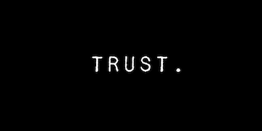
The Impact of Trust on Supervisory Relationships
A number of specific leadership behaviors can erode trust between supervisors and EEs.
  A supervisor’s lack of confidence and courage to stand up for EEs; operating with hidden agendas; unwillingness to apologize for mistakes; unclear or untrue communication; self-centeredness; taking credit for others’ ideas; inappropriate choices; inconsistent behavior; and resistance to getting their “hands dirty” by staying distanced from EEs and the work they do can lower EE’s trust that the supervisor has their best interests at heart.

Slide 29
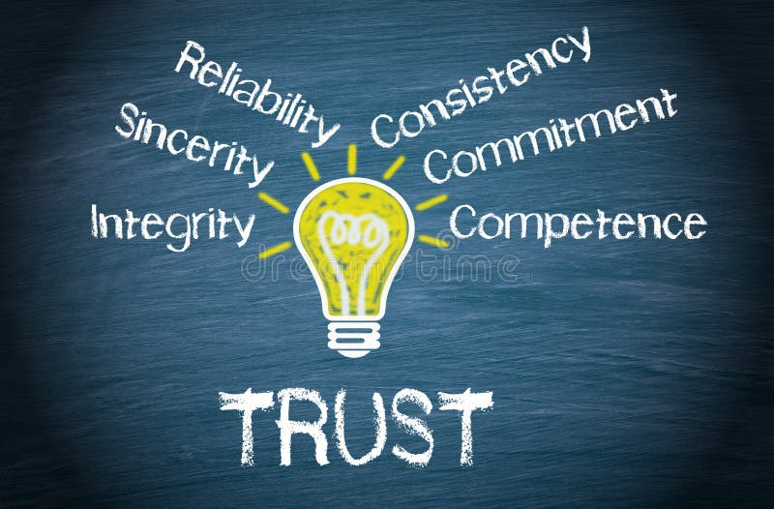
The Impact of Trust on Supervisory Relationships
Relationships of mutual trust can be facilitated by leaders who are authentic, aligning their words and actions to demonstrate integrity and model it for their EEs.
  Supervisors who share their experience while also acknowledging their shortcomings earn the respect of EEs.
    Honest communication, excellent listening skills, and a caring attitude, particularly in times of organizational change, reduce EE’s fear of the unknown and encourage them to trust and support the leader’s decisions when it comes to navigating uncharted waters.

Slide 30

Ethical Values Comprise Character
    Ethics is the system of moral principles that guide the conduct of an individual, group, or society.
  A person’s ethics determine how they distinguish between right and wrong and good and evil relative to their own actions and character, as well as the actions and character of others.
    Ethical values are broad character traits that include honesty, integrity, fairness, reliability, reciprocity, and accountability.

Slide 31

Ethical Values Comprise Character
The Josephson Institute of Ethics suggests six key ethical values, the Six Pillars of Character, comprise a person’s character:
  Trustworthiness
  Respect
  Responsibility
  Fairness
  Caring
  Citizenship
    These values which can be easily remembered with the acronym TRRFCC - are a reminder that good character is terrific.

Slide 32

Ethical Values Inform Leadership and Influence Followers
Returning to our definition of leadership, in which leaders influence the opinions, attitudes, and behaviors of others, consideration of ethics becomes critical because when leaders choose to behave ethically and influence followers to do the same, organizational performance is higher, but when they choose not to, organizational culture suffers, performance drops, and followers can be put in compromising situations.
  Leaders shoulder the responsibility for modeling and promoting ethical values in the workplace and holding EEs accountable for upholding those values through their own behavior.

Slide 33
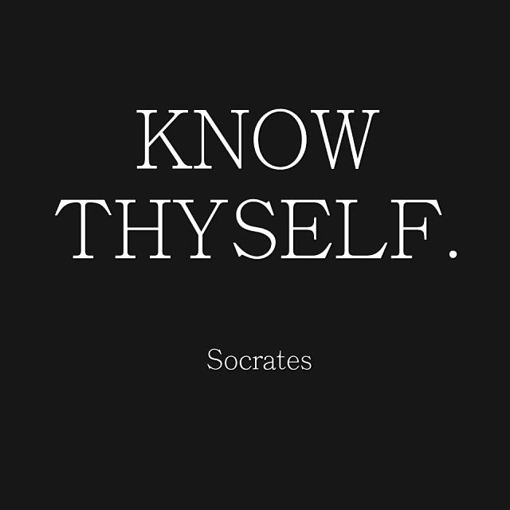
Leaders
Know Thyself and Thy Ethical Values
Before a leader can influence the ethical values of EEs, the leader must first have a clear grasp of their own ethical values and how they drive personal behavior.
  Leaders must engage in self-assessment, particularly in area of ethics, so they can establish a strong ethical foundation with which to influence followers and identify areas in which they need to strengthen their ability to behave ethically and make ethical decisions.

Slide 34

Everyday Ethics
The Community and Leadership Development Center at Indiana University suggests three things anyone can do to demonstrate ethical leadership:
  Be People-Oriented
    Be aware of how your actions impact others and how people will see you as someone who is trustworthy and someone to follow.
  Choose Your Values
    Know what you value and be unshakable in what you believe in.
    If you hold true to your values, you will be less likely to stray from them or influence others in a negative way.
  Motivate Others to Serve the Greater Good
    Help others in the group understand that putting group needs in front of individual needs not only demonstrates ethical values, but also builds a strong commitment toward shared goals and shared responsibility for the final outcome.

Slide 35
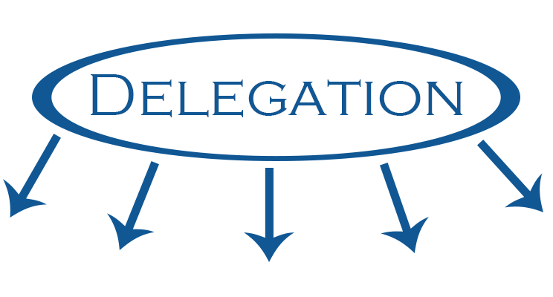
The Process of Delegation
A major aspect of managerial leadership is a managers’ use of the authority inherent in their positions.
  Just as authority is a major component of management, the delegation of authority is essential to the creation and operation of an organization.
    Delegation gives EEs a greater voice in how the job is to be done; the EEs are empowered to make decisions.

Slide 36

The Process of Delegation
Unfortunately, some managers view delegation as a means of lightening their workloads.
  They assign unpleasant tasks to EEs and subsequently find that the EEs are not motivated to complete those tasks.
    The manager must look at delegation as a tool to develop EE skill and ability, rather than as a means to get rid of unpleasant tasks.

Slide 37

The Process of Delegation
A supervisor receives authority from a higher-level manager through delegation, but this does not mean that the manager surrenders all accountability.
  Accountability is the obligation one has to their boss and the expectation that others will accept credit or blame for the results achieved in performing assigned tasks.
    When supervisors delegate, they are still ultimately accountable for the successful completion of work.

Slide 38

The Process of Delegation
Delegation is a strategy for accomplishing objectives.
  It consists of the following three components, all of which must be present:
    Assigning duties to subordinates.
    Granting permission (authority) to make commitments, use resources, and take all actions necessary to perform duties.
    Creating an obligation (responsibility) on the part of the subordinate to perform duties satisfactorily.
      Unless all three components are present, the delegation process is incomplete.
      They are inseparably related; a change in one requires a change in the other two.

Slide 39
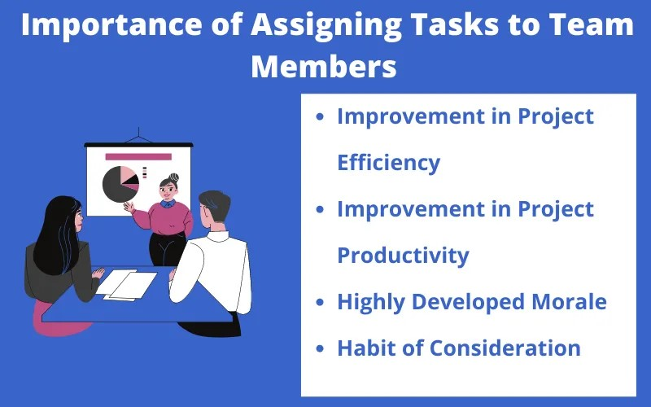
Assigning Duties
Each EE must be assigned a specific job or task to perform.
  Job descriptions may provide a general framework through which the supervisor can examine duties in the department to decide which tasks to assign to each EE.
    The assignment should indicate the scope of the task – what to do, how much to do, the level of quality expected, and when the task should be completed.

Slide 40

Assigning Duties
Routine duties usually can be assigned to almost any EE, but there are other functions that the supervisor can assign only to EEs who are qualified to perform them.
  There are also some functions that a supervisor cannot delegate – functions the supervisor must do.
    The assignment of job duties to EEs is of great significance, and much of the supervisor’s success depends on it.

Slide 41

Granting Authority
The granting of authority means that the supervisor confers upon EEs the right and power to act, to use certain resources, and to make decisions within the prescribed limits.
  Of course, the supervisor must determine the scope of authority that is to be delegated.
    How much authority can be delegated depends in part on the amount of authority the supervisor possesses. The degree of authority is also related to the EEs and the jobs to be done.

Slide 42
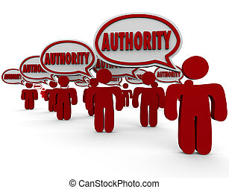
Granting Authority
Enough authority must be granted to the EE to enable them to perform assigned tasks adequately and successfully.
  There is no need for the authority to be larger than the task.
    Authority must be sufficient for the EE to meet their obligations.

Slide 43

Defining Limitations
Throughout the process of delegation, EEs must be reassured that orders and authority come from immediate supervisor.
  A supervisor must be specific in telling EEs what authority they have to perform the assigned task(s) and what they can or cannot do.
    If the supervisor does not state this clearly, the EE will be forced to test limits and learn by trial and error, or return to supervisor to gather more information, which decreases the effectiveness of the delegation process.

Slide 44
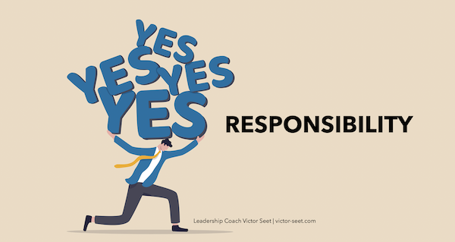
Creating Responsibility
A critical component of the process of delegation is creating an obligation on the part of the EE to perform assigned duties satisfactorily.
  Acceptance of this obligation creates responsibility; without responsibility, delegation is incomplete.
    A subordinate must recognize and accept responsibility if delegation is to succeed.

Slide 45

Supervisory Accountability Cannot be Delegated
Delegation is necessary for jobs to be accomplished – the supervisor cannot do everything.
  While a supervisor may use sound managerial practices, EEs will not always use the best judgment or perform in superior ways. Thus, allowances must be made for errors.
    Accountability remains with supervisors, but supervisors must be able to depend on their EEs. If an EE fails to carry out an assigned task, they are accountable to the supervisor, who must then redirect EEs as appropriate.

Slide 46
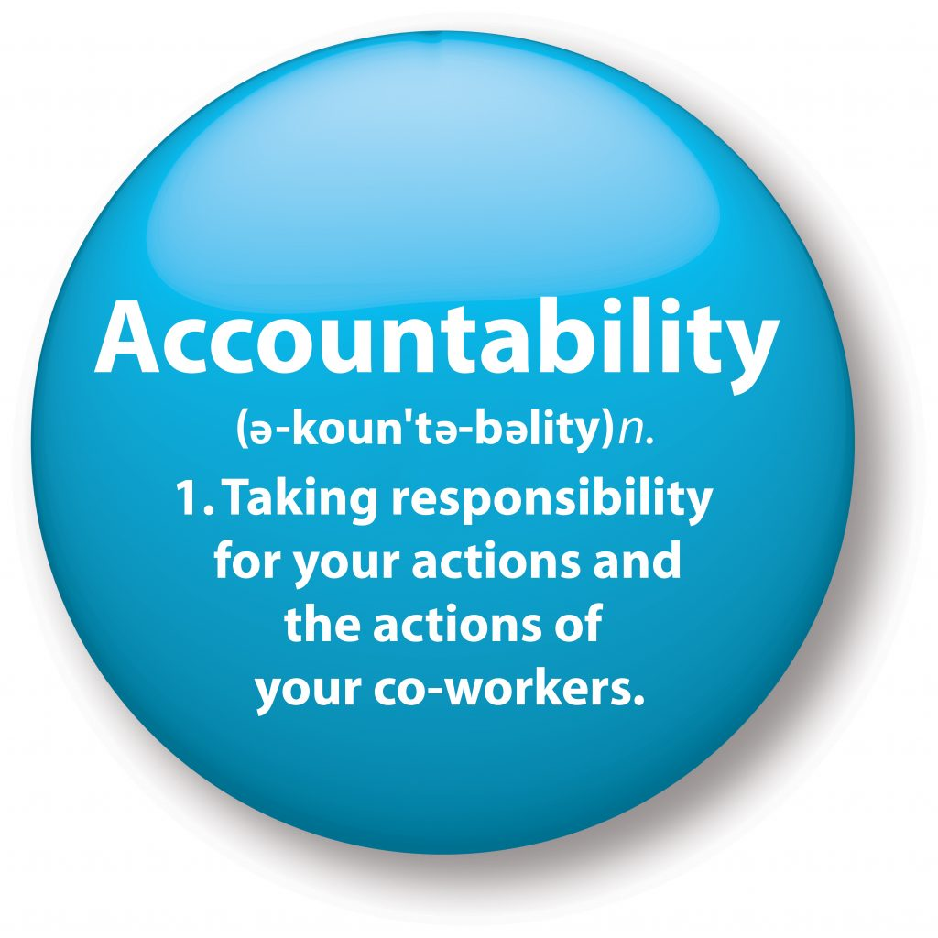
Supervisory Accountability Cannot be Delegated
When appraising a supervisor’s performance, higher-level managers usually consider how much care the supervisor has taken in selecting, training, and supervising EEs, and in controlling their activities.

Slide 47
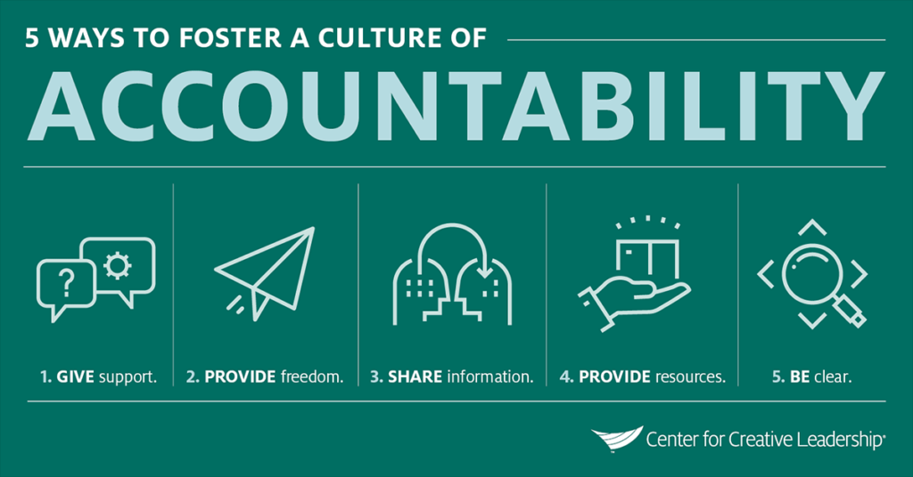
Delegation by the Supervisor
Every supervisor must delegate some authority to EEs, which assumes that the EEs can and will accept the authority delegated to them.
  However, many EEs complain that their supervisors make all the decisions and scrutinize their work because the do not trust the EEs to carry out assignments.
    These complaints usually describe supervisors who are unable or unwilling to delegate.

Slide 48
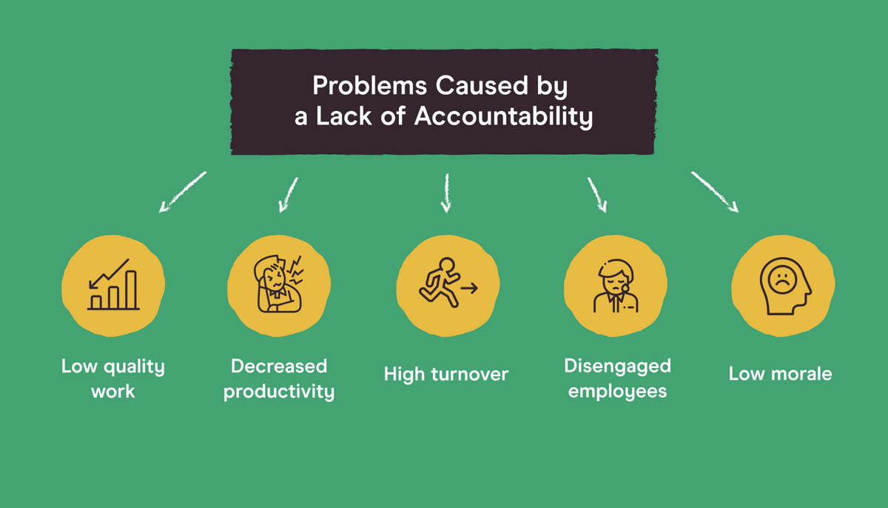
Reasons for Lack of Supervisory Delegation
A supervisor may be reluctant to delegate for several reasons, some of which are valid and some not.
  The following are some barriers the supervisor must overcome to achieve effective delegation:
    “They Can’t Do It” Mentality
    “I’d Rather Do It Myself” Mentality
    “If it is to be Done Right – I have to Do it” Mentality
    Fear of Making Mistakes
    Fear of Being Replaced

Slide 49

Reasons for Lack of Supervisory Delegation
Not everyone wants to take the responsibility for decisions.
  EEs may be reluctant to accept delegation because of their insecurity or fear of failure, or they may think the supervisor will be unavailable for guidance.
  EEs may be reluctant to accept delegation due to past managerial incompetence.
    The supervisor must identify those EEs who need the opportunity to grow and who want to be empowered.

Slide 50
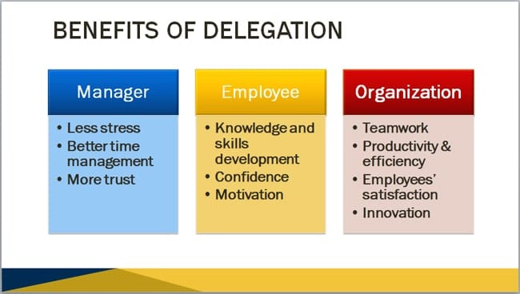
Benefits of Delegation
The supervisor who delegates expects EEs to make more decisions on their own.
  This does not mean that the supervisor is not available for advice.
  It means that the supervisor encourages EEs to make many of their own decisions and to develop self-confidence in doing so.
    This, in turn, should mean that supervisor will have more time to manage.

Slide 51

Benefits of Delegation
Effective delegation should cause EEs to perform an increasing number of jobs and to recommend solutions that contribute to good performance.
  As the supervisor’s confidence in EE expands, the EE’s commitment to better performance should also grow. This growth may take time, and degree of delegation may vary w/each EE and each department.
    However, in most situations, a supervisor’s goal should be to delegate more authority to EEs. This goal contributes to EE motivation and to better job performance.

Slide 52
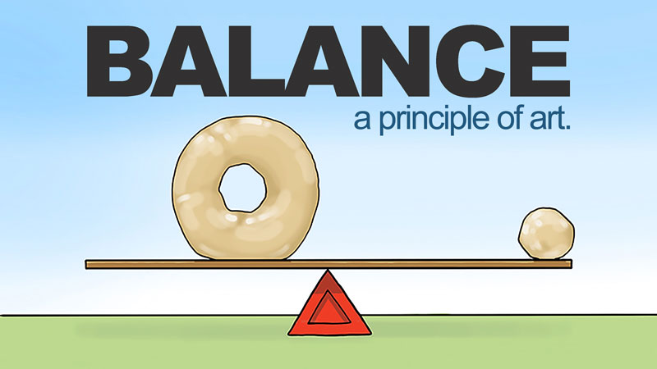
The Proper Balance of Delegation
It is not easy for a supervisor to part with some authority and still be left with the responsibility for the workers’ performance.
  The supervisor must achieve a balance among too much, too little, and just the right amount to delegate to an EE without losing control.

Slide 53
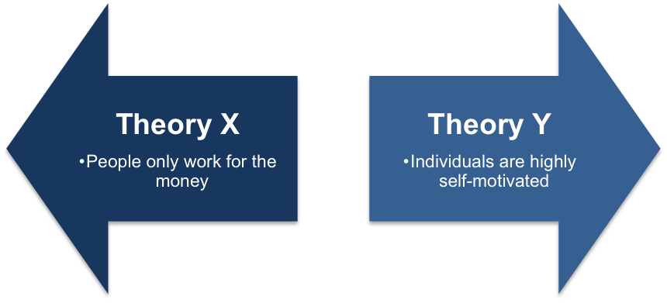
Classifying Supervisory Leadership Styles
We believe that the various leadership theories studied and researched can be classified into two styles or approaches.
  These styles range from essentially autocratic or authoritarian supervisory styles (based on Theory X assumptions) to variations of general supervisory styles (based on Theory Y assumptions).
    These two styles can be presented as the extremes of a continuum.

Slide 54
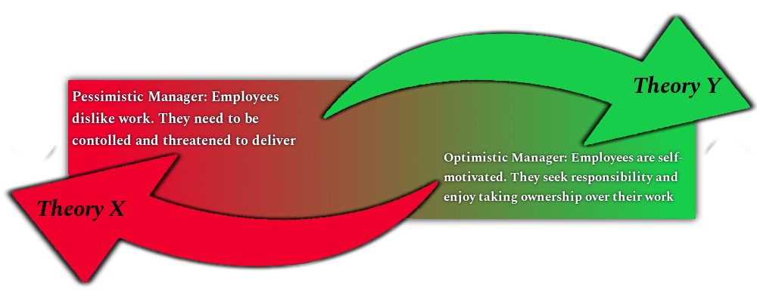
Classifying Supervisory Leadership Styles
However, in practice, a supervisor usually blends these approaches based on a number of considerations that include the supervisor’s skill and experience, the EEs who are involved, the situation, and other factors.
  No one style of supervision is correct in all situations.
    Supervisors must be sensitive to the needs and realities of each situation and must change their styles as necessary to accomplish objectives.

Slide 55

Classifying Supervisory Leadership Styles
Two theories developed by Douglas McGregor can help frame our understanding of supervisory styles:
  Theory X
    Assumes that most EEs dislike work, avoid responsibility, and must be coerced to work hard.
  Theory Y
    Assumes that most EEs enjoy work, seek responsibility, and can self-direct.

Slide 56
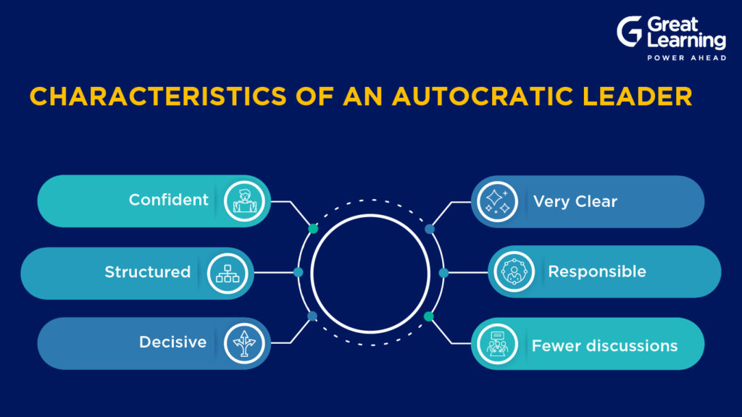
Autocratic (Authoritarian) Supervision
Many supervisors still believe that emphasizing formal authority, or autocratic (authoritarian) supervision, is the best way to obtain results.
  A supervisor of this type often uses pressure to get people to work and may even threaten disciplinary action, including discharge, if EEs do not perform as ordered.
    EEs sometimes call these managers “taskmasters.”

Slide 57
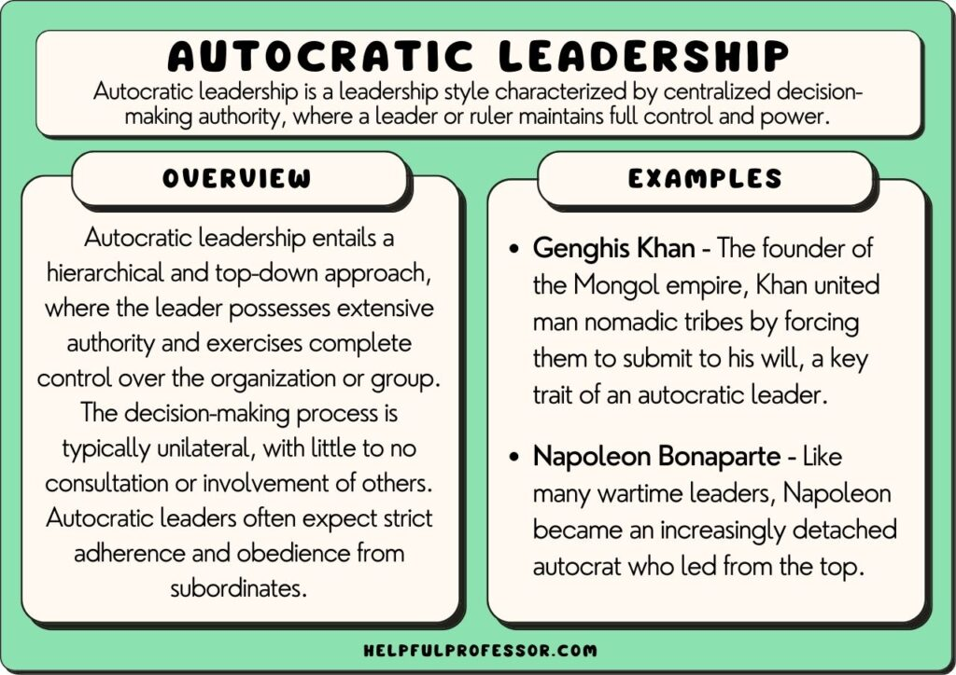
Autocratic (Authoritarian) Supervision
Autocratic supervision means close control of EEs in which supervisors issue directives with detailed instructions and allow EEs little room for initiative.
  Autocratic supervisors delegate very little or no authority.
    They believe that they know how to do the job better than their EEs and that EEs are not paid to think but to follow directions.

Slide 58
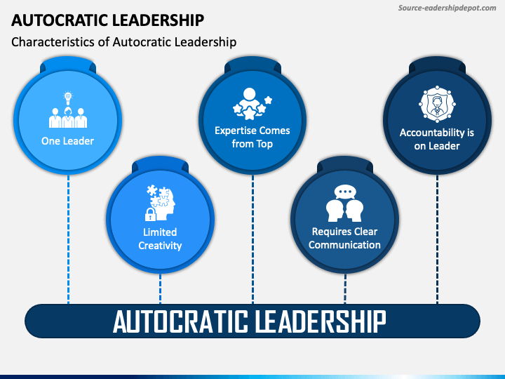
Autocratic (Authoritarian) Supervision
Autocratic supervisors further believe that, because they have been put in charge, they should do most of the planning and decision making.
  Because such supervisors are quite explicit in telling EEs exactly how and in what sequence things are to be done, they follow through with close supervision and are focused on the tasks to be done.

Slide 59
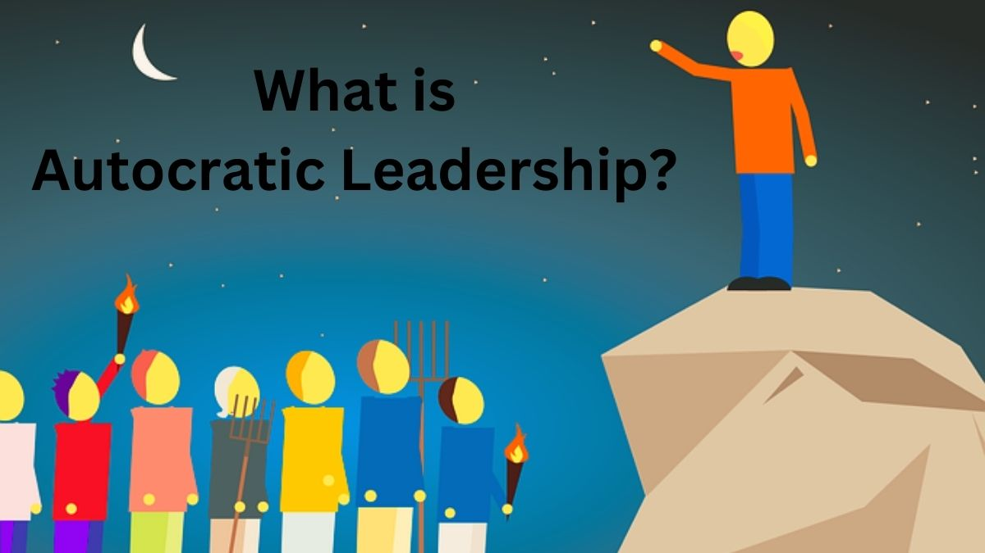
Autocratic (Authoritarian) Supervision
Autocratic supervision is sometimes associated with what has been called the bureaucratic style of supervision.
  This style emphasizes an organizational structure and climate that require strict compliance with managers’ policies, rules, and directives throughout the firm.
    Because bureaucratic managers believe their primary role is to carry out and enforce policies and directives, they adopt an authoritarian approach. “It’s policy,” “Those are the rules,” “Shape up or ship out.”

Slide 60
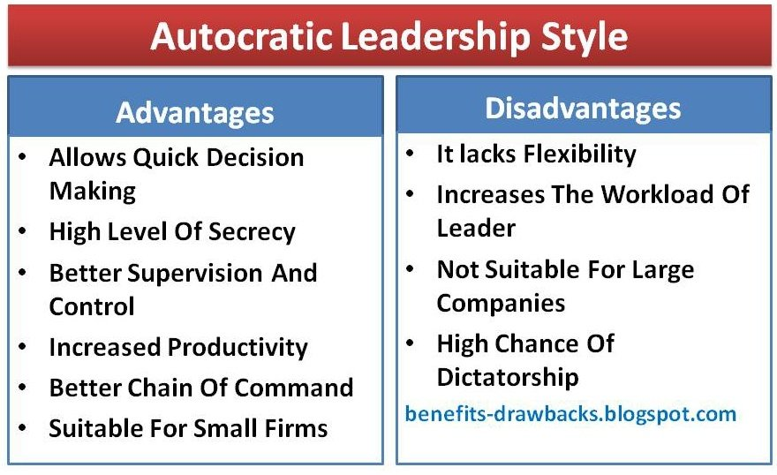
Autocratic (Authoritarian) Supervision
Autocratic supervisors do not necessarily distrust EEs, but they believe that w/o detailed instructions EEs could not do the job.
  Some autocratic supervisors operate from the premise that most EEs do not want to do their jobs; therefore, close supervision and threats of job or income loss are required to get EEs to work (Theory X).
    These supervisors feel that if they are not on the scene watching closely, the EE will stop working or will proceed at a leisurely pace.

Slide 61
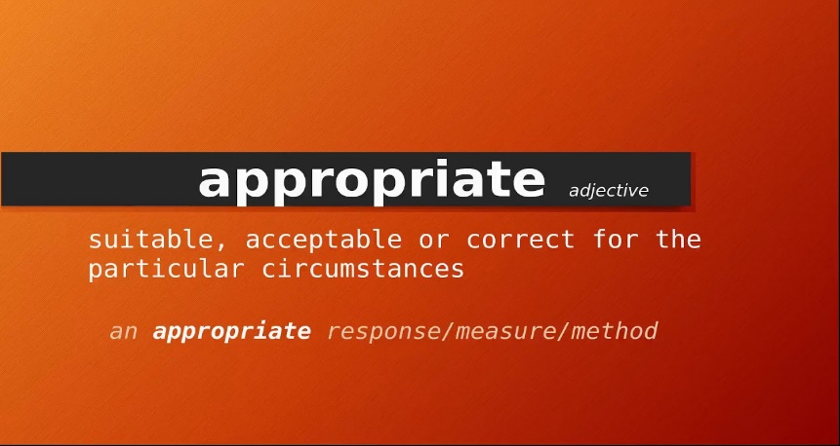
When Autocratic Supervision is Appropriate
Under certain circumstances and with some EEs, autocratic supervision is both logical and appropriate.
  Some EEs do not want to think for themselves; they prefer orders.
  Others lack ambition and do not wish to become involved in their daily jobs. This can be the case when jobs are very structured, mechanized, automated, or routine. EEs in these jobs prefer to have a supervisor who issues orders and otherwise leaves them alone.
    Some EEs prefer an authoritarian environment and expect a supervisor to be firm and totally in charge.

Slide 62
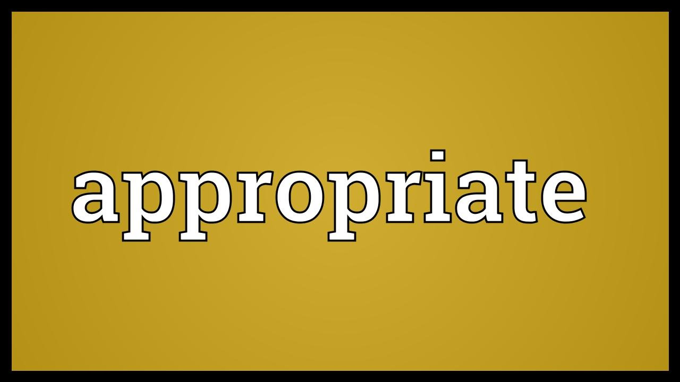
When Autocratic Supervision is Appropriate
The major advantage of autocratic supervision is that it is quick and easy to apply and it may get rapid results in the short run.
  It may be appropriate when EEs are new & inexperienced, especially if the supervisor is under major time pressures and cannot afford to have EEs take time to figure out on their own how to get work done.

Slide 63

Effects of Autocratic Supervision
For the most part, the autocratic method of supervision is not conducive to developing EE talents, and it tends to frustrate EEs who have ambition and potential.
  Such EEs may lose interest and initiative and stop thinking for themselves because there is little need for independent thought.
    EEs who strongly resent autocratic supervision may become frustrated rather than find satisfaction in their daily work. Such frustration can lead to arguments and other forms of discontent.

Slide 64
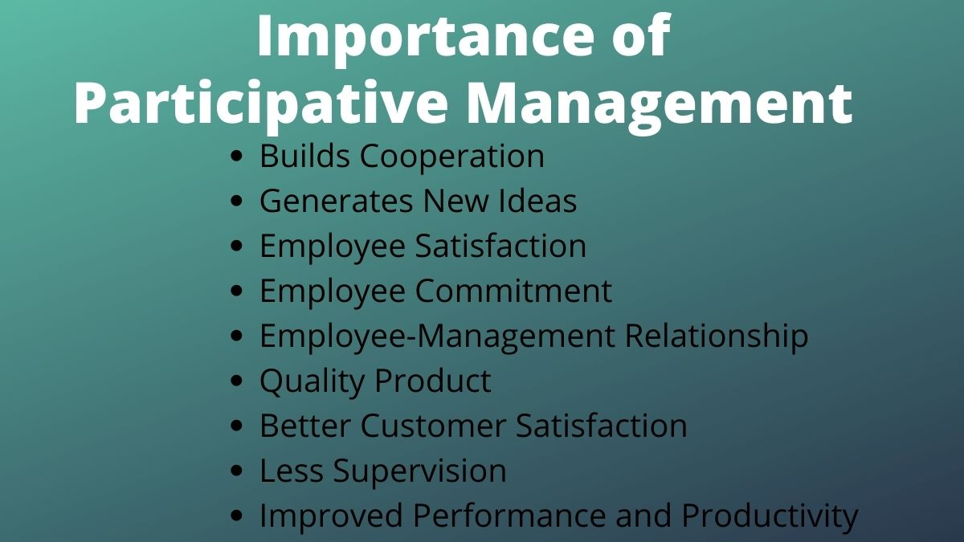
General Supervision and Participative Management
Effective supervisors who want to guide EEs to higher levels of performance recognize that they cannot rely solely on managerial authority.
  General supervision means the supervisor sets goals, discusses goals with EEs, and sets limits within which the work must be done.
    Within this framework, EEs have considerable freedom to decide how to achieve their objectives.

Slide 65

General Supervision and Participative Management
Participative management means that the supervisor discusses with EEs the feasibility, workability, extent, and content of a problem before making a decision and issuing a directive.
  General supervision and participative management are grounded in Theory Y assumptions.
    Regardless of one’s preference for a leadership style, the supervisor must issue directives and ensure the work gets done efficiently and effectively.
    The degree to which the supervisor uses directives will vary with the task to be performed; the skill level, experience, and willingness of the EE; and the urgency of the situation.

Slide 66
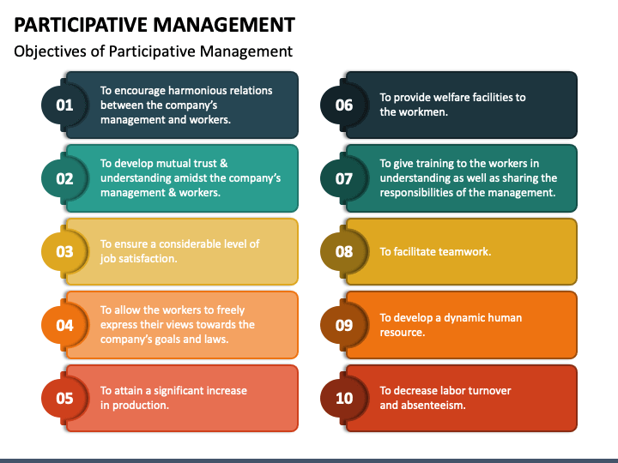
General Supervision and Participative Management
A participatory style does not lessen a supervisor’s authority; the right to decide remains with the supervisor, and the EE’s suggestion can be rejected.
  Participative management involves sharing ideas, opinions, and information between the supervisor and the EEs and thoroughly discussing alternative solutions to a problem, regardless of who originates the solutions.
    A high degree of mutual trust must be evident.

Slide 67
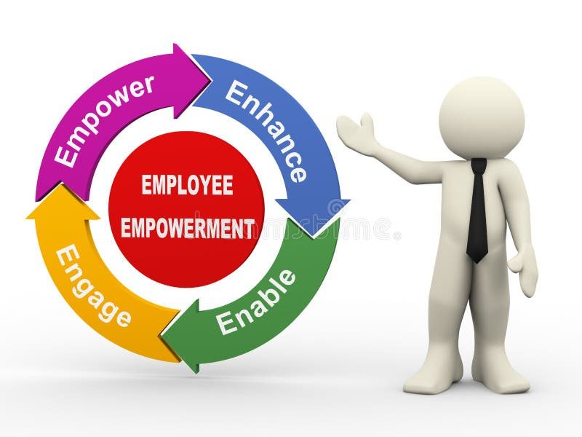
General Supervision and Participative Management
The term “empowerment” has been used to describe an approach by which EEs and work teams are given more responsibility and authority to make decisions about the jobs they do.
  Empowerment relates to philosophy of how to manage and supervise as participative management, and likewise is a matter of degree.
    Empowerment is a situational approach that involves the expectation of distinct amounts of participation by individuals in specific situations.

Slide 68

General Supervision and Participative Management
More important than approach is the supervisor’s attitude.
  Some supervisors are inclined to use a pseudo-participatory approach simply to give EEs the feeling that they have been consulted, asking for input even though a course of action has already been decided. They use this approach to manipulate EEs to do what is required, with or w/o EE consultation.
    However, EEs can sense the superficiality, and when they believe their participation is contrived, the results may be worse than if the supervisor had practiced autocratic supervision.

Slide 69

General Supervision and Participative Management
If participative management is to succeed, the supervisor and the EEs must want it.
  When EEs believe that the supervisor knows best and that making decisions is none of their concern, an opportunity to participate is not likely to induce higher motivation and better morale. EEs should be consulted in areas in which they can draw on their knowledge.
    Asking for participation in areas that are far outside EE’s scope of competence may make them feel inadequate and frustrated.

Slide 70

Advantages of Participative Management and General Supervision
The greatest advantage of participative management is that a supervisor’s directives can be transformed into a solution for which EEs feel shared ownership.
  Contributing to decisions and solutions lead EEs to cooperate more enthusiastically in carrying out a directive, and their morale is apt to be higher when their ideas are valued.
    Participative management permits closer communication between EEs and their supervisor, which strengthens trust and respect for one another, and improves the workplace environment.

Slide 71

Advantages of Participative Management and General Supervision
General supervision means permitting EEs, within prescribed limits, to work out the details of their daily tasks and to make many of the decisions about how tasks will be performed, with the assumption that EEs want to do a good job and will find greater satisfaction in making decisions themselves.
  The supervisor communicates the desired results, standards, and limits within which the EEs can work and then delegates accordingly.

Slide 72
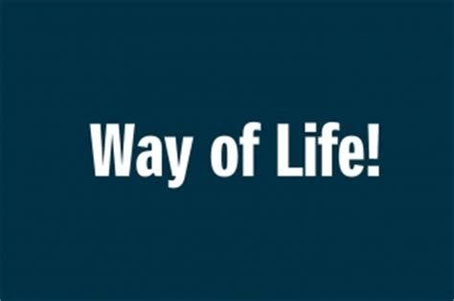
Participative Management and General Supervision as a Way of Life
Participative management and general supervision are a way of life that must be followed over time.
  A supervisor cannot expect sudden results by introducing these types of supervision into an environment in which EEs have been accustomed to authoritarian, close supervision.
    It takes considerable time and patience before positive results are evident.

Slide 73
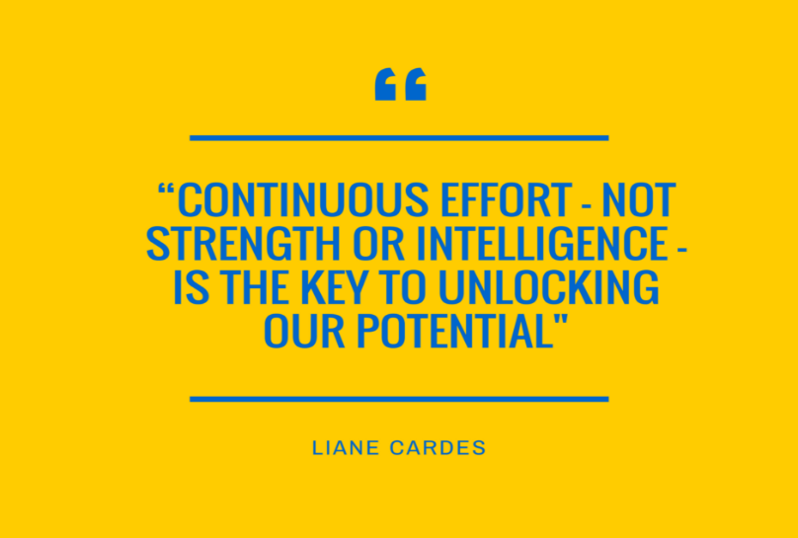
Participative Management and General Supervision as a Way of Life
The successful implementation of participative management and general supervision requires a continuous effort on a supervisor’s part to develop EEs beyond their present skills.
  The participative supervisor spends considerable time encouraging EEs to solve their own problems and to participate in and make decisions because they learn from their own success and failure.

Slide 74

Participative Management and General Supervision as a Way of Life
As EEs become more competent and self-confident, the supervisor has less need to instruct and watch them.
  A valid way to gauge the supervisor’s effectiveness is to study how EEs in the department function when the supervisor is away from the job.
    This is the essence of EE empowerment.

Slide 75
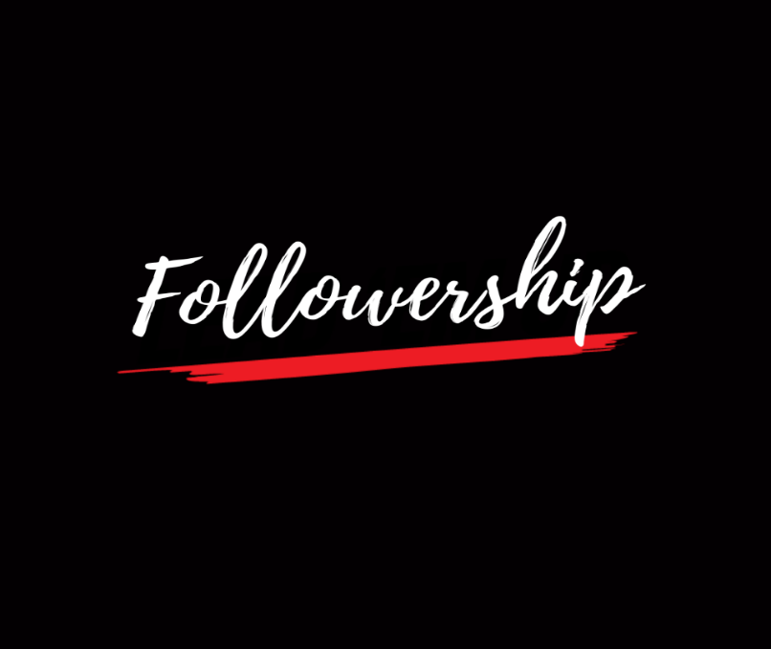
Followership: An Equally Important Part of the Leadership Equation
As we consider the role of leaders in the functions of supervision, it is equally important for us to consider the role of followers.
  The words of General Douglas MacArthur spoke in 1961 still ring true today in any organization, “A general is just as good or just as bad as the troops under his command make him.”

Slide 76
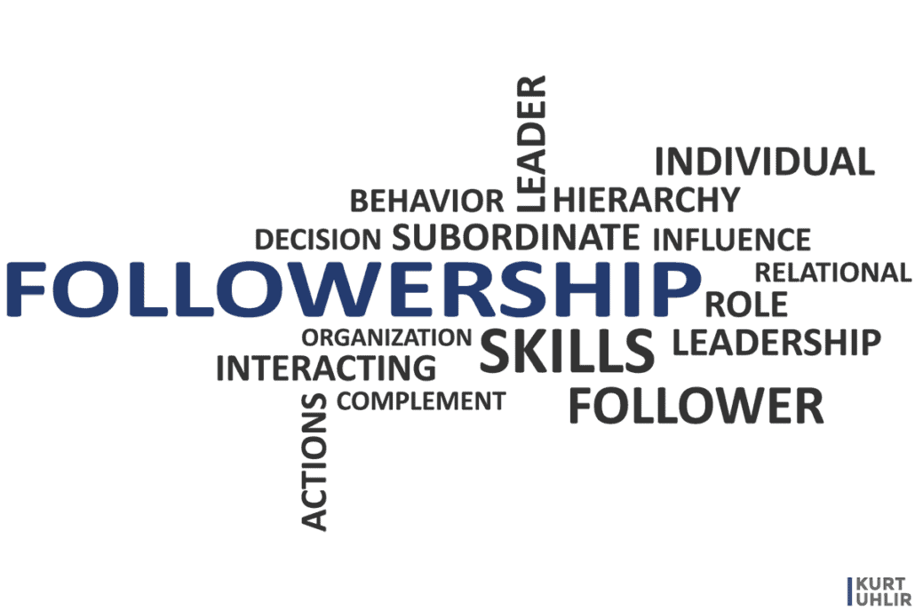
Followership: An Equally Important Part of the Leadership Equation
Nearly anyone can learn leadership skills, but what makes a leader a leader is the presence of followers - people who choose to be guided and influenced by the leader.
  The leader’s effectiveness is reflected in how well followers perform, because it is their collective performance that ultimately achieves the goal of the group.
    With no followers, there are no leaders.

Slide 77

We Are Followers
Followership, the capacity or willingness to follow a leader, completes the reciprocal process of leadership.
  Those who follow in response to the directives of a leader choose the extent to which they engage with and support the leader.

Slide 78
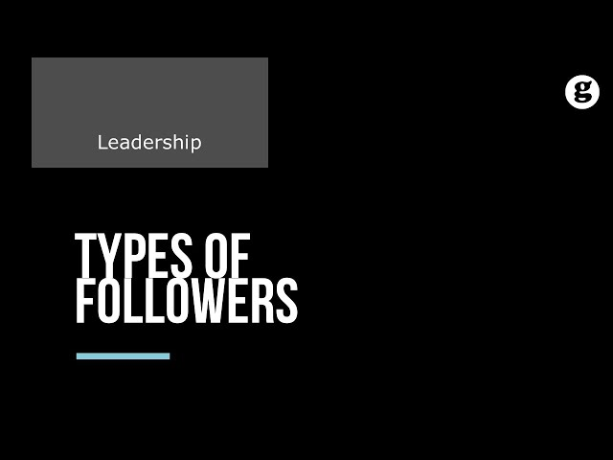
Types of Followers
A variety of followership behaviors can be observed in organizations.
  Carnegie Mellon University professor Robert E. Kelley suggests that followers can be categorized into 5 groups, based on the combination of their tendency to be passive or assertive in their actions and the extent to which they use independent, critical thinking.

Slide 79

Types of Followers
  Passive Followers
    Termed sheep in some writings and are not very engaged with organization. They aren’t actively involved and depend on others to make decisions.
  Conformist Followers
    The “yes men and women,” who are supportive and involved, but they tend to go along with the crowd rather than making their own choices.
  Alienated Followers
    Independent thinkers, but not in a positive way. They are disengaged from the organization’s goals and remain distant from the leader, but they willingly share their ideas, which often come across as skeptical or cynical.
  Exemplary Followers
    Often considered the star of the office, a creative, constructive, independent thinker who actively focuses energy toward group goals. They will back the leader 100% if they agree with the current goal, but if not, they may transform into alternative leadership and steer the group in another direction.
  Pragmatist Followers
    They asses the group situation and choose the followership style that best fits the task, as well as their current workload, attitude toward the goal, and presence of other followers that might fulfill other roles in the group.

Slide 80

Types of Followers
    It shouldn’t be the leader’s goal to transform everyone into one type of follower; rather, the leader should use a variety of management strategies to engage each follower in a way that is most appropriate for their needs and style of followership.
  If all members of a group were similar type followers nothing new would ever get done, either because everyone would be waiting for someone else to do it, everyone would criticize, everyone would agree, or everyone would try to be second in command.

Slide 81

Types of Followers
Leaders need to be aware that followers also have the power to influence.
  Followers’ influence can certainly be positive when it is focused on achieving shared goals, but some followers may use their influence to create unique leadership challenges.

Slide 82

Types of Followers
Strong-willed followers who have their own agenda can rally others in the group to form a competing majority with the intent to turn the course of action in another direction.
  Flattering followers do all they can to get on the boss’s good side and shower them with praise and complements in order to get the best assignments or preferential treatment, but they often insulate the leader from organizational or performance problems because they don’t want to be the bearer of bad news.
    Power mongers with their eyes on the leader’s corner office use organizational information as a tool to make the leader dependent on them, while at the same time demonstrating their value to the organization, hoping it is recognized and rewarded.

Slide 83

Types of Followers
These strategies can undermine the leader’s effectiveness, pollute organizational culture, and negatively impact organizational performance in significant ways.
  A leader should quickly stop toxic follower behaviors by addressing them one-on-one with the EE and providing guidance on more appropriate behaviors.

Slide 84

Qualities of Effective Followers
Although supervisors should value all followers, there are distinct qualities effective followers share.
  Good followers are able to manage themselves well by using good work habits, taking responsibility for their actions, and holding themselves accountable for the work they are assigned.
    They are committed to the goals, vision, or cause of the organization, more so than their own personal gain.

Slide 85

Qualities of Effective Followers
Good followers are competent in their roles and they strive to continually build their competencies.
  Effective followers are ethical and demonstrate courage, honesty, discretion, and credibility.
    Followers can bring perspectives to a problem or task and share insights that may provide alternatives or a more appropriate solution.

Slide 86
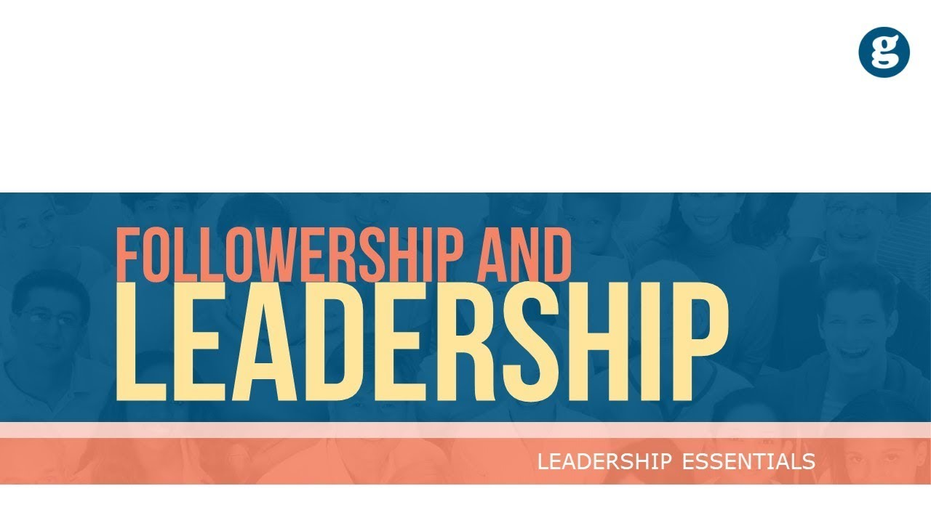
Qualities of Effective Followers
Followership may always be a second thought after leadership, but the truth is, without followers, there are no leaders.
  It is important for supervisors and EEs to remember that everyone is a follower at some point, and learning to be a good follower is excellent preparation for becoming a great leader.

Slide 87

Followership
The ten rules of good followership:
  Don’t blame your boss for an unpopular decision or policy
  Your job is to support, not undermine.
  Argue with your boss if necessary; but do it in private, avoid embarrassing situations, and never reveal discussion to others.
  Make the decision, then run it past the boss; take initiative.
  Accept responsibility whenever it is offered.
  Tell the truth and don’t quibble; your boss will be giving advice up the chain of command based on what you said.
  Do your homework; give your boss all the information needed to make a decision; anticipate possible questions.

Slide 88
Followership
The ten rules of good followership:
  When making a recommendation, remember who will probably have to implement it (that would be you). Know your limitations and weaknesses as well as your strengths.
  Keep your boss informed of what’s going one in the work group; people will be reluctant to tell them their problems and successes. Do it for them, and assume someone will tell the boss about yours.
  If you see a problem, fix it. Don’t worry about who would have gotten the blame or who now gets the praise.
  Put in more than an honest day’s work, but don’t ever forget the needs of your family. If they are unhappy, you will be too, and your job performance will suffer accordingly.

Slide 89
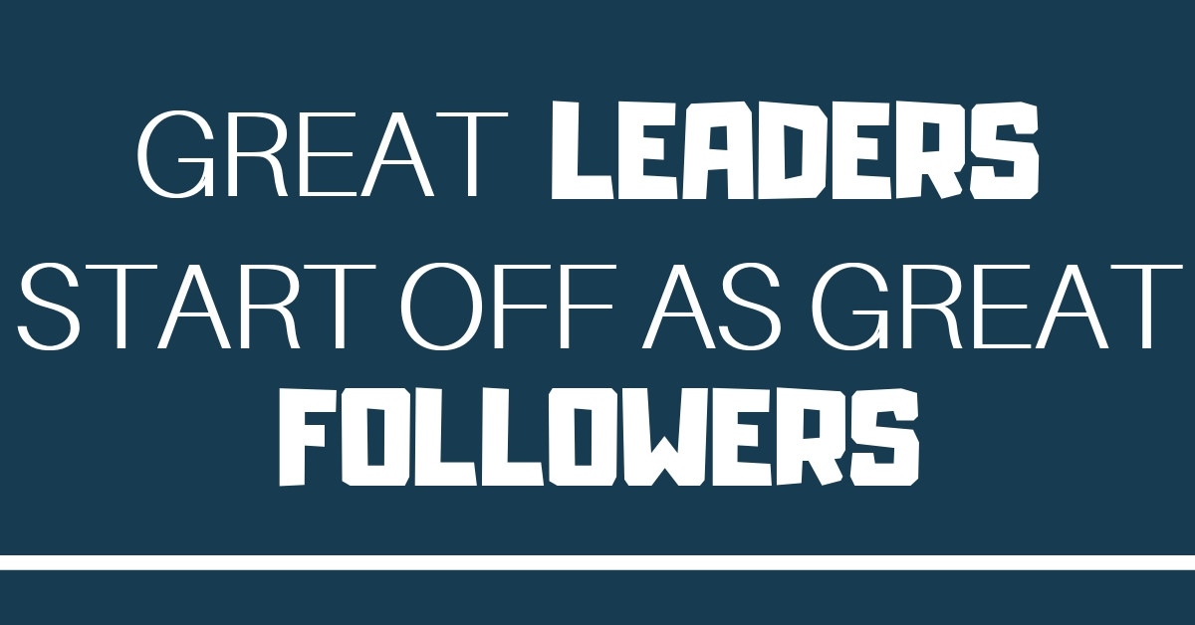
Followership

Slide 90


