Slide 1
MINI MENTOR PROGRAM
Chapter 16: Kids at Hope
www.theshineprogram.org

Slide 2
KIDS AT HOPE
What: An innovative evidence-based concept that proves that all children are capable of success, NO ECEPTIONS!
Who: Adults are “Treasure Hunters” and children are “Kids at Hope.”
Where: KAH is a culture, belief system, and structure that empowers ALL children to reach their potential in school, home life and community.

Slide 3
What is Hope?
Definition: a feeling of expectation or desire for a certain thing to happen; a feeling of trust.
KAH Hope Definition: having the ability to mentally travel to your version of a successful future, return to the present and prepare for the journey.

Slide 4
What is Hope?
Children that have hope for their future will achieve the unexpected, regardless of their current situation.
Adults that have hope for a child’s future will help them achieve success or connect them to someone that will.
Hope gives us the responsibility, motivation, and push we need to achieve our goals.
Hope is science!

Slide 5
Hope is Science
Did you know you can “rewire” your brain to be more positive? Research shows that mindfulness creates more folds in the prefrontal cortex, which is an area in our brain associated with our higher executive functions. Our executive functions include thinking creatively, adapting to situations, and making reasonable decisions.
Therefore, you can also wire your brain to prepare for a successful future.
Hope and Time Travel create neurological pathways in your brain that allow you to create and achieve attainable goals, success and happiness.

Slide 6
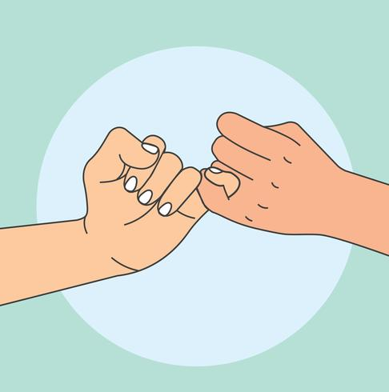
PLEDGES FOR SUCCESS
KIDS AT HOPE PLEDGE
I am a Kid at Hope.
I am talented, smart & capable of success.
I have dreams for the future and I will climb to reach those goals & dreams everyday.
All Children are Capable of Success, No Exceptions!
TREASURE HUNTER’S PLEDGE©
As an adult and a Treasure Hunter
I am committed to search for all the talents, skills and intelligence
that exists in all children and youth.
I believe all children are capable of success,
No Exceptions!

Slide 7
ACE OF HEARTS
Parent/Guardian: Responsible for child’s physical and emotional well being 24 hours a day, 7 days a week, 365 days a year in an unconditional loving way.
Our parents/guardians also have or had an Ace of Hearts in their lives. If they didn’t grow up in an affectionate home, they may not be too comfortable showing affection or communicating. This is okay.
Many times, our Ace of Hearts works very hard to provide a roof over our head. Although they may not say it often, we know they care for us because they protect us, provide for us, and care for our wellbeing.
Notes:
Now that we know what hope is, we can identify people in our lives that help us achieve our goals. You may not have all four Aces, but having one is just as important.

Slide 8
ACE OF CLUBS
Other Caring Adult: Adult that has a positive impact in your life (small or big). The Ace of Clubs can list at least 3 positive characteristics/skills or talents you have. You also feel comfortable asking this person for help.
All adults, regardless of job, status, income or position can be this ace.
You trust the Ace of Clubs and know they truly care about you. Family members, neighbors, teachers, cross guards, anyone can be your Ace of Clubs. Can you think of one?

Slide 9
ACE OF SPADES
High Expectations: Adults that believe in you, have high expectations and can push you to reach your highest potential. You are comfortable sharing your problems/issues beyond an academic subjects.
The Ace of Spades can be a coach, teacher, mentor, and any adult that expects you to do well. They push you and believe in you, even when you don’t believe in yourself.
Sometimes we may want to stay away from them to make our life “easier,” but sticking with Treasure Hunters will help you succeed.

Slide 10
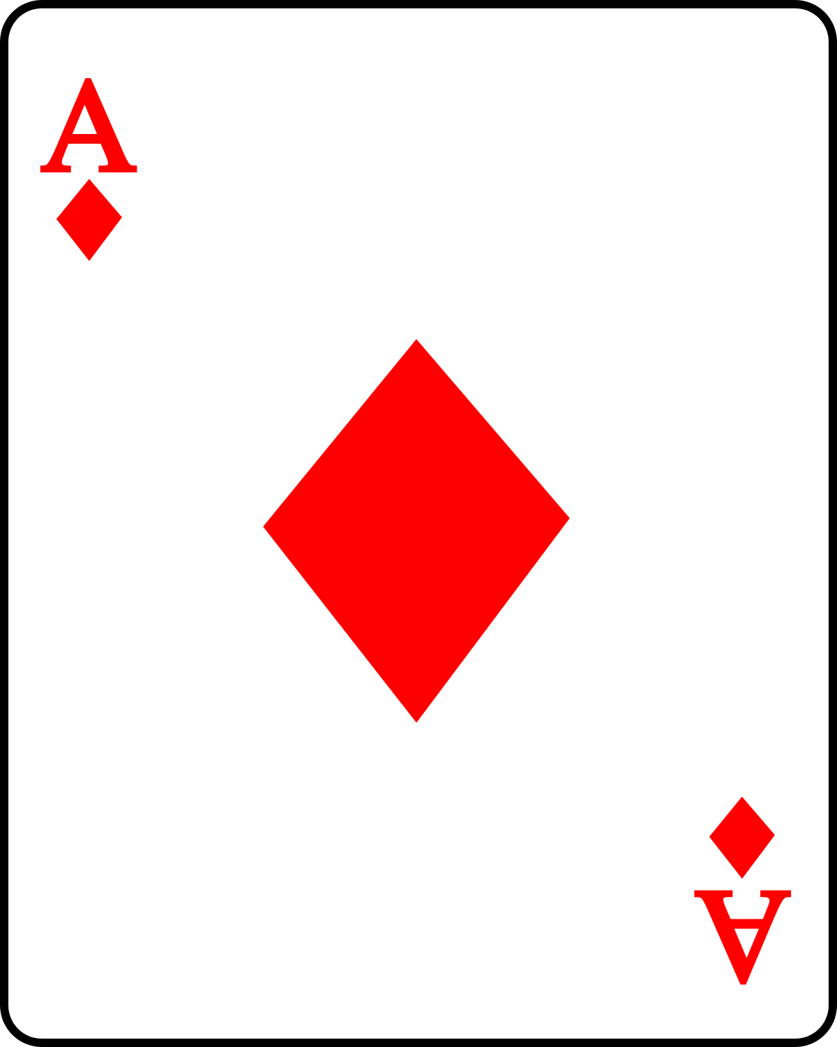
ACE OF DIAMONDS
Opportunities to Succeed: Adults that help you experience success and celebrate your success. There are four ways to help a child feel successful: belonging to something positive, feeling useful, feeling competent, and feeling empowered.
These adults may challenge and push you, but will always provide the tools to be successful. You may not always win, but they will help you learn from your experiences.
The Ace of Diamonds makes you feel valued and appreciated. Who is your Ace of Diamonds?

Slide 11
What is Success?
What does it mean to be successful? Who decides what success means? Is there a “typical” definition of success? Do you agree with it?
Definition: favorable or desired outcome; achievement of something desired, planned, or attempted.
What is your definition of success?

Slide 12
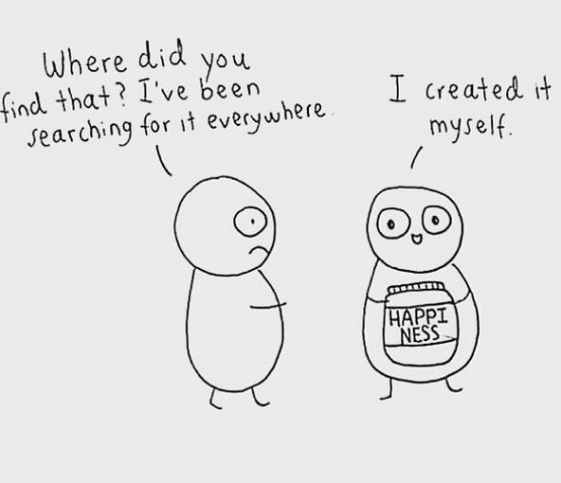
What is Success?
Although others, including our parents/guardians, have specific definitions of success, you must be true to your own definition. Success is happiness! How can you achieve your version of success?
Success does not have to be an extraordinary achievement. Daily success is just as important as life-long accomplishments.
List 3 ordinary things you have done successfully today.

Slide 13
FOUR DESTINATIONS
Time Travel: to mentally travel to your future in four destinations, return to the present and prepare for the journey. To create a mental visual board.
We typically focus on one area, Education and Career, but what about the rest of our lives?
Identifying our own definition of success in each area of our lives is just as important as planning our careers.

Slide 14
Education and Career
Do you want to go to a specific school, training program, or workshop to reach your career goal?
How do you measure success in this area? By income, academic achievements, power, status, degrees, etc.?
If you do not know what success in this area means to you, how will you know when you’re there?

Slide 15
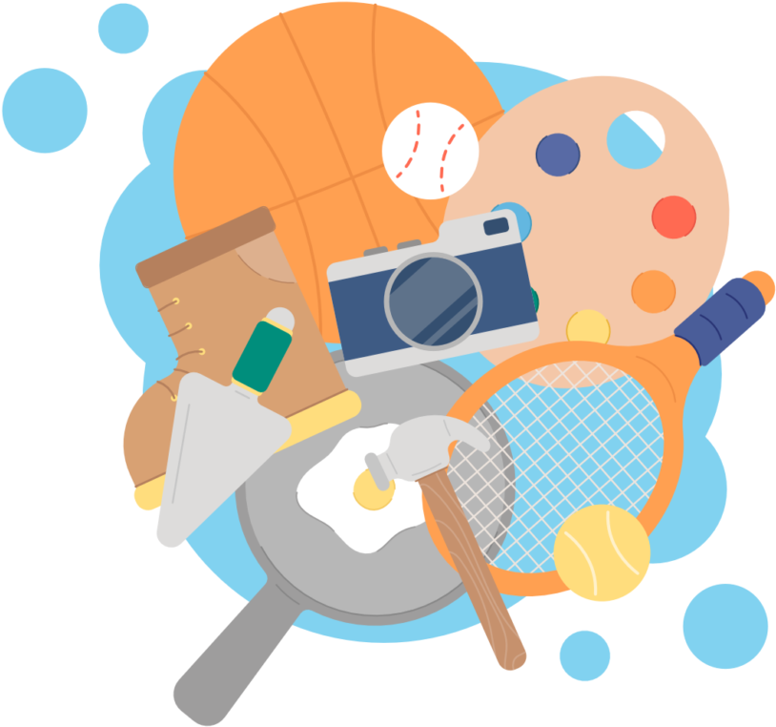
Hobbies and Recreation
Life is so much more than school and work. What do you want to do for fun when you grow up?
We plan our career path, but we forget we can also plan a fun and fulfilling life.
Do you want to travel, play an instrument, or bake?
List 2 dream hobbies and/or recreation activities you want to accomplish in the future.

Slide 16
Home and Family
Where do you want to live? What does your dream house look like?
Do you want a family, children, roommates, pets, or a back yard?
Having a clear picture of your future home life will help you know if you are on track with your lifelong plan.
Just like in our education and career paths, plans can change and that is okay too!

Slide 17
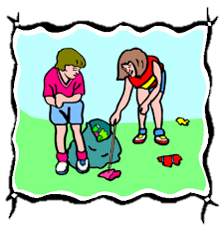
Community and Service
Successful mentor leaders give back to their community.
How can you share your talents in a fun, fulfilling way that helps others?
You don’t have to be the leader of a service organization to impact others.
Will you volunteer at the local food bank, elderly center, clean your neighborhood, or volunteer as a coach?

Slide 18
DISCUSSION
Take 5 minutes to Time Travel and write down how you can be a Mentor Leader in each Destination.
Will you be an Ace? If so, which one and how?

