Slide 1

Business Survey
Session Two Class Presentation
Business Foundations
  A Changing World 11th Edition
    O.C. Ferrell, Geoffrey Hirt, and Linda Ferrell; McGraw Hill Education; New York, NY 2018
      ISBN: 978-1-259-68523-1

Slide 2
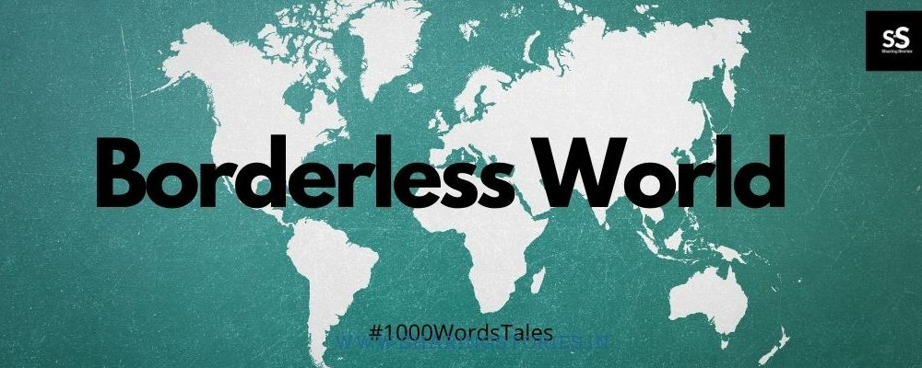
Part One: Business in a Changing World
Chapter Three: Business in a Borderless World

Slide 3


Introduction
Many U.S. firms are finding that international markets provide tremendous opportunities for growth.
  Accessing these markets can promote innovation while competition can lead to better and less expensive products.

Slide 4
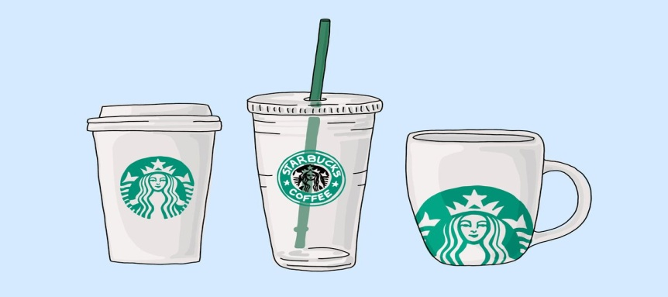
Role of International Business
International Business refers to the buying, selling, and trading of goods and services across national boundaries.
  Falling political barriers and new technology are making it possible for more companies to sell their products overseas and at home.
    Starbucks serves millions of global customers at more than 21,000 locations in 65 countries.

Slide 5

The Role of International Business
Most of the world’s population and two-thirds of its total purchasing power are outside the United States.

Slide 6

Why Nations Trade
Nations and businesses engage in international trade to obtain raw materials and goods that are unavailable to them or are available elsewhere at a lower price than that at which they themselves can produce.

Slide 7
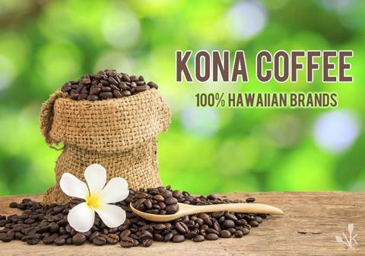

Why Nations Trade
International trade is based on a “comparative advantage”, which occurs when a country specializes in products that it can supply more efficiently or at a lower cost than it can produce other items.
  Hawaii has a comparative advantage in producing pineapples and Kona coffee because of its climate.

Slide 8

Why Nations Trade
Other countries are also gaining a comparative advantage over the U.S. in the provision of some services, such as call-center operations, engineering, and software programming.
  As a result, U.S. companies are outsourcing manufacturing and other tasks to countries where labor and supplies are less expensive.
    Outsourcing has become a controversial practice in the U.S. because many jobs have been moved overseas.

Slide 9
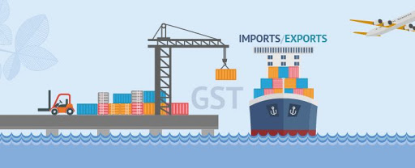
Trade Between Countries
To obtain needed goods and services and the funds to pay for them, nations trade by exporting and importing.
  Exporting
    The sale of goods and services to foreign markets.
  Importing
    The purchase of goods and services from foreign sources.

Slide 10
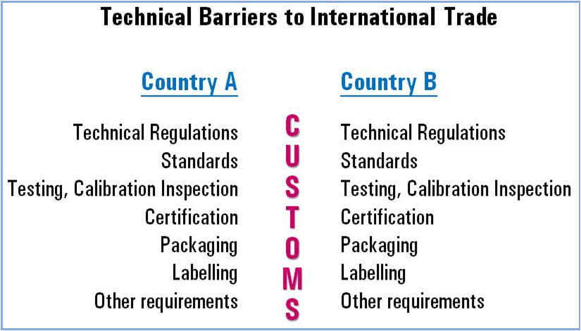
International Trade Barriers
When a company does business outside its own country, it will encounter barriers to international trade.
  Any organization considering international business must research the other country’s economic, legal, political, social, cultural, and technological background.

Slide 11

Economic Barriers
When doing business in another country, managers must consider a number of basic economic factors; such as, economic development, infrastructure, and exchange rates.

Slide 12

Infrastructure
When doing business abroad, business leaders need to recognize that they cannot take for granted other countries offer the same things as are found in industrialized nations.
  A country’s level of development is determined by its infrastructure, the physical facilities that support its economic activities; such as, railroads, highways, ports, airfields, utilities, schools, hospitals, communication systems, and distribution systems.

Slide 13
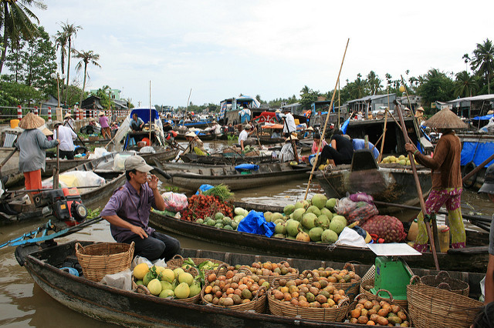
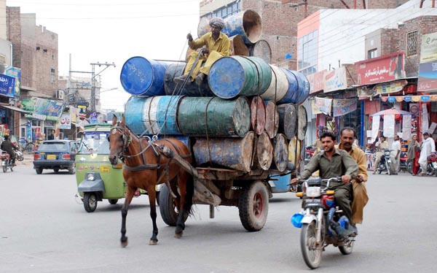
Less Developed Countries
Less-Developed Countries (LDCs) are characterized by low per-capita income, which means that consumers are less likely to purchase non-essential products.
  Nonetheless, LDCs represent a potentially huge and profitable market for many businesses because they may buy technology to improve their infrastructures, and much of the population may desire consumer products.

Slide 14


Exchange Rates
The ratio at which one nation’s currency can be exchanged for another nation’s currency is the Exchange Rate.
  When the value of the U.S. dollar declines relative to other currencies, the price of imports becomes more affordable for U.S. consumers.
    If the exchange rate for the dollar moves from $1.50 per euro to $1.25 per euro, then imports from Europe will be less expensive.

Slide 15

Ethical, Legal, and Political Barriers
A company that enters the international marketplace must contend with potentially complex relationships among the different laws of its own nation, international laws, and the laws of the nation with which it will be trading; various trade restrictions imposed on international trade; changing political climates; and different ethical values.
  Legal and ethical requirements for successful business are increasing globally.

Slide 16

Laws and Regulations
Once outside U.S. borders, businesspeople are likely to find that the laws of other nations differ from those of the U.S.
  Many of the legal rights that Americans take for granted do not exist in other countries, and a firm doing business abroad must understand and obey the laws of the host country.

Slide 17
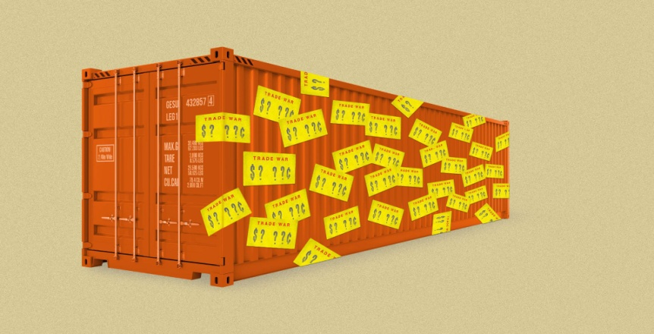
Tariffs and Trade Restrictions
Tariffs and other trade restrictions are part of a country’s legal structure but may be established or removed for political reasons.
  An import tariff is a tax levied by a nation on goods imported.
    A fixed tariff is a specific amount of money levied on each unit of a product brought into the country.
    A valorem tariff is based on the value of the item.

Slide 18
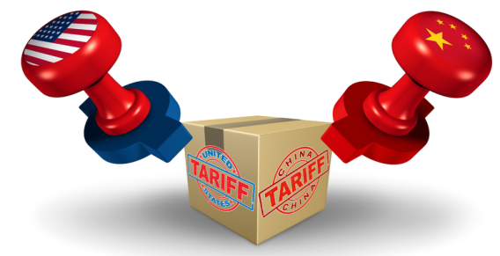
Tariffs
Countries sometimes levy tariffs for political reasons, as when they impose sanctions against other countries to protest their actions.
  However, import tariffs are more commonly imposed to protect domestic products by raising the price of imported ones.
    Protective tariffs allow more expensive domestic goods to compete with foreign ones (expensive U.S. steel vs. inexp. China steel).

Slide 19
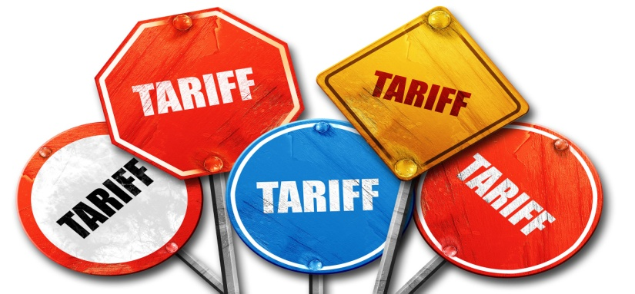
Tariffs
Critics of protective tariffs argue that their use inhibits free trade and competition.
  Supporters of protective tariffs say they insulate domestic industries, particularly new ones, against well established foreign competitors with lower labor costs and other advantages.

Slide 20
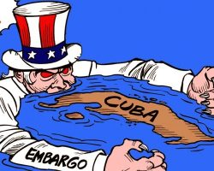
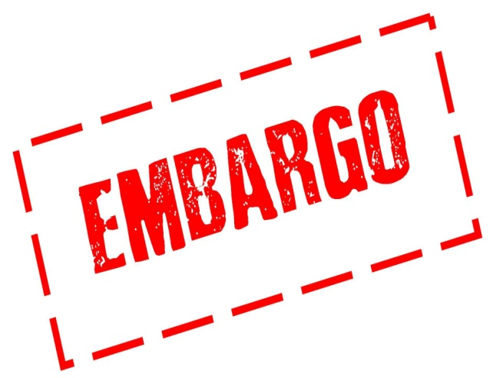
Embargo
An embargo prohibits trade.
  Embargoes are generally directed at specific goods or countries and may be established for political, economic, health, or religious reasons.
    The U.S. currently maintains a trade embargo with Cuba.

Slide 21
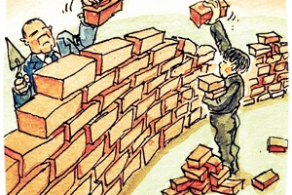
Political Barriers
Unlike legal issues, political considerations are seldom written down and often change rapidly.
  Nations that have been subject to economic sanctions for political reasons in recent years include Cuba, Iran, Syria, and North Korea.
    Political considerations affect international business daily as governments enact tariffs, embargoes, or other types of trade restrictions in response to political events.

Slide 22

Political Barriers
Businesses engaged in international trade must consider the relative instability of countries.
  Political unrest may create a hostile environment for foreign businesses. Natural disasters can cripple a country’s government, making the region even more unstable. A sudden change in power can result in a regime that is hostile to foreign investment.
    As a result, some businesses have been forced out of countries in which they have historically operated.

Slide 23

Social and Cultural Barriers
Most businesspeople engaged in international trade underestimate importance of social and cultural differences; but these differences can derail an important transaction.
  Tiffany & Co. learned that more attentive customer service was necessary in order to succeed in Japan, and bold marketing and advertising served as the recipe for success in China.

Slide 24
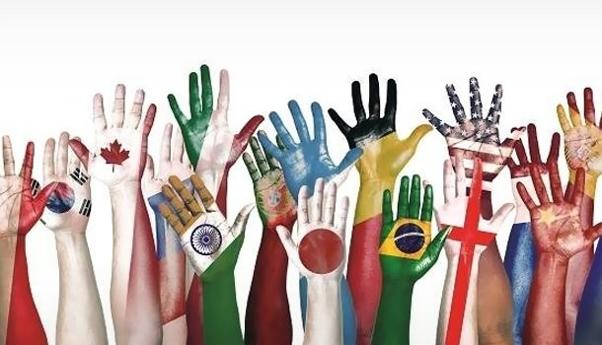
Social and Cultural Barriers
Cultural differences include differences in spoken and written language.
  Although it is possible to translate words from one language to another, the true meaning is sometimes misinterpreted or lost.
    For example the “Coca-Cola” name in China was first read as “Ke-kou-ke-la,” meaning “bite the wax tadpole.”
    In Italy, a campaign for Schweppes Tonic Water translated the name into Schweppes Toilet Water.

Slide 25

Social and Cultural Barriers
Differences in body language and personal space also affect international trade.
  Body language is non-verbal, usually unconscious communication through gestures, posture, and facial expression.
    Gestures vary from culture to culture, and gestures considered acceptable in American society may be rude in others.
      A wink in Japan means “I love you.”
  Personal space is the distance at which one person feels comfortable talking to another.
      Americans = Personal Space
      Arabs = Face-to-Face

Slide 26

Social and Cultural Barriers
Family roles also influence marketing activities.
  Many countries do not allow children to be used in advertising.
  Advertising featuring people in non-traditional roles will fail.
People of other nations often have a different perception of time.
  Americans value promptness, but in Latin American countries it is common to be late or delay meetings.
Companies engaged in foreign trade must observe the national and religious holidays and local customs of the country.
In Russia, smiling is considered appropriate only in private settings, not business.
Most nations use the metric system.

Slide 27
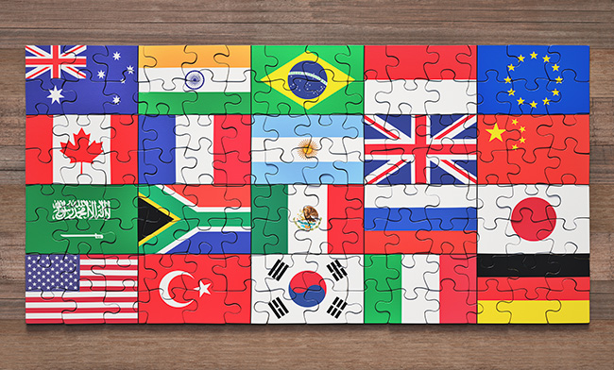
Trade Agreements, Alliances, and Organizations
Although these economic, political, legal, and socio-cultural issues may seem like daunting barriers to international trade, there are organizations and agreements – such as the General Agreement on Tariffs and Trade, the World Bank, and the International Monetary Fund – that foster int’l trade and can help companies get involved in and succeed in global markets.
  Various trade agreements, such as the North American Free Trade Agreement and the EU, also promote trade among member nations by eliminating tariffs and trade restrictions.

Slide 28
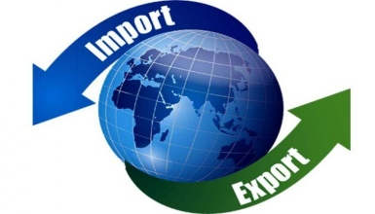
Exporting and Importing
Many companies first get involved in international trade when they import goods from other countries for resale in their own businesses.
  For example, a grocery store chain may import bananas from Honduras and coffee from Colombia.
A business may get involved in exporting when called upon to supply a foreign company with a particular product.
  Exporting to other countries becomes a necessity for established countries that seek to grow continually.
    Products often have higher sales growth potentially in foreign countries than they have in their parent company.

Slide 29
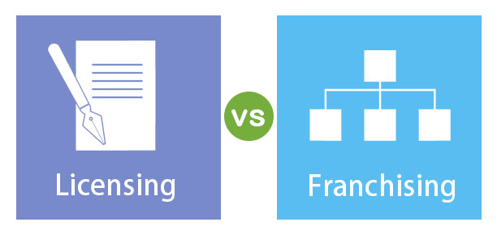
Licensing and Franchising
Licensing is a trade agreement in which one company: the licensor – allows another company – the licensee to use its company name, products, patents, brands, trademarks, raw materials, and/or production processes in exchange for a fee or royalty.
  Franchising is a form of licensing in which a company: the franchiser - agrees to provide a franchisee the name, logo, methods of operation, advertising, products, and other elements associated with the franchiser’s business, in return for a financial commitment and agreement to conduct business in accordance with the franchiser’s standard of operations.

Slide 30
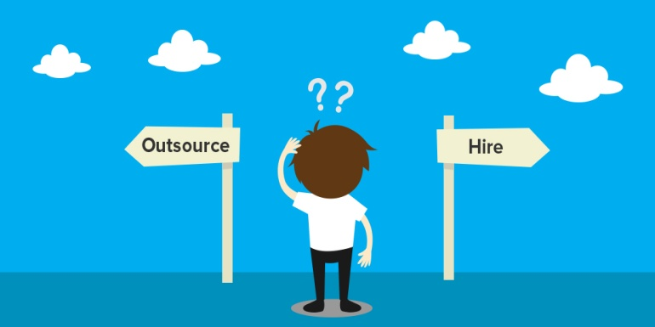

Outsourcing
Outsourcing is the transferring of manufacturing or other tasks to companies in countries where labor and supplies are less expensive.
  Outsourcing has become politically controversial in recent years amid concerns over jobs lost to overseas workers.

Slide 31
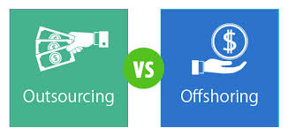
Offshoring
Offshoring is the relocation of a business process by a company, or a subsidiary, to another country.
  Offshoring is different than outsourcing in that the company retains control of the process because it is not subcontracting to a different company.
    Companies may choose to offshore for a number of reasons, ranging from lower wages, skilled labor, or taking advantage of time zone differences in order to offer services around the clock.

Slide 32
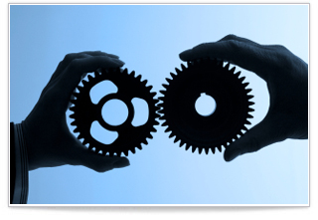

Joint Venture and Alliances
A strategic alliance is a partnership formed to create a competitive advantage on a worldwide basis.
  International competition is so fierce and the costs of competing on a global basis are so high that few firms have the resources to go it alone, so they collaborate with other companies.

Slide 33
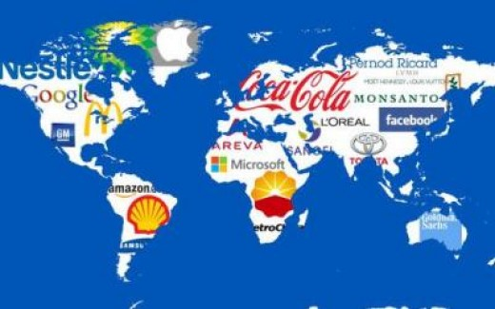
Direct Investment
Multinational Corporation
Companies that want more control and are willing to invest resources in international business may consider Direct Investment, the ownership of overseas facilities.
  The highest level of international business involvement is the Multinational Corporation (MNC), a corporation that operates on a worldwide scale, without significant ties to any one nation.
    (i.e.) Walmart, Subway, Nestle

Slide 34

International Business Strategies
Planning in a global economy requires business persons to understand the economic, legal, political, and socio-cultural realities of the countries in which they will operate.
  These factors will affect the strategy a business chooses to use outside its own borders.

Slide 35

Developing Strategies
Multinational Strategy
Companies doing business internationally use a Multinational Strategy, which is a plan that involves customizing products, promotion, and distribution according to cultural, technological, regional, and national differences.
  When McDonald’s opened its first restaurant in Vietnam, it offered its traditional menu items as well as McPork sandwiches specifically targeted toward Vietnamese customers.

Slide 36

Developing Strategies
Global Strategy (Globalization)
More companies are moving away from this customization strategy to a Global Strategy (Globalization), which is a strategy that involves standardizing products, and as much as possible, their promotion and distribution for the whole world, as if it were a single entity.
  Examples of globalized products are American clothing, movies, music, and cosmetics.

Slide 37

Developing Strategies
Before moving outside their borders, companies conduct environmental analyses to evaluate the potential of and problems associated with various markets and to determine what strategy is best for doing business in those markets.
  Astute businesspeople today “think globally, act locally.”
    That is, while constantly being aware of the total picture, they adjust their firms’ strategies to conform to local needs and tastes.

Slide 38

Part Two: Starting and Growing a Business
Chapter Four: Options for Organizing Business

Slide 39

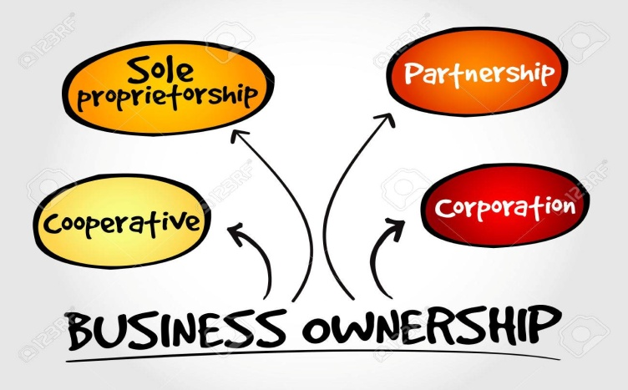
Introduction
All businesses must select a form of organization that is most appropriate for their owners and the scope of their business.
  A business’s legal form of ownership affects how it operates, how much it pays in taxes, and how much control its owners have.

Slide 40
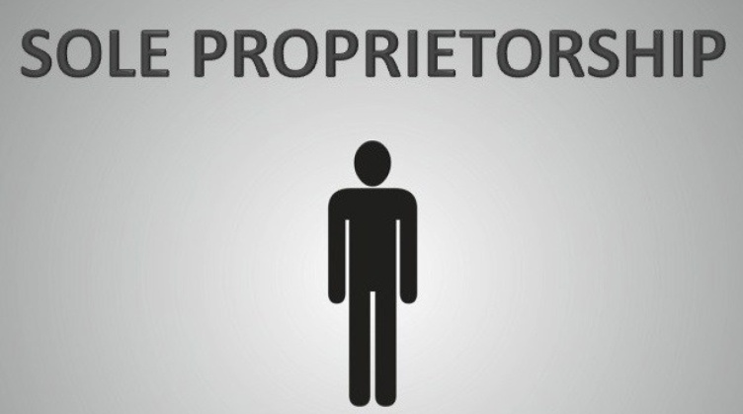
Sole Proprietorships
Sole Proprietorships are businesses owned and operated by one individual, and they are the most common form of business organization in the U.S.
  Common examples include many retailers such as restaurants, hair salons, flower shops, dog kennels, and independent contractors who complete projects or engage in entrepreneurial activities for different organizations, but who are not employees (i.e.) contractors, taxi-drivers, nail technicians, and salespersons for Mary Kay, etc.

Slide 41

Sole Proprietorships
Advantages
Sole proprietorships are generally managed by their owners, and because of this simple management structure, the owner/manager can make decisions quickly.
  This is just one of many advantages of the sole proprietorship. Other advantages include:
    Ease and Cost of Formation
    Secrecy
    Distribution and Use of Profits
    Flexibility and Control of the Business
    Government Regulation
    Taxation
    Closing the Business

Slide 42

Sole Proprietorships
Disadvantages
For profitable businesses managed by capable owners, many of the following factors do not cause problems.
  On the other hand, proprietors starting out with little management experience and little money are likely to encounter many of the following disadvantages:
    Unlimited Liability
    Limited Sources of Funds
    Limited Skills
    Lack of Continuity
    Lack of Qualified Employees
    Taxation

Slide 43
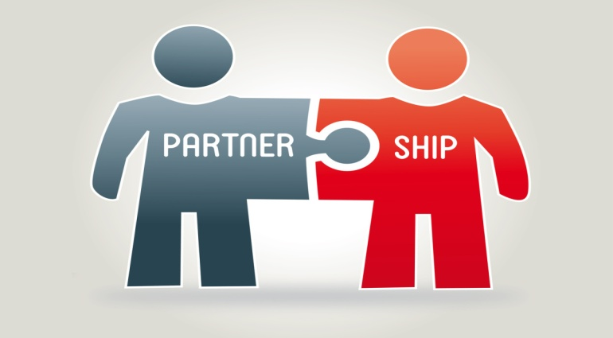
Partnerships
One way to minimize the disadvantages of the sole proprietorship and maximize its advantages is to have more than one owner.
  A Partnership is an association of two or more persons who carry on as co-owners of a business for profit.
    Partnerships are the least used form of business.

Slide 44

Types of Partnerships
There are two basic types of partnership:
  General Partnership
    Involves a complete sharing in the management of a business.
    Each partner has unlimited liability for the debts of the business.
  Limited Partnership
    Has at least one general partner, who assumes unlimited liability, and at least one limited partner, whose liability is limited to their investment in the business. These partnerships exist for risky investment projects where the chance of loss is great.
      Usually the GP receives a larger share of the profits.

Slide 45
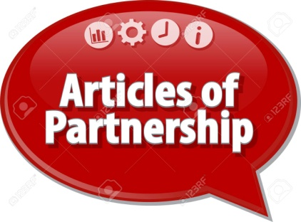
Articles of Partnership
Articles of Partnership are legal documents that set forth the basic agreement between partners.
  Articles of Partnership usually list the money or assets that each partner has contributed (partnership capital), state each partner’s individual management role or duty, specify how the profits and losses of the partnership will be divided among the partners, and describe how a partner may leave the partnership as well as any other restrictions that might apply to the agreement.

Slide 46
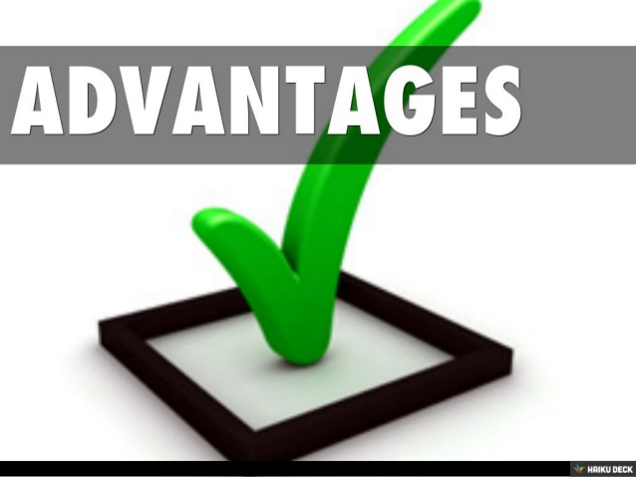
Partnerships
Advantages
The advantages of partnerships must be compared with those offered by other forms of business organization, and not all apply to every partnership.
  The recognized advantages of partnerships include:
    Ease of Organization
    Availability of Capital and Credit
    Combined Knowledge and Skills
    Decision Making
    Regulatory Controls

Slide 47
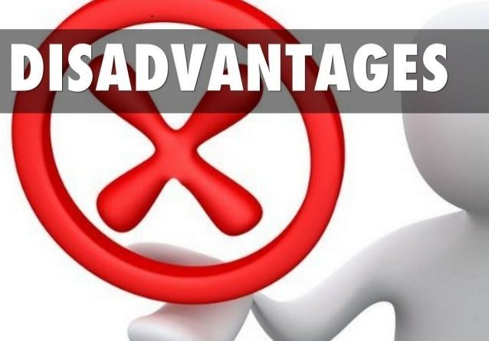
Partnerships
Disadvantages
Partnerships have many advantages compared to sole proprietorships and corporations, but they also have some disadvantages.
  Major disadvantages of partnerships include the following:
    Unlimited Liability
    Business Responsibility
    Life of the Partnership
    Distribution of Profits
    Limited Sources of funds

Slide 48

Taxation of Partnerships
Partnerships do not pay taxes when submitting the partnership tax return to the IRS.
  The tax return simply provides information about the profitability of the organization and the distribution of profits among the partners.
    Partners must report their share of the profits on their individual tax returns and pay taxes at the income tax rate for individuals.

Slide 49
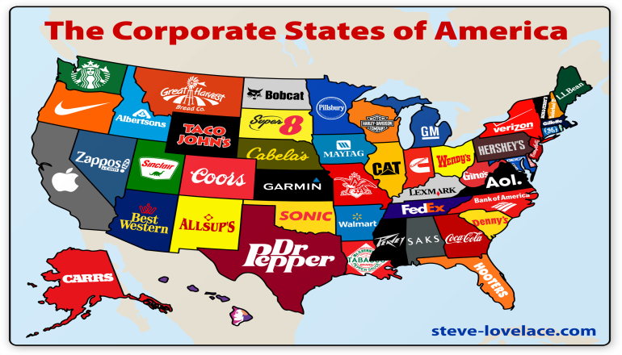
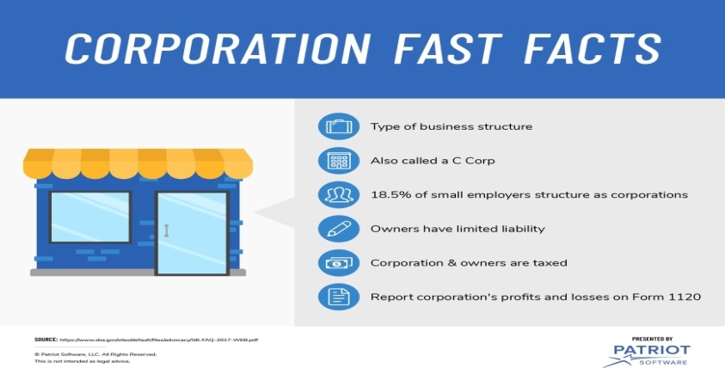
Corporations
A Corporation is a legal entity, created by the state, whose assets and liabilities are separate from its owners.
  As a legal entity, a corporation has many of the rights, duties, and powers of a person, such as the right to receive, own, and transfer property. They can enter into contracts with individuals or with other legal entities, and they can sue and be sued in court.
    Corporations account for the majority of all U.S. sales and income.

Slide 50
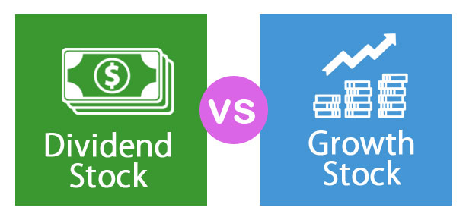
Corporations
Corporations are generally owned by many individuals and organizations who own shares of the business, called stock.
  Stockholders can buy, sell, give or receive as gifts, or inherit their shares of stock. As owners, the stockholders are entitled to all the profits that are left after the corporation’s other obligations have been paid.
    These profits may be distributed in the form of cash payments called dividends, or retained to expand the business.

Slide 51

Types of Corporations
Private vs. Public
A corporation may be privately or publicly owned.
  Private Corporation
    A corporation owned by just one or a few people who are closely involved in the business.
  Public Corporation
    A corporation whose stock anyone can buy, sell, or trade. In large corporations, stockholders are far removed from the management of the company.

Slide 52

Types of Corporations
Initial Public Offering (IPO)
A private corporation that needs more money to expand or take advantage of opportunities may have to obtain financing by “going public” through an initial public offering (IPO).
  An IPO is the process of becoming a public corporation by selling stock so that it can be traded in public markets.

Slide 53

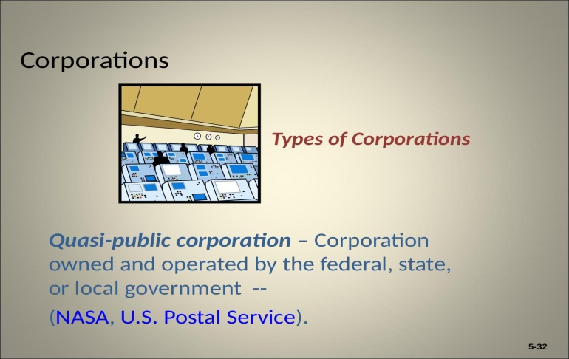

Types of Corporations
Quasi-Public
A Quasi-Public Corporation is a type of public corporation.
  Quasi-Public Corporations are owned and operated by the federal, state, or local government.
    The focus of these entities is to provide a service to citizens, such as mail delivery, rather than earning a profit.

Slide 54

Types of Corporations
Nonprofit
A Nonprofit is a type of public corporation.
  Nonprofit Corporations focus on providing a service rather than earning a profit, but they are not owned by a government entity.
    To fund their operations and services, nonprofit organizations solicit donations from individuals and companies and grants from government and other charitable organizations.
    Nonprofits do not have shareholders, and most are organized as 501(c)3 organizations, which receive certain tax exemptions, and donors contributing may reduce their tax liability.

Slide 55

Elements of a Corporation
Board of Directors
A Board of Directors is a group of individuals, elected by the stockholders to oversee general operation of the corporation, who set the corporation’s long-range objectives.
  It is the Board’s responsibility to ensure that the objectives are achieved on schedule.
    Board Members have a duty of care and loyalty to oversee the management of the firm or for any misuse of funds.
    Another important duty of the Board is to hire corporate officers, such as the President or Chief Executive Officer (CEO), who are responsible to the directors for the management of operations.

Slide 56
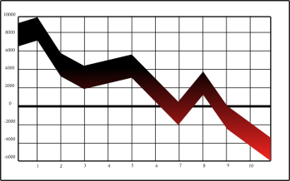

Stock Ownership
Corporations issue two types of stock:
  Preferred Stock
    A special class of owners, because although they generally do not have any say in the company, they have a claim to profits before any other stockholders do.
  Common Stock
    Although these owners do not get preferential treatment with regard to dividends, they do get some say in the operation of the corporation. Their ownership gives them the right to vote for members of the Board of Directors and other important issues.

Slide 57

Advantages of Corporations
Because a corporation is a separate legal entity, it has some very specific advantages over other forms of ownership.
  The biggest advantage may be the limited liability of the owners, nonetheless, the advantages include the following:
    Limited Liability
    Ease of Transfer of Ownership
    Perpetual Life
    External Sources of Funds
    Expansion Potential

Slide 58
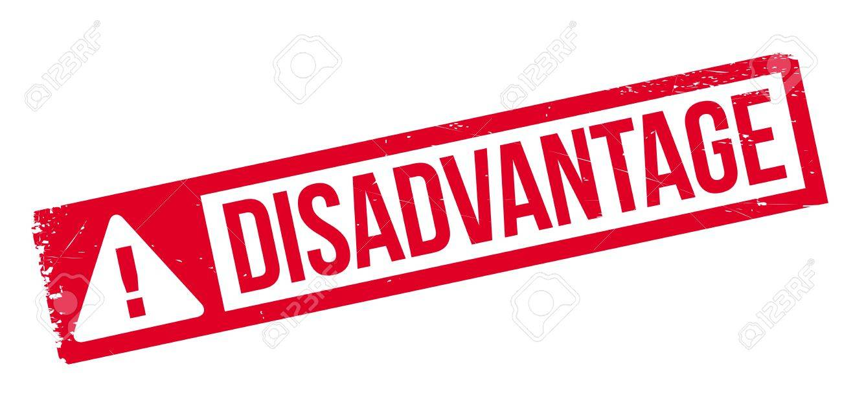

Disadvantages of Corporations
Corporations have some distinct disadvantages resulting from tax laws and government regulation.
  The following are common disadvantages of corporations:
    Double Taxation
    Forming a Corporation
    Disclosure of Information
    Employee-Owner Separation

Slide 59
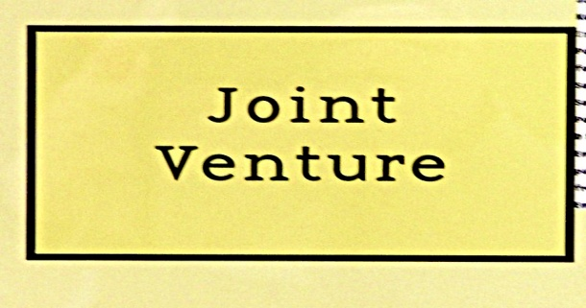
Other Types of Ownership
Joint Ventures
A Joint Venture is a partnership established for a specific project or for a limited time.
  The partners in a joint venture may be individuals or organizations. Governments may also be involved.
  Control of a joint venture may be shared equally, or one partner may control decision making.
    Joint ventures are especially popular in situations that call for large investments (i.e.) extraction of natural resources.

Slide 60

Other Types of Ownership
Limited Liability Company
A Limited Liability Company (LLC) is a form of business ownership that provides limited liability, as in a corporation, but is taxed like a partnership.
  Many consider the LLC a blend of the best characteristics of corporations, partnerships, and sole proprietorships.
  One of the major reasons for the LLC form of ownership is to protect the members’ personal assets in case of lawsuits.
    LLCs are flexible, simple to run, and do not require the members to hold meetings, keep minutes, or make resolutions.

Slide 61

Cooperatives
Another form of organization in business is the Cooperative or Co-Op, an organization composed of individuals or small businesses that have banded together to reap the benefits of belonging to a larger organization.
  A co-op is set up not to make money as an entity. It exists so that its members can become more profitable or save money.
    Many cooperatives exist in small farming communities. The co-op stores and markets grain; orders large quantities of fertilizer, seed, and other supplies at discounted prices; and reduces costs and increases efficiency with good management.

Slide 62

Trends in Business Ownership
Mergers and Acquisitions
Companies large and small achieve growth and improve profitability by expanding their operations, often by developing and selling new products or selling current products to new groups of customers.
  Such growth, when carefully planned and controlled, is usually beneficial to the firm and ultimately helps it reach its goal of enhanced profitability.
    But companies also grow by merging with or purchasing other companies.

Slide 63

Merger and Acquisition
A merger occurs when two companies combine to form a new company. An acquisition occurs when one company purchases another, generally by buying most of its stock.
  The acquired company may become a subsidiary of the buyer, or its operations and assets may be merged with those of the buyer.
    The government sometimes scrutinizes mergers and acquisitions in an attempt to protect customers from a monopoly.

Slide 64
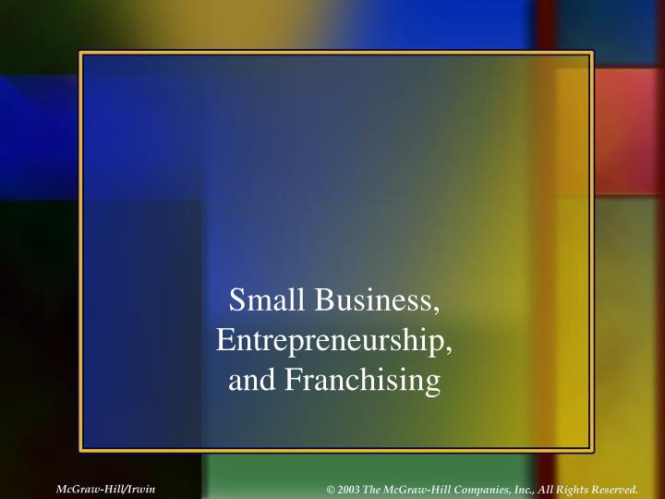
Part Two: Starting and Growing a Business
Chapter Five: Small Business, Entrepreneurship, and Franchising

Slide 65
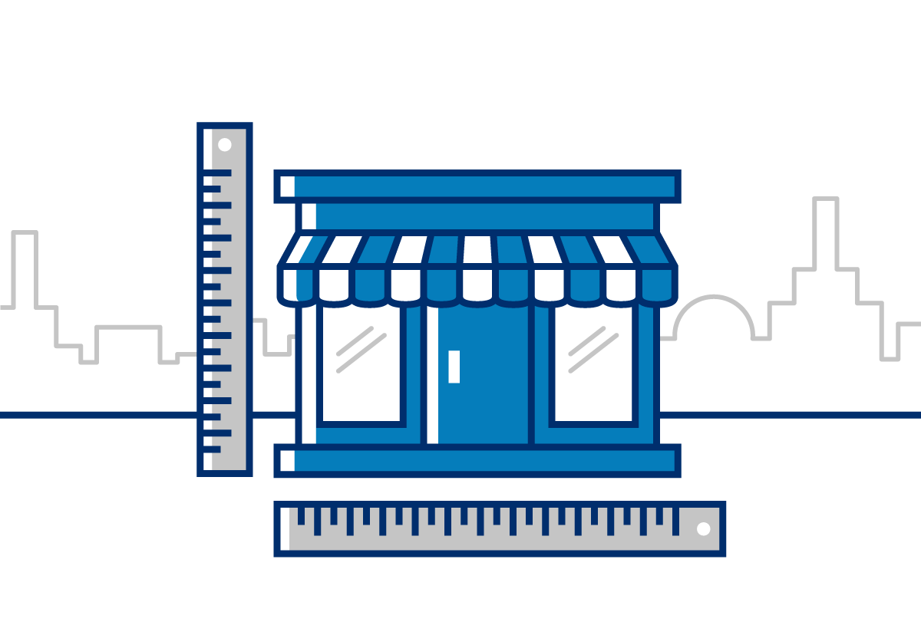

Introduction
Small businesses represent the vision of its owners to succeed by providing new or better products and services.
  Small businesses are the heart of the U.S. economic and social system because they offer opportunities and demonstrate the freedom of people to make their own destinies.
    Small businesses employ about half of all private-sector EE’s
    Today, the entrepreneurial spirit is growing around the world.

Slide 66




The Nature of Entrepreneurship and Small Business
Entrepreneurship is the process of creating and managing a business to achieve desired objectives.
  Today, there are many large businesses you may recognize (Levi Strauss & Co., McDonald’s, Microsoft, Google). All began as small businesses based on the visions of their founders.
    Some entrepreneurs who start small businesses have the ability to see emerging trends; in response, they create a company to provide a product or service that serves customer needs.

Slide 67


Social Entrepreneurs
A growing trend among small businesses is Social Entrepreneurship, which refers to individuals who use entrepreneurship to address social problems.
  They operate by the same principles as other entrepreneurs, but view their organizations as vehicles to create social change.
    For example, the founder of Tom’s Shoes, founded the firm with the purpose of donating one pair of shoes to a child in need for every pair of shoes sold to customers.

Slide 68
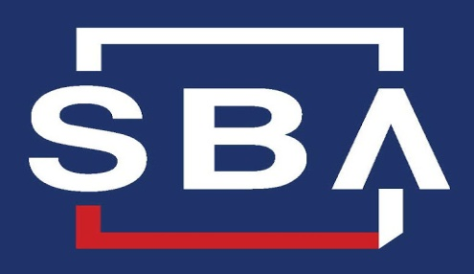
What is a Small Business?
Small Business Administration
A Small Business is an independently owned and operated business that is not dominant in its competitive area and does not employ more than 500 people.
  This definition is similar to the one used by the Small Business Administration (SBA), an independent agency of the federal government that offers managerial and financial assistance to small business.
    On its website, the SBA outlines the first steps in starting a small business and offers a wealth of information to owners.

Slide 69
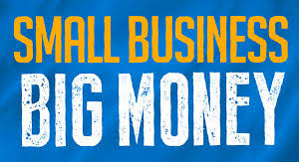
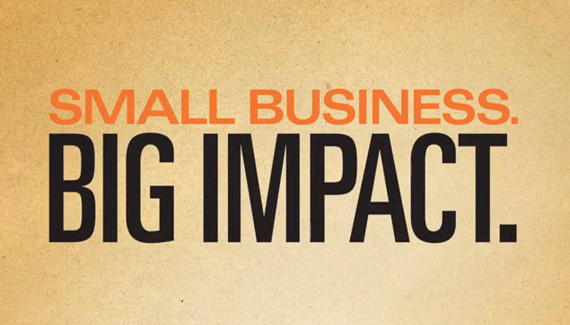
The Role of Small Business in the American Economy
No matter how you define a small business, one clear fact is - they are vital to the American economy.
  More than 99% of all U.S. firms are classified as small businesses, and they employ about half of private workers.
  Small firms are also important exporters, representing 98% of U.S. exporters of goods contributing 33% of the value of exported goods.
    Small businesses are the fuel for job creation and innovation.

Slide 70
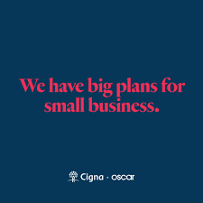
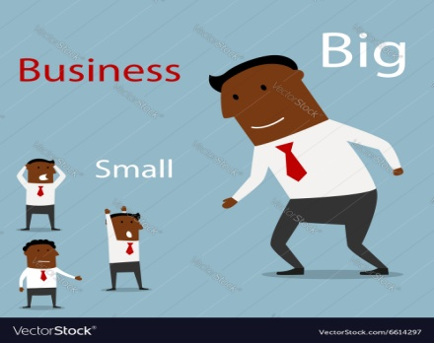
Job Creation
The energy, creativity, and innovative abilities of small-business owners have resulted in jobs for many people.
  Annually, about 63% of new jobs are created by small business.
    Many small businesses today are being started because of encouragement from larger ones. Many new jobs are also created by big company/small company alliances.
    Whether through formal joint ventures, supplier relationships, or product or marketing cooperative projects, the rewards of collaborative relationships are creating numerous jobs for small-business owners and their employees.

Slide 71

Innovation
Perhaps one of the most significant strengths of small businesses is their ability to innovate and to bring significant benefits to customers.
  Small firms produce more than half of all innovations.
    Among the important 20th century innovations by U.S. small firms are the airplane, the audio tape recorder, fiber-optics, heart valve, optical scanner, pacemaker, personal computer, Internet etc.

Slide 72
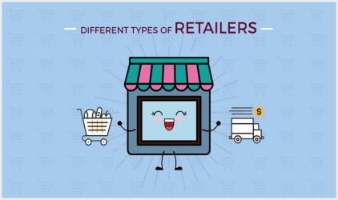
Retailing
Retailers acquire goods from producers or wholesalers and sell them to consumers.
  Main streets, shopping centers, and malls are generally lined with independent music stores, sporting-goods stores, boutiques, restaurants, etc., that sell directly to consumers.
    Retailing attracts entrepreneurs because gaining experience and exposure in retailing is relatively easy. Additionally, an entrepreneur opening a new retail store or establishing a new website does not have to spend large sums of money for the equipment and distribution systems that manufacturing business requires.

Slide 73
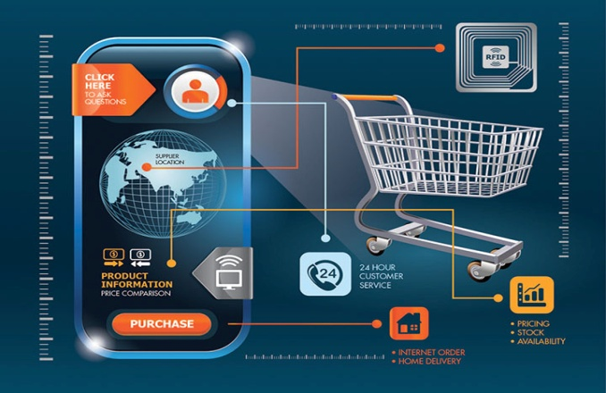
Retailing
Non-Store
Many opportunities exist for non-store retailing as well.
  Non-store retailing involves selling products outside of the retail facility. There are two types of non-store retailing:
    Direct Marketing (i.e. eBay, Amazon, Etsy), which uses the telephone, catalogs, and other media to give consumers an opportunity to place orders by mail, telephone, or Internet
    Direct Selling (i.e. Herbal Life, Mary Kay).

Slide 74
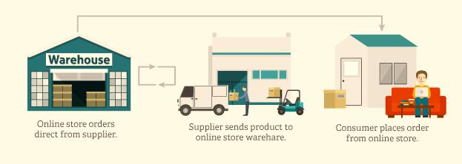
Wholesaling
Wholesalers provide both goods and services to producers and retailers. They can assist their customers with almost every business function.
  Wholesalers supply products to industrial, retail, institutional users for resale or for use in making other products.
    Wholesaling activities range from planning and negotiating for supplies, promoting, and distributing (warehousing and transporting) to providing management and merchandising assistance to clients.

Slide 75

Services
The service sector includes businesses that do not actually produce tangible goods.
  Services include intangible products that involve performance, inauguration, or any effort to provide something of value that cannot be physically possessed.
    Real estate, insurance, accounting firms and personnel agencies, barbershops, banks, and tech repair shops are some examples.
      The service sector accounts for 80% U.S. jobs.

Slide 76
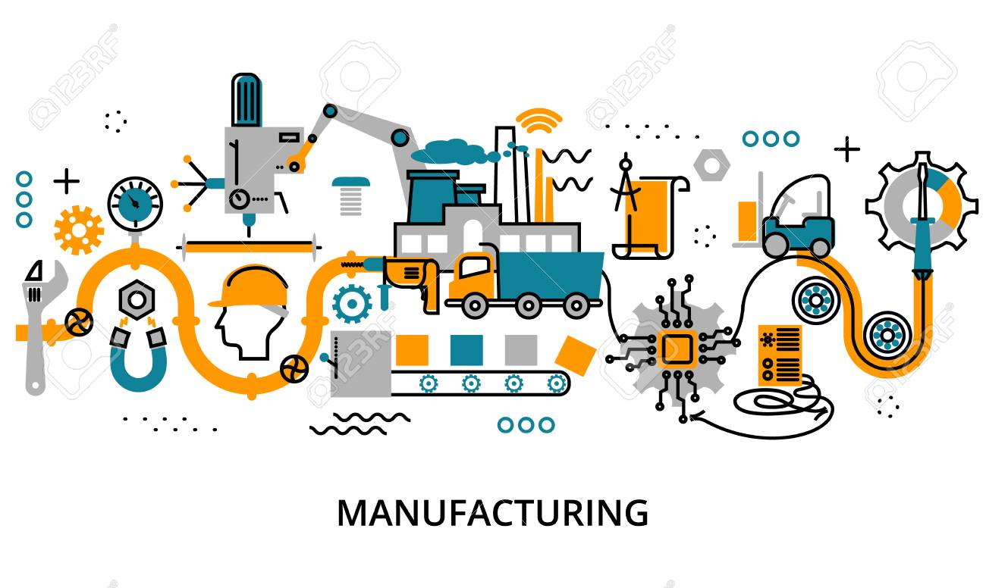
Manufacturing
Manufacturing goods can provide unique opportunities for small businesses.
  Small businesses sometimes have an advantage over larger firms because they can customize products to meet specific consumer needs and wants.
    Products include custom artwork, jewelry, clothing, and furniture.

Slide 77

Technology
Big Technology is a broad term used to describe businesses that depend heavily on advanced scientific and engineering knowledge.
  People who were able to innovate or identify new markets in the fields of computers, bio-technology, genetic engineering, robotics, and other markets have become big tech giants.
    One innovative technology was developed by a teenager interested in virtual reality, and recently his company – Oculus Rift, was sold to Facebook for $2 billion.

Slide 78
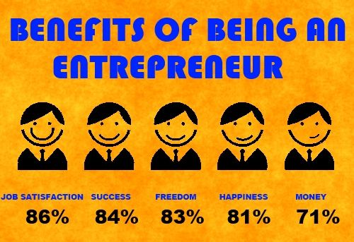
Advantages of Small-Business Ownership
There are many advantages to establishing and running a small business.
  These can be categorized into personal advantages and business advantages.
    Independence
    Costs
    Flexibility
    Focus
    Reputation

Slide 79
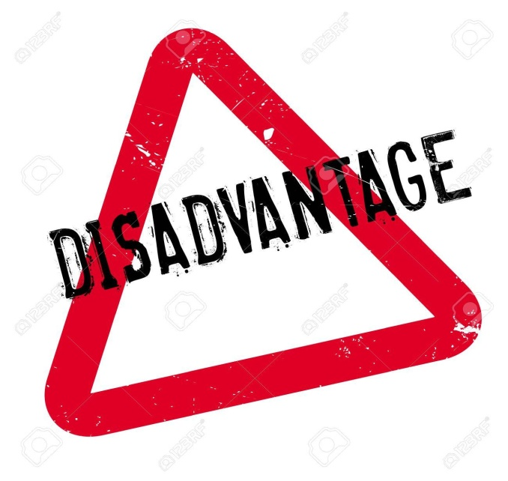
Disadvantages of Small-Business Ownership
The rewards associated with running a small business are so enticing that it’s no wonder many people dream of it. However, as with any undertaking, small business ownership has its disadvantages.
  High Stress Level
  High Failure Rate
    Undercapitalization
    Managerial Inexperience or Incompetence
    Inability to Cope with Growth

Slide 80

Eight Successful Traits of an Entrepreneur
Intuitive
  Using one’s intuition to derive what’s true without conscious reasoning.
Productive
  Being able to produce large amounts of something during a specific time period.
Resourceful
  Understanding how to use and spend resources wisely.
Charismatic
  Having the ability to inspire others behind a central vision.
Innovative
  Being able to come up with new and creative ideas.
Risk-Taker
  Having the ability to pursue risky endeavors despite the possibility of failure.
Persistent
  Continuing in a certain action in spite of obstacles.
Friendly
  Being able to have mutually beneficial interactions with people.

Slide 81

Starting a Small Business
To start any business, large or small, you must have some kind of general idea.
  Next, you need to devise a strategy to guide planning and development in the business.
    Finally, you must make decisions about form of ownership; the financial resources needed; and whether to acquire an existing business, start a new one, or buy a franchise.

Slide 82
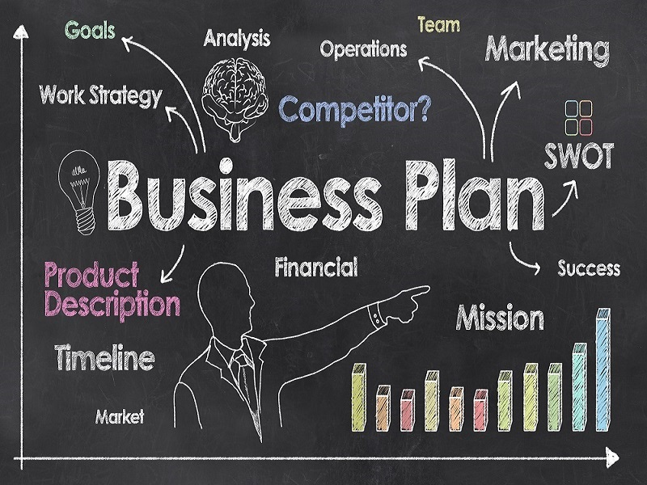
The Business Plan
A key element of business success is a Business Plan, which is a precise statement of the rationale for the business and a step-by-step explanation of how it will achieve its goals.
  The business plan should include an explanation of the business, an analysis of the competition, estimates of income and expenses, and other information. It should also establish a strategy for acquiring sufficient funds to keep the business going.

Slide 83
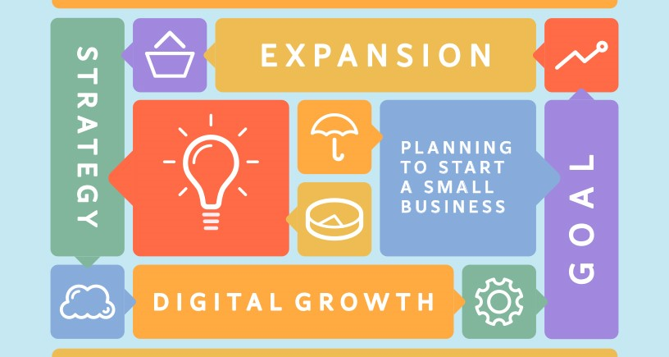
The Business Plan
A business plan should act as a guide/reference document and not a shackle that limits the business’s flexibility and decision-making ability.
  A business plan must be revised periodically to ensure that the firm’s goals and strategies adapt to changes in environment.
    Business plans allow companies to assess market potential, determine price and manufacturing requirements, identify optimal distribution channels, and refine product selection.

Slide 84
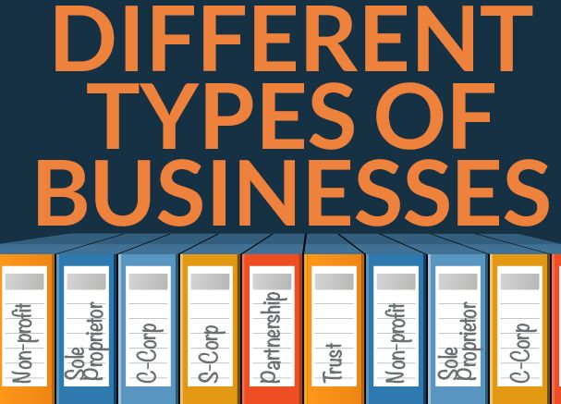

Forms of Business Ownership
After developing a business plan, the entrepreneur has to decide on an appropriate legal form of business ownership – whether it is best to operate as a sole proprietorship, partnership, or corporation – and to examine the many factors that affect that decision.

Slide 85

Financial Resources
The expression “it takes money to make money” holds especially true in developing a business enterprise.
  To make money from a small business, the owner must first provide or obtain money (capital) for rental space, equipment, inventory, etc. to get started and to keep it running smoothly.
    Often, the small business owner has to put up a significant percentage of the necessary capital. And, few business owners have enough of their own capital and must look to other sources for additional financing.

Slide 86

Equity Financing
The most important source of funds for any new business is the owner.
  Many owners include among their personal resources ownership of a home, the accumulated value in a life- insurance policy, or a savings account.
    A new business owner may sell or borrow against the value of such assets to obtain funds to operate a business. Additionally, the owner may bring useful personal assets: such as, a computer, desks and other furniture, a car or truck – as part of their ownership interest in the firm.

Slide 87

Equity Financing
Such financing is referred to as Equity Financing, because the owner uses real personal assets rather than borrowing funds from outside sources to get started in a new business.
  The owner can provide working capital by reinvesting profits into the business or simply by not drawing a full salary.
    Small businesses can also obtain equity financing by finding investors for their operations. They may sell stock in the business to family members, friends, employees, or other investors.

Slide 88

Venture Capitalists
Venture Capitalists are persons or organizations that agree to provide some funds for a new business in exchange for an ownership interest or stock.
  Venture capitalists hope to purchase the stock of a small business at a low price and then sell the stock for a profit after the business has grown successful.
    Although these forms of equity financing have helped many small businesses, they require that the small-business owner share the profits of the business and sometimes control, as well.

Slide 89

Debt Financing
New businesses sometimes borrow more than half of their financial resources.
  Banks are the main suppliers of external financing to small business. They can also look to family and friends as sources for long-term loans or other assets that are exchanged for an ownership interest in a business.
    Anyone lending a friend or family member money for a venture should state the agreement clearly in writing before any money changes hands.

Slide 90

Debt Financing
Line of Credit and Trade Credit
Banks and other financial institutions can also grant a small business a Line of Credit – an agreement by which a financial institution promises to lend a business a predetermined sum on demand.
  A line of credit permits an entrepreneur to take quick advantage of opportunities that require external funding.
    Small business may also obtain funding from their suppliers in the form of Trade Credit – that is, suppliers allow the business to take possession of the needed goods and services and pay for them at a later date or in installments.

Slide 91

Approaches to Starting a Small Business
Starting From Scratch vs. Buying an Existing Business.
  Although entrepreneurs often start new businesses from scratch, they may select instead to buy an existing business.
    This has the advantage of providing a built-in network of customers, suppliers, and distributors and reducing some of the guesswork inherent in starting a new business from the ground up.
    However, an entrepreneur who buys an existing business also takes on any problems the business already has.

Slide 92

Franchising
Many small-business owners find entry into the business world through franchising.
  A license to sell another’s products or to use another’s name in business, or both, is a Franchise. The company that sells the franchise is the “franchiser.” (i.e. Dunkin Donuts, Subway)
  The purchaser of a franchise is called a “franchisee.”
    The franchisee acquires the rights to a name, logo, methods of operation, national advertising, products, and other elements associated with the franchiser’s business in return for a financial commitment and the agreement to conduct business in accordance with the franchiser’s standard of operation.

Slide 93


Franchising
Franchising has both advantages and disadvantages.
  Franchising allows a franchisee the opportunity to set up a small business relatively quickly, and because of its association with an established brand, a franchise outlet often reaches the break-even point faster than an independent business would.

Slide 94

Franchising
Advantages
Franchisees commonly report the following advantages:
  Management and training support.
  Brand-name appeal.
  Standardized quality of goods and services.
  National and local advertising programs.
  Financial assistance.
  Proven products and business formats.
  Centralized buying power.
  Site selection and territorial protection.
  Greater chance for success.

Slide 95

Franchising
Disadvantages
The franchisee must sacrifice some freedom to the franchiser. Some shortcomings experienced by franchisees include:
  Franchise fees and profits sharing with the franchising.
  Strict adherence to standardized operations.
  Restrictions on purchasing.
  Limited product line.
  Possible market saturation.
  Less freedom in business decisions.

Slide 96

The Future for Small Business
Demographic Trends
  Baby Boomers are the market of the future.
  Millennials are concerned with advancement, recognition, and improved capabilities.
    They need direct, timely feedback and frequent encouragement and recognition. They do well when training combines entertainment with learning. Working remotely is more acceptable to this group, and virtual communication is as important as face-to-face meetings.
  Another trend is the growing number of immigrants living in the U.S.
    This vast group provides a greatly untapped market for small business. Retailers who specialize in ethnic products, and service providers who offer bi- or multilingual employees, will find a large amount of business potential in this market.

Slide 97

The Future for Small Business
Technological and Economic Trends
  Advances in technology have opened up many new markets to small businesses. Undoubtedly, the Internet will continue to provide new opportunities for small business.
    Technology has enabled the substantial growth of entrepreneurs working out of their houses, known as home-based businesses.

Slide 98

Making a Big Business Act “Small”
The continuing success and competitiveness of small businesses through rapidly changing conditions in the business world have led many large corporations to take a closer look at what makes their smaller rivals tick.
  More and more firms are emulating small businesses in an effort to improve their own bottom line.
    Many are “downsizing” or reducing management layers, corporate staff, and work tasks in order to make the firm more flexible, resourceful, and innovative.
    Others have sought to make their businesses “smaller” by making their operating units function more like independent small business, each responsible for profits, losses, and resources.

Slide 99


