Slide 1
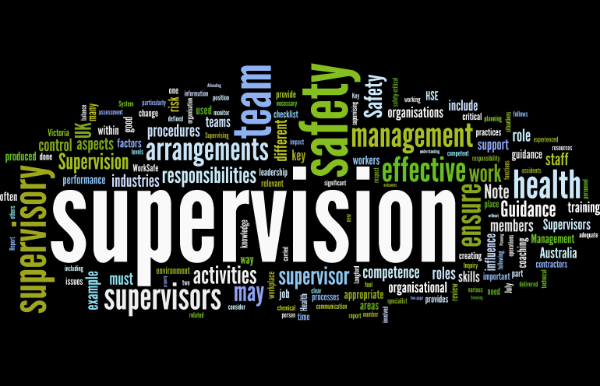
Supervision
Supervision
  Concepts and Practices of Management, 13th Edition
    Edwin C. Leonard, Jr., Ph.D. and Kelly A. Trusty, Ph.D. Cengage Learning, Boston, MA 2013
      ISBN: 978-1-285-86637-6

Slide 2

Part Two: Essentials of Effective Supervision
Chapter Seven: Principles of Motivating Followers
  After studying this chapter, you will be able to:
    Recognize personal and situational factors that may cause EE job dissatisfaction.
    Identify and discuss reasons people behave the way they do.
    Understand the various motivational theories and appreciate their importance.
    Explain use of motivational theories to manage your life & performance of others.
    Appreciate ways to more effectively cope with people who make your life difficult.
    Compare the assumptions and applications of Theory X and Y in supervision.
    Articulate how job redesign, multitasking, and participative management can be used to develop EE skills, knowledge, and abilities (SKAs).

Slide 3

Where Can I Get Satisfaction?
Satisfaction is an emotional state or affective response toward various factors associated with one’s work.
  Job satisfaction surveys vary greatly in their statistics, but the conclusions are the same. Less than ½ of U.S. workers are satisfied with their jobs.
    Economic, political, social, and personal factors may influence the findings, but unlike those factors, working conditions and other work-related factors contribute greatly to the dissatisfaction.

Slide 4

Where Can I Get Satisfaction?
Why do employees leave their job?
  EEs typically state in their exit interviews or tell others that they’re leaving for a better job, more pay, or job security, but researchers have concluded that the real reasons are often a bad supervisor, a non-challenging or unfulfilling work situation, problems with co-workers, and so on.

Slide 5

Where Can I Get Satisfaction?
The economic climate has changed the way EEs look at their employer, their current work, and other aspects of their lives.
  Data illustrates that many EEs still view their work as a career.
    Supervisors must work with human resource professionals and other members of the management team to ensure that their organization is known as a “great place to work.”

Slide 6

Determinants of Human Behavior
We define management as getting things accomplished with and through people by guiding and motivating their efforts toward common objectives.
  To manage effectively, as this definition suggests, supervisors must understand EE motivation and develop approaches that encourage EEs to work to their full capabilities.

Slide 7
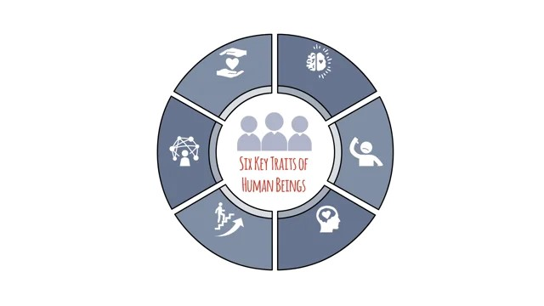
Determinants of Human Behavior
People are the most important resource that a supervisor is asked to manage.
  Human beings have values, attitudes, needs, and expectations that significantly influence their behaviors on the job.
    The feelings people have towards their supervisors, their work environment, personal problems, and numerous other factors are often difficult to ascertain. However, they have an impact on EE motivation and work performance.

Slide 8
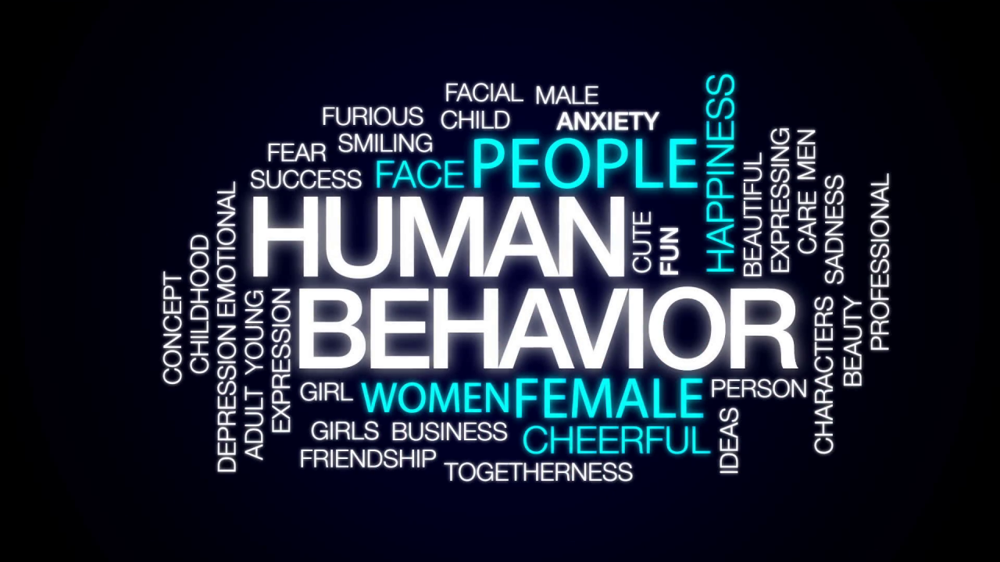
Determinants of Human Behavior
The behavior of people is often rational, consistent, and predictable.
  However, people’s behaviors at other times may seem irrational, inconsistent, and unpredictable.
    People tend to associate with others who are like themselves. This may lead to distrust and misunderstanding of others who differ from them.

Slide 9

Determinants of Human Behavior
The forces that stimulate human behavior come from within individuals and from their environments.
  Understanding the “baggage” that affects EE performance is critical to the supervisor’s success in dealing with people.

Slide 10

Determinants of Personality
Every individual is the product of many factors, and it is the unique combination of these factors that results in an individual human personality.
  Personality is the complex mix of knowledge, attitudes, and attributes that distinguishes one person from all others.

Slide 11

Determinants of Personality
Many people use the word “personality” to describe what they observe in another person. However, the real substance of human personality goes far beyond external behavior.
  The essence of an individual’s personality includes their attitudes, values, and ways of interpreting the environment, as well as many internal-external influences that contribute to behavioral patterns.

Slide 12

Physiological (Biological) Factors
One major influence on human personality is physiological (or biological) makeup.
  Such factors as gender, age, race, height, weight, and physique can affect how a person sees the world. Intelligence, which is at least partially inherited, is another.
    Most biological characteristics are apparent to others, and they may affect the way in which a person is perceived. For example, a person who is tall is sometimes considered to have more leadership ability than a shorter person.

Slide 13

Early Childhood Influences
Many psychologists feel that the very early years of a person’s life are crucial to an individual’s development.
  The manner in which a child is trained, shown affection, and disciplined has a lifelong influence. Parents who encourage autonomy, independence, exploration, and ability to deal with risk, while instilling a willingness to work with others, give the child valuable lessons.
    A person’s background and previous experiences affect the way they are – and the way they act at work.

Slide 14
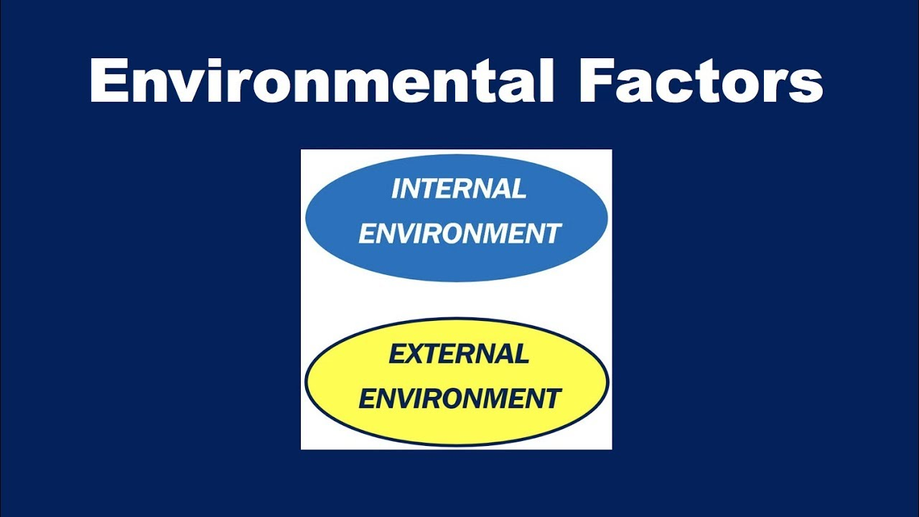
Environmental (Situational) Factors
Sociologists and social psychologists emphasize the immediate situation or environment as being the most important determinant of adult personality.
  Education, income, employer, home, and many other experiences that confront an individual throughout life influence who that person is and eventually becomes.

Slide 15

Environmental (Situational) Factors
Each day’s experiences contribute to an individual’s makeup.
  This is particularly true in terms of the immediate working environment.
    What a supervisor does in a work situation affects the personalities of people being supervised and how they in turn treat others.

Slide 16
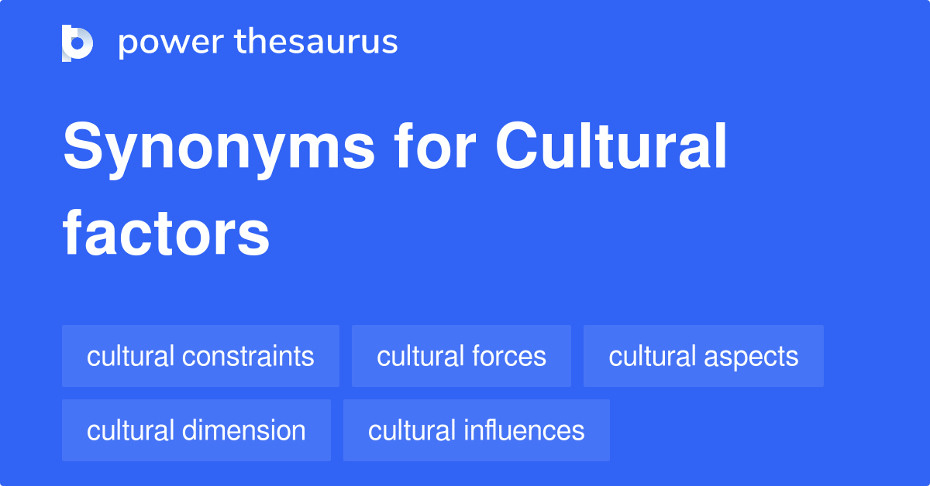
Cultural (Societal) Values
Culture also influences personality.
  In the U.S. such values as competition, rewards for accomplishment, equal opportunities, and similar concepts are part of our society.
  Individuals are educated, trained, and encouraged to think for themselves and to strive to achieve worthwhile goals.
    However, some cultural values are changing. The workforce has become increasingly diversified, reflecting many different subcultures-subgroups.

Slide 17

Cultural (Societal) Values
As the diversity of the workforce has increased, so has the effect of different cultural norms and values on the workplace.
  In particular, the values of certain ethnic, age, and other minority groups may be quite different among EEs.
    By recognizing and respecting different cultural values, supervisors will become more adept in dealing effectively with people unlike themselves.

Slide 18
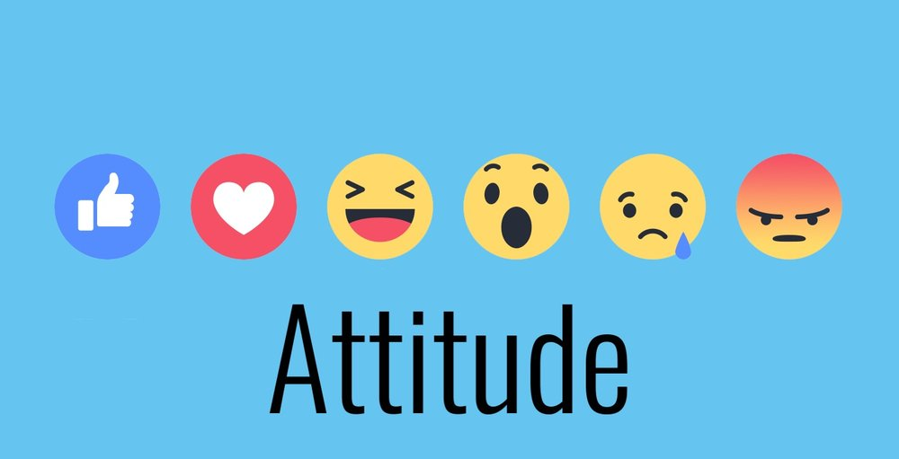
Every Employee has an Attitude
Supervisors must recognize that the positive or negative behavior of one person spills over and impacts the overall attitude of others in either a positive or negative way.
  The behavior of one impacts all. Our attitudes are caused by what others do and say.
    The Rule of Reciprocity suggests that humans react and respond in like manner to the attitude and actions of others.

Slide 19

Understanding Motivation and Human Behavior
Motivation is the willingness to exert effort in order to achieve a goal, stimulated by the effort’s ability to fulfill an individual need.
  EEs are more willing to do what the organization wants if they believe that doing so will result in a meaningful reward.

Slide 20

Understanding Motivation and Human Behavior
The supervisor’s challenge is to stimulate that willingness and ensure that the rewards are commensurate with the results.
  These rewards are not always related to money; but can be anything the EE values.

Slide 21
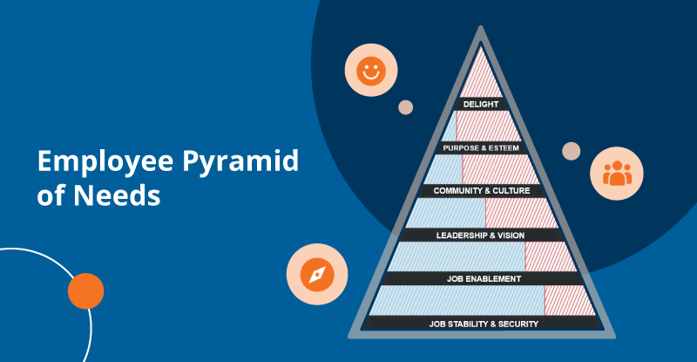
Employee Needs (Maslow and Others)
Most psychologists who study human behavior and personality are convinced that all behavior is caused, goal-oriented, and motivated.
  There is a reason for everything a person does, assuming the person is rational, sane, and in control.
    People constantly strive to attain something that has meaning for them in terms of their needs and in relation to how those people see themselves and the environments in which they live. We all have subconscious motives that govern the ways we behave in different situations.

Slide 22
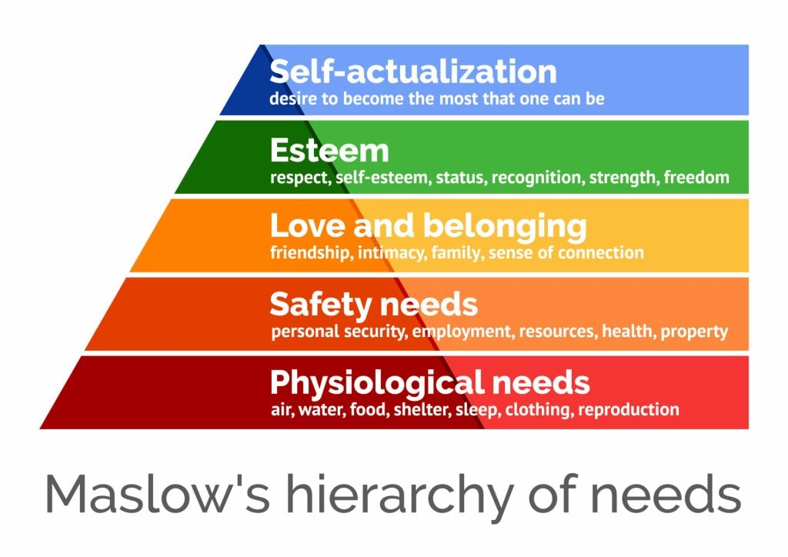
Employee Needs (Maslow and Others)
One of the most widely accepted theories of human behavior is that people are motivated to satisfy certain well defined and more or less predictable needs.
  College professor and psychologist Abraham H. Maslow formulated the concept of a hierarchy (or priority) of needs.
    He maintained that there were five clear stages of needs ranging from low-level to high-level needs, in ascending priority.

Slide 23
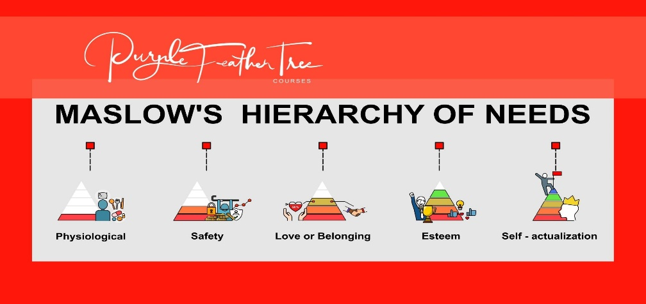
Employee Needs (Maslow and Others)
Maslow’s theory implies that people try to satisfy their needs in the order in which they are arranged in the hierarchy.
  Until the lowest, or most basic, needs are reasonably satisfied, a person will not be motivated strongly by the other levels.
  As one level of need is satisfied to some extent, the individual focuses on the next, which then becomes the stronger motivator of behavior.
    Maslow suggests that once a low level of need was reasonably satisfied, it would no longer motivate behavior, at least in the short term.

Slide 24

Biological (Physiological) Needs
On the first level of Maslow’s hierarchy are physiological (or biological) needs.
  These are the needs everyone has for food, shelter, rest, recreation, and other physical necessities. Virtually every EE views work as a means of caring for these fundamental needs.
    A paycheck enables a person to buy the necessities vital to survival, as well as some of the comforts of life.

Slide 25

Security (Safety) Needs
Once a person’s physiological needs are reasonably satisfied, other needs become important.
  The security (or safety) needs include the need to protect ourselves against danger and to guard against the uncertainties of life.
  Most EEs want a sense of security or control over their future.
    Wage and supplemental benefit packages are designed to satisfy both physiological and safety needs. For example, medical, retirement, disability, and life insurance plans are designed to protect EEs against various uncertainties and associated consequences.

Slide 26

Social (Belonging) Needs
Social needs are needs people have for attention, for being part of a group, for being accepted by their family, friends, and peers, and for love.
  Many studies have shown that group motivation can be a powerful influence on EE behavior at work, either negatively or positively. Some EEs may deliberately perform contrary to organizational goals in order to feel that they are accepted in an informal group. However, if an informal group’s goals are in line with organizational goals, the group can influence the individual toward exceptional performance.

Slide 27

Social (Belonging) Needs
Human connectedness is at top of the list for some people.
  We all know many people who like their jobs but not the people they work with and, as such, seek fulfillment of their social needs through off-the-job interactions.

Slide 28
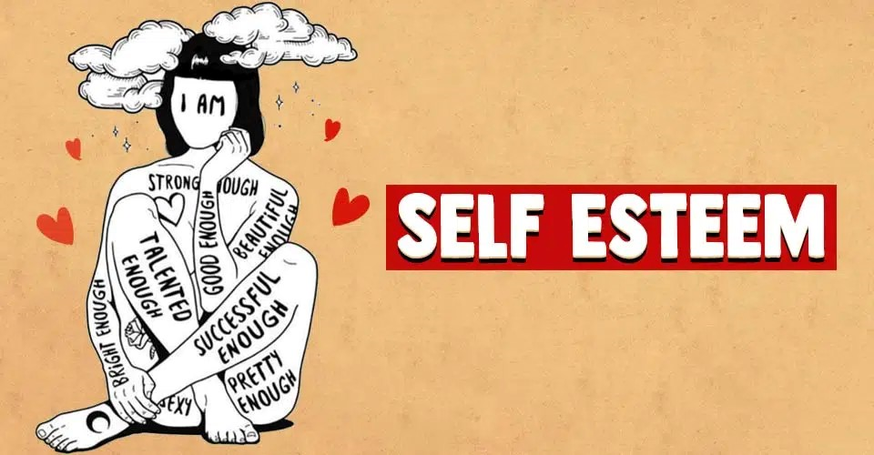
Self-Respect (Esteem) Needs
Closely related to social needs are self-respect (or esteem) needs.
  These are needs everyone has for recognition, achievement, status, and a sense of accomplishment. Self-respect needs are very powerful because they relate to personal feelings of self-worth and importance.
    Supervisors should look for ways to satisfy these internal needs, such as providing varied and challenging work tasks and recognizing good performance. Something as simple as saying “good job” to someone can keep that person doing good work.

Slide 29

Self-Fulfillment Needs
Self-fulfillment (self-actualization) needs refers to the desires to use one’s capabilities to their fullest.
  Maslow suggested that people want to be creative and to achieve within their capacities. Presumably, this need is not satisfied until people reach their full potential. As such, these needs persist throughout a person’s life and can go unsatisfied.
    Maslow contended that self-actualization is the process of making each decision a choice for growth and that striving for continuous improvement can lead to fulfillment.

Slide 30

Self-Fulfillment Needs
Many jobs frustrate rather than satisfy this level of human needs.
  For example, many factory and office jobs are routine & monotonous, and workers must seek self-fulfillment in pursuits off the job and in family relationships.
    However, supervisors can provide opportunities for self-fulfillment on the job by assigning tasks that challenge EEs to use their abilities more fully.

Slide 31
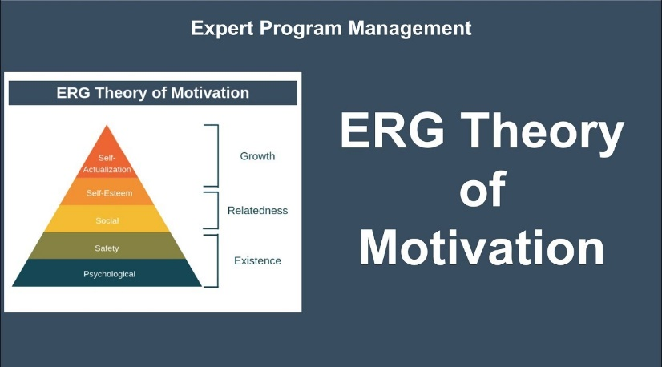
ERG Theory
Based on the works of Maslow and others, Clayton Alderfer introduced the ERG Theory.
  Existence
    Physiological and safety needs
  Relatedness
    Social and external esteem needs
  Growth
    Self-actualization and internal esteem needs

Slide 32
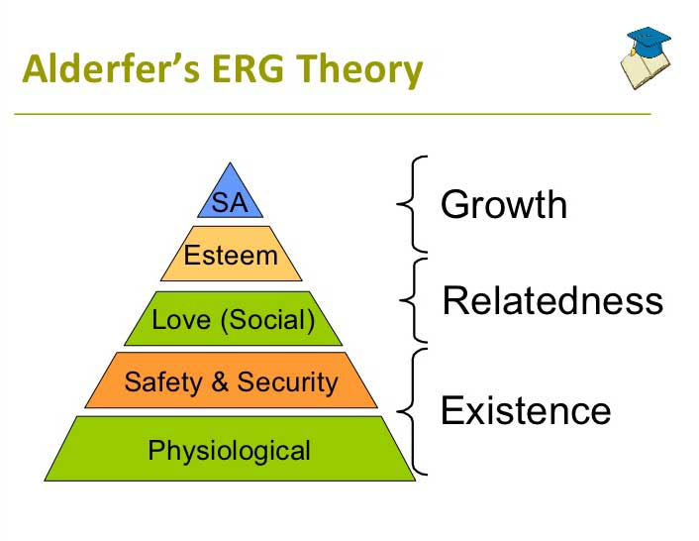
ERG Theory
Alderfer believed that various levels of needs can be pursued at the same time and that the order is different for each individual.
  This theory holds that if a higher-level need is largely unfulfilled, the person may regress to a lower-level that is easier to satisfy.
    He called this the Frustration-Regression Principle, which argues that if higher-needs are not satisfied, individuals will regress to a lower-order need that is more easily fulfilled.

Slide 33
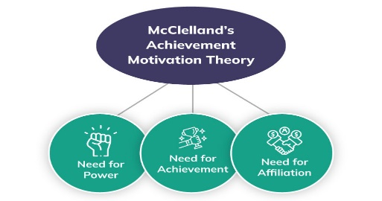
McClelland’s Three-Need Theory
David McClelland examined workplace needs for achievement, affiliation, and power.
  Three needs theory, is a motivational model that attempts to explain how the needs for achievement, affiliation, and power affect the actions of people from a managerial context.

Slide 34

McClelland’s Three-Need Theory
Need for Achievement
Setting and attaining challenging goals, completing difficult assignments, or doing something that had not be done before are examples of fulfilling achievement needs (nACH).
  Interestingly, research shows that those with high ACH needs prefer tasks of moderate difficulty, such as situations where performance is due to their own efforts and a lot of positive feedback is desired.

Slide 35

McClelland’s Three-Need Theory
Need for Affiliation
People with high affiliation needs (nAFF) join groups and spend lots of time and energy maintaining social relationships. They get great satisfaction from being liked and respected by others.
  The prestige of the group may be more important to them than what the group does or doesn’t do.
    Team harmony and cohesion are important to them. It is even better when the team achieves a task previously thought to be unachievable.

Slide 36

McClelland’s Three-Need Theory
Need for Power
Influencing others, defeating a competitor, winning every argument, and attaining a position of control over others to bolster their own position or status are motives for those with high power needs (nP).
  Power is the ability to influence others.
    Top managers should have a high need for power coupled with a low need for affiliation. Balance (consistency) is important, and supervisors often will seek opportunities to maintain a positive self-image.

Slide 37
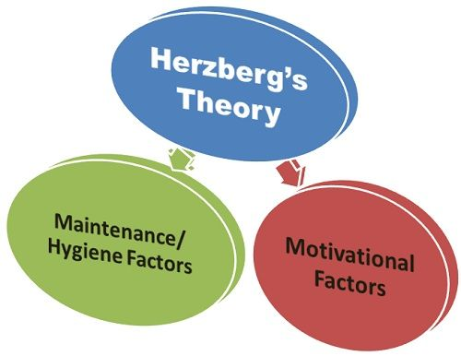
Motivation-Hygiene Theory
Motivation-Hygiene Theory developed by Frederick Herzberg, also called the Two-Factor Theory or the Dual-Factor Theory, suggests that some factors in the work environment that were traditionally believed to motivate people actually serve primarily to reduce their dissatisfaction rather than motivate them.
  There is a clear distinction between factors that tend to motive EEs (motivation factors) and those that, while expected by workers, are not likely to motivate them (hygiene factors).

Slide 38
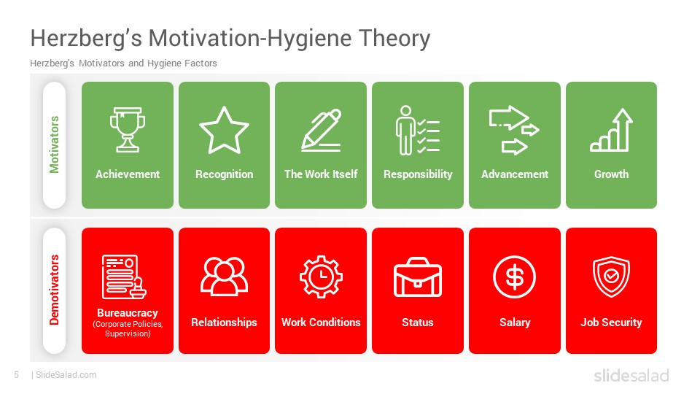
Motivation Factors
Herzberg identified motivation factors as elements intrinsic to the job that promote job performance.
  The most frequently identified motivation factors were the following:
    Opportunity for growth and development
    Achievement or accomplishment
    Recognition for accomplishments
    Challenging or interesting work
    Responsibility for work.

Slide 39
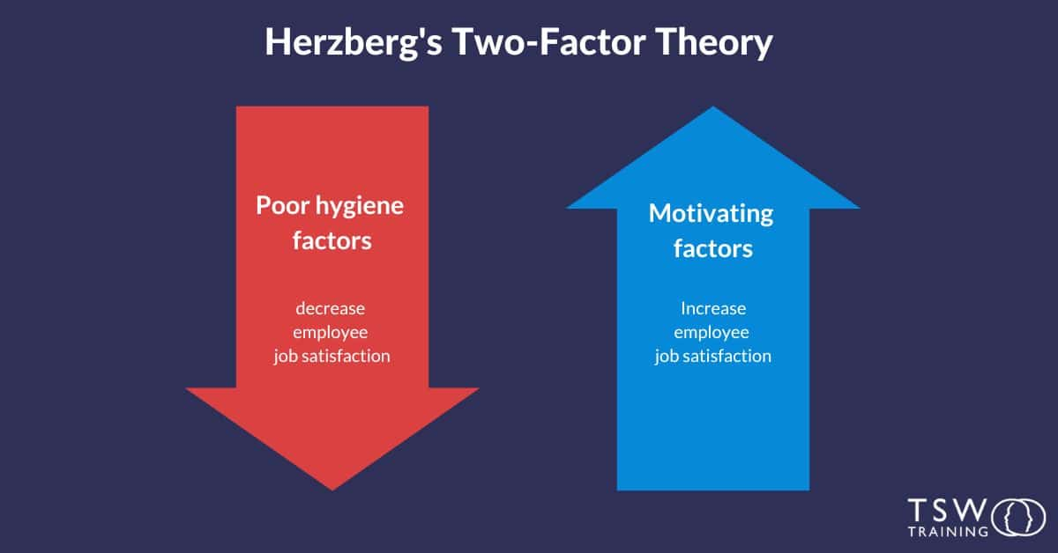
Motivation Factors
Stated another way, job factors that tend to motivate people are primarily related to higher-level needs and aspirations.
  These factors all relate to outcomes associated with the content of the job being performed. Opportunity for advancement, greater responsibility, recognition, growth, achievement, and interesting work are consistently identified as the major factors making work motivating and meaningful.
    The absence of these factors can be frustrating and non-motivating.

Slide 40
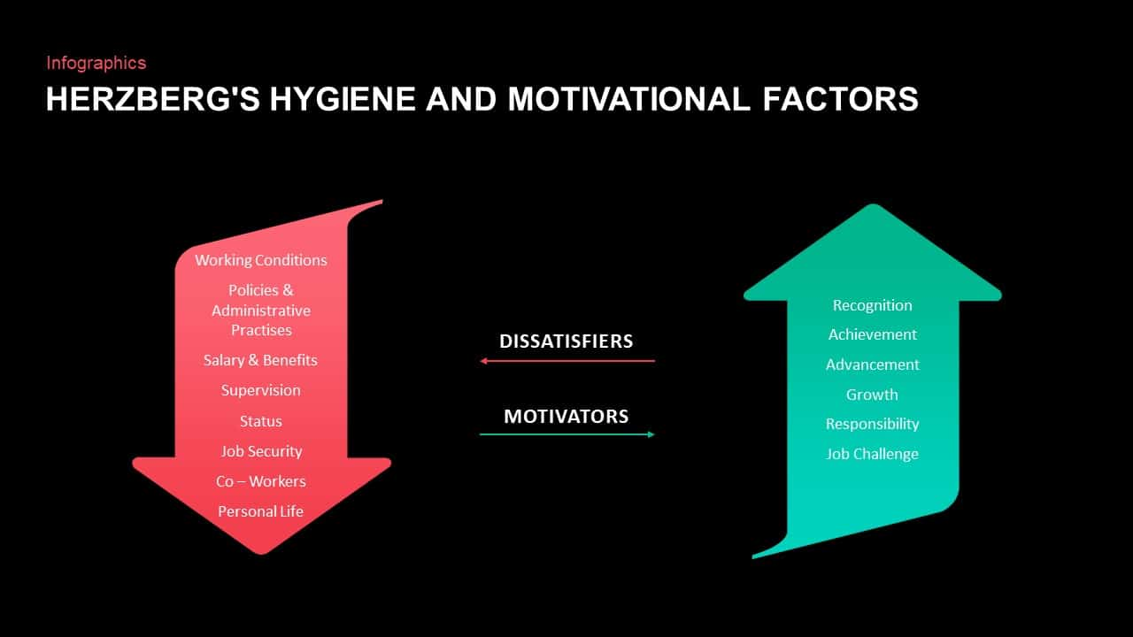
Hygiene Factors
Hygiene Factors, also called Dissatisfiers, are elements of the work environment that, if positive, reduce dissatisfaction, but they do not motivate.
  Herzberg identified the following Hygiene Factors:
    Supervision
    Working conditions
    Money, status, and security
    Interpersonal relationships
    Company policies and administration

Slide 41
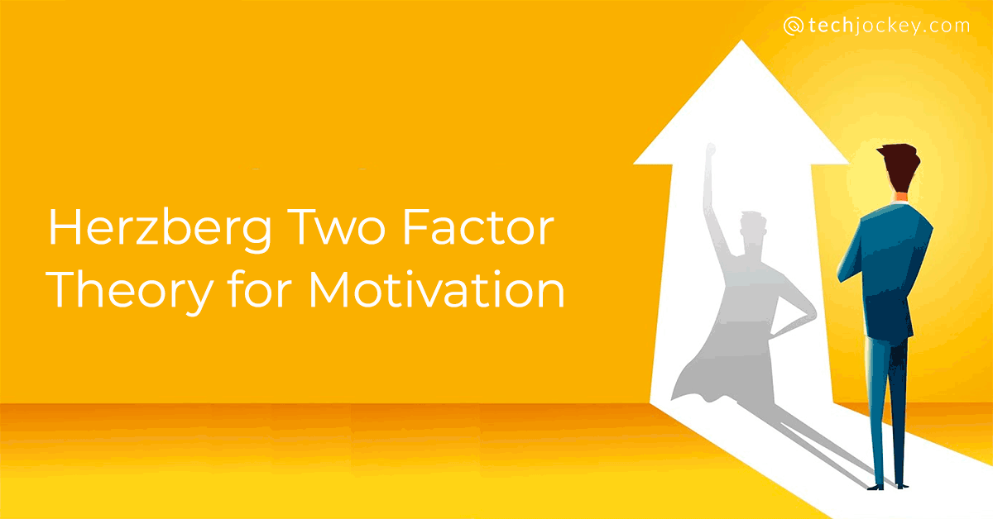
Hygiene Factors
  When these factors are adequate or even excellent they do not, by themselves, promote better job performance.
  However, when these factors are negative or inadequate, EEs are dissatisfied and their performance is negatively affected.
    Hygiene Factors serve primarily to maintain a reasonable level of job motivation, not to increase it.

Slide 42
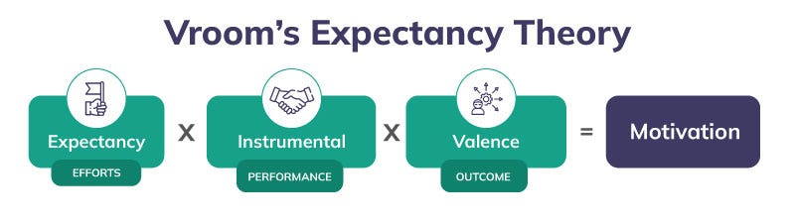
Expectancy Theory
Victor Vroom’s Expectancy Theory is based on a worker’s perception of the relationships among effort, performance, and reward.
  According to Expectancy Theory, workers will be motivated to work harder when they believe enhanced efforts will improve performance and that such improved performance will lead to desired rewards.
    When EEs cannot clearly recognize that this connection exists, they will not be highly motivated.

Slide 43
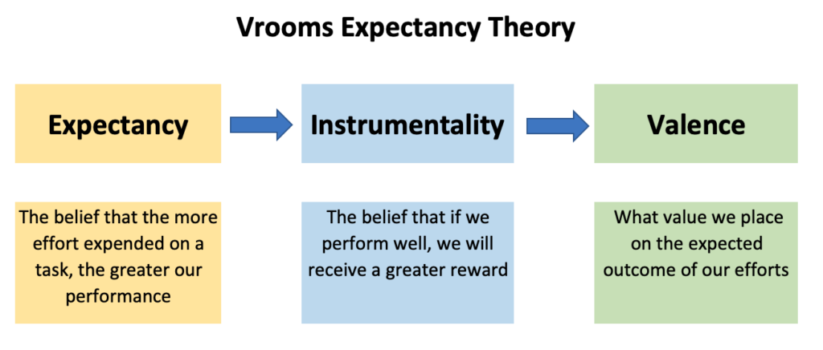
Expectancy Theory
In reality, Expectancy Theory is a simple notion: People will do what is in their best interest.
  EEs will be motivated to put forth more effort if they believe the additional effort will result in something of value.
    For example, if a student believes that more work (study time) will not lead to a better performance on the test, then they will not study more.

Slide 44
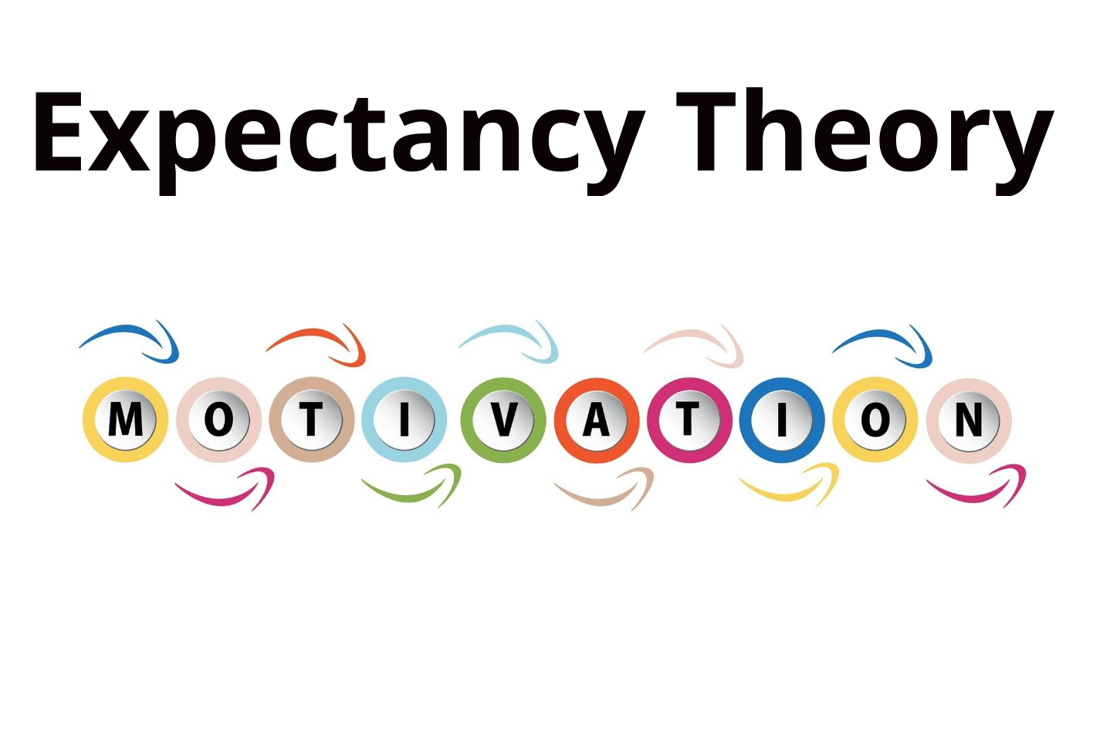
Expectancy Theory
It does not matter how clearly supervisors view linkages among effort, performance, and rewards. The employees must see the connections for themselves.
  Supervisors should strive to show EEs that increased effort will improve work performance, which in turn will increase rewards.
    The most important characteristic of a reward is that it is something the recipient desires and values.

Slide 45
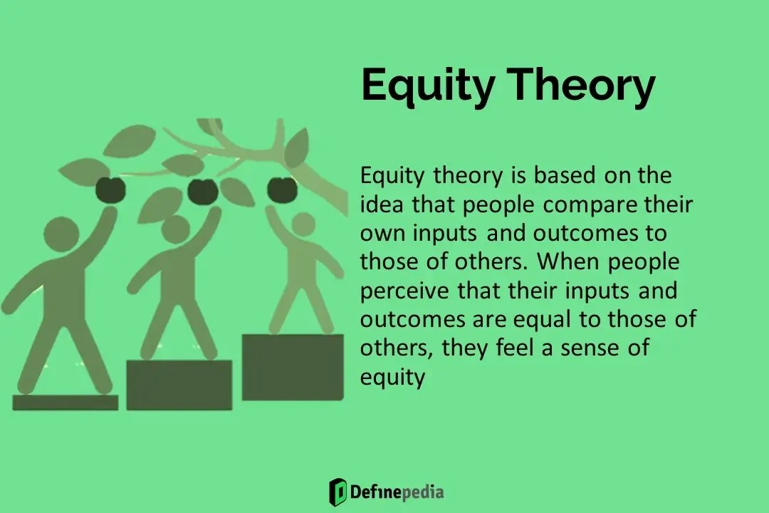
Equity Theory
Equity Theory, based on the works of J. Stacy Adams, is a theory of motivation that explains how people strive for fairness in the workplace.
  Since beginning of time, people have compared themselves to others.
  People compare their own input-outcome ratios to those of others.
    When the ratios are unequal, there is inequity. This inequity will be followed by a motivation to achieve equity, or fairness, by making the input-outcome ratios equal.

Slide 46
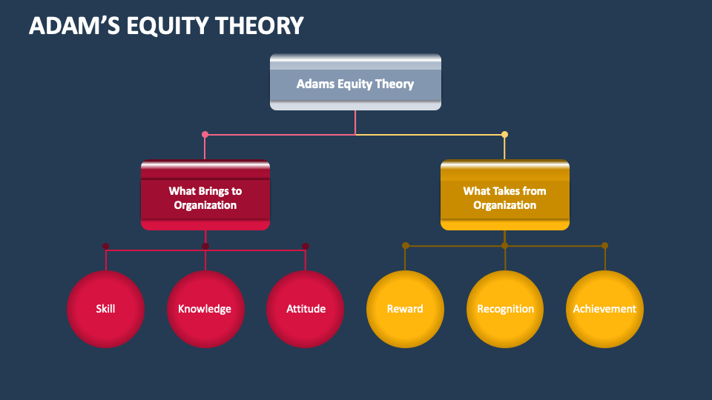
Equity Theory
The important factor in determining motivation is the relative, rather than the absolute, level of outcomes a person receives and the inputs a person contributes.
  Outcomes can include salary, working conditions, degree of EE involvement and decision making, opportunity for advancement and promotion, challenging assignments, pay and benefits, and assorted forms of recognition.
    People can make a number of different kinds of comparisons with others in order to draw conclusions about fairness.
    Effective supervisors must be vigilant for signs of unfairness and immediately address EE concerns.

Slide 47

Practical Suggestions for Using the Motivational Theories
Ultimately, all motivation is self-motivation.
  Therefore, a good supervisor structures the work situation and reward systems so that EEs are motivated to perform well because good work performance leads to satisfaction of their needs.

Slide 48

Supervisory Tips
Motivating Employees:
  Prepare, coach, and equip EEs with the SKAs so they can be the best.
  EEs want to work for a winning team.
  People need to know what is expected in the way of performance.
  Be sure to tell EEs what they must do in order to receive reinforcement.
  Provide opportunities for engagement in projects EEs will enjoy.
  People want to know how they are doing. Provide feedback on performance.
  People want recognition for a job well done.
  When EEs perform, reinforce behavior with consequences deserved and valued.
  Don’t reward all people the same: different strokes for different folks.
  Make the consequences equal to the behavior.
  Remember that failure to respond has reinforcing consequences.
  People need to know that it is okay to make mistakes.
  Create a learning organization that allows for mistakes
  Don’t punish people in front of others.
  EEs will do their best work for people they trust and respect.
  Apply the Golden Rule: Treat your EEs as you would want to be treated.

Slide 49
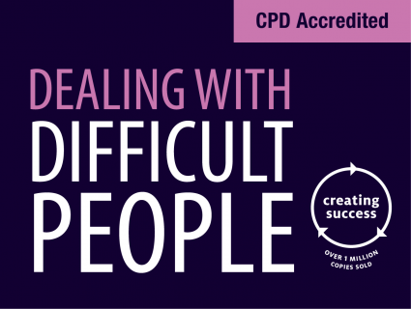
Coping with People Who Make Your Life Difficult
Some people blame others for their problems.
  These blamers-complainers are referred to as “difficult people.”
    A note of caution is warranted: Do not hang labels on people; instead, focus on what they do that makes our lives difficult.
    We want to change behavior.

Slide 50

Coping with People Who Make Your Life Difficult
Conditions that do not produce the fulfillment of a person’s needs ultimately result in dissatisfaction and frustration.
  When their needs are not satisfied on the job, EEs may resort to behavior patterns that are detrimental to their job performance and to the organization.

Slide 51

Coping with People Who Make Your Life Difficult
A typical approach for frustrated EEs is to resign themselves to just “getting by” on the job.
  They simply go through the motions and put in time without trying to perform in other than an average or marginal manner.
  Some EEs constantly find things to distract them from doing the job, and at times, they even try to beat the system.
    EE turnover, absenteeism, tardiness, poor performance, and other unsatisfactory conduct on job can cost an organization a great deal.
    The supervisor is responsible for dealing with these behaviors.
    A supervisor should endeavor to relieve frustration by providing more opportunities for need fulfillment.

Slide 52
Supervisory Tips
Suggestions for coping with people who make your life difficult:
  Do not label people as difficult, no matter how difficult they seem.
  Think in terms of difficult behaviors, not difficult people.
  The easiest way to cope with people is to avoid them, but it’s not the way.
  Change your mindset and focus on what they do well.
  Accentuate the positive – build on their strengths.
  Take control of the situation. Get attention by calling them by name.
  Talk with them in private; give them your undivided attention.
  Avoid accusations, ask open-ended questions, and listen to them.
  Share specific situations that illustrates problem behavior.
  Clearly state that you expect the behavior to improve.
  Focus on changing what they do, not who they are.
  Establish deadlines and timetables for the behavior to cease.
  If the behavior does not change, ask management or HR to step in.

Slide 53

Using the ABCs to Shape Employee Behavior
Employees who experience high levels of job satisfaction are likely to engage in positive behaviors that influence organizational efficiency and productivity.
  Performance management expert Aubrey Daniels developed a practical guide for shaping EE behavior. According to Daniels: Behavior (B) cannot be separated from the antecedents (A) that come before it and the consequences (C) that come after it.

Slide 54
Using the ABCs to Shape Employee Behavior
If supervisors expect good performance, they must set the stage so that the expected performance occurs.
  Supervisors must clearly identify what they want the EE to do.
    EEs must know what the job entails and what is expected in regards to performance.

Slide 55
Using the ABCs to Shape Employee Behavior
The supervisor should play the part of an enabler.
  An enable ensures that EEs have all they need to do their job correctly the first time, including the appropriate instruction, training, tools, and materials.
    If the supervisor does not set the stage by providing the proper antecedents, the EE’s performance is likely to be unsatisfactory.

Slide 56
Using the ABCs to Shape Employee Behavior
Consequences can affect behavior in one of two ways.
  Thorndike’s Law of Effect postulates that “behavior with favorable consequences tends to be repeated while behavior with unfavorable consequences tends to disappear. “
    Unfortunately, some supervisors assume that what would be a favorable consequence for them would also be a desirable consequence for others.

Slide 57
Using the ABCs to Shape Employee Behavior
Types of Reinforcement
  Positive Reinforcement
    Making behavior occur more frequently because it is linked to a positive consequence.
  Negative Reinforcement
    Making behavior occur more frequently by removing an undesirable consequence.
  Extinction
    Good behavior occurs less frequently or disappears because it is not recognized.
  Punishment
    Making behavior occur less frequently because it is linked to an undesirable consequence.

Slide 58
Using the ABCs to Shape Employee Behavior
Supervisors must continually be alert for what their EEs perceive to be important, and timing is critical.
  Aubrey Daniels contends “that an intelligently timed consequence has much more influence than a random one.”
    Immediate feedback on performance and positive reinforcement are essential if the supervisor wants to shape EE behavior positively.

Slide 59
Supervisory Tips
Steps in the ABC analysis:
  Monitor EE performance to uncover areas of low productivity and identify behavior leading to undesirable performance.
  Describe the performance you don’t want and who is doing it.
  Record the specific behavior that needs to be changed.
  Determine links between antecedents, undesirable behavior, and consequences.
  Tell EE what is expected in way of performance (set specific goals).
  Set the stage for good performance (i.e. arrange antecedents so that the EE can achieve the desired behavior).
  Eliminate any consequence that is irrelevant to the EE.
  Ensure linkage between desired behavior and consequences the EE values.
  Provide support and feedback on performance.
  Reinforce positive aspects of EE’s performance with consequences the EE values.
  Ensure that consequences are positive, immediate, and certain.
  Evaluate results and reinforce desired behavior with desirable consequences.
  Experiment to find effective forms of reinforcement and rate of reinforcement.

Slide 60
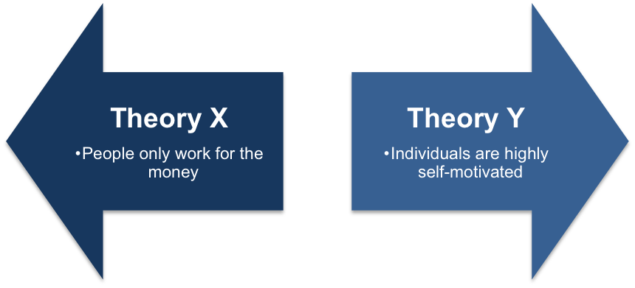
Comparing Theory X and Theory Y
A continuous (and unresolved) question that confronts supervisors is what general approach, or style, best contributes to positive employee motivation.
  This age-old dilemma typically focuses on the degree to which supervisory approaches should be based on satisfying EE’s lower-level and higher-level needs.
    This often becomes an issue of the degree to which supervisors should rely on their authority and position instead of trying to use human relations practices to provide more opportunities for EE motivation.

Slide 61
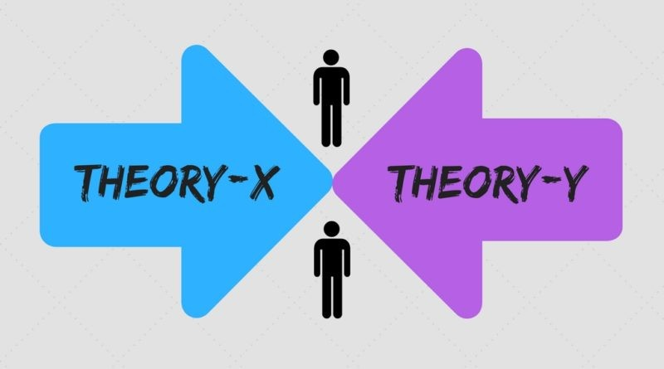
McGregor’s Theory X and Theory Y
In his book, “The Human Side of Enterprise,” Douglas McGregor noted that individual supervisory approaches usually relate to each supervisor’s perceptions about what people are all about.
  That is, each supervisor manages EEs according to their own attitudes and ideas about people’s needs and motivations.
    For comparison, McGregor stated that extremes in attitudes among managers could be classified as Theory X and Theory Y.

Slide 62
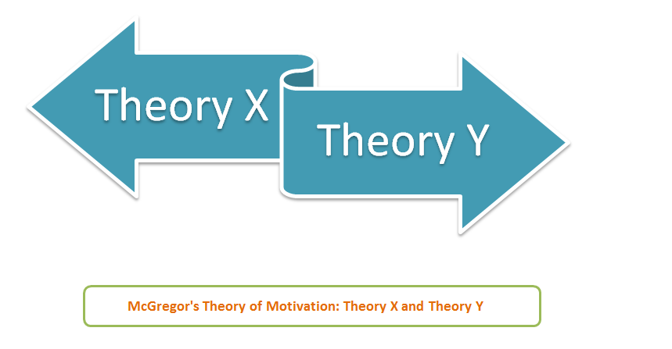
McGregor’s Theory X and Theory Y
Following basic assumptions of Theory X and Theory Y.
  Theory X
    The assumption that most EEs dislike work, avoid responsibility, and must be coerced to work hard.
  Theory Y
    The assumption that most EEs enjoy work, seek responsibility, and can self-direct.

Slide 63
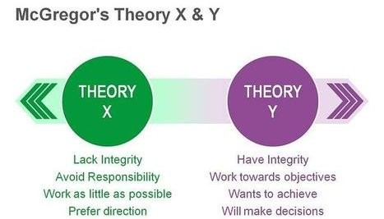
McGregor’s Theory X and Theory Y
Supervisors who are Theory X-oriented have a limited view of EE’s abilities and motivations.
  These supervisors feel EEs must be controlled, closely supervised, and motivated based on money, discipline, and authority.
    Theory X supervisors believe that the key to motivation is in the proper implementation of approaches designed to satisfy EE’s lower-level needs.

Slide 64
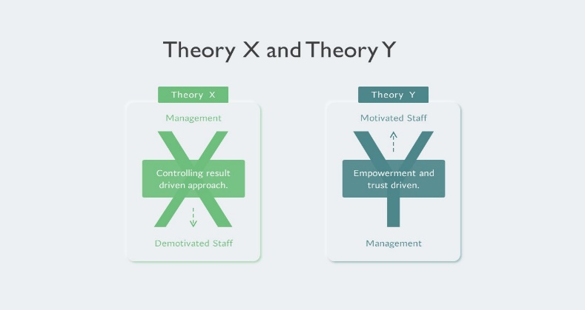
McGregor’s Theory X and Theory Y
Theory Y supervisors have a higher opinion of EE’s abilities.
  These supervisors feel that if the proper approaches and conditions can be implemented, EEs will exercise self-direction and self-control toward the accomplishment of worthwhile objectives.
    According to this view, management’s objectives should fit into the scheme of each EE’s set of needs. Therefore, Theory Y managers believe that the higher-level needs of EEs are more important in terms of each EE’s personality and self-development.

Slide 65
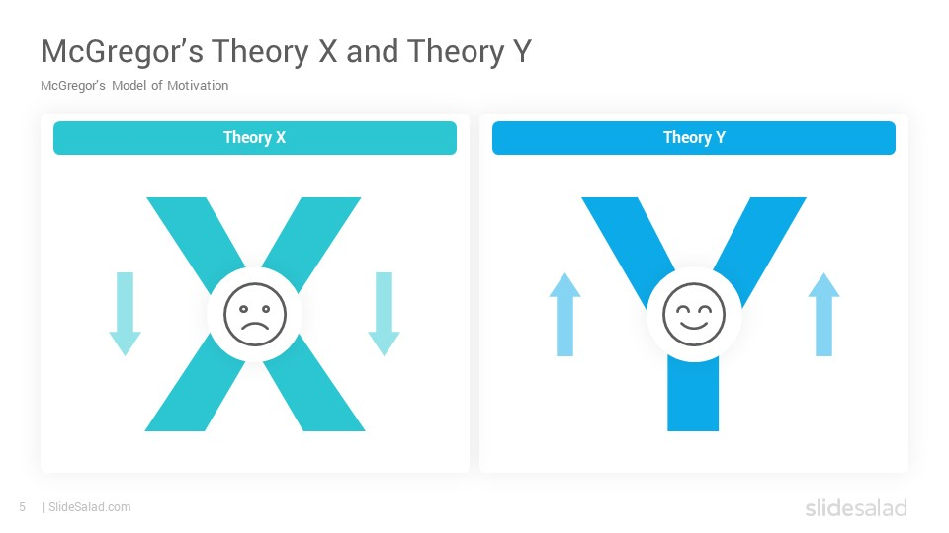
Advantages and Limitations of Theory X
Supervisors who adopt Theory X typically find that, in the short term, a job is done faster.
  Because the questioning of orders is not encouraged, it may appear that workers are competent and knowledgeable and that work groups are well organized, efficient, and disciplined.

Slide 66
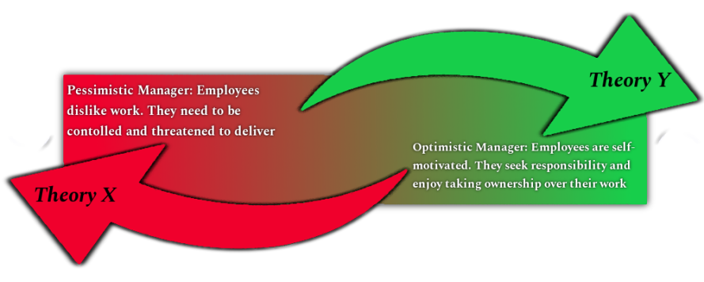
Advantages and Limitations of Theory X
A major disadvantage of the Theory X is that there is little opportunity for the EE’s personal growth.
  Because supervision is close and constant, EEs are unlikely to develop initiative and independence.
    Moreover, most workers resent Theory X supervision, and thus may be unmotivated to do the required work. In the long term, they may exit the job – physically or emotionally.

Slide 67

Advantages and Limitations of Theory X
Supervisors who advocate for the Theory X approach can get EEs to do what they want by using the “carrot-and-stick” approach (“Do what I want and you will be rewarded”).
  Punishments are applied when the job is not done.
    However, EEs may rebel when confronted with the stick, and supervisors may not have sufficient rewards to motivate EEs to subject themselves to this tight control.

Slide 68
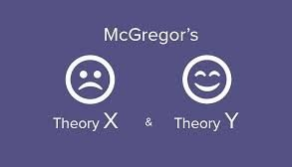
Advantages and Limitations of Theory Y
An overriding advantage of Theory Y supervision is that it promotes individual growth.
  Because workers are given opportunities to assume some responsibility on their own and are encouraged to contribute their ideas in accomplishing their tasks, it is possible for these EEs to partially satisfy their higher-level needs on the job.

Slide 69
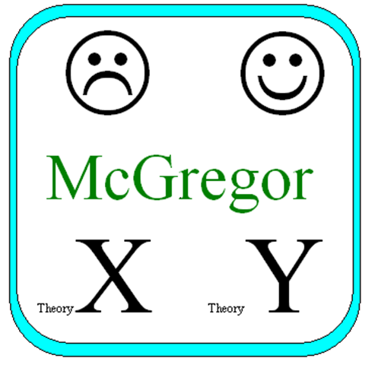
Advantages and Limitations of Theory Y
While the Theory Y approach is viewed as more desirable, it is not without disadvantages.
  Theory Y can be time-consuming, especially in the short term.
  Because personal development is emphasized, supervisors must become instructors and coaches if they are to help EEs move toward the simultaneous attainment of organizational and personal goals.
    Some supervisors find the extreme application of Theory Y to be more idealistic than practical because some EEs expect firm direction from their supervisors.

Slide 70
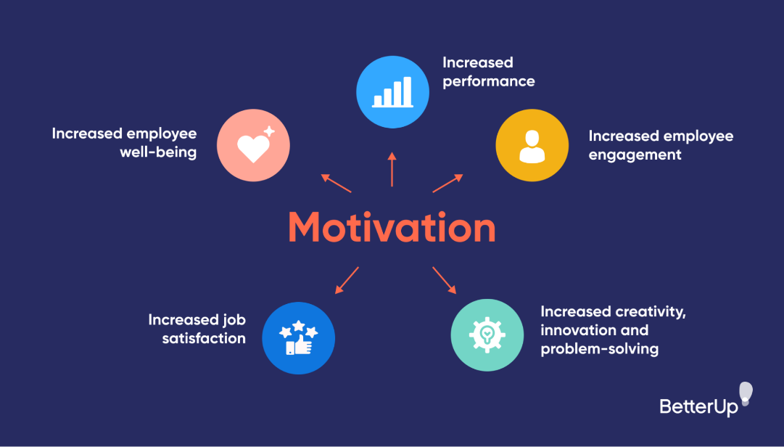
Supervisory Approaches for Attaining
Positive Employee Motivation
There is no simple set of guidelines a supervisor can implement to achieve high motivation and excellent performance.
  Human beings are much too complex for that.
    Supervisory skills can be learned and developed, but they often need to be modified to fit individuals and situations.

Slide 71

Supervisory Approaches for Attaining
Positive Employee Motivation
The workforce and work environment have changed greatly.
  Employees want a high quality of work life.
    Supervisors have used various forms of job enrichment, which means assigning more challenging tasks and giving EEs more decision-making responsibility for their jobs.

Slide 72

Job Enrichment
To enrich jobs, the supervisor should assign everyone a fair share of challenging and routine jobs and give employees more autonomy in accomplishing their tasks.
  Unfortunately, many supervisors prefer to assign difficult or more challenging jobs only to their best EEs and dull jobs to weaker EEs. However, this practice can be defeating in the long term.
    The supervisor should give all EEs opportunities to find challenging and interesting work experiences within the organizational framework.

Slide 73

Job Enrichment
Job enrichment may involve restructuring jobs in such a way that EEs are given direct control and responsibility for what they do.
  If job enrichment is practiced sincerely, subordinates usually assume an active role in making or participating in decisions.
    The result can be better decisions and a more satisfied and motivated workforce.

Slide 74
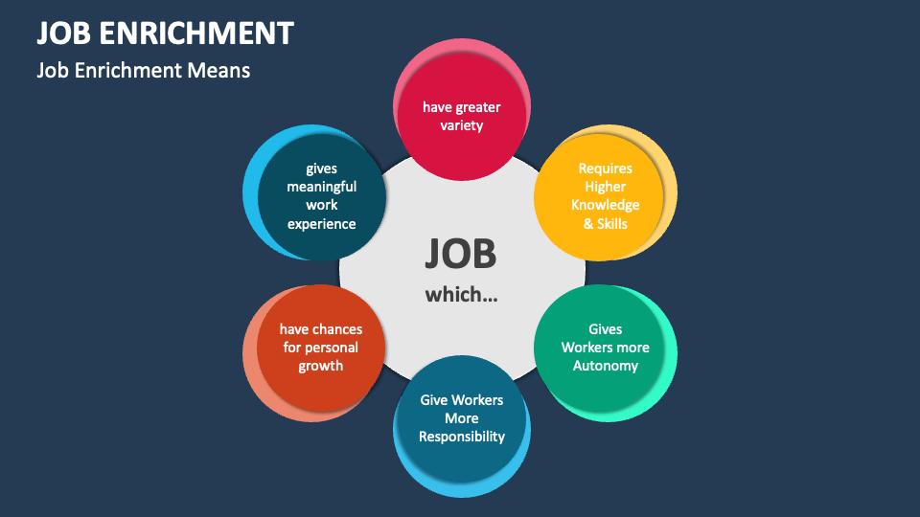
Job Enrichment
Job enrichment may involve an EE’s assumption of some of the supervisor’s everyday responsibilities.
  However, the supervisor remains accountable for the successful fulfillment of these obligations.
    Despite the potential risk, many supervisors endorse job enrichment because it works.

Slide 75
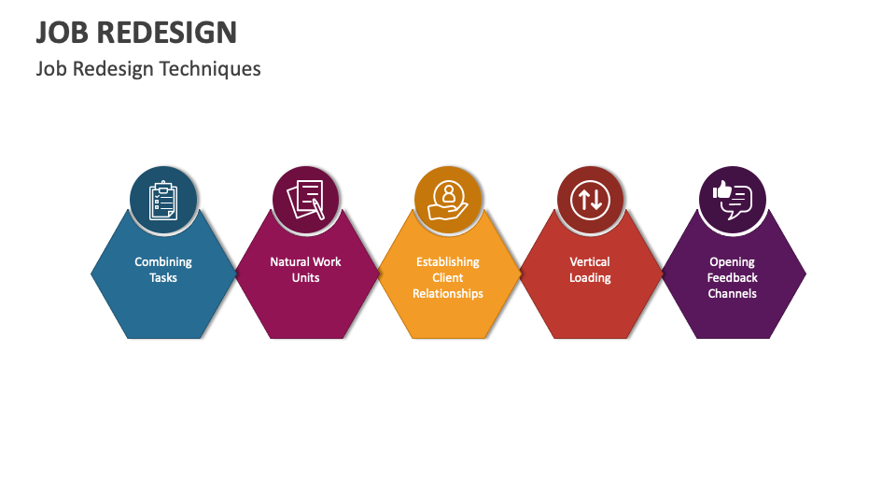
Job Redesign
It is believed that well-designed jobs lead to greater motivation, higher-quality performance, higher satisfaction, and lower absenteeism and turnover.
  These outcomes occur when EEs experience 3 psychological states:
    They believe they are doing something meaningful because their work is important to other people. They feel responsible for how the work turns out. They learn how well they performed their jobs.

Slide 76
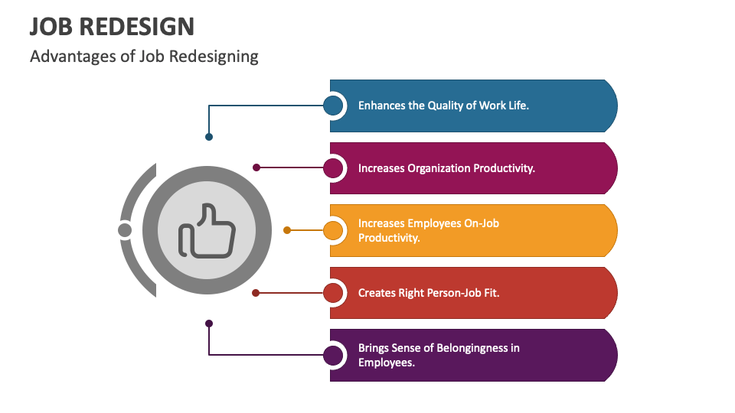
Job Redesign
Many job redesign programs are based on the model developed by Professors Hackman and Oldham.
  They contend that internal motivation is determined by three psychological factors: the experienced meaningfulness of work, responsibility for the work performed, and knowledge of the results.
    The more these factors are positive, the more effort the EE will put forth.

Slide 77

Job Redesign
According to this model, any job can be described in terms of the following five core job dimensions:
  Skill Variety
    The degree to which an EE has an opportunity to do various tasks and to use a variety of skills and abilities.
  Task Identity
    The completion of a whole, identifiable piece of work.
  Task Significance
    The degree to which the job impacts the lives or work of others.
  Autonomy
    The amount of independence, freedom, and discretion an EE has in making decisions about the work to be done.
  Feedback
    The amount of information an EE receives on job performance.

Slide 78

Job Redesign
There are ways to give EEs new tasks and new work experiences by which the basic nature of the job can be broadened in scope and importance.
  The following job-redesign strategies are similar in that each effort attempts to increase EE performance by improving job satisfaction.
    Job Rotation: Switching job tasks among EEs in a work group.
    Multitasking: When an EE performs several tasks simultaneously.
    Participative Management: The supervisory approach in which EEs have an active role in decision making.

Slide 79

Job Rotation
Job rotation not only helps to relieve EE’s boredom but also enhances EE’s job knowledge.
  Although the different tasks may require the same skill level, learning different jobs prepares EEs for promotion.
  A major side benefit to the supervisor is that job rotation results in a more flexible workforce.
    Moreover, job rotation should mean that EEs share both pleasant and unpleasant tasks so work assignments are perceived as fair.

Slide 80

Multitasking
Another motivational strategy is when supervisors expand an EE’s job with a greater variety of tasks.
  Multitasking can be a powerful motivational tool if the EEs can see that the tasks give them a chance to use previously acquired SKAs or develop new ones.
    Some EEs respond positively to multitasking, and this positive attitude is reflected in their performance and in increased job satisfaction.

Slide 81

Participative Management
This supervisory approach, in which EEs have an active role in decision making, is called participative management.
  Delegation is important to motivating EEs. Delegation does not mean running all decisions over to EEs, nor does it mean just making EEs believe they are participating in decisions. Rather, it means the supervisor should earnestly seek their opinions whenever possible and be willing to be influenced by their suggestions and criticisms.
    When EEs feel that they are part of a team and that they can influence the decisions that affect them, they are more likely to accept the decisions and seek new solutions to problems.

Slide 82
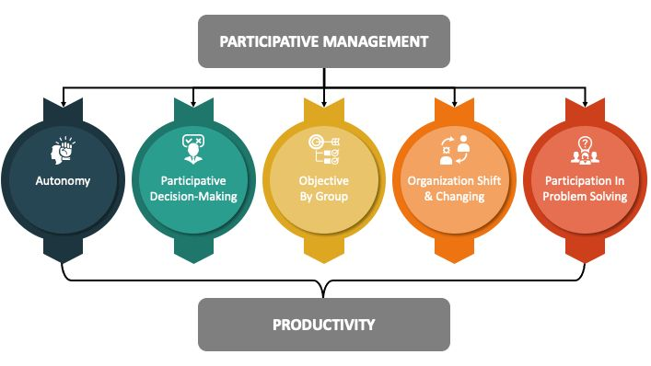
Participative Management
The major advantages of participative management are that decisions tend to be of higher quality and that EEs are more willing to accept those decisions.
  One disadvantage is that this approach can be time-consuming. Also, participation makes it easier for EEs to criticize, which some supervisors find threatening.
    Despite its disadvantages, participative management is widely recognized as an effective motivational strategy.

Slide 83

Conclusion
In his best-selling book “A Great Place to Work,” Robert Levering postulates that the high morale of great workplaces consist of pride in what you do (the job itself), enjoying the people you’re working with (the work group), and trusting the people you work for (management practices and economic rewards).

Slide 84


