Slide 1
Business Communications Session Three
Business Communication
Process and Product – 9th Edition
Mary Ellen Guffey and Dana Loewy; Cengage Learning 2018, 2015
ISBN: 978-1-305-95796-1

Slide 2
Unit Three: Workplace Communication
Chapter Seven: Short Workplace Messages and Digital Media
Learning Outcomes:
Understand email, memos, and the professional standards for their usage, structure, and format in the digital era workplace.
Explain workplace instant messaging and texting as well as their liabilities and best practices.
Identify professional applications of podcasts and wikis, and describe guidelines for their use.
Describe how businesses use blogs to connect with internal and external audiences, and list the best practices for professional blogging.
Define business uses of social networking.

Slide 3
Writing Digital Age Email Messages and Memos
In the workplace, new devices and technologies are transforming the way we exchange information and conduct business.

Slide 4
Writing Digital Age Email Messages and Memos
This chapter explores forms of workplace communication, beginning with email, which many workers love to hate, and memos, which are disappearing but still necessary.
Moving on to newer media, you will learn about workplace text messaging and interoffice chat applications, corporate blogs, podcasts, wikis, and social networking sites.
Learning these workplace technologies and best practices can save you time, reduce blunders, and help you excel as a professional.

Slide 5
Email: Love It or Hate It – But It’s Here to Stay
Critics say that email is outdated, inefficient, and slowly dying. They complain that it takes too much time, increases stress, and leaves a dangerous permanent record admissible in court of law.
However, email in the workplace is unlikely to go away.
Despite attention that social media and new messaging software receive in the news, most business messages are still sent by email.

Slide 6
Knowing When Email is Appropriate
Email is appropriate for short, informal messages that request information and respond to inquiries.
It is especially effective for messages to multiple receivers and messages that must be archived (saved). An email is also appropriate as a cover document when sending longer attachments.
Email, however, is not a substitute for face-to-face conversations or telephone calls. These channels are much more successful if your goal is to convey enthusiasm or warmth, explain a complex situation, present a persuasive argument, or smooth over disagreements.

Slide 7
Knowing When Email is Appropriate
Experts advise delivering messages in person when they “require a human moment” – that is, when they are emotional, require negotiation, and relate to personnel.
Managers and EEs echo this advice, as seen in workplace surveys.
They were adamant about using face-to-face contact, rather than email, for critical work situations such as human resources annual reviews, discipline, and promotions.

Slide 8
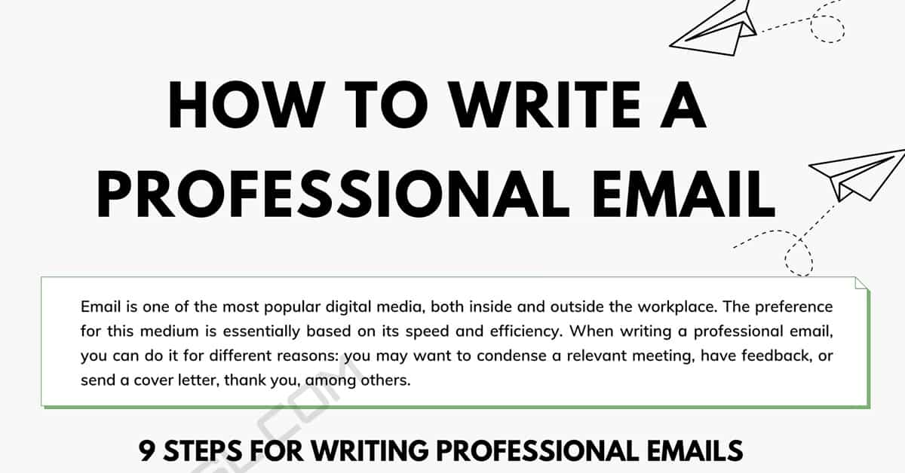
Composing Professional Email
Professional emails are quite different from messages you may send to friends.
Instead of casual words tossed off in haste, professional emails are well-considered messages that involve all three stages of the writing process.
Emails have compelling subject lines, appropriate greetings, well-organized bodies, and complete closing information.

Slide 9
Controlling Your Inbox
Business communicators love to complain about email, and some young people even deny its existence.
In the business world, however, email writing IS business writing.

Slide 10
Writing Interoffice Memos
In addition to email, you should be familiar with another workplace document, the interoffice memorandum.
Although email has replaced memos, you may still use the memo format in specific instances.
Memos are necessary for important internal messages that are (1) too long for email, (2) require a permanent record, (3) demand formality, or (4) inform employees who may not have access to email. W/in organizations, memos deliver changes in procedures, official instructions, and reports.

Slide 11
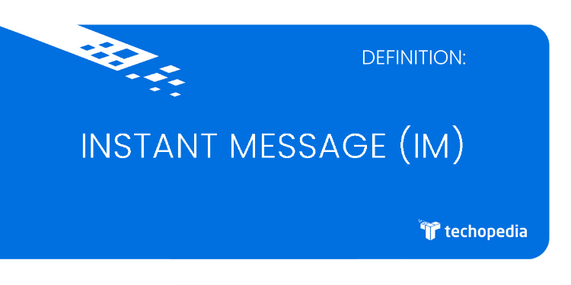
Workplace Messaging and Texting
Instant messaging (IM) and text messaging have become powerful tools beyond teens and twenty-somethings.
IM enables two or more individuals to use the Internet or an Intranet (an internal corporate communication platform) to chat in real time by exchanging brief text-based messages.
Companies large and small now provide live online chats with customer service representatives during business hours, in addition to the usual contact options, such as telephone and email.

Slide 12
Workplace Messaging and Texting
Text messaging, or texting, is another popular means for exchanging brief messages in real time.
Usually exchanged via smartphone, texting requires a short message service (SMS) supplied by a cell phone service provider or a voice over Internet protocol (VoIP) service.
Increasingly, both instant and text messages are sent from mobile devices as almost 64% of Americans now own smartphones and many depend on them for online access.

Slide 13
Best Practices for Instant Messaging
The effectiveness of short messaging for marketing is impressive if the appeal is done right.
Aside from digital marketing, instant messaging and texting can save time and simplify communication with coworkers and customers.
Before using IM or text messaging on the job, be sure you have permission. Do no download software without checking with your supervisor.

Slide 14
Text Messaging and Business Etiquette
Texting is quick and unobtrusive, and for routine messages it is often the best alternative to a phone call or email.
Given the popularity of text messaging, etiquette experts are taking note.

Slide 15
Text Messaging and Business Etiquette
Five things to consider regarding Texting Etiquette:
Timing
Introducing
Addressing
Expressing
Responding

Slide 16
Texting Etiquette 1. Timing
Timing
Don’t text when calling would be inappropriate or rude; for example, at a performance, a restaurant, in a meeting, or a movie theater.
Don’t text or answer your phone during a face-to-face conversation.
If others use their cell phones while talking to you, you may excuse yourself until they stop.

Slide 17
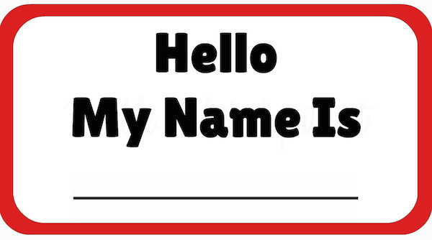
Texting Etiquette 2. Introducing
Introducing
Identify yourself when texting a new contact who doesn’t have your phone number: “Hi – it’s Erica (Office World). Your desk has arrived. Please call (800) 234-5000.”

Slide 18
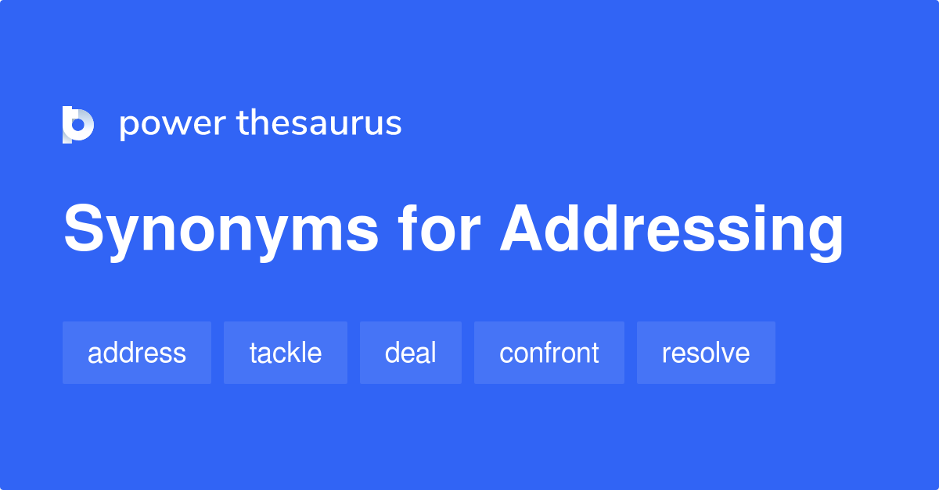
Texting Etiquette 3. Addressing
Addressing
Check that you are texting to the correct phone number to avoid embarrassment. If you receive a message by mistake, alert the sender. No need to respond to the message itself.
Avoid sending confidential, private, or potentially embarrassing texts.

Slide 19
Texting Etiquette 4. Expressing
Expressing
Don’t use text messages to notify others of sad news, sensitive business matters, or urgent meetings, unless you wish to set up a phone call about that subject.

Slide 20
Texting Etiquette 5. Responding
Responding
Don’t expect an instant reply. As with email, we don’t know when the recipient will read the message.

Slide 21
Making Podcasts and Wikis Work for Business
In the digital era, empowered by interactivity, individuals wield enormous influence because they can potentially reach huge audiences.
Far from being passive consumers, Internet users have the power to create Web content; interact with businesses and each other; review products, self-publish, or blog; contribute to wikis; and tag and share images and files.
Businesses often rightly fear the wrath of disgruntled employees and customers, or they curry favor with influential plugged-in opinion leaders, the so-called influencers.
Like Twitter, other communication technologies such as podcasts and wikis are part of the user-centered virtual environment.

Slide 22
Blogging for Business
The biggest advantage of business blogs is that they potentially reach a far-flung, vast audience.
A blog is a website or social media platform with journal entries on any imaginable topic usually written by one person, although most corporate blogs feature multiple contributors. Typically, readers leave comments.
Businesses use blogs to keep customers, employees, and the public at large informed and to interact with them.

Slide 23
Blogging for Business
Marketing firms and their clients are looking closely at blogging for business because blogs can invite spontaneous consumer feedback faster and more cheaply than such staples of consumer research as focus groups and surveys.

Slide 24
How Companies Blog
Like other social networking tools, corporate blogs create virtual communities, build brands and develop relationships.
Specifically, companies use blogs for public relations, customer relations, crisis communication, market research, viral marketing, internal communication, online communities, and recruiting.

Slide 25
Online Communities
Like Twitter, which is now drawing a loyal core following to businesses and brands, company logos can attract a devoted community of participants.
Followers want to keep informed about company events, product updates, and other news. In turn, they can contribute new ideas.
Few companies enjoy the brand awareness and customer loyalty of Coca-Cola. With its colorful blog Coca-Cola Conversations, the soft drink maker shares its rich past (Coke Bottle 100) and thus deepens loyalty.
Coke’s marketing is subtle; the blog is designed to provide a “unique experience” to fans.

Slide 26
Internal Communication and Recruiting
Blogs can be used to keep virtual teams on track and share updates on the road. Members in remote locations can stay in touch by smartphone and other devices, exchanging text, images, sound, and video clips.
In many companies, blogs have replaced hard-copy publications in offering late-breaking news or tidbits of interest to employees.
Blogs can create a sense of community and stimulate employee participation.
Blogs mirror company culture and present an invaluable opportunity for job candidates to size up potential employer and people working there.

Slide 27
Blogging Best Practices Seven Tips for Master Bloggers
Make the best impression when blogging by following these guidelines:
Craft a Catchy but Concise Title
Ace the Opening Paragraph
Provide Details in the Body
Consider Visuals
Include Calls to Action
Edit and Proofread
Respond to Posts Respectfully

Slide 28
Social Networking for Business
Popular social networking sites such as Facebook and Twitter are used by businesses for similar reasons and in much the same way as podcasts, blogs, and wikis.
Social networking sites enable businesses to connect with customers and employees, share company news, and exchange ideas.
Social online communities for professional audiences (i.e. LinkedIn) help recruiters find talent and encounter potential EEs for hire.
94% of hiring managers use social media in their screening processes.

Slide 29
Connecting Far-Flung Workers
Because social networks are about connections, they enable companies to match up and connect dispersed employees.

Slide 30
Crowdsourcing Customers
Social networks and blogs also help companies to invite customer input at the product design stage.

Slide 31
Unit Three: Workplace Communication
Chapter Ten: Persuasive and Sales Messages
Learning Outcomes:
Explain digital age persuasion, identify time-proven persuasive techniques, and apply the 3x3 writing process to persuasive messages in print and online.
Describe the traditional four-part AIDA strategy for creating successful persuasive messages, and apply the four elements to draft effective and ethical business messages.
Craft persuasive messages that request actions, make claims, and deliver complaints.
Understand interpersonal persuasion at work, and write persuasive messages within organizations.
Create effective and ethical direct mail and email sales messages.
Apply basic persuasive techniques in developing compelling press releases.

Slide 32
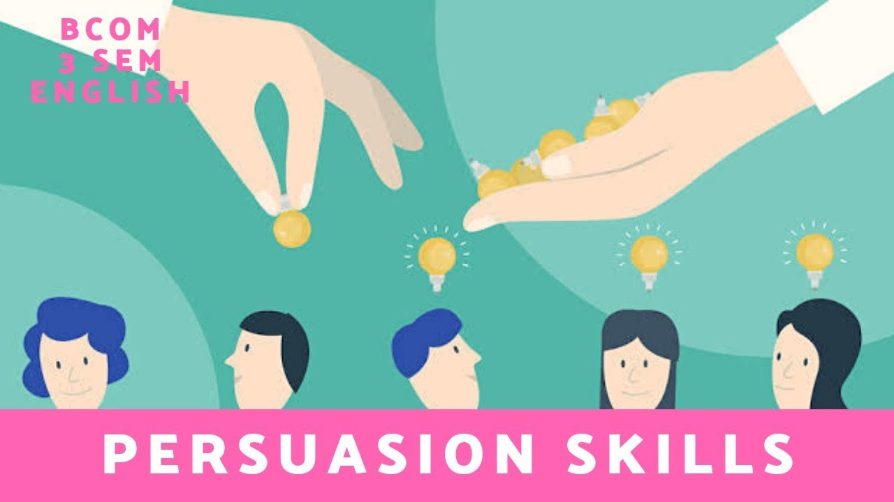
Persuading Effectively and Ethically in the Contemporary Workplace
Contemporary businesses have embraced leaner corporate hierarhcies, simultaneously relying on teams, eliminating division walls, and blurring the lines of authority.
As teams and managers are abandoning the traditional command structure, sophisticated persuasive skills are becoming ever more important at work. Businesspeople must try to influence others.
Pushy hard-sell techniques are waning because today’s consumers have many choices and can be fickle.

Slide 33
Persuading Effectively and Ethically in the Contemporary Workplace
Although we are subjected daily to a barrage of print and electronic persuasive messages, we often fail to recognize the techniques of persuasion.
To be smart consumers, we need to be alert to persuasive practices and how they influence behavior.
Being informed is our best defense.

Slide 34
Persuading Effectively and Ethically in the Contemporary Workplace
More than ever in today’s digital world, we should realize that persuasion has the power “to change attitudes and behaviors on a mass scale,” as persuasion guru B.J. Fogg at Stanford puts it.
Social networks enable individuals or groups to reach virtually limitless audiences and practice what Fogg calls: “mass interpersonal persuasion.”
This puts a lot of power into the hands of many.

Slide 35
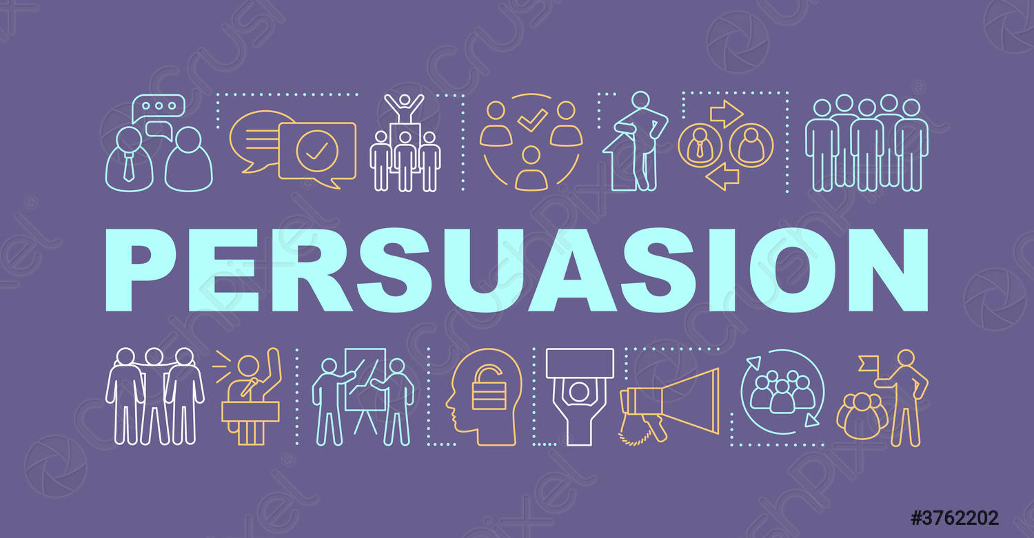
What is Persuasion?
As communication scholar Richard M. Perloff defines it, persuasion is a “symbolic process in which communicators try to convince other people to change their attitudes or behaviors regarding an issue through the transmission of a message in an atmosphere of free choice.
Helping us understand how persuasion works, this definition has five components:
Persuasion is a Symbolic Process
Persuasion Involves an Attempt to Influence
Persuasion is Self-Persuasion (Self-Influence)
Persuasion involves Transmitting a Message
Persuasion Requires Free Choice

Slide 36
What is Persuasion?
1. Persuasion is a Symbolic Process.
Symbols are meaningful words, signs, and images infused with rich meaning – for example, words such as “liberty,” signs such as national flags, and images such as the red cross for rescue or the apple for computers.
An ethical persuader understands the power of symbols and does not use them to trick others.

Slide 37
What is Persuasion?
2. Persuasion Involves an Attempt to Influence.
Persuasion involves a conscious effort to influence another person with the understanding that change is possible.
For instance, when you ask your boss for permission to telecommute, you intend to achieve a specific outcome and assume that your boss can be swayed.

Slide 38
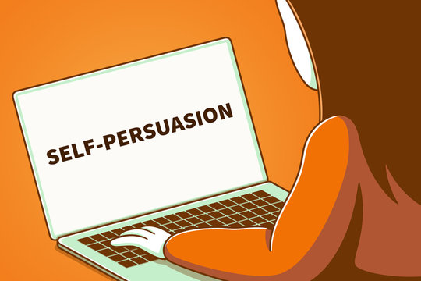
What is Persuasion?
3. Persuasion is Self-Persuasion (Self-Influence)
Ethical communicators give others the choice to accept their arguments by making compelling, honest cases to support them. They plant the seed but do not coerce.
They leave it to others to “self-influence” – that is, to decide whether to make the change.
In the case of telecommuting, you would want to present to boss clear benefits of working from home but definitely not push hard.

Slide 39
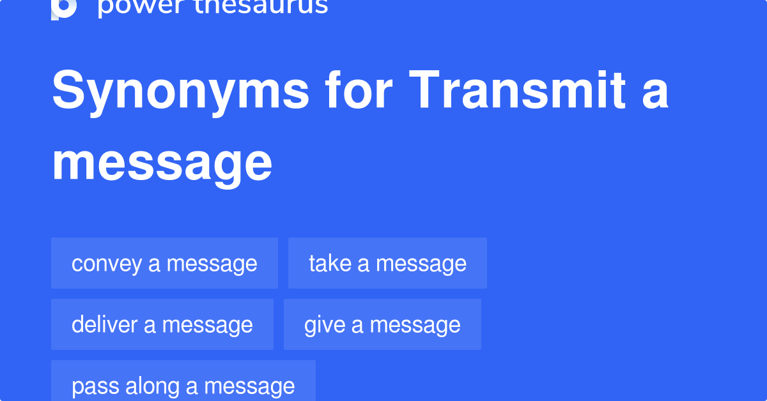
What is Persuasion?
4. Persuasion Involves Transmitting a Message
Persuasive messages can be verbal or nonverbal, and they can be conveyed face-to-face or via the Internet, TV, radio, and other media. Persuasive messages are not always rational. They often appeal to our emotions.
Consider the car commercial playing your favorite tune and showing pristine landscapes, not a gridlocked interstate during rush hour.

Slide 40
What is Persuasion?
5. Persuasion Requires Free Choice
Although free is a difficult term to define, we can perhaps agree that people are free when they are not forced to comply, when they can refuse the idea suggested to them, and when they are not pressured to act against their own preferences.

Slide 41
What is Persuasion?
Many smart thinkers have tried to explain how savvy persuaders influence others.
In the definitive book “Influence,” Robert B. Cialdini outlined six psychological triggers that prompt us to act and to believe:
reciprocation, commitment, social proof, liking, authority, and scarcity.
Each “weapon of automatic influence” motivates us to say “yes” or “no” w/o much thinking or awareness. Our complex world forces us to resort to these shortcuts. Needless to say, such automatic responses make us vulnerable to manipulation.

Slide 42
Six Basic Principles that Direct Human Behavior
Reciprocation
“The Old Give and Take…and Take”
Commitment
“Hobgoblins of the Mind”
Social Proof
“Truths are Us”
Liking
“The Friendly Thief”
Authority
“Directed Deference”
Scarcity
“The Rule of the Few”

Slide 43
Six Basic Principles that Direct Human Behavior
1. Reciprocation: “The Old Give and Take…and Take”
Humans seem to be hardwired to give and take. If someone does us a favor, most of us feel obligated to return the favor.
This rule is so binding that it may lead to a “Yes” to a request we might otherwise refuse. This explains the “gifts” that accompany requests for money.

Slide 44
Six Basic Principles that Direct Human Behavior
2. Commitment: “Hobgoblins of the Mind”
We believe in the correctness of a difficult choice once we make it. We want to keep our thoughts and beliefs consistent with what we have already decided.
Fund-raisers may ask for a small amount at first, knowing that we are likely to continue giving once we start.

Slide 45
Six Basic Principles that Direct Human Behavior
3. Social Proof: “Truths are Us”
To determine correct behavior, we try to find out what other people think is correct. We seen an action as more acceptable when others are doing it.
Advertisers like to tell us that a product is “best-selling;” the message is that it must be good because others think so.

Slide 46
Six Basic Principles that Direct Human Behavior
4. Liking: “The Friendly Thief”
We are more likely to accept requests of people we know and like or those who say they like us.
Tupperware capitalizes on this impulse to buy from a friend.
Strangers are persuasive if they are likable and attractive.
Also we favor people who are or appear to be like us.

Slide 47
Six Basic Principles that Direct Human Behavior
5. Authority: “Directed Deference”
We tend to obey authority because we learn that a widely accepted system of authority is beneficial to the orderly functioning of society. People exuding authority, even con artists, can trigger our mechanical, blind compliance.
Testimonials bank on this response to authority.

Slide 48
Six Basic Principles that Direct Human Behavior
6. Scarcity: “The Rule of the Few”
We tend to regard opportunities as more valuable when their availability is restricted. Scarce items seem more appealing.
The idea of potential loss greatly affects our decisions.
Marketers urge customers not to miss out on “limited-time offer.”

Slide 49
Persuasive Techniques are More Subtle and Misleading
Instead of a blunt, pushy hard-sell approach, persuaders play on emotions by using flattery, empathy, nonverbal cues, and likability appeals.
They are selling an image or a lifestyle, not a product.
In this age of spin, the news media are increasingly infiltrated by partisan interests and spread messages masquerading as news.

Slide 50
Six Effective Persuasion Techniques
Establish Credibility
Show that you are truthful, experienced, and knowledgeable.
Use other’s expert opinions and research to support your position.
Make a Reasonable, Specific Request
Make your request realistic, doable, and attainable.
Be clear about your objective. Vague requests are ineffective.
Tie Facts to Benefits
Line up plausible support such as statistics, reasons, and analogies.
Convert the supporting facts into specific audience benefits.
Recognize the Power of Loss
Show what others stand to lose if they don’t agree.
Know that people dread losing something they already possess.
Expect and Overcome Resistance
Anticipate opposition from conflicting beliefs, values, and attitudes.
Be prepared to counter with well-reasoned arguments and facts.
Share Solutions and Compromise
Be flexible and aim for a solution that is acceptable to all parties.
Listen to people and incorporate their input to create buy-in.

Slide 51
Applying the 3x3 Writing Process to Persuasive Messages
Changing people’s views and overcoming their objections are difficult tasks.
Pulling it off demands planning and being perceptive.
The 3x3 writing process provides a helpful structure for laying a foundation for persuasion. Of particular importance here are (1) analyzing the purpose, (2) adapting to the audience, (3) collecting information, and (4) organizing the message.

Slide 52
Analyzing the Purpose: Knowing What You Want to Achieve
The goal of a persuasive message is to convert the receiver to your ideas and motivate action.
To accomplish this feat in the age of social media, persuaders seek to build relationships with their audiences. Even so, a message without a clear purpose is doomed.
Too often, inexperienced writers reach the end of first draft of a message before discovering exactly what they want the receiver to think or do.

Slide 53
Adapting to the Audience to Make Your Message Heard
In addition to identifying the purpose of a persuasive message, you also need to concentrate on the receiver.
A persuasive message is futile unless it meets the needs of its audience.
In a broad sense, you want to show how your request helps the receiver achieve some of life’s major goals or fulfills key needs. money, power, comfort, confidence, importance, friends, peace of mind, and recognition.

Slide 54
Adapting to the Audience to Make Your Message Heard
On a more practical level, you want to show how your request solves a problem, achieves a personal or work objective, or just makes life easier for your audience.
When adapting persuasive requests to your audience, consider these questions that receivers will very likely be asking:
Why should I?
What’s in it for me?
What’s in it for you?
Who cares?

Slide 55
Adapting to the Audience to Make Your Message Heard
Adapting to your audience means learning about audience members and analyzing why they might resist your proposal. It means searching for ways to connect your purpose with their needs.
If completed before you begin writing, such analysis goes a long way toward overcoming resistance and achieving your goal.
Once you have analyzed the audience and considered how to adapt your message to its needs, you are ready to collect data and organize it.

Slide 56
Researching and Organizing Persuasive Data
The next step in a persuasive message is organizing data into a logical sequence. The classic indirect strategy known by the acronym AIDA works well for many persuasive requests, not just selling.
If you are asking for something that you know will be approved, little persuasion is required. In that case, you make a direct request.
However, when you expect resistance or when you need to educate the receiver, the indirect strategy often works better.

Slide 57
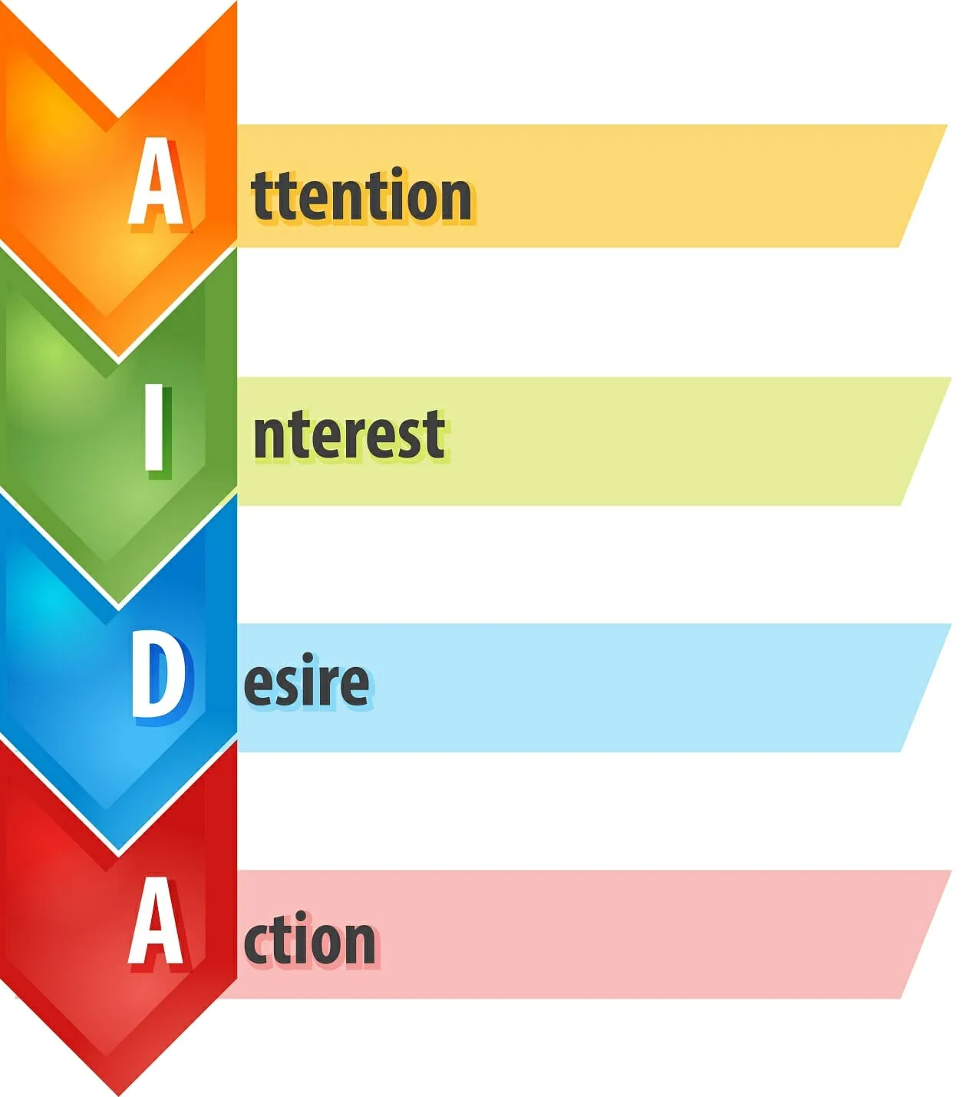
The AIDA Strategy for Persuasive Messages
Attention
Opening
Captures attention, creates awareness, makes a sales proposition, prompts audience to read on.
Interest
Body
Describes central selling points, focuses not on features of product/service but on benefits relevant to the reader’s needs.
Desire
Body
Reduces resistance, reassures the reader, elicits the desire for ownership, motivates action.
Action
Closing
Offers an incentive or gift, limits the offer, sets a deadline, makes it easy for the reader to respond, closes the sale.

Slide 58
Blending Four Major Elements in Successful Persuasive Messages
Although AIDA appears to contain separate steps, successful persuasive messages actually blend steps into a seamless whole.
The sequence of the steps may change depending on the situation and the emphasis. Regardless of where they are placed, the key elements in persuasive requests are:
(1) gaining your audience’s attention, (2) building interest by convincing your audience that your proposal is worthy, (3) eliciting desire for the offer and reducing resistance, and (4) prompting action.

Slide 59
Gaining Attention in Persuasive Messages
To grab attention, the opening statement in a persuasive request should be brief, relevant, and engaging.
When only mild persuasion is necessary, the opener can be low-key and factual. If, however, your request is substantial and you anticipate strong resistance, provide a thoughtful, provocative opening. Following are some examples:
Problem Description
Unexpected Statement
Reader Benefit
Compliment
Related Facts
Stimulating Question

Slide 60
Gaining Attention in Persuasive Messages
Problem Description
Present a capsule of the problem your proposal will help solve.
Unexpected Statement
Get readers thinking immediately.
Reader Benefit
Highlight benefit to reader at the onset.
Compliment
Offer praise or compliments, but avoid obvious flattery.
Related Facts
Relevant facts set stage for the interest-building section to follow.
Stimulating Question
Stimulate curiosity of reader with intriguing question.

Slide 61
Building Interest in Persuasive Messages
After capturing attention, a persuasive request must retain that attention and convince audience that the request is reasonable.
Persuasive requests are likely to be longer than direct requests because audience must be convinced rather than simply instructed.
You can build interest and conviction through use of the following:
Facts – Statistics – Examples – Expert Opinion – Specific Details – Direct Benefits – Indirect Benefits

Slide 62
Building Interest in Persuasive Messages
Showing how your request can benefit the audience directly or indirectly is a key factor in persuasion.
If you were asking alumni to contribute money to college foundation, for example, you might promote direct benefits such as listing the donor’s name in college magazine or sending a sweatshirt w/ college logo. Another direct benefit is a tax write-off for the contribution.
An indirect benefit might be feeling good about “paying it forward,” thus helping the college and knowing that students will benefit from the gift.
All charities rely in part on indirect benefits to promote their causes.

Slide 63
Eliciting Desire and Reducing Resistance in Persuasive Requests
The best persuasive requests anticipate audience resistance. How will the receiver object to the request?
When brainstorming, try “What if?” scenarios:
Let’s say you want to convince management that employees’ cafeteria should switch from disposable to ceramic dishes. What if managers say the change is too expensive? What if they argue that they recycle paper and plastic? What if they contend that ceramic dishes would increase cafeteria labor and energy costs? What if they protest that ceramic is less hygienic?
For each of these “What if?” scenarios, you need a counterargument.

Slide 64
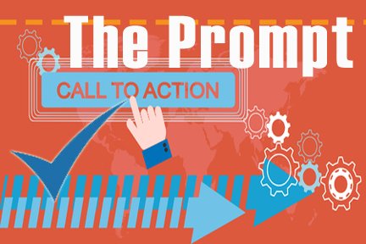
Prompting Action in Persuasive Messages
After gaining attention, building interest, eliciting desire, and reducing resistance, you will want to inspire the newly receptive audience to act.
Knowing exactly what action you favor before you start to write enables you to point arguments toward important final paragraph.
Here you make your recommendation as specifically and confidently as possible – without seeming pushy. In making a request, don’t sound apologetic (I’m sorry to have to ask you this, but…), and don’t supply excuses (If you can spare the time…).

Slide 65
Being an Ethical Persuader
A persuader is effective only when he or she is believable.
If receivers suspect they are being manipulated or misled, or if they find any part of argument untruthful, the total argument fails.
Fudging on the facts, exaggerating a point, omitting something crucial, or providing deceptive emphasis may seem tempting to some business communicators, but such schemes usually backfire.

Slide 66
Writing Persuasive Requests
A persuasive request should incorporate the following techniques:
Establish credibility
Make a reasonable and precise request
Tie facts to benefits
Elicit desire while overcoming resistance in the receiver

Slide 67
Persuading Employees: Messages Flowing Downward
Employees traditionally expect to be directed in how to perform their jobs; therefore, instructions or directives moving downward from superiors to subordinates usually required little persuasion.
Messages such as information about procedures, equipment, or customer service still use the direct strategy, with the purpose immediately stated.

Slide 68
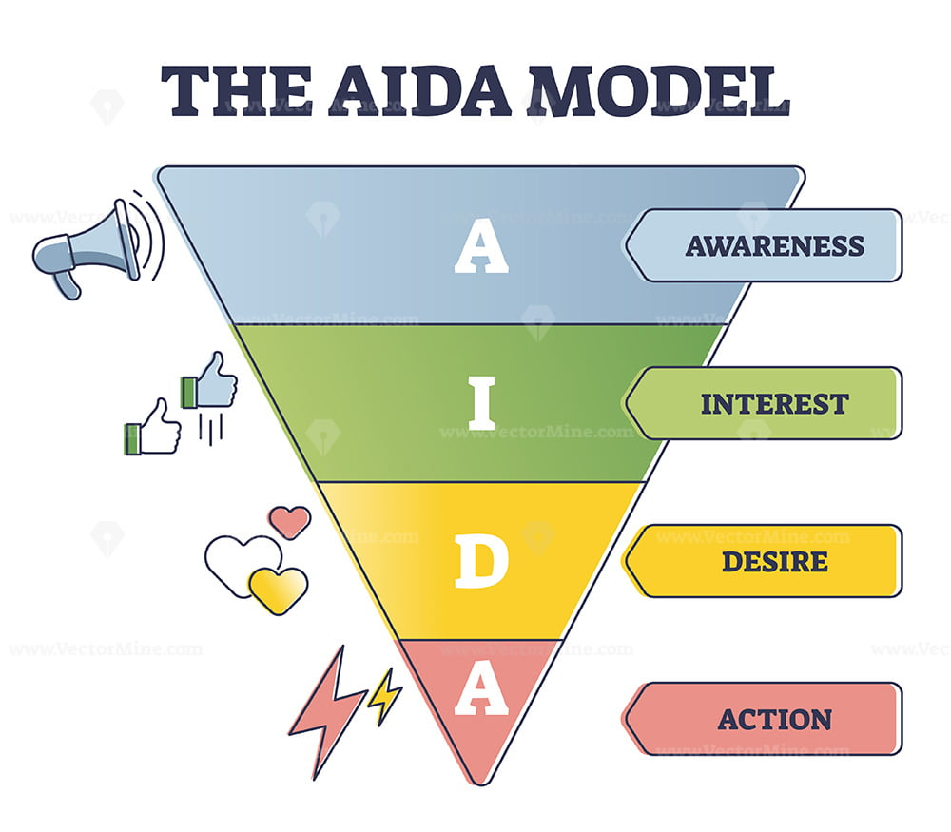
Persuading Employees: Messages Flowing Downward
However, employees are sometimes asked to volunteer for projects such as tutoring disadvantaged children or helping at homeless shelters. Some organizations encourage employees to join programs to stop smoking, lose weight, or start exercising.
Organizations may ask employees to participate in capacities outside their work roles – such as spending their free time volunteering for charity projects.
In such cases, the four-part indirect AIDA strategy provides a helpful structure.

Slide 69
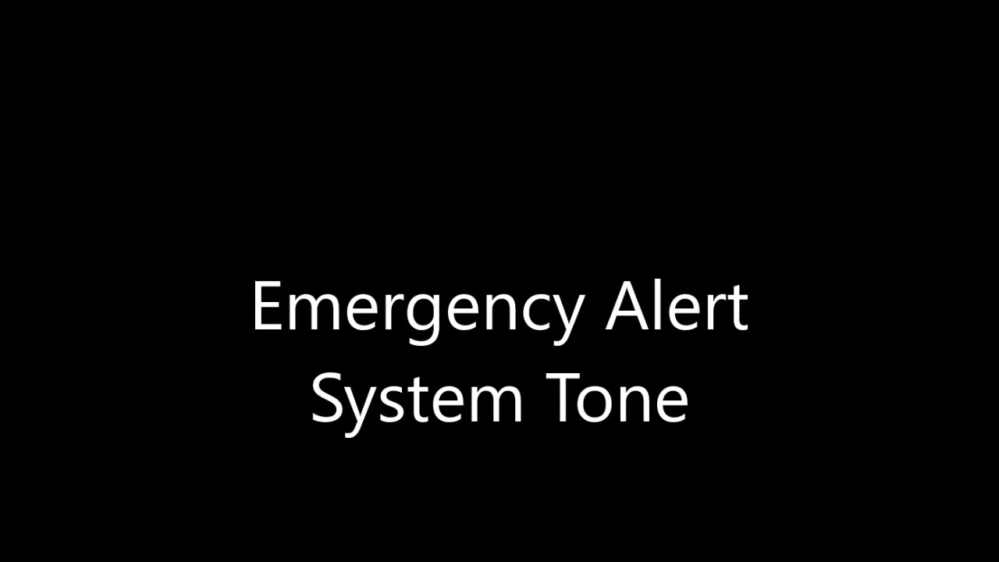
Persuading Employees: Messages Flowing Downward
Because many executives today rely on buy-in instead of exercising raw power, messages flowing downward require attention to tone.
Warm words and a conversational tone convey a caring attitude.
Persuasive requests coming from trusted superiors are more likely to be accepted than requests from dictatorial executives who rely on threats and punishments to secure compliance.
The proverbial carrot has always been more persuasive than the stick.
Because the words “should” and “must” sometimes convey a negative tone, be careful in using them.

Slide 70
Persuading the Boss: Messages Flowing Upward
Convincing management to adopt a procedure or invest in a product or new equipment requires skillful communication.
Managers are just as resistant to change as others are.
Providing facts, figures, and evidence is critical when submitting a recommendation to your boss.
When selling an idea to management, strive to make a strong dollars-and-cents case. A request that emphasizes how the proposal saves money or benefits the business is more persuasive than one that simply announces a good deal or tells how a plan works.

Slide 71
Persuading the Boss: Messages Flowing Upward
In describing an idea to your boss, state it confidently and fairly.
Don’t undermine your suggestions with statements such as “This may sound crazy” or “I know we tried this once before, but…”
Show that you have thought through the suggestion by describing the risks involved as well as the potential benefits.

Slide 72
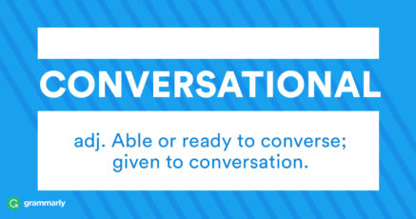
Persuading the Boss: Messages Flowing Upward
Persuasive messages traveling upward require a special sensitivity to tone.
When asking superiors to change views or take action, use phrases such as “we suggest” and “we recommend” rather than “you must” and “we should.” Avoid sounding pushy or argumentative.
Strive for a conversational, yet professional tone that conveys warmth, competence, and confidence.

Slide 73
Applying the 3x3 Writing Process to Sales Messages
Marketing professionals analyze and perfect every aspect of a sales message to encourage consumers to read and act on the message.
Like the experts, you will want to pay close attention to analysis and adaptation before writing the actual message.

Slide 74
Analyzing the Product
Prior to sitting down to write a sales message promoting a product, you must study the item carefully.
What can you learn about its design, construction, raw materials, and manufacturing process?
What can you learn about its ease of use, efficiency, durability, and applications?
Be sure to consider warranties, service, price, premiums, exclusivity, and special appeals. At the same time, evaluate the competition so that you can compare your product’s strengths with the competitor’s weaknesses.

Slide 75
Determining the Purpose of a Sales Message
Equally as important as analyzing the product is determining the specific purpose of your message.
Do you want the reader to call for a free video and brochure? Listen to a podcast of your website? Fill out an order form? Send a credit card authorization?
Before you write the first word of your message, know what response you want and the central selling point you will emphasize to achieve purpose.

Slide 76
Betting on Highly Targeted, Relevant Direct Mail
Professionals who specialize in traditional direct-mail services have made it a science.
They analyze a market, develop an effective mailing list, study the product, prepare a sophisticated campaign aimed at a target audience, and motivate the reader to act.

Slide 77
Considering the Value of Sales Letters
Your primary goal in writing a sales message is to get someone to devote a few moments of attention to it.
You may be promoting a product, a service, an idea, or yourself.
In each case the most effective messages will follow the AIDA strategy and (1) gain attention, (2) build interest, (3) elicit desire and reduce resistance, and (4) motivate action.

Slide 78
Gaining Attention in Sales Messages
One of the most critical elements of a sales message is its opening paragraph.
This opener should be short (one to five lines), honest, relevant, and stimulating. Marketers have found that eye-catching typographical arrangements or provocative messages can hook a reader’s attention. Consider the following approaches:
Offer Something – Make a Promise – Ask a Question – Present Quotation or Proverb – Provide Facts – Share Product Feature and its Benefits – Write a Startling Statement – Outline a Personalized Action Setting
Other openings calculated to capture attention include a solution to a problem, an anecdote, a personalized statement using the receiver’s name, and a relevant current event.

Slide 79
Building Interest with Rational and Emotional Appeals
In this phase of your sales message, you should describe clearly the product or service.
In simple language emphasize the central selling points that you identified during your prewriting analysis.
Those selling points can be developed using rational or emotional appeals.

Slide 80
Building Interest with Rational and Emotional Appeals
A physical description of your product is not enough.
No matter how well you know your product, no one is persuaded by cold, hard facts alone. In the end, people buy because of product benefits.
Your job is to translate those cold facts into warm feelings and reader benefits. A feature is what your product is or does; a benefit is how the audience can use it.

Slide 81
Building Interest with Rational and Emotional Appeals
Emotions Guide Decision Making.
Neurological research supports the view that human decision making is a process guided by emotions. Human beings are also more likely to be persuaded by people or entities they like and know.
These two insights have important implications for social media marketing. They explain why so much emphasis today is placed on customer engagement, mostly carried out through social networks.

Slide 82
Building Interest with Rational and Emotional Appeals
Engagement.
The health of a company relies on the extent to which it creates meaningful and sustainable interactions with customers.
Engaged customers are more loyal and willing to recommend products.
Social media success depends on creating an emotional connection.
One expert likens social media to a cocktail party at which one mingles and networks but does not rudely hawk products and services.

Slide 83
Motivating Action at the Conclusion of a Sales Message
The final paragraph of the sales letter carries the punch line.
This is where you tell readers what you want them to do and give them reasons for doing it.
Most sales letters also include postscripts because they make irresistible reading. Even readers who might skim over or bypass paragraphs are drawn to a P.S.
Use a postscript to reveal your strongest motivator, to add a special inducement for a quick response, or to emphasize a central selling point.

Slide 84
Writing Successful Email Sales Messages
Much like traditional direct mail, email marketing can attract new customers, keep existing ones, encourage future sales, cross-sell, and cut costs. However, e-marketers can create and send a promotion in half the time it takes to print and distribute a traditional message.
To reach today’s consumer, marketers must target their emails well if they wish to even get their messages opened.
“In order for your email program to be truly effective, your messages must be relevant, targeted and engaging to the people who receive them,” says one marketing specialist.

Slide 85
Selling by Email
The first rule of e-marketing is to communicate only with those who have given permission.
By sending messages only to opt-in folks, you greatly increase your open rate – emails that will be opened.
Email users detest spam. However, receivers are surprisingly receptive to offers tailored specifically to them.
Remember that today’s customer is somebody – not just anybody.

Slide 86
Selling by Email
Following are a few guidelines that will help you create effective email sales messages:
Craft a catchy subject line.
Keep the main information “above the fold.”
Make the message short, conversational, and focused.
Sprinkle testimonials throughout the copy.
Provide a means for opting out.

Slide 87
Writing Short Persuasive Messages Online
Increasingly, writers are turning to social network posts to promote their businesses, further their causes, and build their online personas.
As we have seen, social media are not primarily suited for overt selling; however, tweets and other online posts can be used to influence others and to project a professional, positive social online presence.

Slide 88
Writing Short Persuasive Messages Online
Typically, organizations and individuals with followers post updates of their events, exploits, thoughts, and experiences.
In persuasive tweets and posts, writers try to pitch offers, prompt specific responses, or draw the attention of their audiences to interesting events and media links.

Slide 89
Developing Persuasive Press Releases
Press (news) releases announce important information to the media, whether traditional or digital.
Such public announcements can feature new products, new managers, new facilities, sponsorships, participation in community projects, awards given or received, joint ventures, donations, or seminars and demonstrations.
Naturally, organizations hope that the media will pick up this news and provide good publicity. However, purely self-serving or promotional information is not appealing to magazine and newspaper editors or TV producers.

Slide 90
Developing Persuasive Press Releases
To get them to read beyond the first sentence, press release writers follow these principles:
Open with an attention-getting lead or a summary of the important facts.
Include answers to the five Ws and one H (who, what, when, where, why, and how) in the article – but not all in the first sentence!
Appeal to the audience of the target media. Emphasize reader benefits written in the style of the focus publication or newscast.
Present most important information early, followed by supporting info. Don’t put best ideas last as they may be chopped off or ignored.
Insert intriguing and informative quotations of chief decision makers to lend the news release credibility.
Make the document readable and visually appealing.
Look and sound credible.

Slide 91
Developing Persuasive Press Releases
The most important ingredient of a press release, is news.
Articles that merely plug products end up in the circular file, or they languish unread on a company website.
The best press releases focus on information that appeals to a targeted audience. Newspapers, magazines, and digital media are more likely to publish a press release that is informative, interesting, and helpful.
The websites of many organizations today provide readily available media information including press releases and photos.

