Slide 1

Entrepreneurship
Class Presentation SUMM Consolidate. Session 2
Entrepreneurship
  Theory, Process, Practice -12th Edition
    Donald F. Kuratko, Cengage Learning, Boston, MA 2024
      ISBN: 978-0-357-89950-2

Slide 2

Social Entrepreneurship
Chapter 4
Social entrepreneurship combines innovation, risk-taking, and business methods with a mission to solve problems.
  It creates social value first, while financial returns support sustainability. It can exist in all types of organizations.
    It’s goal is systemic change, not just temporary aid.

Slide 3
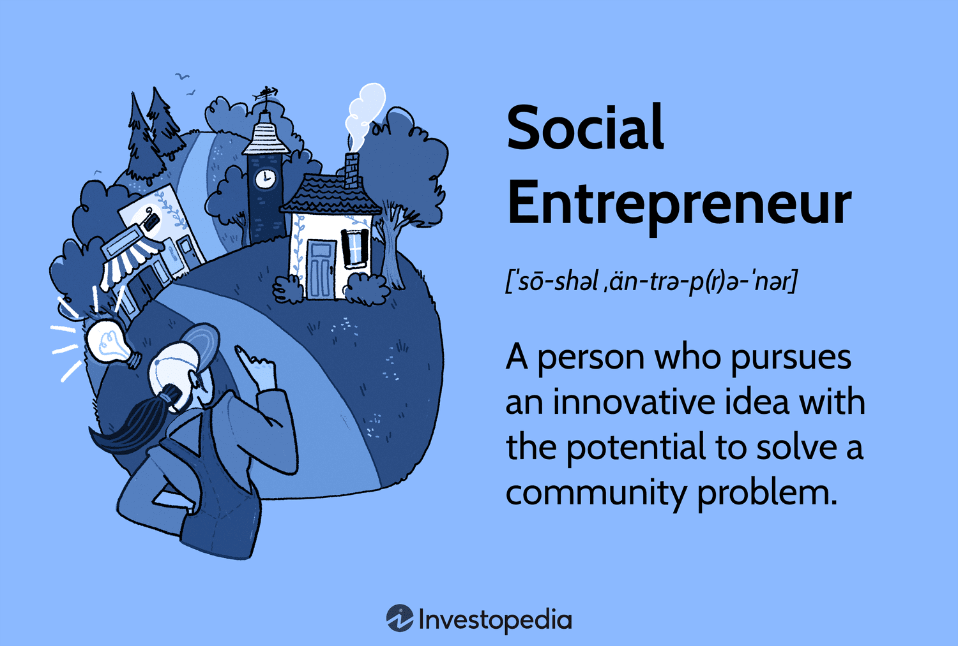
Characteristics of Social Entrepreneurs
Social Entrepreneurs Typically:
  Pursue Social Impact Missions
  Recognize Opportunities to Solve Social Issues
  Innovate Continuously
  Act Despite Limited Resources
  Remain Accountable to Communities Served
    They are change agents, focused on solving root causes rather than symptoms.

Slide 4

Social Enterprises vs. Traditional Businesses
Social Enterprises Exist Along a Spectrum.
  Nonprofit = Social Impact First
  Hybrid = Social and Financial Balance
  For Profit Social Venture = Profit Supports Impact
    TOMS Shoes used the “one-for-one” donation model to scale impact sustainability.

Slide 5
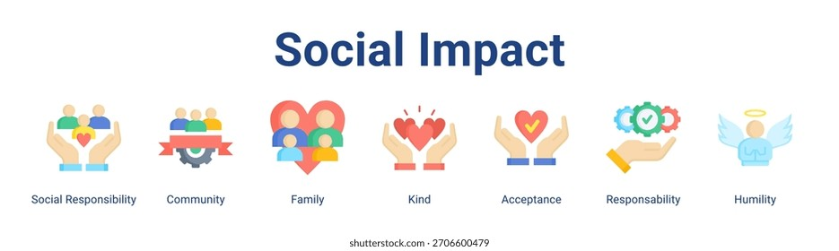
Measuring Social Impact
Impact Can Be Evaluated Through:
  Community Outcomes
    Civic Wealth – Resilience – Well-Being – Regeneration
  Scaling Strategies
    Scale Breadth –> Service More People
    Scale Depth –> Improve Service Quality

Slide 6
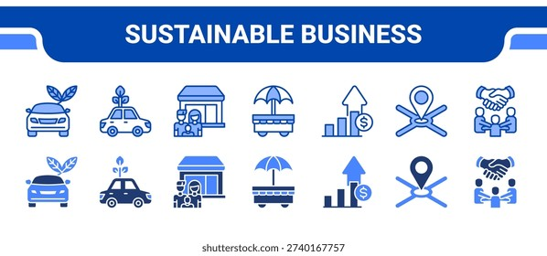
Sustainable Entrepreneurship
Sustainable Entrepreneurship Balances:
  Economic Growth
  Environmental Protection
  Social Responsibility

Slide 7

Sustainable Entrepreneurship
Key Components Include:
  Ecopreneurship
    Environment-Focused Innovation
  Social Entrepreneurship
    Community Improvement Initiatives
  Corporate Social Responsibility
    Voluntary Business Actions Benefiting Society

Slide 8
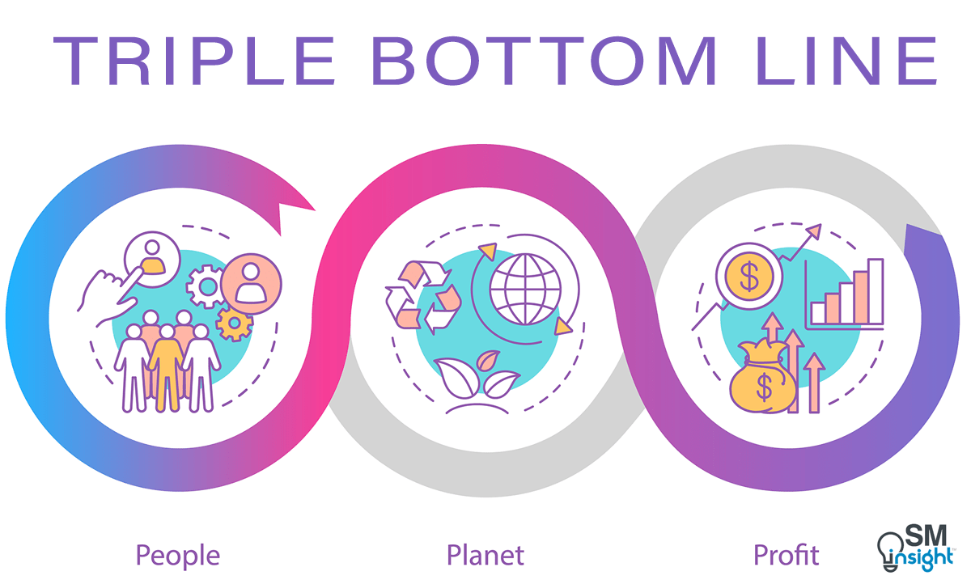
Shared Value and Triple Bottom Line
Modern businesses create shared value by improving society while improving profits.
  The Triple Bottom Line (TBL) Measures: Profit (Economic), People (Social), and Planet (Environmental).
    This shifts business success beyond financial metrics alone.

Slide 9
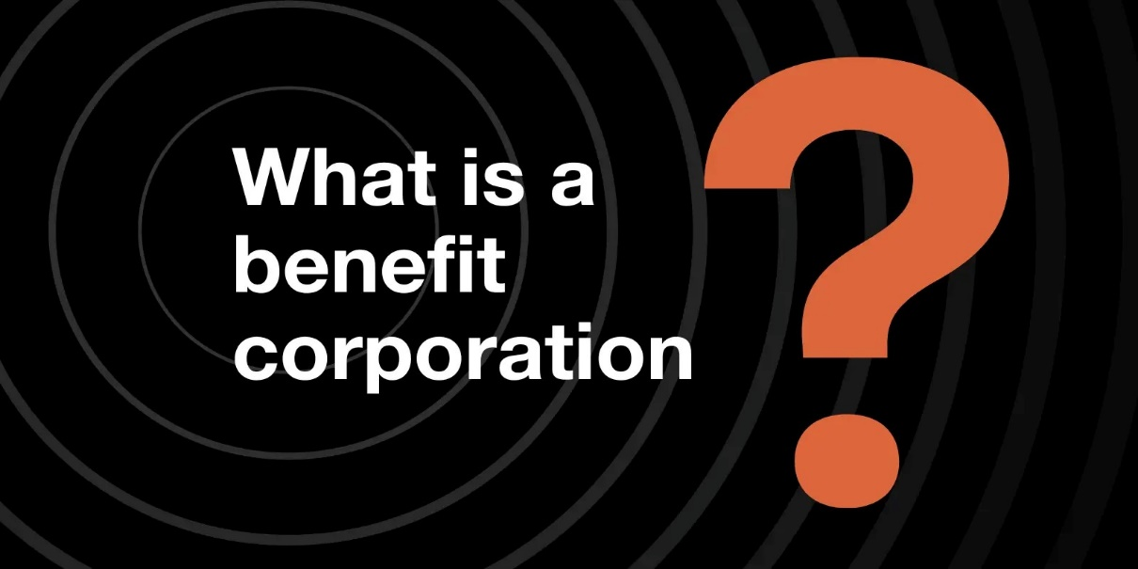
Benefit Corporations
Benefit corporations differ from traditional corporations because they must:
  Create Social and/or Environmental Impact
  Consider Stakeholders Beyond Shareholders
  Publish Transparency Reports
    They are legally structured for mission-driven entrepreneurship.

Slide 10
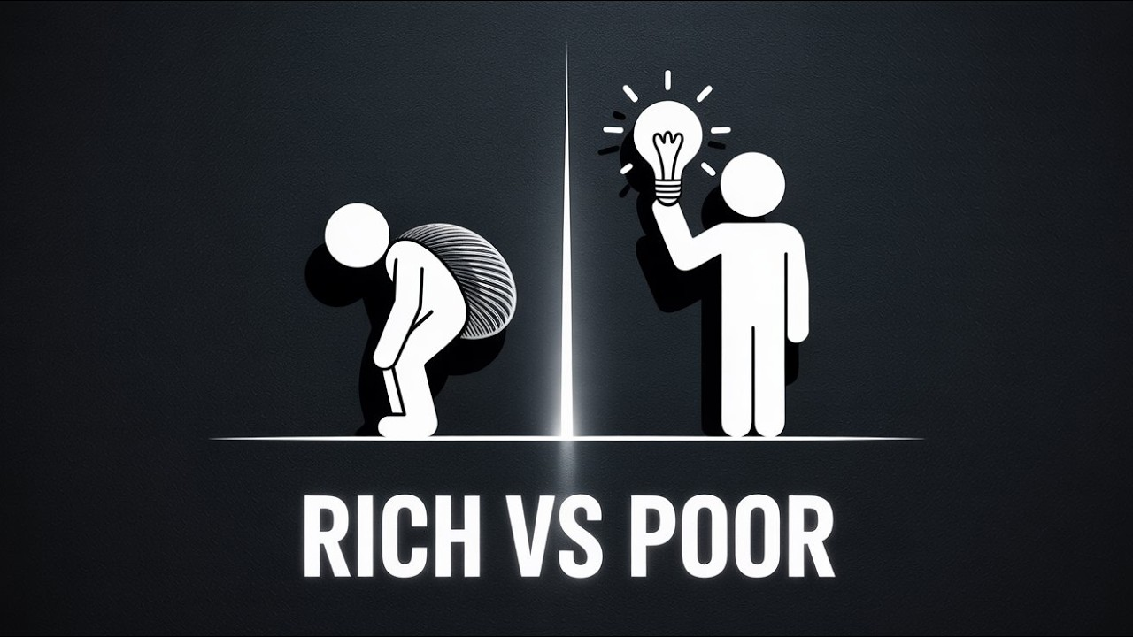
Poverty and Entrepreneurship Challenges
Entrepreneurs in poverty face the liability of poorness, including:
  Literacy Gaps
  Scarcity Mindset
  Personal Pressures
  Lack of Financial Safety Nets

Slide 11


Poverty and Entrepreneurship Challenges
Despite these barriers, entrepreneurs can:
  Build Skills
  Increase Dignity
  Reduce Dependence
  Strengthen Communities

Slide 12

The Global Entrepreneurial Mindset
Global Entrepreneurs:
  Think Beyond National Markets
  Adapt to Multiple Cultures
  Leverage International Networks
  Pursue Cross-Border Opportunities

Slide 13

The Global Entrepreneurial Mindset
Global Entrepreneurs Benefit From:
  Reduced Trade Barriers
  Global Digital Communication
  Diaspora Networks

Slide 14

Entering International Markets
Common Global Entry Strategies Include:
  Importing
  Exporting
  Alliances
  Joint Ventures
  Direct Investment
  Licensing
    Each increases commitment and potential reward.

Slide 15

Key Understanding
Modern entrepreneurship is no longer just about profit.
  Successful Entrepreneurs Must:
    Solve Real Societal Problems
    Integrate Sustainability Into Strategy
    Think Globally from the Beginning
    Balance Mission and Money
    Measure Impact Beyond Revenue

Slide 16
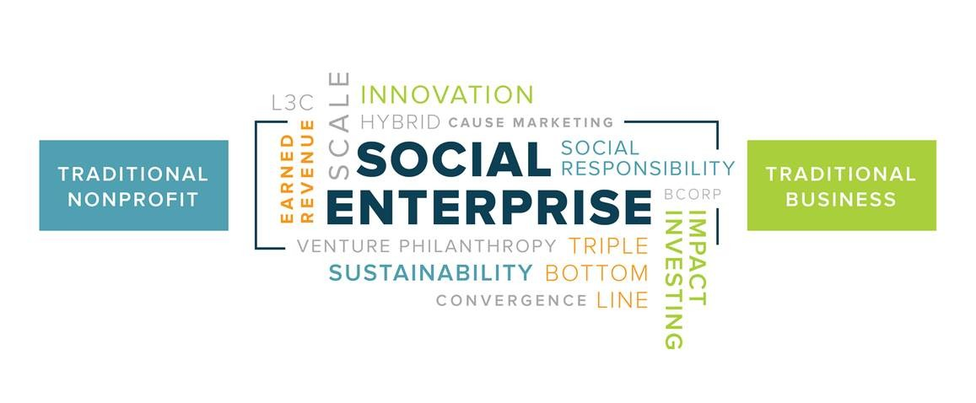
Practical Applications
Application 1: Starting a Social Venture
  A business that sells affordable solar lighting in low-income communities reduces electricity costs, improves safety, and supports sustainability.
    Revenue supports scaling impact.

Slide 17
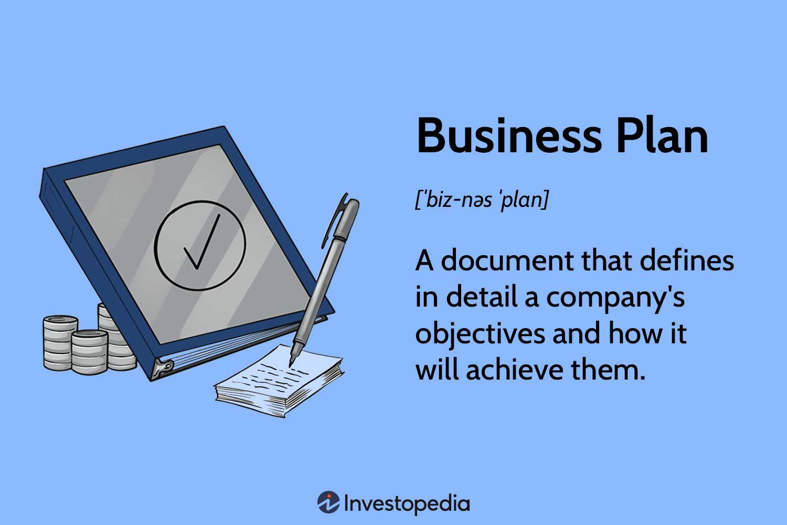
Practical Applications
Application 2: Designing a Business Plan. Must Include:
  Mission Statement with Social Purpose
  Stakeholder Impact Analysis
  Triple Bottom Line Metrics
  Sustainability Strategy
    This strengthens investor appeal.

Slide 18
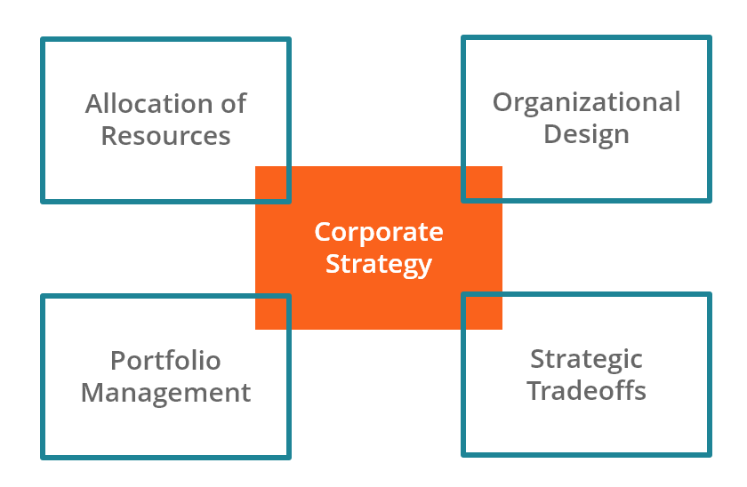
Practical Applications
Application 3: Corporate Strategy
  Companies can adopt shared value by reducing waste, sourcing ethically, supporting local suppliers, and improving worker conditions.
    This increases brand trust and loyalty.

Slide 19

Practical Applications
Application 4: Entering Global Markets
  Export Niche Products
  Partner Through Joint Ventures
  License Technology Internationally
  Leverage Diaspora Connections
    These reduce risk while expanding reach.

Slide 20

Practical Applications
Application 5: Supporting Poverty Entrepreneurship
  Improve Financial Literacy
  Provide Microloans
  Create Mentoring Programs
  Build Support Ecosystems
    This reduces the liability of poorness.

Slide 21
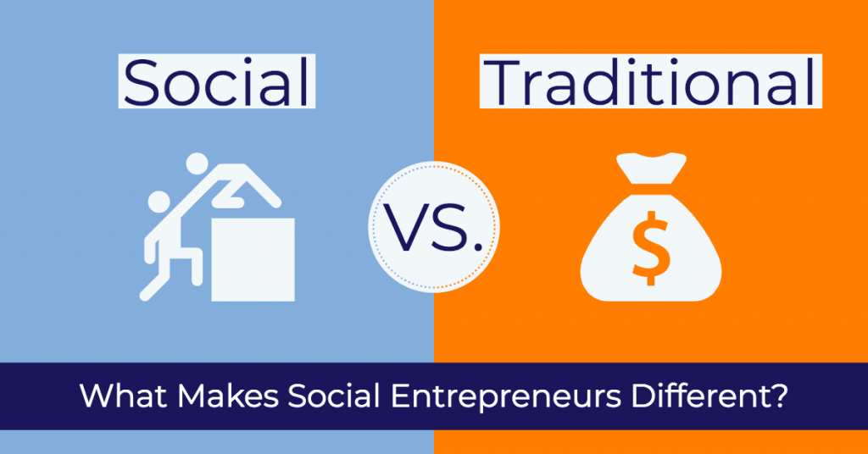
Core Insight
Social entrepreneurship combines innovation, sustainability, and global thinking to create businesses that generate profit while solving society’s most urgent problems.

Slide 22
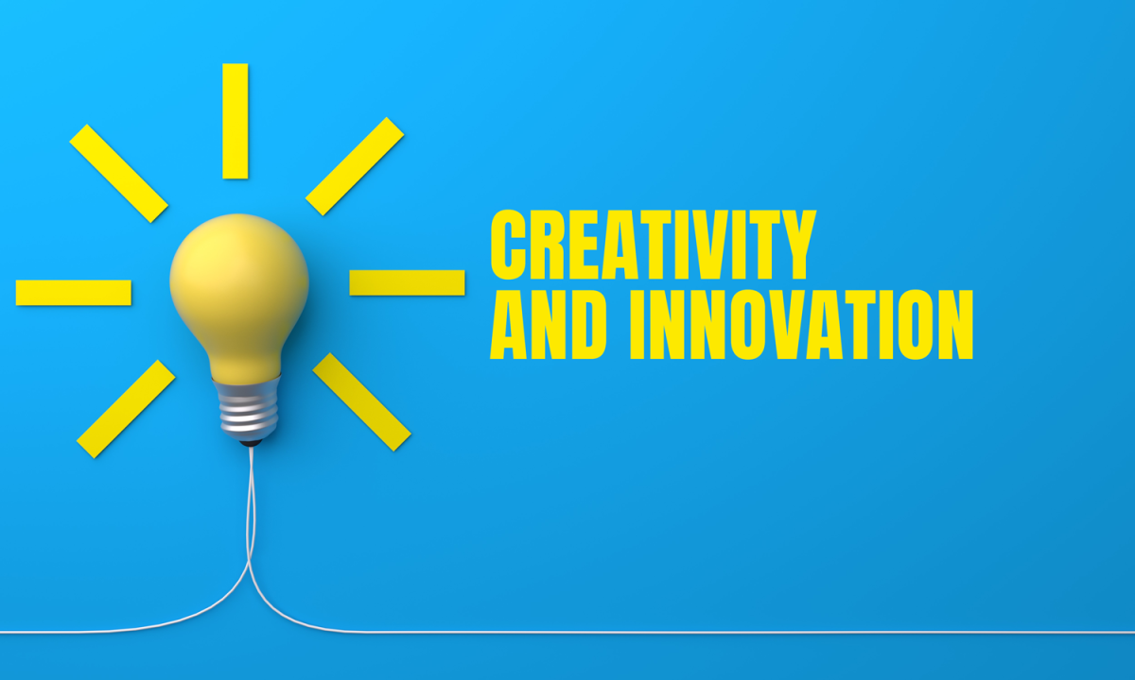
Innovation – The Creative Pursuit of Ideas
Chapter 5

Slide 23
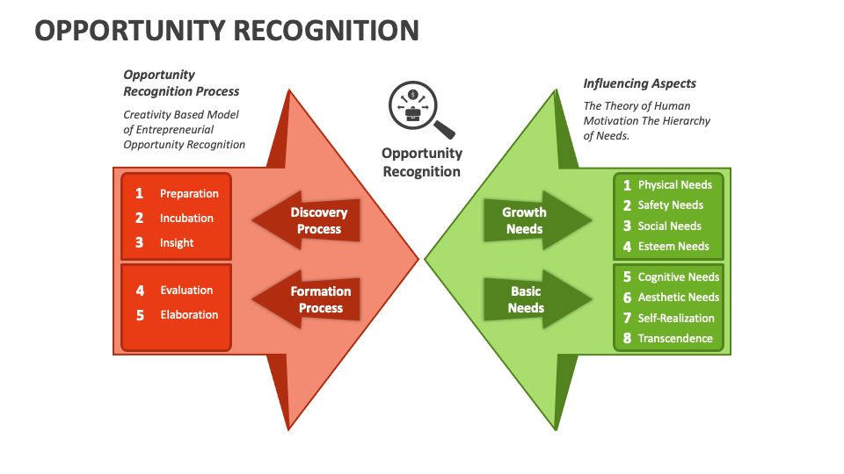
Opportunity Identification
Foundation of Entrepreneurship
Entrepreneurship begins with recognizing opportunities to create value. Opportunities often emerge from:
  Trends
  Unexpected Events
  Incongruities
  Process Needs
  Industry/Market Changes
  Demographic Shifts
  Perceptual Changes
  Knowledge-Based Innovations
    Entrepreneurs transform observations into business opportunities using prior knowledge and learning ability.

Slide 24

Creativity and Entrepreneurial Thinking
Creativity in entrepreneurship is generating ideas that improve effectiveness or efficiency.
  Ask “What if?” and “Why not?”
  See Problems as Opportunities
  Combine Imagination with Structured Thinking
  Use Both Logic and Intuition

Slide 25
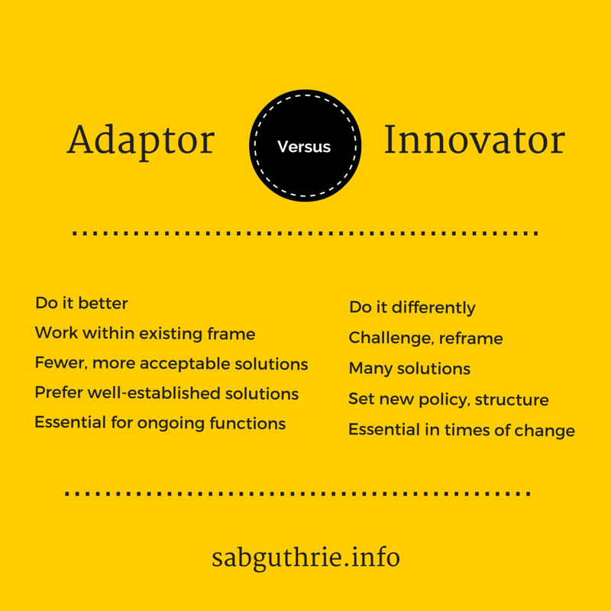
Creativity and Entrepreneurial Thinking
Two Problem-Solving Styles Exist. Both are Valuable.
  Adaptors
    Improve Existing Systems
    Work Methodically
    Focus on Refinement
  Innovators
    Challenge Assumptions
    Seek New Directions
    Prefer Bold Solutions

Slide 26
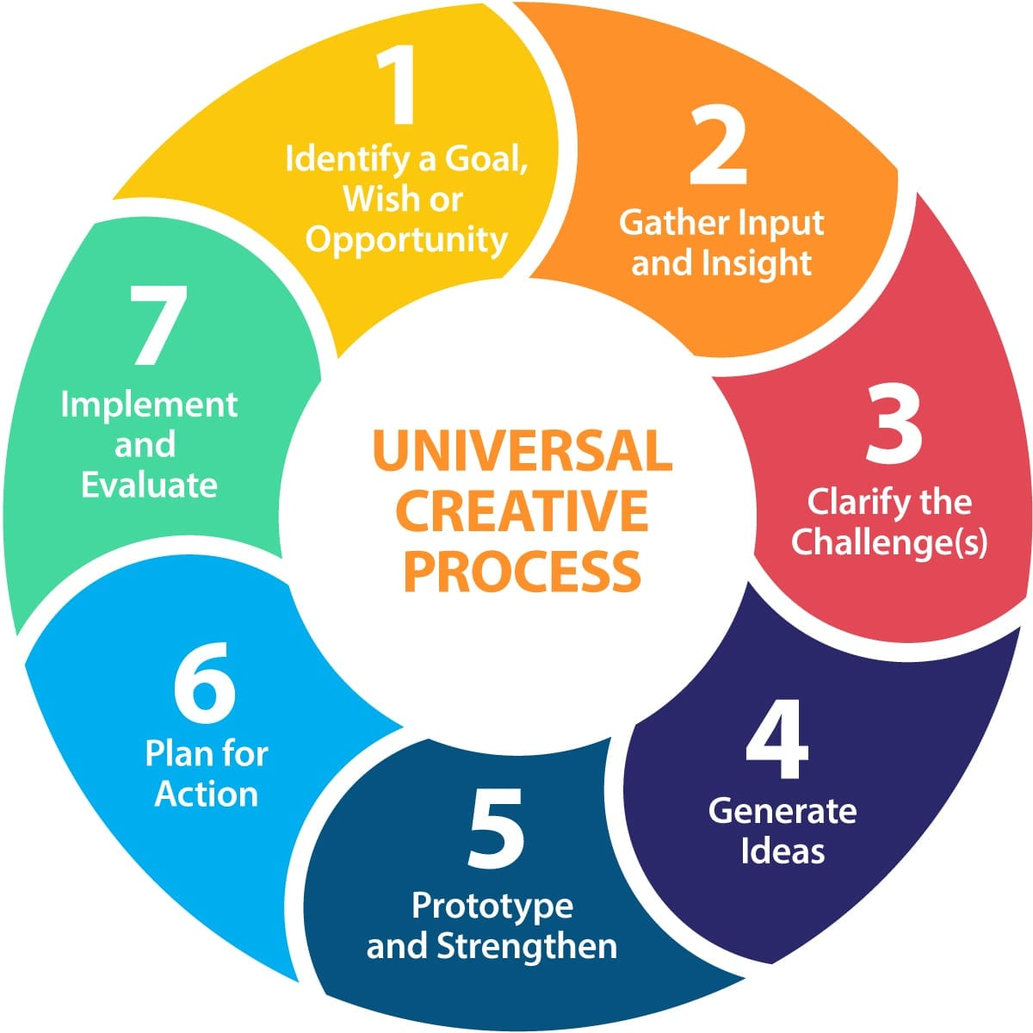
Creativity and Entrepreneurial Thinking
The Four Stages of the Creative Process
  Knowledge Accumulation
    Research – Reading – Networking – Observing Industries
  Incubation
    Let Subconscious Thinking Process Ideas
  Idea Experience
    “Eureka” Moment – Solution Emerges
  Evaluation and Implementation
    Test Feasibility – Refine – Execute

Slide 27
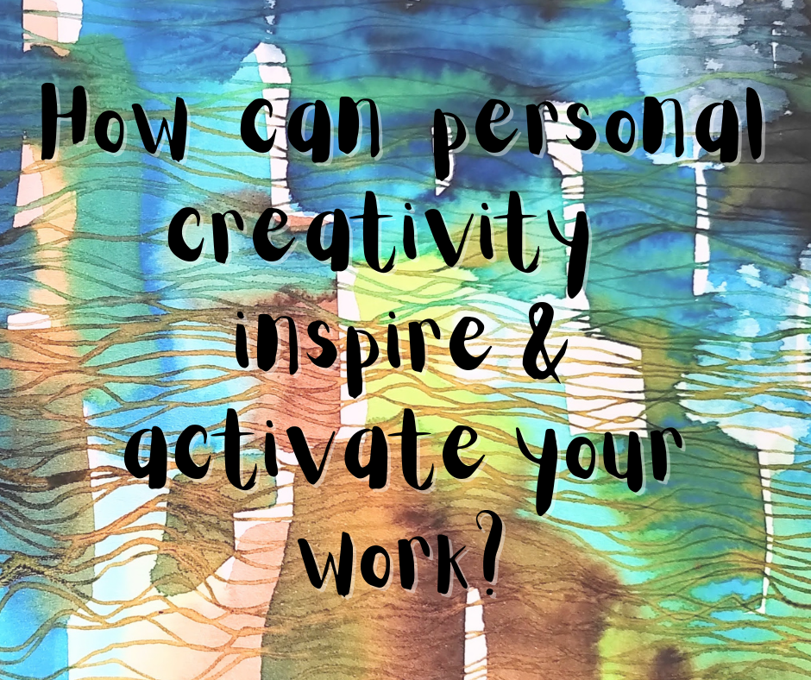
Developing Personal Creativity
Creativity is a Skill That Can Be Trained. Key Strategies:
  Recognize Relationships Between Ideas
  Develop a Functional Perspective (New Uses for Familiar Things)
  Use Both Left-Brain (Logic) and Right Brain (Intuition)
  Avoid Mental Barriers Like:
    Either/Or Thinking
    Perfectionism
    Stereotyping
    Overreliance on Probability

Slide 28

Arenas of Creativity
Where Innovation Happens
Creativity Appears in Many Forms.
  Idea Creativity
  Material Creativity
  Organizational Creativity
  Relationship Creativity
  Event Creativity
  Inner Creativity
  Spontaneous Creativity
    Innovation is not limited to products – it includes leadership, teamwork, and mindset shifts.

Slide 29
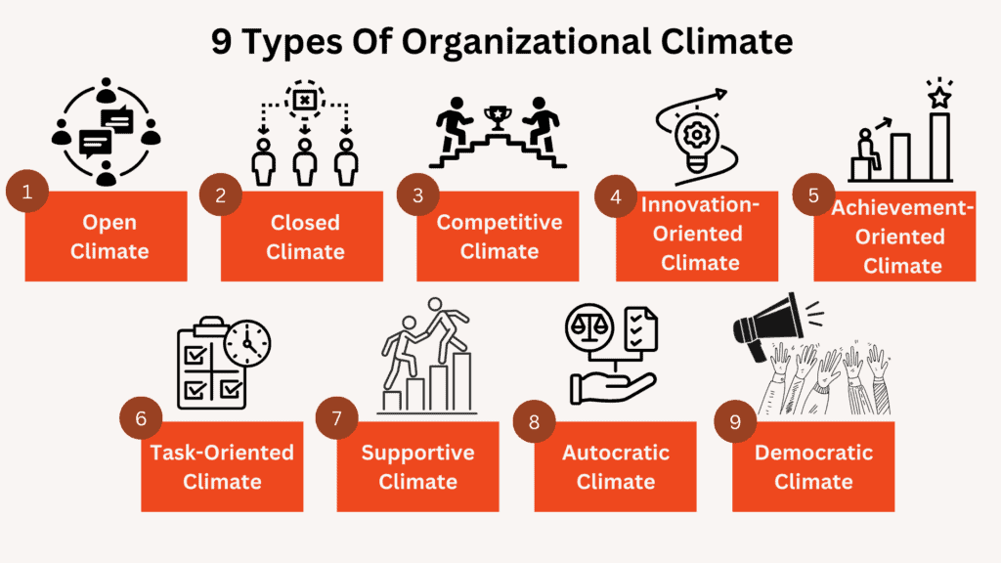
Creative Organizational Climate
Innovation thrives when environments include:
  Trust-Based Leadership
  Open Communication
  Tolerance for Mistakes
  Diverse Personalities
  Experimentation Support
  Sufficient Resources
  External Collaboration
    Culture Shapes Creativity.

Slide 30

Innovation in Entrepreneurship
Innovation converts ideas into market value. It requires:
  Observation
  Customer Understanding
  Experimentation
  Persistence
  Focused Solutions
    Innovation is mostly effort – not inspiration.

Slide 31
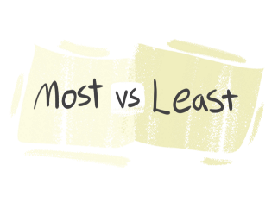
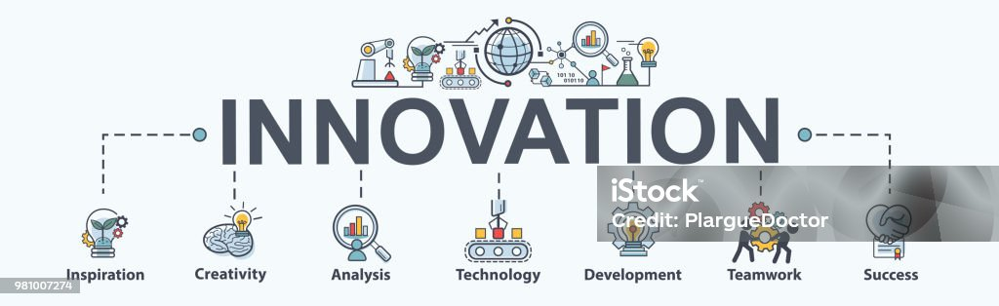
Four Types of Innovation
From Most Original to Least:
  Invention
    Entirely New Solution
  Extension
    New Application of Existing Idea
  Duplication
    Improved Version of Existing Solution
  Synthesis
    Combination of Multiple Ideas

Slide 32

Common Innovation Myths
False Assumptions Include:
  Innovation is Predictable
  Only Large Projects Succeed
  Innovation Depends Mainly on Technology
  Innovation Requires Complete Planning First
  Innovation Comes From Dreams Alone
    Reality: innovation is practical, iterative, and customer-driven.

Slide 33
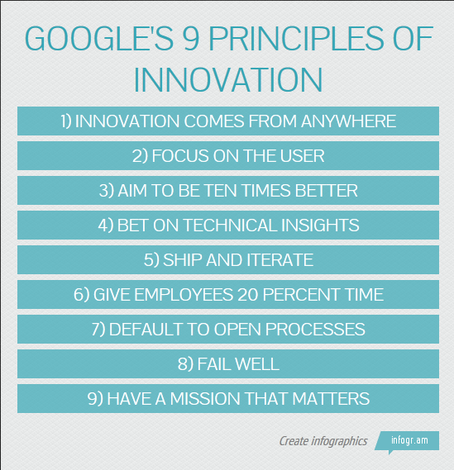
Principles of Innovation
Successful Innovators:
  Act Quickly
  Keep Solutions Simple
  Stay Customer-Focused
  Start Small
  Aim High
  Test and Revise Repeatedly
  Learn from Failure
  Follow Milestones
  Reward Creative Effort
  Work Persistently
    Innovation = Disciplined Experimentation

Slide 34

Understanding the Curriculum
Creative Entrepreneurship is not about random ideas, but about a structured process:
  Observation -> Creativity -> Evaluation -> Implementation

Slide 35

Understanding the Curriculum
It reframes innovation as:
  Learnable
  Repeatable
  Opportunity-Driven
  Customer-Centered

Slide 36
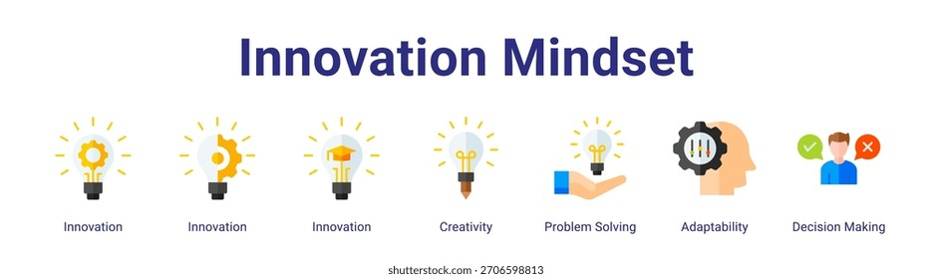
Understanding the Curriculum
It shows that creativity is a behavior, not a personality trait.
  Entrepreneurs succeed because they notice patterns others ignore, connect unrelated concepts, test ideas quickly, tolerate uncertainty, and persist through failure.
    Innovation is less about brilliance and more about the mindset and method.

Slide 37

Practical Application
Spot Opportunities Daily.
  Watch for:
    Inefficiencies
    Customer Frustrations
    Workflow Delays
    Unmet Needs

Slide 38
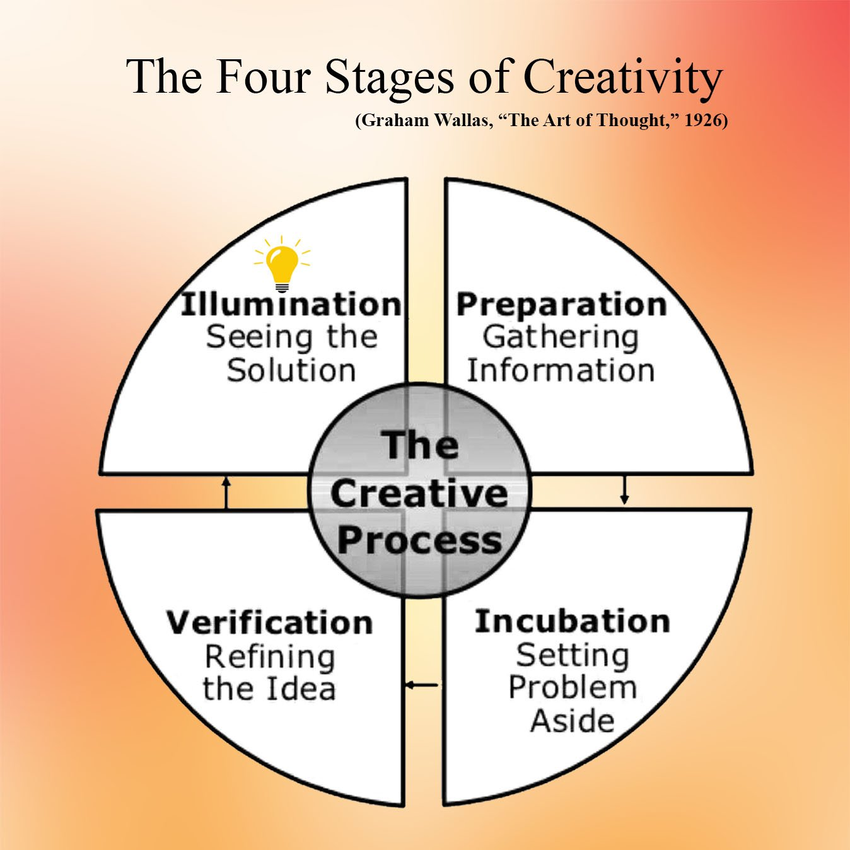
Practical Application
Use the Four-Step Creativity Model
  Research the Problem Deeply
  Step Away From It
  Capture Sudden Ideas
  Test Quickly with Users
    Repeat Until Solution Works.

Slide 39
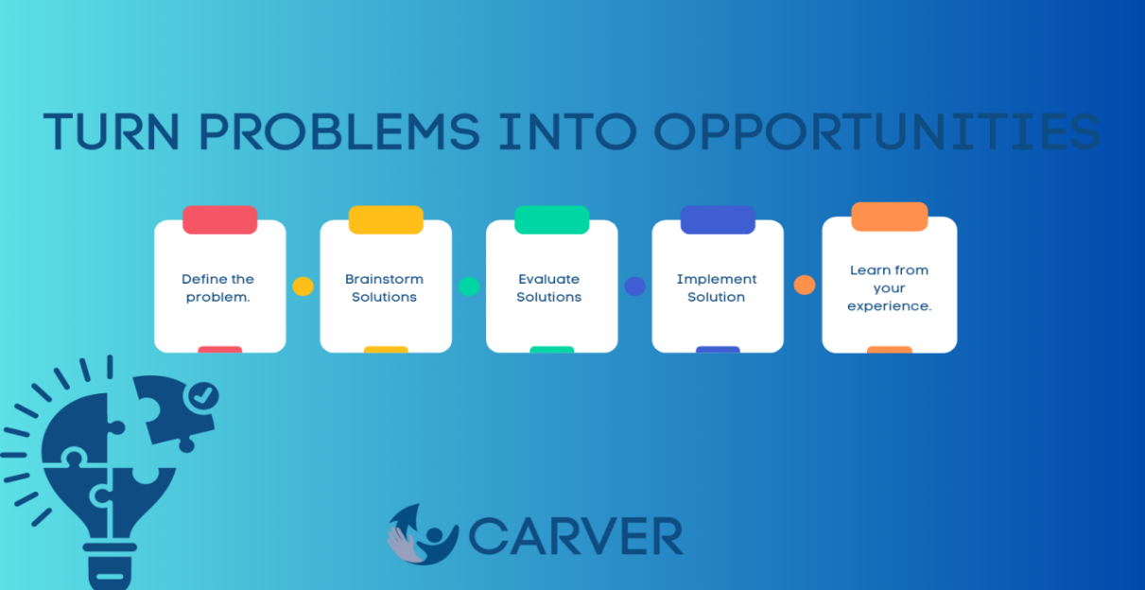
Practical Application
Turn Problems Into Business Ideas. Ask:
  Who Experiences the Issue?
  How Often?
  What Does it Cost Them?
  Would They Pay for a Solution?
    Problems = Market Demand Signals.

Slide 40

Practical Application
Combine Unrelated Things:
  Fitness + Gaming = Fitness Apps
  Banking + Mobile = Digital Wallets
  Education + AI = Personalized Learning Platforms
    Innovation Often Equals Recombination.

Slide 41
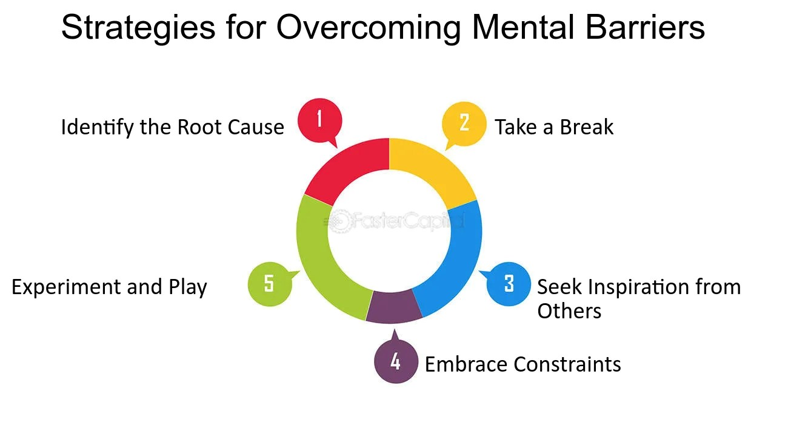
Practical Application
Reduce Mental Barriers
  Instead of saying, “That won’t work”
  Try saying, “What would make this work?”
    This single shift increases creative output dramatically.

Slide 42
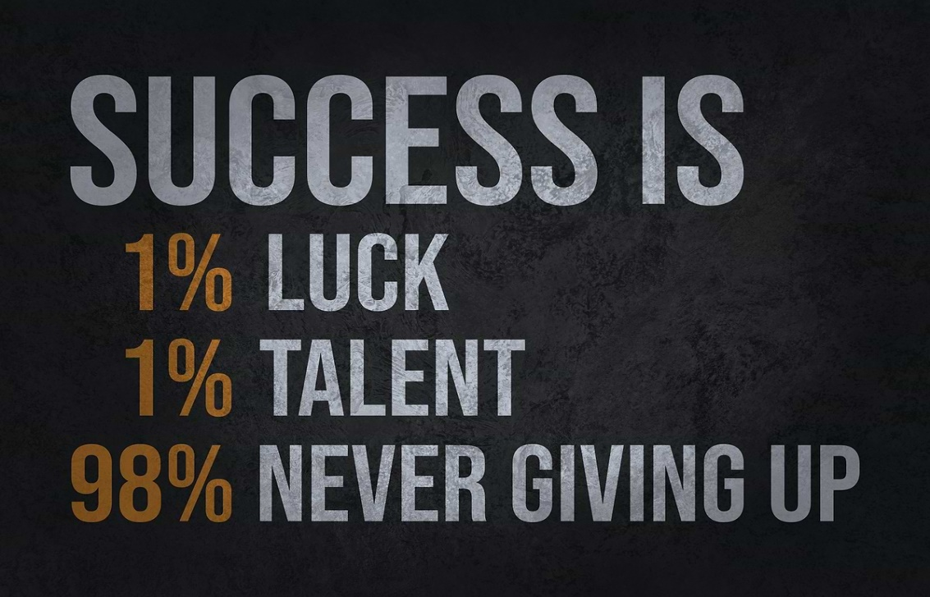
Practical Application
Apply Try-Test-Revise Cycles
  Idea -> Small Test -> Feedback -> Improvement -> Repeat
    This reduces risk and increases success probability.

Slide 43

Practical Application
Start Small But Think Big
  Pilot Project -> Nice Market -> Expansion -> Scaling
    Most successful startups follow this pattern.

Slide 44

Key Takeaway
Entrepreneurial innovation is a disciplined creative process driven by:
  Opportunity Awareness
  Structured Thinking
  Experimentation
  Persistence
  Customer Insight
    Anyone can become more innovative by practicing these steps consistently.

Slide 45


