Slide 1

Customer Service Management
Session One Class Presentation
Customer Service
  Skills for Success – 7th Edition
    Robert W. Lucas; McGraw-Hill Education; New York, NY 2019
      ISBN: 978-1-259-95407-8

Slide 2

Part One: The Profession
Chapter One: The World of Customer Service
  “Treat every customer as if they sign your paycheck, because they do.” (Unknown).

Slide 3
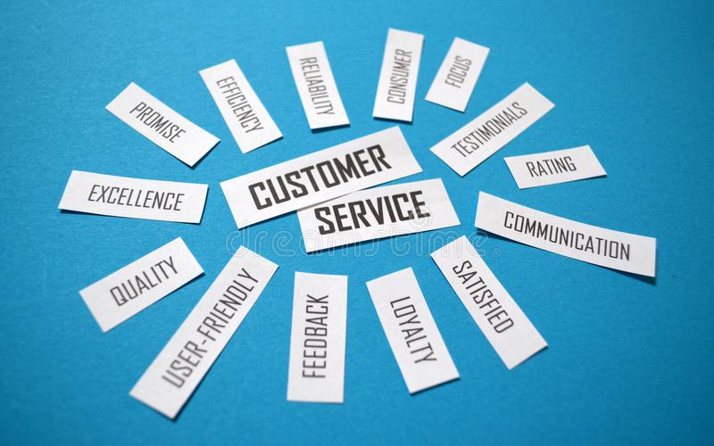
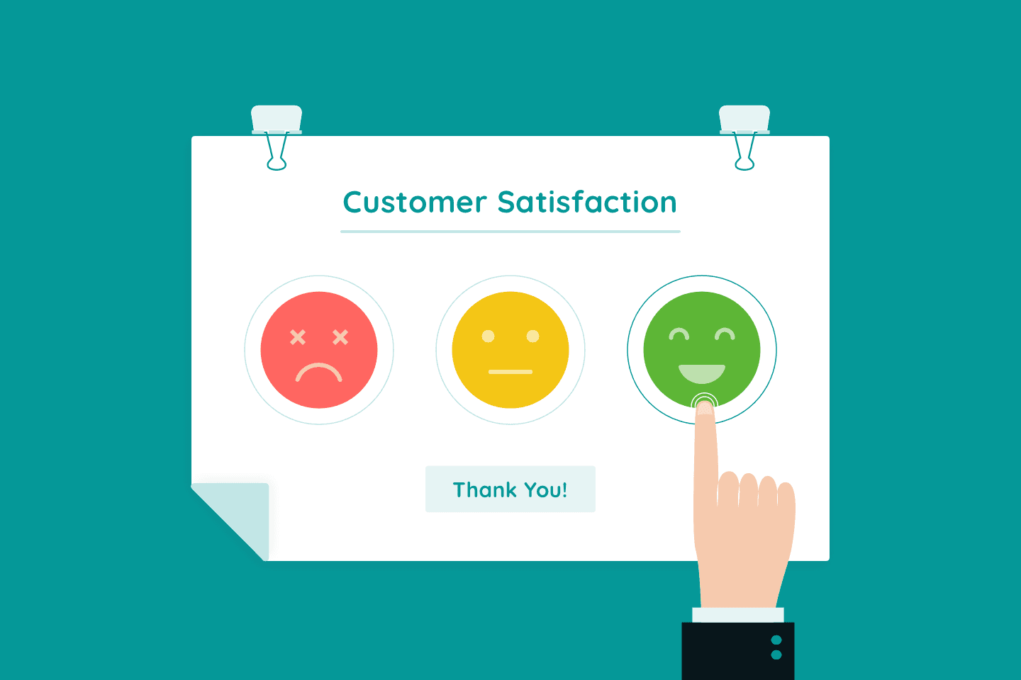
Defining Customer Service
Customer Service is the ability to deliver products and services to customers in a manner that satisfies their needs and results in positive publicity and return business.

Slide 4

Defining Customer Service
By satisfying customer needs, organizations can truly become customer-focused organizations.

Slide 5

Customer-Focused Organizations (CFOs)
CFOs are companies that spend energy and effort on satisfying customers by first identifying their needs, and then establishing policies, procedures, and systems to support excellence in service delivery.

Slide 6
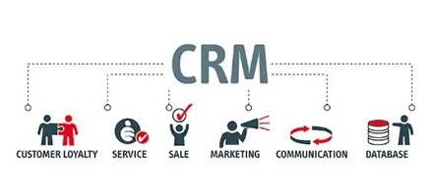
Customer Relationship Management (CRM)
CRM is the concept of identifying customer needs, and understanding and influencing customer behavior through ongoing communication strategies in an effort to acquire, retain, and satisfy the customer.
  The ultimate goal is customer loyalty.

Slide 7
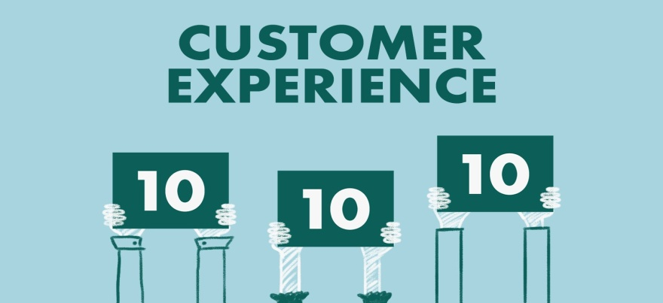
Customer Service
All companies and organizations have both internal and external customers.
  No matter what type of organization you work in, it is crucial for you to remember that when dealing with customers, it is not about you.
  Your purpose and goal should be to assist in meeting their needs whenever possible. Be proactive and positive. Be at your best.
    You have a vested interest to prevail, since your success and that of your organization depend on it.

Slide 8
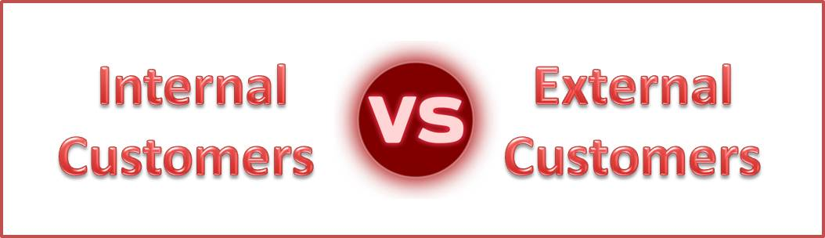
Internal vs. External Customers
Internal Customers
  People within the organization who provide information, products, and services to persons who interact with external customers.
    Such customers include peers, coworkers, bosses, subordinates, and people from other areas of the organization.
External Customers
  People outside the organization who purchase products and services.
    This group includes vendors, suppliers, people on the telephone or Internet, and others not from the organization.

Slide 9

Concept of Customer Service
Business began as barter and trade on farms, in general stores and cottage industries to expanding products and services with traveling salesman.
  The advent of trains, planes, and automobiles led to national and global business and a focus on industry and manufacturing.
    Technological advances created today’s service economy.

Slide 10

Shift to Service
Service Economy is a term used to describe the trend in which businesses have shifted from primarily production and manufacturing to more service delivery.
    As part of this evolution, many organizations have developed specifically to provide services to customers.

Slide 11


Technology’s Impact on the Service Sector
Technology has affected the (1) quantity of jobs created, (2) distribution of jobs, and (3) quality of jobs.
  The service sector is projected to have the largest job growth, particularly in call centers, credit and insurance agencies, retail stores, and banks.
    Employment of customer service representatives is projected to grow faster than average for all occupations.

Slide 12

Parallel Trends in Job Development
Two parallel trends in job development are occurring.
  The need for EEs to be able to have regular access to personal and professional networks and engage in collaborative exchanges.
  The ease of transmission and exchange of info by means of tech.

Slide 13

Network and Education
Make yourself indispensable to your employer by building a strong internal network of associates w/in the organization.
  This will help you share information and resources and add to your personal power base because you will have information that coworkers potentially do not have.
    Also, become thoroughly educated on the products and services that your organization provides and continually volunteer ideas and assistance to improve the organization.

Slide 14

Quality of Service Jobs
Employees who do obtain and maintain the better customer service jobs that provide good working conditions, security, and benefits will be the ones who are better educated, trained, and prepared.
  They will also be the ones who understand and have tapped into the concept of professional networking.
    This is the active process of building relationships inside and outside the organization through meetings; joining boards, committees, associations; interpersonal interactions; and activities that lead to sound relationships and sharing of resources.

Slide 15
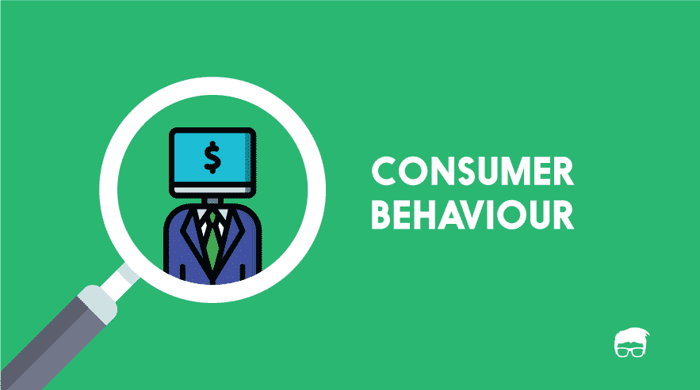
Shifts from Manufacturing to Service
Many factors caused the economic shift from manufacturing to service, including increased technology, globalization, politics, deregulation, and many government programs.
  Additionally, shifts in consumer needs, wants, and expectations, declining economic conditions in some areas, demographic shifts in population are some of the major shifts worldwide.
    It is important for organizations to understand this shift, because if they effectively prepare for and predict coming needs, wants, and expectations they can improve customer service and, ultimately, profit margin.

Slide 16
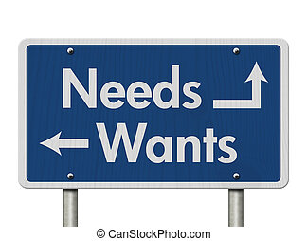

Shifts in Consumer Needs, Wants, and Expectations
Economists use Demand Curves to illustrate shifts in consumer behavior in a particular market.
  Demand Curves are graphic representations of expected behavior in the real world that economists and business people can use to predict coming trends or shifts in consumer needs, wants, or expectations.
    By anticipating changes, they can move revenue or personnel to areas where more customer activity is likely to occur.

Slide 17

Demographic Shifts in Today’s Business World
Many of the shifts that are evident in today’s business world are tied directly to demographic shifts.
  The Aging Population
    Creates a need for a variety of services, such as medical care, vacation planning, transportation, recreational activities, and delivery services.
  Younger Consumers
    Seek out technology-based products, trendy clothing and accessories, activities that involve group engagement, recreation, and entertainment.
  Immigrants
    Often bring needs, wants, and expectations based on their background, beliefs, and values.

Slide 18
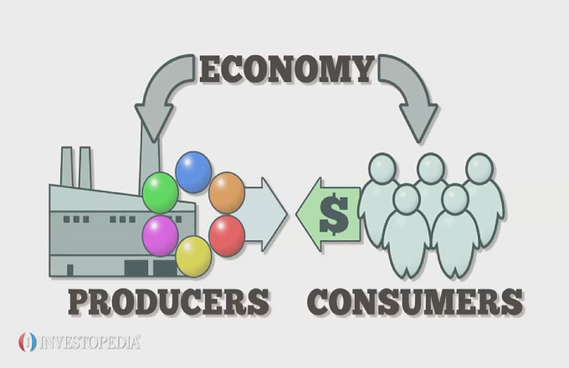
Global Economic Shifts
As the economy took a downward spiral in the latter part of the first decade of the 21st century, consumer confidence shifted, many organizations struggled to provide quality service levels with reduced staff.
  Budgets and revenue from products and services slipped for most organizations as consumers held onto precious cash.
    Consumers often pull back spending when there are economic changes or uncertainty, and businesses are forced to downsize.

Slide 19
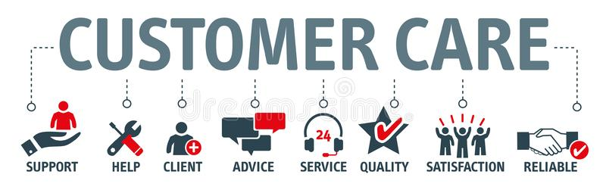
Global Economic Shifts
Large numbers of customers search and do their homework for products and services online and often use retail outlets as a showroom to physically examine things they are interested in potentially purchasing.
  The result is that sales in brick-and-mortar stores are down for many retailers and suppliers.
    The approach to customer service in many instances is no longer “business as usual.” Instead of viewing it as something that should be done well, most see it as something that must be done.

Slide 20

Shifts in the Population and Labor Force
The upside of this growing, evolving, and aging population is that there will be a need for more consumer goods and services to provide for the needs and expectations of diverse customers.
  This will also lead to an expansion of jobs to fill the positions needed to produce products and service customers.
    As experienced workers age out, there is a fairly steady stream of younger skilled workers coming in due to immigration.

Slide 21

Technology Trends
The development and increased sophistication of machines, telephones, service equipment, and computers have caused an increase in production and quality.
  The results of this trend have been acquisition of equipment that enhances the service experience for customers, an increased need for service organizations to take care of the technology, and a decrease in manufacturing and blue-collar jobs.

Slide 22
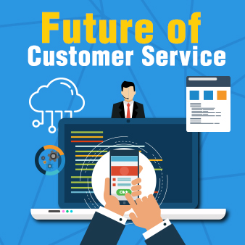
Technology Trends
Service and nonprofit organizations are looking to available technology as a way to communicate with and provide services to their clients and members.
  Expanded Internet access and affordable technology devices allow consumers to shop, search for information, and buy from home.
    The result will be the need for few sales associates and other in-house providers, but doors will open for more customer care representatives, call centers, and technology support people.

Slide 23
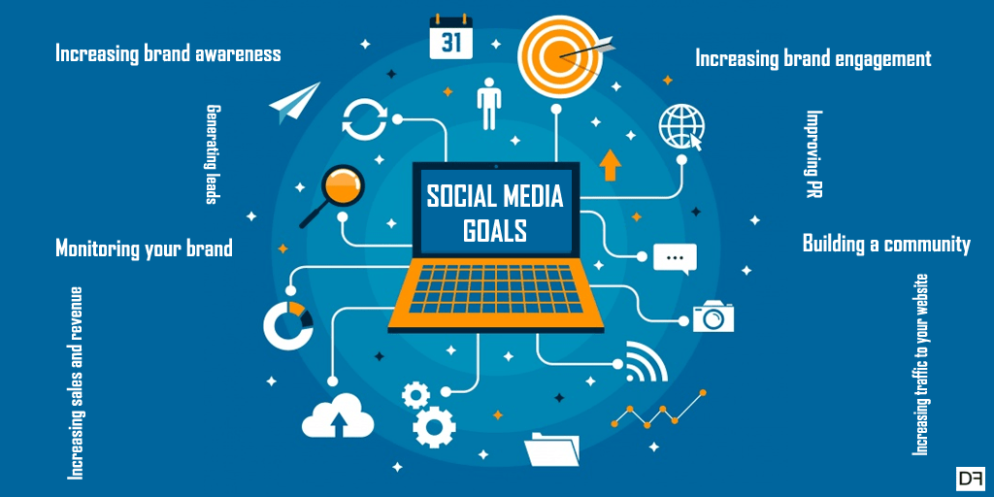
Technology Trends
Many organizations have discovered the power of using social media in their marketing and sales initiatives.
  Not only can they receive and give customer feedback quickly, but they can also send out information about pertinent products, services, and events, and do it a lot cheaper than through traditional marketing and advertisement initiative cost.
    Some organizations also use social media to look for new EEs.

Slide 24

Globalization of the Economy
Advances in technology, communication, and transportation have opened new markets and allowed decentralized worldwide access for production, sales, and service.
  To survive and grow organizations need to sharpen service skills of their EEs, strengthen their quality, enhance their use of technology, and look for new ways of demonstrating that they can meet and exceed customer expectations.

Slide 25

Changing Values
As the world changes so do individual values.
  Such changes can have an impact on what people view as valuable and important, what they want and desire, and how they approach relationships with others around them.
    People in the U.S. value such things as personal control, equality, individualism, action, and competition. People from other parts of the world value traditionalism, group cohesiveness, societal ownership, and acceptance of hierarchy, status, and birthright.

Slide 26

Changing Values
Throughout the world, there has been a tremendous amount of dynamic change in the recent past due to economic instability, quickly expanding and enhanced technology, global mobility where people move quickly and frequently, and other factors.
  The result has been a gradual shift in what many customers hold near and dear.

Slide 27

Changing Values
Because different societies view what is important from different perspectives, clashes can sometimes result when service providers encounter customers who have values different from their own.
  The important thing to remember in such situations is that neither the customer nor the provider has the “right” set of values; they are simply different and each must respect and honor those of the other party if a positive customer-provider relationship is to occur.

Slide 28
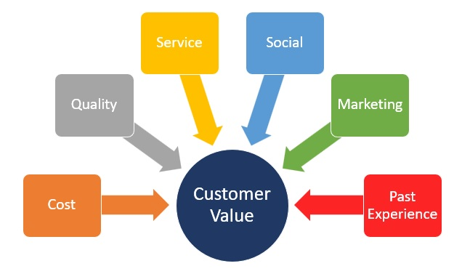
Changing Values
As a result of societal values, companies often change their approach to doing business.
  They focus on finding ways to attract and hold customers. This often includes shifting the way they do business, the products that they deliver, and the manner in which service is delivered.

Slide 29

Different Mindset
In the past, many consumers took “money is no object” approach to shopping because, if they did not have cash readily available, they had credit cards in their wallet that allowed them to spend (often beyond their means).
  Many consumers have had a reality check and have learned that prudence is an important element of commerce.
    A majority of consumers who formerly acted on impulse and bought whatever they desired are now taking a cautious approach.

Slide 30
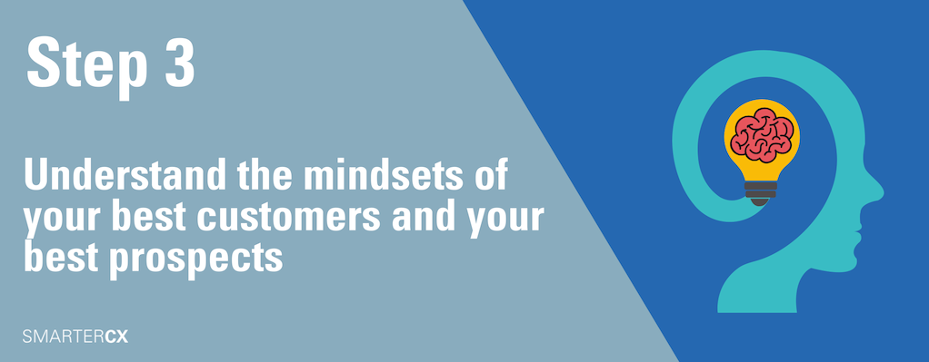
Different Mindset
Recent economic reports are now indicating that people have begun to shift from a “cutting back” mentality to a slightly more optimistic “cautious spending” approach.
  Part of their new strategy is to re-evaluate their paradigm, or the way they look at products.
    Where they might have only gone for the nationally known brand or reputation in the past, they now evaluate and consider generic or store brands with comparable options and services offered by local providers.
    They are also being more conscientious about their spending and seek discount retailers and comparison shop.

Slide 31
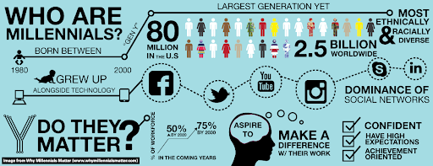
Different Mindset
Another interesting outcome of the recession and job loss is that consumers, especially younger ones, want to have less financial obligation in case something traumatic happens in their life related to employment and financial security.
  Many millennials forego fancy cars, mortgages, large furnishing purchases, and abandoned the shopping patterns of their parents.

Slide 32

Expectation of Quality Service
Most customers expect that if they pay a fair dollar, in return they will receive a quality product or service.
  If their expectations are not met, they simply call or visit a competing company where they can receive what they think they paid for.
    The expectation of quality service creates a need for better-trained and better-educated customer service professionals.

Slide 33
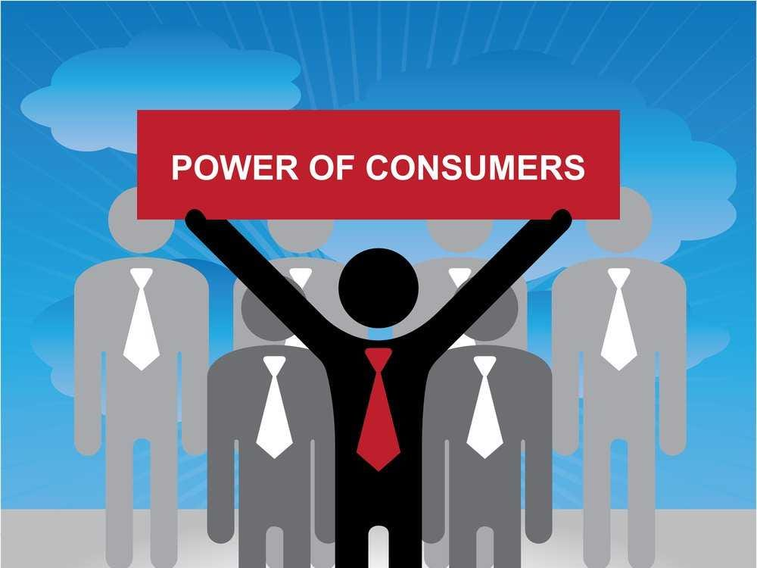
Enhanced Customer Preparation
Customers are not only more highly educated than the past, they are also well informed about price, quality, and value of products and services.
  Since the Internet, consumers are in a “position of power” when dealing with organizations providing products and services wanted.
    Having access to the same information and tools that sales people have available to them levels the playing field.

Slide 34

Enhanced Consumer Preparation
Armed with knowledge about what they should receive for their money, consumers make it difficult for less-than-reputable businesses to prosper or survive in today’s world.
  They must provide customer satisfaction or face losing customers to competitors.
    They also face potential negative publicity through social media where customers can immediately post comments about the level of service and product quality that they receive.

Slide 35

Customer Satisfaction
Customer Satisfaction is the feeling of a person whose needs have been met by an organization.

Slide 36

The Customer Service Environment
A viable customer service environment is the responsibility of every employee of the organization – not just the customer service representatives.

Slide 37
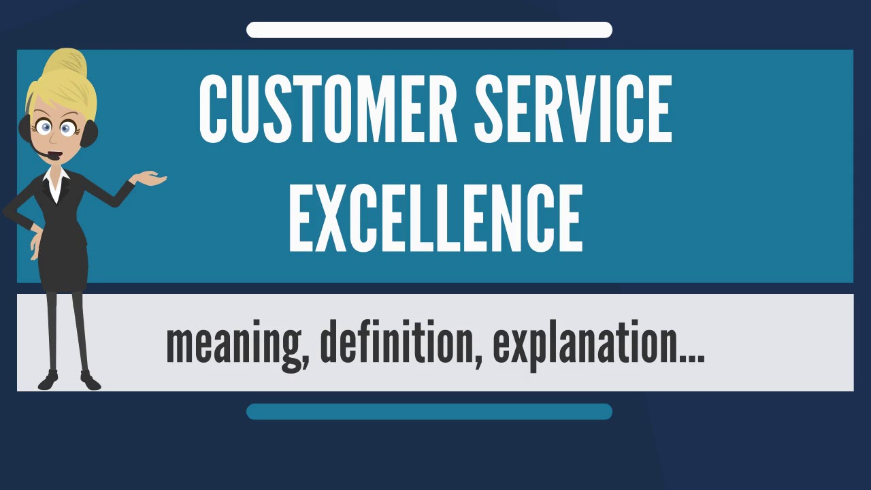
Components of a Customer Service Environment
Many factors affect your customers and what they perceive as quality service. With the exception of the customer, all these factors are under control of the organization.
  Six Key Components of a Customer Service Environment:
    The Customer
    Organizational Culture
    Human Resources
    Products and Deliverables
    Delivery Systems
    Service

Slide 38

1. The Customer
The central component in a customer-focused environment is the customer.
  By striving to identify the specific needs of each individual customer, and then acting to satisfy them, EEs can help ensure their loyalty, satisfaction, and positive word-of-mouth publicity.
    By remembering that all aspects of the service organization revolve around that crucial entity and that without the customer, there is no reason for any organization to exist, service professionals help ensure personal and business success.

Slide 39

Two Kinds of Customers
External Customers
  External Customers may be current or potential customers or clients. They are the ones who actively seek out; research, and buy, rent, or lease products or services.
Internal Customers
  Internal Customer are coworkers, employees of other departments or branches, and other people who work at the same organization.
    Employees from different areas of an organization depend on others for information, products, and services to better meet the needs of their external customers.

Slide 40
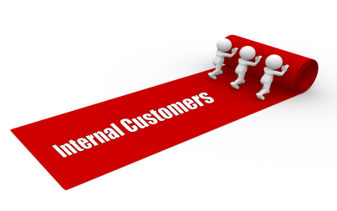
Internal Customers
Suggestions for building stronger relationships and better serving internal customers:
  Be reliable. Follow through.
  Develop positive relationships. Say Please and Thank You.
  Take time to get to know more about others.
  Listen objectively. Consider the merits of others’ ideas.
  Acknowledge the contributions of others. Share Credit.
  Show appreciation for help provided by others. Acknowledge them.
  Avoid office politics and gossip. Maintain good reputation.
  Help others. Be generous and willing to assist.
  Respect diversity. Appreciate other views, values, and beliefs.

Slide 41

Internal Customers
Recognizing internal customers is important and crucial to everyone in the organization for on-the-job success.
  That is because, in the internal customer chain, an employee is sometimes a customer and at other times a supplier.
    Only when both parties are acutely aware of their role in this customer-supplier relationship can the organization effectively prosper and grow to full potential.

Slide 42
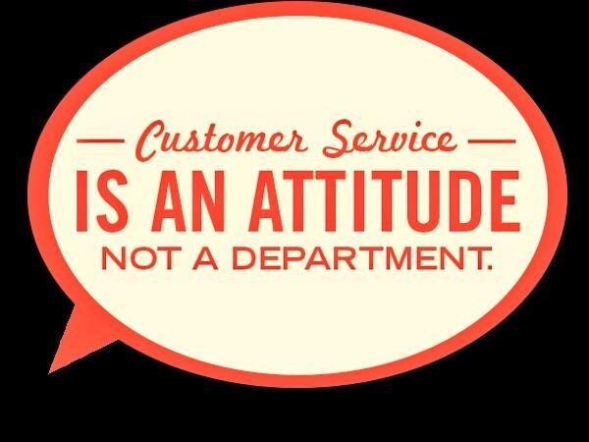
Internal Customer
The important point to remember related to your internal customers is that you must take care of them, just as you do your external customers.
  They must be serviced effectively and treated with respect in order to allow them to provide exceptional service to their customers.
    Without the information, products, and services that you provide them, they do not have the tools needed to do their job.

Slide 43

2. Organizational Culture
Organizational Culture includes any element of an organization that a customer encounters.
  It includes the dynamic nature of the organization and its employees and managers.
    The experiences, attitudes, and norms cherished and upheld by employees and teams within the organization set the tone for the manner in which service is delivered and how service providers interact with both internal and external customers.

Slide 44
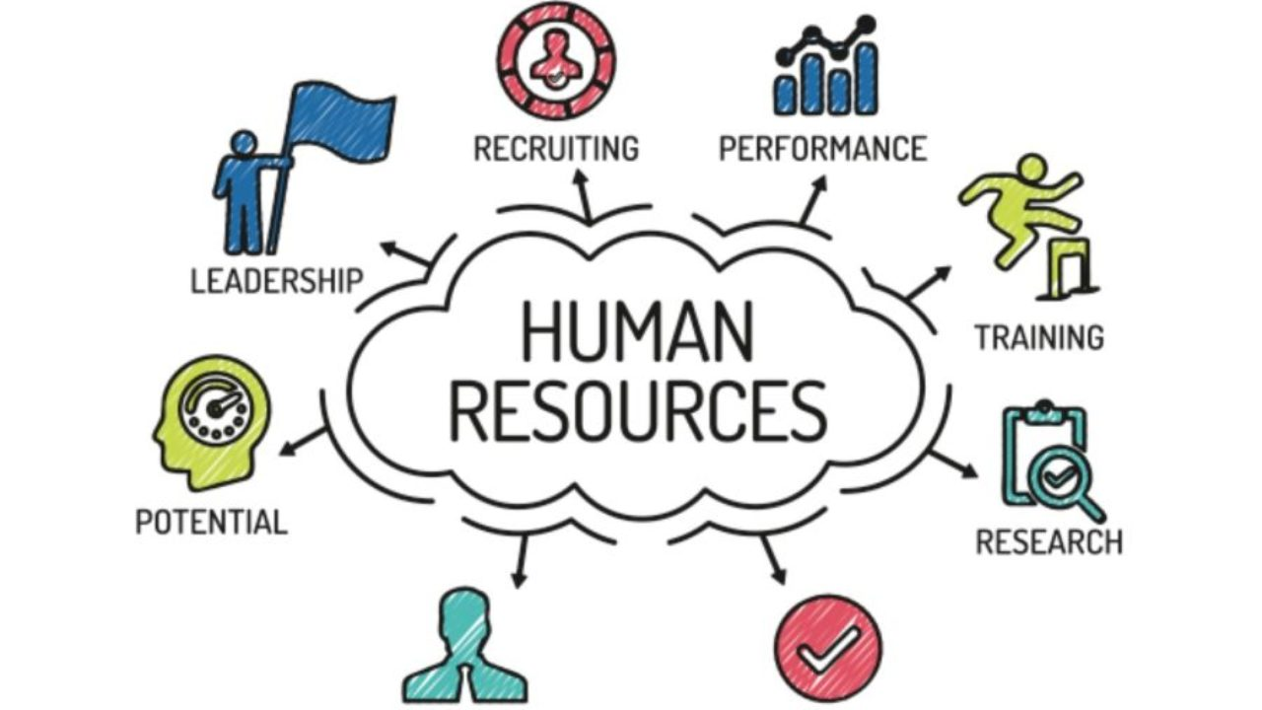
3. Human Resources
Human Resources refers to employees of an organization.
  To make the culture work, an organization must take great care in recruiting, selecting, training, and retaining qualified people.
    Without motivated, competent workers, any planning, policy and procedure change or system adaptation will not make a difference in customer service.

Slide 45
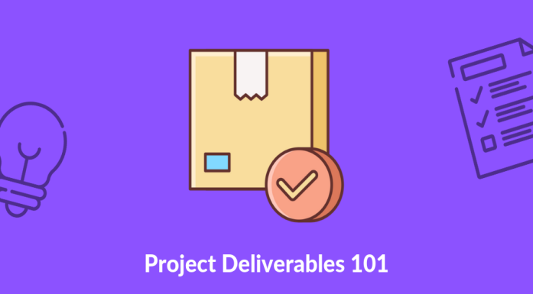
4. Deliverables
A deliverable may be a tangible item manufactured or distributed by the company or a service available to customer.
  There are two potential areas of customer satisfaction or dissatisfaction – quality and quantity.
    If customers receive what they perceive as a quality product or service to the level expected, and in the timeframe promised or viewed as acceptable, they will be satisfied. On the other hand, if customers believe that they were sold an inferior product or given an inferior service or one that does not match their expectations, they will be dissatisfied and could take business elsewhere.

Slide 46
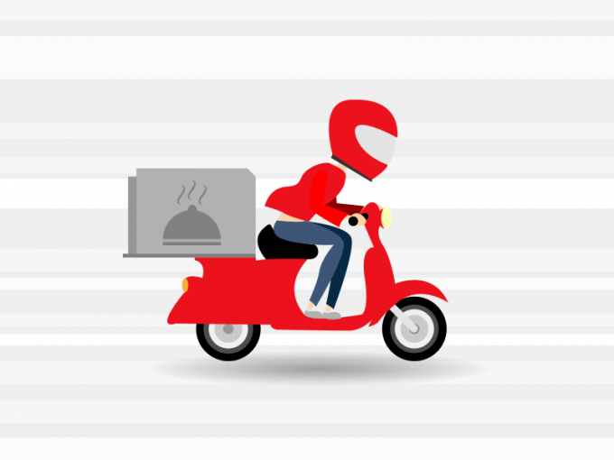
5. Delivery Systems
Delivery Systems are the methods used by an organization to provide services and products to its customers.
  In deciding on delivery systems, organizations examine the following factors:
    Industry Standards
    Customer Expectations
    Capabilities
    Overall Costs
    Current and Projected Requirements

Slide 47
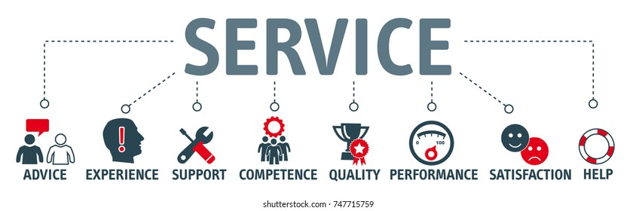
6. Service
Service is the manner in which you and other employees treat your customers and each other as you deliver your company’s products and/or services.
  Effective use of the techniques and strategies related to quality service is required in order to satisfy the needs of customers.

Slide 48
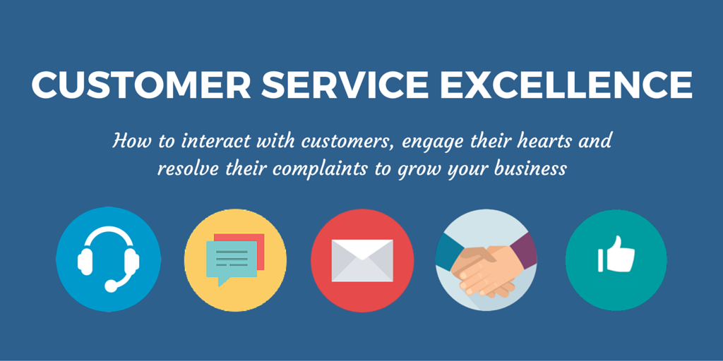
Addressing the Changes
All customer-based organizations must provide excellence in service and an environment in which customer needs are identified and satisfied.

Slide 49
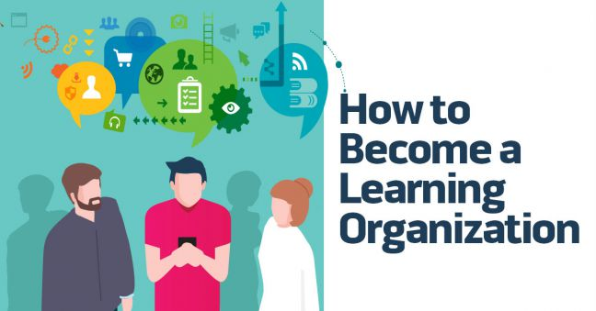
Addressing the Changes
All organizations must become Learning Organizations.
  A learning organization is one that uses knowledge as a basis for competitive advantage. This means providing ongoing training and development opportunities to employees so that they can gain and maintain cutting-edge skills and knowledge while projecting a positive can-do customer-focused attitude.
    Learning organizations ensure there are systems that can adequately compensate and reward employees on the basis of their performance.

Slide 50

Addressing the Changes
In the past, organizations took a reactive approach to service by waiting for customers to ask for something or by trying to recover after a service breakdown.
  In today’s economy, a proactive approach of anticipating customer needs is necessary and becoming common.
    Every EE must take personal responsibility for customer care, and managers should empower employees at all levels to do whatever is necessary to satisfy the customer.

Slide 51

Service Recovery
If a service breakdown does occur, managers in customer-focused organizations should empower EEs at all levels to do whatever is necessary to satisfy the customer.
  Management must educate and train employees on the techniques and policies available to help serve the customer. They must then give employees the authority to act without asking for management intervention in order to resolve customer issues.
    This concept is known as Service Recovery.

Slide 52


