Slide 1
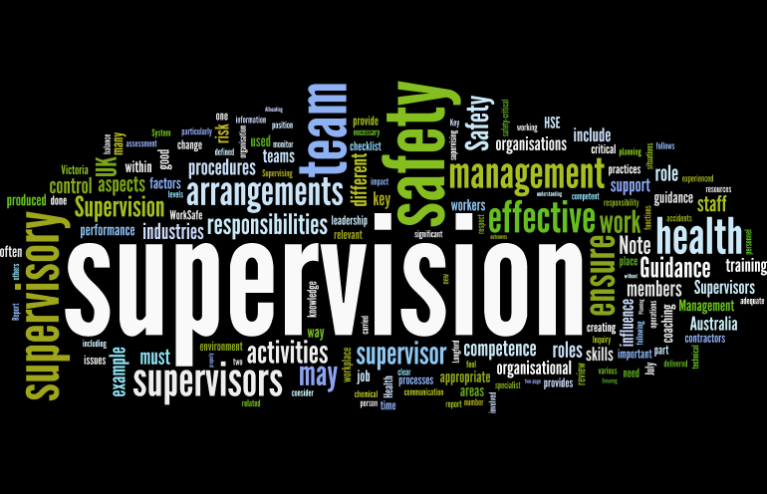
Supervision
Supervision
  Concepts and Practices of Management, 13th Edition
    Edwin C. Leonard, Jr., Ph.D. and Kelly A. Trusty, Ph.D. Cengage Learning, Boston, MA 2013
      ISBN: 978-1-285-86637-6

Slide 2


Part Three: Organizing, Staffing, Managing and Measuring for Success
Chapter Ten: Empowering Employees for Success
  After studying this chapter, you will be able to:
    Discuss the interaction between the supervisor and the human resources department in empowering employees for success.
    Describe actions supervisor should take to prepare for selection process.
    Identify what the supervisor can do to ensure that the most qualified applicant is chosen.
    Describe the hiring process and the importance of documentation.
    Understand how to conduct an effective onboarding program.
    Explain approaches to training and supervisor’s role in EE development.

Slide 3
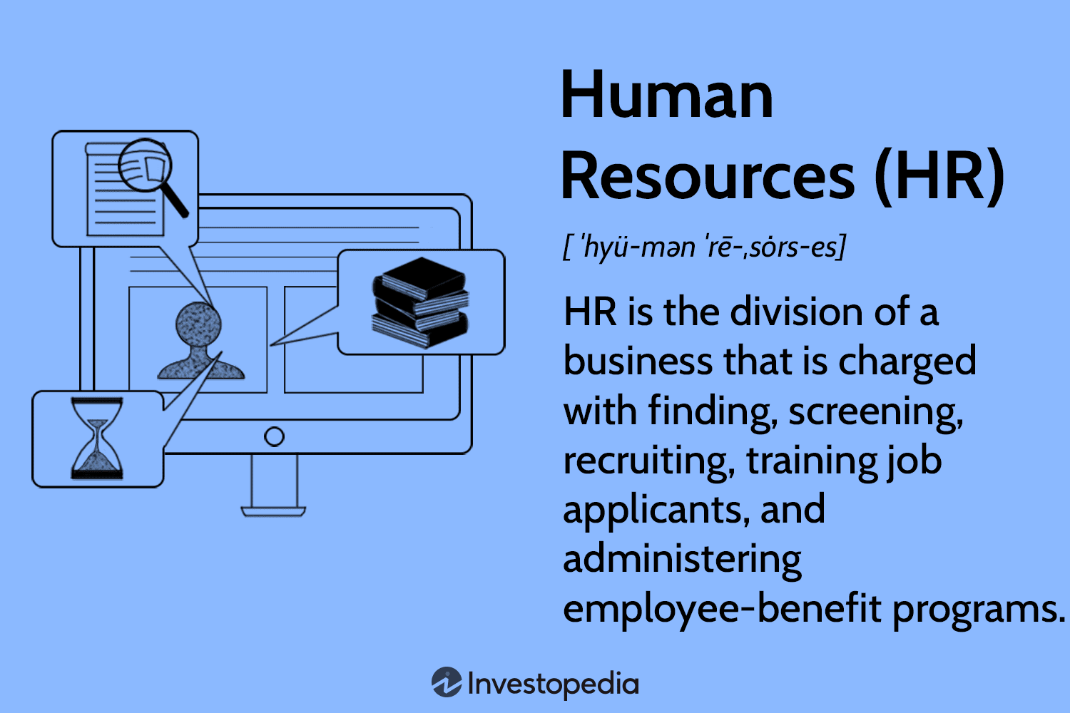
The Human Resources Department and the Supervisor’s Staffing Responsibilities
Regardless of the organization, a qualified workforce must be recruited and maintained in order for the organization to be competitive and successful.
  The management of human resources is the supervisor’s most important activity, and it begins with staffing.

Slide 4

The Human Resources Department and the Supervisor’s Staffing Responsibilities
Staffing involves the recruitment, selection, placement, orientation, and training of employees.
  These activities are part of every supervisor’s responsibilities, although staff specialists may provide help and support.
    The supervisory function also includes the evaluation of EE performance and input regarding how they will be rewarded for their performance.

Slide 5
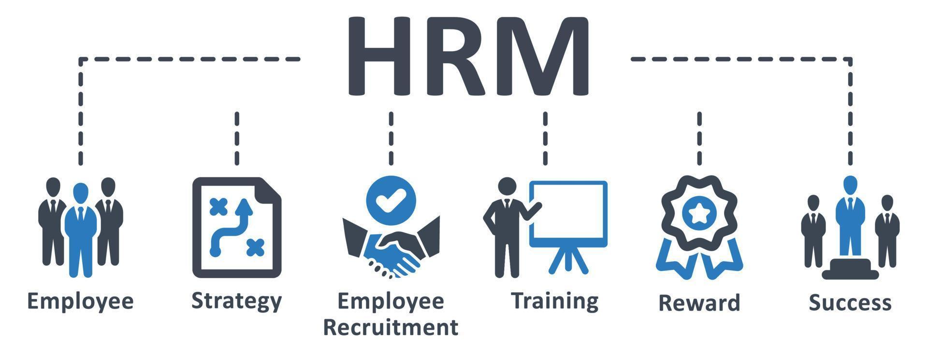
The Human Resources Department and the Supervisor’s Staffing Responsibilities
Human resource management (HRM) encompasses the philosophy, policies, procedures, and practices related to the management of people in the organization.
  To perform the activities necessary to accomplish its goals, every organization must have human resources and use them effectively.
    To facilitate these activities, many firms have a human resource (HR) department.

Slide 6
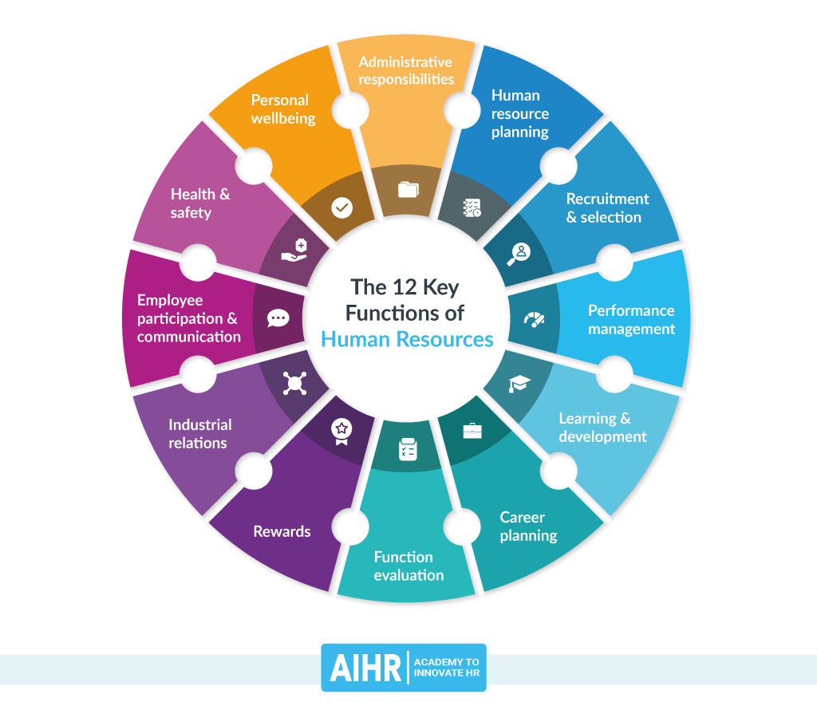
The Human Resources Department and the Supervisor’s Staffing Responsibilities
For many organizations, the role and size of the HR department has expanded, in part, because of the need to comply with government regulations.
  At the same time, some organizations have found it cost-effective to contract out, or outsource, some HR activities.

Slide 7

Human Resources Advice and Supervisory Decisions
The usefulness and effectiveness of any HR department depends on its ability to develop close working relationships with managers and supervisors.
  Effective HR professionals are responsible for developing and implementing strategies, policies, and procedures that enable the organization’s EEs to be the best they can be.

Slide 8
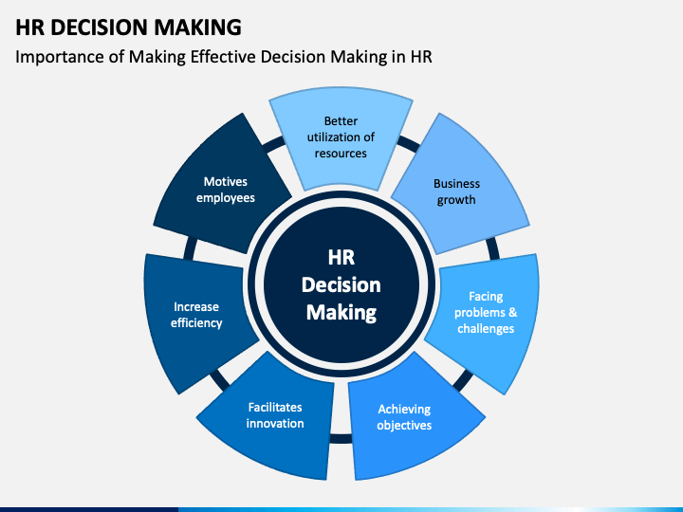
Human Resources Advice and Supervisory Decisions
The HR department is often given primary responsibility for certain activities, and supervisors must follow HR requirements with little or no discretion.
  (X) Certain policies and practices regarding Equal Employment Opportunity (EEO), labor relations, and wage rates are typically formulated and directed by the HR department, but there are many areas and situations in which supervisors must make the decisions.

Slide 9

Human Resources Advice and Supervisory Decisions
Because employee problems arise continually, supervisors should consult with the HR department for assistance, information, and advice.
  HR staff members usually prefer to offer suggestions to supervisors, who, in turn, must decide whether to accept, alter, or reject those suggestions or recommendations.
    Whenever a member of the HR staff has expertise and knowledge directly related to a decision, the supervisor will usually follow that person’s advice and recommendations.

Slide 10

Human Resources Advice and Supervisory Decisions
Some situations pit the supervisor against the HR department.
  Managers often wait until a land mine has detonated to go to HR, rather than working in tandem with HR to solve problems.
  For example, a supervisor avoiding taking an EE problem to HR and threatening to fire a team member if they don’t keep quiet about it; or a manager failing to disclose discrimination or potential violence to HR because an EE shared information “off the record.”
    Situations such as these expose EEs, the supervisor, and the organization as a whole to substantial legal and other risks.

Slide 11

Human Resources Advice and Supervisory Decisions
Some supervisors readily welcome the willingness of the HR staff to make certain decisions for them so that they will not have to solve difficult EE problems in their own departments.
  However, even when supervisors follow the advice of HR, they are still accountable for their decisions.

Slide 12

Human Resources Advice and Supervisory Decisions
The HR Department is not responsible for the performance of a supervisor’s department.
  Usually, the departmental supervisor will have a better understanding of unique factors than anyone else.

Slide 13

Determining the Need for Employees
The staffing function is an ongoing process for the supervisor; it is not something that is done only when a department is first established.
  Although it has a nucleus of EEs, the department will undergo changes due to EE separations from the workforce, changes in operations or growth, or other reasons.
    Because supervisors depend on EEs for results, they must make certain that there are enough well-trained EEs to fill all positions.

Slide 14

Determining the Need for Employees
An ongoing aspect of the supervisory staffing function is that of determining the department’s need for employees, both in number and job positions.
  Supervisors should become familiar with departmental jobs and functions and should consult the organizational chart or manual.
    The supervisor should study each of these job categories to determine how many positions are needed to get the work done and how EEs should work together.

Slide 15

Determining the Need for Employees
Supervisors may have to compromise by adjusting a preferred arrangement to existing realities or by combining several positions into one if there is not enough work in a particular function to keep one EE busy.
  By carefully studying the department’s organization, the supervisor can reasonably determine how many EEs and what skills are needed to accomplish the various work assignments.

Slide 16
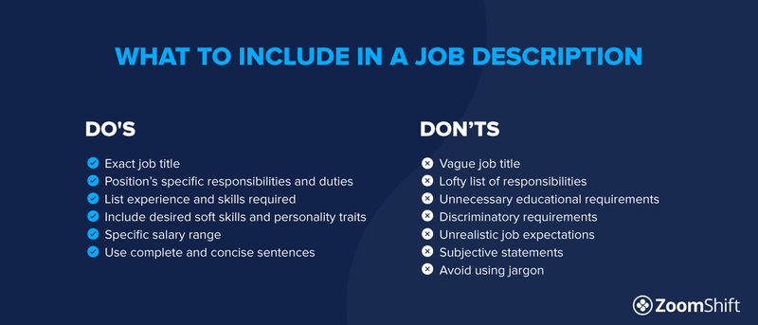
Developing Job Descriptions and Job Specifications
After determining the number of positions and skills that are needed, the supervisor’s next step is to match jobs w/ individuals.
  This usually is done with the aid of job descriptions, which indicate the duties and responsibilities of each job.

Slide 17

Developing Job Descriptions and Job Specifications
The supervisor may find it helpful to ask departmental EEs to write down the tasks they perform during a given period.
  This task list gives the supervisor considerable information from which to strengthen or develop a job description.
    While the final job description may be written by HR, the supervisor is responsible for determining what goes into it.

Slide 18

Developing Job Descriptions and Job Specifications
Job descriptions that describe jobs accurately help supervisors provide realistic job previews, develop performance standards, conduct performance appraisals, and perform other staffing functions.
  As part of the annual job evaluation, supervisors should review what the EE needs to know and the qualifications necessary to perform the designated activities.

Slide 19
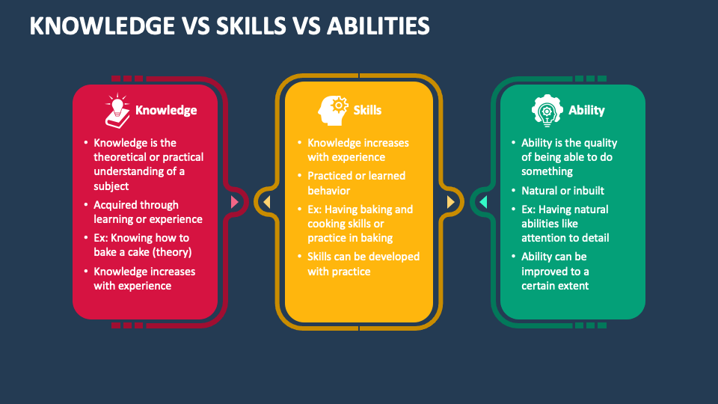
Developing Job Descriptions and Job Specifications
After the content of each job has been determined or evaluated, the supervisor should identify the knowledge and skills required of EEs who are to perform the job.
  A written statement of required skills, knowledge, and abilities (SKA) is called a job specification.
    The job description and specification are combined into one document.

Slide 20

Determining How Many Employees to Hire
Normally, a supervisor must hire a replacement when a regular EE leaves the department for reasons such as promotion, transfer, resignation, dismissal, or retirement.
  In such cases, there is little question that the job must be filled.
    However, if major technological changes or downsizing are anticipated, a replacement may not be needed.

Slide 21

Determining How Many Employees to Hire
There are other situations which may require additional EEs.
  If new functions are to be added to the department and no one in the department possesses the required knowledge and skills, it may be necessary to go into the labor market and recruit new EEs.
  Also, a supervisor may ask for additional help because the workload has increased and the department is under extreme pressure.
    Before requesting additional help, the supervisor should make certain that the EEs currently in the department are being utilized fully and that any additional help is necessary and in the budget.

Slide 22

Soliciting Recruitment and Selection Assistance
When supervisors have open positions in their departments, they normally ask HR to recruit qualified applicants.
  Whether a job will be filled by someone from within or outside the organization, HR knows where to look to find qualified applicants.
  Most companies fill job openings through promotions and transfers.
    Promotions reward EEs for accomplishments; transfers can protect EEs from layoffs or broaden their knowledge.

Slide 23

Soliciting Recruitment and Selection Assistance
Internal applicants already know the organization, and the costs of recruitment, orientation, and training are usually less than those for external applicants.
  Hiring from within sends two clear messages:
    There is a future for someone in the long-term, not only to grow within the current job but also within the company.
    If you continue to learn more and more about the business and add skills to your toolbox, there are often opportunities available to you.

Slide 24
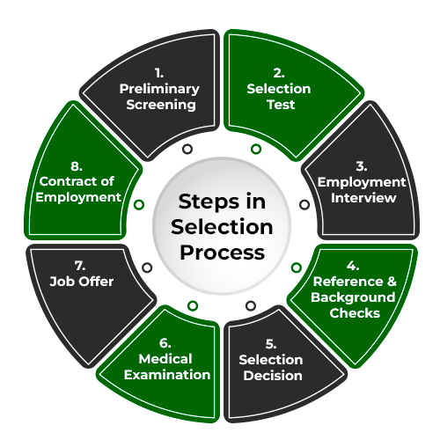
Preparing for Selection
Because the purpose of the selection process is to choose the most qualified person to fill the needs of the organization, supervisors with the help of HR must plan and prepare.
  First the job description and specifications should be reviewed to make sure that they clearly and thoroughly address the current duties, responsibilities, and expectations of the position.

Slide 25

Preparing for Selection
Legislation has somewhat restricted the recruiting and selection process. With the aid of HR personnel, the supervisor should always review the EEO laws.

Slide 26

Understanding the Influence of Equal Employment Opportunity Laws
EEO legislation restricts the questions employers may ask job applicants.
  The overriding principle to follow in EE selection interviews is to ask job-related questions. Questions on topics not related to a person’s ability to perform the job should be avoided.
    EE selection procedures must ensure that legally protected groups, such as minorities and women, are treated fairly.

Slide 27

Understanding the Influence of Equal Employment Opportunity Laws
The same basic questions must be asked of every job applicant.
  When the questions and the selection criteria differ, the hiring decision cannot be justified if it is challenged.

Slide 28

Understanding the Influence of Equal Employment Opportunity Laws
Applications, tests, interviews, reference checks, and physical examinations must be non-discriminatory and must focus on job-related requirements.
  To determine whether a selection criterion is appropriate & complies with the law, one consulting firm has suggested the OUCH Test.
    O-Objective
    U-Uniform in Application
    C-Consistent in Effect
    H-Has Job Relatedness

Slide 29
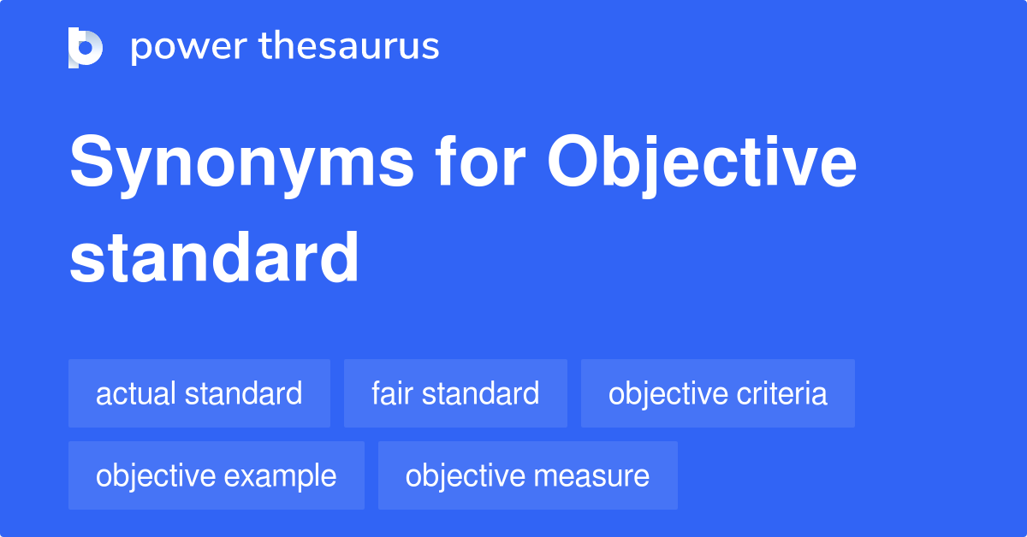
Understanding the Influence of Equal Employment Opportunity Laws
A selection criterion is objective if it systematically measures an attribute without being distorted by personal feelings.
  Examples of objective criteria include work sample test scores, number of years of education, degrees, and length of service in previous positions.
    Examples of subjective criteria include a supervisor’s general impression about a person’s interest in a job or feelings that a person is “sharp.”

Slide 30
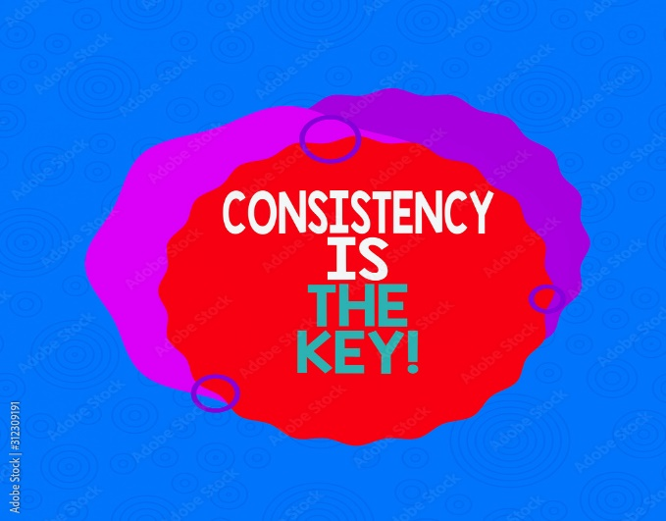
Understanding the Influence of Equal Employment Opportunity Laws
A selection criterion is uniform in application if it is applied consistently to all job candidates.
  Asking only female applications a question such as, “Would working on weekends conflict with your childcare arrangements?” is not uniform in application.
    However, it would be permissible to ask all applicants, “Would you be available to work weekends?”

Slide 31

Understanding the Influence of Equal Employment Opportunity Laws
A selection criterion is consistent in effect if it has relatively the same proportional impact on protected groups as it does on others.
  For example, criteria such as possessing a high school diploma or living in a certain area of town may be objective and uniformly applied to all job candidates, but they could screen out proportionately more members of minority groups.
    When a selection criterion is not consistent in effect, the burden of proof is on the employer to demonstrate that the criterion is job-related.

Slide 32
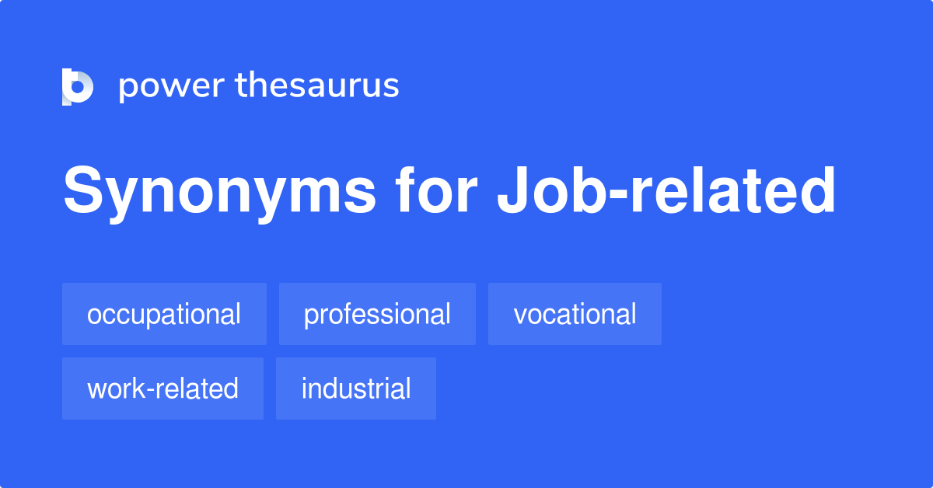
Understanding the Influence of Equal Employment Opportunity Laws
A selection criterion has job relatedness if it can be demonstrated that it is necessary to perform the job.
  For example, in most cases, it would be extremely difficult to prove that a selection criterion such as marital status is job-related.
    Job-related criteria should stress the skill required to perform the job.

Slide 33

Reviewing the Applicant’s Background
Before interviewing a job applicant, the supervisor should review all background information that has been gathered by HR.
  By studying whatever is available, the supervisor can develop in advance a mental impression of the applicant’s qualifications.
    The application will supply information concerning the applicant’s schooling, experience, and other relevant items.

Slide 34

Reviewing the Applicant’s Background
References provide additional information about the applicant.
  Generally, telephone or email checks are preferable because they save time and allow for greater feedback.
    For the most part, information obtained from personal sources, such as friends or character references, will be positively slanted because applicants tend to list only people who will give good references.

Slide 35

Reviewing the Applicant’s Background
Information from previous supervisors who were in positions to evaluate the applicant’s work performance is best.
  However, because of emerging personal privacy regulations and potential damage claims, an employment background investigation is usually conducted by HR.
    If possible, job references should be obtained in writing, should deal with job-related areas, and should be gathered with the knowledge and permission of the applicant.

Slide 36
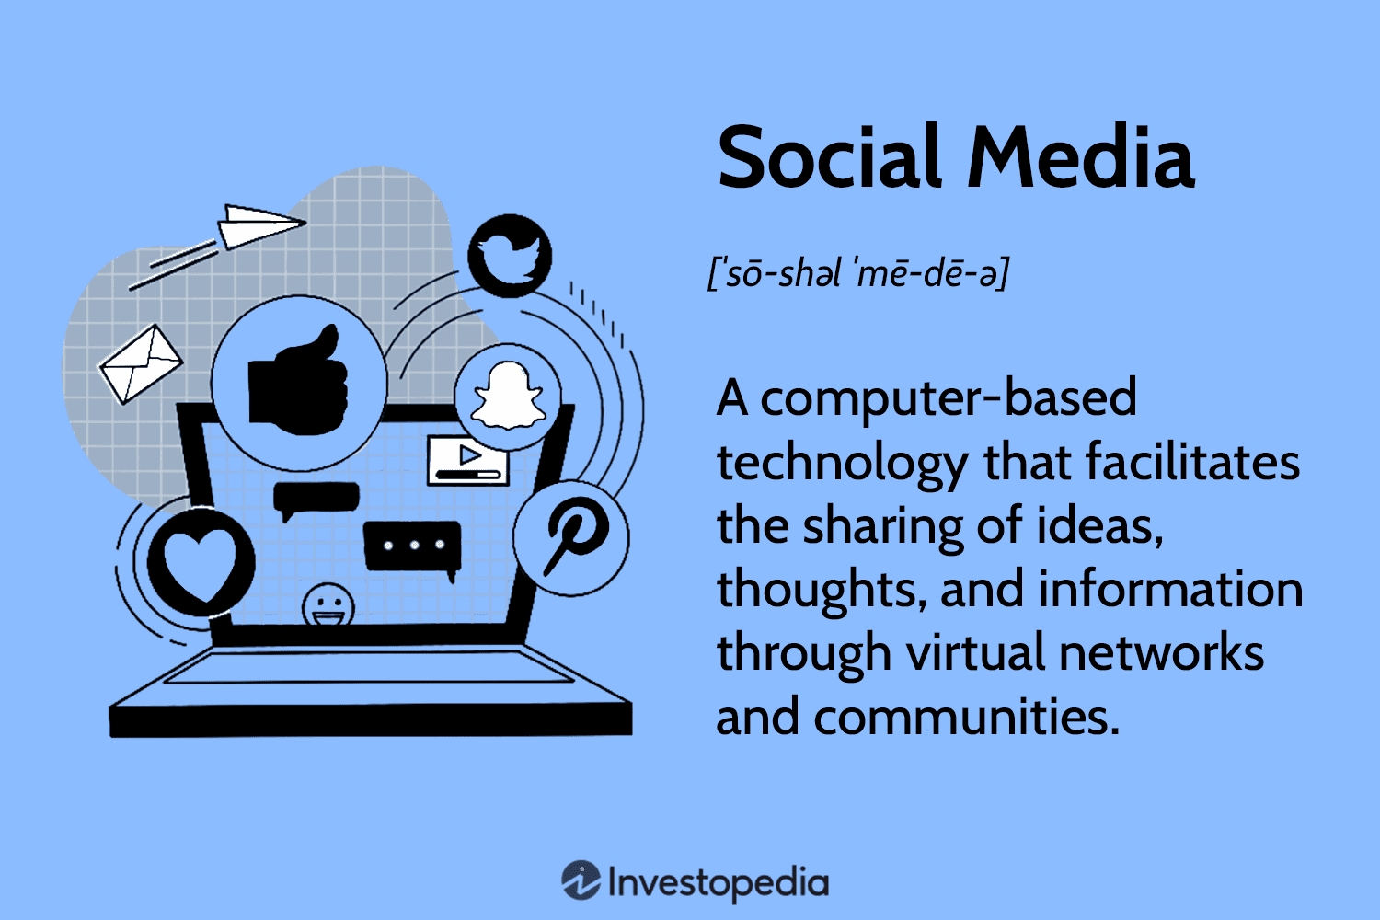
Reviewing the Applicant’s Background
Social media screening is a practice some employers choose to use to learn more about applicants’ backgrounds and activities.
  Scanning a potential hire’s Facebook or LinkedIn page may provide a wealth of positive and negative insight, which many students are warned about as they prepare their job search.
    However, the appropriateness of this strategy is challenged both by legislation and reactions of job candidates.

Slide 37

The Consequences of Failing to Check Adequately
Employers Beware! Your EEs and potential EEs may not be what they claim to be, and there may be trouble if you are negligent in taking some steps to deal with resume exaggeration and fraud.
  Be sure to conduct a thorough background check.

Slide 38


The Consequences of Failing to Check Adequately
Consultant and author Bradford Smart recommends using threat of reference check (TORC).
  He suggests using the question, “If I were to ask you to arrange an interview with your last boss, and the boss was very candid with me, what’s your guess as to what your boss would say were your strengths, weaker points, and overall performance?”
    The interviewer then may gain insight into what makes this applicant tick and how the person is apt to function on the job.

Slide 39


The Consequences of Failing to Check Adequately
The importance of verifying reference or application form data cannot be overemphasized.
  Various organizations have been charged with negligently hiring EEs who later commit crimes. Typically, the lawsuits charge that the organizations failed to adequately check the references, criminal records, or general background information that would have shown the EE’s propensity for deviant behavior.
    You can be held liable if you knew or should have known that the person you were hiring was a potential risk to others.

Slide 40

Preparing Key Questions
In preparing for the interview, the supervisor should develop a list of key questions, which may include directive and nondirective components.
  It is important that all applicants be asked the same set of key questions so that responses can be compared and evaluated.
    The supervisor may want to know technical information about an applicant’s work experience, why the applicant left a previous employer, and whether the applicant can work alternative shift schedules and overtime without difficulty.

Slide 41

Interviewing and Choosing from among Qualified Applicants
After the HR department has screened and selected qualified applicants for a job opening, the supervisor normally interviews each candidate before any decision is made.
  Supervisors should make, or at least should have considerable input in making, the final hiring decisions for jobs in their departments.

Slide 42

Interviewing and Choosing from among Qualified Applicants
Regardless of who makes the final hiring decision, selection criteria must be developed.
  Selection criteria are the factors used to differentiate applicants.
    Education, knowledge, experience, test scores, application forms, background investigations, and interpersonal skills often serve as selection criteria.

Slide 43
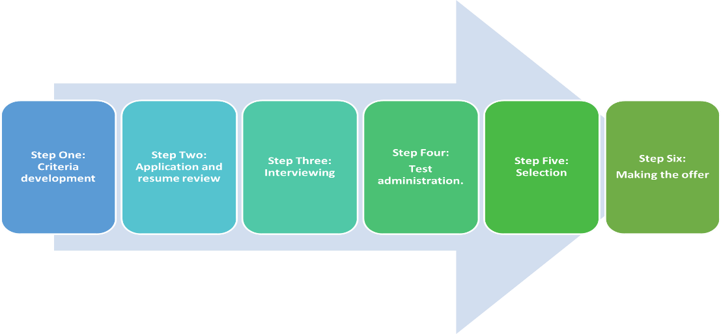
The Selection Process
Selection is the process of screening applicants in order to choose the best person for a job.
  Once job applicants have been located, next is to gather information that will help determine who should be hired. Usually, the HR staff or the supervisor reviews resumes or applications to determine which applicants meet the general qualifications of a position.
    Then, qualified applicants may be further screened with tests, reference or background checks, and interviews to narrow down the pool of applicants.

Slide 44

The Selection Process
The most frequently used selection criterion, and often the most important part of the selection process, is the EE interview.
  It is difficult to accurately appraise a person’s strengths and potential during a brief interview.
    If there are several applicants for a position, the supervisor must ascertain which applicant is most qualified, meaning which applicant is most likely to perform best on the job and to stay with the company long-term.

Slide 45

The Selection Process
While the organization seeks to learn as much as possible about a candidate through and interview, the applicant is also interviewing the organization.

Slide 46

The Selection Process
There are two basic approaches to interviewing: directive and nondirective.
  These approaches are classified primarily according to the amount of structure the interviewer imposed on the interview.
    It is essential that all applicants be asked the same questions and that interviewers receive training in how to conduct legally defensible interviews.

Slide 47

The Directive Interview
In a directive interview, the interviewer guides the discussion with a predetermined outline and objectives in mind.
  An outline helps the interviewer ask specific questions to cover each topic on which information is wanted. It also allows the interviewer to question and expand on related areas. For example, if a supervisor asks about the applicant’s work experience, it may lead to questions about what the applicant liked and did not like about previous jobs.
    The supervisor guides and controls the interview but does not make it a rigid, impersonal experience. If all applicants are asked the same questions, it makes it easier to compare applicants fairly.

Slide 48

The Nondirective Interview
The purpose of a nondirective interview is to encourage interviewees to talk freely and in depth.
  Rather than asking specific questions, the supervisor may stimulate the discussion by asking broad, open-ended questions, such as - “Tell me about your work experience.” Generally, the supervisor will develop a list of possible topics to cover, and depending on how the interview proceeds, may or may not ask related questions.
    This unstructured approach to interviewing allows for great flexibility, but it is generally more difficult and time-consuming to conduct.

Slide 49
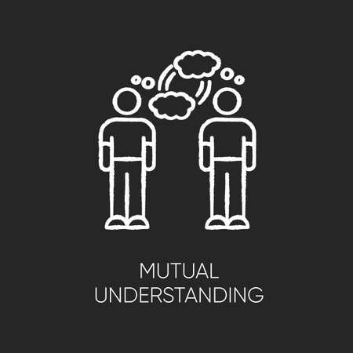
Blending Directive and Nondirective Approaches
Ultimately, the purpose of any interview is to promote mutual understanding – to help the interviewer and interviewee understand each other better through open communication.
  In EE selection interviews, the directive approach is used most often because supervisors find it convenient to obtain information by asking the same direct questions of all applicants.

Slide 50

Blending Directive and Nondirective Approaches
Supervisors should strive to blend directive and nondirective techniques to obtain additional information that might help them reach a decision.
  Interviewers may also use situational questions to assess what the applicant would do in a certain situation. All applicants are given a specific situation to which to respond. For example, the question, “How would you assign daily work when two EEs are absent?” allows the applicants to organize and express their thoughts about a realistic work situation.
    The supervisor may gain deeper insight into applicants’ abilities to think and solve problems that could make the difference in selection.

Slide 51

Opening the Interview
The EE selection interview is not a one-way questioning process; the applicant also will want to know more about the company and the job.
  The interview should enable job seekers to learn enough to help them decide whether to accept the position if it is offered.
    The supervisor must conduct the interview professionally by opening the interview effectively, explaining the job requirements, and using good questioning and note-taking techniques. The supervisor should be welcoming and reduce any tension or anxiety.

Slide 52

Explaining the Job
During the interview, the supervisor should discuss details of the job, working conditions, wages, benefits, and other relevant factors in a realistic way.
  A realistic organizational preview (ROP) includes sharing complete information about the organization: its mission, philosophy, opportunities, and other information that gives applicants a good idea of where the job fits in and why it is important.

Slide 53

Explaining the Job
In discussing the job, a realistic job preview (RJP) informs applicants about the desirable and undesirable aspects of the job.
  Applicants who are given realistic information are more likely to remain on the job because they will encounter fewer unpleasant surprises.

Slide 54

Asking Effective Questions
Even though the supervisor will have some knowledge of the applicant’s background from the application and from information the applicant volunteers, the need still exists to determine the applicant’s specific qualifications for the job.
  The supervisor should not ask the applicant to repeat information on the application. Instead, the supervisor should rephrase questions to probe for additional details.

Slide 55

Taking Notes
In their efforts to make better selection decisions, many supervisors take notes during or immediately after the interview.
  Written information is especially important when a supervisor interviews a number of applicants.
    Trying to remember what several applicants said during their interviews and exactly who said what is virtually impossible.

Slide 56

Avoiding Interviewing and Evaluation Pitfalls
The chief problem in selection lies in interpreting the applicant’s background, personal history, and other pertinent information.
  As human beings, supervisors are unable to eliminate their personal preferences and prejudices, but they should face their biases and make efforts to avoid or control them. Supervisors should particularly avoid making judgments too quickly during interviews with job applicants.
    Although it is difficult not to form an early impression, the supervisor should complete the interview before making any decision and should strive to apply the OUCH test to avoid the numerous pitfalls that can occur both during and after the interview.

Slide 57

Avoiding Interviewing and Evaluation Pitfalls
Supervisors should also avoid generalizations.
  The situation in which a supervisor generalizes from one aspect of a person’s behavior to all aspects of the person’s behavior is known as the halo or horns effect. In practice, the halo or horns effect means that the supervisor bases the overall impression of an individual on only partial information about that individual and uses this limited impression as a primary influence in rating all other factors.
    This may work favorably (halo effect) or unfavorably (horns effect), but in either case it is improper.

Slide 58

Closing the Interview
At the conclusion of the EE selection interview, the supervisor will likely have a choice among several alternatives, ranging from hiring the applicant to deferring decision to rejecting applicant.
  The supervisor’s decision will be guided by the organization’s policies and procedures.

Slide 59

Closing the Interview
If the supervisor wishes to defer the decision until several other candidates for the job have been interviewed, the applicant should be informed that they will be notified later.
  The supervisor should indicate a time frame within which the decision will be made.

Slide 60

Closing the Interview
Although rejecting all but one applicant is part of the process, employers should be cautious in how they communicate with potential new hires.
  Remember that those applicants may buy your products and services and have long-term memories of how they were treated.
  Regardless of the outcome, applicants should leave the interview feeling that they have been treated fairly and courteously.
    It a supervisor’s managerial duty to build as much goodwill as possible because it is in the organization’s self-interest to maintain a good image.

Slide 61

Completing the Post-Interview Evaluation Form
Some organizations have the supervisor and other members of the interview team complete an evaluation form shortly after the interview while the information is still fresh in their minds.
  This approach increases the likelihood that the same selection criteria are applied to each applicant.
    Others may require supervisors submit written evaluations to summarize their impressions of and recommendations for each job candidate.

Slide 62

Making the Hiring Decision
The decision to hire can be challenging when the supervisor has interviewed several candidates and all appear qualified for job.
  There are no definite guidelines a supervisor can use to select the best-suited individual. At times, information from the applications, tests, and interviews indicate which applicants should be hired. However, at other times such information may be unconvincing or perhaps even conflicting.
    (X) An applicant’s aptitude test score for a sales job may be relatively low, but the person has favorably impressed the supervisor in the interview by showing an enthusiastic interest in the job and a selling career.

Slide 63

Making the Hiring Decision
Supervisory judgment and experience come into play.
  The supervisor must select EEs who are most likely to contribute to good departmental performance. The supervisor may consult with members of the HR staff for their evaluations, but, in the final analysis, it should be the supervisor’s responsibility to choose.
    Before the final decision is made, the supervisor should evaluate each applicant against the selection criteria.

Slide 64

Making the Hiring Decision
Hiring decisions always involve uncertainties.
  There are no exact ways to predict how individuals will perform until they are placed on the job.
    A supervisor who approaches the hiring decision thoroughly, carefully, and professionally is likely to consistently select applicants who will become excellent EEs.

Slide 65

Documenting the Hiring Decision
Documentation is necessary to ensure that a supervisor’s decision to accept or reject an applicant is based on job-related factors and is not discriminatory.
  At times, a supervisor’s hiring decision will be challenged; the supervisor must be able to justify that decision.

Slide 66

Bringing New Employees Onboard
In organizations, when new EEs report for their first day of work, HR usually conducts an initial session that familiarizes the new hire with the organization’s vision, structure, culture, handbook, policies and procedures, and perhaps includes a quick tour of the facilities. This initial phase is called orientation.
  Orientation is a process designed to help new EEs become acquainted with the organization and understand the organization’s expectations.
  Orientation helps develop a sense of belonging to the organization.

Slide 67

Bringing New Employees Onboard
Onboarding occurs when the new EE begins and it continues indefinitely.
  It is about helping EEs understand, effectively perform their jobs, learn new tasks, gain new SKAs, and acquire attitudes, behaviors, and knowledge needed to be a successful member of the team.
    Helping new EEs feel comfortable in their new work environment is a supervisory responsibility.

Slide 68
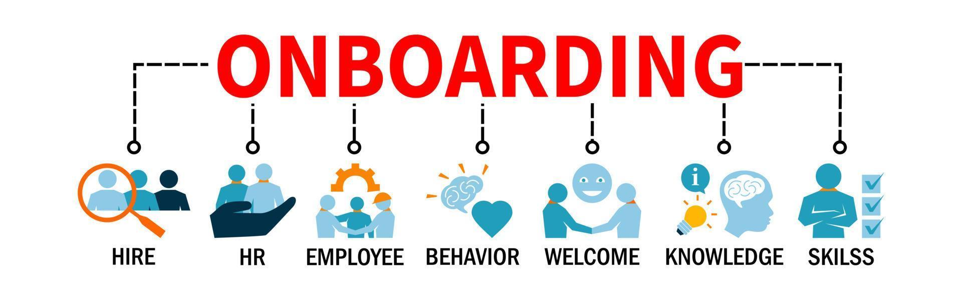
Bringing New Employees Onboard
The manner in which the supervisor welcomes new hires and introduces them to other EEs in the department may have a lasting effect on their future performance.
  The first days on the job for most new EEs are disturbing and anxious. They typically feel like strangers in new surroundings among people whom they have just met.
    It is the supervisor’s responsibility to make the transition as smooth as possible by leading new EEs in the desired directions and helping them become productive as soon as possible.

Slide 69

Using a Checklist
A useful technique to ensure that new EEs are well-oriented is to use a checklist.
  When developing an orientation checklist, the supervisor should strive to identify all the things that a new EE ought to know.
    Checklists can also be used to help new EEs understand the company and its objectives, and to build a more positive attitude toward the supervisor, fellow EEs, and the company.

Slide 70
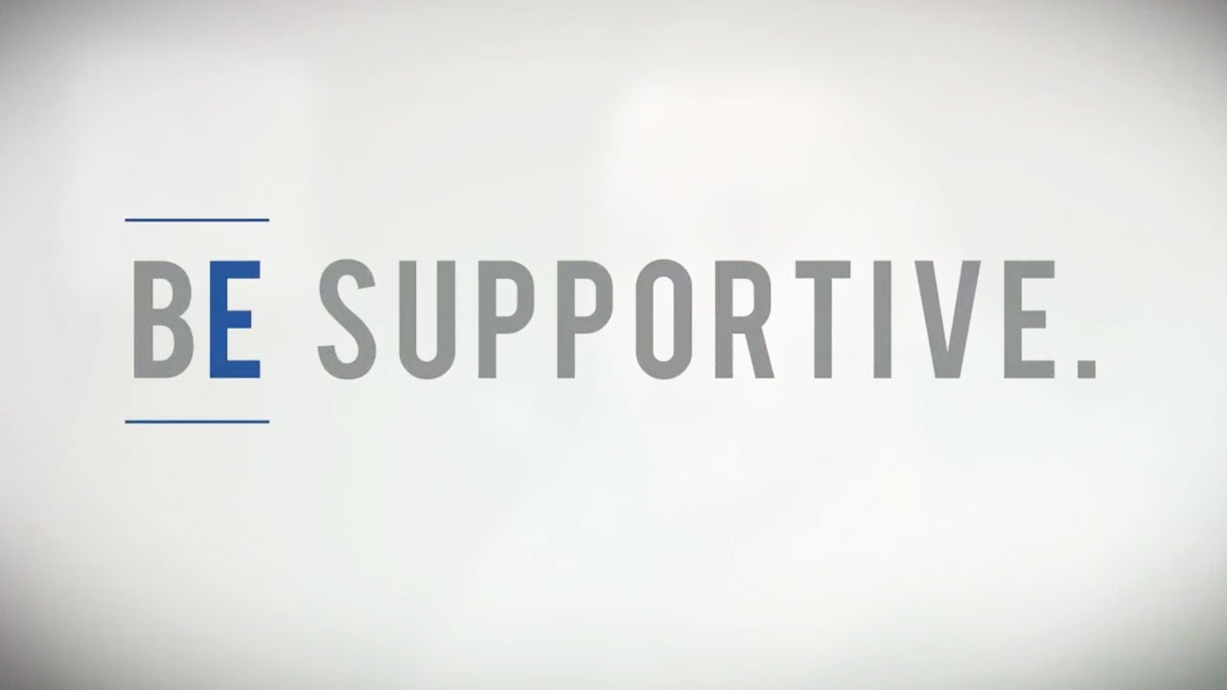
Being Supportive
More important than actual techniques used to orient new EEs are the attitudes and behaviors of the supervisor.
  When a supervisor conveys sincerity in trying to make the transition period a pleasurable experience and tells new EEs that they should not hesitate to ask questions, it will smooth the early days on the job.
    Even when HR provides formal orientation, it remains the supervisor’s responsibility to help each new EE quickly become an accepted member of the departmental work team and a contributing, productive EE.

Slide 71

Setting the Stage
The supervisor should inform other EEs that someone new is joining the group and should let them know something positive about the new person.
  The supervisor needs to set the stage for the new EE’s arrival so that the new EE is socialized properly into the work group.

Slide 72
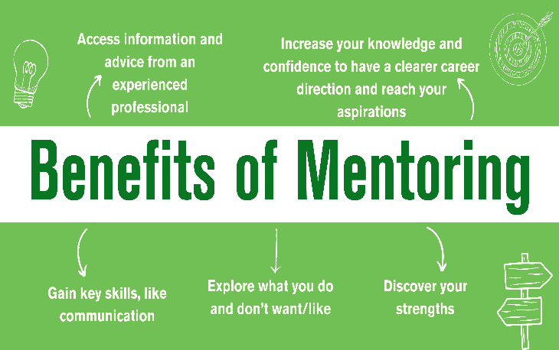
Mentoring
Since the publication of the Harvard Business Review article, “Everyone Who Makes It Has a Mentor,” researchers have explored the roles that mentors play in EE development.
  Mentoring is process of having a more experienced person provide guidance, coaching, or counseling to a less experienced person.
    Broadly defined, the mentor teaches “the tricks of the trade,” gives the new EE all the responsibility they can handle, thrusts EE into new areas, directs and shapes performance, suggests how things are done, and provides protection.

Slide 73

Mentoring
Mentoring should be looked upon as one way to smooth the transition of new EEs into the organization and develop them into productive EEs.
  New EEs can build a network of people who can collectively provide many benefits of a mentor. The ultimate question for the new EE is, “How do I attach myself to a role model who will guide my career?”
    Researchers suggest that putting all your eggs in one basket is a mistake. They believe people should think in terms of multiple mentors. And, they claim that one’s peers can be an excellent source of mentorship.

Slide 74

Mentoring
To expand on the idea of “multiple mentors,” mentors can be identified for the following purposes:
  A mentor for life, a mentor for the season, and a mentor for a specific reason.

Slide 75

Mentoring
Research suggests that mentors are most receptive to people who ask good questions, listen well to responses, and demonstrate they are hungry for advice and counsel.
  Mentoring is a chance for mentors to revitalize their own learning.

Slide 76
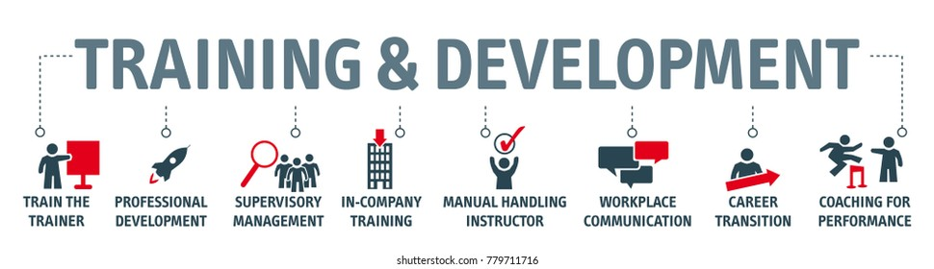
Training and Developing Employees
The supervisor or coach does not have to be a solution provider, but rather the one who engages EEs in activities that help them to reach their potential and the organization to reach or exceed its goals.

Slide 77

Training and Developing Employees
When skilled workers are hired, the training need may be in the area of company and departmental methods and procedures.
  When unskilled EEs are hired, they must understand the importance of the job and why each step must be done correctly. The supervisor or another capable EE should demonstrate the proper way to do job.
    It is critical to the learning process that the supervisor frequently monitor the work being performed, answer questions, make adjustments, provide additional guidance as necessary, and encourage them.

Slide 78

Ensuring Ongoing Employee Development
Supervisors should continually assess the skills and potential of existing EEs and should provide opportunities for the ongoing development of EE skills so that those EEs can perform better now and in the future.
  Training activities should be based on identification of the combined needs of the organization and the EEs.
    Training must be viewed as an ongoing developmental process, not a simple solution to a short-term problem.

Slide 79

Training and Developing Employees
Skills that EEs need to perform essential departmental tasks should be the initial training focus. However, in the current business environment, cross-training is becoming essential.
  Downsizing, outsourcing, reductions in force, and termination of jobs have left EEs wondering what the future holds.
    Supervisors must identify jobs that are important to ongoing performance of their departments and that other EEs can learn.

Slide 80


Training and Developing Employees
EEs will need to learn new skills that will make them more valuable to their organizations.
  Cross-trained EEs learn how to do a variety of important jobs.
    An EE’s ability to perform a variety of tasks makes them more valuable and able to assume additional responsibilities in the future.

Slide 81

Making Yourself More Valuable
The need for training and development is not limited to departmental EEs.
  Supervisors also need training and development to avoid obsolescence or status-quo thinking.
    By expanding their perspectives, supervisors are more likely to encourage EEs to improve their knowledge and abilities and to keep up to date.

Slide 82

Making Yourself More Valuable
Supervisors should join a professional or technical association whose members meet regularly to discuss problems and topics of current interest and to share experiences.
    Also, supervisors should subscribe to technical and managerial publications and should read articles of professional interest.

Slide 83


