Slide 1
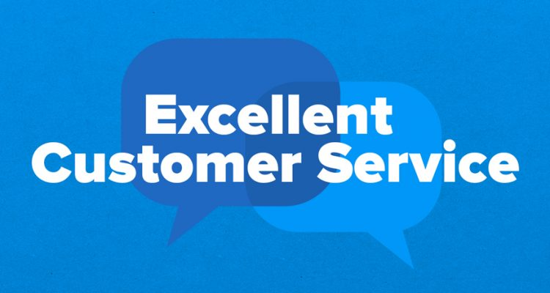
Customer Service Management
Session Four Class Presentation
Customer Service
  Skills for Success – 7th Edition
    Robert W. Lucas; McGraw-Hill Education; New York, NY 2019
      ISBN: 978-1-259-95407-8

Slide 2
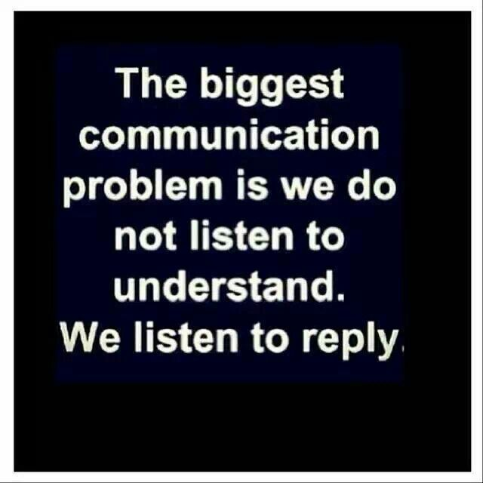
Part Two: Skills for Success
Chapter Five: Listening to the Customer
  “The most basic of all human needs is the need to understand and be understood. The best way to understand people is to listen to them.” - Ralph Nichols

Slide 3
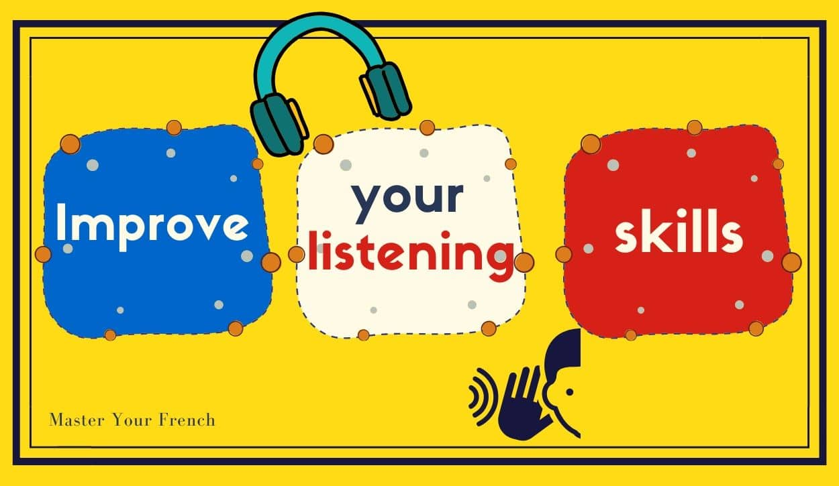
Why is Listening So Important?
To be a better customer service professional, it is necessary to improve your listening skills.
  Listening effectively is the primary means that many customer service professionals use to determine the needs of their customers. Many times, these needs are communicated through inferences, indirect comments, or nonverbal signals rather than directly to you.
    A skilled listener will notice a customer’s words and these cues and conduct follow-up questioning or probing to determine real need.

Slide 4
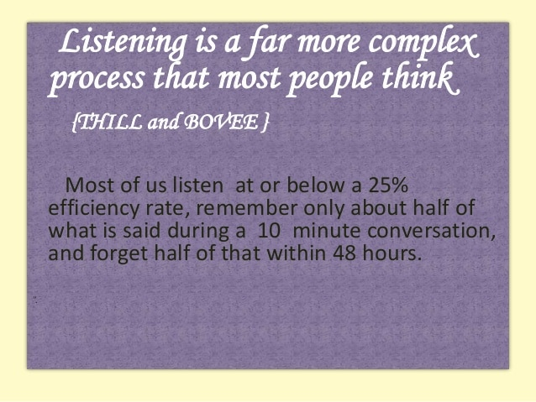
Why is Listening So Important?
In a classic study on listening conducted by Dr. Ralth G. Nichols, who is sometimes called the “Father of the Field of Listening,” data revealed that the average white-collar worker in the U.S. typically has only about a 25% efficiency rate when listening.
  This means that 75% of the message is lost.
    Think about what such a loss in message reception could mean in an organization if the poor listening skills of customer service professionals led to a 75% loss of customer opportunities.

Slide 5
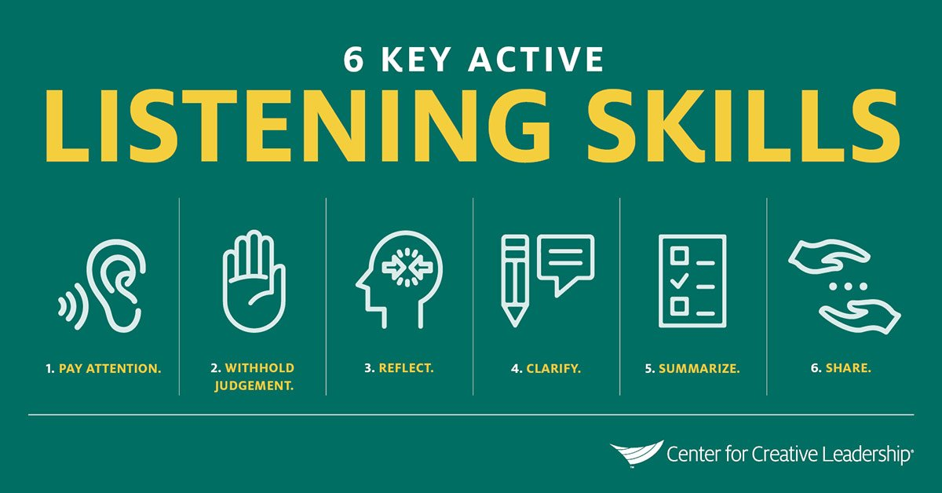
What is Listening?
True listening is an active learned process, as opposed to hearing, which is the physical process of gathering sound waves through the ear canal.
  Phases of active listening:
    Hearing or Receiving the Message
    Attending
    Comprehending or Assigning Meaning
    Responding

Slide 6
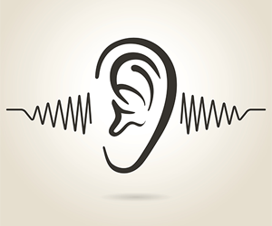
1. Hearing and Receiving the Message
Hearing is a passive physiological process of receiving sound waves and transmitting them to the brain for analysis and action.
  This is usually a simple process; however, because of external noises and internal distracters (psychological and physical), a customer’s message(s) may be lost or distorted.

Slide 7

2. Attending
Once your ears pick up sound waves, your brain goes to work focusing on, or attending to, what you heard. In the process, it sorts out every sound being received.
  The effort involves deciding what is important so that you can focus attention on the proper sound. This becomes extremely difficult when you are receiving multiple messages or sounds.
    It is important to eliminate as many distractions as possible.

Slide 8
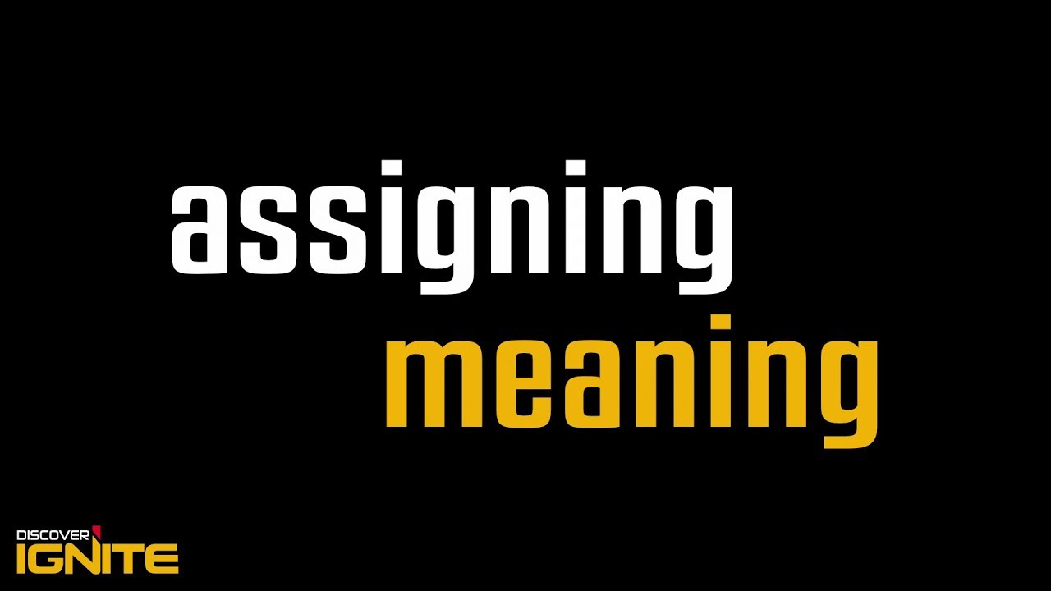
3. Comprehending or Assigning Meaning
Once you have decided to which message or customer you will listen, your brain begins a process of comprehending or assigning meaning to what you heard.
  It “decodes” the message. Just like a computer, your brain has files of information – sounds, sights, shapes, images, experiences, and knowledge on various topics in memory – through which it sorts.
    As it compares what’s heard to what’s stored, it tries to match the pieces (i.e. telephone ring) – it’s called memory and recognition.

Slide 9

4. Responding
Selecting an appropriate response is crucial to the success of your customer interactions. The words you select, the way you deliver them, the timing and location, and the nonverbal signals you send all have meaning, and all affect the way others perceive and interpret your message.
  This is why you should carefully select the appropriate response and method of delivery when dealing with customers.
    You should properly “encode” the message considering such things as who your receiver is, their background, the location, possible message delivery systems available, and any other factor that might aid reception and comprehension by your listener.

Slide 10
Questions for the Listener
In analyzing your customer’s message(s), ask yourself the following questions:
  Am I practicing active listening skills?
  What message is the customer trying to get across?
  What does customer want or need me to do in response to message?
  Should I take notes or remember key points being made?
  Am I forming premature conclusions, or do I need to listen further?
  Are there personal biases or distractions I need to avoid?
  Is customer failing to provide info needed to make a sound decision?
  In addition to words, what other feedback clues are being provided? Are they important to message meaning?
  What questions do I need to ask as follow-up to customer’s message?

Slide 11
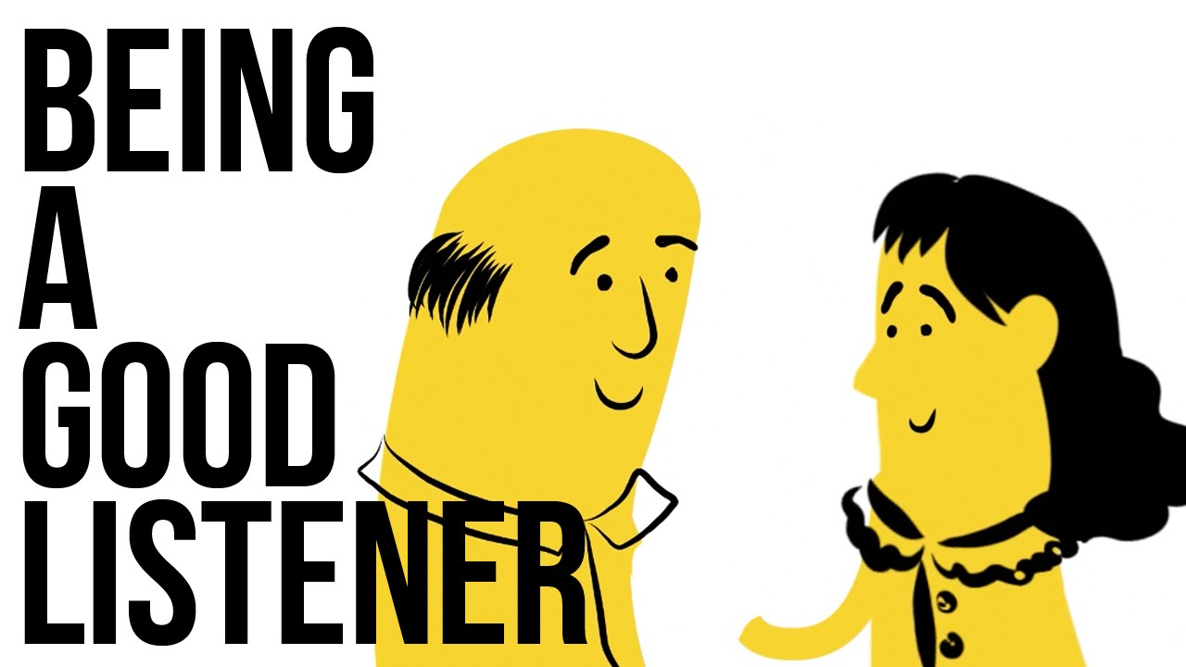
Characteristics of a Good Listener
Successful listening is essential to service excellence.
  The following are characteristics of effective listeners:
    Empathy
    Understanding
    Patience
    Attentiveness
    Objectivity

Slide 12
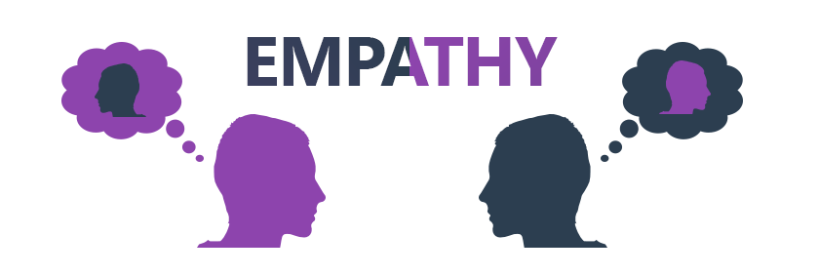
1. Empathy
By putting yourself in the customer’s place and trying to relate to the customer’s needs, wants, and concerns, you can often reduce the risk of poor service.
  Some customer service professionals neglect the customer’s need for compassion, especially when customer is dissatisfied.
    Such negligence tends to magnify or compound the effect of the initial poor service the customer received.

Slide 13
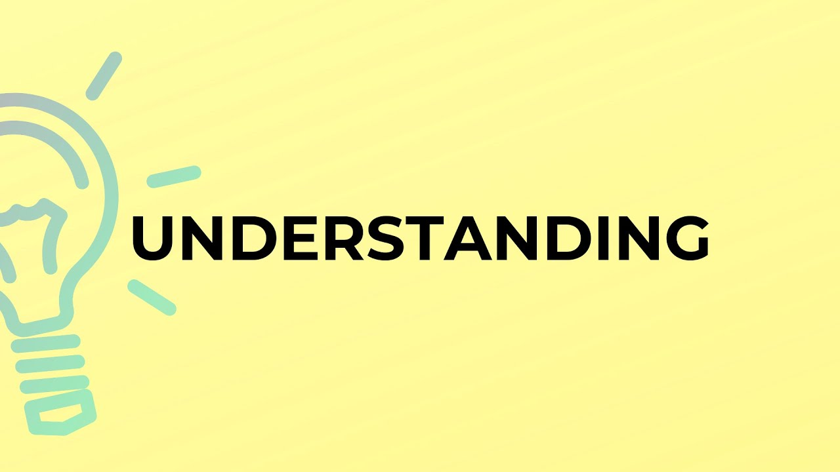
2. Understanding
The ability to listen as customers verbalize their needs, and to ensure that you understand them, is essential in properly servicing the customer.
  Too often, you hear people say, “I understand what you mean,” when it is obvious that they have no clue as to the level of emotion being felt.
    When this happens while a customer is upset or angry, flared tempers, loss of business, bad publicity, and, at the far end of the continuum, violence might result.

Slide 14

3. Patience
Keep in mind that it is your job to serve the customer, and not everyone communicates in the same manner.
  Each customer has different needs, expectations, and under-standing based on age, gender, behavioral style, preference, background, language, cultural background and other factors.
  That is why you must never try to use a cookie-cutter approach to delivering service where you assume all people are the same and respond to the same approach in service delivery.
    Take the time to ask questions and actively listen to their responses before choosing a course of action.

Slide 15

4. Attentiveness
By focusing attention on the customer, you can interpret their message and satisfy their needs. Attentiveness can be displayed through nonverbal cues.
  When you are reading, talking on the phone to someone while servicing your customer, or doing some other task while “listening” to your customer, you are not really focusing.
    Your absorption rate will fall to 25% of listening efficiency.
    Research suggests that the human brain cannot efficiently conduct two activities simultaneously.

Slide 16
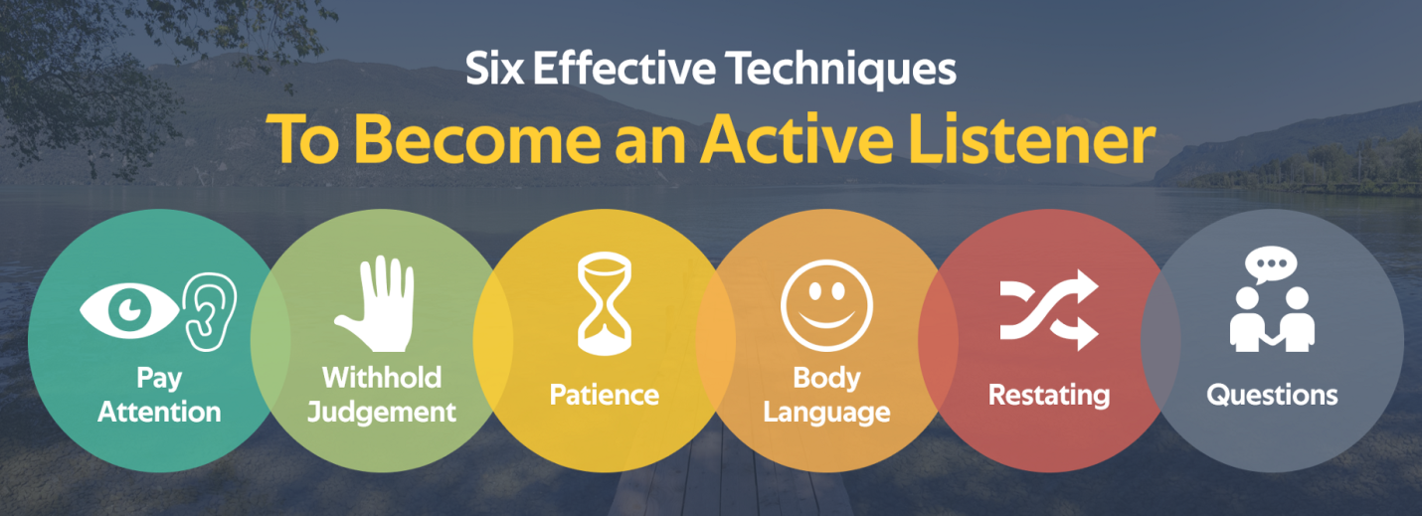
4. Attentiveness
Active listening involves complete attention, a readiness and willingness to take action and an open mind to evaluate customers and determine their needs.
  What should customer service professionals do to achieve these goals of active listening?

Slide 17
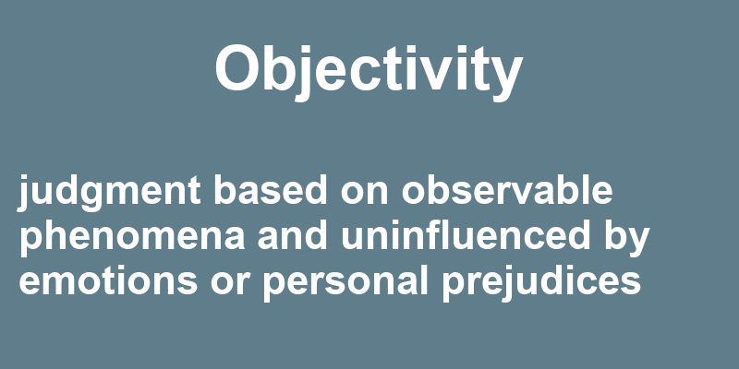
5. Objectivity
In dealings with customers, avoid subjective opinions or judgments. If you have a preconceived idea about customers, their concerns or questions, the environment, or anything related to the customers, you could mishandle the situation.
  Listen openly and avoid making assumptions.
    Allow customers to describe their needs, wants, or concerns in their own words, and then analyze them fairly before taking appropriate action.

Slide 18

Causes of Listening Breakdown
Poor customer service may result from a breakdown of the listening process.
  Many factors contribute to ineffective listening. Some are internal or in your brain, but others are external and you cannot control them.
    The key is to recognize actual and potential factors that can cause ineffective listening and strive to eliminate them.

Slide 19
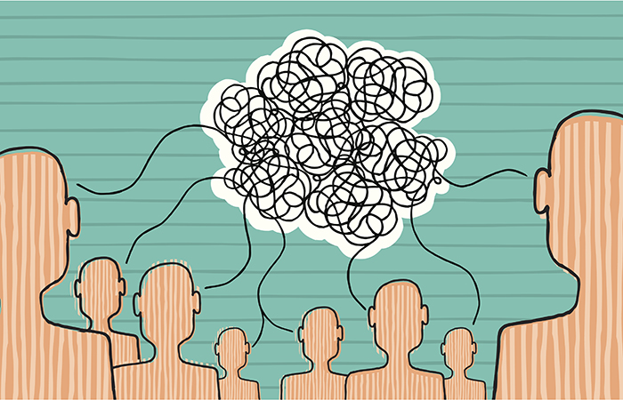
Causes of Listening Breakdown
Personal Obstacles include:
  Biases
  Psychological Distractors
  Physical Condition
  Circadian Rhythm
  Preoccupation
  Hearing Loss

Slide 20
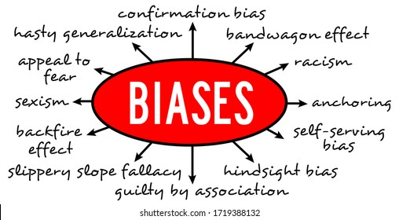
1. Biases
Your opinions or beliefs about a specific person, group, situation, or issue can sometimes cloud your ability to listen objectively to a message.
  These biases may result in preconceived and sometimes incorrect assumptions. They can lead to service breakdowns, complaints, angry or lost customers, or even violence.

Slide 21
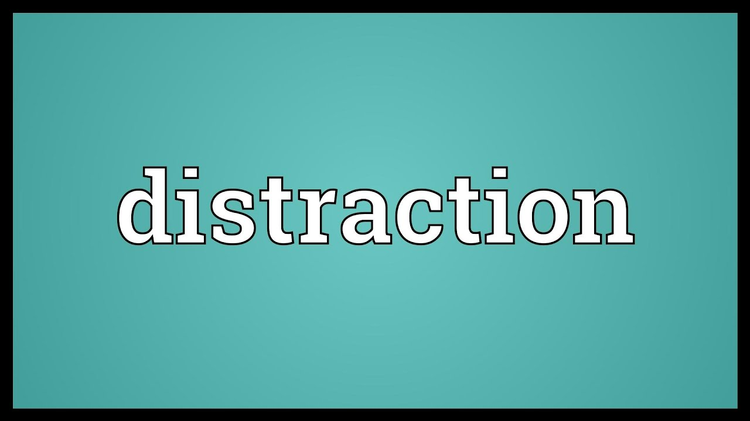
2. Psychological Distracters
Psychological distracters, such as being angry or upset, or simply not wanting to deal with a particular person or situation, may negatively affect your listening.
  Think about a time when you had a negative call or encounter with a customer or someone else and you became frustrated or angry.
    Did your mood and possibly your tone of voice change as a result?
    Did that emotion carry over and affect another person later?

Slide 22

3. Physical Condition
Another internal factor that can contribute to or detract from effectiveness listening is your state of wellness and fitness.
  When you are ill, fatigued, in poor physical condition, or just not feeling well, listening can suffer.

Slide 23
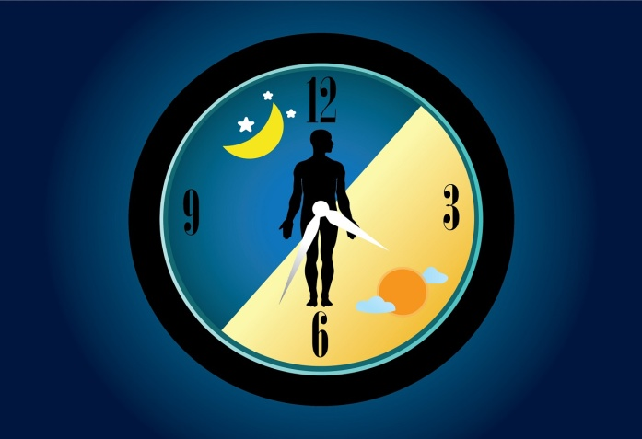
4. Circadian Rhythm
All people have a natural 24-hour biological pattern by which they function. The psychological cycle is associated with the earth’s rotation. It affects metabolic and sleep patterns in humans as day replaces night. This “clock” often establishes the body’s peak performance periods.
  Some people perform better in the morning, whereas others peak later in the day or evening.
    From a listening standpoint, you should recognize your own natural body pattern so that you can deal with the most important listening and other activities during your peak period if possible.

Slide 24
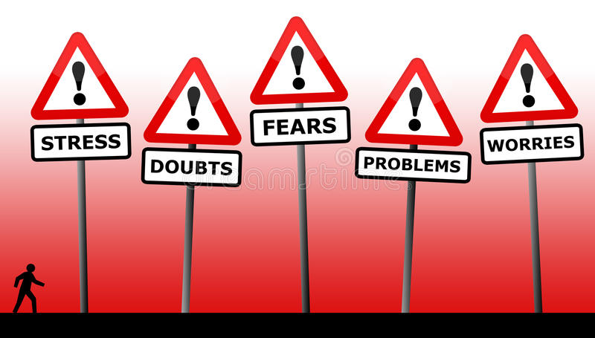
5. Preoccupation
Many people are distracted from work and listening activities by personal factors, such as finances, relationships, family problems, schooling, or stress that override efforts to do a good job each day.
  When you have personal or other matters on your mind, it can become difficult to focus on the needs and expectations of your customer and the job task. This can lead to mutual frustration.
    You should try to resolve personal problems before going to work, even if you must take time off to deal with them.

Slide 25
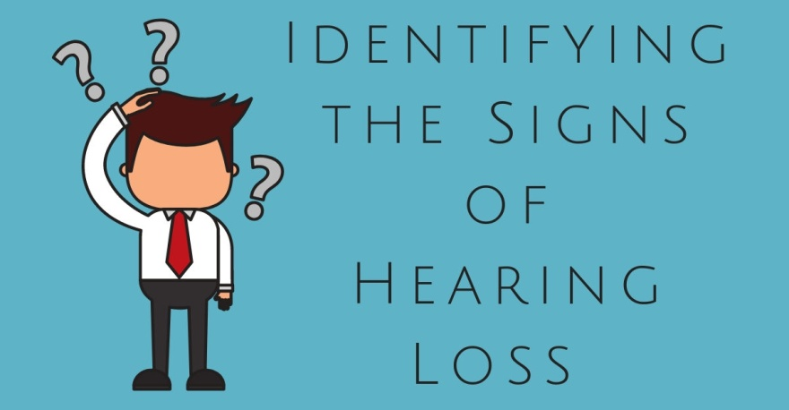
6. Hearing Loss
Many people suffer from hearing loss caused by physiological (physical) problems or extended exposure to loud noises (personal and workplace).
  Sometimes they are not aware that their hearing is impaired, or take no action to remedy the loss.

Slide 26

Listening Skill Level
People communicate on different levels, depending on their knowledge and experiences in the area of communication.
  Childhood experiences influence adult behavior. That is, they are likely to repeat behavior they learned as children.
    (x) If you grew up in an environment where the people around you practiced positive listening skills, providing feedback and using nonverbal communication and effective personal skills for dealing with others, you will likely use similar techniques as an adult. However, if your experiences were negative you will struggle in listening to others effectively.

Slide 27
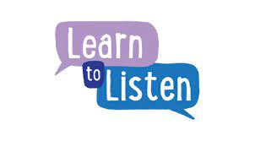
Listening Skill Level
Two other factors can also create barriers and inhibit effective listening when dealing with your customers.
  These are (1) thought speed and (2) faulty assumptions (biases) that you have about others or a situation.

Slide 28

1. Thought Speed
Your brain is capable of comprehending messages delivered at rates of as much as four to six times faster (thought speed) than speed at which average adult speaks.
  In the U.S., this rate is approximately 125 to 150 words per minute, as in other countries or cultures this rate might vary.
    The difference between the two rates is referred to as a “lag time” or “listening gap” during which the mind is momentarily idle or focused on other activity. The result is that your brain does other things to occupy itself (i.e. daydreaming).

Slide 29

Thought Speed
To prevent or reduce such distraction, you must consciously focus on your customer’s message, look for key points made, ask pertinent questions, and respond appropriately.
  One way to help yourself focus is to take notes about an issue, suggestion, or complaint as your customer speaks.
    You then have something to which you can refer to provide feedback from once the customer stops talking. Another benefit of this technique is that you can demonstrate that you are truly interested in their ideas or subject of a conversation.

Slide 30
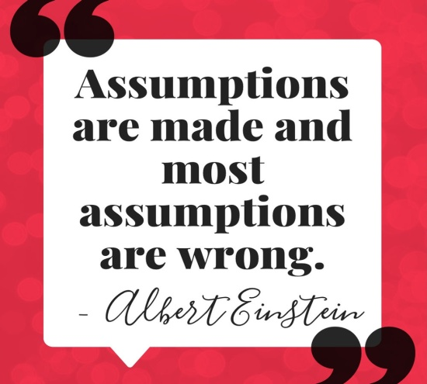
2. Faulty Assumptions
Because of experiences or encounters with others, you may be tempted to make faulty assumptions about your customer’s message(s). Do not do so.
  Each customer and each situation is different and you should regard them as such.
    Take the time to effectively gather information in each customer encounter so you can make an informed decision on the correct course of action. Then, make a judgment on what needs to be accomplished in order to remedy the situation.

Slide 31
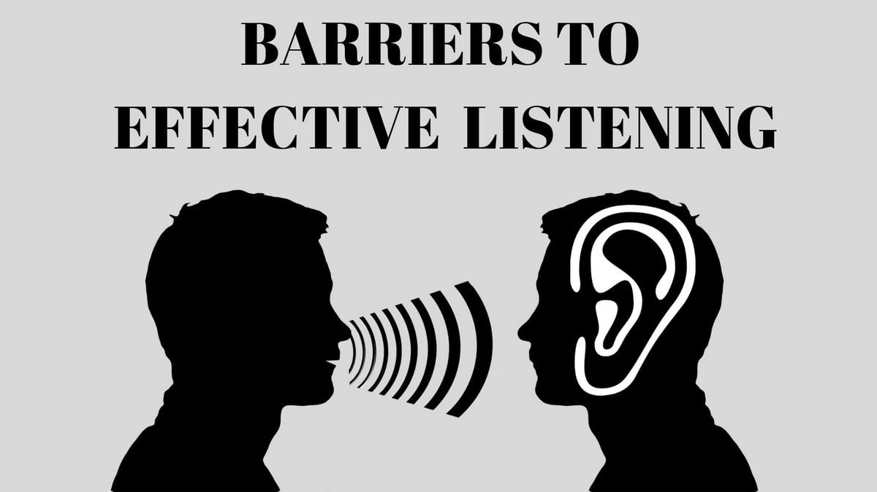
External Obstacles
You cannot remove all barriers to effective listening, but you should still try to reduce them when dealing with customers.
  Some typical examples of external obstacles that often create problems include the following:
    Information Overload
    Other People Talking
    Ringing Phones
    Office and Maintenance Equip.
    Speakerphones
    Physical Barriers

Slide 32
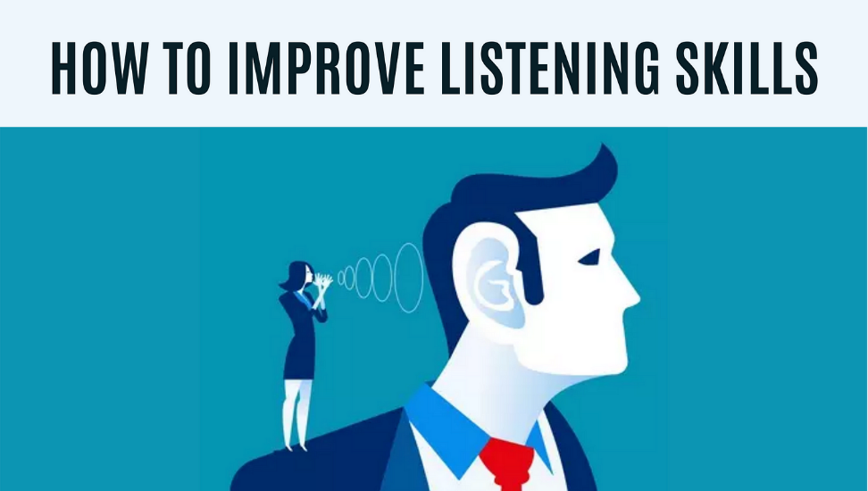
Strategies for Improved Listening
You can improve your listening skills several different ways. One important way is to listen more than you talk.
  These are techniques for becoming a more effective listener.
    Stop Talking
    Prepare Yourself
    Listen Actively
    Show a Willingness to Listen
    Show Empathy
    Listen for Concepts
    Listen Openly
    Send Positive Nonverbal Cues
    Do Not Argue
    Take Notes, if Necessary

Slide 33
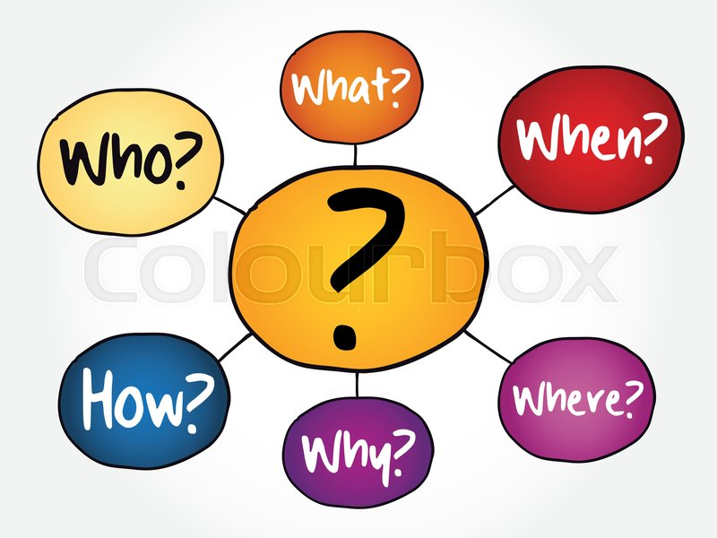
Information-Gathering Techniques
Use appropriate questions to sort out facts from fiction.
  Your purpose in listening to your customers is to gather information about their needs or wants on which you can base decisions on how to best satisfy them.
    Use questions to determine customer needs and to verify and clarify information received. This will ensure that you thoroughly understand the customer’s message prior to responding.

Slide 34
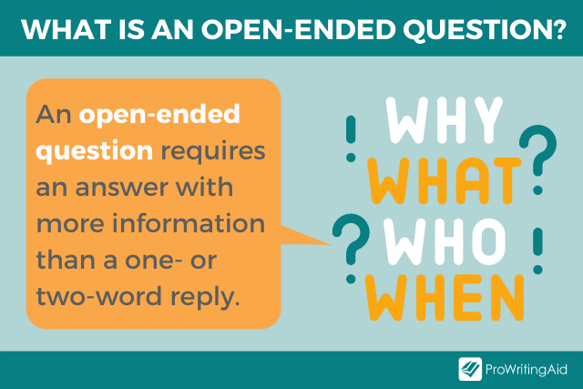
Open-Ended Questions
Open-ended questions establish a number of facts and are used to seek substantial amounts of information and encourage dialogue.
  These type of questions:
    Identify Customer Needs
    Gather a Lot of Information
    Uncover Background Data
    Uncover Objections During a Sale
    Give Customer an Opportunity to Speak

Slide 35
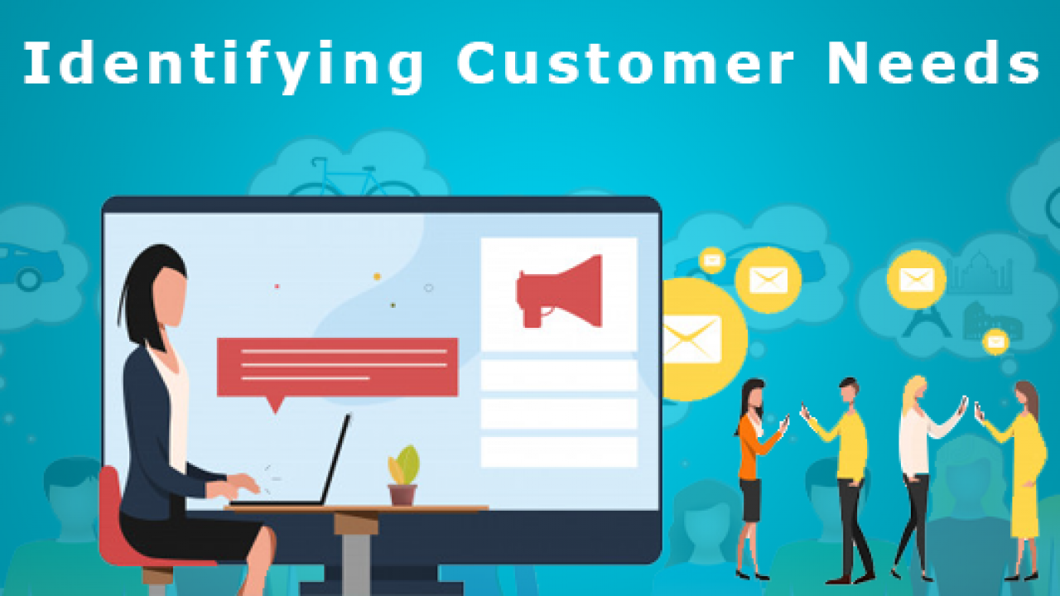
1. Identify Customer Needs
By asking questions, you can help determine customer needs and what they want or expect.
  Some customers are either unsure of what they need or want or do not adequately express their needs or wants.
    What are you looking for in a product or service?

Slide 36

2. Gather a Lot of Information
Open-ended questions are helpful when you are just beginning a customer relationship and are not sure what the customer has in mind or what is important.
  By uncovering details, you can better serve your customer.
    To help me serve you, could you please describe your ideal product or service?

Slide 37

3. Uncover Background Data
When a customer calls to complain about a problem, often they have already taken unsuccessful steps to solve it. In such cases, it is important to find out the background information about the customer or situation.
  By asking open-end questions, you allow customers to share as much information as they feel necessary to answer questions.
    Will you please share the history behind this problem, including all previous attempts to resolve it?

Slide 38
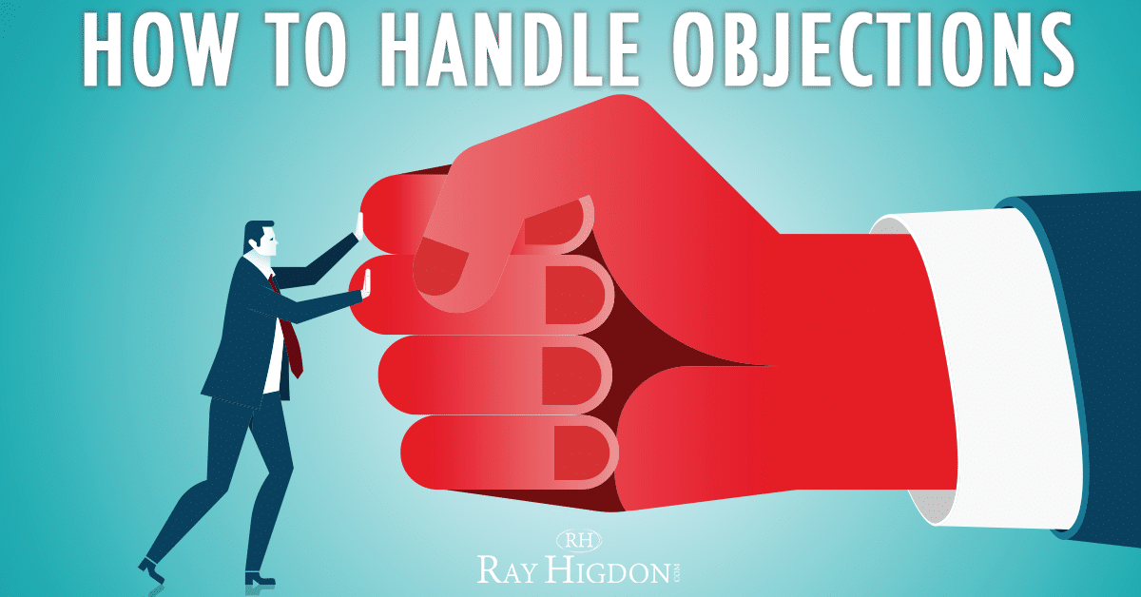
4. Uncover Objections During a Sale
In sales, you will likely encounter objections. The reason for a customer not wanting or needing your product and/or service can be identified through open-ended questions.
  Such questions help you determine whether your customer has questions or objections. Many times, people are not rejecting what you are offering outright; they simply do not see an immediate need for the product or cannot think of appropriate questions to ask. In these cases, you can help them focus their thinking or guide their decision through open-end questions.
    What do you think about the product or service offered?

Slide 39
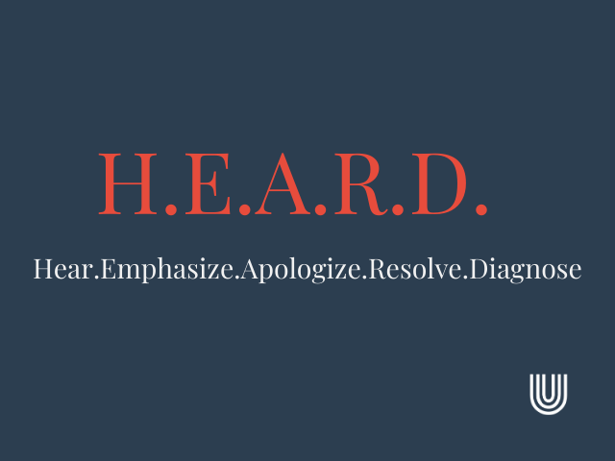
5. Give the Customer an Opportunity to Speak
Although it is important to control the conversation in order to save time and allow you to serve more customers, sometimes you may want to give the customer an opportunity to talk. This is crucial if the customer is upset or dissatisfied about something.
  By allowing customer to “vent” as you listen actively, you can reduce the level of tension and help solve the problem. You might even discover other details that will help you address the situation.
    What suggestions do you have for product/service improvement?

Slide 40
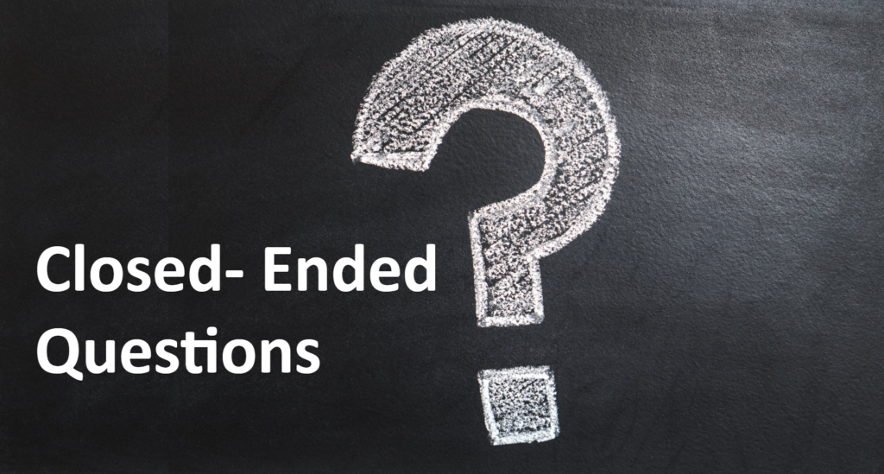
Close-End Questions
Traditionally, closed-end questions start with verbs such as: “do, did, are, and will”; elicit short, one-syllable responses; and gain little new information.
  Many closed-ended questions can be answered “yes or no” or with a specific answer, such as a number or a date.
  Use closed-ended questions for:
    Verifying Information
    Closing an Order
    Gaining Agreement
    Clarifying Information

Slide 41

1. Verifying Information
Closed-end questions are a quick way to check information already shared or agreements made.
  Using them reinforces that you are listening and also helps prevent you from making mistakes because you misinterpreted or misunderstood information.
    Is that correct?

Slide 42

2. Closing an Order
Once you have discovered needs and presented the benefits and features of your product and service, you need to ask for a buying decision. This brings closure to the discussion.
  Asking for a decision also signals the customer that it is their turn to speak. Remember to listen. Recognize the difference between uncertainty and the decision not to purchase.
    May I wrap this up for you?

Slide 43
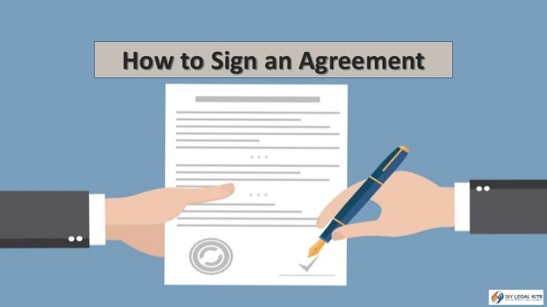
3. Gaining Agreement
When there has been ongoing dialogue and closure or commitment is needed, closed-ended questions can often bring about that result.
  With everything we discussed, I’d like to conclude this project. Can we agree to terms?

Slide 44

4. Clarifying Information
Closed-ended questions can ensure you have the details correct and thus prevent misunderstandings or mistakes.
  Closed-end questions help save time and reduce the number of complaints and/or product returns you or your organization will have to deal with.
    Does it seem I have a good understanding of your issue/concern?

Slide 45

Additional Question Guidelines
Use questions to further your feedback.
  In order to generate meaningful responses from customers, keep the following points in mind:
    Avoid Criticism
    Ask Only Positively Phrased Questions
    Ask Direct Questions
    Ask Customers How You Can Better Serve

Slide 46
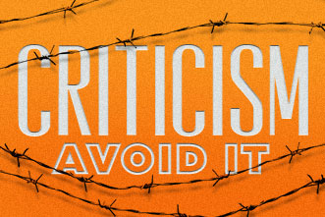
1. Avoid Criticism
Be careful not to seem critical in the way you ask questions. What customers choose should not be your concern.
  Your job is to help by providing excellent customer service.
    Remember that nonverbal messages delivered via tone or body language can suggest criticism, even if spoken words do not.

Slide 47

2. Ask Only Positively Phrased Questions
You can ask for the same information in different ways, some more positive than others.
  As you interact with your customers, it is crucial to send messages in an open, pleasant manner.
    This is accomplished by tone of voice and proper word selection. From “You don’t really want that color, do you?” to “We offer a wide selection of colors.”

Slide 48
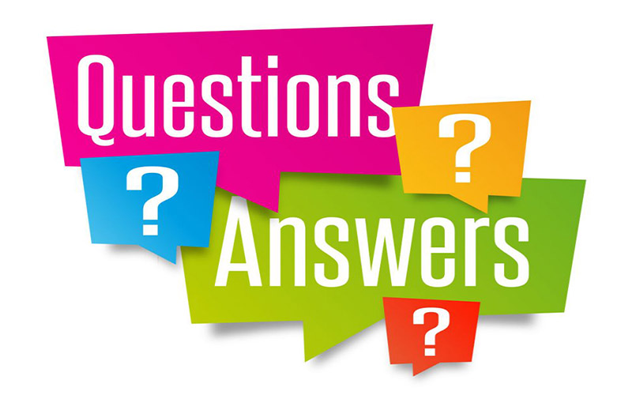
3. Ask Direct Questions
You generally get what you ask for. Therefore, being very specific with your questions can often result in receiving useful information and can save time and effort.
  This does not mean that you should be abrupt or curt in your communication with customers or anyone else.
    Does this meet your needs?

Slide 49
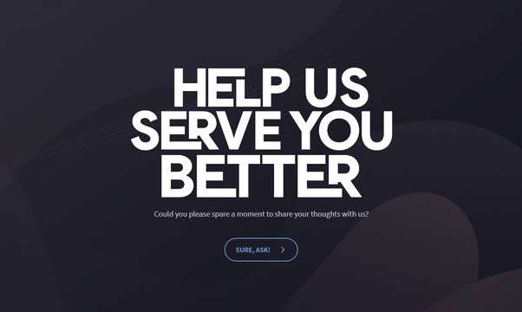
4. Ask Customers How You Can Better Serve
You will find no better or easier way to determine what customers want and expect than to ask them.
  They will appreciate it, and you will do better at serving them.
    If appropriate, a good follow-up approach to gain additional information after a customer has responded to a question is: “That’s interesting; will you please explain to me what makes you feel that way (or believe that’s true)?”

Slide 50
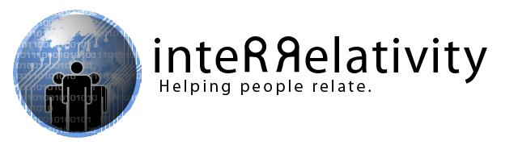
Part Three: Building and Maintaining Relationships
Chapter Six: Customer Service and Behavior
  “To be successful, you have to be able to relate to people; they have to be satisfied with your personality to be able to do business with you and to build a relationship with mutual trust.” - George Ross

Slide 51

What are Behavioral Styles?
Behavioral styles are actions or reactions exhibited when you and others deal with tasks or people. As a service professional, you need to be aware that not everyone is the same.
  There is no “one best type” of behavior and that behavior can change from one situation to another.
    Much of the way that people react in a given situation is driven by personal knowledge, experience, culture, and other background features.
    Various studies indicate most people have a primary style preference, and secondary styles depending on the situation and people involved.

Slide 52

What are Behavioral Styles?
They key to effectively managing your behavior and addressing that of others is to listen to what the customer is saying and watch for nonverbal cues.
  Human behavior is adaptable and often unpredictable.
    By learning more about your own behavioral styles, and how others might behave in various situations, you can increase chances of service success.

Slide 53

What are Behavioral Styles?
Behavioral Styles are observable tendencies (actions that you can see or experience) that you and other people exhibit when dealing with tasks or people.
  As you grow from infancy, your personality forms based on your experiences and your environment.
    These form the basis of your behavioral style preference.

Slide 54
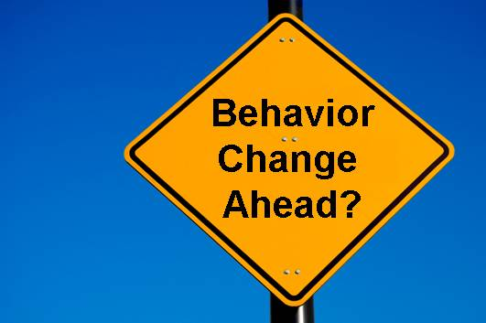
What are Behavioral Styles?
Part of being a customer service professional is that you need to understand human behavioral style characteristics.
  The more proficient you become at identifying your own behavioral characteristics and those of others, the better you will be at establishing and maintaining positive relationships with customers. Self-knowledge is the starting point.
    When encountering differing behavioral styles, there are many strategies that can be used to help modify and adapt your behavior so that it does not clash with that of your customers.

Slide 55
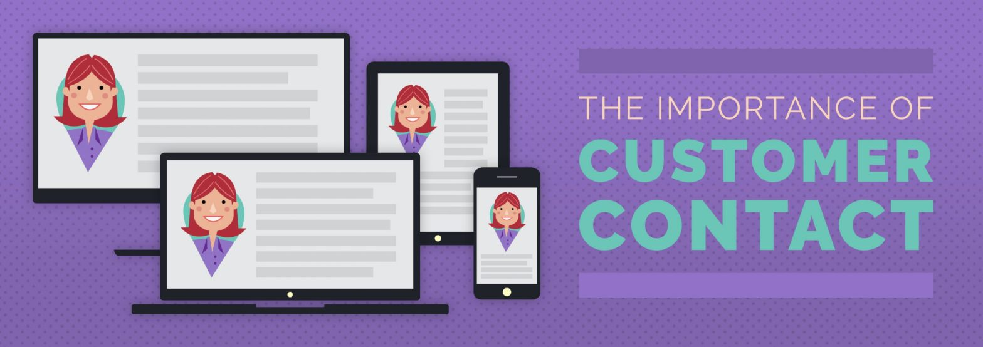
Identifying Behavioral Styles
Each contact in a customer service environment has the potential for contributing to your success.
  Each person should be valued for their strengths and not belittled for what you perceive as shortcomings.

Slide 56
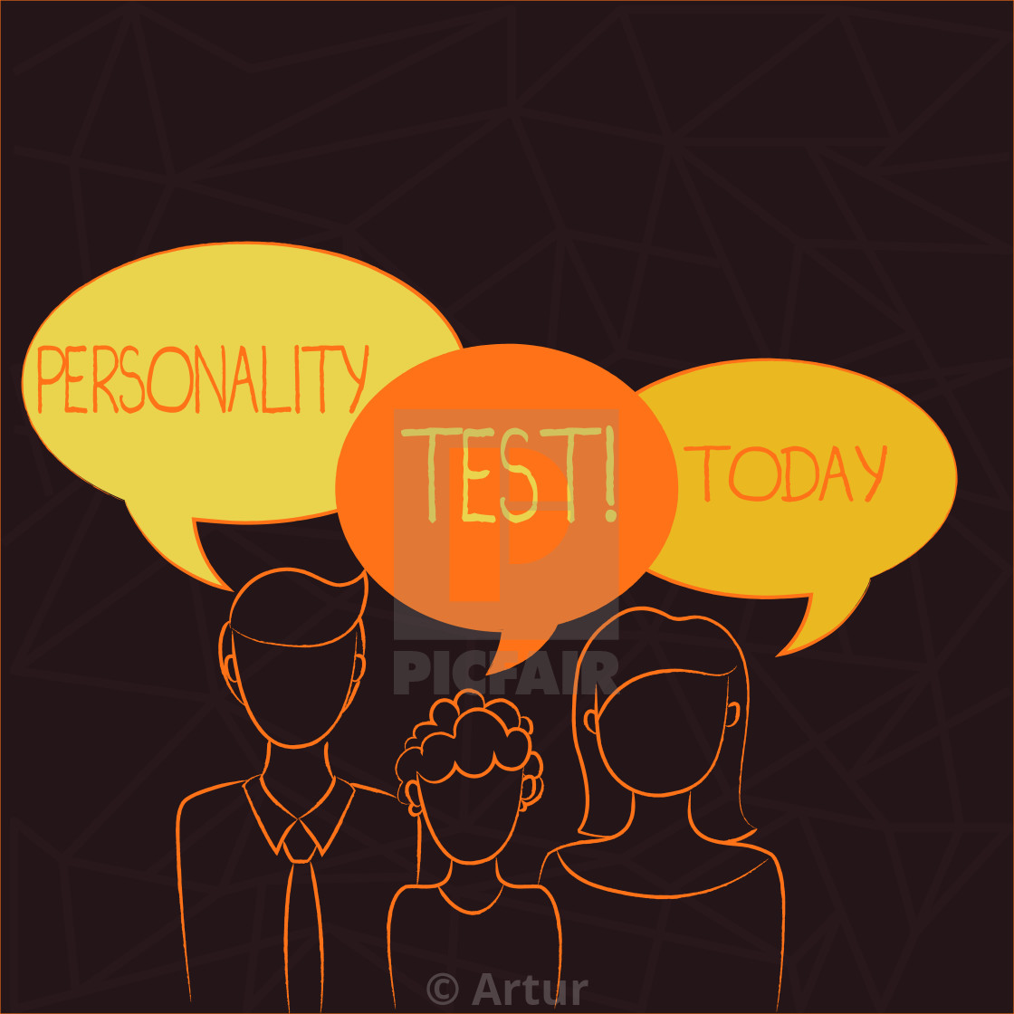
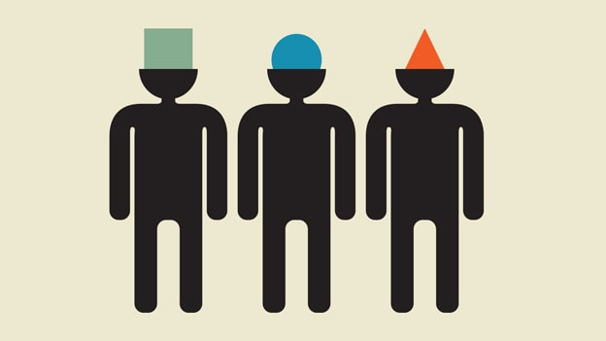
Identifying Behavioral Styles
An awareness of your own style preferences can then lead you to a better understanding of customers, since many also possess similar style preferences.
  By understanding these characteristics, you can improve communication, build stronger relationships, reduce conflict and misunderstandings, and offer better service to customer.

Slide 57
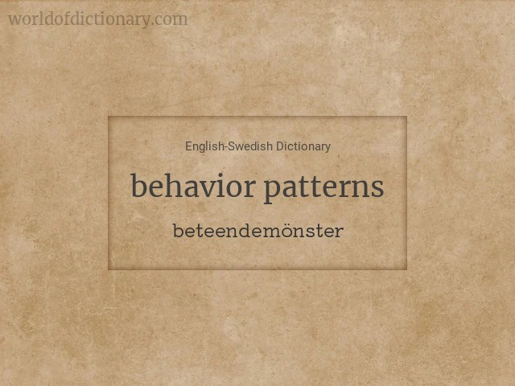
Identifying Behavioral Styles
Although everyone has a primary behavior pattern to which they revert in stressful situations, people are a combination of behavioral styles they pull from as situations change.
  Because of this, customers have characteristics in common and regularly demonstrate similar behavioral patterns.
    Identifying your own style preferences helps you understand and relate to behaviors in others.

Slide 58

Identifying Behavioral Styles
Because of the complexities of human behavior, you should not try to use behavioral characteristics and cues as absolute indicators of the type of person with whom you are dealing.
  Most people are adaptable and can shift style categories or exhibit different characteristics depending on the situation or environment in which they are in.

Slide 59

RIDE
Since people are a combination of styles, they may exhibit some, but not all, of these characteristics at any given time. They may exhibit characteristics from other style categories, as well, based on a given situation or their emotional state.
  The (4) RIDE Behavioral Style Categories include:
    The Rational Style
    The Inquisitive Style
    The Decisive Style
    The Expressive Style

Slide 60
Behavioral Style Categories
Rational
  Individuals with a rational behavioral style approach situations logically and analytically. They prioritize facts, data, and objective reasoning when making decisions or solving problems.
Inquisitive
  People with an inquisitive style are naturally curious and seek to understand the "why" behind ideas and actions. They ask questions, explore possibilities, and value innovation and learning.
Decisive
  Those with a decisive style are action-oriented and confident in making quick decisions. They focus on results, efficiency, and achieving goals, often preferring direct and assertive communication.
Expressive
  Expressive individuals are enthusiastic, outgoing, and emotionally engaged. They value relationships, enjoy collaboration, and often use storytelling and emotion to connect with others.

Slide 61
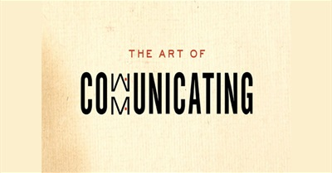
Communicating with Each Style
Once you recognize people’s style tendencies, you can improve your relationships and chances of success by tailoring your communication strategies.
  Keep in mind everyone is a mixture of all 4 styles and can change to a different style to address a variety of situations.

Slide 62

Building Stronger Relationships
Building stronger customer relationships means that you discover customer needs, seek opportunities for service, and respond appropriately to customers’ behavioral styles.

Slide 63
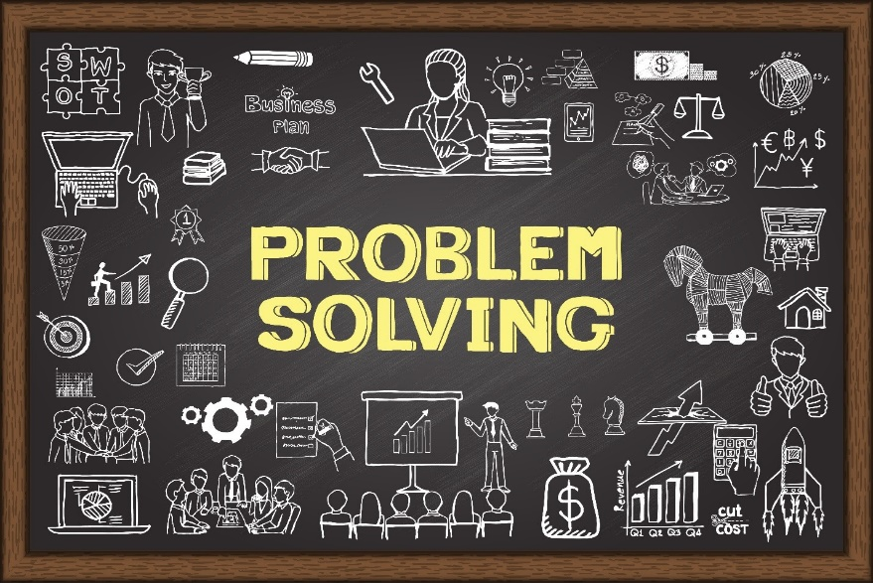
Building Stronger Relationships
Recognizing and relating to customers’ behavioral styles is just the first step in providing better service.
  To deliver total customer satisfaction, you will need to make the customer feel special, which often requires skills such as relationship building through effective communication and problem solving.
    Problem solving is the system of identifying issues, determining alternatives for dealing with them, and then selecting and monitoring a strategy for resolution.

Slide 64
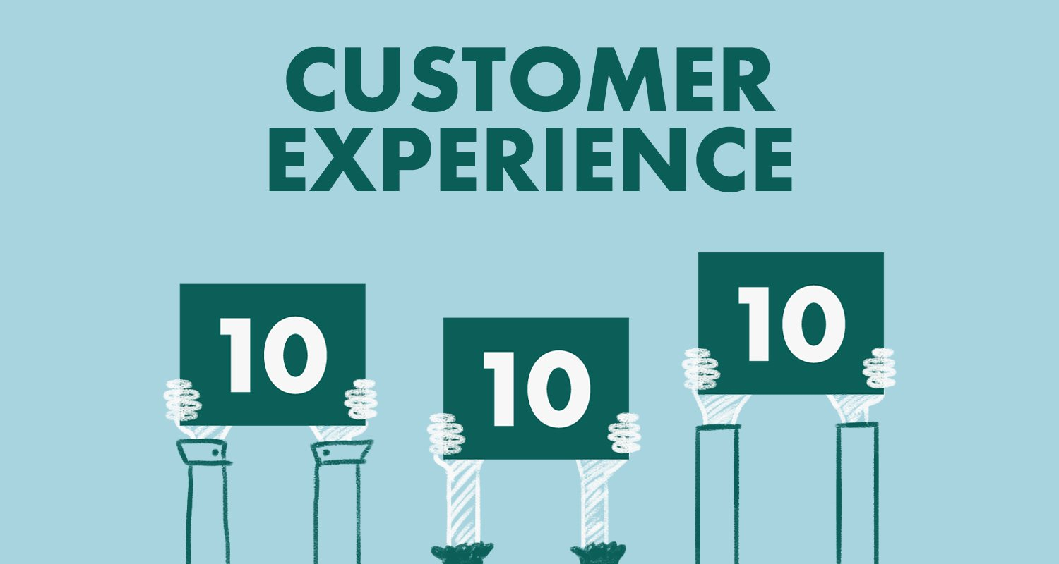
Building Stronger Relationships
Whether a situation involves simply answering a question, guiding someone to a desired product or location, or performing a service, customers should leave the interaction feeling good about what they experienced.
  Providing this feeling not only is good business sense on your part but also helps guarantee the customers return or spread favorable word-of-mouth advertising.

Slide 65

Building Stronger Relationships
There are many ways of partnering with either internal or external customers to solve problems and produce a win-win situation (one in which both the customer and you and your organization succeed and feel good about outcome).
  Whatever you do to achieve this result, your customers should realize that you are their advocate and are acting in their best interests to solve their problems.

Slide 66

Say “Yes”
If you must decline a request or cannot provide a product or service, do so in a positive manner.
  Deemphasizing what you cannot do and providing an alternative puts the customer in a power position.
    That is, even though they may not get their first request, they are once again in control, and can say “yes” or “no” to the alternative you have offered, or they can decide on the next step.

Slide 67

Strategies for Responding to Customer Problems
The Rational Style
Seeks systematic resolution to the situation.
  Stress resolution and security of the issue.
Avoids conflict or disagreement.
  Smile, when appropriate.
Strives for acceptance of ideas.
  Provide references or resources.
Intermittent eye contact.
  Listen actively, make eye contact.
Uses hand and subdued body movements and speech to emphasize key points.
  Focus on personal movements to convey your feelings about the incident (i.e. “How do your feel we can best resolve this problem?”).

Slide 68

Strategies for Responding to Customer Problems
The Inquisitive Style
Listens to explanations.
  Focus on the problem, not the person.
Demands specifics.
  Have details and facts available.
Mild demeanor.
  Approach in nonthreatening manner.
Intermittent eye contact.
  Listen actively, make eye contact, and focus on the situation.
Gives list of issues, in chronological order.
  Be specific in outlining actions to be taken by everyone.
Exhibits patience.
  Follow through on commitments.
Seeks reassurance.
  Offer guarantees of resolution if possible.
Focuses on facts.
  Give facts and pros and cons of suggestions.

Slide 69

Strategies for Responding to Customer Problems
The Decisive Style
Seeks to avoid conflict; just wants resolution.
  Use low-pitched, unemotional speech; be patient; listen.
Loud voice.
  Be patient; listen emphatically.
Finger-pointing or aggressive body gestures.
  Do not internalize; they are angry with the product or service, not necessarily with you.
Firm, active handshake.
  Return a firm businesslike handshake.
Directly places blame on service provider.
  Be brief; tell them what you can do; offer solutions.
Direct eye contact.
  Be formal, businesslike.
Sarcasm.
  Do not take a happy-go-lucky or flippant approach.
Impatient.
  Be time-conscious; time is money to a “D”
Demanding verbiage (i.e. “You better fix this!”).
  Project competence; find the best person to solve the problem.
Irrational assertions (i.e. “You people never, or always…).
  Ask questions that focus on what they need or want (i.e. “What do you think is reasonable?”).

Slide 70

Strategies for Responding to Customer Problems
The Expressive Style
Threats (i.e. “If you can’t help, I’ll go elsewhere.”).
  Reassure; say what you can do.
Intermittent smiling along with verbalizing dissatisfaction.
  Be supportive; tell the customer what you can do for them.
Uses nonaggressive language (i.e. “I’d like to talk with someone about…”).
  Allow them to vent frustrations or verbalize thoughts.
Steady eye contact.
  Smile, if appropriate; return eye contact while conversing.
Elicits your assistance and follow-up (i.e. “I really don’t want to run all over town searching. Will you please call…”).
  Take the time to offer assistance and comply with their requests, if possible.
Shows sincere interest.
  Focus on feelings through empathy (i.e. “I feel that…”).
Enthusiastic active handshake.
  Return a firm businesslike handshake.
Enthusiastically explains the situation.
  Patiently provide active listening; offer ideas and suggestions for resolution.

Slide 71

Seek Opportunities for Service
View complaints as a chance to create a favorable impression by solving a problem.
  Watch the behavioral characteristics your customer exhibits.
  Using what you see and hear, take appropriate action to adapt to their personality needs and solve problem professionally.
    You can take the opportunity to solve the problem and strengthen the relationship at the same time.

Slide 72
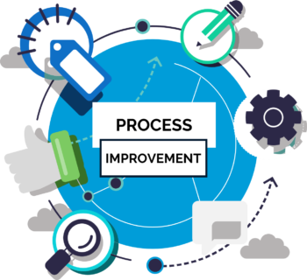
Focus on Process Improvement
You should strive to provide seamless service to customers. This means that they should get great service and never have to worry about your problems or breakdowns.
  When breakdowns do occur, remedy them quickly, and then soothe over the customer relationship. Recognize customers of varying behavioral styles will react differently to breakdowns.
    Try to handle defects in your system or processes or delays when the customer is not present.

Slide 73
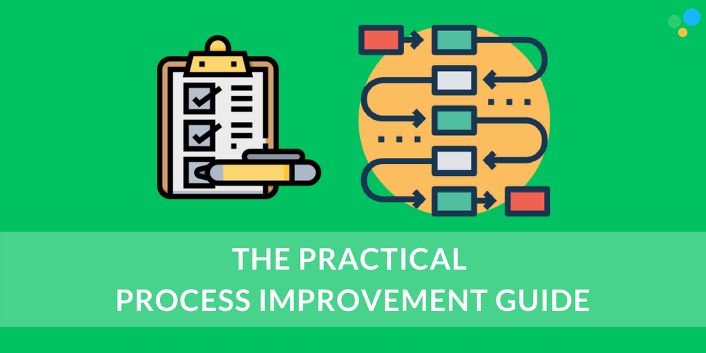
Focus on Process Improvement
Reduce or eliminate customer inconvenience and distress.
  After an extensive delay you may want to compensate the customer for the inconvenience. Make a sincere apology.
    After dealing with a problem, you should personally address the process that caused the breakdown or make a recommendation to your supervisor or other appropriate person. All employees are responsible for quality service and process improvement.

Slide 74
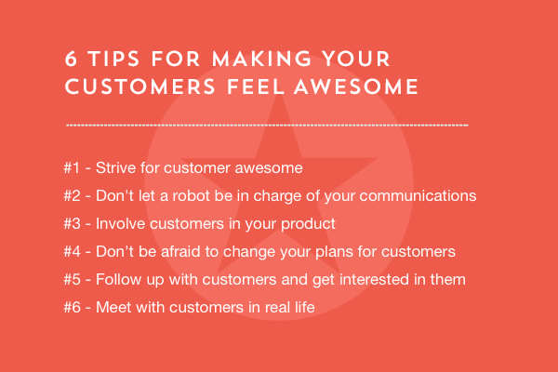
Make Customers Feel Special
Most people like to feel special and appreciated. Creating that feeling in others is what customer service is all about.
  Through simple things like a warm smile, pleasant tone; and welcoming words, you can make your customers feel like the most important people in the world to you…because at that moment they should be.

Slide 75
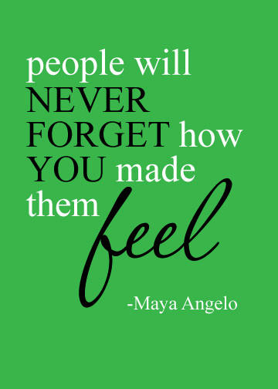
Make Customers Feel Special
By creating a bond with your customers through positive words and actions, you can easily help them feel as if there is no other place they would rather be or with whom they would rather do business.
  With a few simple gestures or phrases, you can be on the way to developing a sound customer-provider relationship that not only results in a loyal customer, but is also likely to generate positive word-of-mouth advertising from the customer to other people that they know.

Slide 76
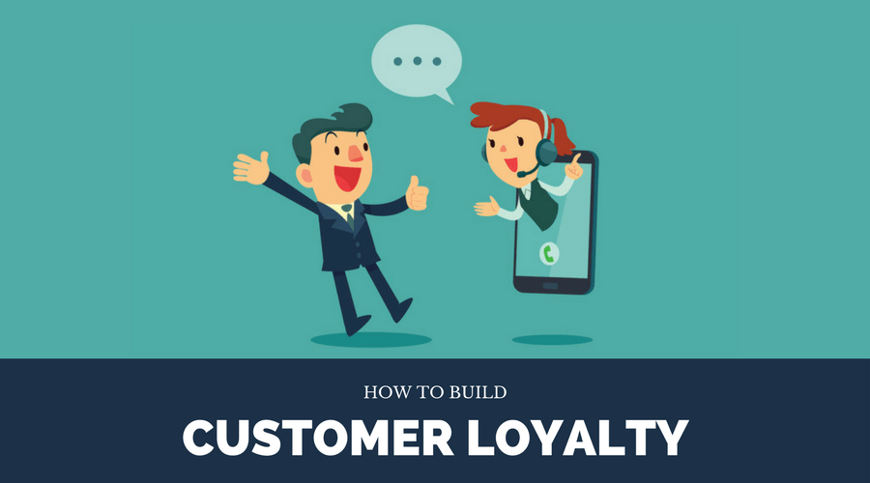
Make Customers Feel Special
When customers feel good about themselves because of something you did or said, they are likely to appreciate what you and your organization can offer them.
  Small tokens of appreciation can be worth their weight in customer gold.
    This strategy goes a long way in guaranteeing customer loyalty.

Slide 77
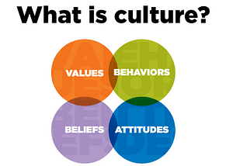
Be Culturally Aware
The reality of a multicultural customer service environment further challenges your ability to deal with behaviors.
  This is because, in today’s multicultural business environment, it is likely that you will interact with someone of a different background, belief system, or culture on any given day.
    Many challenges that develop in these encounters are a result of diversity ignorance.

Slide 78

Be Culturally Aware
Even after you master the concepts of behavioral styles, you must remember that because values and beliefs vary from one culture to another, behavior is also likely to vary.
  For example, in many countries or cultures, the nonverbal gestures that North Americans use have completely different meanings. Likewise, the reactions to such gestures will differ based on the recipient’s personality style and background.
    Symbols and gestures might anger or offend some customers.

Slide 79

Dealing with Perceptions
Often there are many different perceptions of an event.
  Our perceptions are often influenced by many factors such as physical qualities, social roles and behaviors, psychological qualities, and group affiliations.
    A perception is how someone views an item, situation, or others.

Slide 80
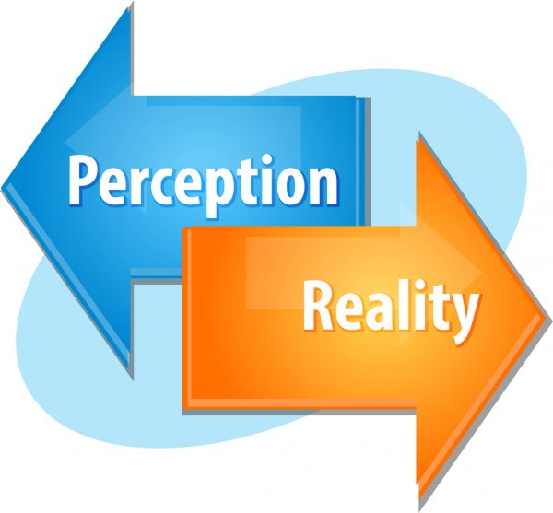
Dealing with Perceptions
Everyone has perceptions about the people and events they encounter.
  A person’s behavioral style as well as background, based on education, experiences, events, and interpersonal contacts, can influence how they view the world.
    In effect, there are sometimes as many different perceptions of an event as there are people involved.

Slide 81

Factors Affecting Perceptions
We tend to base our perceptions of others and categorize people by thinking about the following:
  Personal Appearance
    How does the customer generally look related to factors such as dress, jewelry, grooming, and hygiene?
  Physical Qualities
    What does a person look like? What gender? What body shape? Color of skin? Physical characteristics?
  Social Roles
    What is a person’s position in society? Job title? Achievements? Involvement in social or volunteer organizations?

Slide 82
Factors Affecting Perceptions
We tend to base our perceptions of others and categorize people by thinking about the following (cont.):
  Social Behaviors
    How does this person act in terms of behavioral style characteristics? What social skills do they exhibit in social and business settings? How well do they interact with people?
  Psychological Qualities
    How do they process information mentally? Is this person confident? Stressed out? Insecure? Curious? Paranoid?
  Group Affiliations
    Does person belong to a familiar religious, ethnic, or political group? What kind of qualities are associated with each group? Do they assume leadership roles and demonstrate competence in roles?

Slide 83

Perceptions and Stereotypes
As a customer service provider, you should be aware of how you perceive customers and, in turn, how they perceive you.
  In some cases, you may stereotype people and, in doing so, adversely affect delivery of services. The factors that you might be tempted to project onto an individual (i.e. age, gender, race, ethnicity) might actually stem from their behavioral style preference.
    You need to be very careful that your perceptions about any group of people are not influenced by stereotypes because this clearly works against treating each customer as an individual.

Slide 84
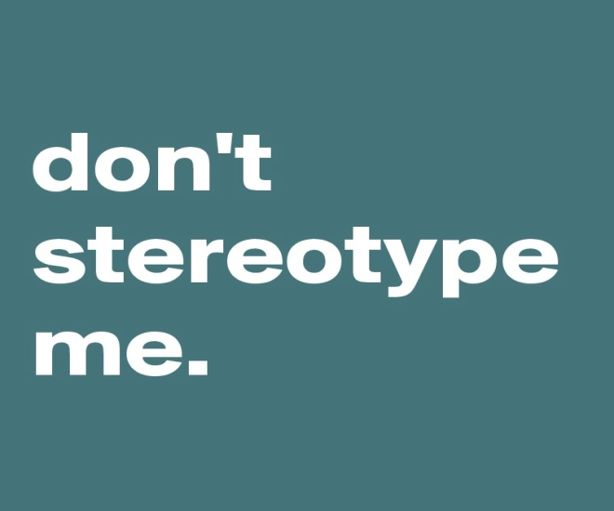
Perceptions and Stereotypes
Stereotyping people affects your relationships with customers. The practice could even lead to legal charges of disparate treatment and liability for you and your organization.
  This is one reason why you should consciously guard against stereotyping when you interact with customers.
    If you pigeonhole people right away because of preconceptions, you may negatively affect future interactions.

Slide 85
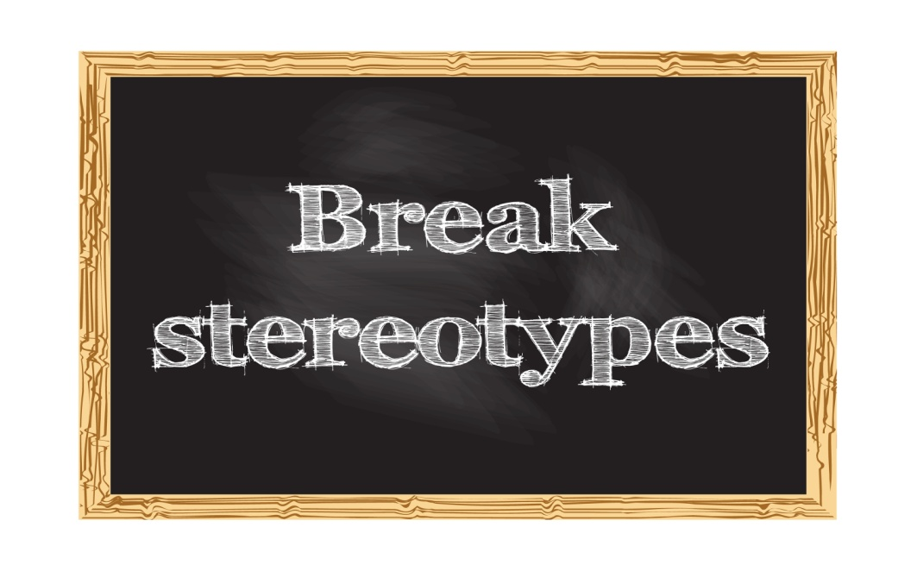
Perceptions and Stereotypes
To avoid categorizing or stereotyping people, spend time observing them, listen to them objectively, and respond according to each unique situation and person.
  Doing this can lead to better relationships and improved customer service.

Slide 86


