Slide 1

The Mentor Leader
Session One

Slide 2
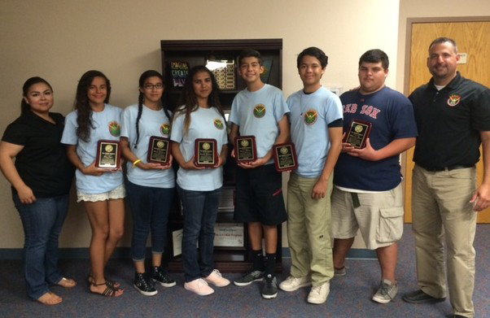
The Mentor Leader
Group One

Slide 3

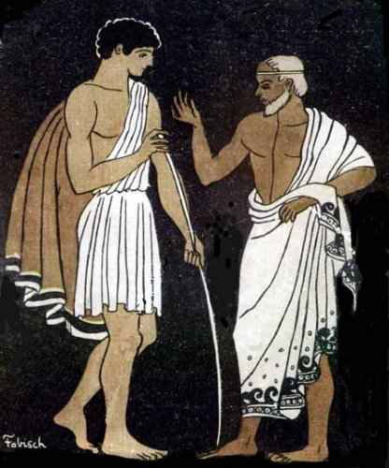

The Mentor Leader
It isn’t a structured program that necessarily makes the difference in people’s lives; rather, the difference is made moment by moment by leaders who care for others.
  The ones who have had the greatest positive impact on my life are the select few who have been not only leaders…but, mentors.

Slide 4


The Mentor Leader
Leadership is not an innate, mystical gift; rather a learned ability to influence the attitudes and behaviors of others.

Slide 5



The Mentor Leader
Mentor leaders seek to have direct, intentional, and positive impact on those they lead.
  At its core, mentoring is about building character into the lives of others, modeling and teaching attitudes and behaviors, and creating a constructive legacy to be passed along to future generations of leaders.

Slide 6



The Mentor Leader
The primary focus of mentor leadership is to shape the lives of the people right in front of you, as you lead, guide, inspire, and encourage those people.

Slide 7



The Mentor Leader
Mentor leadership focuses on developing the strengths of individuals.
  Leaders make the people they lead better in what they do, and ultimately, better people.

Slide 8


The Mentor Leader
Mentor leadership works best when the ones being mentored are aware that the mentor leader has a genuine concern for their development and success.
  Those we lead will be more receptive if they believe we genuinely want them to succeed.

Slide 9



The Mentor Leader
It’s All About Relationships
Mentor leadership is all about shaping, nurturing, empowering, and growing. It’s all about relationships, integrity, and perpetual learning.
  Success is measured in changed lives, strong character, and eternal values rather than in material gain, personal achievement, or status.
    It’s all about changing lives and putting people first!

Slide 10
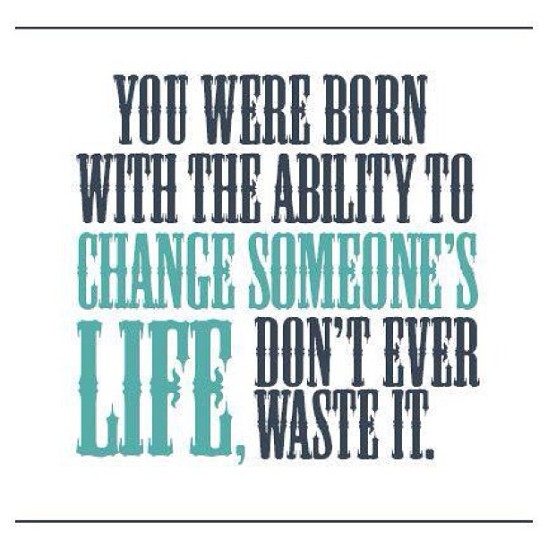
The Mentor Leader
Make an Impact

Slide 11
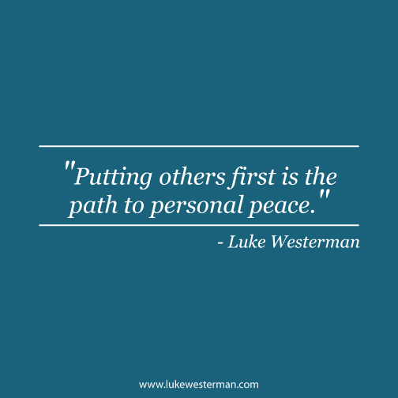
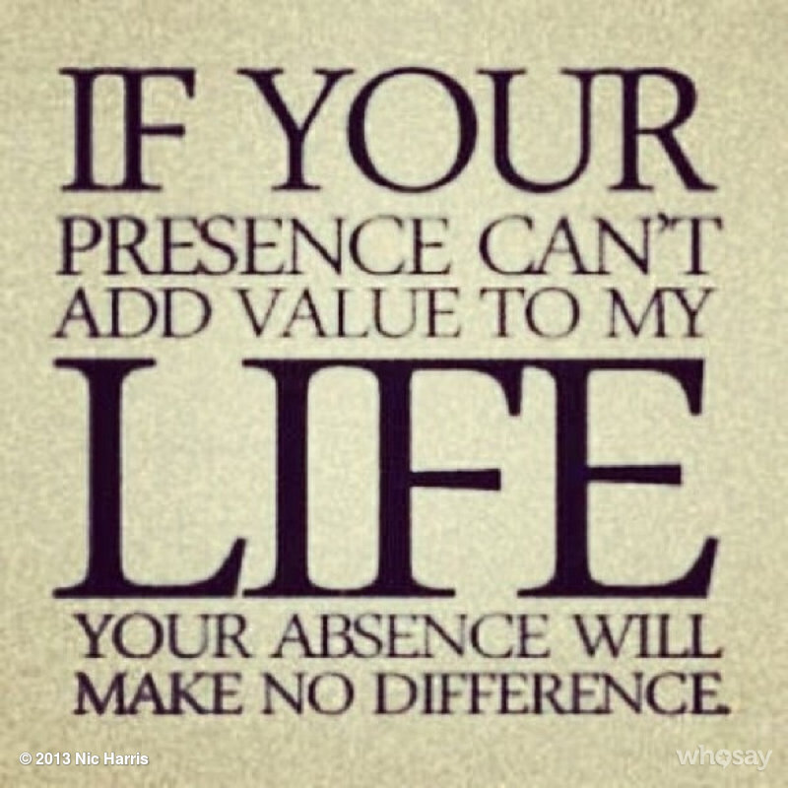
The Mentor Leader
Put Others First
The key to becoming a mentor leader is learning to put other people first.
  The question that burns in the heart of the mentor leader is simply this: What can I do to make other people better, to make them all they were created them to be?

Slide 12
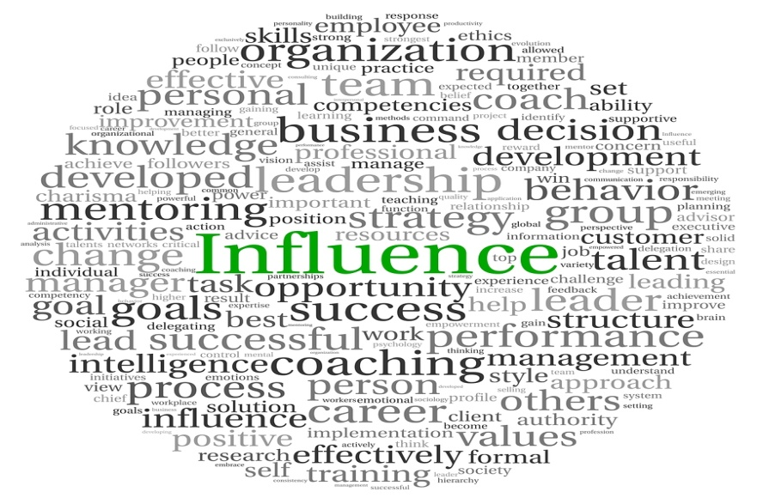

The Mentor Leader
A Positive, Lasting Influence
How does my leadership, involvement in the lives of others have a positive and lasting influence and impact on them?
  If influence, involvement, improvement, and impact are core principles of mentor leadership, how can we make them central to everything we do?

Slide 13


Leadership
Be a Positive Influence
Simply stated, leadership is influence.
  We find opportunities for leadership wherever we go.
  By keeping our motives aligned with doing the best for those around us, we will keep ourselves focused on being a positive influence.
    People’s lives should be better because of influence you’ve had along the way.

Slide 14


Slide 15


Leadership
Focus on Others
Mentor leaders understand that if we lose sight of people, we lose sight of the very purpose of leadership.

Slide 16


Mentor Leadership
Building People Up
Mentor leadership focuses on building people up, building significance into their lives, and building leaders for the next generation.
  Mentor leaders see potential and strive to develop it in the people they lead.

Slide 17


Strength
We need strong men and women who care enough to invest themselves – time, attention, and wisdom – in the lives of others to stem the tide of wasted lives and wasted potential that is increasing at an alarming rate across our nation.
  Making a difference through mentoring relationships that truly embrace and demonstrate the values of a single life is what mentor leadership is all about.

Slide 18

Legacy
Part of our purpose in life is to build a legacy.
  A consistent pattern of building into the lives of others with wisdom, experience, and loyalty that can be passed on to succeeding generations.

Slide 19

Legacy
Building a life of significance, and creating a legacy of real value, means being willing to get your hands dirty.
  It means being willing to step out in your life and onto the platforms of influence given to you and touch the lives of people in need.
    If you want to make a difference in the lives of the people you lead, you must be willing to walk alongside them, lift and encourage them, share moments of understanding with them, and spend time with them, not just shout down at them from on high.

Slide 20

Eternal Perspective
A leader must look into the distance, beyond the immediate return, where the rewards are more permanent, and where the rewards are eternal.

Slide 21


Achieve Good Success
James Brown describes “good success” in his book Role of Lifetime: Reflections on Faith, Family, and Significant Living:
  It’s significance. It’s making a difference in the lives of others.

Slide 22


Good Success
Building for “good success” means creating a culture that will live on through succeeding generations.
  It means building with long-term perspective.

Slide 23

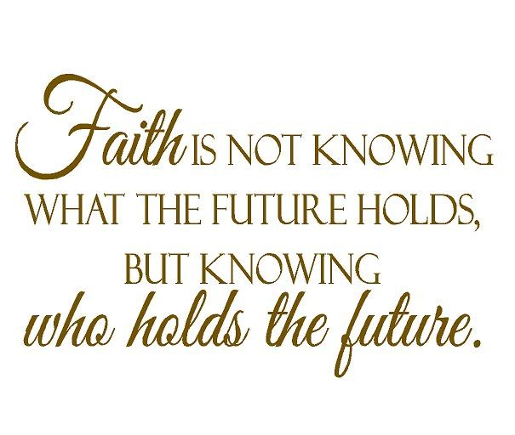

Faith
Maintaining a long-term perspective requires faith.
  Our talents and treasures may pay dividends so far down the road we may never see the outcome.

Slide 24


Action Steps
Integrity
Evaluate your integrity.
  Are your actions consistent with your words?

Slide 25


Action Steps
Impact
Evaluate your impact.
  Are you making lives better?

Slide 26



Action Steps
Perspective
Evaluate your perspective.
  Do you see people as central to your mission of good success?

Slide 27
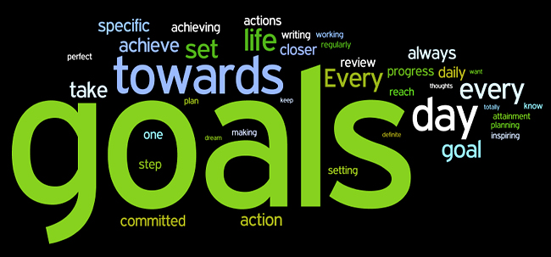

Action Steps
Goals
Evaluate your goals.
  Are you building relationships, or are you building a tower to climb to the top.

Slide 28

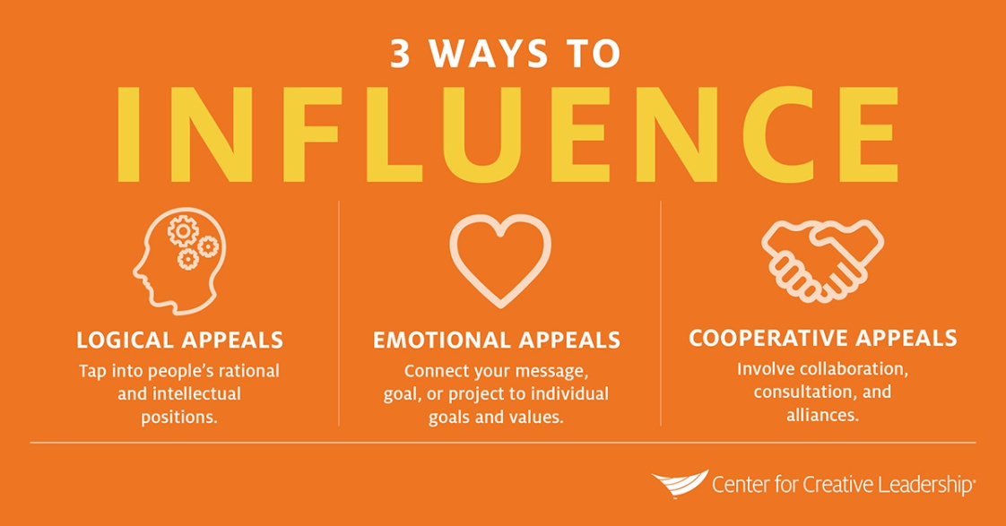
Action Steps
Engage and Influence
Mentor leaders see the opportunity to interact with people, and build into their lives along the way, as part of the journey itself.
  How are you looking for ways to directly engage with and influence other people?

Slide 29
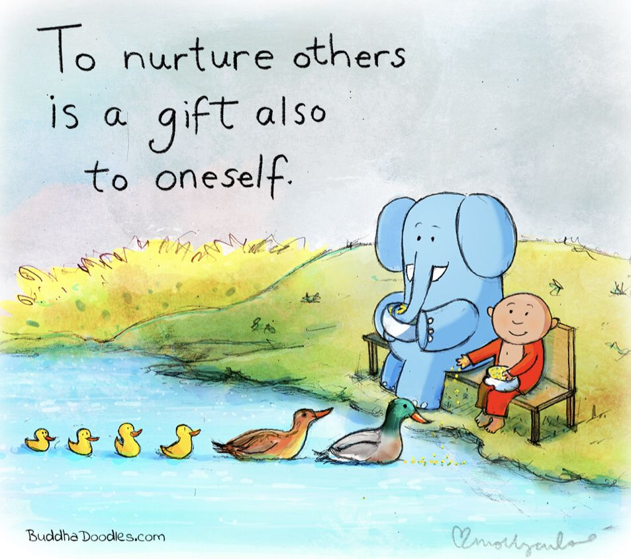
Action Steps
Nurture
How does you leadership style need to change so that people will flourish and grow around you?

Slide 30


Action Steps
Build Relationship
How can you build relationships and strengthen your ability to influence others?

Slide 31


Action Steps
What is Good Success?
From your perspective, what is the difference between “success” and “good success”?

Slide 32
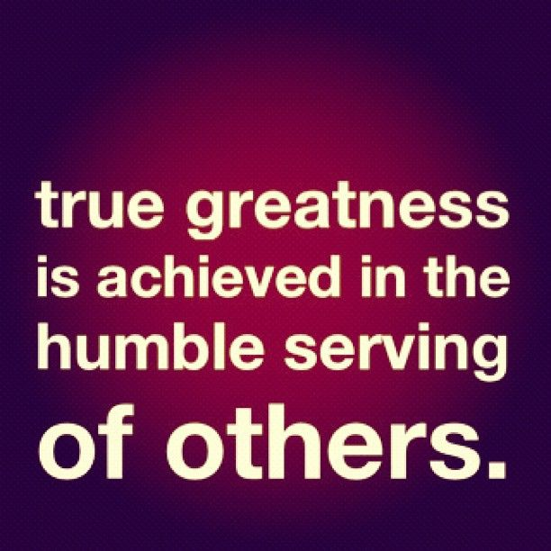
The Mentor Leader
The single most important factor that differentiates mentor leaders from other leaders in any setting is their outward focus on others.
  The mind-set of the mentor leader is about serving others.

Slide 33


The Focus of a Mentor Leader
Mentor leaders realize that leadership is not about them, instead, they focus on the other people they lead and where they should be going together.

Slide 34



The Mentor Leader
Our long-term focus should be on building into the lives of others so that in all situations they learn how to respond properly.
  If we take the time to reach and equip them to handle adversity, success, and changing circumstances on their own, and if we give them the opportunity to develop and test their own judgment, then the time will come when we won’t have to exercise moment-by-moment, hands-on control, because we already spent our time mentoring rather than directing.

Slide 35

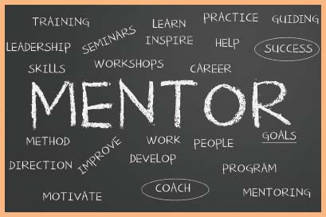
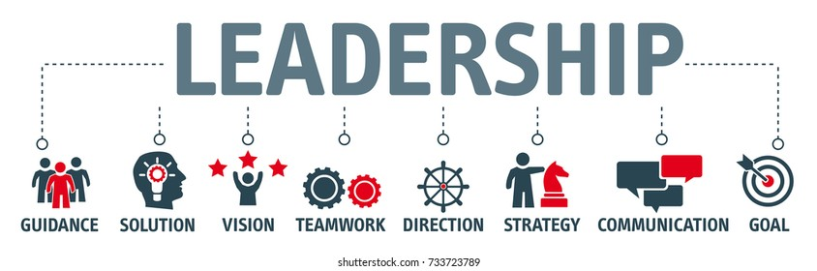
Situational Leadership
There are times when various styles of leadership are needed.
  Situational leadership means that different styles are appropriate at different times, and it is important that a leader be discerning enough and close enough to the situation to know when to use a particular style.
    However, the mentor leadership is essential.

Slide 36


The Mentor Leader
If you do it right, as a mentor leader you may make it all but impossible for other people to give you credit.
  Ask yourself, “Am I prepared to have great success, and not get any credit for it?”

Slide 37

Leadership
Leadership is the art of getting someone else to do something you want done because he wants to do it.
  (Dwight D. Eisenhower).

Slide 38


Vision, Mission, and Values
The vision, mission, and values we establish in life are the guiding lights for our lives and the lives of those we lead.

Slide 39

Vision
Vision paints the picture of where we want to be, what we want to look like, what we hope things will be like in the future if we do what we feel we are called to do.
  A well-cast vision is one that can be commonly shared by all.

Slide 40

Mission
A mission statement serves to answer a fundamental question: Why do we exist?
  First cast the vision then establish the mission.

Slide 41


Values
The final component that guides us are our values.
Values are the “rudder that steers the ship.”
  Our values will determine how we as leaders approach, care for, and develop our mentoring relationships.
  They will clearly demonstrate that we are committed to the advancement and well-being of other people – those we are called to serve and lead.

Slide 42
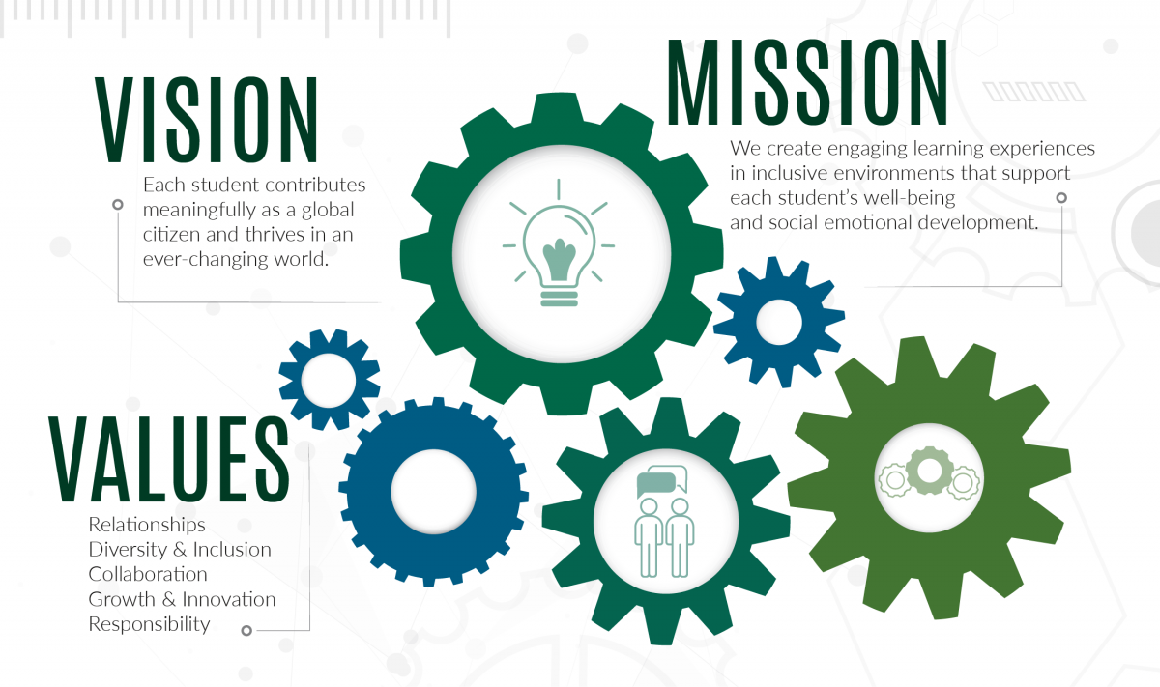
Vision, Mission, and Values
Taken as a whole, our vision, mission, and values tell the world who we are, what is important to us, and what guides our lives.
  They are a snapshot of who we are and the type of leaders we will be.

Slide 43
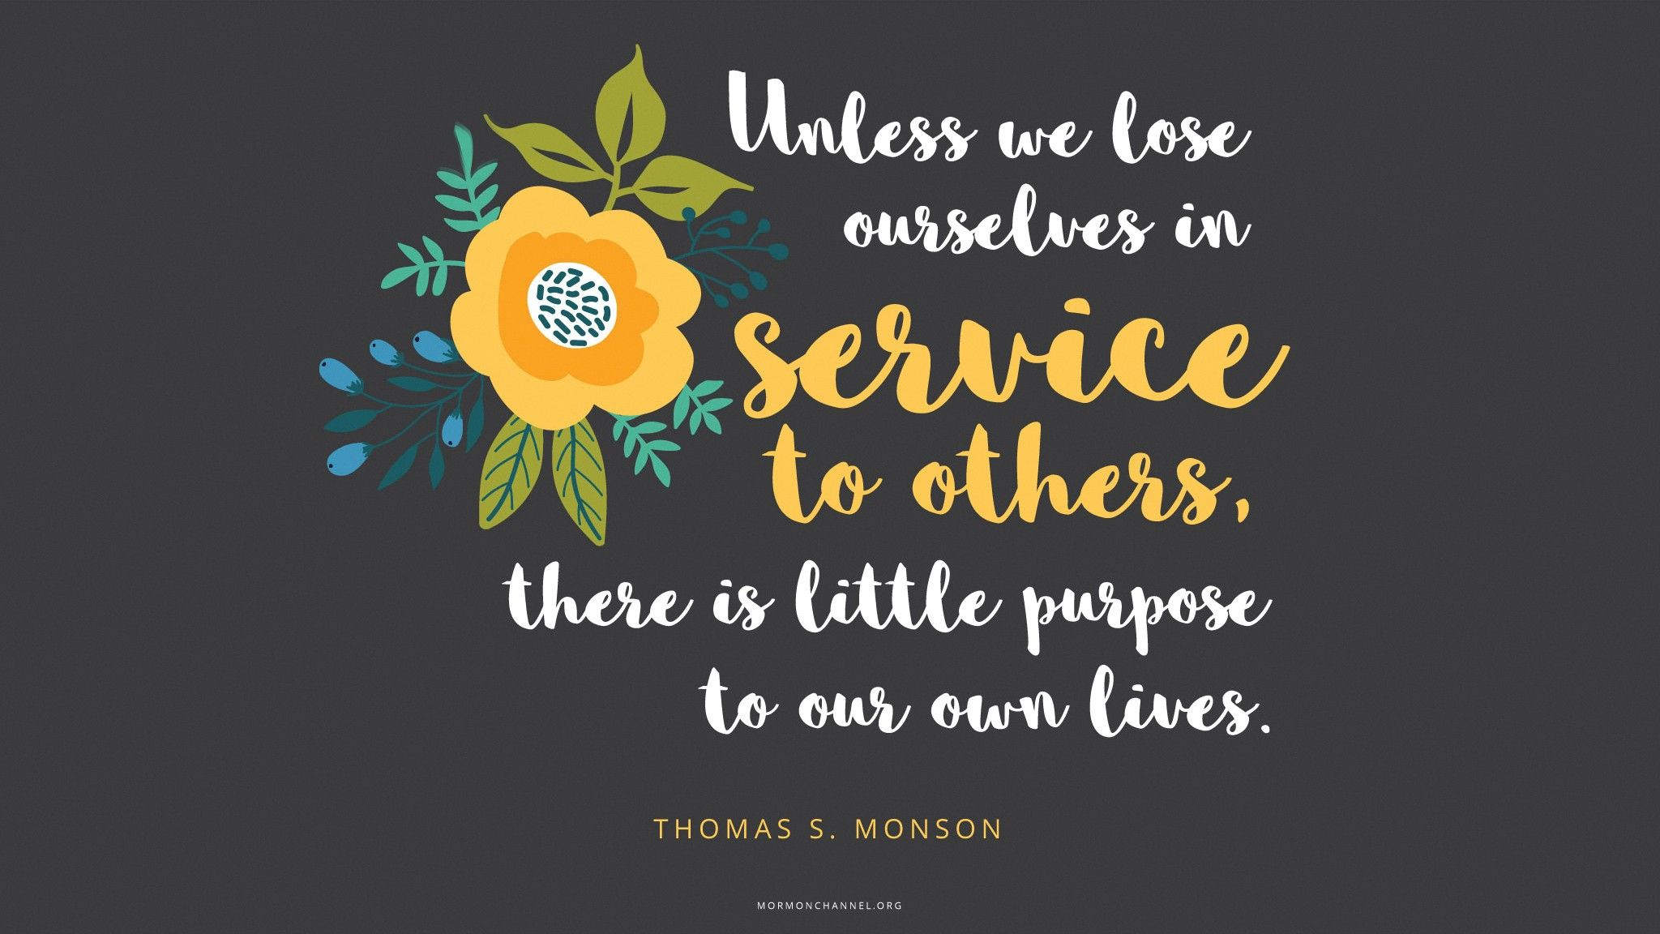
It’s All About Serving
Mentor leaders will clearly demonstrate a commitment to the advancement and well-being of other people – those we are called to lead and serve.

Slide 44
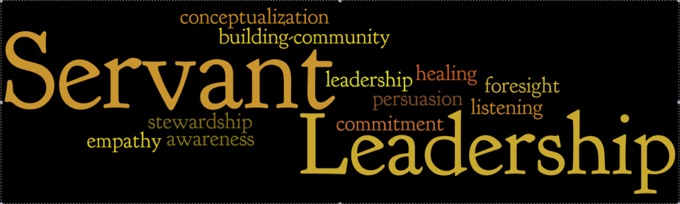
Service
Truly serving others requires putting ourselves and our desires aside while looking for ways and opportunities to do what is best for others.
  Humble servant leadership demonstrates to those you lead that you see them as valuable, and it’s worth your time to serve them – not to have them serving you.

Slide 45
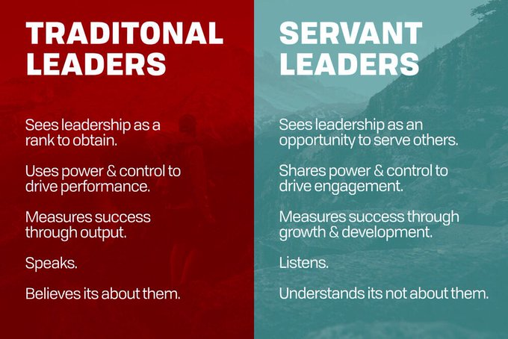
Servant Leadership

Slide 46

Mentoring
Intentional, direct service to others is mentoring, which is the key to leadership success on consistent long-term basis.
  People who are served in this way tend to, by that example, serve others. Mentors produce mentors.

Slide 47

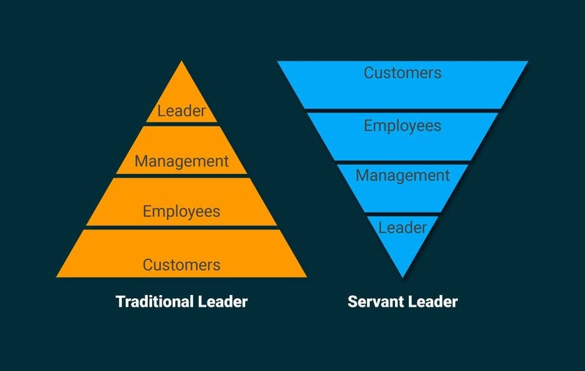

Paradigm Shift
Picture mentor leadership as an inverted organizational chart with the leader and employees at the bottom and community/customers at the top.
  The whole organization will collapse if the leader does not provide the support and strength needed to hold it up.

Slide 48


Nurture
When everyone else understands that his or her role is also to lift, encourage, and equip – and that all members of a group are dependent on one another – it’s clear nurturing relationships is necessary to the team’s health.

Slide 49

Action Steps
Focus
Evaluate your focus.
  Is it centered on benefiting others?

Slide 50

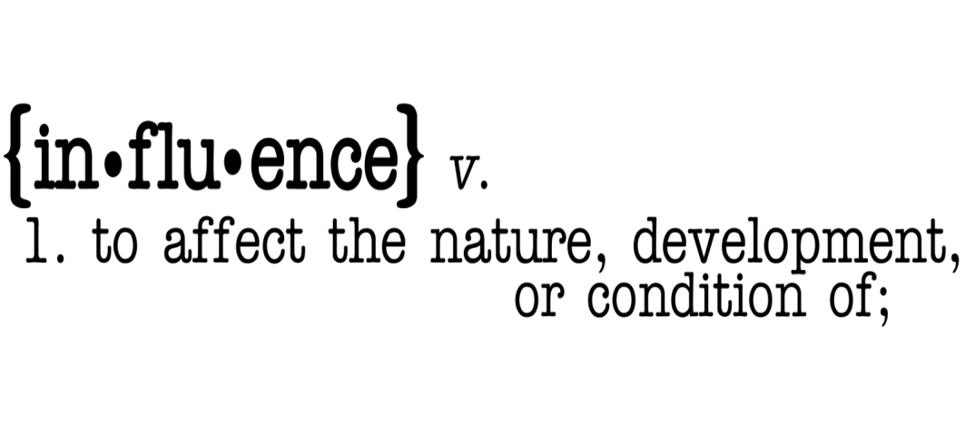
Action Steps
Influence
Evaluate your influence.
  Are you focused on developing your “coaching tree” – building leaders who build leaders, generation after generation?

Slide 51
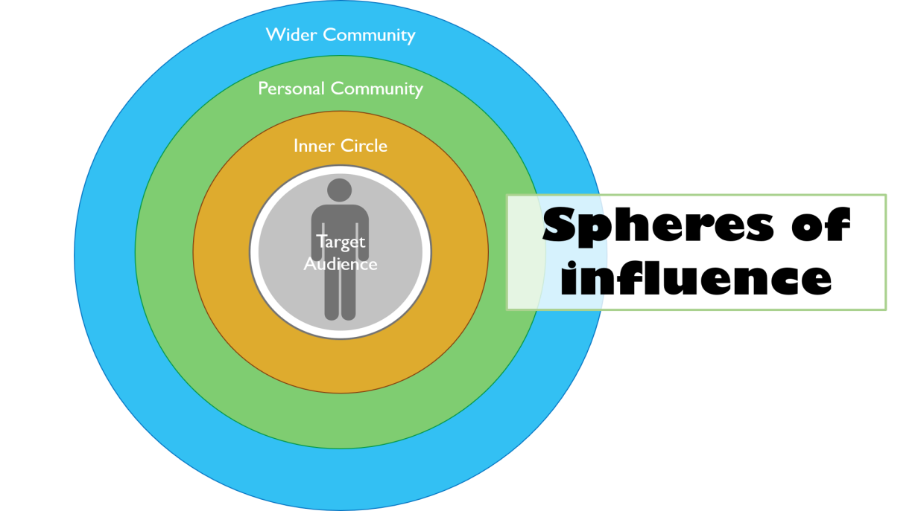
Action Steps
Others
Evaluate your audience.
  Are you able to preserve a long-term focus on growing others while at times appropriately exercising more direct control and involvement?

Slide 52

Action Steps
Look Ahead
Look ahead.
  Know your vision, mission, and values, but remember, life is about the journey, too.

Slide 53

Action Steps
Focus on Present
Focus on the present.
  What can you do today to build into the lives of the people around you? Don’t miss the now. Remember, tomorrow may never come.

Slide 54

Action Steps
Vision
Evaluate your vision.
  What do you hope the future will look like as you proceed?

Slide 55

Action Steps
Mission
Evaluate your mission.
  Does it clearly tell you and the world what you’re about, why you’re here, and why you have chosen these goals?

Slide 56

Action Steps
Value
Evaluate your values.
  Are your “rules of behavior” consistent with your principles? Does your “rudder” steer you in a good direction for how you will behave and treat others?

Slide 57


Action Steps
Approach
Evaluate your approach with family, friends, your community and others: Mentoring is a lifestyle.

Slide 58
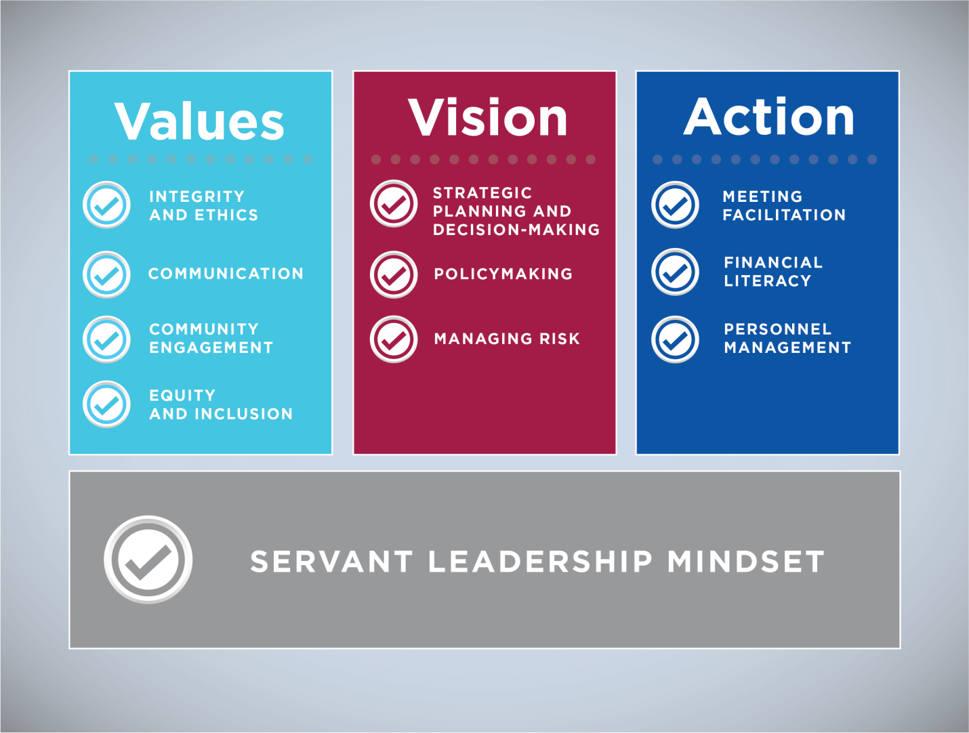
Action Steps
Serve
Remember, mentor leadership is all about serving.

Slide 59


