Slide 1

Business Survey
Session Two
Business Foundations
  A Changing World 11th Edition
    O.C. Ferrell, Geoffrey Hirt, and Linda Ferrell; McGraw Hill Education; New York, NY 2018
      ISBN: 978-1-259-68523-1

Slide 2
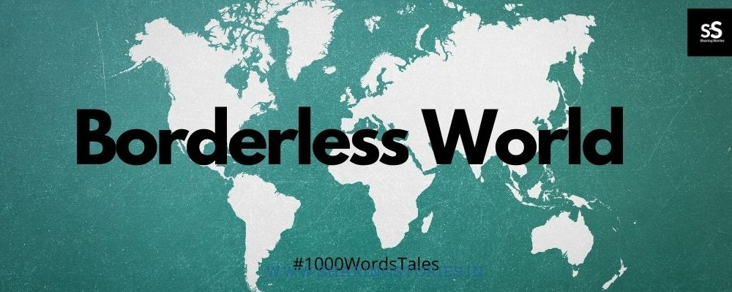
Part One: Business in a Changing World
Chapter Three: Business in a Borderless World

Slide 3


Introduction
Many U.S. firms are finding that international markets provide tremendous opportunities for growth.
  Accessing these markets can promote innovation while competition can lead to better and less expensive products.

Slide 4
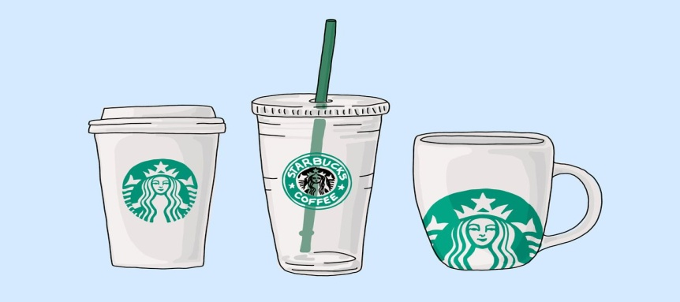
Role of International Business
International Business refers to the buying, selling, and trading of goods and services across national boundaries.
  Falling political barriers and new technology are making it possible for more companies to sell their products overseas and at home.
    Starbucks serves millions of global customers at more than 21,000 locations in 65 countries.

Slide 5

The Role of International Business
Most of the world’s population and two-thirds of its total purchasing power are outside the United States.

Slide 6

Why Nations Trade
Nations and businesses engage in international trade to obtain raw materials and goods that are otherwise unavailable to them or are available elsewhere at a lower price than that at which they themselves can produce.

Slide 7

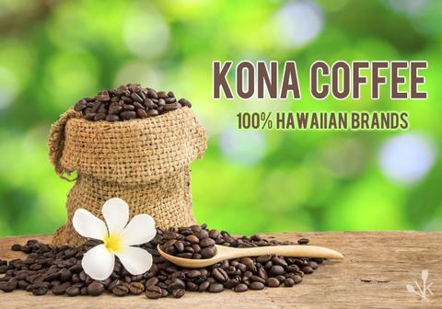
Why Nations Trade
Most international trade is based on “comparative advantage”, which occurs when a country specializes in products that it can supply more efficiently or at a lower cost than it can produce other items.
  Hawaii has a comparative advantage in producing pineapples and Kona coffee because of its climate.

Slide 8

Why Nations Trade
Other countries are also gaining a comparative advantage over the U.S. in the provision of some services, such as call-center operations, engineering, and software programming.
  As a result, U.S. companies are increasingly outsourcing, or transferring manufacturing and other tasks to countries where labor and supplies are less expensive.
    Outsourcing has become a controversial practice in the U.S. because many jobs have been moved overseas.

Slide 9
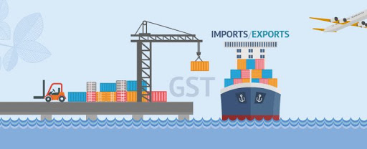
Trade Between Countries
To obtain needed goods and services and the funds to pay for them, nations trade by exporting and importing.
  Exporting is the sale of goods and services to foreign markets.
    The U.S. exports many goods and services, like agricultural, entertainment (movies, TV, etc.), and technological products.
  Importing is the purchase of goods & services from foreign sources.
    Many of the goods you buy in the US are likely to be imports or to have some imported components.

Slide 10
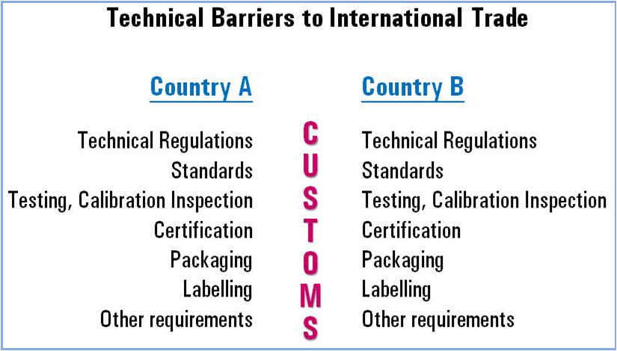
International Trade Barriers
When a company decides to do business outside its own country, it will encounter a number of barriers to international trade.
  Any firm considering international business must research the other country’s economic, legal, political, social, cultural, and technological background.

Slide 11

Economic Barriers
When looking at doing business in another country, managers must consider a number of basic economic factors, such as, economic development, infrastructure, and exchange rates.

Slide 12

Economic Development
Infrastructure
When considering doing business abroad, U.S. businesspeople need to recognize that they cannot take for granted that other countries offer the same things as are found in industrialized nations.
  A country’s level of development is determined by its infrastructure, the physical facilities that support its economic activities, such as, railroads, highways, ports, airfields, utilities, schools, hospitals, communication systems, and distribution systems.

Slide 13
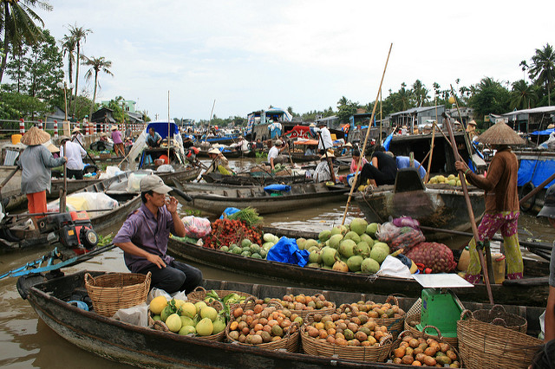
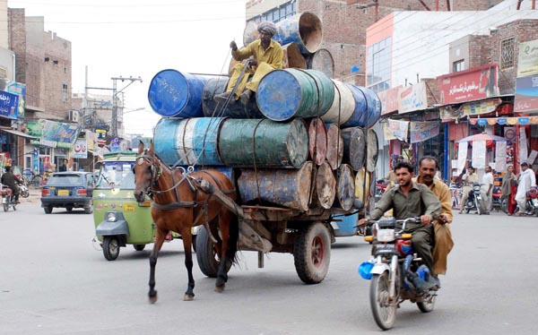
Economic Development
Less-Developed Countries
Less-Developed Countries (LDCs) are characterized by low per-capita income, which means that consumers are less likely to purchase non-essential products.
  Nonetheless, LDCs represent a potentially huge and profitable market for many businesses because they may be buying technology to improve their infrastructures, and much of the population may desire consumer products.

Slide 14


Exchange Rates
The ratio at which one nation’s currency can be exchanged for another nation’s currency is the Exchange Rate.
  When the value of the U.S. dollar declines relative to other currencies, the price of imports becomes more affordable for U.S. consumers.
    If the exchange rate for the dollar moves from $1.50 per euro to $1.25 per euro, then imports from Europe will be less expensive.

Slide 15

Ethical, Legal, and Political Barriers
A company that decides to enter the international marketplace must contend with potentially complex relationships among the different laws of its own nation, international laws, and the laws of the nation with which it will be trading; various trade restrictions imposed on international trade; changing political climates; and different ethical values.
  Legal and ethical requirements for successful business are increasing globally.

Slide 16

Laws and Regulations
Once outside U.S. borders, businesspeople are likely to find that the laws of other nations differ from those of the U.S.
  Many of the legal rights that Americans take for granted do not exist in other countries, and a firm doing business abroad must understand and obey the laws of the host country.

Slide 17
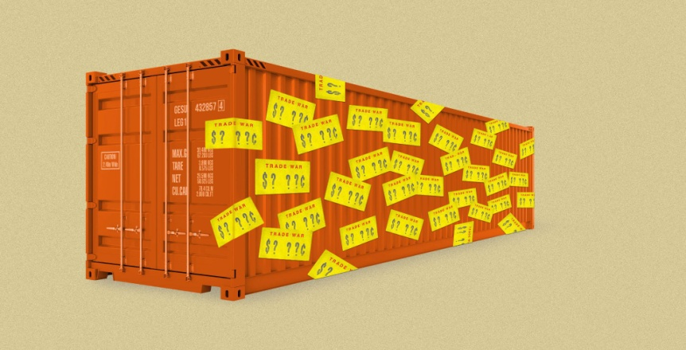
Tariffs and Trade Restrictions
Tariffs and other trade restrictions are part of a country’s legal structure but may be established or removed for political reasons.
  An Import tariff is a tax levied by a nation on goods imported into the country.
  A fixed tariff is a specific amount of money levied on each unit of a product brought into the country.
  A valorem tariff is based on the value of the item.

Slide 18
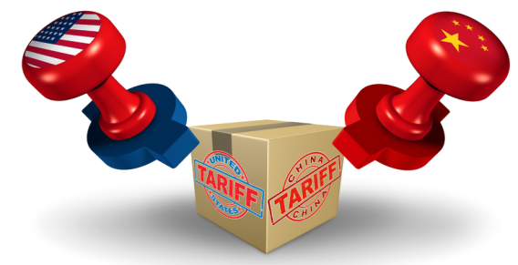
Tariffs
Countries sometimes levy tariffs for political reasons, as when they impose sanctions against other countries to protest their actions.
  However, import tariffs are more commonly imposed to protect domestic products by raising the price of imported ones.
    Protective tariffs allow more expensive domestic goods to compete with foreign ones (expensive U.S. steel vs. inexp. China steel).

Slide 19
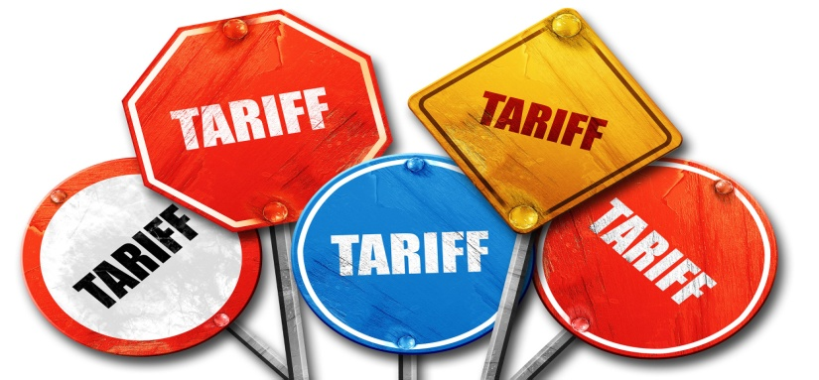
Tariffs
Critics of protective tariffs argue that their use inhibits free trade and competition.
  Supporters of protective tariffs say they insulate domestic industries, particularly new ones, against well established foreign competitors with lower labor costs and other advantages.

Slide 20
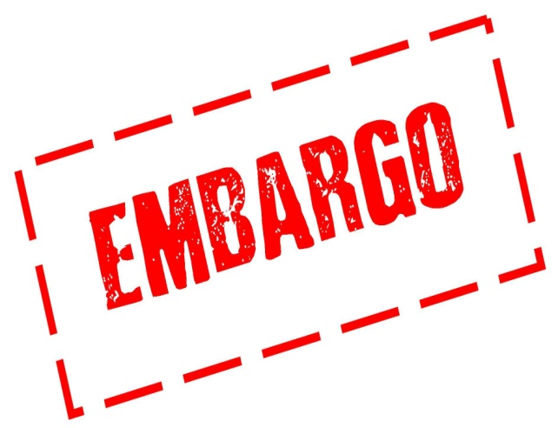
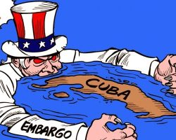
Embargo
An Embargo prohibits trade in a particular product.
  Embargoes are generally directed at specific goods or countries and may be established for political, economic, health, or religious reasons.
    The U.S. currently maintains a trade embargo with Cuba.

Slide 21
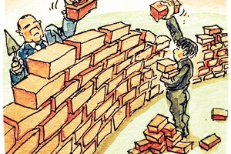
Political Barriers
Unlike legal issues, political considerations are seldom written down and often change rapidly.
  Nations that have been subject to economic sanctions for political reasons in recent years include Cuba, Iran, Syria, and North Korea.
    Political considerations affect international business daily as governments enact tariffs, embargoes, or other types of trade restrictions in response to political events.

Slide 22
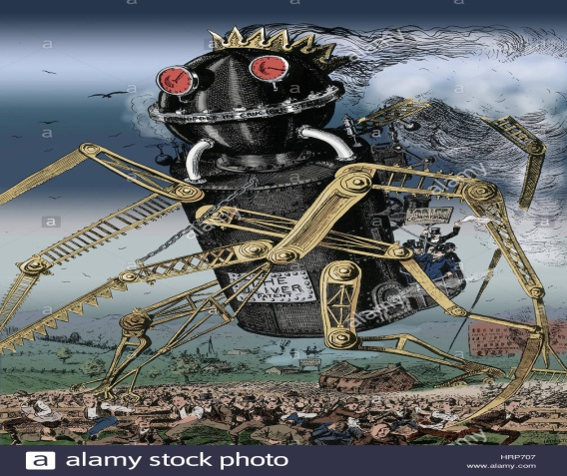

Political Barriers
Businesses engaged in international trade must consider the relative instability of countries.
  Political unrest may create a hostile environment for foreign businesses. Natural disasters can cripple a country’s government, making the region even more unstable. A sudden change in power can result in a regime that is hostile to foreign investment.
    As a result, some businesses have been forced out of countries in which they have historically operated.

Slide 23


Social and Cultural Barriers
Most businesspeople engaged in international trade underestimate importance of social & cultural differences; but these differences can derail an important transaction.
  Tiffany & Co. learned that more attentive customer service was necessary in order to succeed in Japan, and bold marketing and advertising served as the recipe for success in China.

Slide 24
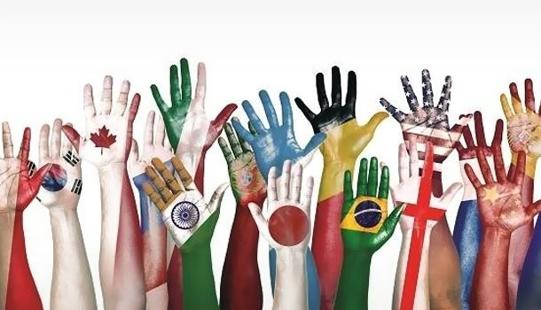
Social and Cultural Barriers
Cultural differences include differences in spoken and written language.
  Although it is certainly possible to translate words from one language to another, the true meaning is sometimes misinterpreted or lost.
    For example the “Coca-Cola” name in China was first read as “Ke-kou-ke-la,” meaning “bite the wax tadpole.”
    In Italy, a campaign for Schweppes Tonic Water translated the name into Schweppes Toilet Water.

Slide 25

Social and Cultural Differences
Differences in body language and personal space also affect international trade.
  Body language is non-verbal, usually unconscious communication through gestures, posture, and facial expression.
    Gestures vary from culture to culture, and gestures considered acceptable in American society may be rude in others.
      A wink in Japan means “I love you.”
  Personal space is the distance at which one person feels comfortable talking to another.
      Americans = Personal Space
      Arabs = Face-to-Face

Slide 26

Social and Cultural Barriers
Family roles also influence marketing activities.
  Many countries do not allow children to be used in advertising.
  Advertising featuring people in non-traditional roles will fail.
People of other nations often have a different perception of time.
  Americans value promptness, but in Latin American countries it is common to be late or delay meetings.
Companies engaged in foreign trade must observe the national and religious holidays and local customs of the country.
In Russia, smiling is considered appropriate only in private settings, not business.
Most nations use the metric system.

Slide 27
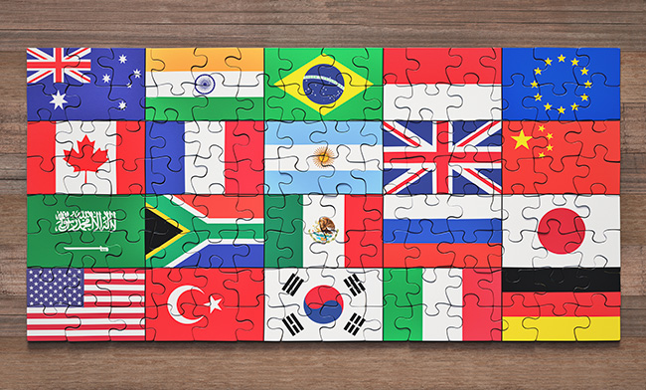
Trade Agreements, Alliances, and Organizations
Although these economic, political, legal, and socio-cultural issues may seem like daunting barriers to international trade, there are organizations and agreements – such as the General Agreement on Tariffs and Trade, the World Bank, and the International Monetary Fund – that foster int’l trade and can help companies get involved in and succeed in global markets.
  Various trade agreements, such as the North American Free Trade Agreement and the EU, also promote trade among member nations by eliminating tariffs and trade restrictions.

Slide 28
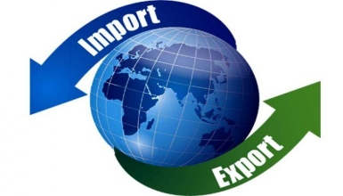
Exporting and Importing
Many companies first get involved in international trade when they import goods from other countries for resale in their own businesses.
  For example, a grocery store chain may import bananas from Honduras and coffee from Colombia.
A business may get involved in exporting when called upon to supply a foreign company with a particular product.
  Exporting to other countries becomes a necessity for established countries that seek to grow continually.
    Products often have higher sales growth potentially in foreign countries than they have in their parent company.

Slide 29
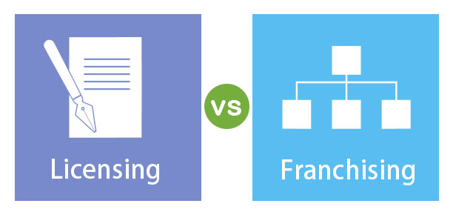
Licensing and Franchising
Licensing is a trade agreement in which one company: the licensor – allows another company – the licensee to use its company name, products, patents, brands, trademarks, raw materials, and/or production processes in exchange for a fee or royalty.
  Franchising is a form of licensing in which a company: the franchiser - agrees to provide a franchisee the name, logo, methods of operation, advertising, products, and other elements associated with the franchiser’s business, in return for a financial commitment and agreement to conduct business in accordance with the franchiser’s standard of operations.

Slide 30
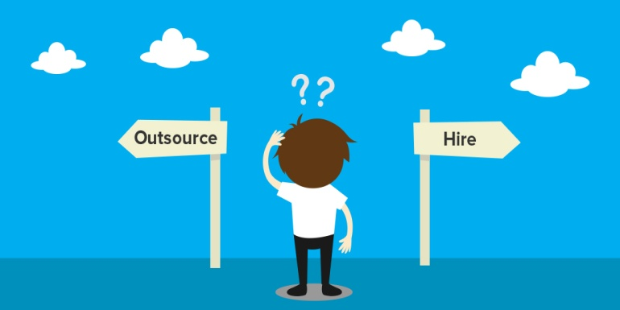

Outsourcing
Outsourcing is the transferring of manufacturing or other tasks, such as information technology operations, to companies in countries where labor and supplies are less expensive.
  Many U.S. firms have outsourced tasks to India, Ireland, Mexico, and the Philippines, where there are many well-educated workers and significantly lower labor costs.
    Outsourcing has become politically controversial in recent years amid concerns over jobs lost to overseas workers.

Slide 31
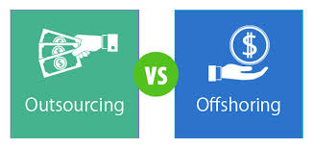
Offshoring
Offshoring is the relocation of a business process by a company, or a subsidiary, to another country.
  Offshoring is different than outsourcing in that the company retains control of the process because it is not subcontracting to a different company.
    Companies may choose to offshore for a number of reasons, ranging from lower wages, skilled labor, or taking advantage of time zone differences in order to offer services around the clock.

Slide 32

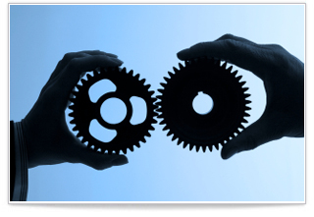
Joint Venture and Alliances
A strategic alliance is a partnership formed to create competitive advantage on a worldwide basis.
  International competition is so fierce and the costs of competing on a global basis are so high that few firms have the resources to go it alone, so they collaborate with other companies.

Slide 33
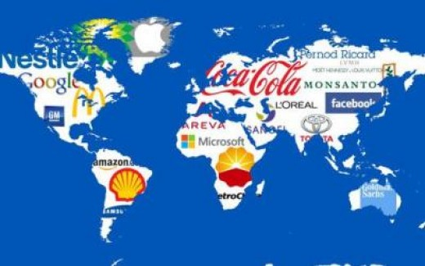
Direct Investment
Multinational Corporation
Companies that want more control and are willing to invest considerable resources in international business may consider Direct Investment, the ownership of overseas facilities.
  The highest level of international business involvement is the Multinational Corporation (MNC), a corporation that operates on a worldwide scale, without significant ties to any one nation.
    (i.e.) Walmart, Subway, Nestle, etc.

Slide 34

International Business Strategies
Planning in a global economy requires businesspeople to understand the economic, legal, political, and socio-cultural realities of the countries in which they will operate.
  These factors will affect the strategy a business chooses to use outside its own borders.

Slide 35

Developing Strategies
Multinational Strategy
Companies doing business internationally have traditionally used a Multinational Strategy, which is a plan used by international companies, that involves customizing products, promotion, and distribution according to cultural, technological, regional, and national differences.
  When McDonald’s opened its first restaurant in Vietnam, it offered its traditional menu items as well as McPork sandwiches specifically targeted toward Vietnamese customers.

Slide 36

Developing Strategies
Global Strategy (Globalization)
More and more companies are moving from this customization strategy to a Global Strategy (Globalization), which is a strategy that involves standardizing products, and as much as possible, their promotion and distribution for the whole world, as if it were a single entity.
  Examples of globalized products are American clothing, movies, music, and cosmetics.

Slide 37

Developing Strategies
Before moving outside their borders, companies must conduct environmental analyses to evaluate the potential of and problems associated with various markets and to determine what strategy is best for doing business in those markets.
  Astute businesspeople today “think globally, act locally.”
    That is, while constantly being aware of the total picture, they adjust their firms’ strategies to conform to local needs and tastes.

Slide 38
Business Survey

Slide 39
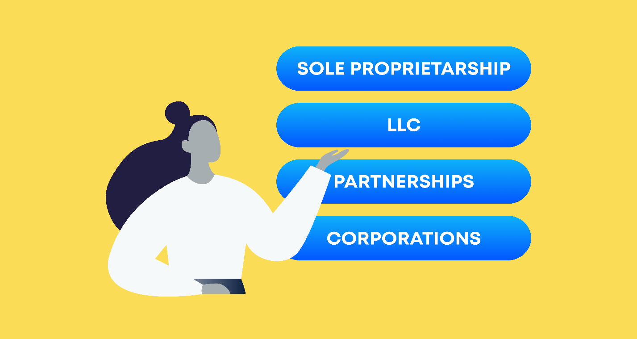
Part Two: Starting and Growing a Business
Chapter Four: Options for Organizing Business

Slide 40
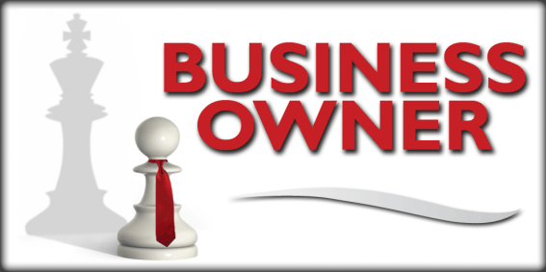
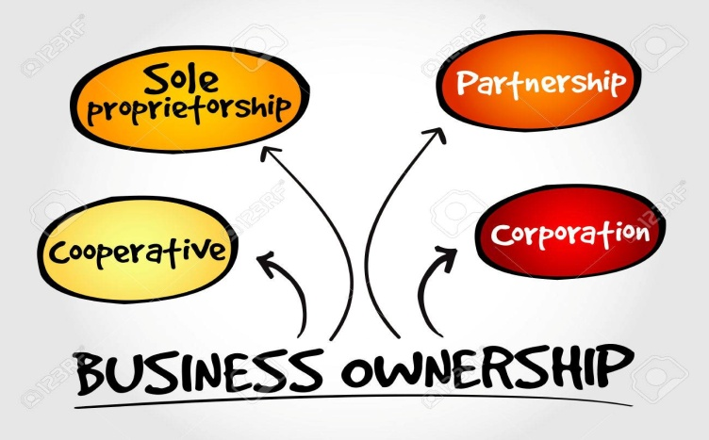
Introduction
All businesses must select a form of organization that is most appropriate for their owners and the scope of their business.
  A business’s legal form of ownership affects how it operates, how much it pays in taxes, and how much control its owners have.

Slide 41
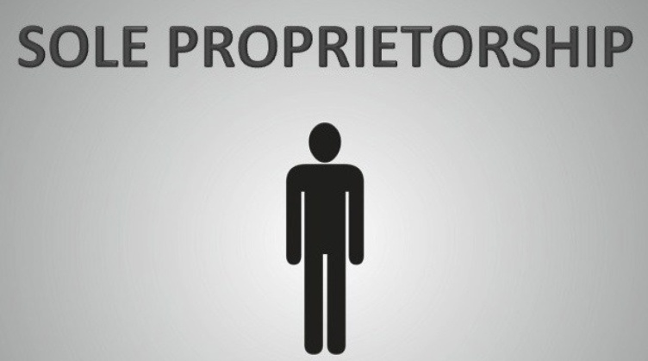
Sole Proprietorships
Sole Proprietorships are businesses owned and operated by one individual, and they are the most common form of business organization in the U.S.
  Common examples include many retailers such as restaurants, hair salons, flower shops, dog kennels, and independent contractors who complete projects or engage in entrepreneurial activities for different organizations, but who are not employees (i.e.) contractors, taxi-drivers, nail technicians, and salespersons for Mary Kay, etc.

Slide 42

Sole Proprietorships
Advantages
Sole proprietorships are generally managed by their owners, and because of this simple management structure, the owner/manager can make decisions quickly.
  This is just one of many advantages of the sole proprietorship. Other advantages include:
    Ease and Cost of Formation
    Secrecy
    Distribution and Use of Profits
    Flexibility and Control of the Business
    Government Regulation
    Taxation
    Closing the Business

Slide 43
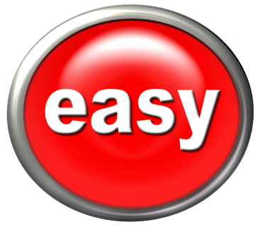
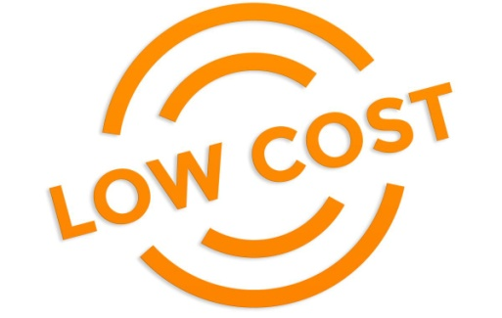
1. Ease and Cost of Formation
Forming a sole proprietorship is relatively easy and inexpensive.
  In some states, creating a sole proprietorship involves merely announcing the new business in the local newspaper.
  Businesses, such as barbershops and restaurants, may require state and local licenses and permits because of the nature of the business.
    Lawyers are not usually needed to create such enterprises, and the owner can usually take care of the required paperwork.

Slide 44

2. Secrecy
Sole proprietorships have the greatest degree of secrecy.
  The proprietor, unlike the owners of a partnership or corporation, does not have to discuss publicly their operating plans, minimizing the possibility that competitors can obtain trade secrets.
    Financial reports need not be disclosed, as do the financial reports of publicly owned corporations.

Slide 45

3. Distribution and Use of Profits
All profits from a sole proprietorship belong exclusively to the owners of a partnership or corporation. They do not have to share them with any partners or stockholders.
  The owner decides how to use the funds – for expansion of the business, for salary increases, for travel to purchase additional inventory, or to find new customers.

Slide 46
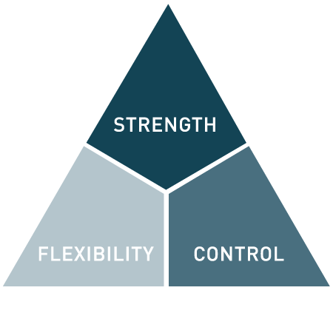
4. Flexibility and Control of the Business
The sole proprietor has complete control over the business and can make decisions on the spot without anyone else’s approval.
  This control allows the owner to respond quickly to competitive business conditions or to changes in the economy.
    The ability to quickly change prices or products can provide a competitive advantaged for the business.

Slide 47
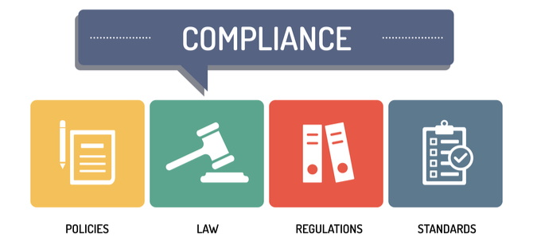
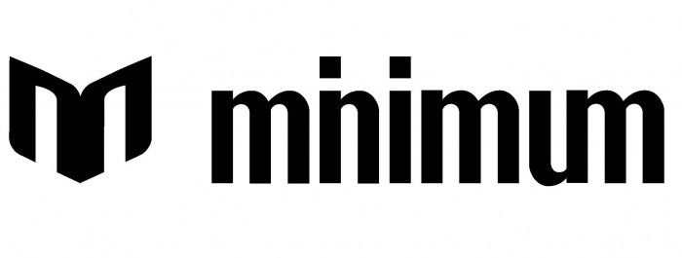
5. Government Regulation
Sole proprietorships have the most freedom from government regulation. Many government regulations apply only to businesses that have a certain number of employees, and securities laws apply only to corporations that issue stock.
  Nonetheless, sole proprietors must ensure that they follow all laws that do apply to their business.
    For example, sole proprietorships must be careful to obey employee and consumer protection regulation.

Slide 48


6. Taxation
Profits from sole proprietorships are considered personal income and are taxed at individual tax rates. The owner, therefore, pays one income tax that includes the business and individual income.
  Another tax benefit is that the sole proprietor is allowed to establish a tax-exempt retirement account or a tax-exempt profit-sharing account.
    Such accounts are exempt from current income tax, but payments taken after retirement are taxed when they are received.

Slide 49
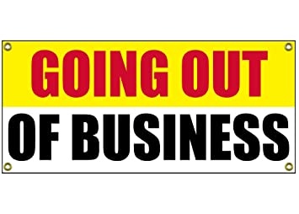
7. Closing the Business
A sole proprietorship can be dissolved easily.
  No approval of co-owners or partners is necessary.
    The only legal condition is that all financial obligations must be paid or resolved.

Slide 50

Sole Proprietorships
Disadvantages
For profitable businesses managed by capable owners, many of the following factors do not cause problems.
  On the other hand, proprietors starting out with little management experience and little money are likely to encounter many of the following disadvantages:
    Unlimited Liability
    Limited Sources of Funds
    Limited Skills
    Lack of Continuity
    Lack of Qualified Employees
    Taxation

Slide 51


1. Unlimited Liability
The sole proprietor has unlimited liability in meeting debts of the business. In other words, if the business cannot pay its creditors, the owner may be forced to use personal, non-business holdings such as a car or a home to pay off the debts.
  There are only a few states in which houses and homesteads cannot be taken by creditors, even if the proprietor declares bankruptcy.
    The more wealth and individual has, the greater is the disadvantage of unlimited liability.

Slide 52

2. Limited Sources of Funds
Among the relatively few sources of money available to the sole proprietorship are banks, friends, family, the Small Business Administration, or their own funds.
  The owner’s personal financial condition determines their credit standing. Additionally, sole proprietorships may have to pay higher interest rates on funds borrowed from banks than do corporations because they are considered a greater risk.
    Often, the only way a sole proprietor can borrow for business purposes is to pledge personal assets as collateral.

Slide 53
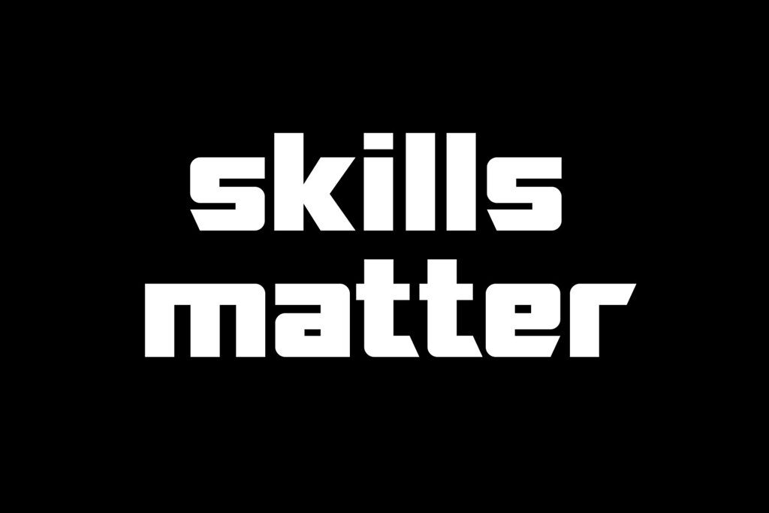
3. Limited Skills
The sole proprietor must be able to perform many functions and possess skills in diverse fields such as management, marketing, finance, accounting, bookkeeping, and personnel management.
  Specialized professionals, such as accountants or attorneys, can be hired by businesses for help or advice.
    It is up to the business owner to make the final decision in all areas of the business.

Slide 54

4. Lack of Continuity
The life expectancy of a sole proprietorship is directly linked to that of the owner and their ability to work.
  The serious illness of the owner could result in failure of the business if competent help cannot be found.
    It is difficult to arrange for the sale of a proprietorship and, at the same time, assure customers that the business will continue to meet their needs.

Slide 55

5. Lack of Qualified Employees
It is sometimes difficult for a small sole proprietorship to match the wages and benefits offered by a large competing corporation because the proprietorship’s profits may not be as high.
  In addition, there may be less room for advancement within the business, so the owner may have difficulty attracting and retaining qualified employees.

Slide 56
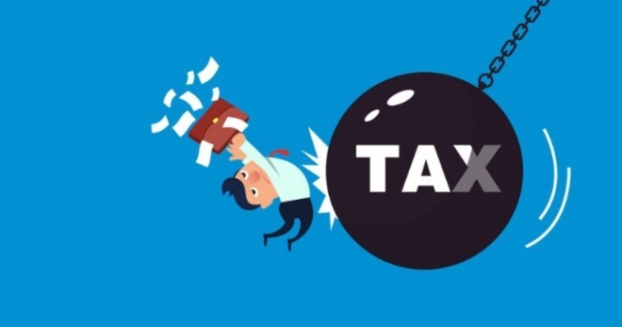
6. Taxation
Although we listed taxation as an advantage for sole proprietorships, it can also be a disadvantage, depending on the proprietor’s income.
  Under current tax rates, sole proprietors pay a higher marginal tax rate than do small corporations. However, sole proprietorships avoid the double taxation of corporate and personal taxes that occurs with corporations.
    The tax effect often determines whether a sole proprietorship chooses to incorporate their business.

Slide 57
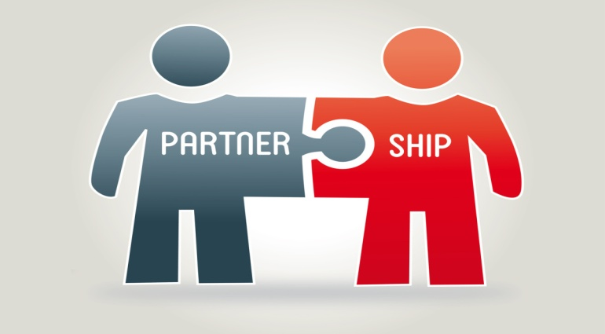
Partnerships
One way to minimize the disadvantages of the sole proprietorship and maximize its advantages is to have more than one owner.
  A Partnership is an association of two or more persons who carry on as co-owners of a business for profit.
    Partnerships are the least used form of business.

Slide 58

Types of Partnerships
There are two basic types of partnership:
  General Partnership
    Involves a complete sharing in the management of a business.
    Each partner has unlimited liability for the debts of the business.
  Limited Partnership
    Has at least one general partner, who assumes unlimited liability, and at least one limited partner, whose liability is limited to their investment in the business.
    These partnerships exist for risky investment projects where the chance of loss is great.
      Usually the GP receives a larger share of the profits.

Slide 59
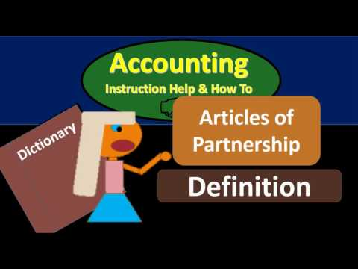
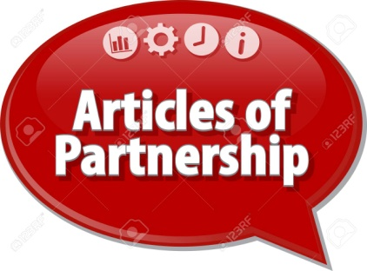
Articles of Partnership
Articles of Partnership are legal documents that set forth the basic agreement between partners.
  Articles of Partnership usually list the money or assets that each partner has contributed (partnership capital), state each partner’s individual management role or duty, specify how the profits and losses of the partnership will be divided among the partners, and describe how a partner may leave the partnership as well as any other restrictions that might apply to the agreement.

Slide 60
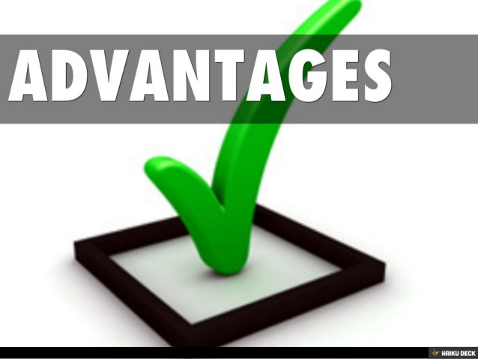
Partnerships
Advantages
The advantages of partnerships must be compared with those offered by other forms of business organization, and not all apply to every partnership.
  The recognized advantages of partnerships include:
    Ease of Organization
    Availability of Capital and Credit
    Combined Knowledge and Skills
    Decision Making
    Regulatory Controls

Slide 61

1. Ease of Organization
Starting a partnership requires little more than drawing up articles of partnership.
  No legal charters have to be granted, but the name of the business should be registered with the state.

Slide 62
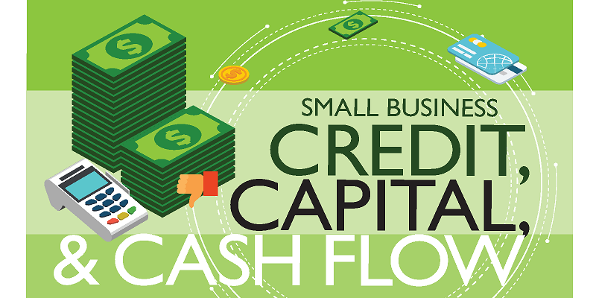
2. Availability of Capital and Credit
When a business has several partners, it has the benefit of a combination of talents and skills and pooled financial resources.
  Partnerships tend to be larger than sole proprietorships and, therefore, have greater earning power and better credit ratings.

Slide 63
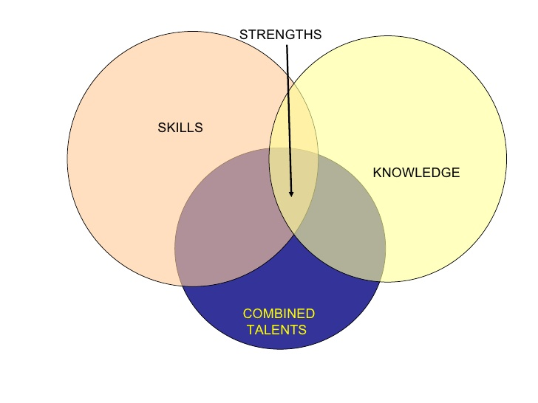
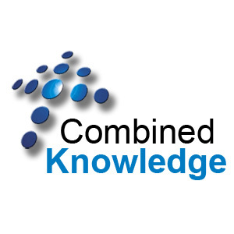
3. Combined Knowledge and Skills
Partners in the most successful partnerships acknowledge each other’s talents and avoid confusion and conflict by specializing in a particular area of expertise such as marketing, production, accounting, or service.
  The diversity of skills in a partnership makes it possible for the business to be run by a management team of specialists instead of by a generalist sole proprietor.

Slide 64
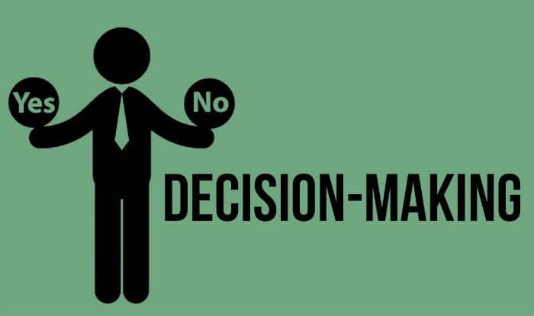
4. Decision Making
Small partnerships can react more quickly to changes in the business environment than can large partnerships and corporations.
  Such fast reactions are possible because the partners are involved in day-to-day operations and can make decisions quickly after consultation.

Slide 65

5. Regulatory Controls
Like a sole proprietorship, a partnership has fewer regulatory controls affecting its activities than does a corporation.
  A partnership does not have to file public financial statements with government agencies or send out quarterly financial reports to several thousand owners, as do corporations.
    A partnership does, however, have to abide by all laws relevant to the industry or profession in which it operates as well as state and federal laws relating to financial reports, employees, consumer protection, and environmental regulations, just as the sole proprietorship does.

Slide 66
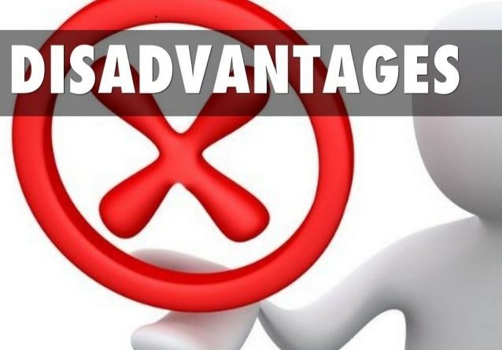
Partnerships
Disadvantages
Partnerships have many advantages compared to sole proprietorships and corporations, but they also have some disadvantages.
  Major disadvantages of partnerships include the following:
    Unlimited Liability
    Business Responsibility
    Life of the Partnership
    Distribution of Profits
    Limited Sources of funds

Slide 67
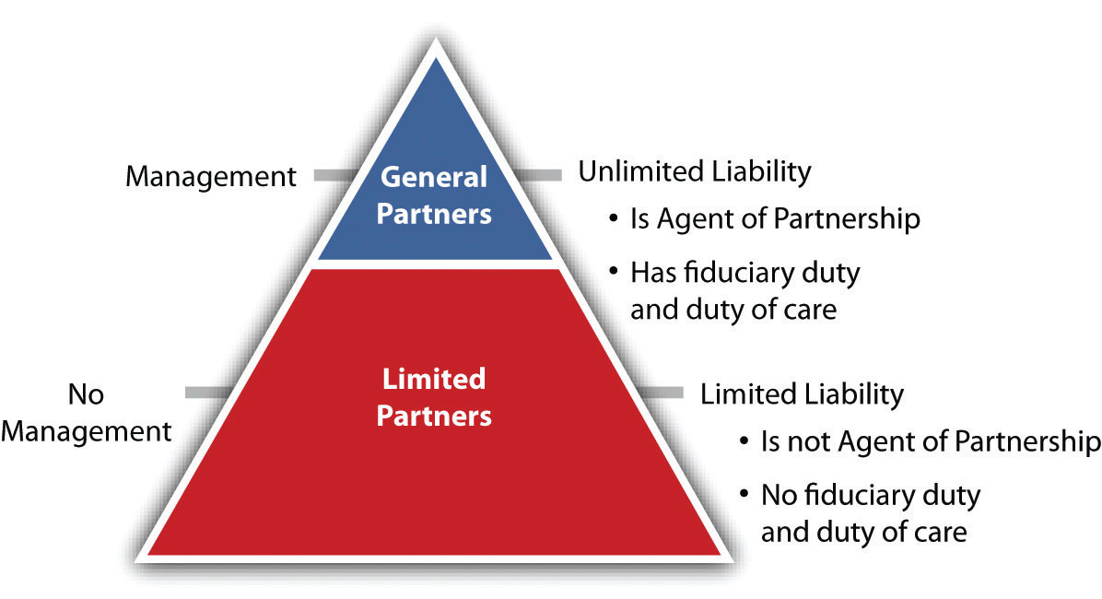
1. Unlimited Liability
In general partnerships, the GPs have unlimited liability for the debts incurred by the business, just as the sole proprietor has unlimited liability for their business.
  Such unlimited liability can be a distinct disadvantage to one partner if their personal financial resources are greater.

Slide 68


2. Business Responsibility
All partners are responsible for the business actions of all others.
  Partners may have the ability to commit the partnership to a contract without approval of the other partners.
    A bad decision by one partner may put the other partners’ personal resources in jeopardy.

Slide 69

3. Life of the Partnership
A partnership is terminated when a partner dies or withdraws. In a two-person partnership, if one partner withdraws, the firm’s liabilities would be paid off and the assets divided between the partners.
  Obviously, the partner who wishes to continue in the business would be at a serious disadvantage. The business could be disrupted, financing would be reduced, and the management skills of the departing partner would be lost.
    Selling a partnership interest has the same effect as the death or withdrawal of a partner.

Slide 70

4. Distribution of Profits
Profits earned by the partnership are distributed to the partners in the proportions specified in the articles of the partnership.
  This may be a disadvantage if the division of the profits does not reflect the work each partner puts into the business.
    Even the perception of an unfair profit-sharing agreement may cause tension between the partners, and unhappy partners can have a negative effect on the profitability of the business.

Slide 71

5. Limited Sources of Funds
As with a sole proprietorship, the sources of funds available to a partnership are limited.
  Because no public value is placed on the business, potential partners do not always know what one partnership share is worth.
  Moreover, because partnership shares cannot be bought and sold easily in public markets, potential owners may not want to tie up their money in assets that cannot be readily sold on short notice.
    Partnerships may also have to pay higher interest rates.

Slide 72

Taxation of Partnerships
Partnerships do not pay taxes when submitting the partnership tax return to the IRS.
  The tax return simply provides information about the profitability of the organization and the distribution of profits among the partners.
    Partners must report their share of the profits on their individual tax returns and pay taxes at the income tax rate for individuals.

Slide 73
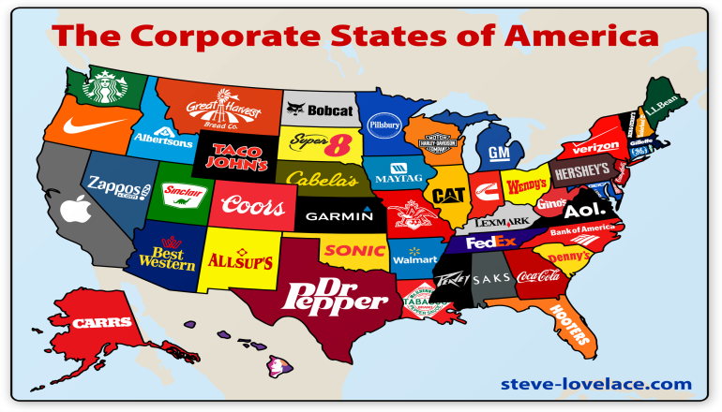
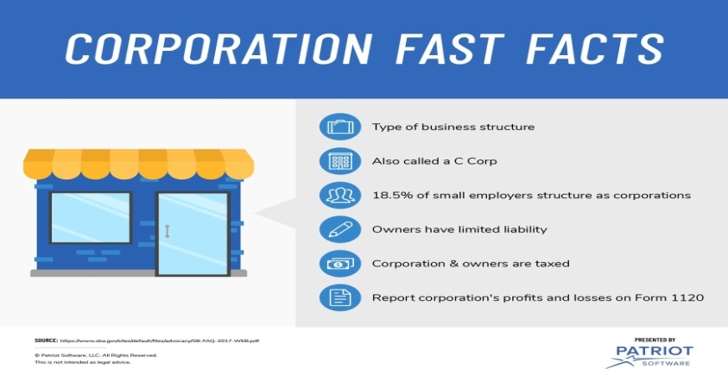
Corporations
A Corporation is a legal entity, created by the state, whose assets and liabilities are separate from its owners.
  As a legal entity, a corporation has many of the rights, duties, and powers of a person, such as the right to receive, own, and transfer property. They can enter into contracts with individuals or with other legal entities, and they can sue and be sued in court.
    Corporations account for the majority of all U.S. sales and income.

Slide 74
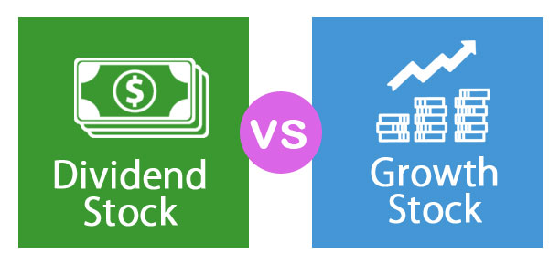
Corporations
Corporations are generally owned by many individuals and organizations who own shares of the business, called stock.
  Stockholders can buy, sell, give or receive as gifts, or inherit their shares of stock. As owners, the stockholders are entitled to all the profits that are left after the corporation’s other obligations have been paid.
    These profits may be distributed in the form of cash payments called dividends, or retained to expand the business.

Slide 75

Types of Corporations
Private vs. Public
If the corporation does business in the state in which it is chartered, it is known as a domestic corporation. In other states where the corporation does business, it is known as a foreign corporation. If a corporation does business outside the nation in which it is incorporated, it is called an alien corporation.
  A corporation may be privately or publicly owned.
    A private corporation is owned by just one or a few people who are closely involved in the business.
    A public corporation is one whose stock anyone may buy, sell, or trade. In large corporations stockholders are far removed from the management of the company.

Slide 76

Types of Corporations
Initial Public Offering (IPO)
A private corporation that needs more money to expand or take advantage of opportunities may have to obtain financing by “going public” through an initial public offering (IPO).
  An IPO is the process of becoming a public corporation by selling stock so that it can be traded in public markets.

Slide 77

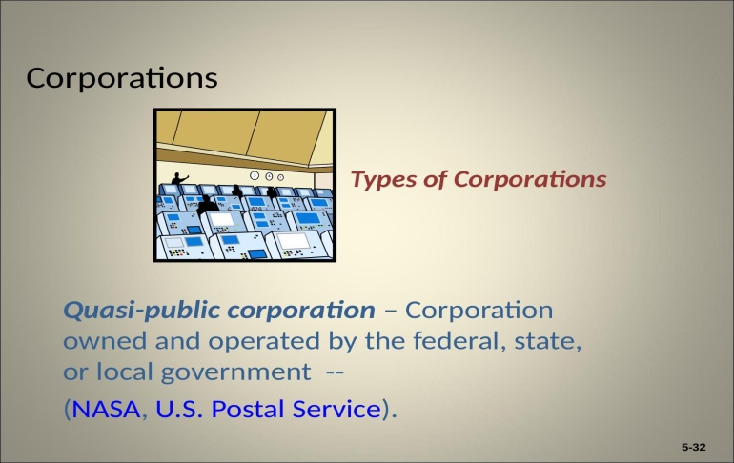

Types of Corporations
Quasi-Public vs. Nonprofit
Quasi-Public Corporations and Nonprofits are two types of public corporations.
  Quasi-Public Corporations are owned and operated by the federal, state, or local government.
    The focus of these entities is to provide a service to citizens, such as mail delivery, rather than earning a profit.

Slide 78

Types of Corporations
Quasi-Public vs. Nonprofit
Quasi-Public Corporations and Nonprofits are two types of public corporations .
  Nonprofit Corporations focus on providing a service rather than earning a profit, but they are not owned by a government entity.
    To fund their operations and services, nonprofit organizations solicit donations from individuals and companies and grants from government and other charitable organizations.
    Nonprofits do not have shareholders, and most are organized as 501(c)3 organizations, which receive certain tax exemptions, and donors contributing may reduce their tax liability.

Slide 79

Elements of a Corporation
Board of Directors
A Board of Directors is a group of individuals, elected by the stockholders to oversee the general operation of the corporation, who set the corporation’s long-range objectives.
  It is the Board’s responsibility to ensure that the objectives are achieved on schedule.
    Board Members have a duty of care and loyalty to oversee the management of the firm or for any misuse of funds.
    Another important duty of the Board is to hire corporate officers, such as the President or Chief Executive Officer (CEO), who are responsible to the directors for the management of operations.

Slide 80
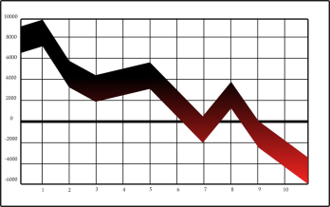

Stock Ownership
Corporations issue two types of stock:
  Preferred Stock
    A special class of owners, because although they generally do not have any say in the company, they have a claim to profits before any other stockholders do.
  Common Stock
    Although these owners do not get preferential treatment with regard to dividends, they do get some say in the operation of the corporation. Their ownership gives them the right to vote for members of the Board of Directors and other important issues.

Slide 81

Advantages of Corporations
Because a corporation is a separate legal entity, it has some very specific advantages over other forms of ownership.
  The biggest advantage may be the limited liability of the owners, nonetheless, the advantages include the following:
    Limited Liability
    Ease of Transfer of Ownership
    Perpetual Life
    External Sources of Funds
    Expansion Potential

Slide 82
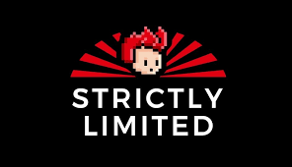
1. Limited Liability
Because the corporation’s assets (money and resources) and liabilities (debt and other obligations) are separate from it’s owners,’ in most cases the stockholders are not held responsible for the firm’s debts if it fails.
  Their liability or potential loss is limited to the amount of their original investment .
    Although a creditor can sue the corporation for not paying its debts, even force bankruptcy, it cannot charge the stockholder.

Slide 83

2. Ease of Transfer of Ownership
Stockholders can sell or trade shares of stock to other people without causing the termination of the corporation, and they can do this without the prior approval of other stockholders.
  This transfer of ownership (unless it is a majority position) does no affect the daily or long-term operations of the corporation.

Slide 84

3. Perpetual Life
A corporation usually is chartered to last forever unless its articles of incorporation stipulate otherwise. The existence of the corporation is unaffected by the death or withdrawal of any of its stockholders.
  It survives until the owners sell or liquidate its assets, or otherwise ends in bankruptcy.

Slide 85

4. External Sources of Funds
Of all the forms of business organization, the public corporation finds it easiest to raise money.
  When a large or public corporation needs to raise money, it can sell more stock shares or issue bonds (corporate IOU’s), which pledge to repay debt, attracting funds from anywhere in the U.S. or overseas.
    The larger a corporation becomes, the more sources of financing are available to it.

Slide 86

5. Expansion Potential
Because large public corporations can find long-term financing readily, they can easily expand into national and international markets.
  And, as a legal entity, a corporation can enter into contracts without as much difficulty as a partnership.

Slide 87


Disadvantages of Corporations
Corporations have some distinct disadvantages resulting from tax laws and government regulation.
  The following are common disadvantages of corporations:
    Double Taxation
    Forming a Corporation
    Disclosure of Information
    Employee-Owner Separation

Slide 88


1. Double Taxation
As a legal entity the corporation must pay taxes on its income, and the U.S. has one of the highest corporate tax rates in the world, with a maximum rate of 35%.
  When after-tax corporate profits are paid out as dividends to the stockholders, the dividends are taxed a second time as part of the individual owner’s income.
    Double taxation does not occur with the other forms of business organization.

Slide 89

2. Forming a Corporation
The formation of a corporation can be costly. A charter must be obtained, and this usually requires the service of an attorney and payment of legal fees.
  Filing fees must be paid to the state that awards the charter, and certain states require that an annual fee be paid to maintain the charter.

Slide 90


3. Disclosure of Information
Corporations must make information available to their owner’s, usually through an annual report to shareholders.
  The annual report contains financial information about the firm’s profit, sales, facilities and equipment, and debts, as well as, descriptions of the company’s operations, products , and plans for the future.
    Public corporations must also file reports with the Securities and Exchange Commission (SEC), the government regulatory agency that regulates securities such as stocks and bonds.

Slide 91


4. Employee-Owner Separation
Many employees are not stockholders of the company for which they work. This separation of owners and employees may cause employees to feel that their work benefits only the owners.
  Employees without an ownership stake do not always see how they fit into the corporate picture and may not understand the importance of profits to the health of the organization.

Slide 92

Other Types of Ownership
Joint Ventures
A Joint Venture is a partnership established for a specific project or for a limited time.
  The partners in a joint venture may be individuals or organizations. Governments may also be involved.
  Control of a joint venture may be shared equally, or one partner may control decision making.
    Joint ventures are especially popular in situations that call for large investments (i.e.) extraction of natural resources.

Slide 93

Other Types of Ownership
Limited Liability Company
A Limited Liability Company (LLC) is a form of business ownership that provides limited liability, as in a corporation, but is taxed like a partnership.
  Many consider the LLC a blend of the best characteristics of corporations, partnerships, and sole proprietorships.
  One of the major reasons for the LLC form of ownership is to protect the members’ personal assets in case of lawsuits.
    LLCs are flexible, simple to run, and do not require the members to hold meetings, keep minutes, or make resolutions.

Slide 94

Cooperatives
Another form of organization in business is the Cooperative or Co-Op, an organization composed of individuals or small businesses that have banded together to reap the benefits of belonging to a larger organization.
  A co-op is set up not to make money as an entity. It exists so that its members can become more profitable or save money.
    Many cooperatives exist in small farming communities. The co-op stores and markets grain; orders large quantities of fertilizer, seed, and other supplies at discounted prices; and reduces costs and increases efficiency with good management.

Slide 95

Trends in Business Ownership
Mergers and Acquisitions
Companies large and small achieve growth and improve profitability by expanding their operations, often by developing and selling new products or selling current products to new groups of customers.
  Such growth, when carefully planned and controlled, is usually beneficial to the firm and ultimately helps it reach its goal of enhanced profitability.
    But companies also grow by merging with or purchasing other companies.

Slide 96

Merger and Acquisition
A merger occurs when two companies combine to form a new company. An acquisition occurs when one company purchases another, generally by buying most of its stock.
  The acquired company may become a subsidiary of the buyer, or its operations and assets may be merged with those of the buyer.
    The government sometimes scrutinizes mergers and acquisitions in an attempt to protect customers from a monopoly.

Slide 97
Business Survey

Slide 98

Part Two: Starting and Growing a Business
Chapter Five: Small Business, Entrepreneurship, and Franchising

Slide 99


Introduction
Small businesses represent the vision of its owners to succeed by providing new or better products and services.
  Small businesses are the heart of the U.S. economic and social system because they offer opportunities and demonstrate the freedom of people to make their own destinies.
    Small businesses employ about half of all private-sector EE’s
    Today, the entrepreneurial spirit is growing around the world.

Slide 100




The Nature of Entrepreneurship and Small Business
Entrepreneurship is the process of creating and managing a business to achieve desired objectives.
  Today, there are many large businesses you may recognize (Levi Strauss & Co., McDonald’s, Microsoft, Google). All began as small businesses based on the visions of their founders.
    Some entrepreneurs who start small businesses have the ability to see emerging trends; in response, they create a company to provide a product or service that serves customer needs.

Slide 101


Social Entrepreneurs
A growing trend among small businesses is Social Entrepreneurship, which refers to individuals who use entrepreneurship to address social problems.
  They operate by the same principles as other entrepreneurs, but view their organizations as vehicles to create social change.
    For example, the founder of Tom’s Shoes, founded the firm with the purpose of donating one pair of shoes to a child in need for every pair of shoes sold to customers.

Slide 102

What is a Small Business?
Small Business Administration
A Small Business is an independently owned and operated business that is not dominant in its competitive area and does not employ more than 500 people.
  This definition is similar to the one used by the Small Business Administration (SBA), an independent agency of the federal government that offers managerial and financial assistance to small business.
    On its website, the SBA outlines the first steps in starting a small business and offers a wealth of information to owners.

Slide 103


The Role of Small Business in the American Economy
No matter how you define a small business, one fact is clear: They are vital to the American economy.
  More than 99% of all U.S. firms are classified as small businesses, and they employ about half of private workers.
  Small firms are also important exporters, representing 98% of U.S. exporters of goods contributing 33% of the value of exported goods.
    In addition, small businesses are largely responsible for fueling job creation and innovation.

Slide 104


Job Creation
The energy, creativity, and innovative abilities of small-business owners have resulted in jobs for many people.
  Annually, about 63% of new jobs are created by small business.
    Many small businesses today are being started because of encouragement from larger ones. Many new jobs are also created by big company/small company alliances.
    Whether through formal joint ventures, supplier relationships, or product or marketing cooperative projects, the rewards of collaborative relationships are creating numerous jobs for small-business owners and their employees.

Slide 105

Innovation
Perhaps one of the most significant strengths of small businesses is their ability to innovate and to bring significant benefits to customers.
  Small firms produce more than half of all innovations.
    Among the important 20th century innovations by U.S. small firms are the airplane, the audio tape recorder, fiber-optics, heart valve, optical scanner, pacemaker, personal computer, Internet etc.

Slide 106

Retailing
Retailers acquire goods from producers or wholesalers and sell them to consumers.
  Main streets, shopping centers, and malls are generally lined with independent music stores, sporting-goods stores, boutiques, restaurants, etc., that sell directly to consumers.
    Retailing attracts entrepreneurs because gaining experience and exposure in retailing is relatively easy. Additionally, an entrepreneur opening a new retail store or establishing a new website does not have to spend large sums of money for the equipment and distribution systems that manufacturing business requires.

Slide 107

Retailing
Non-Store
Many opportunities exist for non-store retailing as well.
  Non-store retailing involves selling products outside of the retail facility. There are two types of non-store retailing:
    Direct Marketing (i.e. eBay, Amazon, Etsy), which uses the telephone, catalogs, and other media to give consumers an opportunity to place orders by mail, telephone, or Internet
    Direct Selling (i.e. Herbal Life, Mary Kay).

Slide 108

Wholesaling
Wholesalers provide both goods and services to producers and retailers. They can assist their customers with almost every business function.
    Wholesalers supply products to industrial, retail, and institutional users for resale or for use in making other products.
      Wholesaling activities range from planning and negotiating for supplies, promoting, and distributing (warehousing and transporting) to providing management and merchandising assistance to clients.

Slide 109

Services
The service sector includes businesses that do not actually produce tangible goods.
  Services include intangible products that involve performance, inauguration, or any effort to provide something of value that cannot be physically possessed.
    Real estate, insurance, accounting firms and personnel agencies, barbershops, banks, and tech repair shops are some examples.
      The service sector accounts for 80% U.S. jobs.

Slide 110

Manufacturing
Manufacturing goods can provide unique opportunities for small businesses.
  Small businesses sometimes have an advantage over larger firms because they can customize products to meet specific consumer needs and wants.
    Such products include custom artwork, jewelry, clothing, and furniture.

Slide 111

Technology
Big Technology is a broad term used to describe businesses that depend heavily on advanced scientific and engineering knowledge.
  People who were able to innovate or identify new markets in the fields of computers, bio-technology, genetic engineering, robotics, and other markets have become big tech giants.
    One innovative technology was developed by a teenager interested in virtual reality, and recently his company – Oculus Rift, was sold to Facebook for $2 billion.

Slide 112

Advantages of Small-Business Ownership
There are many advantages to establishing and running a small business.
  These can be categorized into personal advantages and business advantages.
    Independence
    Costs
    Flexibility
    Focus
    Reputation

Slide 113

Disadvantages of Small-Business Ownership
The rewards associated with running a small business are so enticing that it’s no wonder many people dream of it. However, as with any undertaking, small business ownership has its disadvantages.
  High Stress Level
  High Failure Rate
    Undercapitalization
    Managerial Inexperience or Incompetence
    Inability to Cope with Growth

Slide 114

(8) Successful Traits of an Entrepreneur
1. Intuitive
  Using one’s intuition to derive what’s true without conscious reasoning.
2. Productive
  Being able to produce large amounts of something during a specific time period.
3. Resourceful
  Understanding how to use and spend resources wisely.
4. Charismatic
  Having the ability to inspire others behind a central vision.

Slide 115
(8) Successful Traits of an Entrepreneur
5. Innovative
  Being able to come up with new and creative ideas.
6. Risk-Taker
  Having the ability to pursue risky endeavors despite the possibility of failure.
7. Persistent
  Continuing in a certain action in spite of obstacles.
8. Friendly
  Being able to have mutually beneficial interactions with people.

Slide 116

Starting a Small Business
To start any business, large or small, you must have some kind of general idea.
  Next, you need to devise a strategy to guide planning and development in the business.
    Finally, you must make decisions about form of ownership; the financial resources needed; and whether to acquire an existing business, start a new one, or buy a franchise.

Slide 117

The Business Plan
A key element of business success is a Business Plan, which is a precise statement of the rationale for the business and a step-by-step explanation of how it will achieve its goals.
  The business plan should include an explanation of the business, an analysis of the competition, estimates of income and expenses, and other information.
    It should also establish a strategy for acquiring sufficient funds to keep the business going.

Slide 118

Business Plan
A good business plan should act as a guide and reference document – not a shackle that limits the business’s flexibility and decision-making ability.
  The business plan must be revised periodically to ensure that the firm’s goals and strategies adapt to changes in the environment.
    Business plans allow companies to assess market potential, determine price and manufacturing requirements, identify optimal distribution channels, and refine product selection.

Slide 119


Forms of Business Ownership
After developing a business plan, the entrepreneur has to decide on an appropriate legal form of business ownership – whether it is best to operate as a sole proprietorship, partnership, or corporation – and to examine the many factors that affect that decision.

Slide 120

Financial Resources
The expression “it takes money to make money” holds especially true in developing a business enterprise.
  To make money from a small business, the owner must first provide or obtain money (capital) for rental space, equipment, inventory, etc. to get started and to keep it running smoothly.
    Often, the small business owner has to put up a significant percentage of the necessary capital. And, few business owners have enough of their own capital and must look to other sources for additional financing.

Slide 121

Equity Financing
The most important source of funds for any new business is the owner.
  Many owners include among their personal resources ownership of a home, the accumulated value in a life- insurance policy, or a savings account.
    A new business owner may sell or borrow against the value of such assets to obtain funds to operate a business.
    Additionally, the owner may bring useful personal assets: such as, a computer, desks and other furniture, a car or truck – as part of their ownership interest in the firm.

Slide 122

Equity Financing
Such financing is referred to as Equity Financing, because the owner uses real personal assets rather than borrowing funds from outside sources to get started in a new business.
  The owner can provide working capital by reinvesting profits into the business or simply by not drawing a full salary.
    Small businesses can also obtain equity financing by finding investors for their operations. They may sell stock in the business to family members, friends, employees, or other investors.

Slide 123

Venture Capitalists
Venture Capitalists are persons or organizations that agree to provide some funds for a new business in exchange for an ownership interest or stock.
  Venture capitalists hope to purchase the stock of a small business at a low price and then sell the stock for a profit after the business has grown successful.
    Although these forms of equity financing have helped many small businesses, they require that the small-business owner share the profits of the business and sometimes control, as well.

Slide 124

Debt Financing
New businesses sometimes borrow more than half of their financial resources.
  Banks are the main suppliers of external financing to small business. They can also look to family and friends as sources for long-term loans or other assets that are exchanged for an ownership interest in a business.
    Anyone lending a friend or family member money for a venture should state the agreement clearly in writing before any money changes hands.

Slide 125

Debt Financing
Line of Credit and Trade Credit
Banks and other financial institutions can also grant a small business a Line of Credit – an agreement by which a financial institution promises to lend a business a predetermined sum on demand.
  A line of credit permits an entrepreneur to take quick advantage of opportunities that require external funding.
    Small business may also obtain funding from their suppliers in the form of Trade Credit – that is, suppliers allow the business to take possession of the needed goods and services and pay for them at a later date or in installments.

Slide 126

Approaches to Starting a Small Business
Starting From Scratch vs. Buying an Existing Business.
  Although entrepreneurs often start new businesses from scratch, they may select instead to buy an existing business.
    This has the advantage of providing a built-in network of customers, suppliers, and distributors and reducing some of the guesswork inherent in starting a new business from the ground up.
    However, an entrepreneur who buys an existing business also takes on any problems the business already has.

Slide 127

Franchising
Many small-business owners find entry into the business world through franchising.
  A license to sell another’s products or to use another’s name in business, or both, is a Franchise. The company that sells the franchise is the “franchiser.” (i.e. Dunkin Donuts, Subway)
  The purchaser of a franchise is called a “franchisee.”
    The franchisee acquires the rights to a name, logo, methods of operation, national advertising, products, and other elements associated with the franchiser’s business in return for a financial commitment and the agreement to conduct business in accordance with the franchiser’s standard of operation.

Slide 128


Franchising
Franchising has both advantages and disadvantages.
  Franchising allows a franchisee the opportunity to set up a small business relatively quickly, and because of its association with an established brand, a franchise outlet often reaches the break-even point faster than an independent business would.

Slide 129

Franchising
Advantages
Franchisees commonly report the following advantages:
  Management and training support.
  Brand-name appeal.
  Standardized quality of goods and services.
  National and local advertising programs.
  Financial assistance.
  Proven products and business formats.
  Centralized buying power.
  Site selection and territorial protection.
  Greater chance for success.

Slide 130

Franchising
Disadvantages
The franchisee must sacrifice some freedom to the franchiser. Some shortcomings experienced by franchisees include:
  Franchise fees and profits sharing with the franchising.
  Strict adherence to standardized operations.
  Restrictions on purchasing.
  Limited product line.
  Possible market saturation.
  Less freedom in business decisions.

Slide 131

The Future for Small Business
Demographic Trends
  Baby Boomers are the market of the future.
  Millennials are concerned with advancement, recognition, and improved capabilities.
    They need direct, timely feedback and frequent encouragement and recognition. They do well when training sessions combine entertainment with learning.
    Working remotely is more acceptable to this group, and virtual communication may become as important as face-to-face meetings.
  Another trend is the growing number of immigrants living in the U.S.
    This vast group provides a greatly untapped market for small business. Retailers who specialize in ethnic products, and service providers who offer bi- or multilingual employees, will find a large amount of business potential in this market.

Slide 132

The Future for Small Business
Technological and Economic Trends
  Advances in technology have opened up many new markets to small businesses. Undoubtedly, the Internet will continue to provide new opportunities for small business.
    Technology has enabled the substantial growth of entrepreneurs working out of their houses, known as home-based businesses.

Slide 133

Making a Big Business Act “Small”
The continuing success and competitiveness of small businesses through rapidly changing conditions in the business world have led many large corporations to take a closer look at what makes their smaller rivals tick.
  More and more firms are emulating small businesses in an effort to improve their own bottom line.
    Many are “downsizing” or reducing management layers, corporate staff, and work tasks in order to make the firm more flexible, resourceful, and innovative.
    Others have sought to make their businesses “smaller” by making their operating units function more like independent small business, each responsible for profits, losses, and resources.

Slide 134


