Slide 1
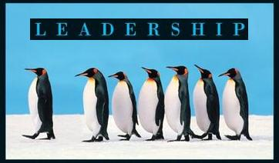
Leadership
Session Two Class Presentation
Leadership
  Enhancing the Lessons of Experience 8th Edition
    Richard L. Hughes, Robert C. Ginnett, and Gordy J. Curphy, McGraw Hill Education, New York, NY 2015
      ISBN: 978-0-07-786240-4

Slide 2
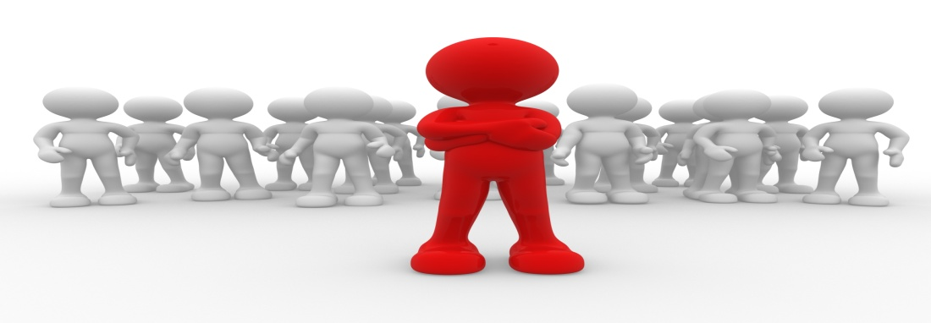
Focus on the Leader
Power and Influence
  The effectiveness of leadership, good or bad, is typically attributed to the leader much more than to the other elements of the framework.
    “Men are nothing; it is the man who is everything”… (Napoleon)

Slide 3


Power and Influence
Power may be the single most important concept in all the social sciences, though scholars today disagree over precisely how to define power or influence.
  Power has been defined as the capacity to produce effects on others or the potential to influence others.

Slide 4
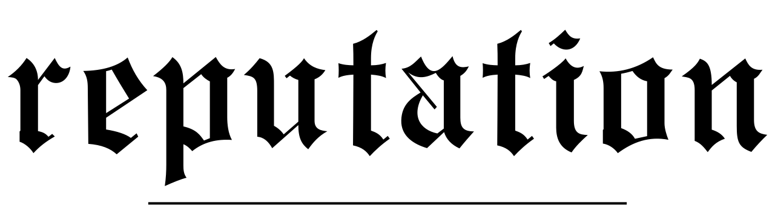
Power and Influence
Merely having the capacity to exert influence can often bring about intended effects, even though the leader may not take any action to influence their followers.
  Power represents an influence or attribution made on the basis of a leader’s observable acts of influence.

Slide 5

Power and Influence
Influence can be defined as the change in a target person’s attitudes, values, beliefs, or behaviors as the result of Influence Tactics.
  Influence Tactics refer to one person’s actual behaviors designed to change a target person’s attitudes, values, beliefs, or behaviors.
    Although we typically examine this from a leader’s perspective, such as how the leader influences followers, it is important to remember that followers can also wield power and have influence over leaders as well as over each other.

Slide 6
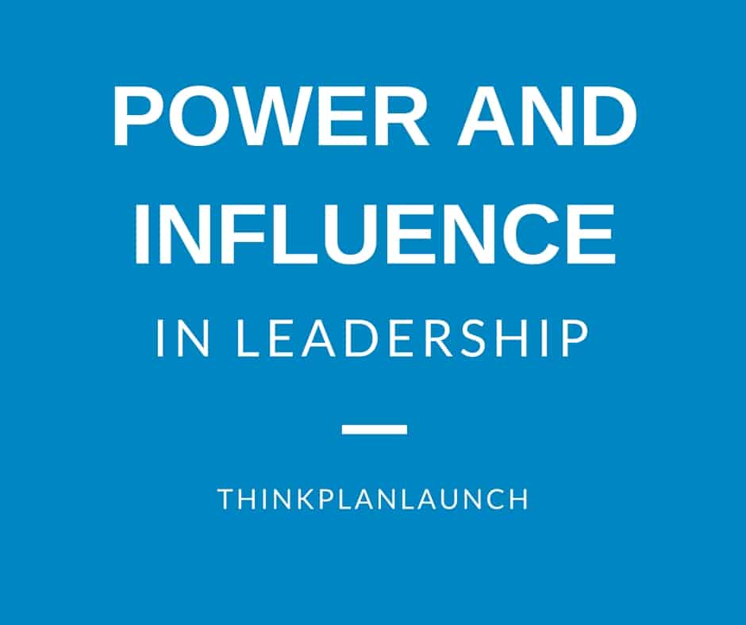
Power and Influence
Leaders can improve their effectiveness by reflecting on the types of power they and their followers have and the types of influence tactics they may use or may be used on them.
  Where power is capacity to cause change, influence is the degree of actual change in a target person’s attitudes, values, beliefs, or behaviors.
    A subordinate’s satisfaction or motivation, group cohesiveness and climate, or unit performance measures can be used to assess the effectiveness of leaders’ influence attempts.

Slide 7
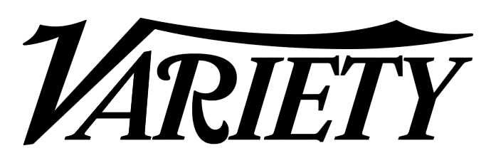
Power and Influence
Leaders and followers use a variety of tactics to influence each other’s attitudes or behavior. They range from emotional appeals, to the exchange of favors, to threats.
  The particular tactic used in a leadership situation is probably a function of the power possessed by both parties.
    For example, a well-respected leader could make an emotional appeal, a rational appeal, a personal appeal, a legitimate request, or a threat to try to modify a follower’s behavior. The follower in this situation may be able to use only ingratiation or personal appeals to change the leader’s attitude or behavior.

Slide 8
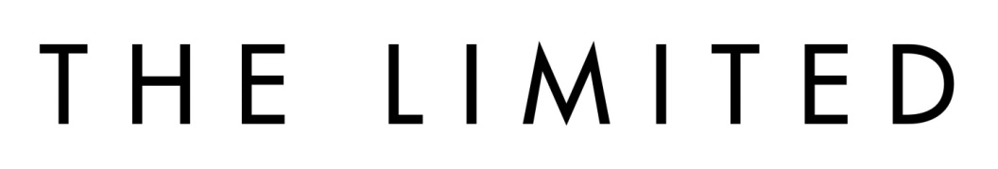
Power and Influence
At the same time, because the formal leader is not always the person who possesses the most power in a leadership situation, followers often can use a wider variety of influence tactics than the leader to modify the attitudes and behavior of others.
  This would be the case if a new leader were brought into a group in which one of their subordinates was well liked and respected.
    The subordinate may have a wider range of influence tactics available, whereas, the new leader may be limited to making only legitimate requests to change attitudes and behaviors of followers.

Slide 9
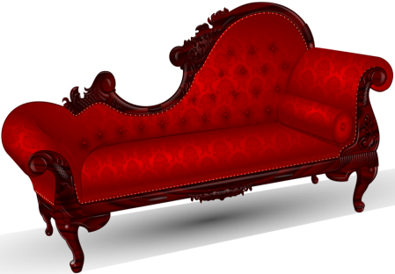
Power and Leadership
Furniture and Seating Arrangements
Something as trivial as the arrangement of furniture in an office can affect perceptions of another person’s power.
  One factor is the shape of the table used for meetings. Individuals sitting at the ends of rectangular tables often wield more power, whereas circular tables facilitate communication and minimize status differentials.
    However, specific seating arrangements even at a circular table can affect participants’ interactions; often individuals belonging to the same cliques and coalitions will sit next to each other.

Slide 10

Power and Leadership
Office Arrangement
Having a private or more open office may not only reflect but also affect power differentials between people.
  Individuals with private offices can dictate to a greater degree when they want to interact with others by opening or closing their doors or by giving instructions about interruptions.
    Prominently displaying symbols like diplomas, awards, and titles also can increase one’s power.

Slide 11
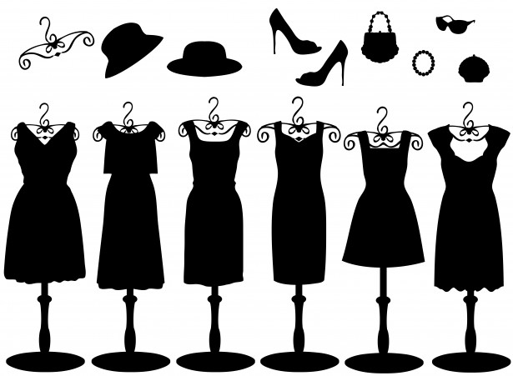

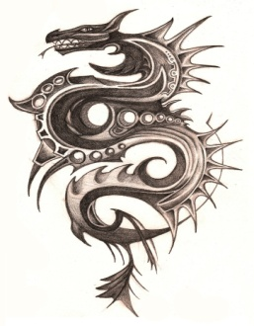
Power and Leadership
Clothing and Tattoos
Even choice of clothing can affect one’s power and influence. Uniforms and other specialized clothing are associated with authority and status.
  Similarly, even the presence of something as trivial as tattoos can affect the amount of power wielded in a group.

Slide 12

Power and Leadership
Crisis Situations
Another situational factor that can affect one’s potential to influence others is the presence or absence of a crisis.
  Leaders usually can exert more power during a crisis than during periods of relative calm.
    Typically, during crises followers are more willing to accept greater direction, control, and structure from leaders.

Slide 13

Source of Power
Sources of power by which a person can influence others.
  Expert Power
    Power of knowledge or expertise.
  Referent Power
    Strength of relationship between leader and followers.
  Legitimate Power
    Formal or official authority based on a person’s role in organization.
  Reward Power
    Control over desired resources (raises, bonuses, promotions, etc.).
  Coercive Power
    Control through fear of punishment or loss of valued outcomes.

Slide 14
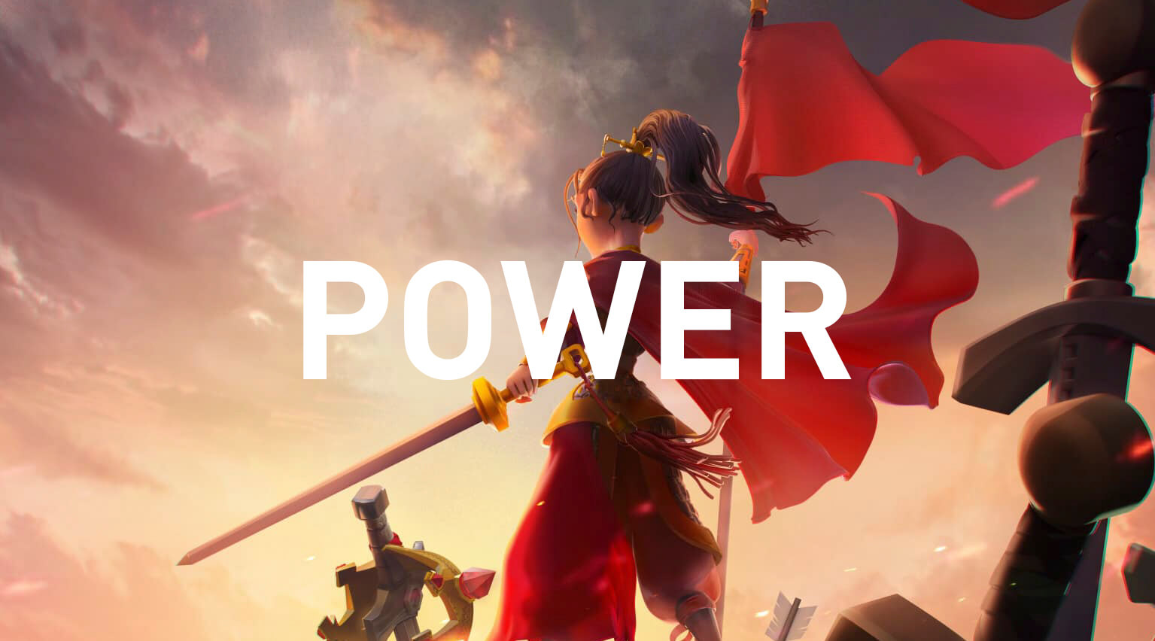
Source of Power
Effective leaders generally work to increase their various power sources, whether it be their expert, referent, reward, or legitimate power, or they become more willing to use their coercive power.

Slide 15
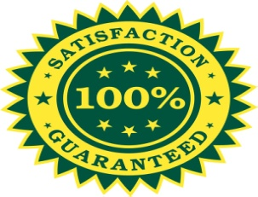
Leader Motives
People vary in their motivation to influence or control others.
  Individuals with a high Need for Power derive satisfaction from influencing others. They seek positions where they can influence others, and are often involved in influencing people in many different organizations or decision-making bodies.
    In such activities they readily offer ideas, suggestions, and opinions, and also seek information they can use in influencing others.
    They are often astute at building trusting relationships and assessing power networks, though they can often be outspoken and forceful.

Slide 16

Leader Motives
Two different ways of expressing the Need for Power:
  Personalized Power
    Individuals who have a high need for Personalized Power are relatively selfish, impulsive, uninhibited, and lacking in self-control.
      These individuals exercise power for their own needs, not for the good of the group or the organization.
  Socialized Power
    Socialized Power implies a more emotionally mature expression of the motive. It is exercised in the service of higher goals to others or organizations and often involves self-sacrifice toward those ends.
      It often involves empowering, rather than an autocratic style of management and leadership.

Slide 17
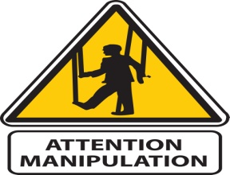
9 Influencing Tactics
1. Rational Persuasion
  Occurs when someone uses logical arguments or factual evidence to influence others.
2. Inspirational Appeals
  Used when making a request or proposal designed to arouse enthusiasm or emotions in others.
3. Personal Appeals
  Used when asking another to do a favor out of friendship.
4. Ingratiation (Praise)
  Occurs when someone attempts to get you in a good mood before making a request.

Slide 18
9 Influencing Tactics
5. Consultation
  Occurs when agents ask others to participate in planning an activity.
6. Exchange
  Occurs when exchanging favors with others to influence them.
7. Coalition Tactics
  Seeking aid or support from others to strengthen ability to influence.
8. Pressure Tactics
  Using threats or persistent reminders to influence others.
9. Legitimization Tactics
  Occurs when agents make requests based on position or authority.

Slide 19

Influence Tactics and Power
A strong relationship exists between the relative power of leaders and followers and types of influence tactics used.
  Because leaders with high amounts of referent power have built close relationships with followers, they may be more able to use a wide variety of influence tactics to modify the attitudes and behaviors of their followers.

Slide 20
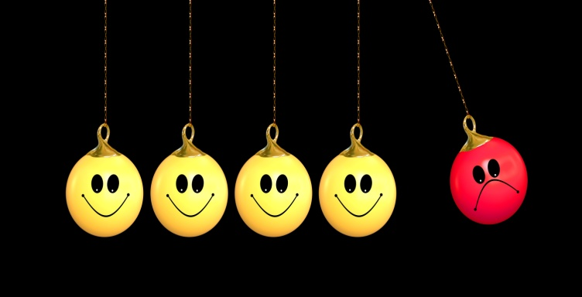
Influence Tactics and Power
There is a tendency for people to resort to hard tactics whenever they have an advantage in clout if other tactics fail to get results.
  As the bank robber Willie Sutton once said, “You can get more with a kind word and a gun than you can with just a kind word.”

Slide 21

Influence Tactics
Research indicates that some reasons for selecting among various possible influence tactics lead to successful outcomes more frequently than others.
  Thinking an act would improve an employee’s self-esteem or morale was frequently associated with successful influence attempts.
    Choosing an influence tactic because it followed company policy or another because it was a way to put a subordinate in his place often resulted in unsuccessful influence attempts.

Slide 22
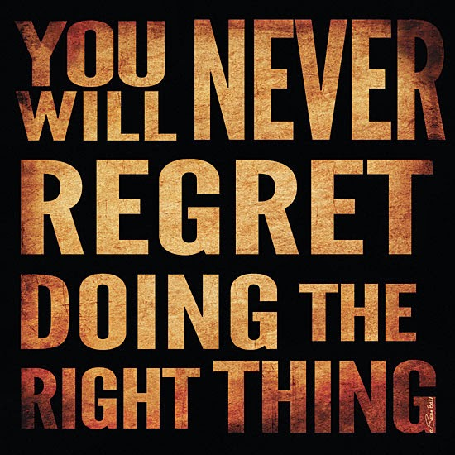
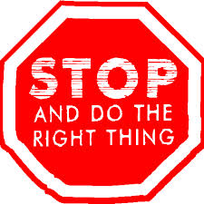
Values, Ethics, and Character
A leader’s personal values and ethical code may be among the most important determinants of how that leader exercises the various sources of power available.
  Leaders face dilemmas that require choices between competing sets of values and priorities, and the best leaders recognize and face them with a commitment to doing what is right, not just what is expedient.

Slide 23

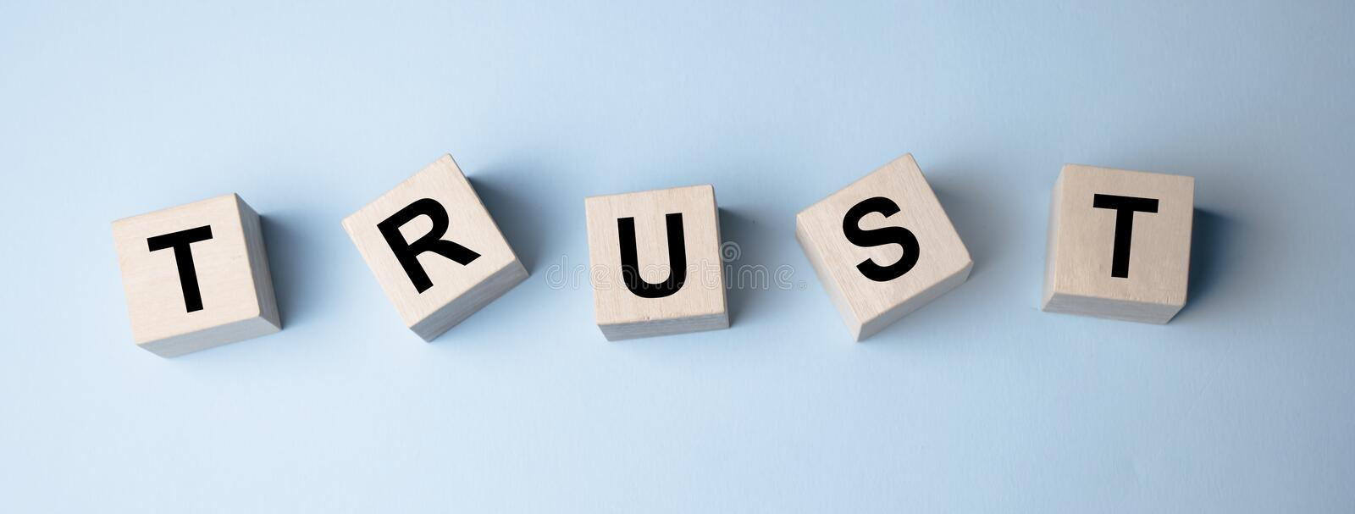
Ethics
Leaders should internalize a strong set of ethics, which are principles of right conduct or a system of moral values.
  Leaders set a moral example for others to follow.
  Leaders who do not honor truth do not inspire it in others.
  Leaders who do not behave ethically do not demonstrate true leadership.
    True leadership is characterized by a high degree of trust between leader and followers.

Slide 24

Trust
Four qualities of leadership that engender trust, include: (1) vision, (2) empathy, (3) consistency, and (4) integrity.
  1. We trust leaders who create a compelling vision.
    Pull people together on the basis of shared beliefs and a common sense of organizational purpose and belonging.
  2. We trust leaders who demonstrate empathy with us.
    Show they understand the world as we see and experience it.
  3. We trust leaders who are consistent.
    This does not mean that we only trust leaders whose positions never change, but that changes are understood as a process of evolution in light of relevant new evidence.
  4. We trust leaders whose integrity is strong.
    Demonstrate commitment to higher principles through their actions.

Slide 25

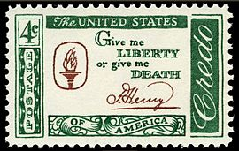
Values
Values are “constructs representing generalized behaviors or states of affairs that are considered by the individual to be important.”
  Values are learned through the socialization process, and they become internalized and for most people represent integral components of the self.
    When Patrick Henry said, “Give me liberty, or give me death,” he was expressing the value he placed on political freedom.

Slide 26
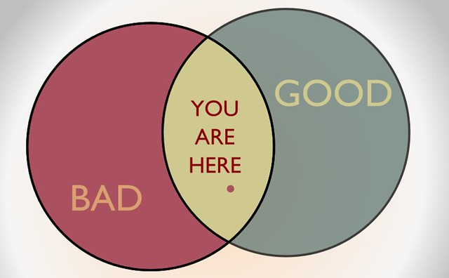
Moral Reasoning
Moral Reasoning refers to the process leaders use to make decisions about ethical and unethical behaviors.
  Values play a key role in the moral reasoning process because value differences among individuals often result in different judgments regarding ethical and unethical behavior.
    Several unconscious biases affect our moral judgments.

Slide 27
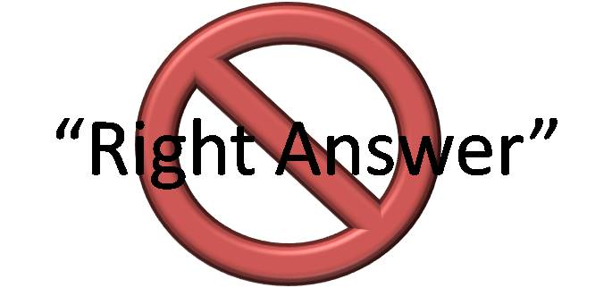
Ethical Dilemmas
An Ethical Dilemma involves choosing between two “rights.”
  Trust vs. Loyalty
    Such as honestly answering a question when doing so could compromise a real or implied promise of confidentiality to others.
  Individual vs. Community
    Such as whether you should protect the confidentiality of someone’s health when the condition may pose a threat to the larger community.
  Short-Term vs. Long-Term
    Such as how a parent chooses to balance spending time with children now as compared with investments in a career that may provide greater benefits for the family in the long run.
  Justice vs. Mercy
    Such as deciding whether to excuse a person’s misbehavior because of extenuating circumstances or a conviction that they “learned a lesson.”

Slide 28

Ethical Dilemmas
Kidder offers 3 principles for resolving Ethical Dilemmas:
  Ends-Based Thinking
    Doing what’s best for the greatest number of people.
  Rule-Based Thinking
    Following the highest principle or duty.
  Care-Based Thinking
    The Golden Rule: “Do what you want others to do to you.”

Slide 29
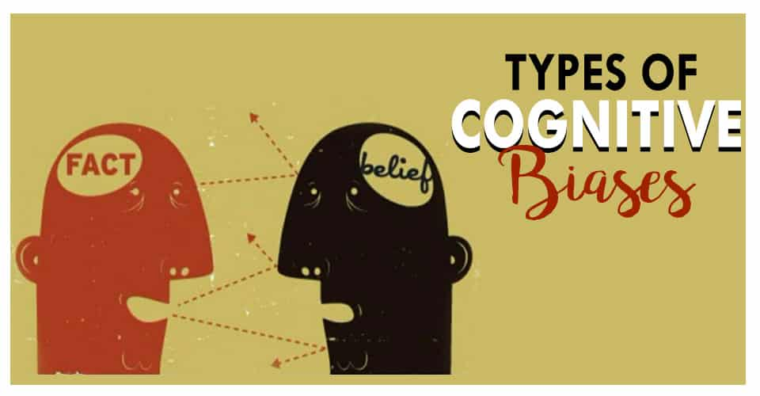
Biases that Impact Decision-Making
Implicit Prejudice
  Although most people claim to judge others by their merits, research shows that implicit prejudice distorts their judgments. Judgments about some groups are systematically biased without one’s awareness of such biases.
In-Group Favoritism
  We often point to numerous favors and acts of kindness we’ve shown toward others, and regard such acts as indicators of our own generosity and kindly spirit. If the pattern of our generous acts were examined, however, there is typically a clear pattern to those whom we’ve helped: most of the time they’re “like us.”
Over-Claiming Credit
  In many kinds of ways we tend to overrate the quality of our own work and our contributions to the groups and teams we belong to.
Conflicts of Interest
  A conflict of interest occurs when an individual’s personal interests – family, friendships, financial, or social factors – could compromise their judgment, decisions, or actions in the workplace. We often underestimate our COI.

Slide 30

Values and Moral Codes
Just because we profess certain values or moral codes does not ensure we will act that way when confronted with situations that engage them.
  When people are confronted with situations they’ve never faced before, their behavior may be different than predicted.
    We don’t always behave as ethically as we think we would in morally demanding situations.

Slide 31

Moral Justification
Moral Justification involves reinterpreting otherwise immoral behavior in terms of a higher purpose.
  Ways to dissociate behavior from one’s moral principles, include:
    Euphemistic Labeling
    Advantageous Comparison
    Displacement of Responsibility
    Diffusion of Responsibility
    Distortion of Consequences
    Dehumanization
    Attribution of Blame

Slide 32
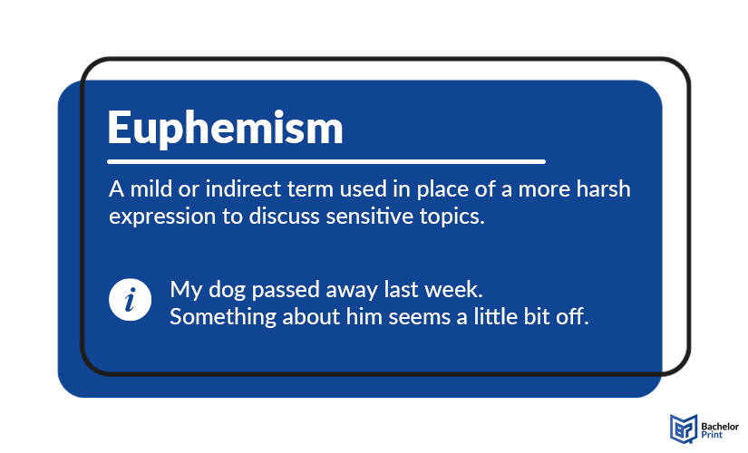
Moral Justification
1. Euphemistic Labeling
Euphemistic Labeling
  This involves using cosmetic words to defuse or disguise the offensiveness or morally repugnant or distasteful behavior.
    Terrorists, for example, may call themselves “freedom fighters,” and firing someone may be referred to as “letting them go.”

Slide 33
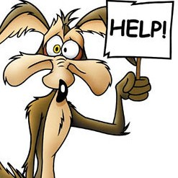

Moral Justification
2. Advantageous Comparison
Advantageous Comparison
  Lets one avoid self-contempt for one’s behavior by comparing it to even more heinous behavior by others.
    If you think we’re insensitive to employees’ needs, you should see how they treat employees at the Acme Co.

Slide 34

Moral Justification
3. Displacement of Responsibility
Displacement of Responsibility
  People may violate personal moral standards by attributing responsibility to others.
    Nazi concentration camp guards, for example, attempted to avoid more responsibility for their behavior by claiming they were merely carrying out orders.

Slide 35


Moral Justification
4. Diffusion of Responsibility
Diffusion of Responsibility
  Whereby reprehensible behavior becomes easier to engage in and live with if others are behaving the same way.
    When everyone is responsible, it seems, no one is responsible.

Slide 36
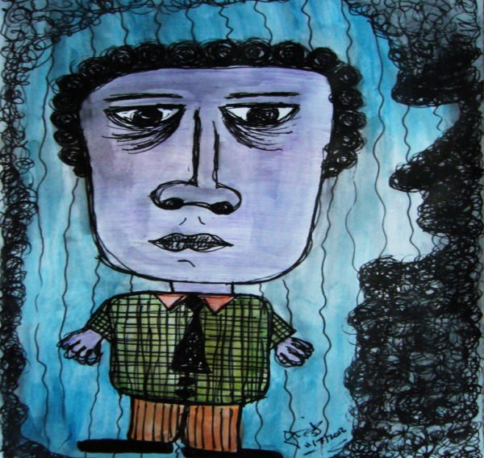
Moral Justification
5. Distortion of Consequences
Distortion of Consequences
  People minimize the harm caused by their behavior.
    This can be a problem in bureaucracies when decision makers are relatively insulated by their position from directly observing the consequences of their decisions.

Slide 37


Moral Justification
6. Dehumanization
Dehumanization
  Another way of avoiding the moral consequences of one’s behavior is by treating others as less than human by using epithets, such as, “devils,” “cockroaches,” “animals,” etc.
    It is easier to treat others badly when they are dehumanized.

Slide 38
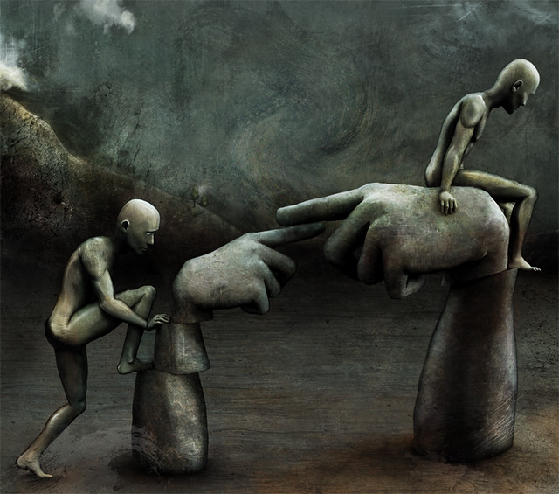
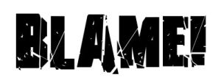
Moral Justification
7. Attribution of Blame
Attribution of Blame
  People sometimes try to justify immoral behavior by claiming it was caused by someone else’s actions. It’s their own fault!

Slide 39
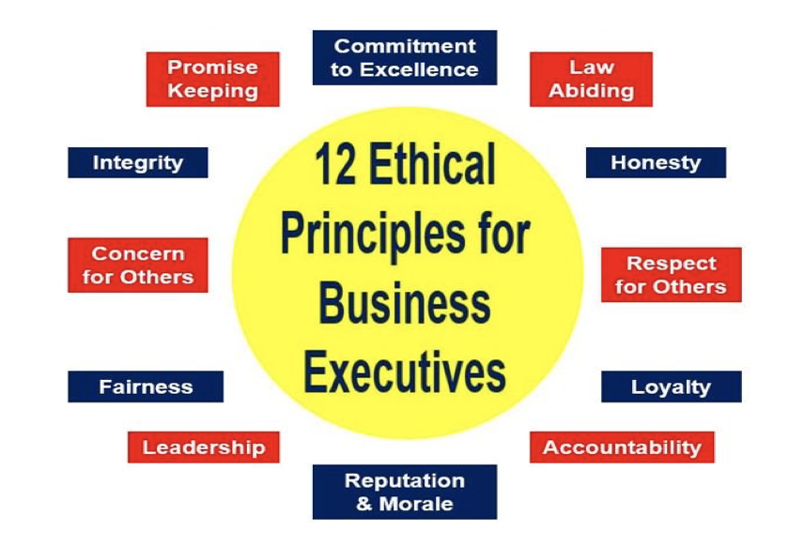
Moral Justification
Behaving Ethically
An important foundation of behaving ethically is to become more self-conscious of one’s own ethical standards and practices.

Slide 40
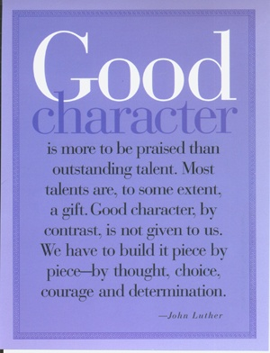
Character
Character is described as “an indispensible component of sustainable leadership performance” and “a central and defining feature of ethical leadership.”
  Character virtues associated with ethical leadership include, prudence, temperance, fortitude, and justice.

Slide 41

Ethical Leadership
Ethical Leadership has two core components:
  The Moral Person
    The moral person is seen as a principled decision maker who cares about people and the broader society.
    The actions of such people indicate they try to do the right things personally and professionally, and they can be characterized as honest, fair, and open. In addition, they have clear ethical standards they pursue in the face of pressure to do so otherwise.
  The Moral Manager
    More than being just moral people, ethical leaders are moral managers who make “ethics an explicit part of their leadership agenda by communicating an ethics and values message, by visibly and intentionally role modeling ethical behavior.”

Slide 42

Authentic Leadership
Authentic Leadership is grounded in the principle found in the familiar adage “to thy own self be true.”
  Authentic Leaders exhibit a consistency between their values, their beliefs, and their actions.
  Authentic Leaders have strong ethical convictions that guide their behavior not so much to avoid doing “wrong” things as to always try to do what’s “right”, including treating others w/ respect and dignity.
  Authentic Leaders behave as they do because of personal conviction rather than to attain status, rewards, or other advantages.
  Authentic Leaders are self-aware and self-consciously align their actions with their inner values.

Slide 43
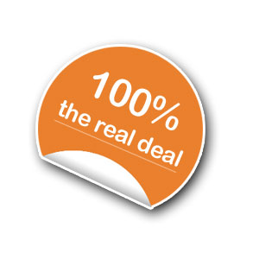
Authentic Leadership
Authentic Leadership shares the belief that:
  Enhancing self-awareness can help people in organizations find more meaning and connection at work.
  Promoting transparency and openness in relationships – even between leader and followers – builds trust and commitment.
  Fostering more inclusive structures and practices in organizations can help build more positive ethical climates.
    In contrast to stereotypical notions of the stoic “hero leader” who shows no weakness and shares no feelings, Authentic Leaders are willing to be viewed as vulnerable by their followers – a vital component of building a trusting leader-follower relationship.

Slide 44

Servant Leadership
In contrast to the common hierarchical Leader’s role, which may be understood as doing whatever it takes to ensure things run smoothly, tasks are performed, and goals met; the Servant Leader’s role is simply to serve others.
  Servant Leaders develop people, helping them to strive and flourish.
    The idea of Servant Leadership has been around for thousands of years. It stems at least in part from the teachings of Jesus Christ, who instructed his disciples that servant-hood is the essence of worthy leadership (such as through the example of Him washing their feet.)

Slide 45

Servant Leadership
Ten characteristics associated with Servant Leadership:
  1. Listening
    Listening effectively to others.
  2. Empathy
    Understanding others’ feelings and perspectives.
  3. Healing
    Strengthening others’ emotional-spiritual health and wholeness.
  4. Awareness
    Understanding own values, feelings, strengths, and weaknesses.
  5. Persuasion
    Influencing others through persuasion, rather than authority.

Slide 46
Servant Leadership
Ten characteristics associated with Servant Leadership:
  6. Conceptualization
    Integrating present realities and future possibilities.
  7. Foresight
    Using intuition to connect the past, present, and future.
  8. Stewardship
    Holding an organization’s resources in trust for the greater good.
  9. Commitment to Others’ Growth
    Developing others to be more responsible, competent, and caring.
  10. Building Community
    Helping create a sense of community among people.

Slide 47
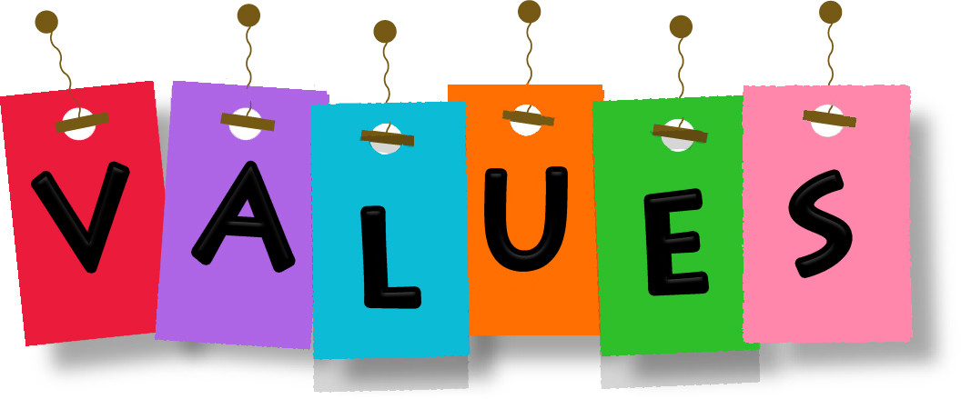
Organizational Leadership
The Roles of Ethics and Values
In any organization, the top leadership’s collective values play a significant role in determining the dominant values throughout the organization, just as an individual leader’s values play a significant role in determining team climate.
  Research has shown that employees with values similar to the organization or team are more satisfied and likely to stay; those with dissimilar values are more likely to leave.
    One reason why leaders fail is not due to a lack of competence, rather conflict between personal and organizational values.

Slide 48
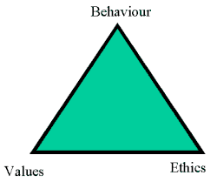

Organizational Leadership
The Roles of Ethics and Values
Values are often a key factor in both intrapersonal and interpersonal conflict.
  Many of the most difficult decisions made by leaders are choices between opposing values. Values also play a key role in conflict between groups.
    It’s vital for a leader to set an example of values-based leadership, and it is also important for leaders to make sure clear values guide everyone’s behavior in the organization.

Slide 49
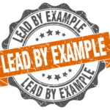
Leading by Example
One of the most quoted principles of good leadership is: “leadership by example.”
  Interpersonal Behaviors
    Show care, concern, and compassion for others.
    Hardworking and helpful.
    Value relationships with others and work to maintain them.
    Focus on positive rather than negative, and accept others’ failures.
  Basic Fairness
    Open to input from others and actively seek it.
    Offer explanations of decisions made.
    Treat others respectfully, not condescendingly even when disagree.

Slide 50
Leading by Example
One of the most quoted principles of good leadership is: “leadership by example” (continued).
  Ethical Actions and Self-Expectations
    Hold oneself to high ethical standards and behave consistently in both public and private life.
    Accept responsibility for and open about own ethical failings.
    Perceived as honest, trustworthy, humble, and having integrity.
  Articulating Ethical Standards
    Articulate a consistent ethical vision and do not compromise it or the high ethical standards it implies.
    Hold others accountable and put ethical standards above personal and short-term company interests.

Slide 51
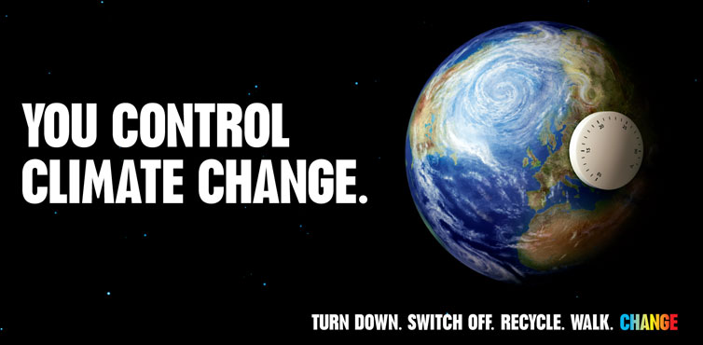
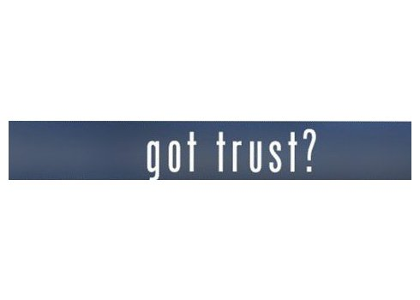
Ethical Climate
The most powerful way organizations can enhance the likelihood that employees will address ethical problems in a constructive manner is by proactively creating an ethical climate within the organization.
      An Ethical Climate needs TRUST established and integrated on all levels.

Slide 52

Focus on the Leader
Leadership Attributes
  “Watch your thoughts, for they become words. Watch your words, for they become actions. Watch your actions, for they become habits. Watch your habits, for they become character. Watch your character, for it becomes destiny.” Anonymous.

Slide 53

Great Man Theory
Researchers once believed that leaders and followers were fundamentally different, and questioned whether certain personality traits, physical attributes, intelligence, or personal values differentiated leaders from followers.
  Ralph Stogdill came to two major conclusions:
    Leaders were not qualitatively different from followers; many followers were just as tall, smart, outgoing, and ambitious as the people who were leading them.
    Some characteristics, such as intelligence, initiative, stress tolerance, responsibility, friendliness, and dominance, were modestly related to leadership success.

Slide 54

Great Man Theory
In Other Words…
People who were smart, hardworking, conscientious, friendly, or willing to take charge were often more successful at building teams and influencing a group to accomplish its goals than people who were less smart, lazy, impulsive, grumpy, or not fond of giving orders.
  Having “the right stuff” did not guarantee leadership success, but it improved the odds of successfully influencing a group toward the accomplishment of its goals.

Slide 55
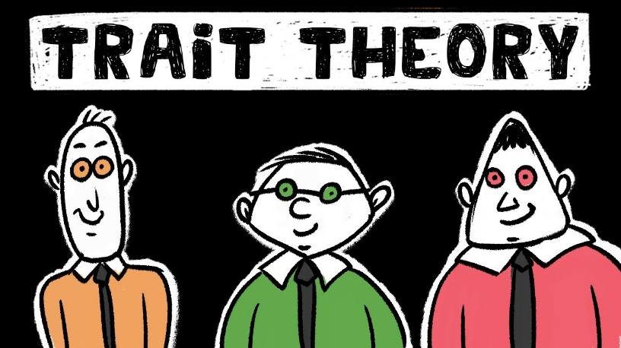
Trait Approach to Personality
The trait approach maintains that people behave as they do because of the strengths of the traits they possess.
  Personality traits are more closely related to leadership effectiveness in weak or ambiguous situations.
    Given the accelerated pace of change in most organizations today, it is likely that leaders will face even more unfamiliar and ambiguous situations in the future.

Slide 56

Five Factor or OCEAN Model of Personality
Research has shown that most of the trait-like terms people use to describe others’ behavioral patterns can be reliably categorized into five broad personality dimensions.
  The Five Factor or OCEAN model of personality categorizes the five major dimensions as follows:
    Openness to Experience: (Imaginative-Curious-Strategic Thinker)
    Conscientiousness: (Careful-Diligent-Dutiful-Doing what is Right)
    Extraversion: (Outward Focus-Sociable-Energetic Demeanor)
    Agreeableness: (Cooperative-Kind-Trusting-Empathetic-Friendly)
    Neuroticism: (Anxiety-Worry-Fear-Anger-Depression)

Slide 57
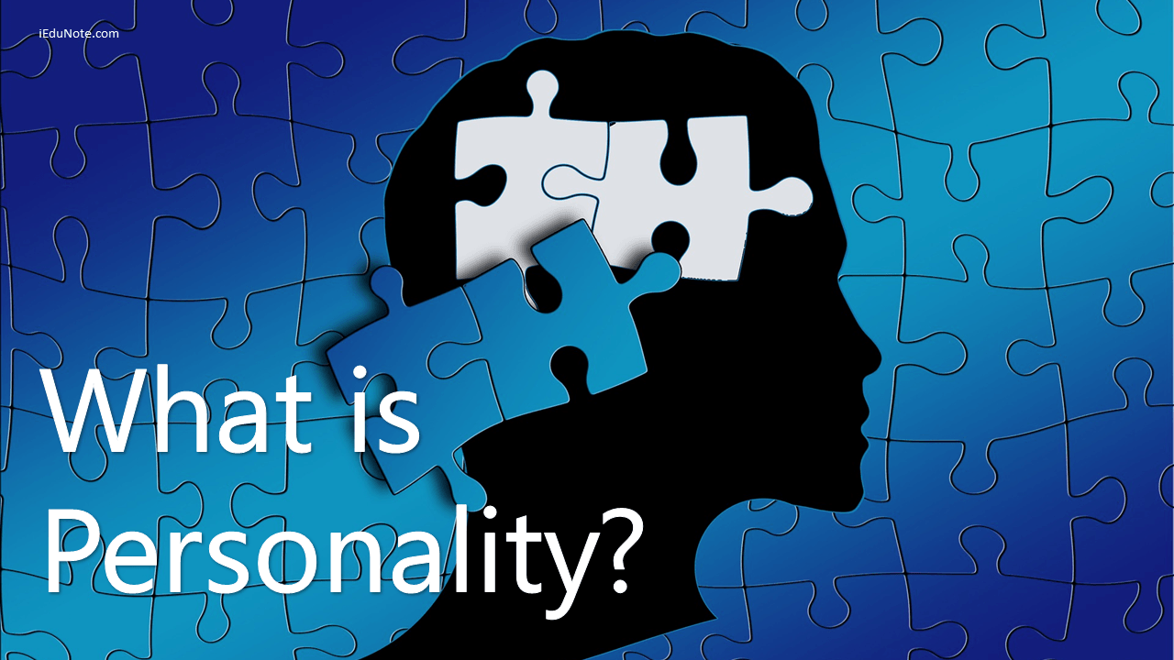
Personality Traits
  Research has shown personality to be an effective measure of leadership potential.
  Personality traits tend to be stable over the years and behavioral manifestations of traits occurs almost automatically, thus it is important for leaders to have insight into their personalities.
    Results of the OCEAN personality assessment are used for hiring new leaders, for giving leaders developmental feedback about various personality traits, and as a key component when promoting leaders.

Slide 58
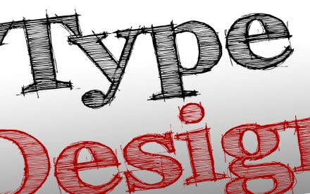
Traits and Types
Traits are not the only way to describe stereotypical behaviors. An alternative framework to describe the differences in people’s day-to-day behavioral patterns is through Types, or in terms of a Personality Typology.
  Typologies tend to put people into discrete psychological categories and emphasize the similarities among all people in the same category regardless of actual score.

Slide 59
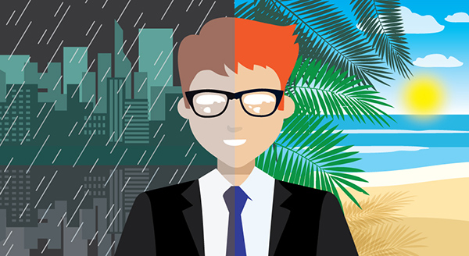
Psychological Preferences as a Personality Typology
One popular personality typology involves psychological preferences, or what we might call “mental habits.”
  Like traits, our preferences play a role in the characteristic and unique ways we behave from day to day.
    According to Carl Jung, preferences influence our choice of careers, ways of thinking, relationships, and work habits.

Slide 60
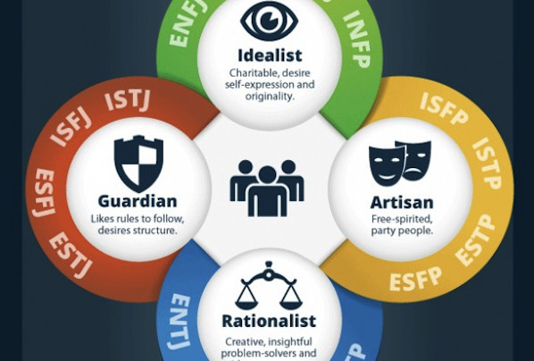
Myers-Briggs Type Indicator (MBTI)
Many people are unaware of the extent to which their preferences shape their perceptions of reality.
  According to Myers and Myers, there are four basic preference dimensions in which people can differ:
    Extraversion-Introversion
    Sensing-Intuition
    Thinking-Feeling
    Judging-Perceiving

Slide 61

Extroversion-Introversion
The E-I dimension is fundamentally concerned with where people get their energy.
  Extraverts have a breadth of interests and a large circle of acquaintances. They are energized by being around others.
    Extraverted leaders are naturally gregarious and outgoing.
    Their tendency to “think out loud” and speak whatever is on their mind can sometimes get them into trouble.
  Introverts are more comfortable being alone or with a few others. They can interact effectively with others, but they are more reserved and deliberate. They may come across as less approachable.
    Introverted leaders prefer to think things through and announce only final decisions, but followers may have a difficult time understanding their process used to reach conclusions.

Slide 62
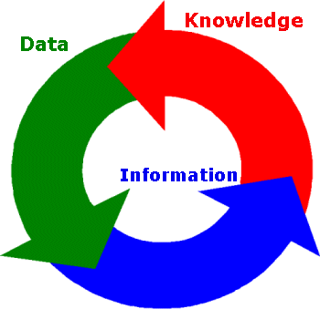
Sensing-Intuition
The S-I dimension is concerned w/ how people look at data.
  Leaders who prefer the sensing mode like facts and details; the focus of information gathering concerns the real, the actual, the literal, the specific, and the present.
    Sensing leaders tend to be practical, orderly, and down-to-earth decision makers.
  By contrast, leaders who rely on their intuition look for the big picture beyond facts and details; information is most meaningful for its pattern, trend, figurative meaning, and future possibilities.
    Intuitive leaders tend to be innovative and conceptual (though sometimes impractical) and are more comfortable with their hunches and inspirations.

Slide 63

Thinking-Feeling
The T-F dimension is concerned with the considerations leaders prefer when making decisions.
  Thinking leaders like to analyze, criticize, and approach decisions impersonally and objectively. They use their heads to adopt a relatively detached stance toward decisions and pay more attention to operational, bottom-line considerations.
  Feeling leaders naturally empathize and appreciate, and they prefer to approach decisions personally and subjectively. They value humaneness and social harmony and use their hearts to weigh the impact of any decision on people.

Slide 64

Judging-Perceiving
The J-P dimension describes the amount of information a leader needs before feeling comfortable making a decision.
  Judging leaders strive for closure; they like things settled and come across as decisive, methodical, and organized.
    Judgers get nervous before decisions get made and want to see the minimal amount of information needed to make decisions.
    Judging leaders can stay focused and make quick decisions.
  Perceiving leaders like to keep their options open; they are curious, spontaneous, and flexible.
    Perceivers prefer to collect as much data as possible before making decisions and get nervous after they are made because they may not feel all the information was collected or analyzed correctly.
    Perceiving leaders can be seen as having “analysis paralysis.”

Slide 65

Personality Traits and Preference Dimensions
As with personality traits, many leaders and followers exhibit the behaviors associated with their preference dimensions almost automatically.
  However, it is important to note that people are not locked into exhibiting only those behaviors associated with their preferences.
    Leaders can and do exhibit behaviors associated with the opposite side of any preference dimension, but it takes personal insight and conscious energy and effort to do so.

Slide 66

Strengths-Based Leadership
The Strengths-Based Leadership approach is predicated on three tenets, which are to:
  Get clarity about what a person is good at.
  Find jobs or tasks that leverage each person’s strengths.
  Minimize the time spent improving weaknesses, as this negatively impacts overall effectiveness.

Slide 67

Intelligence and Leadership
Intelligence is a person’s all-around effectiveness in activities directed by thought.
  Research has shown that more intelligent leaders are faster learners; make better assumptions, deductions, and inferences; are better at creating a compelling vision and developing strategies to make their vision a reality; can develop better solutions to problems; can see more of the primary and secondary implications of their decisions; and are quicker on their feet than leaders who are less intelligent.

Slide 68

Intelligence and Leadership
Like personality traits, however, intelligence alone is not enough to guarantee leadership success.
  Plenty of smart people make poor leaders – just as less intelligent people are great leaders.
    Nevertheless, many leadership activities seem to involve some degree of decision-making and problem-solving ability, which means a leader’s intelligence can affect the odds of leadership success in many situations.

Slide 69
Triarchic Theory of Intelligence (TTI)
The Triarchic Theory of Intelligence offers some of the most significant implications for leadership.
    According to this theory, there are three basic types of intelligence: Analytic, Practical, and Creative Intelligence.
    TTI focuses on what a leader does when solving complex mental problems, such as how information is combined and synthesized when solving problems, what assumptions and errors are made, etc.

Slide 70

Analytic Intelligence
Analytic Intelligence is general problem-solving ability and can be assessed using standardized mental abilities tests.
  Those who posses higher levels of this type of intelligence tend to be quick learners, do well in school, see connections between issues, and have the ability to make accurate deductions, assumptions, and inferences with relatively unfamiliar information.
    There is still much, however, that analytic intelligence does not explain.
    Many people do well on standardized tests, but not in life. And, some people do poorly on standardized intelligence tests, but develop ingenious solutions to practical problems.

Slide 71
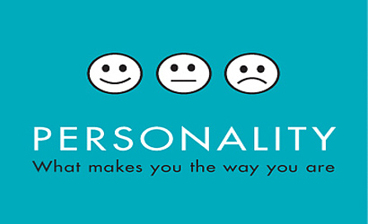
Analytic Intelligence
Leadership effectiveness or emergence is positively correlated with analytic intelligence.
  Smart but inexperienced leaders are less effective in stressful situations than less intelligent, experienced leaders.
    Also, personality is more predictive of leadership emergence and effectiveness than analytic intelligence.

Slide 72

Practical Intelligence
People with “street smarts” know how to adapt to, shape, or select new situations to get their needs met better than people lacking street smarts.
  Practical Intelligence involves knowing how things get done and how to do them. For leaders, practical intelligence is important because it involves knowing what to do and how to do it when confronted with a particular leadership situation, such as dealing with a poorly performing subordinate, resolving a problem with a customer, or getting a team to work better together.
    Practical Intelligence is much more concerned with knowledge and experience than is analytic intelligence.

Slide 73
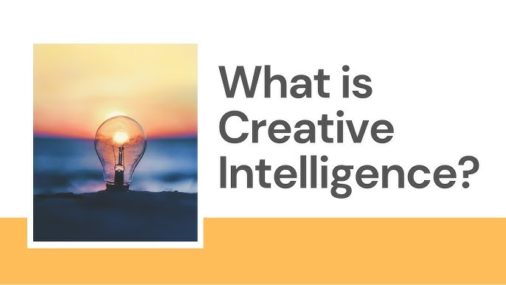
Creative Intelligence
Creative Intelligence is the ability to produce work that is both novel and useful.
  Using both criteria (novel and useful) as components of creative intelligence helps to eliminate outlandish solutions to a potential problem by ensuring that adopted solutions can be realistically implemented or have some type of practical payoff.
    Assessing creativity is no simple matter.
    Creativity may wax and wane over time.

Slide 74

Creative Intelligence
A leader should know that their primary role is not so much to be creative themselves, but to build an environment where others can be creative.
  This is not to say that leaders should be uncreative, but rather that most innovations have roots in ideas developed by people closest to a problem or opportunity (that is, the workers).
    Leaders can boost creativity by selecting creative employees and providing opportunities for others to develop their creativity.

Slide 75

Creative Intelligence
Research has shown that people tend to generate more creative solutions when they are told to focus on their intrinsic motivation for doing so – the pleasure of solving the task itself – rather than focusing on the extrinsic motivation – public recognition or pay.
  When they need to foster creativity, leaders may find it more effective to select followers who truly enjoy working on the task at hand rather than relying on rewards to foster creativity.

Slide 76
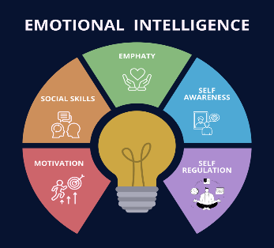
Emotional Intelligence
Dan Coleman argues that success in life is based more on non-cognitive abilities (Emotional Intelligence) than on one’s analytic intelligence or IQ.
  Emotional Intelligence consists of:
    Self Awareness
      Emotional Awareness, Accurate Self-Assessment, Self-Confidence
    Self-Regulation
      Self-Control, Trustworthiness, Conscientiousness, Adaptability, Innovation
    Motivation
      Achievement, Commitment, Initiative, Optimism
    Empathy
      Understanding/Developing Others, Service, Diversity, Political Awareness
    Social Skills
      Influence, Communication, Conflict Management, Leadership, Change Catalyst, Building Bonds, Collaboration, Cooperation, Team Capabilities

Slide 77
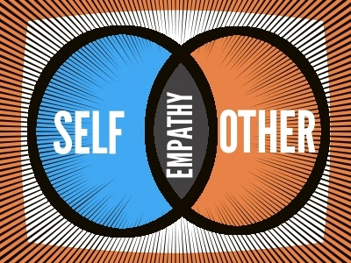
Emotional Intelligence
Human emotions are important aspects of one-on-one interactions and teamwork, but too many leaders and researchers have chosen to ignore the role they play.
  When recognized and leveraged properly, emotions can be the motivational fuel that helps individuals and groups to accomplish their goals. When ignored or discounted, emotions can significantly impede a leader’s ability to build teams or influence a group.
    Leaders who can empathize and get along with others are often more successful than those who cannot.

Slide 78


