Slide 1
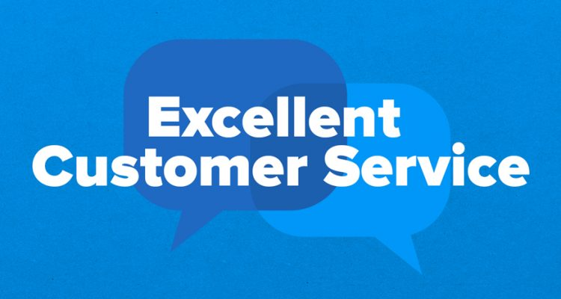
Customer Service Management
Session Five Class Presentation
Customer Service
  Skills for Success – 7th Edition
    Robert W. Lucas; McGraw-Hill Education; New York, NY 2019
      ISBN: 978-1-259-95407-8

Slide 2
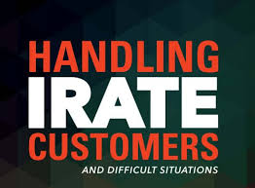
Part Three: Building and Maintaining Relationships
Chapter Seven: Service Breakdowns and Recovery
  “Never underestimate the power of the irate customer.” - Joel Ross

Slide 3
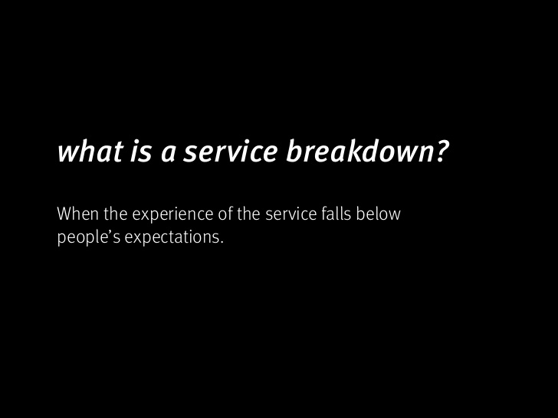
What is a Service Breakdown?
Service breakdowns occur whenever any product or service fails to meet the customer’s expectations.
  Service breakdowns occur daily in all types of organizations.
    They occur whenever the product or service delivered fails to meet customer expectations.

Slide 4
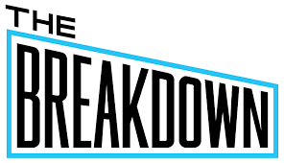
What is a Service Breakdown?
Today’s customers are more discerning and better educated, have access to more up-to-date and accurate information, and are often more demanding than in the past.
  They have certain expectations about products and services, and the way they should be provided.
    Failure to fulfill some or all of these expectations can lead to dissatisfaction and possible confrontation and loss of business.

Slide 5
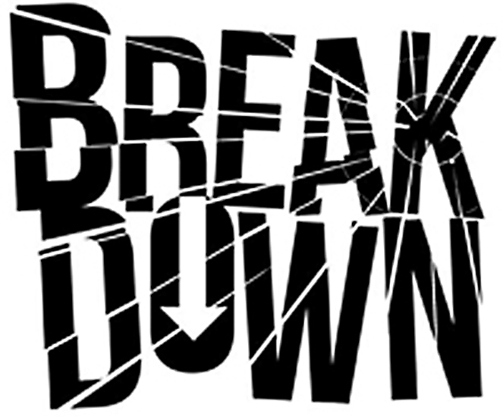
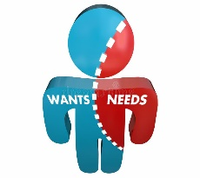
What is a Service Breakdown?
In short, a service breakdown is failure to meet customer wants, needs, and expectations.
  Wants
    Things that customer typically desire but do not necessarily need.
  Needs
    Motivators or drivers that cause customers to seek out specific types of products or services. These may be marketing-driven, based on advertising they have seen, or may tie directly to Abraham Maslow’s hierarchy of needs.
  Expectations
    The perceptions that customers have when they contact an organization or service provider about the kind, level, and quality of products and services they should receive.

Slide 6
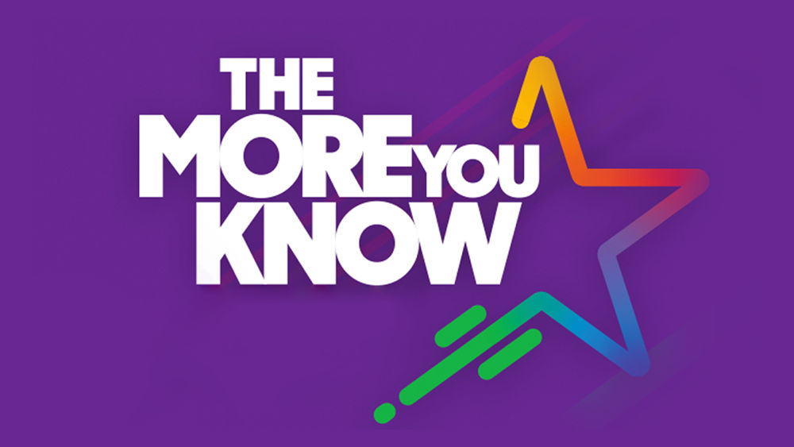
The Role of Behavioral Style
Behavioral preferences have a major effect on interactions of people, and these behavioral styles affect the types of things people want and value.
  If you and your products and services fail to meet those expectations, you can experience a service breakdown and have to deal with an emotional situation that you might not be prepared to handle.
    The more you know about behavioral style preferences, the easier it becomes to deal with people in a variety of situations.

Slide 7

Role of Behavioral Style
Everyone possesses one or a combination of the following four different behavioral styles:
  Rational
    Prefer one-on-one or small group interaction, are congenial and patient, avoid conflict, and dislike calling attention to themselves.
  Inquisitive
    Rarely volunteer feelings, ask “why” questions, desire facts and figures, and are formal, task-oriented, conservative, and punctual.
  Decisive
    Are decisive, directive, task and goal-focused, confident, and competitive; seek immediate gratification or results; and talk more than listen.
  Expressive
    Are open, laid back, flexible, positive, enthusiastic, and informal; prefer dealing with people; and easily share feelings and emotions.

Slide 8
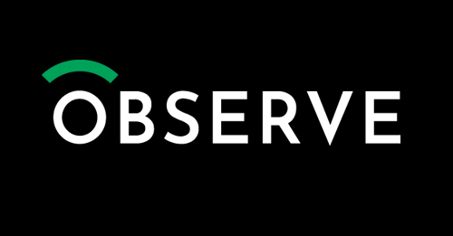
Role of Behavioral Style
Because customers can display various types of behavior from time to time, you should carefully observe their behavior and learn about each style as an indicator of the type of person with whom you are dealing.
  Just remember that human beings are complex and react to stimuli in various ways, so adapt your approach as needed.
    Do not use information you learn about styles as the definitive answer for resolving the situation. In addition, learn to deal with your emotions so that you can prevent or resolve heated situations that may arise when dealing w/ personalities different from yours.

Slide 9
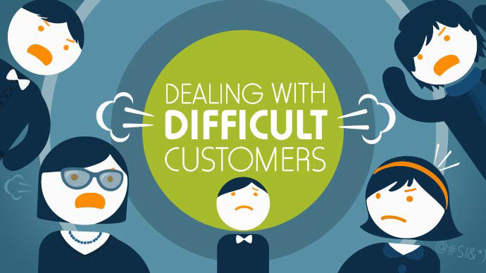
Difficult Customers
Ultimately, successful service is delivered through effective communication skills, positive attitude, patience, and a willingness to help the customer.
  You may think of difficult customer contacts as those in which you have to deal with negative, angry, demanding, or aggressive people.
    These are just a few of the types of potentially difficult interactions that you may encounter as a service representative.

Slide 10
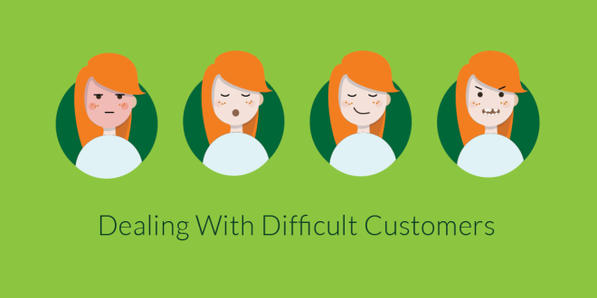
Difficult Customers
From time to time, you will provide assistance to customers who can be described in one or more of the following ways:
  Talkative.
  Dissatisfied with your service products.
  Indecisive or lack knowledge about your product, service, or policies.
  Rude or inconsiderate of others.
  Internal customers with special requests.
  Speak a primary language other than yours.
  Elderly and need extra assistance.
  Young and inexperienced, needing guidance in making good choice.
  Have some type of disability or special needs.
    Each of the above categories can be difficult to handle, depending on your knowledge, experience, and abilities.

Slide 11
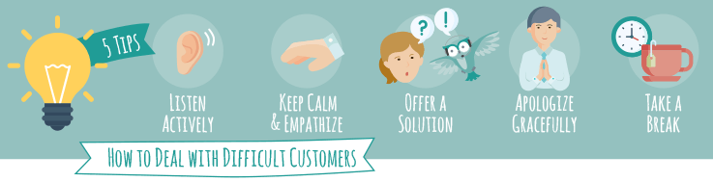
Difficult Customers
A key to successfully serving all types of customers is to treat each person as an individual.
  If you stereotype people, you will likely damage the customer-provider relationship and might even generate complaints to your supervisor or legal action against you and your organization based on perceived discrimination.
    Do not mentally categorize people according to the way they speak, act, or look; and then treat everyone in a “group” the same.

Slide 12
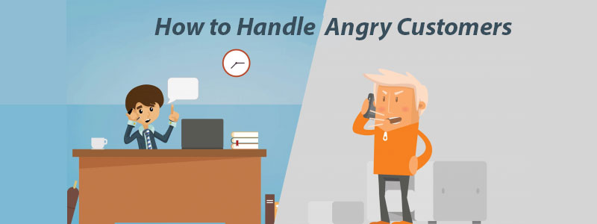
Difficult Customers
Your ability to focus on the situation or problem and not on the person will be a very important factor in your success.
  Although you may not understand or approve of a person’s behavior, they are still your customer, so try to make the interaction a positive one, and if necessary ask for help.

Slide 13

Demanding or Domineering Customers
Customers can at times be demanding or domineering.
Domineering behavior may be part of a personality style or behavior that they have learned. The behavior could also be a reaction to customer service encounters and an expectation that they now have about what should or should not occur.
  A demanding customer may feel a need to be or stay in control, especially if they have felt out of control in the past.
    Often, such people are insecure or have a behavioral style that lends itself to wanting to be in control or to “win.”

Slide 14
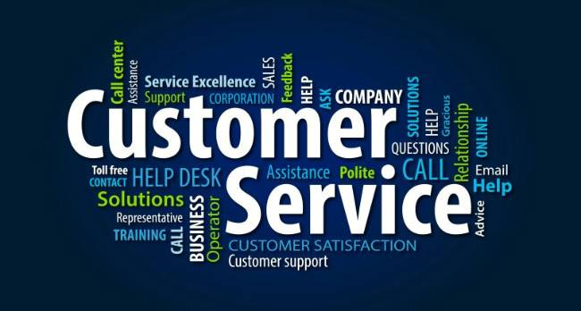
Demanding or Domineering Customers
The following provides strategies for effectively handling demanding customers:
  Be Professional
  Respect the Customer
  Be Firm and Fair and Focus on the Customer’s Needs
  Tell the Customer What You Can Do.

Slide 15
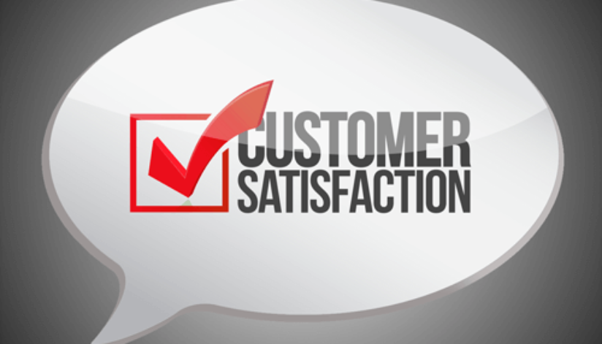
Demanding or Domineering Customers
By being thoroughly familiar with your organization’s policies and procedures and your limits of authority, you will be prepared to negotiate with demanding customers.
  If they want something you cannot provide, you might offer an alternative that will satisfy them.
    Your goal is complete customer satisfaction but not at the expense or excessive loss to your organization.

Slide 16

Indecisive Customers
You will encounter people who cannot or will not make a decision. In some instances, this may be a result of their behavioral style or it might be due to something in their background from which they learned such behavior.
  Such customers sometimes spend long periods vacillating between several options as they seemingly struggle to choose one over the other. They might even leave and come back later to continue their decision-making efforts. Sometimes, they will even bring someone along to help facilitate a decision.

Slide 17
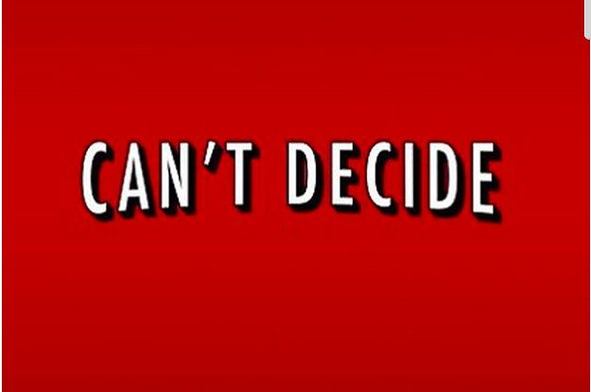
Indecisive Customers
In some cases, indecisive customers truly do not know what they want or need, as when they are looking for a gift for a special occasion.
  In other instances, such customers are afraid that they will choose incorrectly or need reassurance that the product has the features they really need or will use later.
    In the latter situation, use all your product or service knowledge and communication skills to provide them with the information they need to make a buying decision. Otherwise, indecisive customers will occupy your time and detract from your ability to do your job effectively or assist customers.

Slide 18
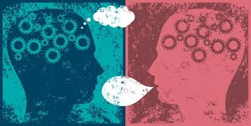
Indecisive Customer
An important point to keep in mind is that some people really are just looking or researching a product or service as they check out sales, kill time between appointments, or relax, or they may simply be lonely and want to be around others.
  Strategies for dealing with an indecisive person are:
    Be Patient
    Ask Open-Ended Questions
    Listen Actively
    Suggest Other Options
    Guide Decision-Making

Slide 19

Dissatisfied and Angry Customers
You will encounter dissatisfied customers or angry ones.
  They may feel that the treatment being received is unfair, that you or someone else is lying to or taking advantage of them, or that they are not getting the service they want or expect.
    Possibly, you or one of your peers, or a competitor, improperly served them in the past, and they now have a preconceived idea about anyone who is in the sales or service profession.
    The challenge is that in instances where you encounter a dissatisfied or angry customer, you represent the organization or you may be considered “just like that last service employee.”
      You have to try to calm these customers and make them happy.

Slide 20

How to Satisfy Dissatisfied and Angry Customers
Listen
  With an open mind to discover the basis for their anger or dissatisfaction.
Remain Positive and Flexible
  While showing a willingness to work with the customer or negotiate.
Smile, Give Your Name, and Offer Assistance
  Projecting a “can do” attitude can lower defenses. By doing so, you can potentially get the customer to do likewise and salvage the situation and customer-provider relationship.
Be Compassionate and Empathize without Making Excuses
  Angry or dissatisfied customers want and expect that you will try to see their side of the situation and will make concessions. This does not mean that you should bow to them if the situation was not your fault or that of your organization. It does mean that you should try to understand their position and settle down to where you can negotiate and resolve the issue.
Ask Open-End Questions and Verify Information
  That allows your customers to talk and vent while providing the degree of information needed to identify what went wrong and offer potential solutions. The only way to start to resolve the issue is to find out what caused it in the first place.
Take Appropriate Action
  Once you have gotten the customer to lower their emotions to the point where you can intelligently discuss the situation, you will be on your way to a solution. If you know your organization’s policies and procedures and are knowledgeable of products and services, you have the tools to potentially get the relationship back on track and resolve the issue.

Slide 21
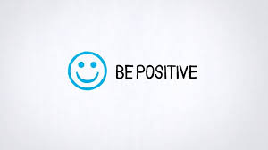
Dissatisfied and Angry Customers
Remember that if you get defensive, you become part of the problem and not part of the solution.
  By maintaining a positive approach and using positive language, you are more likely to bring about a successful outcome when dealing with an angry or dissatisfied person.

Slide 22
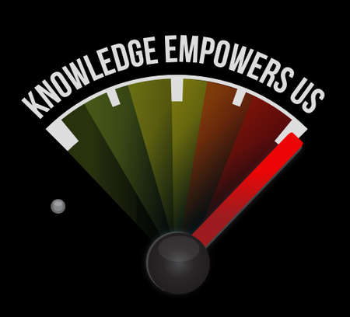
Dissatisfied and Angry Customers
To effectively serve an angry customer, you must move beyond the emotions to discover the reason for their anger.
  Before dealing with customers, check with your supervisor to find out what your policies are and what level of authority you have in making decisions. This relates to EE empowerment.
    By having this information before interacting with a customer, you will have the tools and knowledge necessary to handle customers effectively and professionally.

Slide 23
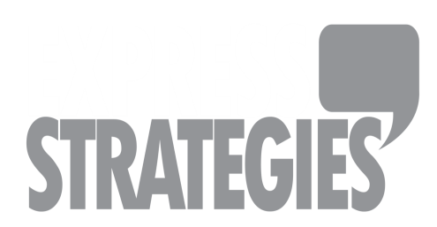
Resolution Strategies for Dissatisfied and Angry Customers
Be Positive
  Tell the customer what you can do rather than what you cannot.
Acknowledge the Customer’s Feelings or Anger
  By taking this approach, you have addressed the customer’s emotional state, demonstrated a willingness to assist, and encouraged the customer to participate in solving the problem.
Reassure
  Indicate that you understand why they are angry and that you will work to solve the problems.
Remain Objective
  Angry customers are often upset with the organization, product, or service you represent, not you.
Listen Actively; Determine the Cause
  Whether the customer is “right” or “wrong” makes no difference. Actively listening and trying to discover the problem without placing blame will reassure the customer of your intention to help.
Reduce Frustrations
  Do not say or do anything that will create further tension. Do your best to handle the situation with this customer before serving another.
Negotiate a Solution
  Elicit ideas or negotiate an alternative with the customer. Be willing to compromise.
Conduct a Follow-Up
  Contact your customer as soon as possible after your attempted resolution in order to show the customer that you are concerned the issue was correctly resolved and that you truly value them.

Slide 24
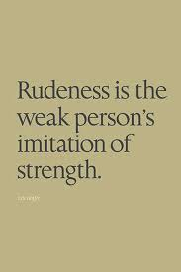
Rude or Inconsiderate Customers
Some people seem to go out of their way to be offensive or to get attention.
  Although they seem confident and self-assured outwardly, they are often insecure and defensive. Some behaviors include:
    Raising their voice
    Demanding to speak to a supervisor
    Using profanity
    Cutting in front of someone else in the line
    Being verbally abrupt
    Otherwise going out of their way to be offensive or in control

Slide 25
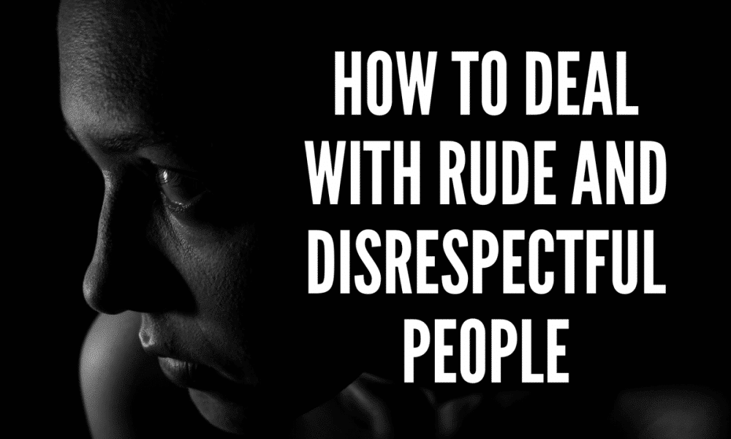
Rude or Inconsiderate Customers
The following are strategies for dealing with rude or inconsiderate customers:
  Remain Professional
    Just because the customer exhibits inappropriate behavior does not justify your reacting in kind. Remain calm, assertive, and in control of the situation. By maintaining decorum you may win over the person or at least keep them in check.
  Do Not Resort to Retaliation
    Retaliation will only infuriate this type of customer, especially if you embarrass them in the presence of others. Remember, such people are still customers, and if they or someone else perceive your actions as inappropriate, you could lose even more.

Slide 26

Talkative Customers
Some customers spend excessive time discussing irrelevant matters such as personal experiences, family, friends, schooling, accomplishments, other service situations, and the weather.
  Remain Warm and Cordial, but Focused
    Recognize that this person’s personality style is probably mainly expressive and their natural inclination is to connect with others. You can smile, acknowledge comments, and carry on a brief conversation as you are serving the customer.
  Ask Specific Open-End Questions
    These questions assist in determining needs and addressing customer concerns.
  Use Closed-End Questions to Control
    Once you have determined the customer’s needs, switch to close-end questions to control the situation and limit the opportunity for the customer to continue talking.
  Manage the conversation
    Keep in mind that if you spend a lot of time with one customer, other customers may feel neglected. You can manage customer encounters through questioning and through statements that let the customer know your objective is to serve customers. You might say, “If you have no further questions, have a great day.”

Slide 27
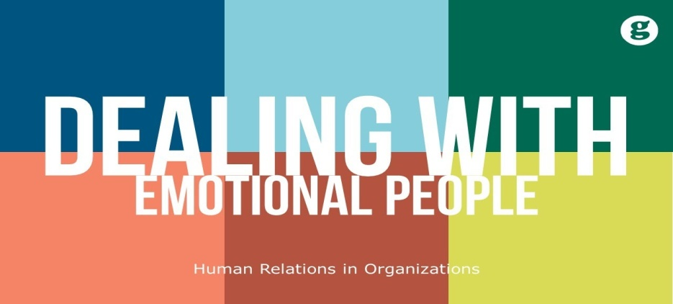
Handling Emotions with the Emotion-Reducing Model
Using the emotion-reducing model helps to calm the customer so that you can then solve the problem.
  It is important to remember when dealing with people who are behaving emotionally (i.e. irritated, angry, upset, crying, etc.) that they are typically upset with the structure, process, organization, or other factors over which you and/or they have no control.
    They are usually not upset with you (unless you have provoked them by exhibiting poor customer service skills or attitude).
    Remain rational and do not react to them emotionally.

Slide 28
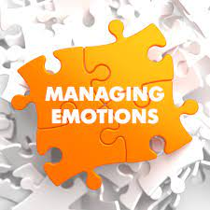
Handling Emotions with the Emotion-Reducing Model
Before you can get the customer to calm down, listen, and address the situation, you must first deal with their emotional state.
  A customer will not be receptive to what you are saying or your attempts to assist until you reduce their emotional state.
    Sometimes, they may even become irritated if you seem uncaring.

Slide 29
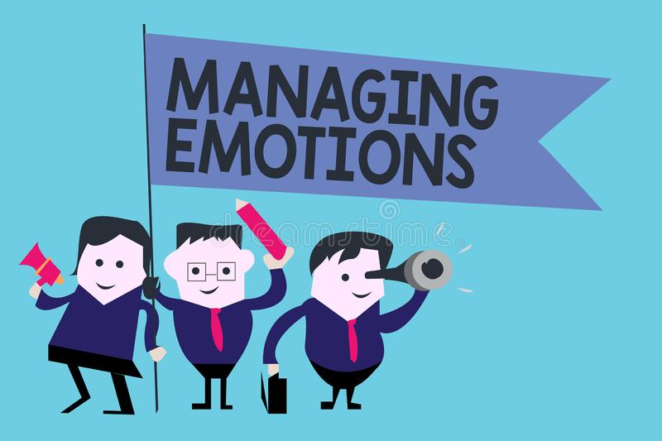
Handling Emotions with the Emotion-Reducing Model
To help calm the customer down, you must send customer-focused verbal and nonverbal messages.
  Demonstrate patience and use positive communication skills such as properly phrased verbal messages and questions, effective nonverbal cues, and active listening skills. Most important among those skills are the ability and willingness to listen to whatever the customer has to say without interrupting or interjecting your views.
    The customer must feel that their emotions were not disregarded.
    This approach often helps prevent situations from escalating.

Slide 30
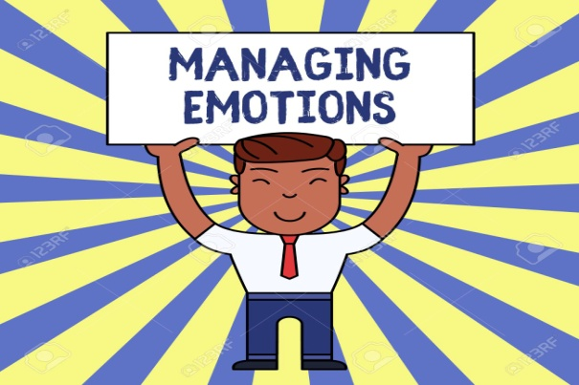
Handling Emotions with the Emotion-Reducing Model
A customer generally wants to be respected and acknowledged as an individual and as being important.
  As you interact with a customer, you can soften the situation and reduce emotion by providing customer-focused responses.
  Simple messages can put you on a friendly (human) level while at the same time helping to calm the situation.
    “Mr. Smith, I understand why you are frustrated about the service, and it seems we did make an error on your order. I do sincerely apologize for that. You are important to us, and I will do my best to try and resolve the situation.”

Slide 31
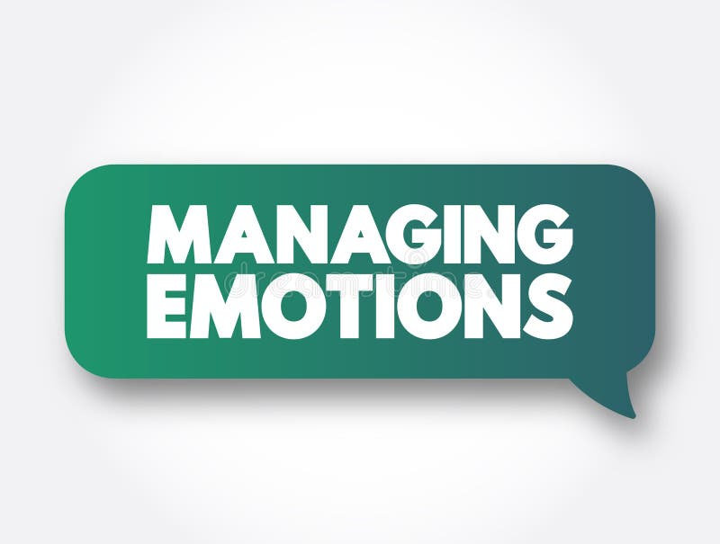
Handling Emotions with the Emotion-Reducing Model
The key to helping resolve any service breakdowns is to frame your problem resolution with a customer-focused message through use of the Emotion-Reducing Model:
  Customer-Focused Message
  Emotional Issue
  Customer-Focused Message
  Problem Solving
  Customer-Focused Message

Slide 32

Emotion-Reducing Model
Here is how the five steps of the emotion-reducing model are implemented:
  Assume a customer has a problem. As the customer approaches (or when you answer the telephone), greet them with “Good morning (or afternoon),” a smile, and open body language and gesturing (1. customer-focused message). Then, as the customer explains the issue (2. emotional issue), you can offer statements such as, “I see and understand how that can feel” (3. customer-focused message). Such statements can help you connect psychologically with the customer. Continue to use positive reinforcement - communication throughout your interaction. Once you define the problem and resolve it (4. problem solving), take one more opportunity at the end of your interaction to send a customer-focused message by smiling and thanking the customer for allowing you to assist. In addition, one last apology may be appropriate for inconvenience, frustration, mistreatment, and so on (5. customer-focused message).

Slide 33
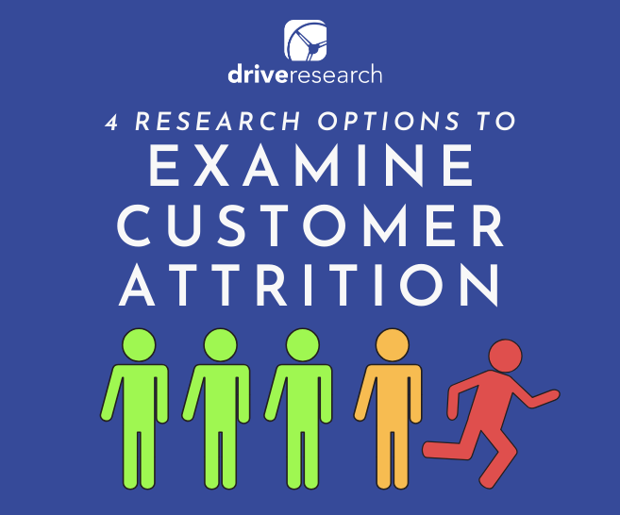
Reasons for Customer Defection
Failing to meet customer’s needs, handling problem inefficiently, treating the customer unfairly, and using inadequate systems are reasons for the customer to leave you and go elsewhere.
  Following a service breakdown, there is often a possibility that you may never see the customer again. This is potentially disastrous to your organization because it costs five to six times as much to win a new customer as it costs to retain one. Moreover, a dissatisfied customer will tell others the bad news.
    Thus, you and your organization must be especially careful to identify reasons for customer defection and remedy the problems.

Slide 34
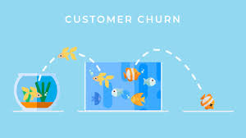
Reasons for Customer Defection
Service providers often make the mistake of trying to project their personal needs onto others.
  However, today’s diverse world requires you to be more knowledgeable and accepting of the ideas, values, beliefs, and needs of others. Failure to be sensitive to diversity may set you, your organization, and the customer on a collision course.
    Never lose sight of the fact that establishing and maintaining trust is crucial in sustaining customer-provider relationships.

Slide 35
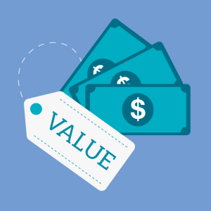
Four Reasons for Customer Defection
1. Price
Customers are often willing to switch product and service providers because of pricing.
  If prices increase or they perceive that they are not getting value for what they pay, then a move to another provider often occurs.
  You may not be able to do much about prices set by organization, but you can counter customer comments regarding costs.
  By being aware of what competitors charge for the same or similar products and services, you can help educate customers on value.
    A convincing argument relates to the quality of service that your organization provides.

Slide 36
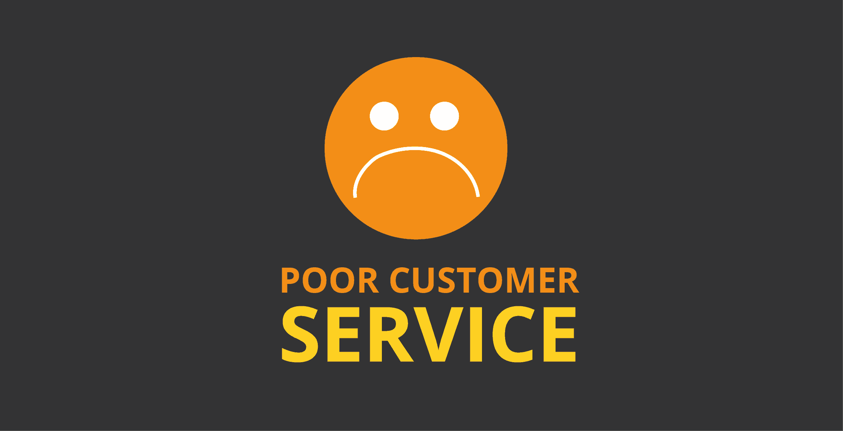
Four Reasons for Customer Defection
2. Poor Service and Complacency
If a concern is important enough for customer to verbalize (formally or informally) or to write down, it is important enough for you to take seriously.
  If customers perceive that you or your organization do not sincerely care about them or about solving problems, they may go elsewhere.
  You should immediately address any identified problem by listening, gathering information, and taking appropriate action.
    Sometimes the obvious solutions are the ones that are overlooked, so be perceptive when dealing with customers and look for little clues that could mean the difference in satisfaction and continued business.

Slide 37
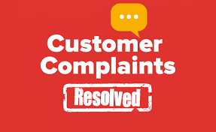
Four Reasons for Customer Defection
3. Inappropriate Complaint Resolution
The key thing to remember about complaint resolution is that it is the customer’s perception of the situation, not yours, that counts.
  If customers believe that they are not treated fairly, honestly, in a timely manner, and in an appropriate fashion, or if they are still dissatisfied, your efforts failed.
    Remember that only a small percentage of customers complain.
    Second attempts at resolution are critical.

Slide 38

Four Reasons for Customer Defection
4. Unmet Needs
Customers have very specific needs to which we must attend, and failure to do so will cause customers to seek an alternative source of fulfillment.
  By using effective communication strategies, we can work with customers to identify expectations and begin to meet them.

Slide 39

Working with Internal Customers
Relationships with your internal customers are important. You should meet your commitments and build a professional reputation.
  If you are a service provider, you have external customers who purchase or use your products or services. In addition to external customers, if you are a service provider and work in any type of organization that has EEs, you have internal customers.
    The bottom line is that, if you give information, products, or services to another person or entity (i.e. team, department, div.), you are a service provider and have customers. If you receive information, products, or services from another person or entity, you are a customer to them.

Slide 40

Working with Internal Customers
Although your interactions with internal customers may not be difficult, they can often be more sensitive than your dealings with outsiders.
  This is because if someone within your organization becomes irritated or dissatisfied with you, they do not necessarily go away. Instead, they might tell coworkers or your supervisor about the encounter, which can damage your reputation and even put your standing in the organization in jeopardy.
    The customer might also withdraw, which means that you might lose access to knowledge, information, or support that you need.

Slide 41
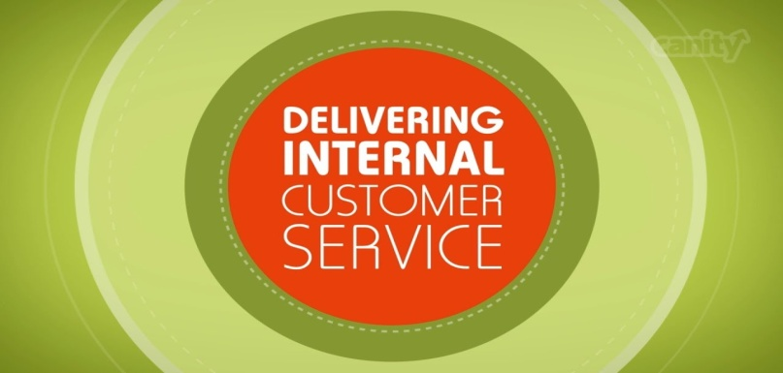
Working with Internal Customers
The importance of effective internal customer service cannot be underestimated, because your relationships with individuals and departments within your organization have significant effects on the organization.
  Sound internal customer service practices can help to boost EE communication and morale while helping to enhance processes and procedures, reduce costs, increase productivity, and replace interdepartmental competition with cooperation.
    Through such internal collaboration, external customer service improves because EEs have access to information and services needed to better serve external customers.

Slide 42
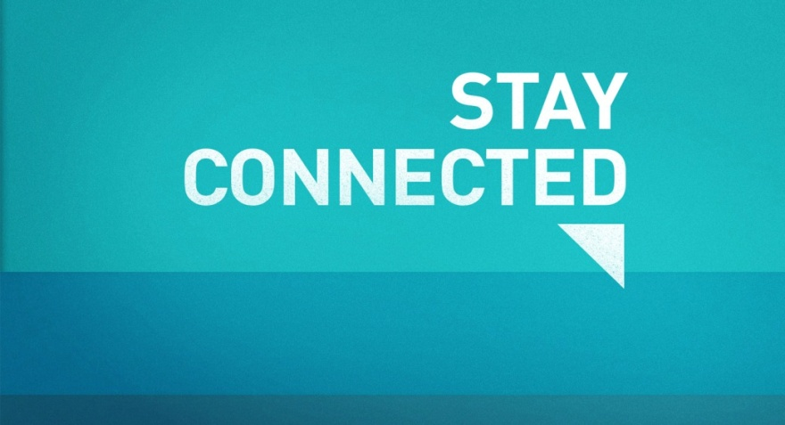
Stay Connected
Since relationships within the organization are so important, make an effort to connect with internal customers regularly. You can do this by dropping by their work area to say “hello,” sending an e-mail, texting, or leaving a voice mail message.
  If you know of a special occasion for a coworker (i.e. birthday) consider sending a card or e-mail to celebrate them.
    This helps strengthens relationship and can keep door to communication open, so if the service does break down someday, you will have a better chance of resolution.

Slide 43
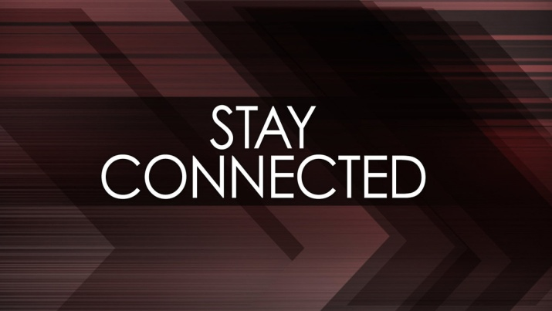
Stay Connected
You might describe your departmental or team coworkers as your “normal” internal customers.
  However, don’t forget the importance of relationships with other organizational employees, such as the cleaning crew (they service your office and work area), security force (they protect you, your organization, and your vehicle), support staff (who provide services like purchasing, payroll, travel, mail, printing, etc.), and the info- technology staff (they maintain your computer equipment).
    All these groups or individuals and many others within the organization add value and might be a big help to you at some point.

Slide 44
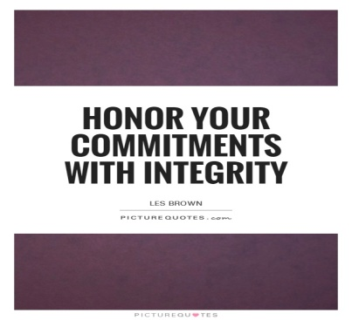
Meet All Commitments
Service providers forget the importance of internal customers. Because of familiarity, they sometimes become lax and fail to give the same degree of attention to internal customers that they give to external customers.
  Do not forget that if you depend on internal suppliers for materials, products, or information, these people can negatively affect your ability to serve external customers by delaying or withholding the items you need. Your external customer could suffer and your reputation and that of the organization are on the line.
    To prevent, or at least reduce, the possibility of such breakdowns, honor all commitments you make to internal customers.
    If you promise to do something…do it, and get it done on time.

Slide 45
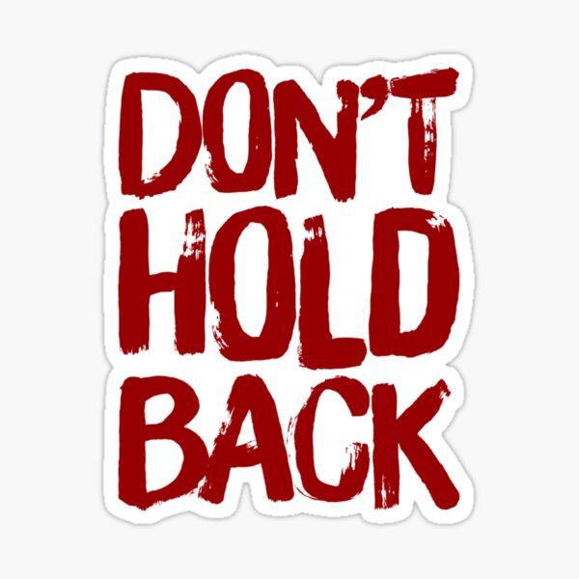
Do Not Sit On Your Emotions
Some people hold on to anger, frustration, and other negative emotions rather than getting their feelings out into the open and dealing with them. Not only is this potentially damaging to health, for it might cause stress-related illnesses, but it can destroy working relationships.
  Whenever something goes wrong or someone troubles you, go to the person and use feedback skills to talk about the situation. Failure to do so can result in disgruntled internal customers, damage to the customer-supplier relationship, and damage to your reputation.
    You will likely have to continue to rely on your customers in the future, so you cannot afford a relationship problem.

Slide 46
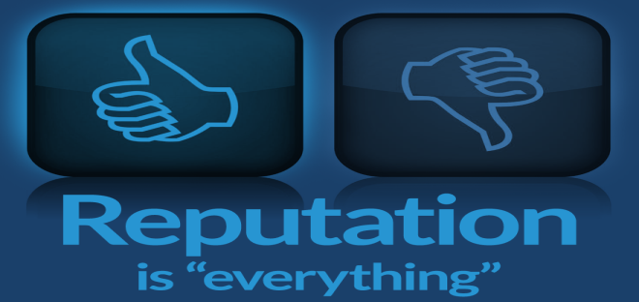
Build a Professional Reputation
Through your words and actions, go out of your way to let your customer and your supervisor know that you have a positive, can-do, customer-focused attitude. Let them know that you will do whatever it takes to create and environment in which internal and external customers are important.
  Part of projecting a professional image is to demonstrate your commitment to proactive service regularly.
    This means gathering information, products, and other tools before engaging with a customer so that you are prepared to deal with a variety of situations and people. It also means doing the unexpected for people and providing exceptional customer service to all customers.

Slide 47


Adopt a Good-Neighbor Policy
Take a proactive approach to building internal relationships so that you can head off negative situations.
  If your internal customers are in your department, act in a manner that preserves sound working relationships. You can accomplish this in part by adopting the following work habits:
    Avoid large gatherings and loud conversation in your workspace.
    Maintain good grooming and hygiene habits.
    Do not overdo call forwarding.
    Avoid unloading personal problems.
    Avoid office politics and gossip.
    Pitch in to help.
    Maintain a clean, organized work area.
    Be truthful.

Slide 48

Strategies for Preventing Dissatisfaction and Problem Solving
Focusing on the customers’ needs and seeking ways to satisfy them quickly while exceeding customer expectations are ways to prevent dissatisfaction.

Slide 49
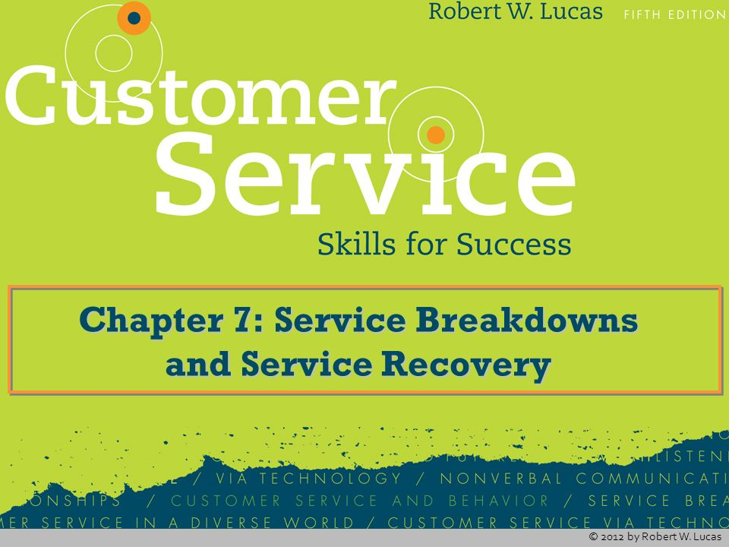
Strategies for Preventing Dissatisfaction and Problem Solving
The best way to deal with a service breakdown is to prevent it from happening. The following are some specific strategies for preventing dissatisfaction.
  Make Positive Initial Contact
  Think Like the Customer
  Pamper the Customer
  Respect the Customer
  Exceed Expectations

Slide 50

Thank Your Customer for the Opportunity
When a customer takes the time to share a concern, complaint, or question, thank them for giving you an opportunity to correct a problem area and then take the following 5 actions:
  React to Remarks or Actions
    Let customer know they are heard.
  Empathize
    Let customers know you are concerned and understand.
  Take Action
    Get agreement from customer on plan of action.
  Reassure or Reaffirm
    Let customer know you have their best interest.
  Follow Up
    Be sure to begin action steps and fulfill promises.

Slide 51
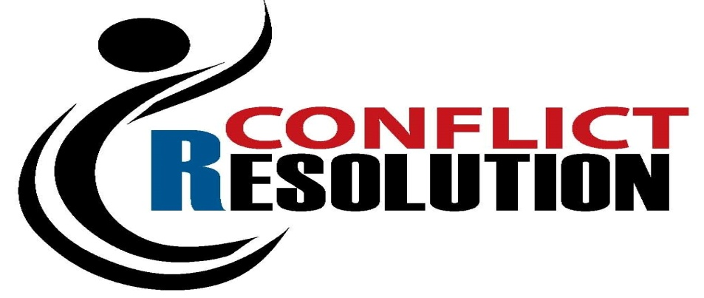
Responding to Conflict
Conflict should be viewed as neither positive nor negative. Instead, it is an opportunity to identify differences that may need to be addressed when dealing with your customers.
  It is not unusual for you to experience conflict when dealing with someone else. In fact, it is normal and beneficial as long as you stay focused on the issue rather than personalizing and internalizing the conflict.
    When you focus on the individual, or vice versa, conflict can escalate and ultimately do irreparable damage to the relationship.

Slide 52
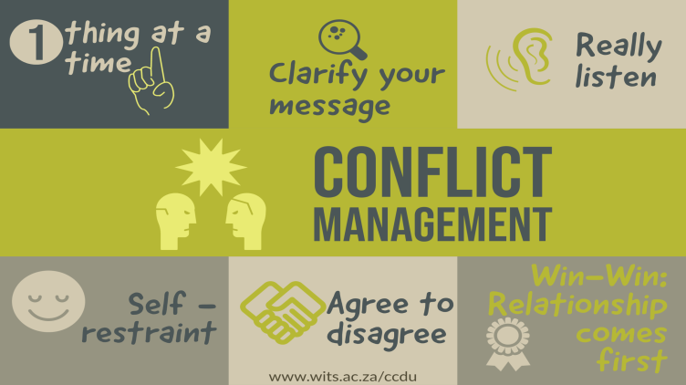
Guidelines for Effective Conflict Management
Even though each situation and person you deal with will differ, there are some basic approaches that may help in resolution of disagreements.
  Remain Calm
  Be Proactive in Avoiding Conflict
  Keep an Open Mind
  Identify and Confront Underlying Issues Immediately
  Clarify Communication
  Stress Cooperation Rather Than Competition
  Focus Resolution Efforts on the Issues

Slide 53

Salvaging Relationships After Conflict
Managing conflict involves more than just resolving the disagreement. If you fail to address emotional and psychological needs of those involved, you may find conflict returning and/or severe damage to the customer-provider relationship may occur.
  Often poorly handled service recovery efforts result in such things as complaints to a service provider’s supervisor or consumer agencies, bad word-of-mouth publicity, and lost customers.
    Depending on the severity of the conflict and how you handle it at each step of the resolution process, it may be impossible to go back to the relationship as it was before the disagreement. The key to reducing this possibility is to identify and address conflicting issues as early as possible and make the effort needed to protect-salvage the relationship.

Slide 54
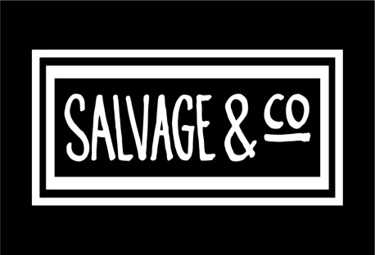
Salvaging Relationships After Conflict
The following strategies can assist in service recovery efforts:
  1. Reaffirm the Value of the Relationship
    You cannot assume that others feel the same as you or understand your intent unless you communicate it. Apologize sincerely and tell them how much you value the relationship between them and the organization. Also, stress that your goal is to assist them in whatever manner possible.
  2. Demonstrate Commitment
    You must verbalize and demonstrate your desire to continue or strengthen your relationship. The way to do this with customers is through sound interpersonal communication efforts. Once you have smoothed things over a bit emotionally with the customer, take definitive action to address the service or product breakdown.
  3. Be Realistic
    Because of cultural, gender, generational, and behavioral style differences, it is difficult for some people to “forgive and forget.” You have to help restore their trust systematically.
  4. Remain Flexible
    A solid customer-provider relationship involves the ability to give and take. It is especially crucial that you and the other people involved make concessions following conflict.
  5. Keep Communication Open
    One of the biggest cause of conflict and destroyed relationships is poor communication. Recognize and soothe emotions. Be willing to compromise and let the customer take the lead in discussion.
  6. Gain Commitment
    You cannot do it all by yourself. Get a commitment to work toward reconciliation from any other person(s) involved. Also, once they relax a bit and seem to be more receptive to listening to your suggestions, reaffirm that you have acted in a manner to resolve the issue to their satisfaction. Let them know that your goal is to help them as best you can.
  7. Monitor Progress
    Do not assume that, because the conflict or problem was resolved, it will remain that way. Deep-seated issues often resurface, especially when you do not obtain commitment from the other party. Be sure to follow-up shortly afterward to ensure that a spark does not rekindle into a blazing fire in their mind.

Slide 55
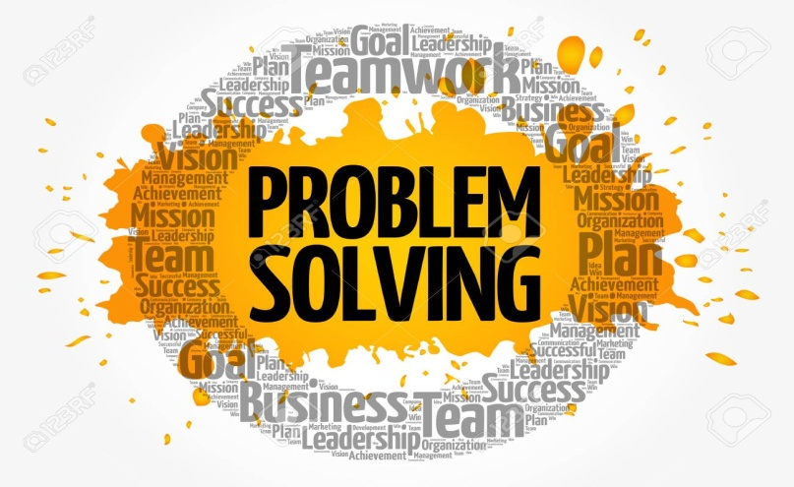
The Problem-Solving Process
Before you begin to solve a customer’s problem, consider the fact that they may not want you to “solve the problem.” A person may simply want to vent frustration or be heard.
  This is where empathetic listening: where you actively listen for messages being sent by the customer and then respond with statements such as, “I can appreciate your frustration,” and “I understand why you feel that way,” will come in handy.

Slide 56
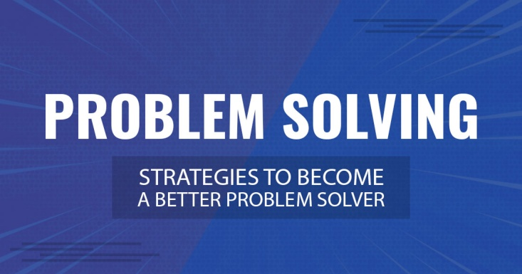
The Problem-Solving Process
Your customer may have a solution in mind when they call. Your role may be to simply listen and offer to facilitate the implementation of the suggested solution.
  In some situations, you may have to “plant a seed” of possible solution by asking an open-end question that suggests your recommended approach. If the customer takes your “seed” and nourishes it, you end up with an outcome for which they feel ownership, yet is actually one that you thought is best.
    If you jointly solve a problem, the customer often feels ownership for the solution – they made the decision, and this leads to customer satisfaction.

Slide 57
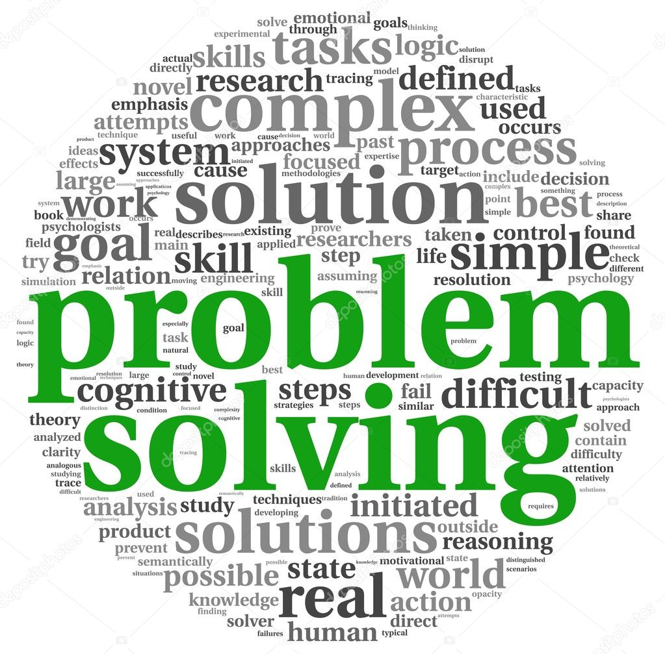
The Problem-Solving Process
To solve a problem, you need to first identify the cause and result of the issue and determine if it needs to be solved.
  Once you decide to solve the problem, follow the six proven steps to problem solving:
    Identify the Problem
    Compile and Analyze the Data
    Identify the Alternatives
    Evaluate the Alternatives
    Make a Decision
    Monitor the Results

Slide 58

Implementing a Service Recovery Strategy
The job of a service provider is to return the customer to a satisfied state. Not listening, poor communication, and lack of respect are roadblocks.
  We make mistakes. Mistakes can appear glaring to customers, who can be very demanding and unforgiving.
    The best you can hope for when something goes wrong is that you can identify the cause and remedy it quickly to satisfaction.

Slide 59

Implementing a Service Recovery Strategy
There are five phases to the service recovery process:
  Apologize, Apologize, and Apologize Again.
  Take Immediate Action
  Show Compassion
  Provide Compensation
  Conduct Follow-up

Slide 60
