Slide 1
Fundamentals of Management Session Five

Slide 2
Part Four: Leading
Chapter Ten: Understanding Groups and Managing Work Teams
Define group and describe the stages of group development.
Describe the major concepts of group behavior.
Discuss how groups are turned into effective teams.
Discuss contemporary issues in managing teams.

Slide 3
Work Teams - Groups
Work Teams are one of the realities and challenges of managing in today’s global environment.
Before we can understand teams, however, we first need to understand some basics about groups and group behavior.

Slide 4
Groups
A group is defined as two or more interacting and interdependent individuals who come together to achieve specific goals.
Formal Groups are work groups that are defined by the organization’s structure and have designated work assignments and specific tasks directed at accomplishing goals.
Informal Groups are social groups.
These groups occur naturally in the workplace and tend to form around friendships and common interests.

Slide 5
Five Stages of Group Development
1. Forming Stage
The first stage of group development in which people join the group and then define the group’s purpose, structure, and leadership.
Involves a great deal of uncertainty as members “test the waters” to determine what kind of behaviors are acceptable.
2. Storming Stage
The second stage of group development, which is characterized by intergroup conflict.
There’s conflict over who will control the group and what the group needs to be doing. A hierarchy of leadership and sense of direction will emerge.
3. Norming Stage
The third stage of group development, which is characterized by close relationships and cohesiveness.
Group demonstrates a strong sense of group identity and set of norms.

Slide 6
Five Stages of Group Development
4. Performing Stage
The fourth stage of group development, when the group is fully functional and works on the group task.
Energies have moved beyond developing group structure and getting to know and understand each another to working on the group’s task.
5. Adjourning Stage
The final stage of group development for temporary groups, during which groups prepare to disband.
Focused on wrapping up group activities instead of task performance.
Group members react in different ways. Some are upbeat, thrilled about the group’s accomplishments. Others may be sad over the loss of camaraderie and friendships.

Slide 7
Five Stages of Group Development
Managers can be more effective if they understand the dynamics of each stage the group is operating in.
Managers need to understand the problems and issues that are most likely to surface within that stage of group development.
Groups do not always proceed sequentially from one stage to next.
Sometimes, groups are storming and performing at the same time.
Groups even occasionally regress to previous stages.

Slide 8
Concepts of Group Behavior Roles
Roles are behavior patterns expected of someone who occupies a given position in a social unit.
We adjust our roles to the group we belong to at the time.
Employees attempt to determine what behaviors are expected of them by reading their job descriptions, getting suggestions from their bosses, and watching what their coworkers do.
Role conflict happens when an EE has conflicting role expectations.

Slide 9
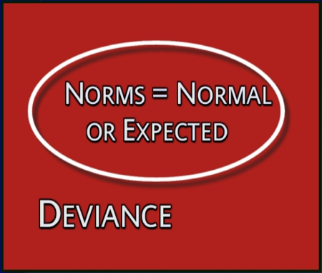
Concepts of Group Behavior Norms
Norms are acceptable standards or expectations that are accepted and shared by group members.
Most organizations have common norms, which typically focus on:
Effort and Performance
Dress Codes

Slide 10
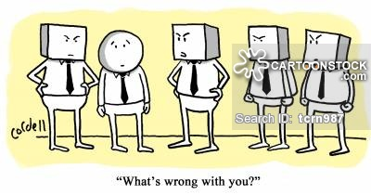
Concepts of Group Behavior Conformity
Conformity is adjusting one’s behavior to align with a group’s norms.
We all want to be accepted by groups to which we belong, which makes us susceptible to conformity pressures.

Slide 11
Concepts of Group Behavior Status Systems
Status System is a prestige grading, position, or rank within a group and an important factor in understanding behavior.
A disparity between what individuals perceive their status to be and what others perceive it to be is a significant motivator with behavioral consequences.
It’s important for people to believe there’s congruency and equity between perceived ranking of an individual and their status symbol.
Anything can have status value if others in the group admire it.

Slide 12
Concepts of Group Behavior Group Size
Group Size affects a group’s behavior, but the effect depends on what criteria you’re using.
Small Groups (5-7 Members) Better At:
Completing tasks faster
Figuring out what to do
Getting the job done.
Large Groups (12 or more Members) Better At:
Problem solving
Finding facts
Gaining diverse input

Slide 13
Concepts of Group Behavior Group Cohesiveness
Group Cohesiveness is the degree to which members are attracted to one another and share the group’s goals.
The more that members are attracted to one another and the more that a group’s goals align with individual goals, the greater the group’s cohesiveness.
Highly cohesive groups are more effective.

Slide 14
Teams
Research suggests that teams typically outperform individuals when the tasks being done require multiple skills, judgment, and experience.
Organizations are using team-based structures because they’ve found that teams are more flexible and responsive to changing events than are traditional departments or other permanent work groups.
Teams have the ability to quickly assemble, deploy, refocus, and disband.

Slide 15
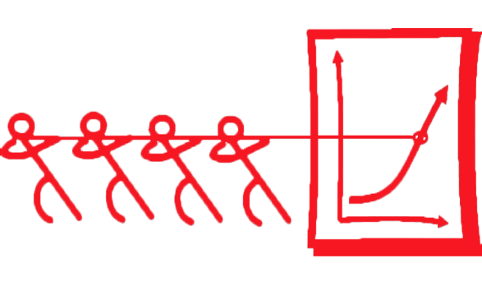
Teams
Teams differ from Groups.
Work Groups interact primarily to share information and to make decisions to help members do their job more efficiently/effectively.
Work Teams are groups whose members work intensely on a specific, common goal using their positive synergy, individual and mutual accountability, and complementary skills.
Managers are looking for that positive synergy that will help the organization improve its performance.

Slide 16
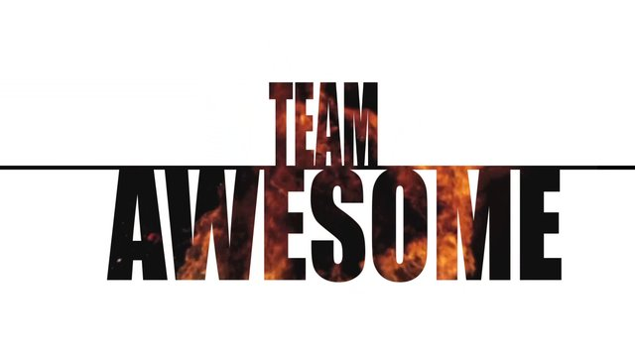
Team Effectiveness Four Key Components
1. Context
Adequate Resources
If a team does not have what it needs its ability to perform is limited.
Leadership and Structure
A team needs to agree on role responsibility and accountability.
Climate of Trust
Facilitates cooperation, reduces need to monitor each others’ behavior, and bonds members around the belief that others will not take advantage.
Performance Evaluation and Reward Systems
Members have to be accountable both individually and jointly.
Members and groups want to be rewarded.

Slide 17
Team Effectiveness Four Key Components
2. Composition
Knowledge, Skills, and Abilities of Members
To perform effectively, a team needs (1) technical expertise, (2) problem-solving and decision-making skills, and (3) interpersonal skills.
Personality
Three of the Big Five dimensions of personality are related to team effectiveness – conscientiousness, openness to experience, agreeableness.
Allocating Roles
Match member strengths with role responsibilities.
Diversity
Research shows that diversity can have a negative effect on team functioning.
Size of Teams
A team should be small enough that it can be fed with two pizzas!
Member Flexibility and Preferences
Some people prefer not to work on teams.

Slide 18
Team Effectiveness Four Key Components
3. Work Design
Important work design elements include: (1) autonomy, (2) using a variety of skills, (3) being able to complete an identifiable task, and (4) working on a task that has a significant impact on others.
Research indicates that these characteristics enhance team member motivation and increase team effectiveness.

Slide 19
Team Effectiveness Four Key Components
4. Process
Common Purpose
Provides direction, momentum, and commitment for team members.
Specific Goals
Facilitate clear communication and help maintain focus on getting results.
Team Efficacy
Emerges when teams believe in themselves and believe they can succeed.
Effective teams have confidence in themselves and in their members.
Conflict Levels
Effective teams need some task conflict.
However, relational conflict is dysfunctional.
Social Loafing
Teams are successful when all members contribute.

Slide 20
Shaping Team Behavior
A manager can do several things to shape a team’s behavior including proper selection, employee training, and rewarding the appropriate team behaviors.

Slide 21
Shaping Team Behavior
Few trends have influenced how work gets done in organizations as much as the use of work teams.
The shift from working alone to working on teams requires EE’s to cooperate with others, share information, confront differences, and sublimate personal interests for the greater good of the team
Managers can build effective teams by understanding what influences performance and satisfaction.

Slide 22
Current Issues
In global organizations, understanding the relationship between team effectiveness and team composition is more challenging because of the unique cultural characteristics represented by members of a global team.
In addition to recognizing team members’ abilities, skills, knowledge, and personality, managers need to be familiar with and clearly understand the cultural characteristics of the group and its members.

Slide 23
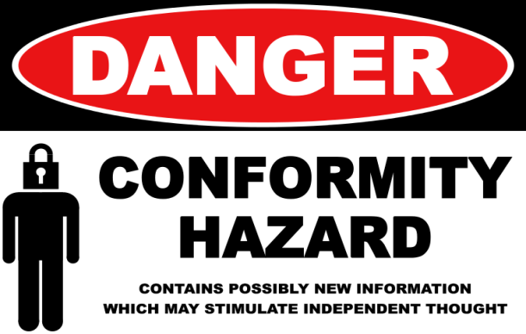
Current Issues
Some of the structural areas where we see differences in managing global teams include conformity, status, social loafing, and cohesiveness.
1. Conformity
Conformity to social norms tends to be higher in collectivist cultures than in individualistic cultures. However groupthink tends to be less of a problem in global teams because members are less likely to feel pressured to conform to ideas, conclusions, and decisions of group.

Slide 24
Current Issues
Some of the structural areas where we see differences in managing global teams include conformity, status, social loafing, and cohesiveness.
2. Status
The importance to status varies among cultures.
Managers must understand who and what holds status when interacting with people from a culture different than their own.

Slide 25
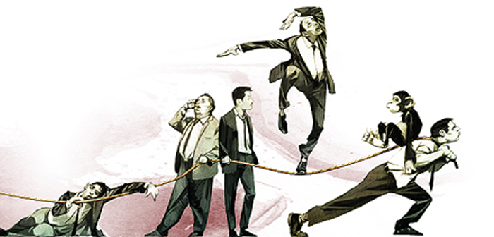
Current Issues
Some of the structural areas where we see differences in managing global teams include conformity, status, social loafing, and cohesiveness.
3. Social Loafing
Social loafing is consistent with individualistic cultures, which are dominated by self interest. It’s not consistent with collectivist societies, in which individuals are motivated by group goals.

Slide 26
Current Issues
Some of the structural areas where we see differences in managing global teams include conformity, status, social loafing, and cohesiveness.
4. Cohesiveness
In a cohesive group, members are unified and “act as one.”
There’s a great deal of camaraderie and group identity is high.
In global teams, however, cohesiveness is often more difficult to achieve because of higher levels of “mistrust, miscommunication, and stress.”

Slide 27
Global Teams
Communication issues often arise because not all team members may be fluent in the team’s working language, which can lead to inaccuracies, misunderstanding, and inefficiencies.

Slide 28
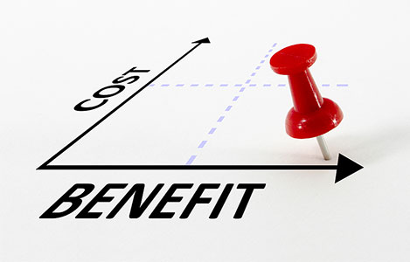
Teamwork
Teamwork takes more time and often more resources than does individual work.
So, the benefits of using teams need to exceed the costs.

Slide 29
Team Managers
Effective work team managers are being described as coaches rather than bosses. They’re expected to provide instruction, guidance, advice, and encouragement to help team members improve their job performance.
They need to:
Analyze ways to improve team performance.
Create a supportive climate.
Influence changed behavior

Slide 30
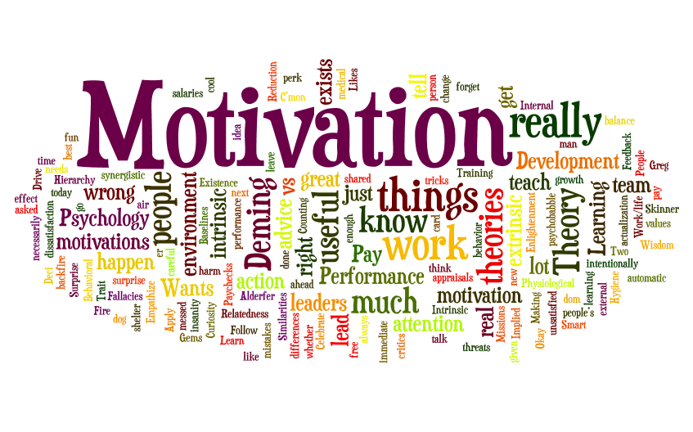
Part Four: Leading
Chapter Eleven: Motivating and Rewarding Employees
Define and explain motivation.
Compare and contrast early theories of motivation.
Compare and contrast contemporary theories of motivation.
Discuss current issues in motivating employees.

Slide 31
Motivation
To get employees to put forth maximum work effort, managers need to know how and why they are motivated.
The secret to being an effective motivator is understanding each individual’s unique needs.

Slide 32
Motivation
Motivation refers to the process by which a person’s efforts are energized, directed, and sustained toward attaining a goal.
The definition has three key elements:
Energy
A measure of channeled intensity or drive.
Direction
Effort directed toward and consistent with organizational goals.
Persistence
Putting forth continuous effort to achieve those goals.

Slide 33
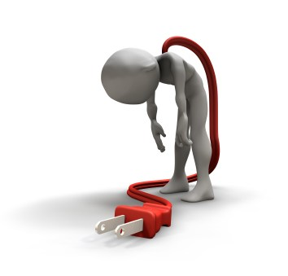
Motivation
Motivating high levels of employee performance is an important organizational concern and managers need to keep looking for answers.
A recent Gallup poll found that a large majority of U.S. employees – some 64 percent are not excited about their work.
“Employees are essentially ‘checked out.’ They’re sleepwalking through their workday, putting time, but not energy or passion, into their work.”

Slide 34
Maslow’s Hierarchy of Needs Theory
Abraham Maslow – a psychologist – proposed that within every person is a hierarchy of five needs: from the physiological to self-actualization
Each level must be substantially satisfied before the next becomes dominant; an individual moves up the hierarchy 0ne level to next.
Lower level needs are satisfied externally, while higher-level needs are satisfied internally.
Managers use this knowledge to satisfy EE’s needs.
Once a need is satisfied, it no longer motivates.

Slide 35
Maslow’s Hierarchy of Needs Theory

Slide 36
McGregor’s Theory X and Theory Y
Based on two assumptions about human nature:
Theory X
A negative view of people that assumes workers have little ambition, dislike work, want to avoid responsibility, and need to be closely controlled to work effectively.
Theory Y
A positive view that assumes employees enjoy work, seek out and accept responsibility, and exercise self-direction.
To maximize EE motivation, use Theory Y practices – Allow EE’s to participate in decisions, create responsible and challenging jobs, and encourage good group relations.

Slide 37
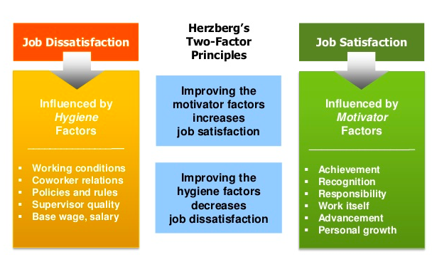
Herzberg’s Two-Factor Theory Motivation-Hygiene Theory
According to Herzberg’s Two-Factor Theory: Intrinsic Factors (Motivators)are related to job satisfaction, while Extrinsic Factors (Hygienes) are associated with job dissatisfaction.

Slide 38
McClelland’s Three-Needs Theory
According to McClelland’s Three-Needs Theory, The following three acquired (not innate) needs are major motives in work:
Need for Achievement
The drive to succeed and excel in relation to a set of standards.
Need for Power
The need to make others behave in a way that they would not have behaved otherwise.
Need for Affiliation
The desire for friendly and close interpersonal relationships.
The best managers tend to be high in need for power, and low in need for affiliation.

Slide 39
Goal-Setting Theory
According to Goal-Setting Theory, specific goals increase performance and difficult goals, when accepted, result in higher performance than do easy goals.
Performance is often higher when EE’s participate in setting goals.
Performance is also higher when EE’s receive feedback on progress.

Slide 40
Goal-Setting Theory
Three other contingencies besides feedback influence the goal-performance relationship:
Goal Commitment
An internal locus of control and participation in goal-setting.
Adequate Self-Efficacy
An individual’s belief that they are capable of performing a task.
National Culture
Americans assume subordinates will be reasonably independent, people will seek challenging goals, and performance is considered important by both managers and subordinates.

Slide 41
Job Design
Managers should design jobs deliberately and thoughtfully to reflect the demands of the changing environment, the organization’s technology, and EE’s skills, abilities, and preferences.
When jobs are designed like that EE’s are motivated to work hard.

Slide 42
Job Design
According to Hackman and Oldman, any job can be described in terms of the following five core job dimensions:
1. Skill Variety
Degree to which the job requires a variety of activities so the worker can use a number of different skills and talents.
2. Task Identity
Degree to which the job requires completion of a whole and identifiable piece of work.
3. Task Significance
Degree to which the job affects the lives or work of other people.

Slide 43
Job Design
According to Hackman and Oldman, any job can be described in terms of the following five core job dimensions:
4. Autonomy
Degree to which the job provides freedom, independence, and discretion to the individual in scheduling the work and in determining the procedures to be used in carrying it out.
5. Feedback
Degree to which carrying out the work activities required by the job results in the individual obtaining direct and clear information about the effectiveness of one’s performance.

Slide 44
Equity Theory
Equity Theory, developed by J. Stacey Adams, proposes that EE’s compare what they get from a job (outcomes) in relation to what they put into it (inputs) and then compare their input-outcome ratio with those of relevant others.
If the ratio is inequitable, whether under-rewarded or over-rewarded, the EE will attempt to do something about it.
The result might be lower or higher productivity, improved or reduced quality of output, increased absenteeism, or voluntary resignation.

Slide 45
Equity Theory
The referent – the other persons, systems, or selves individuals compare themselves against in order to see equity – is an important variable.
The “persons” category includes other individuals with similar jobs in the same organization but also includes friends, neighbors, or professional associates.
The “system” category includes organizational pay policies, procedures, and allocation.
The “self” category refers to input-outcome ratios that are unique to the individual.

Slide 46
Equity Theory
Originally Equity Theory focused on Distributive Justice, which is the perceived fairness of the amount and allocation of rewards among individuals.
Most recent research has focused on looking at issues of Procedural Justice, which is the perceived fairness of the process used to determine the distribution of rewards.
By increasing the perception of procedural justice, EE’s are likely to view their bosses and the organization as positive even if they’re dissatisfied with pay, promotions, and other personal outcomes.

Slide 47
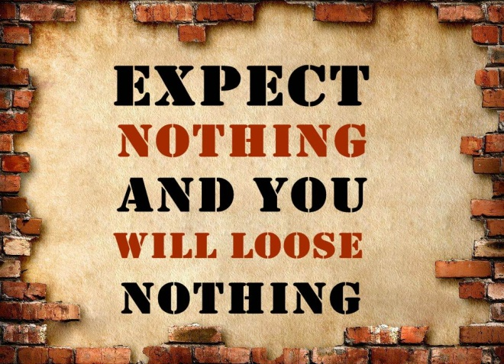
Expectancy Theory
Victor Vroom’s Expectancy Theory states than an individual tends to act in a certain way based on the expectation that the act will be followed by a given outcome and on the attractiveness of that outcome to the individual.
It includes three variables or relationships:
Expectancy – Instrumentality – Valence

Slide 48
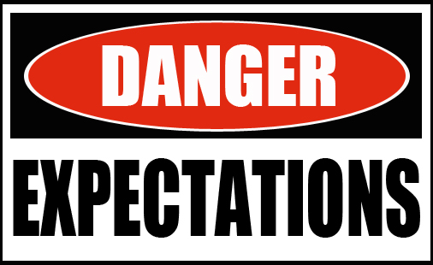
Expectancy Theory
Expectancy or Effort-Performance Linkage
The probability perceived by the individual that exerting a given amount of effort will lead to a certain level of performance.
Instrumentality or Performance-Reward Linkage
The degree to which the individual believes that performing at a particular level is instrumental in attaining the desired outcome.
Valence or Attractiveness of Reward
The importance that the individual places on the potential outcome or reward that can be achieved on the job. It considers both the goals and needs of the individual.

Slide 49
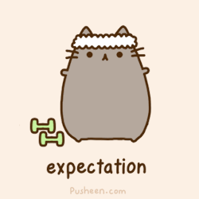
Expectancy Theory
The key to Expectancy Theory is understanding an individual’s goal and the linkage between effort and performance, between performance and rewards, and finally, between rewards and individual goal satisfaction.
Managers should align EE awards with their individual needs.
Managers must recognize that no universal principle explains what motivates individuals, and they must understand why EE’s view certain outcomes as attractive or unattractive.

Slide 50
Rewards Programs
Employee rewards programs play a powerful role in motivating appropriate EE behavior.
1. Open-Book Management
A motivational approach in which an organization’s financial statements are shared with all EE’s as they participate in workplace decisions.
Used to motivate EE’s to make better decisions about their work, be better able to understand the implications of what they do and how they do it, and see the ultimate impact on the bottom line.
By sharing this information, EE’s begin too see the link between their efforts, level of performance, and operational results.

Slide 51
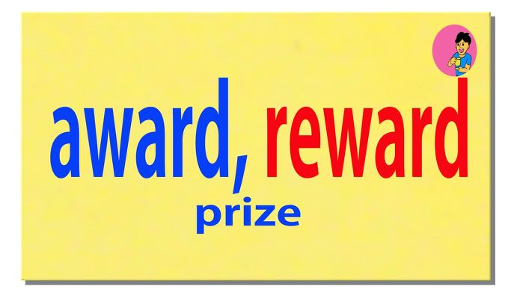
Rewards Programs
Employee rewards programs play a powerful role in motivating appropriate EE behavior.
2. Employee Recognition
Programs that consist of personal attention and expressions of interest, approval, and appreciation for a job well done.
Recognition is the most powerful workplace motivator.
But, recognition doesn’t have to come from managers alone.

Slide 52
Rewards Programs
Employee rewards programs play a powerful role in motivating appropriate EE behavior.
3. Pay-for-Performance
PFP programs are variable compensation plans that pay EE’s on the basis of some performance measure.
Performance measures might include such things as individual productivity, team or work group productivity, departmental productivity, or the overall organization’s profit performance.
Making some or all of an EE’s pay conditional on some performance measure focuses his or her attention and effort toward that measure, then reinforces the continuation of the effort with a reward.

Slide 53
Rewards Programs
It’s hard to keep EE’s productive during challenging times, even though it’s especially critical.
The key with any rewards program is continuing to show EE’s that the company cares about them.
The value in companies comes from EE’s who are motivated to be there, and managers have to give EE’s a reason to want to be there.

