Slide 1

Entrepreneurship
Class Presentation SUMM Consolidate. Session 5
Entrepreneurship
  Theory, Process, Practice -12th Edition
    Donald F. Kuratko, Cengage Learning, Boston, MA 2024
      ISBN: 978-0-357-89950-2

Slide 2
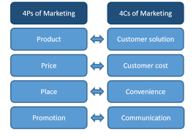
The New Marketing Concept for Entrepreneurs
Modern Marketing Shifts from the Traditional 4Ps to the 4Cs.
  Product = Co-Created with Customers
  Promotion = Communities
  Price = Customizable
  Place = Choice
    Customers Now Drive Decisions, Especially in the Digital Era (Generation C: Connected, Creative, Collaborative)
      Marketing is No Longer Company-Controlled, it is Customer-Centered.

Slide 3
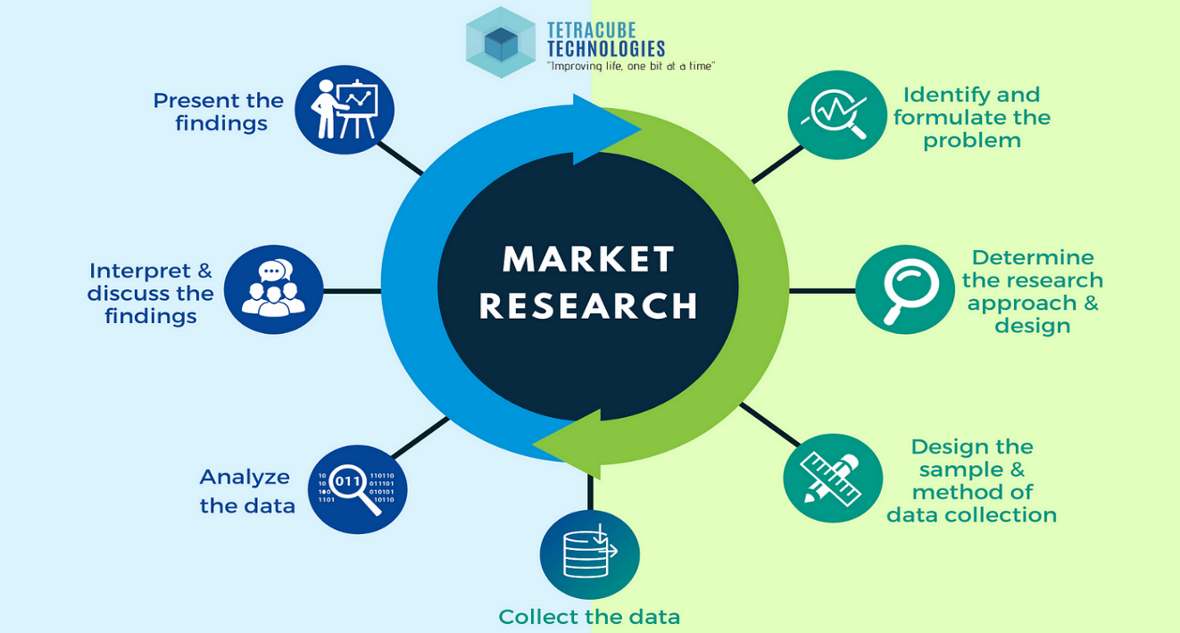
Importance of Marketing Research
Marketing Research Helps Entrepreneurs:
  Understand Customer Needs
  Evaluate Competitors
  Estimate Market Size
  Test Product Ideas
  Improve Positioning

Slide 4

Importance of Marketing Research
Types of Research:
  Secondary Data
    Already Available Information (Reports, Databases, Internal Records)
  Primary Data
    Newly Collected Information through Surveys, Interviews, Observation, and Experiments
      Quantitative Research = Numbers and Statistics
      Qualitative Research = Opinions and Insights

Slide 5
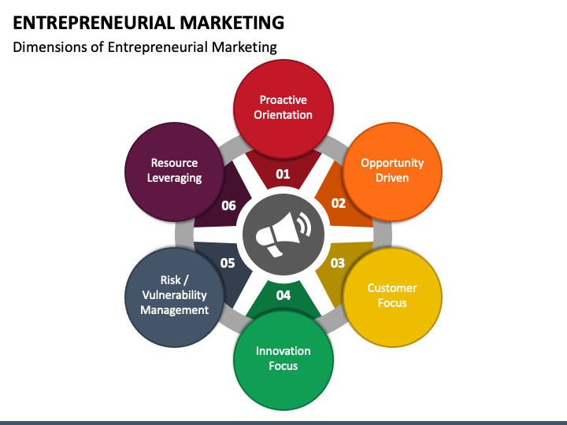
Common Traits of Strong Entrepreneurial Marketers
Successful Entrepreneurial Marketers:
  Spot Hidden Opportunities
  Challenge Assumptions
  Take Calculated Risks
  Stay Competitive
  Adapt Quickly
  Focus on Efficiency and Innovation
  Maintain Long-Term Vision

Slide 6
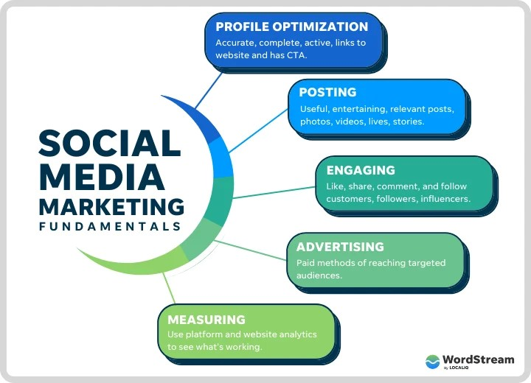
Social Media Marketing
Social Media Marketing is about Conversation, Engagement, and Trust, Not Just Advertising.
  Three Essentials:
    Create Shareable Content
    Let Customers Promote Messages
    Encourage Interaction and Dialogue

Slide 7

Social Media Marketing
Social Media Marketing Differs from Traditional Marketing Because:
  Customers Help Shape Brand Messaging
  Communication is Two-Way
  Authenticity Builds Trust

Slide 8

Mobile Marketing
Mobile Marketing Allows Businesses to Reach Customers Anytime, Anywhere.
  Kaplan’s 4Is Strategy:
    Integrate Marketing into Daily User Activity
    Individualize Messages
    Involve Customers Interactively
    Initiate User-Generated Content

Slide 9

Entrepreneurial Marketing vs. Traditional Marketing
Traditional Marketing:
  Reactive
  Structured
  Resource-Based
  Risk-Reducing
Entrepreneurial Marketing:
  Proactive
  Innovative
  Opportunity-Driven
  Resource-Leveraging
  Customer-Collaborative

Slide 10
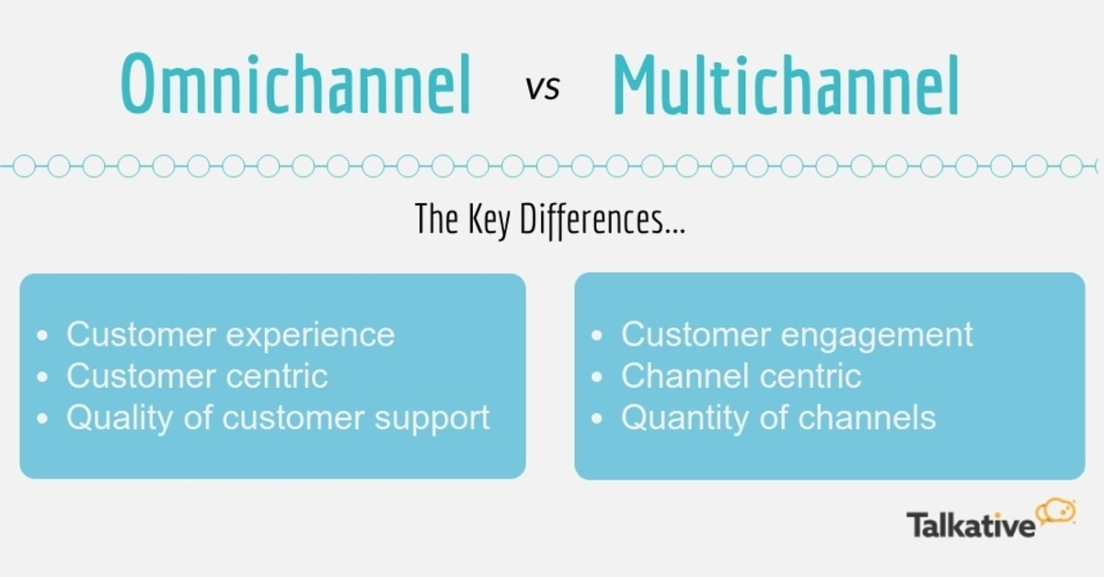
Omnichannel vs. Multichannel Marketing
Multichannel
  Separate Platforms, Brand-Centered
Omnichannel
  Integrated Platforms, Customer-Centered
    Improves Loyalty, Engagement, and Retention Rates

Slide 11

Components of Effective Marketing
Four Pillars:
  Marketing Philosophy
    Options: Product-Driven, Sales-Driven, Consumer-Driven
  Market Segmentation
    Divide Customers by: Demographics, Benefits Sought, Behaviors, and/or Geography
  Consumer Behavior
    Modern Customers: Research Online, Compare Brands, Expect Convenience, Value Community, and Trust Peer Options
  Distribution Channels
    Options: Direct (Manufacturer to Customer), Indirect (Retailers/Distributors), Hybrid (Combination)

Slide 12

Marketing Plan Structure
A Strong Marketing Plan Includes:
  Market Research
  Sales Analysis
  Marketing Information Systems
  Sales Forecasting
  Evaluation Processes
    Create a Structured Path for Attracting and Keeping Customers

Slide 13

Guerrilla Marketing Plan
Quick Strategy Tool
Seven Key Elements:
  Marketing Purpose
  Competitive Advantage
  Target Audience
  Marketing Tools
  Market Niche
  Brand Identity
  Marketing Budget
    Useful for Pitching Ideas Quickly

Slide 14
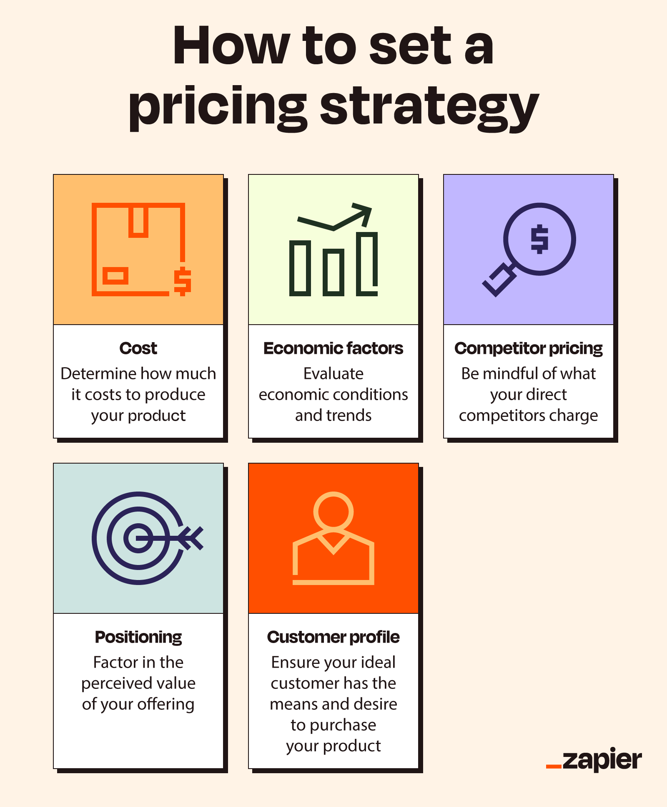
Pricing Strategies
Pricing Depends On:
  Competition
  Demand
  Costs
  Lifecycle Stage
  Customer Perception

Slide 15
Pricing Strategies
Lifecycle Pricing Examples:
Stage | Strategy
Launch | Skimming Pricing
Entry Competition | Penetration Pricing
Growth | Consumer Pricing
Maturity | Demand-Based Pricing
Decline | Loss-Leader Pricing

Slide 16

Digital Revenue Models
Common Startup Pricing Approaches:
  Freemium
  Subscription
  Affiliate
  Advertising
  Virtual Goods

Slide 17

Understanding of Curriculum
Modern Entrepreneurial Marketing is Customer-Driven, Research-Based, Digital-Focused, and Adaptive.
  Instead of Pushing Products to Customers, Entrepreneurs Must:
    Listen First
    Test Ideas Early
    Personalize Experiences
    Engage Communities
    Build Long-Term Relationships
      Marketing Today is Not Just Promotion – It Is Strategy, Innovation, and Communication Combined.

Slide 18
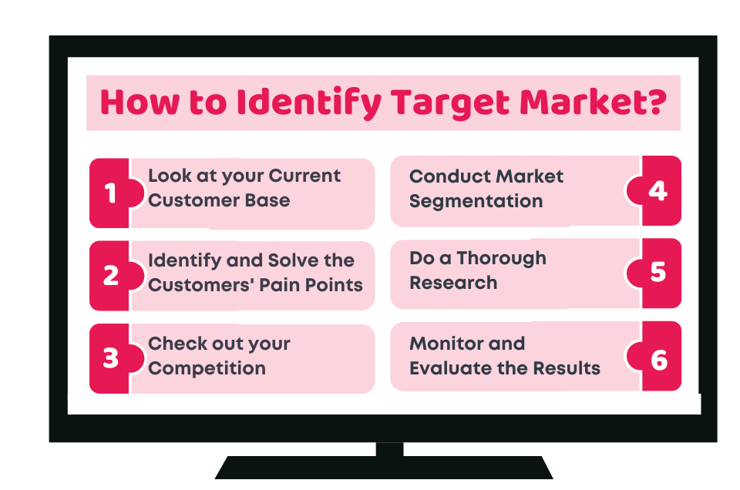
Practical Application
Step 1: Identify Your Market
  Instead of Saying: “I want to Sell Fitness Gear,” Say: “I Want to Sell Eco-Friendly Resistance Bands to College Students Who Work Out at Home.”
    That’s Segmentation.

Slide 19

Practical Application
Step 2: Run Basic Market Research
  Use Google Trends, Instagram Polls, Competitor Reviews, and Online Surveys. Example Questions:
    Where Do Customers Buy Similar Products?
    What Price Do They Expect?
    What Problems Do They Face?

Slide 20
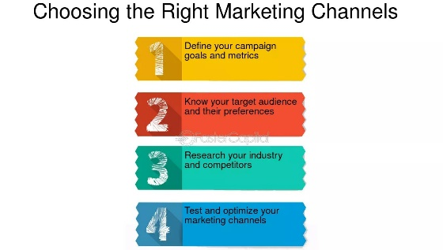
Practical Application
Step 3: Choose the Right Channels
  Example Strategies:
Business Type | Best Channel
Clothing Brand | Instagram and TikTok
Consulting Service | LinkedIn
Gaming Product | Discord and YouTube

Slide 21
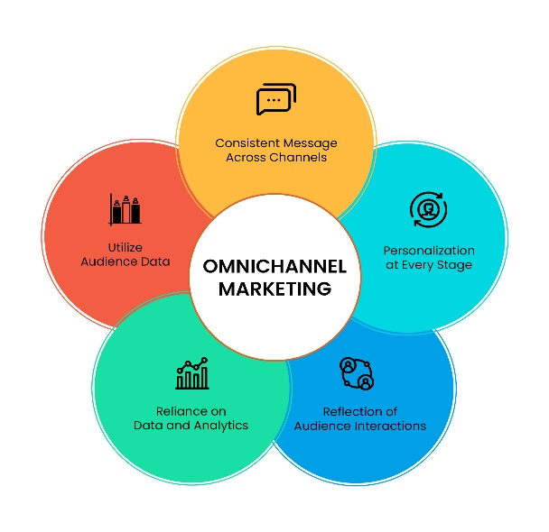
Practical Application
Step 4: Apply Omnichannel Marketing
  Customer Sees:
    TikTok Demo
    Instagram Review
    Website Discount
    Email Reminder
      All Connected Messaging = Stronger Conversion

Slide 22
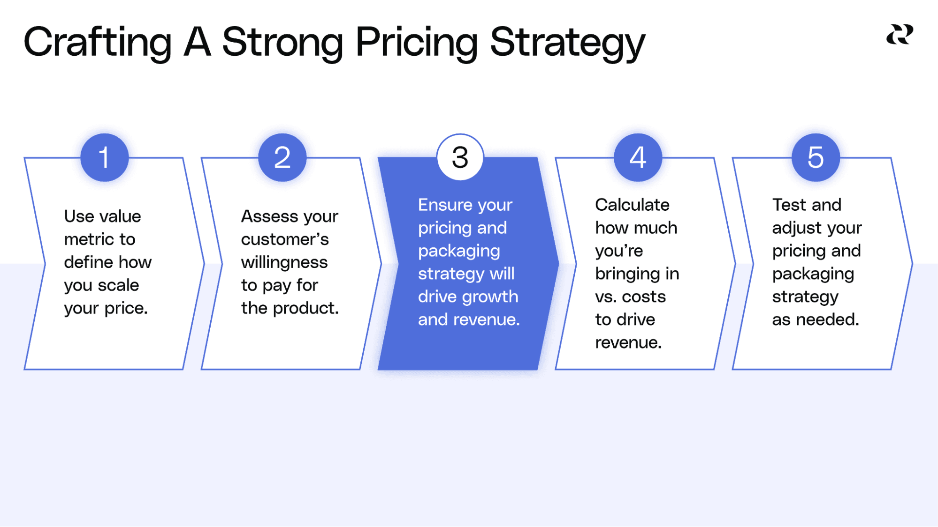
Practical Application
Step 5: Select a Pricing Strategy
  New Tech Application = Freemium
  Luxury Brand = Premium Pricing
  New Snack Product = Penetration Pricing
    Pricing Communicates Value

Slide 23

Practical Application
Step 6: Use Guerilla Marketing
  Low Budget Tactics:
    Campus Demos
    Social Media Giveaways
    Influencer Micro-Partnerships
    Referral Bonuses
      High Impact, Low Cost

Slide 24

Final Takeaway
Successful Entrepreneurs Don’t Just Sell Products:
  They Build Relationships, Gather Insights, Adapt Quickly, and Let Customers Help Shape the Business.

Slide 25

Financial Preparation for Entrepreneurial Ventures
This Curriculum Explains How Entrepreneurs Plan, Measure, and Control Business Finances Using Financial Statements, Budgeting Tools, Investment Evaluation Methods, and Performance Ratios.
  Financial Information Connects All Areas of a Business – (1) Marketing, (2) Operations, and (3) Management – and supports Decision-Making and Investor Confidence.

Slide 26

Financial Preparation for Entrepreneurial Ventures
The Chapter Focuses On:
  Financial Statements
  Budgeting and Forecasting
  Pro Forma Projections
  Capital Budgeting
  Break-Even Analysis
  Ratio Analysis
    Together, These Tools Help Entrepreneurs Evaluate Feasibility, Monitor Performance, and Guide Growth Decisions.

Slide 27

Understanding the Key Financial Statements
Entrepreneurs Rely on Three Core Financial Statements:
  Balance Sheet
    Financial Position Snapshot
  Income Statement
    Profitability Report
  Cash-Flow Statement
    Liquidity Tracker

Slide 28

Understanding the Key Financial Statements
Balance Sheet (Financial Position Snapshot)
  Assets
    What the Business Owns
  Liabilities
    What the Business Owes
  Owner’s Equity
    What Remains
      Assets = Liabilities + Owner’s Equity

Slide 29

Understanding the Key Financial Statements
Entrepreneurs Use a Balance Sheet To:
  Evaluate Business Solvency
  Understand Debt Levels
  Prepare Loan Applications
  Track Growth in Assets Over Time
    A startup reviewing whether it can afford equipment financing checks if current assets exceed current liabilities before borrowing.

Slide 30
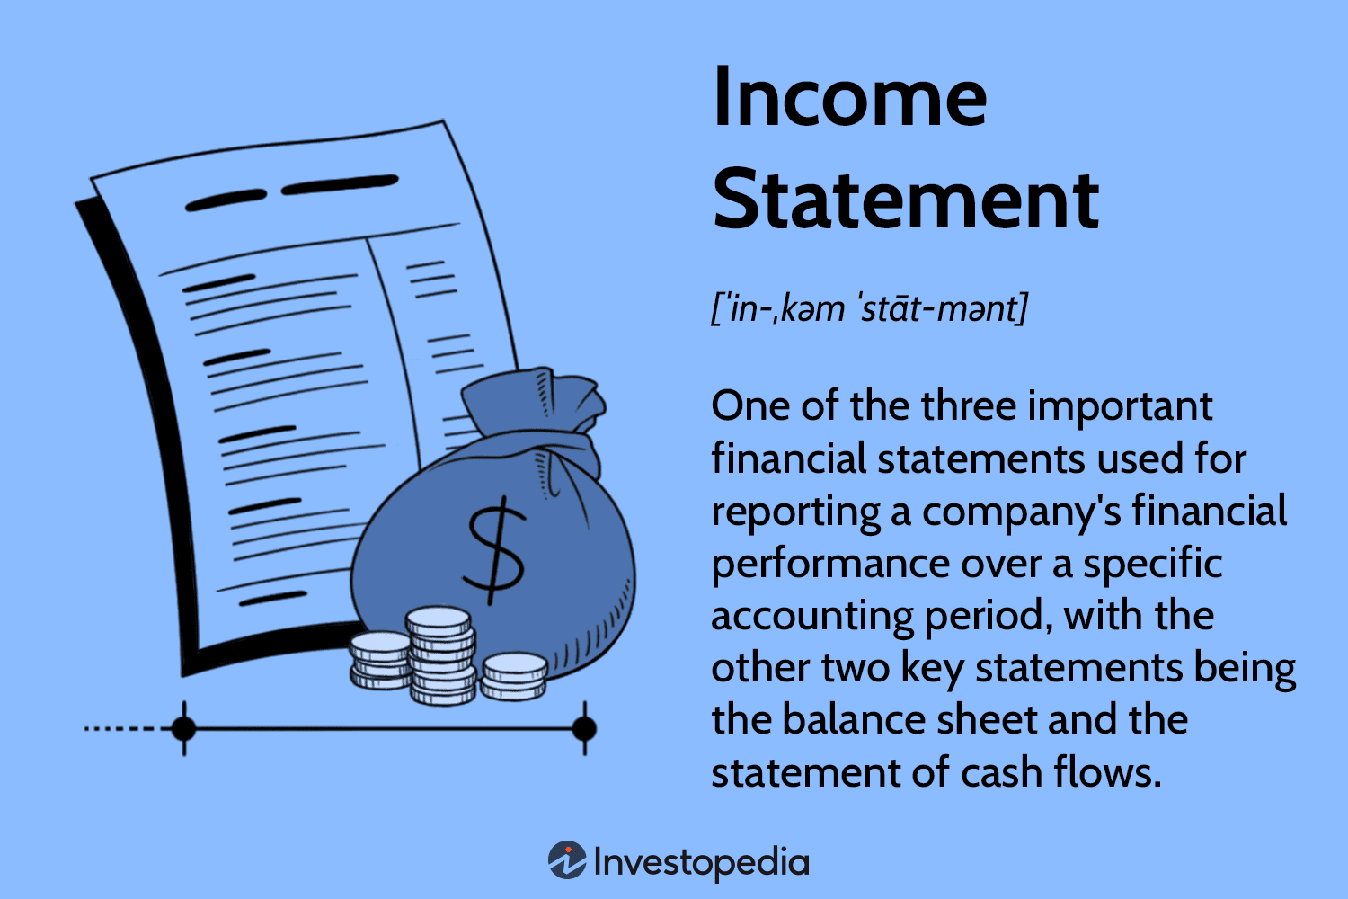
Understanding the Key Financial Statements
Income Statement (Profitability Report)
  Shows:
    Revenue
    Expenses
    Net Profit or Loss

Slide 31
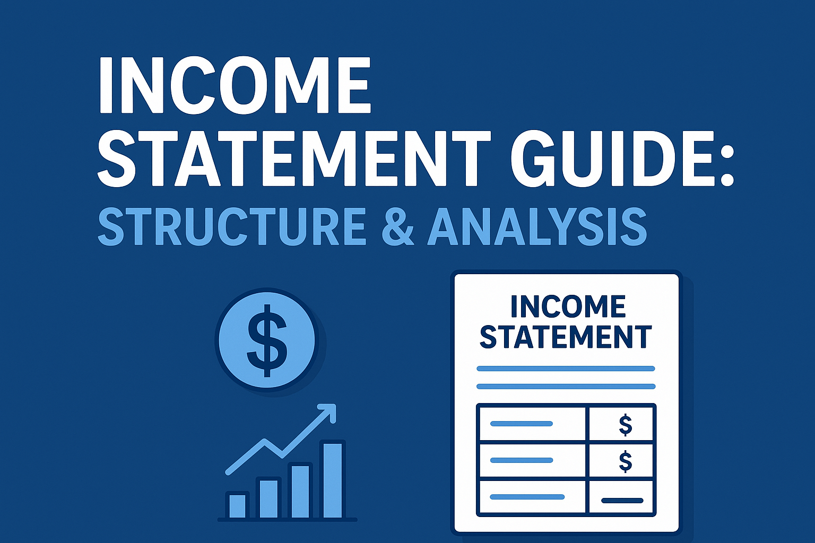
Understanding the Key Financial Statements
Entrepreneurs Use Income Statements To:
  Measure Profitability
  Set Pricing Strategy
  Control Operating Expenses
  Evaluate Business Performance Monthly or Quarterly
    If sales increase but profit falls, owner investigates rising costs.

Slide 32

Understanding the Key Financial Statements
Cash-Flow Statement (Liquidity Tracker)
  Tracks Actual Cash Movement:
    Operating Activities
    Investing Activities
    Financing Activities
      Critical for startups because businesses fail from cash shortages, not lack of profit. (A company profitable on paper still needs loans if customers pay late).

Slide 33
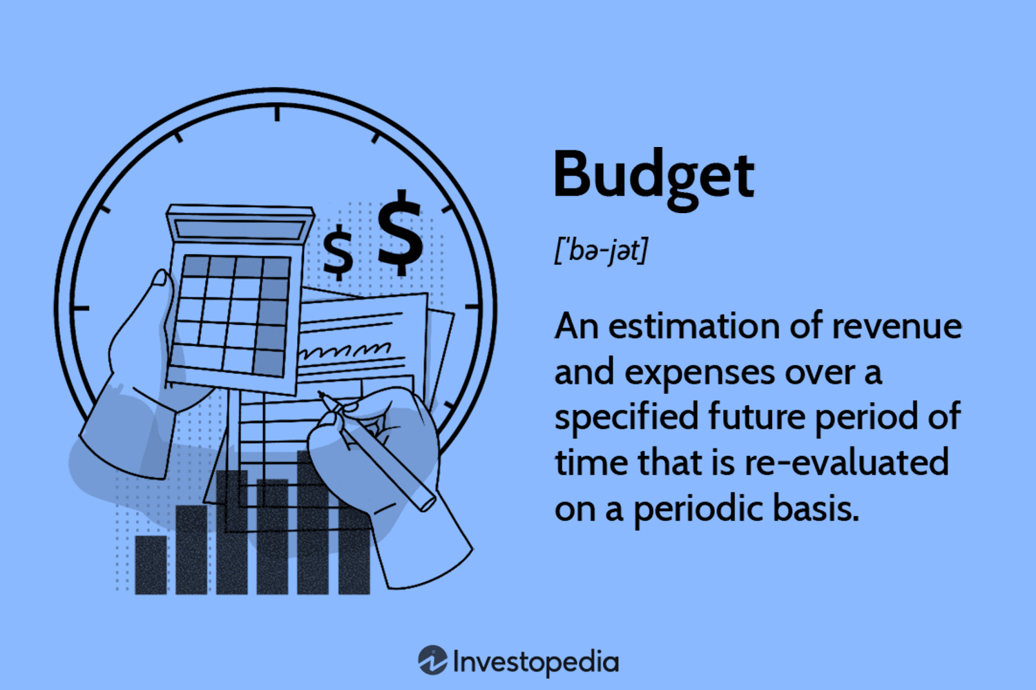
Budgeting as a Panning Tool
Budgets Forecast Future Financial Performance.
  Three Major Types:
    Operating Budget
    Cash-Flow Budget
    Capital Budget

Slide 34

Budgeting as a Panning Tool
Operating Budget
  Estimates: Sales, Cost of Goods Sold, Expenses, and Profit.
    Helps Entrepreneurs: Set Revenue Targets, Plan Staffing Levels, and Control Spending.
      Retailers forecast seasonal sales before holiday inventory purchases.

Slide 35
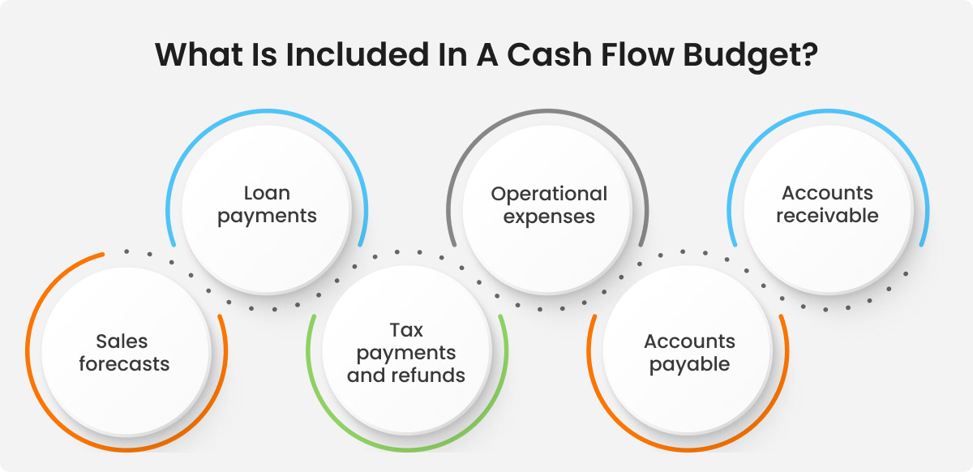
Budgeting as a Panning Tool
Cash Flow Budget
  Predicts: Cash Inflows, Cash Outflows, and Financing Needs.
    Prevents Liquidity Crises.
      A construction firm schedules loan draws before payroll deadlines.

Slide 36
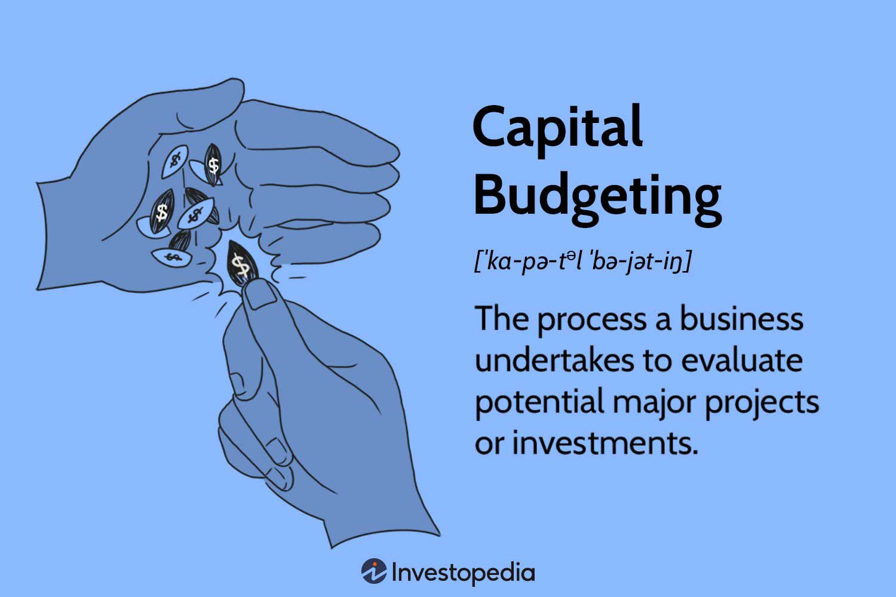
Budgeting as a Panning Tool
Capital Budget
  Plans Investments Lasting Longer Than One Year.
    Examples: Equipment, Buildings, and Technology Upgrades.
      Supports Long-Term Strategic Decisions.

Slide 37


Sales Forecasting Techniques
Entrepreneurs Estimate Future Revenue Using:
  Linear Regression Forecast
    Sales Depend on Advertising Spending
    Helps Predict ROI on Advertising Spending
      S = $200,000 + 2A
  Trend Analysis Forecast
    Uses Historical Data Patterns to Estimate Future Growth
    Useful for Businesses with Multiple Years of Sales History

Slide 38

Pro Forma Financial Statements
Future Projections
Pro Forma Statements Estimate Future Performance:
  Pro Forma Income Statement = Future Profit
  Pro Forma Balance Sheet = Future Financial Position
    Required for: Business Plans, Investor Presentations, Loan Applications, and Expansion Planning.
      A startup predicts 3-year revenue growth before seeking venture funding.

Slide 39

Capital Budgeting
Evaluating Investments
Used to Decide Whether Long-Term Investments are Worthwhile.
  Three Methods:
    Payback Period
    Net Present Value
    Internal Rate of Return

Slide 40
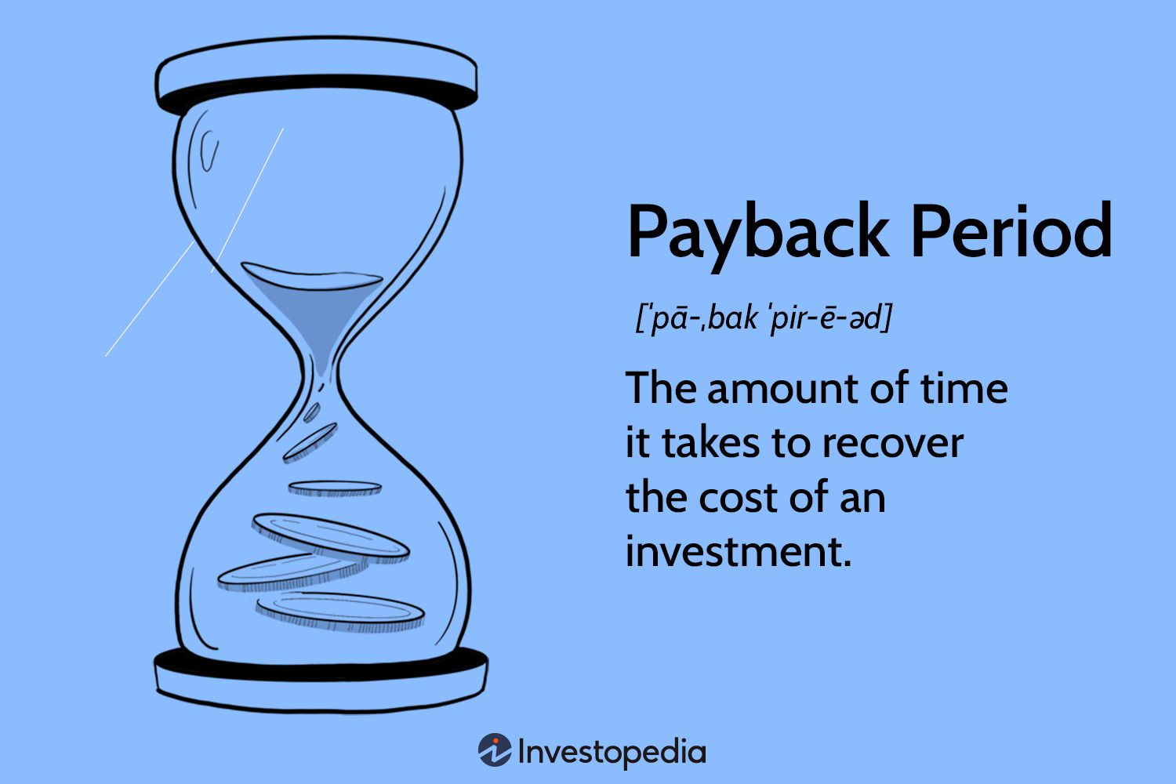
Capital Budgeting
Payback Period
  Measures How Quickly Investment is Recovered.
    Best for: Short-Term Liquidity Concerns
      Limitation: Ignores Long-Term Returns

Slide 41
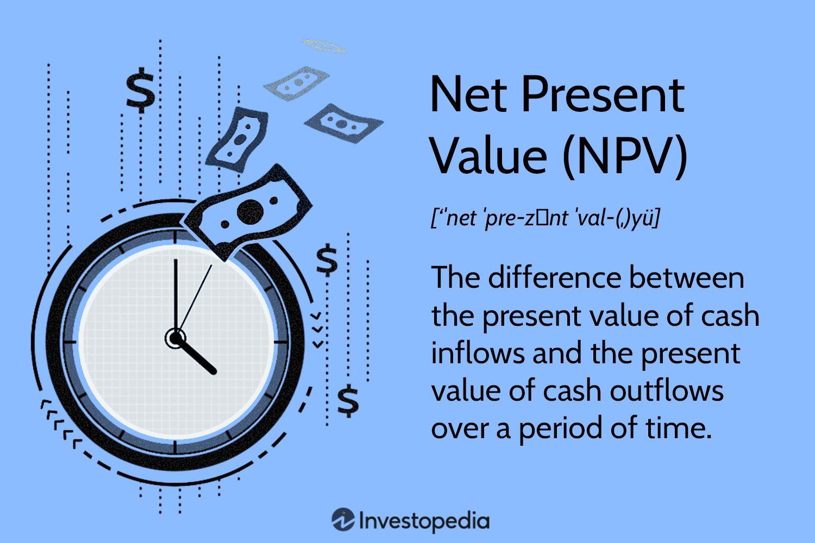
Capital Budgeting
Net Present Value (NPV)
  Accounts for Time Value of Money
  Accept Projects with Highest Positive NPV
    Used When Comparing Expansion Options
      Opening a Second Location vs. Upgrading Machinery

Slide 42

Capital Budgeting
Internal Rate of Return (IRR)
  Finds the Discount Rate Where NPV = 0
  Select Highest IRR Project
    Common in Venture Capital and Corporate Investment Decisions.

Slide 43
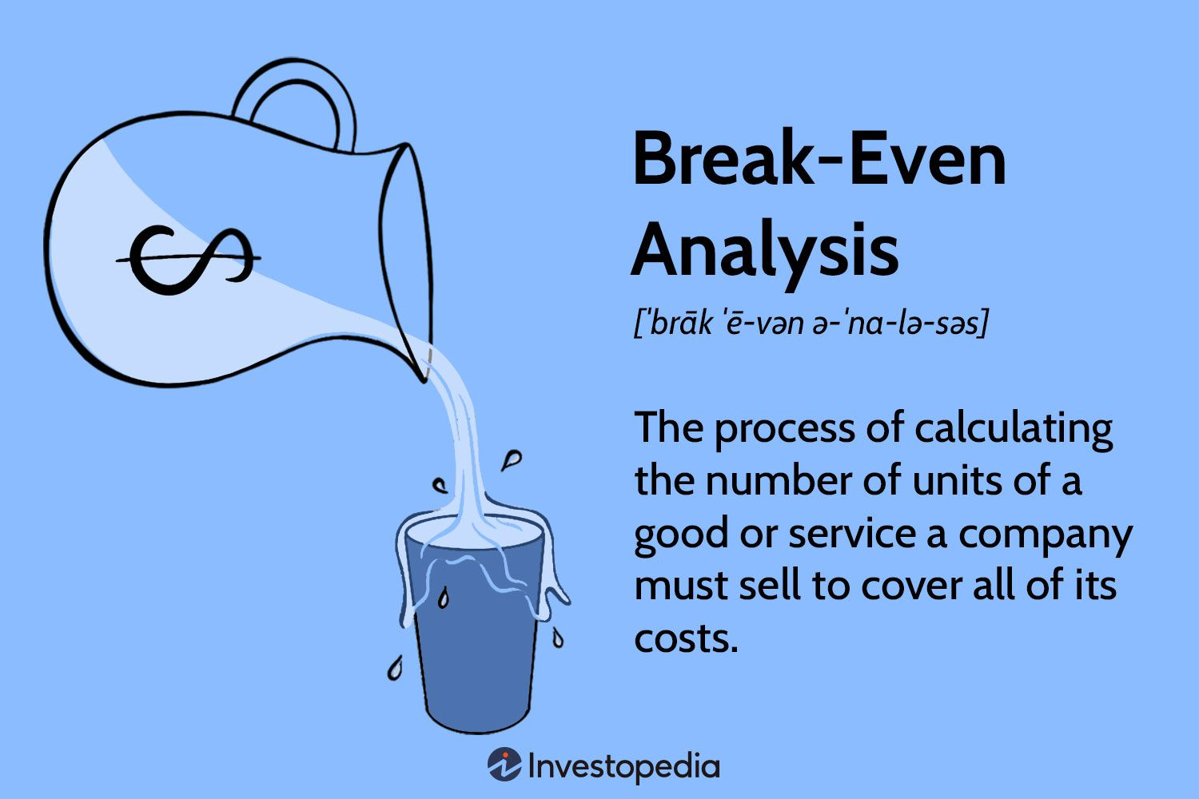
Break-Even Analysis
Profit Planning Tool
Determines How Many Units Must be Sold to Cover Costs.
  Fixed Costs = (Selling Price – Variable Cost) x Units Sold
    Helps Entrepreneurs: Set Pricing, Estimate Minimum Sales Targets, and Evaluate Product Viability.
      A café calculates how many drinks per day must be sold to avoid losses.

Slide 44
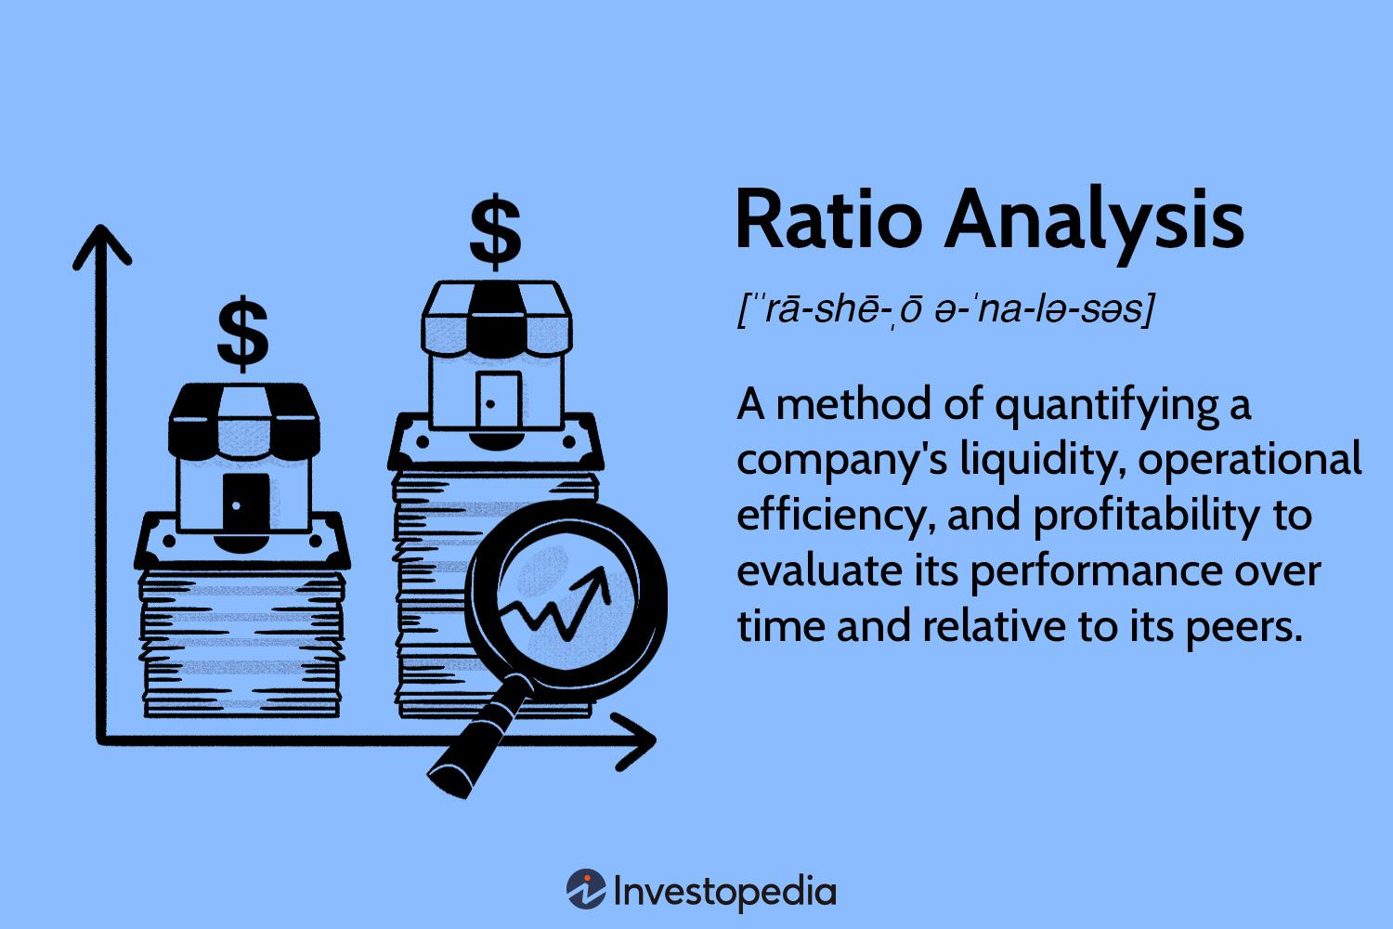
Ratio Analysis
Performance Measurement
Ratios Help Interpret Financial Statements.
  Three Categories:
    Liquidity Ratios (Short-Term Stability)
    Profitability Ratios
    Efficiency Ratios

Slide 45

Ratio Analysis
Liquidity Ratios (Short-Term Stability)
  Current Ratio
  Quick Ratio
  Cash Ratio
    Determine Ability to Pay Short-Term Debts
      Banks check liquidity before approving loans.

Slide 46
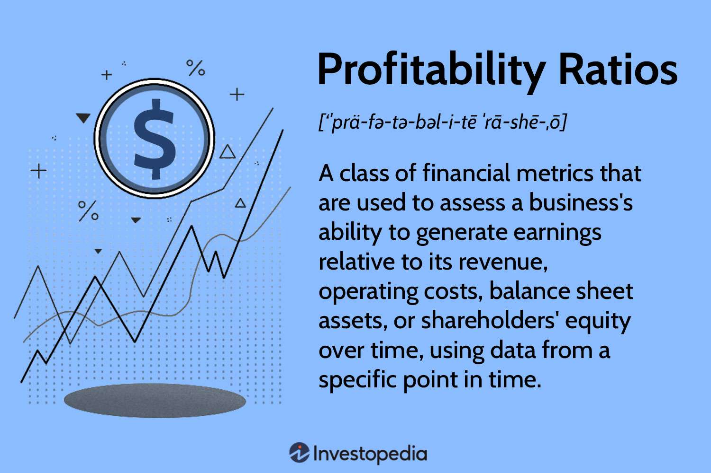
Ratio Analysis
Profitability Ratios
  Gross Margin
  Net Margin
    Measures Efficiency of Operations
      Retailers compare margins across product lines.

Slide 47
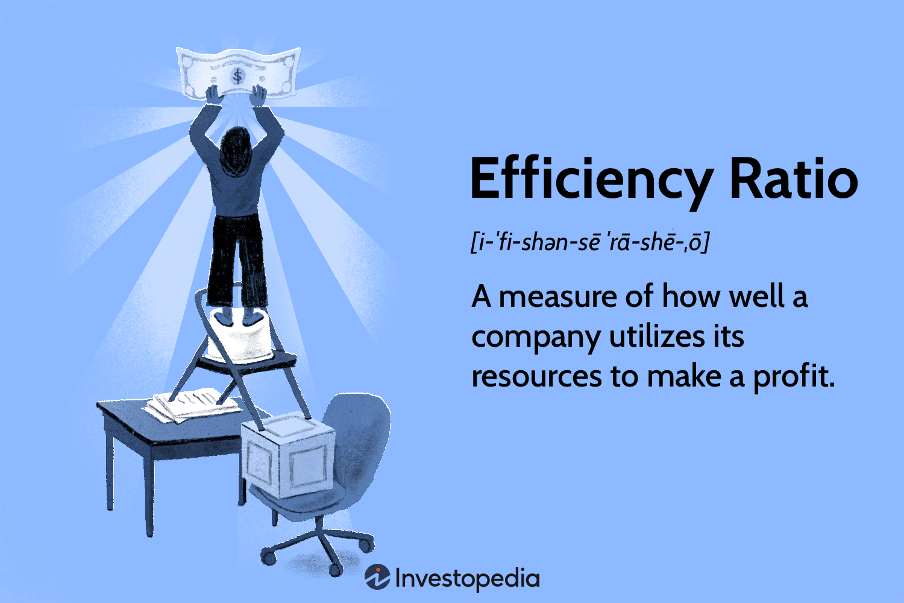
Ratio Analysis
Efficiency Ratios
  Inventory Turnover
  Accounts Receivable Turnover
  Return On Assets (ROA)
  Return On Investment (ROI)
    Evaluates How Effectively Resources Generate Income.
      Slow inventory turnover signals overstocking.

Slide 48


Characteristics of Credible Financial Statements
Strong Entrepreneurial Financials Are:
  Holistic
    Complete
  Precise
    Clear Categories
  Realistic
    Market-Based Assumptions
  Simple
    Easy to Interpret
  Accurate
    Detail-Verified
      These Increase Investor Confidence.

Slide 49
How Entrepreneurs Apply This Curriculum in Practice
Here’s How Everything Connects in Real Business Decisions:
Tool | Decision Supported
Balance Sheet | Can We Afford Debt?
Income Statement | Are We Profitable?
Cash-Flow Statement | Can We Survive Short-Term?
Operating Budget | What Should We Spend?
Cash Budget | When Do We Need Financing?
Pro Forma Statements | Is Expansion Realistic?
Break-Even Analysis | How Much Must We Sell?
Ratio Analysis | Are We Improving or Declining?
NPV/IRR | Which Investment is Best?

Slide 50

Key Takeaway
Financial Preparation is Not Just Accounting – It Is Strategic Decision-Making.
  Entrepreneurs Use Financial Tools To:
    Forecast Growth
    Control Risk
    Secure Funding
    Evaluate Investments
    Set Pricing
    Monitor Performance
    Plan Expansion
      Financial Literacy Turns Ideas Into Sustainable Businesses.

Slide 51


