Slide 1
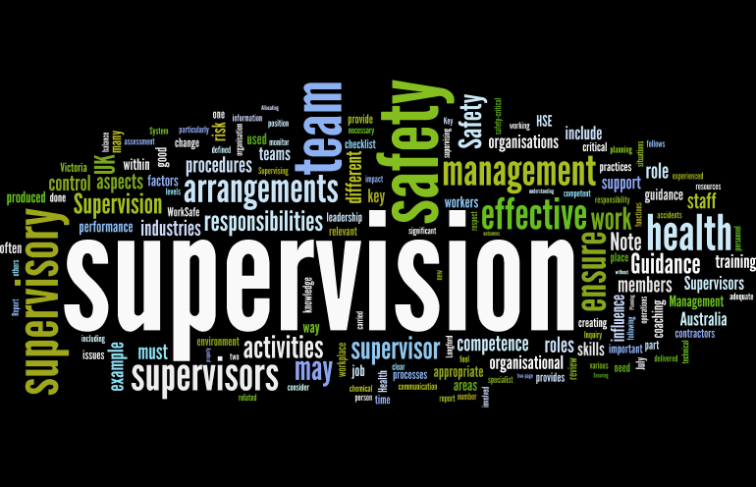
Supervision
Supervision
  Concepts and Practices of Management, 13th Edition
    Edwin C. Leonard, Jr., Ph.D. and Kelly A. Trusty, Ph.D. Cengage Learning, Boston, MA 2013
      ISBN: 978-1-285-86637-6

Slide 2

Part One: Supervisory Management Overview and Challenges
Chapter One: The Supervisory Challenge
  After studying this chapter you will be able to:
    Understand that we are in difficult times.
    Explain the demands and rewards of being a supervisor.
    Describe the contributions of four schools of management thought.
    Identify the economic, demographic, political, and social trends that will affect supervisors.
    Explain why supervisors must continually grow and develop as professionals.
    Recognize ways for getting into a supervisory position.

Slide 3
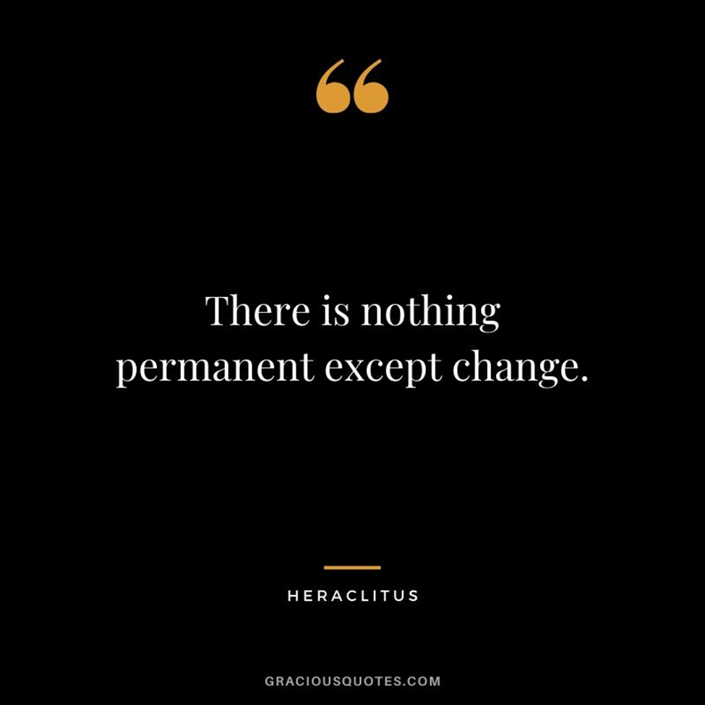
Difficult Times
What does it mean to be a supervisor in uncertain times?
  These recent years have been chaotic, uncertain, and unpredictable. Virtually every aspect of contemporary life has undergone major changes These have certainly been times that try men’s souls.
    There is little doubt that major changes will continue to take place in our society during the coming years, and continuing change will challenge every person in every organization.

Slide 4

Demands and Rewards
If managers and their organizations are to survive, managers at all levels will be at the forefront of planning and coping with trends, factors, and problems requiring attention and more effective management.
  This book focuses primarily on the first tier of management, which is generally called the supervisory level, or supervisory management.
    Supervisors are first-level managers who are in charge of entry-level and other departmental employees.

Slide 5

“The Effective Executive”
Peter F. Drucker defined an executive as:
  “Any member of the organizations who makes decisions that materially affect the capacity of the organization to perform and obtain results.”

Slide 6

Managers and Supervisors
Most managers and supervisors realize that authoritarian direction and close control usually do not bring about the desired results.
  Managers everywhere will continue to expect supervisors to obtain better performance from their human resources and to do so in a constantly changing environment.

Slide 7
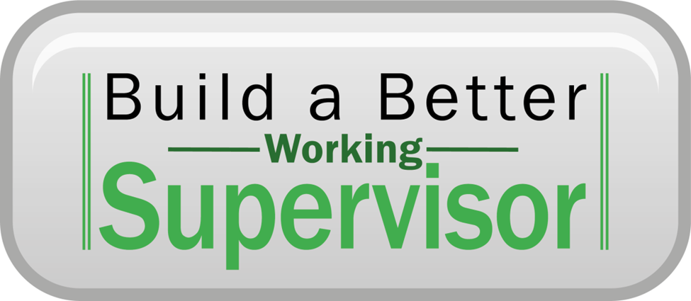
Managers and Supervisors
In many organizations, much of the supervisory work is performed by individuals who may not officially or legally be considered part of management.
  Although these individuals perform many of supervisory functions discussed in this book, they usually have limited authority and are typically working supervisors.
    Other designations for these individuals include foreman, group or team leader, lead person, coach, or facilitator

Slide 8

Managers and Supervisors
Most people obtain their first management experience in supervisory management positions.
  Supervisory work has become more complex, sophisticated, and demanding, and it requires professional and interpersonal skills.

Slide 9

Schools of Management Thought
Management practices can be traced throughout history. The Great Wall of China, the Pyramids of Egypt, the Roman Coliseum, the Eiffel Tower, the Statue of Liberty all resulted from the application of management principles.
  Many early schools of thought still influence the way people approach the supervisory task.
    Although there is no universally accepted theory of management, a common thread runs through the various theories that have been proposed over the years.

Slide 10

Schools of Management Thought
Each theory attempts to answer the question, “What is the best way to manager the task at hand?”
  While there is little agreement on the number and nomenclature of the various management theories, (4) approaches deserve attention:
    The Scientific Management Approach
    The Functional Approach
    The Human Relations-Behavioral Approach
    The Quantitative-Systems Approach

Slide 11
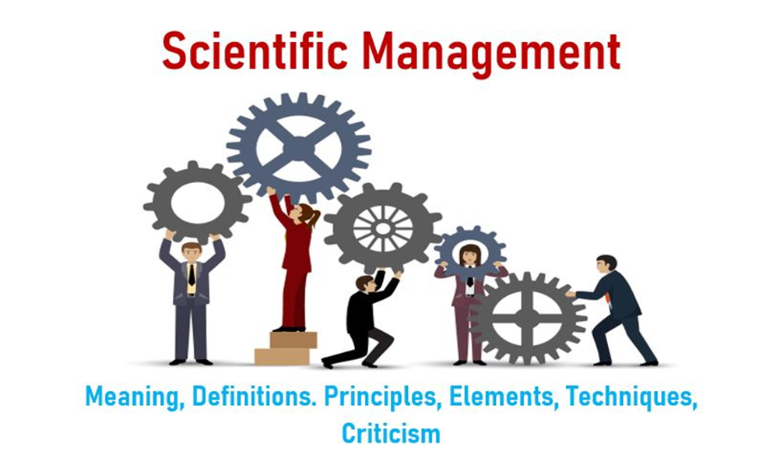
The Scientific Management Approach
Scientific Management Approach focuses on determining the most efficient ways to increase output and productivity.
  Frederick Winslow Taylor, the Father of Scientific Management, believed that managers should plan what, when, where, and how EEs should produce the product. He felt a manager’s job was to perform mental tasks, such as determining the “one best way” to do a job.
    The EE’s job, then, would be to perform the physical tasks of their jobs. To this end, Taylor developed certain principles to increase productivity.

Slide 12

The Scientific Management Approach
Taylor believed that many workers did not put forth their best effort and that, as a result, production often suffered.
  While observing workers in a steel plant, Taylor was shocked at the lack of systematic procedures, output restrictions among groups of workers, and the fact that ill-equipped and poorly trained workers typically were left on their own to determine how to do their jobs.
    Taylor believed that engineering principles could be applied to make people perform somewhat like machines – efficiently, mindlessly, and repetitively. By eliminating choice, operations could be standardized.

Slide 13

The Scientific Management Approach
Taylor’s principles of scientific management, include:
  Analyze the tasks associated with each job. Use the principles of science to find the best way to perform the work.
  Recruit the employee best suited to perform the job; that is, choose the person who has the skills, aptitude, and other attributes to do the job.
  Instruct the worker in the one best way to perform the job.
  Reward the accomplishment of the worker. Taylor believed that workers were economically motivated and would, therefore, do the job the way they were instructed if rewarded with money.
  Cooperate with workers to ensure that the job matches plans and principles.
  Ensure equal division of work & responsibility between managers & workers.

Slide 14

The Functional Approach
Henri Fayol, identified 14 principles of management that he believed could be applied universally.
  Some writers have referred to this concept as the universality of management, which suggests that basic functions, principles, and their applications in management are similar, regardless of an organization’s nature.
    In general, Fayol believed that a manager’s authority should equal that manager’s responsibility, and that the direction and flow of authority through an organization should be unified.

Slide 15

The Functional Approach
The Functional Approach asserts that all managers perform various functions in doing their jobs. He identified five functions critical to managerial effectiveness.
  Planning
    Setting down a course of action.
  Organizing
    Designing a structure, with tasks and authority clearly defined.
  Commanding
    Directing subordinate’s actions.
  Coordinating
    Pulling organizational elements toward common objectives.
  Controlling
    Ensuring that plans are carried out.

Slide 16
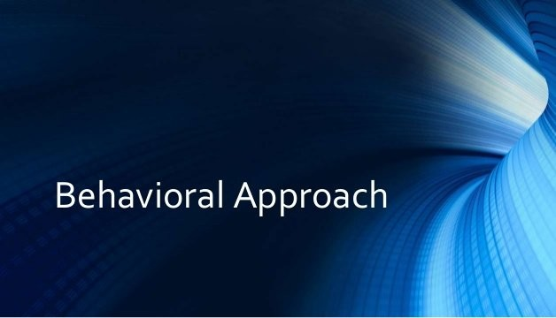
The Human Relations–Behavioral Approach
The contributions of Taylor and others gave rise to the notions that (1) if management used the principles of scientific management, worker efficiency would increase and productivity increases follow, and (2) if managers strove to improve working conditions, productivity would increase.
  The studies at the Hawthorne, Illinois, plant of Western Electric provided some of the most interesting and controversial results in the study of management.

Slide 17
The Human Relations-Behavioral Approach
Elton Mayo and Fritz Roethlisberger, leaders of a Harvard research team, conducted a series of illumination experiments from 1924 to 1936 at Western Electric.
  They hypothesized that if lighting improved, then productivity would increase. Contrary to expectations, productivity rose in both the control group (no change in working conditions) and the experimental group (working conditions varied).
  Numerous variations in working conditions were introduced, and no matter what change was introduced, productivity continued to rise until it stabilized at a relatively high level.
    The researchers concluded that the workers performed differently than they normally did because the researchers were observing them.
    This reaction is known as the Hawthorne Effect.

Slide 18
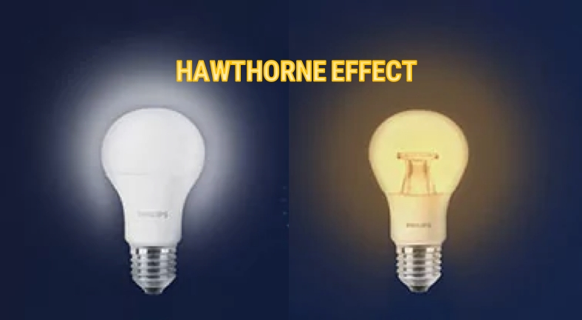
The Human Relations-Behavioral Approach
The experiments at the Hawthorne plant gave rise to what was known as the human relations movement and later as the behavioral science approach.
  This approach focuses on the behavior of people in organizations.
    Contributions from psychologists, sociologists, and other behavioral disciplines have provided numerous insights into individual and group behavior in work settings and the impact of supervisory practices and procedures on EE motivation and work performance.

Slide 19

The Quantitative-Systems Approaches
The Quantitative-Systems Approaches refers to the field of management study that uses mathematical modeling as a foundation.
  Through such models, which attempt to quantitatively describe the interrelationship of variables through data, data can be manipulated and outcomes predicted.
    Quantitative approaches are often closely connected with systems approaches, in which mathematical models are developed as a series or collection of interrelated variables or parts that can be analyzed and used in decision making.

Slide 20

The Quantitative-Systems Approaches
This approach is frequently found in large organizations where sales, costs, and production data are analyzed using computer technology.
  Mathematical modeling typically is use to build “what-if” situations (i.e. what would be the effect on sales if we reduce EEs by 10%?).
    A number of planning concepts introduced in Chapter 3 rely on these types of approaches.

Slide 21
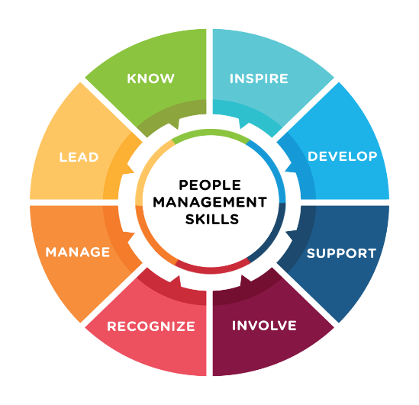
Factors and Trends Affecting the Role of the Supervisor
In the near future, supervisors will have to understand and address many complex environmental factors and trends.
  Although every supervisor is responsible for managing numerous resources, unquestionably the most important, overriding aspect of supervision is the management of people.
    Therefore the nature of the workforce should be of vital concern to the supervisor who plans for the future.

Slide 22

Factors and Trends Affecting the Role of the Supervisor
Finding qualified EEs and onboarding new hires (meaning engaging them in a continuous process of assimilation and growth within the organization) have always been among the most important supervisory responsibilities.
  The traditional challenges of attracting and retaining the most qualified EEs may be superseded by the more acute challenge of leading and motivating an increasingly changing workforce. The most significant characteristic of this changing workforce will be its diversity.
    Work groups will be composed of EEs with different cultural, ethnic, gender, age, educational level, racial, and lifestyle characteristics.
    The supervisor will need to get people from many different cultures to work together.

Slide 23

Population and Workforce Growth
Both the population and workforce will continue to grow.
  Immigration has accounted for, and will continue to account for, a considerable share of the nation’s population and workforce growth.
    The growth in the number of new immigrants (refugees, legal or illegal) may expand certain interracial and intercultural problems that supervisors face in managing diverse workforces.

Slide 24

Population and Workforce Growth
Although managing a diverse workforce presents some difficulties, it also presents numerous opportunities for supervisors to build on the strengths of individuals and groups.
  Supervisors must understand the rights of both their EEs and their employers, regardless of workforce differences.
    Supervisors must recognize the value of a diverse workforce and their own need to become more adaptable to change.

Slide 25

Other Population and Workforce Growth Considerations
Changing Age Patterns
Women in the Workforce and Related Issues
  Flextime – Job Sharing – Telecommuting
Minorities in the Workforce
Barriers for Women and Minorities
  Glass Ceiling – Barrier that Limits Advancement
  Glass Walls – Barriers that Compartmentalize Occupational Classes
Educational Preparation
  Underemployment: Skills-Knowledge-Abilities (SKAs)
  Competitive Advantage
Occupational and Industry Trends
Changing Technology and Business Conditions
Global Challenges
Work Scheduling and Employment Conditions
  Contingent Workforce – Part Time or Temporary to Meet Employer Needs

Slide 26

Corporate Culture and Ethical Conduct
Corporate Social Responsibility (CSR) is a concept whereby organizations consider the interests of society by taking responsibility for the impact of their actions on EEs, customers, suppliers, shareholders, and other stakeholders as well as the environment and communities in which they operate.

Slide 27

Corporate Social Responsibility
Author Archie Carrol developed a four-part definition of CSR that provides a medium for analyzing a company’s responsibilities.
  Legal Responsibilities
    To comply with statutory obligations – play by the rules.
  Economic Responsibilities
    To be profitable – to make money for the shareholders.
  Ethical Responsibilities
    To do what is right, just, and fair.
  Philanthropic Responsibilities
    To contribute resources to improve the community and society.

Slide 28
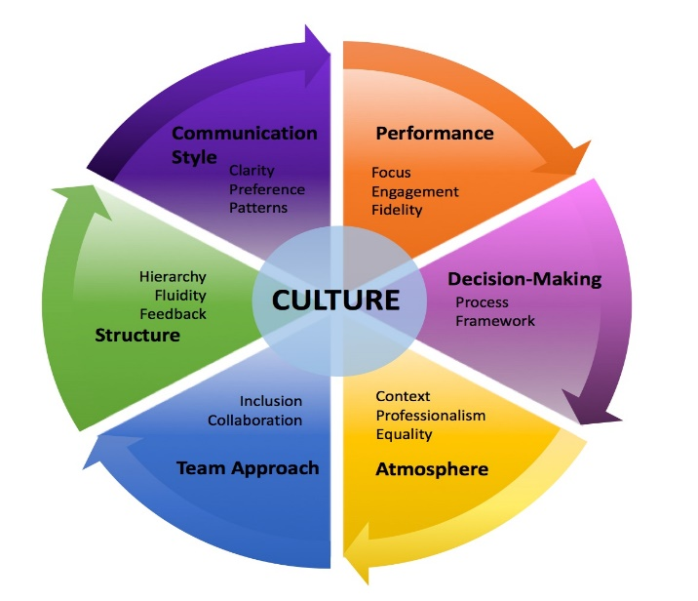
Corporate Culture
Corporate Culture is the set of shared purposes, values, and beliefs that EEs have about their organization.
  Top-level management creates the vision & philosophy for the firm.
    To provide a foundation for the type of corporate culture that is desired, many companies develop mission statements and ethical conduct statements.

Slide 29

Corporate Culture
Supervisors exert major influences in determining the direction of the corporate culture in their departments.
  They play significant roles in informing, educating, and setting examples for ethical behavior.
    Although ethical behavior and fair dealing have always been the foundations for good management, it is clear that ethical conduct has become one of the most challenging issues confronting businesses.

Slide 30

Society of Human Resources Management
The Society of Human Resources Management (SHRM’s) core principle of professional responsibility should apply for all those in supervisory positions.
  “We are responsible for adding value to the organization we serve and contributing to the ethical success of those organizations. As supervisor’s, we must accept professional responsibility for our individual decisions and actions.”
    It is critical that ethical behavior and fair dealings are at the forefront of good management practices, beginning at the supervisory level.

Slide 31


Governmental and Societal Issues
Other emerging governmental and society issues will continue to complicate the supervisory management position.
  For example, numerous environmental concerns continue to be serious long-term problems for business, government, and the general public. Energy availability and costs may be determined by international and domestic political and economic changes.
    These types of issues and societal pressures often become part of business planning and operations.

Slide 32

Government and Societal Issues
Supervisors are influenced both directly and indirectly by such governmental requirements, and they must continue to stay abreast of any legislation that may influence their operations.
  Furthermore, supervisors must be sensitive to pressures exerted by special interests groups.
    Consumer groups have demanded better products and services from business, labor, and government.
    Environmentalists seek to influence business decisions that may adversely impact the environment (going green - conserve energy & protect enviro).

Slide 33

Workplace Incivility
People Who Make Life Difficult
A number of studies report that “rude behavior is on the rise in the workplace and can undermine an organization’s effectiveness.”
  Whether crude or impolite behavior takes place behind closed doors or out in the open, it directly affects the recipients and lowers group morale.

Slide 34
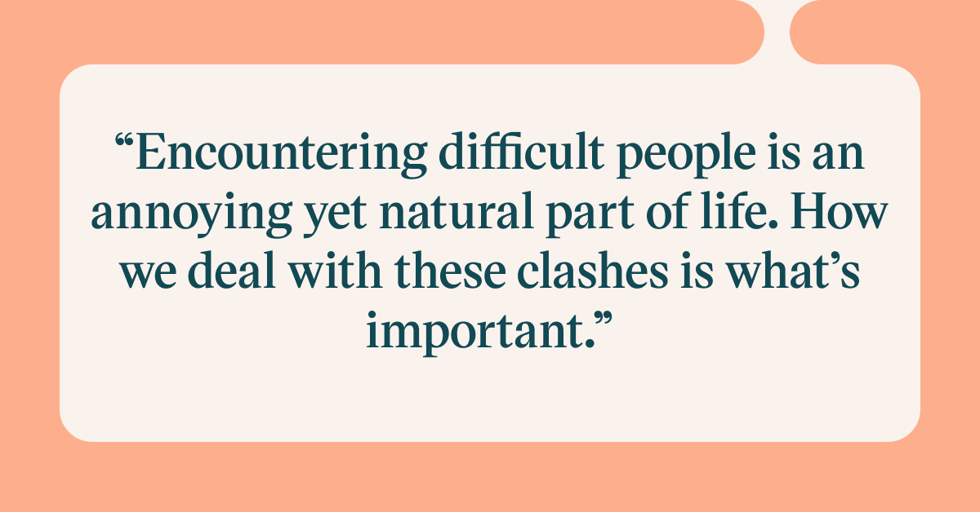
Dealing with Difficult People
Who are These People?
  In his book, “Coping with Difficult People”, Robert M. Bramson writes:
    They are hostile customers or coworkers, the indecisive, vacillating bosses, and the over agreeable subordinates of the world who are constant headaches to work with. Although their numbers are small, their impact is large. The are responsible for absenteeism, significant losses in productivity, and lost customers or clients. They frustrate and demoralize those unlucky enough to have to work with them, and they are difficult to understand. Worst of all, they appear immune to all the usual methods of communication and persuasion designed to convince them or help them to change their ways.

Slide 35
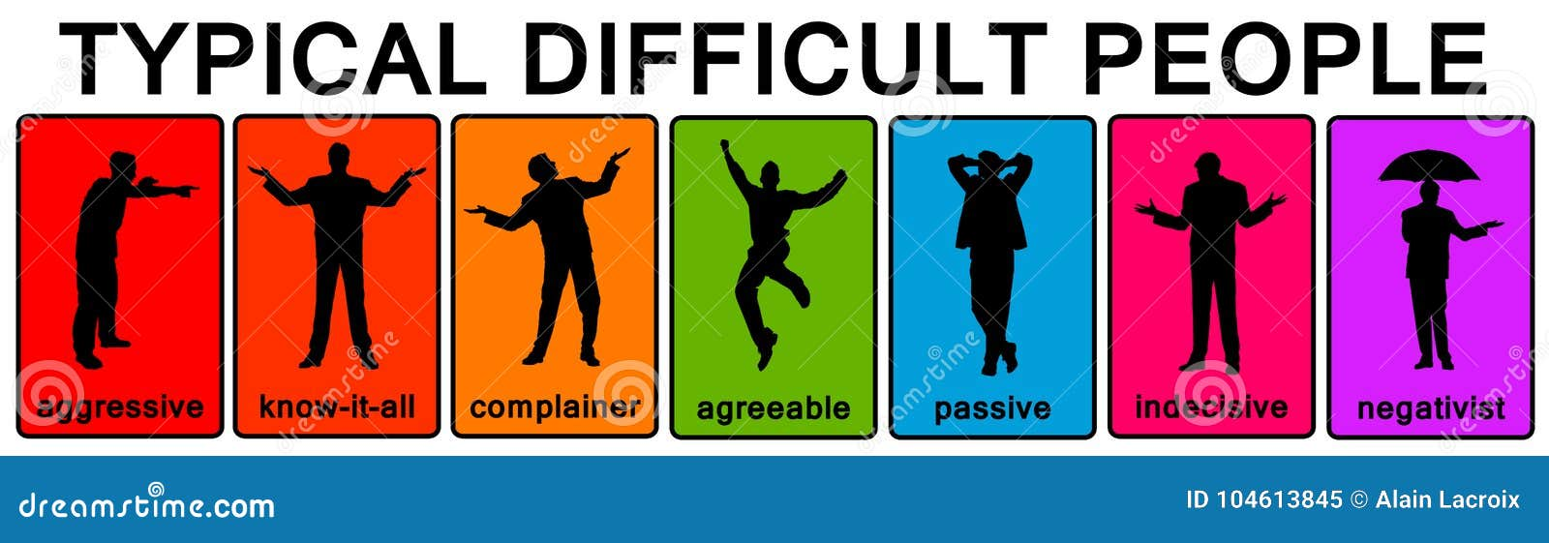
Dealing with Difficult People
The Three E’s – Engagement, Empowerment, and Employee Participating in Decision Making.
  How do you get people off the bench and into the game? How do you get diverse groups of people to work together? These questions have been with us since the beginning of time.
    Some EEs will demand a greater voice in workplace decision making, while others will adopt the “what-how-when” attitude.
    What kind of EE do you want working for you?

Slide 36
Dealing with Difficult People
The Conference Board review of EE engagement research identified certain factors that need to be present for EEs to further both their own self-interests and the interests of their organization.
  They are as follows:
    Do I believe that my job is important?
    Do managers communicate expectations, provide regular feedback, and lead by example?
    Is the job mentally stimulating?
    Is there a direct connection between what I do and the organization’s performance – quality, service, bottom line?
    Are there opportunities for personal and professional growth?
    Am I willing to work with a passion because I am connected to what the organization stands for?
    Is there a climate of open and honest communication between the manager, team members, and myself?
    Have I been empowered to make decision that impact what I do and how I do it?

Slide 37

Engage Employees
Engaged employees are those who are enthused about what they do, where they do it, and who they do it with.
  They are fully involved because they have been engaged.

Slide 38
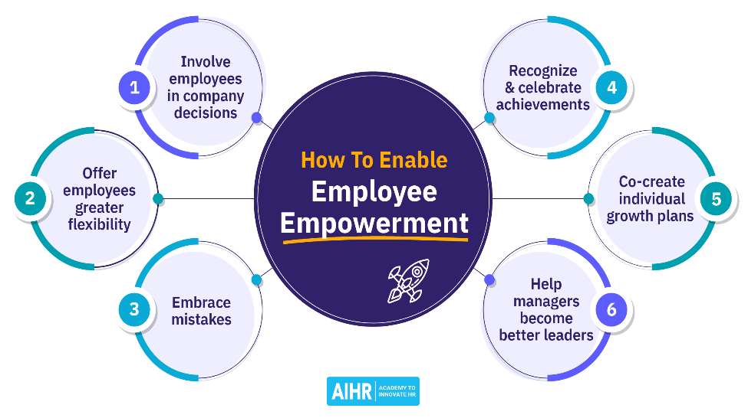
Empower Employees
Empowerment means giving employees the authority and responsibility to achieve objectives.
  Opportunities to make suggestions and participate in decisions affecting their jobs can and should be supported.
    However, some supervisors become worried when workers challenge what have traditionally been management rights, thinking that certain areas should be beyond EE challenge.

Slide 39

Participative Management
Many supervisors have become accustomed to the practice of participative management, which essentially means a willingness to permit EEs to influence or share in managerial decisions.
  If supervisors learn to react to this practice in a positive way, it should improve their own and their company’s performance.

Slide 40

Supervision: A Professional Perspective
The primary responsibility of most supervisors is to manage their firms’ most important resources – human resources.
  Managing people starts with selecting and training individuals to fill job openings, and it continues with ongoing development, motivation, leadership, and preparation of EEs for promotion.
    Thus, supervisors will have to become true professionals with a growing professional perspective, and they will have to develop as innovators and idea people. They must look to the future with a professional awareness of the trends influencing human behavior and observe how those trends impact management in a complex society.

Slide 41

Supervision: A Professional Perspective
It is imperative to take the professional perspective, which recognizes the need for constant self-improvement and self-renewal.
  No amount of formal or informal education can ever be enough to fulfill a supervisor’s personal program of self-improvement.
    Supervisors must recognize that they, too, can become obsolete unless they constantly take measures to update their own skills and knowledge through a program of continuous self-development.

Slide 42

Supervision: A Professional Perspective
Stephen Covey, author of “The Seven Habits of Highly Effective People”, presented the following illustration:
  Suppose you were to come upon someone in the woods working feverishly to saw down a tree.
    “What are you doing”? you ask. “Can’t you see?” comes the impatient reply. “I’m sawing down the tree.” “You look exhausted!” you exclaim. “How long have you been at it?” “Over five hours,” he returns, “and I’m beat! This is hard work.” “Well, why don’t you take a break for a few minutes and sharpen the saw?” you inquire. “I’m sure it would go a lot faster.” “I don’t have time to sharpen the saw,” the man said emphatically. “I’m too busy sawing.”
      What can you do to sharpen your saw!?

Slide 43

Getting Into Supervision
Many individuals are promoted to their first supervisory positions from non-supervisory jobs in the same organization.
  It may be in the same department or in another area.
  They may have formally applied for the position or had a manager recommend them. In either case, the organization made a conscious effort to promote within.
    The author is familiar with many older managers who did not continually find ways to sharpen their saws. Often, they felt they “paid their dues” by being loyal to a particular firm for a long period of time.

Slide 44
Make Yourself More Valuable
The best way to get a supervisory position or to prosper in your current position is to find ways to make yourself more valuable. Always try to improve yourself.
  For example, if you are a student, make yourself available for internships and co-ops, or perhaps volunteer for some type of meaningful activity. Volunteer experiences in community groups can increase your networking opportunities, give you ideas and practical experiences, and help you become more comfortable working with and leading groups of diverse people. Get involved in one or more student organizations.
    Seek opportunities to apply your expertise and use such opportunities to enhance your communication and leadership skills.

Slide 45
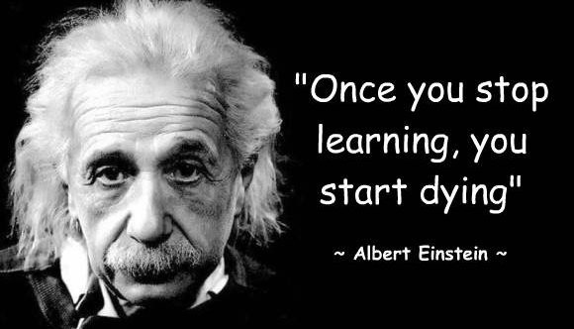
Make Yourself More Valuable
Remember, too, that continuing your educational preparation is an ongoing challenge.
  Finishing an academic degree is only a start; consider going further by enrolling in graduate study degree and non-degree programs that may enhance your technical, managerial, supervisory knowledge.

Slide 46

Make Yourself More Valuable
Look in the mirror. What SKAs do you have in your toolbox? What experiences do you have that can add value to the firm? How might SKAs and experiences be matched to opportunity?
  Remember that when applying for any position, particularly a supervisory position, you must discover the specific needs of the hiring organization and show how you can add value to the firm.
    Our message to you: Be assertive enough, bold enough, and knock on enough doors.

Slide 47


