Slide 1
Mentor Leader Session Three

Slide 2
The Mentor Leader Group One

Slide 3
The Mentor Leader Live the Message
Live the Message of Mentor Leadership at all times.

Slide 4
The Model of a Mentor Leader
You will be known by your words and your actions.

Slide 5
The Model of a Mentor Leader
You will also be known by your faith and your heart.
The commitments of your heart will write the legacy you leave the world.

Slide 6
Known by your Words and Actions
You can tell the world who you are, but the you they see in action will be the you they remember.
Who is the you that you want the world to see?
Who are you? Who do you want to be? Who should you be?

Slide 7
Known by your Words and Actions
Be the role model you were created to be for others.
Be the message you were intended to be to all the world.
It may just be that someone needs that message, that model, that example at this very moment.

Slide 8
Known by your Faith
Faith is the foundation for everything else.
Faith is the essence and energy that empowers and encourages leaders to go on when they’re not sure they can.
Faith is what drives us to look for potential in the lives of others and then compels us to build into those lives.
Faith is the foundation and strength of the Mentor Leader, the guiding principle behind everything we do.

Slide 9
Known by your Legacy
Mentor Leaders will be known by their legacy.
The legacy we leave is a composite of the many things that guide the daily steps of the Mentor Leader.
Relationships – Impact – Involvement – Character – Faith – Actions

Slide 10
Known by your Legacy
Look for lives to change and hearts to impact, that we might model the message of the Mentor Leader, leaving a legacy of changed lives and a better world, day by day, one life at a time.

Slide 11
Action Steps
Consider your legacy. You can tell the world who you are, but the you they hear and see in action will be the you they remember.
What kind of legacy are you building?

Slide 12
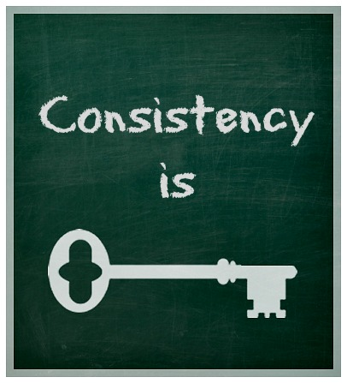
Action Steps
Evaluate your consistency.
Do your actions mirror your words?
There is no surer way to create a credibility gap than if they don’t.

Slide 13
Action Steps
Examine your words.
What comes out of your mouth reveals the condition of your heart.
What do your words reveal about your thoughts, motives, and attitudes?

Slide 14
Action Steps
Evaluate your faith.
Does your faith create a foundation that others can believe in?

Slide 15
The Means of a Mentor Leader
The Means of a Mentor Leader: Maximizing Team Performance.
The secret is to work less as individuals and more as a team.
As a coach, I play not my eleven best, but my best eleven.
(Knute Rockne – Notre Dame).

Slide 16
The Means of a Mentor Leader
To maximize team performance, the leaders must create the appropriate culture: a culture that underscores the mission, vision, and values of the organization.
A healthy culture values its people.

Slide 17
The Means of a Mentor Leader
When a leader creates a healthy, stimulating and nurturing culture and is dedicated to mentoring people, valuing them, and giving them the tools to succeed, the group’s vision and mission are not only achievable, but also sustainable.

Slide 18
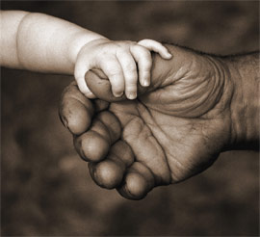
Creating a Culture
The culture you create permeates everything you touch.

Slide 19
Diversity Enhances Excellence
Mentor Leaders are always looking to add the right pieces, the right skill sets, and the right mix of diversity to the organization.
Differences among the team will enhance its drive for success.

Slide 20
Diversity Enhances Excellence
To be effective Mentor Leaders, we must reach beyond the boundaries that separate us and connect with people who are different from us.
With the right focus – on the vision and mission – diverse experiences, backgrounds, and ethnicities are not something to be feared, but rather something to be embraced to maximize the performance of the team.

Slide 21
Always Moving Forward
Every team member is important to the whole, yet the team can move forward without any individual.
“Important but not indispensable” (Coach Noll)

Slide 22
Leading and Being Led
Mentor Leaders are always willing to learn and grow, seeking advice and guidance as they lead others and help them develop. When done right, mentor leadership is an ongoing process of leading and being led, of developing ourselves and developing future leaders.
The easiest way to grow: (1) Listen to others.

Slide 23
Respond
How we respond to advice, correction, and constructive criticism makes all the difference.

Slide 24
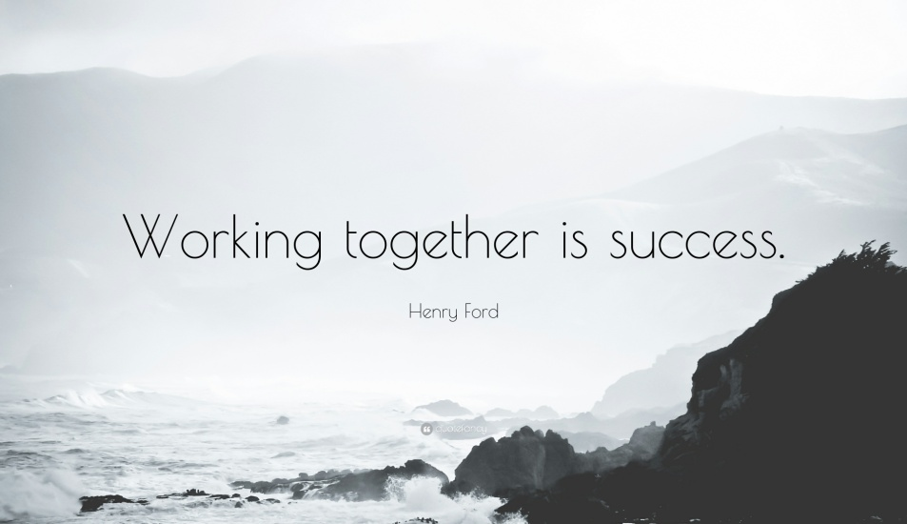
Lead Volunteers for Extraordinary Achievement
The mercenaries will always beat the draftees, but the volunteers will crush them both (Chuck Noll).
Ordinary efforts and processes will lead to ordinary results if people are working only as individuals, or merely working alongside each other, rather than working with each other.
Working together is what leads to exceptional results.

Slide 25
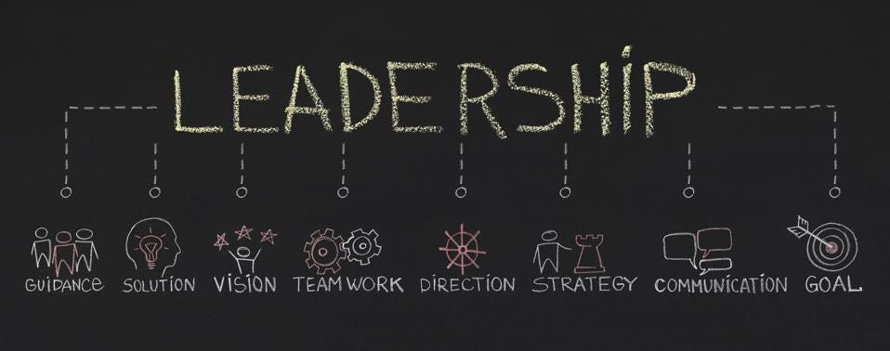
Lead Volunteers for Extraordinary Achievement
One of the best ways to work together is to prepare as if you will be leading a team of volunteers.

Slide 26
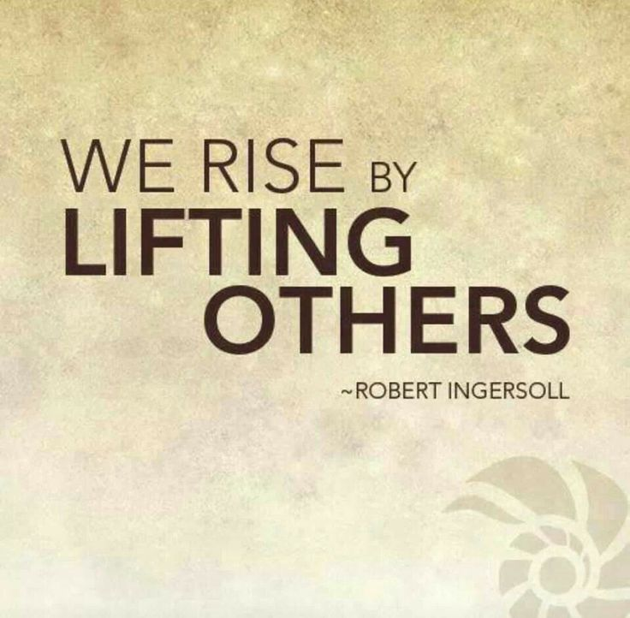
Lead Volunteers for Extraordinary Achievement
You must get to know the members of your team and learn how to energize them before you expect them to buy into a common mission. It must have meaning to them.
To succeed as a Mentor Leader, put other people first.

Slide 27
Lead Volunteers for Extraordinary Achievement
Persuade and empower as if leading and mentoring a group of volunteers.

Slide 28
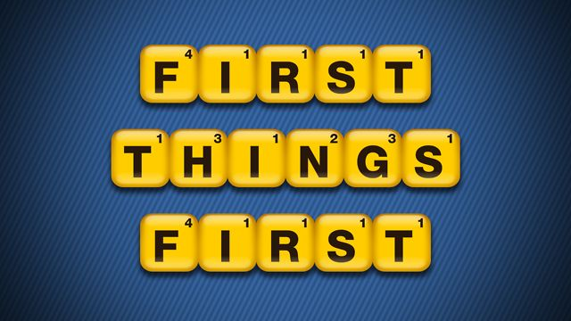
Action Steps
Put first things first.
Create a culture that values people inside and outside the organization.
A culture that puts the interests of others first will set a standard by which everyone in the group will measure his or her own performance.

Slide 29
Action Steps
Get the culture right.
The culture of a group is the first thing other people see.
It determines the direction of the group and how decisions are made.
What can you do to start changing the culture of your group?

Slide 30
Action Steps
Get everyone on the same page.
How can you make your leadership more inclusive?
How can you help your team to embrace the corporate mission?

Slide 31
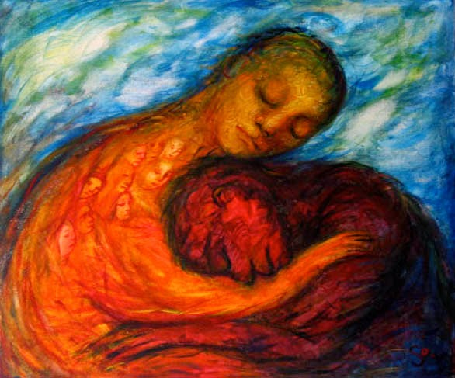
Action Steps
Strengthen your organization by embracing diversity.
What can you do to build on the differences within your team?

Slide 32
Action Steps
Break down barriers.
Leaders cross boundaries that otherwise separate society.
What can you do to break down barriers within (out) your group?

Slide 33
Action Steps
Bring the best people on board.
Accept candid feedback and differing opinions with the idea that someone may have a better way.

Slide 34
Action Steps
Accept and promote this truth for the good of the team.
We are all important, but we are not indispensible.

Slide 35
Action Steps
Be firm in the essentials but flexible in the nonessentials.
Focus on the things that really matter.

Slide 36
Action Steps
Treat the members of your team as you would volunteers.
Mentor Leaders realize the power of persuading others to follow, rather than requiring them to follow.

Slide 37
The Methods of a Mentor Leader
The Seven E’s of Enhancing Potential:
Engage
Educate
Equip
Encourage
Empower
Energize
Elevate
Blessed is the leader who seeks the best for those he serves. (author unknown)

Slide 38
1. Engage
It is critical for Mentor Leaders to engage with those they lead. It is impossible to mentor from a distance.
If you do not engage with those you serve, you will never understand them or know enough about them to be able to have a positive impact in their lives.
Good leadership means getting involved.
Look for ways to connect with the people you lead.

Slide 39
2. Educate
The first step in creating leaders, after engaging with those you lead, is to educate them.
Good teachers help every student earn an A (Wilbur Dungy).
Mentor leadership is all about helping others become the best they can be – it is built on a foundation of teaching, helping, and guiding.

Slide 40
3. Equip
Mentor Leaders create an environment in which others can be productive and excel. They set the parameters and guidelines for the task, project and continually recast the vision, and then provide the tools and equipment needed for everyone to be successful in their assignment and to ultimately accomplish their mission.
In essence, they strive to furnish what is needed for the task – physically, mentally, emotionally, and spiritually – and to accomplish the mission.

Slide 41
4. Encourage
Encouragement is the fuel that powers our efforts to engage, educate, and equip.
Mentor Leaders care.
Mentor Leaders lift others up.
Mentor Leaders encourage.

Slide 42
5. Empower
Once the people you lead are ready…it’s time to turn them loose to do their jobs.
True empowerment is preparation followed by appropriate freedom.

Slide 43
6. Energize
Great leaders energize and inspire those they lead.
Without inspiration, the best powers of the mind are dormant. There is a tinder in us which needs to be quickened with sparks (Johann Gottfried Von Herder)

Slide 44
7. Elevate
The goal of every Mentor Leader is to build other leaders.
To elevate others is to help them become the-best-version-of-themselves.
Raising up leaders is the truly selfless goal of every Mentor Leader

Slide 45
Action Steps
Be engaged with those you lead in order for them to trust that you care and want to believe in you.
Leadership is a “contact” sport.

Slide 46
Action Steps
Help every team member earn an A.
Educate them for success.

Slide 47
Action Steps
Equip those you lead.
Create an environment and provide the resources and the proper tools – physical, mental, spiritual, and emotional for the team to be successful.

Slide 48
Action Steps
Take every opportunity to encourage the people you lead.
When in doubt, do it, then, do it again.

Slide 49
Action Steps
Once your team is ready, stop teaching and let them “take the test.”
Empower them by letting them go.

Slide 50
Action Steps
Energize your team’s effort by believing in them.
The energy to go forward and the inspiration to achieve will come from you.

Slide 51
Action Steps
Develop your team members as leaders.
The mentor leader’s ultimate goal is to build leaders who will leave to lead elsewhere, or who will be elevated to fill the mentor leader’s role.

Slide 52
The Measure of a Mentor Leader
Building Other Lives of Impact
The Mentor Leader adds value to the lives of others, to make the lives of other people better.

Slide 53
The Journey: Adding Value Every Moment
At the end of the day, the journey is about adding value to others’ lives, which ultimately will impact your community for good.

Slide 54
Sharing the Journey
It’s not about you. It’s not about me. It’s about others.

Slide 55
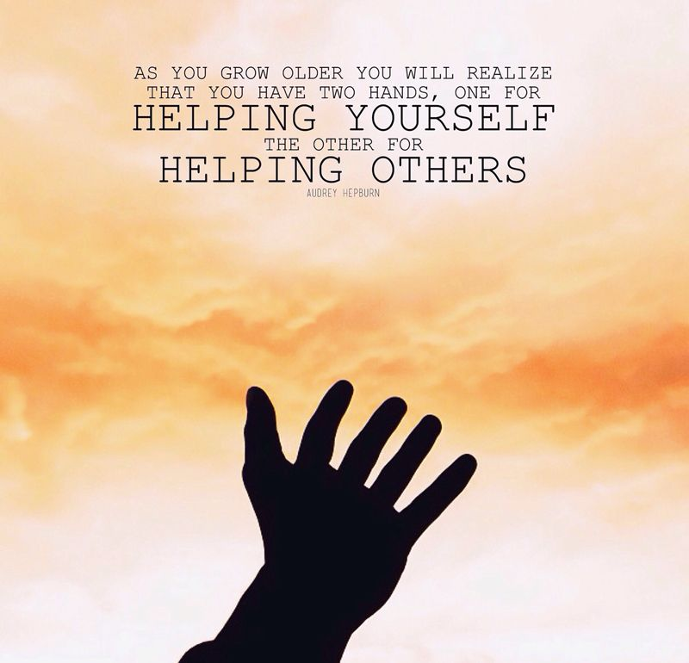
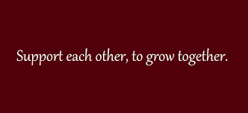
Sharing the Journey
Mentor Leaders will help people grow right where they are. Sometimes, that involves enlisting more help in the effort.

Slide 56
Sharing the Journey
Mentor Leaders should always look to add value to the lives of others, even if it means delegating authority to those they have mentored who are ready to be elevated to new levels of leadership responsibility.
By touching the lives of the people right around us, and by replicating leaders who in turn can replicate more leaders, we can create value far beyond the small sphere that we can reach and touch directly.

Slide 57
The Finish: Living a Life of Significance
We always have time. We always have a platform.
There is always someone whose life we can affect – even if we’re not aware at the time we’re doing it.
The only ones among you who will be really happy are those who will have sought and found how to serve (Albert Schweitzer).

Slide 58
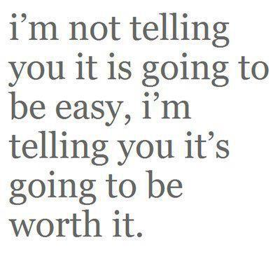
Action Steps
Consider the ultimate outcome.
The Mentor Leader’s ultimate measure of success is simply this: did you add value to the lives of others?

Slide 59
Action Steps
Focus on improvement.
Regardless of “wins” and “losses,” you have succeeded as a Mentor Leader if you have improved the lives of those you lead and of others who are affected by you and your “coaching tree.”

Slide 60
Action Steps
Always be willing to find the right place for someone to serve, knowing that you are uniquely equipped with incredible gifts and abilities.

Slide 61
Action Steps
Prepare yourself to hand off your leadership to someone else who is ready to be elevated.
Be ready to enlist the help of others, and then to call them out when needed.

Slide 62
Action Steps
There is always someone whose life you can affect for good.
Do it.

Slide 63
Action Steps
It’s not about us.
It’s about everything that we can do for others.

Slide 64
Action Steps
At the end of it all, even if one life is better because we lived, our lives have significance.

