Slide 1
Business Communications Session Five
Business Communication
Process and Product – 9th Edition
Mary Ellen Guffey and Dana Loewy; Cengage Learning 2018, 2015
ISBN: 978-1-305-95796-1

Slide 2
Unit Four: Reports, Proposals, and Presentations
Chapter Eleven: Reporting in the Digital Age
Learning Outcomes:
Explain informational and analytical report functions, organizational strategies, and writing styles as well as typical report formats.
Apply the 3x3 writing process to contemporary business reports to create well-organized documents that show a grasp of audience and purpose.
Locate and evaluate secondary sources such as databases and Internet resources, and understand how to conduct credible primary speech.
Identify the purposes and techniques of citation and documentation in business reports, and avoid plagiarism.
Generate, use, and convert numerical data to visual aids, and create meaningful and attractive graphics.

Slide 3
Reporting in the Digital Age Workplace
Digital age organizations compete in a world of constant change facilitated by innovative technology and the ability to generate and share vast amounts of data.
Whether a company decides to launch a new product, expand into new markets, reduce expenses, improve customer service, or increase its social media presence, the decisions are usually based on information submitted in reports.

Slide 4
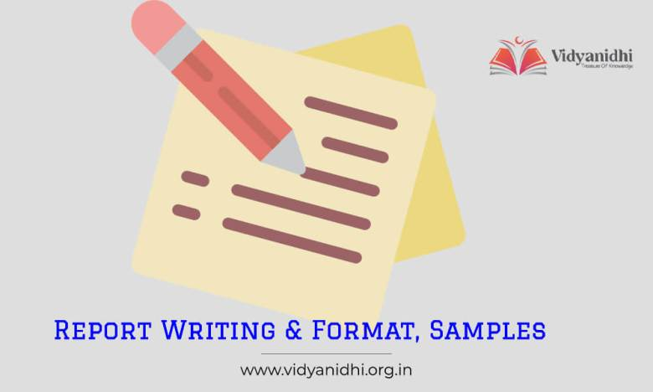
Basic Report Functions
Most reports fit into one of two broad categories:
Informational Reports
Present data without analysis or recommendations.
Writers collect and organize facts, but do not analyze for readers.
Analytical Reports
Provide data or findings, analysis, and conclusions.
If requested, writers also supply recommendations for readers.
These reports may intend to persuade readers to act or change beliefs.

Slide 5
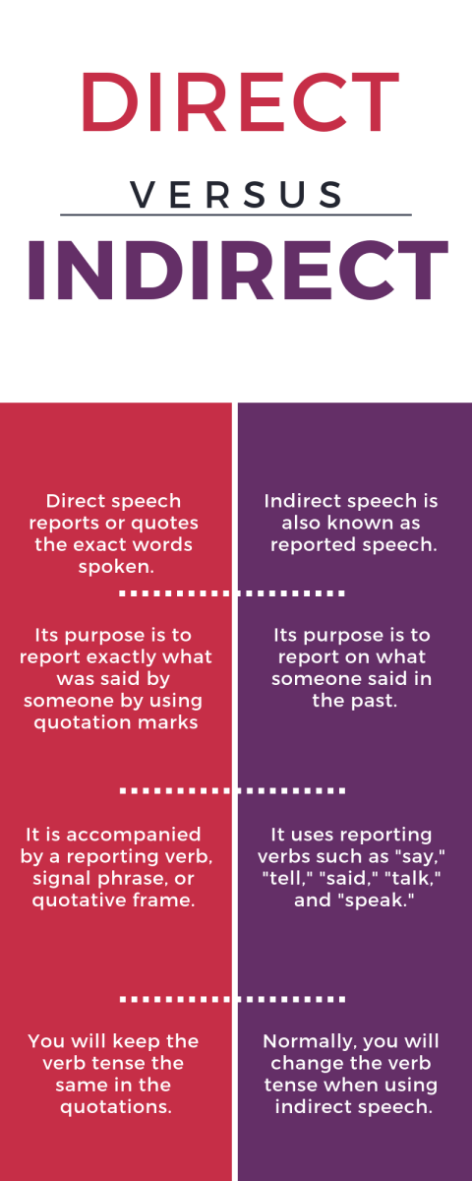
Organizational Strategies
Like other business messages, reports may be organized directly or indirectly. The reader’s anticipated reaction and the content of a report determine its organizational strategy.
Direct Strategy
If readers are informed
If readers are eager to have results first
If readers are supportive
Put recommendations first.
Indirect Strategy
If readers need to be educated
If readers need to be persuaded
If readers may be disappointed or hostile
Put recommendations last.

Slide 6
Informal and Formal Writing Styles
Like other business messages, reports can range from informal to formal, depending on their purpose, audience, and setting.

Slide 7
Applying the 3x3 Writing Process to Contemporary Reports
Because business reports are systematic attempts to compile often complex information, answer questions, and solve problems, the best reports are developed methodically.
In earlier chapters the 3x3 writing process was helpful in guiding the writing of short projects such as emails, memos, and letters.
That same process is even more necessary when writers are preparing longer projects such as reports and proposals.
After all, an extensive project poses a greater organizational challenge than a short one and, therefore, requires a rigorous structure to help readers grasp the message.

Slide 8
Applying the 3x3 Writing Process to Contemporary Reports
Channel the writing process into seven steps:
Analyze the problem and purpose.
Anticipate the audience and issues.
Prepare a work plan.
Conduct research.
Organize, analyze, interpret, and illustrate the data.
Compose the first draft.
Edit, proofread, and evaluate.

Slide 9
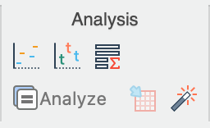
Analyzing the Problem and Purpose
The first step in writing a report is understanding the problem or assignment clearly. For complex reports, prepare a written problem statement to clarify the task.
A written purpose statement defines the focus of the report and provides a standard that keeps the project on target.
In writing useful purpose statements, choose action verbs telling what you intend to do: analyze, choose, investigate, compare, justify, evaluate, explain, establish, determine, and so on.
Some reports require only a simple statement of purpose.
Many assignments, though, demand additional focus to guide the project.

Slide 10
Analyzing the Problem and Purpose
An expanded statement of purpose considers additional factors:
Scope and Limitations
What issues or elements will be investigated?
The scope statement prepares the audience by clearly defining which problem or problems will be analyzed and solved.
What conditions affect the utility of a report’s findings?
The limitations narrow subjects by focusing on constraints or exclusions.
Significance
Why is the topic worth investigating at this time?
Some topics turn out to be less important than originally thought. Others involve problems that cannot be solved, or make a study useless.

Slide 11
Anticipating the Audience and Issues
After defining the purpose of a report, a writer must think carefully about who will read it.
Although one individual may have solicited the report, others within the organization may eventually read it, including people in upper management and in other departments.
A report to an outside client may be read by someone who is familiar with the problem and then distributed to others less familiar with it.
Moreover, candid statements to one audience may be offensive to another audience.

Slide 12
Anticipating the Audience and Issues
When considering primary and secondary readers, ask yourself these questions:
What do my readers need to know about this topic?
What do they already know?
What is their education level?
How will they react to this information?
Which sources will they trust?
How can I make this information readable, believable, and memorable?

Slide 13
Preparing a Work Plan
After analyzing the problem, anticipating the audience, and factoring the problem, you are ready to prepare a work plan.
A good work plan includes the following:
Statement of problem (based on background/contextual information)
Statement of purpose including scope w/ limitations and significance.
Research strategy including a description of potential sources and methods of collecting data.
An Outline that factors the problem into manageable chunks.
Work schedule.

Slide 14
Preparing a Work Plan
Preparing a plan encourages you to evaluate your resources, set priorities, outline a course of action, and establish a schedule.
Having a plan keeps you on track, provides management a means of measuring progress, and gives a complete picture of a project.
Your work plan describes how you expect to generate or collect data.

Slide 15
Conduct Research
Research, or the gathering of information, is one of the most important steps in writing a report.
As the philosopher Goethe once said, “The greater part of all mischief in the world arises from fact that men do not sufficiently understand their own aims. They have undertaken to build a tower, and spend no more labor on foundation than would be necessary to erect a hut.”
Think of your writing a report as building a tower.

Slide 16
Conduct Research
As you analyze a report’s purpose and audience and prepare your research strategy, you will identify and assess the data you need to support your argument or explain your topic.
As you do, you will answer questions about objectives and audience:
Will the audience need a lot of background or contextual information?
Will readers value or trust statistics, case studies, or expert opinions?
Will they want to see data from interviews or surveys?
Will summaries of focus groups be useful?
Should you rely on organizational data?

Slide 17
Conduct Research Internet
To use the Internet meaningfully in your search, you must scrutinize what you find and validate the author and publisher.
Here are specific criteria to consider as you examine a site:
Currency – is the information presented up-to-date?
Authority – is the writer an expert on information?
Content – what is the overall value of the content shared?
Accuracy – are the facts reliable?

Slide 18
Conduct Research Surveys
Surveys may be the best way to generate data for business and student reports.
In preparing print or electronic surveys, consider these pointers:
Select the survey population carefully.
Explain why the survey is necessary.
Consider incentives.
Limit the number of questions.
Use questions that produce quantifiable answers.
(check-off, multiple-choice, yes-no, and scale (rank-order) questions
Avoid leading or ambiguous questions.
Make it easy for respondents to return the survey.
Conduct a pilot study.
(try the questionnaire with a small group to remedy any problems)

Slide 19
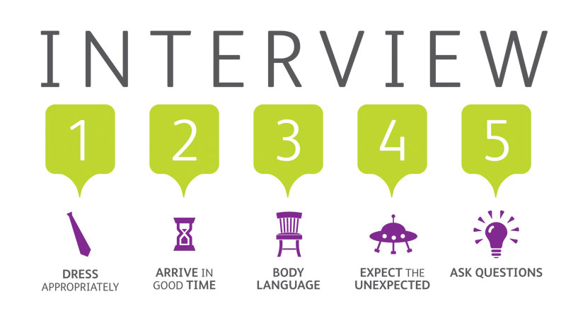
Conduct Research Interviews
Some of the best report information, particularly on topics which little has been written, comes from individuals. They are usually experts or veterans in their fields. Consider both in-house and outside experts for business reports.
These sources will call for in-person, telephone, or online interviews.
To elicit the most useful data, try these techniques:
Locate an expert.
Prepare for the interview.
Maintain a professional attitude.
Make your questions objective and friendly.
Watch the time.
End graciously.

Slide 20
Conduct Research Observation and Experimentation
Some kinds of primary data can be obtained only through firsthand observation and investigation.
If you determine that you need observational data, then you need to plan carefully. Most important is deciding what or whom you are observing and how often those observations are necessary.
For example, if you want to learn more about an organization’s telephone customer service, you probably need to conduct an observation (along with interviews and perhaps even surveys).

Slide 21
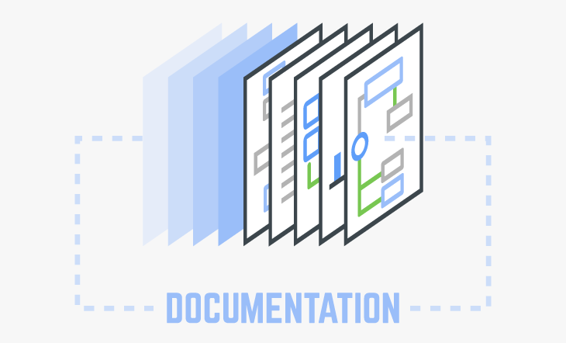
Documenting Information
In writing business reports, you will often build on the ideas and words of others.
In Western culture, whenever you borrow the ideas of others, you must give credit to your information sources.
This is called documentation.

Slide 22
The Purposes of Documentation
As a careful writer, you should take pains to document report data properly for the following reasons:
To strengthen your argument (reputation and credibility).
To protect yourself against charges of plagiarism (ethical).
To instruct the reader, so they can pursue the topic further.
To save time.

Slide 23
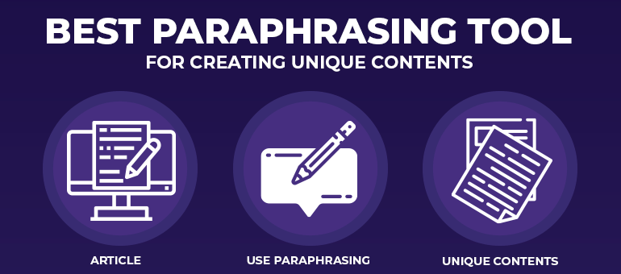
The Fine Art of Paraphrasing
In writing reports and using the ideas of others, you will probably rely heavily on paraphrasing, which means restating an original message in your own words and in your own style.
Read the original material intently to comprehend full meaning.
Write your own version without looking at the original.
Avoid repeating the grammatical structure of the original and merely replacing words with synonyms.
Reread the original to be sure you covered the main points but did not borrow specific language.

Slide 24
When and How to Quote
On occasion, you will want to use the exact words of a source, but beware of overusing quotations.
Documents that contain pages of spliced-together quotations suggest that writers have few ideas of their own. Wise writers and speakers use direct quotations for three purposes only:
To provide objective background data and establish the severity of a problem as seen by experts.
To repeat identical phrasing because of its precision, clarity, or aptness.
To duplicate exact wording before criticizing.

Slide 25
When and How to Quote
When you must use a long quotation, try to summarize and introduce it in your own words.
Readers want to know gist of a quotation before they tackle it.
To introduce quotations or paraphrases, use wording such as the following:
According to…
Writer argues that…

Slide 26
Citation Formats
You can direct readers to your sources with parenthetical notes inserted into the text and with bibliographies.
The most common citation formats are those presented by the Modern Language Association (MLA) and the American Psychological Association (APA).

Slide 27
Creating Effective Graphics
After collecting and interpreting information, you need to consider how to best present it.
If your report contains complex data and numbers, you may want to consider graphics such as tables and charts.
These graphics clarify data, create visual interest, and make numerical data meaningful.

Slide 28
Match Graphics to Objectives
Table
To show exact figures and values
Bar Chart
To compare one item with others
Line Chart
To demonstrate changes in quantitative data over time
Pie Chart
To visualize a whole unit and the proportions of its components
Flowchart
To display a process or procedure
Organization Chart
To define a hierarchy of elements
Photograph, Map, Illustration
To create authenticity, to spotlight a location, and to show an item in use

Slide 29
Unit Four: Reports, Proposals, and Presentations
Chapter Twelve: Informal Business Reports
Learning Outcomes:
Analyze, sort, and interpret statistical data and other information using tables, measures of central tendency (mean, median, and modes), and decision matrices.
Draw meaningful conclusions and make practical report recommendations after sound and valid analysis.
Organize report data logically, and provide reader cues to aid comprehension.
Write short informational reports that describe routine tasks.
Prepare short analytical reports that solve business problems.

Slide 30
Analyzing Digital Age Data
Much of the information that allows decision makers to run their organizations efficiently in this digital age comes to them in the form of reports.
To respond nimbly to changing economic times, businesses need information to stay abreast of what is happening inside and outside of their firms.

Slide 31
Analyzing Digital Age Data
Given easy access to research databases, Web, and other sources of digitized information, collecting information is effortless.
However, making sense of the massive amounts of data you collect is much harder. You may feel overwhelmed as you look at a jumble of digital files, printouts, articles, interview notes, questionnaire results, and statistics.
Unprocessed data become meaningful information through skillful and accurate sorting, analysis, and combination.

Slide 32
Tabulating and Analyzing Data
After collecting numerical data and other information, you must tabulate and analyze them.
Fortunately, several techniques can help you simplify, summarize, and classify large amounts of data.
The most helpful summarizing techniques are tables, statistical concepts (mean, median, and mode), correlations, grids, and decision matrices.

Slide 33
Tabulating and Analyzing Data Tables
Tables usually help researchers summarize and simplify data.
Using columns and rows, tables make quantitative information easier to comprehend.
Tables also help you compare multiple data collected from questionnaires and surveys. Once data is displayed in a table, you can draw conclusions.

Slide 34
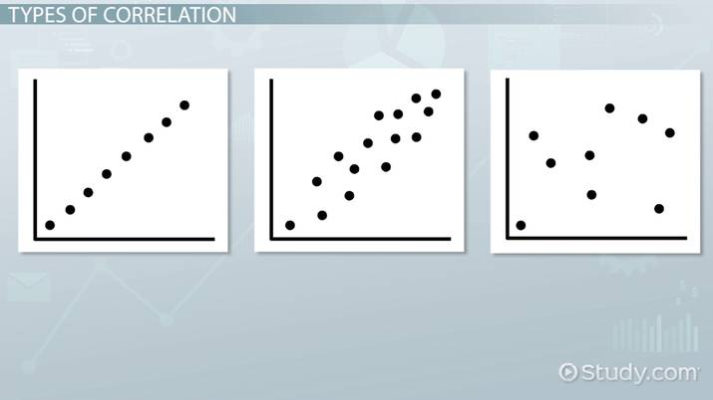
Tabulating and Analyzing Data Correlations
In tabulating and analyzing data, you may see relationships between two or more variables that help explain the findings.
The business researcher who sees a correlation needs to ask why and how the two variables are related.
Apparent correlations stimulate investigation and present possible solutions to be explored.

Slide 35
Drawing Conclusions and Making Recommendations
The sections devoted to conclusions and recommendations are the most widely read portions of a report.
Knowledgeable readers go straight to the conclusions to see what the report writer thinks the data mean. Because conclusions summarize and explain the findings, they represent the heart of a report.
Your value in an organization rises considerably if you can analyze information logically, draw conclusions, and show how the data answer questions and solve problems.

Slide 36
Analyzing Data to Arrive at Conclusions
Any set of data can produce a variety of meaningful conclusions.
Always bear in mind, though, that the audience for a report wants to know how these data relate to the problem being studied.
What do findings mean in terms of solving the original report problem?

Slide 37
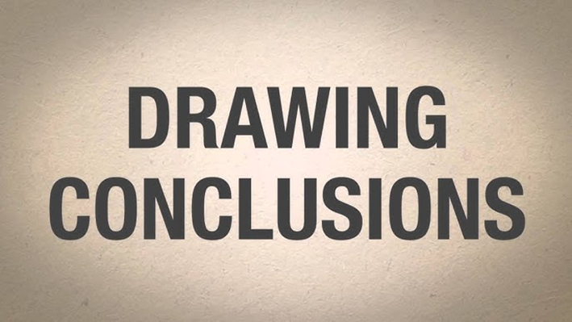
Analyzing Data to Arrive at Conclusions
Although your goal is to remain objective, drawing conclusions naturally involves a degree of subjectivity.
Your goals, background, and frame of reference all color the inferences you make. All writers interpret findings from their own perspectives, but they should not manipulate them to achieve a preconceived purpose.
You can make your report conclusions more objective by using consistent evaluation criteria.

Slide 38
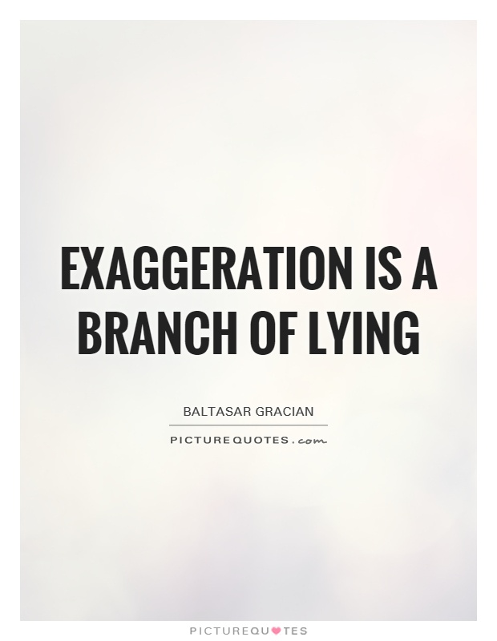
Analyzing Data to Arrive at Conclusions
Avoid the temptation to sensationalize or exaggerate your findings or conclusions.
Be careful of words such as “many,” “most,” and “all.”
Instead of “many of the students felt…”, you might more accurately write “some of the respondents felt…”
Examine your motives before drawing conclusions.
Do not let preconceptions or wishful thinking color your reasoning.

Slide 39
Preparing Report Recommendations
Conclusions explain what the problem is, whereas recommendations tell how to solve it.
Business readers prefer specific, practical recommendations. They want to know exactly how to implement the suggestions.
The specificity of your recommendations depends on your authorization.
What are you commissioned to do, and what does the reader expect?

Slide 40
Preparing Report Recommendations
Use your intuition and your knowledge of the audience to determine how comprehensive your recommendations should be.
A good report provides practical recommendations that are agreeable to the audience.

Slide 41
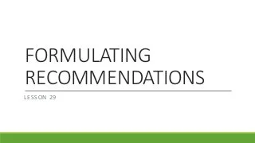
Preparing Report Recommendations
If possible, make each recommendation a command.
Recommendations should begin with a verb.
This structure sounds forceful and confident and helps the reader comprehend the information quickly.
Avoid hedging words such as “maybe” and “perhaps;” they reduce the strength of the recommendation.

Slide 42
Preparing Report Recommendations
Experienced writers may combine recommendations and conclusions.
In short reports writers may omit conclusions and move straight to recommendations.
An important point about recommendations is that they include practical suggestions for solving the report problem.
Furthermore, they are the result of logical analysis.

Slide 43
Moving from Findings to Recommendations
Recommendations evolve from the interpretation of findings and conclusions (see example below).
Finding
Managers perceive family matters to be inappropriate issues to discuss at work.
Conclusion
Managers are neither willing nor trained to discuss family matters that may cause employees to miss work.
Recommendation
Provide managers with training in recognizing and working with personal and family matters that affect work.

Slide 44
Organizing Data
After collecting sets of data, interpreting them, drawing conclusions, and thinking about the recommendations, you are ready to organize the parts of the report into a logical framework.
Poorly organized reports lead to frustration. Readers will not understand, remember, or be persuaded.
Wise writers know that reports rarely “just organize themselves.”
Instead, the report author must impose organization on the data and provide cues so that the reader can follow the logic of the writer.

Slide 45
Organizing Data
Informational reports generally present data w/o interpretation.
Analytical reports generally analyze data and draw conclusions.
For readers who know about the project, are supportive, or are eager to learn the results quickly, the direct strategy is appropriate. Conclusions and recommendations, if requested, appear up front.
For readers who must be educated or persuaded, the indirect strategy works better. Conclusions and recommendations appear last, after the findings have been presented and analyzed.

Slide 46
Organizing Data
Although every report is unique, the overall organizational strategies described here generally hold true.
The real challenge, though, lies in:
Organizing the facts/findings and discussion/analysis sections
Proving reader cues.

Slide 47
Organizational Strategies for Informational and Analytical Reports
Informational Reports
Direct Strategy
Introduction/Background
Facts/Findings
Summary/Conclusion
Analytical Reports
Direct Strategy
Introduction/Problem
Conclusions/Recommendations
Facts/Findings
Discussion/Analysis
Indirect Strategy
Introduction/Problem
Facts/Findings
Discussion/Analysis
Conclusions/Recommendations

Slide 48
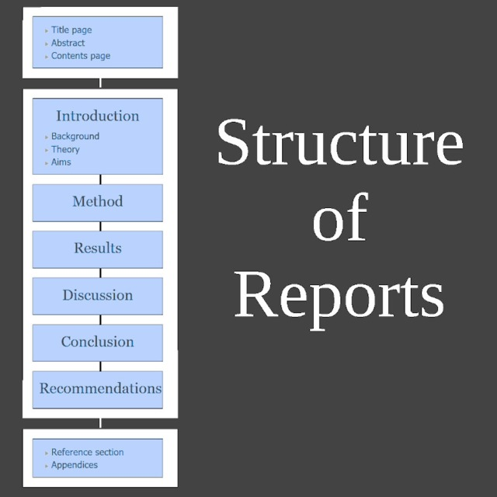
Ordering Information Logically
Whether you are writing informational or analytical reports, you must structure the data you have collected.
Five common organizational methods are by (1) time, (2) component, (3) importance, (4) criteria, and (5) convention.
Regardless of the method you choose, be sure that it helps the reader understand the data. Reader comprehension, not writer convenience, should govern organization.

Slide 49
Ordering Information Logically 1. Time
Ordering data by time means establishing a chronology of events.
Agendas, minutes of meetings, progress reports, and procedures are usually organized by time.
For example, a report describing an eight-week training program would most likely be organized by weeks.
A plan for a step-by-step improvement of customer service would be organized by steps.

Slide 50
Ordering Information Logically 2. Component
Especially for informational reports, data may be organized by components: (x) location, geography, division, product, or part.
For instance, a report detailing company expansion might divide the plan into West Coast, East Coast, and Midwest expansion.
The report could also be organized by divisions: personal products, consumer electronics, and household goods.
Organization by component works best when the classification already exists.

Slide 51
Ordering Information Logically 3. Importance
Organization by importance involves beginning with the most important item and proceeding to least important, or vice versa.
The writer must decide what is most important, always keeping in mind the readers’ priorities, and expectations.
Busy readers appreciate seeing important points first; they may skim or skip other points.
On the other hand, building to a climax by moving from least important to most important enables the writer to focus attention at the end. Thus, the reader is more likely to remember the most important item. Of course, the writer also risks losing the reader’s attention along the way.

Slide 52
Ordering Information Logically 4. Criteria
Establishing criteria by which to judge helps writers to treat topics consistently.
Let’s say your report compares health plans A, B, and C.
For each plan you examine the same standards: cost per employee, amount of deductible, and patient benefits.
The resulting data could be organized either by plans or criteria.

Slide 53
Ordering Information Logically 4. Criteria
Although you might favor organizing the data by plans (because that is the way your collected the data), the better way is by criteria.
When you discuss patient benefits, for example, you would examine all three plans’ benefits together.
Organizing a report around criteria helps readers make comparisons, instead of forcing them to search through the report for similar data.

Slide 54
Ordering Information Logically 5. Convention
Many operational and recurring reports are structured according to convention. That is, they follow a prescribed plan that everyone understands.
For example, an automotive parts manufacturer might ask all sales reps to prepare a weekly report with these headings: “Competitive Observations” (competitor’s price changes, discounts, new products, product problems, distributor changes, product promotions), “Product Problems” (quality, performance, needs), and “Customer Service Problems” (delivery, mailings, correspondence, social media, Web traffic).
Management gets exactly the information it needs in an easy-to-read form.

Slide 55
Ordering Information Logically 5. Convention
Like operating reports, proposals are often organized conventionally. They might use such groupings as background, problem, proposed solution, staffing, schedule, costs, and authorization.
As you might expect, reports following these conventional, prescribed structures greatly simplify the task of organization.

Slide 56
Providing Reader Cues
For both formal and informal reports, devices such as introductions, transitions, and headings prevent readers from getting lost.
When you finish organizing a report, you probably see a neat outline in your mind: major points supported by subpoints and details. Readers, however, do not know the material as well as you do; they cannot see your outline.
To guide them through the data, you need to provide the equivalent of a map and road signs.

Slide 57
Providing Reader Cues 1. Introduction
On of the best ways to point a reader in the right direction is to provide a report introduction that does three things:
Tells the purpose of the report.
Describes the significance of the topic.
Previews main points and order in which they will be developed.

Slide 58
Providing Reader Cues 1. Introduction
Good openers in effect set up a contract with the reader.
The writer promises to cover certain topics in a specified order.
Readers expect the writer to fulfill the contract. They want the topics to be developed as promised – using the same wording as presented in the order mentioned.
Remember that the introduction provides a map to a report; switching the names on the map will ensure that readers get lost.
To maintain consistency, delay writing the introduction until you have completed the report.
Long, complex reports may require introductions, brief internal summaries, and previews for each section.

Slide 59
Providing Reader Cues 2. Transitions
Expressions such as “on the contrary,” “at the same time,” and “however,” show relationships and help reveal the logical flow of ideas in a report.
These transitional expressions enable writers to tell readers where ideas are headed and how they relate. The following transitional expressions enable you to show readers how you are developing your ideas:
To present additional thoughts: additionally, again, also, moreover, furthermore
To suggest cause and effect: accordingly, as a result, consequently, therefore
To contract ideas: at the same time, but, however, on the contrary, though, yet
To show time and order: after, before, first, finally, now, previously, to conclude
To clarify points: for example, for instance, in other words, that is, thus

Slide 60
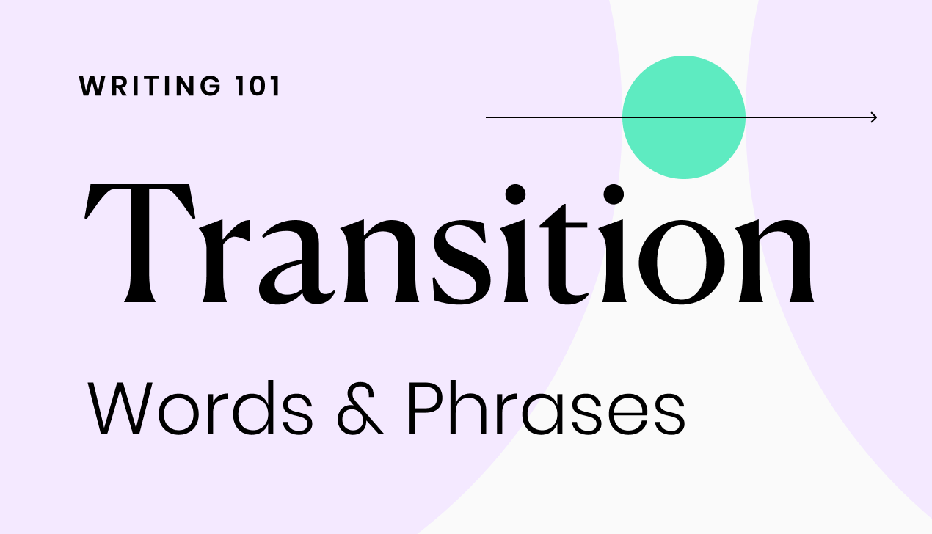
Providing Reader Cues 2. Transitions
In using these expressions, recognize that they do not have to sit at the head of a sentence.
Listen to the rhythm of the sentence, and place the expression where a natural pause occurs. If you are unsure about the placement of a transitional expression, position it at the beginning of the sentence.
Used appropriately, transitional expressions serve readers as guides; misused or overused, they can be as distracting and frustrating as too many road signs on a highway.

Slide 61
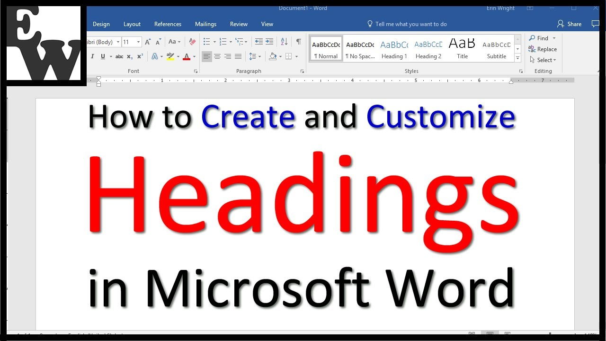
Providing Reader Cues 3. Headings
Good headings are another structural cue that assists readers in comprehending the organization of a report.
They highlight major ideas, allowing busy readers to see the big picture at a glance.
Moreover, headings provide resting points for the mind and for the eye, breaking up large chunks of text into manageable and inviting segments.

Slide 62
Providing Reader Cues 3. Headings
Report writers may use functional or talking headings.
Functional headings show the outline of a report but provide little insight for readers. Functional headings are useful for routing reports. They are also appropriate for sensitive topics that might provoke emotional reactions.
By keeping the headings general, experienced writers hope to minimize reader opposition or reaction to controversial subjects.

Slide 63
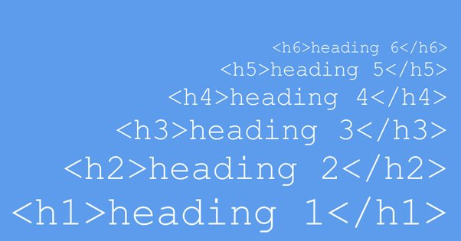
Providing Reader Cues 3. Headings
Talking headings provide more information and spark interest.
Unless carefully written, however, talking headings can fail to reveal the organization of a report. With some planning, though, headings can combine the best attributes of both functional and talking.
The best strategy for creating helpful talking headings is to write a few paragraphs first and then generate a talking heading that covers both paragraphs.

Slide 64
Writing Short Informational Reports
Now that you are familiar with the basics of gathering, interpreting, and organizing data, you are ready to enter that information into short informational or analytical reports.
Informational reports often describe periodic, recurring activities (such as monthly sales or weekly customer calls) as well as situational, nonrecurring events (such as trips, conferences, and special projects). Short informational reports may also take the form of summaries of longer publications.
Most informational reports have one thing in common: a neutral or receptive audience. The readers of informational reports do not have to be persuaded; they simply need to be informed.

Slide 65
Writing Short Informational Reports
You can expect to write many informational reports as an entry-level or middle-management employee. These reports generally deliver nonsensitive data and are therefore written directly.
Although the writing style is usually conversational and informal, the report contents must be clear to all readers.
All headings, lists, and graphics should help the reader grasp major ideas immediately.

Slide 66
Writing Short Informational Reports
The principles of conciseness, clarity, courtesy, and correctness apply to report writing.
Your ability to write effective reports can boost your visibility in an organization and result in advancement.
The following pointers on design features and techniques can assist you in improving your reports:
Summaries – Effective Document Design – Periodic (Activity) Reports – Trip, Convention, and Conference Reports – Progress and Interim Reports – Investigative Reports

Slide 67
Summaries
A summary compresses the main points from a book, report, article, website, meeting, or convention.
A summary saves time by reducing a report or article by 85-95%.
Employees are sometimes asked to write summaries that condense technical reports, periodical articles, or books so that their staff or superiors may grasp the main ideas quickly.
As a student, you may be asked to write summaries of articles, chapters, or books to sharpen your writing skills and to confirm your knowledge of reading assignments.

Slide 68
Summaries
In writing a summary, follow these general guidelines:
Present the goal or purpose of the document being summarized. Why was it written?
Highlight the research methods (if appropriate), findings, conclusions, and recommendations.
Omit illustrations, examples, and references.
Organize for readability by including headings and bulleted or enumerated lists.
Include your reactions or an overall evaluation of the document if asked to do so.
An executive summary summarizes a long report, proposal, or business plan. It concentrates on what management needs to know.

Slide 69
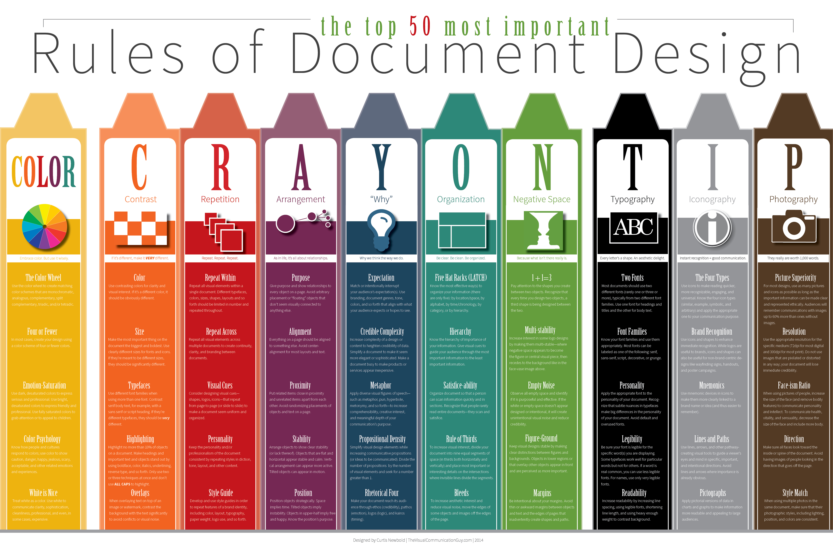
Effective Document Design
Desktop publishing packages, sophisticated word processing programs, and high-quality laser printers now make it possible for you to turn out professional-looking documents and promotional materials.
Resist the temptation, however, to overdo it by incorporating too many features in one document.
The top ten design tips will help you apply good sense and solid design principles in “publishing” your documents.

Slide 70
Top Ten Tips for Designing Better Documents
Analyze Your Audience
Avoid Amateurish Effects – Keep it Clean and Simple
Choose an Appropriate Font Size – Typically 11 or 12 Points Tall
Use a Consistent Type Font – Stay with a Single Family Type
Do Not Justify Right Margins – Use Ragged Right and White Space
Separate Paragraphs and Sentences Properly – Be Consistent
Design Readable Headings – Use Upper and Lower Case
Strive for an Attractive Page Layout – Balance Print and White Space
Use Graphics and Clip Art with Restraint
Develop Expertise – Use Desktop Publishing Features

Slide 71
Preparing Short Analytical Reports
You may recall that informational reports generally provide data only.
There are three common types of analytical business reports: (1) justification/recommendation reports, (2) feasibility reports, and (3) yardstick reports.
These reports involve collecting and analyzing data, evaluating the results, drawing conclusions, and making recommendations.

Slide 72
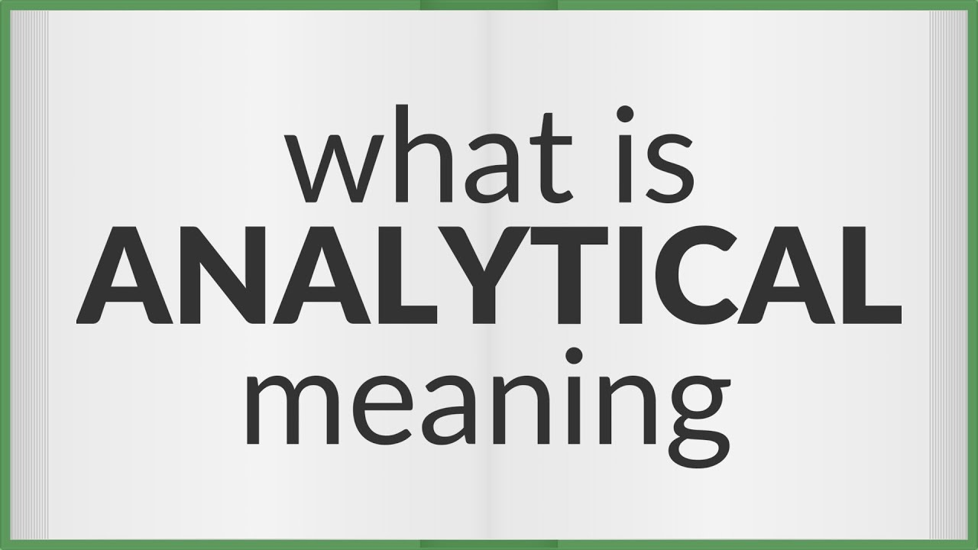
Preparing Short Analytical Reports
Analytical reports differ significantly from informational reports.
Although both seek to collect and present data clearly, analytical reports also evaluate the data and typically try to persuade the reader to accept the conclusions and act on the recommendations.
Informational reports emphasize facts; Analytical reports emphasize reasoning and conclusions.

Slide 73
Preparing Short Analytical Reports
For some situations you may organize analytical reports directly with the conclusions and recommendations near the beginning.
Directness is appropriate when the reader has confidence in the writer, based on either experience or credentials.
Frontloading the recommendations also works when the topic is routine or familiar and the reader is supportive.

Slide 74
Preparing Short Analytical Reports
Directness can backfire, though.
If you announce the recommendation too quickly, the reader may immediately object to a single idea. Once the reader has an unfavorable mind-set, changing it may be difficult.
A reader may also believe that you have oversimplified or overlooked something significant if you provide your recommendations first.
When you must lead the reader through the process of discovering the solution, use the indirect strategy; present conclusions and recommendations last.

Slide 75
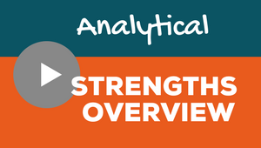
Preparing Short Analytical Reports
Most analytical reports answer questions about specific problems and aid in decision making.

Slide 76
Justification/Recommendation Reports Direct Strategy
For nonsensitive topics and recommendations that will be agreeable to readers, you can organize directly.
Consider the following sequence:
Identify the problem or need briefly.
Announce the recommendation, solution, or action concisely and with action verbs.
Explain more fully the benefits of the recommendation or steps necessary to solve the problem.
Include a discussion of pros, cons, and costs.
Conclude with a summary specifying the recommendation and necessary action.

Slide 77
Justification/Recommendation Reports Indirect Strategy
When a reader may oppose a recommendation or when circumstances suggest caution, do not rush to reveal your recommendation.
Consider the following sequence for an indirect approach to your recommendations:
Refer to problem in general, not to recommendation, in the subject line.
Describe the problem or need your recommendation addresses. Use specific examples, supporting statistics, and authoritative quotes to lend credibility to the seriousness of the problem.
Discuss alternative solutions, beginning with the least likely to succeed.
Present the most promising alternative (your recommendation) last.
Show how advantages of recommendation outweigh its disadvantages.
Summarize your recommendation. Specify the action it requires.
Ask for authorization to proceed, if necessary.

