Slide 1
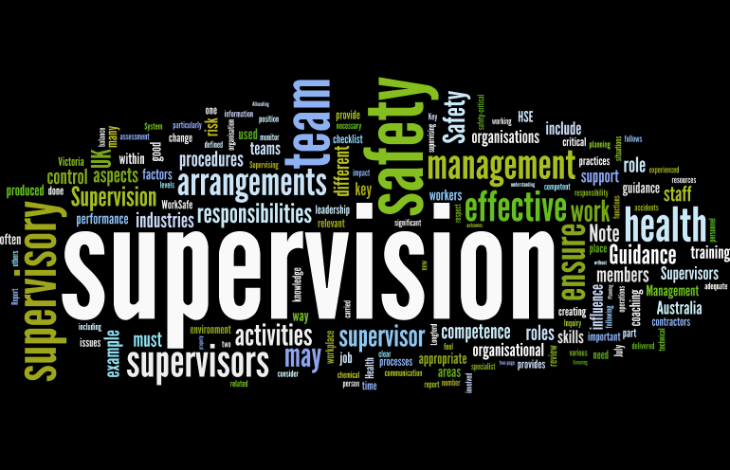
Supervision
Supervision
  Concepts and Practices of Management, 13th Edition
    Edwin C. Leonard, Jr., Ph.D. and Kelly A. Trusty, Ph.D. Cengage Learning, Boston, MA 2013
      ISBN: 978-1-285-86637-6

Slide 2

Part Four: Controlling and Managing Performance Conflict
Chapter Thirteen: Fundamentals of Controlling
  After studying this chapter, you will be able to:
    Describe nature and importance of the managerial controlling function.
    Discuss the characteristics of effective controls and their importance.
    Identify the essential steps in the control process.
    Clarify supervisor’s role in budgeting and using them as a control device.
    Examine the supervisor’s role in maintaining cost consciousness and in responding to higher-level managers’ orders to reduce costs.
    Explain how the controlling function is closely related to the other managerial functions.

Slide 3
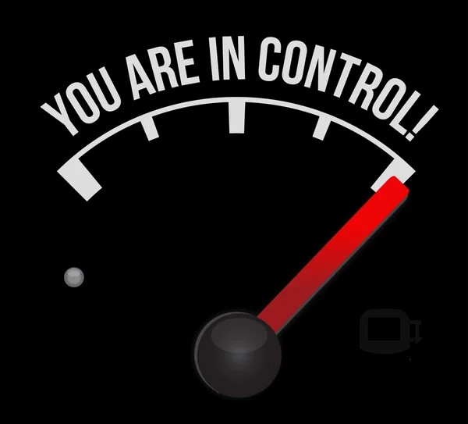
The Supervisor’s Role in Controlling
The word control often elicits negative reactions, but control is a normal part of daily life (i.e. alarm clock, thermostat, fuel gauge).
  Controls play an important role in organizations. The ensure that results match plans.
    Every manager, from CEO to supervisor, must develop and apply controls that regulate the organization’s activities to achieve the desired results.

Slide 4
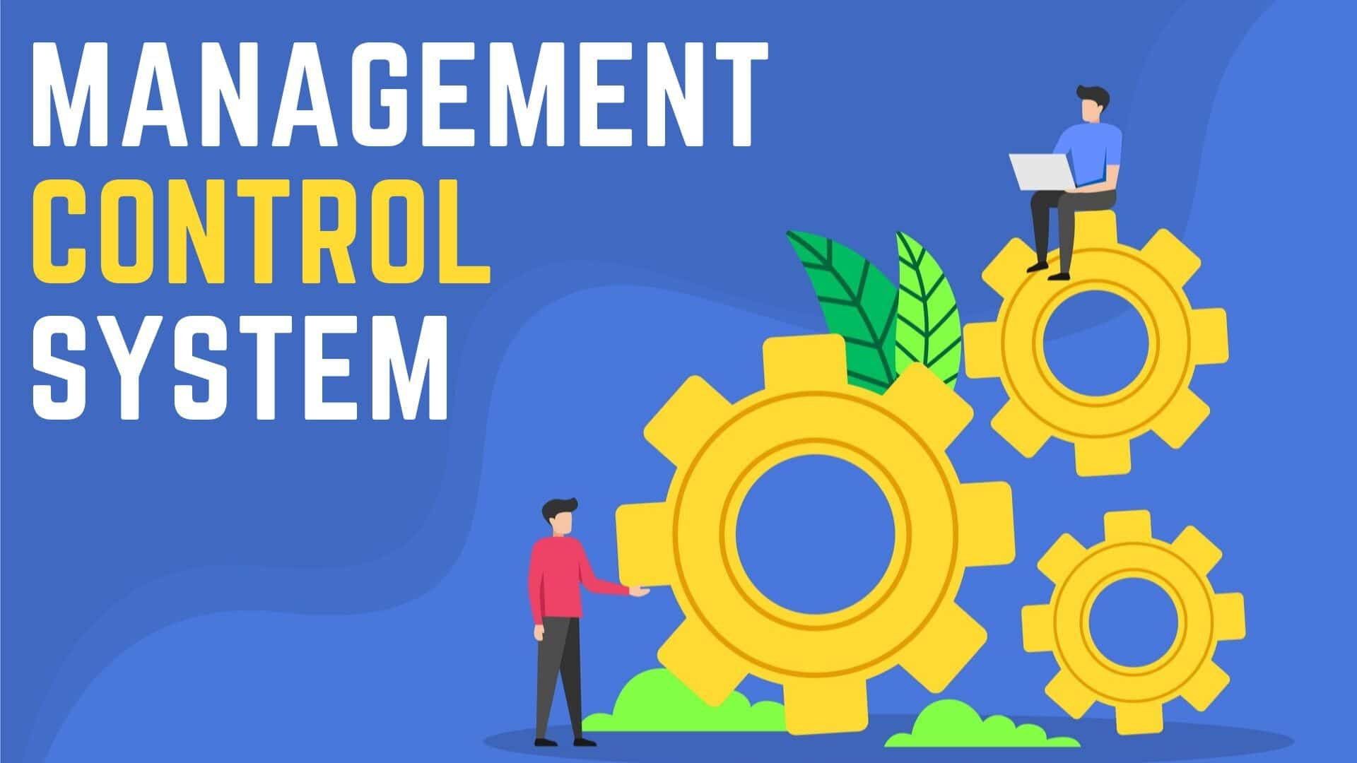
The Supervisor’s Role in Controlling
As management guru Peter Drucker stated, “Checking the results of a decision against its expectations shows managers what their strengths are, where they need to improve, and where they lack knowledge or information.”
  The controlling function consists of checking to determine whether operations adhere to established plans, ascertaining whether progress is being made toward objectives, and taking action, where necessary, to correct deviations from plans.
    In other words, the supervisor acts to make things happen the way they were planned.

Slide 5

The Supervisor’s Role in Controlling
Controlling is essential whenever a supervisor assigns duties to EEs because supervisor remains responsible for assigned work.
  If all plans proceeded according to design and without interference, the controlling function would be obsolete. As every supervisor knows, however, this is not reality.
    Therefore, it is part of supervisor’s job to keep activities in line and, when necessary, to get those activities back on track.

Slide 6
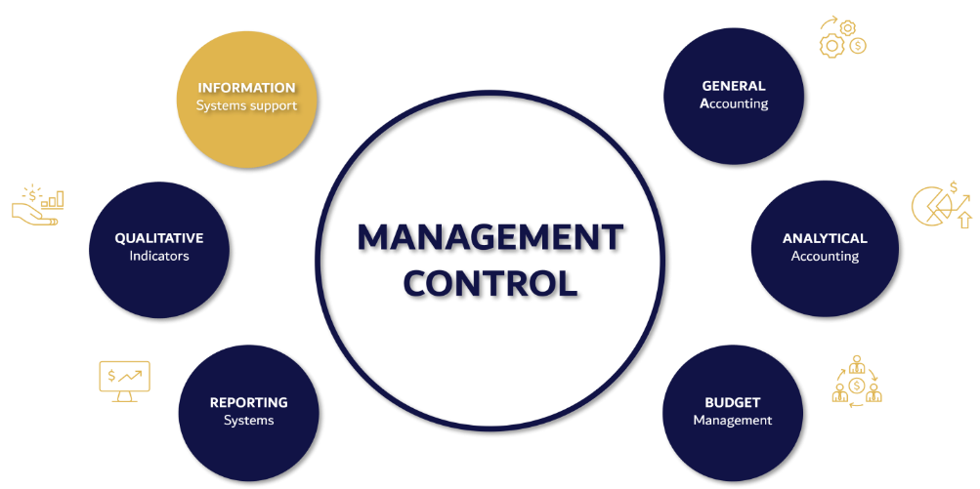
Nature of the Controlling Function
Controlling is most closely related to planning.
  In planning, the supervisor sets objectives, and these objectives become standards against which performance is appraised.
    When performance and standards deviate, the supervisor must carry out the controlling function by taking corrective action, which may involve establishing new plans and different standards.

Slide 7

Employee Responses to Controls
When controls are well-designed and properly implemented, they can positively influence EE motivation and behavior.
  The supervisor should design and apply control systems that EEs will accept without resentment but that will also monitor department performance effectively.
    Interestingly, some firms have at times loosened certain controls and given EEs more freedom, only to be disappointed by the outcome and then forced to tighten or return to discarded controls (i.e. casual Fridays).

Slide 8

Controlling Should Be Forward-Looking
A supervisor can do nothing about the past.
  For example, if work assigned to an EE for the day has not been accomplished, controlling cannot correct the day’s results. Yet some supervisors believe that the main purpose of controlling is to assign blame for mistakes. This attitude is not sound because supervisors should primarily look forward, not backward.
    Of course, supervisors should study the past to learn how and why something happened and then take steps to avoid the same mistakes.

Slide 9

Controlling Should Be Forward-Looking
Because supervisors should look forward while controlling, it is essential that they identify deviations from standards as quickly as possible.
  Controls w/in a process or an activity’s time frame, rather than at its end will enable the supervisor to take prompt corrective action. For example, instead of waiting until the day is over, a supervisor could check at midday to see whether a job is progressing satisfactorily.
    Even though morning is past and nothing can change what has already happened, there may be time to correct the problem before damage becomes excessive.

Slide 10
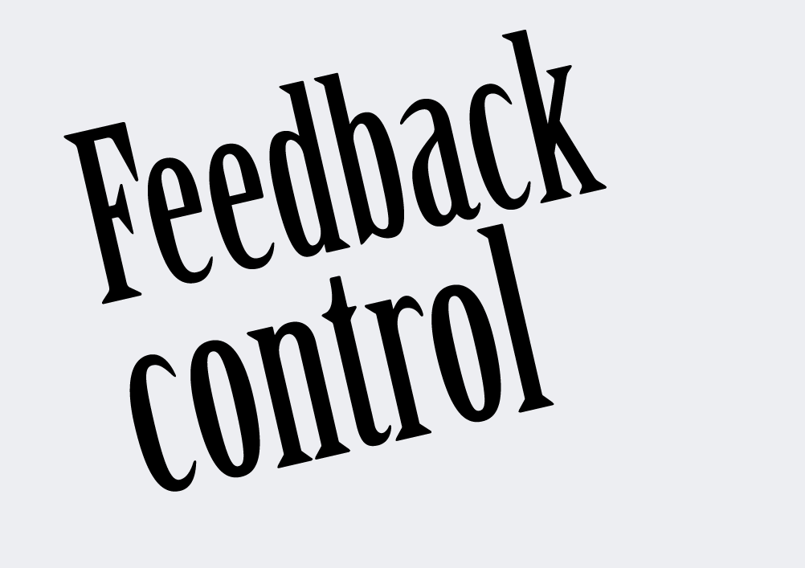
Controlling Should Be Consistent with Strategy
Strategic planning begins with establishing goals and making decisions that enable an organization to accomplish objectives.
  The ultimate question becomes whether the organization achieved what it intended.
    In order to reach our goal, we must establish feedback controls and monitor progress. Then changes, if necessary, must be made.

Slide 11

Controlling Should Be Consistent with Strategy
If you have active, hands-on, fully informed EEs, who have the authority to see things that need to be done and the right to tackle any problem, ask any question of anyone, and apply their knowledge consistent with the organizational mission and culture, then the possibilities are limitless.
  The essence of a successful control system is a consistent reporting.
  Measurements and accountability are the key.
    Unless people know how they are doing, the won’t know what to change or accelerate.

Slide 12
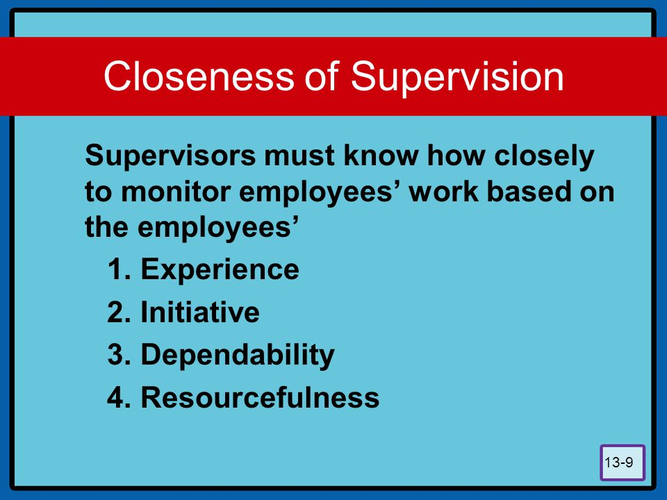
Controlling and Closeness of Supervision
Supervisors must know how closely to monitor EE’s work.
  The closeness of supervisory follow-up is based on such factors as an EE’s experience, initiative, dependability, and resourcefulness.
    Permitting an EE to work on an assignment without close supervision is both a challenge and a test of a supervisor’s ability to delegate.

Slide 13

Controlling and Closeness of Supervision
This does not mean, however, that the supervisor should leave the EE alone until it is time to inspect the final results.
  It does mean that the supervisor should avoid watching every detail of every EE’s work.
    By familiarizing themselves with an EE’s abilities, supervisors can learn how much leeway to give and how closely to follow up and control.

Slide 14
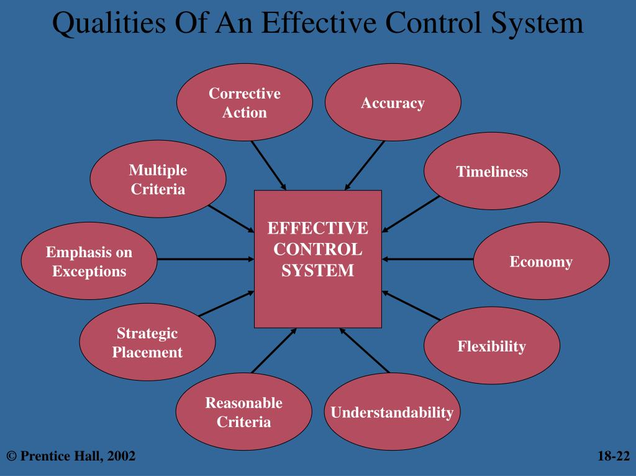
Characteristics of Effective Controls
For control mechanisms to work, they should be understandable, timely, suitable and economical, indicational, and flexible.
  These characteristics are required of the controls used in all supervisory jobs in any industry.
    Because department activities are so diverse, these characteristics are discussed here only generally.

Slide 15
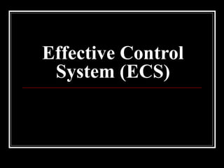
Characteristics of Effective Controls
Understandable
All control mechanisms: Feedforward, Concurrent, and Feedback must be understood by managers, supervisors, and EEs.
  At higher management levels, control mechanisms may be sophisticated and based on management information systems, mathematical formulas, complex charts and graphs, and detailed reports. At the top levels, such controls should be understandable to all mangers who use them.
    At the departmental level, controls should be much less complicated.

Slide 16
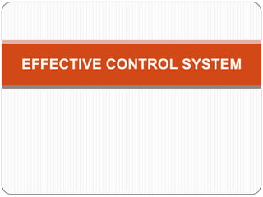
Characteristics of Effective Controls
Timely
Controls should indicate deviations from standards without delay, and such deviations should be reported to the supervisor promptly, even when substantiated only by approximate figures, preliminary estimates, or partial information.
  It is better for the supervisor to know when things are about to go wrong than to learn that they are already out of control.
    The sooner a supervisor knows about deviations, the more quickly the deviations can be corrected.

Slide 17
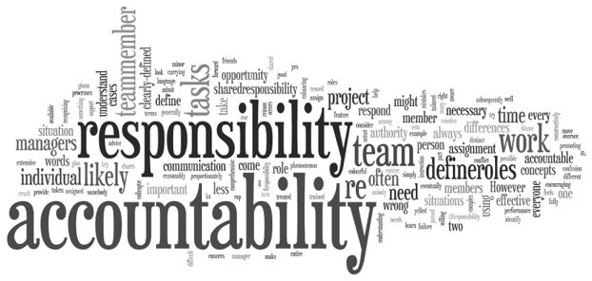
Characteristics of Effective Controls
Indicational
It is not enough for controls just to expose deviations as those deviations occur.
  A control also should indicate who is responsible for the deviation and where the deviation occurred.
    When several operations comprise a work process, the supervisor may need to check performance before and after each step. Otherwise, if results are below standards, the supervisor may not know where to take corrective action.

Slide 18

Characteristics of Effective Controls
Flexible
Supervisors must tailor controls to the activities, circumstances, and needs for their departments.
  But more importantly, they must understand how time impacts what they do when.

Slide 19
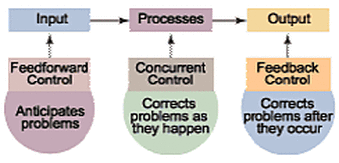
Characteristics of Effective Controls
Time Factor Control Mechanisms
Before we discuss the steps of the controlling process, it is important to distinguish among the following three types of control, which are classified according to time:
  Feedforward (Preliminary-Preventive-Anticipatory)
  Concurrent (In-Process)
  Feedback (After-the-Process)

Slide 20

Feedforward Controls
Preliminary-Preventive-Anticipatory
Because controlling has forward-looking aspects, the purpose of a feedforward control is to anticipate and prevent potential sources of deviation from standards by considering, in advance, the possibility of any malfunctions or undesirable outcomes.
  A preventive maintenance program, designed so that equipment will not breakdown at the height of production, is an ex. of a feedforward control.
  The clerk who selects a sample of fruits and vegetables from crates before they are unloaded and the merchandise is placed on display is an example.
  Requiring assemblers to ascertain components’ quality before installation and signify that they have done so is becoming increasingly common.

Slide 21

Feedforward Controls
Preliminary-Preventive-Anticipatory
Other examples of feedforward controls include such devices as safety posters; fire drills; disciplinary rules; checklists to follow before starting equipment; and the policies, procedures, and methods drawn up by managers when planning operations.
  Everyone uses feedforward controls at one time or another.
    For example, a person who checks a car’s tires, oil, and gas gauge before a trip is using feedforward controls.

Slide 22

Concurrent Controls
In Process
A control that is applied while operations are proceeding and that spots problems as they occur is called concurrent control.
  The traveler who notices that the fuel gauge is below half full or that the fuel warning light has just come on, and who pulls into the next gas station for a fill-up uses a concurrent control.
    Other examples of concurrent controls are online monitoring systems, numerical counters, automatic switches, gauges, and warning signals.

Slide 23

Feedback Controls
After-the-Process
The purpose of a feedback control is to evaluate and, when necessary, correct the results of a process or an operation and to determine ways to prevent deviations from standard.
  The traveler who calculates average miles per gallon and uses that feedback when planning the budget for next trip uses a feedback control.
    Other examples of feedback controls include measurements of the quality and quantity of units produced, various kinds of statistical information, program satisfaction surveys, accounting reports, and visual inspections.

Slide 24

Feedback Controls
After-the-Process
Feedback controls are probably the most widely used category of controls at the supervisory level.
  However, they are often used primarily to determine what went wrong and where to place blame rather than to prevent the problem from recurring.

Slide 25

Steps in the Control Process
The control process involves three sequential steps.
  The first step, which is usually part of the planning function, is to set standards appropriate to the task. In the second step, performance is measured against these standards. If performance does not meet the standards, the third step is to take corrective action.
    These three steps must be followed in sequence if controlling is to achieve the desired results.

Slide 26

Steps in the Control Process
Setting Standards
Standards may be defined as the units of measure or the criteria against which performance or results are judged.
  Standards are targets; they are the criteria to which performance is compared in order to exercise control.
    Standards must be set before a person’s work, a finished product, or a service can be meaningfully evaluated.

Slide 27

Steps in the Control Process
Setting Standards
Goals and objectives give EEs specific targets.
  The presence of objectives does not mean targets will be attained.
    The effective supervisor must follow up to ensure that the actions that are supposed to be taken are taken and the objectives are being achieved.

Slide 28

Steps in the Control Process
Setting Standards
There are many types of standards, depending on the areas of performance or results to be measured.
  Tangible standards are performance targets for results that are identifiable and measurable. These standards can be set to measure such things as quantity of output, quality of output, market share, labor costs, overhead expenses, and time spent producing a unit or providing a service.
    Intangible standards are targets for results that have no physical form; these standards may cover such areas as an organization’s reputation, level of EE engagement, or quality of care and service. It is usually more difficult to establish intangible standards in numerical or precise terms.

Slide 29

Steps in the Control Process
Setting Standards
The most frequent tangible standards that supervisors determine or must follow pertain to departmental operations.
  For example, in a production department, standards can be set for a number of units to be produced; the labor hours per unit; and product quality like durability, finish, and closeness of dimensions.
    In a sales department, standards might be set for number of customers contacted, the sales dollars realized, and the number and types of customer complaints.

Slide 30
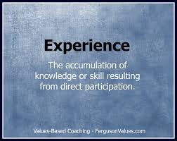
Steps in the Control Process
Setting Standards
In setting standards, a supervisor can use experience and job knowledge as guides.
  Through experience and observation, supervisors have general ideas of how much time it takes to perform certain jobs, the resources that are required, and what constitutes good or poor quality.
    By studying and analyzing previous budgets, past production and service delivery, and other departmental records, supervisors should be able to develop workable standards of performance for most areas of operations.

Slide 31
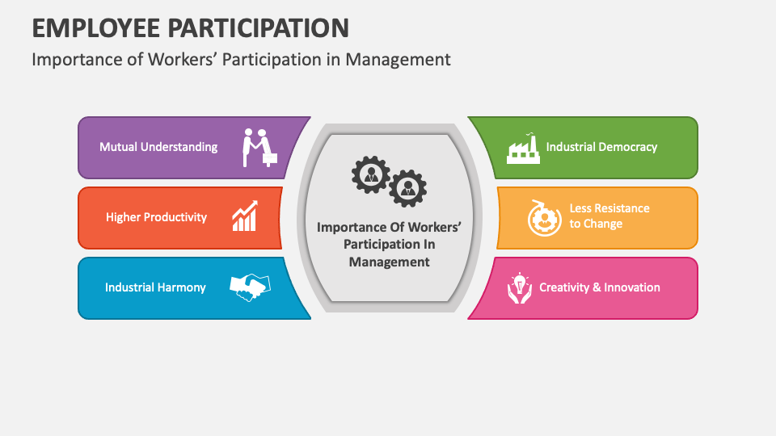
Employee Participation
Some EEs resent standards. This resentment is part of a fear that supervisors use them solely to increase workers’ output.
  However, the main purpose of performance standards should be to create realistic targets, that is, objectives that can be achieved and are considered fair.
    Workers are more apt to accept standards as reasonable and fair when they help formulate the standard.

Slide 32

Employee Participation
One technique for including EEs in standards establishment is to form a committee of workers to help the supervisor carry out a work-measurement program.
  The EEs selected for this committee should be those who, in the supervisor’s judgment, consistently do a fair day’s work.

Slide 33

Employee Participation
When adopting this approach, the supervisor should explain to all EEs what is involved in setting standards, including areas in which judgment is involved.
  EEs should be allowed to challenge standards they consider unfair and even be allowed to request rethinking of standards.
    Most workers accept performance standards when they feel the supervisor has tried to help them understand the basis for standards and has been willing to consider and adjust standards that appear to be unreasonable.

Slide 34

Strategic Control Points
A metric or standard is nothing more than a measure to assess the department’s performance in a particular area.
  Organizations should consider developing metrics for the following:
    Customer Satisfaction – Market Share – Sales – Inventory Measures – Profitability – EE Satisfaction – Product and Service Quality – Performance of Suppliers –EE Suggestions Incorporated –

Slide 35
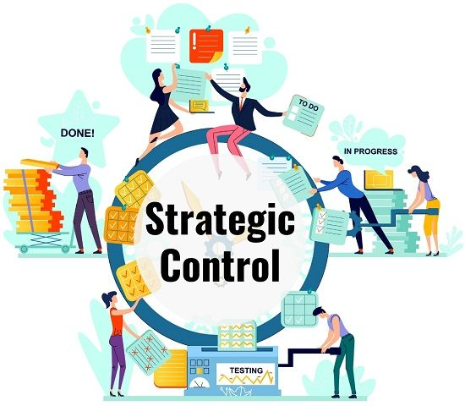
Strategic Control Points
The supervisor should concentrate on certain strategic control points against which overall performance can be monitored.
  Strategic control points or standards are a limited number of key indicators that give the supervisor a good sampling of overall performance.
    There are no rules for selecting strategic control points.

Slide 36

Strategic Control Points
One major consideration that may render one standard more strategic than another is timeliness.
  Because it is essential to control time, the sooner a deviation is discovered, the better it can be corrected.
    A supervisor must recognize at what critical step operations should be checked.

Slide 37

Strategic Control Points
A supervisor should be careful to choose strategic control points that do not significantly impede other important standards.
  For example, excessive control to increase production quantity might erode product quality. Likewise, if labor expenses are selected as a strategic control point, supervisors might try to hold down wage expenses by hiring too few workers, thereby causing both quality and quantity standards to deteriorate.
    What serves well as a strategic control point in one department will not necessarily serve well in another.

Slide 38

Strategic Control Points
Another example of strategic control points is the supervisor who wishes to assess departmental EE relations.
  The following strategic control standards are often described as EE engagement measures:
    Number of voluntary EE resignations and requests for transfer.
    Levels of EE absenteeism, tardiness, and turnover.
    Accident frequency and severity rates.
    Number and types of EE grievances and complaints.
    Number and types of customer complaints.
    Amount of scrap and rejects and unexplained losses of material-inventory.
    Number of EE suggestions for methods or operations improvement.
    EE responses to satisfaction surveys.

Slide 39

Strategic Control Points
By closely watching trends and changes in these indicators, the supervisor should be able to spot problems requiring corrective action.
  If the trends of most or all of these indicators are unfavorable, major supervisory attention is needed.

Slide 40

Checking Performance Against Standards
The second major step in the control process, an ongoing activity for every supervisor, is to check performance against standards.
  The primary ways for a supervisor to do this are to observe, study oral and written reports, spot check, and use statistical sampling.

Slide 41
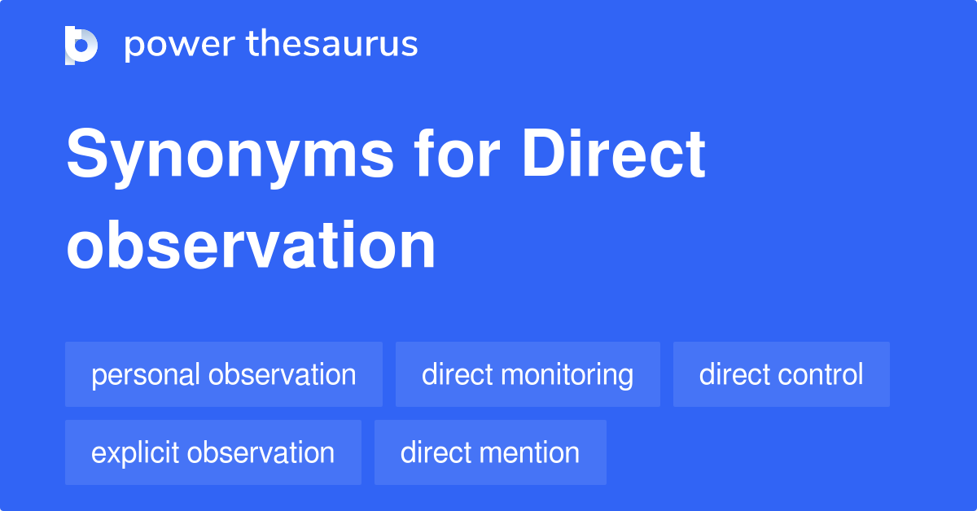
Personal Observation
When monitoring EE performance, there is no substitute for a supervisor’s direct observation and personal contact.
  The opportunity to inspect and closely observe EE performance is an advantage the supervisor has over top-level managers because the further a manager is from EE’s work, the more that manager must depend on reports from others.
    The supervisor has ample opportunity to observe directly all day long.

Slide 42

Personal Observation
When supervisors find deviations from standards, they should assume a questioning, though not necessarily a fault-finding, attitude.
  A problem could be due to something outside the EE’s control, such as a malfunctioning machine or faulty raw materials.
    Supervisors should question mistakes in a positive, helpful manner. For example, instead of criticizing, a supervisor should first ask what caused the problem and whether there is any way in which the supervisor can help the EEs do their jobs more easily, safely, or efficiently.
    Supervisors also should ask EEs what should be done to correct problems.

Slide 43
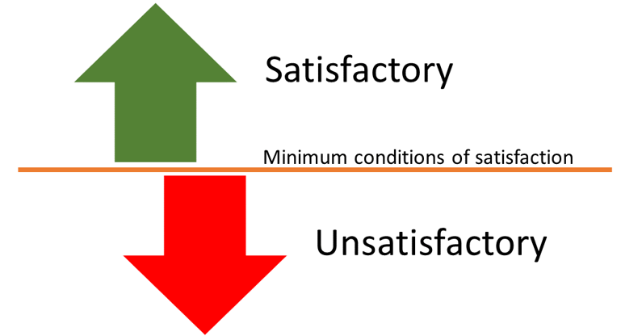
Personal Observation
When standards are stated in general terms, supervisors should look for specific unsatisfactory conditions, such as inadequate output, poor quality work, or unsafe practices.
  It is not enough just to tell EEs that their work is “unacceptable” or “unsatisfactory.”
    When a supervisor can point to specific instances or cite recent examples, the EE is more likely to acknowledge deficiencies that must be corrected.

Slide 44

Personal Observation
To identify the causes of poor performance that are not EEs fault, such as inadequate training, problems with workflow design, or an unusual increase in workload, supervisors can use personal observation and questioning.
  For example, if a retail store supervisor discovers that customers are being processed by the cashier too slowly, the reason may be that an unusually large number of customers entered the store at once. Therefore, instead of chastising EEs, the proper corrective action might be to open another checkout lane. Also, the supervisor may need to hire backup cashiers or to find a better way to predict customer traffic.
    The supervisor may include alternative ways of doing the job in the plan. And, EEs may have valuable ideas for preventing this problem.

Slide 45

Personal Observation
Checking EE performance through personal observation has limitations.
  It is time-consuming, and it may require supervisors to spend hours away from other activities. Also, it may be impossible for the supervisor to observe some important activities at critical times.
  Some EEs will perform well while being observed but will revert to poorer, less diligent habits when the supervisor is not present.
    Nevertheless, personal observation is still the most widely used and probably best method of checking EE performance at supervisory level.

Slide 46

Oral and Written Reports
Whenever reports are required, the supervisor should insist that those reports are clear, complete, concise, and correct.
  When possible, oral presentations should accompany written reports.
    Reports are more effective when they are substantiated with statistical or comparative data.

Slide 47

Oral and Written Reports
Most EEs submit reasonably accurate reports, even when those reports contain unfavorable outcomes.
  Report accuracy depends largely on the supervisor’s reactions to reports and their relationships with EEs.
    When supervisors handle adverse reports constructively and helpfully, appreciating honesty instead of just giving demerits, EEs are encouraged to submit accurate reports, even when reports show them unfavorably.

Slide 48

Oral and Written Reports
When checking reports, supervisors usually find that many activities have been performed according to standards and can be passed over quickly.
  As a result, many supervisors use the exception principle, which means concentrating on those areas in which performance is significantly above or below standard.
    Supervisors may even ask EEs to forgo reporting on activities that have, for the most part, attained standards and to report only on activities that are exceptionally below or above standard.

Slide 49

Oral and Written Reports
When performance is significantly below standard, the supervisor must move to the third stage of the control process – taking corrective action.
  When performance is significantly above standard, the supervisor should praise EEs and encourage the exceptional performance to be repeated.

Slide 50

Spot Checks
When the EE’s work routine does not lend itself to reports, the supervisor may have to rely on periodic spot checks.
  Supervisors with little or no opportunity to spot check usually must depend on reports.

Slide 51

Sampling Techniques
Sampling techniques are really supplements to strategic control points and spot checks.
  In some firms, each part or product is inspected to determine whether it meets standards. However, inspecting every item is time-consuming and costly.
    Therefore, it is crucial for supervisors, particularly in production facilities, to acquaint themselves with statistical quality control (SQC).

Slide 52

Sampling Techniques
SQC is a method to help supervisors determine not only which products, product components, or services to inspect, but also how many to inspect.
  Sampling is the process of inspecting some predetermined number of products from a batch to determine whether the batch is acceptable or unacceptable.
    If a certain number of the samples fail to meet the standard, the entire batch is rejected.

Slide 53
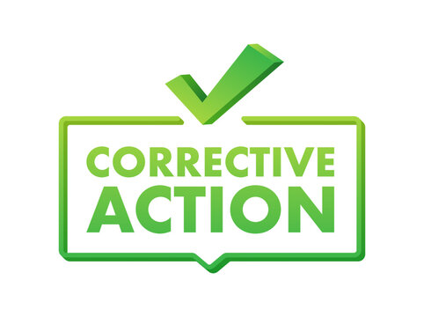
Taking Corrective Action
When no deviations from standards occur, the process of control is fulfilled by the first two steps of control: (1) setting standards and (2) checking performance against standards.
  When, however, deviations are noted through personal observation, reports, or spot checks, the supervisor must take the third step: taking corrective action to bring performance back into line.

Slide 54

Taking Corrective Action
Before taking corrective action, the supervisor should remember that deviations from standards can occur for various reasons.
  Following are some reasons:
    Standards were based on faulty forecasts or assumptions.
    Unforeseen problems arose and distorted results.
    Failure occurred in some preceding job or activity.
    EE who performed the job was unqualified or was given inadequate directions or instructions.
    EE who performed the job was negligent or failed to follow directions or procedures.

Slide 55

Taking Corrective Action
Therefore, before taking corrective action, the supervisor should determine the causes of the deviation by analyzing the situation.
  Only after identifying specific causes can the supervisor decide which remedial actions will obtain better results.
    For example, if the reason for the deviation lies in the standards themselves, the supervisor must revise the standards.

Slide 56

Taking Corrective Action
If the EE who performed the job was unqualified, additional training and closer supervision might be the answer.
  If the EE was given improper instructions, the supervisor should accept blame and improve techniques for giving directives.
    In the case of EE negligence or insubordination, corrective action may consist of a discussion with the EE or a verbal or written reprimand.
    At times, more serious forms of discipline, including EE suspension or replacement, may be needed.

Slide 57

Budgetary Control
Among the tools for financial control, the budget is usually the one with which supervisors have the most frequent contact.
  A budget is a written plan expressed in numerical terms that projects anticipated resources and expenditures for a period, such as a month, a quarter, six months, or one year.
    Firms usually prepare various budgets.

Slide 58

Budgetary Control
Supervisors are most familiar with the operating budget.
  The operating budget projects the dollar amounts of the various costs and expenses needed to run the business, given projected revenues.
    Operating budgets, which may be developed for every department, usually show how much is allocated for inventory, salaries, supplies, travel, rent, utilities, advertising, and other expenses.

Slide 59

Budgetary Control
At times, it is convenient to express budgets in terms other than dollars.
  Budgets pertaining to employment requirements, for example, may be expressed in number of EE-hours allocated for certain activities or the number of workers needed for each job classification.
  Eventually, however, such nonfinancial budgets are converted to monetary figures, such as operating budgets.
    These statements summarize organizations’ overall activities and serve as foundations on which managers can plan and control the use of financial and other resources.

Slide 60

Budgetary Control
All managers, from the CEO to supervisors, must learn how to develop budgets, live within budgetary limits, and use budgets for control purposes.
  The term budgetary control refers to use of budgets by supervisors, accountants, and higher-level managers to control operations so that they comply with organizational standards.

Slide 61
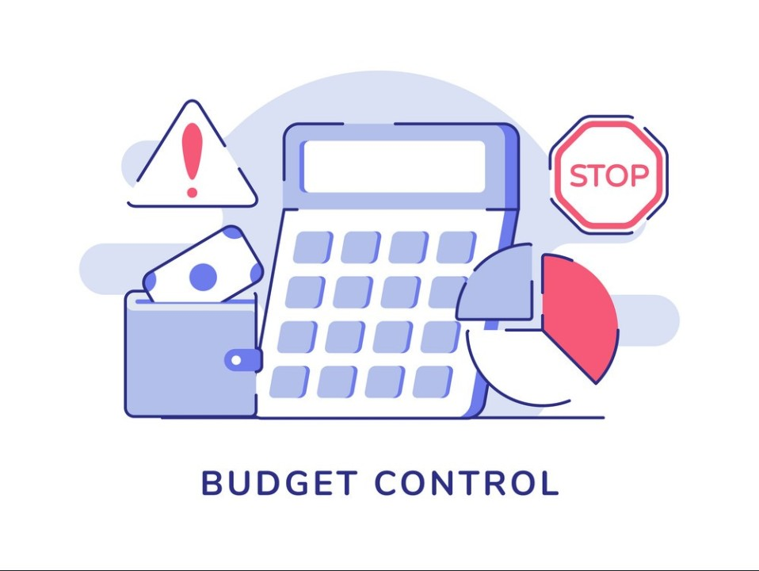
Supervisory Participation in Budget Making
Budget making falls under managerial function of planning, but carrying out the budget, or living within the budget, is part of the controlling function.
  As is true in so many other areas of management, the planning and controlling aspects of the budget process are interrelated.

Slide 62

Supervisory Participation in Budget Making
Preparing a budget, expressed in monetary or other terms, requires the budget-maker to quantify estimates by attaching numerical values to each budgetary item.
  The numerical figures in the final budget become the desired financial standards of the organization.
    The numerical figures in the final departmental budgets become the standards to be met by each department and departmental supervisors.

Slide 63

Supervisory Participation in Budget Making
Most annual budgets are projections for the following year based on the previous year’s budget.
  This approach is known as incremental budgeting.
    Another approach, is zero-base budgeting. When an organization practices zero-base budgeting, all budgets must begin “from scratch,” and each budget item must be justified and substantiated.
    In zero-base budgeting, the previous budget does not constitute a valid basis for a future budget.

Slide 64
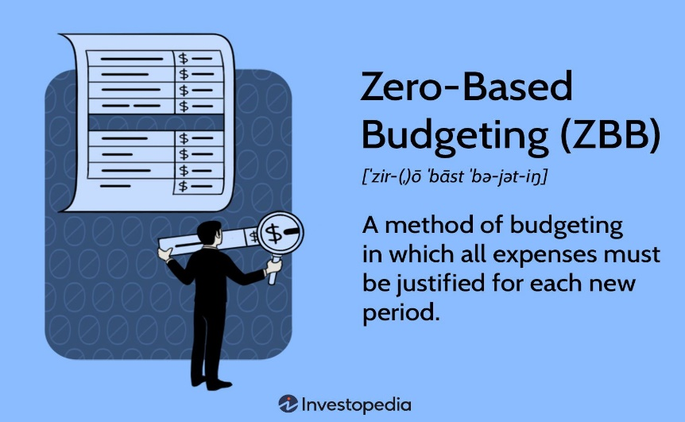
Supervisory Participation in Budget Making
The advantage of zero-base budgeting is that all ongoing programs, activities, projects, products, and the like are reassessed by management in terms of benefits and costs.
  This avoids the tendency of simply continuing expenditures from a previous budget period without much consideration.
    The disadvantage of zero-base budgeting is that it involves a large amount of paperwork and is very time consuming.

Slide 65

Supervisory Participation in Budget Making
To facilitate acceptance, expense budgets should be prepared with the participation and cooperation of those responsible for executing them.
  Supervisors should help make departmental budgets, and should be familiar with both general and detailed aspects of budget preparation.
    Even when a budget is handed down to supervisors by management, they should understand the budget and reasoning behind each budget figure.

Slide 66

Supervisory Participation in Budget Making
To participate successfully in budget making, supervisors must demonstrate the need for each amount requested and document their requests with historical data whenever possible.
  The final budget often contains lower figures than those submitted.
    A supervisor should not consider this as a personal rejection because other supervisors also make budget requests and have them cut out.

Slide 67

Supervisory Participation in Budget Making
It is rarely possible for higher-level management to grant all budget requests.
  Much depends on how realistic the supervisors have been and how well their budgetary needs are documented or substantiated.
    Supervisors can only hope that the final budget will be close to what they requested and will give them sufficient resources to operate their departments efficiently.

Slide 68
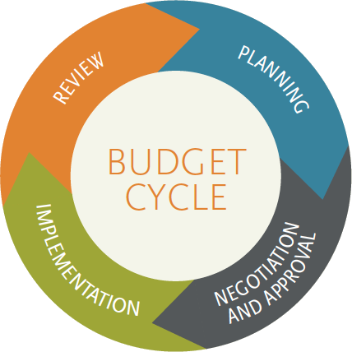
Supervising within the Budget
Supervisors must manage their departments within budget limits and refer to their budgets to monitor their expenditures during the operating period.
  When a budget is approved by higher-level management, the supervisor is allocated specific amounts for each item in the budget.
    Expenditures in the supervisor’s department must be charged against various budget accounts. At regular intervals, the supervisor must review budgetary figures and compare them with expenses.

Slide 69

Supervising within the Budget
If the expenditures for an item greatly exceed the item’s budgeted amount, the supervisor must find out what happened.
  Investigation could reveal a logical explanation for the discrepancy. For example, if the amount spent on labor in a manufacturing dept. exceeded the budgeted amount, it could be due to an unanticipated demand for the firm’s product, which required overtime.
    When supervising programs, sometimes supply costs can run over budget, and a supervisor must deal with the overages when planning for future.

Slide 70

Supervising within the Budget
When the deviation from the budgeted amount can’t be justified, the supervisor must take whatever actions are necessary to bring the out-of-control expenditures back to where they should be, at least from that point on.
  Usually, the supervisor must explain excessive deviations to higher-level managers or to the accounting department.
    A supervisor is well advised to regularly compare expenditures with budgeted amounts to keep expenses close to the budget.

Slide 71

Supervising within the Budget
A supervisor’s budget should not be so detailed and rigidly applied that it becomes a burden.
  The budget should allow the supervisor some freedom to accomplish departmental objectives. Flexibility does not mean that a supervisor can change budget figures, rather, it means that a supervisor should not be led to believe that budget figures are rigid.
    Budgets are guides for decisions, not substitutes for good judgment.

Slide 72
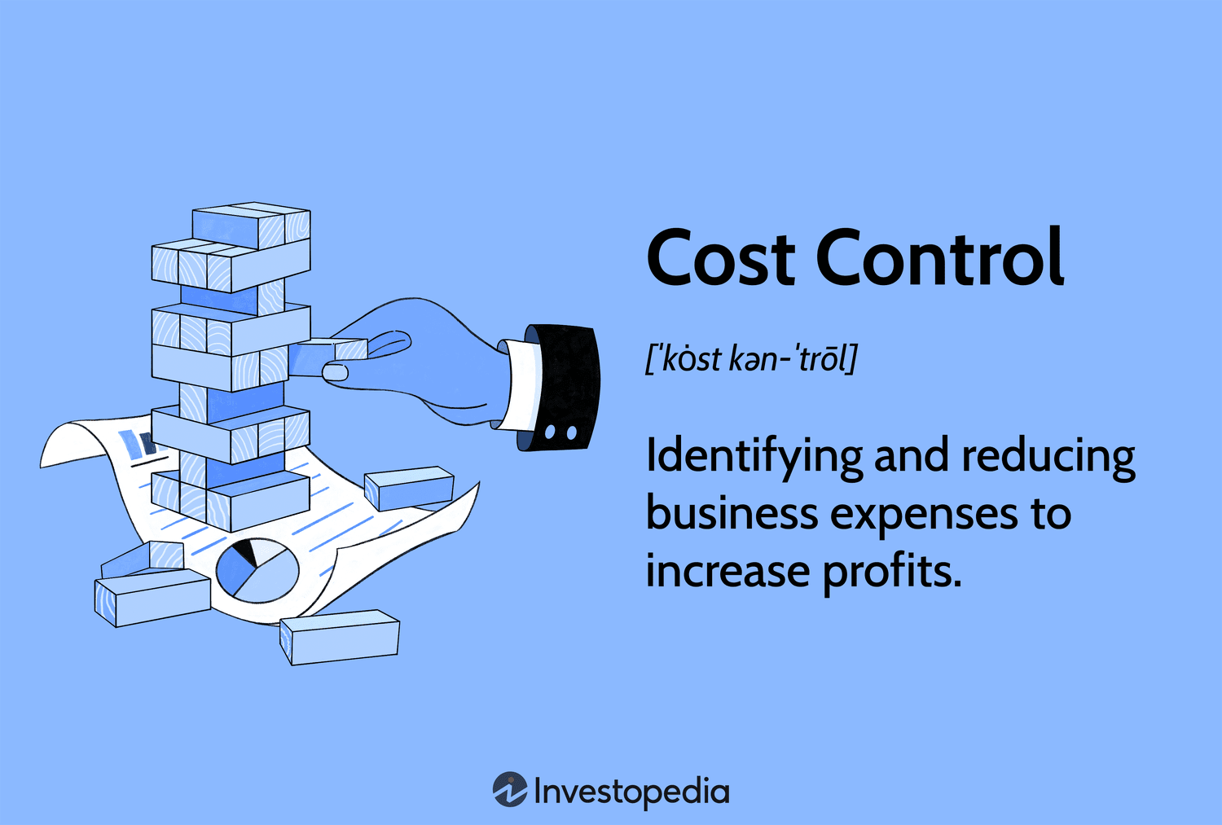
Cost Control and the Supervisor
Intense competition and an uncertain economic environment require all organizations to strive continuously to control costs.
  Most supervisors become involved in some way with cost control because managers expect supervisors to control costs at departmental levels to help meet organizational cost goals. Thus, cost consciousness should be an ongoing supervisory concern.
    Sporadic efforts to reduce costs and eliminate various processes seldom have lasting benefits. It is the supervisor’s duty to look at cost consciousness as a part of the managerial job.

Slide 73

Sharing Information and Responsibility with Employees
Robert Levering examined 20 top U.S. firms and concluded that managers can turn a bad workplace into a good one by granting EEs more responsibility for their jobs.
  According to Levering, this means “establishing a partnership with EEs rather than acting as adversaries.”
    In forging a partnership with its EEs, a firm should be willing to share financial information with them. However, it is not enough for a firm just to share financial information with EEs. EEs must understand financial data and have a basis for comparing their firms’ financial information with that of previous years and their competitors.

Slide 74

Sharing Information and Responsibility with Employees
Many organizations practice transparency, a form of open-book management in which all financial information is shared with EEs and other stakeholders.
  EEs receive timely information on all aspects of the business ranging from revenues & purchasing costs to labor & management expenses.
    Every EE learns to understand the information; and that part of their job is to move those numbers in the right directions and learn how their day-to-day decisions and actions impact revenues, costs, and the bottom line.

Slide 75

Sharing Information and Responsibility with Employees
When EEs have relevant financial data, they may act more conscientiously when making decisions with cost consequences.
  Similarly, EEs with responsibility to make choices about certain expenditures can promote a sense of cost awareness.
    If all financial information is out in the open, there is no place for unscrupulous dealings to hide.

Slide 76

Maintaining Cost Awareness
Because cost consciousness is of ongoing concern to supervisor, plans should be made to achieve cost awareness throughout the department.
  Here is where planning and controlling again become closely interrelated.
    By setting objectives and specific results for a certain time frame, costs can be prioritized.

Slide 77
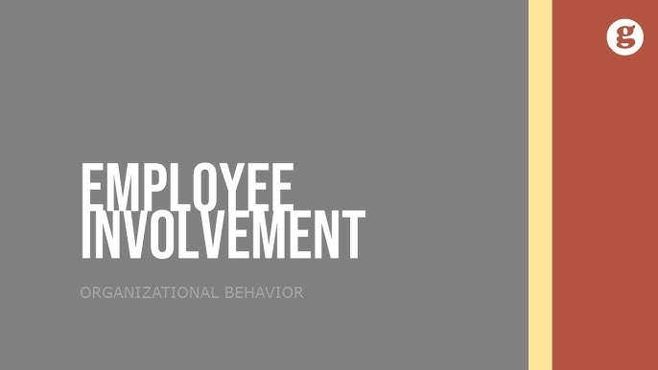
Maintaining Cost Awareness
When setting cost objectives, the supervisor should involve the EEs who will be most affected.
  EEs often can make valuable contributions.
    The supervisor should fully communicate cost-reducing objectives to EEs and get as much input from them as possible.
    The more EEs contribute to a cost-control program, the more committed they will be to meeting objectives.

Slide 78

Responding to a Cost-Cutting Order
It is likely that within an enterprise at one time or another, an order will come from top-level managers to cut all costs.
  Some supervisors are constantly aware of costs and operate their departments efficiently; others are lax and perhaps even wasteful.
  Some supervisors might hold “pep rallies” with EEs or, at the other extreme, harshly criticize EEs and others. Some might stop buying supplies, eventually leading to work delays. Others might eliminate preventive maintenance work, even though doing so could lead to equipment breakdowns and workflow interruptions.
    These actions may reduce costs, but could be more expensive in long run.

Slide 79

Responding to a Cost-Cutting Order
Other supervisors will follow cost-cutting directives half-heartedly.
  They will make minimal efforts here and there to give the appearance that they are doing something about costs. Such efforts are unlikely to impress EEs, who also may make only half-hearted efforts.
    This type of supervisory response contributes inadequately to cost control.

Slide 80


Responding to a Cost-Cutting Order
An across-the-board cost-reduction order may present a hardship to the diligent, cost-conscious supervisor whose department is working efficiently.
  Nevertheless, this supervisor may strive to take some action by looking again at areas where there is still room to reduce expenses.
    This supervisor will call for EE suggestions because EEs can bring about results. An EE might suggest a less expensive way of doing a job. If so, the supervisor should welcome the suggestion.

Slide 81

Responding to a Cost-Cutting Order
The supervisor should point out to EEs which operations are most expensive and let them know what those operations actually cost.
  The supervisor should commit to the cost-reduction campaign and should set a good example whenever possible.
    While supervisors play a key role in cost reduction, they cannot succeed without EE involvement and commitment.

Slide 82

Responding to a Cost-Cutting Order
Effective supervisors constantly seek ways to eliminate costs by questioning the necessity of everything done in the department.
  In addition to focusing on ways to reduce costs, supervisors should search for other alternatives.
    They should get input from EEs on how to increase sales revenue, expand sales efforts, and increase margins on certain products and services, etc.

Slide 83

Responding to a Cost-Cutting Order
Even when an organization lacks a formal suggestion program, supervisors can establish a climate of mutual trust and respect that encourages EE suggestions.
  The supervisor can formally and informally encourage EEs during departmental meetings to emphasize the value of suggestions.
    For example, when an EE or a group of EEs complain about a policy or practice, the supervisor might turn the complaint into a challenge by saying, “You may be right. Why don’t you do something about it? Think of a better way, and we’ll take it to management. Any credit for the idea will be yours.”

Slide 84

Responding to a Cost-Cutting Order
Employee suggestions can be a valuable source of ideas.
  EEs like to see their ideas put into effect and are more committed to the goals they help set.

Slide 85

Controlling is Part of a Continuous Process
Everything that a person does should be reviewed, and when appropriate, changes should be made.
  In addition to accounting and budgetary controls, there are other areas of management control in many organizations.
    In most organizations there are specialists who can help the supervisor get things back on track. It is imperative that supervisors be aware of how various staff specialists can help them do a better job.

Slide 86
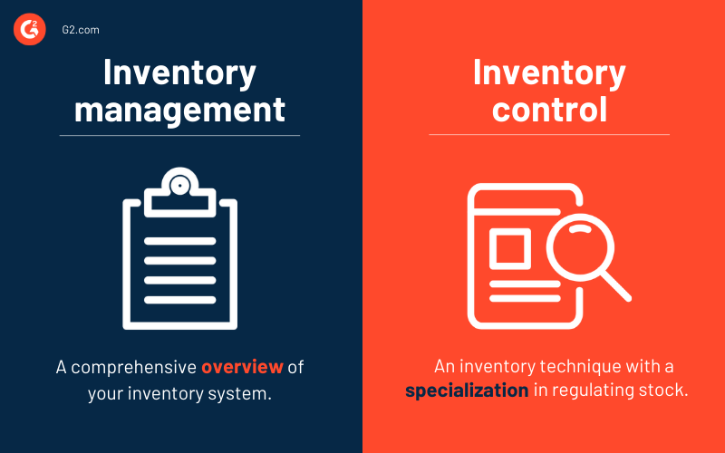
Specialized Controls
Inventory Control
Inventory control means keeping watch over raw materials, supplies, work-in-process, finished goods, and the like.
  Maintaining sufficient, though not excessive, inventory; keeping status records of all inventory; ordering economic lot sizes; and many other tasks are part of inventory control.

Slide 87

Specialized Controls
Quality Control
Quality control means maintaining the quality standards a firm sets for its products or services.
  Products and services must be monitored and improved continually to ensure that quality is maintained. The quality control of products is often accomplished by testing randomly selected samples to determine whether quality standards are being met.
    A commitment to total quality management (TQM) means making an overall effort to respond to customer needs.

Slide 88

Specialized Controls
Production Control
Production control usually consists of a number of activities that are designed to keep overall operations on schedule.
  It involves routing operations, scheduling, and expediting workflow.
  Elaborate charts and network analysis may be used.
    Two of the most widely used tools for analysis are the Program Evaluation Review Technique (PERT) and Gantt Charts.

Slide 89

Controlling and the Other Managerial Functions
The controlling function is intrinsically related to all other managerial functions.
  Controlling is typically performed simultaneously with the other managerial functions. The better supervisors plan, organize, staff, and lead, the better their ability to control activities and EEs.
    Controlling takes a forward-looking view, even though it has been discussed as the final managerial function.

Slide 90


