Slide 1
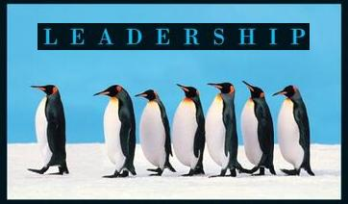
Leadership
Session One Class Presentation
Leadership
  Enhancing the Lessons of Experience 8th Edition
    Richard L. Hughes, Robert C. Ginnett, and Gordy J. Curphy, McGraw Hill Education, New York, NY 2015
      ISBN: 978-0-07-786240-4

Slide 2

Introductions
Who Are You?
  Name – School – Hobbies and Activities
  Why Are You Here?
    Embracing Mindfulness

Slide 3

Leadership
Define Leadership
  Leadership is the process of influencing an organized group toward accomplishing its goals.
    It is a Science and an Art
    It is Both Rational and Emotional

Slide 4
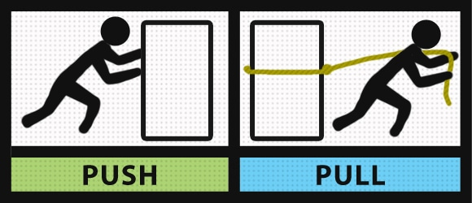
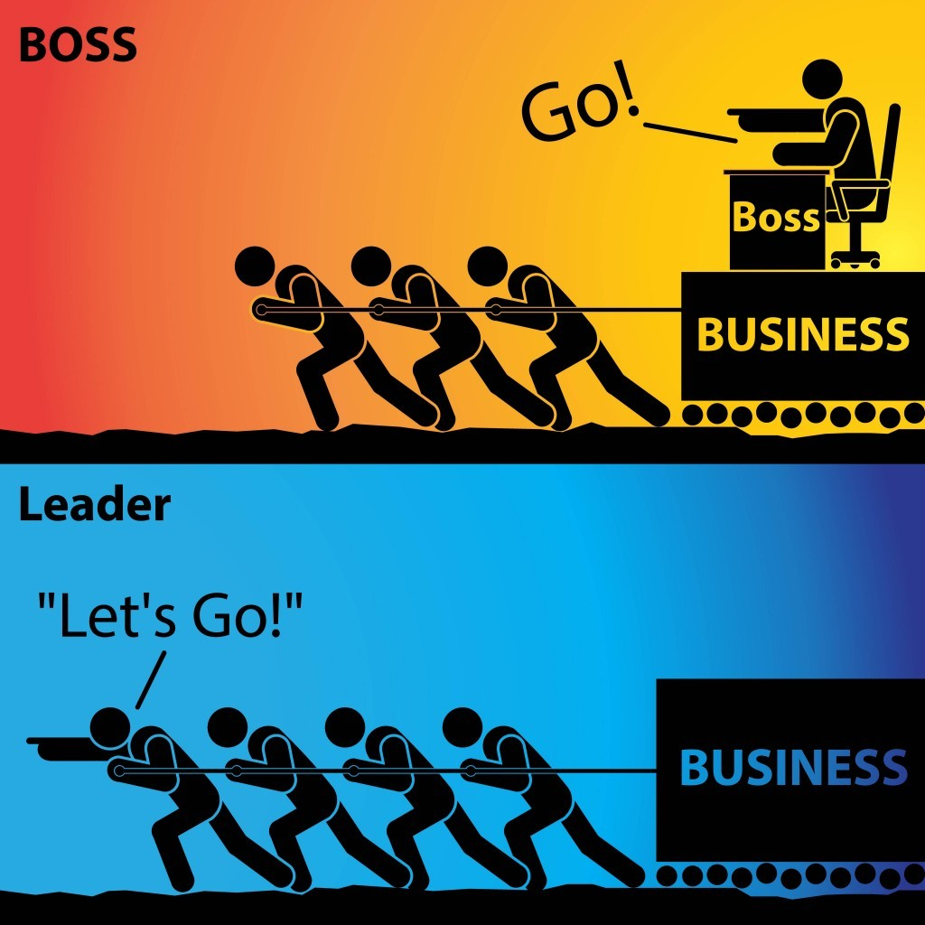
Leadership vs. Management
What is the difference between Leadership and Management?
  Leaders are thought to do the right things, whereas managers are thought to do things right.

Slide 5
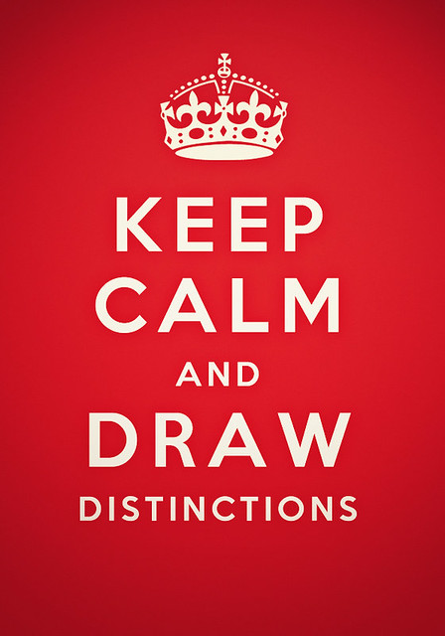
Leadership and Management
Other distinctions between managers and Leaders:
  Managers administer; leaders innovate.
  Managers maintain; leaders develop.
  Managers control; leaders inspire.
  Managers have a short-term view; leaders, a long-term view.
  Managers ask how and when; leaders ask what and why.
  Managers imitate; leaders originate.
  Managers accept the status quo; leaders challenge it.

Slide 6

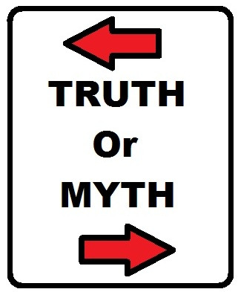
Leadership Myth 1
Good Leadership is All Common Sense.

Slide 7

Leadership Myth 2
Leaders are Born, Not Made

Slide 8
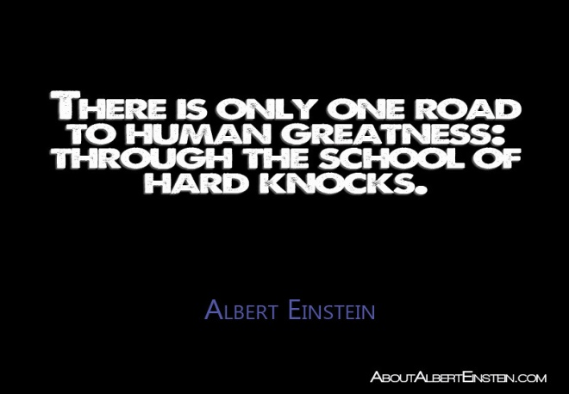

Leadership Myth 3
The Only School You Learn Leadership From is the School of Hard Knocks.

Slide 9

Leadership Myths
Share Perspectives on Leadership Myths
  Good leadership is all common sense.
  Leaders are born, not made.
  The only school you learn leadership from is the school of hard knocks.

Slide 10

Interactional Framework
The Interactional Framework for Analyzing Leadership depicts leadership as a function of three elements, the: (1) Leader, (2) Followers, and (3) Situation.
  A particular leadership scenario can be examined using each level of analysis separately. However, to better understand the process we should examine the interactions among the three elements…

Slide 11

Interactional Framework
The Leader
This element examines primarily what the leader brings as an individual to the leadership equation.
  This can include unique personal history, interests, character traits, and motivation.
    Research shows that leaders differ from their followers, and effective leaders from ineffective leaders, on various personality traits, cognitive abilities, skills, and values.

Slide 12
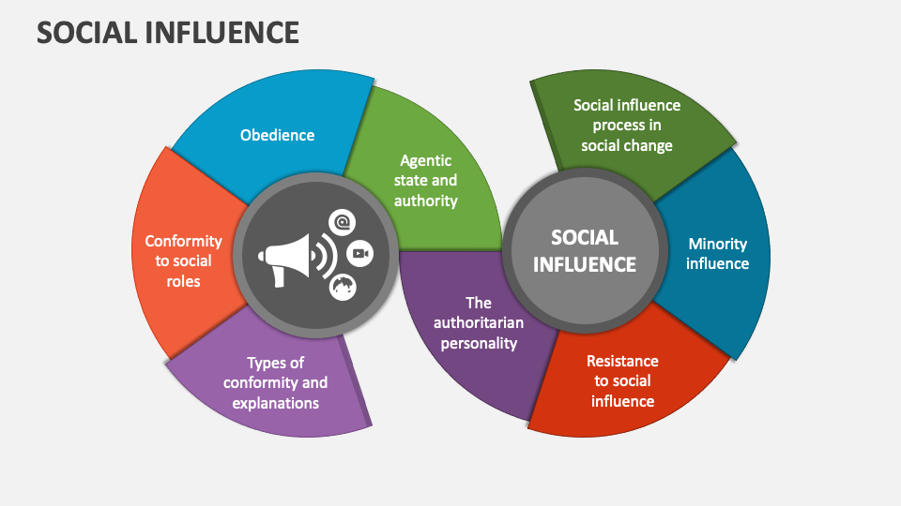
Interactional Framework
The Followers
Leadership is a social influence process shared among all members of a group. It is not restricted to the influence exerted by one person in a particular position or role.
  Followers are an important part of the leadership process.
    The follower’s expectations, personality traits, maturity levels, levels of competence, and motivation affect the process.

Slide 13

Interactional Framework
The Followers
Other relevant variables include followers’ trust in the leader and their degree in confidence that the leader is interested in their well-being.

Slide 14

Interactional Framework
The Followers
There are five basic types of followers:
  Alienated Followers
    See themselves as “Mavericks,” but have a really negative view/influence.
  Conformist Followers
    The “yes people,” but may compromise values and ethics for organization.
  Pragmatist Followers
    Mediocre performers with both positive and negative qualities.
  Passive Followers
    Rely on the leader fully, and show minimal initiative.
  Exemplary Followers
    Apply their talents for the benefit of the organization.

Slide 15

Interactional Framework
The Situation
Even if we knew all we could know about a given leader and a given set of followers, leadership often makes sense only in the context of how the leader and followers interact in a particular setting.

Slide 16
Interactional Framework
The Situation
    Decision making is a good example of how leaders need to behave differently in various situations.
  If the situation is Simple: predictable and orderly; and the right answers exist.
    The leader’s job is to ensure that proper processes are in place, follow best practices, and communicate in clear-direct ways.
  If the situation is Complex: flux, unpredictability, ambiguity, many competing ideas, lots of unknowns.
    The leader’s job is to create environments and experiments that allow patterns to emerge; increase interaction & communication; and use methods to generate new ideas and ways of thinking.

Slide 17
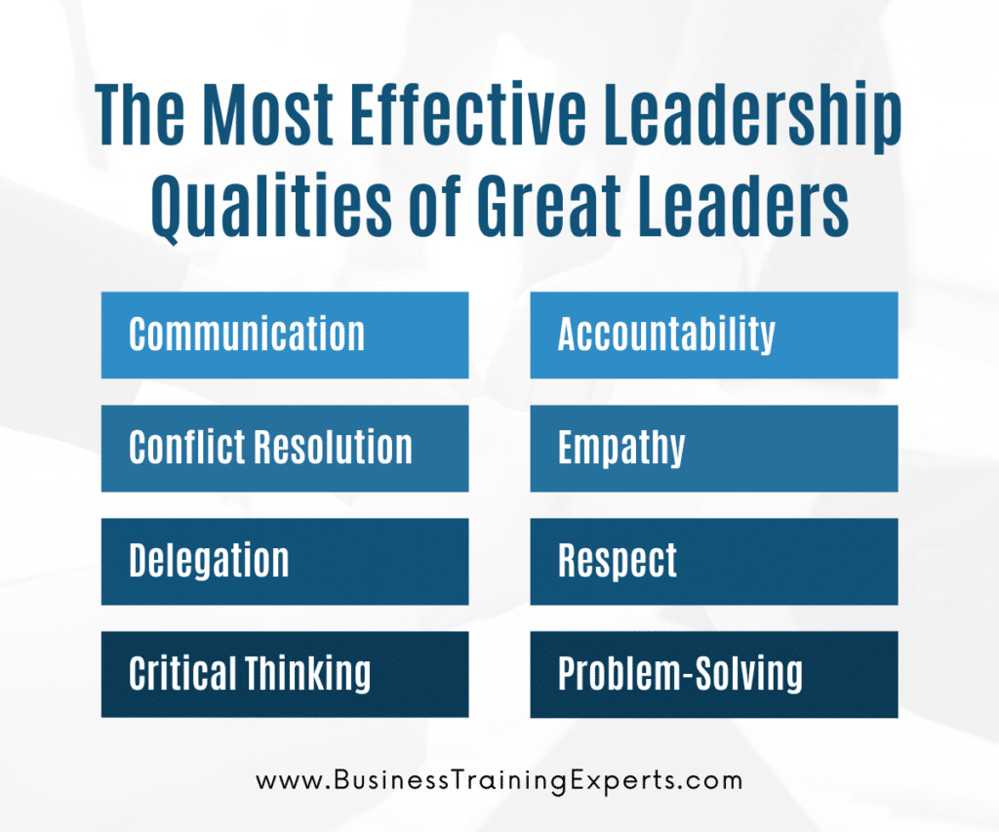
Effective Leadership
There is no simple recipe for effective leadership.
  It is important to understand how the three domains of leadership interact – how the leader, the followers, and the situation are all part of the leadership process.
    Understanding their interaction is necessary before you can draw valid conclusions from the leadership you observe around you.

Slide 18

Leadership Development
Leadership is learned from experience.
  Certain experiences have greater developmental impact than others in shaping a person’s effectiveness as a leader.

Slide 19


Action-Observation-Reflection Model
Leadership development depends not only on the kinds of experiences a person has but on how they use them to foster growth.
  We can learn from our experiences when we spend time thinking about them.

Slide 20

Spiral of Experience
      Leadership development is enhanced when the experience involves three different processes - AOR: (1) Action, (2) Observation, and (3) Reflection.
  Action
    What Did You Do?
  Observation
    What Happened? Results.
    What was the Impact on Others?
  Reflection
    How Do You Look at it Now?
    How Do You Feel about it Now?

Slide 21
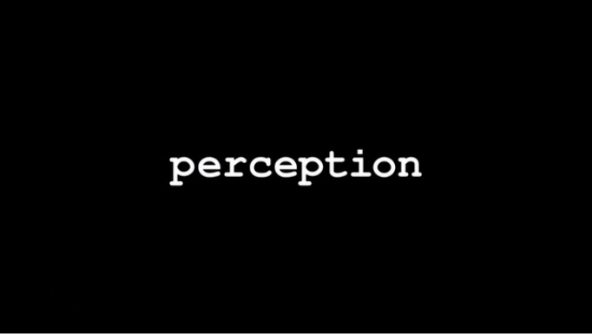
Spiral of Experience
Experience is not just a matter of what events happen; it also depends on how you perceive those events.
  Perception affects all three phases of the AOR model.
    Human beings are not passive recorders of experiences; rather, people actively shape and construct their experiences.

Slide 22

Perception and Attribution
Perception is inherently an interpretive, or a meaning-making, activity. We develop explanations for the behaviors or actions we attend to through a process called Attribution.
  For example, we often attribute causes of another’s failure to dispositional factors within that person, such as, intelligence, personality, physical appearance, or some other factor even though factors beyond their control could have played the part.

Slide 23
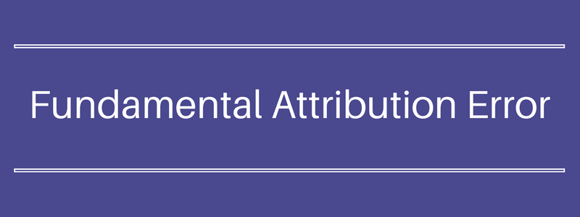
Fundamental Attribution Error
The tendency to overestimate the dispositional causes of behavior and underestimate the environmental causes when others fail is called Fundamental Attribution Error.
  People prefer to explain others’ behavior on the basis of personal attributions even when obvious situational factors may fully account for the behavior.
    On the other hand, if it was our failure under observation-reflection, we would be more likely to blame factors in the situation for failure, rather than make personal attributions.

Slide 24

Actor-Observer Difference
People who are observing an action are much more likely than the actor to make the Fundamental Attribution Error.
  An observer tends to attribute another person’s failure to internal characteristic; whereas, the person himself is more likely to attribute their own failure to external factors.
    Each of us tends to see our own success as due to our intelligence, personality, or physical abilities, but others’ success as more attributable to situational factors or to luck.

Slide 25

Perception and Action
Perception influences both the Observation and Reflection stages in the Spiral of Experience. Perception also affects the Actions we take.
  Managers are typically biased toward making dispositional attributions about subordinate’s substandard performance and, as a result of these attributions, often recommend that punishment be used to remedy performance deficits.

Slide 26

Self-Fulfilling Prophecy
Another perceptual variable that can affect our actions is the Self-Fulfilling Prophecy, which occurs when our expectations or predictions play a causal role in bringing about the events we predict.
  A person’s expectations about another may influence how they act toward that person, and in reaction to that behavior the other may act in a way that confirms those expectations.
    Having expectations (positive or negative) about others can subtly influence our actions, and in turn, affect the way others behave.

Slide 27

Reflection and Leadership Development
Reflection is important because it can provide leaders with a variety of insights into how to frame problems differently, look at situations from multiple perspectives, or better understand subordinates.
  Most managers spend relatively little time on this activity, even though this time reflecting on leadership can be fruitful.

Slide 28

Learning
To be successful, learning must continue throughout life, beyond the completion of one’s formal education.
  The end of extrinsically applied education should be the start of an education that is motivated intrinsically.
    At that point the goal of studying is no longer to make the grade, earn a diploma, and find a good job. Rather, it is to understand what is happening around oneself and to develop a personally meaningful sense of what the experience is about.

Slide 29

Behavioral Change
Some leaders change as they gain insight, others change with social or group support, and some may never change.
  Five critical behavioral change questions:
    Do leaders know which of their behaviors need to change?
    Is the leader motivated to change these behaviors?
    Do leaders have plans in place for changing targeted behaviors?
    Do leaders have opportunities to practice new skills?
    Are leaders held accountable for changing targeted behaviors?

Slide 30

Learning from Experience
Leaders enhance the learning value of their experiences by:
  Creating opportunities to get feedback.
  Taking voluntary but determined efforts to improve skills.
  Learning from others.
  Keeping a journal of daily leadership events.
  Having a developmental plan.

Slide 31
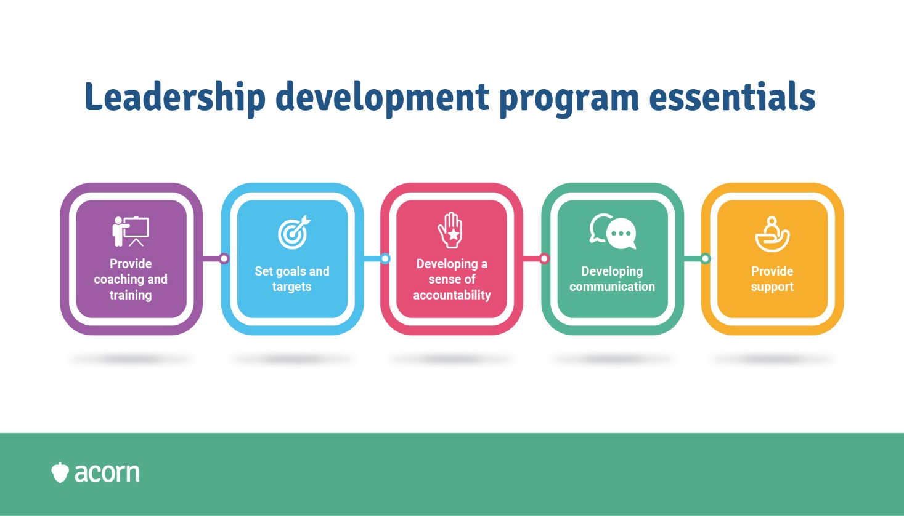
Leadership Development
Leadership Development is a process.
  Good leadership development plans are constantly being revised as new skills are learned or new opportunities to develop skills become available.

Slide 32

Development Planning
Development planning consists of five interrelated phases:
  Identify development needs.
    Identify career goals.
    Assess strengths and weaknesses in light of these goals.
    Seek feedback about how behavior affects others.
    Review organizational standards pertaining to goals.
  Analyze and prioritize development needs.
  Create a focused and achievable development plan.
  Review the plan and reflect on learning.
  Transfer learning to new environments.

Slide 33

GAPS Analysis
The 1st phase in the development planning process is to conduct a GAPS Analysis - Goals, Abilities, Perceptions, Standards.
  The first step in the GAPS Analysis is to clearly identify what you want to do or where you want to go with your career over the years.
  Identify strengths and development needs to achieve your goal.
  Analyze how your skills, abilities, and behaviors affect others.
  Determine the standards your superior or the organization has for your career objectives.

Slide 34
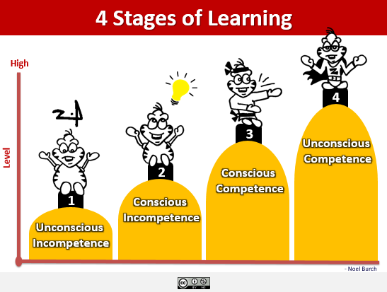
Technical Competence
Leaders who have a high level of technical competence may be able to stimulate followers to think about problems and issues in new ways, which in turn has been found to be strongly related to organizational climate ratings and followers’ motivation to succeed.

Slide 35

Technical Competence
The first step in technical competence is to determine how one’s job contributes to the overall success of the organization.
  Next, people should evaluate their current level of technical skills by seeking verbal feedback from peers and superiors, reviewing past performance appraisal results, or reviewing objective performance data.
    These actions will help individuals get a better handle on their own strengths and weaknesses.

Slide 36
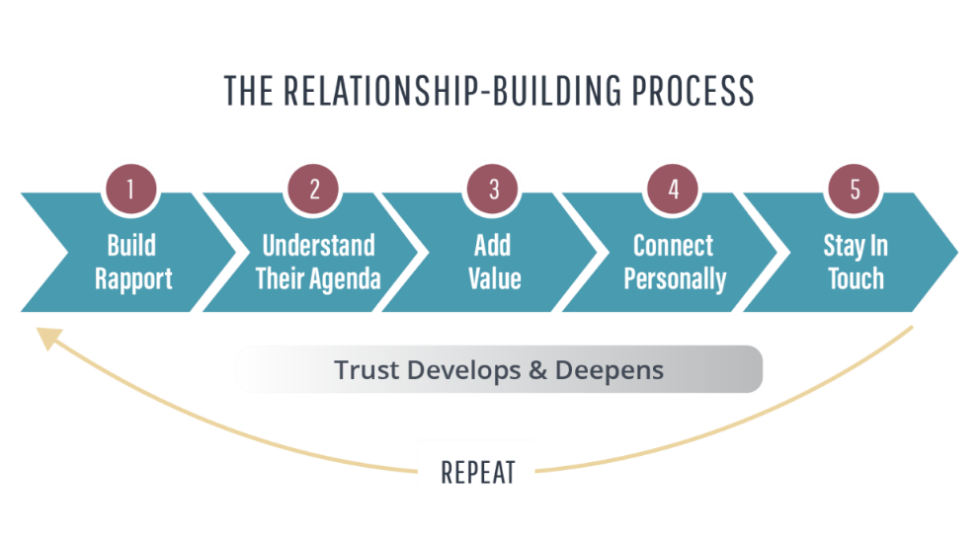
Relationships
Good leaders build effective relationships with their superiors and with their peers.
  When sharing the same values, approaches, and attitudes you will experience less conflict, provide higher levels of mutual support, and be more satisfied with relationships.
    Individuals having good superior-follower relationships are often in the superior’s in-group and thus are more likely to have a say in decisions, be delegated interesting tasks, and have the superior’s support for career advancement.

Slide 37

Relationship with Superiors
Followers interested in developing effective relationships with superiors need to be honest and dependable.
  After integrity, superiors value dependability.
    Superiors value workers who have reliable work habits, accomplish assigned tasks at the right time in the right order, and do what they promise.

Slide 38

Relationship with Peers
A fundamental requirement of leadership effectiveness is the ability to build strong alliances with others, and groups of peers generally wield more influence and can get more things done than individuals working separately.
  Investing the time and effort to develop effective relationships with peers not only has immediate dividends but also can have long-term benefits if a peer earns a position of power.

Slide 39
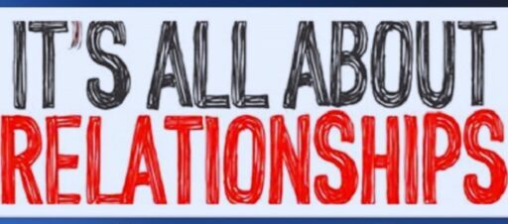
Relationship with Peers
One of the best ways to establish effective working relationships with peers is to acknowledge shared interests, values, goals, and expectations.
  Establishing informal communication links is one of the best ways to discover common interests and values.
    An effective way to establish relationships with your peers is to meet with them in contexts outside normal working relationships.

Slide 40
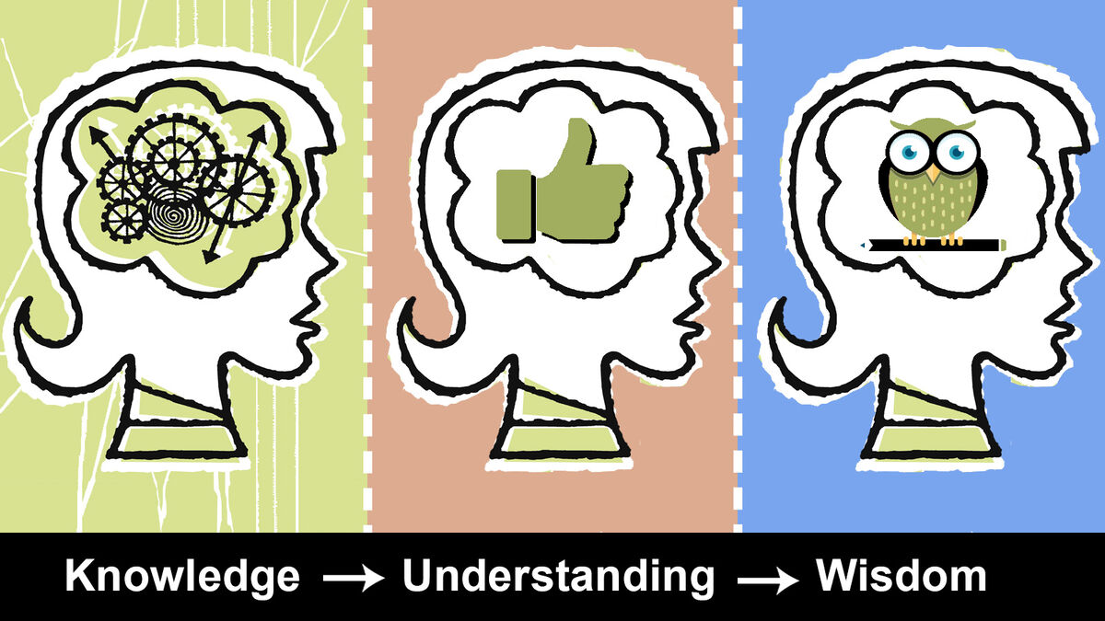
Relationship with Peers
Building a cooperative relationship with others depends on knowing the sorts of tasks others perform in the organization. It also depends on understanding their problems and rewards.
  One of the best ways to establish strong relationships is by lending a hand whenever peers face personal or organizational problems.
    It is important to remember that people repeat behaviors that are rewarded and are less likely to repeat behaviors that are not.

Slide 41


Relationship with Peers
To secure cooperation from others, it helps to know which situational factors reinforce both positive and negative behaviors in others.
  By better understanding the situation facing others, people can determine whether their own positive feedback or lack thereof is contributing to, or hindering the establishment of, effective relationships with peers.
    People should not underestimate the power of their own sincere encouragement, thanks, and compliments in positively influencing the behavior of their colleagues.

Slide 42

Relationship with Peers
Another way to build effective working relationships with peers is to view them from a Theory Y perspective.
  When a person assumes that others are competent, trustworthy, willing to cooperate, and proud of their work, peers will view that person in the same light.

Slide 43

Coaching
Coaching is a key leadership skill that can help leaders improve the strength of a group, which in turn should help the group accomplish its goals.
  Coaching can also help to retain high-quality followers.
    Coaching is the “process of equipping people with the tools, knowledge, and opportunities they need to develop and become more successful.”

Slide 44

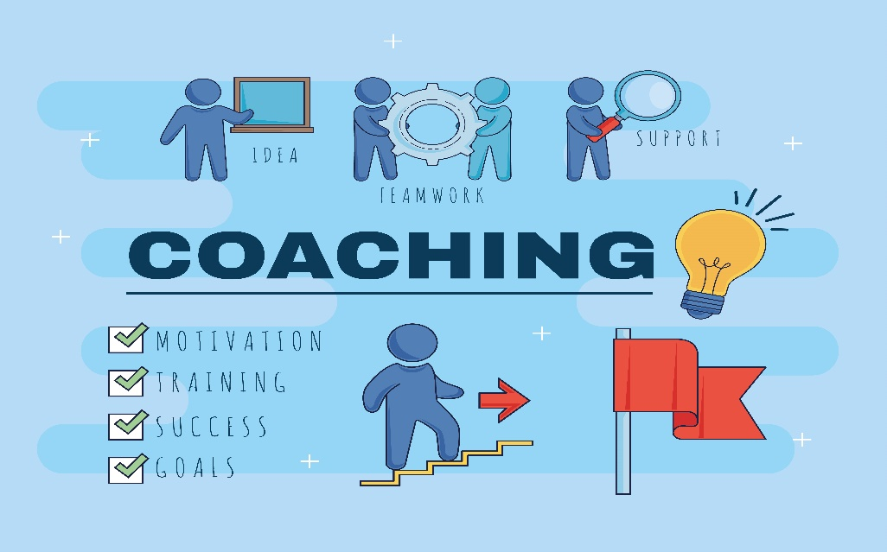
The Steps of Coaching
Forge a Partnership
  Establish Trust
Inspire Commitment
  Work as a Team
Grow Skills
  Develop Character and Skill
Promote Persistence
  Persevere and Take Initiative
Shape the Environment
  Be a Role Model

Slide 45

Coaching
A Summary of Most Useful Factors in Coaching:
  Clear and Direct Feedback
  A New Perspective
  Advice on Handling Situations
  Understanding Objectives
  General Encouragement
  Handling the Politics Involved

Slide 46
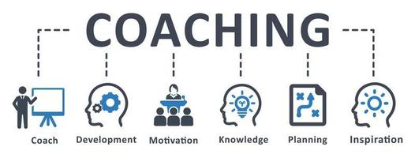
Coaching
A valuable outcome of coaching involves clarification of managers’ values, identification of discrepancies between their espoused values and actual behaviors, and devising strategies to better align their behaviors with their values.

Slide 47

Mentoring
In an organization, you can also gain valuable perspectives and insights through close association with an experienced person willing to take you under their wing.
  Mentoring is a personal relationship in which someone more experienced acts as a guide, role model, and sponsor.
    Mentors provide knowledge, advice, challenge, counsel, and support about opportunities, strategies, policy, politics, etc.

Slide 48

Mentoring
Mentors who provide guidance and support to others throughout their career help to develop the “three Cs” critical to advancement:
  Confidence – Competence – Credibility

Slide 49
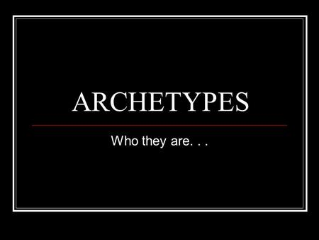
Five Archetypes of Leadership
Teacher-Mentor
  One who cares about developing others and works beside them as a role model.
Father-Judge
  One who provides oversight, control, moral guidance, and caring protectiveness.
Warrior-Knight
  One who takes risks and action in a crisis.
Revolutionary-Crusader
  One who challenges the status quo and guides adaptation.
Visionary-Alchemist
  One who imagines possibilities that can benefit all members and brings them into reality.

Slide 50


