Slide 1

Supervision
Supervision
  Concepts and Practices of Management, 13th Edition
    Edwin C. Leonard, Jr., Ph.D. and Kelly A. Trusty, Ph.D. Cengage Learning, Boston, MA 2013
      ISBN: 978-1-285-86637-6

Slide 2

Part Two: Essentials of Effective Supervision
Chapter Eight: Solving Problems, Making Decisions, and Managing Change
  After studying this chapter you will be able to:
    Explain the importance of problem solving and decision-making skills.
    Describe and apply basic steps and skills involved in the decision-making process.
    Identify and describe various decision-making styles.
    Discuss why a supervisor should not make hasty decisions.
    Suggest approaches for introducing change to EEs and for proposing change to higher-level managers.
    Understand the formula for organizational renewal.

Slide 3
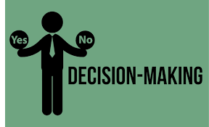
The Importance of Decision-Making Skills
All human activities involve decision making.
  Each of us faces problems at home, at work, at school, and in social groups for which decisions must be made. Problems can be large or small, simple or complex, life-threatening or trivial.
    Some problems can be dealt with almost automatically.
    Other problems can be much more challenging.

Slide 4

The Importance of Decision-Making Skills
Decision making is an essential part of life and an integral part of all managerial functions.
  It lies at the core of the planning function of management.
    Many supervisors claim that solving problems and making decisions are the most important components of what they do daily and throughout their ongoing supervisory management tasks.

Slide 5

The Importance of Decision-Making Skills
Decision making is the process of defining problems and choosing a course of action from among alternatives.
  The term decision making often is used together with the term problem solving because many supervisory decisions focus on solving problems that have occurred or are anticipated.
  However, the term problem solving should not be construed as being limited to decisions about problem areas.
    Problem solving also includes decisions about realistic opportunities that are present or available if planned for appropriately. Therefore, we will use the terms interchangeably.

Slide 6

The Importance of Decision-Making Skills
Many of the problems that confront supervisors in their daily activities recur and are familiar; for these problems, most supervisors have developed routine answers.
  When supervisors are confronted with new and unfamiliar problems however, many find it difficult to chose courses of action.

Slide 7

The Importance of Decision-Making Skills
Managers and supervisors at all levels are constantly required to solve problems that result from changing situations and unusual circumstances.
  Regardless of their managerial levels, supervisors should use a similar, logical, and systematic decision-making process.
    While decisions at the executive level are usually wider in scope and magnitude than decisions at the supervisory level, the decision-making process should be fundamentally the same throughout the management hierarchy.

Slide 8

The Importance of Decision-Making Skills
Once the decision is made, effective action is necessary.
  A good decision that no one implements is of little value.

Slide 9

The Importance of Decision-Making Skills
Supervisors should ensure that their EEs learn to make their own decisions more effectively.
  A supervisor cannot make all the decisions necessary to run a department. Many daily decisions in a department are made by the EEs who do the work.
    For example, EEs often have to decide, with or without their supervisors, what materials to use, how a job is to be done, when a job is to be done, and how to coordinate activities with other departments.

Slide 10

The Importance of Decision-Making Skills
This forward thinking is embodied in the notion of Appreciative Inquiry (AI).
  Professor David Cooperrider explains that “AI is the cooperative search for the best in people, their organizations, and the world around them. AI involves the art and practice of asking questions that strengthen a system’s capacity to heightened positive potential.
    Numerous organizations have embraced the concept in order to push performance to higher levels.

Slide 11
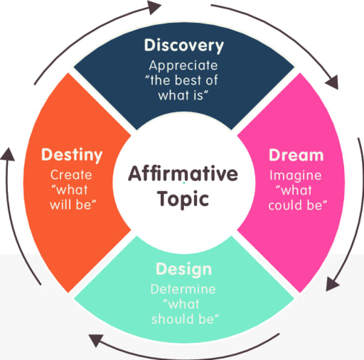
The Importance of Decision-Making Skills
The following definitions provide insight on AI.
  Appreciate
    To recognize the quality, significance, or magnitude of.
    To be fully aware of.
    To be thankful for.
    To admire greatly.
    To raise in value, especially over time.
    Synonyms: value, prize, esteem, treasure, cherish.
    These verbs have a favorable opinion of someone or something.
  Inquire
    To seek information by asking a question.
    To make an inquiry or investigation.
    Synonyms: discovery, search, study, systematic exploration.
  Inquiry
    The act of inquiring. A question.
    A close examination of a matter in the search for information or truth.

Slide 12
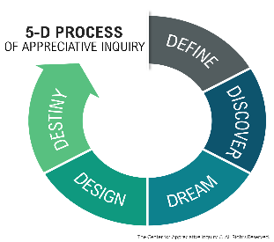
The Importance of Decision-Making Skills
According to Professor Cooperrider, “The excitement of discovering, dreaming, and designing can turn empowered EEs into a revolutionary force for positive organizational change.”
  Instead of relying on traditional managerial decision-making processes, AI assumes that every living system has many untapped resources and unexplored potentials and, as such, managers must believe that their EEs want to be involved and will ultimately make decisions that are in the best interests of their organization.
    In practice, those companies that are the “best companies to work for” are giving EEs more active roles in charting the future of their organizations.

Slide 13
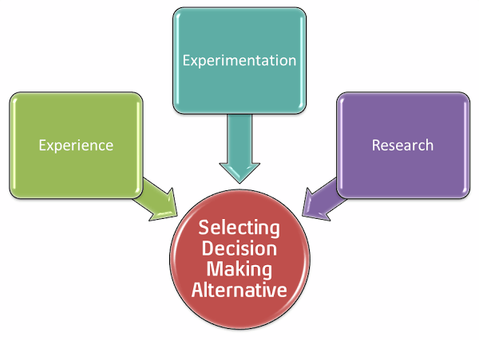
The Decision-Making Process
The decision-making process is a systematic, step-by-step process to aid in choosing the best alternative.
  First, supervisors must define the problem. Second, they must analyze the problem using available information. Third, they must establish decision criteria – factors that will be used to evaluate alternatives. Next after, thorough analysis, supervisors should develop alternate solutions. After these steps, the supervisor should carefully evaluate the alternatives and select the solution that appears to be the best or most feasible under the circumstances.
    The concluding step in this process is the follow-up and appraisal of the consequences of the decision.

Slide 14
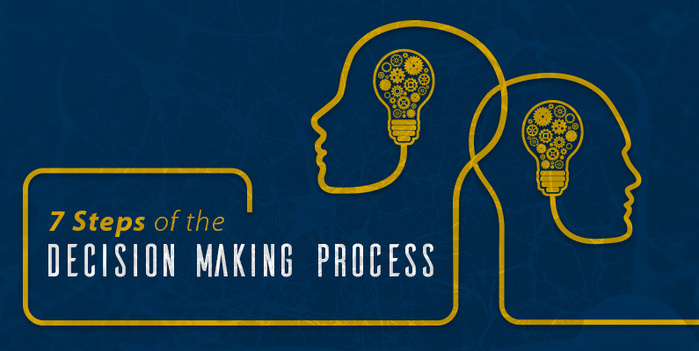
The Decision-Making Process
Effective supervisors follow the decision-making process:
  Define the problem.
  Analyze the problem.
  Establish decision criteria.
  Develop alternatives.
  Evaluate the alternatives.
  Select the “best” alternative.
  Follow up and appraise results.

Slide 15
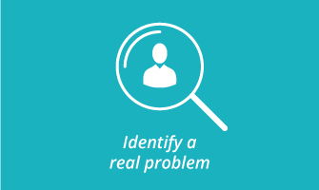
The Decision-Making Process
Step One: Define the Problem
When confronted with a situation, the supervisor should step back, look at the situation, and specifically identify real problem.
  Nothing is as useless as the right answer to the wrong question.
    Defining a problem is not easy. What appears to be the problem might merely be a symptom that shows on the surface. It is usually necessary to delve deeper to locate the real problem and define it.

Slide 16
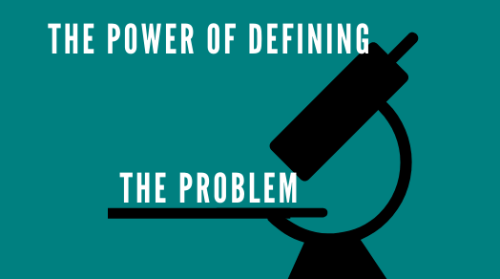
The Decision-Making Process
Step One: Define the Problem
A good problem statement addresses following key questions:
  What is the problem?
  How do you know there is a problem?
  Where has the problem occurred?
  When has the problem occurred?
  Who is involved in, or affected by, the problem?
    Expressing the problem through a problem statement can help the supervisor understand it.

Slide 17
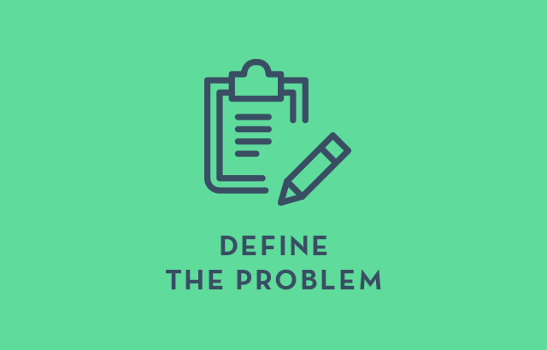
The Decision-Making Process
Step One: Define the Problem
While defining a problem often can be time-consuming, it is time well spent.
  A supervisor should go no further in the decision-making process until the problem relevant to the situation has been pinpointed.
  A problem arises when there is a difference between the way things are and the way they should be.
    Effective supervisors use problem solving not only to take corrective action but also to improve the organization.

Slide 18

The Decision-Making Process
Step Two: Analyze the Problem- Gather Facts and Information
After the problem – not just its symptoms – has been defined, the next steps is to analyze the problem.
  The supervisor begins by assembling facts and other pertinent information. This is sometimes viewed as the first step in decision making, but until the real problem has been defined, the supervisor does not know what information is needed.
    Only after gaining a clear understanding of the problem can supervisor decide how important certain data are and what additional info to seek.
    Today so much information is available, and supervisors should understand the pitfalls and perils of using such data. The supervisor needs to pause and ponder whether the date are factual and relevant to the problem.

Slide 19

The Decision-Making Process
Step Two: Analyze the Problem – Gather Facts and Information
Being human, a supervisor may find that personal opinion impacts decision making.
  This is particularly true when EEs are involved in the problem.
    For example, if a problem involves an EE who performs well, the supervisor may be inclined to show that EE greater consideration than a poor performer. The supervisor should try to be as objective as possible in gathering and examining information.

Slide 20

The Decision-Making Process
Step Two: Analyze the Problem – Gather Facts and Information
Sometimes the supervisor does not know how far to go in searching for additional facts.
  A good practice is to observe reasonable time and cost limitations. This means gathering all information without undue delay and without excessive costs.
  In the process of analysis, the supervisor should try to think of intangible factors that play a significant role. Some intangible factors are reputation, morale, discipline, and personal biases. It is difficult to be specific about these factors, but they should be considered when analyzing a problem.
    As a general rule, written and objective information is more reliable than opinions and hearsay.

Slide 21
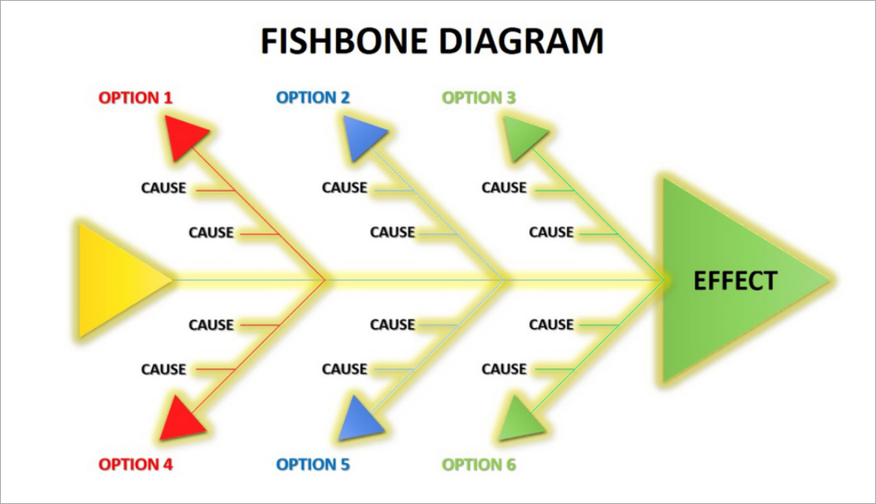
The Decision-Making Process
Step Two: Analyze the Problem – Gather Facts and Information
Another way to depict Steps One and Two of the decision-making process is the Fishbone Technique (Cause-and-Effect Diagram).
  The technique will allow the problem solver not only to identify the various factors that have produced the problem but to consider the potential interrelatedness of the causes of the problem.

Slide 22

The Decision-Making Process
Step Three: Establish Decision Criteria
Decision Criteria are standards or measures for evaluating alternatives; they are typically statements of what the supervisor wants to accomplish with the decision.
  Such criteria also can be used to determine how well implementation phase of the process is going – that is, whether the decision is doing what it was intended to do.

Slide 23

The Decision-Making Process
Step Three: Establish Decision Criteria
Sample Decision Criteria
  The Solution to a Problem
    Should result in work assignments being completed on time.
    Should incur no financial cost.
    Must not impede quality of service to the customer.
    Should put no EE’s job in jeopardy.
    Should allow differentiation of product or service in marketplace.
    Should have no negative impact on EEs.
    Must alleviate the problem within one week.

Slide 24

The Decision-Making Process
Step Three: Establish Decision Criteria
Once the decision criteria are established, the supervisor must determine which criteria are necessary and must establish their order of priority.
  Because no solution alternative is likely to meet all the criteria, the supervisor must know which criteria are most important; thus alternatives can be judged by how many of those criteria the alternatives meet.
    The supervisor may want to consult with upper-level managers, peers, or EEs when prioritizing criteria.

Slide 25

The Decision-Making Process
Step Four: Develop Alternatives
After the supervisor has defined and analyzed the problem and established decision criteria, the next step is to develop alternative solutions.
  The supervisor should consider as many solutions as can reasonably be developed.
    By formulating many alternatives, the supervisor is less apt to overlook the best course of action.

Slide 26

The Decision-Making Process
Step Four: Develop Alternatives
Roger von Oech identified several phases of creative thinking: The explorer is one who looks for ideas (alternatives), and the artist plays with those ideas.
  Inventor, Thomas Edison developed the incandescent electric light. Two of his many quotes are relevant here: “The electric light has caused me the greatest amount of study and has required the most elaborate experiments. Although I was never myself discouraged or hopeless of its success, I can not say the same for my associates,” and “Results?” Why man, I haven’t gotten lots of results! If I find 10,000 ways something won’t work, I haven’t failed. I have learned what not to do. I am not discouraged, because every worn attempt is a step forward.” Edison continued to look for a better way and to experiment until he got the one best result.

Slide 27

The Decision-Making Process
Step Four: Develop Alternatives
Almost all problems have a number of alternative solutions.
  The choices may not always be obvious, so supervisors must search for them. When supervisors fail to make this search, they are likely to fall into an either/or kind of thinking.
    It is not enough for supervisors just to decide from among alternatives that EEs have suggested, because their may be other alternatives to consider. Therefore, supervisors must stretch their minds to develop additional alternatives, even in the most discouraging situations.
    None of the alternatives may be desirable, but at least the supervisor can choose the one that is least undesirable.

Slide 28

The Decision-Making Process
Step Four: Develop Alternatives
A decision is only as good as the best alternative identified.

Slide 29

The Decision-Making Process
Brainstorming and Creative Problem Solving
When enough time is available, a supervisor should meet with a group of other supervisors or EEs to brainstorm alternatives to a perplexing problem.
  Through the free flow of ideas in a group, with judgment suspended, the group should set out to identify as many alternatives as possible. Using this technique, the supervisor presents the problem, and the participants offer as many alternative solutions as they can in the time available.
    Evaluation of ideas is suspended so that participants can give free rein to their creativity.

Slide 30

The Decision-Making Process
Brainstorming and Creative Problem Solving
Of course, brainstorming requires an atmosphere that encourages creativity.
  When supervisors are unwilling to devote sufficient time to brainstorming, or when supervisors try to dominate the process with their own opinions and solutions, the brainstorming effort is likely to fail.

Slide 31

The Decision-Making Process
Brainstorming and Creative Problem Solving
Alex Osborn, an authority on creativity and brainstorming, suggests the following 4 guidelines for effective brainstorming:
  1. Defer All Judgment of Ideas.
    During brainstorming, allow no criticism by the group. People suppress ideas consciously and subconsciously, and this tendency must be avoided. Even if an idea seems impractical and useless, it should not be rejected because rejection could inhibit the free flow of more ideas.
  2. Seek Many Ideas.
    Idea fluency is the key to creative problem solving, and fluency means quantity. The more ideas that are generated, the more likely some ideas will be viable.

Slide 32
The Decision-Making Process
Brainstorming and Creative Problem Solving
Alex Osborn, an authority on creativity and brainstorming, suggests the following 4 guidelines for effective brainstorming:
  3. Encourage Freewheeling.
    Being creative calls for a free-flowing mental process in which all ideas, no matter how extreme, are welcome. Even the wildest idea may, on further analysis, have some usefulness.
  4. “Hitchhike” on Existing Ideas.
    Combining, adding to, and rearranging ideas often produce new approaches that are superior to the original ones. When creative thought processes slow down or stop, review some of the existing ideas and try to hitchhike on them with additions or revisions.

Slide 33

The Decision-Making Process
Nominal Group Technique (NGT)
The preceding guidelines apply to both individual and group brainstorming.
  When it involves a large group, unstructured brainstorming can become long, tedious, and unproductive because many ideas are simply not feasible and because conflicts may develop.
    The Nominal Group Technique (NGT) involves having group members first write down their ideas and their alternatives to the problem. Then, group members share, discuss, evaluate, and refine their ideas.
    The group’s final choice(s) may be made by a series of confidential votes in which a list of ideas is narrowed until consensus is attained.

Slide 34

The Decision-Making Process
Electronic Brainstorming System (EBS)
It may not be feasible or convenient to get EEs together, and the manager may prefer to use the Electronic Brainstorming System (EBS).
  EBS allows participants to share ideas anonymously over the Internet. Another advantage of EBS is that ideas may be evaluated and discussed without going face to face with the person who introduced the ideas.
    Proponents of EBS claim that this technique reduces many of the problems of brainstorming discussed earlier.

Slide 35

The Decision-Making Process
Brainstorming and Creative Problem Solving
Creative approaches and brainstorming meetings are particularly adaptable if the problem is new, important, or strategic.
  Even the supervisor who takes time to brainstorm a problem alone is likely to develop more alternatives for solving the problem than one who does not brainstorm.

Slide 36

The Decision-Making Process
Ethical Considerations
Both when developing and evaluating alternatives, a supervisor should consider only those alternatives that are lawful and acceptable within the organization’s ethical guidelines.
  Supervisors’ decisions should also demonstrate strong ethical values for their EEs. In recent years, firms have become concerned that their managers, supervisors, and EEs make ethical decisions because they recognize that, in the long term, good ethics is good business.
    Many firms have developed handbooks, policies, and official statements that specify their ethical standards and practices, or “ethical tests.”

Slide 37

The Decision-Making Process
Ethical Guidelines
The following guidelines for decision making are not comprehensive, but they are relevant when addressing the ethical aspects of most problem situations:
  Legal/Compliance Test
    Laws, regulations, and policies are to be followed, not broken or ignored. The rationale and explanation that “everybody’s doing it” and “everybody’s getting away with it” are poor excuses if you get caught violating a law, policy, or regulation. If in doubt, ask for guidance from someone who knows the law or regulation. However, compliance should be only a stating point in most ethical decision making.
  Public Knowledge Test
    What would be the consequences if the outcome of an alternative decision became known to the public, one’s family, media, or government agency?

Slide 38
The Decision-Making Process
Ethical Guidelines (Cont.)
  Long-Term Consequences Test
    What would be the long-term vs. short-term outcomes? Weigh those outcomes against each other.
  Examine-Your-Motives Test
    Do motives for a proposed decision benefit the company and others, or are they primarily selfish and designed to harm or destroy other people and their interests?
  Inner-Voice Test
    This is the test of conscience and moral values that has been instilled.
    If something inside you says the choice is or may be wrong, it usually is. It is then prudent to look for a different and better alternative.
  Fairness Test
    Are the decision and corresponding actions fair to all concerned such as the various stakeholders? Will they be beneficial to all concerned? When in doubt about the impact of the decision on various stakeholder groups, check and recheck the process used to arrive at the decision.
  The Four-Way Test
    This test serves as the foundation for their actions. (1) Is it the truth? (2) Is it fair to all concerned? (3) Will it build goodwill and better friendships? (4) Will it be beneficial to all concerned?

Slide 39

The Decision-Making Process
Ethical Considerations
When supervisors believe an alternative is questionable or might be unacceptable within the firm’s ethical policies, they should consult their managers, the human resources department, or other staff specialists who can provide guidance on how to proceed.
  EEs should have access to safe and confidential channels to raise concerns about possible ethics violations.
    It is not enough to just have an ethics policy.
    Supervisors are responsible for ensuring that the company’s ethical policies aren’t just nice words posted in the company handbook; they must be words to live by.

Slide 40

The Decision-Making Process
Step Five: Evaluate the Alternatives
The ultimate purpose of decision making is to choose the course of action that will provide the greatest number of wanted and the smallest number of unwanted consequences.
  After developing alternatives, supervisors can mentally test each of them by imagining that each has already been put into effect.
  Supervisors should try to foresee the probable and undesirable consequences of each alternative.
    By thinking alternatives through and appraising their consequences, supervisors can compare the desirability of choices.

Slide 41

The Decision-Making Process
Step Five: Evaluate the Alternatives
The usual way to begin is to eliminate alternatives that do not meet the supervisor’s decision criteria and ethical standards.
  The supervisor should evaluate how many of the most important criteria each alternative meets.
    The successful alternative is the one that satisfies or meets the largest number of criteria at the highest priority levels. Often, there is no clear choice.

Slide 42

The Decision-Making Process
Step Five: Evaluate the Alternatives
The supervisor is frequently required to choose a course of action without complete information about the situation.
  Because of this uncertainty, the chosen alternative may not yield the intended results; therefore risk is involved. Some supervisors consider the risk and uncertainty of each course of action.
    There is no such thing as a risk-free decision; one alternative may simply involve less risk than others.

Slide 43
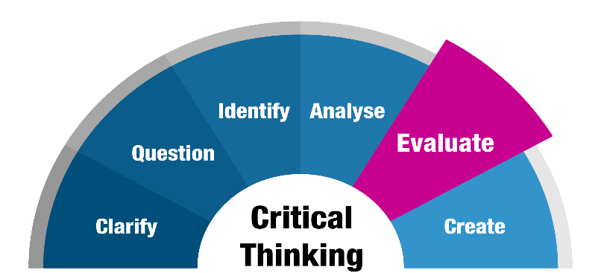
The Decision-Making Process
Step Five: Evaluate the Alternatives
Time may make one alternative preferable, particularly if a difference exists between how much time is available and how much time is required to carry out an alternative.
  The supervisor should consider the available facilities, tools, and other resources.
    It is also critical to judge alternatives in terms of economy of effort and resources. In other words, which action will give the greatest benefits and results for the least cost and effort?

Slide 44
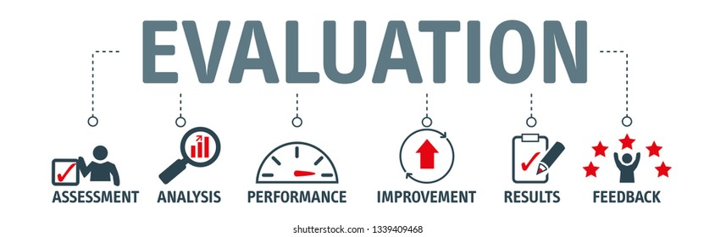
The Decision-Making Process
Step Five: Evaluate the Alternatives
When one alternative clearly appears to provide a greater number of desirable consequences and fewer unwanted consequences than any other alternatives, the decision is fairly easy.
  However, the best alternative is not always to obvious. At times, two or more alternatives may seem equally desirable. Here, the choice may become a matter of personal preference.
    It is also possible that the supervisor may feel that no single alternative is much better than any other. In this case, it might be possible to combine the positive aspects of the better alternatives into one composite solution.

Slide 45

The Decision-Making Process
Step Five: Evaluate the Alternatives
Sometimes no alternatives are satisfactory; all have too many undesirable effects, or none will bring about the desired results.
  In such a case, the supervisor should begin to think of new alternative solutions or perhaps even start all over again by attempting to redefine the problem.

Slide 46

The Decision-Making Process
Step Five: Evaluate the Alternatives
A situation might arise in which the undesirable consequences of all alternatives appear to be so overwhelmingly unfavorable that the supervisor feels the best solution is to take no action.
  However, this may be deceiving because taking no action does not solve the problem. Taking no action is as much a decision as is taking another action, even though the supervisor may believe an unpleasant choice has been avoided.
    The supervisor should visualize the consequences that are likely to result from taking no action. Only if the consequences of taking no action are the most desirable should it be selected as the appropriate course.

Slide 47

The Decision-Making Process
Step Six: Select the Best Alternative
Selecting the alternative that seems best is known as optimizing. However, the supervisor sometimes makes a satisficing decision, selecting an alternative that meets the minimal decision criteria.
  A famous management theorist, Herbert Simon, once likened the difference to finding a needle in a haystack (satisficing) and finding the biggest, sharpest needle in the haystack (optimizing).
    Nevertheless, after developing and evaluating alternatives, the supervisor must make a choice.

Slide 48
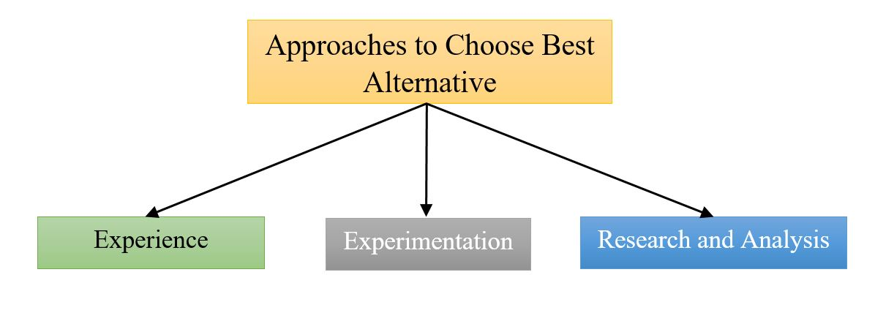
The Decision-Making Process
Step Six: Select the Best Alternative
Among the most prominent bases for choosing the best alternative are experience, intuition, advice, experimentation, and statistical and quantitative decision making.
  Regardless of the process, a supervisor rarely makes a decision that pleases everyone equally.

Slide 49

The Decision-Making Process
Experience
When selecting from alternatives, the supervisor should rely on experience.
  Certain situations will recur, and the old adage, “Experience is the best teacher,” applies to a certain extent. A supervisor can often decide wisely based on personal experience or the experience of other managers.
    Knowledge gained from experience is a helpful guide, and its importance should not be underestimated. On the other hand, it is dangerous to follow experience blindly.

Slide 50

The Decision-Making Process
Experience
When looking to experience as a basis for choosing among alternatives, the supervisor should examine the situation and the conditions that prevailed at the time of the earlier decision.
  It may be that conditions are nearly identical to those that prevailed on the previous occasion and that the decision should be similar to the one made then.
    More often than not, however, conditions change considerably, and the underlying assumptions change. Therefore, the new decision probably should not be identical to the earlier one.

Slide 51

The Decision-Making Process
Experience
Experience can be helpful when supervisors are called on to substantiate their reasons for making certain decisions.
  In part, this may be a defense, but there is no excuse for following experience in and of itself.
    Experience must always be viewed with the future in mind.
    The circumstances of the past, present, and future must be considered realistically if experience is to help supervisors select from alternatives.

Slide 52

The Decision-Making Process
Intuition
At times, supervisors base their decisions on intuition. Some supervisors even appear to solve problems by subjective means.
  However, a deeper search usually reveals that the so-called intuition on which the supervisor appeared to have based a decision was really experience or knowledge stored in the supervisor’s memory.
    By recalling similar situations that occurred in the past, supervisors may be better able to reach decisions, even though they label doing so as having hunches.

Slide 53

The Decision-Making Process
Intuition
Intuition may be particularly helpful when other alternatives have been tried with poor results.
  If the risks are not too great, a supervisor may choose a new alternative because of an intuitive feeling that a fresh approach might bring positive results.
    Even if the hunch does not work out well, the supervisor has tried something different. Supervisors will remember doing so and can draw upon those experiences in future decisions.

Slide 54
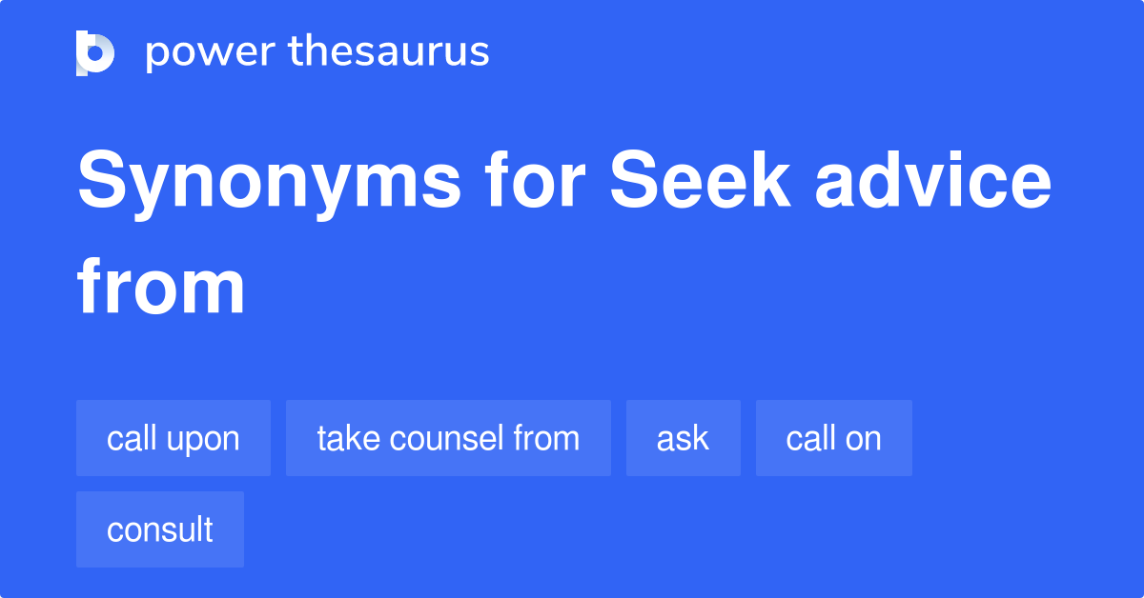
The Decision-Making Process
Advice From Others
Although a supervisor cannot shift personal responsibility for making decisions in the department, the burden of decision making often can be eased by seeking advice of others.
  The ideas and suggestions of EEs, other supervisors, staff experts, technical authorities, and the supervisor’s own manager can be of great help in weighing facts and information.
    Seeking advice does not mean avoiding a decision because the supervisor still must decide whether to accept the advice of others.

Slide 55

The Decision-Making Process
Advice From Others
Many believe that two heads are better than one and that input from others improves the decision process.
  The following four guidelines can help the supervisor decide whether groups should be included in the decision-making process:
    If additional information would increase the quality of the decision, involve those who can provide that information.
    If acceptance of the decision is critical, involve those whose acceptance is important.
    If people’s skills can be developed through participation, involve those who need the development opportunity.
    If the situation is not life-threatening and does not require immediate action, involve others in the process.
      Generally, the varied perspectives and experiences of others adds to the decision-making process.

Slide 56

The Decision-Making Process
Experimentation
In the scientific world, where many conclusions are based on tests in laboratories, experimentation is essential and accepted.
  In supervision, however, experimentation is often too costly in terms of people, time, and materials.
    Nevertheless, in some instances a limited amount of testing and experimentation is advisable. For example, a supervisor may find it worthwhile to try several different locations for a new copy machine in the department to see what location EEs prefer and which location is most convenient for the workflow.

Slide 57

The Decision-Making Process
Experimentation
There are also instances in which a certain amount of testing is advisable to allow EEs to try new ideas or approaches, perhaps of their own design.
  While experimentation may be valid from a motivational standpoint, it can be a slow and relatively expensive method of reaching a decision.

Slide 58

The Decision-Making Process
Quantitative Decision Making
Numerous quantitative techniques and models are available for helping managers improve the quality of their decision making.
  Decision trees, operations research, payback analysis, probability, and simulation models are but a few of these tools. They require the decision maker to quantify information that is relevant to a decision.
    But one desirable feature of quantitative decision making is the ability of the user to perform what if scenarios – the simulations of business situations over and over using different data for select decision areas.
    But, for many supervisors, these techniques are not practical.

Slide 59
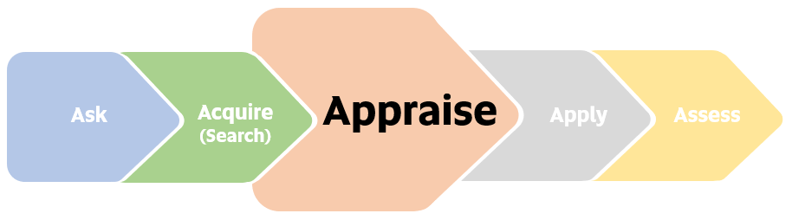
The Decision-Making Process
Step Seven: Follow Up and Appraise the Results
After a decision has been made, specific actions are necessary to carry out that decision.
  Follow-up and appraisal of a decision’s outcome are part of decision making. This can take many forms, depending on the decision, timing, costs, standards, personnel, and other factors. For example, a minor production-scheduling decision could be evaluated easily based on a short written report or perhaps even by the supervisor’s observation or a discussion with EEs.
    In contrast, a major decision involving the installation of complex new equipment requires close and time-consuming follow-up by supervisor, technical EEs, and high-level managers. This type of decision usually requires the supervisor to prepare numerous detailed, written reports of equipment performance under varying conditions that are compared closely with plans or expected standards for the equipment.

Slide 60
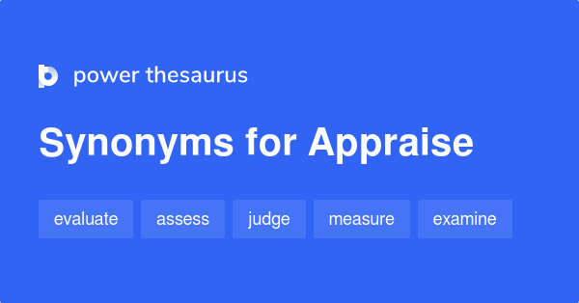
The Decision-Making Process
Step Seven: Follow Up and Appraise the Results
The important point to recognize is that the decision-making task is incomplete without some form of follow up and action appraisal.
  When supervisor establishes decision criteria or objectives that the decision should accomplish, it is easier to evaluate decision’s effects.
    When the consequences are good, the supervisor can feel reasonably confident that the decision was sound.

Slide 61

The Decision-Making Process
Step Seven: Follow Up and Appraise the Results
When the follow-up and appraisal indicate that something has gone wrong or that the results have not been as anticipated, the supervisor’s decision-making process must begin all over again.
  This may even mean going back over each of the steps of the decision-making process in detail. The supervisor’s definition and analysis of the problem and the development of alternatives may have to be completely revised in view of new circumstances surrounding the problem.
    In other words, when follow-up and appraisal indicate that the problem has not been solved, the supervisor should treat the situation as a completely new problem and go through the decision-making process from a completely fresh perspective.

Slide 62

Supervisory Tips
Suggestions for Improving Problem Solving and Decision Making.
  Take enough time to state the problem accurately and concisely and to identify the objectives you want to accomplish with your decision.
  Whenever appropriate, seek opinions and suggestions from others who can contribute their ideas toward solving the problem.
  Before deciding what to do, gather ample facts and information that will help define/clarify the problem and suggest solutions.
  Stretch your mind to develop numerous alternative solutions; brainstorm with others when practical.
  Make your decision based on objective criteria; avoid letting personal biases and organizational political considerations direct your choice.
  When implementing and following up on your decision, do not hesitate to admit and rectify errors in the decision, even if doing so causes some personal embarrassment. Admitting mistakes early is prudent and builds your integrity with others.

Slide 63
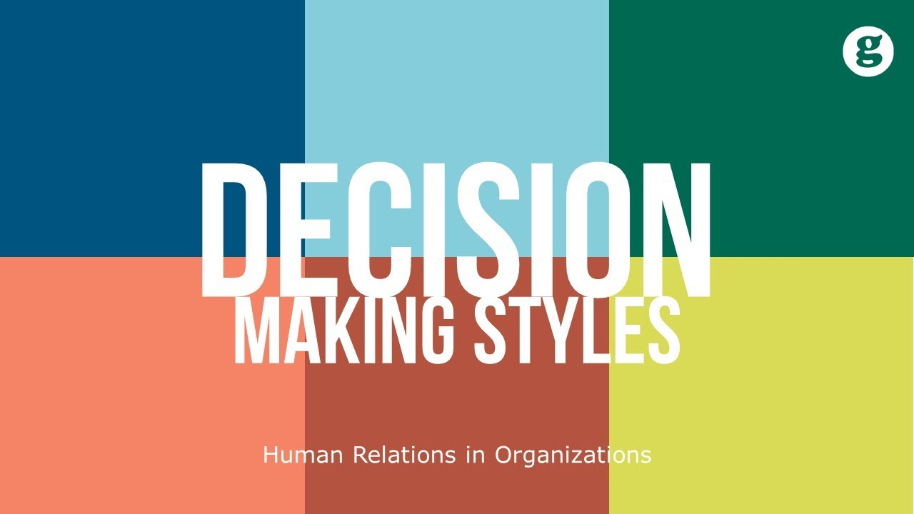
Decision-Making Styles
Decision making is influenced by many factors, making it difficult to formulate a simple-to-do check list that applies to every situation in the same way.
  When supervisors are faced with complex, unusual, or new problems, they must use good judgement, intuition, and creativity in the decision-making process.

Slide 64

Decision-Making Styles
What processes do managers actually use when making decisions?
  We know from observing others and our own experiences that people make decisions differently.
    We have observed two extremes: some people are like the “waffler” who takes forever to study the problem and never makes a decision, while others are like the “gunner” pull the trigger (fire-aim-ready) quickly, and if things don’t go the intended way, they fire again and again until they hit the target (achieve the intended results).

Slide 65
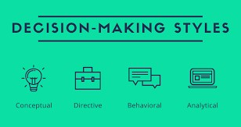

Decision-Making Styles
What is your decision-making style?
Analytic: Deep Thinker
  Decisions are made based on the facts and evidence researched.
    Avoids risks
    Uses solid, tangible, realistic evidence to support decisions
    Makes decisions valid for the present and the future
    Is cautious and deliberate
    Has great need to be “right”
    Is very concerned with details
    Uses an organized process
    Stands behind decisions after they are made

Slide 66
Decision-Making Styles
What is your decision-making style?
Driver: Group Commander
  Decisions are made using the available information without help from others.
    Makes own decisions
    Uses power to influence
    Seeks control
    Overcomes obstacles with force
    Expresses conclusions quickly
    Bases decisions on facts and data
    Takes risks
    Prefers to be presented with options from which to choose

Slide 67
Decision-Making Styles
What is your decision-making style?
Amiable: Consensus Builder
  Decisions are made that are acceptable to the group from shared information and ideas.
    Likes the comfortable and known
    Uses own and others’ personal opinions
    Wants guarantees of results
    Wants minimal risk
    Needs buy-in from others
    Avoids interpersonal confrontation
    Is reluctant to change beliefs
    Checks frequently for group agreement

Slide 68
Decision-Making Styles
What is your decision-making style?
Expressive: Free Spirit
  Decisions are made based on personal feelings and the feelings of others.
    Incorporates feelings of “important people”
    Sidelines facts and logic
    May be creative
    Takes risks
    Makes frequent mistakes
    Makes rapid decisions
    Looks for rewards that are social recognition and prestige
    Uses drama and/or humor to make a point

Slide 69
Decision-Making Styles
What is your decision-making style?
Abdicator: Convenience Seeker
  Decisions are made based on the easiest method readily available.
    Makes fast decisions
    Results in many errors
    Will assign decisions to anyone
    Doesn’t care about results
    Has “Not my problem” attitude
    Gives no direction
    Wishes it would all go away
    Doesn’t want to be involved

Slide 70

Decision-Making Styles
To assist in understanding how you make decisions, look back at your recent decisions.
  Analyze them from the following perspectives.
    What worked?
    What actually happened as a result of the decision?
    What kind of feedback did you receive about the success of a decision?
    What style did you use to make the successful decision?
    What didn’t work?
    How much tweaking did you have to do to make it work?
    What caused the differences between the intended outcome and what actually occurred?
    What kind of feedback did you receive about a failed decision?
    What decision-making style did you use to make the failed decision?

Slide 71

Time Impacts the Decision-Making Process
Supervisors cannot afford to make decisions without considering the steps outlined below.
  Often, when an EE brings up a problem, the supervisor should ask questions like the following:
    How extensive is the problem?
    Does the situation need an immediate response?
    Who else (the stakeholders) is affected by the problem?
    Should they (the stakeholders) be involved in this discussion?
    Have you (the employee) thought through the problem, and do you have an idea of what the end result should be?
    What do your recommend? Why?

Slide 72

Time Impacts the Decision-Making Process
This approach is a form of participative supervision and can help to develop the EE’s analytical skills.
  The supervisor then can better think through the problem, apply the decision-making steps, and make a decision.

Slide 73

Introducing Change
Often when a decision is made by a leader or a supervisor, that decision will indicate that a change is imminent in the department or the whole organization.
  Change is expected as part of life, and the survival and growth of most enterprises depend on change and innovation.
    Indeed, the survival of a firm may depend on the abilities of its managers to make fundamental changes in virtually all aspects of operations while facing the risks of an uncertain future. The impact of change has become so common that security and stability are often concepts and practices related to the past.

Slide 74
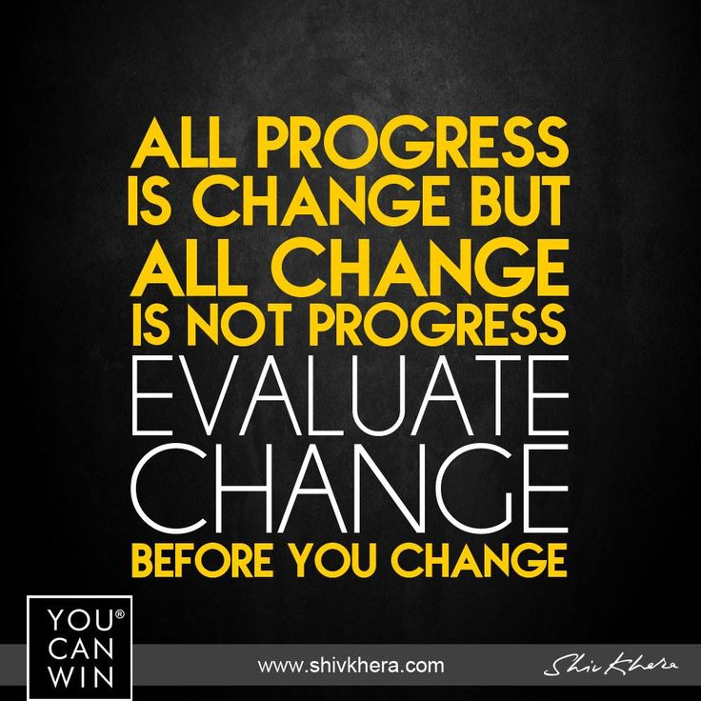
Introducing Change
Making Change Means Supervisory Involvement
Despite the emphasis on change, there still appear to be numerous problems and considerable resentment concerning both the introduction and effects of many organizational changes.
  There is an adage that says, “All progress is change, but not all change is progress.”
    In some cases this is true, particularly when managers identify problems, initiate change, then look for a quick response in their organizations, and they become frustrated when expected results are not achieved.
    Mediocrity is then tolerated, and the net result is that the more things have changed, the more they have stayed the same.

Slide 75

Introducing Change
Making Change Means Supervisory Involvement
Conversely, well-performing organizations can potentially exist for years without making any changes, but they run the risk of eroding EE motivation and effectiveness as organizational silos, departmental routines, and entrenched interests begin to weigh down organizational processes.
  In situations like this, restructuring business units or EE’s responsibilities can energize a stagnant company.
    These contrasting perspectives reinforce that supervisors must consider the pervasiveness of change in organizations, the goals of change, and its impact on EEs, bringing to mind another adage we can translate to the organizational context, “Change is the only constant.”

Slide 76

Introducing Change
Making Change Means Supervisory Involvement
Whether a change has been initiated by upper management or by the supervisor personally, it is the supervisor who has the major role in effecting change.
  The success or failure of any change is usually related to a supervisor’s ability to anticipate and deal with the causes of resistance to change.

Slide 77

Introducing Change
Reasons for Resistance to Change
Some supervisors are inclined to discount the existence and magnitude of human resistance to change.
  What may seem like a trifling change to the supervisor may bring strong reaction from EEs.
    Supervisors should remember that EEs seldom resist change just to be stubborn. They resist because they believe a change threatens their positions socially, psychologically, or economically.
    Therefore, the supervisor should be familiar with the ways in which resistance to change can be minimized and handled successfully.

Slide 78

Introducing Change
Reasons for Resistance to Change
Change disturbs the environment in which people exist.
  EEs become accustomed to a work environment in which patterns of relationships and behavior have stabilized.
  When a change takes place, new ideas and new methods may be perceived as a threat to the security of the work group.
    Many EEs fear change because they cannot predict what the change will mean in terms of their positions, activities, or abilities.
    It makes no difference whether the change actually has a negative result. What matters is that the EEs believe that the change will have negative consequences.

Slide 79
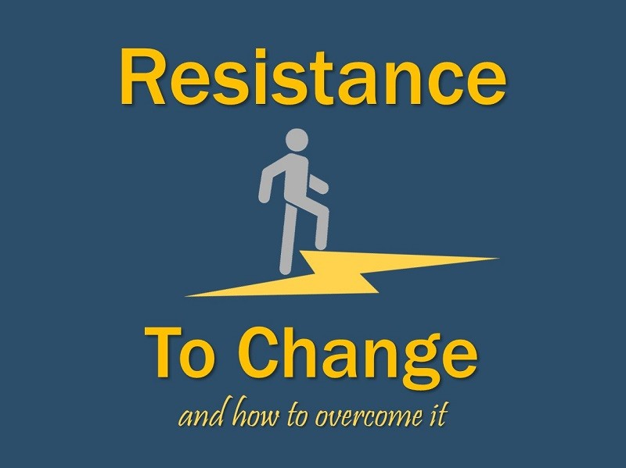
Introducing Change
Reasons for Resistance to Change
A supervisor must learn to recognize how changes affect different EEs and observe how individuals develop patterns of behavior that serve as barriers to accepting change.

Slide 80
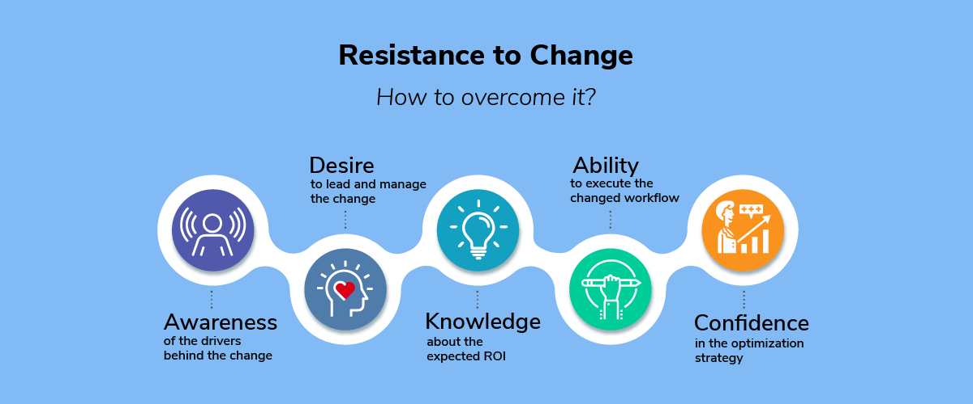
Introducing Change
Overcoming Resistance to Change
The most important factor in gaining EE acceptance of new ideas and methods is the relationship between the supervisor who is introducing the change and the EEs who are affected by it.
  If the relationship has confidence and trust, EEs are more likely to accept the change.
    If a supervisor has regularly interacted with EEs with constancy, caring, candor, and competence, all of which lead to a trusting relationship, EEs are more likely to proceed confidently with the directives they are given because they will trust that the change being proposed will be facilitated with those same virtues.

Slide 81

Introducing Change
Providing Adequate Information
It is not the change itself that usually leads to resistance, but rather the way the supervisor introduces the change.
  Resistance to change, when it comes from fear of the unknown, can be minimized by supplying all the information EEs consciously and subconsciously need to know.
    Presenting EEs with the vision, or idealized picture of the future once a change is fully implemented, can help supervisors introduce change.
    Studies reveal that most EEs tend to adapt more readily to the change and become proactive in the change process when supervisors share a clear, compelling view of the future and how it would be different.

Slide 82

Introducing Change
Encouraging Participation in Decision Making
Another technique for reducing resistance to change is to permit the affected EEs to share in making decisions about the change.
  If several EEs are involved in a change, group decision making is an effective way to reduce their fears and objections.
    When EEs have an opportunity to work through new ideas and methods from the beginning, usually they will consider the new directives as something of their own making and will give those changes their support.
    The group may even apply pressure on those who have reservations about going along with change, and it is likely that each member of the group will carry out the change once there is agreement on how to proceed.

Slide 83

Introducing Change
Encouraging Participation in Decision Making
According to organizational anthropologist Judith Glasser, “When successful change occurs, EEs feel like authors not objects of change. They feel fully invested, accountable and energetic about the future, regardless of challenges.”

Slide 84

Introducing Change
Proposing Change to High-Level Managers
In many organizations, high-level managers complain that supervisors are too content with the status quo and are unwilling to suggest new and innovative ways to improve departmental performance.
  Supervisors, on the other hand, complain that higher-level managers are not receptive to ideas they suggest for their departments.
    There is probably some truth to both allegations.

Slide 85

Introducing Change
Proposing Change to High-Level Managers
If supervisors wish to propose changes, it is important that they understand how to present ideas not only to their EEs, but to higher-level managers as well.
  “Selling” an idea to a manager involves the art of persuasion, same as a good salesperson uses persuasion to sell a product or service to a reluctant customer.

Slide 86
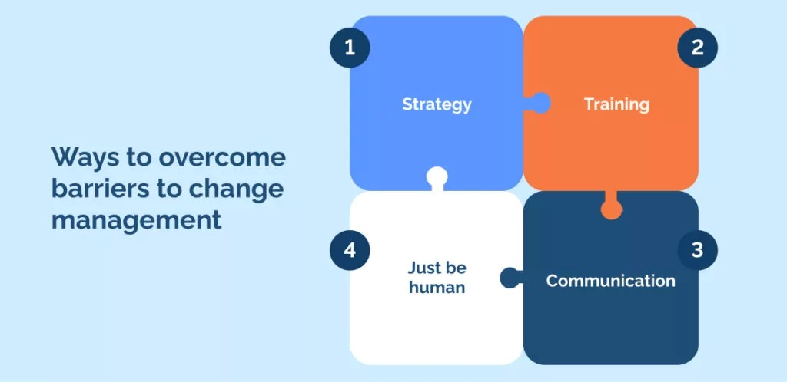
Overcoming the Barriers to Change
Overcoming the Barriers to Change
  Adjust and Modify as Necessary
  Make It Happen
    The Right People – The Right Place – Celebrate Success Aligned w/ Goals
  Encourage Employee Participation
    Seek Their Ideas and Commitment
  Overcome Resisters to Change
    Demonstrate Benefits to Them and Other Stakeholders
  Provide Information on Benefits of Change
  Recognize Need to Change

Slide 87

Introducing Change to High-Level Manager
Obtaining Needed Information
A supervisor who has a good idea or who wishes to suggest a change should first ask, “What aspects of the idea or change will be of most interest to the boss?”
  Higher-level managers usually are interested if a change might improve production, increase sales and profits, improve morale, or reduce overhead and other costs.
    It is important to do considerable homework to see whether a proposed change is feasible and adaptable to the departmental operation.

Slide 88

Introducing Change to High-Level Manager
Obtaining Needed Information
By thinking through the idea carefully and getting as much information as possible, the supervisor will be better positioned to argue strong and weak points of the proposal.
  In addition, the supervisor should find out whether any other departments or organizations have used the proposed idea – successfully or unsuccessfully.
    The manager will be impressed that the supervisor has invested time and effort to investigate the best practices of other organizations.

Slide 89

Introducing Change to High-Level Manager
Consulting with Other Supervisors
To get an idea or a proposal beyond the discussion stage, the supervisor should consult with other supervisors and personnel who might be affected and get their reactions to the proposed change.
  Checking an idea out with them gives them a chance to think the idea through, offer suggestions and criticisms, and work out some of the problems. Otherwise, some supervisors may resist or resent the change if they feel they have been ignored.
    It is helpful to get the tentative commitment of other supervisors.
    Managers will be inclined to consider an idea if it has been discussed in preliminary form with knowledgeable people in the organization.

Slide 90

Introducing Change to High-Level Manager
Forma Written Proposal
A manager may ask a supervisor to put a proposed idea in writing so that copies may be forwarded to higher-level managers, other supervisors, or other personnel.
  The supervisor may have to engage in considerable study outside of normal working hours to obtain all the needed information.
  Relevant information on costs, prices, productivity data, and the like should be included in the proposal, even if some data are only educated guests. Highly uncertain estimates should be labeled as tentative, and exaggerated claims and opinions should be avoided.
    Risks, as well as potential advantages, should be acknowledged in the formal proposal.

Slide 91

Introducing Change to High-Level Manager
Formal Presentation
If a supervisor is asked to formally present the proposal, ample planning and preparation are required.
  The presentation should be made thoroughly and unhurriedly, allowing sufficient time for questions.
  A supervisor who has carefully thought through an idea should be unafraid to express it in a firm and convincing manner.
  The supervisor should be enthusiastic in explaining the idea, but also patient and empathetic with those who may not agree with it.
    A helpful technique in a formal presentation is to use some type of chart, diagram, or visual aid.

Slide 92

Introducing Change to High-Level Manager
Acceptance or Rejection of Change
A supervisor who can persuade higher-level managers and other supervisors to accept a proposed change will likely feel inner satisfaction.
  Of course, any good idea requires careful implementation, follow-up and refinement. Rarely does a change follow the suggested blueprint.
    Following up and working out the problems with others are important aspects of making a change effective.

Slide 93

Introducing Change to High-Level Manager
Acceptance or Rejection of Change
However, despite a supervisor’s best efforts, an idea may be rejected, altered greatly, or shelved.
  This can be frustrating, particularly to supervisors who have worked diligently to develop ideas believed would lead to positive results.
  The important thing is to avoid becoming discouraged & developing a negative outlook. There may be valid reasons for rejection of ideas, or the timing may not have been right.
    A supervisor should resolve to try again and perhaps to further refine and polish the idea for resubmission.

Slide 94

Introducing Change to High-Level Manager
Acceptance or Rejection of Change
A supervisor who has developed an idea for change, even if it has not been accepted, usually will find that higher-level managers appreciate such efforts.
  Moreover, the experience of having worked through a proposal for change will make the supervisor a more valuable member of the organizational team, and there will be many other opportunities to work for change.

Slide 95

A Formula for Organizational Renewal
We must accept reality that organizations must change or die.
  Many organizations, like people, wait until they are near death before they recognize the need to make changes.
    Harvard professors Michael Tushman and Charles O’Reilly pointed out that “leading an organization is an ongoing process.”

Slide 96

A Formula for Organizational Renewal
Renewal requires doing the right thing today so that they are prepared to meet the challenges of tomorrow.
  In short, organizational renewal means that management must improve upon and sustain what they are doing today while creating processes for long-term success.

Slide 97

A Formula for Organizational Renewal
The beginning of the journey for organizational renewal starts with a focus on the organization’s core values.
  The five-pillar resources serve as a starting point for establishing organizational objectives: (1) service, (2) quality, (3) people, (4) finance, and (5) growth. Once objectives are set for each pillar, they are cascaded throughout, from division to department to unit to individual. These pillars then lay the metrics and framework for consistent evaluations.
    Additional pillars can be added to meet the uniqueness of a particular organization.

Slide 98

A Formula for Organizational Renewal
Among the true tests of leadership are (1) whether anyone follows and (2) the legacy the leader leaves.
  That is, what does the organization look like three years after they leave?

Slide 99
A Formula for Organizational Renewal
The following process will help point you in the right direction for change:
  Remember that as leader of the team, you are also a member of the team.
  Identify the issues confronting the organization.
  Analyze how those issues prevent goal attainment.
  Recognize the difference between needed change and change for the sake of change.
  Identify metrics that will be used to monitor and evaluate the change process.
  Communicate to and involve all who have a stake in the change.
  Understand what needs to be changed.
  Seek consensus, but recognize when to sacrifice unanimity for decisiveness.
  Confront the resisters to change.
  Establish clear targets.
  Take risks, experiment, and innovate.
  Spend money to develop (train) EEs so they have competencies to implement change.
  Focus on the outcome(s).
  Monitor progress and make adjustments as necessary.
  Provide feedback and encouragement.
  Guarantee total commitment to organizational renewal – to be the “best of the best.”
  Celebrate victories.

Slide 100

A Formula for Organizational Renewal
Noted leadership theorist John Kotter said, “Behavior change happens mostly by speaking to people’s feelings.”

Slide 101


