Slide 1
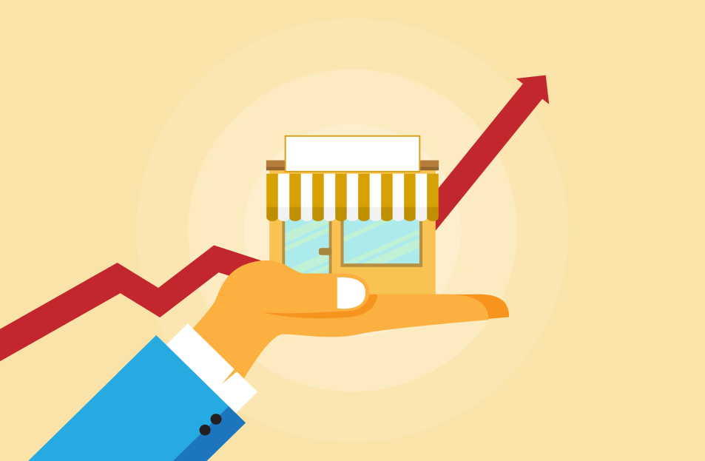
Business Survey
Session Six Class Presentation
Business Foundations
  A Changing World 11th Edition
    O.C. Ferrell, Geoffrey Hirt, and Linda Ferrell; McGraw Hill Education; New York, NY 2018
      ISBN: 978-1-259-68523-1

Slide 2
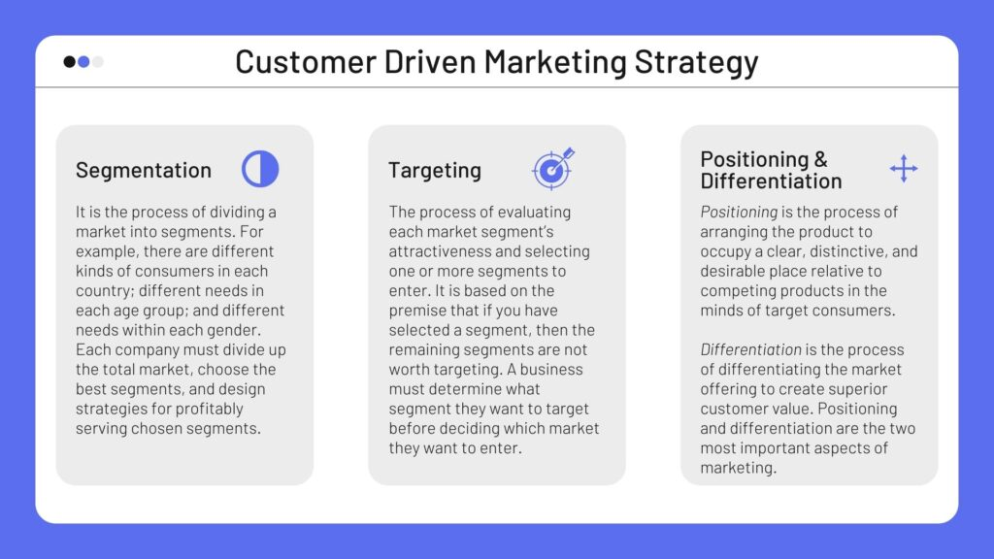
Part Five: Marketing: Developing Relationships
Chapter Eleven: Customer-Driven Marketing

Slide 3
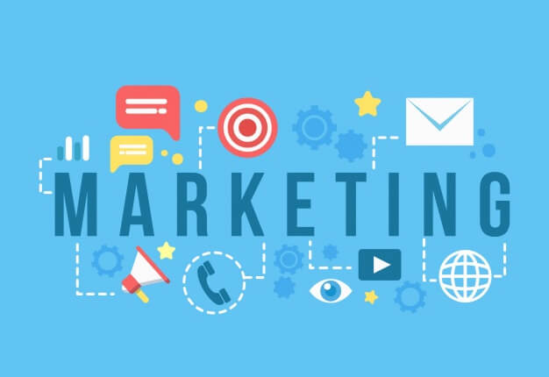
Introduction
Marketing involves planning and executing the development, pricing, promotion, and distribution of ideas, goods, and services to create exchanges that satisfy individual and organizational goals.
  These activities ensure that the products consumers want to buy are available at the price they are willing to pay and that consumers are provided with information about product features and availability.

Slide 4

The Exchange Relationship
At the heart of all business is the exchange: the act of giving up one thing (money, credit, labor, goods) in return for something else (goods, services, ideas).
  Businesses exchange goods, services, or ideas for money supplied by customers in a voluntary exchange relationship.
  The Buyer must feel good about the exchange or the relationship will not continue.

Slide 5
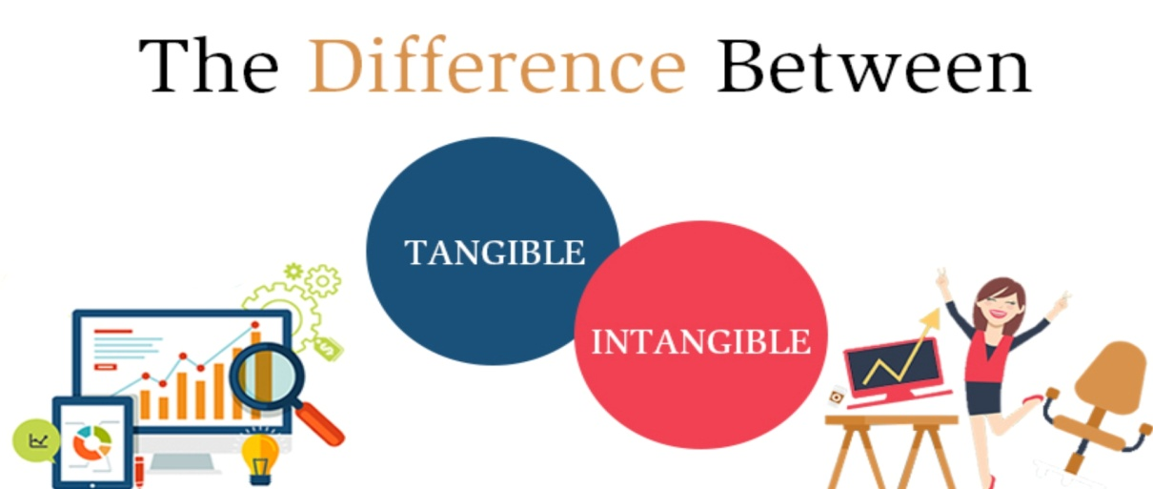
The Exchange Relationship
When you think of marketing products, you may think of tangible things, but what most consumers want is a way to get a job done, solve a problem, or gain some enjoyment.
  The intangible may be the capability gained from using a product or the image evoked by it, or even the brand name.
    (x) You might purchase a vacuum cleaner not because you want a vacuum cleaner but because you want clean carpets.

Slide 6
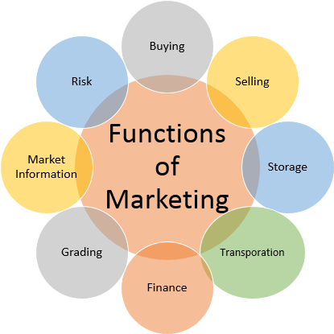
Functions of Marketing
Marketing focuses on a complex set of activities (8) that must be performed to accomplish objectives and generate exchanges.
  1. Buying
    A marketer must understand buyers’ needs and desires to determine what products to make available.
  2. Selling
    Marketers view selling as a persuasive activity that is accomplished through promotion – advertising, personal selling, sales promotion, publicity, and packaging.
  3. Transporting
    Transporting is the process of moving products from seller to buyer.
    Marketers focus on transportation costs and services.
  4. Storing
    Storing is part of distribution and includes warehousing goods.
    Warehouses hold some products for lengthy periods for time utility (i.e. seasonal product storage, such as orange juice).

Slide 7
Functions of Marketing
Marketing focuses on a complex set of activities (8) that must be performed to accomplish objectives and generate exchanges.
  5. Grading
    Standardizing products by dividing them into subgroups and displaying and labeling them so that consumers clearly understand their nature and quality. Some standards are set by the government.
  6. Financing
    For many products, especially large items such as automobiles, refrigerators, and new homes, the marketer arranges credit to expedite the purchase.
  7. Market and Research
    Through research, marketers ascertain need for new goods-services.
  8. Risk Taking
    Risk is the chance of loss associated with marketing decisions.

Slide 8
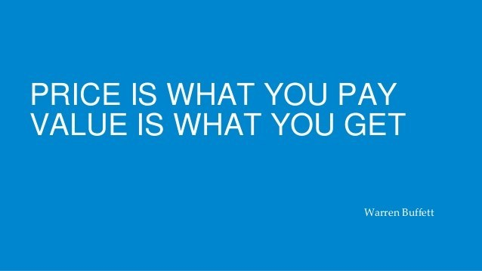
Creating Value with Marketing
Value is an important element of managing customer relationships and implementing the marketing concept.
  Value is a customer’s subjective assessment of benefits relative to costs in determining the worth of a product. Customer benefits include anything a buyer receives in exchange, including the experience alone.
    Customer costs include anything a buyer must give up to obtain the benefits the product provides – price, time and effort to find product, risks associated with it, etc.

Slide 9
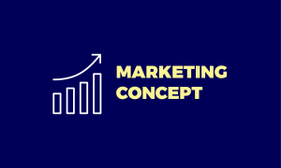
The Marketing Concept
A basic philosophy that guides all marketing activities is the Marketing Concept, the idea that an organization should try to satisfy customers’ needs through coordinated activities that also allow it to achieve its own goals.
  According to the marketing concept, a business must find out what consumers desire and then develop the good, service, or idea that fulfills their needs or wants.
    The business must then get the product to the customer.

Slide 10
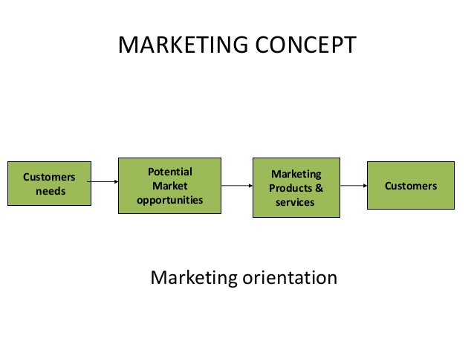
The Marketing Concept
To remain competitive, companies must be prepared to add or adapt their product lines to satisfy customers’ desires.
  Each business must determine how best to implement the marketing concept, given its own goals and resources.
    Trying to determine customers’ true needs is increasingly difficult because no one fully understands what motivates people to buy.

Slide 11
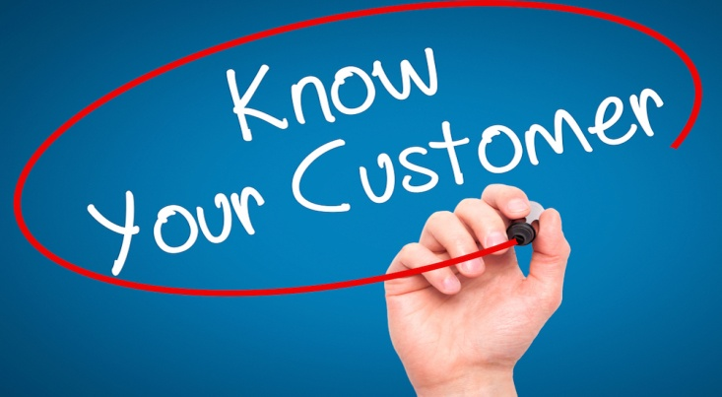
The Marketing Concept
To implement the marketing concept, a firm must have good information about what consumers want, adopt a consumer orientation, and coordinate its efforts throughout the entire organization; otherwise, it may be left with goods, services, and ideas that consumers do not want or need.
  Successfully implementing the marketing concept requires that a business view the customer’s perception of value as the ultimate measure of work performance and improving value, and the rate at which this is done, as the measure of success.

Slide 12
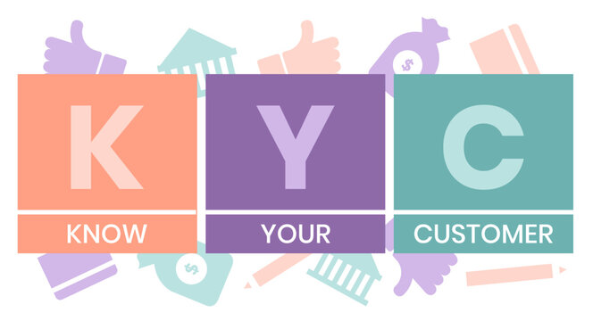
The Marketing Concept
Everyone in organization must know what customers want, and know they are selling ideas, benefits, philosophies, and experiences – not just goods and services.
  Companies should strive for a team effort to deliver the right goods or services to customers. A breakdown at any point in the organization – whether it be in production, purchasing, sales, distribution, or advertising – can result in lost sales, lost revenue, and dissatisfied customers.

Slide 13
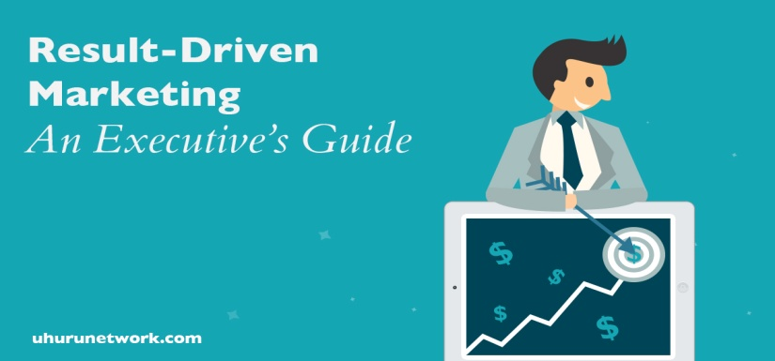
Market Orientation
A Market Orientation requires organizations to gather information about customer needs, share that information throughout the entire firm, and use it to help build long-term relationships with customers.
  Top executives, operations mangers, marketing managers, and customers all become mutually dependent and cooperate in developing and carrying out a market orientation.
    Operation managers must communicate with marketing managers to share information important to understanding the customer.

Slide 14
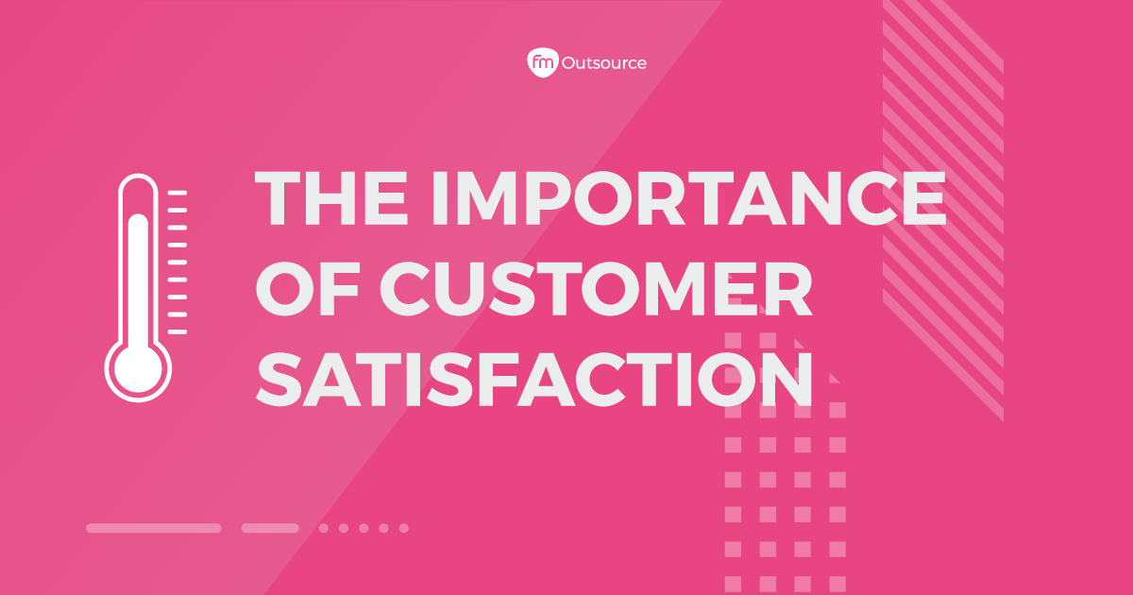
Market Orientation
Trying to assess what customers want, which is difficult to begin with, is further complicated by the rate at which trends, fashions, and tastes can change.
  Businesses want to satisfy customers and build meaningful long-term relationships with them.
    It is more efficient and less expensive for the company to retain existing customers and even increase the amount of business each customer provides the organization than to find new customers.
    The relationship with customer is key.

Slide 15

Market Orientation
Customer relationship management (CRM) is important in a market orientation because it can result in loyal and profitable customers.
  Without loyal customers, businesses would not survive; therefore, achieving the full profit potential of each customer relationship should be the goal of every marketing strategy.
    In short, profits are obtained through relationships by acquiring new customers, enhancing the profitability of existing customers, and extending the duration of customer relationships.
        Communication is Key.

Slide 16
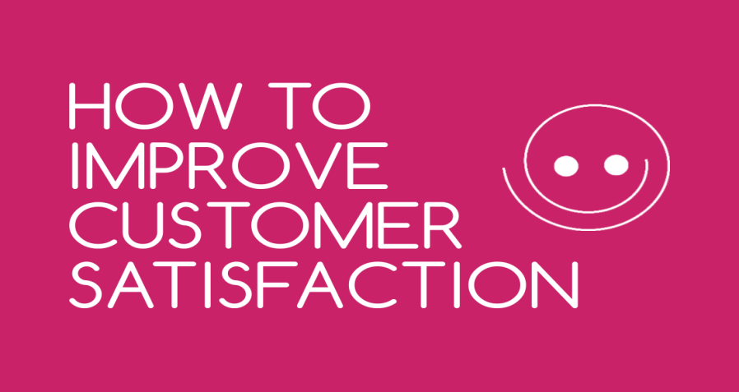
Market Orientation
Communication
Communication remains a major element of any strategy to develop and manage long-term customer relationships.
  Regardless of medium through which communication occurs, customers should be the drivers of the marketing strategy because they understand what they want.
    Customer relationship management systems should ensure that marketers listen to customers in order to respond to their needs and concerns and build long-term relationships.

Slide 17
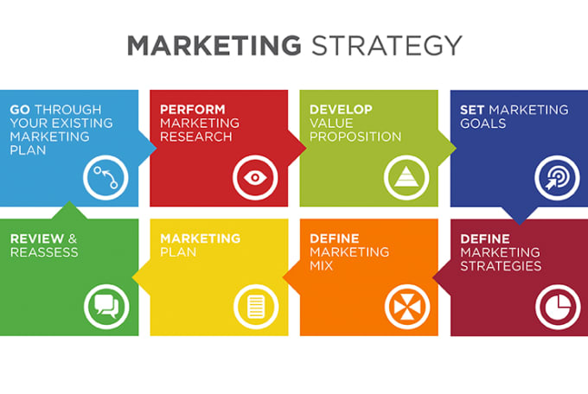
Developing a Marketing Strategy
To implement the marketing concept and CRM, a business needs to develop and maintain a Marketing Strategy – a plan of action for developing, pricing, distributing, and promoting products that meet the needs of specific customers.
  This definition has two major components: (1) selecting a target market and (2) developing an appropriate marketing mix to satisfy the target market.

Slide 18

Selecting a Target Market
A Market is a group of people who have a need, purchasing power, and the desire and authority to spend money on goods, services, and ideas.
  A Target Market is a more specific group of consumers on whose needs and wants a company focuses its marketing efforts. Target markets can be further segmented:
    Business to Business – marketing products to customers who will use the product for resale or other products.
    Business to Customer – marketing directly to consumer.

Slide 19
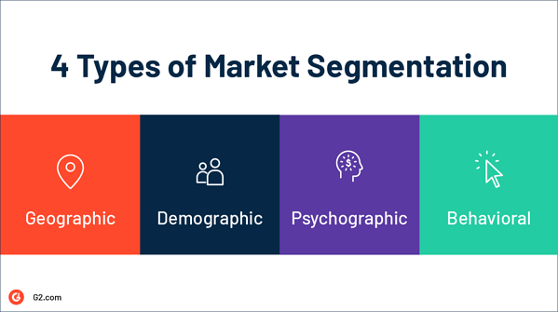
Selecting a Target Market
Marketing managers may define a target market as a relatively small number of people within a larger market, or they may define it as the total market.
  Some firms use a Total-Market Approach, in which they try to appeal to everyone and assume all buyers have similar needs and wants.
    Most firms use Market Segmentation and divide total market into groups of people. A Market Segment is a collection of individuals, groups, or organizations who share one or more characteristics and have relatively similar product needs and desires.

Slide 20
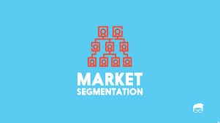
Selecting a Target Market
Three Market Segmentation Approaches
Concentration Approach
  A market segmentation approach whereby a company develops one marketing strategy for a single market segment.
    (i.e.) Porsche.
Multi-Segment Approach
  A market segmentation approach where the marketer aims its efforts at two or more segments, developing a marketing strategy for each – using different ads for different segments.
    (i.e.) U.S. Post Office – Personalized Stamps
Niche marketing
  A narrow market segment focus when efforts are on one small, well-defined group that has a unique, specific set of needs.
    (i.e.) Freshpet – All natural gourmet pet food.

Slide 21
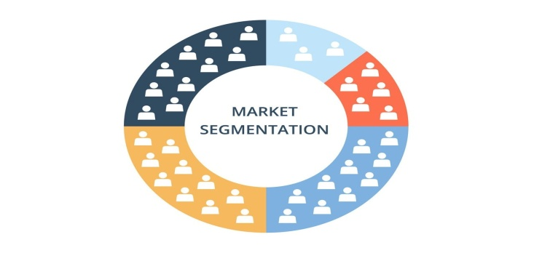
Selecting a Target Market
Three Market Segmentation Approaches
For a firm to successfully use a concentration or multi-segment approach to market segmentation, several requirements must be met:
  Consumers’ needs for the product must be heterogeneous.
  The segments must be identifiable and divisible.
  The total market must be divided in a way that allows sales potential, cost, and profits of the segments to be compared.
  At least one segment must have enough profit potential to justify developing and maintaining a special marketing strategy.
  The firm must be able to reach the chosen market segment with a particular market strategy.

Slide 22
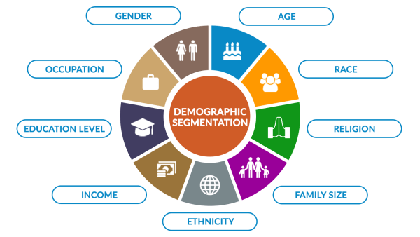
Selecting a Target Market
Segmentation Approaches
Firms segment markets on the bases of (4) variables:
  1: Demographic
    Age, sex, race, ethnicity, income, education, occupation, family size, religion, social class. These characteristics are often closely related to customers, product needs and purchasing behavior, and they can be readily measured.
      (i.e. Secret deodorant for woman and Old Spice for men)

Slide 23

Selecting a Target Market
Segmentation Approaches
Firms segment markets on the bases of (4) variables:
  2: Geographic
    Climate, terrain, natural resources, population density, subcultural values. These influence consumer needs and product usage.
      Climate influences consumer purchases of clothing, cars, heating and air conditioning, leisure activity equipment, etc.

Slide 24
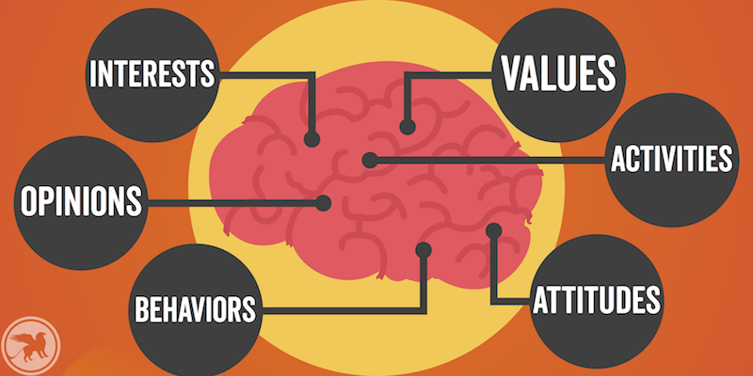
Selecting a Target Market
Segmentation Approaches
Firms segment markets on the bases of (4) variables:
  3: Psychographic
    Personality characteristics, motives, and lifestyles.
      Soft-drink marketers provide their products in several types of packaging, including two-liter bottles and cases of cans, to satisfy different lifestyles and motives.

Slide 25
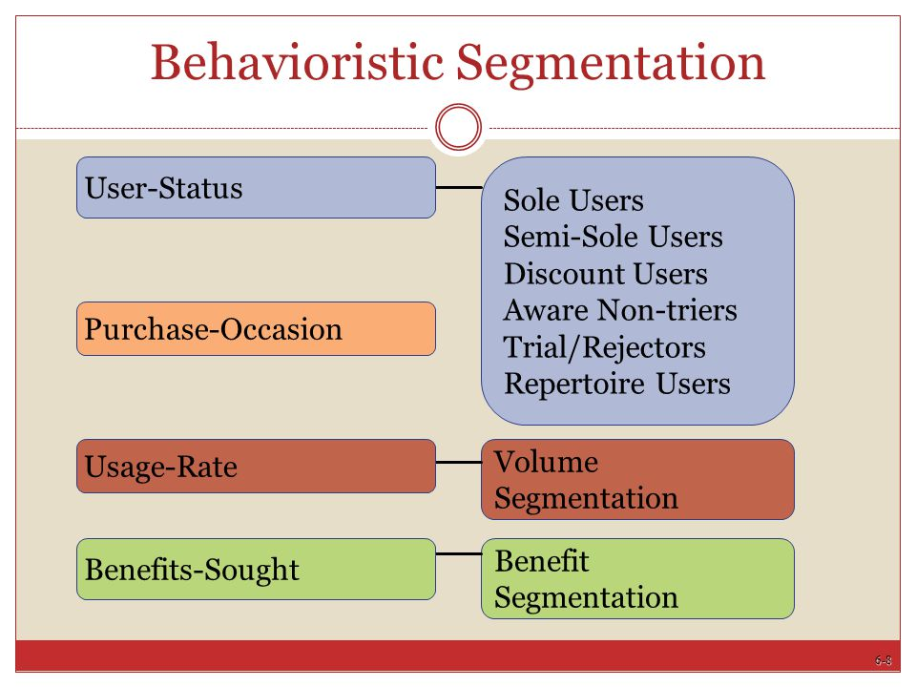
Selecting a Target Market
Segmentation Approaches
Firms segment markets on the bases of (4) variables:
  4: Behavioristic
    Some characteristic of the consumer’s behavior toward product. These characteristics commonly involve aspects of product use.
      Low-fat, low-carb food products would target those who desire the benefits of a healthier diet.

Slide 26
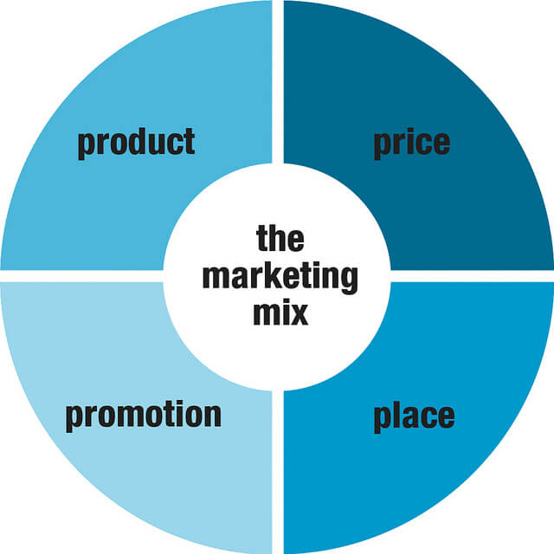
Developing a Marketing Mix
The second step in developing a marketing strategy is to create and maintain a satisfying marketing mix.
  The Marketing Mix refers to four marketing activities – (1) product, (2) price, (3) distribution, and (4) promotion – that the firm can control to achieve specific goals within a dynamic marketing environment.
    The buyer or target market is the central focus of all activities.

Slide 27
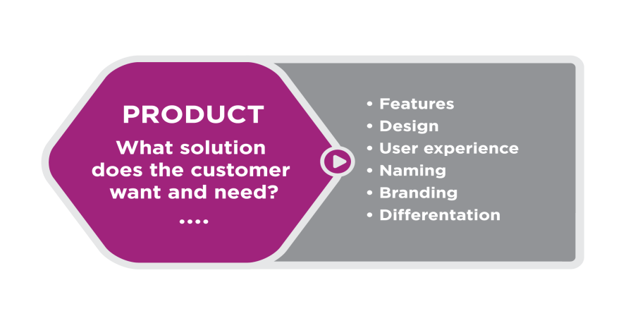
Developing a Marketing Mix
Product
A product – whether it is a good, a service, an idea, or some combination – is a complex mix of tangible and intangible attributes that provide satisfaction and benefits.
  A product has emotional and psychological, as well as physical, characteristics that includes everything the buyer receives from the exchange.

Slide 28
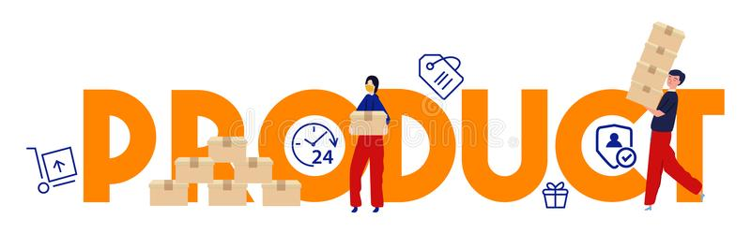
Developing a Marketing Mix
Product
If products do not meet consumer needs and expectations, sales will be difficult, and product life spans will be brief.
  The product is an important variable of the marketing mix; the other variables (price, promotion, distribution) must be coordinated with product decisions.

Slide 29
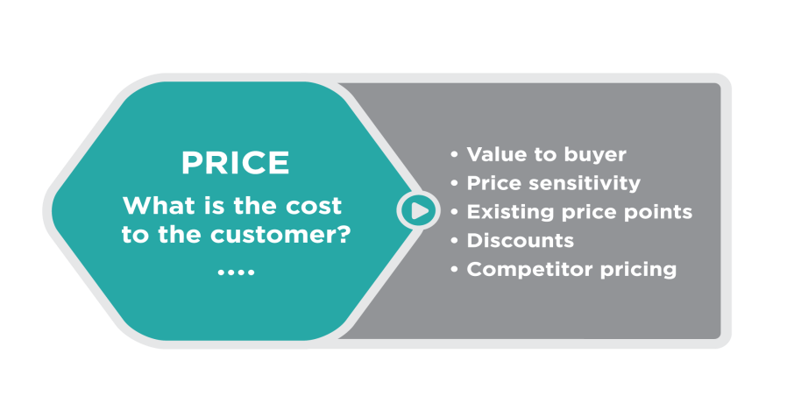
Developing a Marketing Mix
Price
Almost anything can be assessed by a price, a value placed on an object exchanged between a buyer and a seller.
  Although the seller usually establishes the price, it may be negotiated between the buyer and the seller. The buyer usually exchanges the purchasing power – income, credit, wealth – for the satisfaction or utility associated with a product.
    Because price is the measure of value commonly used in an exchange, it quantifies value and is the basis of market exchange.

Slide 30
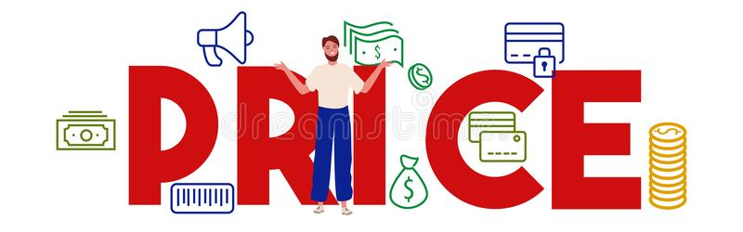
Developing a Marketing Mix
Price
Marketers view price as much more than a way of assessing value, however.
  Price is a key element of the marketing mix because it relates directly to the generation of revenue and profits.
    Prices can also be changed quickly to stimulate demand or respond to a competitor’s actions.

Slide 31
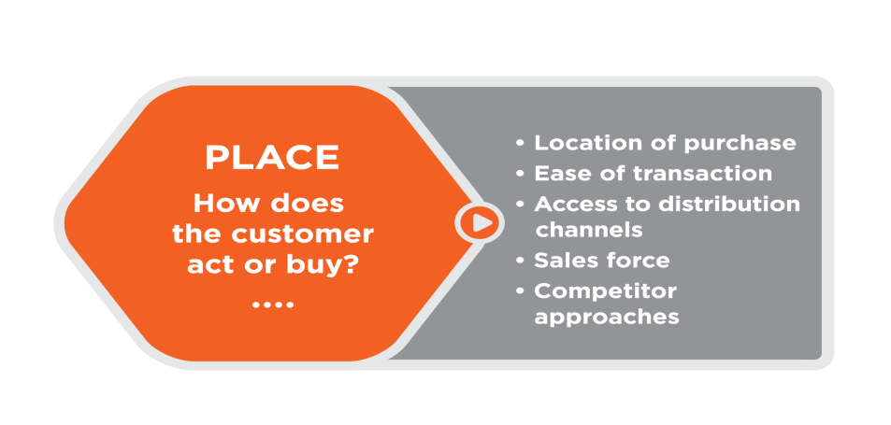
Developing a Marketing Mix
Distribution (Place)
Distribution is making products available to customers in places and quantities desired.
  Intermediaries, usually wholesalers and retailers, perform many of the activities required to move products efficiently from producers to consumers or industrial buyers.
    These activities involve transporting, warehousing, materials handling, and inventory control, as well as packaging and communication.

Slide 32
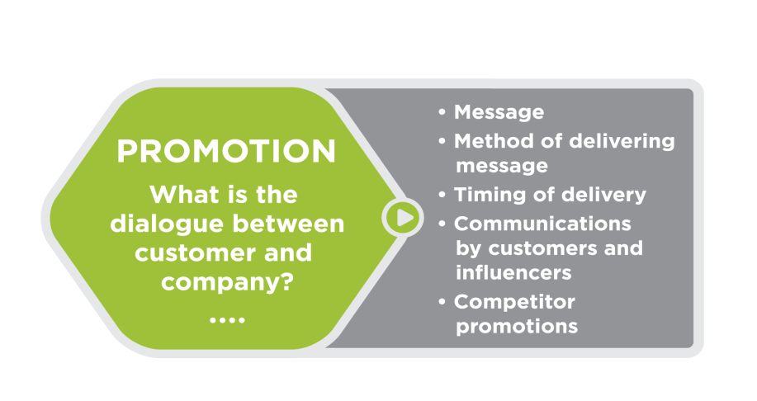
Developing a Marketing Mix
Promotion
Promotion is a persuasive form of communication that attempts to expedite a marketing exchange by influencing individuals, groups, and organizations to accept goods, services, and ideas.
  Promotion includes advertising, personal selling, publicity, and sales promotion.
    The aim of promotion is to communicate directly or indirectly with individuals, groups, and organizations to facilitate exchanges.

Slide 33

Developing a Marketing Mix
Promotion
When marketers use advertising and forms of promotion, they must effectively manage their promotional resources and understand product and target-market characteristics to ensure that these promotional activities contribute to the firm’s objectives.
  Most companies have set-up websites on the Internet to promote themselves and their products.
    While traditional advertising media such as television, radio, newspapers, and magazines remain important, digital advertising and use of social media is less expensive and more expansive.

Slide 34

Marketing Research and Information Systems
Before marketers can develop a marketing mix, they collect in-depth, up-to-date information about customer needs.
  Marketing Research is a systematic, objective process of getting information about potential customers to guide marketing decisions.
    Information might include data about the age, income, ethnicity, gender, and educational level of people in the target market, their preferences for product features, attitudes toward competitors’ products, and the frequency with which they use the product.

Slide 35
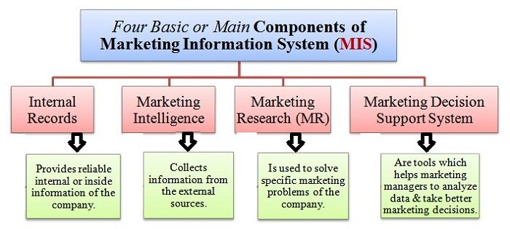
Marketing Research and Information Systems
A Marketing Information System is a framework for accessing information about customers from both inside and outside the organization.
  Inside the organization, there is a continuous flow of information about prices, sales, and expenses. Outside the organization, data is readily available through private or public reports and census statistics, as well as, from other sources.

Slide 36
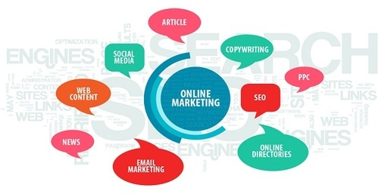
Online Marketing Research
Social networks are a great way to obtain information from consumers who are willing to share experiences about products and companies.
  In a way, this process identifies those consumers who develop an identity or passion for certain products, as well as, those consumers who have concerns about quality or performance.
    It is possible for firms to tap into existing online social networks and simply “listen” to what consumers have on their mind.

Slide 37
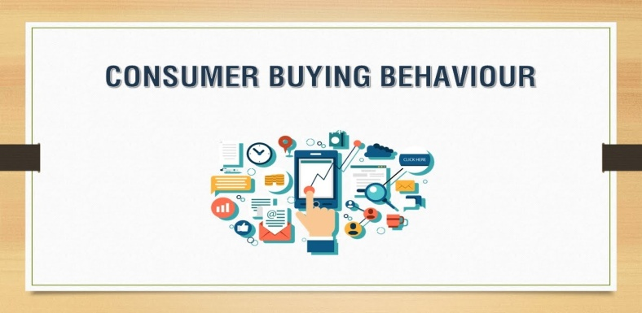

Buying Behavior
Carrying out a marketing concept is impossible unless marketers know what, when, where, how consumers buy.
  Researching factors that influence buying behavior helps marketers develop effective marketing strategies.
    Buying Behavior refers to the decision processes and actions of people who purchase and use products. It includes the behavior of both consumers purchasing products for personal use and organizations buying products for business use.

Slide 38
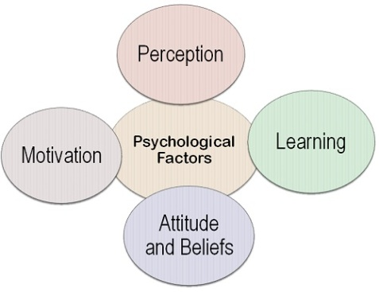
Buying Behavior
Psychological Variables of Buying Behavior, include:
  Perception
    The process by which a person selects, organizes, and interprets information received from their senses.
  Motivation
    An inner drive that directs a person’s behavior toward goals.
  Learning
    Changes in a person’s behavior based on information and experience.
  Attitude
    Knowledge and positive or negative feelings about something.
  Personality
    The organization of an individual’s distinguishing character traits, attitudes, or habits.

Slide 39

Buying Behavior
Social factors include Social Roles – a set of expectations for individuals based on some position they occupy.
  A person may have many roles: mother/father, husband/wife, student/executive. Each of these can influence buying behavior.
    In choosing which car to buy, a person’s buying power may be affected by the opinions and experiences of their family and friends and by the various roles they assume.

Slide 40
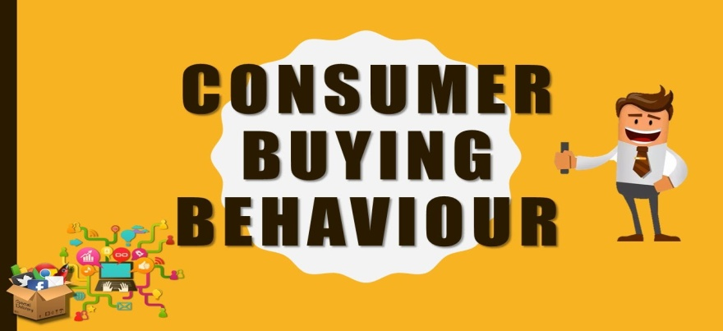
Buying Behavior
Other Social Factors of Buying Behavior, include:
  Reference Groups
    Groups with whom buyers identify and whose values or attitudes they adopt.
  Social Classes
    A ranking of people into higher or lower positions of respect.
  Culture
    The integrated, accepted pattern of human behavior, including thought, speech, beliefs, actions, and artifacts.

Slide 41
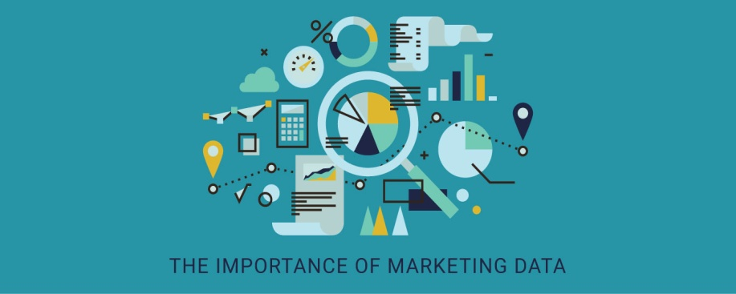
Importance of Marketing to Business and Society
Marketing is a necessary function to reaching consumers, establishing relationships, and creating revenue.
  Marketing is essential in communicating the value of goods and services.
    For consumers, marketing is necessary to ensure they get the products they desire at the right prices in the right quantities and at a reasonable price. From the perspective of businesses, marketing is necessary in order to form valuable relationships with customers to increase profitability and customer support.

Slide 42
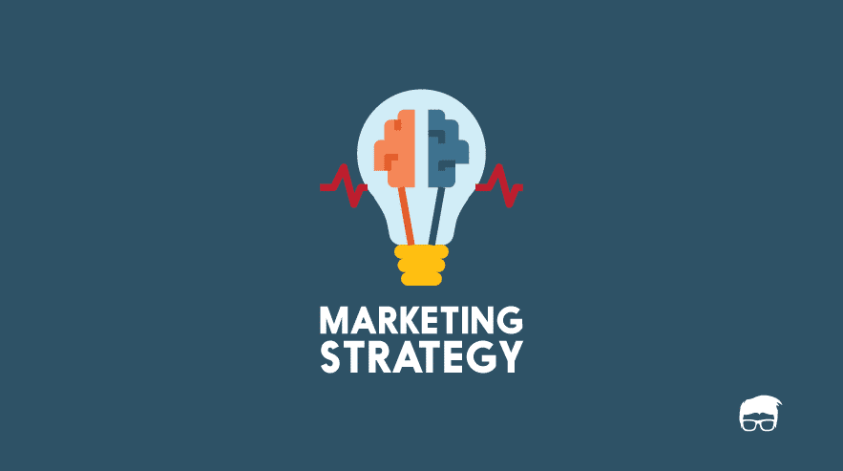
Part Five: Marketing: Developing Relationships
Chapter Twelve: Dimensions of Marketing Strategy

Slide 43

Introduction
The key to developing a marketing strategy is selecting a target market and maintaining a marketing mix that creates long-term relationships with customers.
  Getting the right mix of product, price, promotion, and distribution is critical if a business is to satisfy its target customers and achieve its own objectives (implement the marketing concept).

Slide 44
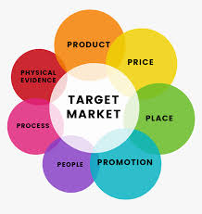
The Marketing Mix
The marketing mix is the part of a marketing strategy that involves decisions regarding controllable variables.
  After selecting a target market, marketers have to develop and manage the dimensions of the marketing mix to give their firm an advantage over competitors.
    Successful companies offer dimensions of value usually associated with a marketing mix element that surpasses all competitors in the marketplace in meeting customer expectations.
      (i.e.) Walmart exceeds the competition in price.

Slide 45
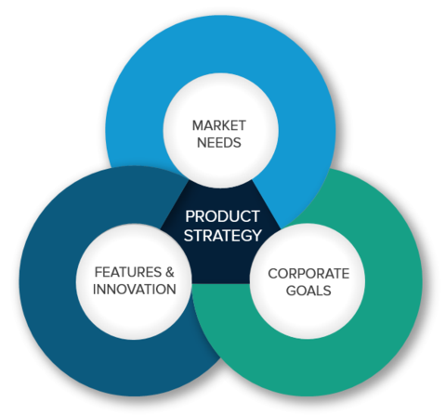
Product Strategy
The term product refers to goods, services, and ideas.
  Because the product is often the most visible of the marketing mix dimensions, managing product decisions is crucial.

Slide 46

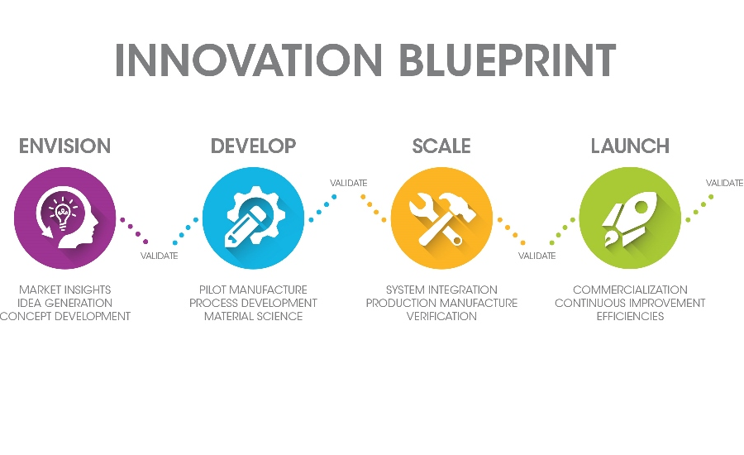
Developing New Products
Before introducing a new product, a business must follow a multistep process: (1) idea development, (2) the screening of new ideas, (3) business analysis, (4) product development, (5) test marketing, and (6) commercialization.
  Thousands of products are introduced annually, but few succeed.
  It can take considerable time to get a product ready for market.

Slide 47
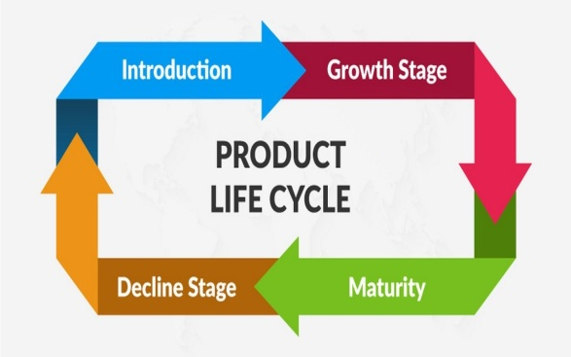
Product Life Cycle
Products are born, grow, mature, and eventually die. However, some products may have very long lives.
  There are four stages in the life cycle of a product: (1) introduction, (2) growth, (3) maturity, and (4) decline. The stage of a product helps to determine its marketing strategy.
    In the personal computer industry, desktop computers are in the decline stage, laptop computers have reached the maturity stage, and tablet computers are currently in the growth stage. Manufacturers of these products are adopting different advertising and pricing strategies to maintain/increase demand.

Slide 48

Product Life Cycle
Product stages do not always go one way.
  Products that moved to the maturity stage or the decline stage can still rebound through redesign or new uses for the product.
    Originally, baking soda was only used for cooking, which meant it reached the maturity stage very quickly. However, once it was discovered that baking soda could be used as a deodorizer, sales shot up and bumped baking soda into the growth stage.

Slide 49

Identifying Products
Branding, packaging, and labeling can be used to identify or distinguish one product from others.
  As a result, they are key marketing activities that help position a product appropriately for its target market.

Slide 50

Identifying Products
Branding
Branding is the process of naming and identifying products.
  A brand is a name, term, symbol, design, or combination that identifies a product and distinguishes it from other products. (i.e. Xerox with photocopiers and Kleenex with tissues).
    The brand name is the part of the brand that can be spoken and consists of letters, words, and numbers (i.e. WD40).
    A brand mark is the part of the brand that is distinctive in design (i.e. McDonald’s golden arches logo).
    A trademark is a brand that is registered with the U.S. Patent Trademark Office and is legally protected from use by others.

Slide 51
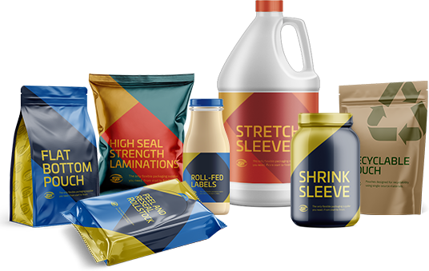
Identifying Products
Packaging
The Packaging, or external container that holds and describes the product, influences consumers’ attitudes and their buying decisions.
  Surveys have shown that consumers are willing to pay more for certain packaging attributes.
    One of the attributes includes clearly stated nutrition and ingredient labeling, especially if it indicates whether or not the product is organic, gluten free, and environmentally friendly.
    Recyclable and biodegradable packaging is also popular.

Slide 52

Identifying Products
Packaging
A package can perform several functions, including protection, economy, convenience, and promotion.
  Packaging can also be used to appeal to emotions (i.e.) pet food packaging appeals to emotions of pet owners with illustrations of animals happily running, eating, and looking serene.
    It is estimated that consumers’ eyes linger only 2.5 seconds on each product on an average shopping trip; therefore packaging should be designed to attract and hold consumers’ attention.

Slide 53

Identifying Products
Labeling
Labeling, the presentation of important information on the package, is closely associated with packaging.
  The content of labeling, often required by law, may include ingredients or content, nutrition facts (calories, fat, etc.), care instructions, suggestions for use (such as recipes), manufacturer’s address, phone number, website, and other useful information.
  This information can have a strong impact on sales.
    Labels of many products, particularly food and drugs, must carry warnings, instructions, certifications, or manufacturer’s info.

Slide 54

Identifying Products
Product Quality
Quality reflects the degree to which a good, service, or idea meets the demands and requirements of customers.
  Quality products are often referred to as reliable, durable, easily maintained, easily used, a good value, or a trusted brand name.
    The level of quality is the amount of quality that a product possesses, and the consistency of quality depends on the product maintaining the same level of quality over time.

Slide 55
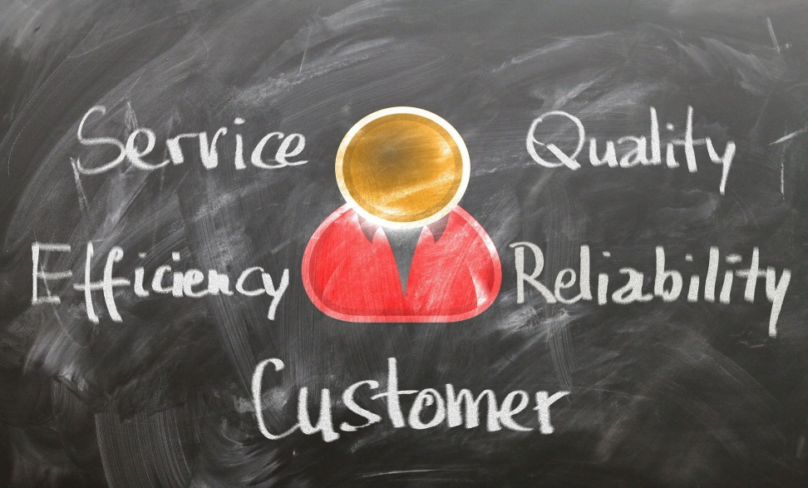
Quality of Service
Quality of service is difficult to gauge because it depends on customers’ perceptions of how well the service meets or exceeds their expectations.
  In other words, service quality is judged by consumers, not the service providers. For this reason, it is quite common for perceptions of quality to fluctuate from time to time.

Slide 56
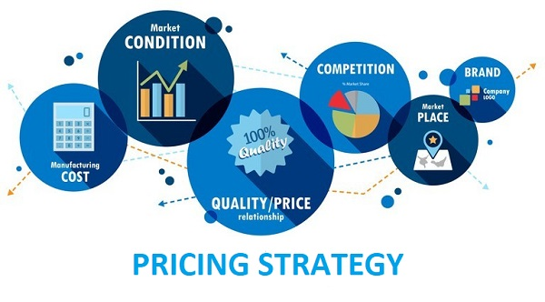
Pricing Strategy
Price is defined as the value placed on an object exchanged between a buyer and a seller.
  Buyer’s interest in price stems from their expectations about the usefulness of a product or the satisfaction they may derive from it.
    Because buyers have limited resources, they must allocate those resources to obtain the products they most desire. They’ll decide whether the benefits gained in an exchange are worth the buying power sacrificed.

Slide 57
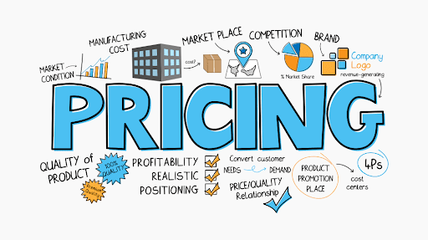
Pricing Strategy
Many factors influence the evaluation of value, including time constraints, price levels, perceived quality, and motivations to use available information about prices.
  Consumers vary in their response to price: some focus solely on the lowest price, while others consider quality or the prestige associated with a product and its price.

Slide 58
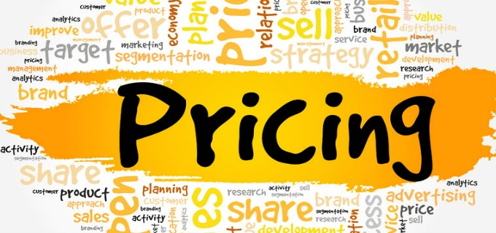
Pricing Strategy
Price is a key element in the marketing mix because it relates directly to the generation of revenue and profits.
  The ability to set price depends on the supply of and demand for a product. For most products, the quantity demanded goes up as the price goes down, and as the price goes up, the quantity demanded goes down.
    Changes in buyers’ needs, variations in the effectiveness of other marketing mix variables, the presence of substitutes, and dynamic environmental factors can influence demand.

Slide 59
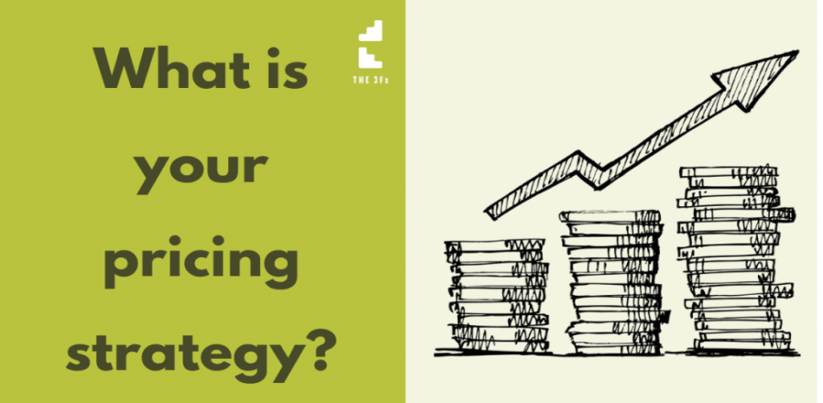
Pricing Strategy
Pricing is probably the most flexible variable in the marketing mix. Although it may take years to develop a product, establish channels of distribution, and design and implement promotion, a product’s price may be set and changed in a few minutes.
  Price also depends on the cost to manufacture a good or provide a service or idea, and although a firm may temporarily sell products below cost to match competition, to generate cash flow, or even increase market share, in the long run, it cannot survive by selling products below cost.

Slide 60
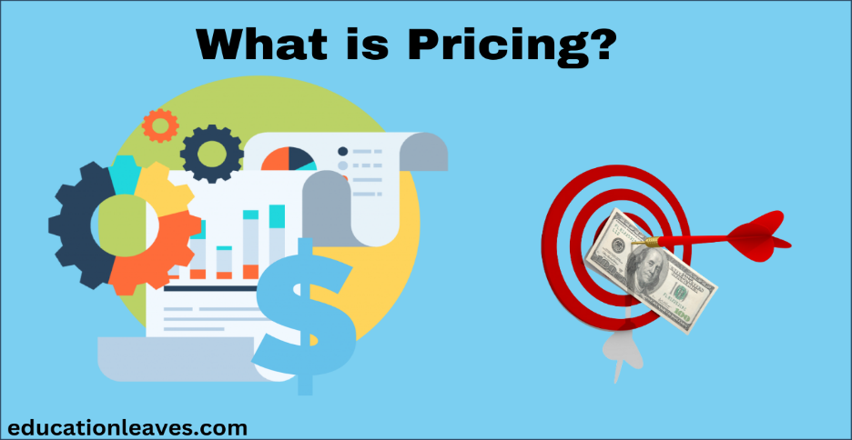
Pricing Strategies
Setting the price for a new product is critical: the right price leads to profitability; the wrong price may kill the product.
  There are two basic strategies to setting the base price for a new product.
    Price Skimming: Charging the highest possible price that buyers who want the product will pay.
    Penetration Price: Charging a low price to help a product enter the market and gain market share rapidly.

Slide 61
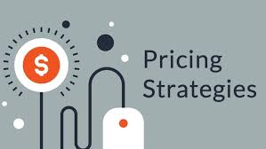
Pricing Strategies
Psychological Pricing
  Encourages purchases based on emotional rather than rational responses to the price.
    The assumption behind even-odd pricing is that people will buy more of a product for $9.99 than $10 because it seems like a bargain.
    The assumption behind symbolic-prestige pricing is that high prices connote high quality.
Reference Pricing
  A type of psychological pricing in which a lower-priced item is compared to a more expensive brand in hopes that the consumer will use the higher price as a comparison price.
Price Discounting
  Temporary price reductions, often employed to boost sales.
    Quantity, seasonal, and promotional discounts are the most widely used.

Slide 62
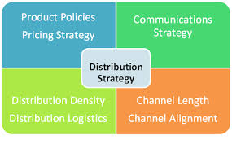
Distribution Strategy
The best products in the world will not be successful unless companies make them available where and when customers want to buy them.
  Factors involved in a product’s success include distribution strategies, the intensity of market coverage, and the physical handling of products during distribution.

Slide 63
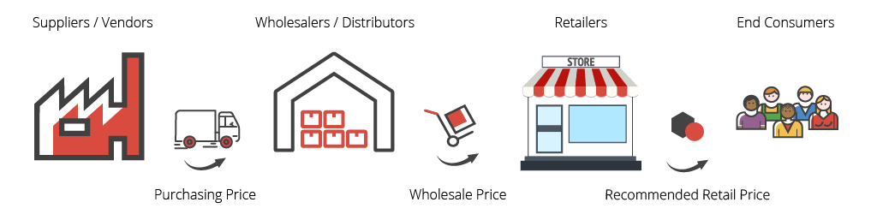
Distribution Strategy
Marketing Channels
A Marketing Channel, or channel of distribution, is a group of organizations that move products from producers to customers.
  Marketing channels make products available to buyers when and where they desire to purchase them.
    Organizations that bridge the gap between a product’s manufacturer and the ultimate consumer are called “middlemen” or intermediaries. They create time, place, and ownership utility.
    Two intermediary organizations are retailers and wholesalers.

Slide 64

Distribution Strategy
Marketing Channels: Retailers
Retailers buy products from manufacturers and sell them to consumers for home and household use rather than for resale or for use in producing other products.
  By bringing together an assortment of products from competing producers, retailers create utility.
    Retailers arrange for products to be moved from producers to a convenient retail establishment (place utility), maintain hours of operation for their retail stores to make merchandise available when consumers want it (time utility), and assume the risk of ownership of inventories (ownership utility).

Slide 65
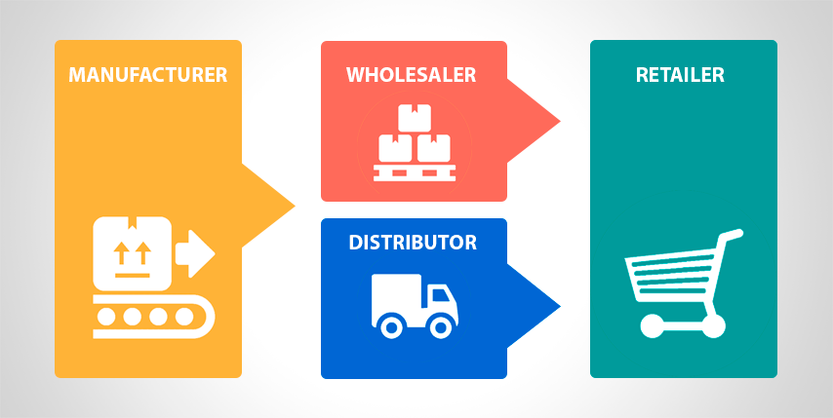
Distribution Strategy
Marketing Channels: Wholesalers
Wholesalers are intermediaries who buy from producers and sell to retailers.
  They usually do not sell in significant quantities to ultimate consumers.

Slide 66
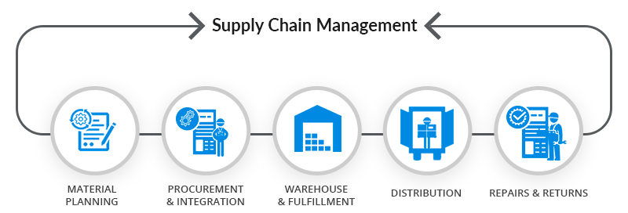
Distribution Strategy
Supply Chain Management
In an effort to improve distribution channel relationships among manufacturers and other channel intermediaries, Supply Chain Management (SCM) creates alliances between channel members.
  SCM connects and integrates all parties or members of the distribution system in order to satisfy customers.
    It involves long-term partnerships among marketing channel members working together to reduce cost, waste, and unnecessary movement in the marketing channel to satisfy customers.

Slide 67

Promotion Strategy
The role of promotion is to communicate with individuals, groups, and organizations to facilitate an exchange directly or indirectly.
  It encourages marketing exchanges by attempting to persuade individuals, groups, and organizations to accept goods, services, and ideas.
    Promotion is used not only to sell products but also to influence opinions and attitudes toward an organization, person, or cause.

Slide 68

Promotion Strategy
The Promotion Mix
Advertising, personal selling, publicity, and sales promotion are collectively known as the promotion mix because a strong promotion program results from careful selection and blending of these elements.
  The process of coordinating the promotion mix elements and synchronizing promotion as a unified effort is called: Integrated marketing Communications (IMC).
    When planning promotional activities, an integrated marketing communications approach results in the desired message.

Slide 69

Promotion Strategy
Promotion Mix: Advertising
Advertising is a paid form of nonpersonal communication transmitted through a mass medium, such as television commercials or magazine advertisements.
  An Advertising Campaign involves planning a series of advertisements and placing them in various media to reach a particular target audience.

Slide 70

Promotion Strategy
Advertising Campaign
The basic content and form of an advertising campaign are a function of several factors:
  A product’s features, uses, and benefits affect the content of the campaign message and individual ads.
  Characteristics of the people in the target audience – gender, age, education, race, income, occupation, lifestyle, and other attributes – influence both content and form.
    To communicate effectively, advertisers use words, symbols, and illustrations that are meaningful, familiar, and attractive to people in the target audience.

Slide 71

Promotion Strategy
Advertising Campaign
Advertising media are the vehicles or forms of communication used to reach a desired audience.
  Print media include newspapers, magazines, direct mail, and billboards, while electronic media include television, radio, and Internet advertising. Choice of media influences the content and form of the message.
    Effective outdoor displays and short broadcast announcements require concise, simple, messages.
    Magazine and newspaper advertisements can include considerable detail and long explanations.

Slide 72

Promotion Strategy
Promotion Mix: Personal Selling
Personal Selling is direct, two-way communication with buyers and potential buyers.
  Personal selling is the most flexible of the promotional methods because it gives marketers the greatest opportunity to communicate specific information that might trigger purchase.
    For many products, interaction between a salesperson and the customer is probably the most important promotional tool.
    Only personal selling can zero in on a prospect and attempt to persuade that person to make a purchase.

Slide 73

Promotion Strategy
Promotion Mix: Personal Selling
Personal Selling is a Six Step Process:
  Prospecting
    Identifying potential buyers of the product.
  Approaching
    Using a referral or calling on a customer without prior notice to determine interest in the product.
  Presenting
    Getting the prospect’s attention with a product demonstration.
  Handling Objections
    Countering reasons for not buying the product.
  Closing
    Asking the prospect to buy the product.
  Following-Up
    Checking customer satisfaction with the purchased product.

Slide 74

Promotion Strategy
Promotion Mix: Publicity
Publicity is nonpersonal communication transmitted through mass media but not paid for directly by the firm.
  A firm does not pay the media cost for publicity and is not identified as the originator of the message; instead, the message is presented in news story form.
    A company can benefit from publicity by releasing to news sources newsworthy messages about the firm and involvement with public.
    Many companies have public relations departments to try to gain favorable publicity.

Slide 75

Promotion Strategy
Promotion Mix: Sales Promotion
Sales Promotion involves direct inducements offering added value or other incentives for buyers to enter into an exchange.
  Sales pr0motions are generally easier to measure and less expensive than advertising.
    The major tools of sales promotion are store displays, premiums, samples and demonstrations, coupons, contests and sweepstakes, refunds, and trade shows.

Slide 76

Promotion Strategies
Push or Pull
In developing a promotion mix, organizations must decide whether to fashion a mix that pushes or pulls the product down to their customers.
  Push Strategy
    An attempt to motivate intermediaries to push the product down to their customers.
  Pull Strategy
    The use of promotion to create consumer demand for a product so that consumers exert pressure on marketing channel members to make it available.

Slide 77

Objectives of Promotion
The marketing mix a company uses depends on its objectives.
  It is important to recognize that promotion is only one element of the marketing strategy and must be carefully tied to the goals of the firm, its overall marketing objectives, and the other elements of the marketing strategy.
    Firms use promotion to stimulate demand, to stabilize sales, and to inform, remind, and reinforce customers.

Slide 78

Promotional Positioning
Promotional Positioning uses promotion to change or reinforce an image of a product in buyers’ minds.
  In promotional positioning, the firm targets a given product or brand at a portion of the total market. A promotional strategy helps differentiate the product and makes it appeal to a particular market segment.
    For example, to appeal to safety-conscious consumers, Volvo heavily promotes the safety and crashworthiness of its vehicles.

Slide 79

Importance of Marketing Strategy
Marketing creates value through the marketing mix.
  For customers, value means receiving a product in which the benefit of the product outweighs the cost, or price paid for it.
  For marketers, value means that the benefits (usually money) received from selling the product outweigh the costs it takes to develop and sell it.
    This requires carefully integrating ALL the elements of the marketing mix into an effective marketing strategy.

Slide 80

Part Five: Marketing: Developing Relationships
Chapter Thirteen: Digital Marketing and Social Networking

Slide 81

Introduction
The Internet and information technology have dramatically changed the environment for business.
  Marketer’s new ability to convert all types of communications into digital media has created efficient, inexpensive ways of connecting businesses and consumers and has improved the flow and the usefulness of information.
    Businesses have the information they need to make informed decisions, and consumers have access to a greater variety of products and more information about choices and quality.

Slide 82

Growth and Benefits of Digital Communication
The Internet has created opportunities for businesses to forge relationships with consumers, target markets more precisely, and even reach previously inaccessible markets at home and around the world.
  The Internet also facilitates business transactions, allowing companies to network with manufacturers, wholesalers, retailers, suppliers, and outsource firms to serve customers more quickly and more efficiently. Digital communication offers a completely new dimension in connecting with others.

Slide 83

Using Digital Media in Business
Given almost instant communication with precisely defined consumer groups, firms can use real-time exchanges to create and stimulate interactive communication, forge closer relationships, and learn more accurately about consumer and supplier needs.
  Because it is fast and inexpensive, digital communication is making it easier for businesses to conduct marketing research, provide and obtain price and product information, and advertise, as well as to fulfill their business goals by selling good and services online.

Slide 84

Digital Media and the Marketing Mix
There are a few important differences between digital marketing and conventional marketing techniques.
  Digital media make customer communications faster & interactive.
  Digital media help companies reach new target markets easily, affordably, and more quickly than ever before.
  Digital media help marketers utilize new resources in seeking out and communicating with customers.
    One of the most important benefits of digital marketing is the ability of marketers and customers to easily share information.

Slide 85

1. Product Considerations
Like traditional marketers, digital marketers must anticipate consumer needs and preferences, tailor goods and services to meet these needs, and continually upgrade them to remain competitive.
  The connectivity created by digital media provides opportunity for adding services and can enhance product benefits.
    The Internet provides a major resource for learning more about consumer wants and needs.

Slide 86

2. Distribution Considerations
The Internet is a new distribution channel for making products available at the right time, at the right place, and in the right quantities.
  Marketer’s ability to process orders electronically and increase speed of communication via Internet reduces inefficiencies, costs, and redundancies while increasing speed throughout the marketing channel.
    Convenience and constant availability are two major reasons consumers prefer to shop online.

Slide 87

3. Promotion Considerations
One of the best ways businesses can utilize digital media is for promotion purposes – whether they are increasing brand awareness, connecting with consumers, or taking advantage of social networks or virtual worlds to form relationships and generate positive publicity or “buzz” about their products.
  Thanks to online promotion, consumers can be more informed than ever, including reading customer-generated content before making purchasing decisions.
    Consumer consumption patterns are radically changing, and marketers must adapt their promotional efforts to meet them.

Slide 88

4. Pricing Considerations
Digital marketing can enhance value of products by providing extra benefits such as service, information, and convenience.
  Through digital media, discounts and other promotions can be quickly communicated.
    As consumers have become better informed about their options, the demand for low-priced products has grown, leading to the creation of deal sites where consumers can compare prices.

Slide 89

Social Networking
A Social Network is a website where users can create a profile and interact with users, post information, and engage in other forms of web-based communication.
  Social networks are changing the way consumers communicate with each other and with businesses.
    Sites such as Facebook and Twitter, etc. emerged as opportunities for marketers to build communities, provide product information, and learn about consumer needs.

Slide 90

Types of Consumer-Generated Marketing and Digital Media
While digital marketing has generated exciting opportunities for companies to interact with their customers, digital media are also more consumer-driven than traditional media.
  Internet users are creating and reading consumer-generated content as never before and are having a profound effect on marketing in the process.

Slide 91

Types of Consumer-Generated Marketing and Digital Media
Two factors have sparked the rise of consumer-generated information:
  The increased tendency of consumers to publish their own thoughts, opinions, reviews, and product discussions.
  Consumer tendencies to trust other consumers vs. corporations.
    Consumers often rely on the recommendation of friends, family, and fellow consumers when making purchasing decisions.

Slide 92

Social Networks
Social networking sites are useful for relationship marketing, or the creation of relationships that mutually benefit the business and customer.
  Approximately 30% of consumers claim social media has some influence on their purchasing decisions.
    Facebook
    Twitter
    Instagram
    YouTube
    Podcasts
    Blogs and Wikis
    Virtual Gaming
    Applications and Widgets

Slide 93


Using Digital Marketing to Reach Consumers
Customer-generated communications and digital media connect consumers as never before. These connections let consumers share information/experiences without company interference, so they get more of the “real story” on product or company features.
  While consumers use digital media to access more product information, marketers can use the same sites to get better and more targeted information about the consumer.

Slide 94

Using Digital Marketing to Learn about Consumers
Marketing research and information systems can use digital media and social networking sites to gather useful information about consumers and their preferences.
  Sites such as Facebook and Twitter can be good substitutes for focus groups. Online surveys can serve as an alternative to mail, telephone, or personal interviews.
    Crowdsourcing describes how marketers use digital media to find out the opinions or needs of the crowd (or potential markets).

Slide 95

Digital Media’s Impact on Marketing
To be successful in business, you need to know much more than how to use a social networking site to communicate with friends.
  Developing a strategic understanding of how digital marketing can make business more efficient and productive is increasingly necessary.
    If you are thinking about becoming an entrepreneur, then the digital world can open doors to new resources and customers.

Slide 96


