Slide 1
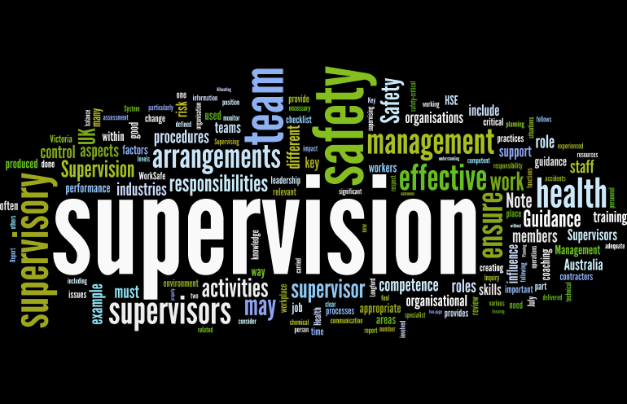
Supervision
Supervision
  Concepts and Practices of Management, 13th Edition
    Edwin C. Leonard, Jr., Ph.D. and Kelly A. Trusty, Ph.D. Cengage Learning, Boston, MA 2013
      ISBN: 978-1-285-86637-6

Slide 2

Part Four: Controlling and Managing Performance Conflict
Chapter Fifteen: Positive Discipline
  After studying this chapter, you will be able to:
    Discuss the basis and importance of positive discipline in an organization.
    Identify disciplinary situations that violate standards of conduct and discuss the need to confront those situations appropriately.
    Identify approaches that ensure proper action for just cause.
    Describe and discuss the application of progressive discipline.
    Explain the “Hot Stove Rule” approach to discipline.
    Discuss need to document disciplinary actions and to provide right of appeal.
    Differentiate between the “discipline without punishment” approach and other alternatives to progressive discipline.
    Recognize the importance of “fairness” in the disciplinary process.

Slide 3
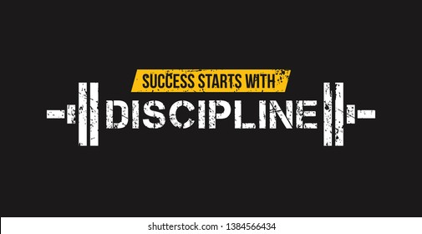
The Basis and Importance of Positive Discipline
The term discipline is used in several different ways.
  Many supervisors associate discipline with the use of authority, force, or punishment.
    Discipline is a condition of orderliness – that is, the degree to which members of an organization act properly and observe the expected standards of behavior.

Slide 4
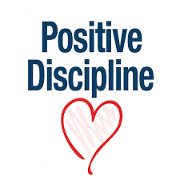
The Basis and Importance of Positive Discipline
Positive discipline exists when EEs generally follow the rules and meet the standards of the organization.
  Discipline is negative, or bad, when EEs follow organizational rules reluctantly or when they disobey regulations and violate prescribed standards of acceptable behavior.

Slide 5
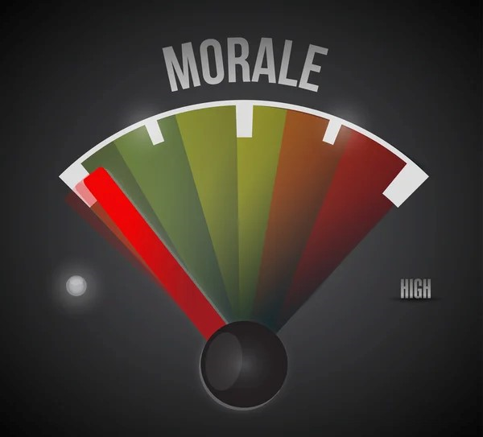
The Basis and Importance of Positive Discipline
Morale is a composite of people’s attitudes and feelings toward their work, whereas discipline is primarily a state of mind.
  However, some relationship exists between morale and discipline.
    Fewer disciplinary problems arise when morale is high; conversely, low morale is accompanied by a higher number of disciplinary problems.
    However, a high degree of positive discipline could be present despite low morale; this could result from insecurity, fear, or sheer force.

Slide 6

The Basis and Importance of Positive Discipline
It is unlikely, however, that a high degree of positive EE discipline will be maintained indefinitely unless there is an acceptable level of EE morale.
  The past few years have been very difficult. Morale and job satisfaction have been at low levels, but EE turnover is low. Why? Many EEs are dissatisfied, but know that they may not be able to find a job that is nearly as good as the one they dislike.

Slide 7

The Basis and Importance of Positive Discipline
The best type of discipline is positive self-discipline in which EEs essentially regulate themselves out of self-interest.
  This type of discipline is based on the normal human tendency to do what needs to be done, to do one’s share, and to follow reasonable standards of acceptable behavior.
    Most people accept the idea that following instructions and observing fair rules of conduct are among the normal responsibilities of any job.

Slide 8

The Basis and Importance of Positive Discipline
Positive self-discipline relies on premise that most EEs want to do the right thing and can be counted on to exercise self-control.
  They believe in performing their work properly, coming to work on time, following the supervisor’s instructions, and refraining from fighting, using drugs, drinking alcohol, or stealing.
  They know it is natural to subordinate some of their personal interests to the needs of the organization.
    As long as company rules are communicated and are perceived as reasonable, most EEs will observe those rules.

Slide 9
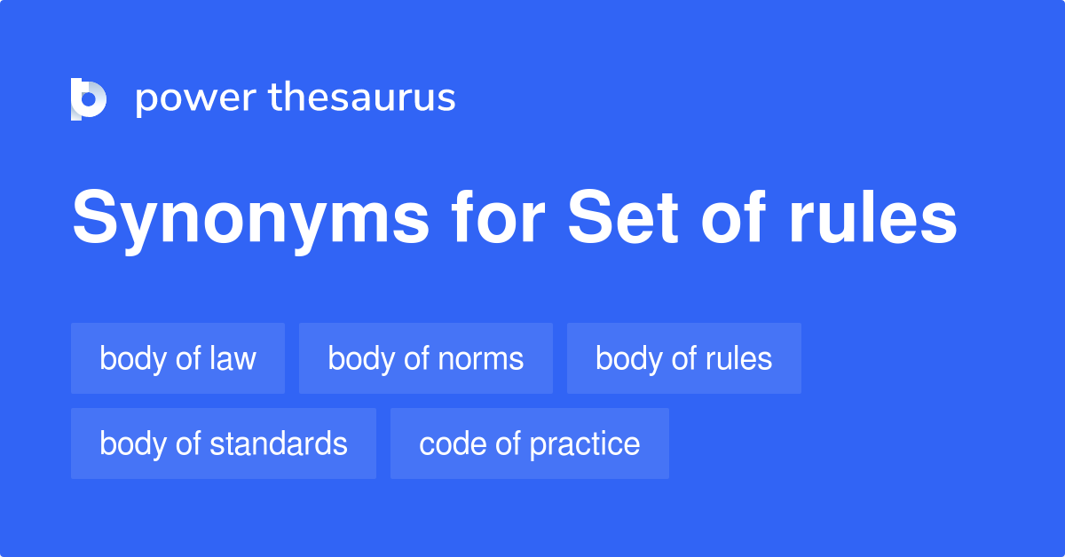
Positive Employee Discipline
Requires Supervisory Example
Unfortunately, there are always some EEs who, for one reason or another, fail to observe established rules and standards, even after they have been informed of them.

Slide 10

Positive Employee Discipline
Requires Supervisory Example
Occupational fraud, more commonly known as EE theft, amounts to billions of dollars of loss annually.
  What do you think the cost to U.S. business is if one considers other forms of EE dishonesty, including habitual misuse or “stealing” of company time by unwarranted absenteeism and tardiness, doing personal business, and socializing on company time?
    It is estimated that EEs spend at least two hours a day on non-work-related Internet matters.

Slide 11

Positive Employee Discipline
Requires Supervisory Example
Supervisors should maintain a balanced perspective since EEs at the department level will take most of their cues for self-discipline from their supervisors and managers.
  Positive self-discipline should exist throughout management team, beginning at the top and extending through all supervisors.
    Supervisors should not expect their EEs to practice positive self-discipline if they themselves do not set good examples.

Slide 12
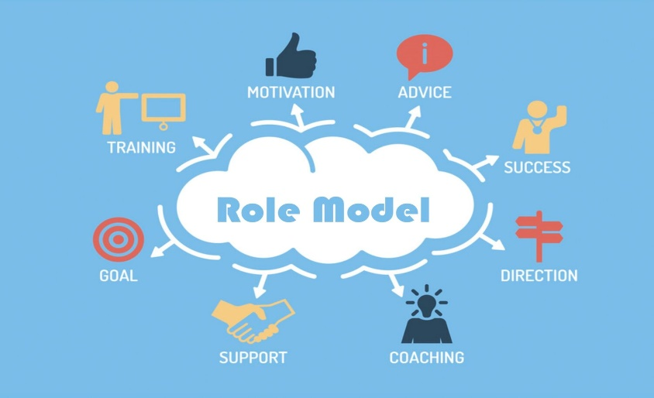
Positive Employee Discipline
Requires Supervisory Example
A supervisor’s actions and behavior are easy targets for EEs to either emulate or reject. If the supervisor can encourage the vast majority of EEs to show a strong sense of self-discipline, those EEs will exert group pressure on the dissenters.
  For example, if a no-smoking rule is posted for a building, usually someone in the work group will enforce this rule by reminding smokers to leave the premises before lighting a cigarette.
    As a result, the supervisor has little need for corrective action when most EEs practice positive self-discipline.

Slide 13

Positive Employee Discipline
Requires Supervisory Example
Oren Harari, a professor and management consultant, has commented that good EE discipline depends mostly on the supervisor’s daily behavior and on aligning decisions in the same positive direction and with consistency of actions.
  He states, “Discipline is the daily grind that makes things happen and lets people know that you’re worthy of your word.”
    In short, it’s about honor and integrity.

Slide 14
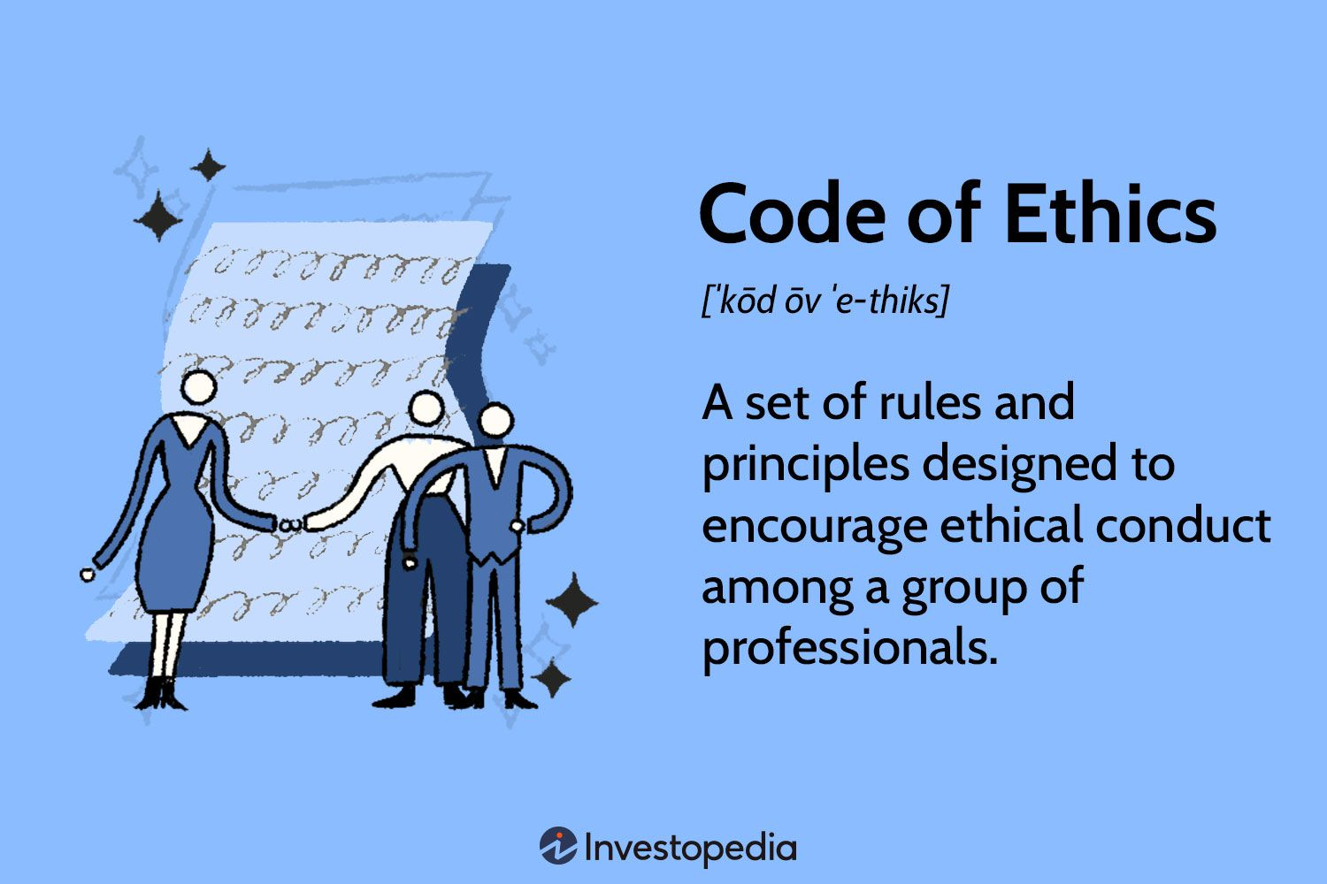
Identifying and Confronting Disciplinary Situations
Because individuals do not always agree on what constitutes acceptable standards of conduct, top-level managers must define the standards for supervisors and EEs.
  In many companies, standards are defined in statements of ethical codes and rules of conduct.

Slide 15
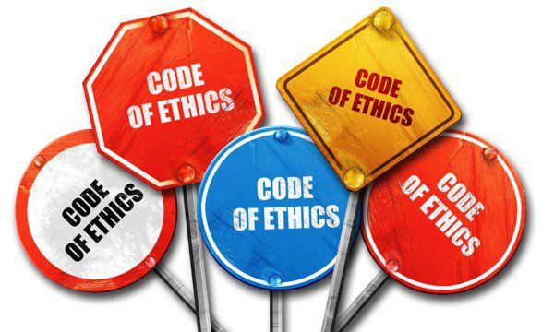
Ethical Codes and Policies
A code of ethics alone does not ensure ethical conduct.
  Some codes are documents that primarily outline legal requirements and restrictions, and they provide only limited guidance for solving moral and ethical dilemmas at work.
    Because ethical standards and ethical behavior can be interpreted in varying ways, some firms have developed their ethical codes and policies with major input from teams of EEs and supervisors. Furthermore, some major firms have established hotlines or ethics-reporting systems by which EEs are encouraged to report questionable situations or individuals who they believe are acting unethically, improperly, or illegally.

Slide 16
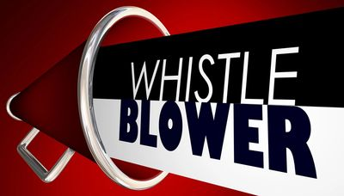
Ethical Codes and Policies
The person who reported the alleged wrongdoing, usually called a whistleblower, should be afforded anonymity.
  There is supposed to be no retaliation, regardless of whether the report is substantiated by facts and evidence.
    It is recognized that a hotline or an ethics-reporting system requires top level management’s commitment to make the system credible – that is, both to deal firmly with wrongdoing when it is reported and to prevent retaliation against the messenger who delivers an unwelcome message.

Slide 17
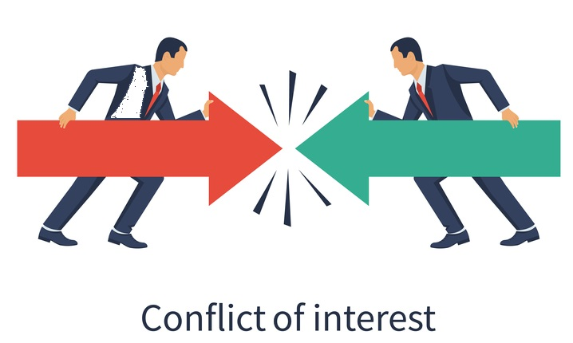
Ethical Codes and Policies
In addition to the preceding tools, some firms have developed statements and policies for addressing conflicts of interest.
  These statements may be part of, or in addition to, ethical codes.
    Conflict-of-interest statements usually define situations and EE behaviors that are inconsistent with an EE’s primary obligations to the employer.

Slide 18

Ethical Codes and Policies
In the final analysis, a firm’s commitment to high standards of ethical behavior must go beyond codes and policy statements.
  An ethical commitment requires everyone in the organization, especially those in management and supervision, to show daily, by word and deed, that behaving ethically at work is not optional.

Slide 19
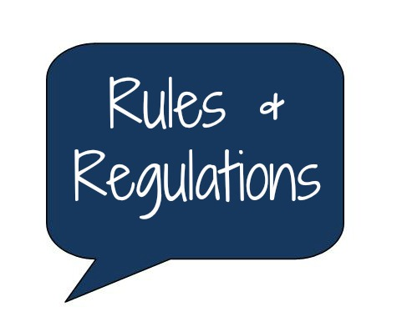
Rules of Conduct
Not every organization has a published code of ethics or conflict-of-interest statement; however, most have some formal statement or list of rules of behavior to which EEs are expected to conform.
    Policies, procedures, methods, and rules cover many aspects of ongoing operations. These tools are vital in informing EEs which standards of behavior are expected and which are unacceptable.

Slide 20

Rules of Conduct
Most organizations give their EEs written lists of rules or codes of conduct.
  These lists are often included in EE handbooks, or provided as separate booklets or as memoranda posted in departments.
    Supervisors must ensure that EEs read and understand general and departmental rules, which may include safety and technical regulations, depending on a department’s activity.

Slide 21
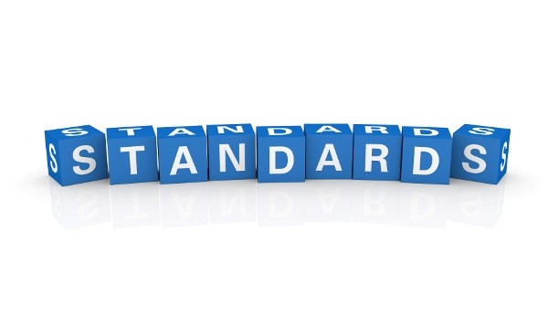
Rules of Conduct
Written rules and regulations provide standards that should help the supervisor encourage EE self-discipline.
  Some organizations provide detailed lists of rules and infractions; these lists may include classifications of penalties for violations.
    Other organizations, probably most, prefer to list their major rules and regulations but not the consequences of rule violations.

Slide 22
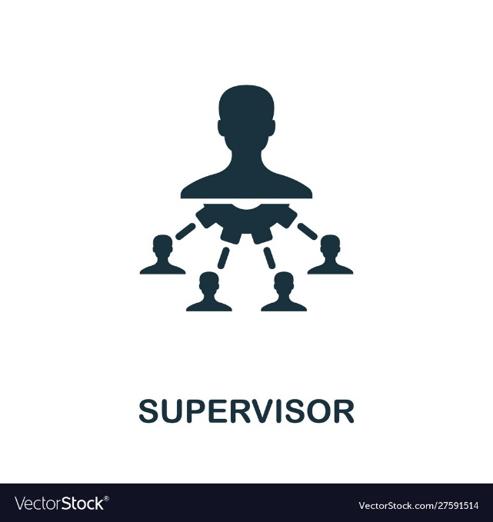
Rules of Conduct
Regardless of what type of list is used, the supervisor is the person most responsible for the consistent application and enforcement of company and departmental rules.
  In fact, the degree to which EEs follow corporate rules in a positive, self-disciplined way is usually more attributable to the supervisor’s role and example than to any other factor.

Slide 23
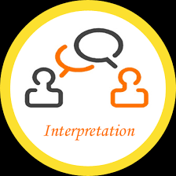
Rules of Conduct
Rules of conduct and policy statements in EE handbooks and manuals are often subject to review and change because of legal problems and interpretations.
  While the review and revision of EE handbooks are usually the responsibility of HR staff, supervisors should be very familiar with the content of EE handbooks.
    Supervisors should suggest revisions when revisions are justified.

Slide 24

Rules of Conduct
Confronting Disciplinary Situations
Despite best efforts to prevent infractions, supervisors will at times confront situations requiring some type of disciplinary action.
  The following require immediate action by the supervisor.
    Excessive absenteeism or tardiness.
    Defective or inadequate work performance.
    Poor attitudes that influence work of others or damage firm’s reputation.
    Infractions of rules regarding time schedules, rest periods, procedures, safety, and so forth.

Slide 25
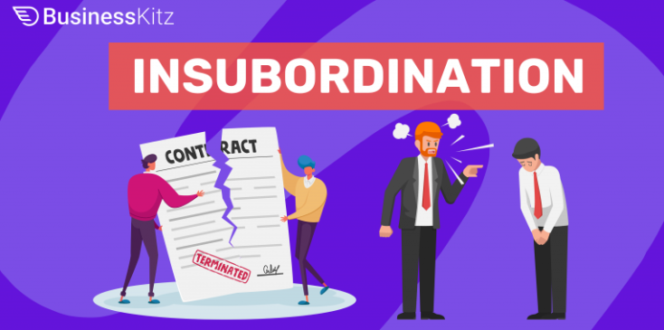
Rules of Conduct
Confronting Disciplinary Situations
A supervisor may at times experience open insubordination, such as when an EE refuses to carry out a legitimate work assignment.
  A supervisor may even confront disciplinary problems stemming from EE behavior off the job. For example, an EE may have a drinking problem or may be taking illegal drugs.
    Whenever an EE’s off-the-job conduct affects on-the-job performance, a supervisor must be prepared to respond to the problem appropriately.

Slide 26

Rules of Conduct
Confronting Disciplinary Situations
Situations that require disciplinary action are unpleasant, but the supervisor must have courage to deal with them.
  If the supervisor does not take action when required, borderline EEs might be encouraged to try similar violations.

Slide 27

Rules of Conduct
Confronting Disciplinary Situations
A supervisor should not hesitate to draw on authority inherent in the supervisory position, even though it might be easier to overlook the matter or to pass it off to higher-level managers or the HR department.
  Supervisors who ask the HR department to assume all disciplinary problems neglect responsibility and undermine their own authority.

Slide 28

Rules of Conduct
Confronting Disciplinary Situations
Normally, good supervisors will not have to take disciplinary action very frequently.
  When such action is necessary, however, the supervisor should be ready to act, no matter how unpleasant the task may be.

Slide 29
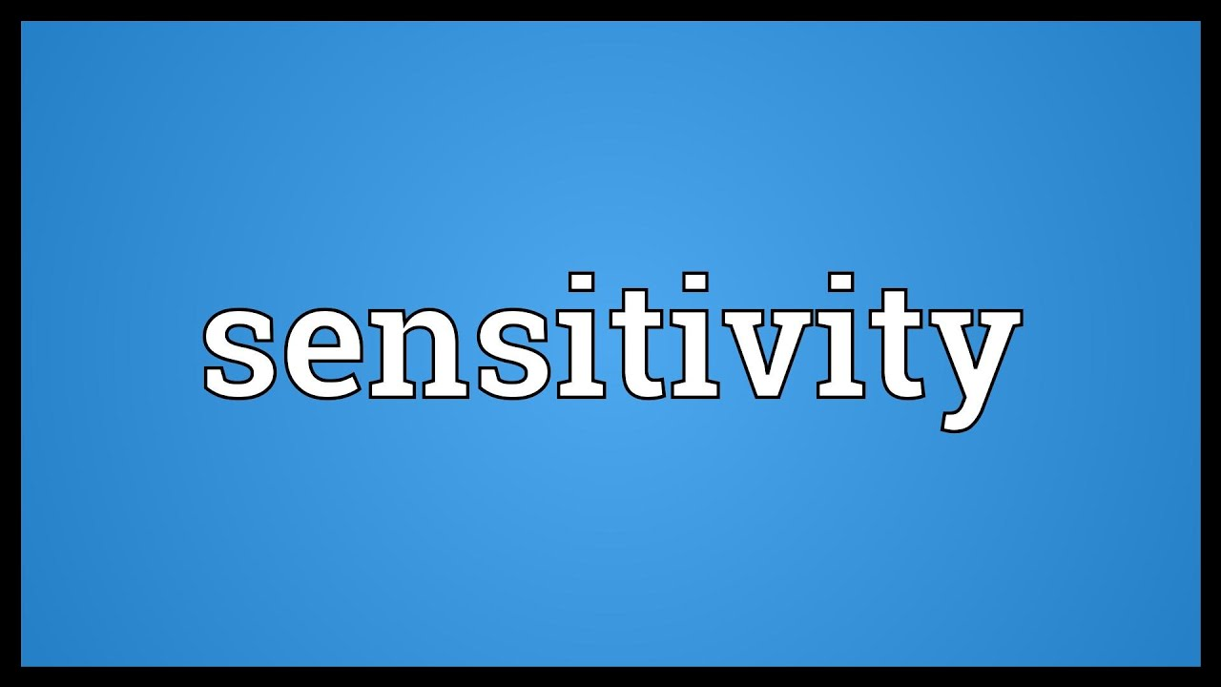
The Disciplinary Process and Just Cause
Supervisors must initiate any disciplinary action with sensitivity and sound judgment.
  The purpose of disciplinary action should not be to punish or to seek revenge but to improve the EE’s behavior.
    The main purpose of disciplinary action is to prevent similar infractions.

Slide 30
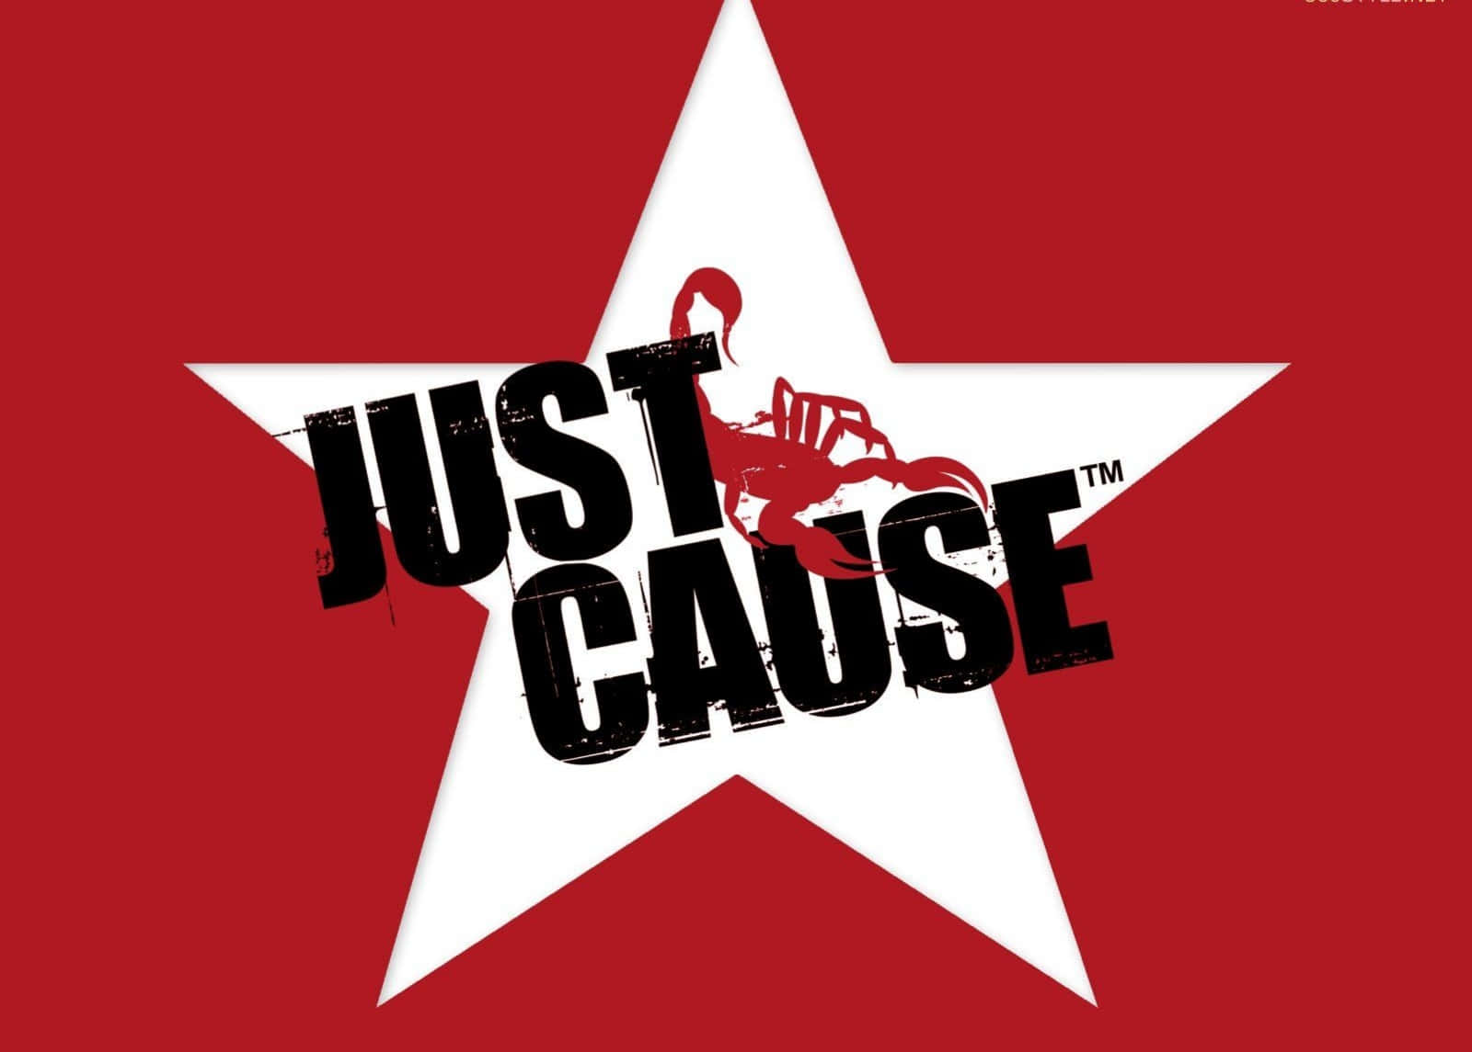
Disciplinary Action Should Have Just Cause
Most employers accept the general premise that disciplinary action taken against an EE should be based on “just cause.”
  To be viewed as “just,” the disciplinary action must consider all the facts in the individual case and be consistent with past practice.

Slide 31

Disciplinary Action Should Have Just Cause
Eight Tests for Just Cause
  1. Give Advance Warning
    Did the company give the EE forewarning of the possible or probable disciplinary consequences of the EE’s behavior?
  2. Clarify Expectations – Everyone Needs to Know Rules of the Game
    Was the company’s rule or managerial order reasonably related to the (a) orderly, efficient, and safe operation of the company’s business and (b) performance the company might properly expect of the EE?
  3. Investigate Immediately
    Did the company, before administering discipline to an EE, make an effort to discover whether the EE did, in fact, violate or disobey a rule or an order of management?
  4. Be Objective
    Was the company’s investigation conducted fairly and objectively?

Slide 32
Disciplinary Action Should Have Just Cause
Eight Tests for Just Cause
  5. Analyze the Evidence
    After investigation, was there substantial evidence or proof that the EE was guilty as charged?
  6. Be Consistent, Uniform, and Impersonal
    Has the company applied its rules, orders, and penalties evenhandedly and without discrimination?
  7. Punishment in Relation to the Offense
    Was the degree of discipline administered by the company in a particular case reasonable related to the seriousness of the EE’s proven offense and the record of the EE’s service with the firm?
  8. Cover Your Rear – Be Sure to Document (5 W’s and 1 H…?)
    Has the company kept records of the offense committed, the evidence, and the decision made, including the reasoning involved in the decision?

Slide 33
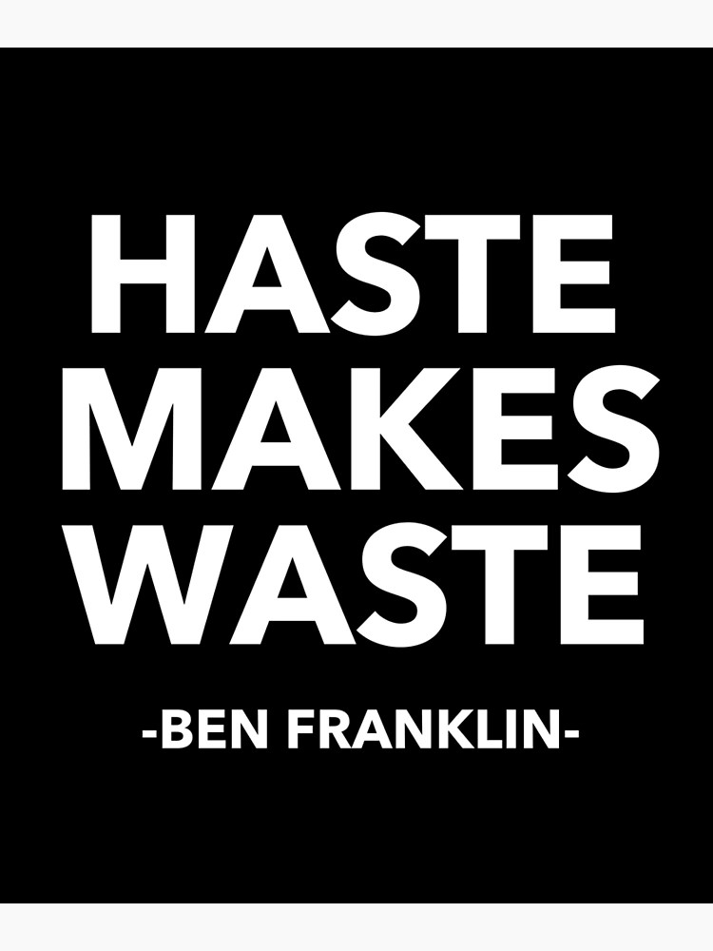
Pause Before Taking Action
As a first consideration in any disciplinary situation, a supervisor should guard against undue haste or unwarranted action based on an emotional response.
  A supervisor should answer and follow a number of precautionary questions and measures before deciding on any disciplinary action in response to an EE’s alleged offense.

Slide 34
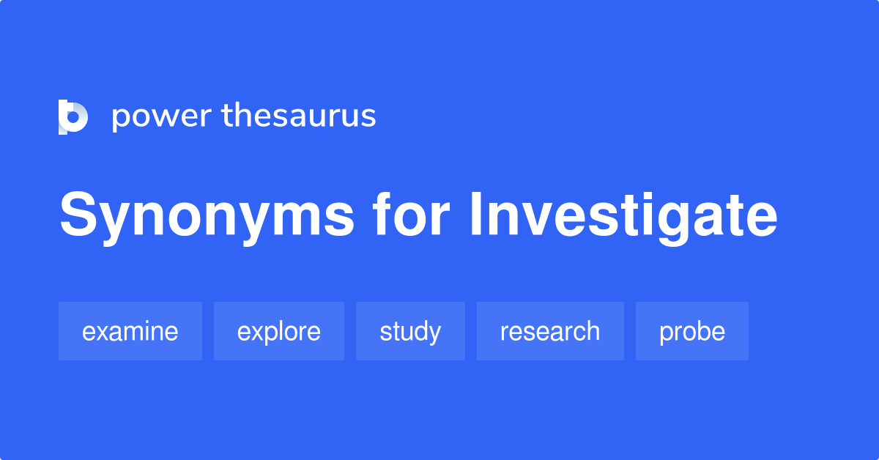
Investigate the Situation
Before doing anything else, the supervisor should investigate what happened and why.
  For certain serious violations, such as stealing, illegal substance use, and violence, an organization may call in the authorities to investigate and take appropriate action.
    When an EE is injured on the job, many firms require the EE to take a drug-and-alcohol screening test.

Slide 35

Supervisory Tips
Questions to Ask During a Disciplinary Investigation.
  Are all or most of the facts available, and are they reported accurately?
  How serious is the offense (minor, major, or intolerable)?
  Were others involved in or affected by the offense?
  Were company funds or equipment involved?
  Was there damage to the organization’s reputation, product or service quality, personal injury, or other identifiable harm?
  Did the EE know the rule, standard, and/or expectations?
  Does the EE have a reasonable excuse, are there extenuating circumstances?
  What is EE’s disciplinary record, length of service, and performance level?
  Does the offense indicate carelessness, absentmindedness, or loss of temper?
  How doe this EE react to constructive criticism?
  Should EE receive the same treatment others have had for the same offense?
  Is documentation available in case the matter leads to outside review?

Slide 36

Investigatory Interviews
As part of the supervisor’s investigation of an alleged infraction, it may be necessary to question the EE involved as well as other EEs who may have relevant information.
  In general, such interviews should be conducted privately and individually, perhaps with a guarantee of confidentiality.
    These situations are usually less threatening to EEs who may otherwise be reluctant to tell what they know. Such situations help prevent EEs from being unduly influenced by another’s version or interpretation.

Slide 37

Investigatory Interviews
The principles of interviewing and effective communication apply to investigatory interviewing.
  Supervisors should ask directive and nondirective questions that are designed to elicit specific answers about what happened and why?
    The supervisor should avoid making final judgments until all interviews have been conducted and other relevant information assembled.

Slide 38
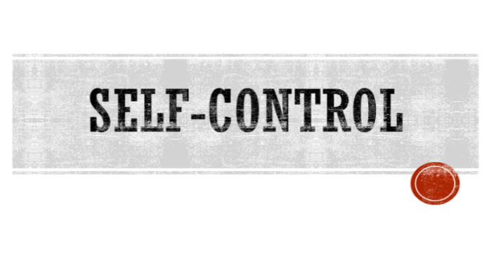
Maintaining Self-Control
Regardless of the severity of an EE’s violation, a supervisor must maintain self-control.
  This does not mean a supervisor should face a disciplinary situation halfheartedly or indifferently, but if supervisors feel they are in danger of losing control of their tempers or emotions, they should delay the interview and take no action until they regain control.
    A supervisor’s loss of self-control or display of anger could compromise fair and objective judgment.

Slide 39

Maintaining Self-Control
A supervisor should never lay a hand on an EE in any way.
  Except for emergencies, when an EE has been injured or becomes ill, or when EEs who are fighting must be separated, any physical gesture could be easily misunderstood.
    A supervisor who engages in physical violence, except in self-defense, normally is subject to disciplinary action by higher-level management.

Slide 40

Privacy in Disciplining
When supervisors decide on disciplinary actions, they should communicate those actions to the offending EEs in private.
  A public reprimand not only can humiliate the EE in the eyes of coworkers but also erode department morale or inspire a grievance.
    If, in the opinion of other EEs, a public disciplinary action is too severe for the violation, the disciplined EE might emerge as a martyr.

Slide 41

Privacy in Disciplining
It is always desirable to have another management person present to witness any discussion requiring corrective action.
  It is also essential that the witness confirm the discussion and actions that took place.
    It is most important to document all of your discussions and actions, which some people refer to as “covering your rear” (CYR).

Slide 42

Privacy in Disciplining
Only under extreme circumstances should disciplinary action be taken in public.
  For example, a supervisor’s authority may be challenged directly and openly by an EE who repeatedly refuses to carry out a reasonable work request, or an EE may be drunk or fighting on the job. In these cases, the supervisor must reach a disciplinary decision quickly (i.e. send the offending EE home on suspension pending further investigation).
    Supervisors may have to act in the presence of other EEs to regain control of situations and to maintain their respect.

Slide 43

Practicing Progressive Discipline
Unless a serious violation, such as stealing, physical violence, or gross insubordination, has been committed, rarely is the offending EE discharged for a first offense.
  Although the type of disciplinary action varies according to the situation, many organizations practice progressive discipline, which increases the severity of the penalty with each offense.

Slide 44

Practicing Progressive Discipline
The following outlines a system of progressive disciplinary action:
  Informal Discussion with the EE.
    Place documentation of discussion in the EE’s file.
  Oral Warning and Counseling.
  Written Warning.
  Disciplinary Layoff.
    Suspension without pay, usually for one to three days. The more serious the infraction, the longer the suspension.
  Transfer or Demotion.
  Discharge.
    Serious infractions may warrant termination in the first and only step.

Slide 45

Practicing Progressive Discipline
Many disciplinary situations can be handled by the supervisor without escalating those situations to difficult confrontations.
  In the early stages of progressive discipline, the supervisor communicates with the EE about the problem and how to correct it.

Slide 46
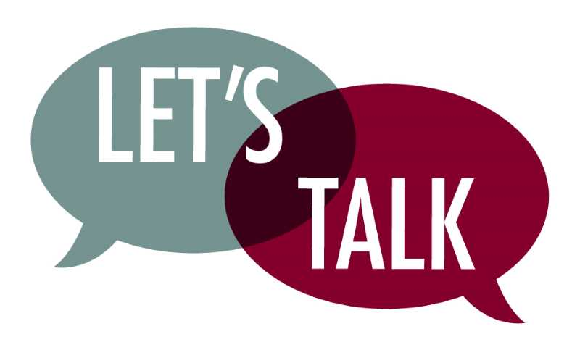
Informal Discussion
If the offense is relatively minor and EE has no disciplinary record, a friendly and informal talk will clear up the problem in many cases.
  During this talk, the supervisor should try to determine the underlying reasons for the EE’s unacceptable conduct.
  The supervisor should reaffirm the EE’s sense of responsibility and acknowledge previous good behavior.
    The supervisor should record the date-place-time-nature of the incident. If others witnessed the incident, their names also should be noted.

Slide 47

Oral Counseling (Warning)
If a friendly talk does not take care of the situation, the next step is to provide the EE with counseling (AKA an oral warning).
  Here, the supervisor emphasizes in a straightforward manner the undesirability of the EE’s repeated violation.
  While the supervisor should stress the preventive purpose of discipline, the supervisor should also emphasize that unless the EE improves, more serious disciplinary action will be taken.
    A record of this oral warning should be kept in the EE’s file.

Slide 48
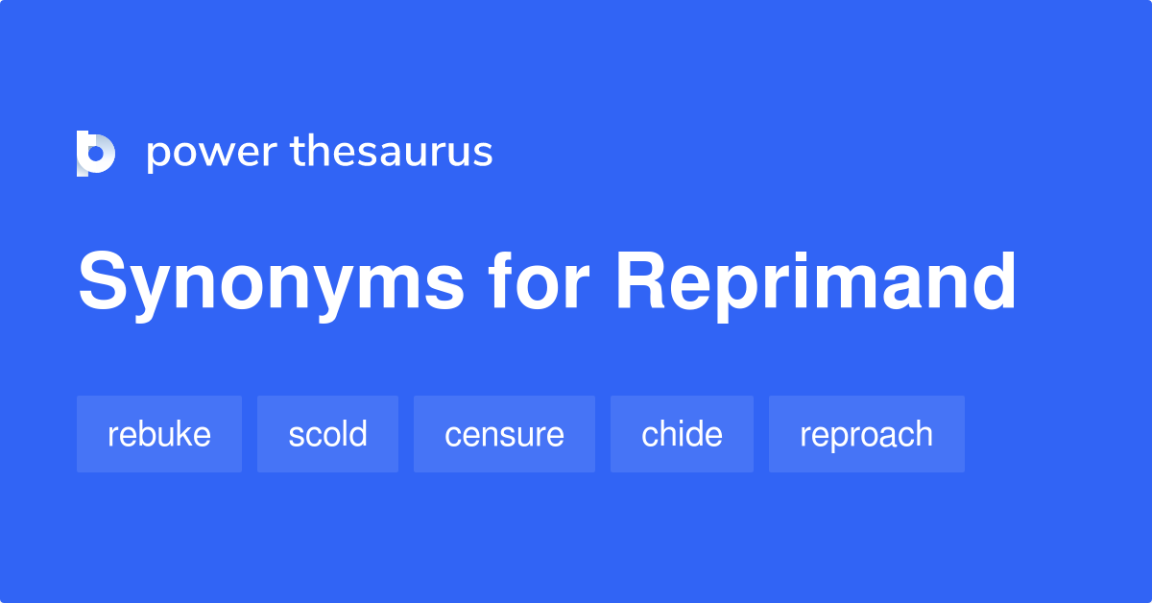
Written Reprimand
A written reprimand contains a statement of the violation and the potential consequences of future violations.
  It is a formal document that becomes a permanent part of EE’s record.
    The supervisor should review with the EE the nature of this written warning and should once again stress the need for improvement.
    The EE should be placed on notice that future infractions or unacceptable conduct will lead to more serious discipline, such as suspension or discharge.

Slide 49
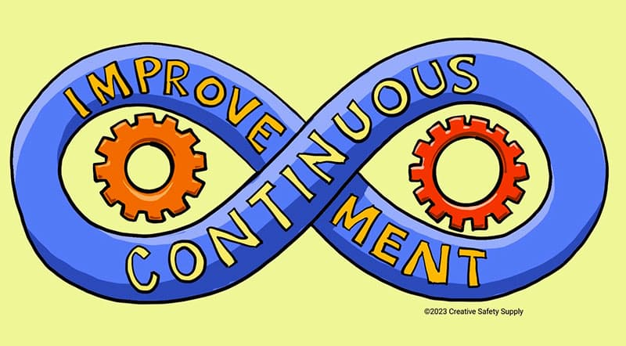
Written Reprimand
The supervisor should continue to express to the EE a belief in the EE’s ability to improve and the supervisor’s willingness to help in whatever ways possible.
  The primary goal of disciplinary action up until discharge should be to help the EE improve and add value to the organization.

Slide 50

Suspension (Disciplinary Layoff)
If previous warnings were of no avail, a disciplinary layoff may constitute the next disciplinary step.
  Disciplinary layoffs involve a loss of pay and usually extend from one day to several days or weeks.
    Because a disciplinary layoff involves loss of pay, most organizations limit a supervisor’s authority at this stage. Most supervisors can only initiate or recommend a disciplinary layoff. The layoff must then be approved by higher-level managers after consulting with HR.

Slide 51

Suspension (Disciplinary Layoff)
EEs who do not respond to oral or written warnings usually find a disciplinary layoff to be a rude awakening.
  The layoff may restore in them the need to comply with the organization’s rules and regulations.
    In many EE situations, disciplinary layoffs are an effective disciplinary measure.

Slide 52
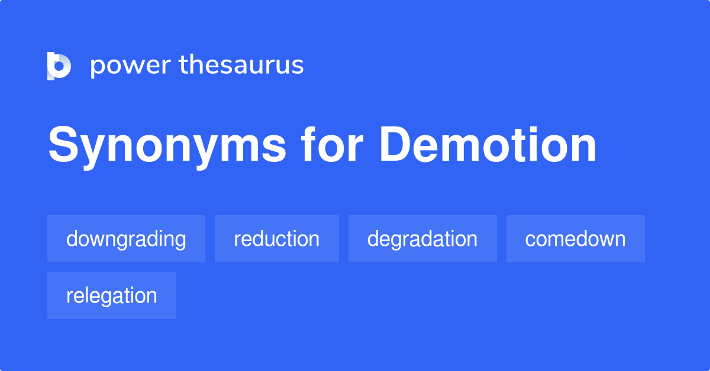
Demotion
Another disciplinary measure, the value of which is questionable, is demotion (downgrading) to a lower-paying job.
  This course of action is likely to bring about dissatisfaction and discouragement because losing pay and status over an extended period is a form of ongoing punishment. The dissatisfaction of the demoted EE also can spread to other EEs.
    Therefore, most organizations avoid demotion as a disciplinary action.

Slide 53

Demotion
Demotion should be used only in unusual situations in which disciplinary layoff or discharge is not a better alternative.
  For example, when a long-service EE is not maintaining standards of work performance required in a certain job, this EE may accept a demotion as an alternative to discharge to retain seniority and other accrued benefits.

Slide 54
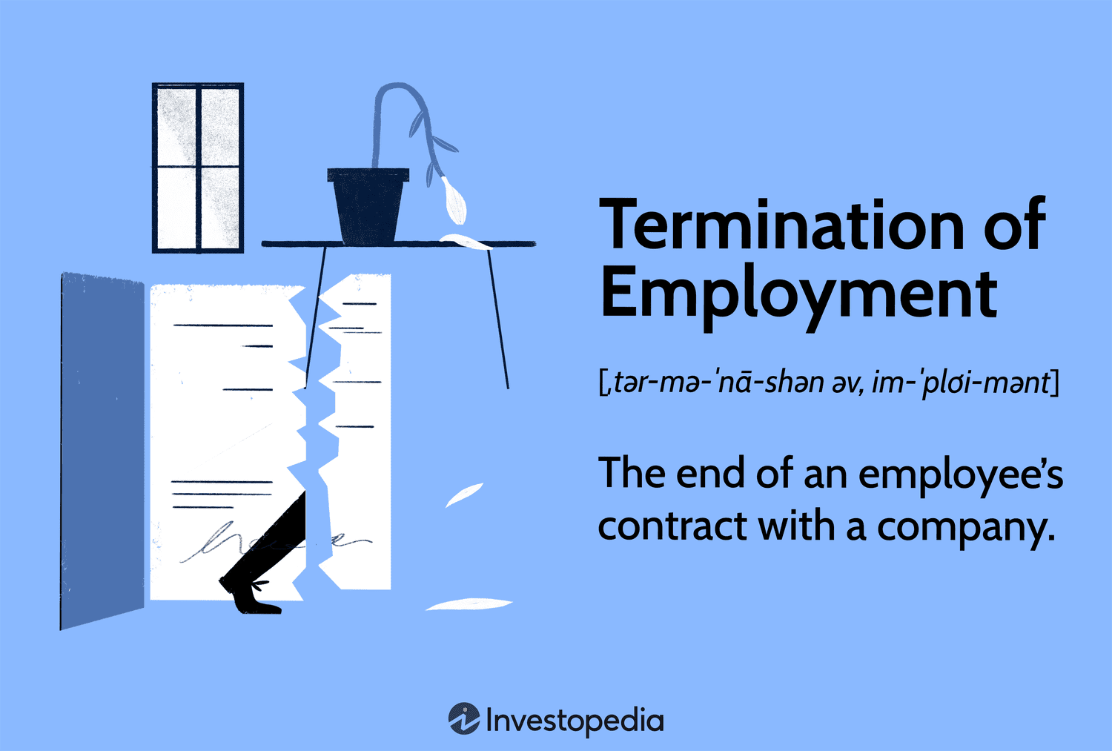
Termination (Discharge)
The most drastic form of disciplinary action is termination or discharge.
  The discharged EE loses all seniority and may have difficulty obtaining employment elsewhere.
    Discharge should be reserved only for the most serious offenses and as a last resort.

Slide 55

Termination (Discharge)
A discharge means having to train another EE to do the job and disrupting the makeup of the work group, which may affect the morale of other EEs.
  If the discharge involves an EE who is a member of a legally protected group, management will have to be concerned about meeting appropriate standards for nondiscrimination.

Slide 56

Termination (Discharge)
Because of legal and other concerns, the final termination interview with the discharged EE may be conducted by HR.
  When supervisors conduct the termination interview, however, they should be careful to focus on the reasons for the termination and to respond to the questions of the EE being terminated.
    The supervisor should not lose emotional control or engage in a heated debate about the fairness of the termination decision.

Slide 57
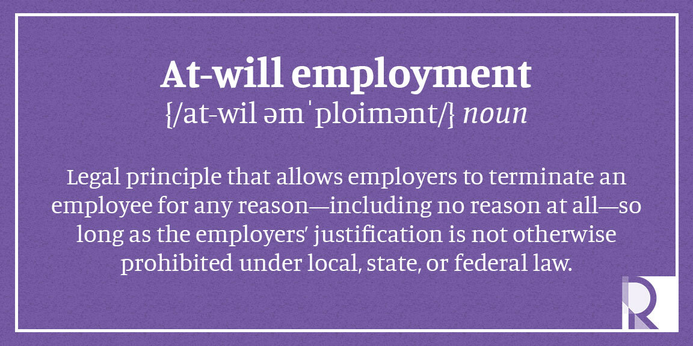
Termination (Discharge)
When employers follow the principles of progressive disciplinary action and couple them with good supervisory practices, those employers usually do not have to resort to employment-at-will to decide whether to terminate an EE who has not performed acceptably.

Slide 58
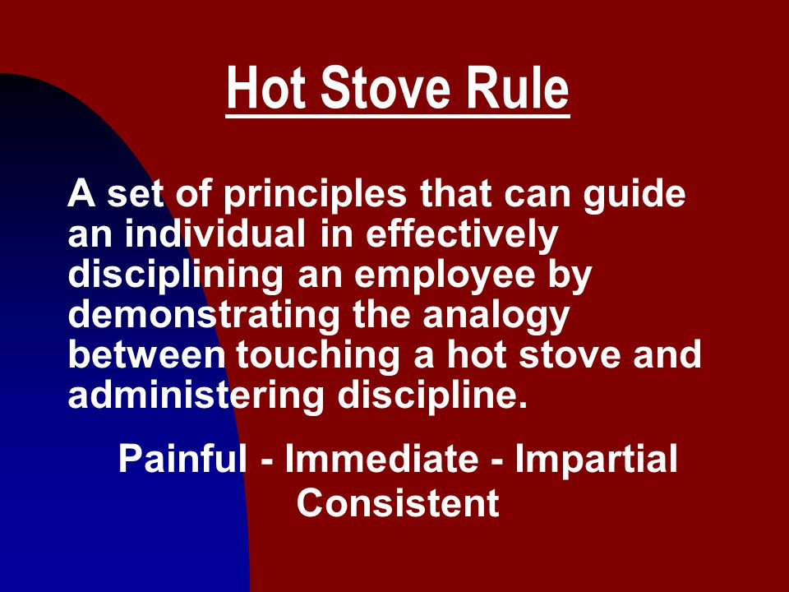
Applying the Hot Stove Rule
Taking disciplinary action may place the supervisor in a strained or difficult position.
  Disciplinary action is an unpleasant experience that tends to generate EE resentment.
    To help the supervisor apply the disciplinary measure so that it will be least resented and most likely to withstand challenges from various sources, authorities have advocated the use of the Hot Stove Rule.

Slide 59
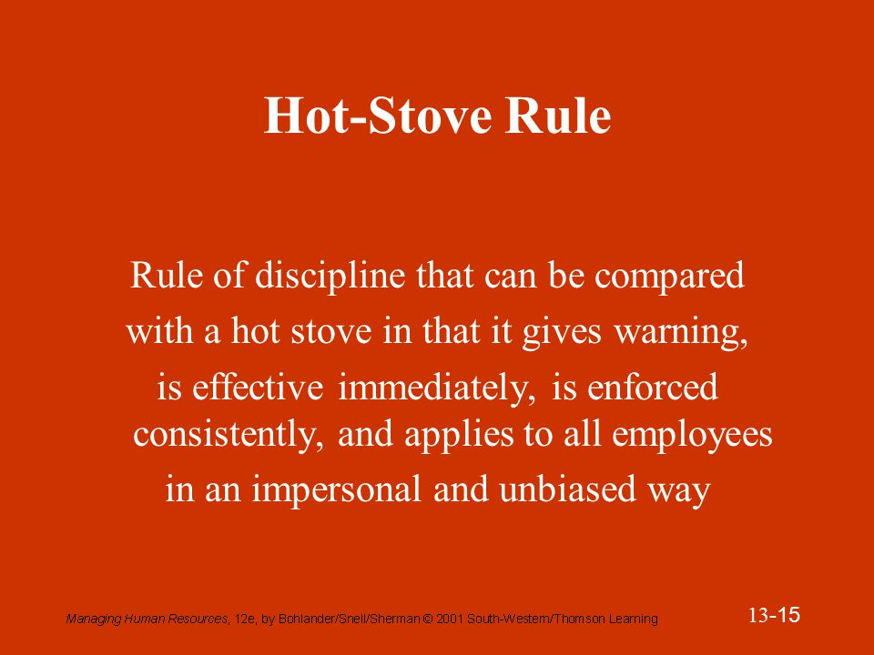
Applying the Hot Stove Rule
The Hot Stove Rule equates to touching a hot stove with experiencing discipline.
  Both contain the following four elements:
    Advance Warning
    Immediacy
    Consistency
    Impersonality

Slide 60

Applying the Hot Stove Rule
  The supervisor can apply these four elements of the hot stove when maintaining EE discipline.
  Advance Warning
    Everyone knows what happens if they touch a red-hot stove.
  Immediacy
    Someone who touches a hot stove gets burned right away, with no questions of cause and effect.
  Consistency
    Every time a person touches a hot stove, that person gets burned.
  Impersonality
    Whoever touches a hot stove is burned because the stove treats all people the same.

Slide 61

1. Advance Warning
For EEs to accept disciplinary action as fair, they must know in advance their expectations as well as rules and regulations.
  EEs must be informed that certain acts will lead to disciplinary action, and supervisors should clarify any questions that arise concerning rules and their enforcement.

Slide 62

2. Immediacy
After noticing an offense, the supervisor should take disciplinary action as promptly as possible.
  At the same time, the supervisor should avoid haste, which might lead to unwarranted reactions.
    The sooner the discipline is imposed, the more closely it will be connected with the offensive act.

Slide 63
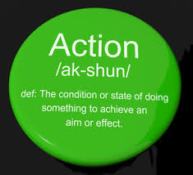

3. Consistency
Appropriate disciplinary action should be taken each time an infraction occurs.
  The supervisor who feels inclined to be lenient every now and then is, in reality, doing EEs no favor.
    Inconsistent discipline leads to EE anxiety and creates doubts as to what EEs can and cannot do.

Slide 64

4. Impersonality
All EEs who commit the same or similar offense should be treated the same way.
  Penalties should be connected with the offense, not offending EE.
  It should make no difference whether the EE is white or black, male or female, young or old, or a member of any other group.
    The standards of disciplinary expectations and actions apply uniformly.

Slide 65
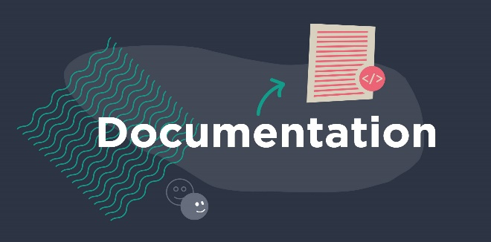
Documentation and the Right to Appeal
Whenever a disciplinary action is taken, the supervisor must record the offense and the decision, including the reasoning involved in the decision.
  This is called documentation, and it may include keeping files of the memoranda, minutes of meetings, and other documents that were part of the case handling.
    Documentation is necessary because the supervisor may be asked to justify the action, and the burden of proof is usually on the supervisor.

Slide 66

Documentation and the Right to Appeal
The right to appeal means it should be possible for an EE to request a review of the supervisor’s disciplinary action from higher-level management.
  If the EE belongs to a labor union, this right is part of a grievance procedure.

Slide 67

Documentation and the Right to Appeal
Supervisors should encourage an EE to appeal to higher-level management if the EE feels they have been treated unfairly.
  Supervisors should not feel that appeals threaten or weaken their positions as department managers. For the most part, a supervisor’s manager will be inclined to support the supervisor’s action.

Slide 68

Documentation and the Right to Appeal
During an appeal, the higher-level manager may reduce or reverse discipline imposed or recommended by a supervisor.
  The supervisor’s decision might be reversed because the supervisor imposed disciplinary action inconsistently or failed to consider all the facts. Under these circumstances, supervisors may become discouraged and feel their managers failed to back them up.
    Although this situation is unfortunate, it is better for the supervisor to be disheartened than for an EE to be penalized unjustly.

Slide 69
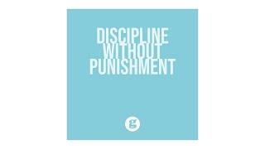
Discipline without Punishment
A growing number of companies have adopted disciplinary procedures called discipline without punishment.
  The major thrust of this approach is to stress extensive coaching, counseling, and problem solving and to avoid confrontation.
  A significant (and controversial) feature is paid decision-making leave, in which EEs are sent home for a day or more with pay to decide whether they are willing to commit to meeting performance standards previously not met.
    If an EE commits to improving but fails to do so, the EE is terminated.

Slide 70
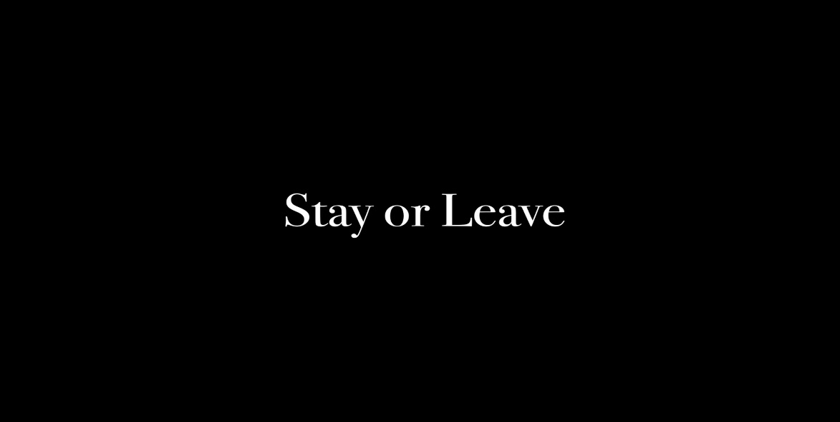
Discipline without Punishment
Discipline without punishment replaces warnings and suspensions with coaching sessions and reminders by supervisors of expected standards.
  The decision making leave with pay is posed as a decision to be made by the EE, namely, to improve and stay or to quit.

Slide 71

Discipline without Punishment
Organizations that have implemented this approach successfully have reported various benefits, particularly reduced complaints and grievances and improved EE morale.
  A discipline without punishment approach requires commitment from all management levels – especially from supervisors – if it is to be carried out successfully.

Slide 72
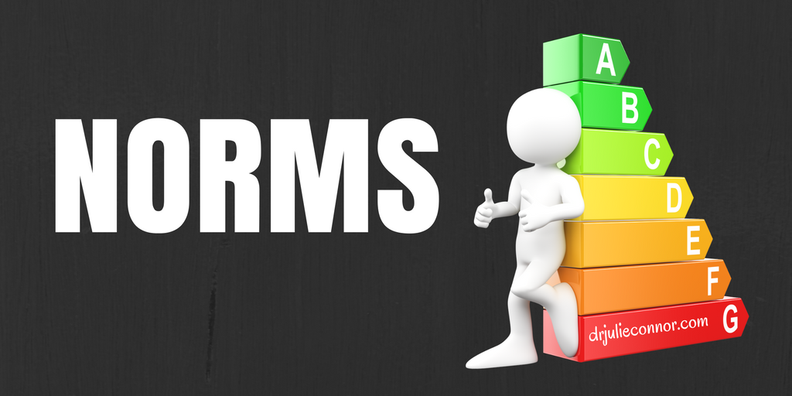
Fairness and Dissatisfaction
Every individual brings certain expectations to work.
  The values, beliefs, and perceptions are unique to that person.
    However, each work group has a set of norms.

Slide 73
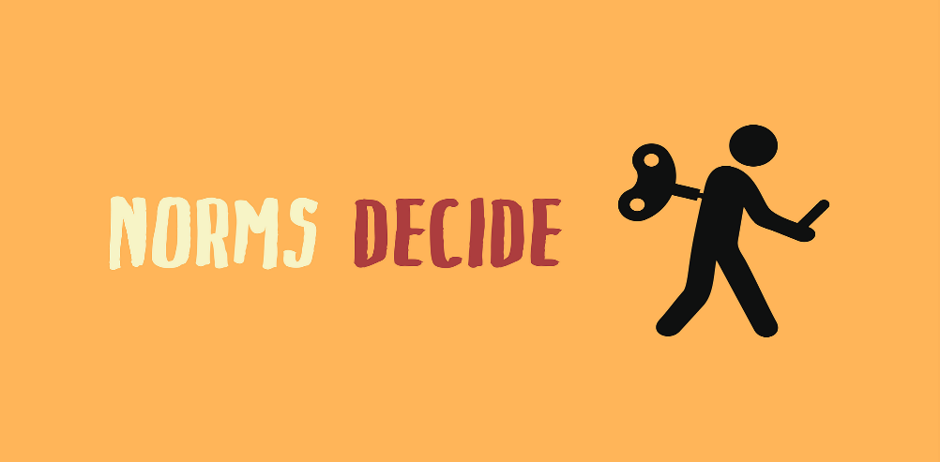
Fairness and Dissatisfaction
Norms are the organized and shared ideas regarding what members should do and feel, how this behavior should be regulated, and what sanctions should be applied when behavior does not coincide with organization or group expectations.
  When an EE encounters a situation, whether new or old, their behavior is guided by past experiences and expectations.
    They may react in several different ways depending on how they perceive the situation and are impacted by it.

Slide 74

Fairness and Dissatisfaction
Various writers purport that one’s sense of fair treatment is contingent upon the following: interactions that one has with one’s supervisors, procedures used to arrive at the action taken, and the outcomes (the punishment or reward).
  The lack of consistency in disciplinary action or the inconsistency in meting out rewards may lead an EE to the conclusion that “life is not fair.”
    Dissatisfaction is a potential source of trouble for supervisors.
    With a grievance procedure, however, supervisors are able to respond to EE concerns in a timely manner and reduce the potential for EE dissatisfaction to fester and lead to bigger problems.

Slide 75

Fairness and Dissatisfaction
In a most basic sense, people react to unfair treatment in 3 ways:
  Fight
    EE uses the organization’s grievance procedure to deal with the perception of unfairness.
  Flight
    EE leaves the organization, or psychologically disappears from the job.
  Go with the Flow
    EE accepts the situation and stays with the organization.
    If the feelings of unfairness are great, the EE may talk with others about how badly they were treated. This may stir emotions, fester, and escalate.
    Clearly, supervisors must be vigilant for feelings of EE dissatisfaction.

Slide 76
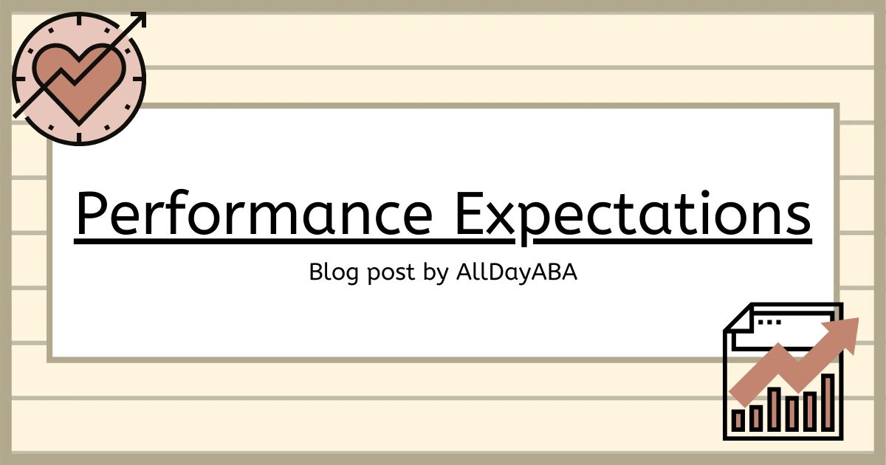
Conclusion
Employees need to know what is expected of them in the way of performance.
  Dealing with EEs who are not performing to expected standards requires taking corrective actions. Focus on performance.
    Not everyone will accept the fact that they must change their behavior.
    When problems occur, deal with them immediately and fairly.

Slide 77


