Slide 1
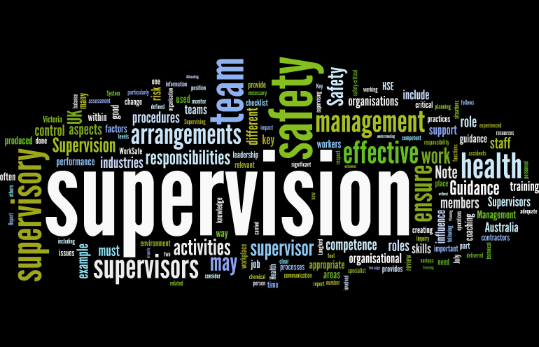
Supervision
Supervision
  Concepts and Practices of Management, 13th Edition
    Edwin C. Leonard, Jr., Ph.D. and Kelly A. Trusty, Ph.D. Cengage Learning, Boston, MA 2013
      ISBN: 978-1-285-86637-6

Slide 2

Part Four: Controlling and Managing Performance Conflict
Chapter Fourteen: Resolving Conflicts
  After studying this chapter, you will be able to:
    Recognize that handling disagreements and conflicts in the workplace is a component of supervision.
    Describe strategies for addressing bullying in the workplace.
    Identify and contrast 5 styles inherent in conflict resolution approaches.
    Distinguish between supervisor handling of EE complaints in any work setting and grievances in a unionized setting.
    Explain the major distinctions between grievance procedures, complaint procedures, and alternative dispute resolution (ADR) procedures.
    Analyze and understand supervisory guidelines for resolving complaints and grievances effectively.

Slide 3

Disagreements and Conflicts are Part of the Workplace
    Personalized conflict, in which two people simply do not like each other, is laden with emotions.
  According to author Todd Bowerman:
    A personalized conflict is fueled primarily by emotions. Anger, jealousy and any other number of human responses can cause this type of conflict, and indulging in it is rarely productive for you or your workforce.
    Personalized conflict is dangerous in that it often escalates rather than fades away, and it must be addressed early, or the problems might fester before erupting again.

Slide 4

Disagreements and Conflicts are Part of the Workplace
Personalized conflict, including bullying and other forms of incivility, appears to be on the rise.
  Personalized conflict that can’t be resolved leads to “dysfunctional conflict.” The end result is a communications break down. And, the workplace may become politicized as other team members either choose sides or withdraw.
    Energy and effort that should be devoted to the accomplishment of goals and objectives is diverted as a result of the conflict.

Slide 5

Bullies at Work
During childhood, many of us experienced the playground bully.
  In some instances, the playground bully has grown up and now works alongside us. The dilemma for many EEs is learning to work with such a person.
    The findings of various studies, report that “rude behavior is on the rise in the workplace and can undermine an organization’s effectiveness.”

Slide 6

Bullies at Work
Almost everyone has been on the receiving end of a rude person’s temper or a bully’s wrath.
  Whether crude or impolite behavior takes place behind closed doors or in the open, it directly affects recipients and lowers group morale.
    Psychologist Dr. Michelle Callahan contrasts bullying with a boss having a bad day every once in a while. She describes bullying as a recurring behavior that can include yelling, intimidation, humiliation, or sabotage.

Slide 7
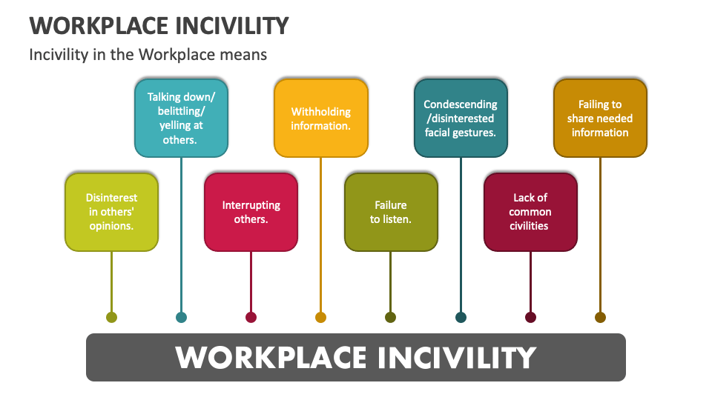
Addressing Workplace Incivility
Workplace incivility occurs when one acts in a discourteous, rude, or demeaning manner.
  Bullying is one form of incivility. Verbally abusing, swearing, making fun of you, or giving impossible jobs for which you either lack SKAs or the time to get them done are all forms of psychological incivility.
    Physical incivility occurs when the EE is attacked, touched, or threatened.

Slide 8

Addressing Workplace Incivility
Workplace violence, defined as violent acts, including physical assaults and threats of assaults directed toward EEs at work or on duty, has increased dramatically.
  Experts agree it is impossible to accurately predict violent behavior; however, some studies have identified certain behavioral problems that may portend serious problems on the job.
    Supervisors are typically best positioned to identify the warning signals, which include an individual’s extreme interest in weapons or bringing weapons to the workplace; paranoid behavior, such as panicking easily or perceiving that the “whole world is against me”; reacting to or failing to take criticism; and unexplained dramatic changes in an individual’s productivity, attendance, or hygiene.

Slide 9
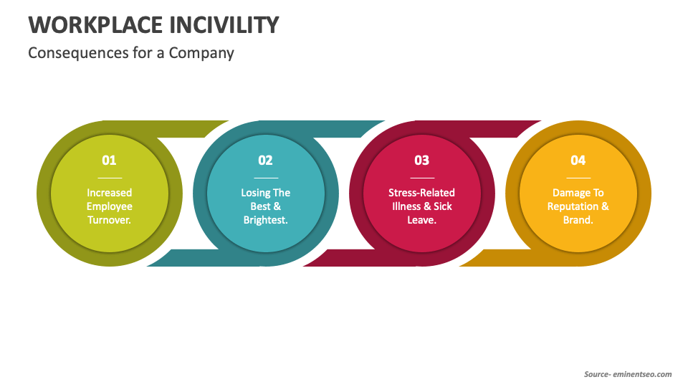
Addressing Workplace Incivility
Often incidents of workplace incivility escalate to violent actions.
  Studies of violent acts in workplace have shown these acts typically start as verbal disputes and involve people who know each other.
  Disputes may occur over trivial matters, or they may involve major disagreements with supervisors or EEs.
    Supervisors should address bad behaviors promptly, before they escalate.

Slide 10

Addressing Workplace Incivility
A supervisor should be alert to those EEs who have difficulty adjusting to coworkers or who make lives of others unbearable.
  Through counseling sessions with these individuals, the supervisor may be able to uncover the reasons for problem behaviors and to help individuals stop those behaviors.
    The supervisor should also work with HR to determine if individuals who are behaving in uncharacteristically hostile or inappropriate ways should be referred to Employee Assistance Programs to access help and support to deal with personal or mental health issues.

Slide 11
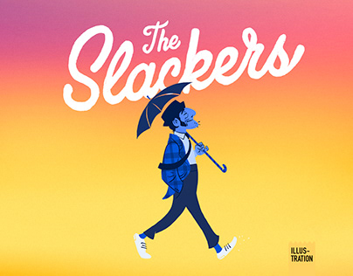
Slackers Cause Stress
In recent years, EEs have begun to reference coworkers of a certain type of character as particularly frustrating and demoralizing to work with.
  The office slacker, or person who withholds effort and could be much more productive but makes persistent, conscious decisions not to be, aggravates and angers hardworking colleagues.
    High performers who see others loafing, freeloading, sandbagging, or even sabotaging others’ efforts simply because they do not want to put forth more effort can begin to scale back their work, too.

Slide 12

Slackers Cause Stress
Furthermore, if slacker behavior is not addressed by the supervisor and changed through performance management efforts, conflict between EEs typically increases and the level of communication and information sharing decreases.
  In some instances, coworkers have been known to cover up or accommodate others’ slacking in order to protect the group, which leads to increased tension.
    It is in the supervisor’s best interest to observe work habits carefully over time and address slacker behavior in order to encourage productivity and reduce this potential source of personalized and dysfunctional conflict.

Slide 13

Slackers Cause Stress
Conflict, at times, can be good because we can learn a great deal by talking out our differences and settling on a course of action that meets the needs of both parties.
  Good conflict, often called constructive conflict or functional conflict, is healthy for the organization and helps improve performance.
  Various researchers have contended that team leaders (supervisors) need to encourage team members to express disagreement, and build commitment to the team decision.
    When the needs of EEs and the organization are met, constructive conflict results in a win-win situation for all concerned.

Slide 14

Slackers Cause Stress
Conflict is inevitable, and workplace conflict is increasing.
  Organizational development consultant Arlyne Diamond suggests three main reasons for the increase. First, the workplace has flatter chains of command, and workers have more decision-making latitude, which can cause power issues. Second, the world is smaller, and people from all cultures and backgrounds bring a wider variety of experiences and expectations to work with them, which can cause misunderstandings, differential treatment, and discord. Third, the workplace is populated by equal numbers of males/females, whose behavioral and communication styles may not always be compatible.
    In order to effectively deal with the impact of the interpersonal aspects of your workplace, you will need to develop conflict resolution strategies.

Slide 15

Supervisory Tips
Strategies for Addressing Workplace Incivility
  Be assertive.
  Eliminate the problem behavior.
  Help the team accomplish its goals.
  Preserve team cohesiveness.
  Maintain the self-esteem of team members.
  Pause and evaluate what was really said (content-text-tone)
  Stay in control when attacked: do not counter attack.
  Address the person by name.
  Take action – stop problem behavior when it happens.
  State how you feel: “Name, when you do ___ I feel ___.”
  State why you feel: “It is inappropriate, because ___.”
  State your expectations: “I expect this behavior to stop immediately.”
  Ask the individual to commit to ceasing the behavior.
  State the repercussions if the behavior happens again.
  Document the discussion. If appropriate, report it to HR.

Slide 16
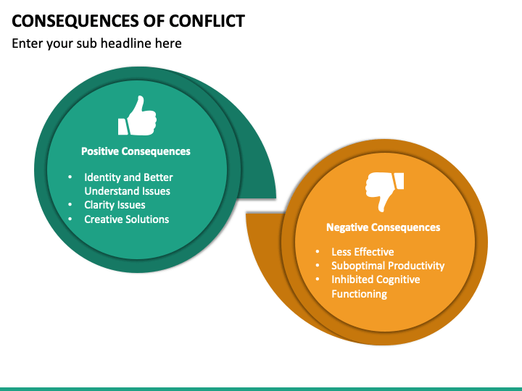
Workplace Conflicts Must Be Resolved
In the workplace, many supervisors become irritated and confused when EE complaints or grievances challenge their authority.
  Some supervisors find it difficult to function because they feel that disagreements with EEs reflect on supervisor performance or perhaps that there is something wrong with their supervisory abilities.

Slide 17
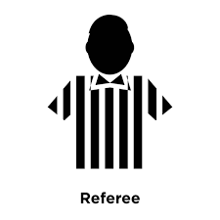
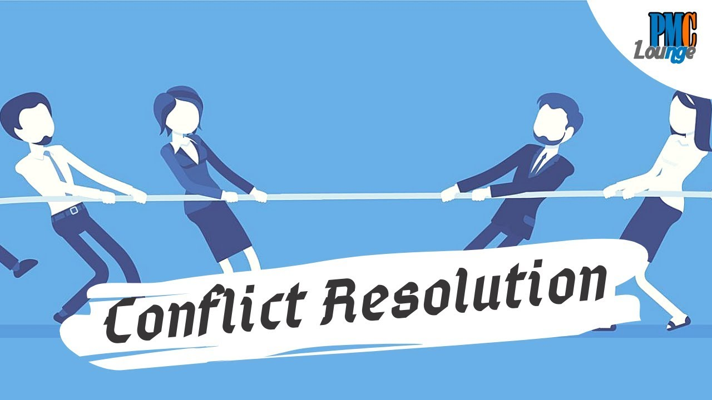
Workplace Conflicts Must Be Resolved
At times, supervisors must act like referees to resolve EE conflicts.
  Most supervisors do not like conflict because they may be drawn into the fray and they must guard against losing their tempers.
    When conflicts are handled improperly, EE disputes can turn into further anger and conflict that is directed toward the supervisor.

Slide 18
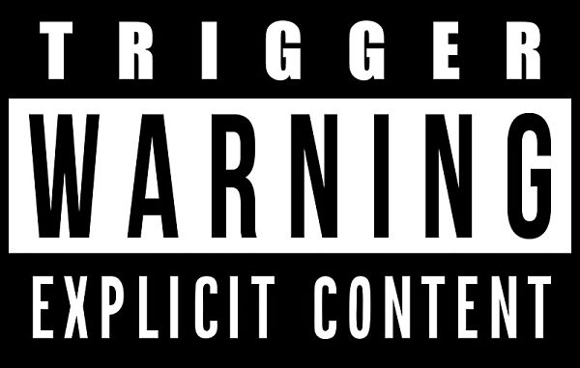
Workplace Conflicts Must Be Resolved
Many workplace events can trigger complaints and conflicts.
  Communication breakdowns, competition over scarce resources, unclear job boundaries, inconsistent policy application, unrealized expectations, and time pressures are workplace events that often lead to irritations, disagreements, and complaints.

Slide 19
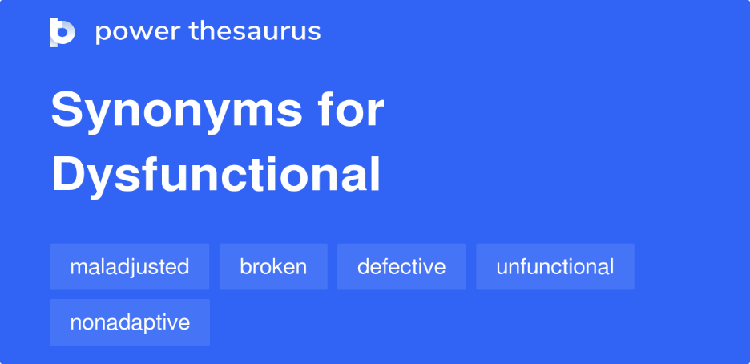
Workplace Conflicts Must Be Resolved
For these and other reasons, many supervisors view workplace conflict as dysfunctional because it distracts and detracts from the completion of objectives.
  However EE conflicts, complaints, and grievances should be viewed as expected parts of workplace relationships.
    It is undesirable for supervisors to confront a constant flood of EE disagreements because this would indicate severe departmental problems.

Slide 20

Workplace Conflicts Must Be Resolved
Supervisors should understand that, as they carry out their managerial responsibilities, it is normal that supervisory perspectives and decisions may conflict with those of EEs or the labor union.
  Further, EEs are human beings who, like anyone else, are not immune to the irritations and frustrations that can lead to conflict.
    Therefore, a supervisor should recognize that handling conflicts and resolving EE complaints and grievances are natural components of departmental relationships and the supervisory position.

Slide 21

Workplace Conflicts Must Be Resolved
Consider dealing with slackers – one of a tremendous variety of sources of conflict – as an example of the necessity of supervisory involvement in conflict prevention.
  Authors assert slacker behavior can be demonstrated in 4 different ways and that supervisors must address these behaviors differently.
    Supervisors should consider the situation and the individuals involved and use strategies that will help all workers achieve common goals, which will build cohesiveness and reduce the potential for conflict.

Slide 22

Workplace Conflicts Must Be Resolved
Types of Slacker Behavior
Sandbaggers
  Look like they are working, but they are simply holding up the appearance of doing so by attending meetings or carrying papers. Supervisors should use reward systems to re-channel their efforts toward desired behaviors.
Parasites
  Align themselves with a group and put less effort than the rest of the members. Upon reporting this type of behavior, workgroup members should be encouraged by the supervisor to set performance goals that increase in magnitude overtime. If the parasites don’t pull their weight, they should be dismissed.
Weasels
  Do the minimum amount of work required to complete a task and manipulate work systems to keep output expectations low. Supervisors can provide incentives for increased outputs to boost these workers’ productivity levels.
Mercenaries
  Often engage in highly structured jobs, waste time with jokes or tardiness and slow down the pace of the whole work process. Supervisors can set up self managed teams and encourage them to compete with each other to achieve specific outcomes, and teams can direct slackers to stay on task.

Slide 23

Workplace Conflicts Must Be Resolved
Remember, passivity, silence or wishful thinking will not cause the conflict to go away.
  There are times when the supervisor must respond to the situation on the spot.

Slide 24
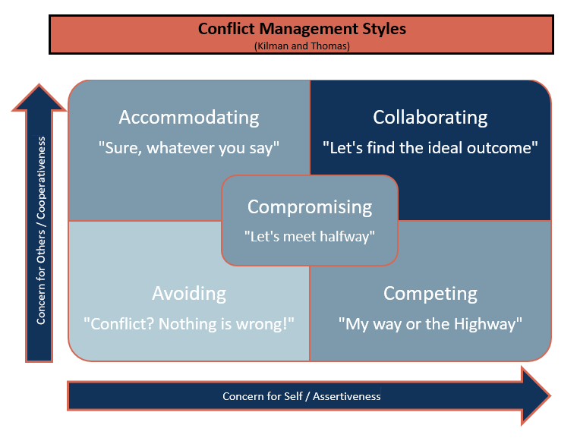
Resolving Conflict Successfully Requires Effective Communication
Although supervisors may approach conflict resolution differently, they should understand the five basic conflict resolution styles:
  Compete-Force-Dominate
    “I Win-You Lose”
  Collaborate-Integrate-Problem Solve
    “I Win-You Win”
  Withdrawal-Avoid
    “Do Nothing-We Lose”
  Accommodate-Oblige
    “You Win-I Lose”
  Compromise
    “Win Some-Lose Some”

Slide 25

Resolving Conflict Successfully Requires Effective Communication
Withdrawal-Avoid
  This approach may be appropriate when the issue is perceived to be minor and the costs of solving problem are greater than the benefits.
    However, a workplace conflict between two EEs must be addressed when noticed by a supervisor. When left alone, conflict tends to fester.

Slide 26

Resolving Conflict Successfully Requires Effective Communication
One needs to assess each situation or potential situation and accept personal responsibility for withdrawing, avoiding, going with the flow, or taking proactive action to deal with the situation (or at least putting a plan in place for dealing with future situations).
  Supervisors must asses each situation and decide whether to address the conflict or avoid it.
    Ask this question: “If I do nothing, what is likely to happen?”
    If avoidance might result in declining performance or create fear, resentment, or dissatisfaction in work group, then you must take action.

Slide 27

Resolving Conflict Successfully Requires Effective Communication
Accommodate-Oblige
  The primary strength of the accommodate-oblige style is that it encourages cooperation. This style is thought of as “You win-I lose.”
    Because no one wants to lose all the time, this style implies the rule of reciprocity, or the reciprocity reflect – that is, you give up something now to eventually get something of value in return.

Slide 28

Resolving Conflict Successfully Requires Effective Communication
Accommodate-Oblige (Cont.)
  Some use this style because it is easy. You do not have to communicate your preferences or provide data to support your “real stance” on a situation.
    Supervisors who rely on this style may be well-liked but not respected.

Slide 29
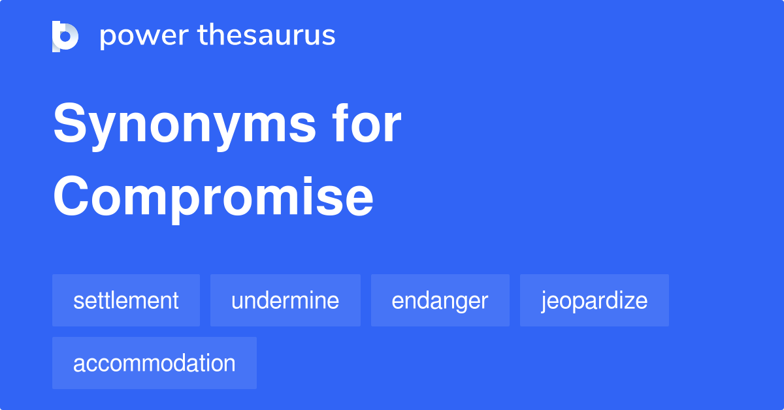
Resolving Conflict Successfully Requires Effective Communication
Compromise
  The compromise style is called “Win Some-Lose Some.”
  What is wrong with splitting the difference? Unfortunately, when one party knows that the other always compromises, that party will bring inflated demands to the bargaining table. As a result, valuable time is wasted trying to identify the real issues.
    There are certain things for which there should be no compromise (Quality-Honesty-Integrity-Fairness).

Slide 30

Resolving Conflict Successfully Requires Effective Communication
Compete-Force-Dominate
  This style is characterized as “I Win-You Lose.”
  The forcing style may foster resentment and cause problems.
    There is nothing wrong with competition as long as it is healthy.

Slide 31

Resolving Conflict Successfully Requires Effective Communication
Collaborate-Integrate-Problem Solve
  This style is characterized as “I Win-You Win.”
  In essence, collaborative problem solving means that you must first seek to determine what the other person really wants and then find a way or show that person how to get the desired result.
    At the same time, you can get what you want.

Slide 32

Resolving Conflict Successfully Requires Effective Communication
Collaborate-Integrate-Problem-Solve (Cont.)
  This style gives the supervisor an opportunity to question the other parties to ascertain their interests and needs.
    Joint problem solving leads all parties to understand the issues and constraints and to consider options.
    Solutions are developed collaboratively, and mutual trust and respect can be primary gains of this style.
      Although this style of conflict resolution is ideally best, it tends to be the most time-consuming. Also, not every issue can be resolved with a “win-win” solution; some resolutions clearly have winners and losers.

Slide 33

Communication in Resolving Conflicts
The most effective communication and problem solving take place when people try to share perspectives.
  When EEs are on the same team and want to do a good job – and when supervisors are clear in their objectives and work to improve human relations – there is a better chance of making organizational climate conducive to the effective resolution of most complaints, grievances, and conflicts that will inevitably occur.
    Remember, EEs need to know where they stand and what is expected.
    A sincere, genuine, compliment from the other party (or boss) may go a long way toward resolving conflict.

Slide 34
Supervisory Tips
Suggestions for Resolving Conflicts
  Take responsibility for resolving the conflict – do not let it escalate.
  Identify the issue(s).
    Explore all sides of the issue(s).
    Become aware of each party’s position, needs, and feelings.
    Ask open-ended questions – probe.
    Use paraphrasing and reflective questioning to ensure understanding.
    Establish ground rules for the meeting management.
  Do not be quick to use your authority or position power.
  Help parties to agree on the issue or problems.
  Ask all parties to commit to working with you to solve the problem.
  Create a climate of open communication so you can help the parties explore “win-win” alternatives.
  Develop fallback alternatives if parties cannot reach consensus.
    If parties cannot agree, use your position power to resolve.
  Follow up to make certain the conflict has been resolved or is minimized.

Slide 35
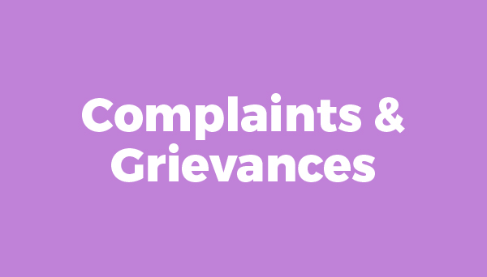
Complaints and Grievances in Supervision
For supervisors at the department level, resolving conflicts involves handling and settling EE complaints and grievances.
  A complaint is a problem or dissatisfaction that EEs can channel upward to management. A complaint can normally be lodged in any work environment, and the term can be used to include legal issues, such as a complaint of racial or sexual discrimination.
    A grievance is defined as a formal complaint involving the interpretation or application of the labor agreement in a unionized setting. This means that it has been presented to a management representative by a steward or some other union official.

Slide 36
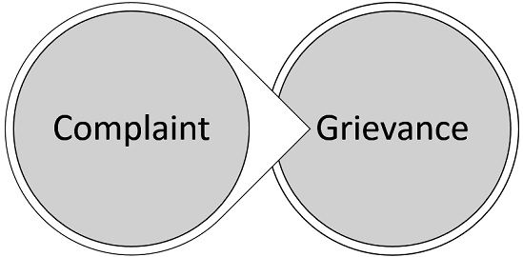
Complaints and Grievances in Supervision
We use the terms complaint and grievance interchangeably.
  Whether EEs are unionized, every supervisor should handle EE complaints and grievances systematically and professionally. Doing so requires skills and efforts that are indicators of a supervisor’s overall managerial capabilities.
    The underlying principles for handling complaints and grievances are basically the same, even though procedures for processing may differ.

Slide 37

Procedures for Resolving Grievances and Complaints
Although the procedures for resolving grievances and complaints are similar, there are some important distinctions supervisors should understand.

Slide 38

Grievance Procedures
Grievances usually result from a misunderstanding, a different interpretation of the labor agreement, or an alleged violation of a provision of the labor agreement.
  Virtually all labor agreements contain a grievance procedure, which is a negotiated series of steps for processing grievances, usually beginning at the departmental level. If a grievance is not settled at the first step, it may be appealed to higher levels of management or to the HR department.
    The last step typically involves having a neutral arbitrator render a final and binding decision in the matter.

Slide 39

Complaint Procedures
Many nonunion organizations have adopted formal problem-solving or complaint procedures to resolve the complaints EEs bring to their supervisors.
  A complaint or “problem-solving procedure,” is a management-designed procedure for handling EE complaints that usually provides for a number of appeal steps before a final decision is reached.
    A complaint procedure is usually explained in an employee handbook or a policies and procedures manual.

Slide 40

Complaint Procedures
Even when no formal system is spelled out, it is understood that EEs have the right to register a complaint with the possibility of appealing to higher-level management.
  A procedure for handling complaints differs from a union grievance procedure in two primary respects.
    First, the EE normally must make the complaint without assistance in presenting or arguing the case. Second, the final decision is usually made by the CEO or the HR director rather than by an outside arbitrator.

Slide 41

Complaint Procedures
The following is an example objective from a typical organization of a problem-solving procedure for complaints.
  Our purpose is to give EEs an effective means of bringing problems to the attention of management and getting those problems solved. A problem may be any condition of employment an EE feels is unjust or inequitable. EEs are encouraged to air any concern about their treatment or conditions of work over which the company might be expected to exercise some control.

Slide 42
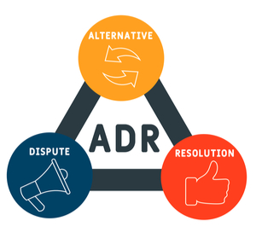
Alternative Dispute Resolution Procedures
In recent years, some companies have offered their EEs assistance in processing complaints by providing a neutral person or a counselor to serve as an intermediary.
  Some companies offer the services of a mediator, usually a 3rd party, who facilitates discussion but has no authority to decide outcomes.
    Numerous companies have adopted “juries” or “panels” of EEs and managers who serve as arbitration boards in the final step of complaint procedures. This approach, often called peer review, can be adapted as an alternative to litigation to resolve various disputes.

Slide 43
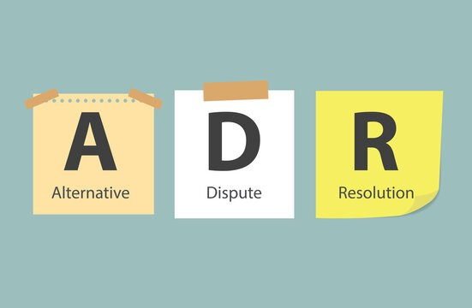
Alternative Dispute Resolution Procedures
Some organizations use outside arbitrators as the final step to resolve complaints.
  When outside arbitrators are used, all parties agree to abide by the arbitrator’s decisions. The arbitrator is a neutral third party, and policies for the arbitrator’s selection, fee, and hearing procedure are specified and agreed on before the case is heard.
    A number of organizations have combined mediation and arbitration, called “med-arb.” Under med-arb procedures, the parties’ first attempt to resolve a dispute is through mediation. If mediation fails to achieve a satisfactory solution, then there is recourse to an outside arbitrator.

Slide 44

Alternative Dispute Resolution Procedures
Collectively, these approaches have been labeled alternative dispute resolution (ADR), which generally means processing and deciding EE complaints internally as an alternative to lawsuits, usually in discharge of employment discrimination cases.
  ADR approaches are becoming more common, driven primarily by the desire of employers to expedite dispute resolution and avoid the high costs of litigation.

Slide 45

Alternative Dispute Resolution Procedures
In a major organizational policy statement, the Society for Human Resource Management(SHRM), a national organization of HR professionals, has strongly endorsed ADR procedures that:
  Provide EEs a process that is accessible, prompt, and impartial, and that results in reduced dispute resolution costs and more timely resolution of complaints as an alternative to costly litigation.
    In the same policy statement, SHRM has recognized that for ADR to be effective, certain standards of fairness and due process must be met.

Slide 46
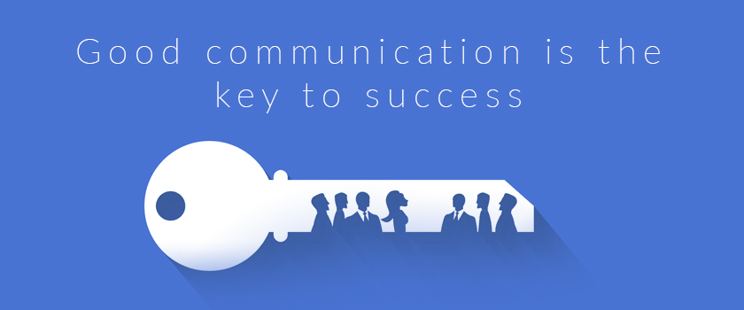
Alternative Dispute Resolution Procedures
A review of management literature, particularly arbitration decisions, indicates that many disputes could be prevented if supervisors practiced good communication skills and displayed genuine concern for EE problems.
  Time and time again, workers complain that they do not know their employers’ expectations, lack the materials to do their jobs, and cannot get timely responses from their supervisors.

Slide 47

Alternative Dispute Resolution Procedures
In summary, if ADR is to succeed, companies must train supervisors to respond positively to EE requests, concerns, and complaints, and to address conflict and resolve complaints to ensure that fairness prevails.

Slide 48
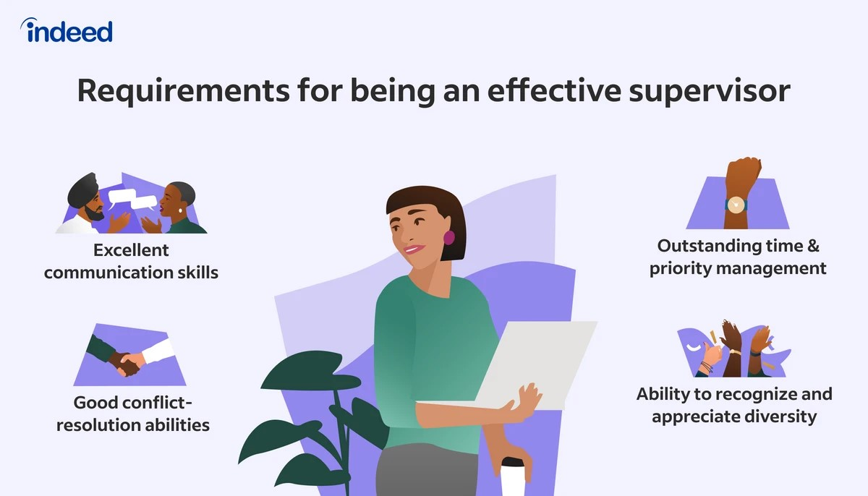
The Supervisor and the Significant First Step in Resolving Complaints
The supervisor’s role in handling EE complaints and grievances is often the most crucial part of the outcome.
  Supervisors also become involved in ADR procedures and in the resolution of other types of conflict at the departmental level.

Slide 49

The Supervisor and the Significant First Step in Resolving Complaints
As the first step in a unionized firm, the steward usually will present a grievance to the supervisor, and the aggrieved EE or EEs may be present.
  The supervisor should listen to these parties very carefully.
    There should be frank and open communication among the parties.

Slide 50

The Supervisor and the Significant First Step in Resolving Complaints
It is unusual for an aggrieved EE to present a grievance to a supervisor in the absence of the steward.
  However, if this should happen, it is appropriate for the supervisor to listen to the EE’s problem and to determine whether the problem involves a steward or the union. Under no circumstances should a supervisor give the impression they are trying to undermine the union, the steward’s authority, or the relationship with the EE.
    When the labor agreement or union interests are involved, the supervisor should notify the steward concerning the EE’s presentation of problem.

Slide 51

The Supervisor and the Significant First Step in Resolving Complaints
When a grievance is not settled at the first step and when the steward believes the grievance is justified, the grievance proceeds to the next step.
  The steward is usually an elected representative, is familiar with the labor agreement, and is knowledgeable in submitting grievances.
    The steward may carry a grievance further with another objective in mind.
    The steward may be eager to receive credit for filing a grievance. By making a good showing or by winning as much as possible for the EEs, stewards enhance their chances of reelection.

Slide 52

The Supervisor and the Significant First Step in Resolving Complaints
When a firm is not unionized, EEs may be afraid to bring their complaints to supervisors, even when complaints are legitimate.
  They may fear that complaining may be held against them and that there may be retaliation if they challenge a supervisor’s decision.

Slide 53
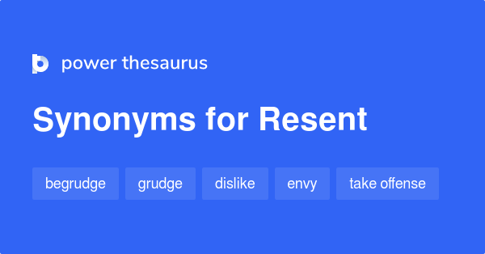
The Supervisor and the Significant First Step in Resolving Complaints
At the other extreme are EEs who resent supervisory authority and take opportunities to complain about departmental matters.
  They relish making supervisor uncomfortable by lodging complaints.
    Because they lack union representation, EEs may approach the supervisor as a group, believing that in doing so gives them strength and protection.

Slide 54

The Supervisor and the Significant First Step in Resolving Complaints
The importance of the supervisor’s handling of EE complaints at the first step cannot be overemphasized.
  Open and frank communication between all parties is usually the key element in amicable resolution of a problem.
    When such communication does not occur, disagreement, resentment, and possibly an appeal to higher levels of management are likely.

Slide 55

Supervisory Guidelines for Resolving Complaints and Grievances
For the most part, the supervisor should handle grievances and complaints with the same general considerations and skills.
  Regardless of the nature of an EE complaint or grievance, a supervisor should fully investigate the problem and determine whether the problem can be solved quickly.
    It is always better to settle minor issues before they grow into major ones.

Slide 56

Supervisory Guidelines for Resolving Complaints and Grievances
The supervisor should endeavor to settle or resolve the issues at the first step.
  When many complaints go beyond the first step, supervisors probably are failing to carry out their duties appropriately.
    Unless circumstances are beyond the supervisor’s control, complaints and grievances should be handled within reasonable time limits and brought to fair conclusions within the pattern of supervisory guidelines.

Slide 57
Supervisory Tips
Guidelines for Resolving Complaints and Grievances
  Do it as soon as possible; make time available.
  Do it privately, not publicly.
  Listen patiently and with an open mind.
  Distinguish facts from opinions.
  Determine the real issue(s).
  Focus on one issue at a time.
  Deal with the behaviors the person can change.
  Check and consult.
  Avoid setting precedents.
  Exercise self-control.
  Minimize delays in reaching a decision.
  Explain decisions clearly and sensitively.
  Keep records and documents.
  Do not fear a challenge.
  Don’t forget the compliments. End on a positive note.
  And remember: When it is over, it is over.

Slide 58

Make Time Available
The supervisor should find time to hear a complaint or grievance as soon as possible.
  This does not mean the supervisor must drop everything to meet with the EE or steward immediately. Rather, it means making every effort to set a time for an initial hearing.
    A long delay could be interpreted to mean that the supervisor does not consider the problem important. It could even be interpreted as stalling and indifference. Therefore, the EE may become frustrated and resentful.

Slide 59

Listen Patiently and with an Open Mind
Often, supervisors become preoccupied with defending themselves and trying to justify their positions.
  They fail to give stewards or EEs ample time to present their cases.

Slide 60

Listen Patiently and with an Open Mind
    All people involved should be encouraged to say whatever is on their mind.
  When EEs believe a supervisor is willing to listen and wants to provide fair treatment, problems may seem less serious. Also, the more a person talks, the more likely that person is to make contradictory remarks that weaken the argument. EEs may even uncover solutions as they talk out problems.
  Sometimes, EEs simply want to vent frustrations. After allowing them to do so, attention can then be focused on the real problem.
    Therefore, by listening empathetically, the supervisor can minimize tensions and even solve some problems

Slide 61

Distinguish Facts from Opinions
Distinguishing facts from opinions means weighing hearsay and opinions cautiously.
  The supervisor should avoid confusing the EE or steward.
    The supervisor should ask factual, pointed questions regarding who or what is involved; when, where, and why the alleged problem took place; and whether there is any connection between this situation and some other problem.

Slide 62

Distinguish Facts from Opinions
It is impossible to gather all relevant information at once, which makes it difficult to settle a complaint or grievance immediately.
  Under such conditions, supervisors should tell the EEs or stewards that they will gather the necessary information within a reasonable time and by a definite date.
    The supervisor should not postpone a decision with the excuse of needing more facts when the relevant information can be obtained without delay.

Slide 63
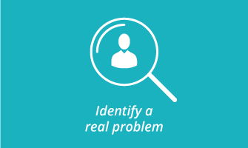
Determine the Real Issue
EE complaints are sometimes symptoms of deeper problems.
  For example, a complaint of unfair work assignments may really reflect personality clashes among several EEs. A complaint that newly installed machinery prevents EEs from maintaining incentive rates may indicate EEs are actually having a difficult time adjusting to the operation of new equipment.
    Unless the real issue is clearly defined and settled, complaints of a similar nature are likely to be raised again.

Slide 64

Check And Consult
Checking and consulting are among the most important aspects of a supervisor’s role in handling EE complaints and grievances.
  We cannot emphasize enough that the labor agreement, as well as company policies and procedures, must be administered fairly and uniformly.
    The supervisor should make decisions only after carefully reviewing the company’s policies and procedures and the labor agreement, if applicable.

Slide 65
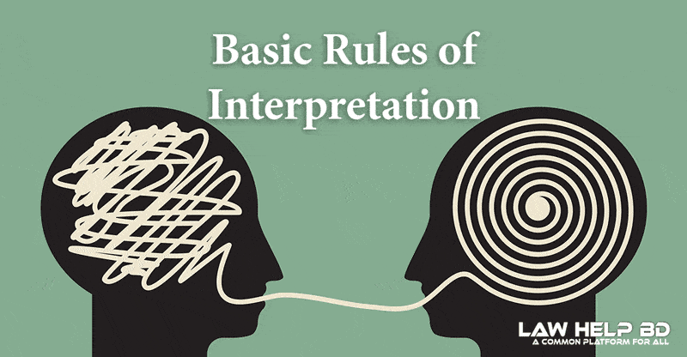
Check And Consult
Grievances revolve around the interpretation of company policies and procedures and applicable labor agreements.
  Complaints that involve allegations of discrimination and other aspects of equal employment opportunity have legal implications.
    Whenever a grievance or complaint requires contractual, policy, or legal interpretation, the supervisor should tell the complaining individual(s) that it will be necessary to look into the matter and that an answer will be given by a definite date.

Slide 66

Check And Consult
Subsequently, the supervisor should consult with the HR staff and higher-level managers for advice and guidance.
  Seeking assistance is not passing the buck or revealing ignorance, nor should it be considered showing weakness.
    The supervisor is usually not authorized or qualified to make the policy or legal interpretations necessary to respond to complaints and grievances.

Slide 67

Avoid Setting Precedents
The supervisor should consult settlement records and ensure that any decision is consistent with established practices.
  If an issue has not been encountered before, the supervisor should seek guidance from others who may have experienced similar, though not necessarily identical, problems.
    When circumstances require a departure from previous decisions, the supervisor should explain why, as well as, whether any exception will create a new precedent.

Slide 68

Avoid Setting Precedents
Unless there is a valid reason, or unless there has been prior approval from higher-level management or the HR department, the supervisor should avoid making exceptions to policies.
  Exceptions set precedents, and precedents often haunt supervisors and the organization.

Slide 69
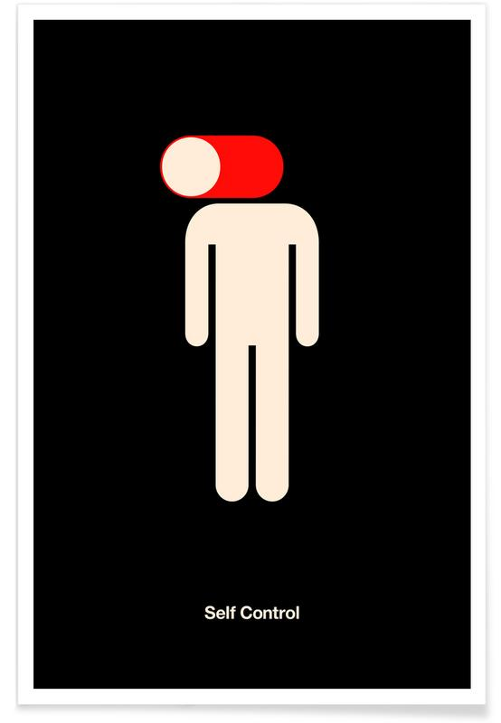
Exercise Self-Control
Emotions, arguments, and personality clashes sometimes distort communication between the supervisor and complaining EEs.
  The worst thing the supervisor can do in these situations is to engage in a shouting match or to “talk down” to the EEs.

Slide 70

Exercise Self-Control
Emotional outbursts usually impede constructive thinking.
  Arguing and shouting may escalate a problem to far more serious proportions. Of course, a supervisor’s patience is limited.
    When an EE or a steward persists in loud arguments, profanity or the like, the supervisor should terminate the meeting and schedule another, so the problem can be discussed later in a calm and less emotional manner.

Slide 71

Exercise Self-Control
When a complaint for grievance is trivial or invalid, the supervisor must be careful to show no animosity toward the steward or the complaining EE.
  Instead, the supervisor should explain why a grievance has no merit.

Slide 72
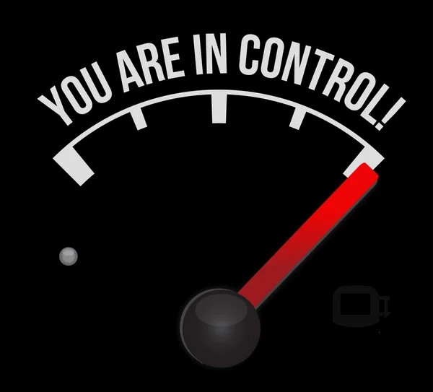
Exercise Self-Control
Sometimes, an EE or a steward may deliberately provoke an argument to put the supervisor on the defensive.
  Even this tactic should arouse no hostility on the supervisor’s part.
    When supervisors do not know how to handle these types of situations, they should consult higher-level managers or HR staff for assistance.

Slide 73

Minimize Delays in Reaching a Decision
When an EE raises a complaint, that EE should be entitled to know, within a reasonable time, exactly when management will make a decision concerning that complaint.
  When the complaint can be handled immediately, and when the supervisor is authorized to do so, this should be done immediately.
    When, however, the complaint requires consultation with higher-level managers or HR staff, the supervisor should close the hearing with a definite commitment as to when an answer or a decision will be given.

Slide 74

Minimize Delays in Reaching a Decision
When delay is necessary, the supervisor should tell parties the reason for the delay and not leave them thinking that they are being ignored.
  Because delayed decisions can frustrate all parties, prompt handling is crucial.

Slide 75
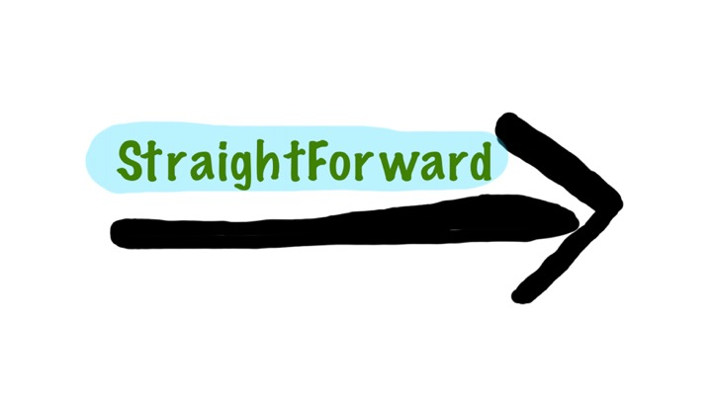
Explain Decisions Clearly and Sensitively
The supervisor should make every effort to give straightforward, clear answers to a complaint or grievance.
  The supervisor should also communicate, as specifically as possible, the reasons for the decision, especially when not in the EE’s favor.
    It is frustrating for an EE to get just a “no” with no explanation other than that management feels it does not have to comply with the EE’s request.

Slide 76
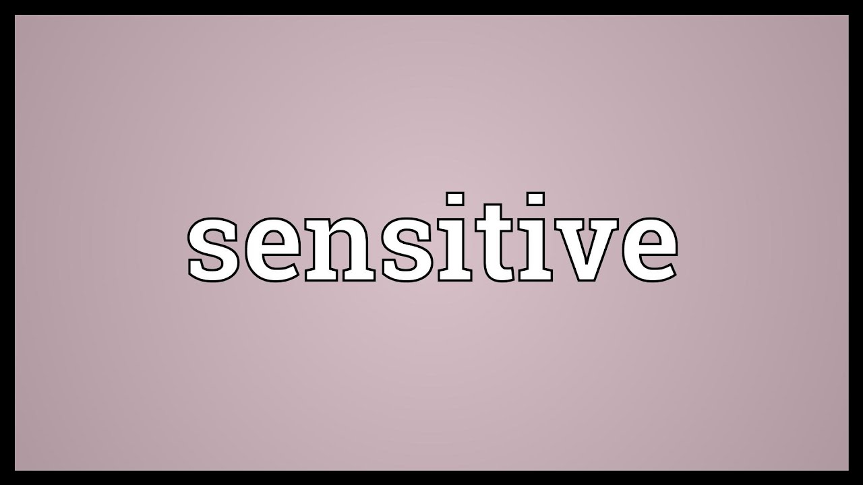
Explain Decisions Clearly and Sensitively
Even when a complaint is not justified, the supervisor should in no way convey that the problem is trivial or unnecessary.
  The EE likely has good reasons for raising the complaint.
    Therefore, the supervisor should be sensitive to the EE’s perspective.

Slide 77

Explain Decisions Clearly and Sensitively
When a labor agreement requires a written reply to a grievance, the supervisor should restrict the reply to the grievance and ensure that the response relates to the case.
  References to labor-agreement provisions or plant rules should be confined to those in question.
    The supervisor should discuss a written reply with higher-level managers or HR staff to ensure it is written properly.

Slide 78

Keep Records and Documents
Despite the good-faith efforts to settle complaints or grievances, an EE may choose to appeal a decision.
  When a complaint involves discrimination, the EE may file a formal complaint with a government agency. When there is a union grievance, it may go all the way to arbitration. In a nonunionized firm, the complaint procedures may provide several steps for appeal, which is why it is important for a supervisor to document all evidence, discussions, and meetings.
    Written evidence is superior to oral testimony and hearsay.

Slide 79

Keep Records and Documents
Many firms have policies for the confidential handling of certain EE records and documents.
  Supervisors must be careful to adhere to any such policies, especially when documents involve issues of EE performance and company disciplinary actions.

Slide 80

Keep Records and Documents
Keeping good records is especially important when a complaint or a grievance is not settled at the supervisory level.
  The burden of proof is usually on management. Therefore, a supervisor should be ready to explain actions without having to depend solely on memory.
    Documentation can be very supportive in this regard.

Slide 81

Do Not Fear a Challenge
A supervisor should make every effort to resolve a complaint or grievance at the first step without sacrificing a fair decision.
  Supervisors are at times tempted to grant questionable complaints or grievances because they fear challenges or want to avoid hassles.
  By giving in to an EE or the union just to avoid an argument, the supervisor may invite others to adopt the “squeaky-wheel-gets-the-grease” theory.
    That is, other EEs or stewards will be encouraged to submit complaints because they feel that by complaining often and loudly they have a better chance of gaining concessions. In this way, a supervisor may establish a perception that can lead to even greater problems.

Slide 82

Do Not Fear a Challenge
In efforts to settle a complaint or grievance, there will always be gray areas in which a supervisor must use judgment.
  The supervisor should be willing to admit and rectify mistakes. However, when supervisors believe decisions are fair and objective, they should have the courage to hold firm, even when EEs threaten to appeal.
    If an EE appeals a decision it does not mean that the supervisor is wrong.
    Even if higher-level managers or arbitrators reverse supervisor’s decision, poor handling on the supervisor’s part is not implied. Some decisions will be modified or reversed during appeal for reasons that may go beyond the supervisor’s responsibility.

Slide 83

Do Not Fear a Challenge
Management may decide to settle a case on terms that are more favorable to an EE than what the supervisor may believe is appropriate.
  This occurs because management is concerned about losing the case in arbitration or litigation and incurring excessive extra costs.
    Reversal of a supervisor’s decision is usually not desirable because doing so can weaken a supervisor’s position with EEs and cause resentment. It may happen, though, and a supervisor should avoid frustration.

Slide 84

Do Not Fear a Challenge
Supervisors who generally follow the guidelines and who do their best to reach equitable solutions will enjoy the support of higher-level management in most cases.
  A supervisor should be able to handle a complaint or grievance professionally and prevent minor issues from escalating.

Slide 85
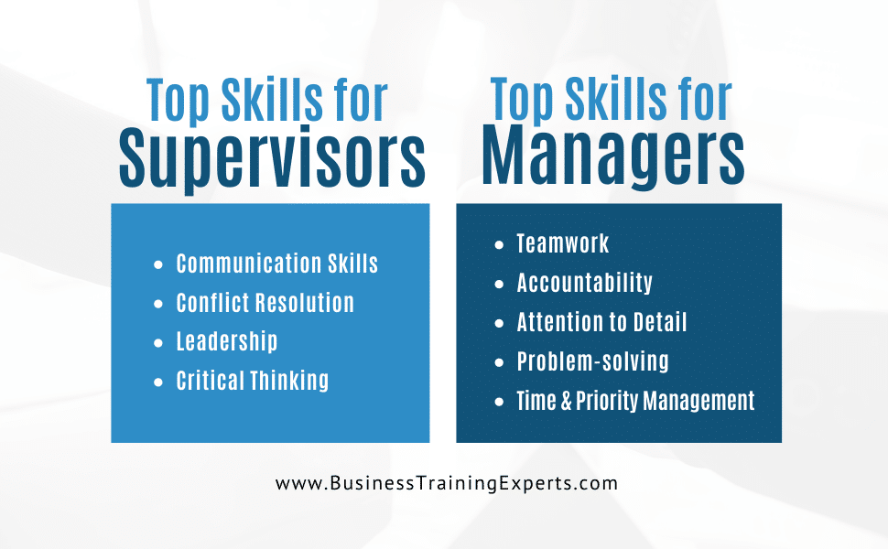
Do Not Fear a Challenge
In summary, handling EE complaints and grievances is another of the many skills of effective supervision.
  It requires sensitivity, objectivity, and sound analytical judgment, the same qualities required other areas of supervisory management.

Slide 86


