Slide 1
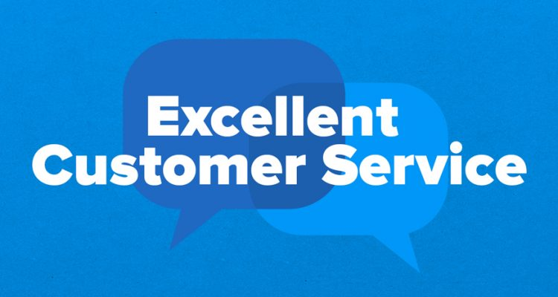
Customer Service Management
Session Seven Class Presentation
Customer Service
  Skills for Success – 7th Edition
    Robert W. Lucas; McGraw-Hill Education; New York, NY 2019
      ISBN: 978-1-259-95407-8

Slide 2
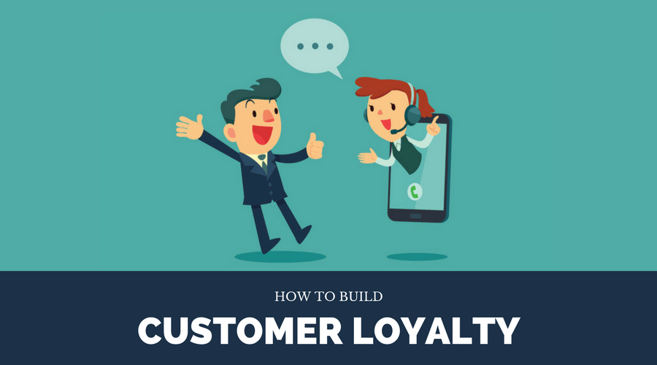
Part Four: Retaining Customers
Chapter Ten: Encouraging Customer Loyalty
  “You don’t earn loyalty in a day. You earn loyalty day-by-day.” - Jeffrey Gitomer

Slide 3
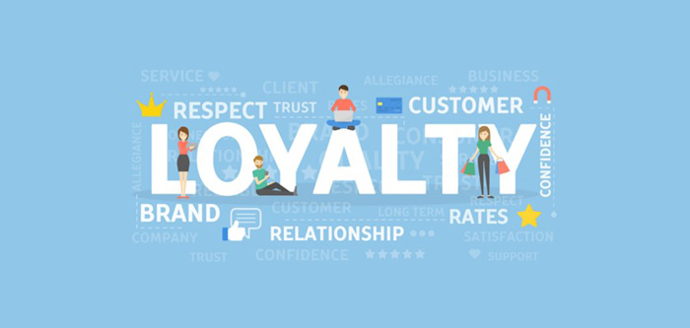
Customer Loyalty
Customer and brand loyalty are a crucial element of any organization’s success.
  Customer loyalty is an emotional rather than a rational thing.

Slide 4
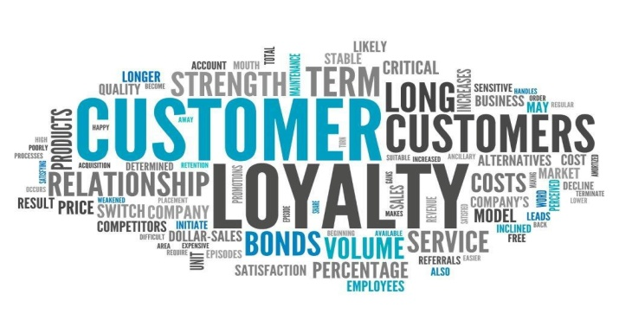
Customer Loyalty
Each time there is contact at a touch point where the customer and provider come together, there is opportunity for strengthening the customer relationship and loyalty or driving a wedge between the customer and organization, due to failure to meet expectations or needs.
  With every contact, service providers should strive to demonstrate commitment to exceed customer expectations and provide an experience beyond anything they might have hoped.

Slide 5
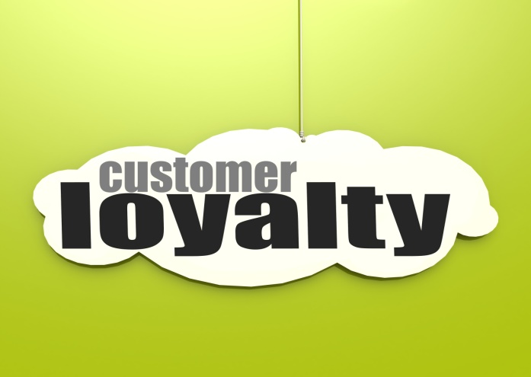
Customer Loyalty
    Loyalty is typically based on customer interest in maintaining a relationship with your organization.
      Customer interest is created and maintained through one or more positive experiences that lead to a relationship.
    True customer loyalty stems from an organization’s concerted, ongoing efforts that are part of its strategic goals to meet and exceed the expectations and needs of its customers.

Slide 6
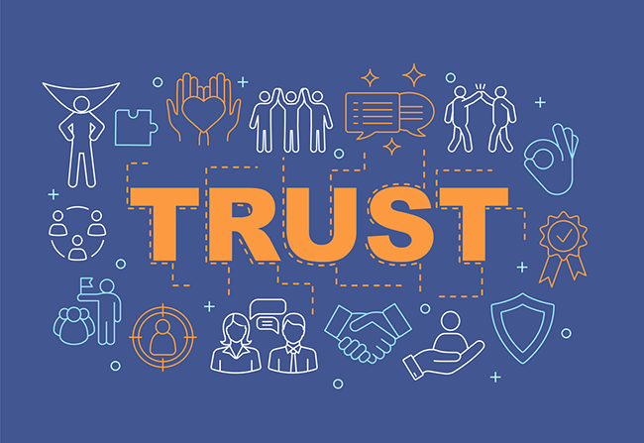
Customer Loyalty
Trust builds lasting customer relationships and loyalty.
  The most important thing to remember about trust is that, without it, you have no relationship. This applies to all human situations, not just the customer service environment.
    In the business world, trust typically results in positive word-of-mouth advertising. This mode of endorsement can be powerful and contribute to organization and product success.

Slide 7
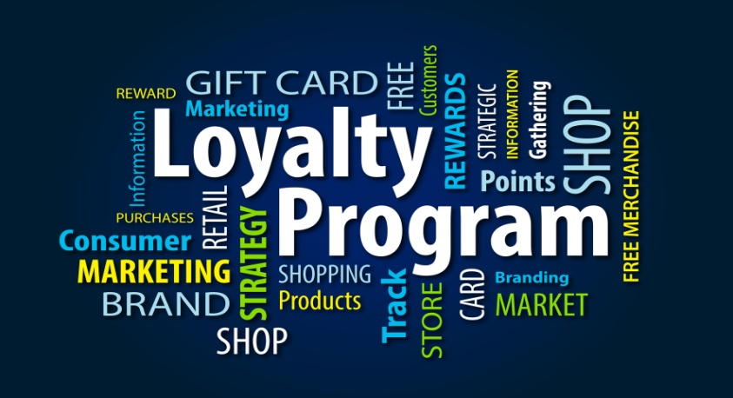
Customer Loyalty
The key to establishing and maintaining customer loyalty is to put forth an honest and ongoing series of initiatives and efforts that demonstrate to customers that they are important to the organization.
  Through words and actions, service providers can show they are truly there to help customers meet their needs, wants, and expectations.
    One way that organizations try to cement relationships and encourage customer loyalty and retention is through loyalty or rewards programs.

Slide 8

The Role of Trust
Trust is the most important criterion for a relationship.
  Trust depends on many factors. Communicating effectively, keeping your word, caring for, and trusting your customers, etc.
    Trust is at the heart of any relationship, especially when there is an exchange of money for products or services.

Slide 9
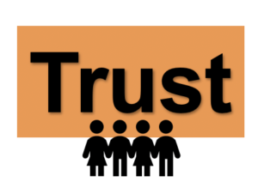
The Role of Trust
For trust to start and grow, your customers must believe several things about you and your organization.
  You and the organization have the customer’s best interests in mind before, during, and after the transaction.
  You and the organization are honest and forthcoming with customers and your goal is to deliver the best products and services possible in a timely manner and at a fair price.
  You have quality products and services that are backed by a guarantee that should something go wrong, it will quickly and earnestly be taken care of.

Slide 10

The Role of Trust
For customers to continue doing business with you, they must trust you and your organization.
  You must earn your customers’ trust. It is not gained overnight.
  Through continued positive efforts on the part of everyone in your organization you can demonstrate to customers that you are worthy of their trust and thereby positively affect customer retention.
    Through actions and deeds, you must deliver quality products and services that are competitively priced and information that satisfies the needs of your customers. Every touch point with your customer is an opportunity for you and your organization to influence customer loyalty.

Slide 11

The Role of Trust
Even when you win trust and achieve customer satisfaction, the customer relationship is very fragile.
  It is easy to destroy trust quickly; an inappropriate tone, a missed appointment, failure to follow through on a promise, a lie, and a misleading statement or information to a customer are just some of the ways you can sabotage this relationship.

Slide 12

The Role of Trust
To gain and maintain trust, you and the organization must actively work toward incorporating the values and beliefs into daily actions. Failure to do so can send a message that you are not trustworthy or that you act according to a double standard of saying one thing but doing another.
  You must exhibit trustworthiness in words and actions, for although it takes a long time to gain trust, it can be lost in seconds.
    Once trust is gone, if you do not act quickly to correct the situation through a sound service recovery initiative, you may never regain total customer confidence.

Slide 13

The Role of Trust
One way that consumers are turned off from a trust standpoint is through a loss of confidence that follows a breakdown in an organization’s manufacturing and distribution processes.
  Often glitches occur that result in recalls of products, which can immediately take away most or all of the consumer confidence in the safety and/or reliability of products they used regularly for years.
    The manner in which a company handles such situations has a potentially lasting positive or negative impact on consumer confidence and trust in the future.

Slide 14
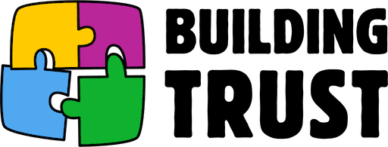
The Role of Trust
There are numerous things that you can do to personally help build trust with your customers in recall situations and when minor service breakdowns occur.
  Some potential trust-building success strategies include:
    Communicate Effectively and Convincingly
    Display Caring and Concern
    Be Fair
    Admit Errors or Lack of Knowledge
    Trust Your Customers
    Keep Your Word
    Provide Peace of Mind
    Be Responsible for Customer Relationships
    Personalize Your Approach
    Keep an Open Mind
    Individualize Service
    Show Respect
    Elicit Customer Input

Slide 15
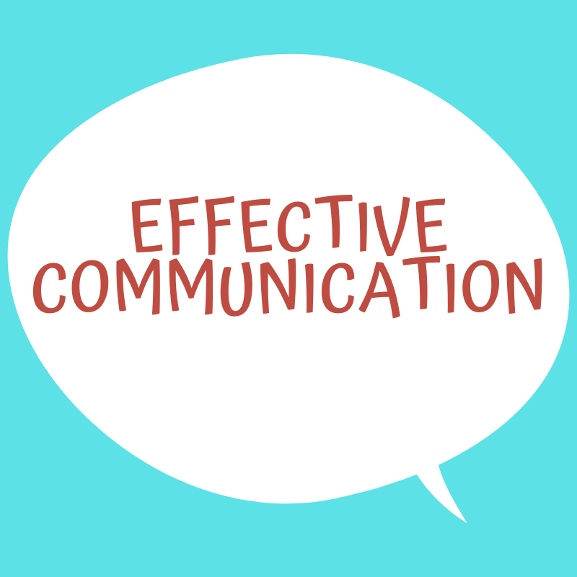
1. Communicate Effectively and Convincingly
If you can’t articulate or clearly explain (verbally and in writing) information in a manner that customers can comprehend and act upon, they will not believe in you.
  You must provide more than facts and figures; you must send a message of sincerity, knowledge, and honesty.
    Never forget that customer-provider relationships are based on personal interactions, not on policy and procedures.

Slide 16
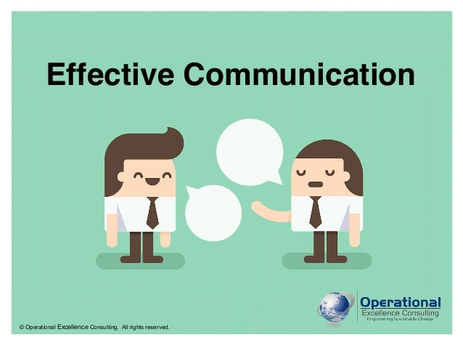
Communicate Effectively and Convincingly
As you communicate, project your feelings and emotions by being positive and enthusiastic. Let customers know that you are human and approachable.
  Also, communicate frequently and keep customers informed, particularly if there is a service breakdown.

Slide 17

2. Display Caring and Concern
Emphasize to your customers that you have their best interests at heart. Work to demonstrate that you are willing to assist in satisfying their needs.
  Asking questions that uncover their needs and then taking positive action to satisfy them can do this.
    It can also be accomplished through passionate efforts to solve problems. Remember that their problem is your problem.

Slide 18

3. Be Fair
Make sure that you treat all customers (internal-external) with respect and consistency.
  If your organization offers special initiatives to attract new customers that are not offered to current customers, the latter may resent this practice and feel that even though they demonstrated brand loyalty, they are not valued. As a result, they may search out competitors who provide them incentives to come aboard as a customer.
    People like to feel that they are special. If a customer believes another customer is getting something that they are not, you could have problems.

Slide 19
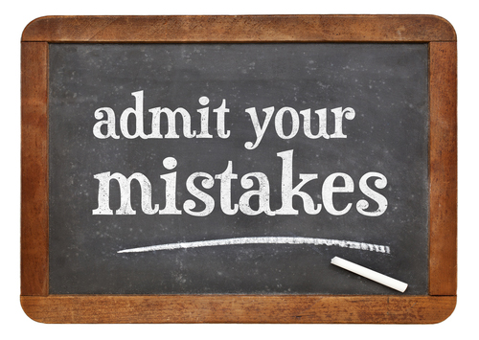
4. Admit Errors or Lack of Knowledge
You are human and are expected to make mistakes.
The key is to recover from errors by apologizing, accepting responsibility, and then quickly and appropriately solving the problem or getting the necessary information.
  One of the biggest mistakes any service provider can make is to deny accountability in dealing with a customer.
    When you or your organization, or the products or services it sells, cause customer inconvenience, loss, or dissatisfaction, take responsibility immediately, apologize, and work toward an acceptable resolution with the customer.

Slide 20
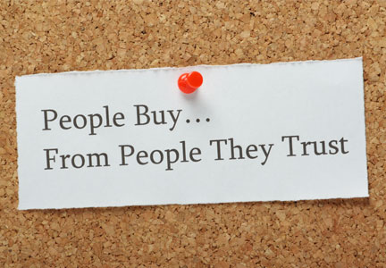
5. Trust Your Customers
Most customers are not out to cheat or “rip off” you or your organization. However, they do want the best value and service for their money and expect you to provide it.
  Make a good-faith effort to accomplish this and deal effectively with customers by communicating openly, listening objectively to their questions and concerns, providing service to the best of your ability, showing compassion for their needs, and demonstrating that you are their advocate when things go wrong (if appropriate).

Slide 21
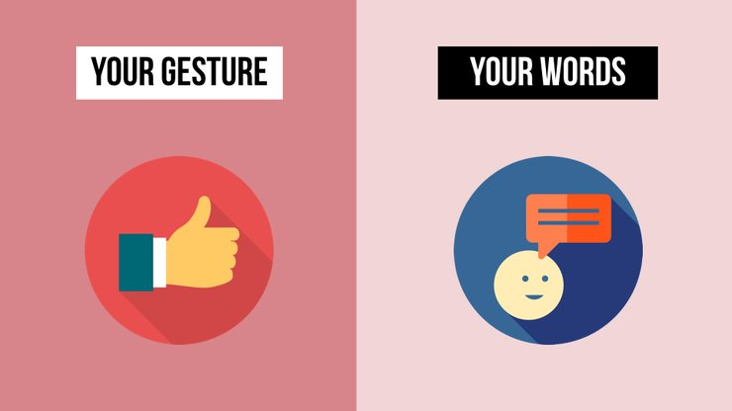
Trust Your Customers
One of the most common mistakes service providers make in dealing with customers who have a complaint or problem is to verbally acknowledge and agree, but nonverbally send a message of skepticism.
  To protect customer relationships ensure your nonverbal cues are congruent with your verbal message.

Slide 22
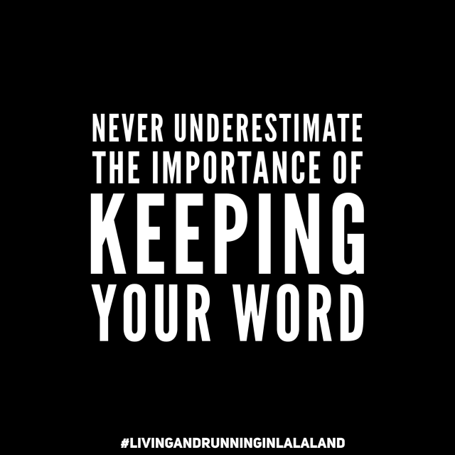
6. Keep Your Word
Customers have many choices in selecting a service or a product provider. If they feel you cannot be depended upon to take action, they simply leave, often without complaint or comment.
  When you tell customers you will do something, do it.
    Do not promise what you cannot deliver; many people take your word as your bond. Break the bond and you risk destroying the relationship.

Slide 23

7. Provide Peace of Mind
Be positive and assertive. Assure customers through your words and actions that you are confident, have their best interests at heart, and are in control of the situation.
  Let them know that their calls or messages, questions, and needs will be addressed professionally and in a timely manner. Reassure them that what they purchase is the best quality, has solid warranty, will be backed by the organization, and will address their needs while providing many benefits. Also, assure them that their requests and information will be processed rapidly and promises will be met.
    All of these things can lead them to believe they made the right decision in selecting you and your organization and that you will take care of needs.

Slide 24
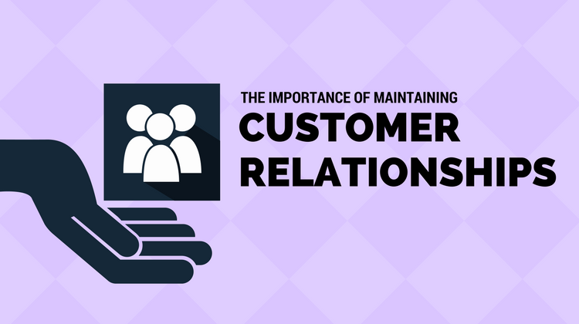
8. Be Responsible for Your Customer Relationships
Taking a concerned, one-on-one approach to working with customers helps satisfy immediate needs while building a basis for long-lasting relationships.
  Customers tend to enjoy dealing more with people whom they believe are caring and have their best interest at heart.
    Interacting with someone they like is a pleasant experience and is likely to encourage trust and an enhanced relationship.

Slide 25

9. Personalize Your Approach
Mostly, people are a social species and need to be around others to grow and flourish. Helping your customers feel accepted can create a bond that will keep them coming back.
  To create a social bond with customers, you will need to take time to get to know your regular customers and serve them individually. Recognizing them and using their names while interacting goes a long way toward creating that bond.
    Treating customers as individuals and not as a number or one in a series is a very important step in building rapport and loyalty.

Slide 26
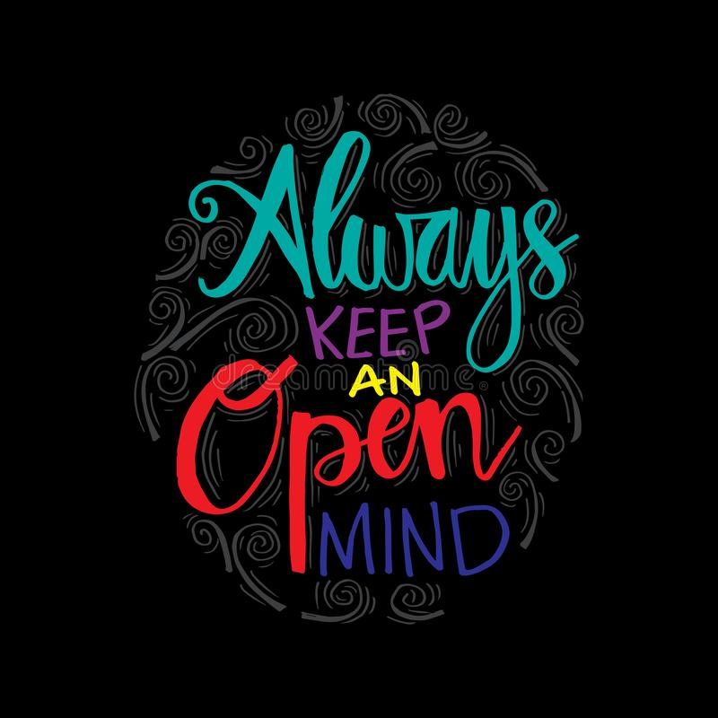
10. Keep an Open Mind
To develop and maintain an open mind, make it a habit to assess your attitude about your job, customers, products, and services before making contact with your customers.
  Make sure that you are positive, objective, prepared, and focused. Do not let negative attitudes block good service.
    Most all service providers go through slumps during which they feel down about themselves, their jobs, supervisors, organizations, customers, etc. This is normal. Customer service is a stressful job, and both internal and external factors influence one’s perception of people and world in general; however, guard against pessimism.

Slide 27
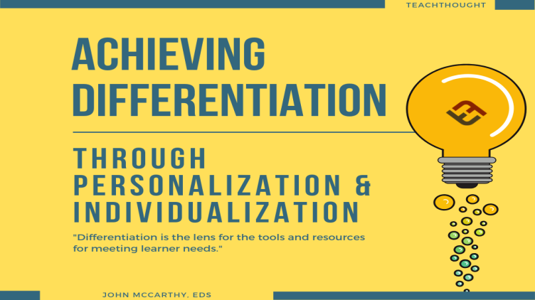
11. Individualize Service
Each customer is unique and has their own desires and needs. For that reason, every situation you handle will be slightly different. You should view each person as an individual and not deal with customers on the basis of preconceived ideas or the demographic group of which they are part.
  By addressing a customer as an individual, listening so that you can discover their personal needs and problems, and working to satisfy their needs or solve problems, you potentially create loyal customers.

Slide 28

12. Show Respect
Even if you do not agree with a customer, respect their point of view and provide the best possible service. In return, the customer will respect and appreciate your efforts.
  If you lose sight of the fact that it is the customer who supports the organization, pays your salary, provides for your benefits, and gives you a job, you may want to examine why you are working there.
    By acknowledging the value of your customers and affording them the respect and service they deserve, you can greatly improve your chances of having a satisfied customer.

Slide 29

Show Respect
Show respect to your customers by doing the following:
  When addressing the customer, use their last name and title.
  Stop talking when the customer begins to speak.
  Take time to address the customer’s questions or concerns.
  Do not get into arguments with customers.
  Return calls or e-mail messages within reasonable time.
  Show up on time for scheduled meetings.
  Do what you promised to do, do it right, and complete it on time.
  Tell customers that you value them and appreciate their business.

Slide 30

13. Elicit Customer Input
Some organizations reward customers who complain.
Complaints provide feedback that enable service providers and organizations to rapidly shift resources to fix things that are not working well in order to satisfy the customer.
  By taking the time to ask for customer input and actually listening to what they have to say, and then acting appropriately upon those comments, you can solidify a bond and further enhance the customer’s level of trust in you.
    You cannot fix what you do not know is broken.

Slide 31
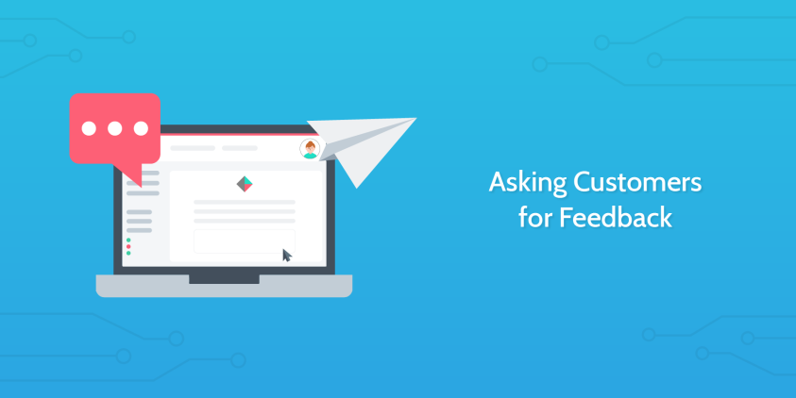
Elicit Customer Input
Many times, service providers do not take the time to ask for feedback because they are afraid that it may not be good. In other instances, they simply do not think of asking for customer input or care to do so.
  To increase your own effectiveness and that of your organization, actively and regularly seek input from your customers.
  No one knows better than the customer what they like or need.
    By asking customers questions, you give them an opportunity to express interests, concerns, emotion, and even complaints.

Slide 32
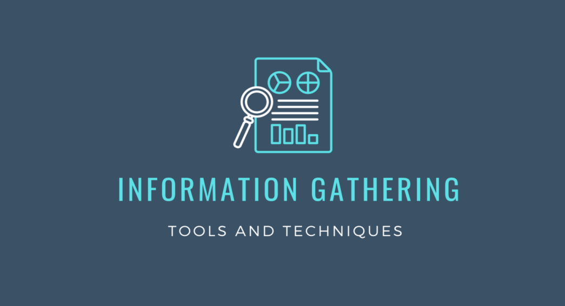
Customer Information-Gathering Techniques
There are many ways to gather information about customer satisfaction levels. Some of the more common include:
  Customer Comment Cards
  Toll-Free Numbers
  Verbal Comments
  Follow-Up Telephone Surveys
  Service Contact Surveys
  Automated Surveys
  Exit Interviews
  Shopper/Customer Surveys
  Focus Groups
  Sales and Service Records

Slide 33
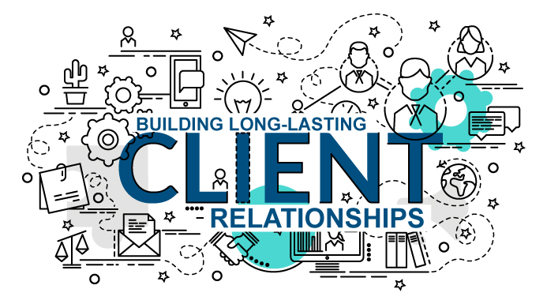
The Importance of Customer Relationship Management
Long-term relationships sustain organizations.

Slide 34
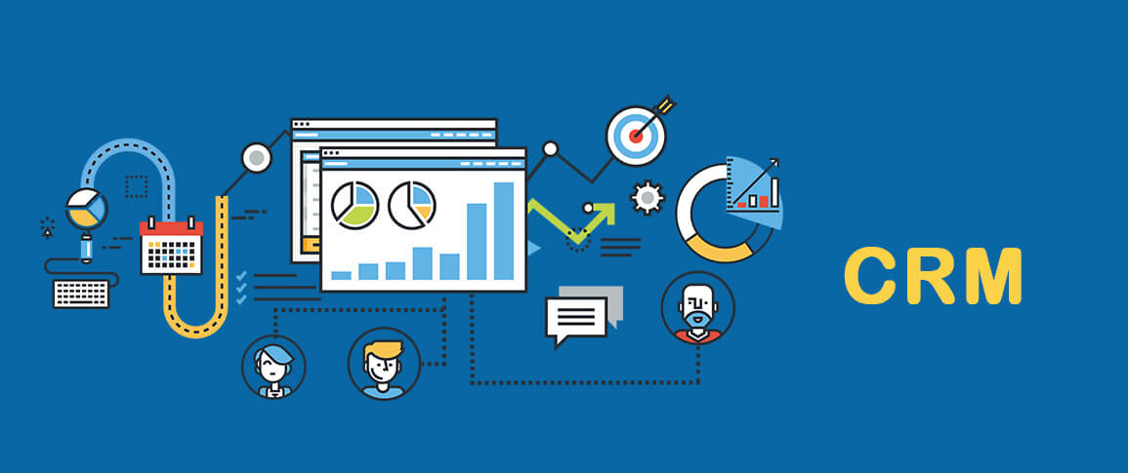
The Importance of Customer Relationship Management
Customer Relationship Management (CRM) refers to the concept of identifying customer needs; understanding and influencing customer behavior through ongoing communication strategies in an effort to acquire, retain, and satisfy the customer.
  There are a number of components in the CRM process:
    Operational – involving sales and service representatives
    Relational and Collaborative – involving interactions with customers
    Technological – web pages and automated voice response systems
    Analytical – analyzing customer data for marketing and forecasting

Slide 35
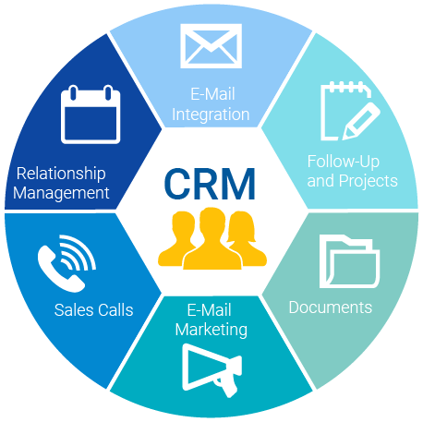
The Importance of Customer Relationship Management
Through CRM, organizations and employees get to better know their customers and project needs that can be satisfied through appropriate products and services.
  Numerous service organizations use CRM software to better keep track of customer needs, access multiple sources of customer information, and record service provided.
    CRM is a crucial element of customer loyalty.

Slide 36
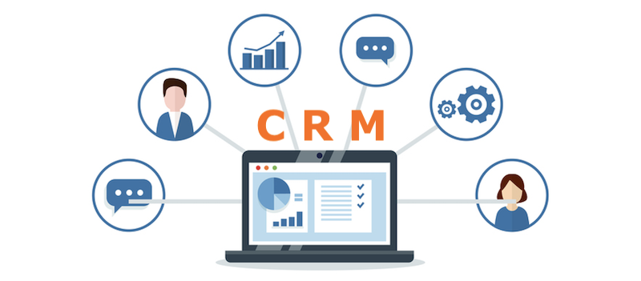
The Importance of Customer Relationship Management
Many service providers look at customer interactions from a short-term perspective. They figure that a customer calls or comes in, they provide service, and then the customer leaves.
  A more customer-focused approach is to view customers from a relationship standpoint.
    By treating both internal and external customers in a manner that leads them to believe that you care for them and have their best interests at heart, you can start to generate reciprocal feelings.
    People gravitate toward organizations and people with whom they have developed rapport, respect, and trust, and who treat them as if they are valued as a person.

Slide 37
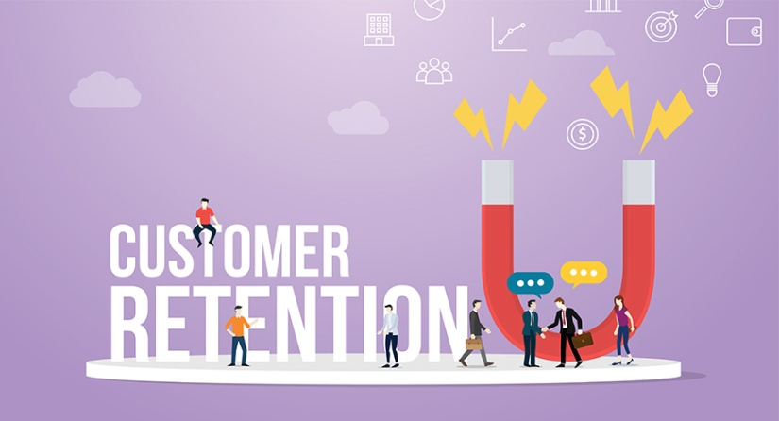
The Importance of Customer Relationship Management
Remember that long-term customer relationships are the ones that sustain organizations. This is referred to as customer retention.
  In many organizations, the churn rate – number of customers who leave a supplier during a given time period – is often an indicator of customer dissatisfaction, better targeted marketing and sales efforts, better or cheaper pricing by competitors, or factors related to service provider relationships with customers.
    No matter the cause, the issue is that organizations that have an ongoing high churn rate are doomed to failure.

Slide 38
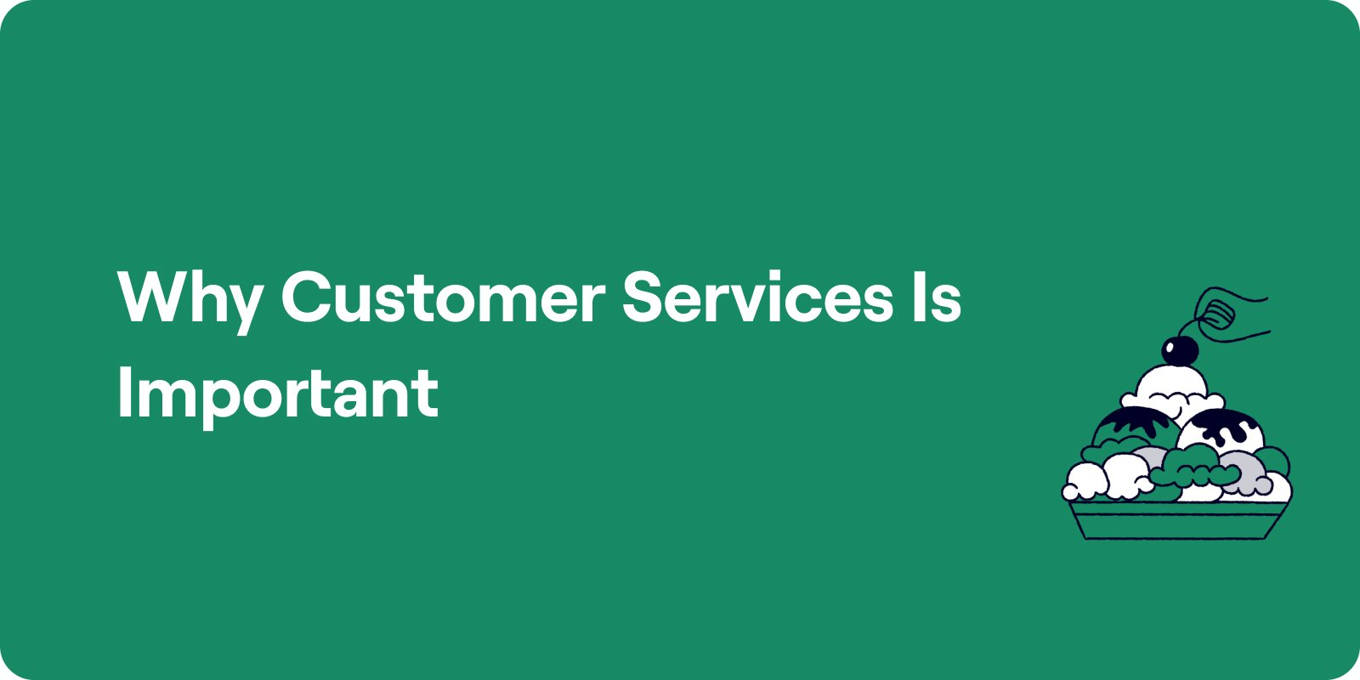
The Importance of Customer Relationship Management
The days of a customer adopting one product or company for life are long gone.
  With easy access and global competitiveness, customers are often swayed by advertising and a chance at a “better deal.”
  Quality levels and features between competing brands and organizations are often comparable.
    The thing that separates most competitors is their level of service.

Slide 39
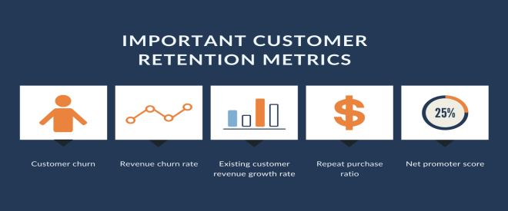
The Importance of Customer Relationship Management
Seeking out new or replacement customers through advertising and other means is a very costly proposition.
  Harvard Business Review claims, “acquiring a new customer is 5-25 times more expensive than retaining an existing one.”
    In addition to having to find new customers, you and organization have to educate and win them over. You have to prove yourself to newly acquired customers. And, more than likely, new customers are also going to be more apprehensive, skeptical, and critical than customers who have previous experience with your organization.

Slide 40
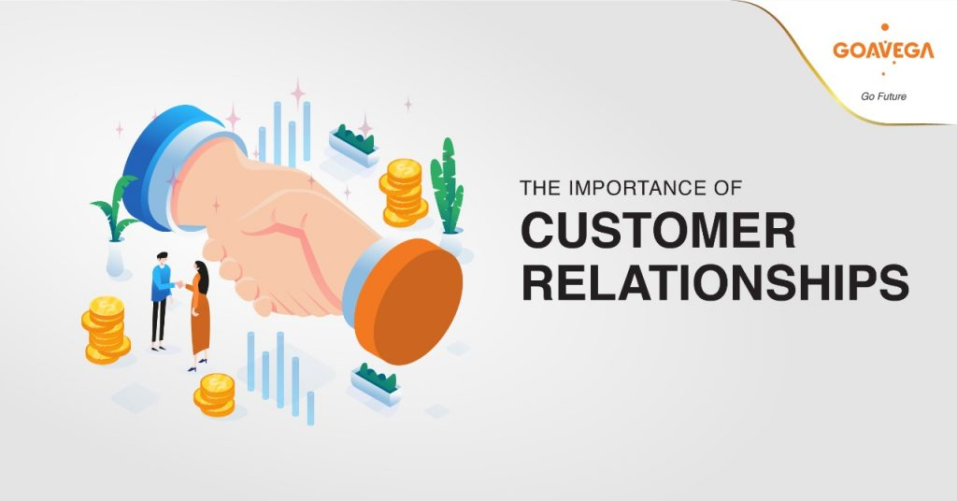
The Importance of Customer Relationship Management
    It is imperative that you and every member of your organization work to build and strengthen customer relationships and develop loyalty on the part of those customers with whom you have an existing relationship.
  Companies must train all employees to build relationships on an interpersonal level and to take every opportunity to reinforce the value of customers when they interact with them.

Slide 41
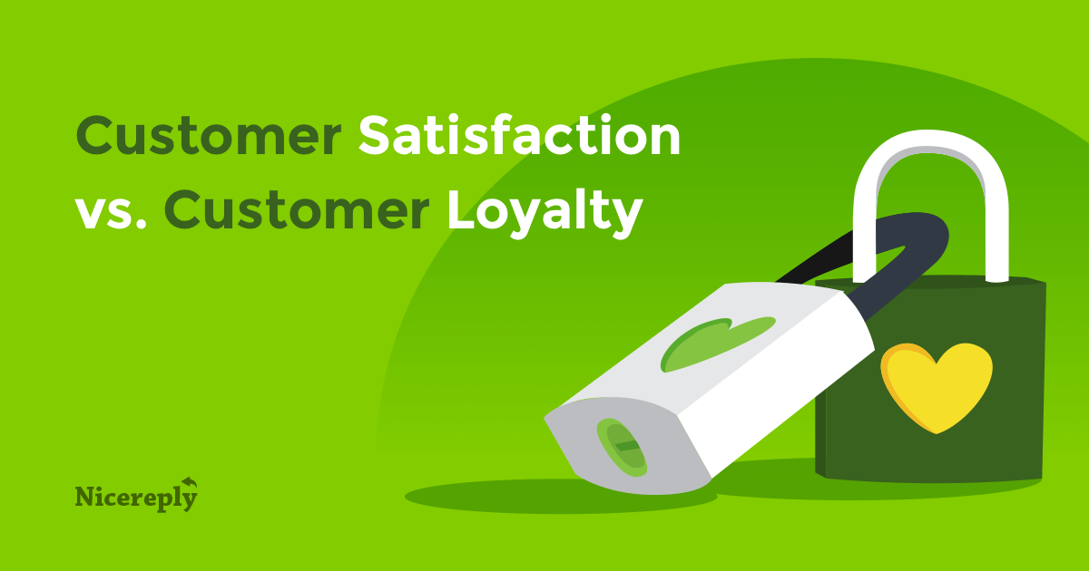
Benefits of Customer Relationship Management
When organizations attain a high degree of brand recognition and a reputation for providing quality products and services at a competitive price, while going above and beyond their customer’s expectations, they are typically rewarded with customer loyalty and repeat and referral business.

Slide 42
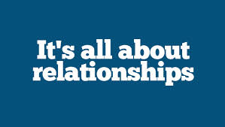
Benefits of Customer Relationship Management
By providing excellent customer service and dealing with dissatisfaction as soon as you identify it, you can help ensure that customers remain loyal and keep coming back.
  Customers will remain loyal to a product, service, or organization that they believe meets their needs.
    Even when there is a perceived breakdown in quality, customers will return to an organization that they believe sincerely attempts to solve a problem or make restitution for an error.

Slide 43

Provider Characteristics Affecting Customer Loyalty
Personal characteristics of a service provider may affect customer loyalty positively or negatively.
  The following describe some of the most common qualities of service providers that affect customers:
    Responsiveness
    Adaptability
    Communication Skills
    Decisiveness
    Enthusiasm
    Ethical Behavior
    Initiative
    Knowledge
    Perceptiveness
    Planning Ability
    Problem-Solving Ability
    Professionalism

Slide 44

1. Responsiveness
Customers typically like to feel that they are the most important person in the world when they encounter an organization. This is a human need.
  If customers do not feel appreciated or welcome by you or another service provider, they will likely take their business elsewhere.
    A simple way to demonstrate responsiveness is to attend to customer needs promptly.

Slide 45
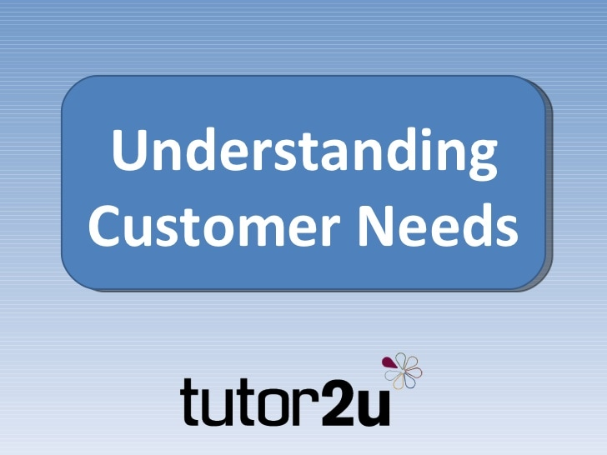
Addressing Customer Needs
The following are six common customer needs:
  To Feel Welcome
  To Be Understood
  To Feel Comfortable
  To Feel Appreciated
  To Feel Important
  To Be Respected

Slide 46

2. Adaptability
In today’s world, you have many opportunities to deal with customers who have different, values, beliefs, perceptions, needs, and expectations. You will also encounter people whose personality style differs from yours.
  Each of these encounters will provide an opportunity for you to adapt your approach in dealing with others. By doing so, you can increase the likelihood of a successful interaction and a satisfied customer.
    Take measures to adapt your personality style to that of your customers in order to communicate with and serve them effectively.

Slide 47
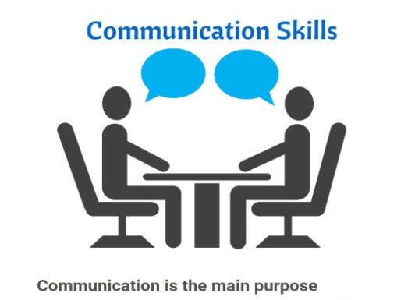
3. Communication Skills
Your ability to obtain and give information; listen, write, and speak effectively; and deal with emotional situations are keys to successful customer service.
  By using a variety of effective interpersonal techniques, you can determine customer needs. The most successful service providers are the ones who have learned to interact positively and build rapport with customers.
    You should strive to improve your ability to interact and communicate with a variety of people. The better your skills, the more likely you will be able to address different situations that arise in the workplace.

Slide 48
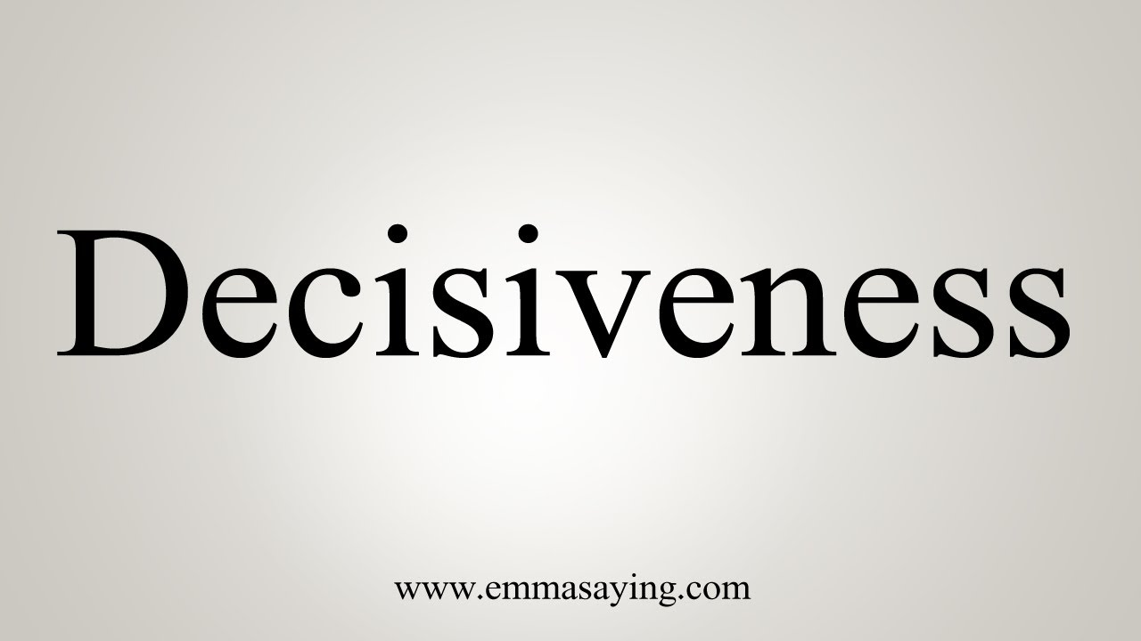
4. Decisiveness
Decisiveness relates to being able and willing to make a decision and take necessary actions to fulfill customer needs.
  Taking a wait-and-see approach to customer service often leads to customer dissatisfaction. By causing customers to wait while you go to someone else for a decision or answer can be frustrating. Try to resolve these barriers in advance of a potential situation.
    Once you have supportive systems in place, gather information effectively by using active listening techniques. Then carefully and quickly analyze the situation and make a decision on how to best solve the problem.

Slide 49

5. Enthusiasm
Attaining and maintaining a level of excitement about your customers, products, services, organization, and job that says, “I am happy to help you,” is an important step toward establishing a relationship.
  If you are enthusiastic about serving your customers, they will often respond by supporting you and the organization. People often react positively to enthusiastic employees who appear to be enjoying themselves as they work.
    Find a good balance between fun and professionalism.

Slide 50
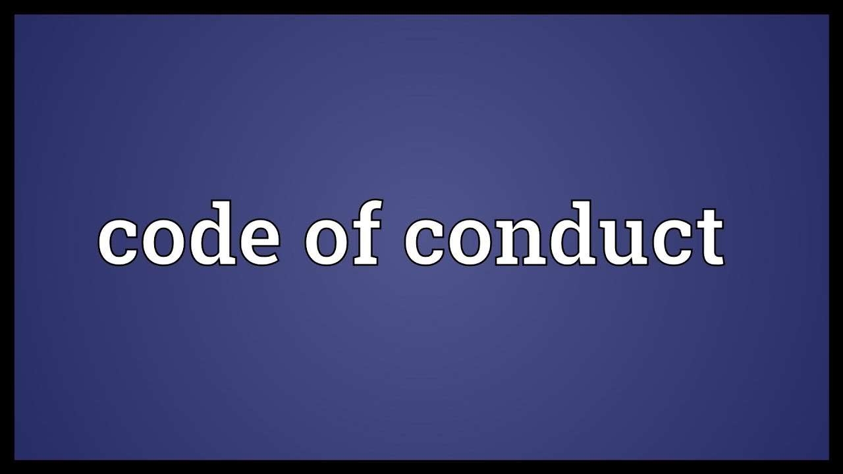
6. Ethical Behavior
Having a written standard of conduct, organizations demonstrate to customers that they are concerned for their welfare. They also demonstrate that they have the intention of operating in an ethical manner. This effort can ease customer trepidation or concerns that employees will take advantage of them.
  A Code of Ethics is a set of standards, often developed by employees, that guide the conduct of all employees.

Slide 51
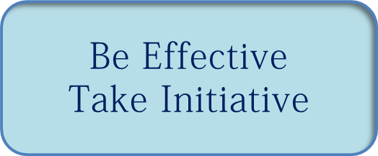
7. Initiative
Taking action related to your job or customer service without receiving instructions from others is a sign of initiative. Such actions also help to ensure that you identify and meet the needs of your customer in a timely fashion.
  Too many providers take the “It is not my job” or “I cannot do that” approach to dealing with customer situations. This can lead to customer dissatisfaction. To counter such impressions, you should take responsibility for solving problems as they arise.
    Initiative does not only apply to external customer situations.
    What you do around your boss and coworkers (internal customers) also sends a powerful message about you.

Slide 52

8. Knowledge
Your customers expect you to know about the organization.
  With all the products and service variations available to customers, the high level of technology, deregulation of industries, and innovations coming on the market daily, customers depend on service providers to educate and guide them in making purchases and decisions.
    Taking the time to learn about policies, procedures, resources, products, services, and other information can help you provide total customer satisfaction in an efficient and timely manner.

Slide 53
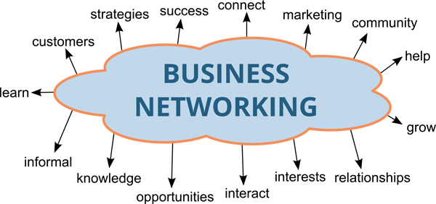
Information and Networking
Develop a network with other key employees throughout the organization and community and use those networks to gain access to information.
  Attend general training sessions through organizations involved in your particular product or service and/or join a trade association.
  Locate business mentors who can help with your career development.
  Network with others in your line of work outside the organization.

Slide 54

9. Perceptiveness
Recognizing the need to pay close attention to verbal and nonverbal cues, cultural factors, and the feelings or concerns of others is important.
  By staying focused on customers and the signals they send, you can often recognize hesitancy, interest in a product or adamant rejection, irritation, anxiety, and a multitude of other unspoken messages.
    Once you identify customers’ signals, you can react appropriately and address their needs. One way you can effectively address customer needs is to anticipate them.

Slide 55

10. Planning Ability
Planning is a crucial skill to possess when operating in today’s fast-paced, changing customer service environment, especially in technology-based environments.
  To prepare for all types of customer situations, you and your organization must have a strategy. This often involves assessing various factors related to your organization, industry, products, services, policies and procedures, resources, and customer base.
    You should have an immediate plan to resolve any systematic breakdown and have alternative contingency plans readily available for backup.

Slide 56
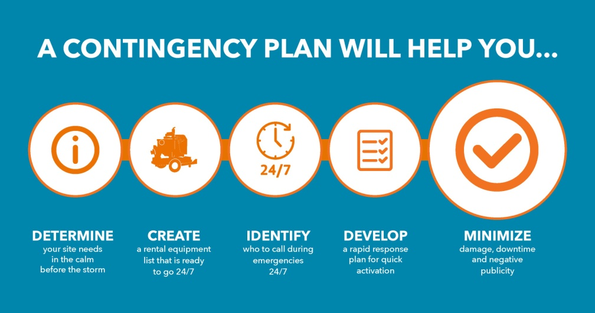
Planning Process Model
The Planning Process Model is a five-step process for creating contingency or backup plans to better serve customers when problems arise or things do not go as expected.
  Set a Goal
  Examine and Evaluate the Situation
  Identify Alternatives
  Select the Best Alternatives
  Create an Implementation Plan

Slide 57
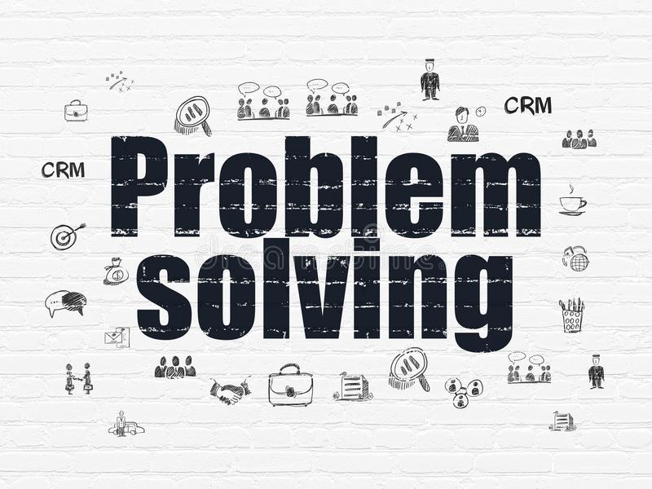
11. Problem-Solving Ability
If a customer has a problem, you have a problem. Remembering this simple concept can go a long way in reminding you of your purpose for being a service provider.
  You primary job function is to address the needs of your customer. To do this when a customer is dissatisfied or has a concern, you should take responsibility for the problem instead of trying to place blame and defer the issue to someone else or something else.
    Your goal is to identify and implement appropriate solutions to the extent of your approved authority. Otherwise, you should seek assistance.

Slide 58
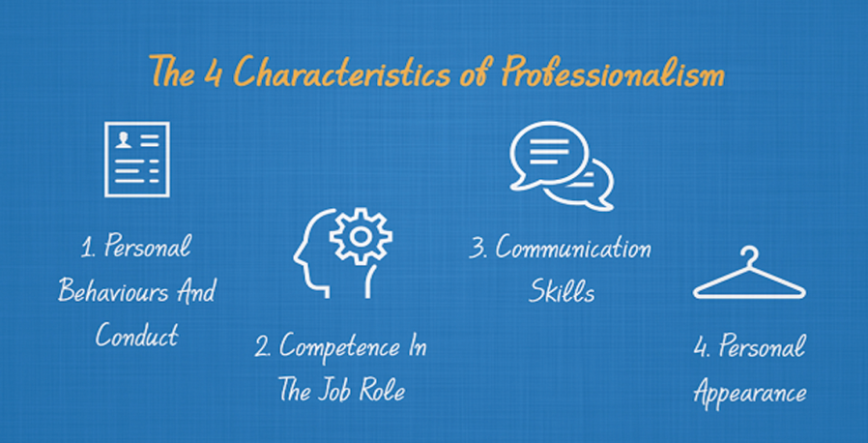
12. Professionalism
Projecting a positive personal image – through manner of dress, knowledge, appearance of work area, and your mental attitude – is a crucial element in communicating an “I care” image to customers and potential customers.
  By paying close attention to such factors, you are better positioned to establish and maintain a strong customer relationship. This is especially true where attitude is concerned.
    Attitude can mean success or failure when dealing with customers.
    You can communicate it through various verbal and nonverbal cues.

Slide 59
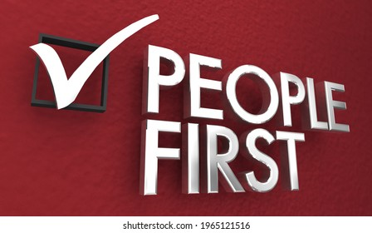
Making the Customer Number One
Make a good first impression by establishing rapport; then identify and satisfy your customers’ needs. Follow up to obtain repeat business.
  Most people like to feel that they are important and valued. By recognizing and acting on that fact, you can go a long way toward providing solid customer service, reducing churn, and building a strong relationship with customers.
    By being an “I care” person, you can generate much goodwill while meeting customer needs.

Slide 60

Making the Customer Number One
Every time you encounter a customer in person, through technology, or over the phone, you have an opportunity to provide excellent service.
  Some companies call a service encounter the moment of truth or refer to them as contact points, in which the customer comes into contact with some facet of the organization.
    At this point you and other service providers have an opportunity to deliver “knock your socks off” service.

Slide 61
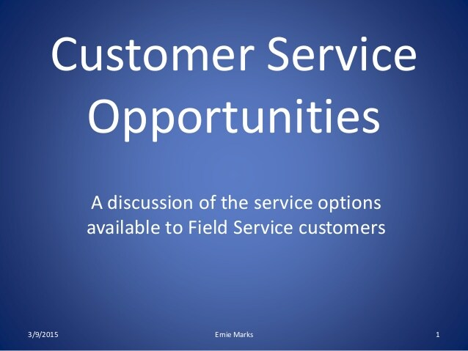
Making the Customer Number One
Each customer encounter moves through the following stages, although sometimes the order varies. At each step, you have another opportunity to provide excellent customer service.
  Establish Rapport
  Identify and Satisfy Customer Needs
  Exceed Expectations
  Follow Up

Slide 62

1. Establish Rapport
Customers react to and deal effectively with employees whom they perceive as likable, helpful, and effective.
  Throughout your interaction, continue to be helpful, smile, listen, use the customer’s name frequently, and attend to the customer’s needs or concerns. Look for opportunities to generate small talk about non-business-related matters.
    When something goes wrong, people who feel a kinship with service providers typically give higher ratings on the relationship-rating point scale than people who do not feel this connection.

Slide 63
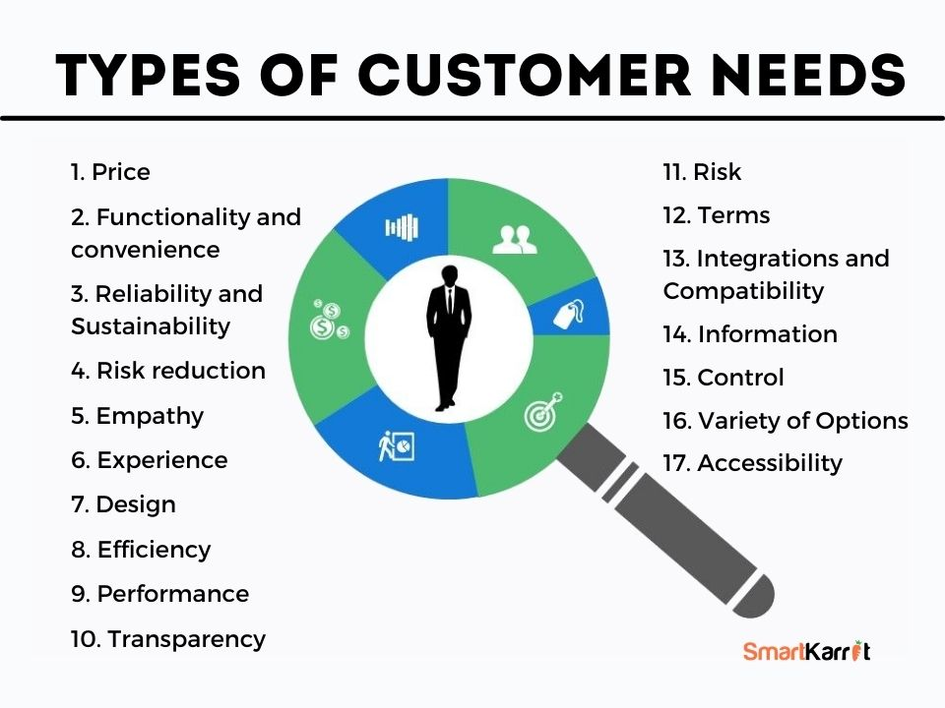
2. Identify and Satisfy Customer Needs
Use questioning, listening, observing, and feedback skills to focus on issues of concern to the customer.
  By effectively gathering information, you can then move to the next phase of customer service.

Slide 64

3. Exceed Expectations
Customers typically expect that, if they pay a certain price for a product or service, they will receive a specific quality and quantity in return; this is not an unusual expectation.
  If you and your organization fail to deliver as promised or expected, customers may simply go away or move on to another company that has competitive prices, and quality products and services.
    Today’s customers tend to be better educated consumers who recognize that if they cannot fulfill their needs in one place, they can easily access the same or similar products and services by visiting another competitor. Therefore, you need to exceed a customer’s expectations.

Slide 65

4. Follow Up
Follow-through is a major factor in obtaining repeat business. After you have satisfied a customer’s needs, follow up with the customer on their next visit or via mail, e-mail, or telephone to ensure that they were satisfied.
  For external customers, you can couple this follow-up with a small thank-you card, coupons for discounts on future purchases, small presents, or any other incentive to reward their patronage.
  You can follow up with internal customers by using voice mail or e-mail messages, leaving Post-it notes on their desk, inviting them out for coffee, or any other number of ways.
    The prime objective is to let them know that you have not forgotten them and appreciate their business and support.

Slide 66

Enhancing Customer Satisfaction as a Strategy for Retaining Customers
The following are tips that can help provide quality service to customers.
  Pay Attention
  Deal with One Customer at a Time
  Know Your Customers
  Give Customers Special Treatment
  Service Each Customer Adequately
  Do the Unexpected
  Handle Complaints Effectively
  Sell Benefits, Not Features
  Know Your Competition
  Understand Cost of Dissatisfied Customers

Slide 67
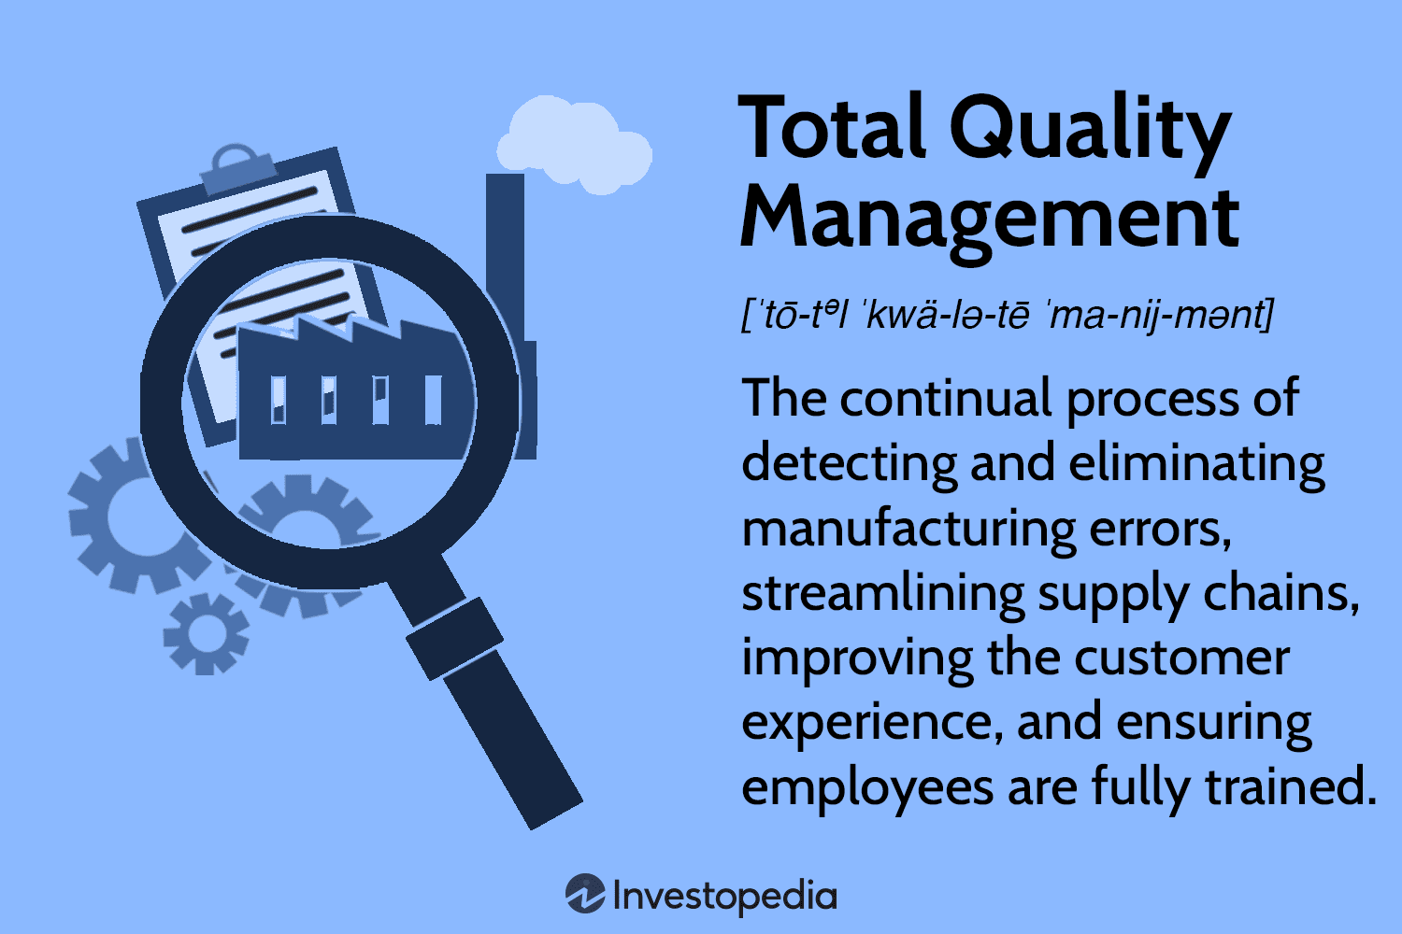
Strive for Quality
A customer’s perception of quality service is often one of the prime reasons for their return.
  Total Quality Management (TQM) and continuous quality improvement are systematic approaches to identifying and quantifying best practices in an organization and/or industry in order to make improvements in effectiveness and efficiency.
    Your organization’s ability to deliver quality service depends on you and the others who provide frontline service to customers.

Slide 68


