Slide 1
Business Communications Session One
Business Communication
Process and Product – 9th Edition
Mary Ellen Guffey and Dana Loewy; Cengage Learning 2018, 2015
ISBN: 978-1-305-95796-1

Slide 2
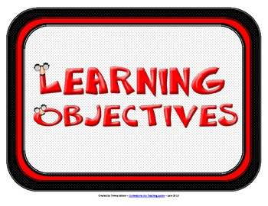
Unit One: Communication Foundations
Chapter One: Business Communication in the Digital Age
Learning Outcomes:
Explain how communication skills fuel career success, and understand why writing skills are vital in a digital, mobile, and social-media driven workplace.
Identify the tools for success in the hyper-connected 21st century workplace; appreciate the importance of critical-thinking skills and personal credibility in the competitive job market of the digital age; and discuss how your education may determine your income.
Describe significant trends in today’s dynamic, networked work environment, and recognize that social media and other communication technologies require excellent communication skills, in any economic climate.
Examine critically the internal and external flow of communication in organizations through formal and informal channels, explain the importance of effective media choices, and understand how to overcome typical barriers to organizational communication.
Analyze ethics in the workplace, understand the goal of ethical business communicators, and choose tools for doing the right thing.

Slide 3
Communicating in the Digital World
In this increasingly complex, networked, and mobile environment, communication skills matter more than ever.
Such skills are most significant when competition is keen.
Job candidates with exceptional communication skills immediately stand out.

Slide 4
Communication Skills: Your Pass to Success
Employer surveys consistently show that strong communication skills are critical to effective job placement, work performance, career advancement, and organizational success.
In making hiring decisions, employers often rank communication skills among the most desirable.
In a poll, Fortune 1000 executives cited writing, critical-thinking, and problem-solving skills along with self-motivation and team skills as their top choices in new hires.

Slide 5
Writing in the Digital Age
Although interpersonal skills still matter greatly, writing effectively is critical.
Writing matters more than ever because online media requires more of it, not less.
Participating employers admitted that their expectations of EEs have increased because challenges on the job are more complex.

Slide 6
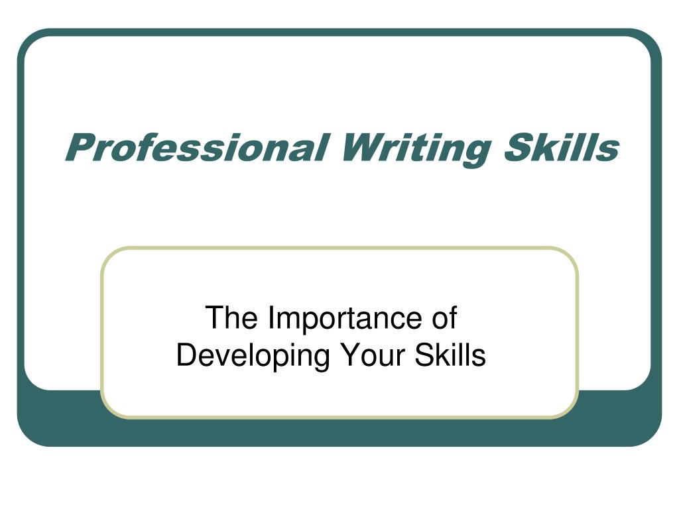
Writing in the Digital Age
Communicating clearly and effectively has NEVER been more important than it is today.
Whether it’s fair or not, life-changing critical judgments about you are being made based solely on your writing ability.

Slide 7
The Digital Revolution and You: Tools for Success in the 21st Century Workplace
Information technology has changed how we work, play, and communicate.
It has never been easier to access and share information via various digital media from a vast network of sources and distribute it instantly to widespread audiences.
What hasn’t changed is that communication skills need time and effort to develop.

Slide 8
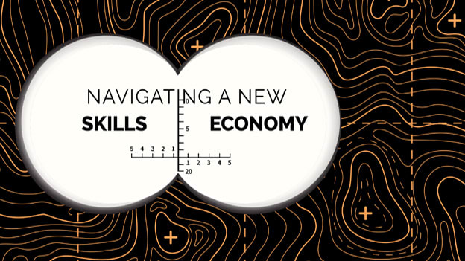
Why Should You Care?
As a knowledge worker in the skills economy, you can expect to be generating, processing, and exchanging information.
You will need to be able to transmit it effectively across various communication channels and multiple media.
With added job responsibilities, you will be expected to make sound decisions and solve complex problems.

Slide 9
Think Critically in the Digital Age
All workers from executives to subordinates, need to think creatively and critically.
Management and employees work together in such areas as product development, quality control, and customer satisfaction.

Slide 10
Creative Problem-Solving Process Osborn-Parnes
The following is a summary of the 3-point plan to help you think critically and solve problems competently:
Explore the Challenge
Identify the challenge.
Gather information and clarify the problem.
Generate Ideas
Come up with many ideas to solve the problem.
Pick the most promising ideas.
Implement Solutions
Select and strengthen solutions.
Plan how to bring your solution to life and implement it.

Slide 11
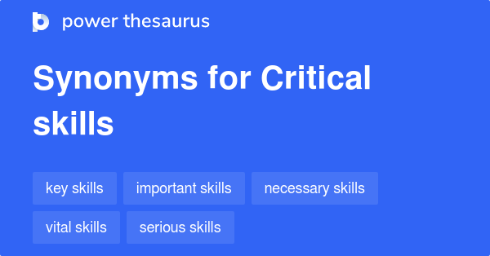
Skills Job Seekers Should Offer
The following are critical skills job seekers should offer:
Leadership – 78%
Ability to Work in a Team – 78%
Written Communication Skills – 73%
Problem-Solving Skills – 71%
Strong Work Ethic – 70%
Analytical and Quantitative Skills – 68%
Technical Skills – 68%
Verbal Communication Skills – 67%

Slide 12
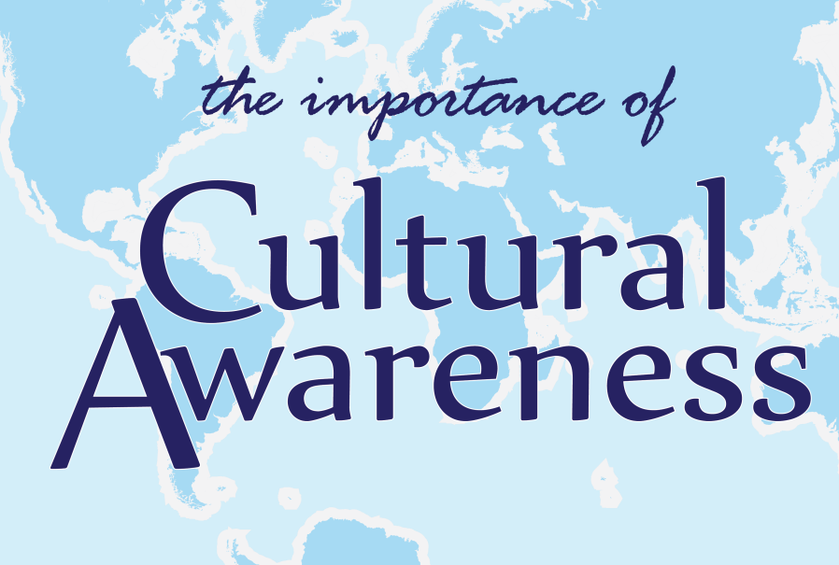
The Global Marketplace and Competition
Successful communication in new markets requires developing new skills and attitudes.
These include cultural awareness, flexibility, and patience.

Slide 13
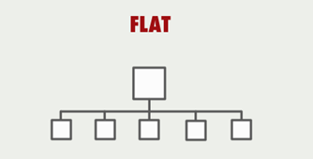
Shrinking Management Layers
In traditional companies, information flows through many levels of managers.
In response to intense global competition and other pressures, however, innovative businesses have for years been cutting costs and flattening their management hierarchies.
This flattening means that fewer layers of managers separate decision makers from line workers.

Slide 14
Shrinking Management Layers
Management moved away from command and control to connecting and collaborating horizontally.
This means that work is organized so that people can use their own talents more wisely.

Slide 15
Shrinking Management Layers
Today’s flatter organizations, however, also pose greater communication challenges.
In the past, authoritarian and hierarchal management structures did not require that every employee be a skilled communicator.
Managers simply passed along messages to the next level.
Today, however, frontline employees as well as managers participate in critical thinking and decision making. Nearly everyone is a writer and a communicator.

Slide 16
Collaborative Environments and Teaming
Many companies have created cross-functional teams to empower employees and boost their involvement in decision making.

Slide 17
Information Flow and Media Choices in Today’s Workplace
Business communication functions can be summarized in three simple categories: (1) to inform, (2) to persuade, and (3) to promote goodwill.
On the job, you will have a vast array of media to help you share information and stay connected both internally and externally.
You will need to know which medium is most suitable to accomplish your goal and be able to distinguish between formal and informal channels.

Slide 18
The Networked Workplace in a Hyperconnected World
Social media and other information technology coupled with flatter hierarchies have greatly changed the way people communicate internally and externally at work.
One major shift is away from one-sided, slow forms of communication such as hard-copy memos and letters to interactive, instant, less paper-based communication.
Speeding up the flow of communication in organizations are email, instant messaging, texting, blogging, and interacting with social media such as Facebook, Twitter, and LinkedIn.

Slide 19
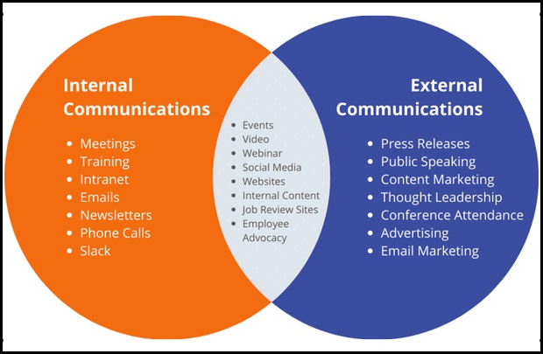
Internal and External Communication
Although most businesses rely on email and digital files for communication, they still produce some paper-based documents.
In certain, situations, though, written documents may not be as effective as oral communication.
Each form of communication has advantages and disadvantages.

Slide 20
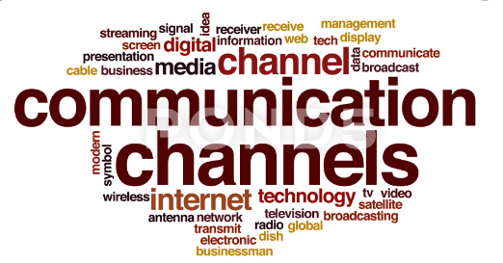
Media Richness and Social Presence
Business communicators must be able to choose from a wide range of communication channels the one most suitable to get the job done; that is, most likely to elicit the desired outcome.
How to choose the appropriate medium to avoid ambiguity, confusing messages, and misunderstandings has long been studied by researchers.
Media Richness Theory and the Concept of Social Presence are particularly useful for evaluating the effectiveness of old and new media in a given situation.

Slide 21
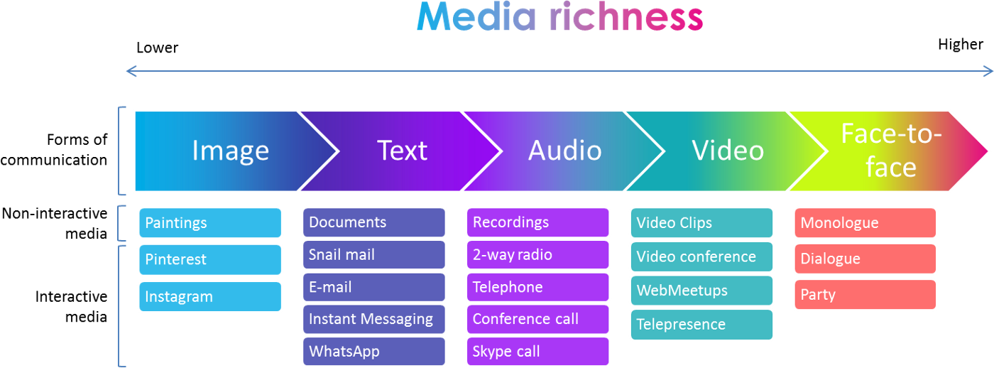
Media Richness
Draft and Lengel’s Media Richness Theory attempts to classify media in organizations according to how much clarifying information they are able to convey from a sender to a recipient.
The more helpful cues and immediate feedback the medium provides, the richer it is; face-to-face and on the telephone, managers can best deal with complex organizational issues.
For routine, unambiguous problems, however, media of lower richness such as memos, reports, and other written communication, usually suffice.

Slide 22
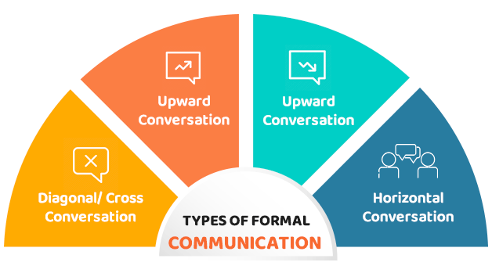
Formal Communication Channels
Information within organizations flows through formal and informal communication channels.
A free exchange of information helps organizations respond rapidly to changing markets, boost efficiency and productivity, build EE morale, serve the public, and take full advantage of the ideas of today’s knowledge workers.
Official information within an organization typically flows through formal channels in three directions: downward, upward, and horizontally.

Slide 23
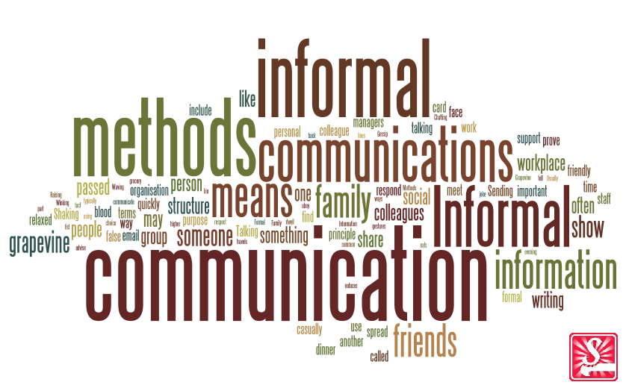
Informal Communication Channels
Most organizations today share company news through consistent, formal channels such as email, intranet posts, blogs, and staff meetings.
Regardless, even within organizations with consistent formal channels, people still spread rumors about the company and gossip about each other.

Slide 24
The Grapevine
The Grapevine is an informal channel of communication that carries organizationally relevant gossip.
This powerful but informal channel functions through social relationships; people talk about work when they are lunching, working out, golfing, and carpooling, as well as, in emails, texts, and blogs.
Today, gossip travels much more rapidly online.

Slide 25
Using the Grapevine Productively
Managers can use the grapevine productively by doing the following: (a) respecting employees’ desire to know, (b) increasing the amount of information delivered through formal channels,(c) sharing bad as well as good news, (d) monitoring the grapevine, and (e) acting promptly to correct misinformation.
In addition, managers should model desirable behavior and not gossip themselves.

Slide 26
Ethics
Ethics refers to conventional standards of right and wrong that prescribe what people should do.
These standards usually consist of rights, obligations, and benefits to society. They also, include virtues such as fairness, honesty, loyalty, and concern for others.
Ethics is about having values and taking responsibility.
Ethical individuals are law abiding citizens.

Slide 27
Defining Ethics
As a business communicator, you should understand basic ethical principles so that you can make logical decisions when faced with dilemmas in the workplace.
Professionals in any field deal with moral dilemmas on the job.
However, just being a moral person and having sound personal or professional ethics may not be sufficient to handle the ethical issues you may face in the workplace.

Slide 28
Doing What Ethical Communicators Do
Dealing honestly with colleagues and customers develops trust and builds strong relationships.
The following guidelines can help you set specific ethical goals. Although these goals hardly constitute a formal code of conduct, they will help you maintain a high ethical standard.
Abide by the Law – Tell the Truth – Label Opinions – Be Objective – Communicate Clearly – Use Inclusive Language – Give Credit

Slide 29
Guide to Ethical Decisions
The following 5 questions may help you resolve most ethical dilemmas:
Is the action legal?
Would you do it if you were on the opposite side?
Can you rule out a better alternative?
Would a trusted advisor agree?
Would family, friends, employers, or coworkers approve?

Slide 30
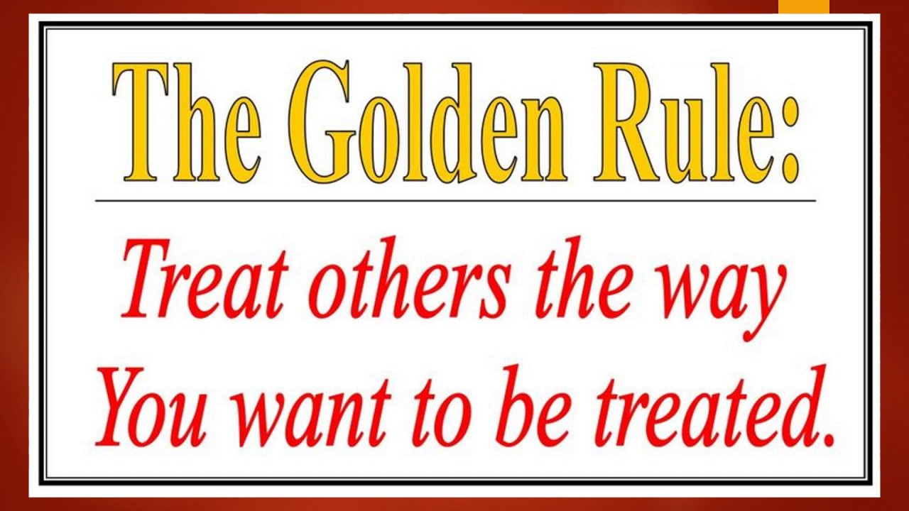
Guide to Ethical Decisions
Ethics hold us to a higher standard than the law.
Even when an action is legal, it may violate generally accepted principles of right and wrong.
The best advice in ethical matters is contained in the Golden Rule: Treat Others as You Wish to be Treated.

Slide 31
Unit One: Communication Foundations
Chapter Two: Professionalism: Team, Meeting, Listening, Nonverbal, and Etiquette Skills.
Learning Outcomes:
Understand the importance of teamwork in the digital-era workplace, and explain how you can contribute positively to team performance.
Discuss effective practices and technologies for planning and participating in face-to-face meetings and virtual meetings.
Explain and apply active listening techniques.
Understand how effective nonverbal communication can advance a career.
Improve your competitive advantage by developing professionalism and business etiquette skills.

Slide 32
Adding Value to Professional Teams
Most businesses seek EEs who can get along and deliver positive results that increase profits and boost their image.
You have a stake in acquiring skills that will make you a strong job applicant and a valuable employee.

Slide 33
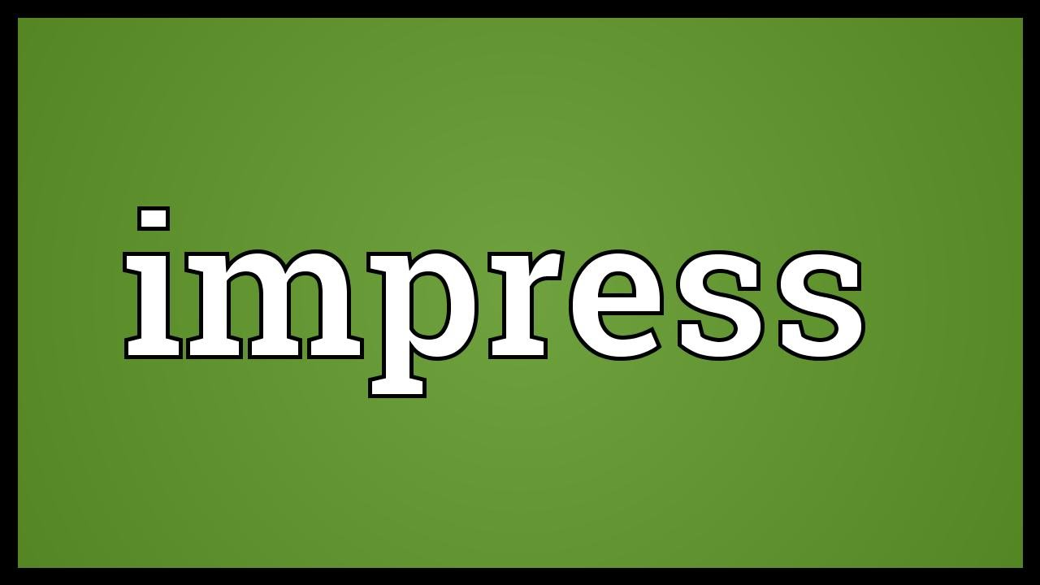
Impressing Digital-Age Employers
Employers are typically interested in four key areas: education, experience, hard skills, and soft skills.
Hard skills refer to the technical skills in your field.
Soft skills, however, are increasingly important in the knowledge-based economy of the digital era.
Desirable competencies include not only oral and written communication skills but also active listening skills, appropriate nonverbal behavior, and proper business etiquette.

Slide 34
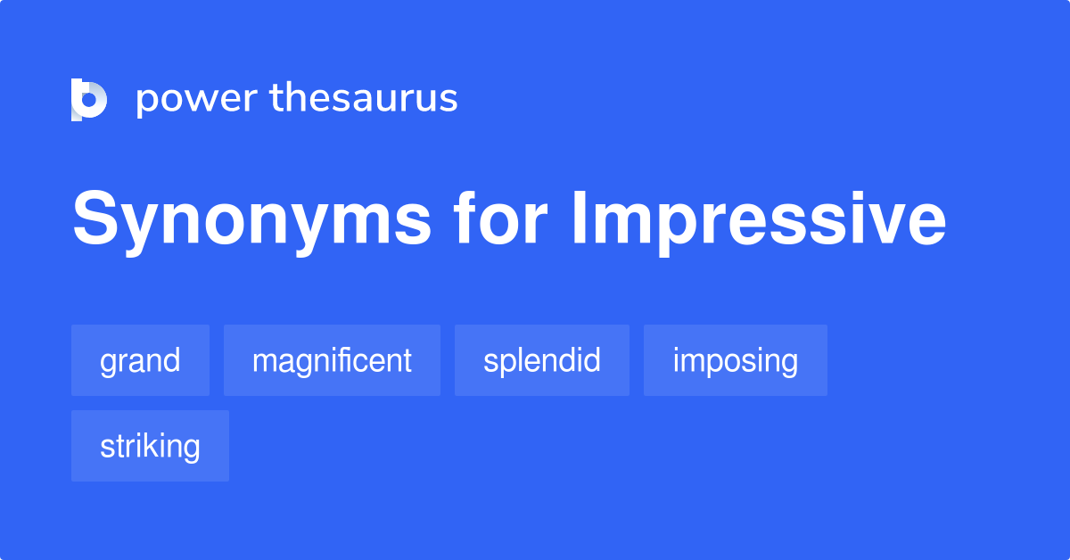
Impressing Digital-Age Employees
In addition employers want efficient and productive team members.
They want EEs who are comfortable with diverse audiences, listen actively to customers and colleagues, make eye contact, and display good workplace manners.
These soft skills are immensely important not only to be hired, but also to be promoted.

Slide 35
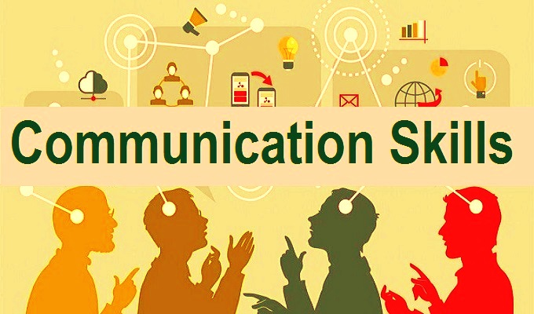
Impressing Digital-Age Employees
Hiring managers expect you to have technical expertise in your field and know the latest communication technology.
Such skills and an impressive resume may get you in the door.
However, your long-term success depends on how well you communicate with your boss, coworkers, and customers whether you can be an effective and contributing team member.

Slide 36
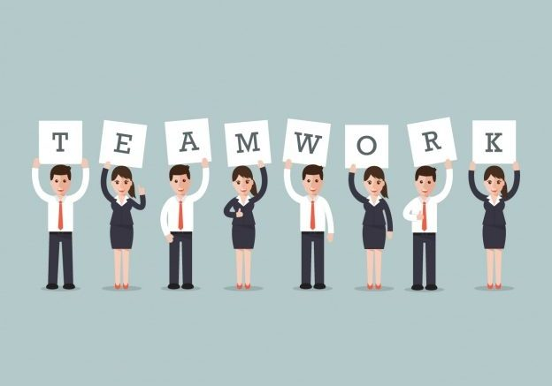
Excelling in Teams
You will discover that the workplace is teeming with teams.
You might find yourself a part of a work team, project team, cross-functional team, or some other group.
All of these teams are formed to accomplish specific goals.
One of the most important objectives of businesses is finding ways to do jobs better at less cost.

Slide 37
Excelling in Teams
Teams are formed for the following 7 reasons:
1. Better Decisions
Decisions are generally more accurate and effective because group and team members contribute different expertise and perspectives.

Slide 38
Excelling in Teams
Teams are formed for the following 7 reasons:
2. Faster Responses
When action is necessary to respond to competition or to solve a problem, small groups and teams can act rapidly.

Slide 39
Excelling in Teams
Teams are formed for the following 7 reasons:
3. Increased Productivity
Because they are often closer to the action and to the customer, team members can see opportunities for improving efficiency.

Slide 40
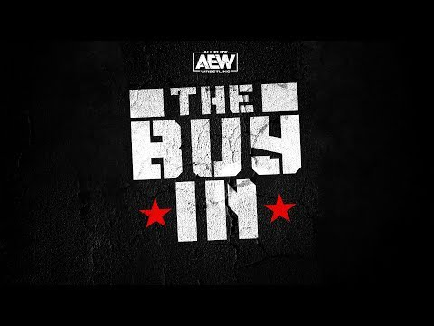
Excelling in Teams
Teams are formed for the following 7 reasons:
4. Greater Buy-In
Decisions arrived at jointly are usually better received because members are committed to the solution and are more willing to support it.

Slide 41
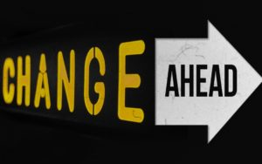
Excelling in Teams
Teams are formed for the following 7 reasons:
5. Less Resistance to Change
People who have input into decisions are less hostile, aggressive, and resistant to change.

Slide 42
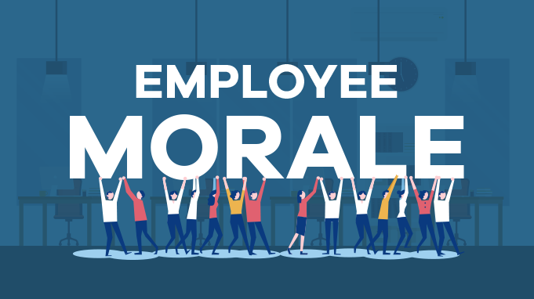
Excelling in Teams
Teams are formed for the following 7 reasons:
6. Improved Employee Morale
Personal satisfaction and job morale increases when teams are successful.

Slide 43
Excelling in Teams
Teams are formed for the following 7 reasons:
7. Reduced Risk
Responsibility for a decision is diffused on a team, thus carrying less risk for any individual.

Slide 44
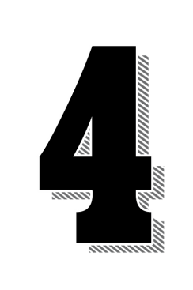
Four Phases of Team Development SUMMARY
Forming
Select Members
Become Acquainted
Build Trust
Form Collaborative Culture
Storming
Identify Problems
Collect and Share Information
Establish Decision Criteria
Prioritize Goals
Norming
Discuss Alternatives
Evaluate Outcomes
Apply Criteria
Prioritize Alternatives
Performing
Select Alternative
Analyze Effects
Implement Plan
Manage Project

Slide 45
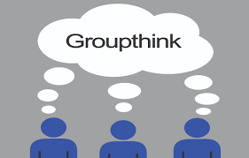
Combating Groupthink
Conflict is normal in team interactions, and successful teams are able to resolve it. But some teams avoid conflict. They smooth over and in doing so may fall victim to groupthink.
Groupthink is a term coined by theorist Irving Janis to describe faulty decision-making processes by team members who are overly eager to agree with one another.
Apparently, when we deviate from a group, we fear rejection. Scientists call this natural reluctance “the pain of independence” or describe it as “the hazards of courage.”

Slide 46
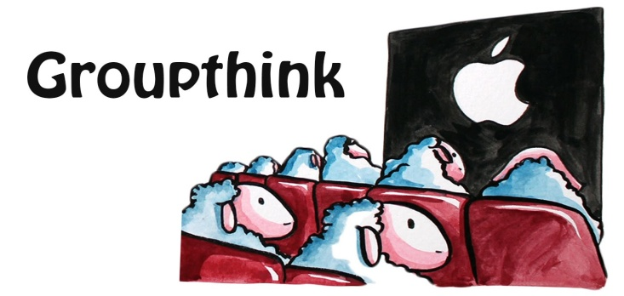
Combating Groupthink
Conditions that lead to groupthink: team members with similar backgrounds, lack of systematic procedures, demand for a quick resolution, and strong leaders who favor a specific outcome.
Symptoms of groupthink include pressure placed on any member who argues against the group’s mutual beliefs, self-censorship of thoughts that stray from the group’s agreement, collective efforts to rationalize, and unquestioned belief in the group’s moral authority.
Team’s suffering from groupthink fail to check alternatives, are biased in collecting & evaluating information, and ignore risks of preferred choice.

Slide 47
Combating Groupthink
Effective teams avoid groupthink by striving for team diversity – in age, gender, background, experience, and training.
They encourage open discussion, search for relevant information, evaluate many alternatives, consider how a decision will be implemented, and plan for contingencies in case the decision doesn’t work out.

Slide 48
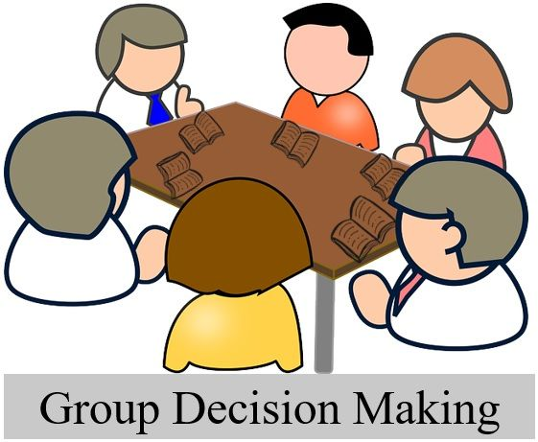
Reaching Group Decisions
The way teams reach decisions greatly affects their morale and commitment, as well as the implementation of any decision.
In U.S. culture the majority usually rules, but other methods, may be more effective - including the following:
Majority
Consensus
Minority
Averaging
Authority Rule with Discussion

Slide 49
Defining Successful Teams
The use of teams has been called the solution to many ills in today’s workplace.
Someone even observed that as an acronym TEAM means: Together Everyone Achieves More.
However, teams that do not work well together can actually increase frustration, lower productivity, and create employee dissatisfaction.

Slide 50
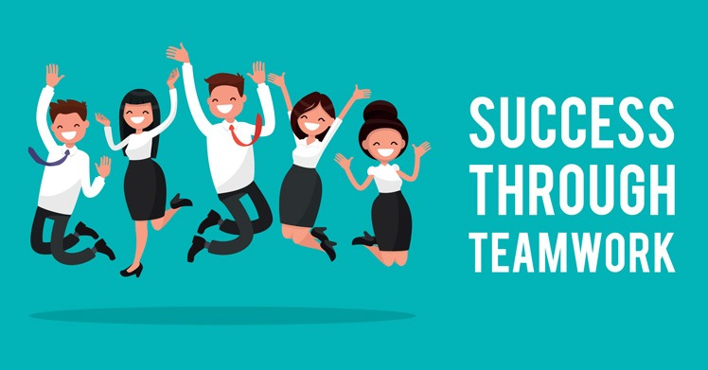
Defining Successful Teams
Effective teams share some or all of the following characteristics:
Stay Small and Embrace Diversity
Agree on a Purpose
Establish Procedures
Confront Conflict
Communicate Effectively
Collaborate Rather than Compete
Accept Ethical Responsibilities
Share Leadership

Slide 51
Planning and Participating in Face-to-Face and Virtual Meetings
As you prepare to join the workforce, expect to attend meetings – lots of them.
Estimates suggest workers on average spend four hours a week in meetings and consider more than half of that time wasted.
Managers spend even more time in meetings.

Slide 52
Making Face-to-Face Meetings Productive
As inevitable and commonplace as meetings are, most workers dread them. Nearly 50% of respondents in a Salary.com survey named “too many meetings” as the biggest waste of time at work.
However, if meetings are well run, workers actually desire more, not fewer, of them.
Your task, then, as a business communicator is to learn how to make them more efficient, satisfying, and productive.

Slide 53
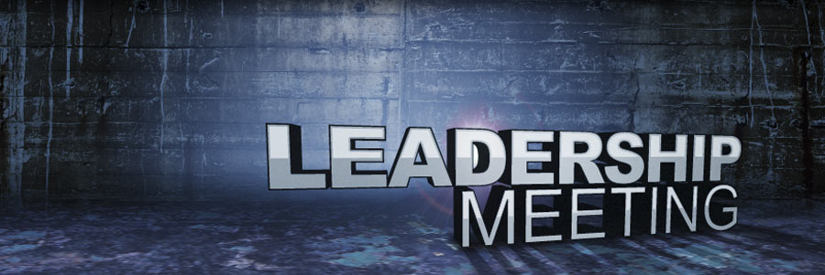
Making Face-to-Face Meetings Productive
Although meetings are disliked, they can be career-critical.
At meetings, judgments are formed and careers are made or blunted.
Therefore, instead of treating them as thieves of your valuable time, try to see them as golden opportunities to demonstrate your leadership, communication, and problem-solving skills.

Slide 54
Determining the Purpose of a Meeting
A face-to-face meeting provides the most nonverbal cues and other signals that help us interpret the intended meaning of words. Thus, an in-person meeting is the richest of available media.
No meeting should be called unless it is important, can’t wait, and requires an exchange of ideas. If people are merely being informed, send an email, text message, memo/letter, or make a phone call.
The real expense of a meeting is the lost productivity of all the people attending.

Slide 55
Selecting Meeting Participants
Ideally, decision makers and people with the information necessary to make the decision should attend.
Also attending should be people who will be responsible for implementing the decision and representatives of groups who will benefit from the decision.
Inviting key stakeholders who represent various interests, perspectives, and competencies ensures valuable input and, therefore, is more likely to lead to informed decisions.

Slide 56
Managing the Meeting
Whether you are the meeting leader or a participant, it is important to act professionally during the meeting.
Meetings can be more efficient and productive if leaders and participants recognize how to get the meeting started, establish ground rules, move the meeting along, and handle conflict.

Slide 57
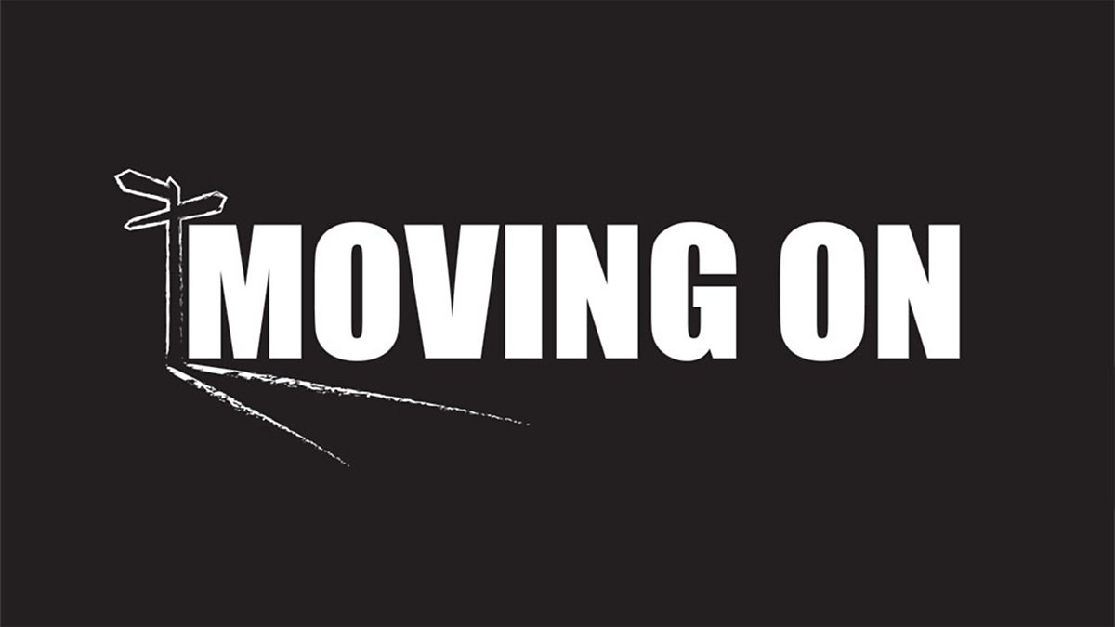
Moving the Meeting Along
An effective leader lets others talk and tries to involve all participants.
If the group has one member who dominates, the leader might encourage quieter participants to speak up. Another way to handle digressions is to say, “Folks, we’re drifting astray,” or “Let’s press on and return to the issue.”
To avoid allowing digressions to sidetrack the group, a leader might generate a “parking lot” list to set topics for later discussion.
It is important to adhere to the agenda and the schedule.

Slide 58
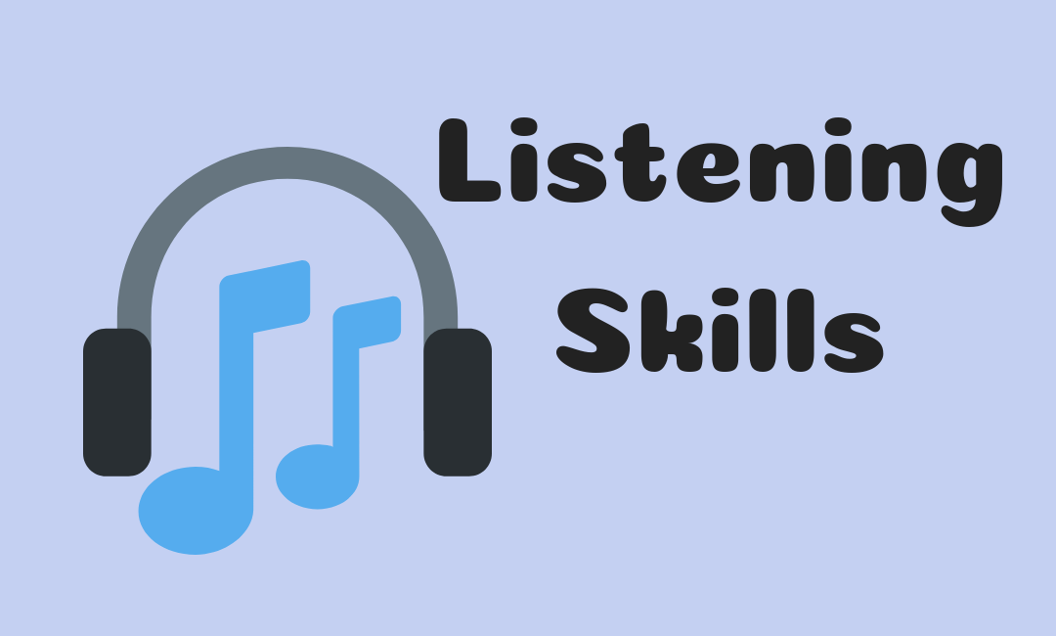
Listening in the Workplace
Listening skills are important for career success, organization effectiveness, and worker satisfaction.
Numerous studies and experts report that good listeners make good managers and that good listeners advance more rapidly in their organizations.
Studies of Fortune 500 companies report that soft skills such as listening, writing, and speaking are most likely to determine hiring and career success.

Slide 59
Listening to Colleagues and Teammates
Two kinds of listening are important:
Critical Listening
Discriminative Listening

Slide 60
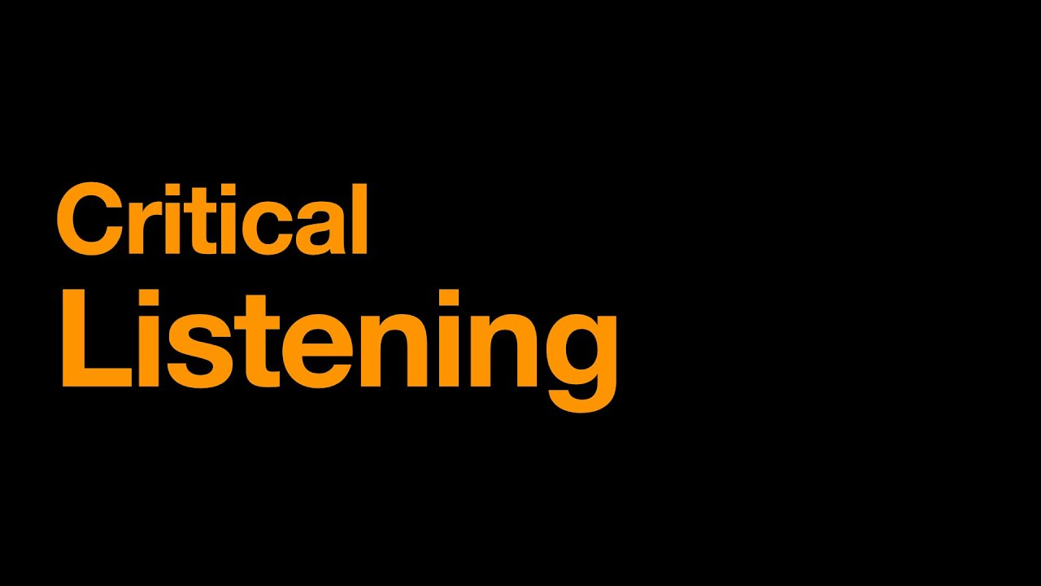
Listening to Colleagues and Teammates
Critical listening enables you to judge and evaluate what you hear.
You will be listening to decide whether the speaker’s message is fact, fiction, or opinion. You will also be listening to decide whether an argument is based on logic or emotions.
Critical listening requires an effort on your part. You must remain objective, particularly when you disagree with what you are hearing.
Control your tendency to prejudge.
Let the speaker complete the message before you evaluate it.

Slide 61
Listening to Colleagues and Teammates
Discriminative listening is necessary when you must discern, understand, and remember.
It means you must identify main ideas, understand a logical argument, and recognize the purpose of the message.

Slide 62
Ten Keys to Building Powerful Listening Skills
The following recommendations can help you improve your workplace listening effectiveness.
Control external and internal distractions.
Become actively involved.
Separate facts from opinions.
Identify important facts.
Avoid interrupting.
Ask clarifying questions.
Paraphrase to increase understanding.
Capitalize on lag time.
Take notes to ensure retention.
Be aware of potential gender differences.

Slide 63
Communicating Nonverbally
Understanding messages often involves more than merely listening to spoken words.
Nonverbal cues, in fact, can speak louder than words.
These cues include eye contact, facial expressions, body movements, time, space, territory, and appearance.
All of these nonverbal cues affect how a message is interpreted.

Slide 64
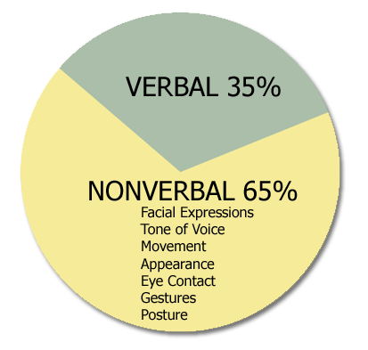
What is Nonverbal Communication?
Nonverbal communication includes all written and unspoken messages, whether intended or not.
These silent signals have a strong effect on receivers. However, understanding them is not simple.
Does a downward glance indicate modesty? Fatigue? Does a constant stare reflect coldness? Dullness? Aggression? Do crossed arms mean defensiveness, withdrawal, or just that the person is shivering?

Slide 65
Appearance Sends Silent Messages
Much like the personal appearance of an individual, the physical appearance of a business document transmits immediate and important nonverbal messages.
Ideally, these messages should be pleasing and professional.
The way an email, letter, memo, or report looks can have either a positive or a negative effect on the receiver.

Slide 66
Unit One: Communication Foundations
Chapter Three: Intercultural Communication
Learning Outcomes:
Understand the powerful effects of globalization and major trends fueling it.
Define culture, name its primary characteristics, and explain the five key dimensions of culture: (1) context, (2) individualism, (3) time orientation, (4) power distance, and (5) communication style.
Discuss strategies for enhancing intercultural effectiveness, reflect on nonverbal intercultural communication, assess how social media affect intercultural communication, and apply techniques for successful oral and written interactions across cultures.
Grasp the complexities of ethics across cultures, including business practices abroad, bribery, prevailing customs, and methods for coping.
Explain the advantages and challenges of workforce diversity, and address approaches for improving communication among diverse workplace staff.

Slide 67
The Growing Importance of Intercultural Communication
The global village predicted many years ago is here, making intercultural communication skills even more important.
Around the world, the movement toward a global economy has swelled to a torrent.
Expanding companies sometimes stumble when they cross borders and are forced to surmount obstacles never before encountered.

Slide 68
The Growing Importance of Intercultural Communication
Confusion and clashes result from intercultural differences.
Learning more about the powerful effect culture has on behavior will help you reduce friction and misunderstanding in your dealings with people from other cultures.

Slide 69
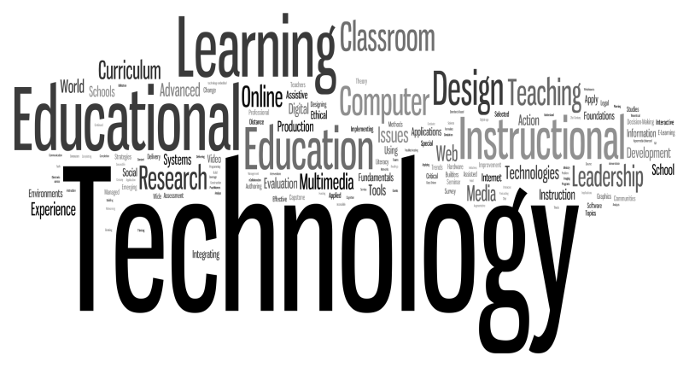
Changing Landscape
The changing landscape of business and society clearly demonstrates the need for technology savvy and connectedness around the world.
Career success and personal wealth depend on the ability to use technology effectively.

Slide 70
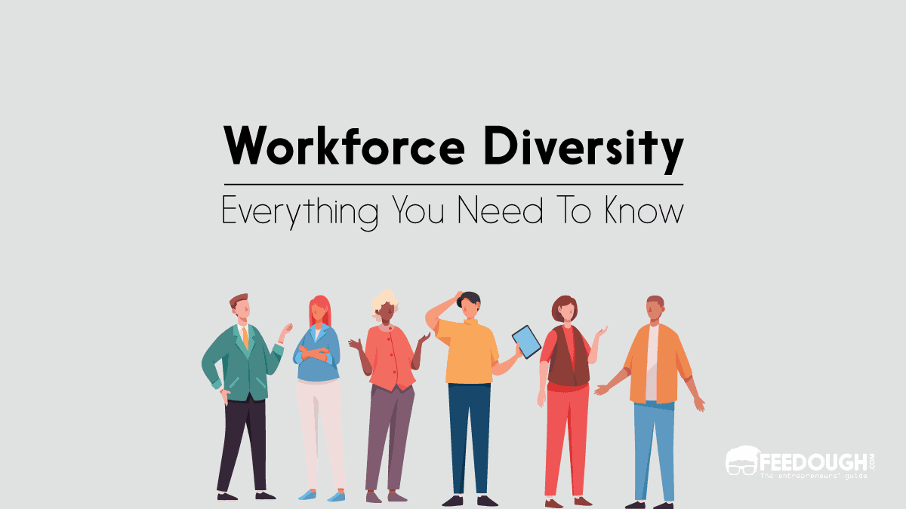
Domestic Workforce is Becoming Increasingly Diverse
As world commerce becomes more and more interconnected, another trend gives intercultural communication increasing importance: people are on the move.
Lured by the prospects of peace, prosperity, education, or a fresh start, people from many cultures are moving to countries promising to fulfill their dreams.
For generations the two most popular destinations have been the United States and Canada.

Slide 71
Domestic Workforce is Becoming Increasingly Diverse
As we seek to accommodate multiethnic neighborhoods, multinational companies, and an intercultural workforce, we can expect some changes to happen smoothly.
Other changes will involve conflict and resentment, especially for people losing their positions of power and privilege.
Learning to accommodate and manage intercultural change is an important part of the education of any business communicator.

Slide 72
Culture and Communication
Comprehending the verbal and nonverbal meanings of a message is difficult even when communicators share the same culture.
When they come from different cultures, special sensitivity and skills are necessary.
Although global business, new communication technologies, the Internet, and social media span the world, reducing distances, cultural differences still exist and can cause significant misunderstandings.

Slide 73
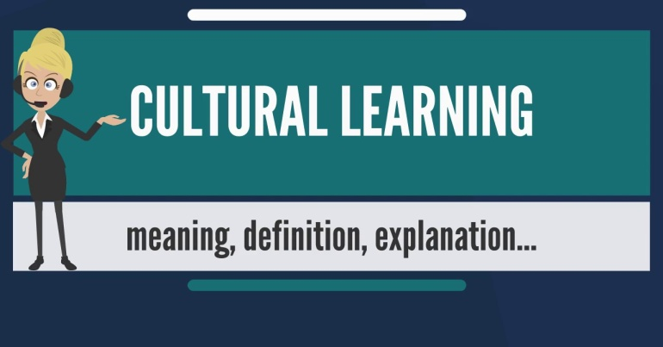
Culture and Communication
Culture may be defined as the complex system of values, traits, morals, and customs shared by a society.
Rules, values, and attitudes of a culture are learned and passed down from generation to generation.
Culture is a powerful operating force that molds the way we think, behave, and communicate.

Slide 74
Dimensions of Culture
The more you know about culture in general and your own culture in particular, the better able you will be to adopt an intercultural perspective.
To help you better understand your culture and how it contrasts with other cultures, we describe five key dimensions of culture:
Context
Individualism
Time Orientation
Power Distance
Communication Style

Slide 75
1. High and Low Context
Low-Context Cultures tend to be logical, analytical, and action oriented.
Communicators stress clearly articulated messages that they consider to be objective, professional, and efficient.
High-Context Cultures are more likely to be intuitive and contemplative.
Communicators pay attention to more than spoken or written words.
They emphasize interpersonal relationships, nonverbal expression, physical setting, and social setting.

Slide 76
2. Individualism and Collectivism
An attitude of independence and freedom from control characterizes individualism.
Members of low-context cultures, particularly Americans, tend to value individualism.
They believe initiative and self-assertion result in personal achievement.
They believe in individual action and personal responsibility, and they desire a large degree of freedom in their personal lives.

Slide 77
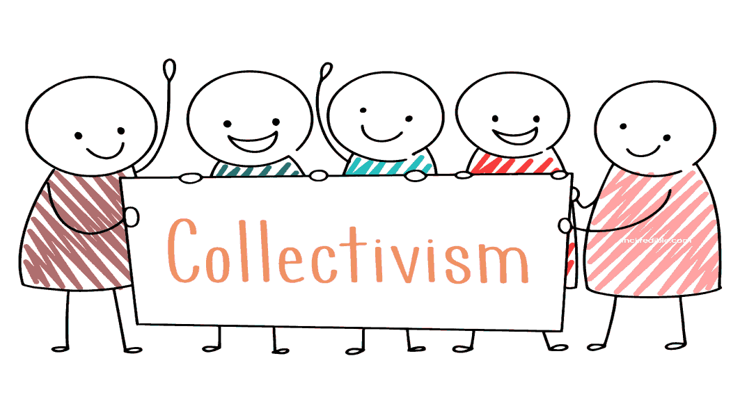
2. Individualism and Collectivism
Members of high-context cultures are more collectivist.
They emphasize membership in organizations, groups, and teams; they encourage acceptance of group values, duties, and decisions.
They typically resist independence because it fosters competition and confrontation instead of consensus.

Slide 78
3. Time Orientation
North Americans consider time a precious commodity to be conserved. They correlate time with productivity, efficiency, and money.
Keeping people waiting for business appointments is considered a waste of time and also rude. In other cultures, however, time may be perceived as an unlimited resource to be enjoyed.

Slide 79
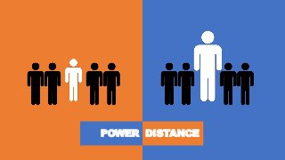
4. Power Distance
The Power Distance Index measures how people in different societies cope with inequality: in other words, how they relate to more powerful individuals.
In high-power-distance countries, subordinates expect formal hierarchies and embrace relatively authoritarian, paternalistic power relationships. In low-power-distance cultures, subordinates consider themselves as equals to their supervisors.

Slide 80
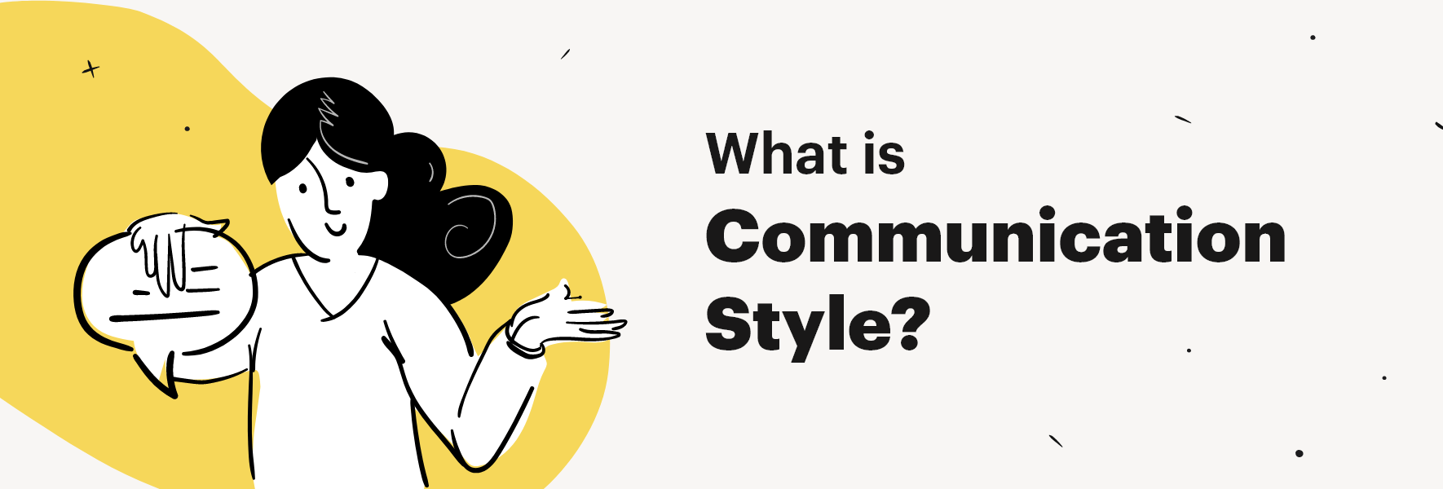
5. Communication Style
People in low-and high-context cultures tend to communicate differently with words.
To people in low-context cultures, words are very important, especially in contracts and negotiations.
People in high-context cultures place more emphasis on the surrounding context than on the words describing a negotiation.

Slide 81
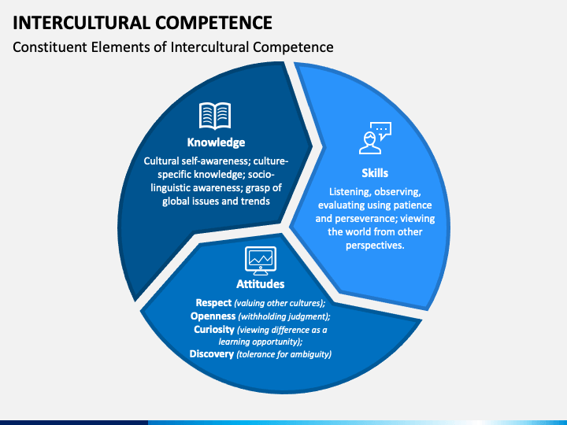
Becoming Interculturally Proficient
Being aware of your own culture and how it contrasts with others is an important first step in achieving intercultural proficiency.
Another step involves recognizing barriers to intercultural accommodation and striving to overcome them.
Some of these barriers occur quite naturally and require conscious effort to surmount.
Intercultural competence will lead to a more satisfying personal life and a more productive, gratifying, and effective work life.

Slide 82
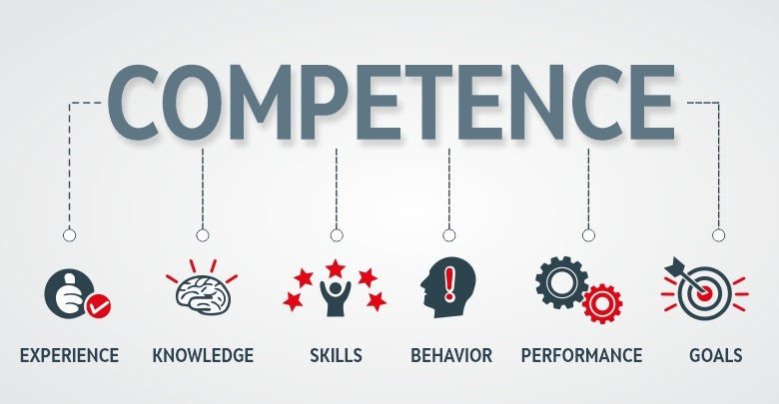
Techniques for Achieving Intercultural Competence
For improving effectiveness and achieving intercultural competence, one expert, M. R. Hammer, suggested that three processes or attitudes are effective.
Descriptiveness
Nonjudgmentalism
Supportiveness

Slide 83
Techniques for Achieving Intercultural Competence 1. Descriptiveness
1. Descriptiveness refers to the use of concrete and specific feedback.
Descriptive feedback is more effective than judgmental feedback.
For example using objective terms to describe the modest attire of Muslim women is more effective than describing it as unfeminine or motivated by the oppressive and unequal treatment of females.

Slide 84
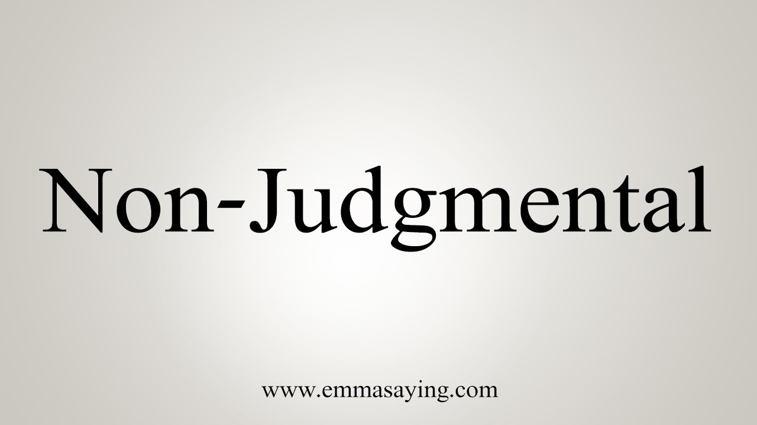
Techniques for Achieving Intercultural Competence 2. Nonjudgmentalism
2. Nonjudgmentalism is an attitude that goes a long way in preventing defensive reactions from communicators.

Slide 85
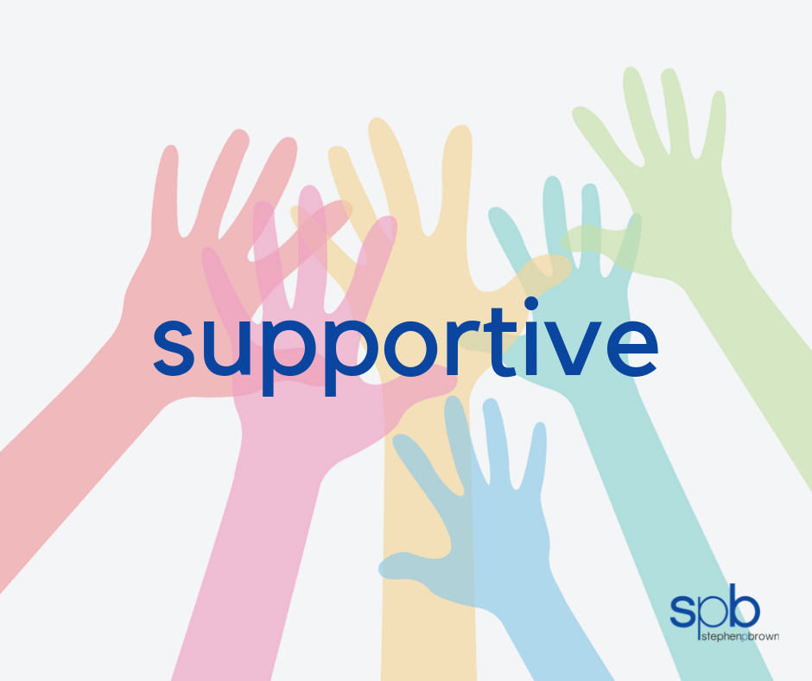
Techniques for Achieving Intercultural Competence 3. Supportiveness
3. Most important in achieving effective communication is supportiveness.
This attitude requires us to support others positively with head nods, eye contact, facial expression, and physical proximity.

Slide 86
Enhancing Oral Communication
Following are suggestions to improve oral intercultural communication:
Observe Eye Messages to Ensure in Sync with Listener
Encourage Accurate Feedback by Asking Probing Questions
Accept Blame for Misunderstandings in Communication
Listen Without Interrupting. Allow Others to Speak
Smile When Appropriate. Be Sincere.
Follow-up in Writing to Confirm Results and Agreements

Slide 87
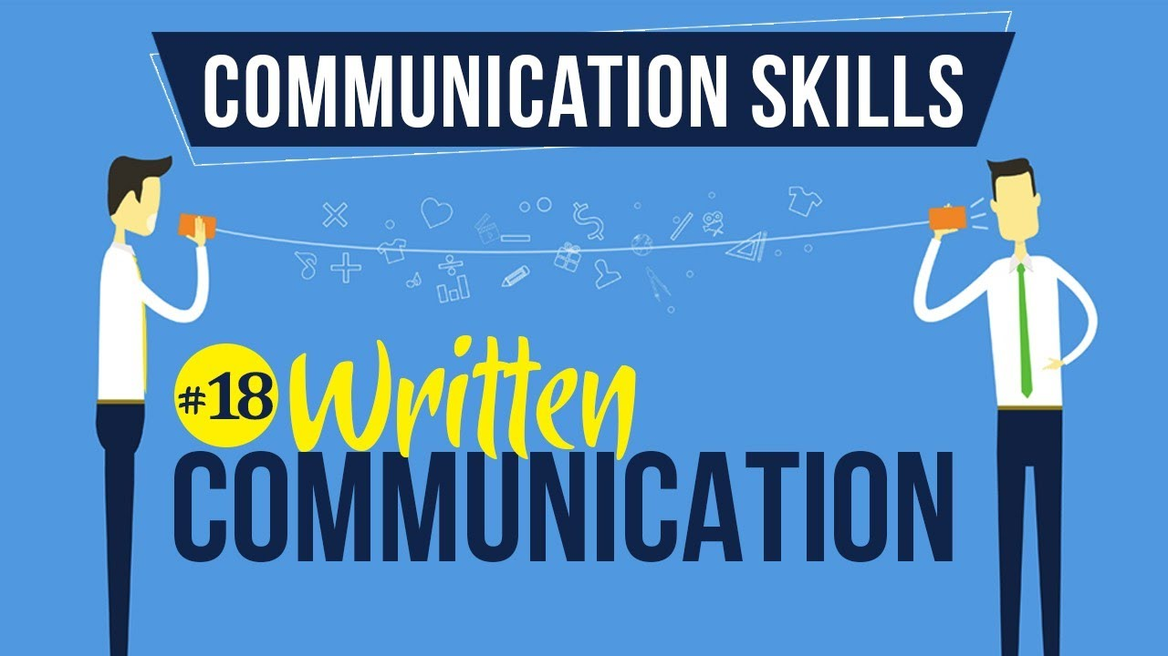
Improving Written Communication
In sending letters, emails, and other documents to business-people in other cultures, try to adjust your writing style and tone.
For example, in cultures in which formality and tradition are important, be scrupulously polite. Don’t even think about sharing the latest joke. Humor translates very poorly and can cause misunderstanding and negative reactions.
Familiarize yourself with customary channels of communication.

Slide 88
Improve Written Communication
The following suggestions can help you prepare successful written messages for intercultural audiences.
Use short sentences and short paragraphs.
Observe titles and rank. Use last name, titles, and other status.
Avoid ambiguous expressions and jargon.
Strive for clarity. Avoid words with many meanings.
Use correct grammar.
Cite numbers carefully (i.e. metric system, local currency)

Slide 89
Workforce Diversity: Benefits and Challenges
While North American companies are expanding global operations and adapting to a variety of emerging markets, the domestic workforce is also becoming more diverse.
Diversity has many dimensions: race, ethnicity, age, religion, gender, national origin, physical ability, sexual orientation, and others.

Slide 90
Diversity and Discord
Diversity can be a positive force within organizations. However, all too often it causes divisiveness, discontent, and clashes.
Many of the identity groups, the workforce disenfranchised, have legitimate gripes.

Slide 91
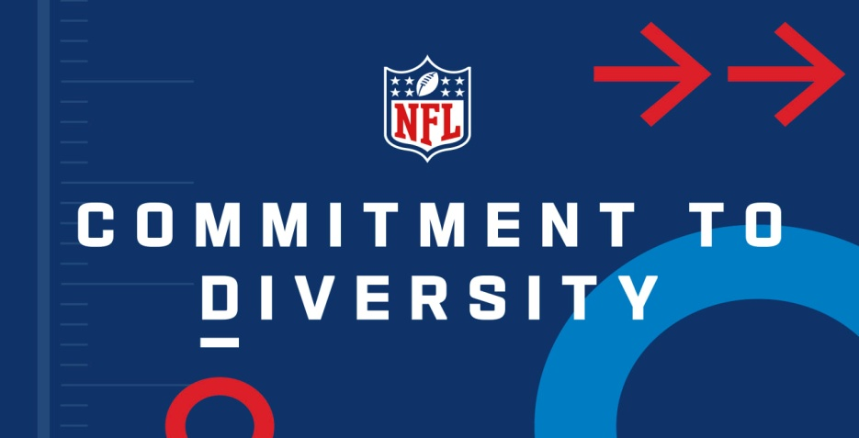
Improving Communication Among Diverse Workplace Audiences
Harmony and acceptance do not happen automatically when people who are dissimilar work together.
This means that organizations must commit to diversity.
Harnessed effectively, diversity can enhance productivity and propel a company to success. Mismanaged, it can become a tremendous drain on a company’s time and resources.
How companies deal with diversity will make all the difference in how they compete in an increasingly global environment.

