Slide 1

Business Communications
Session Two Class Presentation
Business Communication
  Process and Product – 9th Edition
    Mary Ellen Guffey and Dana Loewy; Cengage Learning 2018, 2015
      ISBN: 978-1-305-95796-1

Slide 2
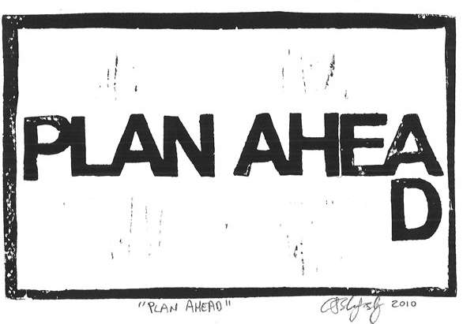
Unit Two: The Writing Process
In the Digital Era
Chapter Four: Planning Business Messages

Slide 3

Understanding the Communication Process
In its simplest form, communication may be defined as the transmission of information and meaning from sender to receiver.
  The crucial element in this definition is meaning.
    The process is successful only when the receiver understands an idea as the sender intended it.

Slide 4

Steps in the Communication Process
Summary
Sender Has Idea
  Clarify idea – decide on purpose of message – analyze idea and how it can be best presented – anticipate effect on receiver
Sender Encodes Message
  Consider receiver’s background – communication skills – experience – culture – context
Sender Selects Channel, Transmits Message
  Consider importance of message, feedback required, interactivity – choose a channel that the receiver prefers – think of ways to reduce channel noise and distractions – be aware of competing messages
Receiver Decodes Message
  Avoid prejudging message – strive to understand both verbal and nonverbal cues – ignore distractions – creative receptive environment – expect to learn
Feedback Returns to Sender
  Craft clear and complete response that reveals comprehension of message meaning – begin the cycle again when the receiver becomes the sender with the same concerns.

Slide 5
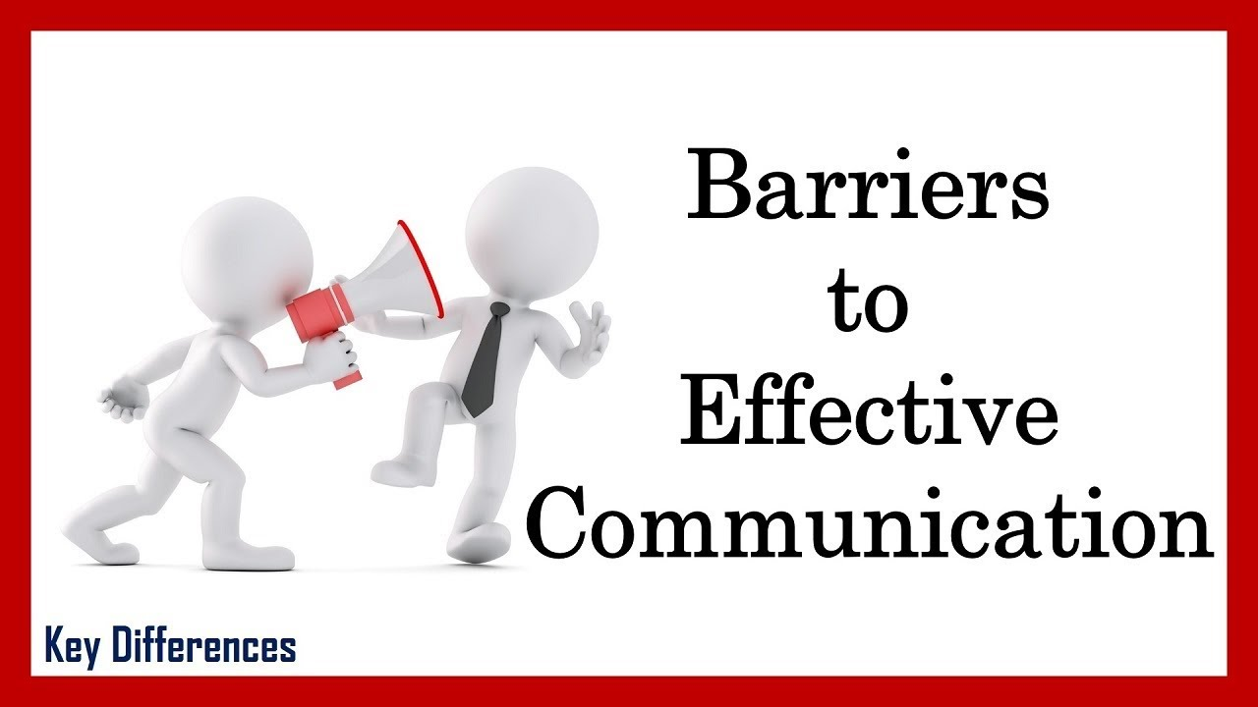
Barriers that Create Misunderstanding
The communication process is successful only when the receiver understands the message as intended by the sender.
  Most messages that we send reach their destinations, but many are partially understood.
    You can improve your chances of communicating successfully by learning to recognize barriers that are known to disrupt the process.
    Some of the most significant barriers for individuals are bypassing, differing frames of reference, lack of language skill, and distractions.

Slide 6
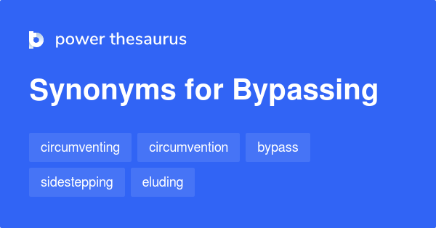
1. Bypassing
An important barrier to clear communication involves words.
Each of us attaches a little bundle of meanings to every word, and these meanings are not always similar.
  Bypassing happens when people miss each other w/ their meanings.
    Let’s say your boss asks you to help with a task, and when you begin the work you learn that you are expected to do the task yourself. You and your boss attach different meanings to the word “help.”

Slide 7
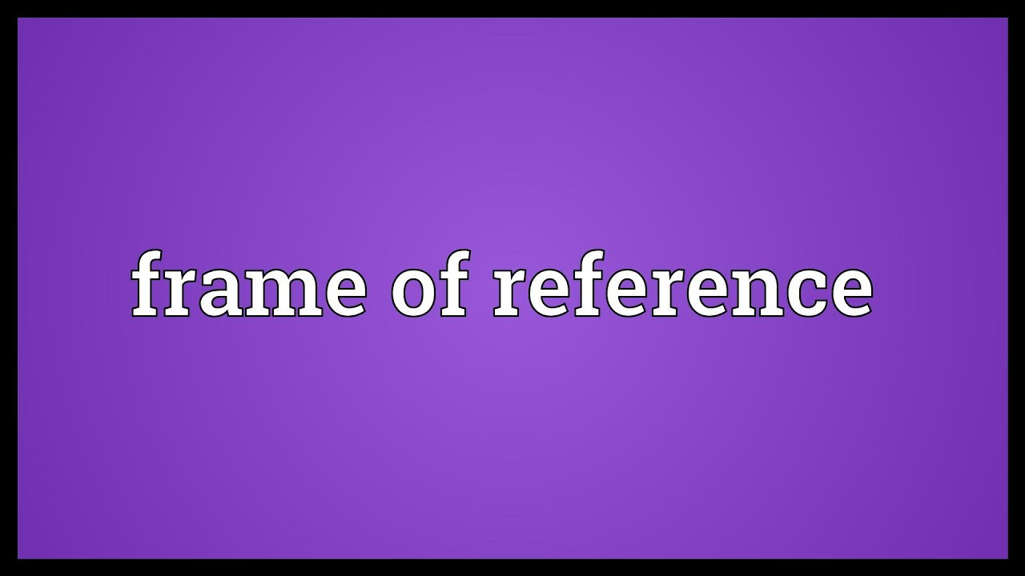
2. Differing Frames of Reference
Another barrier to clear communication is your frame of reference. Everything you see and feel in the world is translated through your individual frame of reference.
  Your unique frame is formed by a combination of your experiences, education, culture, expectations, personality, and other elements.
    As a result, you bring your own biases and expectations to any communication situation. Because your frame of reference is different from everyone else’s, you will never see things exactly as others do.

Slide 8

3. Lack of Language Skill
No matter how extraordinary the idea is, it won’t be understood or fully appreciated unless the communicators involved have good language skills.
  Each individual needs an adequate vocabulary and skill in oral and written expression. Using unfamiliar words, jargon, unrecognizable abbreviations can seriously impede the transmission of meaning.

Slide 9
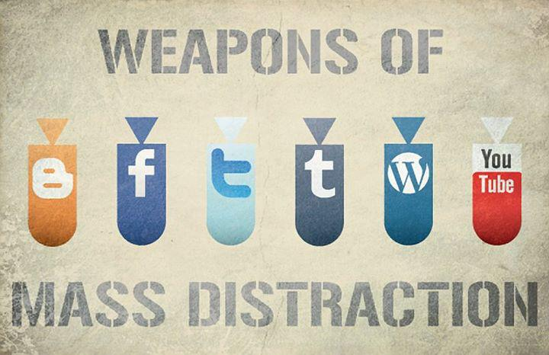
4. Distractions
Other communication barriers are emotional interference, physical distractions, and digital interruptions.
  Shaping an intelligent message is difficult when one is feeling joy, fear, resentment, hostility, sadness, or some other strong emotion.
    To reduce the influence of emotions on communication, both senders and receivers should focus on content of message and try to remain objective.

Slide 10
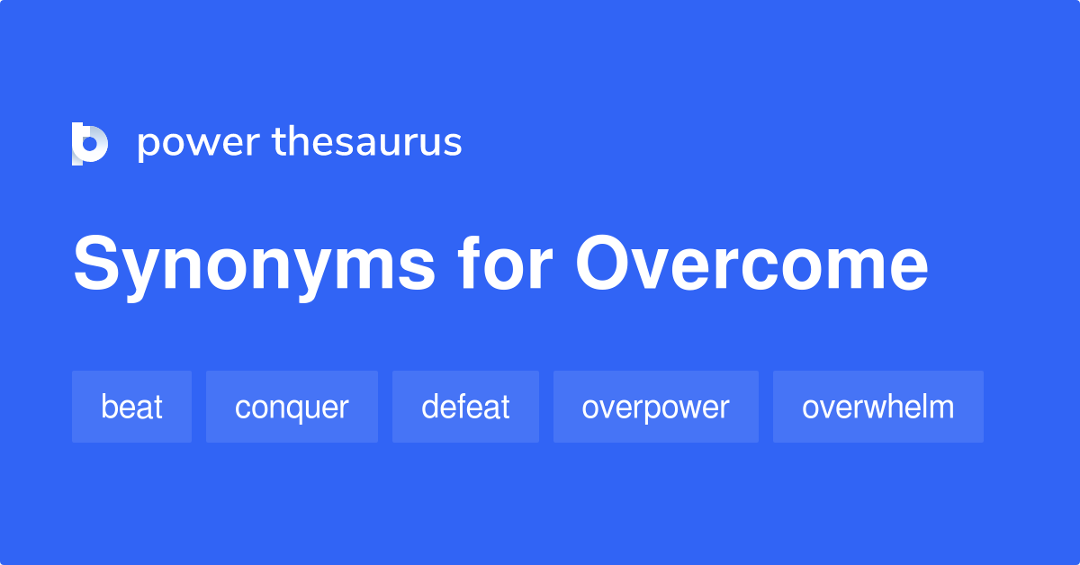
Overcoming Communication Obstacles
Half the battle in communicating successfully is recognizing that the entire process is sensitive and susceptible to breakdown.
  Like a defensive driver anticipating problems on the road, a good communicator anticipates problems in encoding, transmitting, and decoding a message.
    Effective communicators also focus on the receiver’s environment and frame of reference.

Slide 11

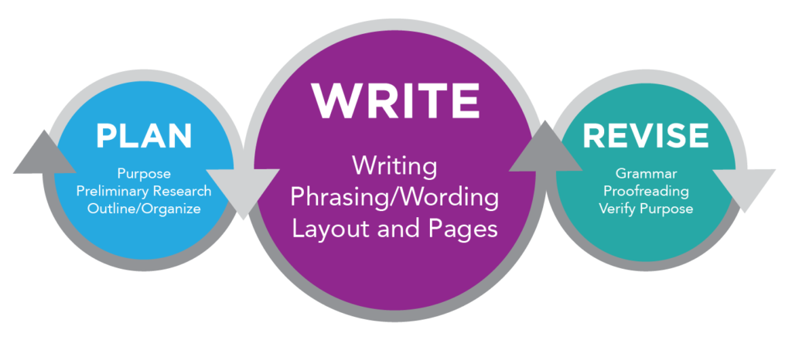
Using the 3x3 Writing Process as a Guide
Today’s new media and digital technologies enable you to choose from innumerable communication channels to create, transmit, and respond to messages.
  Nearly all communication, however, revolves around writing.
    Whether you are preparing a message that will be delivered digitally, orally, or in print, that message requires thinking and writing.

Slide 12
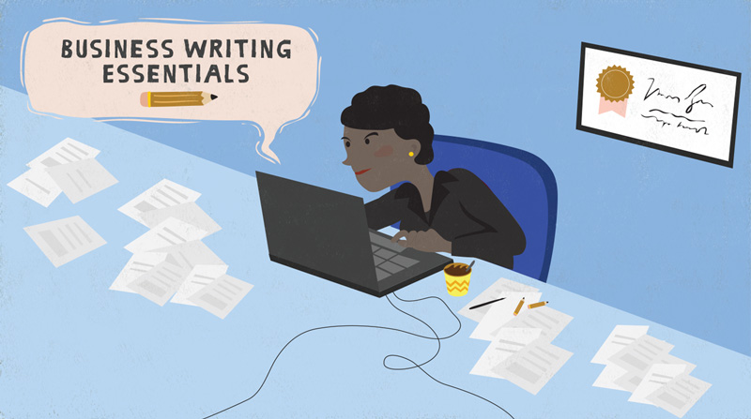
Defining Your Business Writing Goals
Business writing skills should have the following characteristics:
  Purposeful
    You will be writing to solve problems and convey information.
    You will have a definite strategy to fulfill in each message.
  Economical
    You will try to present ideas clearly but concisely. Length is not rewarded.
  Audience Oriented
    You will concentrate on looking at a problem from the perspective of the audience instead of seeing it from your own.

Slide 13

Introducing the 3x3 Writing Process
Regardless of what you are writing, the process will be easier if you follow a systematic plan. The 3x3 writing process breaks the entire task into three phases:
  Planning (25%) - Prewriting
    Analyze your audience and purpose for writing.
    Anticipate how your audience will react to your message.
  Organizing (25%) - Drafting
    Research info, organize evidence, and draft your message.
  Revising (50%)
    Edit, proofread, and evaluate your message for clarity, conciseness, and readability.

Slide 14


Anticipating and Profiling the Audience
No matter how short your message is, spend some time thinking about the people in your audience so that you can tailor your words to them.
  Remember that your receivers will be thinking, “What’s in it for me? (WIIFM).
    Every message you write should begin with the notion that your audience is thinking WIIFM.

Slide 15

Making Choices Based on the Audience Profile
Another consideration in profiling your audience is the possibility of a secondary audience.
  (Example) You may send an email to your primary receiver, however the receiver may forward email as is to another. Given this potential, you may decide to alter the message content, format, tone, etc.
    Analyzing the task and anticipating the audience help you adapt your message so it will be effective for both primary and secondary receivers.

Slide 16

Spotlighting Audience Benefits
Adapting your message to the receiver’s needs means putting yourself in that person’s shoes. It’s called empathy.
  Empathetic senders think about how a receiver will decode a message.
    They try to give something to the receiver, solve the receiver’s problems, save the receiver’s money, or just understand the feelings and position of that person.

Slide 17
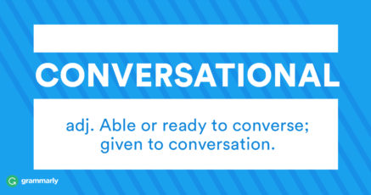
Sounding Conversational but Professional
Most of the business messages you write replace conversation. Thus, they are most effective when they convey an informal, conversational tone instead of a formal, pretentious tone.
  Just how informal you can be, depends greatly on the workplace.
    The dilemma for you, then, is knowing how casual to be in your writing.
    We suggest that you strive to be conversational but professional, especially until you learn what your organization prefers.

Slide 18
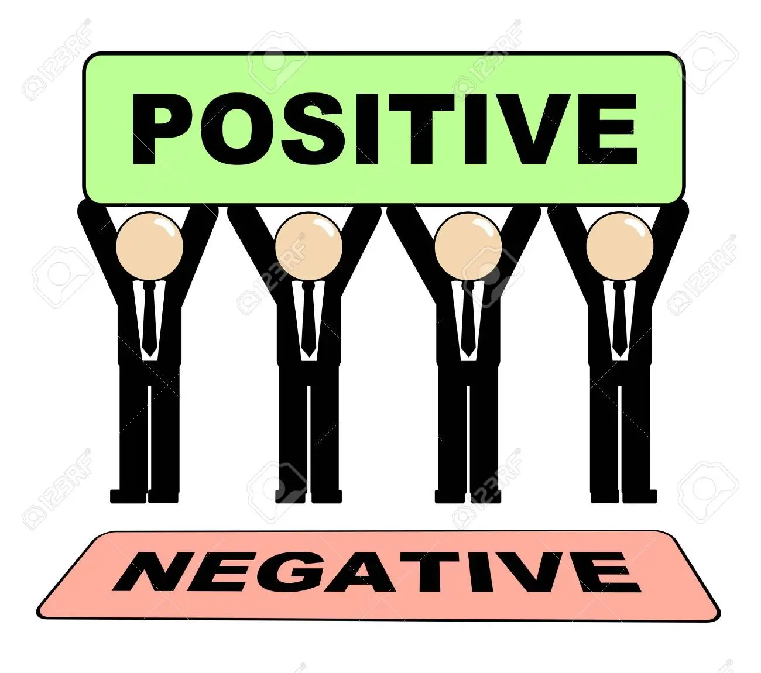
Being Positive Rather Than Negative
You can improve the clarity, tone, and effectiveness of a message by using positive rather than negative language.
  Positive language generally conveys more information than negative language does. Moreover, positive messages are uplifting and pleasant to read.
    Positive wording tells what is and what can be done rather than what isn’t and what can’t be done.
      (Example) An office supply store adjacent to an ice cream parlor posted a sign on its door that reads: “Please enjoy your ice cream before you enjoy our store.” That sounds much more positive and inviting than “No food allowed.”

Slide 19
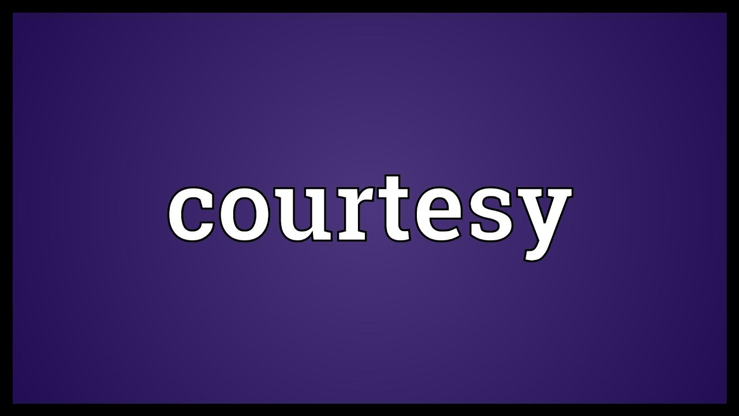
Expressing Courtesy
Maintaining a courteous tone involves not just guarding against rudeness but also avoiding words that sound demanding or preachy.
  Expressions such as “you should,” “you must,” and “you have to” cause people to instinctively react with “Oh, yeah?”
    One remedy is to turn these demands into rhetorical questions that begin with “Will you please…” Giving reasons for a request also softens the tone.

Slide 20

Expressing Courtesy
Even when you feel justified in displaying anger, remember that losing your temper or being sarcastic will seldom accomplish your goals as a business communicator: to inform, to persuade, and to create good will.
  When you are irritated, frustrated, or infuriated, keep cool and try to defuse the situation.
    In dealing with customers in telephone conversations, use polite phrases such as “I would be happy to assist you with that,” Thank you for being so patient,” and “It was a pleasure speaking with you.”

Slide 21

Unit Two: The Writing Process
In the Digital Era
Chapter Five: Organizing and Drafting Business Messages

Slide 22

Beginning with Research
Businesspeople must constantly make decisions, solve problems, and determine how to proceed.
  They solve problems and make decisions by gathering info, generating ideas, and organizing those ideas into logical messages that guide their organizations.
    These activities are part of the second phase of the 3x3 writing process: researching, organizing, and drafting.

Slide 23

Beginning with Research
No smart businessperson would begin drafting a message before gathering background information.
  We call this process “research,” a rather formal-sounding term. For our purposes, however, research simply means collecting information about a certain topic.
    This is an important step in the writing process because that information helps the writer shape the message.

Slide 24

Beginning with Research
Discovering significant information after a message is half completed often means having to start over and reorganize.
  To avoid frustration and inaccurate messages, writers collect information that answers several questions:
    What does the receiver need to know about the topic?
    What is the receiver to do?
    How is the receiver to do it?
    When must the receiver do it?
    What will happen if the receiver doesn’t do it?

Slide 25

Generating Ideas and Organizing Information
Not all information for making decisions is available by research. Often fresh ideas to solve problems must be generated.
  For years, organizations have tried to solve problems and generate ideas in group discussion. Two methods have prevailed:
    Brainstorming and Brainwriting
    Crowdsourcing

Slide 26

Brainstorming and Brainwriting
Traditionally, groups have generated ideas by brainstorming, which may be defined as the spontaneous contribution of ideas from members of a group.
  In short, a group gathers to solve a problem, and every member strives to present as many ideas as possible.
  The emphasis is on quantity, not quality.
    The ideas are then evaluated, and the best are selected.

Slide 27

Brainstorming and Brainwriting
Critics, however, charge that brainstorming in this traditional format doesn’t work.
  Brainstorming favors first ideas, thus promoting groupthink and limiting fresh avenues of thought.
    It results in the “loudmouth meeting-hog phenomenon,” in which one extrovert dominates the conversation.
    Not only can one person dominate the session, but early ideas tend to sway the group. “It’s called anchoring, and it crushes originality.”

Slide 28

Brainstorming and Brainwriting
To overcome the shortcomings of traditional brainstorming, some critics champion brainwriting. This creative technique involves writing out ideas rather than speaking them.
  Supporters claim that brainwriting generates far more creative ideas than traditional brainstorming.
    Brainstorming can be a wild affair with visionary off-the-wall suggestions, whereas, brainwriting is quieter and more thoughtful.

Slide 29

Crowdsourcing
Crowdsourcing describes the practice of requesting ideas or services online from unknown crowd members rather than from traditional employees or contractors.
  Crowdsourcing has become an appealing and inexpensive method of tapping into the collective knowledge of consumers.

Slide 30

Grouping Ideas to Show Relationships
After collecting data and generating ideas, writers must find some way to organize their information.
  The process includes: (1) grouping and (2) strategizing.
    Skilled writers group similar items together. Then they place ideas in a strategic sequence that helps the reader understand relationships and accept the writer’s views.

Slide 31

Using Lists and Outlines
Writers should organize their ideas into a hierarchy, such as an outline.
    The beauty of preparing an outline is that it gives writers a chance to organize their thoughts before becoming bogged down in word choice and sentence structure.

Slide 32

Tips for Making an Outline
Tips for Making an Outline
  Define the main topic in the title.
  Divide the main topic into major components (preferably 3 to 5).
  Break the components into subpoints (2 or more).
  Strive to make each component exclusive (no overlapping).
  Use details, illustrations, and evidence to support subpoints.

Slide 33

Organizing Ideas Into Strategies
How you order the information in your outline depends on the strategy you choose.
  In the Direct Strategy, the main idea comes first, followed by details, explanation, or evidence.
  In the Indirect Strategy, the main idea follows the details, explanation, and evidence.
    The strategy you select is determined by how you expect the audience to react to the message.

Slide 34
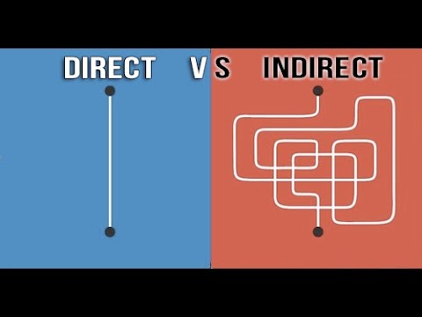
Direct Strategy for Receptive Audiences
Anticipate the audience’s reaction to your ideas and frame your message accordingly.
  When you expect the reader to be pleased, interested, or neutral: use the Direct Strategy. Get to your point quickly.
    Place the purpose of your message in the first or second sentence.

Slide 35

Direct Strategy for Receptive Audiences
The Direct Strategy has three advantages:
  Saves the reader time.
    Messages that take too long to get to the point may lose readers along the way.
  Sets a proper frame of mind.
    Learning the purpose up front helps the reader put the details and explanations in perspective.
  Reduces frustration.
    Poorly organized messages create a negative impression of writer.

Slide 36

Indirect Strategy for Unreceptive Audiences
When you expect audience to be uninterested, unwilling, displeased, or hostile, the Indirect Strategy is appropriate.
  In this strategy you reveal the main idea only after you have offered an explanation and evidence.
    This approach works well with 3 kinds of messages: (1) bad news, (2) ideas that require persuasion, and (3) sensitive news, especially when being transmitted to superiors.

Slide 37

Indirect Strategy for Unreceptive Audiences
The Indirect Strategy has three benefits:
  Respects the feelings of the audience.
    Bad news is always painful, but the trauma can be lessened by preparing the receiver for it.
  Facilitates a fair hearing.
    Messages that may upset the reader are more likely to be read when the main idea is delayed. Beginning immediately with bad news or a persuasive request, may cause the receiver to stop reading or listening.
  Minimize a negative reaction.
    A reader’s overall reaction to a negative message is generally improved if the news is delivered gently.

Slide 38
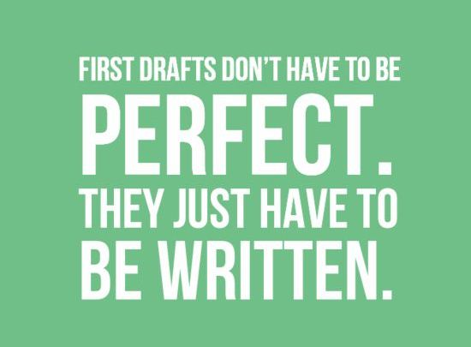
Composing the First Draft with Effective Sentences
One you have researched your topic, organized the data, and selected a strategy, you’re ready to begin drafting.
  Many writers have trouble getting started, especially if they haven’t completed the preparatory work.
  Organizing your ideas and working from an outline are very helpful in overcoming writer’s block.
  Composition is also easier if you have a quiet environment in which to concentrate.
    Businesspeople with messages to compose set aside given time and allow no calls, visitors, or other interruptions.

Slide 39

Achieving Variety with Four Sentence Types
To avoid monotony and to add spark to your writing, use a variety of sentence types.
  You have four sentence types from which to choose:
    Simple Sentence
    Compound Sentence
    Complex Sentence
    Compound-Complex Sentence

Slide 40
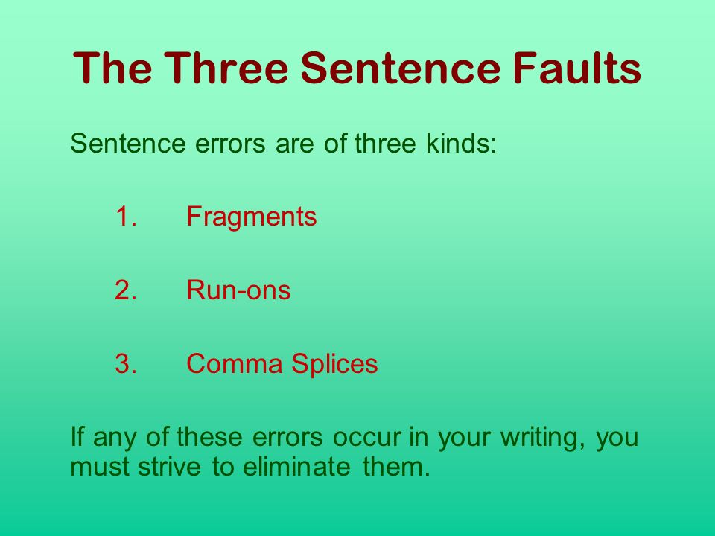
Avoiding Three Common Sentence Faults
As you craft your sentences, beware of three common traps: (1) fragments, (2) run-on (fused) sentences, and (3) comma-splice sentences.
  If any of these faults appear in a business message, the writer immediately loses credibility.

Slide 41

Favoring Short Sentences
Because your goal is to communicate clearly, you should strive for sentences that average 20 words. Some sentences will be shorter; some will be longer.
  The American Press Institute reports that reader comprehension drops off markedly as sentences become longer.
    Therefore, in crafting your sentences, think about the relationship between sentence length and comprehension.

Slide 42
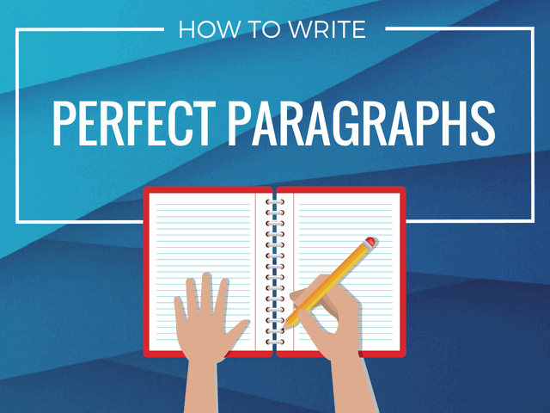
Building Well-Organized Paragraphs
A paragraph is a group of sentences about one idea.
  Well-constructed paragraphs discuss only one topic.
    A topic sentence reveals the primary idea in a paragraph and usually, but not always, appears first.

Slide 43

Building Well-Organized Paragraphs
Paragraphs may be composed of three kinds of sentences.
These sentences may be arranged in any of three classic paragraph plans: direct, pivoting, and indirect.
  Topic Sentence
    Expresses the primary idea of the paragraph.
  Supporting Sentence
    Illustrates, explains, or strengthens the primary idea.
  Limiting Sentence
    Opposes the primary idea by suggesting a negative or contrasting thought; may precede or follow the topic sentence.

Slide 44

Developing Paragraph Coherence
Paragraphs are coherent when ideas cohere – that is, when the ideas stick together and when one idea logically leads to the next.
  Well-written paragraphs take the reader through a number of steps.
  These techniques will help keep the reader in step with your ideas:
    Sustaining the Key Idea
    Dovetailing Sentences
    Including Pronouns
    Employing Transitional Expressions

Slide 45

Controlling Paragraph Length
Although no rule regulates the length of paragraphs, business writers recognize that short paragraphs are more attractive and readable than longer ones.
  Paragraphs with eight or fewer lines look inviting.
  Long, solid chunks of print appear formidable.
    If a topic can’t be covered in eight or fewer printed lines (not sentences), consider breaking it up into small segments.

Slide 46
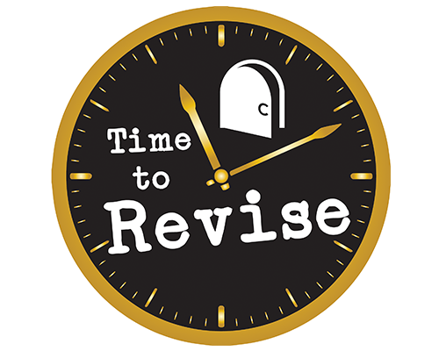
Unit Two: The Writing Process
In the Digital Era
Chapter Six: Revising Business Messages

Slide 47

Stopping to Revise: Applying Phase 3 of the Writing Process
The final phase of the 3x3 writing process focuses on editing, proofreading, and evaluating.
  Editing means improving the content and sentence structure of your message. Proofreading involves correcting its grammar, spelling, punctuation, format, and mechanics. Evaluating is the process of analyzing whether your message achieves its purpose.
    Revision can often mean the difference between acceptance or rejection of ideas.

Slide 48
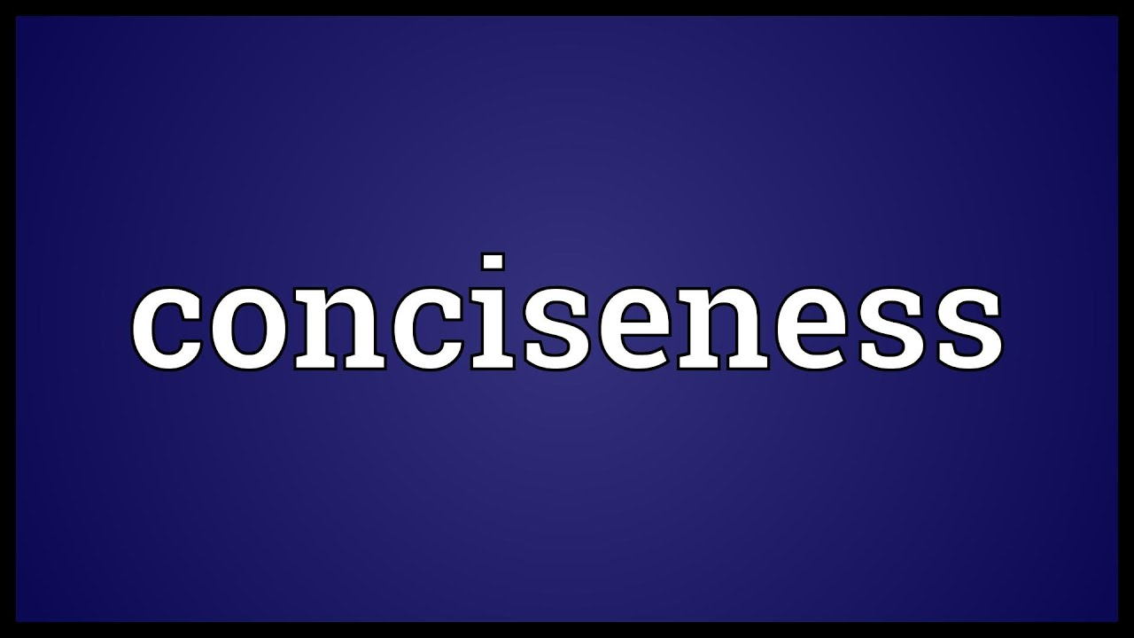
Polishing Your Messages by Revising for Conciseness
Messages that are written directly and efficiently are easier to read and comprehend.
  In the revision process, look for shorter ways to say what you mean.
  Examine every sentence. Can message be converted in fewer words?
    Writing will be more concise if you drop unnecessary introductory and empty words, and eliminate redundancies.

Slide 49

Improving Message Clarity
One of the most important tasks in revising is assessing the clarity of your message.
  A clear message is one that is immediately understood.
    Employees, customers, and investors increasingly want to be addressed in a clear and genuine way. Fuzzy, long-winded, and unclear writing prevents comprehension.

Slide 50

Improving Message Clarity
Readers understand better when information is presented clearly and concisely.
  Numerous techniques can improve the clarity of your writing including applying the KISS formula (Keep It Short and Simple), dumping trite business phrases, scrapping clichés and buzzwords, rescuing buried verbs, and restraining exuberance.

Slide 51
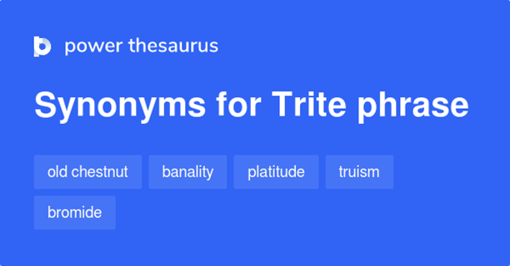
Slashing Trite Business Phrases
In an attempt to sound businesslike, some business writers repeat the same stale expressions that others have used over the years. Your writing will sound fresher and more vigorous if you eliminate trite phrases or find more original ways to convey the idea.

Slide 52
Slashing Trite Business Phrases
Trite Phrase | Improved
As per you request | As you request
Pursuant to your request | At your request
Enclosed please find | Enclosed is
Every effort will be made | We’ll try
In accordance with your wishes | As you wish
In receipt of | Have received
Please do not hesitate to | Please
Respond forthwith | Respond immediately
Thank you in advance | Thank you
Under separate cover | Separately
With reference to | About

Slide 53
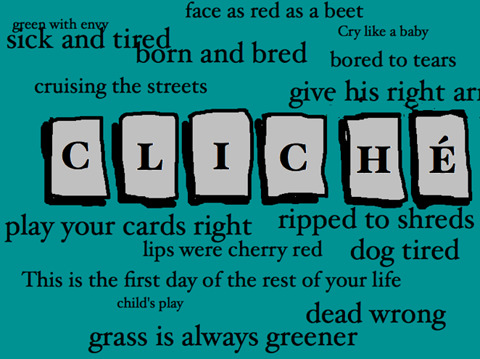
Cutting Clichés
Clichés are expressions exhausted by overuse.
  Cliches lack not only freshness but also clarity.
    Instead of repeating clichés, find other ways to say what you mean.

Slide 54
Cutting Cliches
Cliché
Below the belt | Last but not least
Better than new | Make a bundle
Beyond a shadow of a doubt | Pass with flying colors
Easier said than done | Quick as a flash
Exception to the rule | Shoot from the hip
Fill the bill | Stand your ground
First and foremost | Think outside the box
Good to go | True to form

Slide 55

Scrapping Slang and Buzzwords
Slang is composed of informal words with arbitrary and changed meanings.
  Slang words quickly go out of fashion because they are no longer appealing when everyone begins to understand them.
    If you want to sound professional, avoid the use of slang.

Slide 56
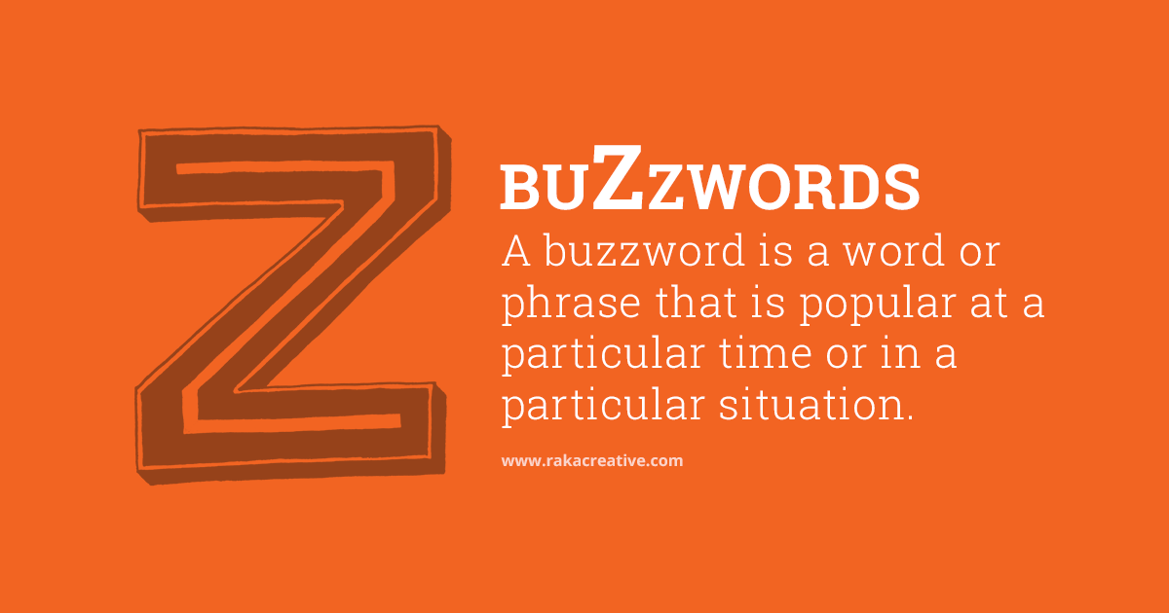
Scrapping Slang and Buzzwords
Equally unprofessional and imprecise are business buzzwords. These are technical expressions that have become fashionable and often are meant to impress rather than express.
  Business buzzwords include empty terms: “optimize,” “incentivize,” “impactful,” “leveraging,” “right-size,” and “paradigm shift.”
    Countless businesses today use vague rhetoric such as “cost effective,” “positioned to perform,” “solutions-oriented,” etc.

Slide 57
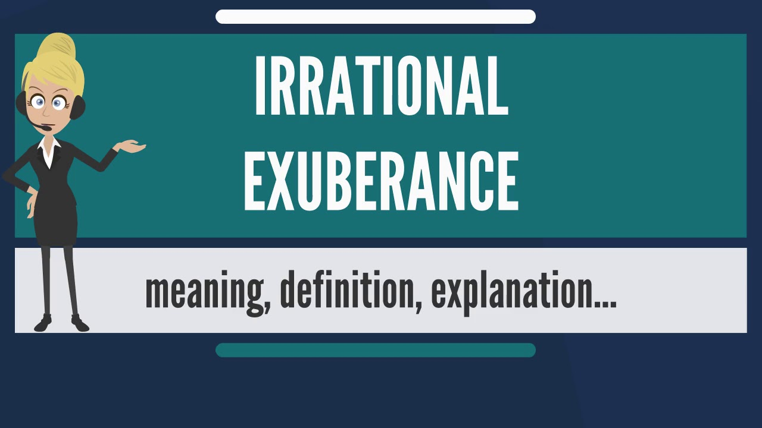
Restraining Exuberance
Occasionally, we show our exuberance with words such as “very,” “definitely,” “quite,” “completely,” “extremely,” “really,” “actually,” and “totally.” These intensifiers can emphasize and strengthen your meaning. Overuse, however, is unprofessional.
  Control your enthusiasm and guard against excessive use.
    From: “The manufacturer was extremely upset to learn that its product was definitely being counterfeited.” To: “The manufacturer was upset to learn that its product was being counterfeited.”

Slide 58

Applying Document Design to Enhance Readability
Use document design to enhance readability of messages.
  In revision process, you have a chance to adjust formatting and make other changes so that the readers grasp your main points quickly.
    Significant design techniques to improve readability include appropriate use of white space, margins, typefaces, numbered and bulleted lists, and headings for visual impact.

Slide 59

Employing White Space
Empty space on a page is called white space.
  A page crammed full of text or graphics appears busy, cluttered, and unreadable. To increase white space, use headings, bulleted or numbered lists, and effective margins. Short sentences and short paragraphs improve readability and comprehension.
    As you revise, think about shortening long sentences.
    Consider breaking up long paragraphs into shorter chunks.

Slide 60

Understanding Margins and Text Alignment
Margins determine the white space on the left, right, top, and bottom of a block of type.
  They define the reading area and provide important visual relief.
    Business letters and memos usually have side margins of 1 to 1.5 inches.

Slide 61
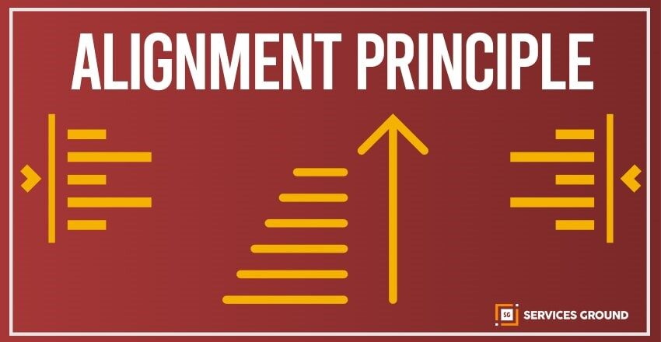
Understanding Margins and Text Alignment
Your word processing program probably offers four forms of margin alignment:
  Lines align only at the left
  Lines align only at the right
  Lines align at both left and right (justified)
  Lines are centered.
    Nearly all text in Western culture is aligned at the left and reads from left to right. The right margin may be either justified or ragged right.

Slide 62
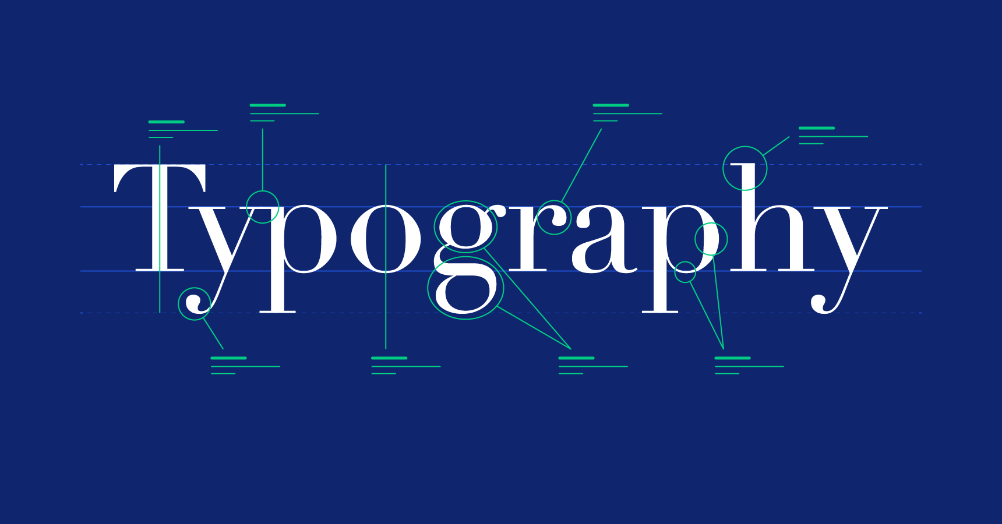
Choosing Appropriate Typefaces
Business writers today may choose from a number of typefaces on their word processors. A typeface defines the shape of text characters – review Theme Fonts in Microsoft Word
  A wide range of typefaces is available for various purposes. Some are decorative and useful for special purposes. The most commonly used for business messages is – Times New Roman.

Slide 63
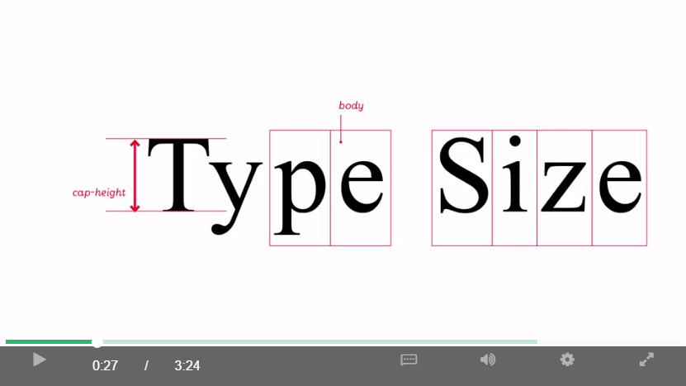
Understanding Type Fonts, Sizes, and Listing Techniques
During the revision process, think about type size.
  Readers are generally most comfortable with 11 to 12-point type for body text.
    Smaller type enables you to fit more words into a space.
    Larger type, however, is appropriate for headings.

Slide 64

Numbering and Bulleting Lists for Quick Comprehension
One of the best ways to ensure rapid comprehension of ideas is through the use of numbered or bulleted lists.
  Lists provide high skim value. This means that readers can browse quickly and grasp main ideas.
    By breaking up complex information into smaller chunks, lists improve readability, understanding, and retention. They also force the writer to organize ideas and write efficiently.

Slide 65
Numbering and Bulleting Lists for Quick Comprehension
In the revision process, look for ideas that could be converted to lists, and follow techniques to make lists look professional.
  Numbered Lists
    Use for items that represent a sequence or reflect numbering system.
  Bulleted Lists
    Use to highlight items that don’t necessarily show a chronology.
  Capitalization
    Capitalize the initial word of each line.
  Punctuation
    Add end punctuation only if the listed items are complete sentences.
  Parallelism
    Make all the lines consistent; for example, start each with a verb.

Slide 66
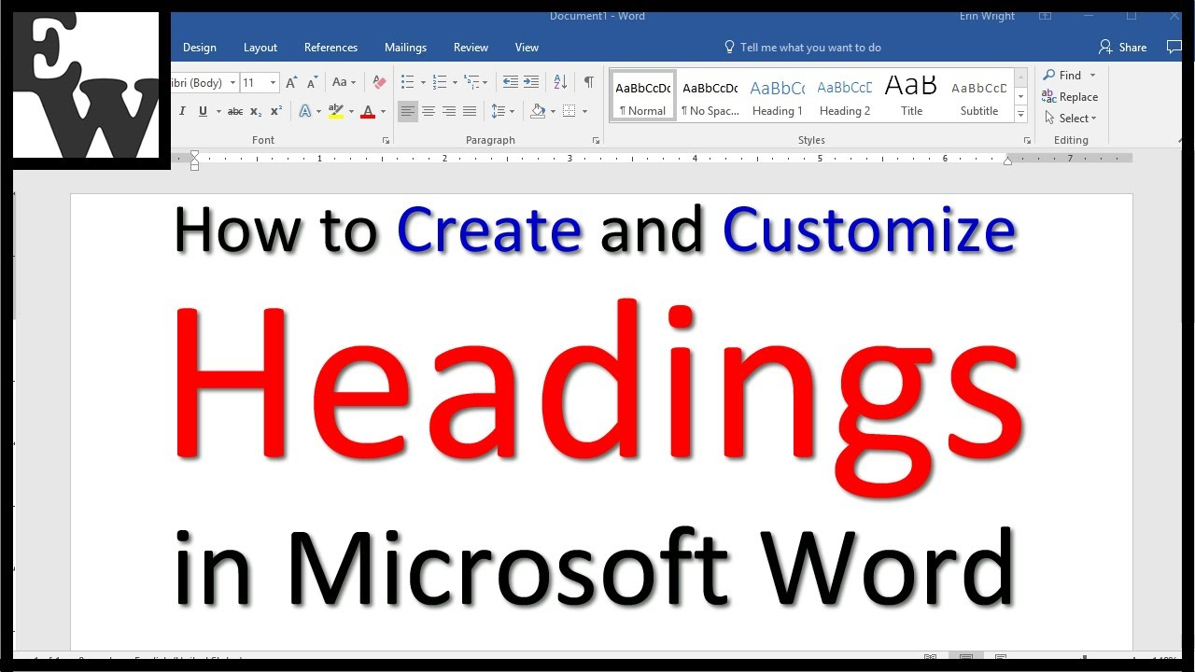
Adding Headings for Visual Impact
Headings are an effective tool for highlighting information and improving readability.
  They encourage the writer to group similar material together.
    Headings help the reader separate major ideas from details.
    They enable a busy reader to skim familiar or less important information. They also provide a quick preview or review.

Slide 67
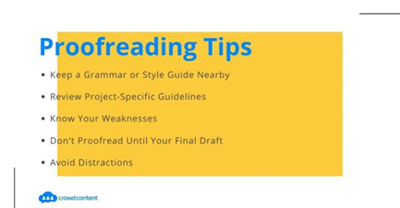
Proofreading to Catch Errors
None of us is perfect, and even the best writers sometimes make mistakes. The problem, however, is not making the mistakes; rather not finding or correcting them.
  Documents with errors affect your credibility and the success of your organization.
    Proofread.

Slide 68

Proofreading to Catch Errors
When you finish a first draft, plan for a cooling-off period.
  Put the document aside and return to it after a break, preferably 24 hours or longer.
    Proofreading is difficult because we read what we thought we wrote. That’s why it’s important to look for specific problem areas.

Slide 69
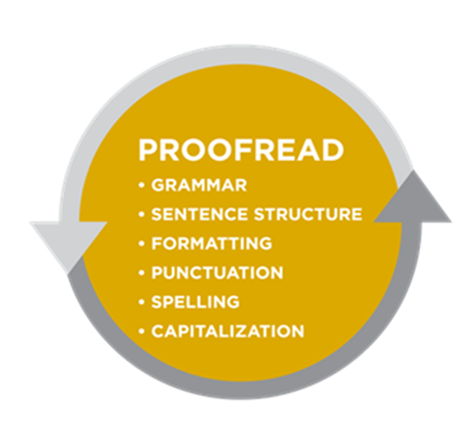
What to Watch for in Proofreading
Careful proofreaders check for problems in following areas:
  Spelling
  Grammar
  Punctuation
  Names and Numbers
  Format

Slide 70
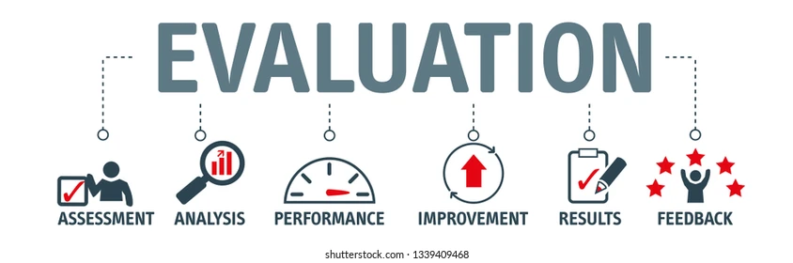
Evaluating the Effectiveness of Your Message
Evaluate your writing, and remember that everything you write, takes the place of a personal appearance.
  If meeting in person, you would dress appropriately/professionally. This standard applies to writing.
    Evaluate your writing to be certain that it attracts the reader’s attention.
    Is it polished and clear enough to convince the reader that you are worth listening to? How successful will this message be? Does it say what you want it to? Will it achieve your purpose? How will you know it succeeds?

Slide 71

Evaluating the Effectiveness of Your Message
The best way to judge the success of your communication is through feedback.
  For this reason, you should encourage the receiver to respond to your message.
    This feedback will tell you how to modify future efforts to improve your communication technique.

Slide 72


