Slide 1
Customer Service Management Session One
Customer Service
Skills for Success – 7th Edition
Robert W. Lucas; McGraw-Hill Education; New York, NY 2019
ISBN: 978-1-259-95407-8

Slide 2
Part One: The Profession
Chapter One: The World of Customer Service
“Treat every customer as if they sign your paycheck, because they do.” (Unknown).

Slide 3
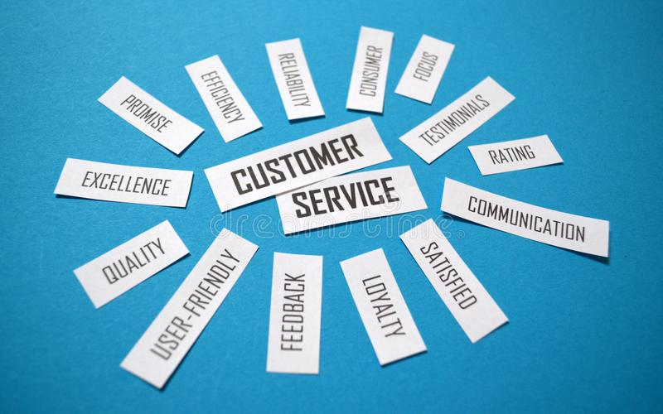
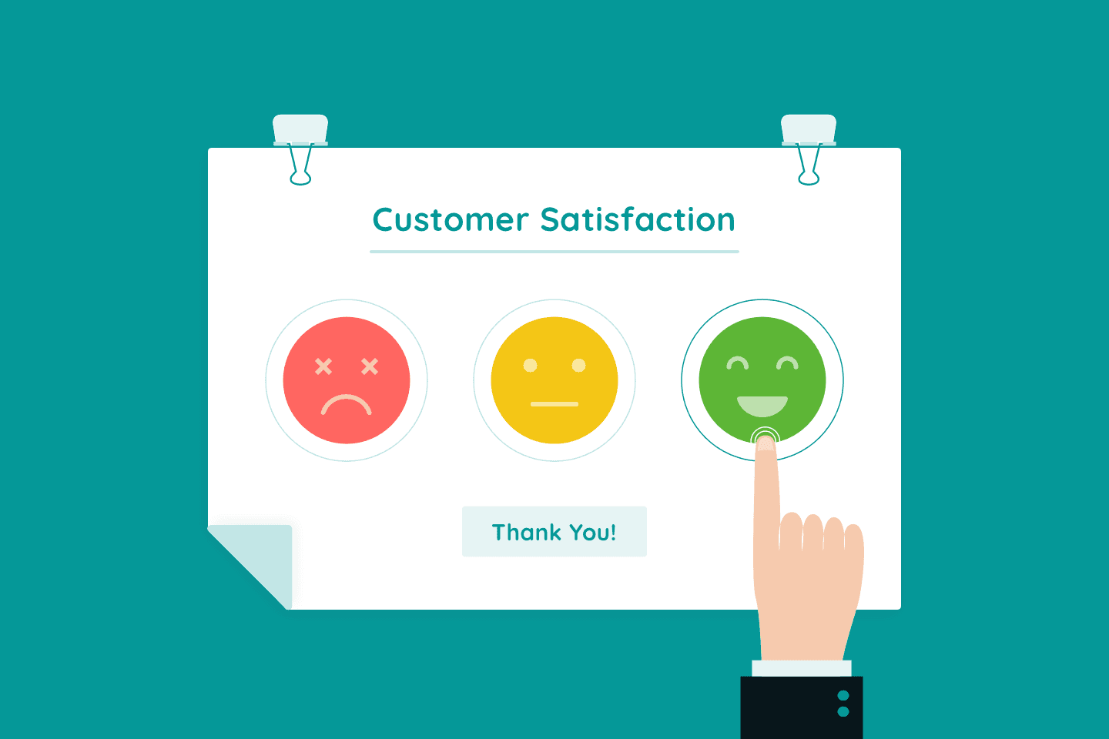
Defining Customer Service
Customer Service is the ability of knowledgeable, capable, and enthusiastic employees to deliver products and services to their internal and external customers in a manner that satisfies needs and ultimately results in positive word-of-mouth publicity and return business.

Slide 4
Defining Customer Service
By satisfying customer needs, organizations can truly become customer-focused organizations.

Slide 5
Customer-Focused Organizations (CFOs)
CFOs are companies that spend energy and effort on satisfying internal and external customers by first identifying customer needs, and then establishing policies, procedures, and management and reward systems to support excellence in service delivery.

Slide 6
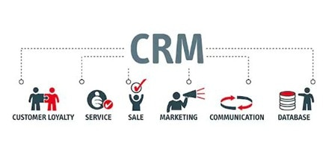
Customer Relationship Management (CRM)
CRM is the concept of identifying customer needs: understanding and influencing customer behavior through ongoing communication strategies in an effort to acquire, retain, and satisfy the customer.
The ultimate goal is customer loyalty.

Slide 7
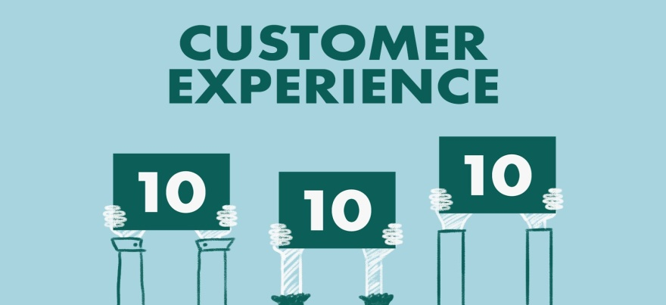
Customer Service
All companies and organizations have internal or external customers, or both.
No matter what type of organization you work in, it is crucial for you to remember that when dealing with customers, it is not about you. Your purpose and goal should be to assist in meeting their needs whenever possible. Be proactive and positive. Be at your best.
You have a vested interest to prevail, since your success and that of your organization depend on it.

Slide 8
Customer Service
Internal Customers
People within the organization who either require support and service or provide information, products, and services to service providers who interact with external customers.
Such customers include peers, coworkers, bosses, subordinates, and people from other areas of the organization.

Slide 9
Customer Service
External Customers
Those people outside the organization who purchase or lease products and services.
This group includes vendors, suppliers, people on the telephone or Internet, and others not from the organization.

Slide 10
Concept of Customer Service
In the past when many people worked on farms, small artisans and business owners provided customer service to their neighbors. No multinational chain stores existed.
Many small towns and villages had their own blacksmith, general store, feed store, boardinghouse (hotel), restaurant, tavern, barber, dentist, doctor, and similar service-oriented establishments owned and operated by people living in the town
Often the place of business was also their residence.

Slide 11
Concept of Customer Service
People bought materials at the general store to make their own repairs to clothing, equipment, and household items. To supplement their income, many people made and sold or bartered products from their homes in what came to be known as Cottage Industries.
For people living in more rural areas, peddlers w/ wagons of kitchenware, medicine, and other goods made their way from one location to another to serve their customers and distribute various products.

Slide 12
Concept of Customer Service
As trains, wagons, carriages, and stagecoaches began to cross the U.S., Europe, Asia, and other parts of the world, they carried vendors and supplies, and provided transportation.
During that time, customer service differed from today by the fact that the owners were also the chief executive officers (CEOs) and motivated frontline employees working face-to-face with customers.
They had a vested interest in providing good service and succeeding.

Slide 13
Key Developments in Customer Service
When industry, manufacturing, and larger cities started to grow, the service industry really started to gain ground.
In the late 1800s, societal and technological changes occurred that set the stage for what would become the customer service profession of today.

Slide 14
Shift to Service Service Economy
Today, businesses have changed dramatically as the economy has shifted from a dependence on manufacturing to a focus on providing timely quality service.
Service Economy is a term used to describe the trend in which businesses have shifted from primarily production and manufacturing to more service delivery.
As part of this evolution, many organizations have developed specifically to provide services to customers.

Slide 15
Service Standards
Organizations such as the International Council of Customer Service Organizations (www.iccso.org) work to help develop and promote service and professional excellence standards throughout the world.
This is being done by setting internationally acceptable standards and certifications to create a global atmosphere of service and to enhance the customer service experience.

Slide 16
Growth of the Service Sector
Technology affected jobs in the following ways: quantity of jobs created, distribution of jobs, and quality of jobs.
The service sector is projected to have the largest job growth, particularly in telephone call centers, credit and insurance agencies, banks, and retail stores.
Employment of customer service representatives is projected to grow faster than average for all occupations.

Slide 17
Growth of the Service Sector
As greater numbers and greater varieties of goods are produced, more service people, sales people, managers, and other professionals are needed to design and market service delivery systems that support those products.
Technology-related service jobs such as those of database administrators, computer support specialists, computer scientists, computer engineers, and systems analysts are expected to continue to grow at a rapid pace.

Slide 18
Quality of Jobs Being Created
A variety of factors, including prevailing interest rates and customer demand, typically cause companies to evaluate how many people they need and which jobs will be established or maintained.
In addition, the advent of technology has brought with it the need for people with many new technical skills in the areas of computer hardware and software operation and maintenance.
At the same time, technology has created an opportunity for organizations to transfer to automation tasks previously performed by employees.

Slide 19
Distribution of Jobs
Two parallel trends in job development are occurring.
The first comes about from the need for employees to be able to have regular access to personal and professional networks and engage in collaborative exchanges.
The second arises from the ease of transmission and exchange of information by means of technology.

Slide 20
Customer Service Success Tip
Make yourself indispensable to your employer by building a strong internal network of associates w/in the organization in order to reduce your chance of layoff during downsizing.
This will help you share information and resources and add to your personal power base because you will have information that coworkers potentially do not have.
Also, become thoroughly educated on the products and services that your organization provides and continually volunteer ideas and assistance to improve the organization.

Slide 21
Quality of Service Jobs
Employees who do obtain and maintain the better customer service jobs that provide good working conditions, security, and benefits will be the ones who are better educated, trained, and prepared.
They will also be the ones who understand and have tapped into the concept of professional networking.
This is the active process of building relationships inside and outside the organization through meetings; joining boards, committees, associations; interpersonal interactions; and activities that lead to sound relationships and sharing of resources.

Slide 22
Societal Factors Affecting Customer Service
Many factors caused the economic shift from manufacturing to service.
Increased technology, globalization of the economy, deregulation, politics, and many government programs are a few factors.
Additionally, shifts in consumer needs, wants, and expectations, declining economic conditions in some areas, demographic shifts in population, increases in the number of white-collar workers, socio-economic program development, and more women entering the workplace are some of the major shifts worldwide.

Slide 23
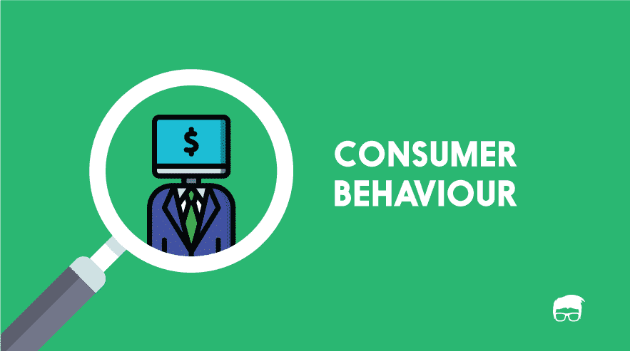
Shifts in Consumer Needs, Wants, and Expectations
Consumer behavior continues to shift.
Organizations and service providers that effectively prepare for and predict coming needs, wants, and expectations can improve their profit margin.
They can do so by eliminating waste and better preparing to serve their customer base.

Slide 24
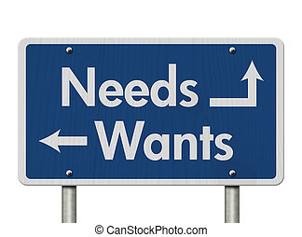
Shifts in Consumer Needs, Wants, and Expectations
Economists use Demand Curves to illustrate shifts in consumer behavior in a particular market.
Demand Curves are graphic representations of expected behavior in the real world that economists and business people can use to predict coming trends or shifts in consumer needs, wants, or expectations.
By anticipating changes, they can move revenue or personnel to areas where more customer activity is likely to occur.

Slide 25
Shifts in Consumer Needs, Wants, and Expectations
Many of the shifts that are evident in today’s business world are tied directly to demographic shifts.
The aging population creates a need for a variety of services, such as medical care and assistance, vacation planning, transportation, recreational activities, and delivery services for purchases made.
Younger consumers often seek out technology-based products, trendy clothing and accessories, activities that involve group engagement and recreation, and entertainment.
People who immigrate into a country often bring needs, wants, and expectations based on their background, beliefs, and values.

Slide 26
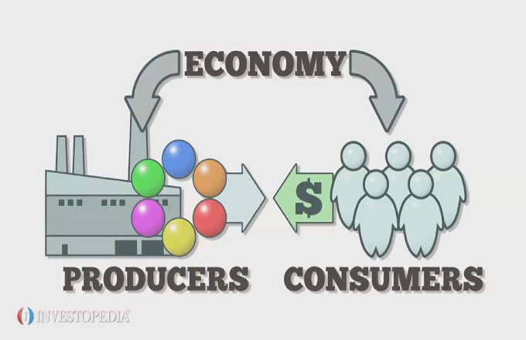
Global Economic Shifts
As the economy took a downward spiral in the latter part of the first decade of the 21st century, consumer confidence shifted, many organizations struggled to provide quality service levels with reduced staff.
Budgets and revenue from products and services slipped for most organizations as consumers held onto precious cash.
Consumers often pull back spending when there are economic changes or uncertainty, and businesses are forced to downsize.

Slide 27
Global Economic Shifts Consumers Do Business as Never Before
Large numbers of customers search and do their homework for products and services online and often use retail outlets as a showroom to physically examine things they are interested in potentially purchasing.
The result is that sales in brick-and-mortar stores are down for many retailers and suppliers.
The approach to customer service in many instances is no longer “business as usual.” Instead of viewing it as something that should be done well, most see it as something that must be done.

Slide 28
Shifts in the Population and Labor Force
The upside of this growing, evolving, and aging population is that there will be a need for more consumer goods and services to provide for the needs and expectations of diverse customers.
This will also lead to an expansion of jobs to fill the positions needed to produce products and service customers.
As experienced workers age out, there is a fairly steady stream of younger skilled workers coming in due to immigration.

Slide 29
Increased Efficiency in Technology
The development and increased sophistication of machines, telephones, service equipment, and computers have caused an increase in production and quality.
Three results of this trend have been acquisition of equipment that enhances the service experience for customers, an increased need for service organizations to take care of the technology, and a decrease in manufacturing and blue-collar jobs.

Slide 30
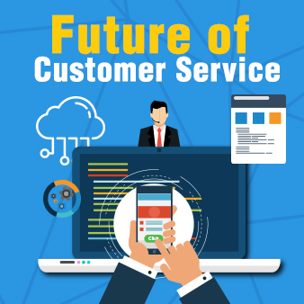
Increased Efficiency in Technology
Service and nonprofit organizations are looking to available technology as a way to communicate with and provide services to their clients and members.
Expanded Internet access and affordable technology devices allow consumers to shop, search for information, and buy from home.
The result will be the need for few sales associates and other in-house providers, but doors will open for more customer care representatives, call centers, and technology support people.

Slide 31
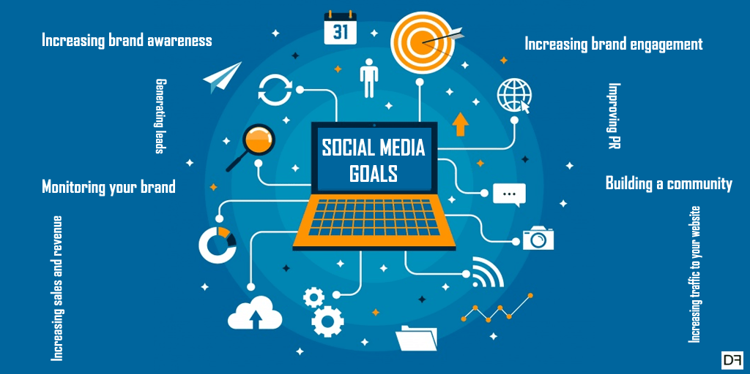
Trending Now
Many organizations have discovered the power of using social media in their marketing and sales initiatives. Not only can they receive and give customer feedback quickly, but they can also send out information about pertinent products, services, and events and do it a lot cheaper than through traditional marketing and advertisement initiative cost.
Some organizations also use social media to look for new employees.

Slide 32
Globalization of the Economy
Advances in technology, communication, & transportation have opened new markets and allowed decentralized worldwide access for production, sales, and service.
To survive and hold onto current market share while opening new gateways, U.S. firms need to hone the service skills of their EEs, strengthen their quality, enhance their use of technology, and look for new ways of demonstrating that they can not only meet but also exceed the expectations of customers.
All this means more competition and the evolution of new rules and procedures that they were not able to obtain in the past.

Slide 33
Changing Values
As the world changes so do individual values.
Such changes can have an impact on what people view as valuable and important, what they want and desire, and how they approach relationships with others around them.
Many people in the U.S. value such things as personal control, equality, individualism, action, and competition. People from other parts of the world value traditionalism, group cohesiveness, societal ownership, and acceptance of hierarchy, status, and birthright.

Slide 34
Changing Values
Throughout the world, there has been a tremendous amount of dynamic change in the recent past due to economic instability, quickly expanding and enhanced technology, global mobility where people move quickly and frequently, and other factors.
The result has been a gradual shift in what many customers hold near and dear.

Slide 35
Changing Values
Because different societies view what is important from different perspectives, clashes can sometimes result when service providers encounter customers who have values different from their own.
The important thing to remember in such situations is that neither the customer nor the provider has the “right” set of values; they are simply different and each must respect and honor those of the other party if a positive customer-provider relationship is to occur.

Slide 36
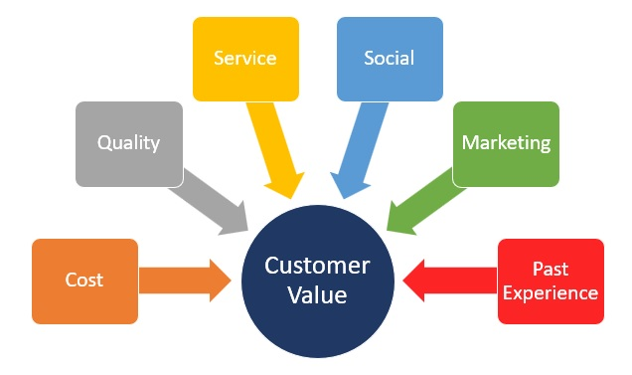
Changing Values
As a result of societal values, companies often change their approach to doing business.
They focus on finding ways to attract and hold customers. This often includes shifting the way they do business, the products that they deliver, and the manner in which service is delivered.

Slide 37
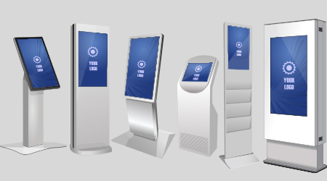
Trending Now
Self-service kiosks are becoming standard in many business locations.
In addition to traditional financial institution ATMs, customers can now order food in the lobby of some McDonald’s locations, then pick up their food at the counter once it has been prepared instead of standing in line to deal with a cashier.
In theaters, patrons can order their tickets and bypass the long lines that are traditional during peak periods.
Additionally, many supermarket and “big box” retailers are using kiosks to allow people with only a few items to use self-checkout and avoid waiting behind those customers with full baskets.

Slide 38
More Women Entering the Workforce
The fact that women are in the workplace means that many of their traditional roles in society have shifted, out of necessity or convenience, to service providers.
The tasks previously handled by the stay-at-home wife and mother are now being handled by the employees of various service companies.

Slide 39
More Women Entering the Workforce
Studies on consumer buying habits find that women either make or heavily influence buying decisions at home.
As service providers, they are in a good position to recognize needs and recommend appropriate products and services, especially those related to the home and family.

Slide 40
A More Racially and Ethnically Diverse Population Entering the Workforce
The increase in numbers of people from different cultures entering the workforce will have a profound impact on the business environment.
Members of this expanded worker category bring with them new ideas, values, expectations, needs, and levels of knowledge, experience, and ability.
As consumers themselves, they also bring a better understanding of the needs of the various groups that they represent.

Slide 41
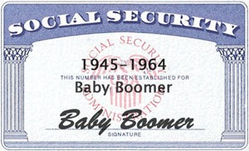
More Older Workers Entering the Workforce
The growth of older workers entering the workforce is the result of a variety of social factors.
The most significant factor is that the median age of people in the U.S. is rising because of the aging of the “baby-boom” generation (born between 1945 and 1964).
From a workplace perspective, this means that more of the people in this age group will stay in the workplace or return after they leave. This may be caused by economic and social necessity.

Slide 42
Growth of E-Commerce
Almost any product or service is available at the click of a mouse, press of a key, or voice command.
Consumers regularly “surf the net” for values in products and services without ever leaving their homes or offices.
Entire business-to-business customer relationships occur every day between people who are strangers but who provide key products and services to their customers electronically.

Slide 43
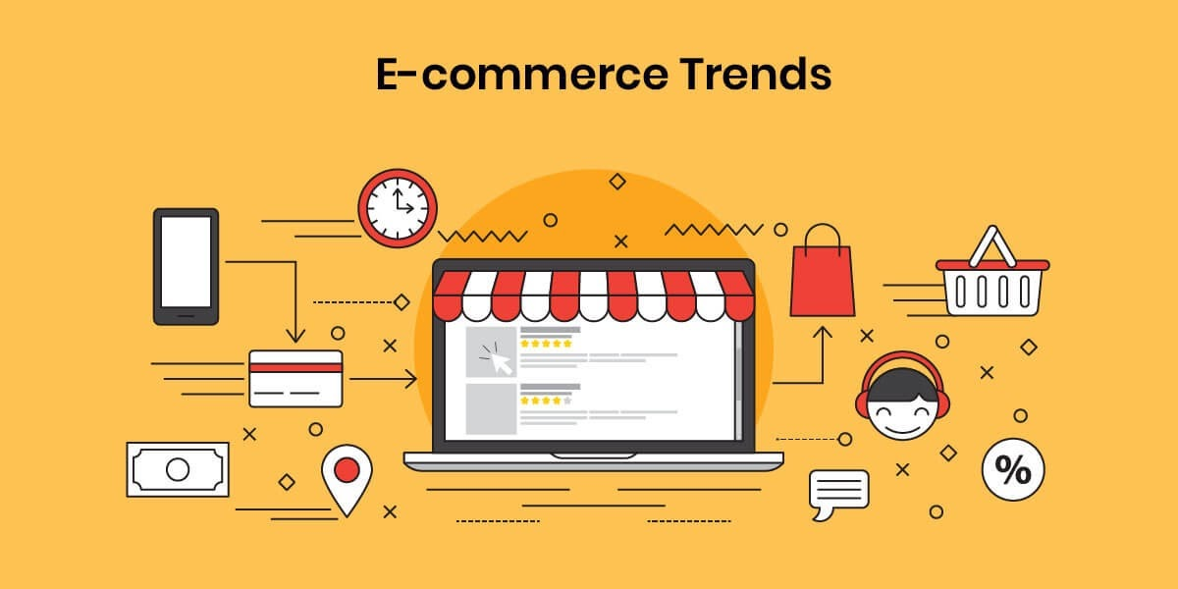
E-Commerce
Armed with a password, site address, and credit cards, shoppers use this virtual marketplace to satisfy needs or wants that they likely did not know they had before logging onto their computer and connecting with the Internet.
With so many options available for just a small investment of time, they can comparison-shop simply by changing screens.
The creators and owners of the most innovative sites and products can provide products, services, and information worldwide w/out ever physically coming into contact with a customer.

Slide 44
Consumer Behavior Shifts
Many people in different parts of the world are still struggling to make ends meet financially due to some of the worst economic conditions in recent memory.
They are looking for ways to maintain their desired standard of living without too many sacrifices.
The result has been a shift in the ways people approach buying and obtaining the necessities and desired products and services.

Slide 45
Different Mindset
In the past, many consumers took “money is no object” approach to shopping because, if they did not have cash readily available, they had credit cards in their wallet that allowed them to spend (often beyond their means).
Many consumers have had a reality check and have learned that prudence is an important element of commerce.
A majority of consumers who formerly acted on impulse and bought whatever they desired are now taking a cautious approach.

Slide 46
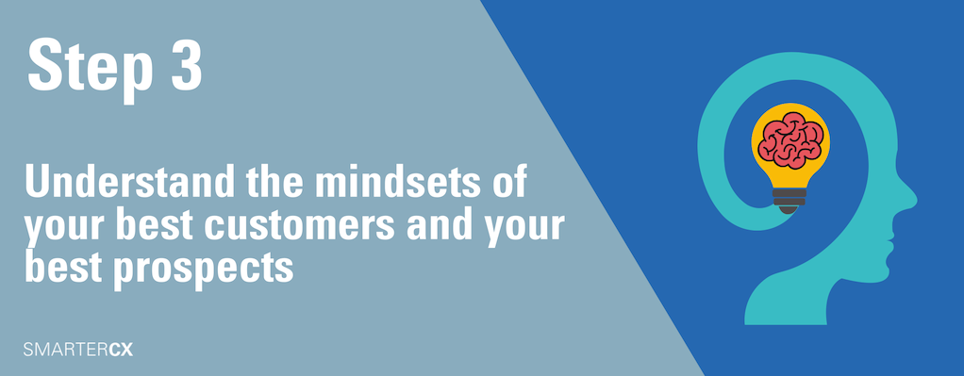
Different Mindset
Economic reports are now indicating that people have begun to shift from a “cutting back” mentality to a slightly more optimistic “cautious spending” approach.
Part of their new strategy is to re-evaluate their paradigm, or the way they look at products.
Where they might have only gone for the nationally known brand or reputation in the past, they now evaluate and consider generic or store brands with comparable options and services offered by local providers.
They are also being more conscientious about their spending and seek discount retailers and comparison shop.

Slide 47
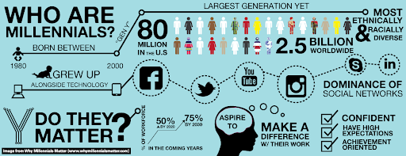
Different Mindset
Another interesting outcome of the recession and massive job losses is that many consumers, especially younger ones, want to have less financial obligation in case something traumatic happens in their life related to employment and financial security.
Many millennials forego fancy cars, mortgages, large furnishing purchases, and abandoned the shopping patterns of their parents.

Slide 48
Expectation of Quality Service
Most customers expect that if they pay a fair dollar, in return they will receive a quality product or service.
If their expectations are not met, they simply call or visit a competing company where they can receive what they think they paid for.
The expectation of quality service creates a need for better-trained and better-educated customer service professionals.
Not only do service professionals need up-to-date product information in order to be at the top of their game when interacting with customers, but they also need to be abreast of current organizational policies and procedures, what the competition offers, and the latest techniques in customer service and satisfaction.

Slide 49
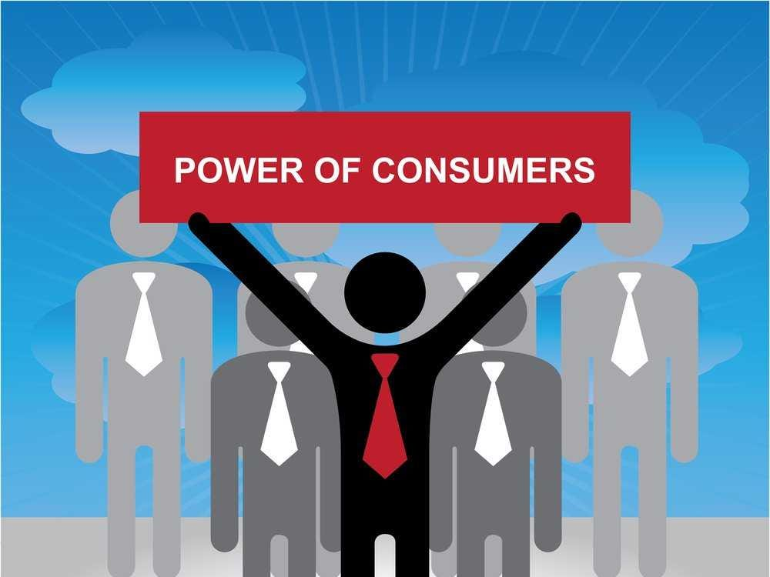
Enhanced Customer Preparation
Customers are not only more highly educated than in the past, they are also well informed about price, quality, and value of products and services.
With the advent of the Internet, consumers are really in a power position when it comes to dealing with organizations providing products and services they want.
Having access to the same information and tools that sales people have available to them levels the playing field.

Slide 50
Enhanced Consumer Preparation
Armed with knowledge about what they should receive for their money, consumers make it extremely difficult for less-than-reputable businesspeople to prosper or survive in today’s world.
They must provide customer satisfaction or face losing customers to competitors. They also face potential negative publicity through social media where customers can immediately post comments about the level of service and product quality that they receive.

Slide 51
Customer Satisfaction
Customer Satisfaction is the feeling of a person whose needs have been met by an organization.

Slide 52
The Customer Service Environment
A viable customer service environment is the responsibility of every employee of the organization – not just the customer service representatives.

Slide 53
Components of a Customer Service Environment
Many factors affect your customers and what they perceive as quality service. With the exception of the customer, all these factors are under control of the organization.
Six Key Components of a Customer Service Environment:
The Customer
Organizational Culture
Human Resources
Products and Deliverables
Delivery Systems
Service

Slide 54
1. The Customer
The central component in a customer-focused environment is the customer.
By striving to identify the specific needs of each individual customer, and then acting to satisfy him or her, employees can help ensure his or her loyalty, satisfaction, and positive word-of-mouth publicity.
By remembering that all aspects of the service organization revolve around that crucial entity and that without the customer, there is no reason for any organization to exist, service professionals help ensure personal and business success.

Slide 55
Two Kinds of Customers
External Customers
External Customers may be current or potential customers or clients. They are the ones who actively seek out; research, and buy, rent, or lease products or services.
Internal Customers
Internal Customer are coworkers, employees of other departments or branches, and other people who work at the same organization.
Employees from different areas of an organization depend on others for information, products, and services to better meet the needs of their external customers.

Slide 56
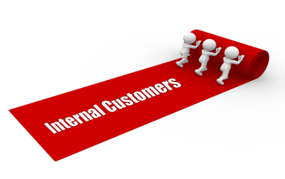
Internal Customers
Suggestions for building stronger relationships and better serving internal customers:
Be reliable. Follow through.
Develop positive relationships. Say please and thank you.
Take time to get to know more about others.
Listen objectively. Consider the merits of others’ ideas.
Acknowledge the contributions of others. Share Credit.
Show appreciation for help provided by others. Acknowledge them.
Avoid office politics and gossip. Maintain good reputation.
Help others. Be generous and willing to assist.
Respect diversity. Appreciate other views, values, and beliefs.

Slide 57
Internal Customers
Recognizing internal customers is important and crucial to everyone in the organization for on-the-job success.
That is because, in the internal customer chain, an employee is sometimes a customer and at other times a supplier.
Only when both parties are acutely aware of their role in this customer-supplier relationship can the organization effectively prosper and grow to full potential.

Slide 58
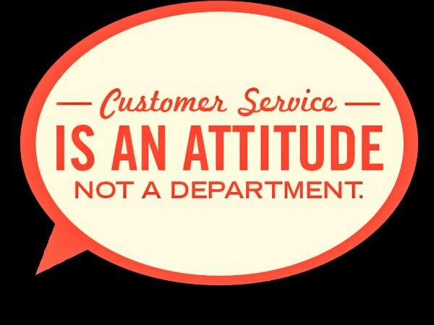
Internal Customer
The important point to remember related to your internal customers is that you must take care of them, just as you do your external customers.
They must be serviced effectively and treated with respect in order to allow them to provide exceptional service to their customers.
Without the information, products, and services that you provide them, they do not have the tools needed to do their job.

Slide 59
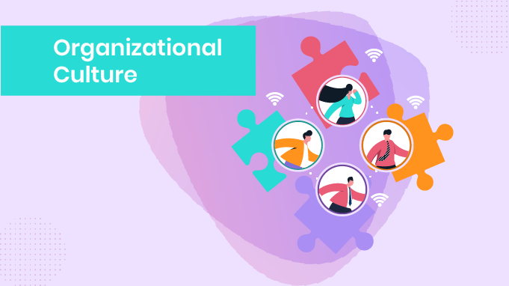
2. Organizational Culture
Organizational Culture includes any element of an organization that a customer encounters.
It includes the dynamic nature of the organization and its employees and managers.
The experiences, attitudes, and norms cherished and upheld by employees and teams within the organization set the tone for the manner in which service is delivered and how service providers interact with both internal and external customers.

Slide 60
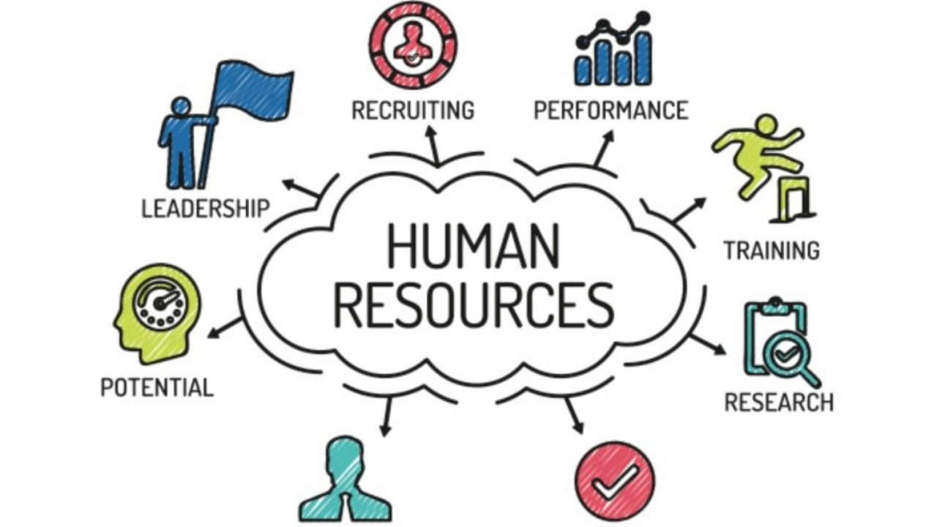
3. Human Resources
Human Resources refers to employees of an organization.
To make the culture work, an organization must take great care in recruiting, selecting, training, and retaining qualified people.
Without motivated, competent workers, any planning, policy, and procedure change or systems adaptation will not make a difference in customer service.

Slide 61
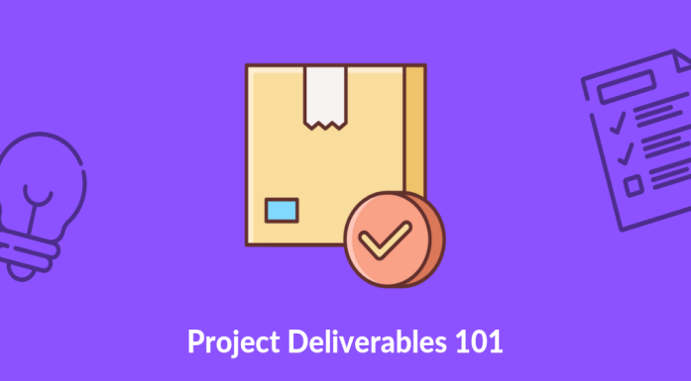
4. Deliverables
A deliverable may be a tangible item manufactured or distributed by the company or a service available to the customer.
In either case, there are two potential areas of customer satisfaction or dissatisfaction – quality and quantity.
If your customers receive what they perceive as a quality product or service to the level that they expected, and in the timeframe promised or viewed as acceptable, they will be satisfied.
On the other hand, if customers believe that they were sold an inferior product or given an inferior service or one that does not match their expectations, they will be dissatisfied and could take business elsewhere.

Slide 62
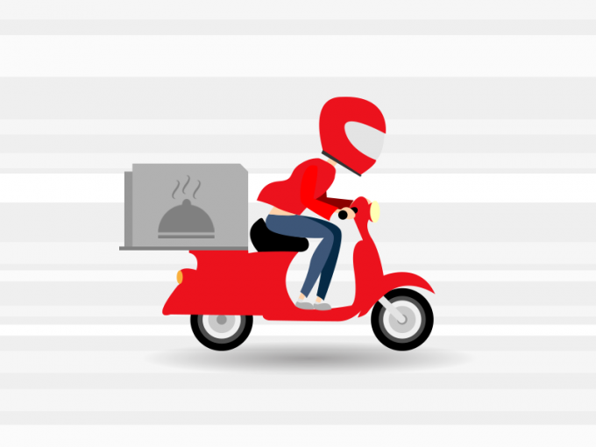
5. Delivery Systems
Delivery Systems are the methods used by an organization to provide services and products to its customers.
In deciding on delivery systems, organizations examine the following factors:
Industry Standards
Customer Expectations
Capabilities
Overall Costs
Current and Projected Requirements

Slide 63
6. Service
Service is the manner in which you and other employees treat your customers and each other as you deliver your company’s deliverables.
Effective use of the techniques and strategies related to quality service is required in order to satisfy the needs of customers.

Slide 64
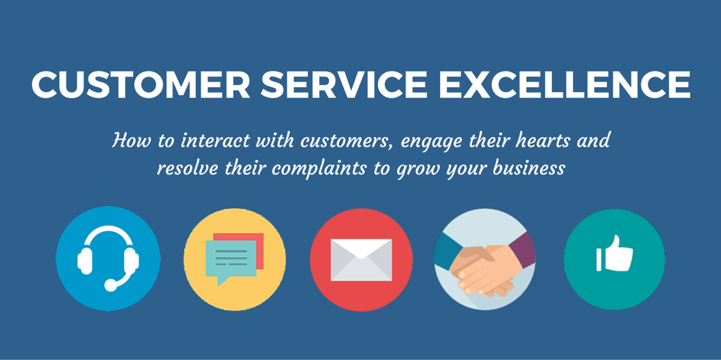
Addressing the Changes
All customer-based organizations must provide excellence in service and an environment in which customer needs are identified and satisfied.

Slide 65
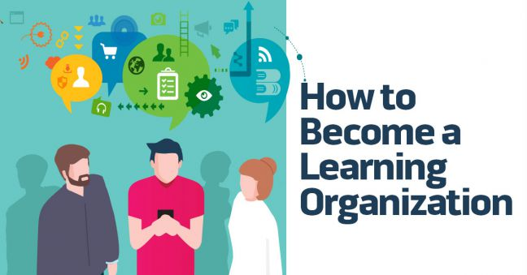
Addressing the Changes
Organizations must become Learning Organizations.
A learning organization is one that uses knowledge as a basis for competitive advantage. This means providing ongoing training and development opportunities to employees so that they can gain and maintain cutting-edge skills and knowledge while projecting a positive can-do customer-focused attitude.
Learning organizations ensure there are systems that can adequately compensate and reward employees on the basis of their performance.

Slide 66
Addressing the Changes
In the past, organizations took a reactive approach to service by waiting for customers to ask for something or by trying to recover after a service breakdown.
In today’s economy, a proactive approach of anticipating customer needs is necessary and becoming common.
Every EE must take personal responsibility for customer care, and managers should empower employees at all levels to do whatever is necessary to satisfy the customer.

Slide 67
Service Recovery
If a service breakdown does occur, managers in truly customer-focused organizations should empower EEs at all levels to do whatever is necessary to satisfy the customer.
Management must educate and train employees on the techniques and policies available to help serve the customer. They must then give employees the authority to act without asking first for management intervention in order to resolve customer issues.
This concept is known as Service Recovery.

