Slide 1

Business Communications
Session Three Class Presentation
Business Communication
  Process and Product – 9th Edition
    Mary Ellen Guffey and Dana Loewy; Cengage Learning 2018, 2015
      ISBN: 978-1-305-95796-1

Slide 2

Unit Three: Workplace Communication
Chapter Seven: Short Workplace Messages and Digital Media
  Email
  Memos
  Text Messages
  Instant Messaging
  Corporate Blogs
  Social Networking
  Facebook and Twitter
  LinkedIn

Slide 3
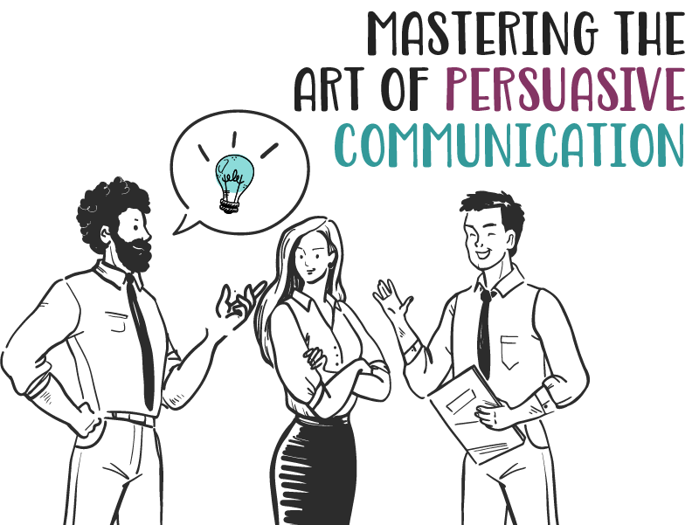
Unit Three: Workplace Communication
Chapter Ten: Persuasive and Sales Messages

Slide 4
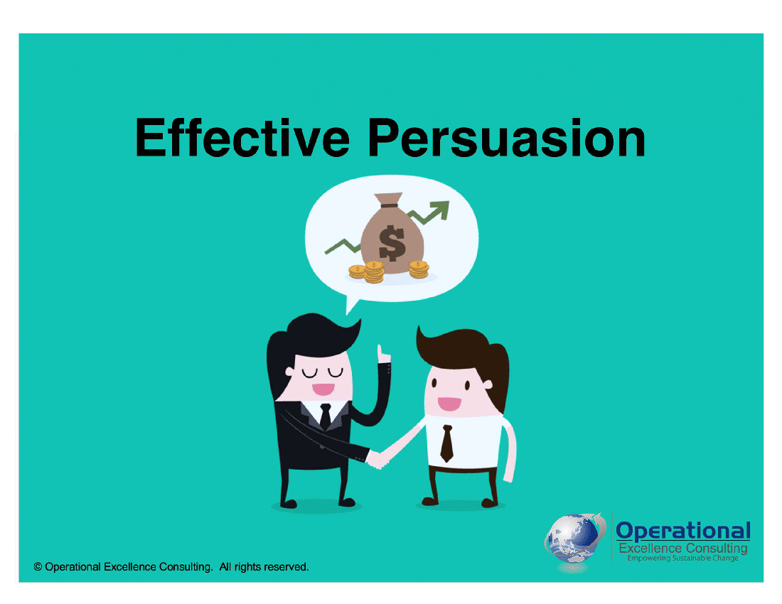
Persuading Effectively and Ethically in the Contemporary Workplace
Although we experience a barrage of print and electronic persuasive messages daily, we often fail to recognize the techniques of persuasion.
  To be smart consumers, we need to be alert to persuasive practices and how they influence behavior.
    Being informed is our best defense.

Slide 5

Persuading Effectively and Ethically in the Contemporary Workplace
Persuasion has the power “to change attitudes and behaviors on a mass scale,” as B.J. Fogg at Stanford puts it.
  Social networks enable individuals or groups to reach virtually limitless audiences and practice what Fogg calls: “mass interpersonal persuasion.”
    This puts a lot of power into the hands of many.

Slide 6
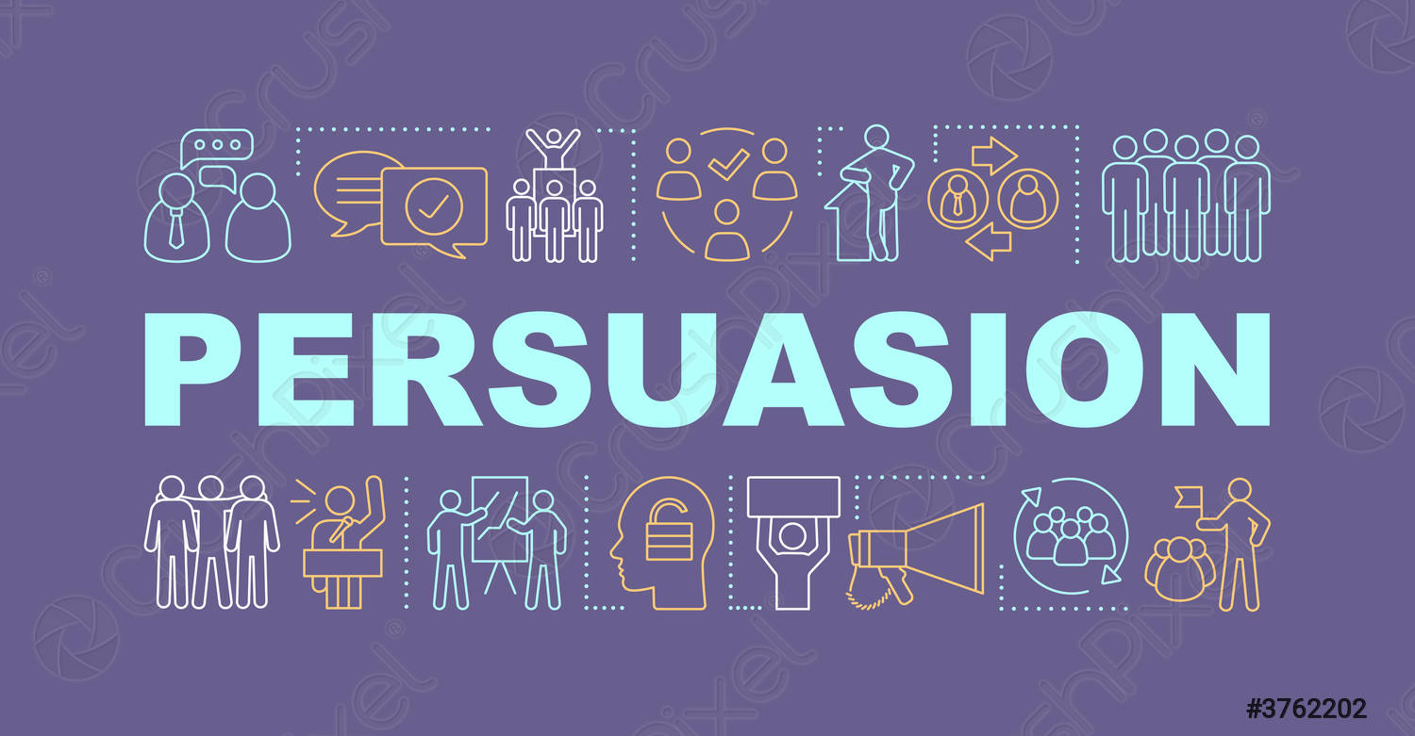
What is Persuasion?
Richard M. Perloff defines persuasion as a “symbolic process in which communicators try to convince others to change their attitudes or behaviors regarding an issue through the transmission of a message in an atmosphere of free choice.”
  This definition has five components:
    Persuasion is a Symbolic Process
    Persuasion Involves an Attempt to Influence
    Persuasion is Self-Persuasion (Self-Influence)
    Persuasion involves Transmitting a Message
    Persuasion Requires Free Choice

Slide 7

What is Persuasion?
1. Persuasion is a Symbolic Process
Persuasion is a Symbolic Process.
  Symbols are meaningful words, signs, and images infused with rich meaning – for example, words such as “liberty,” signs such as national flags, and images such as the red cross for rescue or the apple for computers.
    An ethical persuader understands the power of symbols and does not use them to trick others.

Slide 8

What is Persuasion?
2. Persuasion Involves an Attempt to Influence
Persuasion Involves an Attempt to Influence.
  Persuasion involves a conscious effort to influence another person with the understanding that change is possible.
    For example, when you ask your boss for permission to telecommute, you intend to achieve a specific outcome and assume that your boss can be swayed.

Slide 9
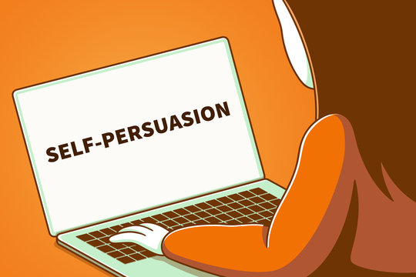
What is Persuasion?
3. Persuasion is Self-Persuasion (Self-Influence)
Persuasion is Self-Persuasion (Self-Influence)
  Ethical communicators give others the choice to accept their arguments by making compelling, honest cases for support. They plant the seed but do not coerce.
  They leave it to others to “self-influence” – that is, to decide whether to make the change.
    In the case of telecommuting, you would want to present to boss clear benefits of working from home but definitely not push hard.

Slide 10
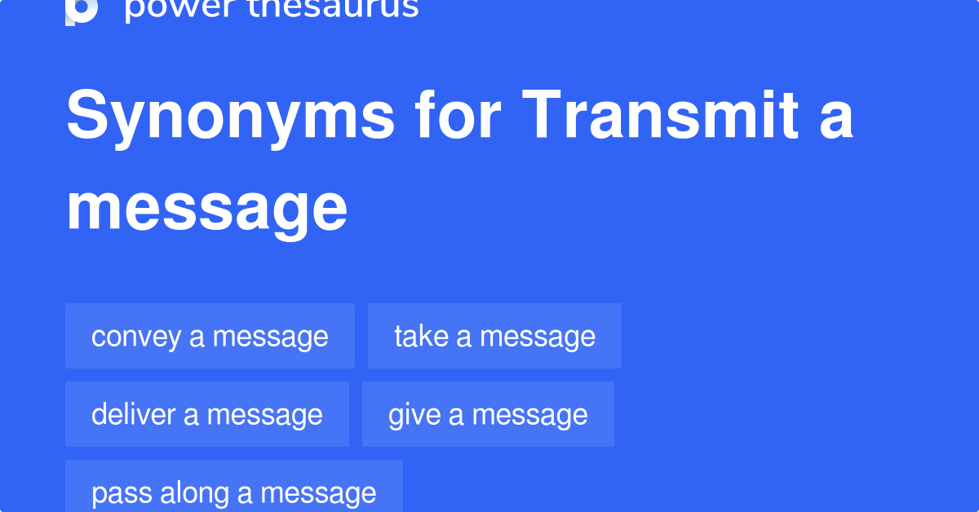
What is Persuasion?
4. Persuasion Involves Transmitting a Message
Persuasion Involves Transmitting a Message
  Persuasive messages can be verbal or nonverbal, and can be conveyed face-to-face, Internet, TV, radio, and other media.
    Persuasive messages are not always rational. They often appeal to our emotions. Consider the car commercial playing your favorite tune and showing pristine landscapes, not a gridlocked interstate during rush hour.

Slide 11

What is Persuasion?
5. Persuasion Requires Free Choice
Persuasion Requires Free Choice
  People are free when they are not forced to comply, when they can refuse the idea suggested to them, and when they are not pressured to act against their own preferences.

Slide 12

What is Persuasion?
Many smart thinkers have tried to explain how savvy persuaders influence others.
  In his book “Influence,” Robert B. Cialdini outlined six psychological triggers that prompt us to act and to believe: (1) Reciprocation, (2) Commitment, (3) Social Proof, (4) Liking, (5) Authority, and (6) Scarcity.
    Each “weapon of automatic influence” motivates us to say “yes” or “no” w/o much thinking or awareness. Our complex world forces us to resort to these shortcuts. Needless to say, such automatic responses make us vulnerable to manipulation.

Slide 13

Six Basic Principles that Direct Human Behavior
Reciprocation
  “The Old Give and Take…and Take”
Commitment
  “Hobgoblins of the Mind”
Social Proof
  “Truths are Us”
Liking
  “The Friendly Thief”
Authority
  “Directed Deference”
Scarcity
  “The Rule of the Few”

Slide 14

Six Basic Principles that Direct Human Behavior
1. Reciprocation
Reciprocation: “The Old Give and Take…and Take”
  Humans seem to be hardwired to give and take. If someone does us a favor, most of us feel obligated to return the favor.
    This rule is so binding that it may lead to a “Yes” to a request we might otherwise refuse. This explains the “gifts” that accompany requests for money.

Slide 15

Six Basic Principles that Direct Human Behavior
2. Commitment
Commitment: “Hobgoblins of the Mind”
  We believe in the correctness of a difficult choice once we make it. We want to keep our thoughts and beliefs consistent with what we have already decided.
    Fund-raisers may ask for a small amount at first, knowing that we are likely to continue giving once we start.

Slide 16

Six Basic Principles that Direct Human Behavior
3. Social Proof
Social Proof: “Truths are Us”
  To determine correct behavior, we try to find out what other people think is correct. We see an action as more acceptable when others are doing it.
    Advertisers like to tell us that a product is “best-selling;” the message is that it must be good because others think so.

Slide 17

Six Basic Principles that Direct Human Behavior
4. Liking
Liking: “The Friendly Thief”
  We are more likely to accept requests of people we know and like or those who say they like us.
    Tupperware capitalizes on this impulse to buy from a friend.
    Strangers are persuasive if they are likable and attractive.
    Also we favor people who are or appear to be like us.

Slide 18

Six Basic Principles that Direct Human Behavior
5. Authority
Authority: “Directed Deference”
  We tend to obey authority because we learn that a widely accepted system of authority is beneficial to the orderly functioning of society. People exuding authority, even con artists, can trigger our mechanical, blind compliance.
    Testimonials bank on this response to authority.

Slide 19
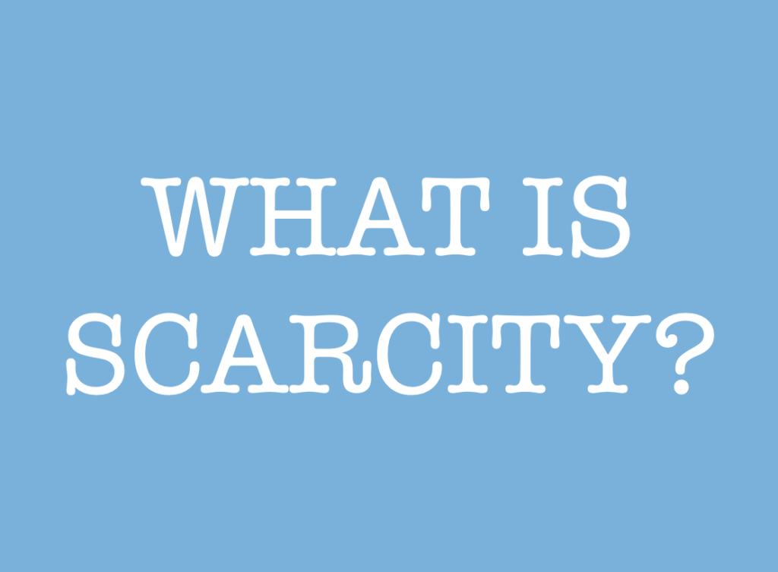
Six Basic Principles that Direct Human Behavior
6. Scarcity
Scarcity: “The Rule of the Few”
  We tend to regard opportunities as more valuable when their availability is restricted. Scarce items seem more appealing.
  The idea of potential loss greatly affects our decisions.
    Marketers urge customers not to miss out on “limited-time offers.”

Slide 20

Persuasive Techniques are More Subtle and Misleading
Instead of a blunt, pushy hard-sell approach, persuaders play on emotions by using flattery, empathy, nonverbal cues, and likability appeals.
  They are selling an image or a lifestyle, not a product.
    In this age of spin, the news media are increasingly infiltrated by partisan interests and spread messages masquerading as news.

Slide 21

Six Effective Persuasion Techniques
Establish Credibility
  Show that you are truthful, experienced, and knowledgeable.
  Use other’s expert opinions and research to support your position.
Make a Reasonable, Specific Request
  Make your request realistic, doable, and attainable.
  Be clear about your objective. Vague requests are ineffective.
Tie Facts to Benefits
  Line up plausible support such as statistics, reasons, and analogies.
  Convert the supporting facts into specific audience benefits.
Recognize the Power of Loss
  Show what others stand to lose if they don’t agree.
  Know that people dread losing something they already possess.
Expect and Overcome Resistance
  Anticipate opposition from conflicting beliefs, values, and attitudes.
  Be prepared to counter with well-reasoned arguments and facts.
Share Solutions and Compromise
  Be flexible and aim for a solution that is acceptable to all parties.
  Listen to people and incorporate their input to create buy-in.

Slide 22

Applying the 3x3 Writing Process to Persuasive Messages
Changing people’s views and overcoming their objections are difficult tasks.
  Pulling it off demands planning and being perceptive.
    The 3x3 writing process provides a helpful structure for laying a foundation for persuasion. Of particular importance here are (1) analyzing the purpose, (2) adapting to the audience, (3) collecting information, and (4) organizing the message.

Slide 23


Analyzing the Purpose:
Knowing What You Want to Achieve
The goal of a persuasive message is to convert the receiver to your ideas and motivate action.
  Persuaders seek to build relationships with their audiences.
  A message without a clear purpose is doomed.
    Too often, inexperienced writers reach the end of first draft of a message before discovering exactly what they want the receiver to think or do.

Slide 24

Adapting to the Audience to Make Your Message Heard
In addition to identifying the purpose of a persuasive message, you also need to concentrate on the receiver.
  A persuasive message must meet the needs of its audience.
    In a broad sense, you want to show how your request helps the receiver achieve some of life’s major goals or fulfills key needs: money, power, comfort, confidence, importance, friends, peace of mind, and recognition.

Slide 25

Adapting to the Audience to Make Your Message Heard
You need to show how your request solves a problem, achieves a personal or work objective, or just makes life easier for your audience.
  When adapting persuasive requests to your audience, consider these questions that receivers will very likely be asking:
    Why should I?
    What’s in it for me?
    What’s in it for you?
    Who cares?

Slide 26

Adapting to the Audience to Make Your Message Heard
Adapting to your audience means learning about audience members and analyzing why they may resist your proposal. It means searching for ways to connect your purpose with their needs.
  If completed before you begin writing, such analysis goes a long way toward overcoming resistance and achieving your goal.
    Once you have analyzed the audience and considered how to adapt your message to its needs, you are ready to collect data and organize it.

Slide 27
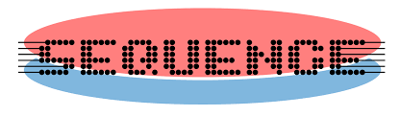
Researching and Organizing Persuasive Data
    The next step in a persuasive message is organizing data into a logical sequence. The classic indirect strategy known as AIDA works well for many persuasive requests, not just selling.
  If you are asking for something that you know will be approved, little persuasion is required. In that case, you make a direct request.
  However, when you expect resistance or when you need to educate the receiver, the indirect strategy often works better.

Slide 28
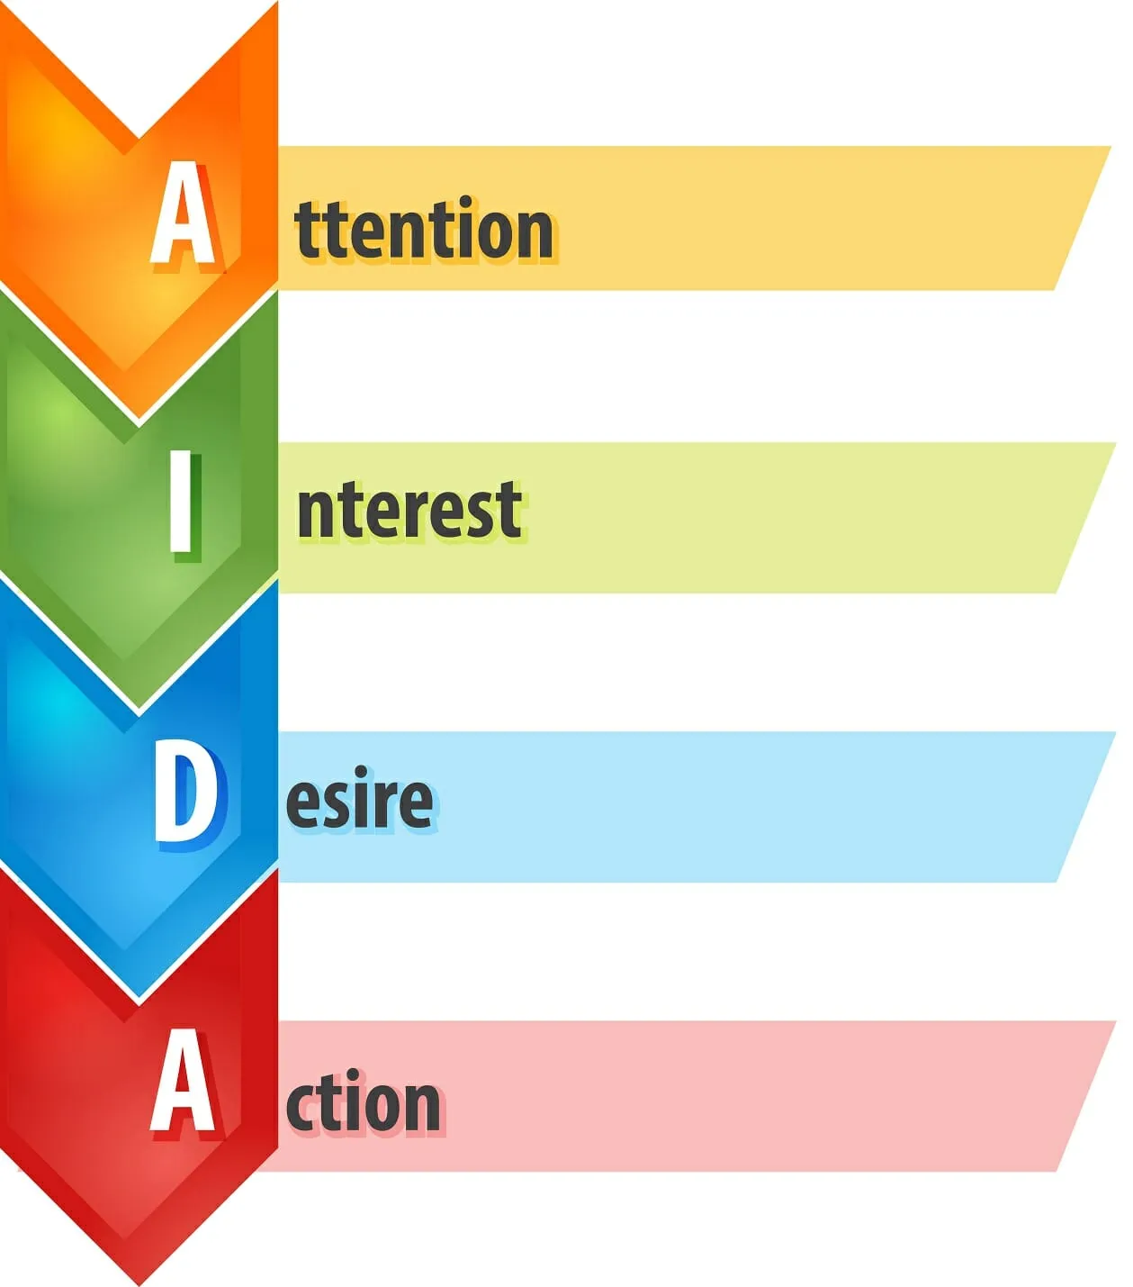
The AIDA Strategy for Persuasive Messages
Attention
  Opening
    Captures attention, creates awareness, makes a sales proposition, prompts audience to read on.
Interest
  Body
    Describes central selling points, focuses not on features of product/service but on benefits relevant to the reader’s needs.
Desire
  Body
    Reduces resistance, reassures the reader, elicits the desire for ownership, motivates action.
Action
  Closing
    Offers an incentive or gift, limits the offer, sets a deadline, makes it easy for the reader to respond, closes the sale.

Slide 29

Blending Four Major Elements in Successful Persuasive Messages
Although AIDA appears to contain separate steps, successful persuasive messages actually blend steps into a seamless whole.
  The sequence of the steps may change depending on the situation and the emphasis. Regardless of where they are placed, the key elements in persuasive requests are:
    (1) Gaining your audience’s attention, (2) Building interest by convincing your audience that your proposal is worthy, (3) Eliciting desire for the offer and reducing resistance, and (4) Prompting action.

Slide 30

Gaining Attention in Persuasive Messages
To grab attention, the opening statement in a persuasive request should be brief, relevant, and engaging.
  When only mild persuasion is necessary, the opener can be low-key and factual. If, however, your request is substantial and you anticipate strong resistance, provide a thoughtful, provocative opening. Following are some examples:
    Problem Description
    Unexpected Statement
    Reader Benefit
    Compliment
    Related Facts
    Stimulating Question

Slide 31

Gaining Attention in Persuasive Messages
Problem Description
  Present a capsule of the problem your proposal will help solve.
Unexpected Statement
  Get readers thinking immediately.
Reader Benefit
  Highlight benefit to reader at the onset.
Compliment
  Offer praise or compliments, but avoid obvious flattery.
Related Facts
  Relevant facts set stage for the interest-building section to follow.
Stimulating Question
  Stimulate curiosity of reader with intriguing question.

Slide 32

Building Interest in Persuasive Messages
After capturing attention, a persuasive request must retain that attention and convince the audience that the request is reasonable.
  Persuasive requests are likely to be longer than direct requests because the audience must be convinced rather than instructed.
  You can build interest and conviction through use of the following:
    Facts – Statistics – Examples – Expert Opinion – Specific Details Direct Benefits – Indirect Benefits

Slide 33

Building Interest in Persuasive Messages
Showing how your request can benefit the audience directly or indirectly is a key factor in persuasion.
  If you were asking alumni to contribute money to college foundation, you might promote direct benefits such as listing the donor’s name in the college magazine or sending a sweatshirt with the college logo. Another direct benefit is a tax write-off for the contribution.
    An indirect benefit might be feeling good about “paying it forward,” thus helping the college and knowing that students will benefit from the gift.
    All charities rely in part on indirect benefits to promote their causes.

Slide 34

Eliciting Desire and Reducing Resistance in Persuasive Requests
The best persuasive requests anticipate audience resistance.
  How will the receiver object to the request?
    When brainstorming, try “What if?” scenarios. For each of these “What if?” scenarios, you’ll need a counterargument.

Slide 35
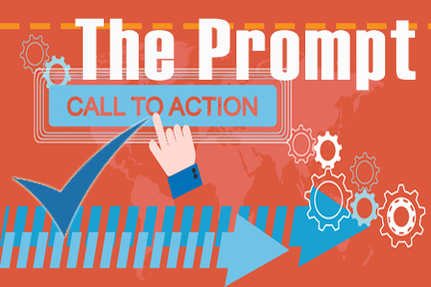
Prompting Action in Persuasive Messages
After gaining attention, building interest, eliciting desire, and reducing resistance, you will want to inspire the newly receptive audience to act.
  Knowing exactly what action you favor before you start to write enables you to point arguments toward important final paragraph.
    Make your recommendation as specifically and confidently as possible – without seeming pushy. In making a request, don’t sound apologetic (I’m sorry to have to ask you this, but…), and don’t supply excuses (If you can spare the time…).

Slide 36

Being an Ethical Persuader
A persuader is effective only when they are believable.
  If receivers suspect they are being manipulated or misled, or if they find any part of argument untruthful, the total argument fails.
    Fudging on the facts, exaggerating a point, omitting something crucial, or providing deceptive emphasis may seem tempting to some business communicators, but such schemes usually backfire.

Slide 37

Writing Persuasive Requests
A persuasive request should incorporate the following:
  Establish credibility
  Make a reasonable and precise request
  Tie facts to benefits
  Elicit desire while overcoming resistance in the receiver

Slide 38

Persuading Employees: Messages Flowing Downward
Employees traditionally expect to be directed in how to perform their jobs; therefore, instructions or directives moving downward from superiors to subordinates usually required little persuasion.
  Messages such as information about procedures, equipment, or customer service still use the direct strategy, with the purpose immediately stated.

Slide 39
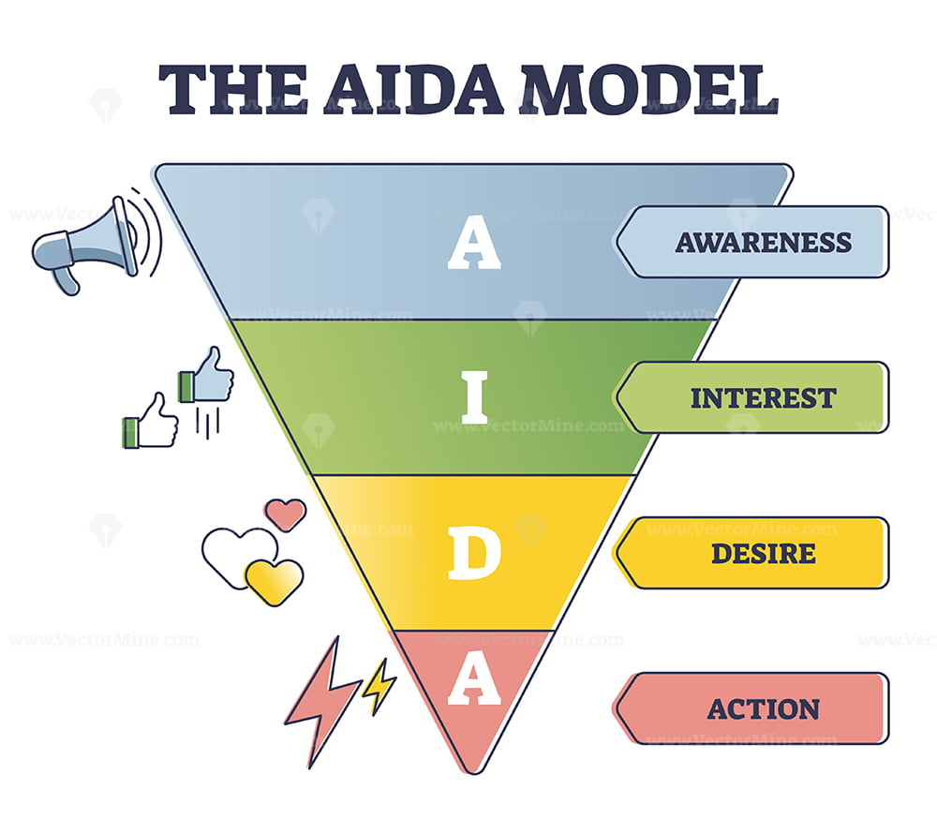
Persuading Employees: Messages Flowing Downward
However, employees are sometimes asked to volunteer for projects or committees, and some are encouraged to join programs to stop smoking, lose weight, or start exercising.
  Organizations may ask employees to participate in capacities outside their work roles. In such cases, the four-part indirect AIDA strategy provides a helpful structure.

Slide 40
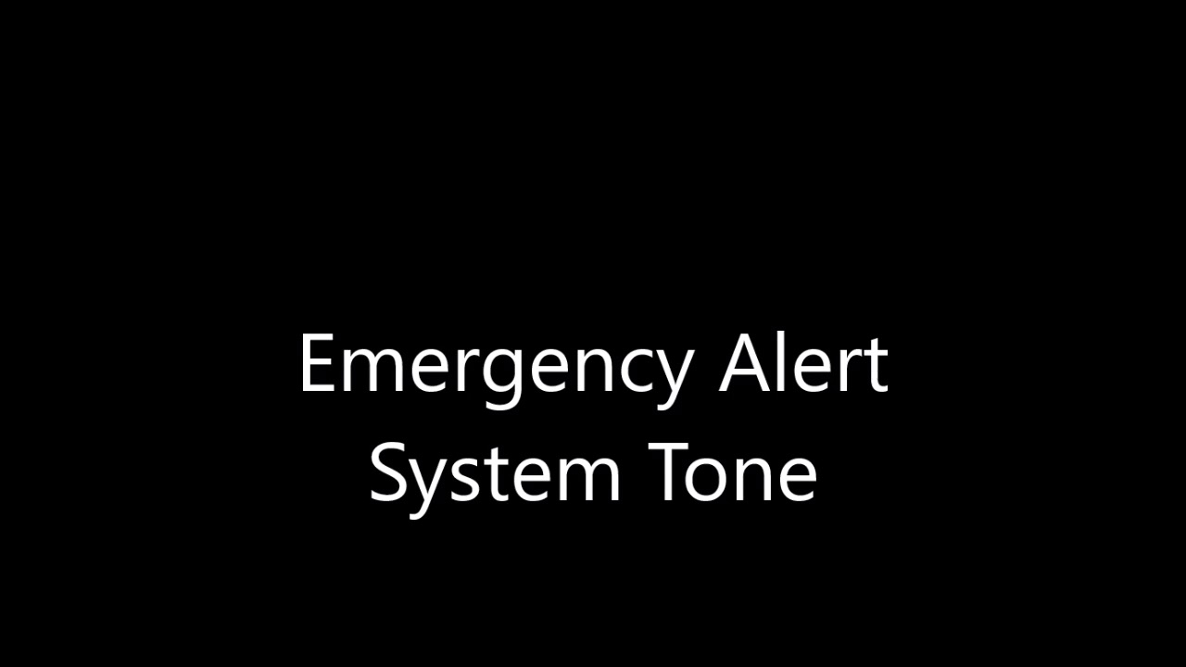
Persuading Employees: Messages Flowing Downward
Because many executives today rely on buy-in instead of exercising raw power, messages flowing downward require attention to tone.
  Warm words and a conversational tone convey a caring attitude.
  Persuasive requests coming from trusted superiors are more likely to be accepted than requests from dictatorial executives who rely on threats and punishments to secure compliance.
    The proverbial carrot has always been more persuasive than the stick.
    Because the words “should” and “must” sometimes convey a negative tone, be careful in using them.

Slide 41

Persuading the Boss: Messages Flowing Upward
When describing an idea to your supervisor or manager, state it confidently and fairly.
  Don’t undermine your suggestions with statements such as: “This may sound crazy” or “I know we tried this before, but…”
    Show that you have thought through the suggestion by describing the risks involved as well as the potential benefits.

Slide 42
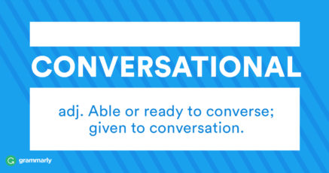
Persuading the Boss: Messages Flowing Upward
Persuasive messages traveling upward require a special sensitivity to tone.
  When asking superiors to change views or take action, use phrases such as “we suggest” and “we recommend” rather than “you must” and “we should.” Avoid sounding pushy or argumentative.
    Strive for a conversational, yet professional tone that conveys warmth, competence, and confidence.

Slide 43
Applying the 3x3 Writing Process to Sales Messages
Marketing professionals analyze and perfect every aspect of a sales message to encourage consumers to read and act on the message.
  Like the experts, you will want to pay close attention to analysis and adaptation before writing the actual message.

Slide 44

Analyzing the Product
Prior to sitting down to write a sales message promoting a product, you must study the item carefully.
  What can you learn about its design, construction, raw materials, and manufacturing process? What can you learn about its ease of use, efficiency, durability, and applications?
    Be sure to consider warranties, service, price, premiums, exclusivity, and special appeals. At the same time, evaluate the competition so that you can compare your product’s strengths with the competitor’s weaknesses.

Slide 45

Determining the Purpose of a Sales Message
Equally as important as analyzing the product is determining the specific purpose of your message.
  Before you write the first word of your message, know what response you want and the central selling point you will emphasize to achieve your purpose.

Slide 46

Considering the Value of Sales Letters
Your primary goal in writing a sales message is to get someone to devote a few moments of attention to it.
  You may be promoting a product, service, idea, or yourself.
    The most effective messages will follow the AIDA strategy and (1) gain attention, (2) build interest, (3) elicit desire and reduce resistance, and (4) motivate action.

Slide 47
Gaining Attention in Sales Messages
One of the most critical elements of a sales message is its opening paragraph.
  It should be short (1-5 lines), honest, relevant, and stimulating.
  Marketers have found that eye-catching typographical arrangements or provocative messages can hook a reader’s attention.
  Consider the following approaches:
    Offer Something – Make a Promise – Ask a Question – Present Quotation or Proverb – Provide Facts – Share Product Feature and its Benefits – Write a Startling Statement – Outline a Personalized Action Setting
    Other openings calculated to capture attention include a solution to a problem, an anecdote, a personalized statement using the receiver’s name, and a relevant current event.

Slide 48

Building Interest with Rational and Emotional Appeals
In this phase of your sales message, you should describe clearly the product or service.
  In simple language emphasize the central selling points that you identified during your prewriting analysis.
    Those selling points can be developed using rational or emotional appeals.

Slide 49

Building Interest with Rational and Emotional Appeals
A physical description of your product is not enough.
  No matter how well you know your product, no one is persuaded by cold, hard facts alone.
  People buy because of product benefits.
    Translate those cold facts into warm feelings and reader benefits.
    A feature is what your product is or does; a benefit is how the audience can use it.

Slide 50

Building Interest with Rational and Emotional Appeals
Emotions Guide Decision Making
  Neurological research supports the view that human decision making is a process guided by emotions. Human beings are also more likely to be persuaded by people or entities they like and know.
    These two insights have important implications for social media marketing. They explain why so much emphasis today is placed on customer engagement, mostly carried out through social networks.

Slide 51

Building Interest with Rational and Emotional Appeals
The health of a company relies on the extent to which it creates meaningful and sustainable interactions and engagement with customers.
  Engaged customers are more loyal and willing to recommend products.
    Social media success depends on creating an emotional connection.
    One expert likens social media to a cocktail party at which one mingles and networks but does not rudely hawk products and services.

Slide 52

Motivating Action at the Conclusion of a Sales Message
The final paragraph of the sales letter carries punch line. This is where you tell readers what you want them to do and give them reasons for doing it.
  Most sales letters also include postscripts because they make irresistible reading. Even readers who might skim over or bypass paragraphs are drawn to a P.S.
    Use a postscript to reveal your strongest motivator, to add a special inducement for a quick response, or to emphasize a central selling point.

Slide 53

Writing Short Persuasive Messages Online
Writers are turning to social network posts to promote their businesses, further causes, and build online personas.
  Social media are not primarily suited for overt selling; however, tweets and other online posts can be used to influence others and to project a professional, positive social online presence.

Slide 54

Writing Short Persuasive Messages Online
Organizations and individuals with followers post updates of their events, exploits, thoughts, and experiences.
  In persuasive tweets and posts, writers try to pitch offers, prompt specific responses, or draw the attention of their audiences to interesting events and media links.

Slide 55

Developing Persuasive Press Releases
Press (news) releases announce important information to the media, whether traditional or digital
  Such public announcements can feature new products, new managers, new facilities, sponsorships, participation in community projects, awards given or received, joint ventures, donations, or seminars and demonstrations.
    Organizations hope that the media will pick up this news and provide good publicity. However, purely self-serving or promotional information is not appealing to magazine and newspaper editors or TV producers.

Slide 56

Developing Persuasive Press Releases
To get them to read beyond the first sentence, press release writers follow these principles:
  Open with an attention-getting lead or a summary of the important facts.
  Include answers to the five Ws and one H (who, what, when, where, why, and how) in the article – but not all in the first sentence!
  Appeal to the audience of the target media. Emphasize reader benefits written in the style of the focus publication or newscast.
  Present most important information early, followed by supporting info. Don’t put best ideas last as they may be chopped off or ignored.
  Insert intriguing and informative quotations of chief decision makers to lend the news release credibility.
  Make the document readable and visually appealing.
  Look and sound credible.

Slide 57

Developing Persuasive Press Releases
The most important ingredient of a press release, is news.
Articles that merely plug products end up in the trash, or they languish unread on a company website.
  The best press releases focus on information that appeals to a targeted audience.
    Newspapers, magazines, and digital media are likely to publish a press release that is informative, interesting, and helpful.

Slide 58


