Slide 1
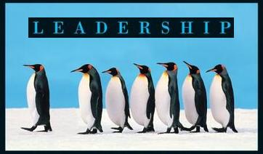
Leadership
Session Six Class Presentation
Leadership
  Enhancing the Lessons of Experience 8th Edition
    Richard L. Hughes, Robert C. Ginnett, and Gordy J. Curphy, McGraw Hill Education, New York, NY 2015
      ISBN: 978-0-07-786240-4

Slide 2

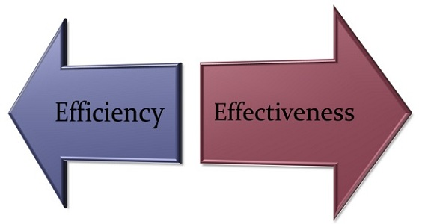
Part Four: Focus on the Situation
Contingency Theories of Leadership
  Contingency Theories maintain that leadership effectiveness is maximized when leaders correctly make their behaviors contingent on certain situational and follower characteristics.

Slide 3
Leader-Member Exchange (LMX) Theory
LMX argues that leaders do not treat all followers as if they were a uniform group of equals. Rather, the leader forms specific and unique linkages with each subordinate, thus creating a series of dyadic relationships.
  In general, the linkages tend to be differentiated into two groups.
    In the out-group, or low-quality exchange relationships, interpersonal interaction is largely restricted to fulfilling contractual obligations.
    With the in-group, or high-quality exchange relationships, leaders may empower, mentor, and support subordinates beyond the confines of what the job requires. LMX

Slide 4

Leader-Member Exchange (LMX) Theory
Stages of development as the relationship develops overtime:
  Role-Taking
    Happens early in a follower’s work experience. Here the leader offers opportunities and evaluates the follower’s performance/potential.
  Role-Making
    The next phase where a role is created based on a process of trust building. Any perceived betrayals can lead to the follower being dropped from the developing in-group and assigned to the out-group.
  Routinization
    It is in this phase that similarities (for the in-group) and differences (often accentuated for the out-group) become cemented.

Slide 5

Leader-Member Exchange (LMX) Theory
LMX suggests behaviors that the leader should engage in to actively develop relationships and build more in-group relations across the follower pool, include:
  Enhancing overall organizational effectiveness by developing more in-groups and reducing the number of out-groups.
    Developing relationships with all followers, offering each an opportunity for new roles, responsibilities, and challenges, nurturing high-quality exchanges, and focusing on ways to build trust and respect with all subordinates – resulting in the entire team becoming an in-group rather than accentuating the differences between in-groups and out-groups.

Slide 6


Normative Decision Model
Vroom and Yetton maintain that leaders can often improve group performance by using an optimal amount of participation in the decision-making process.
  Thus, the Normative Decision Model is directed solely at determining how much input subordinates should have in the decision-making process.

Slide 7
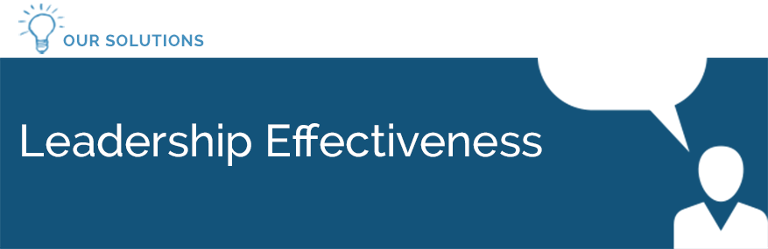
Normative Decision Model
The Normative Decision Model was designed to improve some aspects of leadership effectiveness.
  Researchers explored how various leader, follower, and situational factors affect the degree of member participation in the decision-making process and, in turn, group performance.
    They discovered a continuum of decision-making processes ranging from completely autocratic to completely democratic, where all members of the group have equal participation.

Slide 8
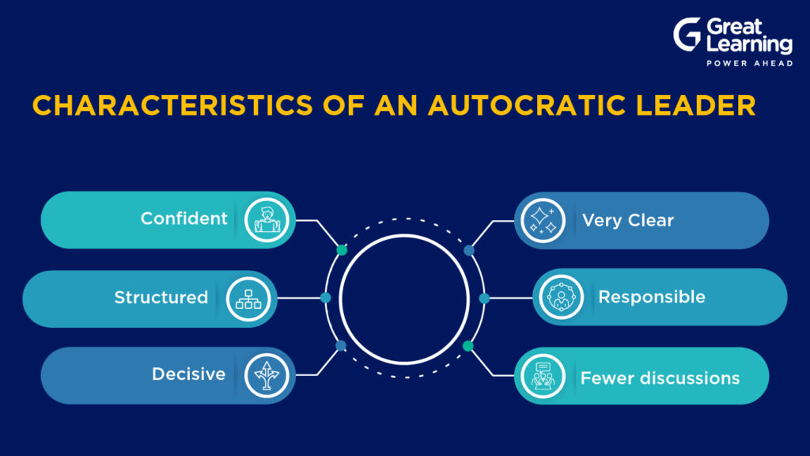
Normative Decision Model
Levels of Participation – Autocratic Processes
Autocratic Process is when leader solves the problem or makes the decision themselves using the information available at the time.
  The leader obtains any necessary information from followers, then decides on a solution to the problem.
    They may or may not tell followers the purpose of their questions or give info about the problem or decision they are working on.

Slide 9

Normative Decision Model
Levels of Participation
Consultative Process is when leader shares the problem with relevant followers individually, getting their ideas and suggestions w/out bringing them together as a group.
  Then the leader makes a decision.
    The decision may or may not reflect the follower’s influence.

Slide 10
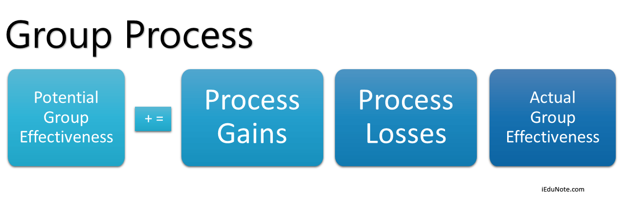
Normative Decision Model
Levels of Participation
Group Process is when leader shares the problem with followers as a group. Together they generate and evaluate alternatives and attempt to reach agreement (consensus) on a solution.
  The leader’s role is much like that of a chairman, coordinating the discussion, keeping it focused on the problem, and making sure the critical issues are discussed.
    The leader provides the group with information or ideas they have, but does not try to press them to adopt the leader’s solution.

Slide 11
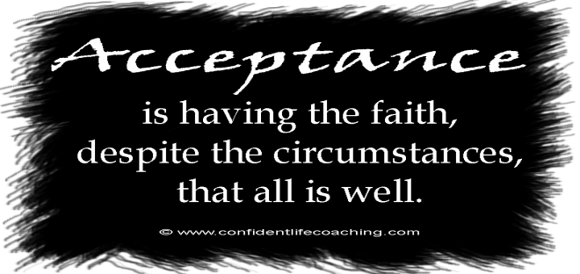

Decision Quality and Acceptance
Vroom and Yetton believed decision quality and decision acceptance were the two most important criteria for judging the adequacy of a decision.
  Decision Quality means simply that if the decision has a rational or objectively determinable “better or worse” alternative, the leader should select a better alternative.
  Decision Acceptance implies that followers accept the decision as if it were their own and do not merely comply with the decision.
    Acceptance of the decision is critical, because followers will bear responsibility for implementing it.

Slide 12


Decision Quality and Acceptance
Leaders sometimes assume that they do not need to worry about acceptance because they have so much power over their followers that overt rejection of a decision is not likely to occur.
  Because followers generally do not openly object to the decisions made by leaders with this much power, these leaders often mistakenly assume that their decisions have been accepted and will be fully implemented.
    This is a naïve view of what really goes on in organizations.

Slide 13

The Decision Tree
Having settled on quality and acceptance as the two principal criteria for effective decisions, A Normative Decision Model was developed to reflect what ought to happen rather than describing what does happen.
  Researchers developed a set of questions to protect quality and acceptance by eliminating decision processes that would be wrong or inappropriate.
    Generally, these questions concern the problem itself, the amount of pertinent information possessed by the leader and followers, and various situational factors.

Slide 14

Leadership Decision Tree
The following questions incorporated in a decision tree:
  Does the problem possess a quality requirement?
  Do I have sufficient information to make a high-quality decision?
  Is the problem structured?
  Is acceptance by members important for effective implementation?
  If I were to make the decision myself, is it reasonably certain it would be accepted by members?
  Do members share the organizational goals to be attained in solving this problem?
  Is conflict among members over preferred solutions likely?

Slide 15
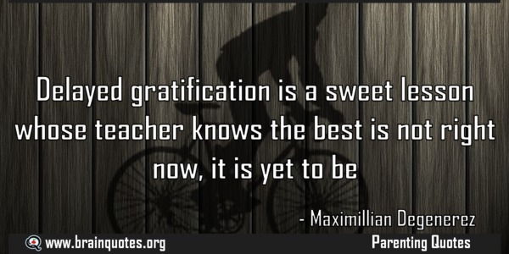
How Much Time Do I Have?
A key lesson of “Artful Procrastination” is never to make a decision today that can reasonably be put off to tomorrow.
  With respect to timing, almost all great leaders have understood that making quick decisions is typically counterproductive.
    Delaying a decision as long as reasonably possible generally leads to the best decision being made.

Slide 16

Situational Leadership Model
Although leaders often have different interactional styles when dealing with individual followers, is there an optimum way for leaders to adjust their behavior with different followers and thereby increase their likelihood of success?
  If there is, what factors should the leader base their behavior on – the follower’s intelligence? Personality traits? Values? Preferences? Technical Competence?
    The Situational Leadership Model offers some answers.

Slide 17

Situational Leadership Model
Leader Behaviors
As Situational Leadership evolved, so did the labels, but not the content, for the two leadership behavior categories.
  Task Behaviors
    The extent to which a leader spells out the responsibilities of an individual or group. Task Behaviors include telling people what to do, how to do it, when to do it, and who is to do it.
  Relationship Behaviors
    The extent to which a leader engages in two-way communication. Relationship Behaviors include listening, encouraging, facilitating, clarifying, explaining why a task is important, and giving support.

Slide 18

Situational Leadership Model
Leader Behaviors
The relative effectiveness of these two behavior dimensions often depend on the situation.
  Certain combinations of task and relationship behaviors may be more effective in some situations than others.

Slide 19

Follower Readiness
The key contingency factor: Follower Readiness, refers to a follower’s ability and willingness to accomplish a task.
  Readiness is not an assessment of an individual’s personality, traits, values, age, and so on. It’s not a personal characteristic, but rather how ready an individual is to perform a particular task.
    Any given follower could be low on readiness to perform one task but high on readiness to perform a different task.

Slide 20

Follower Readiness
When leaders would like to see followers increase their level of readiness for particular tasks, they can implement a series of Developmental Interventions to help boost follower readiness levels.
  The process would begin by first assessing a follower’s current level of readiness and then determining the leader behavior that best suits that follower in that task.

Slide 21

Situational Leadership Model
The only situational consideration is knowledge of the task, and the only follow factor is readiness.
  Situational Leadership is a useful way to get leaders to think about how leadership effectiveness may depend somewhat on being flexible with different members, and not acting the same way toward them all.

Slide 22

The Contingency Model
Although leaders may be able to change their behaviors toward individual members, leaders also have dominant behavioral tendencies.
  Some leaders may be more supportive and relationship-oriented, whereas others may be more concerned with task or goal accomplishment.
    The Contingency Model recognizes leaders have general behavioral tendencies and specifies situations where certain leaders, or behavioral dispositions, may be more effective.

Slide 23

Part Four: Focus on the Situation
Leadership and Change
  Organizations today face a myriad of potential challenges.
    To be successful they must cope effectively with the implications of new technology, globalization, changing social/political climates, new competitive threats, shifting economic conditions, industry consolidation, swings in customer preferences, and new performance standards.

Slide 24
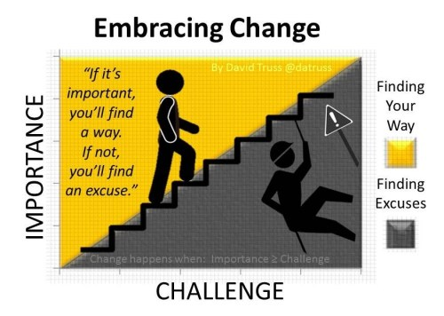
Leadership and Change
Leading change is perhaps the most difficult challenge facing any leader, yet this skill may be the one best differentiator of managers from leaders and of mediocre from exceptional leaders.
  The best leaders are those who recognize the situational and follower factors inhibiting or facilitating change, paint a compelling vision of the future, and formulate and execute a plan that moves their vision from a dream to reality.

Slide 25

Leadership and Change
Leaders can use goal setting, coaching, mentoring, delegation, or empowerment skills to effectively change the behaviors and skills of individual direct reports.
  To successfully lead larger-scale change initiatives, leaders need to attend to situational and follower factors affecting the organization.
    They must also use their intelligence, problem-solving skills, creativity, and values to sort out what’s important and formulate solutions to the challenges they face.

Slide 26

Leadership and Change
Solutions in and of themselves are no guarantee for change; leaders must use power and influence, personality traits, coaching and planning skills, and knowledge of motivational techniques and group dynamics to drive change.
  Unlike the rational approach to change, the charismatic and transformational leadership framework places considerable weight on followers’ heightened emotional levels to drive change.

Slide 27

Rational Approach
Beer offered a rational and straightforward approach to organizational change that addresses many issues.
  Beer’s model provides a road map for leadership practitioners wanting to implement an organizational change initiative, as well as a diagnostic tool for understanding why change initiatives fail.
    C = D x M x P > R

Slide 28

Beer’s Model for Organizational Change
C = D x M x P > R
C= Change:
  D=Dissatisfaction
    Followers’ dissatisfaction with the current status quo.
  M=Model
    The model for change, including leader’s vision of the future as well as the goals and systems that need to change to support the new vision.
  P=Process
    Concerns developing and implementing a plan that articulates the who, what, when, where, why, and how of the change initiative.
  R=Resistance
    People resist change because they fear a loss of identity or social contacts, and good change plans address these sources of resistance.

Slide 29
Change Model
C = D x M x P > R
Leaders can increase the amount of change by increasing the level of dissatisfaction, increasing the clarity of vision, developing a well-thought-out change plan, or decreasing the amount of resistance in followers.
  If followers are content with the status quo, it may be difficult for leaders to get followers to change, no matter how compelling their vision or change plan may be.
    This model maintains that organizational change is a systematic process, and large scale changes can take time to implement.

Slide 30
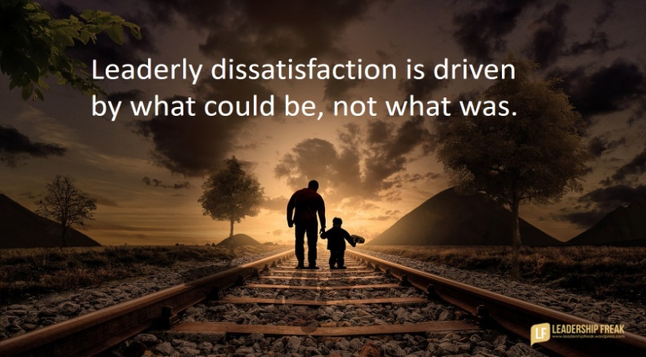
Change Model
Dissatisfaction
Followers’ level of satisfaction is an important ingredient in a leader’s ability to drive change.
  Followers who are relatively content are not apt to change; malcontents are more likely to do something to change the situation.
    Although EE satisfaction is an important outcome of leadership, leaders who want to change the status quo may need to take action to decrease EE satisfaction levels.

Slide 31


Change Model
Dissatisfaction
Follower’s emotions are the fuel for organizational change, and change often requires a considerable amount of fuel.
  The key for leadership practitioners is to increase dissatisfaction to the point where followers are inclined to take action, but not so much that they decide to leave the organization.

Slide 32

Change Model
Dissatisfaction
The first step is to determine how satisfied followers are with the current situation.
  This information can be obtained from EE satisfaction surveys, grievance records, customer complaints, or internal conversations.
    To increase dissatisfaction, leaders can talk about potential competition, technology, legal threats, or EE concerns about the status quo. They can also capitalize on or create some type of financial or political crisis, compare benchmarks against other organizations, or increase performance standards.

Slide 33
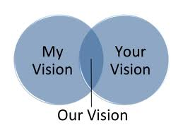

Change Model
Dissatisfaction
All of these actions can potentially heighten followers’ emotional levels.
  However, leaders must ensure that these emotions are channeled toward the leader’s vision for the organization.

Slide 34

Change Model
Model-Vision and Goals
There are four key components to the model variable in the change formula, and these include environmental scanning, a vision, the setting of new goals to support the vision, and needed system changes.
  Good leaders constantly scan the external environment to assess the seriousness of these threats. They also scan the internal environment to understand where the organization is doing well and where it is falling short.
    Keeping up to date on current events, reviewing organizational reports, and listening to followers’ concerns are some techniques leaders can use for their scanning efforts.

Slide 35
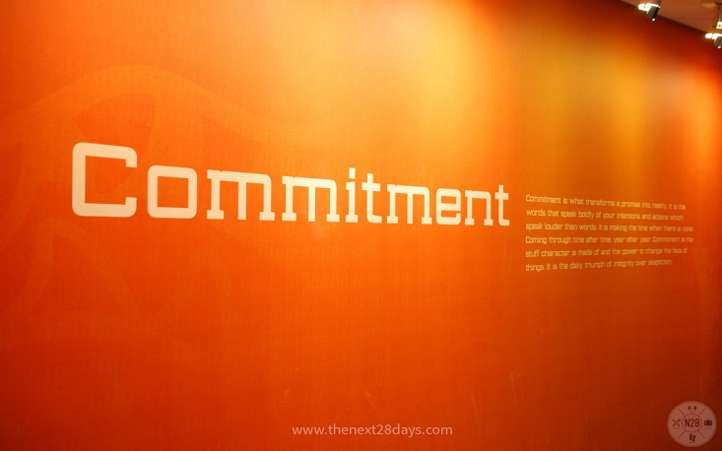

Change Model
Model–Vision and Goals
Scanning can generate helpful information needed to formulate a vision for the change initiative.
  A vision statement does not have to be a solo effort, as leaders can often solicit followers for ideas or will work with a team of followers to craft a vision statement.
    Both of these actions can help to increase followers’ commitment to the new vision.

Slide 36
Change Model
Model–Vision and Goals
It is important to understand the difference between an organization’s vision and goals.
  Just as ancient mariners used the stars to navigate, so should a vision provide guidance for an organization’s actions.
    A vision helps an organization make choices about what it should or should not do, the kind of people it should hire and retain, the rules by which it should operate, and so on.
  But, just as stars were not the final destination for mariners, a vision is not final the destination for an organization.
    An organization’s goals are the equivalent of the mariners’ final destination, and they should spell out specifically what the organization is trying to accomplish.

Slide 37

Change Model
Model-Vision and Goals
After determining the organization’s goals, the leader will need to determine which systems need to change for the organization to fulfill its vision and accomplish its goals.
  The leader needs to ask, does the current organizational structure or culture support or interfere with the new vision?

Slide 38

Systems Thinking Approach
Leaders wanting their organizational change initiatives to succeed will need to take a Systems Thinking Approach after setting organizational goals.

Slide 39
Systems Thinking Approach
A Systems Thinking Approach asks leaders to think about the organization as a set of interlocking systems, and explains how changes in one system can have intended and unintended consequences for other parts of the organization.
  Leaders may need to set goals and put action plans in place for each of these system changes to maintain overall effectiveness.

Slide 40

Systems Thinking Approach
Leaders changing organizational vision or goals will need to think through the needed changes in the organization’s structure, culture, systems, and leader and follower capabilities.
  One of the keys to successful organizational change is ensuring that all components are in alignment.

Slide 41
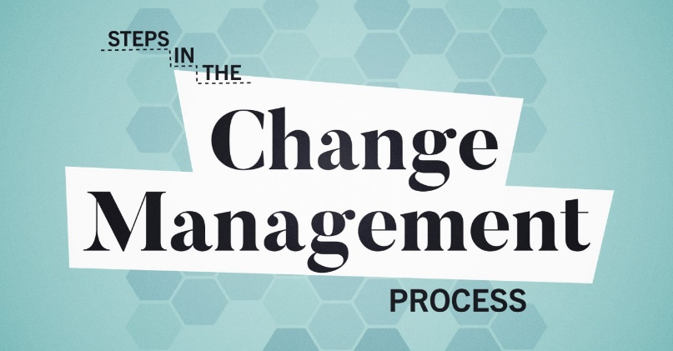
Change Model
Process
The Process component of the change model is where the change initiative becomes tangible and actionable because it consists of the development and execution of the change plan.
  Good change plans outline the sequence of events, key deliverables, timelines, responsible parties, metrics, and feedback mechanisms needed to achieve the new organizational goals.
    They may also include the steps needed to increase dissatisfaction and deal with anticipated resistance, an outline of training and resource needs, and a comprehensive communication plan to keep all relevant parties informed.

Slide 42
Change Model
Process
Change will occur only when the action steps outlined in the plan are actually carried out.
  The best way to get followers committed to a change plan is to have them create it.
    Many times it is impossible for all the followers affected by the change to be involved with plan creation. In these cases, follower commitment can be increased if the new expectations for behavior and performance are explicit, the personal benefits of the change initiative are made clear, and followers already have a strong and trusting relationship with their leader.

Slide 43
Change Model
Process
Leaders will need to spend considerable time regularly reviewing progress and holding people accountable for their roles and responsibilities in the change plan.
  Followers face competing demands for time and effort, and a lack of follow-through will cause many followers to drop the change initiative off of their radar screens.

Slide 44

Change Model
Resistance: SARA Model
These reactions to change – SHOCK, ANGER, REJECTION, and ACCEPTANCE – make up the SARA Model.
  Most people go through these four stages whenever they get passed over for a promotion, receive negative feedback, or get criticized by their boss.
    A leader needs to recognize the four reactions to change, understand the time followers may need to adjust to their reaction, demonstrate empathy and listen to follower concerns, and respect that the change initiative will stall until it is fully accepted.

Slide 45

Rational Approach to Organizational Change
Concluding Thoughts
Although organizational vision, goals, and change plans are often seen as a collaborative effort between the leader and followers, they are the primary responsibility of the leader.
  The leader needs both good leadership and good management skills if a change initiative is to succeed over the long term.
    Leadership skills are important for determining a new vision for the organization, increasing the dissatisfaction, coaching followers on how to do things differently, and overcoming resistance.
    Management skills are important when setting new goals and creating, implementing, and reviewing progress on change plans.

Slide 46
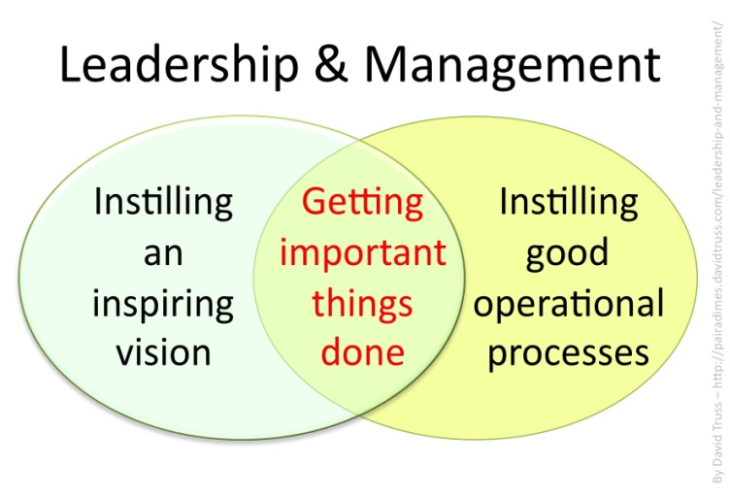
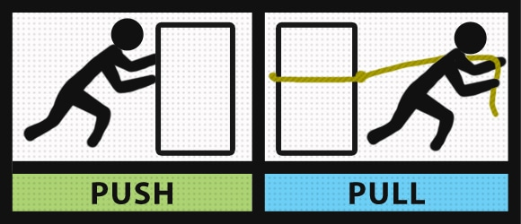
Rational Approach
It is almost impossible for an organization to successfully change if the person in charge does not have a compelling vision or fails to motivate others to do something different.
  Many of the other reasons why change initiatives fail have roots in underdeveloped leadership or management skills.

Slide 47
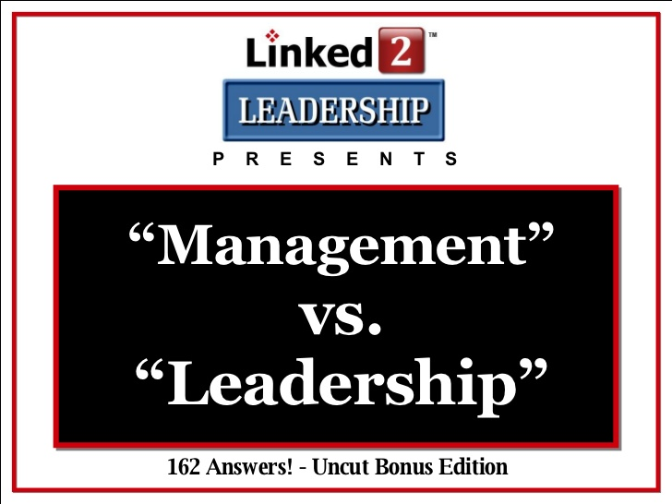
Rational Approach
Two leadership and management skills that are vitally important to driving change are:
  Adaptive Leadership
    Involves behaviors associated with being able to successfully flex and adjust to changing situations.
  Learning Agility
    Is the capability and willingness to learn from experience and apply these lessons to new situations.

Slide 48

Rational Approach
Force Field Analysis
Force Field Analysis (FFA) is a tool that can be used to gain a better understanding of organizational change.
  The first step in an FFA is to graphically depict the current state of organizational affairs: driving forces and barriers.
    In many cases the driving forces and the barriers to organizational change should more or less balance out, because they represent the status quo.
  The second step is to formulate strategies to increase the drivers or reduce the barriers to organizational change.
    Leaders will often get better results if they focus on reducing barriers rather than increasing the number or size of the drivers for change.
  The final step is to create and implement change plans that outline the steps, accountable parties, and timelines for change.

Slide 49
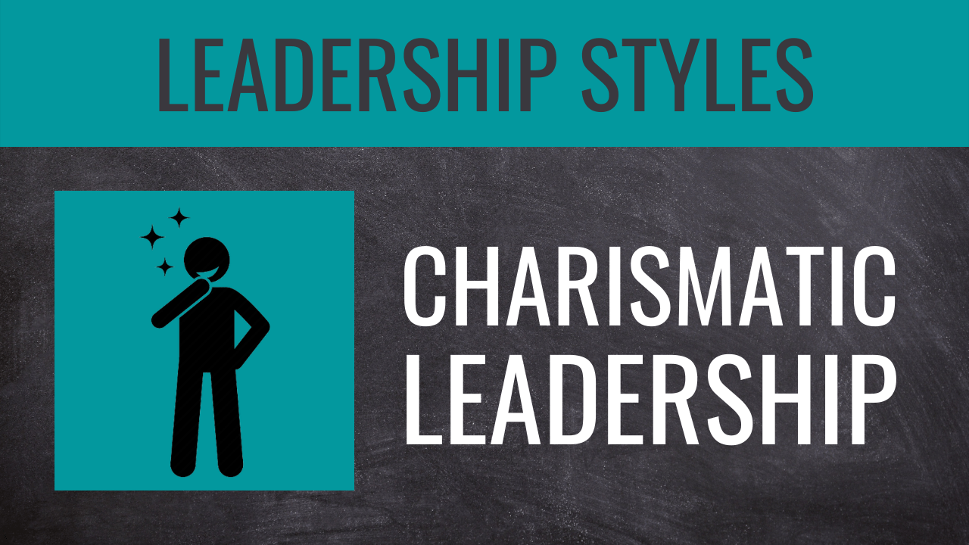
Emotional Approach
Charismatic and Transformational Leadership
The rational approach provides a straightforward model for organizational change, however, many large-scale political, societal, or organizational changes were not this formulaic.
  For example, it is doubtful that Jesus Christ, Hitler, Gandhi, or Martin Luther King Jr., followed some change formula or plan, yet they were able to fundamentally change their respective societies.
    Although these leaders differ in a number of important ways, one distinct characteristic they all share is charisma.

Slide 50

Charismatic Leaders
Charismatic leaders are passionate, driven individuals who can generate high levels of excitement among followers and build particularly strong emotional attachments with them.
  The combination of a compelling vision, heightened emotional levels, and strong personal attachments often compels followers to put forth greater effort to meet organizational or societal challenges.

Slide 51



Charismatic Leaders
The enthusiasm and passion generated by charismatic leaders seems to be a dual-edged sword.
  Some charismatic movements can result in positive and relatively peaceful organizational or societal changes; whereas, when this passion is used for selfish or personal gains it can have an equally devastating effect on society.

Slide 52
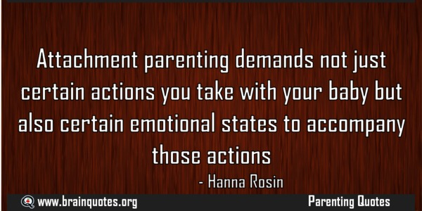
Charismatic Leadership
Researchers have argued that the litmus test for charismatic leadership does not depend on the leader’s qualities or the presence of a crisis in which to recognize the relevance of a leader’s qualities, rather it depends on followers’ reactions to their leader.
  Charisma is attributed only to those leaders who can develop particularly strong emotional attachments with their followers.

Slide 53

Charismatic Leadership
Transactional and Transformational
The debate surrounding charismatic leadership shifted with the publication of James MacGregor Burn’s “Leadership.” He believed that leadership could take one of two forms:
  Transactional Leadership
    Occurred when leaders and followers were in some type of exchange relationship to get needs met. The exchange could be economic, political, or psychological.
  Transformational Leadership
    Changes the status quo by appealing to followers’ values and their sense of higher purpose. Transformational leaders articulate the problems in the current system and have a compelling vision of what a new society or organization could be.

Slide 54

Charismatic vs. Transformational Leadership
All transformational leaders are charismatic, but not all charismatic leaders are transformational.
  Transformational leaders are charismatic because they can articulate a compelling vision of the future and form strong emotional attachments with followers.
    However, this vision and these relationships are aligned with their followers’ value systems and help them get their needs met.
  Charismatic leaders who are not transformational can convey a vision and form strong emotional bonds with followers.
    But they do so to get their own (that is, the leader’s) needs met.

Slide 55

Charismatic vs. Transformational Leadership
Both Charismatic and transformational leaders strive for organizational or societal change; the difference is whether the changes are for the benefit of the leader or followers.
  Transformational leaders are always controversial.
  Charismatic leadership almost inherently raises conflicts over values or definitions of the social good.
    Controversy also arises because the people with most to lose in any existing system will put up most resistance to a transformational change initiative, and the emotional levels of those resisting is just as great as those who embrace the change.

Slide 56

Charismatic vs. Transformational Leadership
Transformational leadership involves conflict and change, and transformational leaders must be willing to embrace conflict, make enemies, exhibit a high level of self-sacrifice, be thick-skinned and focused to perpetuate their cause.
  Transformational leaders are believed to achieve stronger results because they heighten member awareness of goals and the means to achieve them, they convince followers to take action for the collective good of group, and their vision of the future helps followers satisfy higher order needs.

Slide 57
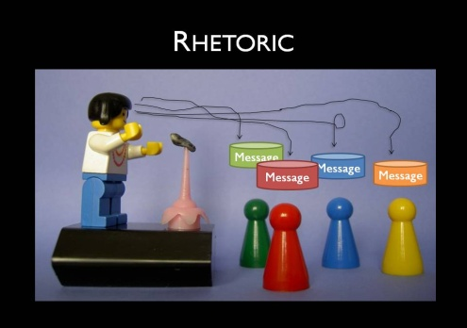
Leader Characteristics
Rhetorical Skills
In addition to having vision, charismatic leaders are gifted in sharing their vision. These leaders have excellent rhetorical skills that heighten followers’ emotional levels and inspire them to embrace the vision.
  The content of a transformational speech and the way it is delivered is vitally important. Often the delivery is even more important than the content.
    Charismatic leaders make extensive use of metaphors, analogies, and stories rather than abstract and colorless rational discourse to reframe issues and make their points.
    Their delivery is hypnotic and moving.

Slide 58

Leader Characteristics
Image and Trust Building
Transformational leaders build trust in their leadership and the attainability of their goals through an image of unshakable self-confidence, strength of moral conviction, personal example, self-sacrifice, and unconventional tactics or behavior.
  They are perceived to have unusual insight and ability, and act in a manner consistent with their vision and values.
    Transformational leaders build trust by showing commitment to followers’ needs over self-interest, whereas some charismatic leaders are so concerned with image that they take credit for others’ accomplishments or exaggerate their own.

Slide 59

Leader Characteristics
Personalized Leadership
One of the most important aspects of charismatic and transformational leadership is the personal nature of the leader’s power.
  These leaders share strong, personal bonds with followers, even when the leader occupies a formal organizational role.
    It is the personalized leadership style that seems to be responsible for the feelings of empowerment notable among followers of charismatic or transformational leaders.

Slide 60

Follower Characteristics
Identification with the Leader and the Vision
Two effects associated with charismatic leadership include a strong affection for the leader and a similarity of follower beliefs with those of the leader.
  These effects describe a sort of bonding or identification with leader personally and a parallel psychological investment to a goal or activity (a “cause”) bigger than oneself.
    Followers bond with a leader because they may be dissatisfied with the status quo and see the implementation of the vision as a solution to their problems.
    Being like the leader, or approved by the leader, also becomes an important part of followers’ self-worth.

Slide 61

Follower Characteristics
Heightened Emotional Levels
Charismatic leaders are able to stir followers’ feelings, and this heightened emotional level results in increased levels of effort and performance.
  Emotions are often the fuel driving large-scale initiatives for change, and charismatic leaders will often do all they can to maintain them, including getting followers to think about their dissatisfaction with the status quo or making impassioned appeals directly to followers.
    Some may become alienated with the vision and the movement and have emotions in conflict with those following the vision.

Slide 62

Follower Characteristics
Feelings of Empowerment
Followers of charismatic leaders are moved to expect more of themselves, and work harder to achieve higher goals.
  Charismatic leaders set high expectations while expressing confidence in their abilities and providing ongoing encouragement and support.
    Somewhat paradoxically, followers feel stronger and more powerful at the same time they willingly subordinate themselves to the charismatic leader.

Slide 63


Situational Characteristics
Crisis
Many researchers believe that situational factors also play an important role in determining whether a leader will be perceived as charismatic.
  Perhaps the most important situational factor associated with charismatic leadership is the presence or absence of a crisis.
    A crisis often creates “charisma hungry” followers who are looking for a leader to alleviate or resolve their crisis.
    Some leaders may even create or manufacture crises to increase followers’ acceptance of their vision, actions, and effort.

Slide 64


Situational Characteristics
Social Networks
Social networks can also affect the attribution of charisma.
  Attributions of charisma will spread more quickly in organizations having well established social networks.
    And more often than not charismatic leaders have bigger social networks and play a more central role in their networks than leaders seen as less charismatic.

Slide 65

Concluding Thoughts
The bottom line for charisma seems to be relationships certain leaders share with followers, and there may be a variety of ways in which these relationships can develop.
  It is also important to recognize that charismatic leadership is a two-way street.
    Not only do followers develop strong emotional bonds with leaders, but leaders also develop strong emotional bonds with followers and are concerned with follower development.

Slide 66

Concluding Thoughts
There is evidence that transformational leadership is a significantly better predictor of organizational effectiveness than transactional or laissez-faire leadership.
  Transformational leadership augments performance above and beyond what is associated with transactional leadership.
    Transactional leaders motivate followers by setting goals and promising rewards for desired performance; however, it was determined that use of rewards does not result in long-term changes associated with transformational leadership.

Slide 67


