Slide 1
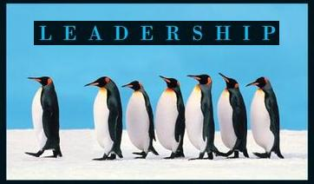
Leadership
Session Five Class Presentation
Leadership
  Enhancing the Lessons of Experience 8th Edition
    Richard L. Hughes, Robert C. Ginnett, and Gordy J. Curphy, McGraw Hill Education, New York, NY 2015
      ISBN: 978-0-07-786240-4

Slide 2
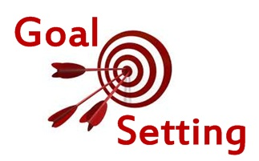
Focus on the Followers
Skills for Developing Others
  Setting goals and developing plans of action to attain them are important for individuals and groups.
    Once group goals are agreed on, they induce member compliance, act as a criterion for evaluating the leadership of group members, and become the criteria for evaluating group performance.

Slide 3
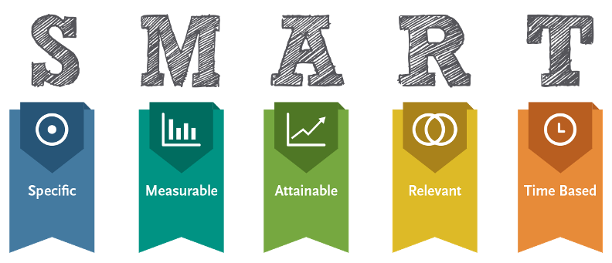
Setting Goals
Perhaps the most important step in accomplishing a personal or group goal is stating it right in the first place.
  Some ways of writing goal statements increase the likelihood that we will successfully achieve the desired goals.
    Goals should be specific, observable, attainable and challenging, based on top-to-bottom commitment, and designed to provide feedback to personnel about their progress toward them.

Slide 4
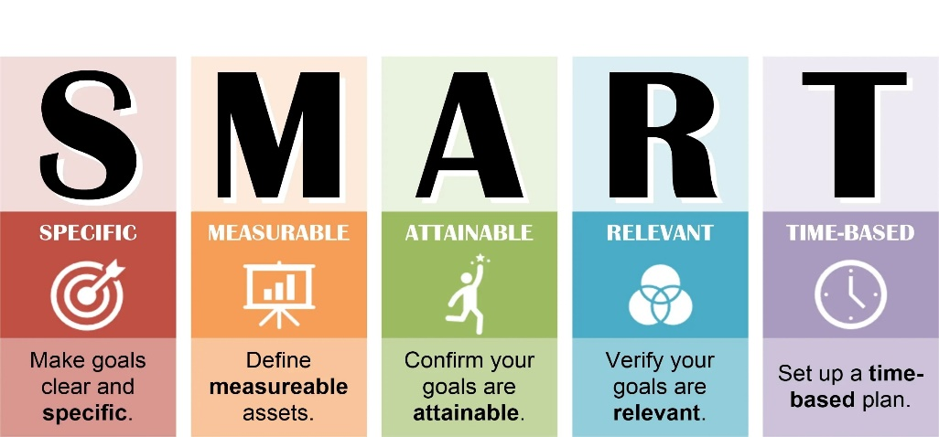
Specific and Observable
Research shows that specific goals lead to higher levels of effort and performance than general goals.
  General goals do not work well, because they often do not provide enough information regarding which behaviors are to be changed or when a clear end state has been attained.

Slide 5


Specific and Observable
Specific and observable goals must also have a time limit.
  Without time limits for accomplishing goals, there would be little urgency associated with them.
    Neither would there be a finite point at which it is clear whether a person or group has accomplished the goals.

Slide 6

Attainable but Challenging
Goals must be realistic and challenging.
  Setting easy goals does not result in high levels of performance; higher levels of performance comes about when goals stretch and inspire people toward doing more than they thought they could.
    Goals need to be challenging, but attainable to get the best out of ourselves.

Slide 7

Commitment
Organizational goals are most likely to be achieved if there is commitment to them at both the top and the bottom of the organization.
  Subordinates often become committed to goals simply by seeing the sincere and enthusiastic commitment of top leadership to them.
  Another way to build subordinate acceptance and commitment to goals is to have subordinates participate in setting the goals.
    Worker acceptance and satisfaction tend to increase when workers are allowed to participate in setting goals.

Slide 8

Feedback
One of the most effective ways to improve any kind of performance is to provide feedback about how closely a person’s behavior matches some criterion.
  Research shows that performance is much higher when goals are accompanied by feedback than when either goals or feedback are used alone.
    People should seek feedback from a variety of sources or provide feedback using a variety of criteria.

Slide 9
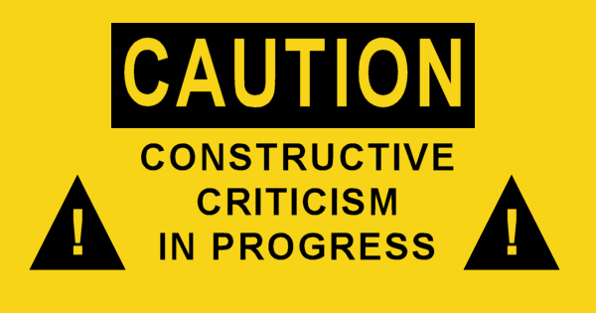
Providing Constructive Feedback
Giving constructive feedback involves sharing information or perceptions with another about the nature, quality, or impact of that person’s behavior.
  It can range from giving feedback pertaining specifically to a person’s work (performance feedback) to impressions of how aspects of that person’s interpersonal behavior may be pervasively affecting relationships with others.

Slide 10

Providing Constructive Feedback
Getting helpful feedback is essential to a subordinate’s performance and development.
  Besides fostering growth, effective supervisory feedback also plays a major role in building morale.

Slide 11

Providing Constructive Feedback
Positive and Negative
There are a number of reasons why leaders are hesitant to provide both positive and negative feedback, but leaders need to keep in mind that followers will perform at a higher level if they are given accurate and frequent feedback.
  Positive feedback is necessary to tell followers they should keep doing what they are doing well.
  Negative feedback is needed to give followers or members ideas for how to change their behavior to improve their performance.

Slide 12


Feedback Skills
Tips for improving Feedback Skills:
  Be Helpful
  Be Direct
  Be Specific
  Be Descriptive
  Be Timely
  Be Flexible

Slide 13
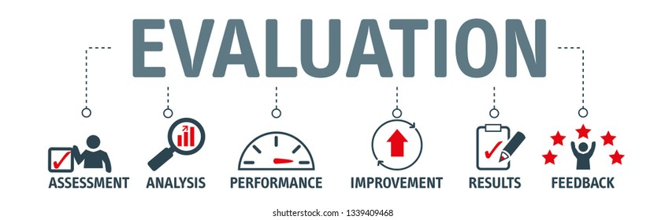
Criteria for Evaluative Feedback
The following are types of criteria to use for Evaluative Feedback:
  Compare behavior with others’ measured performance.
  Compare behavior with an accepted standard.
  Compare behavior with a previously set goal.
  Compare behavior with past performance.

Slide 14

Give Positive as well as Negative Feedback
Giving both positive and negative feedback is more helpful than giving only positive or negative feedback alone.
  Positive feedback tells the other person or the group only what they are doing right, and negative feedback tells the other person or group only what they are doing wrong.
    Providing both kinds of feedback is best.

Slide 15

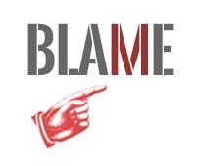
Avoid Blame or Embarrassment
The purpose of feedback is to give useful information to other people to help them develop, so talking to them in a way merely intended (or likely) to demean or make them feel bad is not helpful.
  Followers are more likely to believe feedback if it comes from leaders who have had the opportunity to observe behavior and are perceived to be credible, competent, and trustworthy.

Slide 16
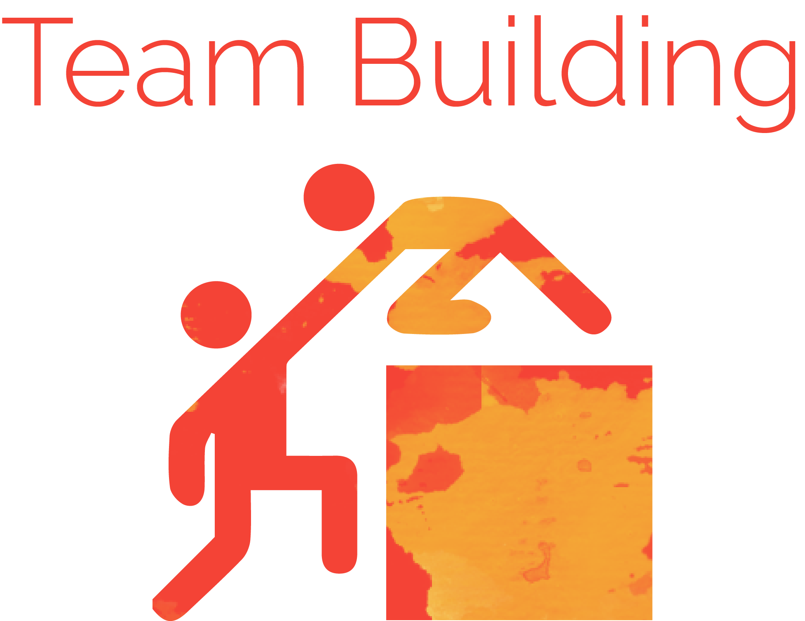
Team Building
Team-building activities help team members understand why they are having difficulty in achieving team objectives, and suggest coping strategies for an intolerable situation.
  They are not, however, likely to remove root causes of problems.

Slide 17
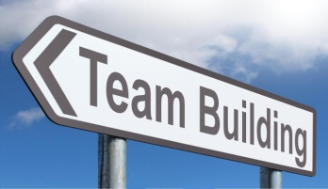
Team Building
As a basis for any work at the team level, individual team members must first be comfortable with themselves.
  They must be able answer the questions “What do I bring to the team?” and “What do I need from the team?”
  When these questions have been answered, team members are in a position to begin dealing at the interpersonal level, where they now comfortably ask, “What do you bring to the team, or need from us?”
    Not resolving these issues results in caution in dealing with other members, and interactions at the “polite façade” level rather than at the level of truth and understanding.

Slide 18
Team Building
An intervention at the team level must meet three general requirements to be successful.
  Awareness Raising
    Include a healthy dose of team-based research findings about how teams really work as a critical element of a workshop.
  Diagnostic, Instrument-Based Feedback
    Provide team members with a reasonably valid map of where they and their teammates are now located.
  Include a Practice Field
    Practice is necessary for athletic success, and in organizations too.
    Provide an opportunity to test new skills in a risk-free space.

Slide 19

High Performance Teams
The Rocket Model
Leadership is not an individual process, rather it involves influencing a group to pursue some over-reaching goal.
  Teams may vary in a number of important factors, such as group size, norms, development stages, and cohesion.
    Leaders need to take these factors into consideration when creating and leading teams.

Slide 20

The Rocket Model
The Rocket Model of Team Effectiveness is prescriptive in that it tells leaders what steps to take and when to take them.
  The model can be used as a tool for understanding where teams are falling short and what leaders need to do to get them back on track.

Slide 21
The Rocket Model
There are eight components of the Rocket Model:
  Context
  Mission
  Talent
  Norms
  Buy-In
  Power
  Morale
  Results

Slide 22

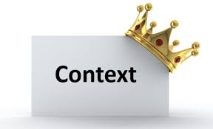
The Rocket Model
1. Context: What is the Situation?
A critical first step to building high-performing teams is gaining alignment on team context.
  Most teams either influence or are influenced by competitors, suppliers, customers, government regulators, market conditions, other internal teams, the larger organization, etc.
    All too often team members have different assumptions about these constituencies, and as a result take well intended, but misguided actions that destroy team morale and performance. Leaders must identify all the constituencies affecting the team, and ask team members to share their assumptions about each. Then identify challenges.

Slide 23

The Rocket Model
2. Mission: What are We Trying to Accomplish?
Once the situation has been clearly defined the next thing a leader must do is clarify the team’s purpose and goals.
  Thus, the mission component of the Rocket Model is concerned with setting a common direction for the team.
    Who makes these decisions is not as important as ensuring that all the team members understand what the team is trying to accomplish and how they contribute to team success.

Slide 24

The Rocket Model
3. Talent: Who is on the Bus?
The talent component of the Rocket Model is about answering the right questions:
  Does the team have the right number of people, with the right organizational structure, in the right roles, with the right skills, and for the right reasons?
    Clarifying the reporting structure, defining roles/responsibilities, selecting the right kind of people, and continuously developing those skills needed to achieve team goals are the key leadership activities in this component of the model.

Slide 25
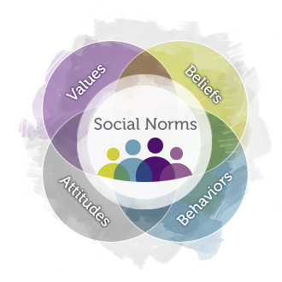
The Rocket Model
4. Norms: What are the Rules?
Once team members are in place and clearly understand the team’s situation, goals, and roles, leaders need to address the norms component.
  Norms are the rules that govern how teams make decisions, conduct meetings, get work done, hold team members accountable for results, and share information.

Slide 26

The Rocket Model
5. Buy-In: Is Everyone Committed and Engaged?
Just because team members understand the team’s goals, roles, and rules does not necessarily mean they will automatically be committed to them.
  Teams with high levels of buy-in have team members who believe in what the team is trying to accomplish and will put forth the effort needed to complete their assigned tasks and make the team successful.

Slide 27

The Rocket Model
5. Buy-In: Is Everyone Committed and Engaged?
There are three basic ways team leaders can get buy-in.
  Develop a compelling team vision or purpose.
    Many team members want to be part of something bigger than themselves, and serving on a team can fulfill this need.
  Have a high level of credibility.
    Leaders with high levels of relevant expertise who share trusting relationships with team members often gain their buy-in.
  Involve members in the goal, role, and rule-setting process.
    Participation strengthens commitment.

Slide 28

The Rocket Model
6. Power: Do We Have Enough Resources?
The power component concerns the decision-making latitude and resources the team has to accomplish its goals.
  Teams reporting high levels of power have considerable decision-making authority and all the equipment, time, facilities, and funds needed to accomplish team goals.
    Good teams figure out ways to make do with what they have, or devise ways to get what they need.
    Dysfunctional teams spend time and energy complaining about perceived lack of resources, rather than figuring out ways to achieve team goals.

Slide 29
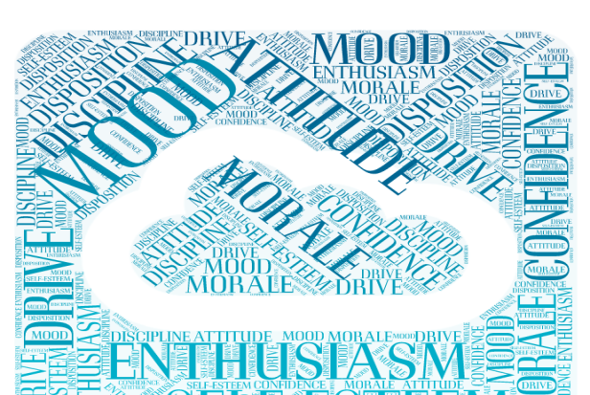
The Rocket Model
7. Morale: Can’t We All Just Get Along?
Just because individual team members understand what the team is trying to accomplish, are committed to achieving team objectives, and understand the rules by which the team gets work done does not necessarily mean team members will all get along with each other.
  Teams that report high levels of morale tend to deal effectively with interpersonal conflict and have high levels of cohesion.

Slide 30
The Rocket Model
8. Results: Are We Winning?
One thing we know about successful military leaders and athletic coaches is that they teach their teams how to win.
  They are continually devising strategies and tactics to leverage their team’s strengths, minimize weaknesses, and do just the opposite of their opponents.
Business leaders rarely teach their teams how to win.
  To do this, team leaders need to set well-defined team goals, create executable plans with clear timelines and accountable parties to achieve these goals, and conduct periodic progress reviews to identify key learning and revise plans as needed.

Slide 31
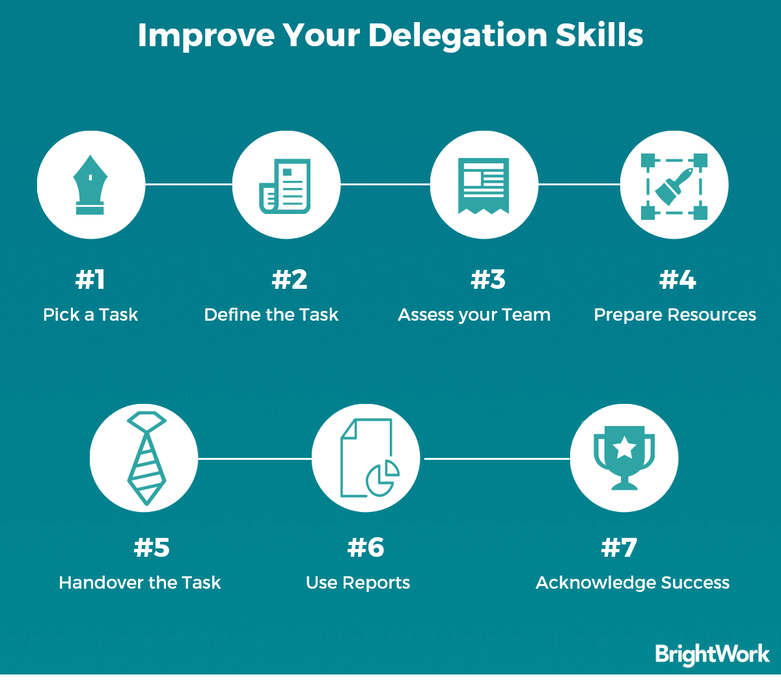
Delegation
Delegation is a simple way for leaders to free themselves of time-consuming chores; give followers developmental opportunities; and increase the number of tasks accomplished by the team.
  Delegation is often an overlooked and underused tool.

Slide 32

Delegation
Delegation implies that someone has been empowered by a leader to take responsibility for completing certain tasks or engaging in certain activities.
  Delegation gives responsibility for decisions to individuals most likely to be affected by or to implement the decision
    Delegation is more concerned with autonomy, responsibility, and follower development than participation.

Slide 33
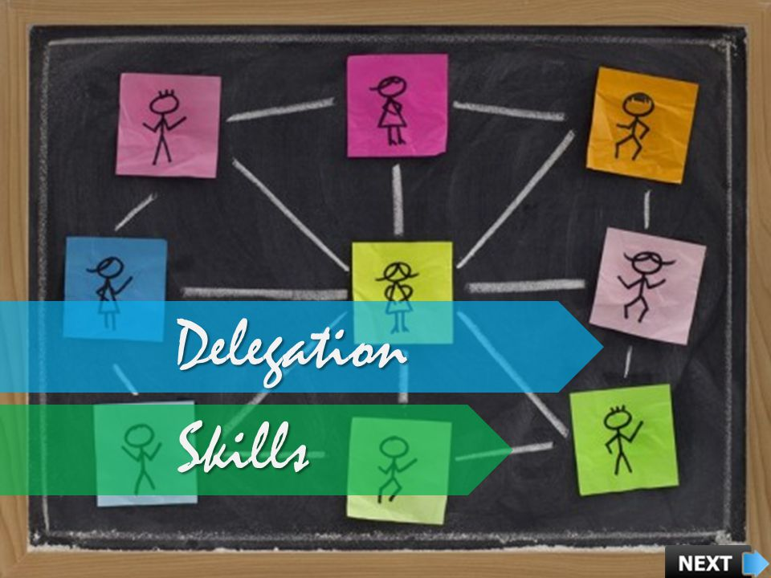
Delegation
Leaders who delegate skillfully have more satisfied followers than leaders who do not delegate well.
  Subordinates need to feel they have the appropriate authority to accomplish a delegated task, they appreciate minimal monitoring of their approach and efforts, and expect to be delegated tasks of importance rather than tasks the leader is unwilling to do.

Slide 34

Why Delegation is Important
The essence of leadership is achieving goals through others, not trying to accomplish them oneself.
  Developing subordinates is one of the most important responsibilities any leader has, and delegating significant tasks to them is one of the best ways to support growth. In doing so, organizations will be strengthened.

Slide 35
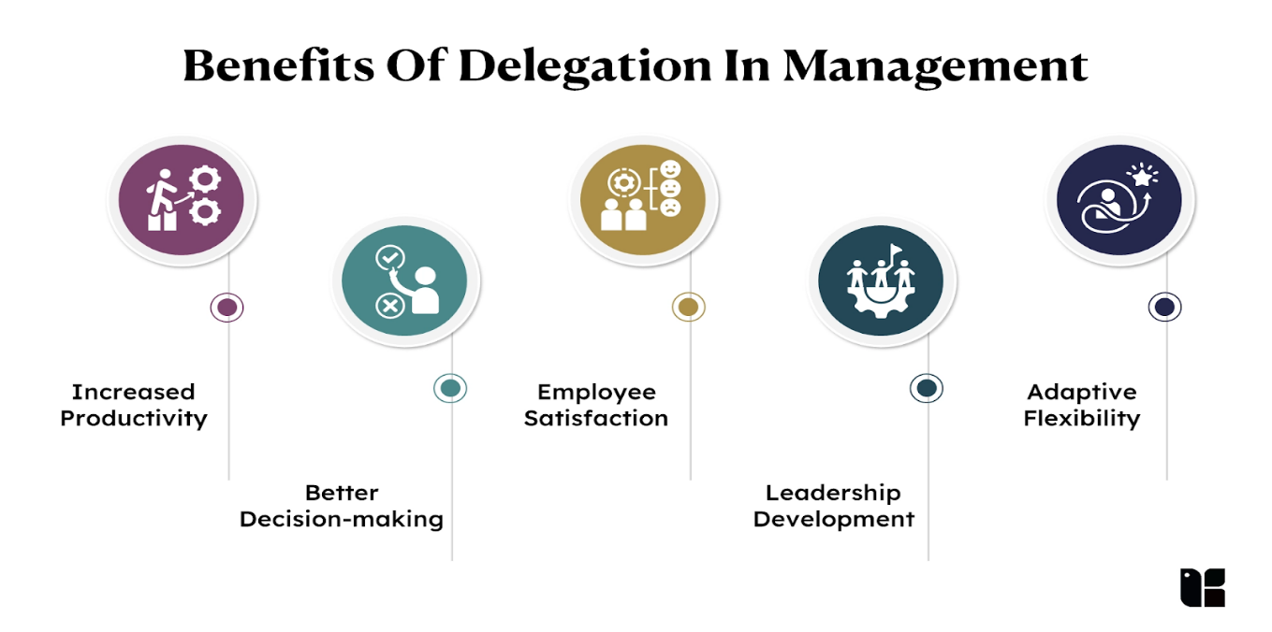
Why Delegation is Important
Delegation
    Frees Time for Other Activities
    Develops Followers
    Strengthens the Organization

Slide 36

Common Reasons for Avoiding Delegation
The following are some common reasons leaders try to avoid delegating tasks to subordinates:
  Delegation Takes Too Much Time
    Requires Staff Training and Oversight
  Delegation Is Risky
    Can Feel Threatening to Leader (Career Risk) and Loss of Control
  The Job Will Not Be Done as Well
    Subordinates May Lack Technical Competence
  The Task Is a Desirable One
    May Create a Source of Power or Be a Prestigious Task
  Others Are Already Too Busy
    Leader May Feel Guilty for Adding to Workload

Slide 37
Principles of Effective Delegation
The following are principles of effective delegation:
  Decide What to Delegate
    Justify Time Spent On Each Activity
  Decide Whom to Delegate
    Select Appropriate Person and Balance Development Opportunities
  Make the Assignment Clear and Specific
    Clarify Task and Expectations
  Assign an Objective, Not a Procedure
    Indicate What is to be Accomplished, Not How It Needs to Be Done
  Allow Autonomy, but Monitor Performance
    Do Not Micromanage
  Give Credit, Not Blame
    Leaders Always Remain Fully Responsible and Accountable

Slide 38

Coaching
A key success factor in most organizations today is having leaders and followers with the right knowledge and skills.
  Many companies look at “bench strength” as an advantage.
  There are two ways to acquire bench strength, employers:
    Buy (hire) the talent they need.
    Build existing talent through development and coaching.
      Most leaders engage in some form of informal coaching.

Slide 39

Coaching
Peterson and Hicks have described coaching as the “process of equipping people with the tools, knowledge, and opportunities they need to develop themselves and become more successful.”
  Good coaches help followers clarify career goals, identify and prioritize development needs, create and stick to development plans, and create environments that support learning and coaching.
    Good coaches orchestrate rather than dictate development.

Slide 40

Forging a Partnership
Informal coaching involves establishing a relationship built on mutual trust and respect with a follower.
  There are several things leaders can do to forge a partnership:
    Establish credibility.
    Understand that the contexts in which the EE operates can be as important as the relationship you share.
    Provide realistic career advice based on employee’ skills.
    Ask questions to understand aspirations and motivators.

Slide 41
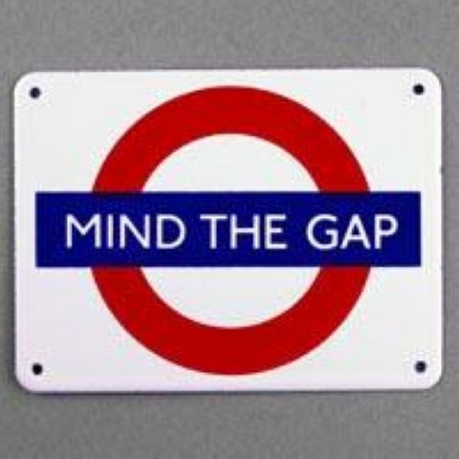
Conduct a GAPS Analysis
Goals
  Where do you want to go?
    Career objectives and Career strategies:
Abilities
  What can you do now?
    What strengths do you have for your career objectives?
    What development needs will you have to overcome?
Standards
  What does your boss or the organization expect?
    Expectations: _________________________________.
Perceptions
  How do others see you?
    360 degree and performance review results and feedback from: Boss-Peers-Direct Reports

Slide 42
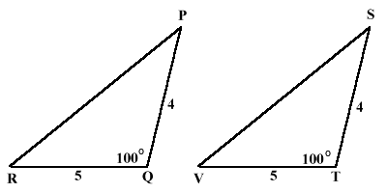
Create Development and Coaching Plans
Once the employee’s development needs are identified and prioritized, they will need to build development plans to overcome their targeted needs.
  In addition to the development plan, leaders must build a coaching plan that outlines the actions they will take to support the employee’s development.
    These plans should be congruent with one another.

Slide 43

Development Plan Checklist
Objectives
  One-year career objective identified?
  Areas in which the EE is motivated and committed to change and develop?
Criteria for Success
  Is the new behavior clearly described? Can it be measured or observed?
Action Steps
  Specific, attainable, and measurable steps? On the job activities?
Seek Feedback and Support
  Involvement of a variety of others? Management support?
Stretch Assignments
  Do the stretch assignments relate to the employee’s career objectives?
Resources
  Use a variety of books, seminars, and other resources?
Reflect with a Partner
  Includes periodic reviews of learning?

Slide 44
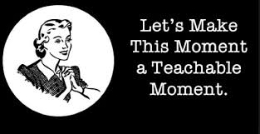
Promoting Persistence
Helping Followers Stick to Their Plans
Leaders can help to promote persistence as partners in the development plan by capitalizing on coachable moments.
  To capitalize on a coachable moment, leaders must know their followers’ development objectives, be in situations where they can observe followers practicing their objectives, and then provide immediate feedback on their observations.

Slide 45

Transferring Skills
Creating a Learning Environment
To build bench strength, leaders need to create a learning environment so that personal development becomes an ongoing process rather than a one-time event.
  The most successful organizations are those that emphasize the learning and teaching process – they focus on constantly creating leaders throughout the company.
    Leaders will need to role-model development.
    Creating a feedback-rich environment is crucial for success.

Slide 46
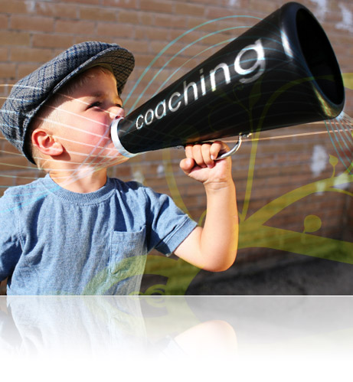
Coaching
Given the competitive advantage of companies that have a well-developed and capable workforce, in the future it will be hard to imagine leadership excellence without coaching.

Slide 47
Focus on the Situation
The Situation
  It is virtually impossible to understand leadership without taking the situation into consideration.
    No factor in the interactional framework is as complex as the situation. Not only do a variety of task, organizational, and environmental factors affect behavior, but the impact of these factors varies dramatically across people.
                Situation

Slide 48
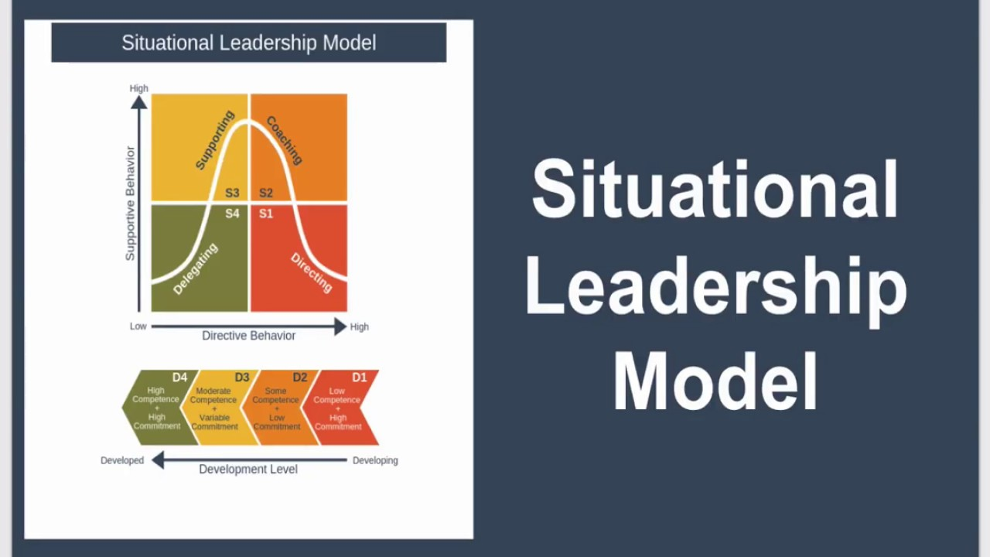
The Situation
It is difficult to predict anyone’s behavior unless you take the situation into account.
  Situation is one of the most powerful variables in the leadership equation. It is important to understand how it influences both leaders and followers.

Slide 49

The Situation
Leaders and followers often overlook how changing the situation can help them to change their behavior.
  This is called Social Engineering.
    The situation we are in often explains far more about what is going on and what kinds of leadership behaviors will be best than any other single variable we have discussed so far.

Slide 50

The Situation
The appropriateness of a leader’s behavior with a group of followers often makes sense only when you look at the situational context in which the behavior occurs.
  Researchers have maintained that the situation, not someone’s traits or abilities, plays the most important role in determining who emerges as a leader.

Slide 51

Role Theory
In Role Theory a leader’s behavior depends on a leader’s perceptions of some critical aspects of the situation, like: rules and regulations governing the job; role expectations of subordinates, peers, and superiors; nature of the task; and feedback about subordinates’ performance.
  Role Theory clarifies how these situational demands and constraints could cause role conflict and role ambiguity.
    A leader’s ability to successfully resolve such conflicts may well determine leadership effectiveness.

Slide 52
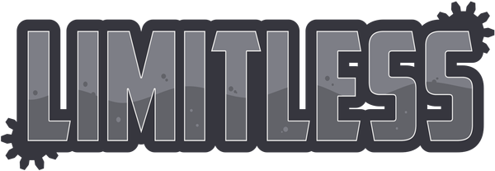
Multiple-Influence Model (MIM)
In the Multiple-Influence Model researchers determine that micro-variables (such as task characteristics) and macro-variables (such as the external environment) had pervasive influence on leadership behaviors.
  Both Role Theory and MIM confirm that situations can vary in countless ways.

Slide 53

Situational Levels
Because situations can vary in so many ways, it is helpful for leaders to have an abstract scheme for conceptualizing situations. A basic abstraction is Situational Levels.
  The idea behind situational levels is best be conveyed by an example: Suppose someone asked, “How are things going at work?” - - - You may respond with comment on (1) specific tasks performed, (2) aspects of the organization, or (3) factors affecting it.
    Responses deal w/ situation, but refer to different levels of abstraction: the task level, the organization level, and the environmental level.
    Each of these three levels provides different perspectives to examine the leadership process.

Slide 54


Situational Levels
Situations also differ in terms of physical variables like noise and temperature levels, workload demands, and the extent to which work groups interact with other groups.
  Organizations also have unique “corporate cultures,” which define a context for leadership. And, there are even broader economic, social, legal, and technological aspects of situations within which the leadership process occurs.
    What amid all this situational complexity, should leaders pay attention to?

Slide 55

The Task
The most fundamental level of the situation involves tasks to be performed by individuals or team w/in organizations.
  Industrial and organizational psychologists researched, classified, and categorized tasks to better understand how to enhance worker satisfaction and productivity.

Slide 56
The Task
The research is relevant to leadership, in regards to:
    Task Autonomy
    Feedback
    Structure
    Interdependence

Slide 57

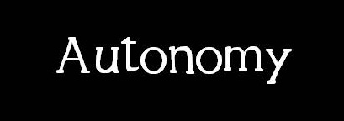
1. Task Autonomy
Task Autonomy is the degree to which a job provides an individual with some control over what they do and how they do it.
  Responsibility and job satisfaction often increase when autonomy increases.

Slide 58
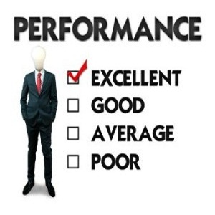

2. Task Feedback
Task Feedback refers to the degree to which a person accomplishing a task receives information re: performance from performing the task itself.
  Leaders should understand that followers may eventually become dissatisfied if leaders provide high levels of feedback for tasks that already provide intrinsic feedback.

Slide 59
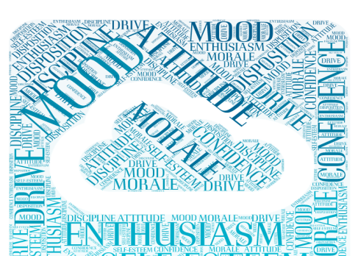
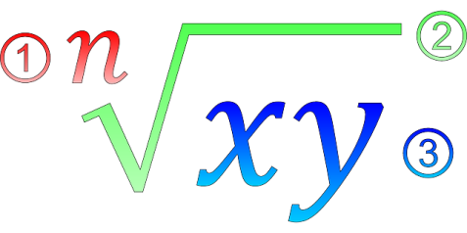
3. Task Structure
A structured task is when there is a known procedure for accomplishing the task; there are rules governing how one goes about accomplishing it; and if people follow the rules, there is one result (i.e. solve for X).
  An unstructured task is one where there are many different ways, perhaps none of which is obvious or necessarily the best for approaching a solution (i.e. solving a morale problem).
    People vary in their preferences for, or ability to handle, structured versus unstructured tasks.

Slide 60

3. Task Structure
Once a subordinate knows or understands a task, a supervisor’s continuing instruction may provide excess information and eventually become irritating.
  Subordinates need help when a task is unstructured, when they do not know what the desired outcome looks like, and when they do not know how to achieve it. Anything a supervisor can do to increase a subordinates’ ability to perform unstructured tasks is likely to increase their performance and job satisfaction.

Slide 61
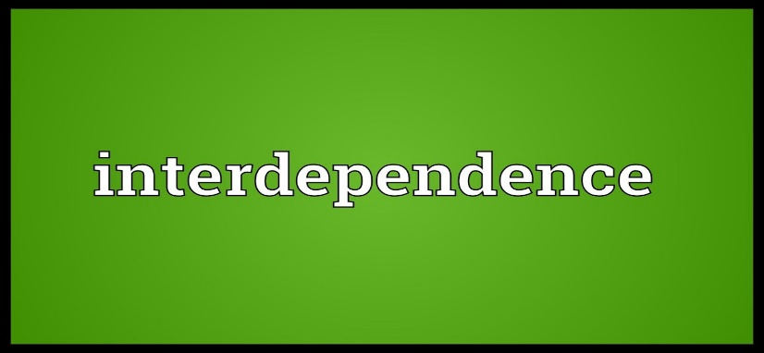
4. Task Interdependence
Task Interdependence concerns the degree to which tasks require coordination and synchronization for work groups or teams to accomplish desired goals.
  Task interdependence differs from autonomy in that workers or team members may be able to accomplish their tasks in an autonomous fashion, but the products of their efforts must be coordinated for the group or team to succeed.
    Tasks with high levels of interdependence place a premium on leaders’ organizing, planning, directing, and communication skills.

Slide 62
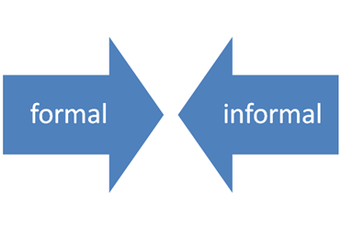
The Organization
To understand how organizations cope with change, it will be helpful to look at two different facets of organizations:
  The formal organization
  The informal organization, or organizational culture.

Slide 63
The Formal Organization
Many aspects of the formal organization have a profound impact on leadership.
  Level of Authority
    The types of behaviors most critical to leadership effectiveness can change substantially as we move up the organizational ladder.
  Organizational Structure
    The way organizational activities are coordinated and controlled, represents another level of situation in which the leader operates.
      Organizational structures vary in terms of their complexity, formalization, and decision-making.

Slide 64
The Informal Organization:
The word that sums up the Informal Organization better than any other is its Culture.
  Organizational Culture has been defined as a system of shared backgrounds, norms, values, or beliefs among members of a group.
  Organizational Climate concerns members’ subjective reactions to Organizational Culture.
    These two concepts are distinct in that organizational climate is partly a function of, or reaction to, organizational culture.
    Climate and (indirectly) culture are related to how well organizational members get along with one another.

Slide 65



Organizational Culture
Just as there are many cultures across the world, there are a great number of different cultures across organizations.
  One of the more fascinating aspects of organizational culture is that it often takes an outsider to recognize it; organizational culture becomes so second nature to many organizational members that they are unaware of how it affects their behaviors and perceptions.

Slide 66


Organizational Culture
Some questions that define Organizational Culture:
  What can be talked about or not talked about?
  How do people wield power?
  How does a person get ahead or stay out of trouble?
  What are the unwritten rules of the game?
  What are the organization’s morality and ethics?
  What stories are told about the organization?

Slide 67
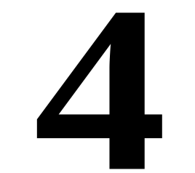
Organizational Culture
Four Key Organizational Culture Factors:
  Myths and Stories
    The tales about the organization that are passed down over time and communicate a story of the organization’s underlying values.
  Symbols and Artifacts
    Objects that can be seen and noticed and that describe various aspects of the culture.
  Rituals
    Recurring events or activities that reflect important aspects of the underlying culture.
  Language
    The jargon, or idiosyncratic terms of an organization.

Slide 68
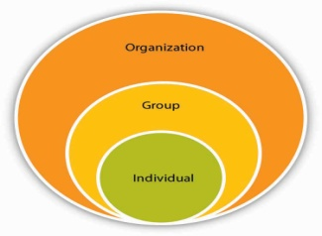
Organizational Culture
Leaders must realize that they can play an active role in changing an organization’s culture, not just be influenced by it.
  Leaders can change culture by attending to or ignoring particular issues, problems, or projects.
  They can modify culture through their reactions to crisis, by rewarding new or different kinds of behavior, or by eliminating previous punishments or negative consequences for behaviors.
  Their general personnel policies send messages about the value of employees to the organization, and they can use role-modeling and self-sacrifice as a way to inspire or motivate others to work more vigorously or interact with each other differently.
  Leaders can change culture by the criteria they use to select or dismiss followers.

Slide 69

Stages of Leadership Culture Development
Researchers at the Center for Creative Leadership studied different kinds of leadership cultures, which they define as the values, beliefs, and assumptions of how people work together in an organization, reflecting a collective approach to achieving direction, alignment, and commitment.
  While virtually all large organizations include aspects of all three types, often one of these cultures will be most dominant.
    Dependent Leadership Cultures
    Independent Leadership Cultures
    Interdependent Leadership Cultures

Slide 70
1. Dependent Leadership Cultures
Dependent Leadership Cultures are characterized by belief and practice that it’s primarily people in positions of authority who are responsible for leadership.
  This assumption may lead to organizations that emphasize top-down control and deference to authority.
  You can think of dependent culture as “conforming” cultures.
  Other characteristics associated with dependent cultures include:
    There may be a command and control mind-set.
    Seniority and position levels are less important bases of respect.
    There’s great emphasis on keeping things running smoothly.
    People operate with the philosophy that it’s usually safest to check things out with one’s boss before taking a new direction.

Slide 71
2. Independent Leadership Cultures
Independent Leadership Cultures are characterized by belief and practice that leadership emerges as needed from a variety of individuals, based on knowledge and expertise.
  There is great emphasis on individual responsibility; decentralized decision making; and the promotion of experts, professionals, and individual contributors into positions of authority.
  Think of independent cultures as “achievement-oriented” cultures.
  Other characteristics include:
    The results that leaders achieve are an important basis of respect.
    Even during times of stress, there is great pressure not to let performance numbers go down.
    Bold and independent action that gets results is highly prized.
    The organization is successful because of its large number of highly competent and ambitious individuals.

Slide 72
3. Interdependent Leadership Cultures
Interdependent Leadership Cultures are characterized by belief and practice that leadership is a collective activity requiring mutual inquiry and learning.
  There’s vast use of dialogue, collaboration, horizontal networks, valuing of differences, and a focus on learning.
  Think of interdependent culture as “collaborative” cultures.
  Other characteristics include:
    Many people wear several hats at once, and roles change frequently as the organization continually adapts to changing circumstances.
    People believe its’ important to let everyone learn from your experience, even your mistakes.
    There’s a widely shared commitment to doing what it takes to make the entire organization be successful, not just one’s group.
    Openness, candor, and building trust across departments are valued.

Slide 73

Organizational Culture
Truly significant organizational change or transformation is unlikely to be successful without addressing organizational culture, as well as, the formal organization.
  Furthermore, a change effort is more likely to be successful if it is based on an established theory of organizational culture, and not merely subjective preferences about what needs to change.
    Absent a guiding theory, misguided and superficial targets of change may be selected that miss the point and usually create problems rather than produce desired results.

Slide 74

A Theory of Organizational Culture
The Competing Values Framework derives its name from the fact that the values depicted on opposite ends of each axis are inherently in tension with each other.
  They represent competing assumptions about the desired state of affairs in the organization. Thus, it’s impossible that an organization could be both (A) extremely flexible and extremely stable always, or both (b) internally focused and integrated and externally focused and differentiated all the time.
    An organization’s culture represents a balance or trade-off between these competing values that tends to work.

Slide 75


Competing Values Framework
The Competing Values Framework is designed to help organizations be more deliberate in identifying a culture more likely to be successful given their respective situations, and in transitioning to it.
  The intersection of competing values creates four different combinations of values, and the distinctive sets of values define the following unique organizational cultures:
    Hierarchy Culture
    Clan Cultures
    Adhocracy Cultures
    Market Cultures

Slide 76
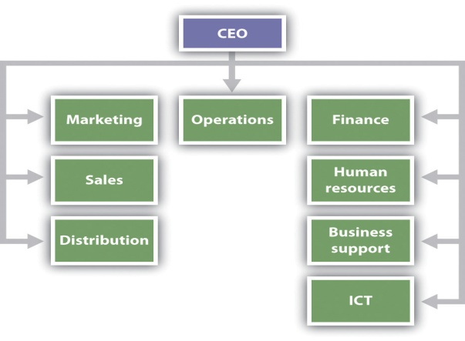
1. Hierarchy Culture
Organizations that emphasize stability and control, and also focus their attention inward (on how people within the organization interact with each other, or whether internal operating procedures are followed, and so forth), have a Hierarchy Culture.
  Organizations with a Hierarchy Culture tend to have formalized rules and procedures; they tend to be highly structured places to work.

Slide 77
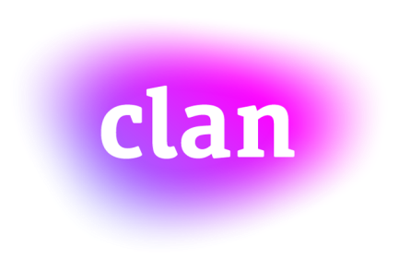

2. Clan Culture
Organizations that emphasize having a high degree of flexibility and discretion, and also focus primarily inward rather than outward, are known as Clan Cultures, because in many ways they are thought of as extended family.
  A strong sense of cohesiveness characterizes Clan Cultures along with shared values and a high degree of participation and consensus building.
    Clan Cultures believe their path to success is rooted in teamwork, loyalty, and taking care of people within the organization.

Slide 78

3. Adhocracy Culture
Organizations that emphasize having a high degree of flexibility and discretion, and focus primarily on the environment outside the organization, are called Adhocracy Cultures.
  In many ways Adhocracy Cultures represent an adaptation to the transition from the industrial age to the information age.
    This form of organizational culture is most responsive to the turbulent and rapidly changing conditions of the present age.
    They are by nature dynamic and changing so as to best foster creativity, entrepreneurship, and staying on the cutting edge.

Slide 79

4. Market Culture
Organizations that, like Hierarchy Cultures, emphasize stability and control but focus their attention primarily on the external environment (outside the organization itself) are called Market Cultures.
  Their interest is more on interactions with external constituencies like customers and suppliers.
  Market Cultures are competitive and results-oriented, and the results that count most are financial measures of success, such as profit.
    They achieve measurable goals and targets.

Slide 80
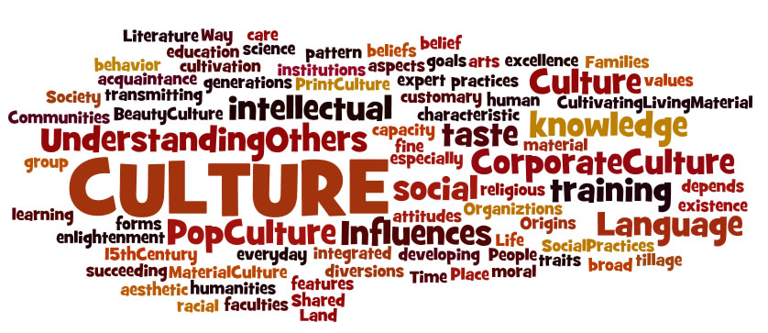
Organizational Cultures
The complexities and necessities of organizational life and survival inevitably require that all cultures include elements from all four cultures previously defined.
  It should be apparent that different approaches to leadership are called for based on which of these four distinctive cultures dominates any organization at any time.

Slide 81

Organizational Cultures
Leadership Response to Organizational Cultures
  Hierarchy Cultures
    Emphasizes careful management of info, monitoring detailed aspects of the organization, and assuring operational dependability and reliability.
  Clan Cultures
    Focuses on process more than output, especially as it minimizes conflict and maximizing consensus. A premium is placed on leadership that is empathetic and caring and that builds trust.
  Adhocracy Cultures
    Requires vision, creativity, and future-thinking.
  Market Cultures
    Places a premium on aggressiveness, decisiveness, productivity, and outperforming competitors.

Slide 82
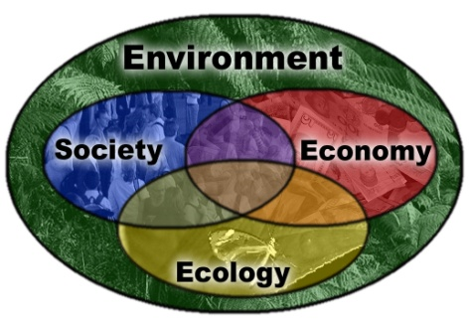
The Environment
The environmental level of the situation refers to factors outside task or organization that affect leadership process.
  Two interrelated aspects of these extra-organizational aspects of the situation, include:
    Ways in which leaders increasingly confront situations that are unexpected, unfamiliar, complex, and rapidly changing; and
    Growing importance of leadership across different cultures.

Slide 83

Degree of Change in Leadership
One general aspect of the situation that affects leadership is the degree of change that’s occurring.
  The nature of challenges facing leaders is changing as never before.
  Rondald Heifetz argues that leaders are not only facing more crises than ever before, but a new mode of leadership is needed because we are in a permanent state of crisis.
    Leadership is more than an individual leader or their behavior or skills.
    Certain kinds of relationships with followers are vital, and distinctive skill sets are needed, as is a certain kind of organizational cultures.

Slide 84

Workplace Trends
In response to increasing competitiveness, uncertainty, globalization, and pace of change, several leadership trends have identified how organizations can face the future:
  Recognize that complex challenges are on the rise, and new approaches to leadership and development are required.
  Embrace innovation as a driver of organizational success.
  Prepare for the need for virtual leadership.
  Collaboration will be essential to organizational success.
  Because trust and respect will be vital, leaders will need to be more authentic in their roles than ever before.
  The next generation of leaders will place new kinds of leadership demands on their organizations.
  A crisis of talent in organizations is coming: need development.
  Ensuring the health and fitness of all employees must be a priority.

Slide 85


Societal Culture
Societal Culture refers to learned behaviors characterizing the way of life members are living within any society.
  Cultures differ from one another just as individuals differ.
    The most salient aspect of any culture typically involves behavior – the distinctive actions, mannerisms, and gestures characteristic of that culture.

Slide 86
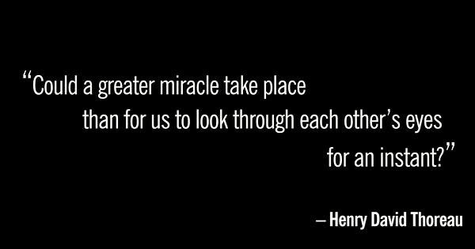
Societal Culture
A clear implication for business leaders in the global context, therefore, is the need to become aware and respectful of cultural differences and perspectives.
  Barnum pointed out the importance of being able to look at one’s own culture through the eyes of another:
    Consciously or unconsciously they will be using their own beliefs as the yardsticks for judging you, so know how you compare to those yardsticks by ferreting out their values and noting where they differ from yours.

Slide 87
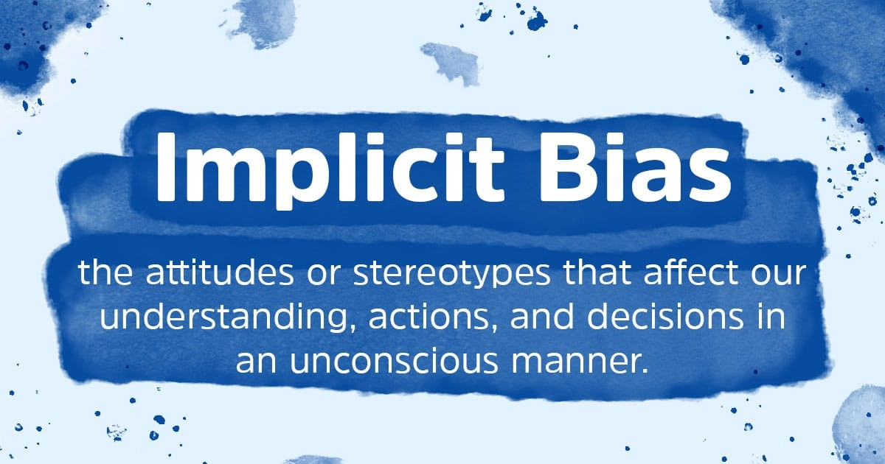
Implicit Leadership Theory
The Implicit Leadership Theory holds that individuals have implicit beliefs and assumptions about attributes and behaviors that distinguish leaders from followers, effective leaders from ineffective, and moral leaders from immoral.
  The research further posits that relatively distinctive implicit theories of leadership characterize different societal cultures from each other as well as organizational cultures within those societal cultures – culturally endorsed implicit theories of leadership (CLT).

Slide 88
Dimensions of Leadership
Six dimensions of leadership applicable across all global cultures.
  Charismatic/Value-Based Leadership
    Reflects the ability to inspire, motivate, and expect high performance from others on the basis of shared core values.
  Team-Oriented Leadership
    Emphasizes effective team building and implementation of a common purpose or goal among team members.
  Participative Leadership
    Reflects the degree to which managers involve others in making and implementing decisions.
  Human-Oriented Leadership
    Reflects supportive and considerate leadership – compassion and generosity.
  Autonomous Leadership
    Refers to independent and individualistic leadership.
  Self-Protective Leadership
    Focuses on ensuring the safety and security of the individual/group member.

Slide 89


Universal Leadership Attributes
(Positive) Universal Leadership Attributes
  Trustworthy – Just – Honest – Foresighted – Plans Ahead Encouraging – Informed – Excellence Oriented – Positive Dynamic – Motive Arouser – Confidence Builder – Motivational Dependable – Coordinator – Intelligent – Decisive – Effective Bargainer – Win-Win Problem Solver – Administratively Skilled Communicative – Team Builder
(Negative) Universal Leadership Attributes
  Loner – Asocial – Non-Cooperative – Irritable – Non-Explicit Egocentric – Ruthless – Dictatorial

Slide 90


