Slide 1

Business Survey
Session Seven
Business Foundations
  A Changing World 11th Edition
    O.C. Ferrell, Geoffrey Hirt, and Linda Ferrell; McGraw Hill Education; New York, NY 2018
      ISBN: 978-1-259-68523-1

Slide 2
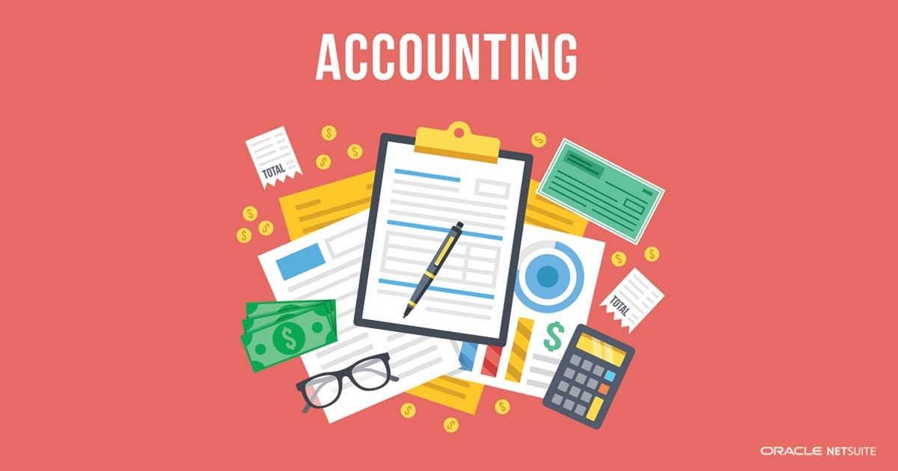
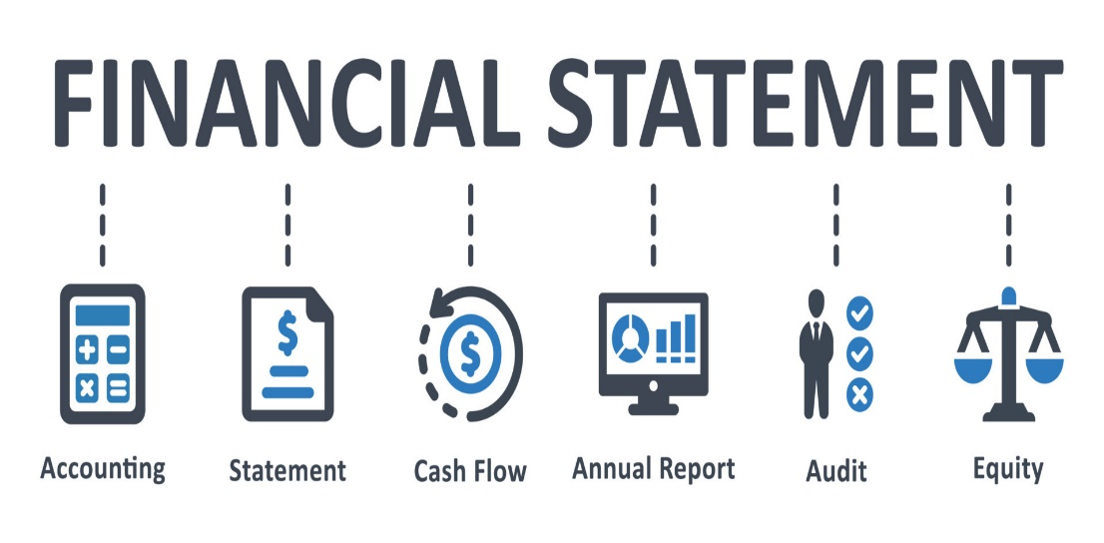
Part Six: Financing the Enterprise
Chapter Fourteen: Accounting and Financial Statements

Slide 3
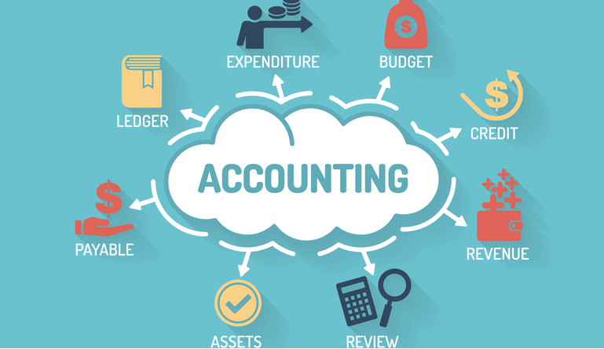
The Nature of Accounting
Accounting is the recording, measurement, and interpretation of financial information.
  Large numbers of people and institutions, both within and outside businesses, use accounting tools to evaluate organizational operations.

Slide 4
The Uses of Accounting Information
Accountants summarize the information from a firm’s business transactions in various statements for a variety of stakeholders, including managers, investors, creditors, and government agencies.
  Many business failures may be directly linked to ignorance of the information “hidden” inside these financial statements.
  Likewise, most business successes can be traced to informed managers who understand the consequences of decisions.

Slide 5
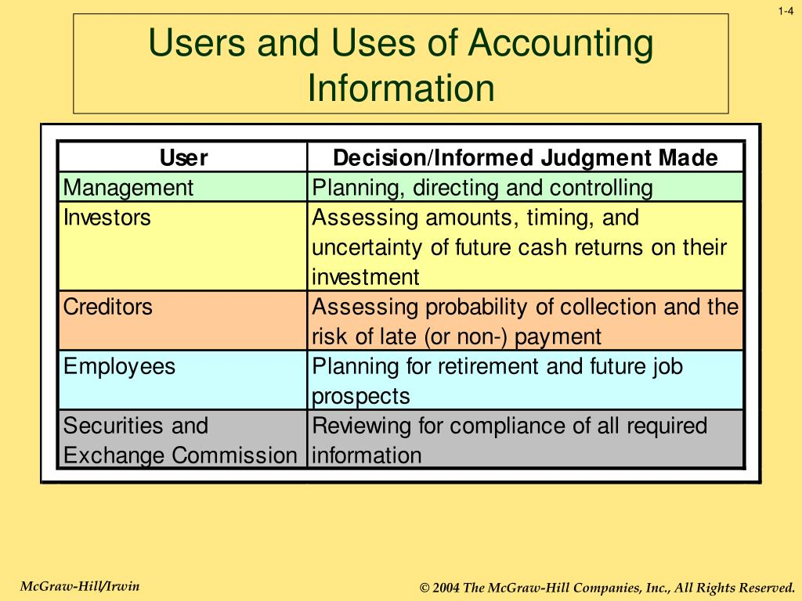
The Uses of Accounting Information
Managers and owners use financial statements:
  To aid in internal planning and control.
  For external purposes such as reporting to the Internal Revenue Service (IRS), stockholders, creditors, customers, employees, and other parties.

Slide 6

Internal Uses of Accounting Info
Cash Flow
Managerial Accounting refers to the internal use of accounting statements by managers in planning and directing the organization’s activities.
  Management’s greatest concern is Cash Flow, the movement of money through an organization over a set period of time.
    For any business to succeed, it needs to generate enough cash to pay its bills when they are due.

Slide 7
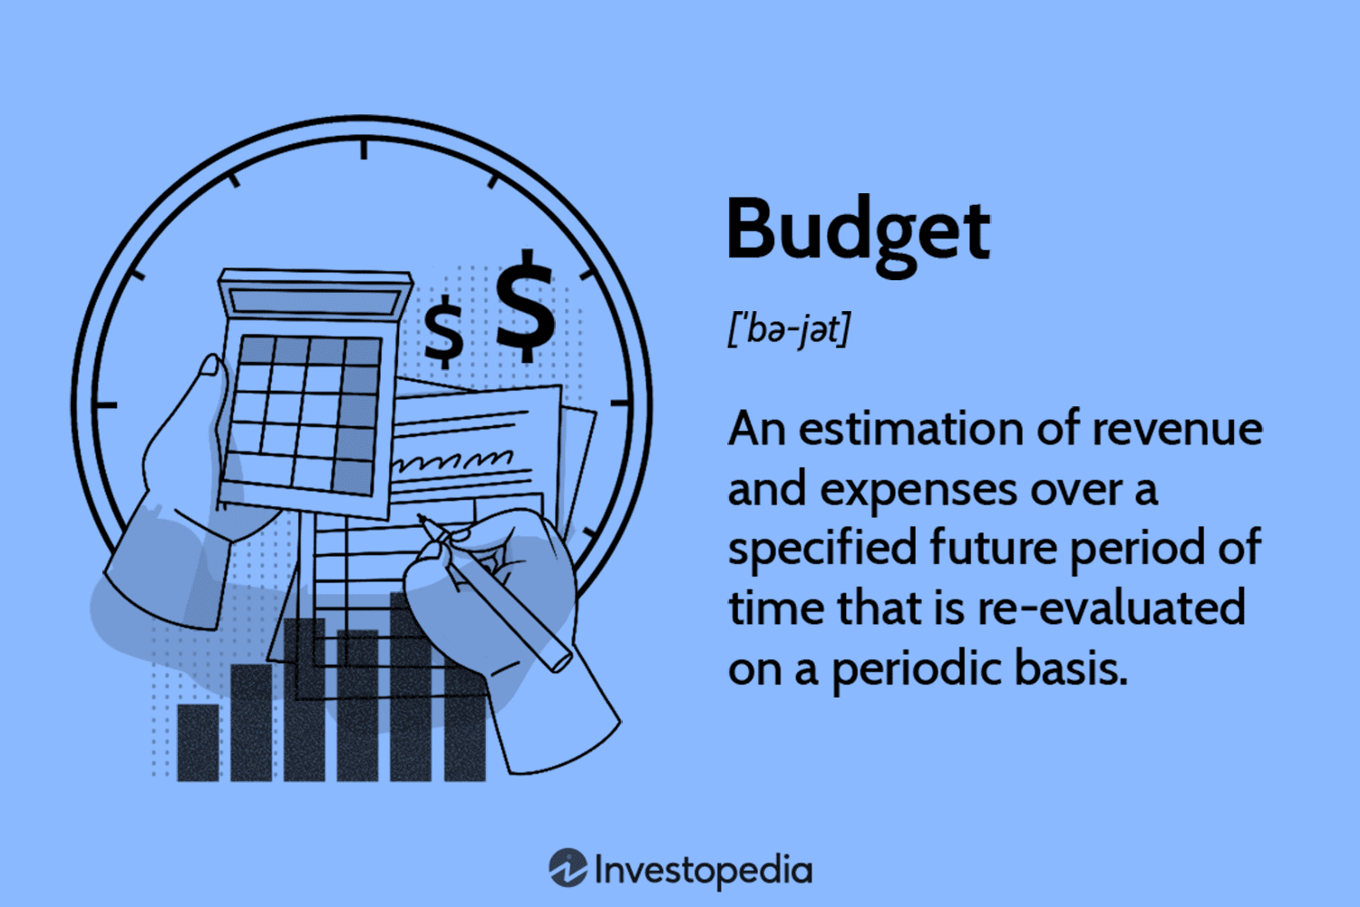
Internal Uses of Accounting Info
Budget
Managerial accountants also help prepare an organization’s Budget, an internal financial plan that forecasts income and expenses over a set period of time.
  The principle value of a Budget lies in its breakdown of cash inflows (revenue) and outflows (expenses).

Slide 8

External Uses of Accounting Info
Annual Report
Managers also use accounting statements to report the business’s financial performance to outsiders.
  Statements are used for filing income taxes, obtaining credit from lenders, and reporting results to the firm’s stockholders.
    They become the basis for the Annual Report, which is a summary of the company’s financial information, products, and growth plans for owners and potential investors.

Slide 9
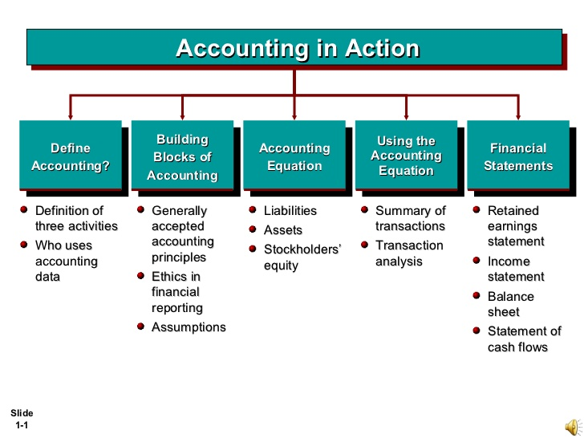
The Accounting Process
Many view accounting as a primary business language. It is of little use, however, unless you know how to “speak” it.
  Fortunately, the fundamentals – the accounting equation and the double-entry bookkeeping system – are not difficult to learn.
    These two concepts serve as the starting point for all currently accepted accounting principles.

Slide 10
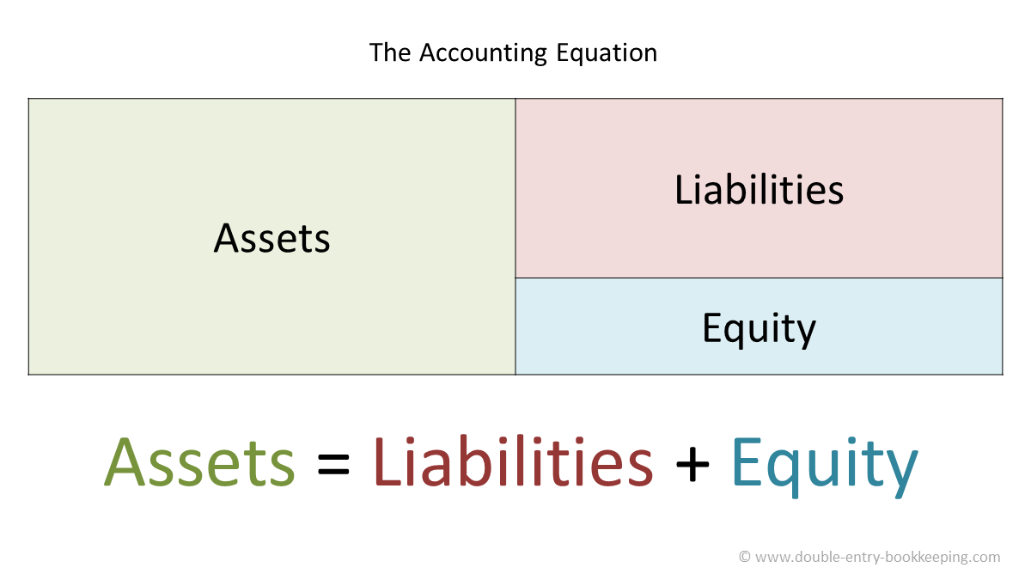
The Accounting Equation
The relationship among assets, liabilities, and owner’s equity is a fundamental concept in accounting and is known as the Accounting Equation (Assets = Liabilities + Owner’s Equity).
  Assets
    A firm’s economic resources, or items of value that it owns, such as cash, inventory, land, equipment, buildings, and other tangible and intangible things.
  Liabilities
    Debts that a firm owes to others.
  Owner’s Equity
    Equals Assets minus Liabilities and reflects historical values of initial and ongoing financial contribution(s) to the company.

Slide 11
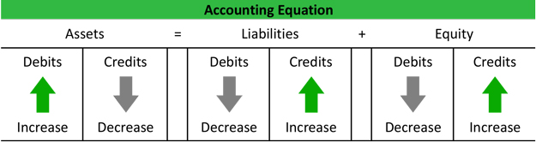
Double-Entry Bookkeeping
Double-Entry Bookkeeping is a system of recording and classifying business transactions in separate accounts in order to maintain the balance of the Accounting Equation
  For example, If an owner buys $200 worth of product on credit then it should later be recorded once as a liability, or debt to a supplier, and again as an asset known as “inventory.”

Slide 12
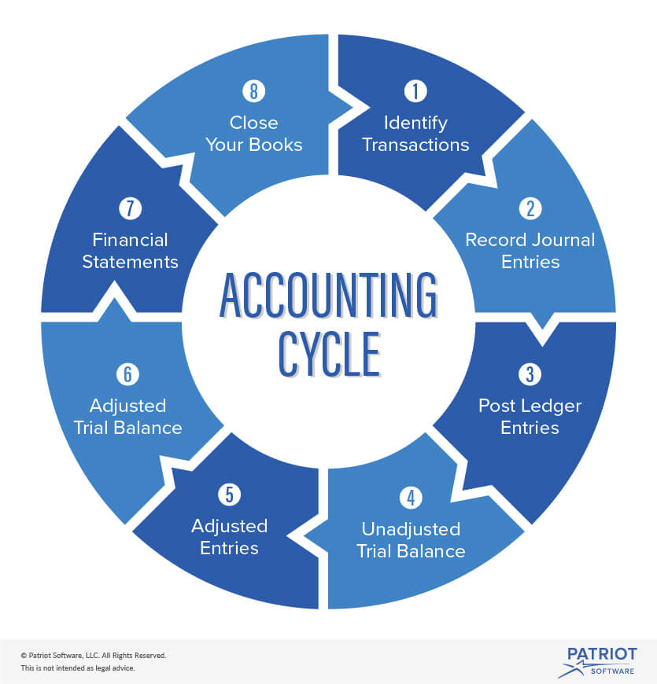
The Accounting Cycle
An Accounting Cycle is the four-step procedure of an accounting system, which includes:
  Examining source documents (checks, receipts, etc.).
  Recording transactions in an accounting journal.
  Posting recorded transactions from the journal into a ledger.
  Preparing financial statements.

Slide 13
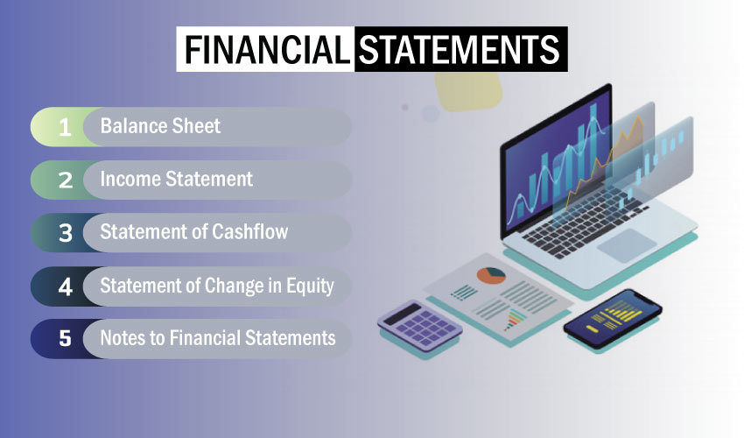
Financial Statements
The end result of the accounting process is a series of financial statements.
  The Income Statement, Balance Sheet, and Statement of Cash Flows are the best known examples of financial statements.
    They are provided to stockholders and potential investors in a firm’s annual report as well as to other relevant outsiders such as creditor’s, government agencies, and the IRS.

Slide 14

The Income Statement
The question, “What’s the bottom line?” derives from the income statement, where the bottom line shows the overall profit or loss of the company after taxes.
  The Income Statement is a financial report that shows an organization’s profitability over a period of time.
    It offers a clear picture of the company’s overall revenues and the costs incurred in generating those revenues.
    It indicates the firm’s profitability or income (the bottom line), which is derived by subtracting expenses from its revenues.

Slide 15
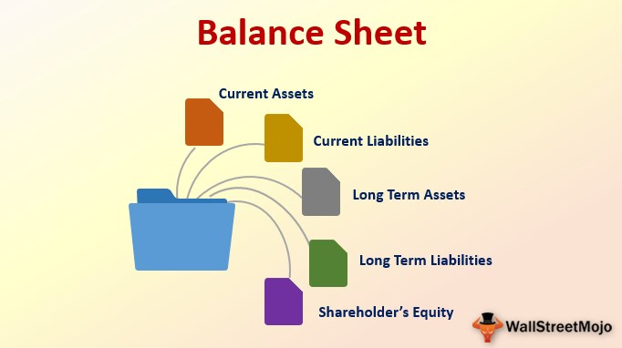
The Balance Sheet
The second basic financial statement is the Balance Sheet, which represents a “snapshot” of an organization’s financial position at a given moment.
  As such, the Balance Sheet indicates what the organization owns or controls and the various sources of the funds used to pay for these assets, such as bank debt or owner’s equity.
    The Balance Sheet takes its name from its reliance on the accounting equation: Assets = Liabilities + Owner’s Equity.

Slide 16
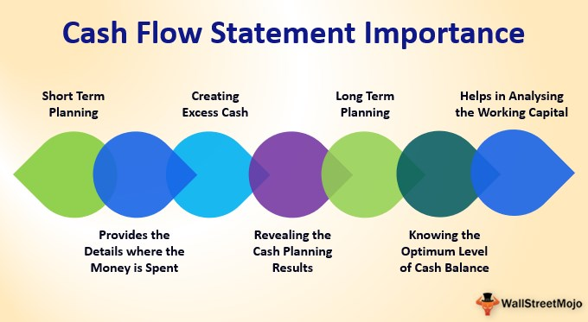
The Statement of Cash Flows
The third primary financial statement is called the Statement of Cash Flows, which explains how the company’s cash changed from the beginning of the accounting period to the end.
  The Statement of Cash Flows takes the cash balance from one year’s Balance Sheet and compares it with the next while providing detail about how the firm used the cash.

Slide 17

Ratio Analysis
Analyzing Financial Statements
The Income Statement shows a company’s profit or loss, while the Balance Sheet itemizes the value of assets, liabilities, and owner’s equity.
  Together, the two statements provide the means to answer two critical questions:
    How much did the firm make or lose?
    How much is the firm presently worth based on historical values found on the Balance Sheet?

Slide 18

Ratio Analysis
Analyzing Financial Statements
Ratio Analysis, calculations that measure an organization’s financial health, brings the complex information from the Income Statement and Balance Sheet into sharper focus so that managers, lenders, owners, and other interested parties can measure and compare the organization’s productivity, profitability, and financing mix with similar entities.
  A ratio is simply one number divided into another, with the result showing the relationship between the two numbers.
    For example we measure fuel efficiency with miles per gallon.

Slide 19

Profitability Ratios
Profitability Ratios measure how much operating income or net income an organization is able to generate relative to its assets, owner’s equity, and sales.
  Common Profitability Ratios include profit margin, return on assets, and return on equity.

Slide 20
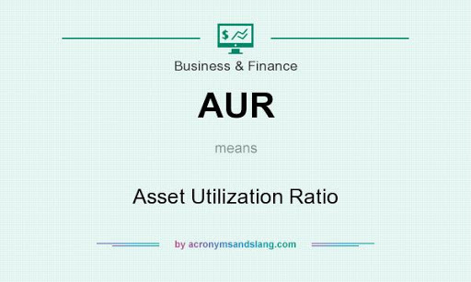
Asset Utilization Ratios
Asset Utilization Ratios (AURs) measure how well a firm uses its assets to generate each $1 of sales.
  Companies using their assets more productively will have higher returns on assets than their less efficient competitors.
  Managers can use AURs to pinpoint areas of inefficiency in their operations.
    These ratios relate Balance Sheet assets to sales, which are found on the Income Statement.

Slide 21

Liquidity Ratios
Liquidity Ratios compare current assets to current liabilities to indicate the speed with which a company can turn its assets into cash to meet debts as they come due.
  High Liquidity Ratios may satisfy a creditor’s need for safety, but ratios that are too high may indicate that the organization is not using its current assets efficiently.

Slide 22

Debt Utilization Ratios
Debt Utilization Ratios provide information about how much debt an organization is using relative to other sources of capital, such as owner’s equity.
  Because the use of debt carries an interest charge that must be paid regularly regardless of profitability, debt financing is much riskier than using equity.

Slide 23

Importance of Integrity in Accounting
Strong compliance to accounting principles creates trust among stakeholders.
  Accounting and financial planning is important for all organizational entities.
    Integrity in accounting is crucial to creating trust, understanding the financial position of an organization or entity, and making financial decisions that will benefit the organization.

Slide 24
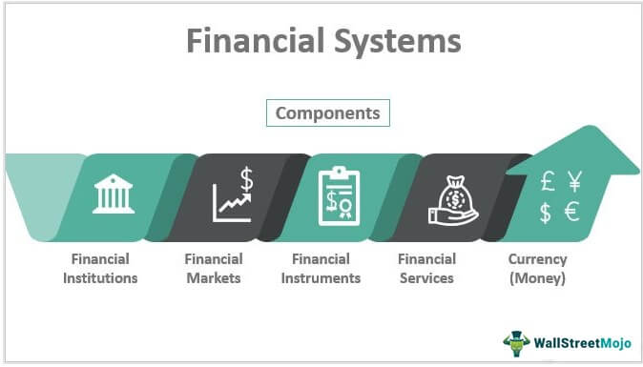
Part Six: Financing the Enterprise
Chapter Fifteen: Money and the Financial System

Slide 25
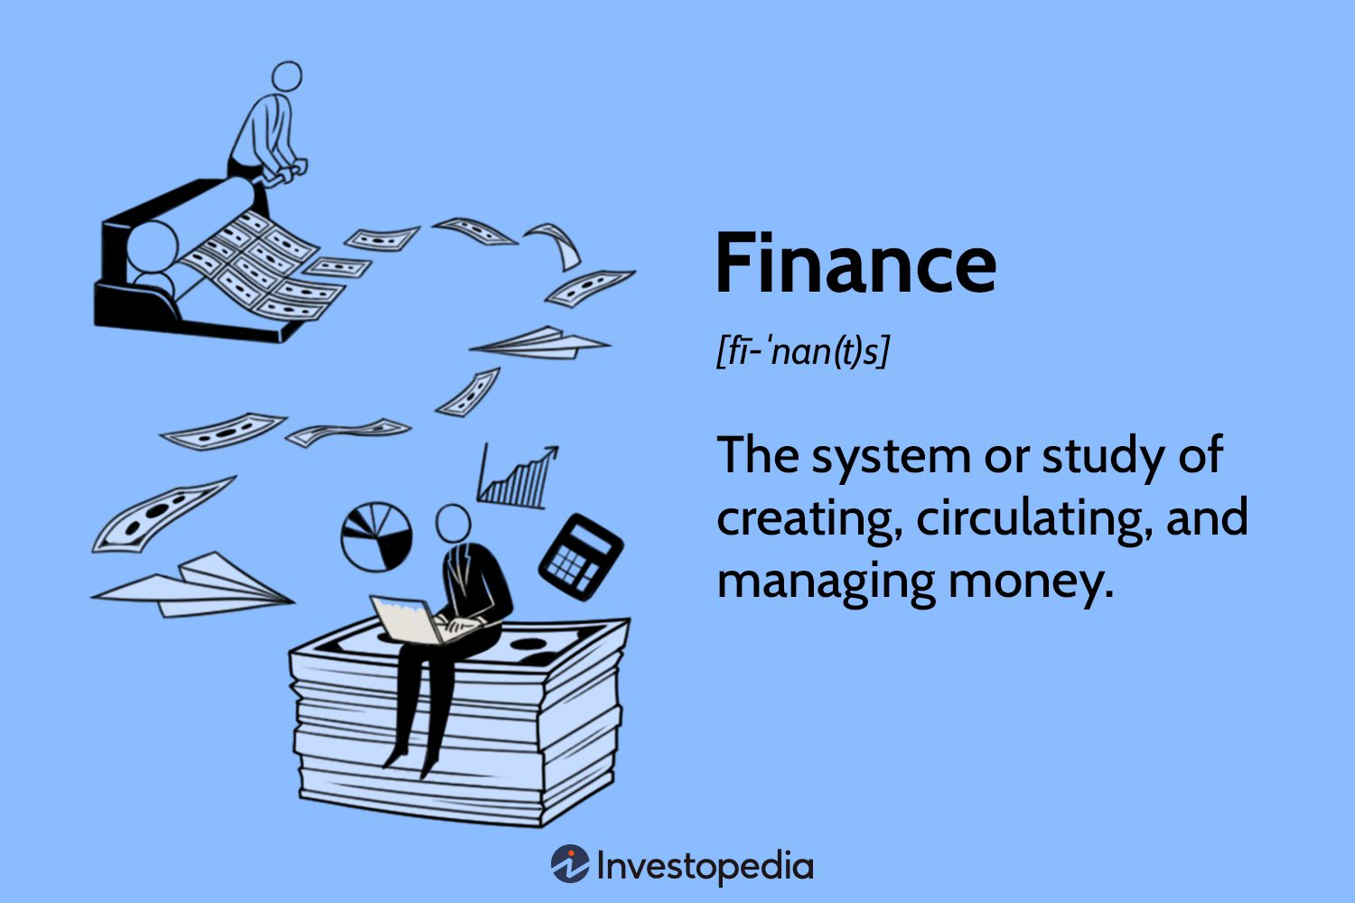
Introduction
Finance is the study of how money is managed by individuals, companies, and governments.
  If you have a checking account, automobile insurance, or a credit card, you already have personal experience with some of the key players in the financial world.

Slide 26
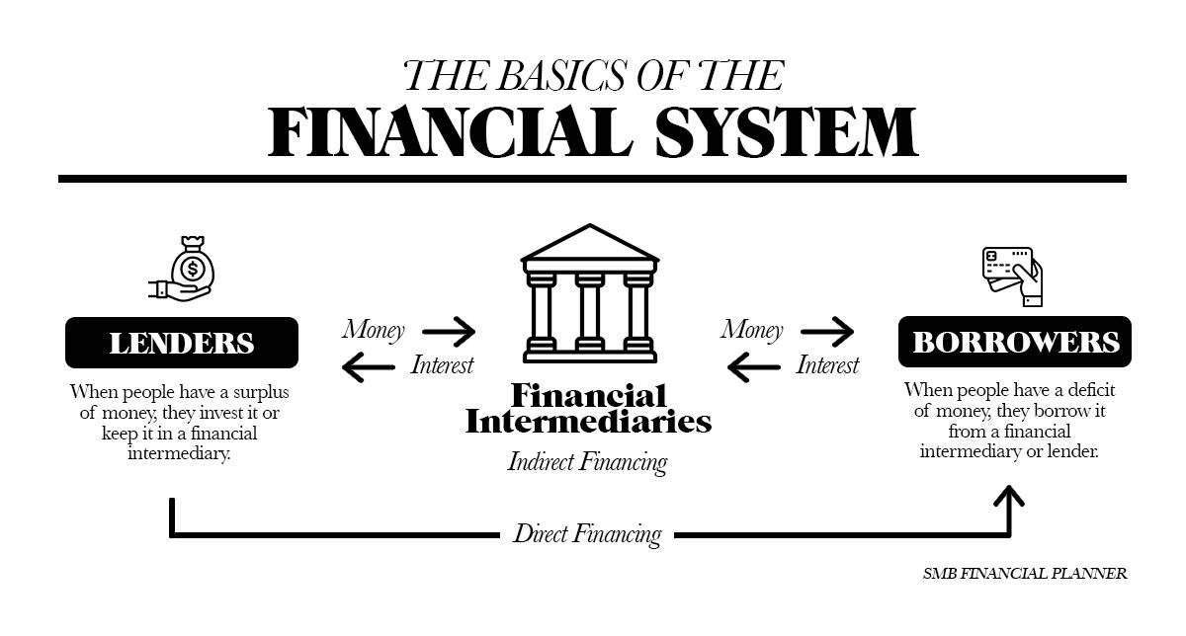
The American Financial System
The U.S. financial system fuels our economy by storing money, fostering investment opportunities, and making loans for new businesses and business expansion.
  This amazingly complex system includes banking institutions, non-banking financial institutions such as finance companies, and systems that provide for the electronic transfer of funds throughout the world.

Slide 27

The Federal Reserve System
The guardian of the American financial system is the Federal Reserve Board, or “the Fed,” as it is commonly called, an independent agency of the federal government established in 1913 to regulate the nation’s banking and financial industry.
  The Federal Reserve Board is the chief economic policy arm in the United States.

Slide 28

Federal Reserve System
Working with Congress and the President, the Fed tries to create a positive economic environment capable of sustaining low inflation, high levels of employment, a balance in international payments, and long-term economic growth.
  To this end, the Federal Reserve Board has four major responsibilities:
    Control the supply of money, or monetary policy.
    Regulate banks and other financial institutions.
    Manage checking account procedures, or check clearing.
    Supervise the federal deposit insurance programs of banks.

Slide 29
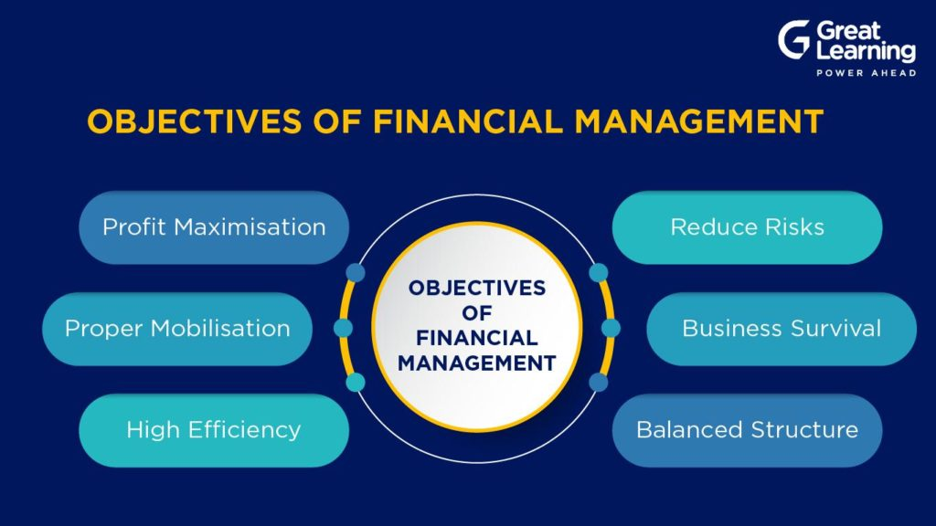
Part Six: Financing the Enterprise
Chapter Sixteen: Financial Management and Securities Markets

Slide 30

Introduction
Financial Management is the field that addresses the issues of obtaining and managing the funds and resources necessary to run a business successfully.
  All organizations must manage their resources effectively and efficiently if they are to achieve their objectives.

Slide 31

Managing Current Assets and Liabilities
Effectively managing assets and liabilities involves understanding the balance sheet.
  Current Assets
    Resources such as cash, investments, accounts receivable, and inventory.
  Current Liabilities
    Debts such as accounts payable, accrued salaries, accrued taxes, and short-term bank loans.

Slide 32
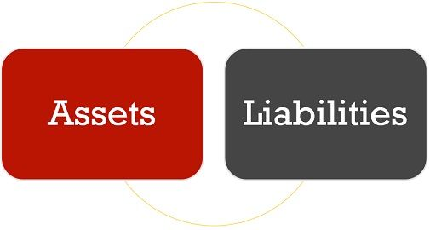
Managing Current Assets
The chief goal of a financial manager is to maximize the return to the business on cash, investments, accounts receivable, and inventory.

Slide 33

Managing Current Liabilities
Most organizations obtain funds for operations from banks.
  In most instances, the credit services granted these firms take the form of a line of credit or fixed dollar loan.
    A Line of Credit is an arrangement by which a bank agrees to lend a specified amount of money to the organization upon request. In general, a business LOC is similar to a credit card.

Slide 34

Managing Current Liabilities
In addition to credit lines, banks also make both secured (collateral) and unsecured (reputation and rating) loans.
  We build credit ratings from a history of borrowing and repaying borrowed funds on time and in full.
    A lack of credit history or poor credit history can make it difficult to get loans from financial institutions.

Slide 35

Managing Fixed Assets
One of the most important jobs performed by the financial manager is to decide what fixed assets, projects, and investments will earn profits for the organization beyond the cost necessary to fund them.
  The process of analyzing the needs of the business and selecting the assets that will maximize its value is called capital budgeting.
    The capital budget is the amount of money budgeted for investment in such long-term assets.

Slide 36
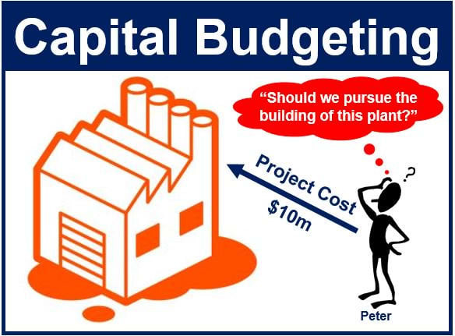
Managing Fixed Assets
Capital Budgeting does not end with selection and purchase of a particular piece of land, equipment, or major investment.
  All assets and projects must be continually reevaluated to ensure their compatibility with the organization’s needs.
    If a particular asset does not live up to expectations, management must determine why and take necessary corrective action.

Slide 37

Managing Fixed Assets
Assessing Risk
Every investment carries some risk.
  The longer a project or asset is expected to last, the greater its potential risk because it is hard to predict whether a piece of equipment will wear out or become obsolete in 5 or 10 years.
    The level of a project’s risk is also affected by the stability and competitive nature of the marketplace and the world economy.

Slide 38

Managing Fixed Assets
Pricing Long-Term Money
The ultimate profitability of any project depends not only on accurate assumptions of how much cash it will generate, but also on its financing costs.
  Because a business must pay interest on money it borrows, the returns from any project must cover not only the costs of operating the project but also the interest expenses for the debt used to finance its construction.

Slide 39

Financing with Long-Term Liabilities
To develop the needed fixed assets, companies must raise low-cost long-term funds to finance them.
  Two common choices for raising these funds are:
    Attracting new owners (equity financing)
    Taking on long-term liabilities (debt financing).

Slide 40

Investment Banking
A company that needs more money to expand or take advantage of growth opportunities may be able to obtain financing by issuing stock.
  When a company offers its stock to the public for the very first time, it is said to be “going public,” and the sale is called an Initial Public Offering (IPO).

Slide 41

Investment Banking
New issues of stocks and bonds are sold directly to the public and to institutions in what is known as the Primary Market, the market where firms raise financial capital.
  The primary market differs from secondary markets, which are stock exchanges and over-the-counter markets where investors can trade their securities with other investors rather than the company that issued the stock or bonds.

Slide 42


Stock Markets
Stock Markets exist around the world. The two biggest stock markets in the United States are the New York Stock Exchange (NYSE) and the NASDAQ market.

Slide 43

Measuring Market Performance
Investors, especially professional money managers, want to know how well their investments are performing relative to the market as a whole.
  They also need to know how their companies’ securities are performing when compared with their competitors.’
    Thus, performance measures – averages and indexes – are very important to many different people. They not only indicate the performance of a particular securities market but also provide a measure of the overall health of the economy.

Slide 44
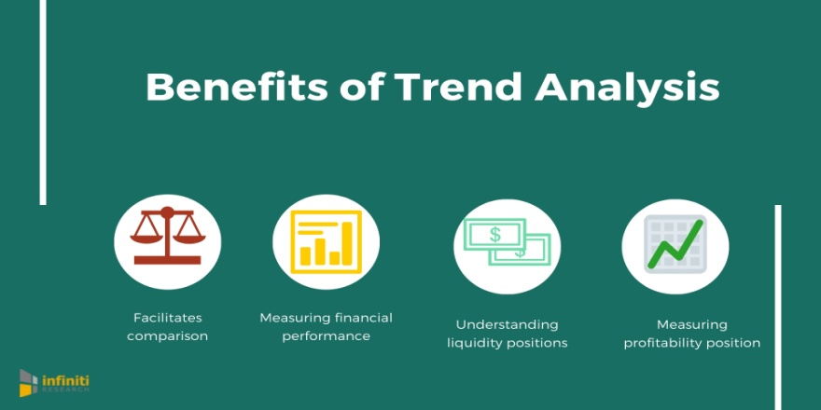
Measuring Market Performance
An Index compares current stock prices with those in a specified base period. An Average is the average of certain stock prices.
  Investors perform better by keeping an eye on the long-term trend line and not the short-term fluctuations.
    Many investors follow the activity of the Dow Jones Industrial Average to see whether the stock market has gone up or down.

Slide 45

Measuring Market Performance
Great leaders don’t just build companies—they strategically access capital markets to fuel expansion, seize opportunity, and position their organizations for long-term dominance.
  By understanding how investment banking, IPOs, and market performance indicators work together, you empower your business to leverage liquidity, attract investment, and grow with confidence in both strong and uncertain economies.

Slide 46


