Slide 1
Business Communications Session Seven
Business Communication
Process and Product – 9th Edition
Mary Ellen Guffey and Dana Loewy; Cengage Learning 2018, 2015
ISBN: 978-1-305-95796-1

Slide 2
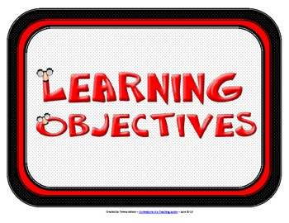
Unit Five: Employment Communication
Chapter Fifteen: The Job Search, Resumes, and Cover Letters in the Digital Age
Learning Outcomes:
Begin a job search by recognizing emerging trends and technologies, exploring your interests, evaluating your qualifications, and investigating career opportunities.
Develop savvy search strategies by recognizing how job seekers find their jobs and how they use digital tools to explore the open job market.
Expand your job search strategies by using both traditional and digital tools in pursuing the hidden job market.
Organize your qualifications and skills into effective resume categories, and use that information to prepare a personalized LinkedIn resume.
Enhance job search and resume by taking advantage of today’s digital tools.
Understand the value of cover messages and how to draft and submit a customized message to highlight your candidacy.

Slide 3
Job Search in the Digital Age
A successful job search today requires a blend of old and new job-hunting skills.
Traditional techniques are still effective, but savvy job candidates must also be ready to act on emerging trends.
Job boards, social networks, and mobile technologies have all become indispensable tools in hunting for a job.
Surprisingly, however, even in this digital age, personal networking, referrals, and who you know continue to be primary routes to hiring.

Slide 4
The Resume Is Not Dead
It’s natural to think that the first step in finding a job is writing a resume. However, that’s a mistake. The job-search process actually begins long before you are ready to prepare your resume.
Regardless of the kind of employment you seek, you must invest time and effort in getting ready.
Your best plan for completing a successful job search involves a four-step process: (1) analyzing yourself, (2) developing a job search strategy, (3) preparing a resume, and (4) knowing the hiring process.

Slide 5
4 Steps in a Successful Job Search
Analyze Yourself
Identify your interests and goals - Assess your qualifications - Explore career opportunities.
Develop a Job-Search Strategy
Search the open job market - Pursue the hidden job market - Cultivate your online presence - Build your personal brand - Network, network, network!
Create a Customized Resume
Choose a resume style - Organize your info concisely - Tailor your resume to each position - Optimize for digital technology
Know the Hiring Process
Submit a resume, application, or e-portfolio – Undergo screening and hiring interviews – Accept an offer or reevaluate your progress

Slide 6
Launching Your Job Search with Self-Analysis
The first step in a job search is analyzing your interests and goals and evaluating your qualifications.
This means looking inside yourself to explore what you like and dislike so that you can make good employment choices.

Slide 7
Launching Your Job Search with Self-Analysis
For guidance in choosing a career that proves to be satisfying, ask yourself the following questions:
What are you passionate about? Can you turn this passion into a career?
Do you enjoy working with people, data, or things?
How important are salary, benefits, technology support, & job stimulation?
Must you work in a specific city, geographic area, or climate?
Are you looking for security, travel opportunities, money, power, prestige?
How would you describe the perfect job, boss, and coworkers?

Slide 8
Evaluating Your Qualifications
In addition to analyzing your interests and goals, take a good look at your qualifications.
Remember that today’s job market is not so much about what you want, but what the employer wants.
What assets can you offer?

Slide 9
Evaluating Your Qualifications
Prepare your resume foundation by asking following questions:
What technology skills can you present? What specific software programs are you familiar with, what Internet experience do you have, and what social media skills can you offer?
Do you communicate well in speech and in writing? Do you know another language? How can you verify these talents?
What other skills have you acquired in school, on the job, or through activities? How can you demonstrate these skills?
Do you work well with people? Do you enjoy teamwork? What proof can you offer? Consider extracurricular activities, clubs, class projects, and jobs.
Are you a leader, self-starter, or manager? What evidence can you offer? What leadership roles have you held?
Do you learn quickly? Can you think critically? How can you demonstrate these characteristics?

Slide 10
Developing a Job-Search Strategy Focused on the Open Job Market
Once you have analyzed what you want in a job and what you have to offer, you are ready to focus on the job-search strategy.
You are probably most interested in how job seekers today are finding their jobs.
What methods did they use?

Slide 11
How Did Job Seekers Find Their Best Jobs?
Personal Networking | 40%
Online Social Networking | 21%
Online Job Board | 20%
Classified Advertisement | 19%
Recruiter | 10%
Career Fair | 7%
College or University Connection | 7%

Slide 12
Unlocking the Hidden Job Market with Networking
The most successful job candidates seek to transform themselves from unknown into known quantities through networking.
More jobs today are found through referrals and person-to-person contacts than through any other method. That’s because people trust what they know.
Therefore, your goal is to become known to a large network of people.

Slide 13
Building a Personal Network
Because most candidates find jobs today through networking, be prepared to work diligently to build your personal networks.
This effort involves meeting people and talking to them about your field or industry so that you can gain information and locate job vacancies.
Not only are many jobs never advertised, but some positions aren’t even contemplated until the right person appears.

Slide 14
Building a Personal Network
Three steps that will help you establish your own network:
Develop a Contact List
Make a list of anyone willing to talk with you about finding a job.
Make Contacts in Person and Online
Call the people on your list or connect online.
Be friendly, polite, and interested in what the person has to say.
Provide a copy of your resume and stay centered on job search.
Get at least two referrals.
Follow Up on Your Referrals
Don’t ask for a job.
Ask how individual got started in career.
Ask what they like best (or least) about their work.
Ask what career paths exist in your field, and how you can get started.
Stay in contact during and after your search

Slide 15
Targeting Social Media in a Job Search
As digital technology continues to change our lives, job candidates have powerful new tools at their disposal: social media networks.
These networks have become critical in a job search.
If you are seriously looking for a job, it’s extremely important that you list yourself in LinkedIn. This social media site dominates the world of job searching, recruiting, and networking.
In addition to LinkedIn, job seekers can join Facebook, Twitter, and Google+ to find job opportunities, market themselves to companies, showcase skills, highlight experience, and possibly land that dream job.

Slide 16
Creating Your Personal Brand
A large part of your job-search involves building a brand for yourself.
Before you get into the thick of the job hunt, focus on developing your brand so that you know what you want to emphasize.

Slide 17
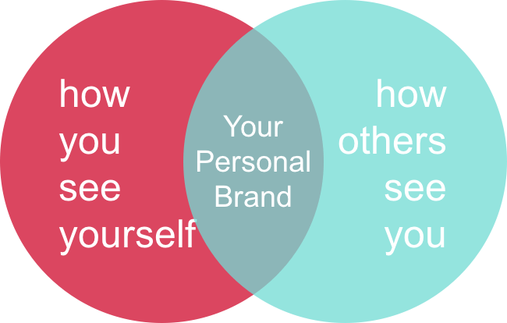
Creating Your Personal Brand
Personal branding involves deciding what makes you special and desirable in the job market.
What is your unique selling point? What special skill set makes you stand out among job applicants? What would your instructors or employers say is your greatest strength?
Think about your intended audience.
What are your promoting about yourself?

Slide 18
Creating Your Personal Brand
Experts suggest that you create a tagline that describes what you do, who you are, and what’s special about you.
Keep your tagline simple, short, and truthful so that it’s easy to remember. A nurse wrote this tagline: “Tireless, caring Registered Nurse who helps pediatric cancer patients and their families feel at ease throughout treatment and recovery.”
Once you have a tagline, prepare a professional-looking business card with your name and tagline. Include and easy-to-remember email address such as firstname.lastname@domain.com.

Slide 19
Creating Your Personal Brand
Now that you have your tagline and business card, work on an elevator speech.
This is a pitch that you can give in 60 seconds or less describing who you are and what you can offer.
Tweak your speech for your audience, and practice until you can say it naturally.

Slide 20
Elevator Speech
Here are suggestions to help you prepare your own authentic elevator speech depending on your situation:
Hi, my name is ____, and I am about to graduate from ____ with a major in ____. I’m looking to ____ because I enjoy ____. Recently I ____ where I was able to develop skills such as ____. I’m most confident about my skills in ____. I’m inspired by the field (or position) of ____ because ____. My ultimate aim is to ____. I’m looking for a position in ____. Do you have any suggestions or advice on how I can ____?

Slide 21
Customizing Your Resume
In today’s highly competitive job market, the focus is not so much on what you want but on what the employer needs.
That’s why you must customize your resume for every position you seek. The competition is so stiff today that you cannot get by with a generic, one-size-fits-all resume.
Although you can start with a basic resume, you should customize it to fit each company and position if you want it to stand out from the crowd.

Slide 22
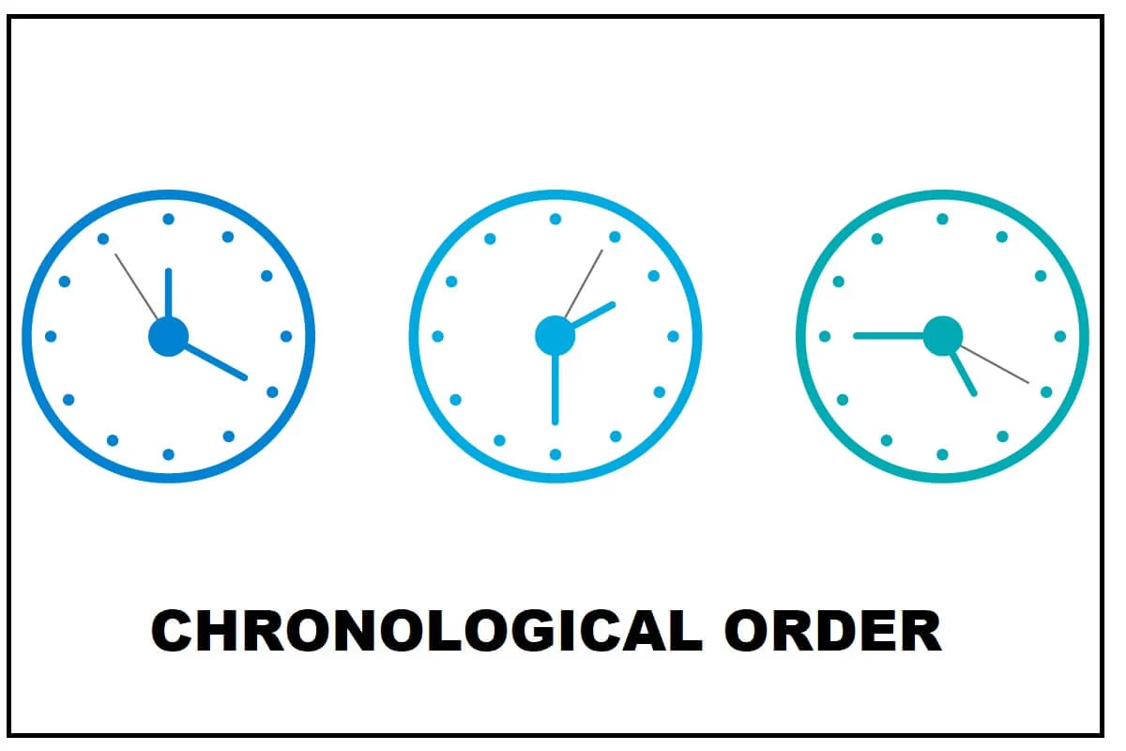
Choosing a Resume Style Chronological
The most popular resume format is the chronological format.
The chronological resume lists work history job by job but in reverse order, starting with the most recent position.
Recruiters favor chronological format because they are familiar w/it and because it reveals a candidate’s education and experience.

Slide 23
How Long Should a Resume Be?
Experts disagree on how long a resume should be.
Conventional wisdom holds that recruiters prefer one-page resumes. However, recruiters who are serious about candidates prefer the kind of details that can be provided in a two-page or longer resume.
The best advice is to make your resume as long as needed to present your skills to recruiters and hiring managers. Individuals with more experience will naturally have longer resumes.

Slide 24
Organizing Your Information Into Effective Resume Categories
Although resumes have standard categories, their arrangement and content should be strategically planned.
A customized resume emphasizes skills and achievements aimed at a particular job or company.
It shows a candidate’s most important qualifications first, and it de-emphasizes weaknesses.

Slide 25
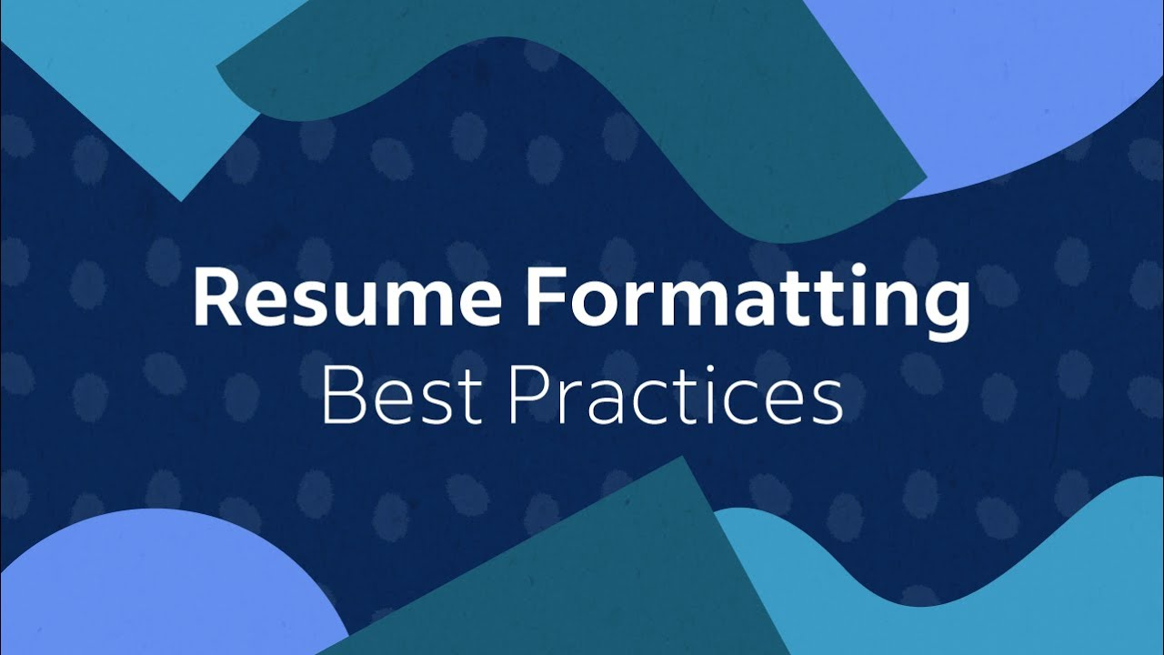
Organizing Your Information Into Effective Resume Categories
In organizing your qualifications and information, try to create as few headings as possible.
Most resumes include the following:
Main Heading
Career Objective
Summary of Qualifications
Education
Experience
Capabilities and Skills
Awards and Activities

Slide 26
Organizing Your Information Into Effective Resume Categories 1. Main Heading
Your resume should start with an uncluttered and simple main heading.
The first line should be your name; add middle initial for more professional look. Format your name so it stands out on the page.
Following your name, list your contact information, including your address, area code and phone number, and email address.
Some omit street address to protect privacy and for safety reasons.

Slide 27
Organizing Your Information Into Effective Resume Categories 2. Career Objective
Although experts don’t agree on whether to include an objective on a resume, nearly all agree that if you do, it should be specific.
A well-written objective – customized for the job opening – makes sense, especially for new grads with fresh training and relevant skills.
Strive to include keywords from the job listing because these will help tracking systems select your resume.
Focus on what you can contribute to the organization, not what the organization can do for you.
Instead of an objective, one resume expert recommends listing the job title of the position for which you are applying.

Slide 28
Organizing Your Information Into Effective Resume Categories 3. Summary of Qualifications
A summary of qualifications may be a short summary statement or a list of three to eight bulleted statements that prove you are the ideal candidate for the position.
When formulating these statements, consider your experience in the field, your education, your unique skills, awards you have won, certifications you hold, and any other accomplishments.
Strive to quantify your achievements wherever possible.
Target the most important qualifications an employer will be looking for in the person hired for this position. Focus on the nouns that might be selected as keywords by a tracking system.

Slide 29
Organizing Your Information Into Effective Resume Categories 4. Education
The next component in a chronological resume is your education – if it is more noteworthy than your work experience.
In this section you would include the name and location of schools, dates of attendance, major fields of study, and degrees received.
Your grade point average (GPA) and/or class ranking may be important to prospective employers.
Once you have attended college, you don’t need to list high school information on your resume.

Slide 30
Organizing Your Information Into Effective Resume Categories 5. Work Experience or Employment History
When your work or volunteer experience is significant and relevant to the position sought, this information should appear before your education.
List your most recent employment first and work backward, including only those jobs that you think will help you win the targeted position. A job application form may demand a full employment history, but your resume may be selective.
Be aware that time gaps in your employment history will probably be questioned in the interview.

Slide 31
Organizing Your Information Into Effective Resume Categories 5. Work Experience or Employment History
Your employment achievements and job duties will be easier to read if you place them in bulleted lists.
Rather than list every single thing you have done, customize your information so that it relates to the targeted job.
Bulleted points should be concise but not complete sentences, and they usually do not include personal pronouns (I, me, my).
Strive to be specific.

Slide 32
Organizing Your Information Into Effective Resume Categories 5. Work Experience or Employment History
In addition to technical skills, employers seek individuals with communication, management, and interpersonal capabilities.
This means you will want to select work experiences and achievements that illustrate your initiative, dependability, responsibility, resourcefulness, flexibility, and leadership.
Employers also want people who can work in teams.

Slide 33
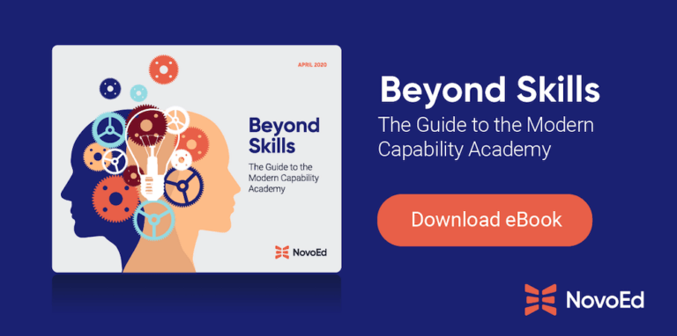
Organizing Your Information Into Effective Resume Categories 6. Capabilities and Skills
Recruiters want to know specifically what you can do for their companies.
List your special skills, including many nouns that relate to the targeted position. Talk about your ability to use the Internet, search engines, software programs, social media, office equipment, and communication technology tools.
Use expressions such as “proficient in,” “competent in,” “experienced in,” and “ability to.”

Slide 34
Organizing Your Information Into Effective Resume Categories 6. Capabilities and Skills
You will also want to highlight exceptional aptitudes, such as working well under stress, learning computer programs quickly, and interacting with customers.
If possible, provide details and evidence that back up your assertions.
Include examples of writing, speaking, management, organizational, interpersonal, and presentation skills – particularly those that are relevant to your targeted job.

Slide 35
Organizing Your Information Into Effective Resume Categories 7. Awards, Honors, and Activities
If you have any awards or honors, highlight them by listing them under a separate heading. It is also appropriate to include school, community, volunteer, and professional activities.

Slide 36
Include References?
Listing references directly on a resume takes up valuable space. Instead, recruiters prefer that you bring to the interview a list of individuals willing to discuss your qualifications.
You should prepare a separate list of three to five individuals, such as instructors, your current employer or previous employers, colleagues or subordinates, and other professional contacts.
Do not include personal or character references, such as friends, family, or neighbors.

Slide 37
Enhancing Your Job Search with Today’s Digital Tools
Just as electronic media have changed the way candidates seek jobs, these same digital tools are transforming the way employers select qualified candidates.
As discussed earlier, the first reader of your resume may very well be an applicant tracking system (ATS). Scores of companies are now employing these systems.
Approximately 75% of resumes don’t make it past the ATS screening.

Slide 38
Maximizing the Rank of Your Resume
The higher your resume ranks when it is evaluated by an applicant tracking system, the more likely it will be reviewed by a recruiter or hiring manager.
In the past candidates tried to game the system by stuffing resumes with keywords. Newer screening systems are not so easily fooled.
Although keywords are important, “the system looks for relevance of the keyword to your work history and education,” advises job-search authority Quint Careers.

Slide 39
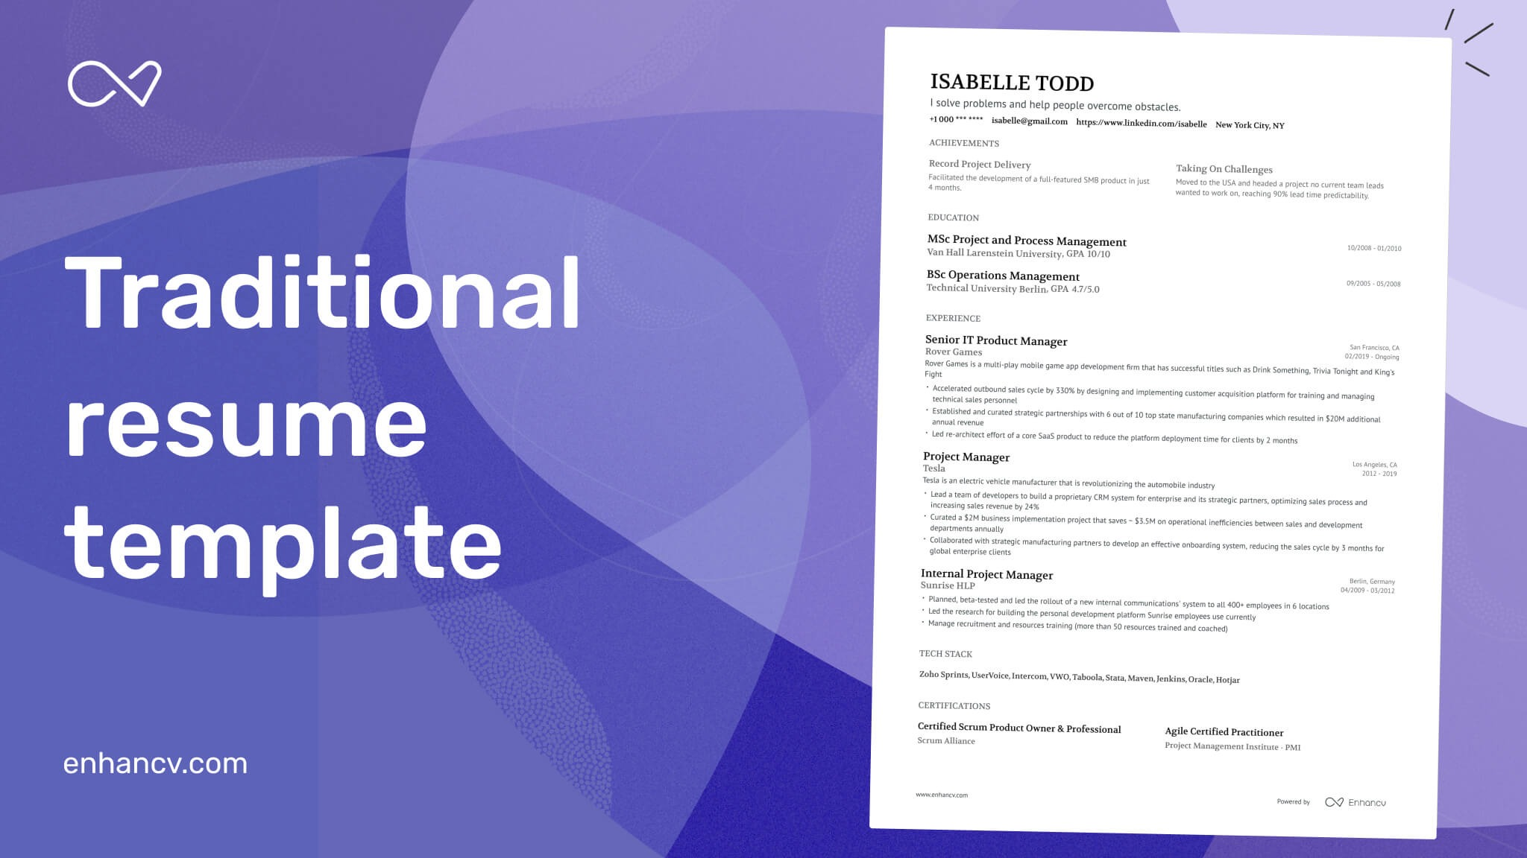
Preparing a Basic Print Resume
The one basic resume you should prepare is a print-based traditional resume.
It should be attractively formatted to maximize readability.
This resume is useful (1) during job interviews, (2) for person-to-person networking situations, (3) for recruiters at career fairs, and (4) when you are competing for a job that does not require an electronic submission.

Slide 40
Cover Messages
A cover message, also known as a cover letter or letter of application, has always been a graceful way of introducing your resume.
Hiring managers argue cover letters are critical as they reveal writing skills and key evidence missing in a resume.
They suggest well-written cover letters will help a candidate stand apart from others.

Slide 41
Creating a Customized Cover Message
Regardless of its length (from 2 paragraphs to full page), a cover message should have three primary parts:
An opening that captures attention, introduces the message, and identifies the position
A body that sells the candidate and focuses on the employer’s needs
A closing that requests an interview and motivates action
When putting your cover message together, remember that the biggest mistake job seekers make when writing cover messages is being too generic. You should, therefore, write a personalized, customized cover message for every position that interests you.

Slide 42
Unit Five: Employment Communication
Chapter Sixteen: Interviewing and Following Up
Learning Outcomes:
Explain the purposes, sequence, and types of job interviews, including screening, one-on-one, panel, group, sequential, and video interviews.
Describe what to do before an interview, including ensuring professional phone techniques, researching the target company, rehearsing success stories, cleaning up digital dirt, dressing properly, and fighting fear.
Describe what to do during an interview, including controlling nonverbal messages and answering typical interview questions.
Describe what to do after an interview, including thanking the interviewer, contacting references, and writing follow-up messages.
Prepare additional employment documents: applications, rejection follow-up messages, acceptance messages, and resignation letters.

Slide 43
Interviewing Effectively in Today’s Competitive Job Market
Whether you are completing your education and searching for your first serious position or are in the workforce and striving to change jobs – a job interview can be life changing.
Because employment is a major part of everyone’s life, the job interview takes on enormous importance.

Slide 44
Purpose and Sequencing of Employment Interviews
An interview has several purposes for you as a job candidate.
It is an opportunity to (1) convince the employer of your potential, (2) learn more about the job and the company, and (3) expand on the information in your resume.
This is the time for you to gather information to determine whether you would fit into the company culture. You should also be thinking about whether the job suits your career goals.

Slide 45
Purpose and Sequencing of Employment Interviews
From an employer’s perspective, the interview is opportunity to:
Assess your abilities in relation to the requirements for the position.
Discuss your training, experience, knowledge, and abilities in more detail.
See what drives and motivates you,
Decide whether you would fit into the organization.

Slide 46
Hiring/Placement Interviews
No matter what interview structure you encounter, you will feel more comfortable if you know what to do before, during, and after the interview.

Slide 47
Before the Interview
Once you have sent out at least one resume or filled out one job application, you must consider yourself an active job seeker.
Being active in the job market means that you should be prepared to be contacted by potential employers. Employers often use screening interviews to narrow the list of candidates.
If you do well in the screening interview, you will be invited to an in-person or video meeting.

Slide 48
Ensuring Professional Phone Techniques
Even with the popularity of email, most employers contact job applicants by phone to set up interviews.
Employers can judge how well applicants communicate by hearing their voices and expressions over the phone.
Once you are actively looking for a job, anytime the phone rings, it could be a potential employer. Don’t make the mistake of letting an unprofessional voice mail message or lazy roommate or a sloppy cell phone manner ruin your chances.

Slide 49
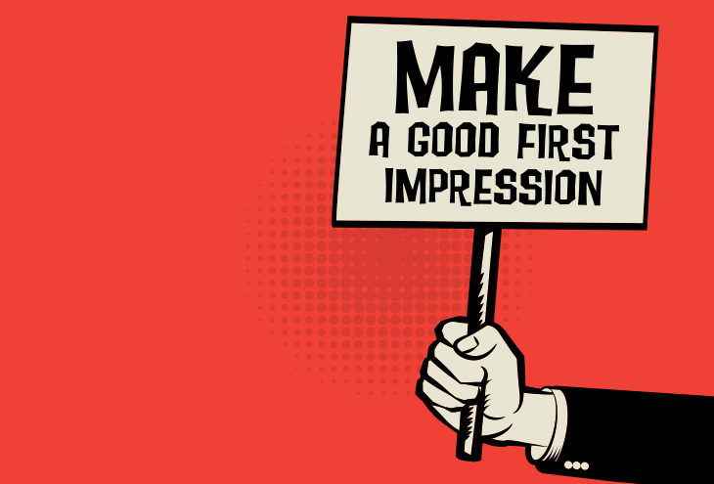
Making the First Conversation Impressive
Whether you answer the phone directly or return an employer’s call, make sure you are prepared for the conversation.
Remember that this is the first time employer has heard your voice.
How you conduct yourself on the phone will create a lasting impression.

Slide 50
Researching the Target Company
Once you have scheduled an in-person or video interview, you need to start preparing for it.
One of the most important steps in effective interviewing is gathering detailed information about a prospective employer.
Never enter an interview cold. Recruiters are impressed by candidates who have done their homework.

Slide 51
Researching the Target Company Scouring the Internet for Important Company Data
Search the potential employer’s website, news sources, trade journals, and industry directories.
Unearth information about the job, the company, and the industry.
Learn all you can about the company’s history, mission and goals, size, geographic locations, and number of employees.
Check its customers, competitors, culture, management structure, reputation in the community, financial condition, strengths and weaknesses, and future plans, as well as the names of its leaders.
A good place to check is the About Us section on its website.

Slide 52
Researching the Target Company Analyzing the Company’s Advertising
In addition to online presence, examine the company’s ads and promotional materials, including sales and marketing brochures.

Slide 53
Rehearsing Success Stories
To feel confident and be ready to sell your qualifications, prepare and practice success stories.
These stories are specific examples of your educational and work-related experience that demonstrate your qualifications and achievements.
Look over the job description and your resume to determine what skills, training, personal characteristics, and experience you want to emphasize during the interview. Then prepare a success story for each one.
Incorporate numbers, such as dollars saved or percentage of sales increased, whenever possible. Keep your stories brief.

Slide 54
Rehearsing Success Stories
Practice telling your success stories until they fluently roll off your tongue and sound natural.
Then in an interview, be certain to find places to insert them.
Tell stories about:
Dealing with a crisis
Handling a tough interpersonal situation
Successfully juggling many priorities
Changing course to deal with changed circumstances
Learning from a mistake
Working on a team
Going above-beyond expectations.

Slide 55
Cleaning Up Digital Dirt
Potential employers definitely screen candidates’ online presence using Google and social media sites such as Facebook, LinkedIn, and Twitter.
A recent CareerBuilder survey revealed that 49% of hiring managers who screen candidates via social networks said they had found information that caused them not to hire a candidate.

Slide 56
Cleaning Up Digital Dirt
The top reasons employers chose not to hire candidate:
Provocative or inappropriate photographs, videos, or information.
Contents about drinking or doing drugs.
Discriminatory comments related to race, religion, and other protected categories.
Criticism of previous employers or colleagues.
Poor communication skills.
Teasing photographs and provocative comments about drinking, drug use, and sexual exploits make students look immature & unprofessional.

Slide 57
Cleaning Up Digital Dirt
Tips to clean up your online presence:
Remove Questionable Content
Remove any incriminating, provocative, or distasteful photos, content, and links that make you look unprofessional to potential employers.
Stay Positive
Don’t complain about things in professional or personal life online. Even negative reviews you have written can turn employers off.
Be Selective About Who is on Your List of Friends
Don’t associate with negative, immature, or unprofessional people. Make personal social networking pages private. Monitor settings.
Don’t Discuss Your Job Search if You are Still Employed
Don’t write status updates or send tweets about your current job.

Slide 58
During the Interview
Throughout the interview you will be answering questions and asking your own questions.
Your demeanor, body language, and other nonverbal cues will also be on display. The interviewer will be trying to learn more about you, and you should be learning more about the job and the organization.
Although you may be asked some unique questions, many interviewers ask standard, time-proven questions, which means that you can prepare your answers ahead of time.

Slide 59
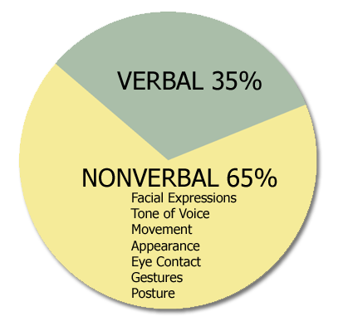
Sending Positive Nonverbal Messages and Acting Professionally
You have already sent nonverbal messages to your interviewer by arriving on time, being courteous, dressing appropriately, and greeting the receptionist confidently.
You will continue to send nonverbal messages throughout interview.
What comes out of your mouth and what is written on your resume are not the only messages an interviewer receives about you.
Nonverbal messages also create powerful impressions.

Slide 60
Preparing to Answer Interview Questions
Always aim your answers at key characteristics interviewers seek: expertise, competence, motivation, interpersonal skills, decision-making skills, enthusiasm for the company and the job, and a pleasing personality.
Remember to stay focused on your strengths.
Don’t reveal weaknesses, even if you think they make you look human.
You won’t be hired for your weaknesses, only for your strengths.

Slide 61
Questions to Get Acquainted
After opening introductions, recruiters generally try to start the interview with personal questions designed to put you at ease.
They are also striving to gain an overview to see whether you will fit into the organization’s culture.
When answering these questions, keep the employer’s needs in mind and try to incorporate your success stories.

Slide 62
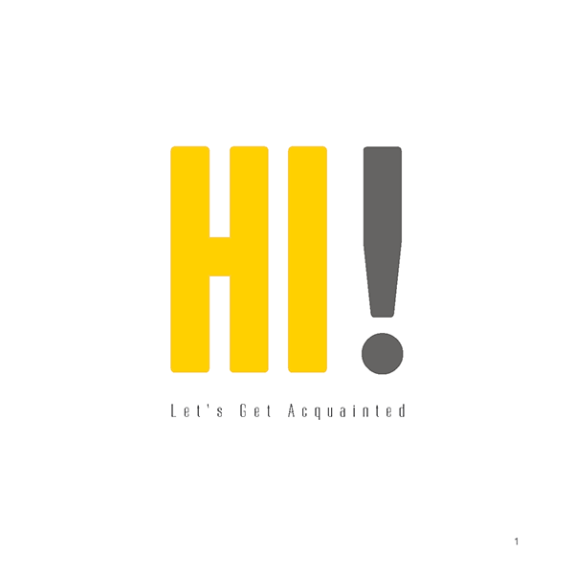
Questions to Get Acquainted…
Tell me about yourself.
Keep this answer short (1-2 minutes), but on target.
Use this chance to promote yourself.
Stick to educational, professional, or business-related strengths; avoid personal or humorous references.
Be ready with at least 3 success stories illustrating characteristics important to this job.
Demonstrate responsibility you have been given; describe how you contributed as a team player.

Slide 63
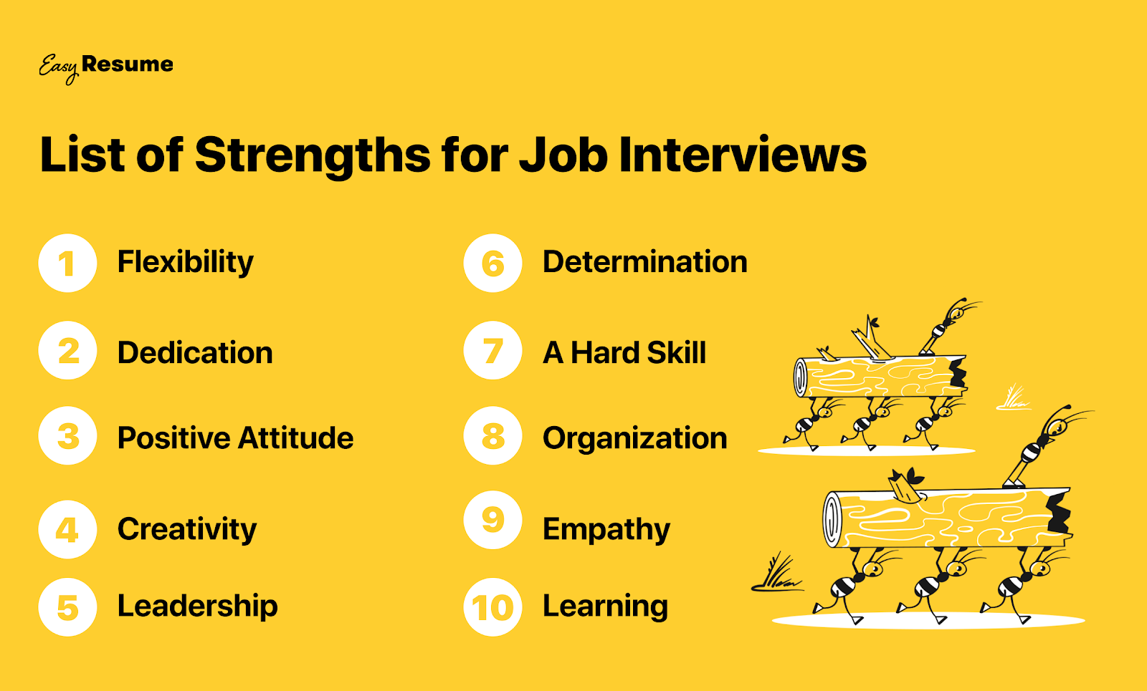
Questions to Get Acquainted…
What are your greatest strengths?
Reread your resume and cover letter to review what you want to promote. Stress your strengths that are related to the position, such as “I am well organized, thorough, and attentive to detail.”
Tell success stories and give examples that illustrate these qualities:

Slide 64
Questions to Get Acquainted…
Do you prefer to work by yourself or with others? Why?
This question can be tricky.
Provide a middle-of-the-road answer that not only suggests your interpersonal qualities but also reflects an ability to make independent decisions and work without supervision.
What was your major in college, and why did you choose it?
What are some things you do in your spare time?

Slide 65
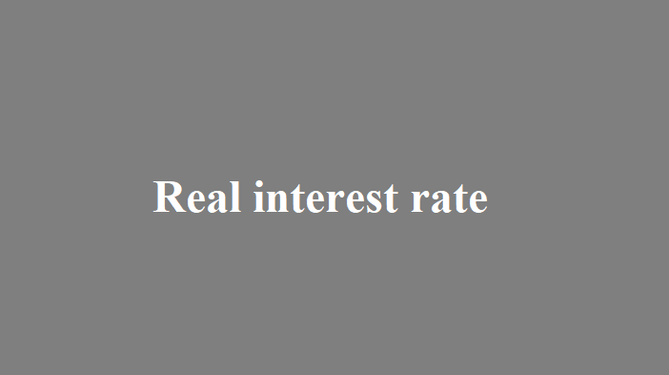
Questions to Gauge Your Interest
Interviewers want to understand your motivation for applying for a position.
Although they will realize that you are probably interviewing for other positions, they still want to know why you are interested in this particular position with this organization.
These types of questions help them determine your level of interest.

Slide 66
Questions to Gauge Your Interest…
Why do you want to work for (name of company)?
Questions like this illustrate why you must research an organization thoroughly before the interview.
The answer to this question must prove that you understand the company and its culture.
This is the perfect place to bring up the company research you did before the interview. Show what you know about the company, and discuss why you want to become part of this organization.
Describe your desire to work for this organization not only from your perspective but also from its point of view.
What do you have to offer that will benefit the organization?

Slide 67
Questions to Gauge Your Interest…
Why are you interested in this position?
What do you know about our company?
Why do you want to work in this industry?
What interests you about our products (or services)?

Slide 68
Questions About Your Experience and Accomplishments
After questions about your background and education and questions that measure your interest, the interview generally becomes more specific with questions about your experience and accomplishments.
Remember to show confidence when you answer these questions.
If you are not confident in your abilities, why should an employer be?

Slide 69
Questions About Your Experience and Accomplishments…
Why should we hire you when we have applicants with more experience or better credentials?
In answering this question, remember that employers often hire people who present themselves well instead of others with better credentials.
Emphasize your personal strengths that could be an advantage with this employer. Are you a hard worker? How can you demonstrate it?
Have you had recent training? Some people have had more years of experience but have less knowledge because they do the same thing.
Stress your experience using the latest methods and equipment.
Be sure to mention your computer training and Internet savvy.
Emphasize that you are open to new ideas and learn quickly.
Above all, show that you are confident in your abilities.

Slide 70
Questions About Your Experience and Accomplishments…
Describe the most rewarding experience of your career so far.
How have your education and professional experiences prepared you for this position?
What were your major accomplishments in each of your past jobs?
What was a typical workday like?
What job functions did you enjoy most? Least? Why?
Tell me about your technical skills.
Who was the toughest boss you ever worked for and why?
What were your major achievements in college?
Why did you leave your last position? Or, Why are you leaving your current position?

Slide 71
Questions About the Future
Questions that look into the future tend to stump some candidates, especially those who have not prepared adequately.
Employers ask these questions to see whether you are goal oriented and to determine whether your goals are realistic.

Slide 72
Questions About the Future…
Where do you expect to be five (or ten) years from now?
Formulate a realistic plan with respect to your present age and situation. The important thing is to be prepared for this question.
It is a sure kiss of death to respond that you would like to have the interviewer’s job! Instead, show an interest in the current job and in making a contribution to the organization.
Talk about the levels of responsibility you would like to achieve.
One employment counselor suggests showing ambition but not committing to a specific job title.
Suggest that you hope to have learned enough to have progressed to a position in which you will continue to grow.
Keep your answer focused on educational and professional goals, not personal goals.

Slide 73
Questions About the Future…
If you got this position, what would you do to be sure you fit in?
This is a (x) organization. Do you think you will like that environment?
Do you plan to continue your education?
What do you predict for the future of the (x) industry?
How do you think you can contribute to this company?
What would you most like to accomplish if you get this position?
How do you keep current with what is happening in your profession?

Slide 74
Challenging Questions
Challenging questions may make you uncomfortable, but the important thing to remember is to answer truthfully without dwelling on your weaknesses.
As quickly as possible, convert any negative response into a discussion of your strengths.

Slide 75
Challenging Questions…
What is your greatest weakness?
Many candidates knock themselves out of the competition by answering this question poorly. Actually, you have many choices.
You can present a strength as a weakness: “Some people complain that I am a workaholic or that I’m too attentive to details.” However, hiring managers have heard that cliché too often.
Instead, mention a corrected weakness: “Because I was terrified of making presentations, I took a college course and joined a speaker’s club.”
You could cite an unrelated skill: “I need to brush up on my Spanish.”
You can cite a learning objective: “One of my long-term goals is to learn more about coding and programming.”
Another possibility is to reaffirm your qualifications: “I have no weaknesses that would affect my ability to do this job.”

Slide 76
Challenging Questions…
What type of people do you have no patience for?
If you could live your life over, what would you change and why?
How would your former/current supervisor describe you as employee?
What do you want the most from your job?
What is your G.P.A, and does it accurately reflect your abilities?
Have you ever used drugs?
Who in your life has influenced you the most and why?
What are your reading right now?
Describe your ideal work environment?
Is the customer always right?
How do you define success?

Slide 77
Questions About Salary
Nearly all salaries are negotiable, depending on your qualifications. Knowing the typical salary range for the target position is very important in this negotiation.
If you have had little experience, you will probably be offered a salary somewhere between the low point and the midpoint in the range.
With more experience, you can negotiate for a higher figure.
A word of caution, though. One personnel manager warns that candidates who emphasize money are suspect because they may leave if offered a few thousand dollars more elsewhere.

Slide 78
Questions About Salary…
What salary are you looking for?
One way to handle salary questions is to ask politely to defer the discussion until it is clear that a job will be offered to you: “I’m sure when the time comes, we will be able to work out a fair compensation package. Right now, I’d rather focus on whether we have a match.”
If salary comes up and you are not sure whether the job is being offered to you, be blunt. Ask, “Are you making me a job offer?”
Another possible response to a salary question is to reply candidly that you can’t know what to ask until you know more about position and company.
If you continue to be pressed for a dollar figure, give a salary range with an annual dollar amount. Be sure to do research before the interview so that you know what similar jobs are paying in your geographic region.
As an expert negotiator said, “In business as in life, you don’t get what you deserve, you get what you negotiate.”

Slide 79
Questions About Salary…
How much are you presently earning?
How much do you think you are worth?
How much money do you expect to earn within the next ten years?
Are you willing to take a pay cut from your current (or previous) job?

Slide 80
Situational Questions
Questions related to situations help employers test your thought processes and logical thinking.
When using situational questions, interviewers describe a hypothetical situation and ask how you would handle it.
Situational questions are based on the type of position for which you are interviewing.
Knowledge of the position and the company culture will help you respond favorably to these questions.
Even if the situation sounds negative, keep your response positive.

Slide 81
Situational Questions…
How would you respond if your fellow team members strongly resisted a proposal you made in a meeting?
You might explain the rationale behind your proposal with specific examples of benefits that recommendations could bring to the team.
If the team continues to oppose your proposal, you should let it go and move on.

Slide 82
Situational Questions…
What would you do if you knew that your boss gave your team data that was totally wrong?
Let’s say, for example, that in a team meeting your boss provided data that had not been updated, and you recognized the error immediately. Before responding, you should confirm that your figures are correct. Then you might tactfully share the correct data in a private conversation with your boss. You could suggest that the error was an oversight perhaps caused by figures that were released after an initial report, and say that you know that your boss would want to base the team project on accurate data.
You would not correct your boss in front of the team, and you would try to understand why the mistake was made.

Slide 83
Situational Questions…
Your supervisor has just told you that she is dissatisfied with your work, but you think it is acceptable. How would you resolve the conflict?
Your supervisor told you to do something a certain way, and you think you know a far better way to complete the task. What would you do?
Assume that you are hired for this position. You soon learn that one of the staff members is extremely resentful because she applied for your position and was turned down. As a result, she is being unhelpful and obstructive. How would you handle the situation?
A colleague told you in confidence that she suspects another colleague of stealing. What would your actions be?
You have noticed that communication between upper management and first-level employees is eroding. How would you address this problem?

Slide 84
Behavioral Questions
Instead of interview questions, you may be asked to tell stories.
The interviewer may say, “Describe a time when…” or “Tell me about a time when…” To respond effectively, learn to use storytelling, or the STAR technique.
Ask yourself what the Situation or Task was, what Action you took, and what the Results were.

Slide 85
Components of the STAR Technique
Situation
Briefly explain the background and context of a situation.
What happened? When? Where?
Task
Describe the problem. What needed to be done? Why?
Action
What did you do? What skills or tools did you use?
Results
Explain the results (i.e. savings, greater efficiency).
Try to quantify.

Slide 86
Behavioral Questions…
Tell me about a time when you solved a difficult problem.
Describe a situation in which you were able to use persuasion to convince someone to see things your way.
Describe a time when you had to analyze info and make a recommendation.
Describe a time that you worked successfully as part of a team.
Tell me about a time that you dealt with confidential information.
Give me an example of a time when you were under stress to meet a deadline.
Tell me when you had to go above and beyond the call of duty to get a job done.
Tell me about a time you were able to deal with another person successfully even though that individual did not like you personally (or vice versa)
Give me an example of when you showed initiative and took the lead.
Tell me about a recent situation in which you had to deal with an upset customer or coworker.

Slide 87
Illegal and Inappropriate Questions
U.S. federal law states that “it is illegal to discriminate against someone (applicant or employee) because of that person’s race, color, religion, sex (including gender identity, sexual orientation, and pregnancy), national origin, age (40 or older), disability or genetic information.”
Therefore, it is inappropriate for interviewers to ask any question related to these areas.
These questions become illegal, though, only when a court of law determines the employer is asking them with the intent to discriminate.

Slide 88
Illegal and Inappropriate Questions
Many illegal interview questions are asked innocently by inexperienced interviewers.
Some interviewers are only trying to be friendly when they inquire about your personal life or family. Regardless of the intent, how should you react?
If you find the question harmless and if you want the job, go ahead and answer it. If you think that answering it would damage your chance to be hired, try to deflect the question tactfully with a response such as “Could you tell me how my status relates to the responsibilities of this position?” or “I prefer to keep my personal and professional lives separate.”

Slide 89
Asking Your Own Questions
At some point in the interview, usually near the end, you will be asked whether you have any questions.
The worst thing you can do is say “No,” which suggests that you are not interested in the position. Instead, ask questions that will help you gain information and will impress the interviewer with your thoughtfulness and interest in the position.
Remember that this interview is a two-way street.

Slide 90
Asking Your Own Questions…
What will my duties be (if not already discussed)?
Tell me what it is like working here in terms of the people, management practices, workloads, expected performance, and rewards.
What training programs are available from this organization? What specific training will be given for this position?
Who would be my immediate supervisor?
What is the organizational structure, and where does this position fit in?
Is travel required in this position?
How and by whom will my job performance be evaluated?
Assuming my work is excellent, where do you see me in five years?
How long do employees generally stay with this organization?
What are the major challenges for a person in this position?
What do you see in the future of this organization?
May I have a tour of the facilities?
This job seems to be exactly what I’d really like to do. Do we have a fit here?
What is the next step in the hiring process?
When do you expect to make a decision?

Slide 91
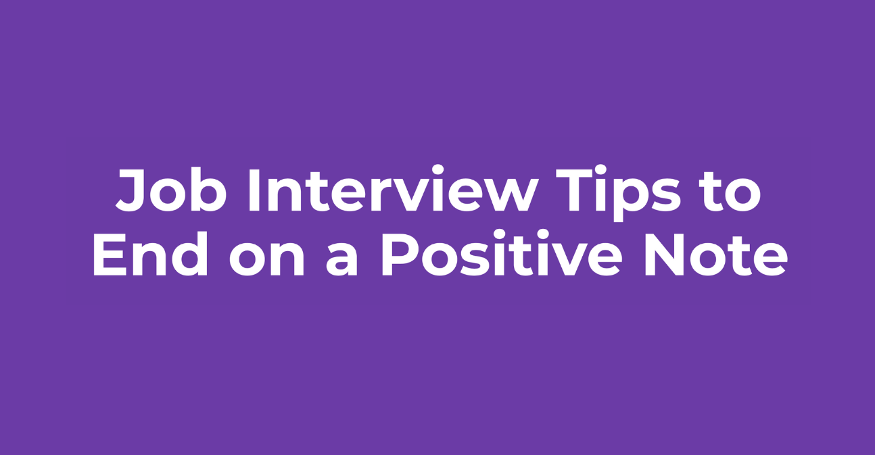
Ending Positively
After you have asked your questions, the interviewer will signal the end of the interview, usually by standing up or by expressing appreciation that you came.
If not addressed earlier, you should at this time find out what action will follow. It is recommended that you ask when a decision will be made and whether you may follow up.
Too many candidates leave the interview without knowing their status or when they will hear from the recruiter.

Slide 92
Ending Positively
Before you leave, summarize your strongest qualifications, show your enthusiasm, for obtaining this position, and thank the interviewer for a constructive interview and for considering you for the position.
Ask the interviewer for a business card, which will provide the information you need to write a thank-you message.

Slide 93
Contacting Your References
Once you have thanked your interviewer, it is time to alert your references that they may be contacted by the employer.
You might also have to request a letter of recommendation to be sent to the employer by a certain date.
You should have already asked permission to use these individuals as references, and you should have supplied them with a copy of your resume and information about types of positions you are seeking.

