Slide 1
Human Relations in Organizations Session 4

Slide 2
Chapter Eight
Motivating Performance

Slide 3
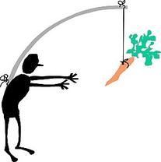
Motivating Performance
The primary reason people do what they do is to meet their needs/wants - Motivation is the internal process leading to behavior to satisfy those needs/wants.
Motivation is about answering people’s often unasked question, “What’s in it for me?” by helping them meet their needs/wants.

Slide 4
Motivation
The process people go through to meet their need is:
Need – Motive – Behavior – Satisfaction or Dissatisfaction
For Example:
You are thirsty (Need) and have a drive (Motive) to get a drink.
You drink (Behavior) that quenches your thirst (Satisfaction)

Slide 5
Motivation
Managers often view motivation as an employee’s willingness to put forth effort and commitment to achieve organizational objectives.
Your ability to motivate yourself and others is critical to career success.
Motivated, engaged employees give companies a competitive advantage through increased performance.

Slide 6
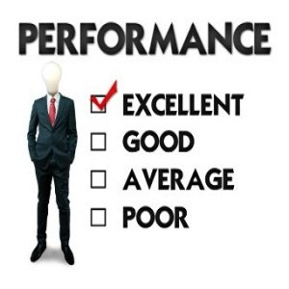
The Performance Formula
The level of performance attained is determined by three independent factors:
Ability
Motivation
Resources
For performance levels to be high, it is the manager’s responsibility to ensure all three factors are addressed.
Performance = Ability x Motivation x Resources

Slide 7
Content Motivational Theories
To increase performance, managers must know their own needs and their employees’ needs, and must satisfy them – this is the goal of human relations.
The Content Motivational Theories focus on identifying people’s needs in order to understand what motivates them.

Slide 8
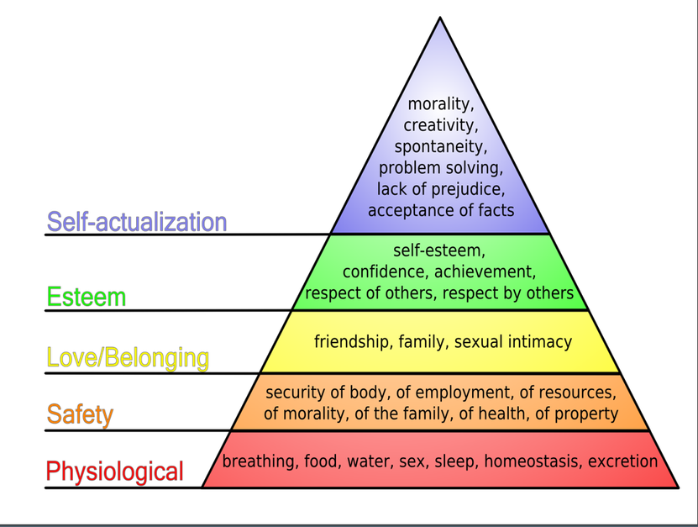
Needs Hierarchy Maslow
The Needs Hierarchy is Maslow’s theory of motivation, which is based on five needs:
Physiological
Safety
Social
Esteem
Self-Actualization

Slide 9
ERG Theory Clayton Alderfer
ERG Theory organizes Maslow’s hierarchy into three levels of needs:
Existence (Physiological and Safety Needs)
Relatedness (Social Needs)
Growth (Esteem and Self-Actualization)
To use ERG Theory, answer six questions:
What need does the individual have?
What needs have been satisfied?
Which unsatisfied need is the lowest in the hierarchy?
Have some higher-order needs been frustrated? If so, how?
Has the person refocused on the lower-level need?
How can the unsatisfied needs be satisfied?

Slide 10
Two-Factor Theory Herzberg
Two-Factor Theory is Herzberg’s classification of needs as:
Hygienes
Hygienes are called “extrinsic factors” because attempts to motivate come from outside the job itself.
Motivators
Motivators are called “intrinsic factors” because motivation comes from the job itself.

Slide 11
Using Two-Factor Theory to Motivate Employees
Herzberg contends: providing hygiene factors keeps people from being dissatisfied, but it does not motivate people.
To motivate, you must ensure hygiene factors are adequate – once employees are satisfied with their environment, they can be motivated through their jobs.
The best way to motivate employees is to build challenge and opportunity for achievement into the job itself.

Slide 12
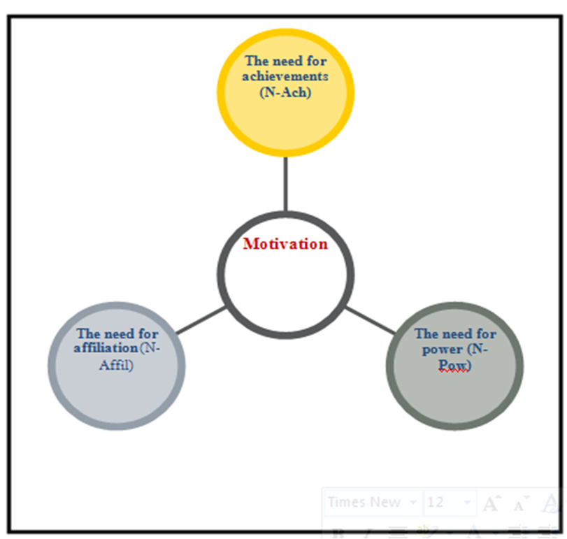
Manifest Needs Theory McClelland
The Manifest Needs Theory of motivation is primarily McClelland’s classification of needs as:
Achievement (Esteem and Self-Actualization)
Power (Esteem and Self-Actualization)
Affiliation (Social and Relatedness Needs)
It is a personality-based approach to motivation.
All people possess the need for achievement, power, and affiliation – but, to varying degrees.

Slide 13
Manifest Needs Theory
1. The Need for Achievement
Wanting to take personal responsibility for solving problems; goal-oriented; seeking challenge, excellence and individuality; taking calculated, moderate risks; desiring concrete feedback on their performance; willing to work hard.

Slide 14
Manifest Needs Theory
2. The Need for Power
Wanting to control the situation; wanting influence or control over others; enjoying competition in which they can win; willing to confront others.

Slide 15
Manifest Needs Theory
3. The Need for Affiliation
Seeking close relationships with others; wanting to be liked by others; enjoying list of social activities; seeking to belong.

Slide 16
Process Motivation Theories
Content Motivation Theories attempt to understand what motivates people, whereas Process Motivation Theories attempt to understand how and why people are motivated.
Their focus is more on behavior than needs.

Slide 17
Expectancy Theory Victor Vroom
The Expectancy Theory states motivation depends on how much people want something and how likely they’re get it.
Motivation = Expectancy x Valence
Expectancy
Person’s perception of their ability (probability) to accomplish objective.
The higher one’s expectancy, the better the chance for motivation.
Valence
The value a person places on the outcome or reward.
The higher the value (importance) of the outcome or reward, the better the chance of motivation.

Slide 18
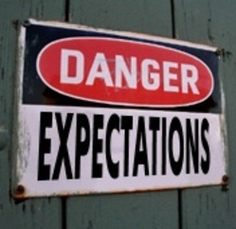
Motivating with Expectancy Theory
The following conditions should be implemented to motivate others:
Define objectives and necessary performance needed to achieve.
Tie performance to rewards.
Be sure rewards are of value to the person(s).
Make sure they believe you will do what you say you will do – you need their trust to motivate.

Slide 19
Equity Theory
According to Equity Theory, people compare inputs - effort, experience, seniority, status, intelligence, and so forth – and outputs – praise, recognition, promotions, increased status, supervisor’s approval, etc. – with those of relevant others.
If employees believe there is inequity, they will change their behavior to create equity, such as doing less work, changing the situation – like getting a raise, or getting another job.
Most employees tend to inflate their own efforts or performance when comparing themselves with others.

Slide 20
Motivating with Equity Theory
Using Equity Theory in practice can be difficult because you don’t know:
Who the employee’s reference group is, and
What their view of inputs and outcomes is
Some useful general recommendations:
Equity is based on perception.
Rewards should be equitable.
High performance should be rewarded, but employees must understand the inputs needed to attain certain outcomes.
Realize that what people know or don’t know isn’t important – all that really counts is what they feel.

Slide 21
Reinforcement Theory B.F. Skinner
Reinforcement Theory focuses on getting people to do what you want them to do through incentives, because incentives do motivate behavior and performance.
The Theory contends that people’s behavior is learned through experiences of positive and negative consequences.
It suggests that rewarded behavior tends to be repeated while unrewarded behavior tends not to be repeated.
An individual learns what is, and is not, desired behavior as a result of the consequences for specific behavior.

Slide 22
Four Types of Reinforcement
Positive Reinforcement
A method of encouraging continued behavior is to offer attractive consequences (rewards) for desirable performance.
Avoidance Reinforcement
Avoidance is also called “negative reinforcement.”
The person avoids the negative consequence.
Extinction
Extinction attempts to reduce or eliminate undesirable behavior by withholding reinforcement when the behavior occurs.
Punishment
Punishment is used to provide an undesirable consequence for undesirable behavior.

Slide 23
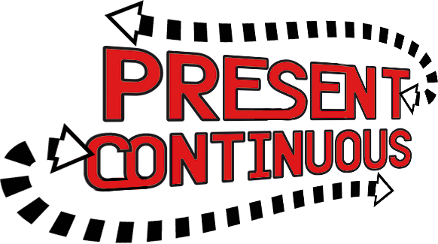
Schedules of Reinforcement
The frequency and magnitude of the reinforcement may be as important as the reinforcement itself
The two major classifications are:
Continuous Reinforcement
Each desired and undesired behavior is reinforced.
Intermittent Reinforcement
The reward is given based on the passage of time or output.

Slide 24
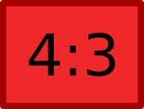
Intermittent Reinforcement
When electing to use Intermittent Reinforcement, there are four alternatives:
Fixed Interval Schedule
Variable Interval Schedule
Fixed Ratio Schedule
Variable Ratio Schedule
Ratios are generally better motivators than intervals.
The variable ratio is the most powerful schedule for sustaining behavior.

Slide 25
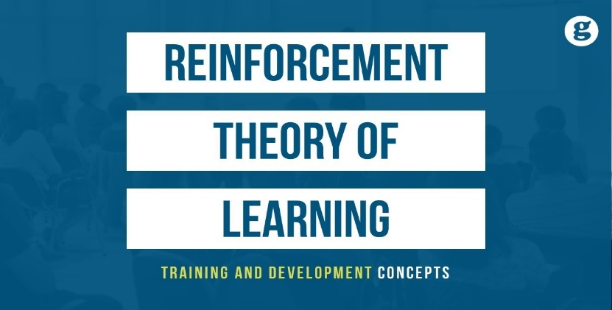
Motivating with Reinforcement
Generally, positive reinforcement is the best motivator.
Following are some general guidelines:
Make sure employees know exactly what is expected of them.
Select appropriate awards.
Select the appropriate reinforcement schedule.
Do not reward mediocre or poor performance.
Look for positive and give praise, don’t focus on negative and criticizing.
Never go a day without giving praise.
Do things for people, instead of to them, and you will see improvement.

Slide 26
Incentives and Recognition
People do respond to incentives and we can nearly always get them to do what we want them to do as long as we find the right levers – combination of types and schedules of reinforcement – to motivate the desired behavior.
One great method of recognition that we can all use, and that is not part of a formal program is giving praise.

Slide 27
Giving Praise
Giving praise develops a positive self-concept and leads to better performance through the Pygmalion Effect.
Praise is a motivator – not a hygiene – because it meets the employees’ needs for self-esteem and self-actualization, growth, and achievement: It is probably the most powerful, least expensive, simplest, and yet most underused motivational technique.

Slide 28
Giving Praise
The steps in the Giving Praise are as follows:
Tell the person exactly what was done correctly.
Tell the person why the behavior is important.
Stop for a moment of silence.
Encourage repeat performance.
Praise is a reinforcement that is very effective when used with a variable interval schedule.
Send “thank you” notes:
A handwritten note is personal and powerful.

Slide 29
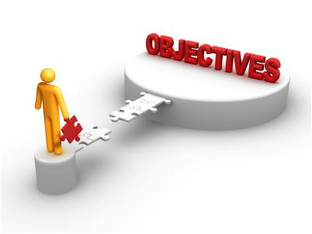
Objectives and MBO
Setting difficult objectives leads to higher levels of motivation and performance.
Motivate people to high levels of performance; objectives should be:
Difficult but Achievable
Observable and Measurable
Specific – with a Target Date
Participatively Set when Possible
Accepted

Slide 30
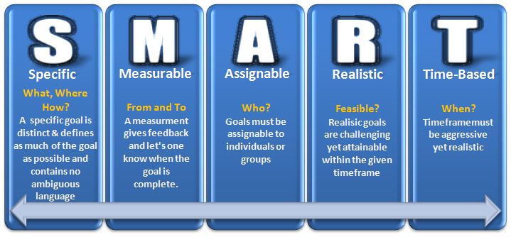
Writing Objectives
Objectives should be written, and:

Slide 31
Management By Objectives (MBO)
Management by Objectives is the process in which managers and their employees jointly set objectives, periodically evaluate the performance, and reward according to the results.
Three steps of an MBO program are as follows:
Set Individual Objectives and Plans
Give Feedback and Evaluate Performance
Reward According to Performance

Slide 32
Management By Objectives (MBO)
An MBO program is a motivator – not a hygiene – because it meets employee’s needs for esteem and self-actualization, growth, power and achievement.
An MBO program empowers employees to increase responsibility with an opportunity for creating meaningful challenging work to help them grow and accomplish what they and the manager want/need to accomplish.
An MBO program creates a win-win situation.

Slide 33
Chapter Eleven
Team Dynamics, Creativity and Problem Solving, and Decision Making.

Slide 34
Teamwork
Teamwork involves working together to achieve something beyond the capabilities of individuals working alone.
The common organizational structure is based on teams.

Slide 35
Teamwork
Job recruiters ranked ability to work well within a team as the second most sought after skill in new employees, just below communication and interpersonal skills, which are the foundation for team skills.

Slide 36
Types of Teams Formal
There are formal groups, which are sanctioned by the organization (departments).
Functional Teams are formal, ongoing teams that consist of managers and their employees.
Task teams (committees) work together on a specific activity – this is in addition to your job in a functional group, so it’s possible you could have two bosses.

Slide 37
Types of Teams Informal
There are informal groups, which are developed spontaneously when members get together voluntarily because of similar interests.

Slide 38
Types of Teams Informal
Employees are commonly members of multiple teams.

Slide 39
The Team Performance Model
The Team Performance Model is a function of:
Team Structure + Team Dynamics+ Team Development Stage

Slide 40
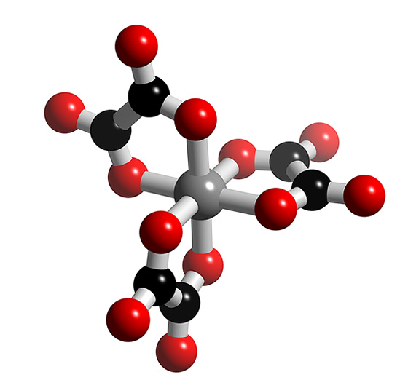
Team Structure
There are four team structure components that, along with team dynamics and development, affect team performance.
Conflict
Leadership
Composition
Creative Problem-Solving and Decision-Making

Slide 41
Team Dynamics
Team dynamics refers to the patterns of interactions that emerge as groups develop.
Six components of team dynamics:
Objectives
Team Size
Team Norms
Group Cohesiveness
Status within the Team
Group Roles

Slide 42
Team Dynamics Defined
Objectives
Teams must agree on objectives and be committed to achieving them.
Team Size
The ideal size depends on the team’s purpose.
Team Norms
Functional groups policies and rules to help provide guidelines for behavior.
Group Cohesiveness
The extent to which a group will abide by and enforce its norms depends on its attractiveness and closeness.
Status within the Team
The more respect, prestige, influence, and power a member has the higher his or her status within the team.
Group Roles
Roles are shared expectations of how members will fulfill the requirements of position: there are (1) task, (2) maintenance, and (3) self-interest roles.

Slide 43
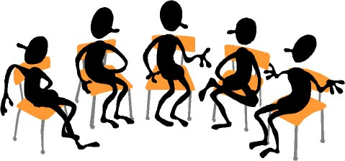
Group Roles Found in Teams
Task Roles
Focus on getting the job done, and influencing others to help.
Maintenance Roles
Things group members do and say to develop and sustain group dynamics.
Focus on people working effectively together, and influencing others to work as team members.
Self-Interest Roles
Things group member do and say to meet their own needs or objectives at the expense of the team.

Slide 44
Group Roles Implications for Leaders
To be effective, a team must have members who play task roles and maintenance roles, while minimizing self-interest.

Slide 45
Team Development Stages
Orientation – Forming Stage
Low development level, high commitment, and low competence
Dissatisfaction – Storming Stage
Moderate development level, lower commitment, and some competence
After members work together for some time, they tend to become dissatisfied with the group
Resolution – Norming Stage
High development level, variable commitment, and high competence
As members develop competence, they often become more satisfied with the group and committed to it
Production – Performing Stage
Outstanding development level, high commitment, and high competence
High commitment and competence enhances productivity & performance
Termination
During this stage, members experience feelings about leaving the group

Slide 46
Key Variables
The two key variables identified through each stage of group development are:
Work on the task (competence)
The socioemotional tone or morale (commitment)

Slide 47
Team Development and Situational Supervision
With each stage of group development, a different supervisory style is needed to help the group perform effectively at that stage and to develop to the next level.
Role(s) the manager should play during the different stages of group development:
Orientation = Autocratic Style
Dissatisfaction = Consultative Style
Resolution = Participative Style
Production = Laissez-Faire Style

Slide 48
Leadership Skills
With the trend toward teams, today there are typically more meetings in the workplace.

Slide 49
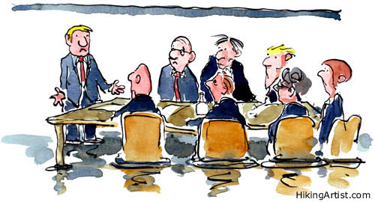
Planning Meetings
You need meeting leadership skills for career success.
There are at least five areas in which planning a meeting is needed:
Objectives
Participants and Assignments
Agenda
Date, Time, and Place
Leadership
The Written Plan

Slide 50
Conducting Meetings
The First Meeting
At the first meeting, the group is in the orientation stage.
This leader should use the high task role; however, the members should be given the opportunity to spend time getting to know one another.
The Three Parts of Each Meeting
Begin the meetings on time; waiting for late members personalize the members who are on time and develops a norm for coming late.
Each meeting should cover the following:
Objectives
Agenda
Summarize and Review Assignments

Slide 51
Handling Problem Team Members
1. The Silent Member
Encourage the silent member to participate.
2. The Talker
Slow down the talkers, don’t shut them up, and don’t let them dominate the group.
3. The Wanderer
Keep the group on track – cut-off unwanted conversation.

Slide 52
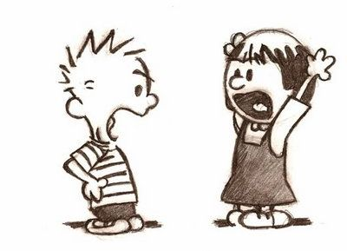
Handling Problem Team Members
4. The Bored Member
Keep members motivated – assign tasks.
5. The Arguer
Resolve the conflict, but not in an argumentative way.
6. The Social Loafer
Use peer pressure to get them to do their work.
Confront social loafers assertively.

Slide 53
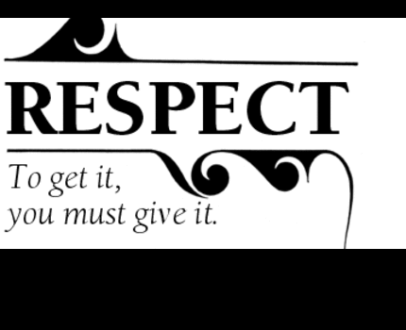
Conclusion
When you work in a team, do not embarrass, intimidate, or argue with any members, no matter how much they provoke you.
If you do, the result will make martyrs of them and a bully of you.

Slide 54
Problem-Solving and Decision-Making
Problem-solving and decision-making are an important part of group structure, affecting behavior, human relations, and performance.
Decision-making separates the successful from the failed teams.

Slide 55
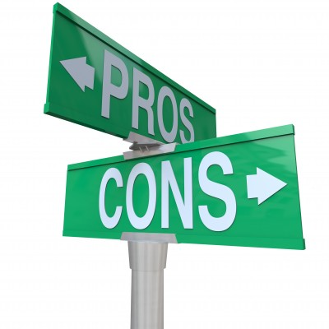
Problem-Solving and Decision-Making
Problem-Solving
The process of taking corrective action in order to meet objectives.
Decision-Making
The process of selecting an alternative course of action to solve a problem.

Slide 56
Three Decision-Making Styles
Reflexive Style
A reflexive decision maker likes to make quick decisions, without taking the time to get all the information that may be needed and without considering all alternatives.
Reflective Style
A reflective decision maker likes to take plenty of time to make decisions, taking into account considerable information and an analysis of several alternatives.
Consistent Style
A consistent decision maker makes decisions without rushing or wasting time – knows when they have enough information and alternatives to make a sound decision – and have the most consistent record of good decisions.

Slide 57
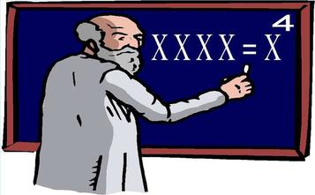
Decision-Making Model
We all like to think that we are rational and have great intuitive judgment when making decisions. However, research reveals the opposite effect.
People are far from rational and often act against their best interests.
Intuitive judgment is flawed and doesn’t help make good decisions.

Slide 58
Five Steps in the Decision-Making Model
The five steps in the Decision-Making Model do not simply go from start to end – at any step, you may have to return to a previous step to make changes.
Define the Problem
Set Objectives and Criteria
Generate Alternatives
Analyze Alternatives and Select One
Plan, Implement the Decision, and Control

Slide 59
Using Groups to Generate Creative Alternatives
In step three of the decision-making process, organizations today are using group input to generate creative alternatives.
Brainstorming
Synectics
Nominal Grouping
Consensus Mapping
Delphi Technique

Slide 60
1. Brainstorming
Brainstorming is the process of suggesting many alternatives, without evaluation, to solve a problem
Quantity
Team members should generate as many ideas as possible.
No Criticism
Team members should not criticize or evaluate ideas in any way during the solution-generation phase.
Freewheel
You can’t think outside the box when you are in it – you have to see things from new angles or perspectives.
Extend
Team members should try to build on ideas of others and even take them in new directions.
Brainwriting
To eliminate the influence of team peer pressure and other members’ suggestions, participants write their own ideas down.

Slide 61
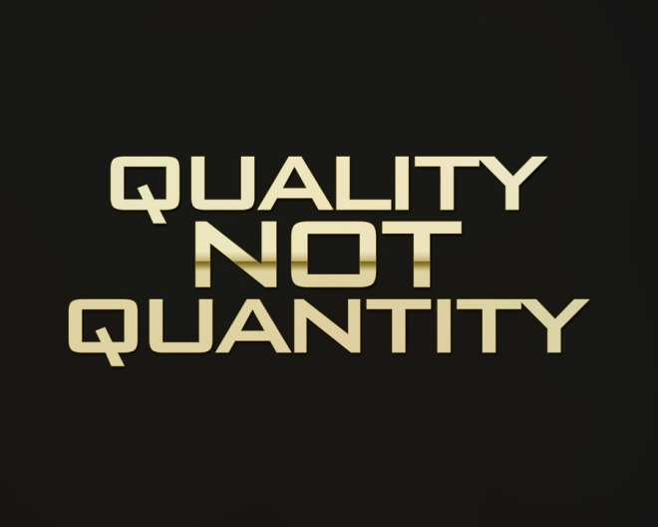
2. Synectics
Synectics focuses on coming up with novel ideas rather than a quantity of ideas.
It is the process of generating novel alternatives through role-playing and fantasizing.

Slide 62
3. Nominal Grouping
Nominal Grouping is the process of generating and evaluating alternatives through a structured voting method.
It is appropriate to use Nominal Grouping to ensure that status difference among members doesn’t influence the process and decision; some members tend to agree with the boss or informal leader and ignore low status ideas.

Slide 63
4. Consensus Mapping
A consensus is a cooperative attempt to develop a solution acceptable to all employees, rather than a competitive battle in which a solution is forced on some members

Slide 64
5. Delphi Technique
The Delphi Technique is considered a variation of nominal grouping, without face-to-face interaction at any point, and it also includes consensus.
Uses anonymous questionnaires.

Slide 65
Advantage/Disadvantage
There are advantages and disadvantages of using groups to make decisions.
Synergy occurs when the group’s solution to a problem or opportunity is superior to all individual’s.
Unfortunately, research indicates that people often choose inferior alternatives when choosing in groups.

Slide 66
Advantages of Using Groups
Better Decisions
With synergy, including avoiding errors with the help of the devil’s advocate technique.
More Alternatives
More people provide diverse ideas.
Acceptance and Commitment
People tend to accept and be more committed to implement decisions they help make.
Morale
Participants have more job satisfactions.

Slide 67
Disadvantages of Using Groups
Time
It takes a long time to make group decisions.
Domination
Powerful individuals or a coalition may actually make the decision.
Conformity of Groupthink
Members may go along with the suggested decision without questioning when they disagree with it to avoid conflict and keep social solidarity.
Responsibility and Social Loafing
No one individual is accountable for the decision, so people don’t take it as seriously and some don’t do their fair share of the work.

Slide 68
Putting it all Together
Organizations use groups to meet performance objectives.
The more effective the group structure and dynamics, the higher the stage of development, and the higher the stage of development, the greater the level of performance.
The group’s performance affects its behavior and human relations.

Slide 69
Review

