Slide 1

Customer Service Management
Session Six Class Presentation
Customer Service
  Skills for Success – 7th Edition
    Robert W. Lucas; McGraw-Hill Education; New York, NY 2019
      ISBN: 978-1-259-95407-8

Slide 2

Part Three: Building and Maintaining Relationships
Chapter Eight: Customer Service in a Diverse World
  “Diversity is the one true thing we all have in common. Celebrate it every day.” - Anonymous

Slide 3
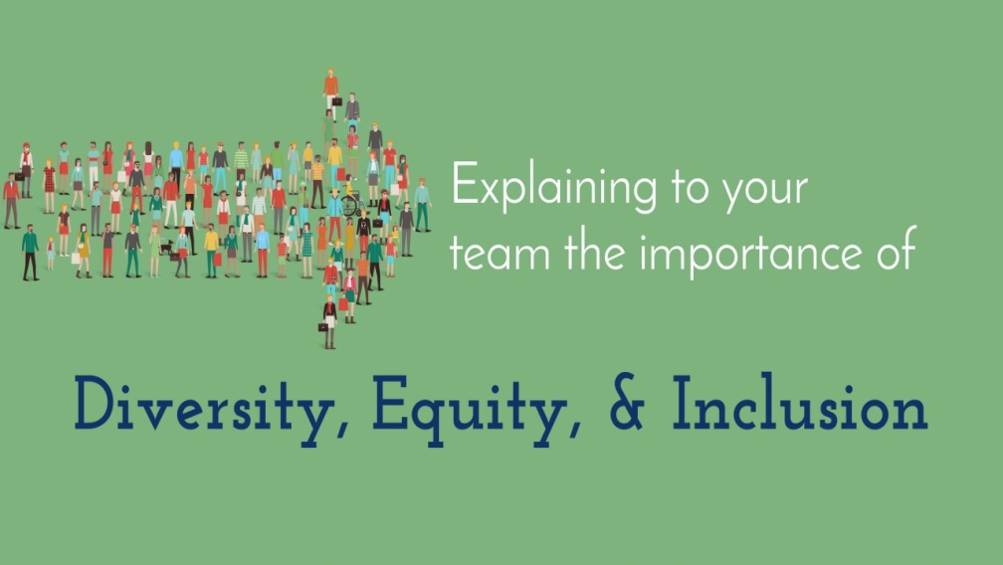

The Impact of Diversity
Diversity is encountered everywhere and is an important aspect of everyone’s life.
  Encounters with others give us an opportunity to expand our knowledge of others and build relationships with them, while growing personally.

Slide 4

The Impact of Diversity
    One significant impact that diversity has on customer service is that people from varied backgrounds and cultures bring with them expectations based on the “norm” of their country or group.
      Whether this diversity pertains to cultural or ethnic differences, beliefs, values, religion, age, gender, ability, or other factors, a potential breakdown in customer satisfaction can occur if people get other than what they want or expect.

Slide 5
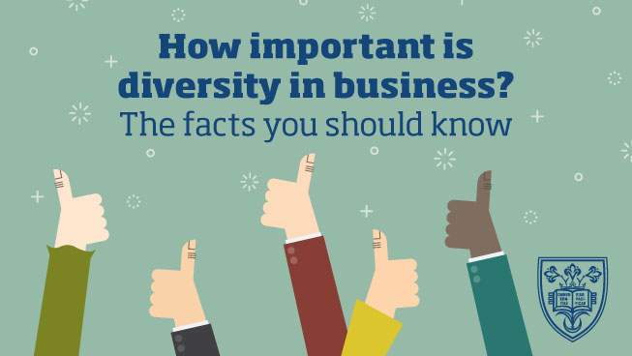
The Impact of Diversity
Part of creating a diverse customer business environment is to train service providers in the ways of dealing with people who have backgrounds that are different from their own.
  Additionally, this effort involves each employee taking ownership for enhancing their knowledge and skills related to working with a diverse customer base.

Slide 6

The Impact of Diversity
As you begin your journey through the concept of dealing with diverse customers, stop and think about the following questions:
  How do you define diversity?
  What do you already know about diverse cultures around the world?
  In what ways do your cultural beliefs and values differ from those of cultures with which you have contact as a service provider?
  In what ways are your cultural beliefs and values similar to those of cultures with which you have contact as a service provider?
  How do the beliefs and expectations of people from a gender other than your own affect your ability to serve them effectively?
  What is your personal interest in learning about cultures or diverse groups?
  What training or research have you done on diversity and how has that influenced your views or perspectives toward others different from you?

Slide 7

Defining Diversity
“Diversity” encompasses a broad range of differences. Many people associate the term with race or color of skin.
  However, it also encompasses a variety of other individual and group characteristics such as cultural diversity.
    Cultural diversity refers to the different racial, ethnic, and socioeconomic varieties, based on factors such as values, beliefs, and experiences, that are present in people grouped together in a given situation, group, or organization.

Slide 8
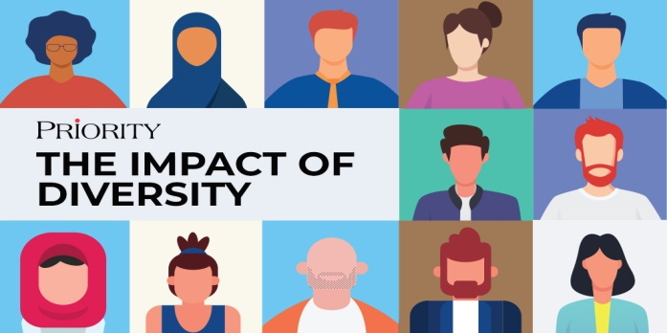
Defining Diversity
Start your journey to better understanding of diversity by being fair to people and keeping an open mind when interacting with them.
  People from varying groups and geographic locations bring with them special knowledge, experience, and value.
    Even though people may have differences or may not look alike, they have many traits in common. These similarities form a solid basis for successful interpersonal relationships. Failure to recognize may lead to a service or organizational breakdown.

Slide 9
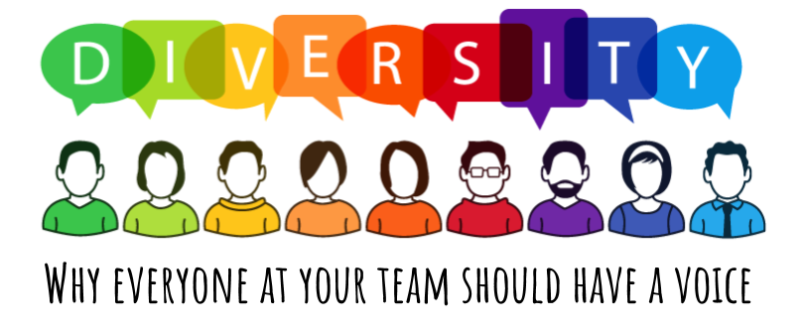
Defining Diversity
Some factors that make people different are innate, that is, they are born with them, such as height, weight, hair color, gender, skin color, physical and mental condition, etc. All these factors contribute to our uniqueness and either help or inhibit us throughout our lives, depending on perceptions we have.
  We gain or learn other factors that make us unique through our environment and our life experiences, such as, religion, values, beliefs, economic levels, lifestyle choices, profession, marital status, education, and political affiliation.
    Often we use these factors to assign people to categories.
    Use caution when considering any of these characteristics, since grouping people can lead to stereotyping and possible discrimination.

Slide 10

Defining Diversity
The bottom line is that all of these factors affect each customer encounter.
  Your awareness of differences and of your own preferences is crucial in determining your success in each instance.

Slide 11
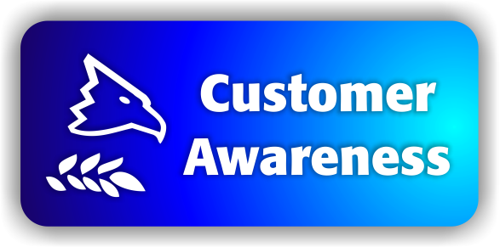
Customer Awareness
Applying your own cultural practices and beliefs to a situation involving someone from another culture can result in frustration, anger, poor service, and lost business.
  No two people are alike, no two generations are alike, and no two cultures are alike. In addition, each customer has needs based on their own perceptions and situation.
    The diverse nature of your customer population requires you to be aware of the various ways people from different cultures or groups interact in the business setting.

Slide 12

Customer Awareness
A changing customer world brings potential differences in the way some people perceive factors such as time, communication style, gender roles, religion, dress, and members of other countries and cultures.
  By better understanding other cultures and contexts, you have an opportunity for building a solid customer-provider relationship. You also significantly reduce the chance for communication and service breakdowns due to differing perspectives and expectations.
    Cultural awareness training is crucial to your success.

Slide 13

The Impact of Cultural Values
Values often dictate which behaviors and practices are acceptable or unacceptable.
  Values may or may not have direct bearing on serving the customer, but they can have a very powerful influence on what the customer wants, needs, thinks is important, and seeks or accepts. Values can also influence your perceptions and actions toward others.
    Being conscious of differences can lead to a better understanding of customers and potentially reduce conflict or misunderstanding.

Slide 14


The Impact of Cultural Values
Values are the “rules” that people use to evaluate issues or situations, make decisions, interact with others, and deal with conflict.
  A person’s value system often guides thinking and helps them determine right from wrong or good from bad.
  From a customer service prospective, values often strongly drive customer needs and influence the buying decision.
    Values also differ from one culture to another, depending on its views on ethics, morals, religion, and many other factors.
    Values come from deeply held beliefs, and are powerful.

Slide 15

The Impact of Cultural Values
To be effective in dealing with others, service providers should not ignore the power of values and beliefs, nor should they think that their value system is better than that of someone else.
  The key to service success is to be open-minded and accept that someone else has a different belief system that determines needs.
    Your goal is to provide excellent service to the customer, and in order to achieve success in accomplishing this goal, you must be sensitive to, tolerant of, and empathetic toward customers.

Slide 16

Modesty
Modesty refers to the way that cultures view propriety of dress and conduct.
  In some cultures (i.e. Muslim and Quaker), conservative dress by women is one manifestation of modesty.
  In other cultures, nonverbal communication cues send messages (i.e. eye contact).
    Be aware of your work environment and nonverbal communication to ensure you are not offensive to others.

Slide 17

Expectations of Privacy
Based on your personality and prior life experiences, you may be more or less likely to disclose personal information, especially to people you do not know well.
  You should be aware that disclosing personal information about oneself is often a cultural factor and expectations of privacy vary.
    Being congenial and welcoming is a good thing during a customer interaction; however, if you tend to be gregarious and speak freely about virtually any topic, you should curtail this tendency in the customer service environment. Be cordial but don’t talk excessive.

Slide 18

Expectations of Privacy
A good rule of thumb is to stay focused on the business of serving your customer in an expeditious and professional manner. Keeping your conversations centered on satisfying the customer’s needs can accomplish this.
  This does not mean that you should avoid “small talk;” just keep it under control and watch customer reactions closely.
    Talking about the weather, traffic, or some other impersonal topic might be fine, but avoid controversial topics that might be emotional hot buttons or sensitive to other people (i.e. politics and religion).

Slide 19

Forms of Address
Although North Americans often pride themselves on their informality, people from other countries may see informality as rudeness, arrogance, or over-familiarity.
  For example, if you were from the U.S. doing business in another country and failed to greet the customer appropriately or called customers from a more formal culture by their first name without their permission, you might possibly irritate or anger them.
    When meeting someone from another culture who has not been acculturated into your own, you might greet the customer according to their cultural background. This demonstrates sensitivity and respect.

Slide 20

Respect for Elders
In most cultures, some level of respect is paid to older people. This stems from a belief that with age comes knowledge, experience, wisdom, authority, and, often, higher status.
  You must be careful to pay appropriate respect when speaking to older customers. Further, you should be sensitive to the fact that if the customer demands to speak to a senior person or to the manager or owner, they may simply be exhibiting a customary expectation for their culture and generation.
    If you can assist without creating conflict, do so; if not, honor the request when possible.

Slide 21

Importance of Relationships
Before business is conducted in many cultures, the building of a strong interpersonal relationship is very important.
  Interpersonal relationships focus on the need for service providers to build strong bonds with customers.
    In many cultures, having a number of informal meetings with people in an organization to build a relationship is often expected before coming to an agreement.

Slide 22
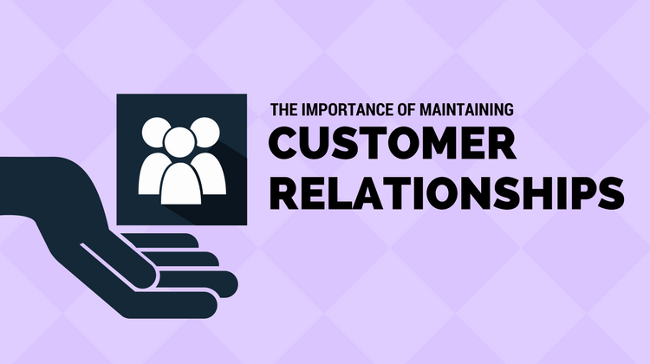
Importance of Relationships
Failure to establish rapport or an environment of trust could lead to a breakdown in service and/or lost customers. This does not mean that you should hesitate to assume a quicker familiarity with customers from such cultures, as this could also alienate them.
  Instead, when you will be having ongoing contact or doing repeat business, follow the customer’s lead.
    Get to know them and share information about your organization and yourself that could lead to mutual trust and respect.

Slide 23
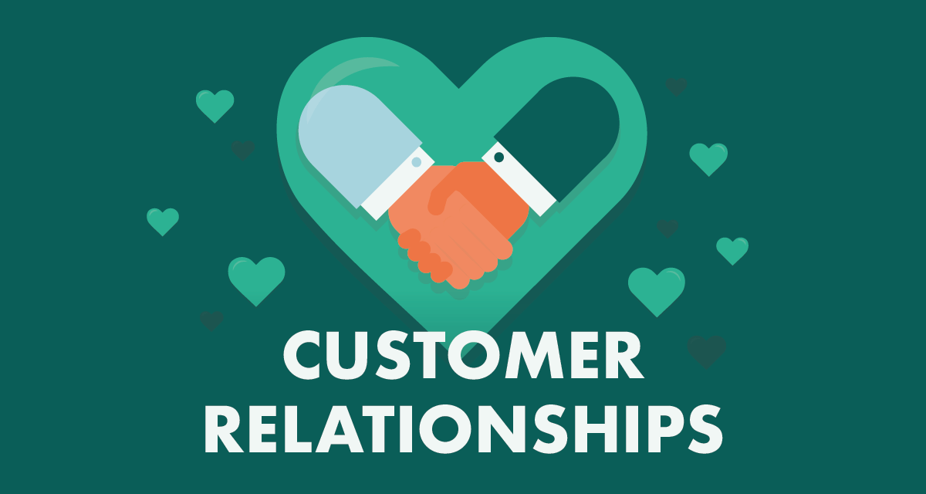
Importance of Relationships
Relationship building may also involve presenting gifts to persuade various people in the organization that you are a friend and have their interests at heart. Only then can you proceed to determine needs and provide service.
  People from many countries view this as an appropriate form of etiquette, while others may label such gratuities as bribes.
    Whatever your belief, if the practice is a cultural norm, you may do well to follow it when dealing with customers from other regions.

Slide 24

Gender Roles
Culturally and individually, people view the role of men and women differently.
  Although gender roles are continually evolving throughout the world, decision-making and authority are often clearly established as male prerogatives within many cultures, subcultures, and families.
    You do not have to agree with these practices, but you will need to consider them when facing them in some customer encounters.

Slide 25
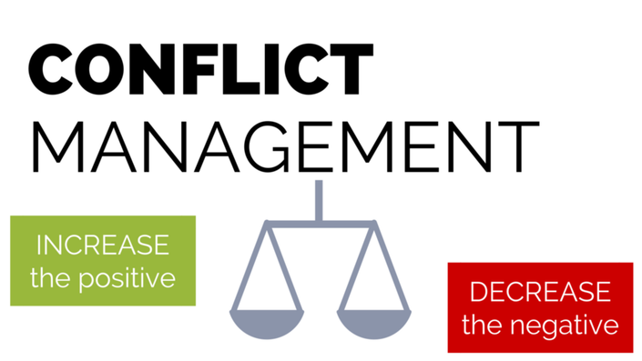
Attitude Toward Conflict
By recognizing your biases and preferences, and being familiar with other cultures, you can reduce the potential for disagreement.
  Certainly, there will be times when a customer initiates conflict. In such instances, all you can do is remain positive.
    If necessary, you may need to ask for assistance to resolve the conflict.

Slide 26

Attitude Toward Conflict
Depending on the individuals you encounter and their cultural background, you and your customers may deal differently with conflict. Regardless of culture or group, people choose different conflict resolution styles based on personality style preferences.
  If you use the wrong strategy, emotions could escalate and customer dissatisfaction could follow.
    The key is to listen and remain calm, especially if customer gets agitated.

Slide 27

The Concept of Time
People from the U.S. are typically very time-conscious (monochronic). You’ve heard the phrase “time is money,” which stresses the impatience and need to maximize time usage and to be punctual/efficient.
  Many North Americans tend to expect people from other cultures to be as time-conscious as they are; however, this is not always the case.
  Arab, Asian, and Hispanic cultures tend to be polychronic and are often late for meetings or miss them altogether.
    Such tardiness is not viewed as disrespect for the time of others or rudeness; it is simply indicative of a cultural value or way of life.

Slide 28
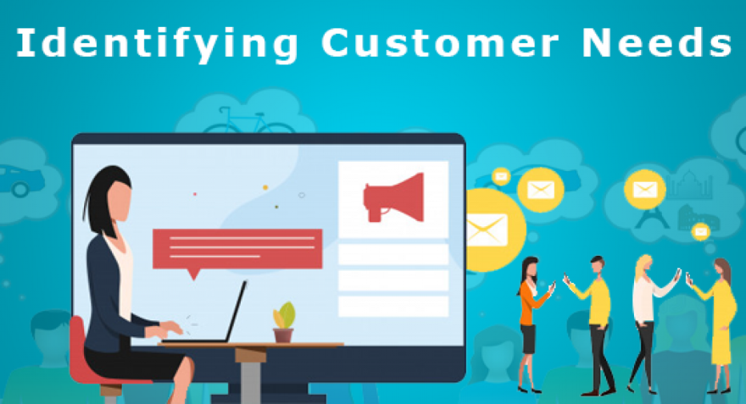
Ownership of Property
People have differing levels of needs. Ask customers what their needs are and listen to their responses.
  Do not persist in upgrading a customer’s request to a higher level or more expensive product if they decline your suggestion. You may offend and lose a customer.
    Of course, if you are in sales, you must make a judgment on whether an objection is one that you should attempt to overcome or whether it is emphatic or culturally based and means “no.”

Slide 29
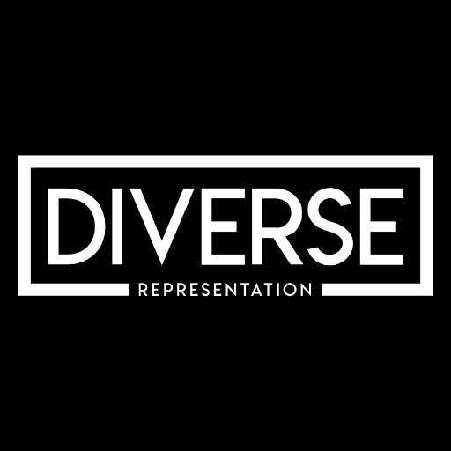
Providing Quality Service to Diverse Customer Groups
As a service provider, you should become proficient in working with customers with language differences and disabilities; you also need to work with young and elderly customers.
  Given the potential diversity of your customer base, it may be impossible to establish a service strategy for each group.
    However, you should think of what you might do to address the needs of some of the larger categories of customers you will meet.

Slide 30
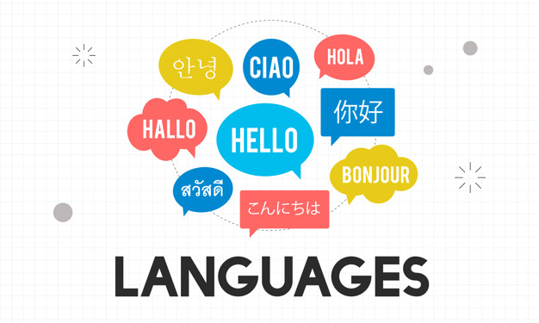
Customers with Language Differences
One major obstacle for service providers in the U.S. is that many adults believe that most of the world’s population speaks English.
  In actuality, English is the third most spoken language behind Mandarin Chinese and Spanish.
    However, if you combine the number of native English speakers and nonnative people who speak English as a second language, English moves up to first or possibly second behind Chinese.

Slide 31

Customers with Different Languages
The key to effectively serving all customers, and particularly people from different cultures, is flexibility.
  You are likely to encounter customers from virtually any country in the world when you speak in today’s business environment, so you need to be prepared. You need to have a way to use alternative methods or strategies for providing service.
    Some organizations have employees who can speak multiple languages, or use an on-call list of translators. Others may have important information readily translated for customers.

Slide 32

Customers with Disabilities
From a customer service perspective, you will certainly encounter someone in the workplace who has a disability and may require your assistance in serving them.
  Some service professionals are uncomfortable working w/ customers with disabilities. This is because they have had little prior exposure to people w/ special needs, they are uniformed about disabilities, or they have an unfounded fear or anxiety in relating to them.
    Even though you may be unfamiliar with how people with disabilities adapt to life experiences, strive to provide excellent service to them.

Slide 33

Customers with Disabilities
In most cases, customers who have disabilities have learned to accommodate their own personal needs and do not want to be treated differently; they want to be treated equally.
  Related to this, a point to remember is that many people with disabilities will not disclose the fact out of concern that they might be treated differently or discriminated against.
    In reality, their disability is the norm for them and they do not see it as big of an issue as someone who does not share their disability or have knowledge about it.

Slide 34

Customers with Disabilities
Do not assume that just because someone has an obvious disability that they require or want your assistance.
  Offer assistance, if appropriate, and follow your customer’s lead in offering assistance.
    Unsolicited assistance can be offensive and even dangerous if it is unexpected and causes person to lose balance or distracts them.

Slide 35
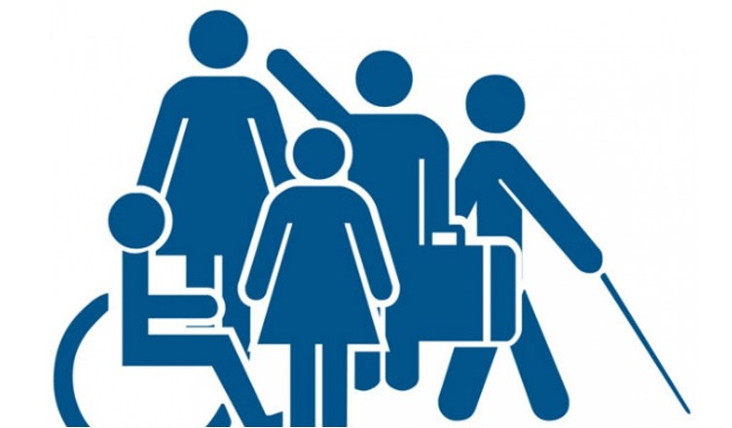
General Strategies for Servicing Customers with Disabilities
In addition to the suggestions offered in this chapter for serving customers with specific disabilities, the following are some general guidelines for success:
  Be Prepared and Informed
  Be Careful Not to Patronize
  Treat Them Equally, Not Differently
  Refer to the Person, Not the Disability
  Offer Assistance, but Do Not Rush to Help Without Asking
  Be Respectful

Slide 36

Elderly Customers
As the population ages there will be a greater need for services – and service providers – to care for elderly people and allow them to enjoy a good quality of life.
  The following are strategies for better serving these customers:
    Be Respectful
    Be Patient
    Answer Questions
    Try Not to Sound Patronizing
    Remain Professional
    Guard Against Biases

Slide 37

Younger Customers
When providing customer service to someone close to your age be sure not to make the mistake of being overly familiar with them in delivering service.
  And, don’t treat younger customers as your children, condescend, or talk down to them.
    Remember when you were young and felt that adults did not understand or care about your wants or needs? Consider that younger customers may feel the same way about you.

Slide 38

Younger Customers
An additional point to remember when dealing with younger customers is that they may not have the product knowledge and sophistication in communicating that older customers might have.
  Decrease confusion and increase communication effectiveness by using words that are appropriate for their age group and by taking the time to explain and/or demonstrate technical points.
    Keep it simple without being patronizing if you are older than your customers and make sure not to allow any frustration to show in your tone of voice.

Slide 39
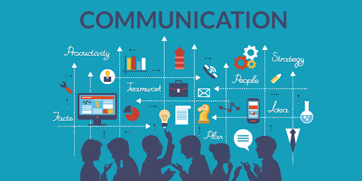
Communicating with Diverse Customers
Many considerations need to be taken into account when you are delivering service to diverse customers.
  Consider the following basic guidelines for communicating with all types of customers:
    Use Appropriate Language
    Be Careful with Your Remarks and Jokes
    Make Sure that Your Language is “Inclusive”
    Respect Personal Preferences when Addressing People
    Use General Terms
    Recognize the Impact of Words
    Use Care with Nonverbal Cues

Slide 40

Part Three: Building and Maintaining Relationships
Chapter Nine: Customer Service Via Technology
  “In the world of Internet customer service, it’s important to remember that your competitor is only one mouse click away.” - Doug Warner

Slide 41

The Role of Technology in Customer Service
Customer service is a 24/7 responsibility, and technology can assist in making it effective.
  Computers and other forms of technology are continually becoming smaller, more complex, and more powerful; we have only started to see the impact that technology will have on shaping the future.
    Most businesses in the U.S. are technologically dependent in some form.

Slide 42
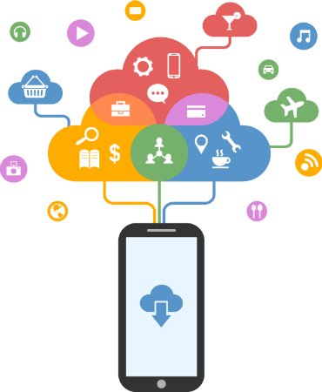
The Role of Technology in Customer Service
More people access telephone-related customer service. This significantly influences the economies of many countries via technology-based customer services.
  More than ever, people are using their smartphones and other electronic mobile applications, devices, and computers to surf the Internet and place orders.

Slide 43

The Role of Technology in Customer Service
As a result, more people have opted to do their shopping and business from the comfort of their own home.
  With access to products and services at almost any time customers are in a position of power as never before.
    Companies that are not prepared to meet the future using technology will lose business as customers migrate to providers that are better prepared.

Slide 44
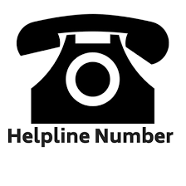
The Customer Contact/Call Center or Help Desk
Electronic commerce is an expanding and powerful way to employ technology to conduct business.
  The growing trend of customer care center or call center expansion that provide technology-based services has resulted in reduced staff and costs, while maintaining or increasing service effectiveness.

Slide 45
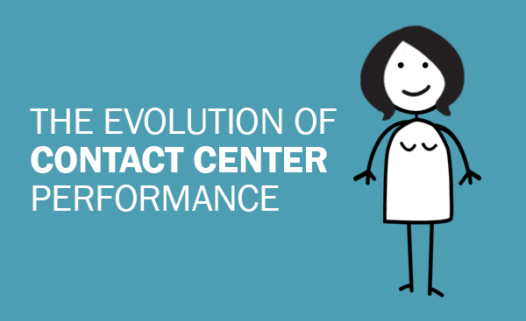
The Customer Contact/Call Center or Help Desk
Customer contact centers, or help desks, are more powerful and complicated than ever before. They also provide more functions than their rather ineffectual predecessors did.
  Additionally, because of changing expectations from customers and new regulatory guidelines related to how technology can be applied, traditional business metrics and approaches to interacting with customers and potential customers need to be reexamined by organizations.

Slide 46

The Customer Contact/Call Center or Help Desk
Any technology application considered today must incorporate a real-time solution for all customer interactions, while effectively monitoring EE performance and productivity results and tying directly to workflow processes that best satisfy customer needs.
  Additionally, such systems should provide opportunities for creating future business opportunities (i.e. gathering customer needs data that can potentially lead to additional sales).

Slide 47
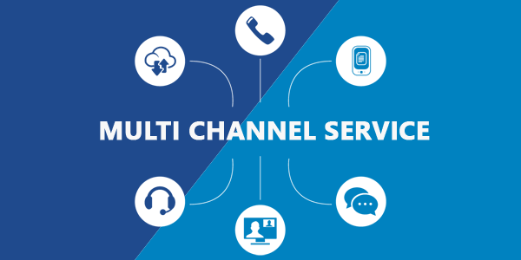
The Customer Contact/Call Center or Help Desk
Even with all the technological advances, it is clear that: Many customers still appreciate old-fashioned, personalized customer service.
  Factors such as a customer’s age, socioeconomic and educational background, comfort level with technology, access to technology, and behavioral style preference can influence whether or not a customer would rather deal with a person or technology.
    Successful service organizations realize that each customer is unique and provide multichannel customer support that offers a variety of means for customer access (i.e. telephone, e-mail, live chat, or face-to-face).

Slide 48

The Customer Contact/Call Center or Help Desk
Some people are “high touch” (preferring assistance) while others are “low touch” (preferring to serve themselves); therefore, offering a variety of service delivery systems is smart business.
  Whether you deliver service face-to-face or via technology, there is often no substitute for a dedicated, knowledgeable, and well-trained employee to assist when needed.
    You and your customer service peers are the lifeline of your organization.

Slide 49

Tapping into Web-Based and Mobile Technologies
Evolving technology is changing the way businesses and organizations of all sizes around the world do business.
  Web-based and mobile technologies continue to multiply and expand on a daily basis, and so do ways in which businesses are rapidly learning to harness their power. Everything from organizational branding, sharing information, introducing new products, and communicating and helping satisfy customer needs is possible with technology that is rapidly evolving.
    While service representatives do not typically use all of the technology approaches identified, a familiarity with terminology and technical capabilities is important to professional success.

Slide 50


Tapping into Web-Based and Mobile Technologies
The following are some ways that organizations are tapping into today’s evolving web-based and mobile technology to better serve potential, new, and existing customers:
  Websites and Social Media

Slide 51

Websites
Websites are a series of electronic “pages” that are hosted on a web server and provide vital organizational, product, and service information, and multiple ways for consumers to get in touch with key company representatives.
  Websites provide organizations with a valuable tool for presenting a “face” to the entire world. They are a part of the organization’s professional brand.
    Few successful businesses can survive today without having a professional-looking and functional website.

Slide 52

Websites
These standards of technology are able to share information about a person or a company’s organization, products and services, contacts, service options, and much more.
  As part of their overall marketing strategy, they can offer informative blogs, advertising links, and important connections to their social media accounts. All of these can better promote the organizational brand, generate leads, identify potential customers, provide service to current customers, and create residual income streams.
    Small, one-person businesses and bloggers often capitalize on affiliate, banner, and other types of web advertising to generate income.

Slide 53
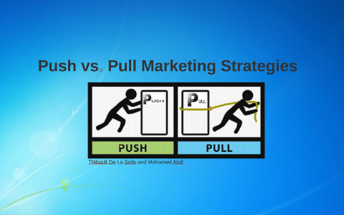
Websites
Websites are basically a “pull” mechanism. That means that site owners post info, provide service chat support, and encourage people to come to the site to retrieve information, use services and support, and make purchases.
  This is opposed to “push” technology, which proactively sends out information to customers and potential customers.
    Examples of push technology include e-mail and Twitter messages, blog articles, e-Newsletters, mailings, etc. These methods put information into the hands of customers.

Slide 54

Social Media
The Internet has exploded with social networking websites (i.e. Facebook, Twitter, LinkedIn, Pinterest) that allow people and organizations a vehicle to post information about themselves, products, and services.
  Social media has become so popular and available to consumers that businesses and other organizations are tapping into it to help establish their brand, share information, identify and connect with customers, and target specific demographic groups while keeping their name in front of millions of people.

Slide 55

Social Media
There are many factors to consider before moving forward into the social media arena. Part of the initiative should be to identify what is in it for site users and the organization.
  Five reasons that people are likely to follow your company brand on social media:
    To receive coupons and discounts
    To show their friends that they like your brand
    To receive entertaining or educational content
    To receive customer support
    To receive exclusive information and content

Slide 56

Social Media
Imagine the simplicity of creating a short video that discusses your organization’s mission, vision, and value statements or provides an overview of products and services and then uploading it to a site like YouTube.
  This simple free tool could direct job candidates, vendors, consumers, and anyone else with an interest in the organization to your website link to view the content.
    Such vehicles could save companies time and money in their marketing effort or in orienting new employees to what the organization is all about.

Slide 57

Advantages and Disadvantages of Technology
Like anything else related to customer service, technology offers advantages and disadvantages, particularly in the following areas:
    Organizational Issues
    Employee Issues
    Customer Issues
    Other Issues

Slide 58
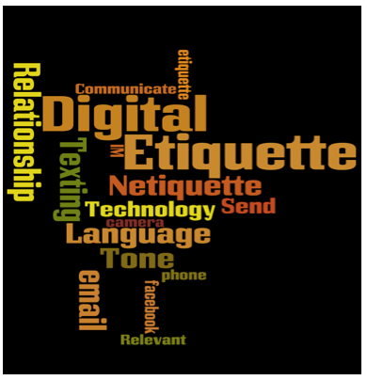
Technology Etiquette and Strategies
Using technology ethically and with the correct etiquette is important.
  As with any other interaction with people, you should be aware of the potential and risk related to using technology to interact with and serve your customers.
    Failure to observe some commonsense rules can cause loss of a customer and raise ethical concerns.

Slide 59
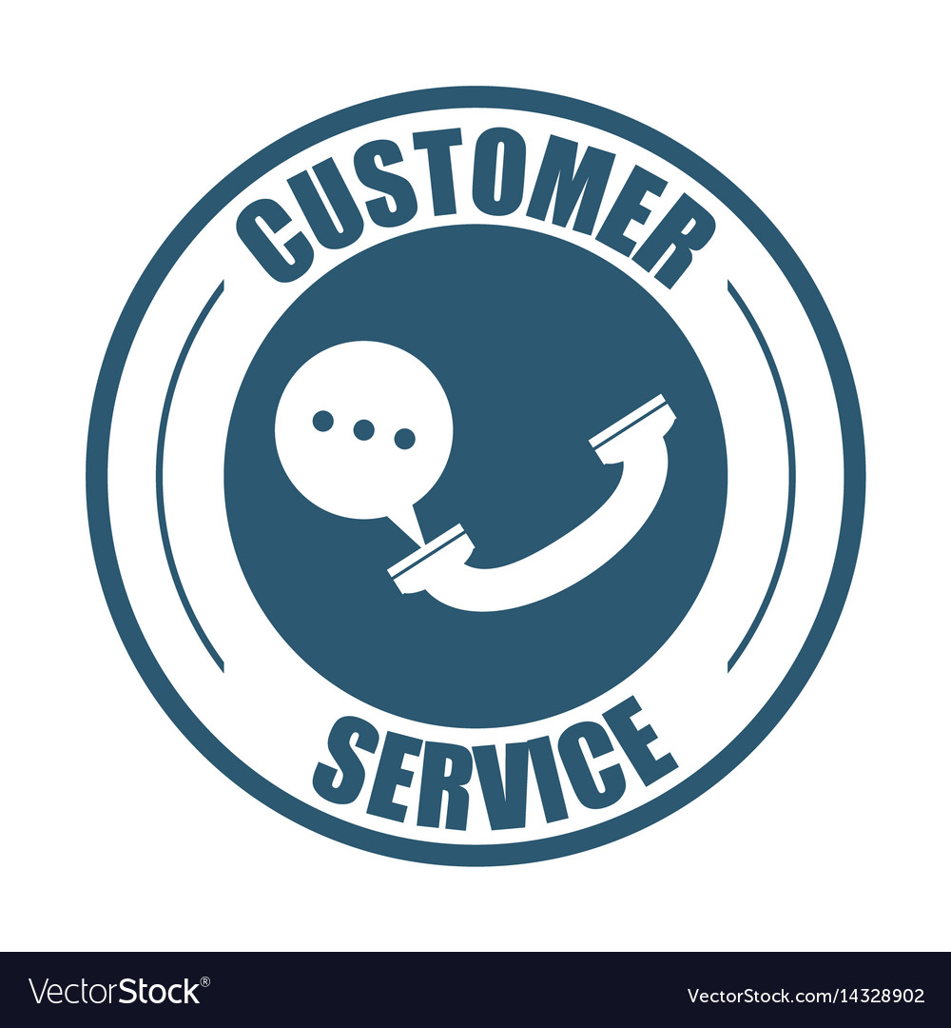
Communication Skills for Success
Just as you deliver service face-to-face with a customer, the same skills apply to providing effective customer service through email and over the telephone, especially the use of written and oral communication skills, and listening skills.
  Your customer cannot communicate with or understand you if they do not accurately receive your message.

Slide 60


