Slide 1

Supervision
Supervision
  Concepts and Practices of Management, 13th Edition
    Edwin C. Leonard, Jr., Ph.D. and Kelly A. Trusty, Ph.D. Cengage Learning, Boston, MA 2013
      ISBN: 978-1-285-86637-6

Slide 2

Part Two: Essentials of Effective Supervision
Chapter Eight: Solving Problems, Making Decisions, and Managing Change
  After studying this chapter, you will be able to:
    Explain the importance of problem solving and decision-making skills.
    Describe and apply basic steps and skills involved in the decision-making process.
    Identify and describe various decision-making styles.
    Discuss why a supervisor should not make hasty decisions.
    Suggest approaches for introducing and proposing change.
    Understand the formula for organizational renewal.

Slide 3
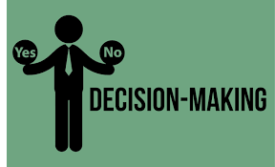
The Importance of Decision-Making Skills
Decision making is an essential part of life and an integral part of all managerial functions.
  It lies at the core of the planning function of management.
    Many supervisors claim that solving problems and making decisions are the most important components of what they do daily and throughout their ongoing supervisory management tasks.

Slide 4

The Importance of Decision-Making Skills
Decision making is the process of defining problems and choosing a course of action from among alternatives.
  The term decision making often is used together with the term problem solving because many supervisory decisions focus on solving problems that have occurred or are anticipated.
    Problem solving also includes decisions about realistic opportunities that are present or available if planned for appropriately. Therefore, we will use the terms interchangeably.

Slide 5

The Importance of Decision-Making Skills
Many of the problems that confront supervisors in their daily activities recur and are familiar; for these problems, most supervisors have developed routine answers.
  When supervisors are confronted with new and unfamiliar problems however, many find it difficult to choose courses of action.

Slide 6

The Importance of Decision-Making Skills
Managers and supervisors at all levels are constantly required to solve problems that result from changing situations and unusual circumstances.
  Regardless of their managerial levels, supervisors should use a similar, logical, and systematic decision-making process.

Slide 7

The Importance of Decision-Making Skills
Once the decision is made, effective action is necessary.
  A good decision that no one implements is of little value.

Slide 8

The Importance of Decision-Making Skills
Supervisors should ensure that their EEs learn to make their own decisions more effectively.
  A supervisor can’t make all decisions necessary to run a department.
    Many of these type decisions are made by the EEs who do the work. For example, EEs often have to decide, with or without their supervisors, what materials to use, how a job is to be done, when a job is to be done, and how to coordinate activities with other departments.

Slide 9
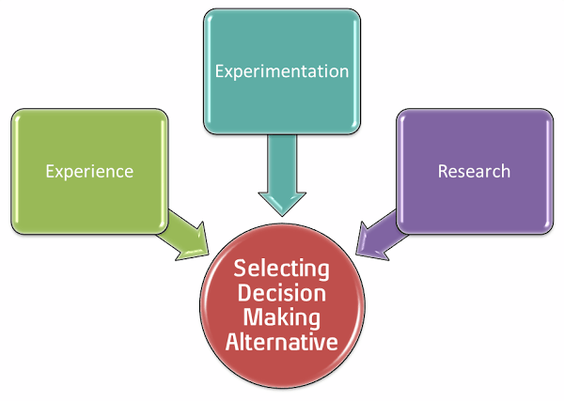
The Decision-Making Process
The decision-making process is a systematic, step-by-step process to aid in choosing the best alternative.
  Supervisors must define the problem. They must analyze the problem using available information. They must establish decision criteria – factors that will be used to evaluate alternatives. After a thorough analysis, supervisors should develop alternate solutions. Then, the supervisor should carefully evaluate the alternatives and select the solution that appears to be the best or most feasible under the circumstances.
    The concluding step in this process is the follow-up and appraisal of the consequences of the decision.

Slide 10
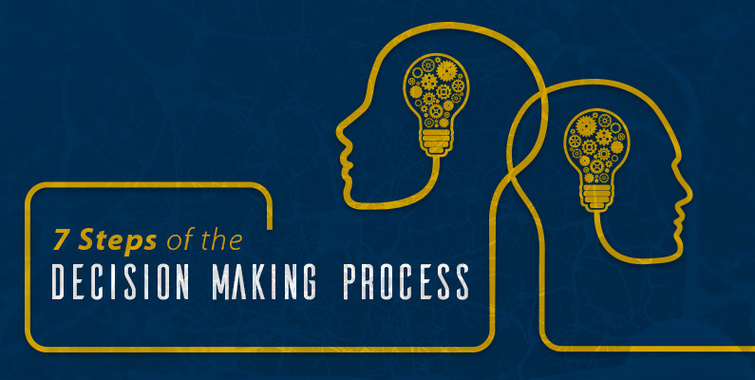
The Decision-Making Process
Steps in the decision-making process:
  Define the problem.
  Analyze the problem.
  Establish decision criteria.
  Develop alternatives.
  Evaluate the alternatives.
  Select the “best” alternative.
  Follow up and appraise results.

Slide 11
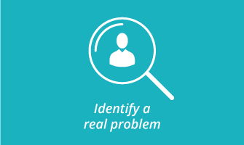
The Decision-Making Process
Step One: Define the Problem
When confronted with a situation, the supervisor must step back, look at the situation, and specifically identify the real problem.
  Nothing is as useless as the right answer to the wrong question.
    Defining a problem is not easy. What appears to be the problem might merely be a symptom that shows on the surface. It is usually necessary to delve deeper to locate the real problem and define it.

Slide 12
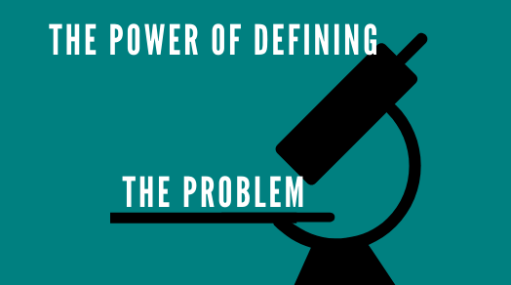
The Decision-Making Process
Step One: Define the Problem
A good problem statement addresses the following key questions:
  What is the problem?
  How do you know there is a problem?
  Where has the problem occurred?
  When has the problem occurred?
  Who is involved in, or affected by, the problem?
    Expressing the problem through a problem statement can help the supervisor understand it.

Slide 13
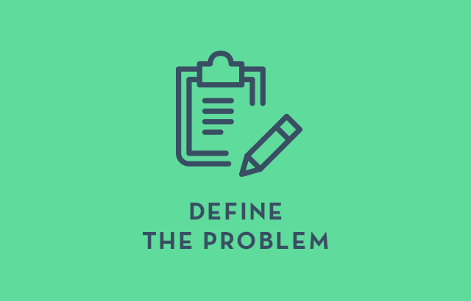
The Decision-Making Process
Step One: Define the Problem
While defining a problem often can be time-consuming, it is time well spent.
  A supervisor should go no further in the decision-making process until the problem relevant to the situation has been pin-pointed.
  A problem arises when there is a difference between the way things are and the way they should be.
    Effective supervisors use problem solving not only to take corrective action but also to improve the organization.

Slide 14

The Decision-Making Process
Step Two: Analyze the Problem- Gather Facts and Information
After the problem – not just its symptoms – has been defined, the next step is to analyze the problem.
  Until the real problem has been defined, the supervisor does not know what information is needed.
    The supervisor then begins analysis by assembling facts and other pertinent information.

Slide 15

The Decision-Making Process
Step Two: Analyze the Problem – Gather Facts and Information
Sometimes the supervisor does not know how far to go in searching for additional facts.
  A good practice is to observe reasonable time and cost limitations.
  In the process of analysis, the supervisor should try to think of intangible factors that play a significant role. Some intangible factors are reputation, morale, discipline, and personal biases. It is difficult to be specific about these factors, but they should be considered when analyzing a problem.
    As a general rule, written and objective information is more reliable than opinions and hearsay.

Slide 16
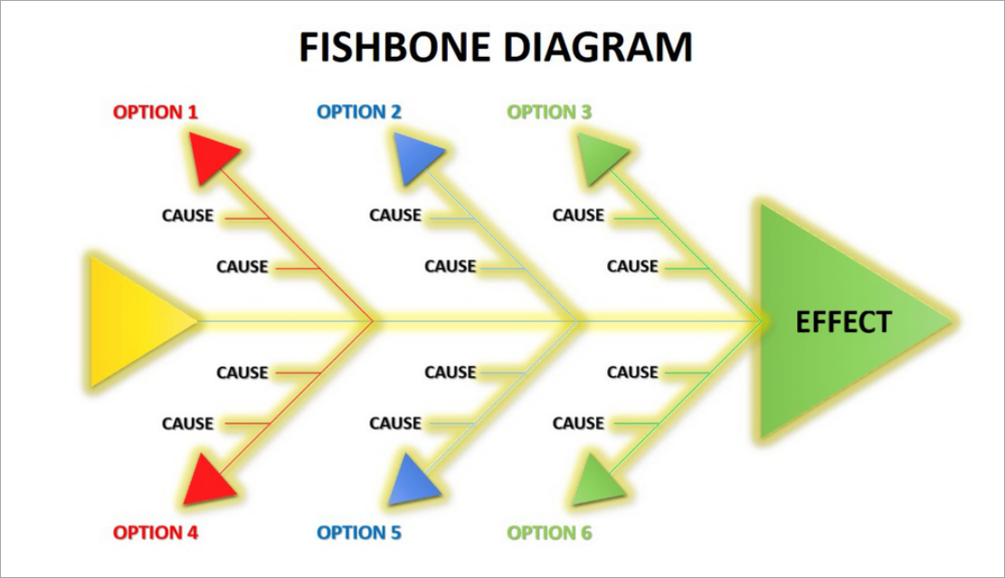
The Decision-Making Process
Step Two: Analyze the Problem – Gather Facts and Information
Another way to depict Steps One and Two of the decision-making process is the Fishbone Technique (Cause-and-Effect Diagram).
  This technique will allow the problem solver not only to identify the various factors that have produced the problem but to consider the potential interrelatedness of the causes of the problem.

Slide 17

The Decision-Making Process
Step Three: Establish Decision Criteria
Decision Criteria are standards or measures for evaluating alternatives; they are statements of what the supervisor wants to accomplish with the decision.
  Such criteria can be used to determine how well the implementation phase of the process is going – that is, whether the decision is doing what it was intended to do.

Slide 18

The Decision-Making Process
Step Three: Establish Decision Criteria
Sample Decision Criteria
  The Solution to a Problem:
    Should result in work assignments being completed on time.
    Should incur no financial cost.
    Must not impede quality of service to the customer.
    Should put no EE’s job in jeopardy.
    Should allow differentiation of product or service in marketplace.
    Should have no negative impact on EEs.
    Must alleviate the problem within one week.

Slide 19

The Decision-Making Process
Step Three: Establish Decision Criteria
Once the decision criteria are established, the supervisor must determine which criteria are necessary and must establish their order of priority.
  Because no solution alternative is likely to meet all the criteria, the supervisor must know which criteria are most important; thus alternatives can be judged by how many of those criteria the alternatives meet.
    The supervisor may want to consult with upper-level managers, peers, or EEs when prioritizing criteria.

Slide 20

The Decision-Making Process
Step Four: Develop Alternatives
After the supervisor has defined and analyzed the problem and established decision criteria, the next step is to develop alternative solutions.
  The supervisor should consider as many solutions as can reasonably be developed.
    By formulating many alternatives, the supervisor is less apt to overlook the best course of action.

Slide 21

The Decision-Making Process
Step Four: Develop Alternatives
Almost all problems have a number of alternative solutions.
  The choices may not always be obvious, so supervisors must search for them. When supervisors fail to make this search, they are likely to fall into an either/or kind of thinking.
    None of the alternatives may be desirable, but at least the supervisor can choose the one that is least undesirable.

Slide 22

The Decision-Making Process
Step Four: Develop Alternatives
A decision is only as good as the best alternative identified.

Slide 23

The Decision-Making Process
Brainstorming and Creative Problem Solving
When enough time is available, a supervisor should meet with a group of other supervisors, EEs, or stakeholders to brainstorm alternatives to a perplexing problem.
  Through the free flow of ideas in a group, with judgment suspended, the group should set out to identify as many alternatives as possible.
    Evaluation of ideas is suspended so that participants can give free rein to their creativity.

Slide 24

The Decision-Making Process
Brainstorming and Creative Problem Solving
Brainstorming requires an atmosphere that encourages creativity.
  When supervisors are unwilling to devote sufficient time to brainstorming, or when supervisors try to dominate the process with their own opinions and solutions, the brainstorming effort is likely to fail.

Slide 25

The Decision-Making Process
Brainstorming and Creative Problem Solving
Alex Osborn, an authority on creativity and brainstorming, suggests the following 4 guidelines for effective brainstorming:
  Defer All Judgment of Ideas.
  Seek Many Ideas.
  Encourage Freewheeling.
  Hitchhike on Existing Ideas.

Slide 26

The Decision-Making Process
Nominal Group Technique (NGT)
When it involves a large group, unstructured brainstorming can become long, tedious, and unproductive because many ideas are simply not feasible and because conflicts may develop.
  The Nominal Group Technique (NGT) involves having group members write down ideas and alternatives to the problem. Then, members share, discuss, evaluate, and refine their ideas.
    The group’s final choice(s) may be made by a series of confidential votes in which a list of ideas is narrowed until consensus is attained.

Slide 27

The Decision-Making Process
Brainstorming and Creative Problem Solving
Creative approaches and brainstorming meetings are particularly helpful if the problem is new, important, or strategic.
  Even the supervisor who takes time to brainstorm a problem alone is likely to develop more alternatives for solving the problem than one who does not brainstorm at all.

Slide 28

The Decision-Making Process
Ethical Considerations
Both when developing and evaluating alternatives, a supervisor should consider only those alternatives that are lawful and acceptable within the organization’s ethical guidelines.
  Supervisors’ decisions should also demonstrate strong ethical values for their EEs. Remember, good ethics is good business.
    Many firms have developed handbooks, policies, and official statements that specify their ethical standards and practices, or “ethical tests.”

Slide 29

The Decision-Making Process
Ethical Guidelines
The following guidelines for decision making are not comprehensive, but they are relevant when addressing the ethical aspects of most problem situations:
  Legal-Compliance Test
    Laws, regulations, and policies are to be followed, not broken or ignored.
    If in doubt, ask for guidance from someone who knows laws-regulations.
    Compliance should only be a starting point in ethical decision making.
  Public Knowledge Test
    What would be the consequences if the outcome of an alternative decision became known to the public, one’s family, media, or government agency?
  Long-Term Consequences Test
    What would be the long-term vs. short-term outcomes? Weigh those outcomes against each other.

Slide 30
The Decision-Making Process
Ethical Guidelines (Cont.)
  Examine-Your-Motives Test
    Do motives for a proposed decision benefit the company and others, or are they primarily selfish and designed to harm or destroy other people and their interests?
  Inner-Voice Test
    This is the test of conscience and moral values that has been instilled.
    If something inside you says the choice is or may be wrong, it usually is. It is then prudent to look for a different and better alternative.
  Fairness Test
    Are the decision and corresponding actions fair to all concerned such as the various stakeholders? Will they be beneficial to all concerned? When in doubt about the impact of the decision on various stakeholder groups, check and recheck the process used to arrive at the decision.
  The Four-Way Test
    This test serves as the foundation for their actions: (1) Is it the truth? (2) Is it fair to all concerned? (3) Will it build goodwill and better friendships? (4) Will it be beneficial to all concerned?

Slide 31

The Decision-Making Process
Ethical Considerations
When supervisors believe an alternative is questionable or might be unacceptable within the firm’s ethical policies, they should consult their managers, the human resources department, or other staff specialists who can provide guidance on how to proceed.
  EEs should have access to safe and confidential channels to raise concerns about possible ethics violations.
    Supervisors are responsible for ensuring that the company’s ethical policies aren’t just nice words posted in the company handbook; they must be words to live by.

Slide 32

The Decision-Making Process
Step Five: Evaluate the Alternatives
The ultimate purpose of decision making is to choose the course of action that will provide the greatest number of wanted and the smallest number of unwanted consequences.
  After developing alternatives, supervisors can mentally test each of them by imagining that each has already been put into effect.
  Supervisors should try to foresee the probable and undesirable consequences of each alternative.
    By thinking alternatives through and appraising their consequences, supervisors can compare the desirability of choices.

Slide 33

The Decision-Making Process
Step Five: Evaluate the Alternatives
The usual way to begin is to eliminate alternatives that do not meet the supervisor’s decision criteria and ethical standards.
  The supervisor should evaluate how many of the most important criteria each alternative meets.
    The successful alternative is the one that satisfies or meets the largest number of criteria at the highest priority levels. Often, there is no clear choice.

Slide 34

The Decision-Making Process
Step Five: Evaluate the Alternatives
The supervisor is frequently required to choose a course of action without complete information about the situation.
  Because of this uncertainty, the chosen alternative may not yield the intended results; therefore risk is involved. Supervisors must consider the risk and uncertainty of each course of action.
    There is no such thing as a risk-free decision; one alternative may simply involve less risk than others.

Slide 35
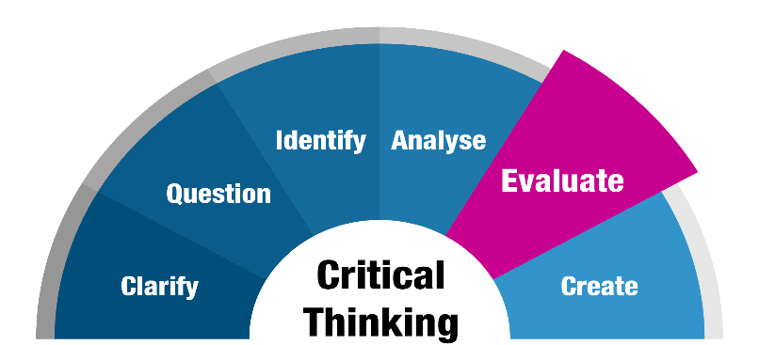
The Decision-Making Process
Step Five: Evaluate the Alternatives
Time may make one alternative preferable, particularly if a difference exists between how much time is available and how much time is required to carry out an alternative.
  The supervisor should consider the available facilities, tools, and other resources.
    It is also critical to judge alternatives in terms of economy of effort and resources. In other words, which action will give the greatest benefits and results for the least cost and effort?

Slide 36
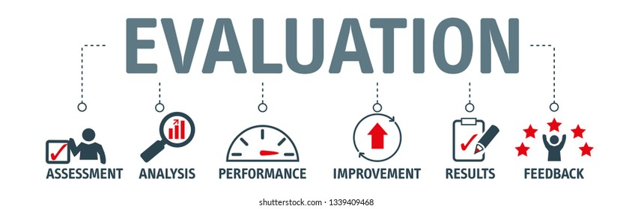
The Decision-Making Process
Step Five: Evaluate the Alternatives
When one alternative clearly appears to provide a greater number of desirable consequences and fewer unwanted consequences than any other alternatives, the decision is fairly easy.
  However, the best alternative is not always to obvious.
    At times, two or more alternatives may seem equally desirable. Here, the choice may become a matter of personal preference.

Slide 37

The Decision-Making Process
Step Five: Evaluate the Alternatives
Sometimes no alternatives are satisfactory; all have too many undesirable effects, or none will bring about the desired results.
  In such a case, the supervisor should begin to think of new alternative solutions or perhaps even start all over again by attempting to redefine the problem.

Slide 38

The Decision-Making Process
Step Six: Select the Best Alternative
Selecting the alternative that seems best is known as optimizing.
  However, the supervisor sometimes makes a satisficing decision - selecting an alternative that meets the minimal decision criteria.
    Nevertheless, after developing and evaluating alternatives, the supervisor must make a choice.

Slide 39
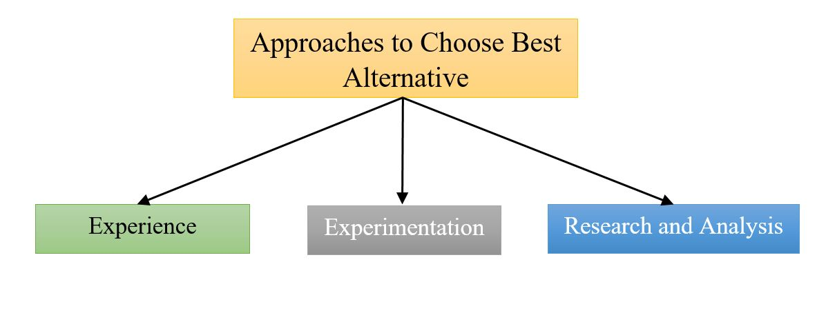
The Decision-Making Process
Step Six: Select the Best Alternative
Among the most prominent bases for choosing the best alternative are experience, intuition, advice, experimentation, and statistical and quantitative decision making.
  Regardless of the process, a supervisor rarely makes a decision that pleases everyone equally.

Slide 40

The Decision-Making Process
Experience
When looking to experience as a basis for choosing alternatives, the supervisor should examine the situation and the conditions that prevailed at the time of the earlier decision.
  It may be that conditions are identical to those that prevailed on the previous occasion and the decision should be similar to the one made then at that time.
    However, conditions change considerably, and underlying assumptions change. Therefore, the new decision probably should not be identical to the earlier one.

Slide 41

The Decision-Making Process
Intuition
At times, supervisors base their decisions on intuition. Some supervisors even appear to solve problems by subjective means.
  However, a deeper search usually reveals that the so-called intuition on which the supervisor appeared to have based a decision was really experience or knowledge stored in the supervisor’s memory.
    By recalling similar situations that occurred in the past, supervisors may be better able to reach decisions, even though they label doing so as having hunches.

Slide 42

The Decision-Making Process
Intuition
Intuition may be particularly helpful when other alternatives have been tried with poor results.
  If the risks are not too great, a supervisor may choose a new alternative because of an intuitive feeling that a fresh approach might bring positive results.
    Even if the hunch does not work out well, the supervisor has tried something different. Supervisors will remember doing so and can draw upon those experiences in future decisions.

Slide 43
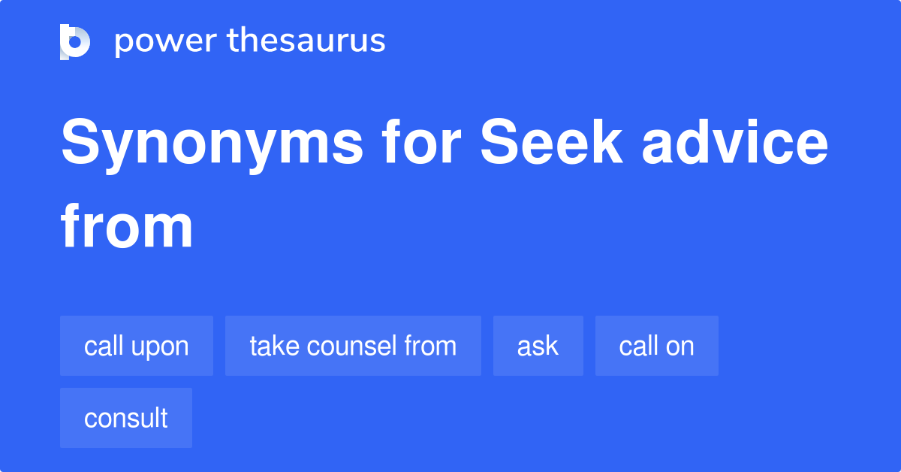
The Decision-Making Process
Advice From Others
Although a supervisor cannot shift personal responsibility for making decisions in the department, the burden of decision making often can be eased by seeking advice of others.
  The ideas and suggestions of EEs, other supervisors, staff experts, technical authorities, and the supervisor’s own manager can be of great help in weighing facts and information.
    Seeking advice does not mean avoiding a decision because the supervisor still must decide whether to accept the advice of others.

Slide 44

The Decision-Making Process
Experimentation
In the scientific world, where many conclusions are based on tests in laboratories, experimentation is essential and accepted.
  In supervision, however, experimentation is often too costly in terms of people, time, and materials.
    Nevertheless, in some instances a limited amount of testing and experimentation is advisable. For example, a supervisor may find it worthwhile to try several different locations for a new copy machine in the department to see what location EEs prefer and which location is most convenient for the workflow.

Slide 45

The Decision-Making Process
Experimentation
There are also instances in which a certain amount of testing is advisable to allow EEs to try new ideas or approaches, perhaps of their own design.
  While experimentation may be valid from a motivational standpoint, it can be a slow and relatively expensive method of reaching a decision.

Slide 46

The Decision-Making Process
Quantitative Decision Making
Numerous quantitative techniques and models are available for helping managers improve the quality of their decision making.
  Decision trees, operations research, payback analysis, probability, and simulation models are but a few of these tools. They require the decision maker to quantify information that is relevant to a decision.
    But one desirable feature of quantitative decision making is the ability of the user to perform what if scenarios – the simulations of business situations over and over using different data for select decision areas.
    But, for many supervisors, these techniques are not practical.

Slide 47
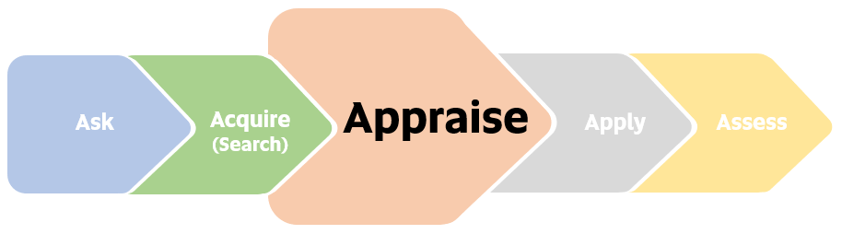
The Decision-Making Process
Step Seven: Follow Up and Appraise the Results
After a decision has been made, specific actions are necessary to carry out that decision.
  Follow-up and appraisal of a decision’s outcome are part of decision making. This can take many forms, depending on the decision, timing, costs, standards, personnel, and other factors. For example, a minor production-scheduling decision could be evaluated easily based on a short written report or perhaps even by the supervisor’s observation or a discussion with EEs.
    In contrast, a major decision involving the installation of complex new equipment requires close and time-consuming follow-up by supervisor, technical EEs, and high-level managers. This type of decision usually requires the supervisor to prepare numerous detailed, written reports of equipment performance under varying conditions that are compared closely with plans or expected standards for the equipment.

Slide 48
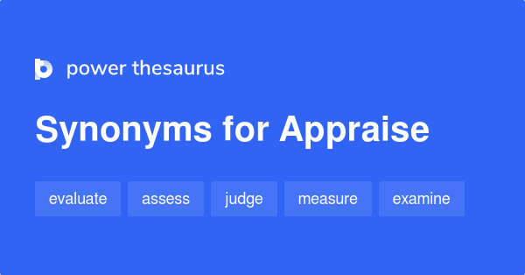
The Decision-Making Process
Step Seven: Follow Up and Appraise the Results
The important point to recognize is that the decision-making task is incomplete without some form of follow up and action appraisal.
  When supervisor establishes decision criteria or objectives that the decision should accomplish, it is easier to evaluate effects of decision.
    When the consequences are good, the supervisor can feel reasonably confident that the decision was sound.

Slide 49

The Decision-Making Process
Step Seven: Follow Up and Appraise the Results
When the follow-up and appraisal indicate that something has gone wrong or that the results have not been as anticipated, the supervisor’s decision-making process must begin all over again.
  In other words, when follow-up and appraisal indicate that the problem has not been solved, the supervisor should treat the situation as a completely new problem and go through the decision-making process from a completely fresh perspective.

Slide 50

Supervisory Tips
Suggestions for Improving Problem Solving and Decision Making.
  Take enough time to state the problem accurately and concisely and to identify the objectives you want to accomplish with your decision.
  Whenever appropriate, seek opinions and suggestions from others who can contribute their ideas toward solving the problem.
  Before deciding what to do, gather ample facts and information that will help define and clarify the problem and suggest solutions.
  Stretch your mind to develop numerous alternative solutions; brainstorm with others when practical.
  Make your decision based on objective criteria; avoid letting personal biases and organizational political considerations direct your choice.
  When implementing and following up on your decision, do not hesitate to admit and rectify errors in the decision, even if doing so causes some personal embarrassment. Admitting mistakes early is prudent and builds your integrity with others.

Slide 51
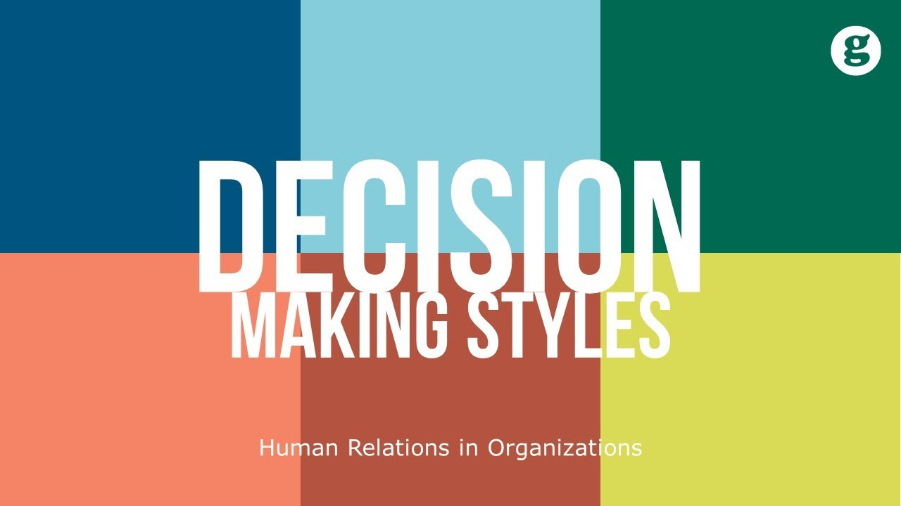
Decision-Making Styles
Decision making is influenced by many factors, making it difficult to formulate a simple-to-do check list that applies to every situation in the same way.
  When supervisors are faced with complex, unusual, or new problems, they must use good judgement, intuition, and creativity in the decision-making process.

Slide 52

Decision-Making Styles
We know from observing others and our own experiences that people make decisions differently.
  We have observed two extremes: some people are like the “waffler” who takes forever to study the problem and never makes a decision, while others are like the “gunner” pull the trigger (fire-aim-ready) quickly, and if things don’t go the intended way, they fire again and again until they hit the target (achieve the intended results).

Slide 53
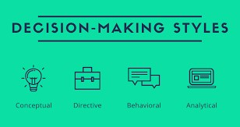

Decision-Making Styles
What is your decision-making style?
Analytic: Deep Thinker
  Decisions are made based on the facts and evidence researched.
    Avoids risks
    Uses solid, tangible, realistic evidence to support decisions
    Makes decisions valid for the present and the future
    Is cautious and deliberate
    Has great need to be “right”
    Is very concerned with details
    Uses an organized process
    Stands behind decisions after they are made

Slide 54
Decision-Making Styles
What is your decision-making style?
Driver: Group Commander
  Decisions are made using available information without help from others.
    Makes own decisions
    Uses power to influence
    Seeks control
    Overcomes obstacles with force
    Expresses conclusions quickly
    Bases decisions on facts and data
    Takes risks
    Prefers to be presented with options from which to choose

Slide 55
Decision-Making Styles
What is your decision-making style?
Amiable: Consensus Builder
  Decisions are made that are acceptable to the group from shared information and ideas.
    Likes the comfortable and known
    Uses own and others’ personal opinions
    Wants guarantees of results
    Wants minimal risk
    Needs buy-in from others
    Avoids interpersonal confrontation
    Is reluctant to change beliefs
    Checks frequently for group agreement

Slide 56
Decision-Making Styles
What is your decision-making style?
Expressive: Free Spirit
  Decisions are made based on personal feelings and feelings of others.
    Incorporates feelings of “important people”
    Sidelines facts and logic
    May be creative
    Takes risks
    Makes frequent mistakes
    Makes rapid decisions
    Looks for rewards that are social recognition and prestige
    Uses drama and/or humor to make a point

Slide 57
Decision-Making Styles
What is your decision-making style?
Abdicator: Convenience Seeker
  Decisions are made based on the easiest method readily available.
    Makes fast decisions
    Results in many errors
    Will assign decisions to anyone
    Doesn’t care about results
    Has “Not my problem” attitude
    Gives no direction
    Wishes it would all go away
    Doesn’t want to be involved

Slide 58

Decision-Making Styles
To assist in understanding how you make decisions, look back at your recent decisions.
  Analyze them from the following perspectives.
    What worked?
    What didn’t work?
    What actually happened as a result of the decision?
    What kind of feedback did you receive about the success of a decision?
    What style did you use to make the successful decision?
    How much tweaking did you have to do to make it work?
    What caused the difference between intended and actual outcome?
    What kind of feedback did you receive about a failed decision?
    What decision-making style did you use to make the failed decision?

Slide 59

Decision-Making Process
Supervisors cannot afford to make decisions without considering the steps outlined below.
  Often, when an EE brings up a problem, the supervisor should ask questions like the following:
    How extensive is the problem?
    Does the situation need an immediate response?
    Who else (the stakeholders) is affected by the problem?
    Should they (the stakeholders) be involved in this discussion?
    Have you (the employee) thought through the problem, and do you have an idea of what the end result should be?
    What do your recommend? Why?

Slide 60

Introducing Change
Often when a decision is made by a leader or a supervisor, that decision will indicate that a change is imminent in the department or the whole organization.
  Change is expected as part of life, and the survival and growth of most enterprises depend on change and innovation.
    The survival of a firm may depend on the abilities of its managers to make fundamental changes in virtually all aspects of operations while facing the risks of an uncertain future.

Slide 61
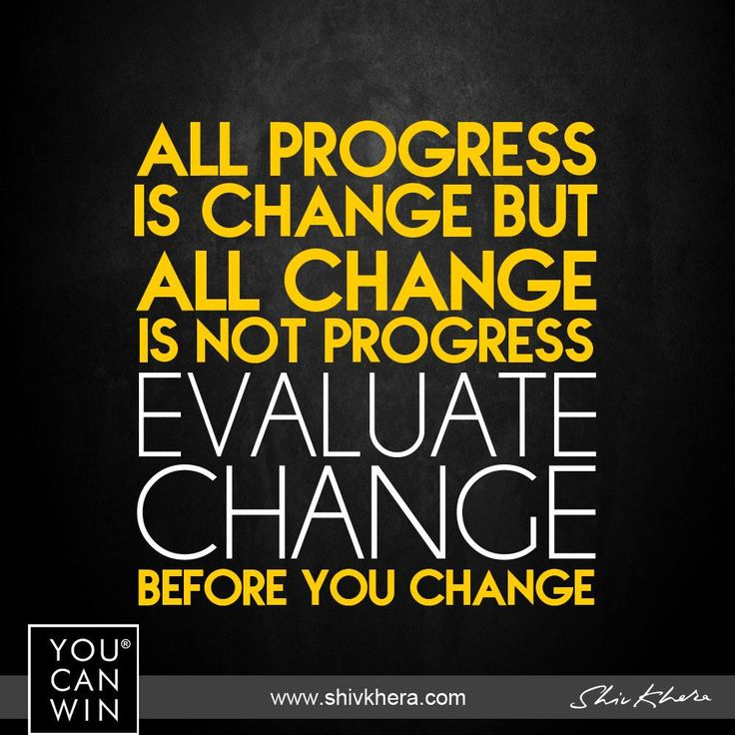
Introducing Change
Making Change Means Supervisory Involvement
Despite the emphasis on change, there still appear to be numerous problems and considerable resentment concerning both the introduction and effects of many organizational changes.
  There is an adage that says, “All progress is change, but not all change is progress.”
    In some cases this is true, particularly when managers identify problems, initiate change, then look for a quick response in their organizations, and they become frustrated when expected results are not achieved.
    Mediocrity is then tolerated, and the net result is that the more things have changed, the more they have stayed the same.

Slide 62

Introducing Change
Making Change Means Supervisory Involvement
Conversely, well-performing organizations can potentially exist for years without making any changes, but they run the risk of eroding EE motivation and effectiveness as organizational silos, departmental routines, and entrenched interests begin to weigh down organizational processes.
  In situations like this, restructuring business units or EE’s responsibilities can energize a stagnant company.
    These contrasting perspectives reinforce that supervisors must consider the pervasiveness of change in organizations, the goals of change, and its impact on EEs, bringing to mind another adage we can translate to the organizational context, “Change is the only constant.”

Slide 63

Introducing Change
Making Change Means Supervisory Involvement
Whether a change has been initiated by upper management or by the supervisor personally, it is the supervisor who has the major role in effecting change.
  The success or failure of any change is usually related to a supervisor’s ability to anticipate and deal with the causes of resistance to change.

Slide 64

Introducing Change
Reasons for Resistance to Change
Some supervisors are inclined to discount the existence and magnitude of human resistance to change.
  What may seem like a trifling change to the supervisor may bring strong reaction from EEs.
    Supervisors should remember EEs seldom resist change to be stubborn. They resist because they believe change threatens their positions socially, psychologically, or economically. Therefore, the supervisor should be familiar with the ways in which resistance to change can be minimized and handled successfully.

Slide 65
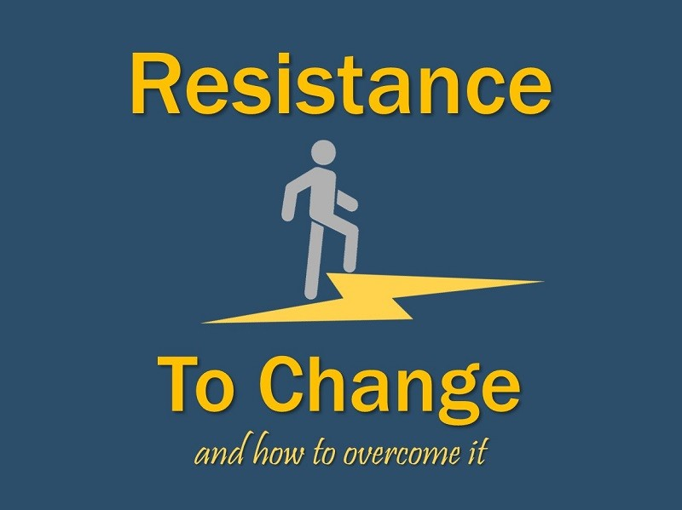
Introducing Change
Reasons for Resistance to Change
A supervisor must learn to recognize how changes affect different EEs and observe how individuals develop patterns of behavior that serve as barriers to accepting change.

Slide 66
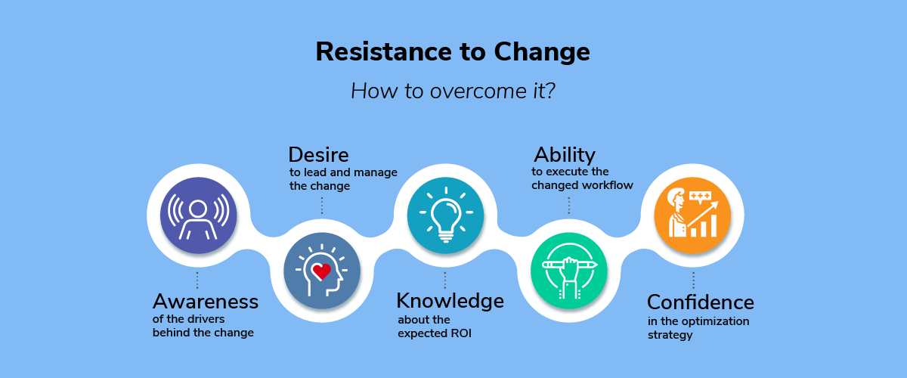
Introducing Change
Overcoming Resistance to Change
The most important factor in gaining EE acceptance of new ideas and methods is the relationship between the supervisor who is introducing the change and the EEs who are affected by it.
  If the relationship has confidence and trust, employees are more likely to accept the change.
    If a supervisor has regularly interacted with EEs with constancy, caring, candor, and competence, all of which lead to a trusting relationship, EEs are more likely to proceed confidently with the directives they are given because they will trust that the change being proposed will be facilitated with those same virtues.

Slide 67

Introducing Change
Providing Adequate Information
It is not the change itself that usually leads to resistance, but rather the way the supervisor introduces the change.
  Resistance to change, when it comes from fear of the unknown, can be minimized by supplying all the information EEs consciously and subconsciously need to know.
    Presenting EEs with the vision, or idealized picture of the future once a change is fully implemented, can help supervisors introduce change.
    Studies reveal that most EEs tend to adapt more readily to the change and become proactive in the change process when supervisors share a clear, compelling view of the future and how it would be different.

Slide 68

Introducing Change
Encouraging Participation in Decision Making
Another technique for reducing resistance to change is to permit the affected EEs to share in making decisions about the change.
  If several EEs are involved in a change, group decision making is an effective way to reduce their fears and objections.
    When EEs have an opportunity to work through new ideas and methods from the beginning, usually they will consider the new directives as something of their own making and will give those changes their support.
    The group may even apply pressure on those who have reservations about going along with change, and it is likely that each member of the group will carry out the change once there is agreement on how to proceed.

Slide 69

Introducing Change
Encouraging Participation in Decision Making
According to organizational anthropologist Judith Glasser:
  When successful change occurs, employees feel like authors not objects of change. They feel fully invested, accountable, and energetic about the future, regardless of challenges.

Slide 70

Introducing Change
Proposing Change to High-Level Managers
If supervisors wish to propose changes, it is important that they understand how to present ideas not only to their EEs, but to higher-level managers as well.
  Selling an idea to a manager involves the art of persuasion, same as a good salesperson uses persuasion to sell a product or service to a reluctant customer.

Slide 71

Introducing Change to High-Level Manager
Obtaining Needed Information
A supervisor who has a good idea or who wishes to suggest a change should first ask, “What aspects of the idea or change will be of most interest to the boss?”
  Higher-level managers usually are interested if a change might improve production, increase sales and profits, improve morale, or reduce overhead and other costs.
    It is important to do considerable homework to see whether a proposed change is feasible and adaptable to the departmental operation.

Slide 72

Introducing Change to High-Level Manager
Obtaining Needed Information
By thinking through the idea carefully and getting as much information as possible, the supervisor will be better positioned to argue strong and weak points of the proposal.
  In addition, the supervisor should find out whether any other departments or organizations have used the proposed idea – successfully or unsuccessfully.
    The manager will be impressed that the supervisor has invested time and effort to investigate the best practices of other organizations.

Slide 73

Introducing Change to High-Level Manager
Formal Presentation
If a supervisor is asked to formally present the proposal, ample planning and preparation are required.
  The presentation should be made thoroughly and unhurriedly, allowing sufficient time for questions.
  A supervisor who has carefully thought through an idea should be unafraid to express it in a firm and convincing manner.
    The supervisor should be enthusiastic in explaining the idea, but also patient and empathetic with those who may not agree with it.

Slide 74

Introducing Change to High-Level Manager
Acceptance or Rejection of Change
A supervisor who can persuade higher-level managers and other supervisors to accept a proposed change will likely feel inner satisfaction.
  Any good idea requires careful implementation, follow-up and refinement. Rarely does a change follow the suggested blueprint.
    Following up and working out the problems with others are important aspects of making a change effective.

Slide 75

Introducing Change to High-Level Manager
Acceptance or Rejection of Change
However, despite a supervisor’s best efforts, an idea may be rejected, altered greatly, or shelved.
  This can be frustrating, particularly to supervisors who have worked diligently to develop ideas believed would lead to positive results.
  It is important to avoid becoming discouraged and developing a negative outlook. There may be valid reasons for rejection of ideas, or the timing may not have been right.
    A supervisor should resolve to try again and perhaps to further refine and polish the idea for resubmission.

Slide 76

Introducing Change to High-Level Manager
Acceptance or Rejection of Change
A supervisor who has developed an idea for change, even if it has not been accepted, usually will find that higher-level managers appreciate such efforts.
  Moreover, the experience of having worked through a proposal for change will make the supervisor a more valuable member of the organizational team, and there will be many other opportunities to work for change.

Slide 77

A Formula for Organizational Renewal
We must accept the reality that organizations must change or die.
  Many organizations, like people, wait until they are near death before they recognize the need to make changes.
    Harvard professors Michael Tushman and Charles O’Reilly suggest that “leading an organization is an ongoing process.”

Slide 78

A Formula for Organizational Renewal
The following process will help point you in the right direction for change:
  Remember that as leader of the team, you are also a member of the team.
  Identify the issues confronting the organization.
  Analyze how those issues prevent goal attainment.
  Recognize the difference between needed change and change for the sake of change.
  Identify metrics that will be used to monitor and evaluate the change process.
  Communicate to and involve all who have a stake in the change.
  Understand what needs to be changed.
  Seek consensus, but recognize when to sacrifice unanimity for decisiveness.
  Confront the resisters to change.
  Establish clear targets.
  Take risks, experiment, and innovate.
  Spend money to develop (train) EEs so they have competencies to implement change.
  Focus on the outcome(s).
  Monitor progress and make adjustments as necessary.
  Provide feedback and encouragement.
  Guarantee total commitment to organizational renewal – to be the “best of the best.”
  Celebrate victories.

Slide 79


A Formula for Organizational Renewal
Noted leadership theorist John Kotter said:
  Behavior change happens mostly by speaking to people’s feelings.

Slide 80


